Slide 1
Power BI

Slide 2
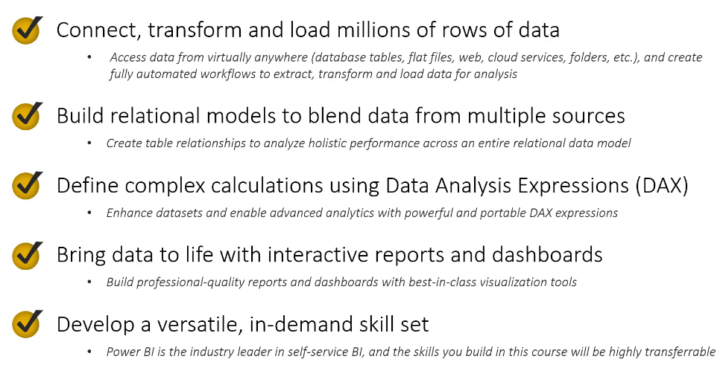
Why power BI?

Slide 3
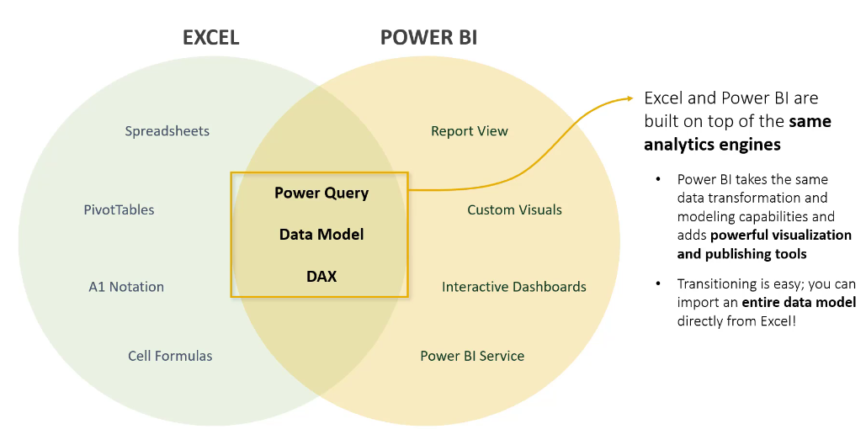
Excel vs power bi

Slide 4
Power bi desktop vs power bi service
Feature | Power BI Desktop | Power BI Service
Platform | Windows desktop application | Cloud-based web application
Primary Purpose | Build and design reports | Share, view, and collaborate on reports
Data Connection | Connect to multiple data sources | Uses published datasets or connects to cloud data
Data Transformation | Full support using Power Query | Limited transformation capabilities
Data Modeling | Create relationships, measures (DAX), and calculated columns | Limited modeling capabilities
Report Creation | Yes | Basic editing only
Dashboard Creation | No | Yes
Publishing Reports | Publish to Power BI Service | Manage published reports
Sharing | Cannot directly share | Share dashboards and reports with users
Collaboration | Not available | Workspaces, comments, apps, and collaboration features
Scheduled Refresh | Manual refresh | Automatic scheduled refresh (with gateway if needed)
AI Features | Basic | Advanced AI features (depending on license)
License | Free | Free, Pro, and Premium licenses available
In most organizations, developers use Power BI Desktop to build reports and then publish them to Power BI Service, where end users access and interact with the reports.

Slide 5
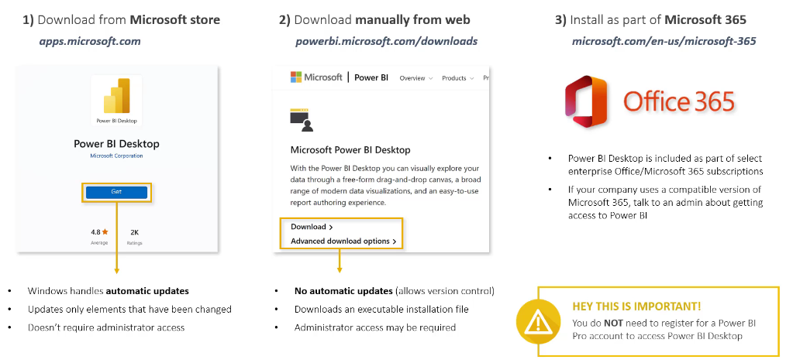
Installing power bi desktop

Slide 6
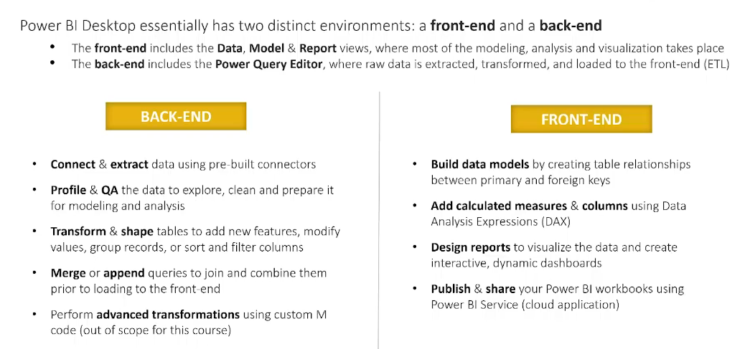
Front-end vs back-end

Slide 7
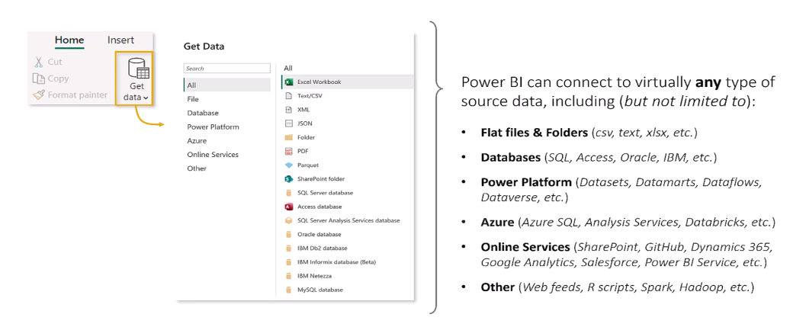
Data connectors

Slide 8
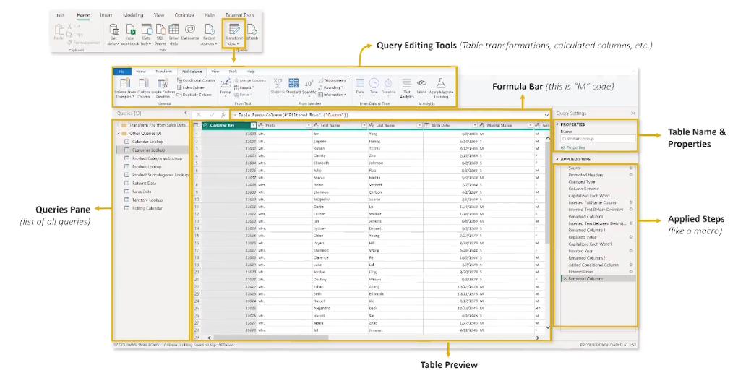
Power query editor

Slide 9
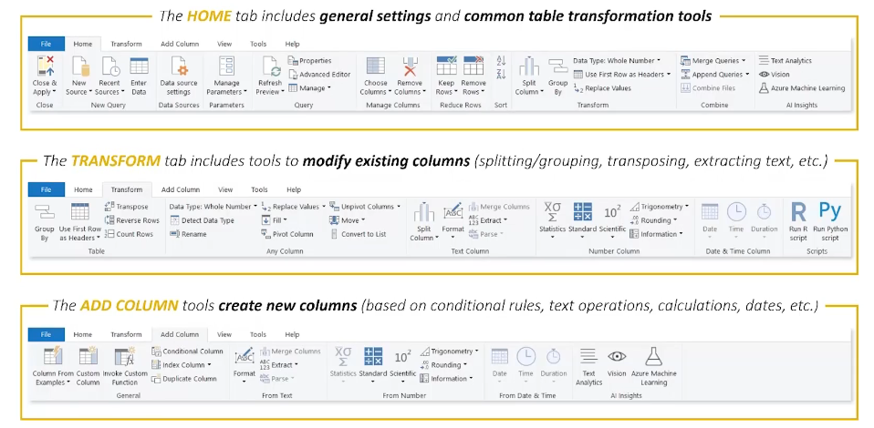
Query Editing Tools

Slide 10
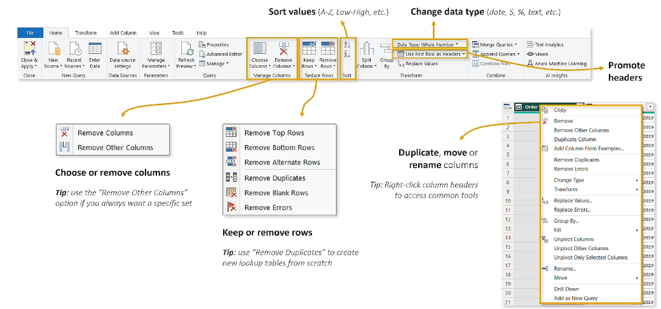
Basic table transformations

Slide 11
Walkthrough
Let’s load 2 csv files: Territory Lookup & Product Lookup
In product lookup let’s:
Note the column data types
Remove the product size column
Change the data type of ProductCost and ProductPrice to Fixed Decimal Number (currency)
View our tables in our data model UI

Slide 12
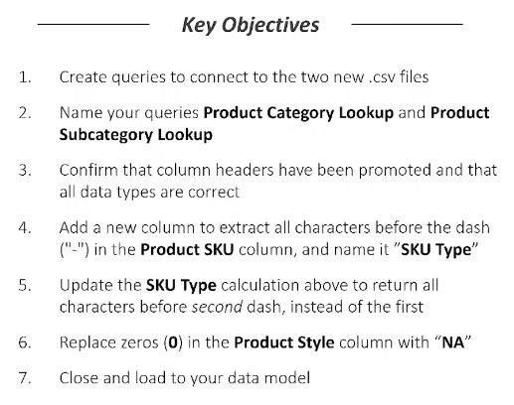
Challenge

Slide 13
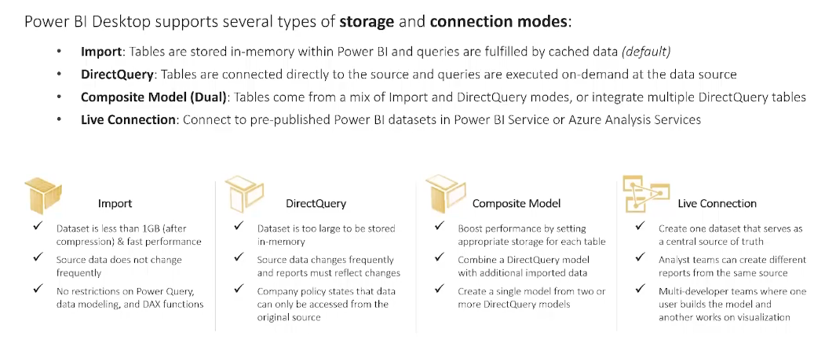
Storage & connection modes

Slide 14
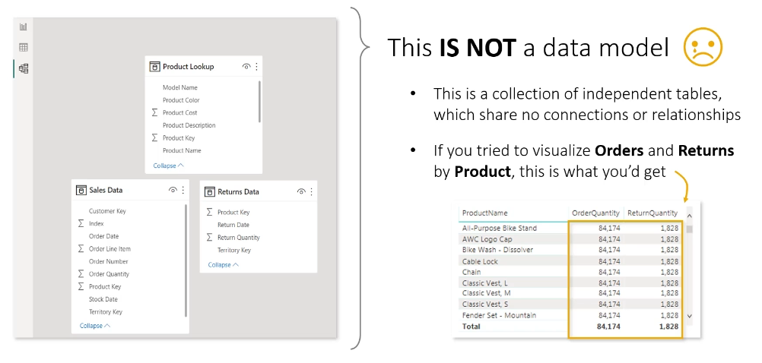
What is a power bi data model?

Slide 15
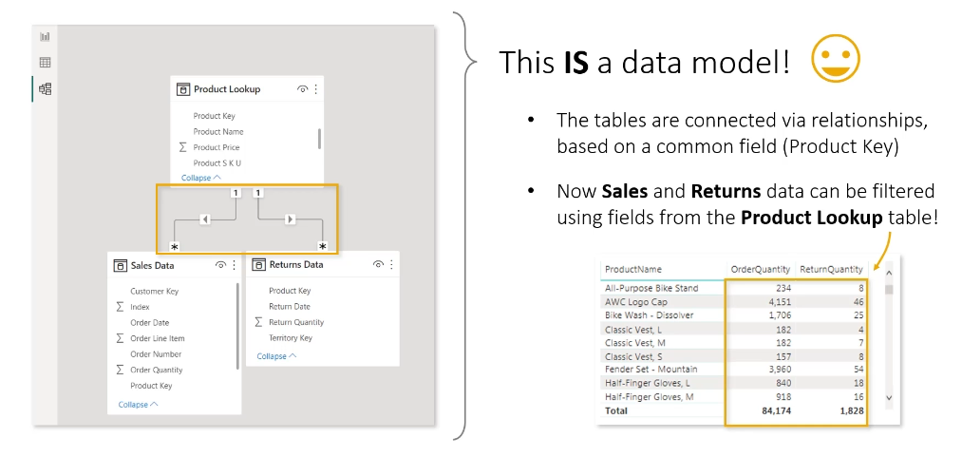
What is a power bi data model?

Slide 16
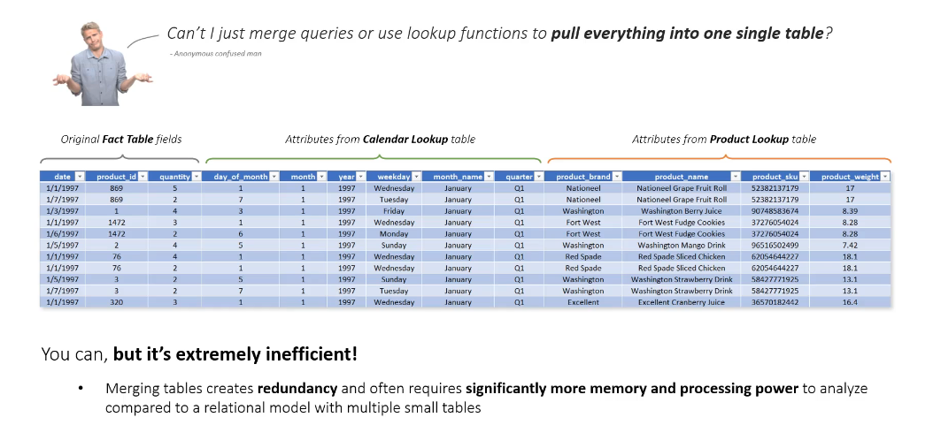
Relationships vs merged tables

Slide 17
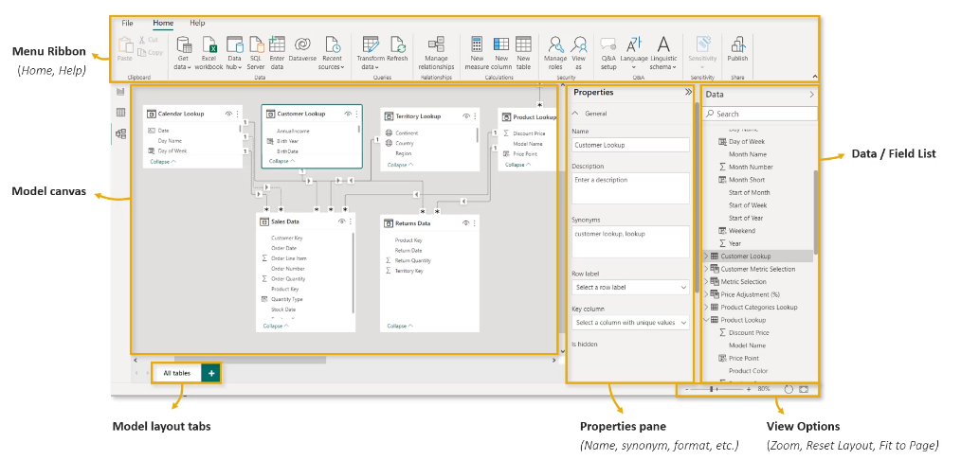
The model view

Slide 18
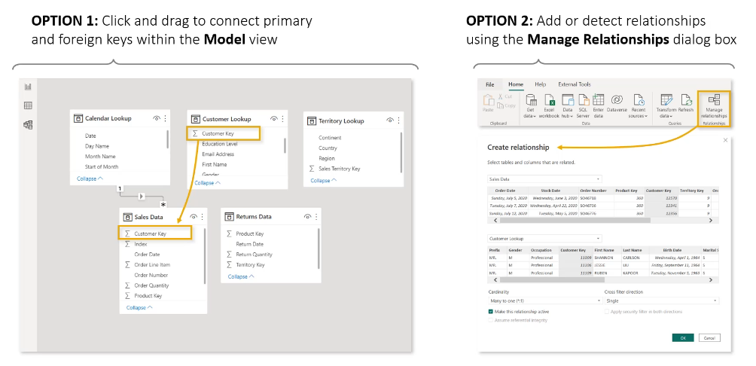
Creating table relationships

Slide 19
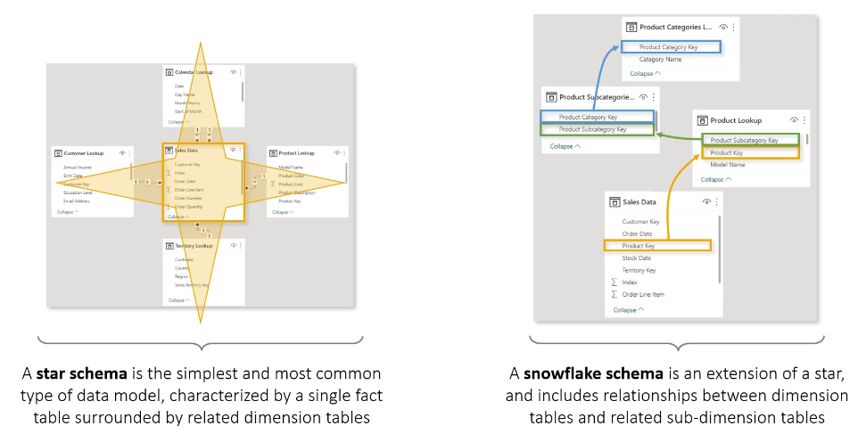
Star vs snowflake schemas in power bi

Slide 20
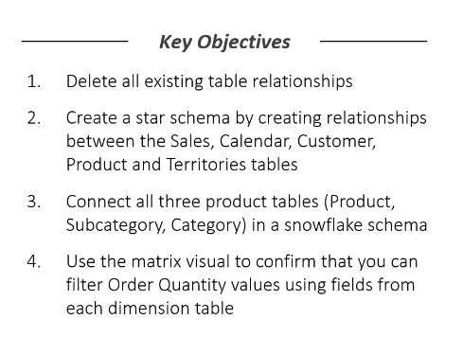
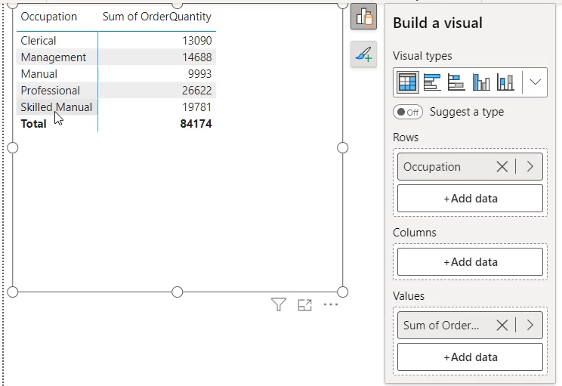
Challenge
You can create a matrix table from the report view

Slide 21
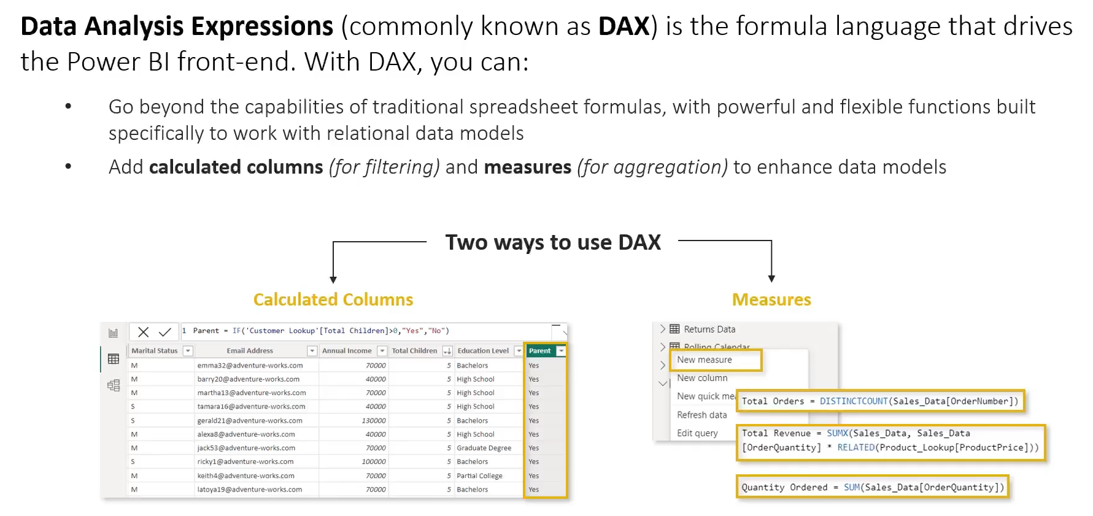
DAX

Slide 22
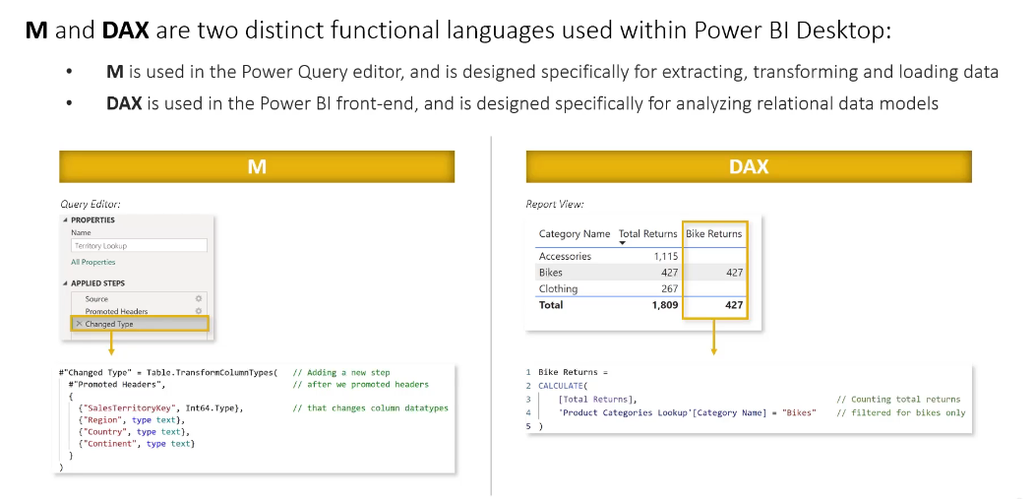
M code vs dax

Slide 23
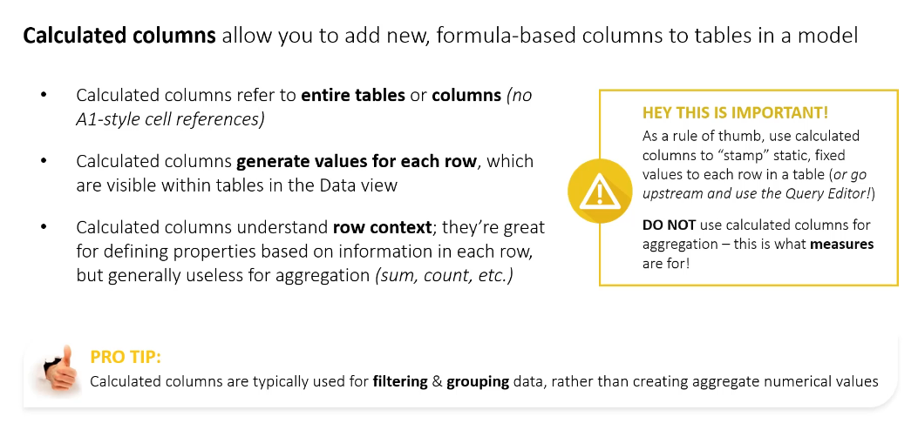
Calculated columns

Slide 24
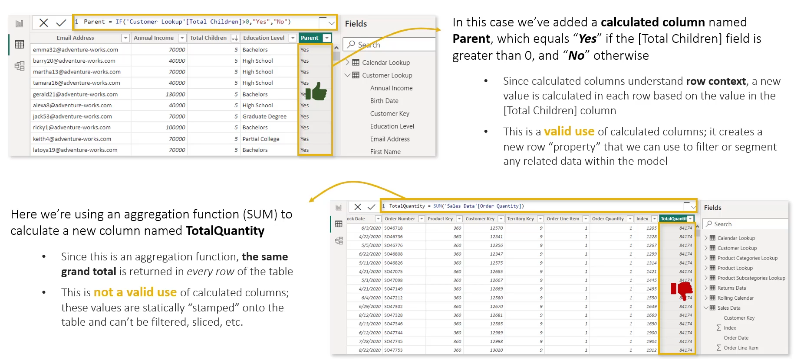
Example: calculated Columns

Slide 25
Challenge
On the Sales Data table, create a new Calculated Column with DAX
The column should display ‘Multiple Items’ if OrderQuantity is over 1, else ‘Single Item’

Slide 26
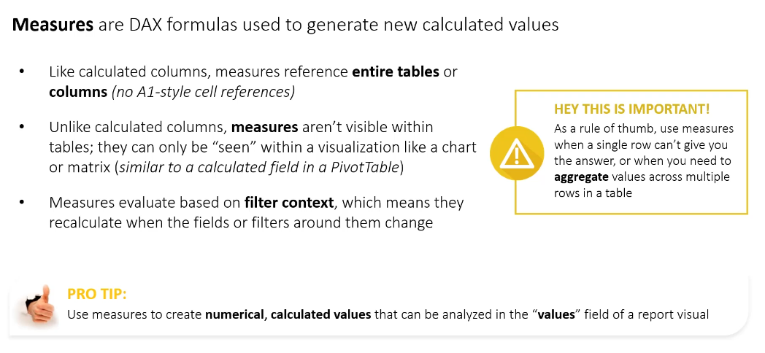
Dax Measures

Slide 27
Challenge
In the report view, use measures to show the Sum of OrderQuantity and sum of ReturnQuantity by product name
You may need to ‘Get Data’ for the ‘returns’ table and map its relationships

Slide 28
Types of Dax functions
Aggregation
SUM(), AVERAGE(), COUNT()
Filter/Context
CALCULATE(), FILTER(), ALL()
Statistics
MEDIAN(), AVERAGE(), STDEV.P(), VAR.P(), PERCENTILEX.INC()

Slide 29
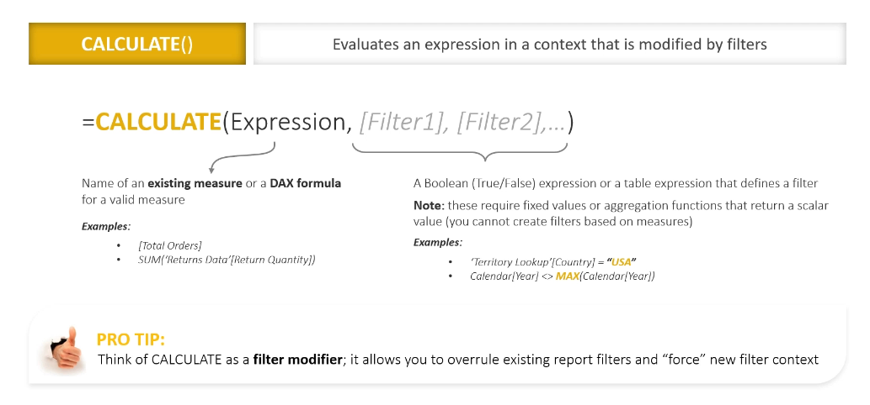
Calculate()

Slide 30
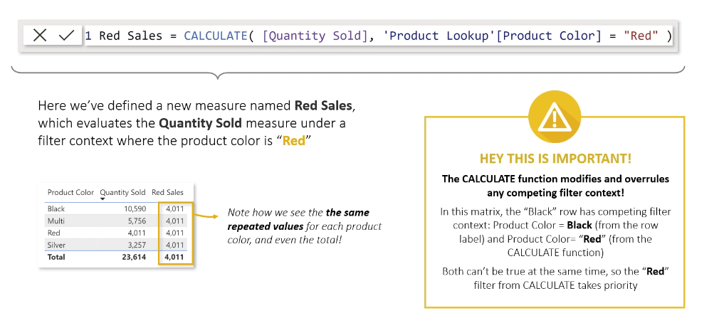
Example: calculate

Slide 31
Challenge
Create a matrix report view with: CategoryName selected for ‘rows’
Create a couple measures: TotalOrders & Sum of OrderQuantity
Create a new measure called ‘Bulk Orders’ that uses CALCULATE()
We just want the total number of orders in this column where OrderQuantity > 1

Slide 32
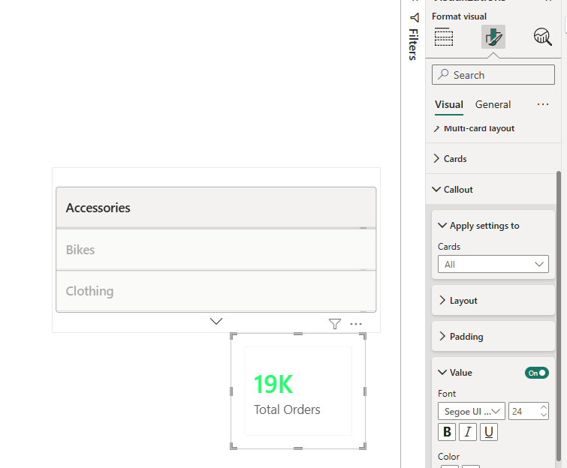
Designing dashboards & Conditional rendering
Under ‘format visuals’, ‘callout’ properties allow us to conditionally add styles to dashboard elements

Slide 33
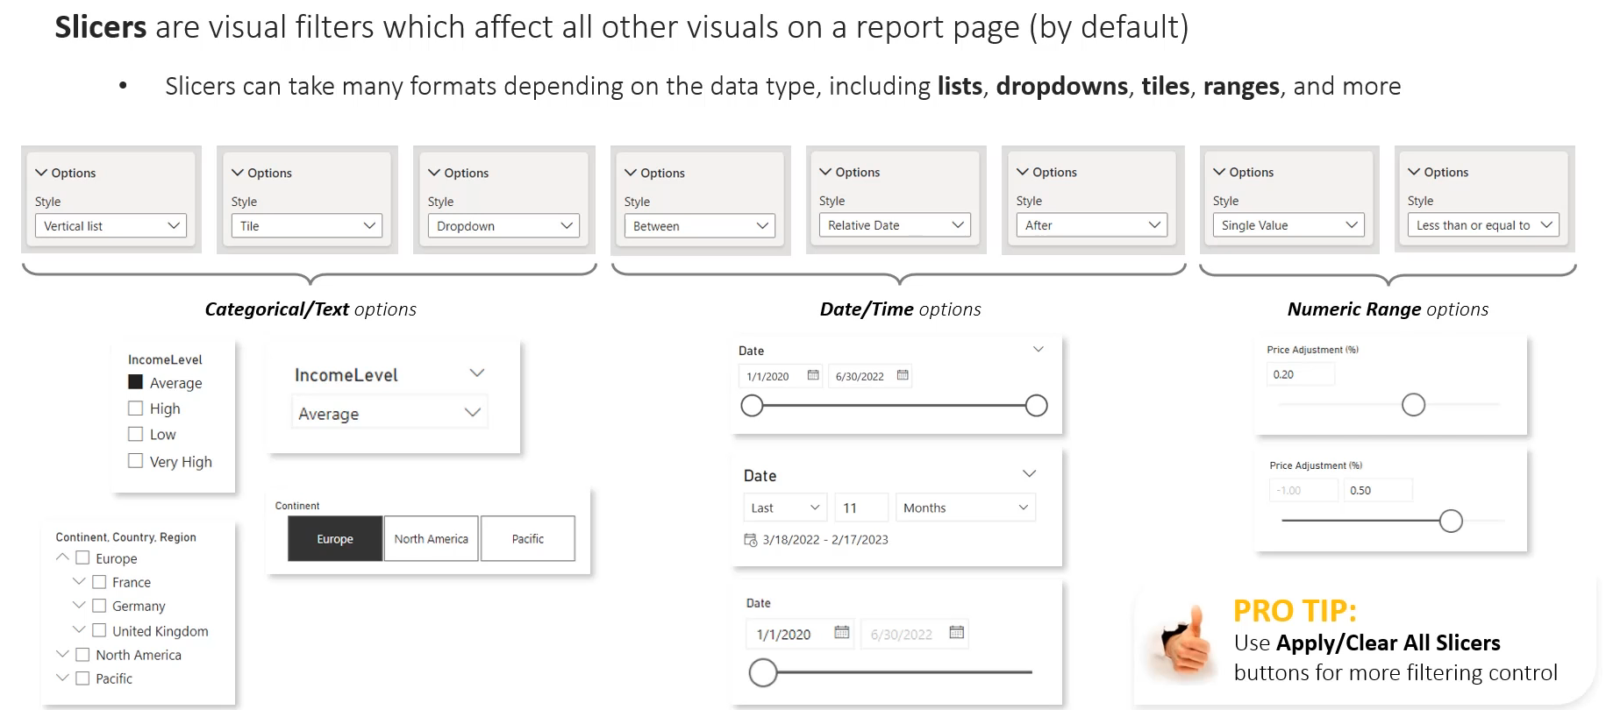
Slicers & filtering

Slide 34
Data alerts
Prerequisites:
Report must be published in Power BI Service
The visual must be pinned to the dashboard
The dataset must be configured to refresh (or use DirectQuery/Live Connection so values can change)
Select the card, KPI, or gauge tile
Click ‘More Options’, ‘Manage Alerts’, and then ‘Add alert rule’
Notifications can be configured to run on the Power BI Service or Email notifications

Slide 35
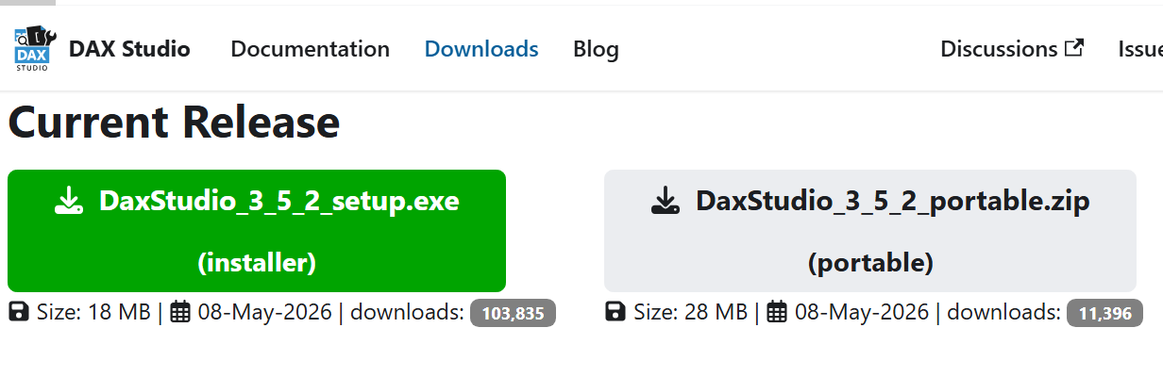
DAX Studio
DAX Studio is a 3rd party application to run DAX queries against our data
We can get detailed performance statistics
Easy installation from: daxstudio.org

Slide 36
Walkthrough
Please see ‘dax_studio_sample_queries.txt’ in your course materials

Slide 37
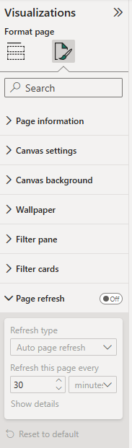
Refreshing your data – DirectQuery mode
Click the canvas (not an object)
Under visualization click ‘Format page’
Here we can enable ‘Page refresh’ to update the dashboard periodically (will query for updated records with the DirectQuery connection mode)

Slide 38
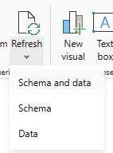
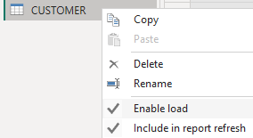
Refreshing your data – import mode
On the home ribbon we can refresh manually with the button
In the Power Query Editor we can right-click the table and Enable load & Include in report refresh so data is re-cached when we refresh the report
We can setup scheduled refreshes in Power BI Service

Slide 39

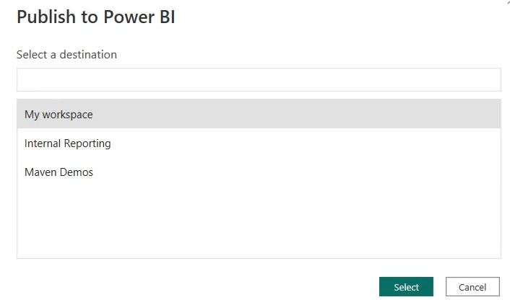
Publishing to power BI service
Click the ‘Publish’ button on the ‘Home’ ribbon
Log in if not already
Choose the destination in Power BI service to populate report

Slide 40
Goal:
Scenario: 5 min
Complete a hands-on challenge
Your organization needs to relay technical concepts to you. Clients often need to do the same. Take a few moments to get some pen and paper ready to take notes.

