Slide 1
Airflow

Slide 2
Prerequisites
Docker
Python
Recommend uv for package management / build tool (installed in WSL)
https://github.com/astral-sh/uv

Slide 3
Airflow
Apache Airflow is an open source platform to programmatically author, schedule, and monitor workflows:
Set the order of our tasks
Make sure each task only starts when the previous ones are done
Control the timing of the entire data process
Example: You need to collect data from a database, clean it, perform calculations, and then generate a report
Airflow helps us define this sequence and makes sure each step happens in the correct order, even if some tasks take longer than others

Slide 4
Airflow – more features / benefits
Python-based
Dynamic tasks – generate tasks based on dynamic inputs
Dynamic workflows – generates workflows based on static inputs
Branching – execute different sets of tasks based on a condition or result
Example: If yesterday’s sales data was higher than normal, Airflow could automatically add extra tasks to process every sale, without you having to manually change anything
Has a visual dashboard where you can see and control your tasks and workflows

Slide 5
Airflow UI
Monitor and troubleshoot workflows
Highlight relationships between workflows and tasks
Identify bottlenecks with performance metrics
Manage users and roles of your Airflow instance

Slide 6
Airflow - extensibility
Many providers: package with functions to interact with a tool or service (AWS, Snowflake, ect)
Customizable UI
Customize existing functions

Slide 7
Airflow components
The metadata database – stores info about your tasks and their status
The scheduler – determines when tasks should run
The DAG file processor – parses DAG files and serializes them into the metadata database; (internal, we don’t see this when running Airflow)
Transforms Python workflow definitions into structured execution plans that Airflow’s scheduler can efficiently run
Used to be a part of the scheduler, now it’s a separate component for scalability and security reasons
The Executor – determines how your tasks will be run, deciding whether to run them in sequence or parallel, and on which system; (internal, we don’t see this when running Airflow)
The API server – provides endpoints for task operations, i.e. start/stop tasks; Serves our UI
The Worker – the processes that actually perform tasks
The Queue – list of tasks waiting to be executed; (internal, we don’t see this when running Airflow)
The Triggerer – responsible for managing deferrable tasks; Allows Airflow to handle tasks that depend on external factors without blocking other processes (Advanced)

Slide 8
Airflow – concepts
DAG – Directed Acyclic Graphs define tasks and their dependencies
Operator – defines a single, ideally idempotent, task in your DAG
Airflow has thousands of Operators such as:
The PythonOperator to execute a Python script or function
The BashOperator to execute a Bash script or command
The SQLExecuteQueryOperator to execute a SQL query to a database
The FileSensor to wait for a file
Task – specific instance of an operator. When an operator is assigned to a DAG, it becomes a task.
Workflow – the entire process defined by your DAG, including all tasks and dependencies

Slide 9
Airflow is not…
Airflow is not:
a data processing framework
a real-time streaming solution
a data storage system

Slide 10
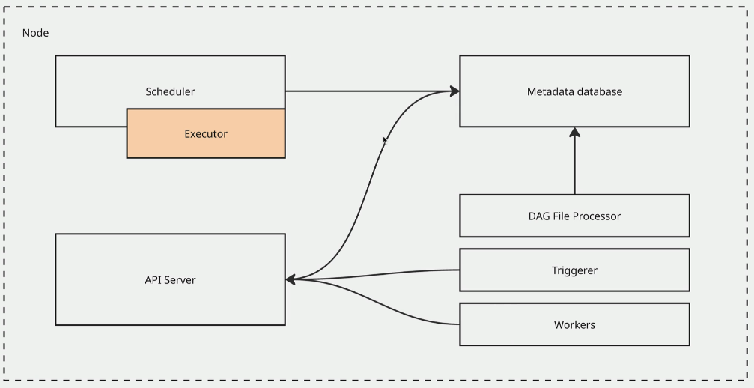
Airflow single node Architecture
This is fine for running locally or for smaller projects
Not scalable for heavy production workflows

Slide 11
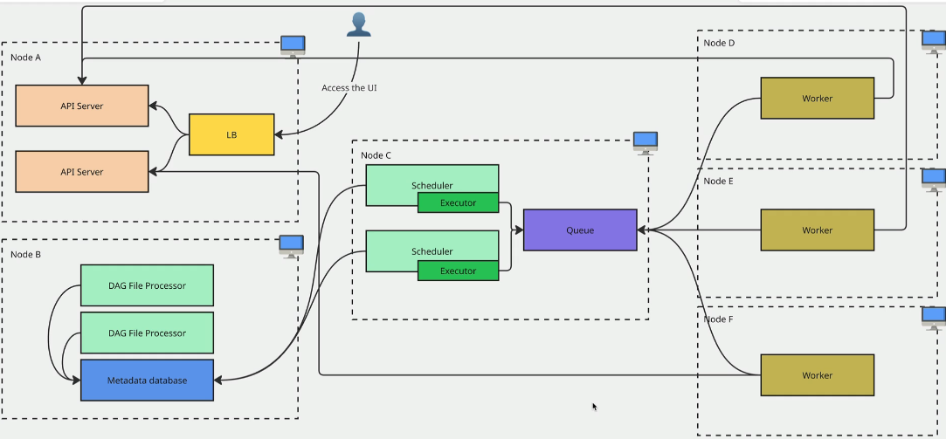
Airflow multi-node architecture
Scalable

Slide 12
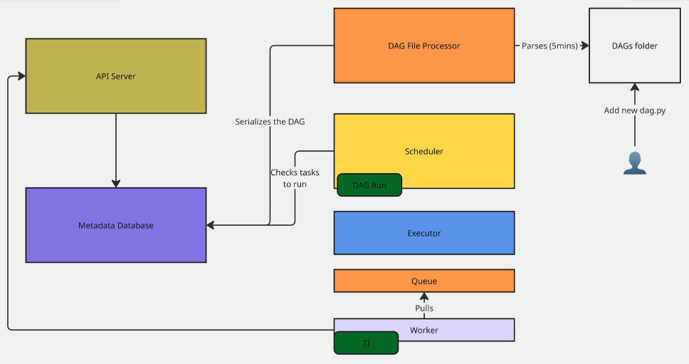
Runtime execution
The scheduler produces a task instance object
This object starts with a state of “Scheduled”
The scheduler sends the task object to the executor which queues up the task and marks its state to “Queued”
A worker pulls the task from the Queue, updates it status to “Running” until it completes the job, then the status is marked as “Success”, “Failed”, “Skipped”, etc.
The worker notifies the API server of the result, and the results are posted to the Metadata Database

Slide 13
Running Airflow in the cloud
Just like how Kafka could be run in the cloud with Amazon MSK, or pyspark could be run in the cloud with Amazon EMR, there are also managed cloud options for Airflow
The Amazon service for Airflow is called Amazon MWAA (managed workflows for Apache Airflow)
You just write your dags and cluster management is handled for us

Slide 14
Installing Apache Airflow
See ‘docker-compose.yaml’ in your course materials
This file is pre-configured to install and run Airflow locally via Docker containers – it shouldn’t be used in prod
The file is a modified version of he official docker-compose.yaml provided from Airflow:
https://airflow.apache.org/docs/apache-airflow/stable/howto/docker-compose/index.html
Create a project folder in WSL, and place the yaml file inside
Create a venv with python 3.11 (as of this writing this version is compatible with the Airflow version we will use)
Commands with uv (in your project folder):
uv venv –python 3.11
source .venv/vin/activate
uv pip install apache-airflow==3.0.0
docker compose up (this will take a while the first time as the images are downloaded!)
Airflow UI is exposed at localhost:8080 – the default username=airflow password=airflow

Slide 15
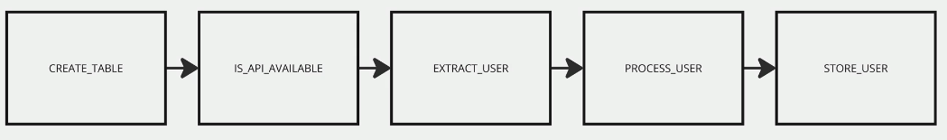
Our mini-project
We will create a multi-step DAG

Slide 16
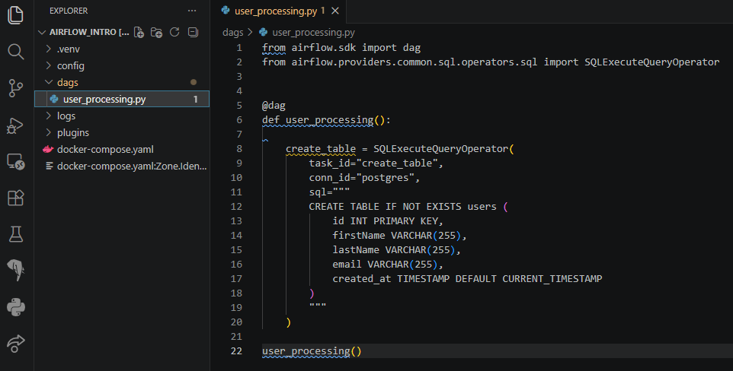
Defining a DAG
Use the @dag decorator
Dags go in the ‘dags’ folder

Slide 17
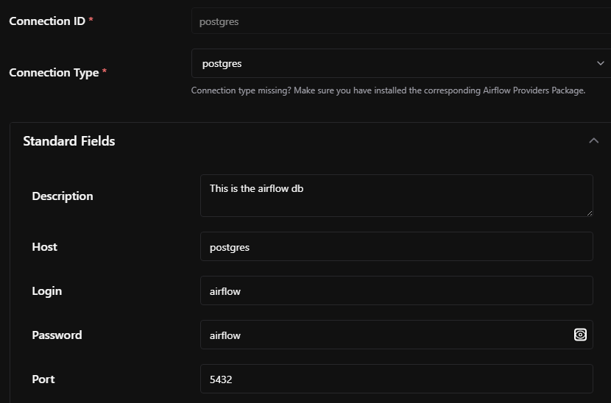
Adding connections
In Airflow UI we create connections to access databases, snowflake, etc.
Admin > Connections
Note the matching connection ID from our last slide

Slide 18
Providers
When adding connections, let’s say a technology is missing which you would like to integrate
We can extend the functionality of Airflow with Providers
These are essentially pip packages we would install to add the functionality
https://airflow.apache.org/docs/apache-airflow-providers/

Slide 19
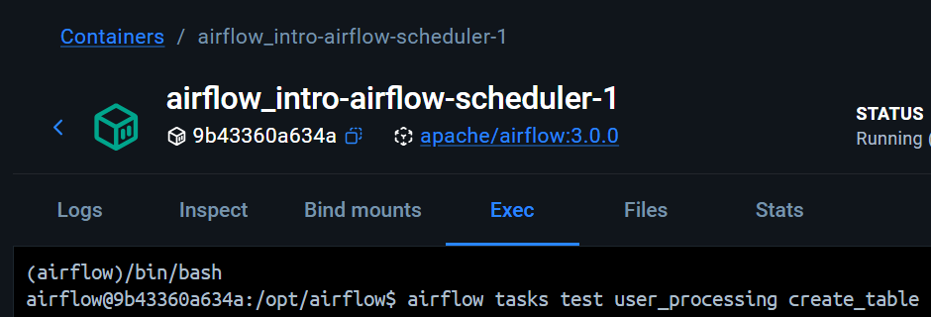
Test/schedule tasks directly
On docker desktop, select the scheduler and then ‘Exec’
/bin/bash ← access to scheduler CLI
Airflow tasks test <dag_name> <task_id> ← test a task to see what will happen, it will not save the metadata

Slide 20
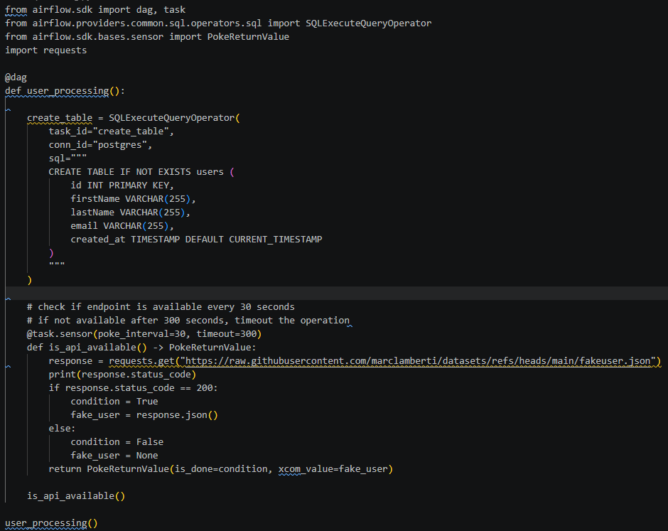
Check if an api is available
There are many other helpful sensors that may come out of the box, instead of making our own
HttpSensor, FileSensor, S3KeySensor

Slide 21
Extracting data – classic way
Please see ‘user_processing_old.py’ in course materials

Slide 22
Extract user as a task - without pythonoperator
Please see ‘user_processing.py’ in your course materials
Also note the new task to write the data to csv
Let’s install an airflow Hook to programmatically interact with our db:

Slide 23
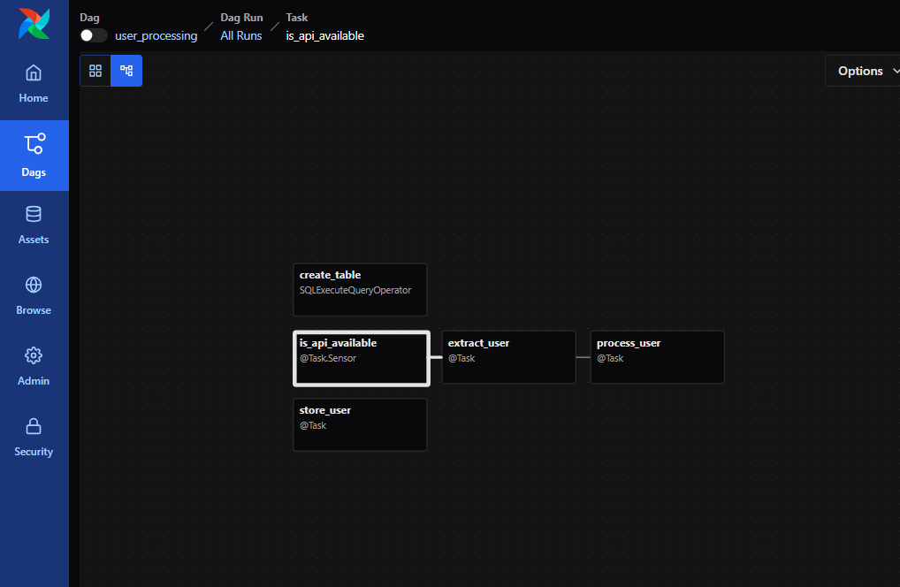
Cleaning up task dependencies

Slide 24
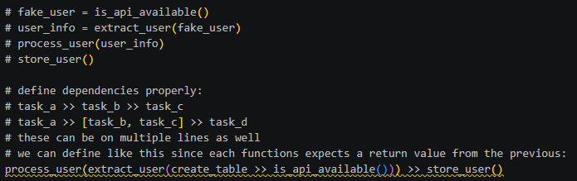
Setting task dependencies

Slide 25
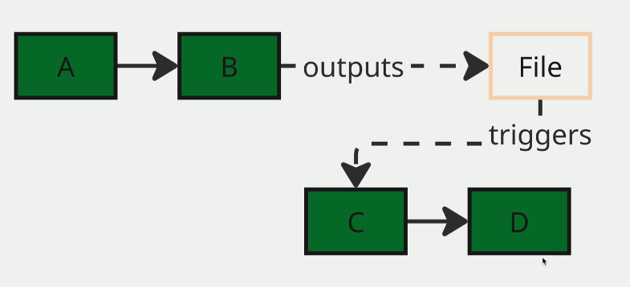
Assets
Assets are a newer feature of Airflow 3.x
It is a mental shift from the task itself to what tasks produce
Task centric → data centric orchestration
Completed assets can trigger other workflows that may produce an asset themselves

Slide 26
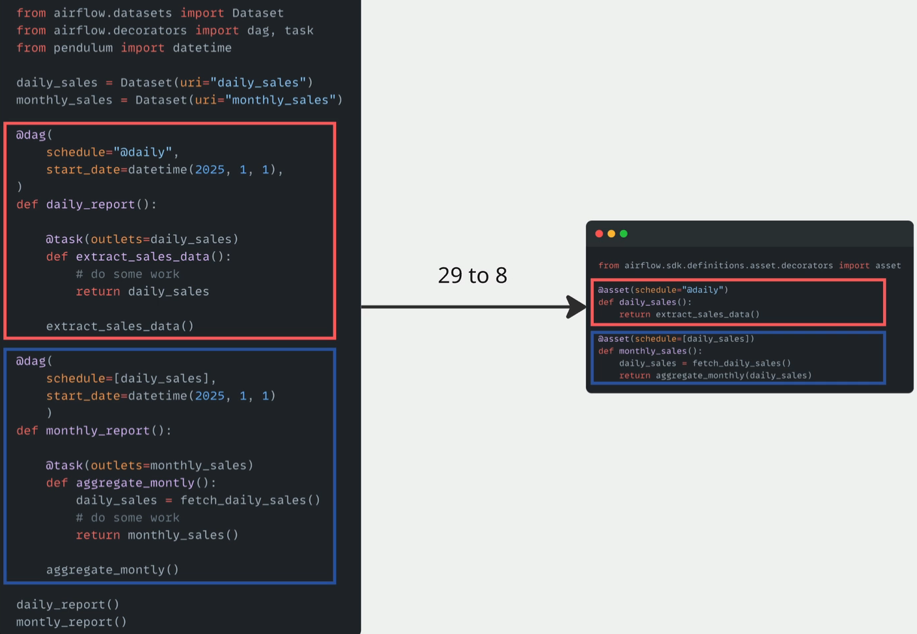
Working with dependent assets & dependent dags
On the left is Airflow 2.x, and on the right is Airflow 3.x
Airflow 2.x = Datasets
Airflow 3.x = Assets

Slide 27
Walkthrough
Please see ‘user.py’ in your course materials

Slide 28
Goal:
Scenario: 5 min
Complete a hands-on challenge
Your organization needs to relay technical concepts to you. Clients often need to do the same. Take a few moments to get some pen and paper ready to take notes.

