Slide 1
Kafka

Slide 2
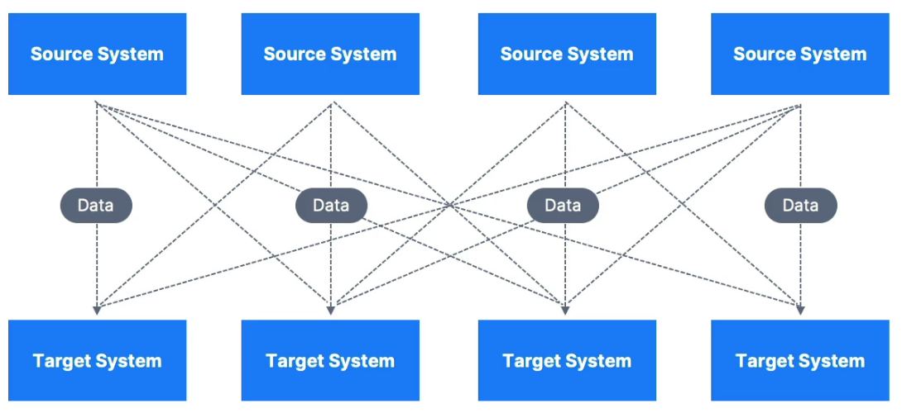
The problem
4 source systems * 6 target systems = 24 integrations
Each integration could be wildly different: Protocols (TCP, HTTP, REST, ftp, JDBC), data formats (csv, json, etc), schemas

Slide 3
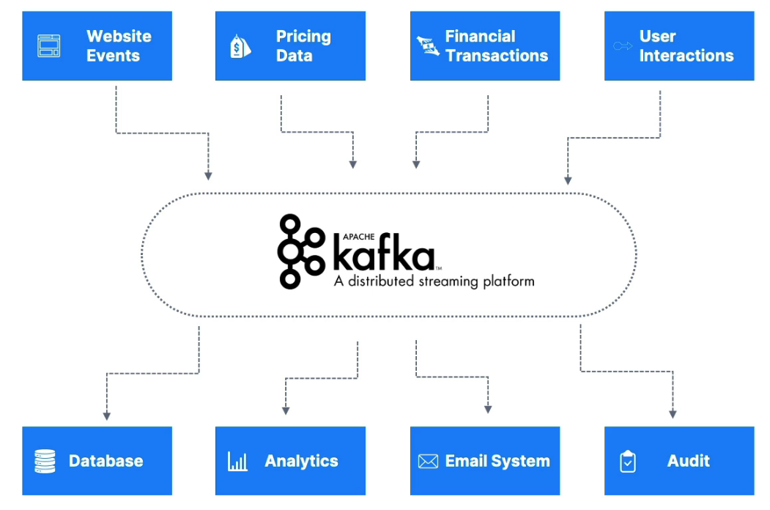
solution
Kafka decouples our data streams and systems
Producers = Sends (publishes) messages to Kafka topics
Consumers = Reads (subscribes) messages from Kafka topics
Distributed, resilient architecture, fault tolerant
Horizontal scalability:
Can scale to 100s of brokers
Can scale to millions of messages per second
High performance: latency of less than 10ms

Slide 4
Kafka use cases
Messaging System
Activity Tracking
Gather metrics from many locations
Application logs gathering
Stream processing (with Kafka Streams API)
De-coupling of system dependencies
Integrations with Spark, Flink, Storm, Hadoop, and many other Big Data Technologies
Micro-services pub/sub

Slide 5
Real life examples
Netflix uses Kafka to apply recommendations in real-time while you’re watching
Uber uses Kafka to gather user, taxi, and trip data in real-time to compute and forecast demand, and compute surge pricing
LinkedIn uses Kafka to prevent spam and collect user interactions to make better connection recommendations in real time
** Kafka owned by LinkedIn

Slide 6
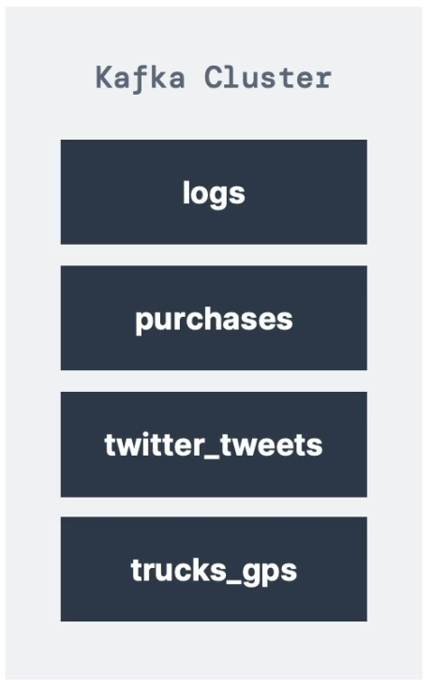
Kafka Topics
Kafka topics are streams of data
Like a table in a database (without any constraints)
You can have as many topics as you want
A topic is identified by its name
Any kind of message format: JSON, Avro, CSV, text, Binary data (images, PDF, MP4, etc.)
The sequences of messages in a topic are called a data stream
You don’t query topics, instead, producers/consumers handle it

Slide 7
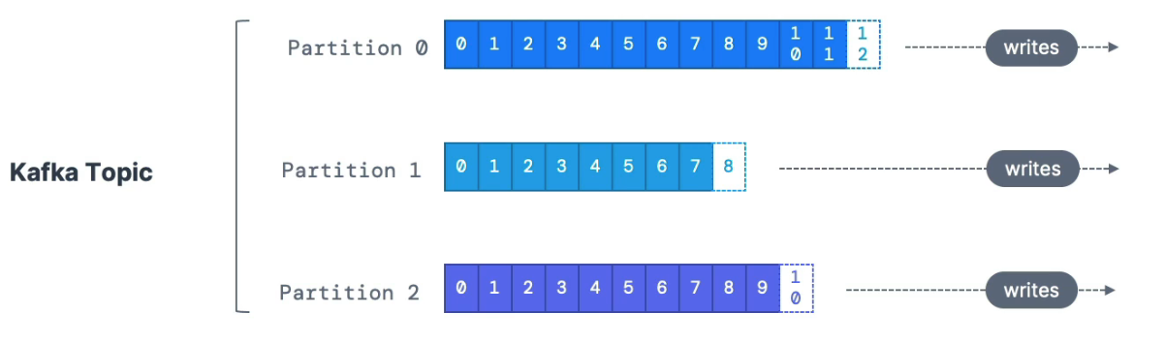
Partitions & offsets
Topics are split into partitions
Messages within each partition are ordered
Each message gets an incremental ID, called its offset
Kafka Topics are immutable: once data is written to them, it cannot be changed

Slide 8
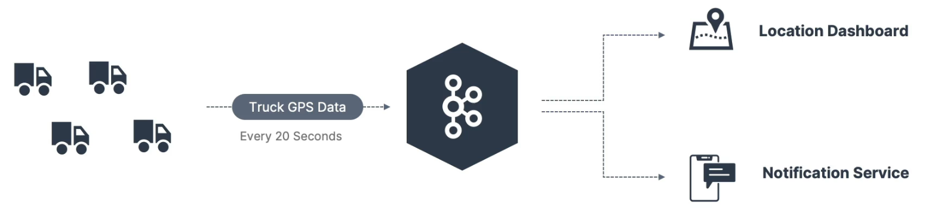
Topic example: truck_gps
A fleet of trucks reports its position every 20 seconds via a producer
Each truck sends its id, latitude, and longitude into the kafka topic
trucks_gps kafka topic now has the position of ALL trucks
We can choose to create the topic with x amount of partitions

Slide 9
Topics, partitions, & offsets – a bit more
IMMUTABILITY
Data is kept only for a limited time (default is one week – configurable)
Offsets only have meaning for a specific partition:
Offset 3 in partition 0 doesn’t represent the same data as Offset 3 in partition 1
Offsets are not re-used even if previous messages have been deleted
Order is guaranteed only within a partition (not across partitions)
Data is assigned randomly to a partition unless a key is provided
You can have as many partitions per topic as you want

Slide 10
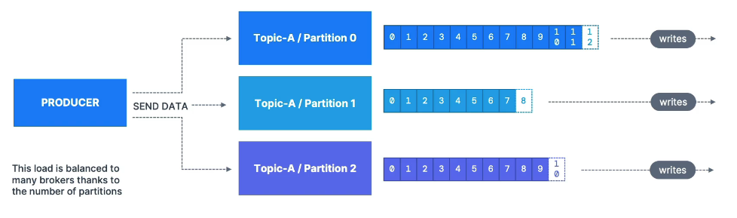
Producers
Producers write data to topics (which are made of partitions)
Producers know which partition to write to (and which Kafka broker has it; more on those later)
In case of Kafka broker failures, Producers will automatically recover

Slide 11
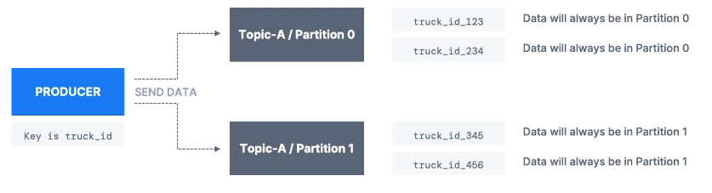
Producers: Message Keys
Producers can choose to send a message key (string, number, binary, ect.)
If key = null, data is sent round robin (partition 0, then partition 1, etc.)
If key != null, then all messages for that key will always go to the same partition (uses hashing strategy)
A key is typically sent if you need message ordering for a specific field (example: truck_id)

Slide 12
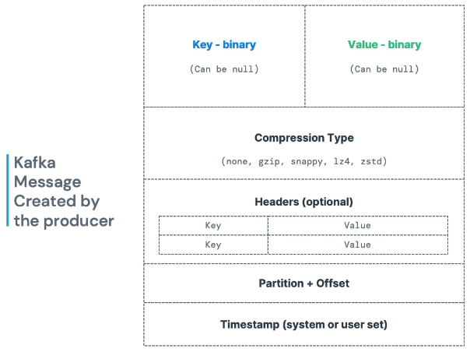
Kafka Message anatomy

Slide 13
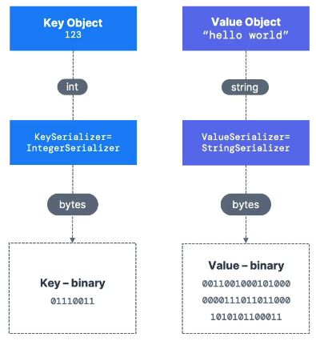
Kafka message serializer
Kafka only accepts bytes as an input from producers and sends bytes out as output to consumers
Message serialization means transforming objects / data into bytes
They are used on values and keys
Common serializers:
String (including JSON)
Int, Float
Avro
Protobuf

Slide 14
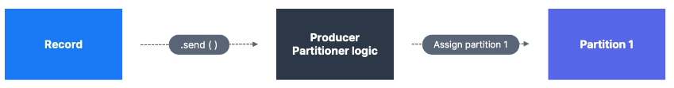
For the curious: Kafka message hashing
This is under-the-hood behavior – more than you probably need to know
Key takeaway: the producer determines which partition to send data
A Kafka partitioner is responsible for taking a record and determining which partition to send it into
Key Hashing – the process of determining the mapping of a key to a partition
In the default Kafka partitioner, the keys are hashed using the murmur2 algorithm, with the formula below for those curious:

Slide 15
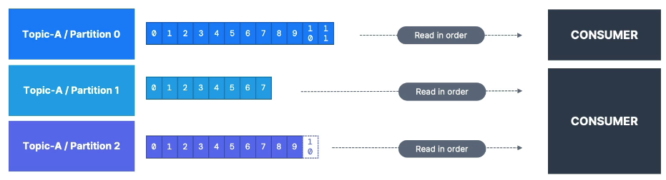
Consumers & Deserialization
Consumers read data from a topic (identified by name) – pull model
Consumers automatically know which broker to read from
In case of broker failures, consumers know how to recover
Data is read in order from low to high offset within each partition

Slide 16
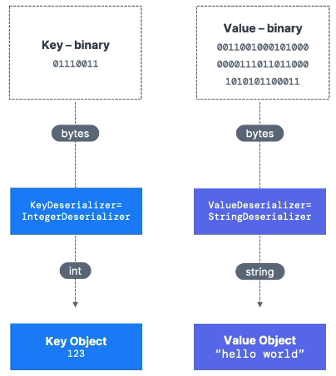
Consumer Deserializer
Deserialize indicates how to transform bytes into objects / data
They are used on the value and the key of the message
Common deserializers:
String (including JSON)
Int, Float
Avro
Protobuf
The serialization/deserialization type must not change during a topic lifecycle (create a new topic instead)

Slide 17
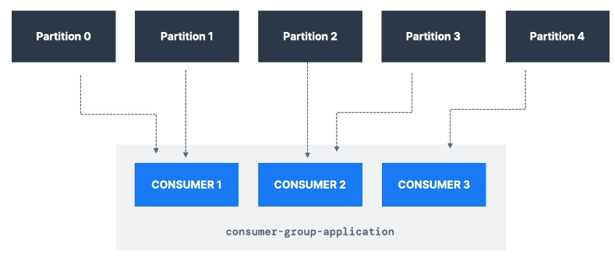
Consumer Groups
All the consumers in an application read data as a consumer group
Each consumer within a group reads from exclusive partitions

Slide 18
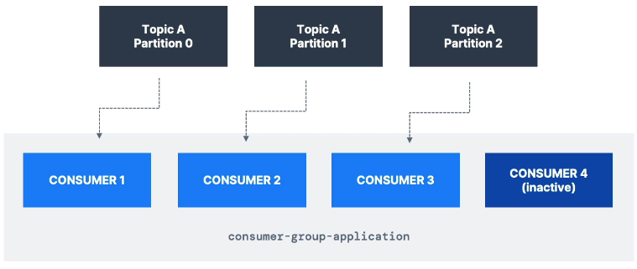
Consumer group – what if too many consumers?
If you have more consumers than partitions, some consumers may be inactive

Slide 19
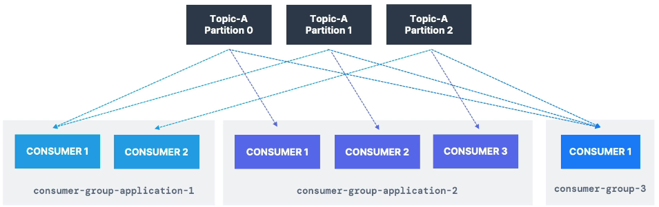
Multiple consumers on one topic
In Apache Kafka, it is acceptable to have multiple consumer groups on the same topic
Often makes sense to have a group per service. I.e. truck location service & truck notification service
To create distinct consumer groups, use the consumer property group.id

Slide 20
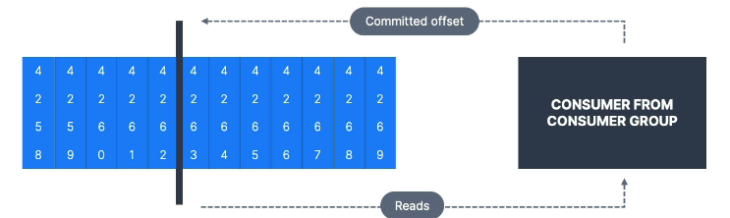
Consumer offsets
Kafka stores the offsets at which a consumer group has been reading
The offsets committed are in a Kafka topic named __consumer_offsets
When a consumer in a group has processed data received from Kafka, it should periodically commit the offsets (the kafka broker will write to __consumer_offsets)
If a consumer dies, it will be able to read back from where it left off thanks to the committed consumer offsets!

Slide 21
Delivery semantics for consumers
By default, Java consumers will automatically commit offsets (at least once)
There are 3 different semantics if you choose to commit manually:
At least once (usually preferred)
Offsets are committed after the message is processed
If the processing goes wrong, the message will be read again
This can result in duplicate processing of messages. Make sure your processing is idempotent
At most once
Offsets are committed as soon as messages are received
If the processing goes wrong, some messages may be lost
Exactly once
For Kafka → Kafka workflows: use the Transactional API (easy with Kafka streams API)
For Kafka → External System workflows: use an idempotent consumer

Slide 22
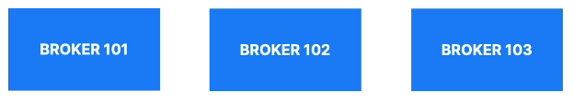
Kafka Brokers
A Kafka cluster is composed of multiple brokers (servers)
Each broker is identified with its ID (integer)
Each broker contains certain topic partitions
After connecting to any broker (called a bootstrap broker), you will be connected to the entire cluster
A good number to get started is 3 brokers, but some big clusters have over 100 brokers

Slide 23
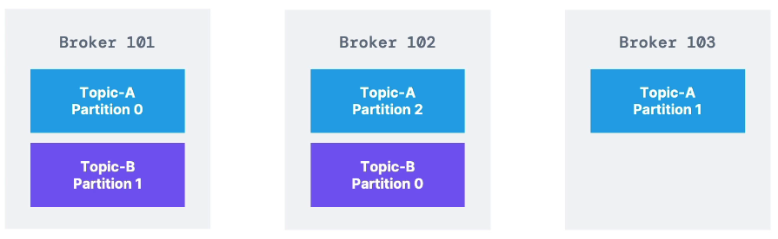
Brokers & topics
Example of topic A with 3 partitions and topic B with 2 partitions
Data is distributed, and broker 103 doesn’t have any topic B data
This provides horizontal scaling

Slide 24
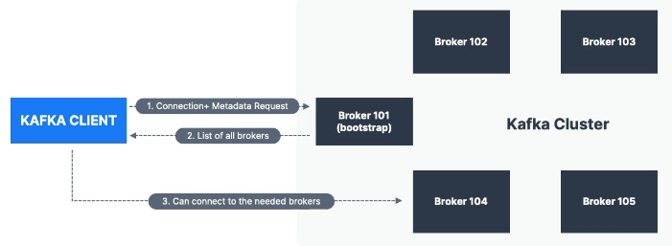
Kafka broker discovery
Every Kafka broker is also called a ‘bootstrap server’
You only need to connect to one (any) broker, and that broker will send back to the client the metadata of all other brokers, topics, and partitions

Slide 25
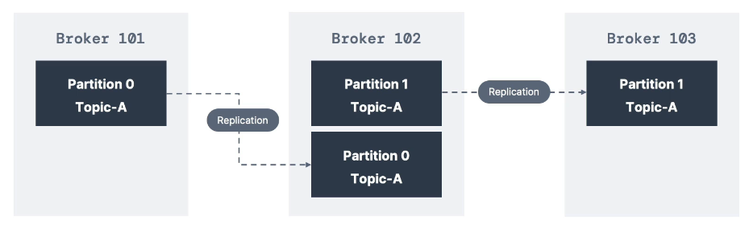
Topic replication Factor
Topics should have a replication factor > 1 (usually between 2-3 in prod)
This way if a broker is down, another broker can serve the data
Example: Topic-A with 2 partitions and replication factor of 2

Slide 26
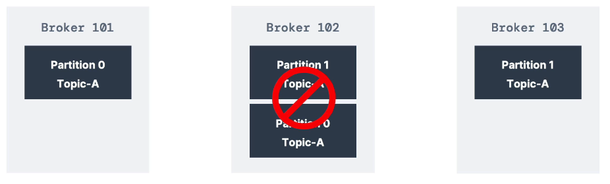
Topic Replication Factor
Example: we lost broker 102
Result: Broker 101 & 103 can still serve the data

Slide 27
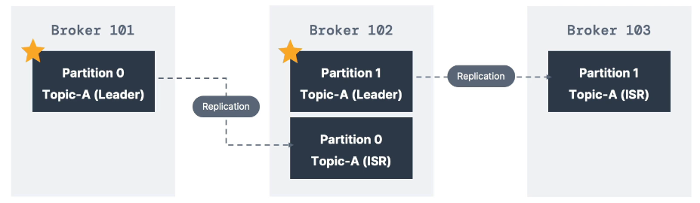
Concept of leader for a partition
At any time only ONE broker can be a leader for a given partition
Producers can only send data to the broker that is leader of a partition
The other brokers will replicate the data
Therefore, each partition has one leader and multiple ISR (in-sync-replica)

Slide 28
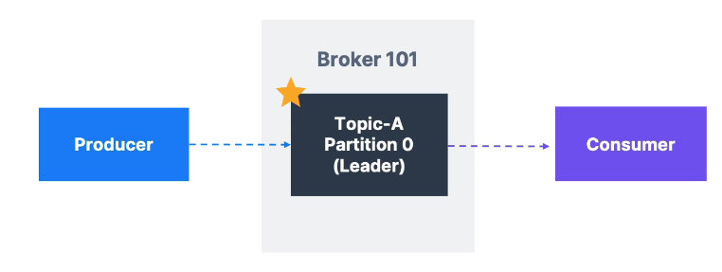
Default producer & consumer behavior with leaders
Kafka Producers can only write to the leader broker for a partition
Kafka Consumers by default will read from the leader broker for a partition

Slide 29
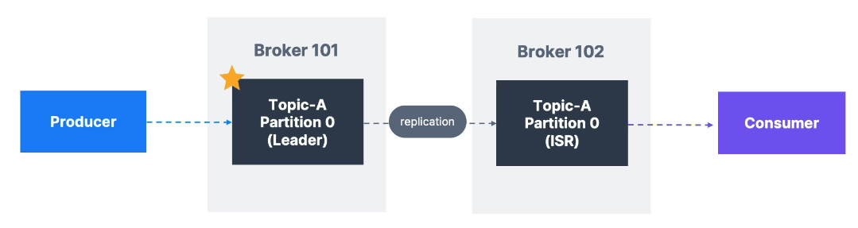
Kafka consumers replica fetching (kafka v2.4+)
Since Kafka 2.4, it is possible to configure consumers to read from the closest replica
This may help improve latency, and decrease network costs if using the cloud

Slide 30
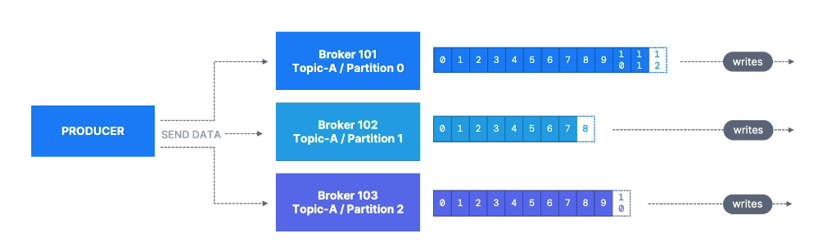
Producer acknowledgements (acks)
Producers can choose to receive acknowledgement of data writes:
Acks=0: Producer won’t wait for acknowledgement (possible data loss)
Acks=1: Producer will wait for leader acknowledgement (limited data loss)
acks=all: Leader + replicas acknowledgement (no data loss)

Slide 31
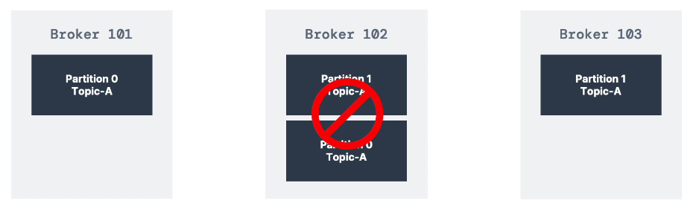
Kafka topic durability
For a topic replication factor of 3, topic data durability can withstand 2 brokers lost
As a rule, for a replication factor of N, you can permanently lose up to N-1 brokers and still recover your data

Slide 32
Zookeeper
Zookeeper manages brokers (keeps a list of them)
Zookeeper helps in electing leaders for partitions
Zookeeper sends notifications to Kafka in case of changes (e.g. new topic, broker dies, broker comes up, delete topics, etc.)
Kafka 2.x can’t work without Zookeeper
Kafka 3.x can work without Zookeeper (KIP-500) – using Kafka Raft (kraft) instead
Kafka 4.x will not have Zookeeper
Zookeeper by design operates with an odd number of servers (1, 3, 5, 7)
(Zookeeper does NOT store consumer offsets with Kafka > v0.10)

Slide 33
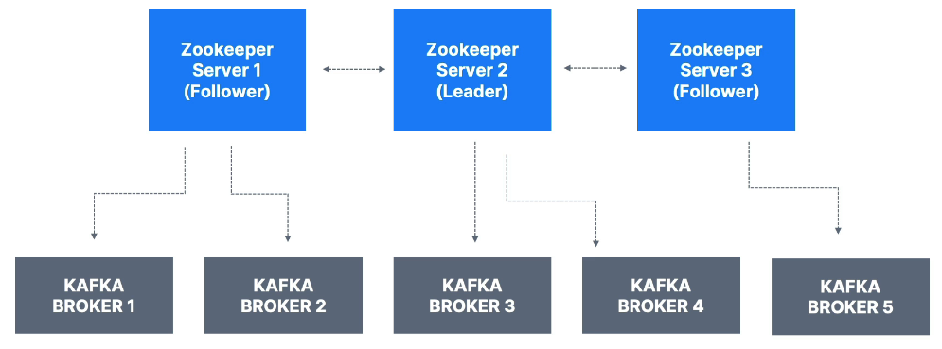
Zookeeper cluster (ensemble)

Slide 34
Should you use zookeeper?
With Kafka Brokers?
Yes, until Kafka 4.0 is out while waiting for Kafka without Zookeeper to be production ready
With Kafka Clients?
Over time, the Kafka clients and CLI have been migrated to leverage the brokers as a connection endpoint instead of Zookeeper
Since Kafka 0.10, consumers store offset in Kafka. We must not connect to Zookeeper directly as it is deprecated
All the APIs and commands that were previously leveraging Zookeeper are migrated to use Kafka instead, so that when clusters are migrated to be without Zookeeper, the change is invisible to clients
Zookeeper is also less secure than Kafka, and therefore Zookeeper ports should only be opened to allow traffic from Kafka brokers, and not Kafka clients
Therefore, to be a good Kafka developer, never ever use Zookeeper as a configuration in your Kafka clients, and other programs that connect to Kafka

Slide 35
About Kafka Kraft
In 2020, the Apache Kafka project started work to remove the Zookeeper dependency from it (KIP-500)
Zookeeper shows scaling issues when Kafka clusters have > 100,000 partitions
By removing Zookeeper, Apache Kafka can
Scale to millions of partitions, and becomes easier to maintain and set up
Improve stability, makes it easier to monitor, support, and administer
Single security model for the whole system
Single process to start with Kafka
Faster controller shutdown and recovery time
Kakfa 3.x now implements the Raft protocol (KRaft) in order to replace Zookeeper
Production ready since Kafka 3.3.1 (KIP-833)
Kafka 4.0 will be released only with KRaft and no Zookeeper

Slide 36
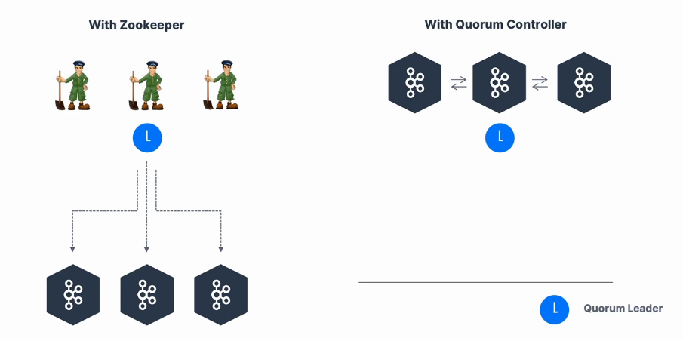
Kafka kraft architecture

Slide 37
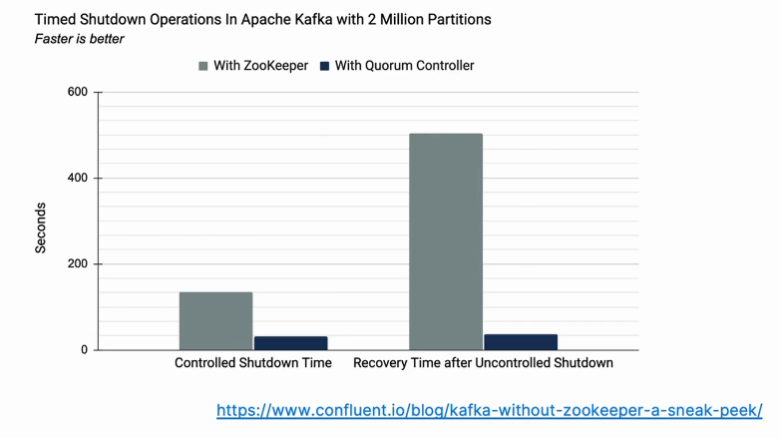
Kraft Performance Improvements

Slide 38
Kafka Install & setup – wsl/windows
Install JDK (recommend correto 21)
Install kafka binaries and extract to you wsl home location
https://kafka.apache.org/quickstart/
nano .bashrc → edit path env variable to add kafka to cli

Slide 39
CLI walkthrough
See the ‘1-kafka-cli’ folder in your course materials
The sh files contain our walkthrough scripts

Slide 40
Creating Kafka projects
Kafka SDK list – we will use Java
For this course we recommend Java 11 JDK (Amazon Corretto 11)
You could use IntelliJ Idea, VSCode, etc. – we will use VSCode in our examples
We could use Maven or Gradle as our build tool – we will go with Gradle in our course

Slide 41
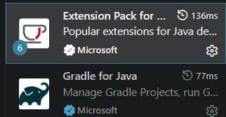
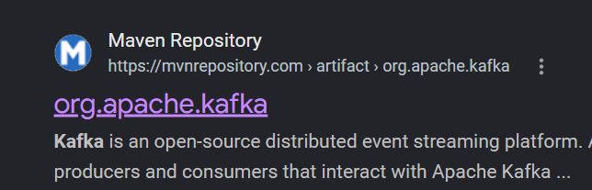
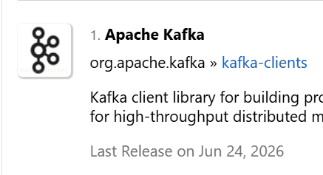
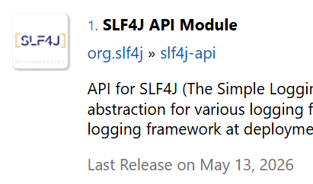
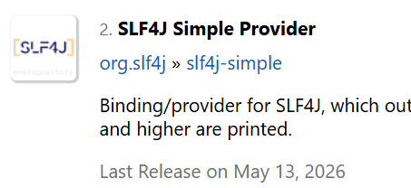
VSCode java setup
Grab the extensions
Run the command pallete to create a new gradle project (select groovy for the script DSL)
Google search ‘kafka maven’ to find the org.apache.kafka page
Get the gradle(short) imports for these three packages, and place them under your build.gradle file dependencies

Slide 42
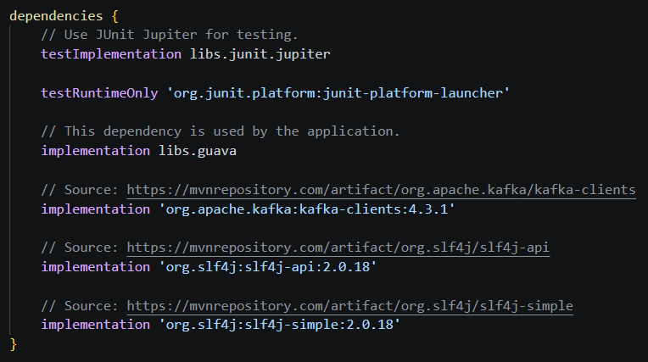
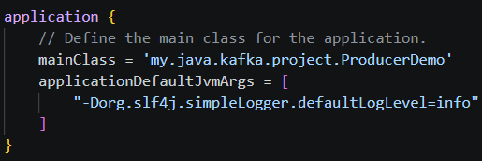
Example build.gradle
Running gradle via extension will format output and hide some logs. Run directly via CLI to see all logs:

Slide 43
Producer Walkthrough
Please see ‘ProducerDemo.java’ in your course materials
Run the script, then open a consumer in the CLI to retrieve our message

Slide 44
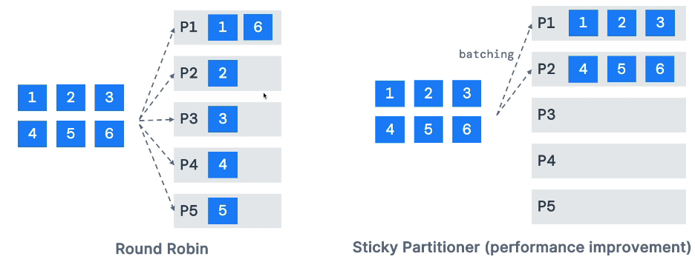
Sticky partitioner
In our last example we send a single message each time we run it, these will populate into different partitions
In our upcoming example, we will see what happens when we flush() and close() a batched group of messages

Slide 45
Producer/Consumer walkthrough - java
Please see ‘ProducerDemoWithCallback.java’ in your course materials
Please see ‘ProducerDemoWithKeys.java’ in your course materials
Please see ‘ConsumerDemo.java’ in your course materials

Slide 47
Goal:
Scenario: 5 min
Complete a hands-on challenge
Your organization needs to relay technical concepts to you. Clients often need to do the same. Take a few moments to get some pen and paper ready to take notes.

