Slide 1
Git & Github

Slide 2
Overview
Intro to Git & GitHub
init & config
add, commit, remote, push, & status
clone, branch, fetch, pull

Slide 3
What is Git? What is Github?
Definition: Git – a version control system (VCS) that tracks changes in source code, so developers can collaborate, roll back to earlier versions, and branch off for experiments without breaking the main codebase.
Definition GitHub – a cloud-based hosting platform for Git repositories.

Slide 4
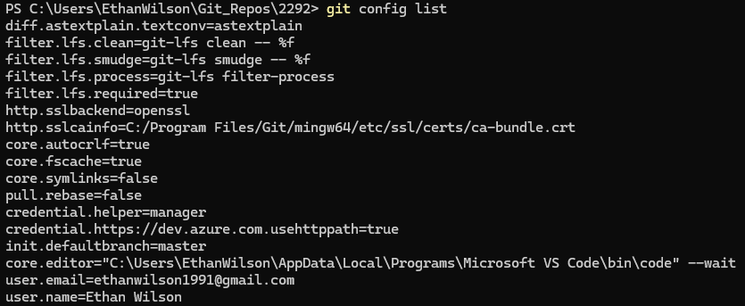
Init & config

Slide 5
Challenge – Create a local Repo
Goal:
Scenario: 5 min
Create a local git repo
Your organization needs you to start a new project. Let’s create a new git repo to track our file changes!

Slide 6
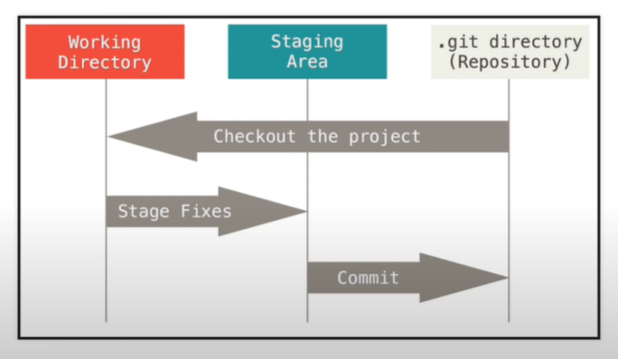
Working & staging

Slide 7
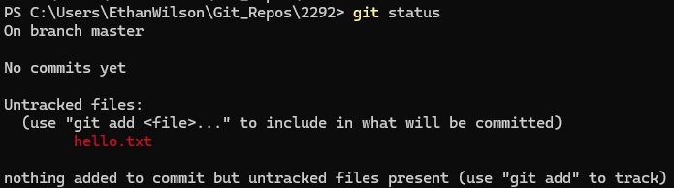
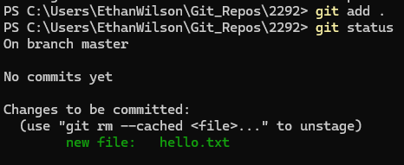
Add

Slide 8
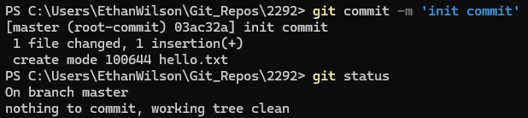
Commit

Slide 9
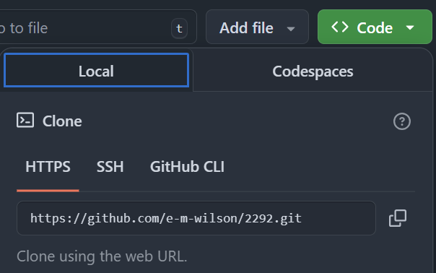
Remote
Get the link to use for the remote from github:

Slide 10
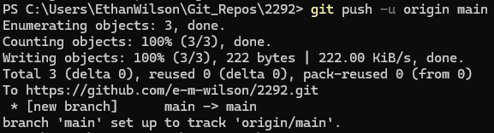
Push

Slide 11
Challenge – Push to Github
Goal:
Scenario: 5 min
Push a readme
Create a text file in your repo that describes your project, and then push it to your remote repo: “This is my first challenge I’ve uploaded to github!”

Slide 12
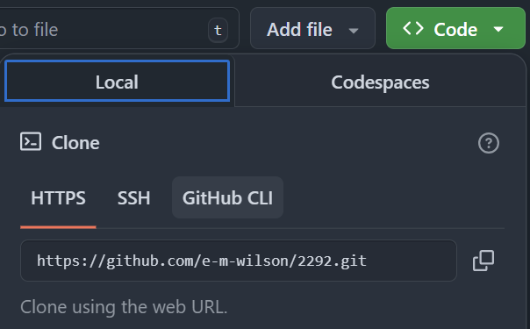
Clone

Slide 13

branch

Slide 14
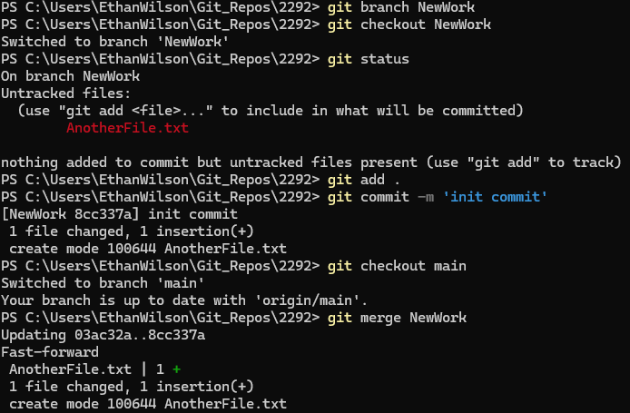
Branch continued

Slide 15
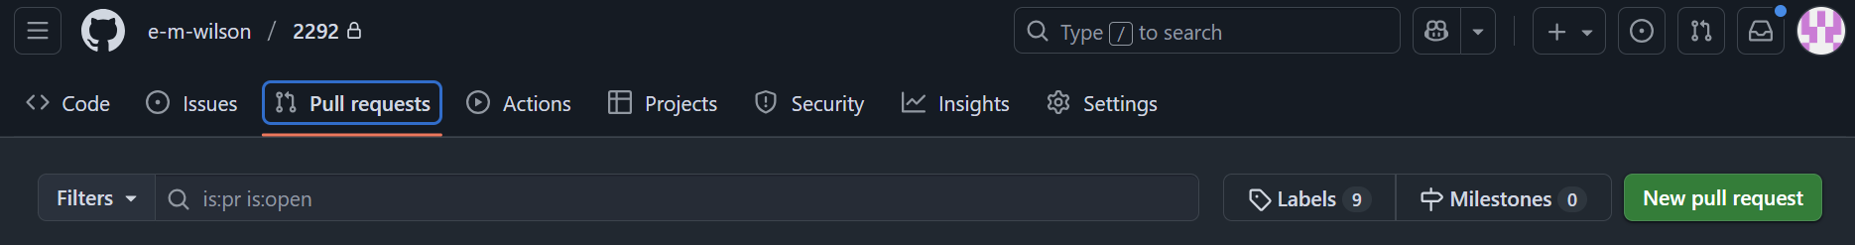
Pull Request

Slide 16
Pull vs fetch
git pull will check all remote changes and bring them into your working directory immediately.
git fetch will check for remote changes but will NOT bring those changes into your working directory immediately. I.e. you get to see what others have contributed first before downloading all their stuff.

Slide 17
Challenge – Create a working branch
Goal:
Scenario: 5 min
Create a working branch and pull request
Create a new branch called ‘working’. Create a new text file in your branch that describes your favorite food. Merge this into your main branch with:
The Git CLI
The GitHub Pull Request UI

