Slide 1
TypeScript & React

Slide 2
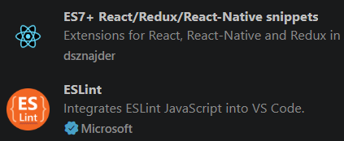
TypeScript
TypeScript is JavaScript + Types
Made by Microsoft
Makes larger apps scale easier
Gives our linters warnings when we make typos / use incorrect types
VS Code extensions:

Slide 3
Typescript – Intro Commands
npm install -g typescript
tsc --version
compile a file:
tsc app.ts -> compiles into .js file
tsc --init -> generates tsconfig.json file (compiler settings)

Slide 4
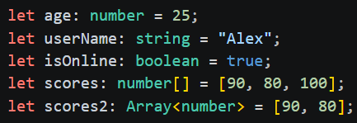
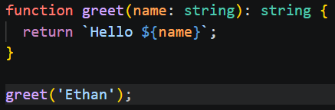
TypeScript
With TypeScript we assign types ☺
Variables, functions, classes, etc may now all accept type definitions

Slide 5
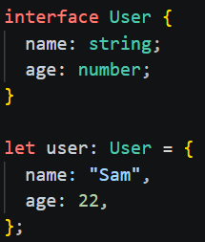
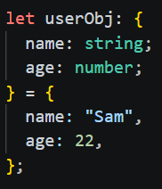
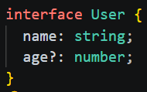
TypeScript – Objects & Interfaces
We can define object literals with types
We use interfaces to define reusable types
We typically use interfaces over classes when defining new types because interfaces define only a contract and will not generate any runtime code like a class would
We can mark a field as nullable with ‘?’ when defining interfaces

Slide 6
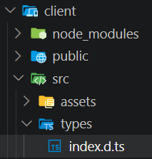
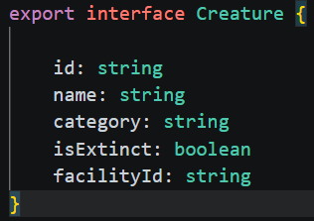
TypeScript – Definition Files
‘.d.ts.’ file extension
Contains no runtime code, only definitions for types used elsewhere

Slide 7

Typescript – Type Aliases & Type Unions
We can create type aliases with the ‘type’ keyword: ID is either a string OR a number
Type union = when we have a new type made from 2 or more other types;
i.e. ‘string | number’ syntax

Slide 8
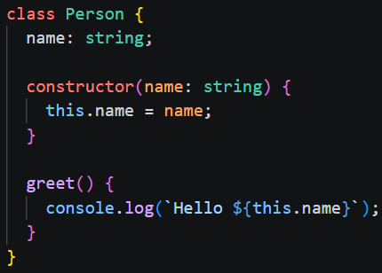
Typescript Classes

Slide 9
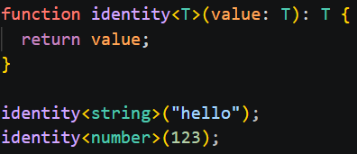
Typescript – Generic Types
‘T’ represents a generic type

Slide 10
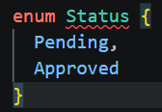
Typescript - Enum
We typically use ‘type’ syntax instead of defining an actual enum with ‘enum’ keyword
Doing it this way generates zero runtime cost (less bundled code after compilation)

Slide 11
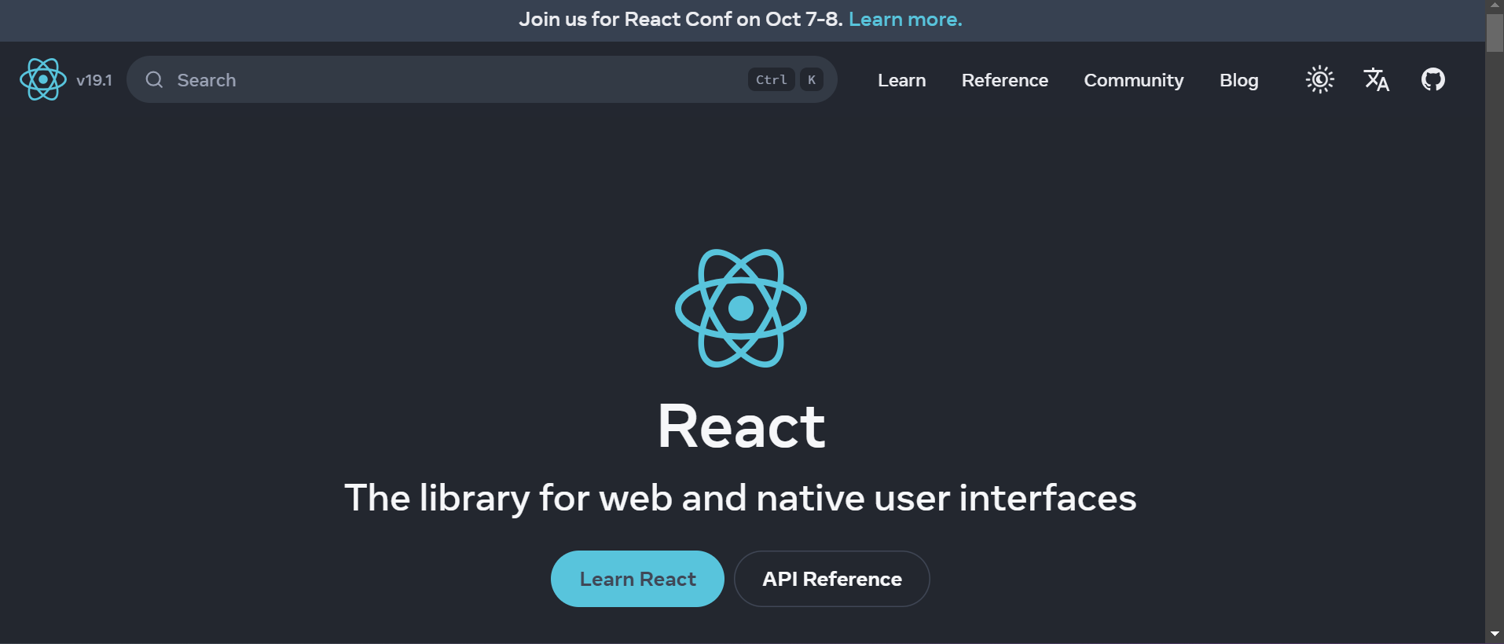
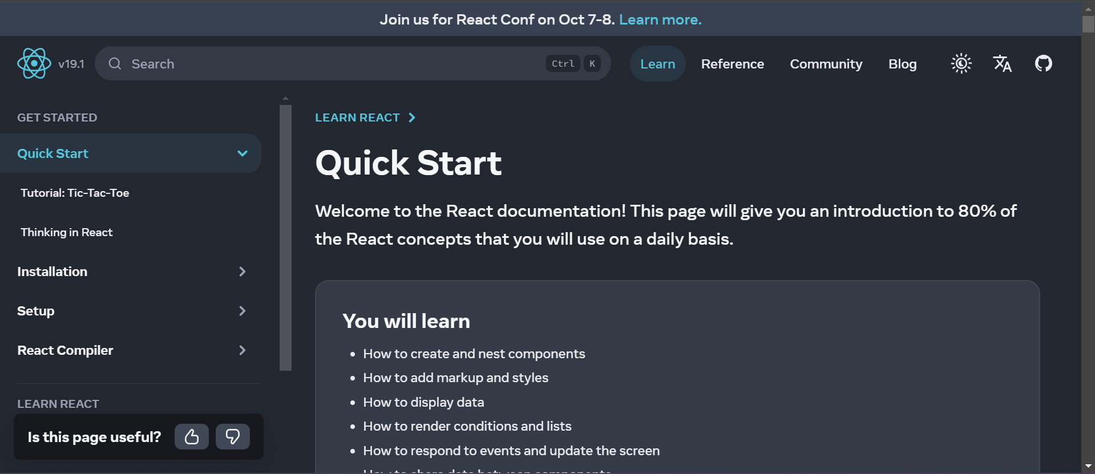
What is React?
Definition: React is a front-end JavaScript library
React is also known as React.js or ReactJS
React is a tool for building UI components
react.dev/learn

Slide 12

How Does React Work?
React creates a virtual DOM in memory
Instead of manipulating the browser’s DOM directly, React creates a virtual DOM in memory, where it does all the necessary manipulating, before making changes in the browser DOM

Slide 13

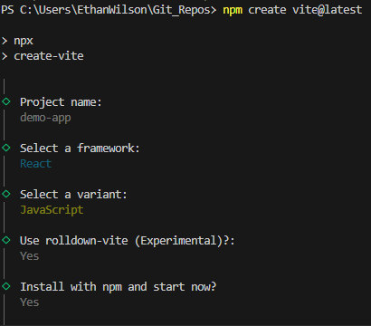
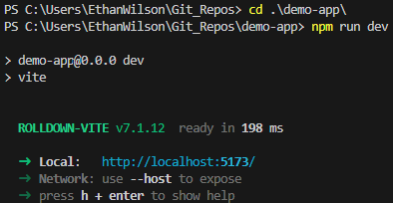
What we Need
NPM, included with Node.js
Vscode
Vite
Project names all lowercase/dashes
Recommended: React Developer Tools browser extension
2026 – use Typescript – Compiler option NOT SWC

Slide 14
Challenge – Create Your First App
Goal:
Scenario:
Create a React project
Your organization needs to build a portal for service technicians. This portal should be able to view, modify, and delete incident records. This application will be written in React.
To get started, setup your development environment

Slide 15
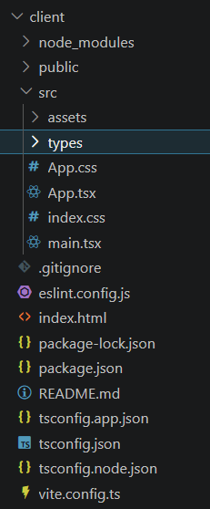
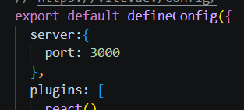
React Project Structure
Note: TypeScript React projects use .tsx, normal React uses .jsx files!
Index.html – entrypoint; loads our main.tsx
Main.tsx – loads app.tsx; typically add global dependencies here
App.tsx – main app structure/components go here
Package.json – contains our NPM dependencies + versions
Vite.config.ts – configuration for vite’s build tools; e.g. set the port
that our front-end will launch on:
Author’s opinion:
The Assets folder can be deleted…
The public folder
is already accessible
easily from components
We will just use that for any image resources

Slide 16
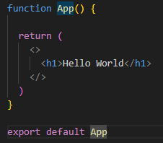
What is a React Component?
Definition: A component is a piece of the UI that has its own logic and appearance
A component can be as small as a button, or as large as an entire page
React components are JavaScript functions that return markup
Pascal-case naming
Two types: class components and function components (default)
Definition: These are called Fragments – special React components that groups a list of children without adding extra nodes to the DOM.

Slide 17
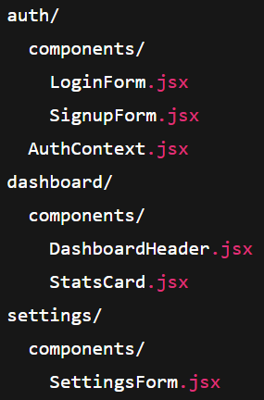
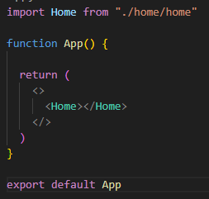
Project Organization & Component Nesting
It’s common to group up components in your project folder based on features
We can import one component into another

Slide 18
Challenge – Create Your First React component
Goal:
Scenario:
Create a React component
Your organization needs to build a portal for service technicians. This portal should be able to view, modify, and delete incidents. This application will be written in React.
Create a component called ‘Header’ and place it inside the default ‘App’ component.
Put in some dummy text so you know it works

Slide 19
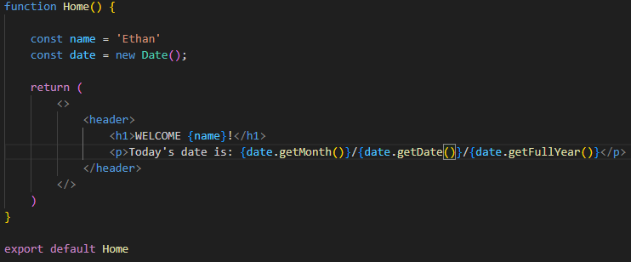
What is JSX?
JSX stands for JavaScript XML
Expressions are written in braces: { }
Expressions can include React variables, properties, or any other valid JavaScript expression
There can only be one top-level element
Comments are written as: {/* */}

Slide 20
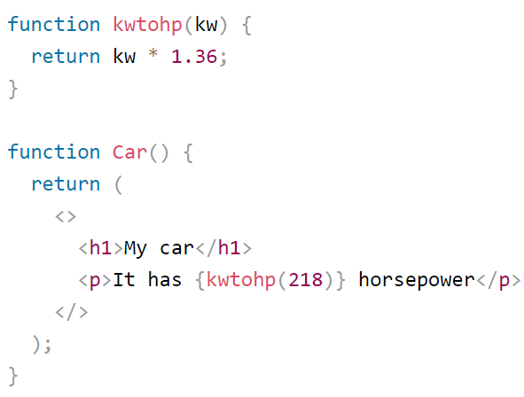
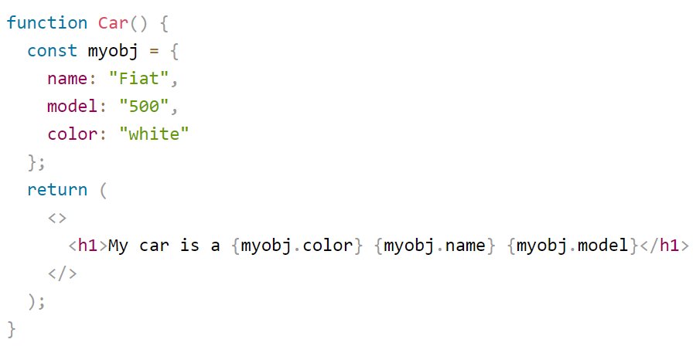
What Is JSX?
Functions may be used in expressions
Object properties may be used in expressions

Slide 21
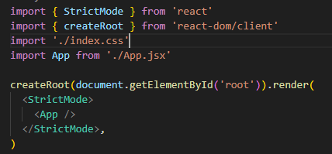
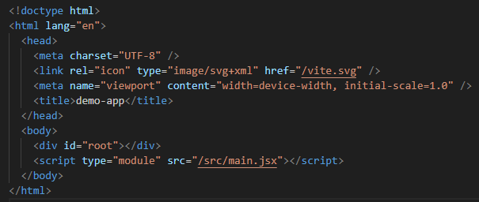
Remove The Default Styling
Delete index.css & remove its reference in main.jsx
Delete app.css & remove its reference
Index.html:
Remove or swap out the browser icon
Change the title
With Material UI: <CssBaseline/>

Slide 22
Styling Our Components
There are many ways to style react components:
Inline – limited and unsightly
Global CSS - .css files (styles are global and can accidently override eachother)
CSS Modules – ComponentName.module.css file (styles are scoped per component)
CSS-in-JS – write CSS directly inside JS/TS
Utility-First Frameworks (Tailwind CSS) – predefined utility classes directly in JSX
Component Libraries – premade components with styles, e.g. MaterialUI, Chakra UI, Radix UI

Slide 23
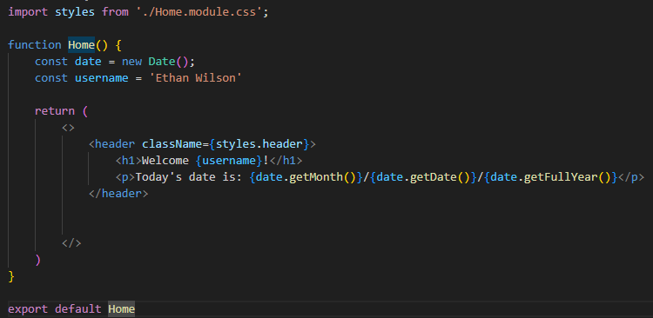
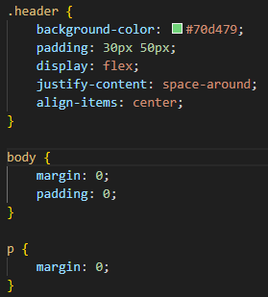
CSS Modules
Classes work differently in React, notice className
Notice the naming convention to enable modules: ComponentName.module.css
Notice the reset for the <body> & <p> elements

Slide 24
Challenge – Modify the header
Goal:
Scenario:
Modify header element
Your organization needs to build a portal for service technicians. This portal should be able to view, modify, and delete incidents. This application will be written in React.
In the ‘App’ component, create a header using semantic html.
Within the header element, include a welcome message that reads: “Welcome {user.Prefix} {user.LastName}! Time since last incident: {dummyTimeValue}”
The data should come from an object in your component that stores your own name, the time value may be faked or left empty for now
Also include two links for ‘Home’ and ‘Incidents’
Style your component

Slide 25
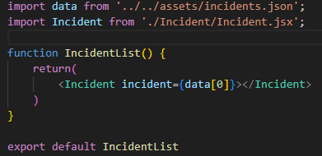
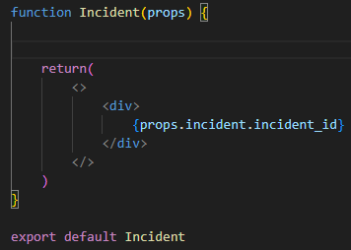
Props
Short for properties
Child components can receive a ‘props’ object
This object contains items passed from the parent
These items can be objects, arrays, strings, numbers, and more

Slide 26

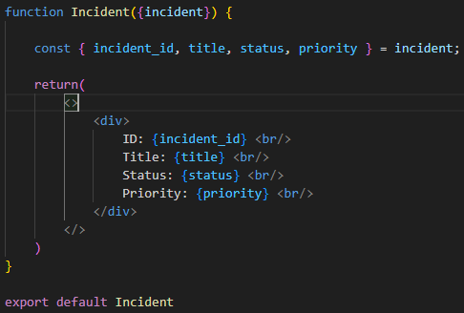
Destructuring Props
We can pull out from the props object only what we need with destructuring
This is standard JavaScript (ES6 feature)

Slide 27
What Are Hooks?
Hook | Purpose
useState | Adds state to a functional component.
useEffect | Handles side effects like data fetching or subscriptions (replaces lifecycle methods).
useReducer | Manages complex state logic with a reducer function.
useContext | Accesses context values without wrapping in a Consumer.
useRef | Stores mutable values or references to DOM elements.
useMemo | Memoizes results of expensive calculations.
useCallback | Memoizes functions to prevent unnecessary re-renders.
Definition: React Hooks are a special types of functions that let us ‘hook into’ React features like state, lifecycle, and context from functional components.
Before hooks, class components were the only way to alter state or hook into the lifecycle of a component.
Always called at the top level of a component.
Memoize – caching the result of a computation

Slide 28
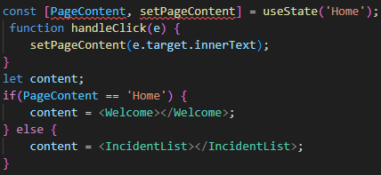
Keeping State
Definition: State is an object that holds data or information about a component that may change over time.
The ‘memory’ of a component
It allows the component to keep track of values between renders
When state changes, React automatically re-renders the component (and any children that depend on the state) so the UI stays in sync with data
State should always be declared at the top of the component function

Slide 29
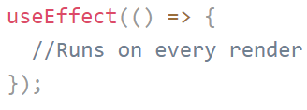
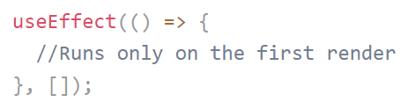
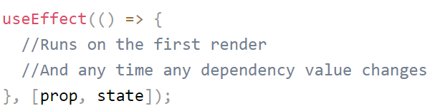
Effect
Definition: useEffect is a hook that lets us perform ‘side effects’ in functional components.
Definition: A Side Effect is any action that happens outside the normal flow of rendering:
Fetching data from an API
Setting up subscriptions or event listeners
Updating the DOM manually
Stating/stopping timers
useEffect accepts two arguments:
1. A function to run when it is triggered
2. An array of dependencies that when changed, cause the useEffect to run again (props or states)

Slide 30
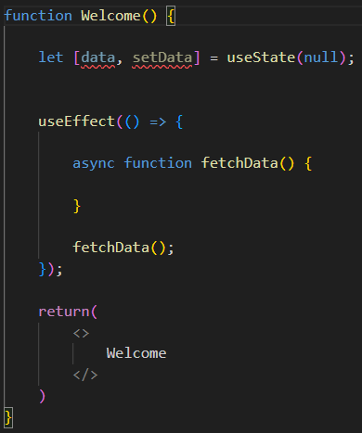
Async Code with Effects
The callback function provided to useEffect can NOT be asynchronous
Instead, we place an asnyc inner function inside of the callback, and then call that

Slide 31
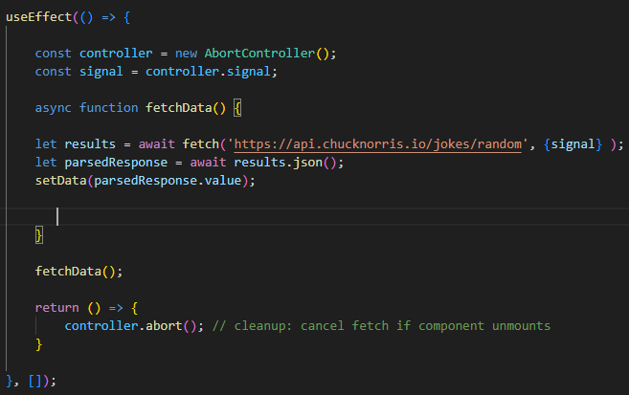
Effect Optimization
Certain effects should be ‘cleaned up’ after they are no longer needed
This reduces the chance we will have a memory leak
Timeouts, subscriptions, event listeners, and any effect that doesn’t need to continuously be available to the application should be disposed
Use the AbortContoller browser API to cancel fetch requests no longer needed

Slide 32
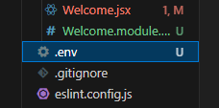

Storing Api Keys
Create a file that is only the file extension ‘.env’
In the file define your data
Import it where you need it
Don’t forget to add environment variables to your gitignore

Slide 33
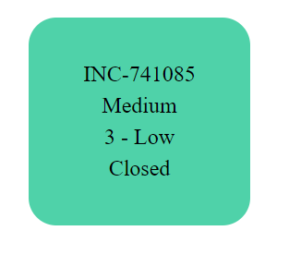
Challenge – View an Incident
Goal:
Scenario:
Create components to help manage incidents
Your organization needs to build a portal for service technicians. This portal should be able to view, modify, and delete incidents. This application will be written in React.
In the ‘App’ component, under the header, nest an ‘IncidentList’ component. Then, inside of ‘IncidentList’, nest an ‘Incident’ component.
Import the provided JSON dummy data into ‘IncidentList’
Render the first incident record by passing the record data down via props to the ‘Incident’ component
Style the Incident component into a card that displays the incident id, priority, severity, and status fields

Slide 34
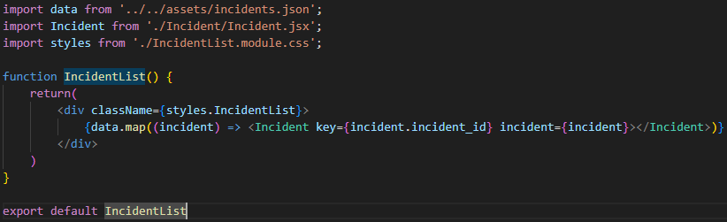
Lists
The JavaScript map() array method is used for looping through a list and rendering content:
A key is HIGHLY encouraged (or else you will get a warning) – A key allows React to update an item and refresh the component properly if it is updated or removed

Slide 35
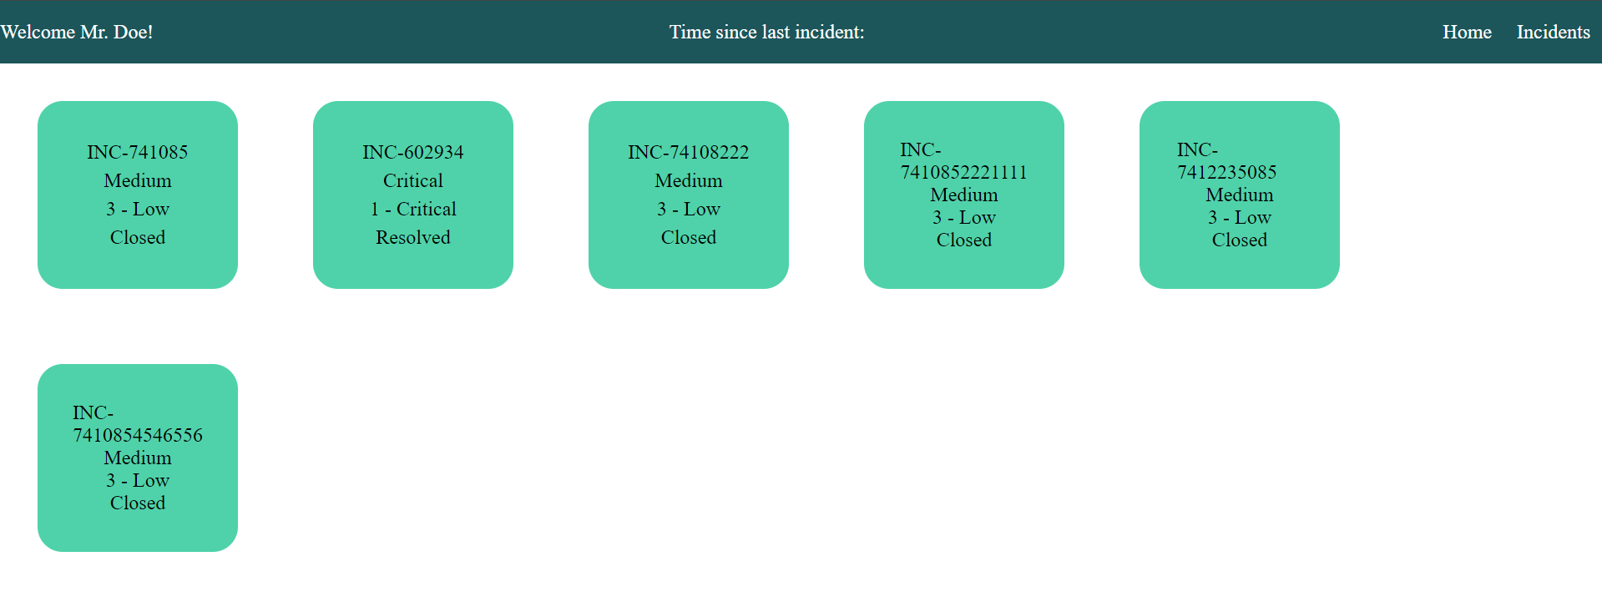
Challenge – View All the incidents
Goal:
Scenario:
Edit your work so that all incidents display
Your organization needs to build a portal for service technicians. This portal should be able to view, modify, and delete incidents. This application will be written in React.
Modify your ‘IncidentList’ component so that it loops through the dummy data and displays all the incident records.
Style your components so each record is displayed on a card

Slide 36
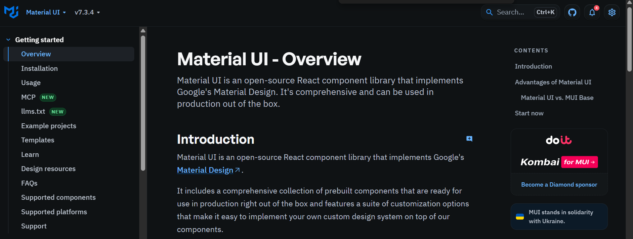
What Is Material UI?
Definition: Material UI is a popular React component library
Provides pre-built, customizable UI components that help developers build consistent, modern, and responsive user interfaces quickly

Slide 37
Setup Material UI
@mui/material – core components
@emotion/react & @emotion/styled – required for styling
@mui/icons-material – optional icons (but we may use them so install them anyway)

Slide 38
Using Material UI Components
After installing with NPM:
Import the component you’d like to use
Customize it with props
The documentation is your best friend

Slide 39
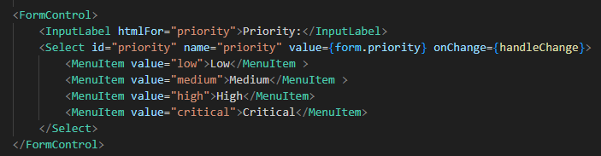
No, Seriously, Use the Documentation
This is why - look at that code, there is no way you will remember that unless you use it ever day
And that is just for a simple dropdown, it’s not even part of the rest of the form

Slide 40
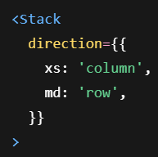

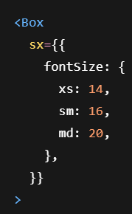
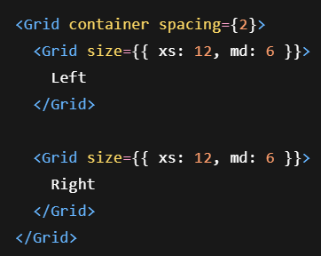
Material UI Heavy Hitters
Stack is great for quick flex containers in row/column layouts; you can make it responsive!
Box is roughly equivalent to a div; you can make them responsive!
Css grids and responsive styling is easy with Grid components!

Slide 41

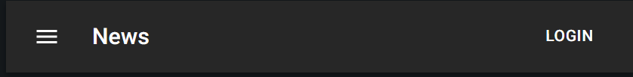
Material UI Heavy Hitters
Paper/Card is great for cards
App Bars are great for page headers and navigation

Slide 42
Challenge – Use Material UI
Goal:
Scenario:
Update the app to use Material UI
Use Material UI

Slide 43
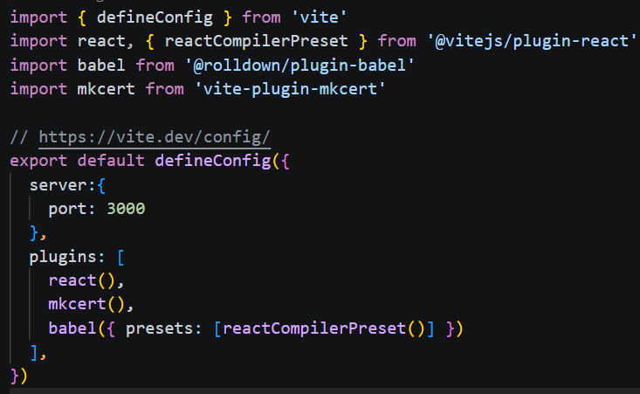
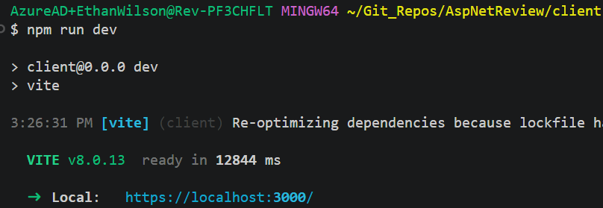
Adding HTTPS Support In development
Install mkcert into client project
Update your vite.config.ts file
Rerun to the project to start using HTTPS

Slide 44

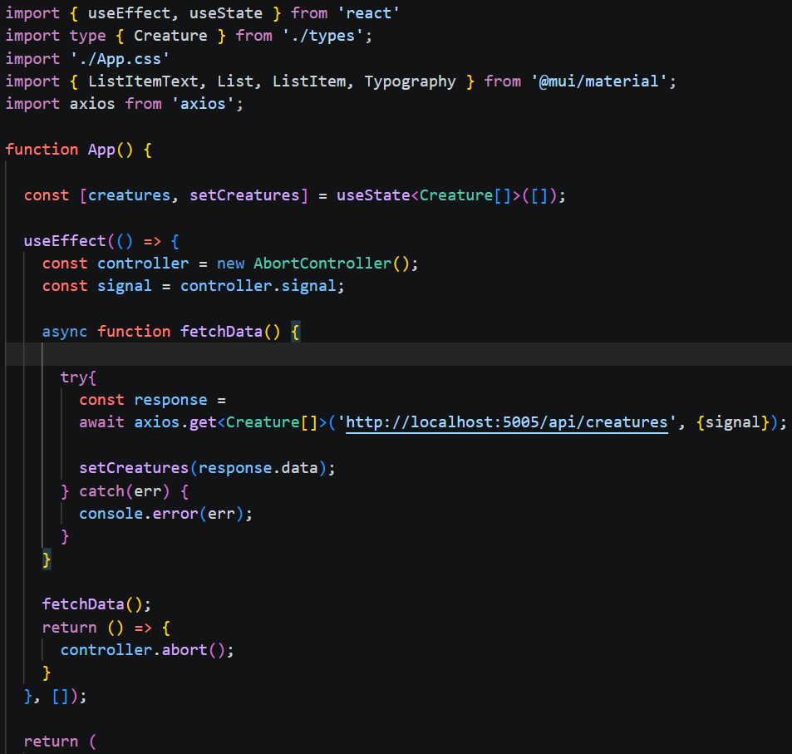
Axios
Definition: Axios is a popular JavaScript library for making HTTP requests from the browser or Node.js
Promise based
Automatic JSON parsing (no need for .json() )
GET, POST, PUT, DELETE, PATCH, etc.
Works with AbortController

Slide 45



Other Types of Requests

Slide 46
Challenge – Use Axios
Update your fetch request to Axios
Goal:
Scenario:
Install the NPM package
Import it into your .jsx

Slide 47
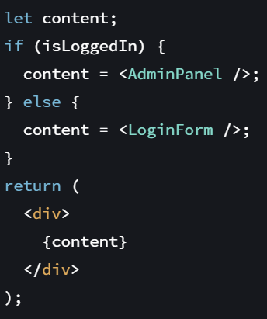


Conditional Rendering
Conditional rendering makes it easy to show or hide any elements/components as we wish

Slide 48

Firing Events
Define an event handler function inside the component
Notice ‘onClick’ vs ‘onclick’ in JavaScript

Slide 49
Challenge – Create Basic App Navigation
Goal:
Scenario:
Edit your work to conditionally render components
Your organization needs to build a portal for service technicians. This portal should be able to view, modify, and delete incidents. This application will be written in React.
Modify your ‘App’ component so that under the header, it will conditionally render either your ‘IncidentList’ component or a ‘Welcome’ component.
It should conditionally render via navigation links in the header
The ‘Welcome’ component may be a very simple dummy component that simply returns text ‘Welcome’

Slide 50


Callback Props
A callback prop is when we use a prop to pass down a function to a child component
Notice how we pass in a callback function into the Incident component called ‘handleClick’
Then in our parent component, we can set the callback that will be performed for ‘handleClick’
In this case, ‘handleClick’ will fire off another function local to the parent component

Slide 51
React Query / Tanstack Query
Rebranded: Tanstack Query
Provides data fetching and state management features
Gives us a global cache that components can snatch data from
Aside from caching, it also has background fetching and synchronization features
Client-side state management: useState(), useContext(), useReducer()
Asynchronous State Management: synchronize client-side state with server-side state; This is what Tanstack Query provides

Slide 52

What we are doing now

Slide 53

Tanstack Query

Slide 54


Tanstack Setup
Main.tsx/jsx:

Slide 55

Tanstack Query & Custom Hook
We setup a file (our custom hook) to wire up queries and commands; the idea is to make files for common aggregates:
Just use the hook when needed:

Slide 56

Axios Interceptor
We will setup an Axios interceptor to create a baseURL
This isn’t using the full benefit yet, later we will be able to auto-include auth tokens for subsequent requests, among other bonuses

Slide 57


custom hook using tanstack
useActivities.ts:

Slide 58

FormData
FormData can get all the values from a form, but won’t pickup checkboxes if they are unchecked

Slide 59


Calling our query and mutation functions
Deconstruct needed function:
Call it:
← navigate() = routing

Slide 60

Challenge – Add Incident Records
Goal:
Scenario:
Create a form to add incidents
You will need to make edits to the App and Incident list components:
Create a form on the ‘IncidentList’ component.

Slide 61

Challenge – Delete Incidents
Goal:
Scenario:
Create a button on the incident component to delete the incident from the list
Modify your ‘Incident’ component so that it has a delete button
The button should remove the Incident from the Incident list component

Slide 62
Sharing Component Data / Lifting Up State
Where we use state matters
Lifting State – refers to moving state from one component to a common parent so that multiple child components can share and update it
App
IncidentList
Welcome
If state is at the IncidentList component, then it will be reset each time the component unloads from the virtual DOM; not accessible from Welcome
Incident

Slide 63

Sharing Component Data / Lifting Up State
App
If state is instead placed at ‘App’, and we modify the incident list, the updated list is now accessible to both child components
IncidentList
Welcome
Incident

Slide 64


Reducer
Definition: Reducers are a hook that allow us to centralize state management logic
In more complex applications, this helps avoid bugs and is easier to maintain
Scalable
Reducers should be placed under imports, but before the component function

Slide 65

Context
The useContext hook allows a component to access the current value of a context without having to receive it through props
This avoids ‘prop-drilling’
The value of a context may be any JavaScript datatype
This is a separate file from your components
ThemeContext.js

Slide 66

Publishing Context
App.jsx
We apply our context as a provider
The mandatory ‘value’ attribute will pass our context data down to any subscribing components

Slide 67


Subscribing To Context
We import useContext along with our context ‘.js’ file
We call useContext using our imported ThemeContext reference to get our theme
We could use that data in many ways, such as dynamically building class lists on components

Slide 68
MVC
Definition: Model View Controller (MVC) is a classic architectural design pattern used to structure applications.
Model – The data and business logic of an application
View – The UI
Controller – The middleman between the model and view, often handling user input

Slide 69
What is React Router? What is Deep linking?
Definition: React Router is a library that provides easy navigation between different views.
This enabled deep linking
Handle URL parameters and query strings
Manage browser history & navigation
Create nested routes and layouts
Implement protected routes for authentication
Definition: Deep Linking is the practice of using hyperlinks to send users directly to specific content within our applications
1-2 levels deep: most apps
/dashboard
/products/45
3-4 levels deeps: common for structured apps
/dashboard/reports/weekly
/shop/products/46/reviews
5+ levels deep: Rare but possible, usually in enterprise
/orgs/12/projects/55/tasks/34/comments/2

Slide 70



React Router Setup
Routes.tsx & App.tsx:
Install package and setup the route provider:

Slide 71

Routing
NavLink components (or composed ones) will trigger routing to the <Outlet/>
Multiple ways: NavLink or useNavigate()
useParams() lets us deconstruct url params:

Slide 72

Calendars
Material UI calendars a pain to work with and style, so we can use this:

Slide 73


Material UI Themes
lightTheme.ts:
Wrap app with theme provider:

Slide 74


Calling Identity endpoints with tanstack
useAccount.ts:
Agent.ts:
This will ensure the http only cookie gets sent along with future requests

Slide 75


Conditionally Making queries
Once we’ve setup identity, we can bring in the currentUser from our custom hook into our useActivities custom hook, this lets us stop queries from executing from Tanstack unless we are authenticated:

Slide 76


Private Routes
Routes.tsx:
RequireAuth.tsx:

Slide 77

Login form redirect
After logging in we can send them back to their last location state if it exists
OR ‘/activities’ if there wasn’t a last location

Slide 78
Challenge – Implement Routing
Implement Routing
Goal:
Scenario:
Implement routing so that:
‘Welcome’ component is on this route: ‘/’
‘IncidentList’ component is on this route: ‘/incidents’

Slide 79

Deleting Items From Lists
The JavaScript filter() function will return a new array where all items meet the criteria
In this example, we are getting a copy of the array will all items except for the incident where its ID was provided

Slide 80



onCHange & Object State Updates
onChange allows us to call a JavaScript function on each keystroke for text input elements, or on each selection for dropdowns
We can use the event object to help us update state
Notice that form is an object, so we use “{“ and “}” when updating the entry in the object:
{…prev, [name]:value}
If it was an array:
[…stateOfArray, incident]

Slide 81
Challenge – Lift Up Incident List State
Goal:
Scenario:
Lift the state of the Incident list
You will need to make edits to the App and Incident list components:
Move state and ‘delete’ function to ‘App’ component
Chain a callback prop function from Incident list component to the App component – this wires up the delete function

Slide 82
Challenge – Refactor
Goal:
Scenario:
Refactor your code to use a reducer
You will need to make edits to the App component:
Make the reducer function
Swap out useState for useReducer when working with the incident list
Edit your functions to call the dispatch method rather than ‘setIncidents’

Slide 83
Challenge – Create an Effect
Goal:
Scenario:
Create an Effect
You will need to make edits to the Welcome component:
Utilize useEffect to display a joke under the text ‘Welcome’

Slide 84


Challenge – Implement Dark Mode
You will need to make edits to App, Welcome, and IncidentList
You should ‘publish’ your command to toggle dark mode from your ‘App’ component
Both the Welcome & IncidentList components should change their style to reflect darkmode
Goal:
Scenario:
Implement a darkmode feature using useContext
Don’t forget about callback props!

