Slide 1
ASP.NET

Slide 2
Agenda
01
02
03
04
What is a Database?
SQL Environment Setup
Database Design
Database Normalization
Database Setup for Development
SQL Starting Commands
SQL Constraints
What is a Database Schema?
Three-Schema Approach
ERD
Table Relationships
Relationship Constraints
1rst
2nd
3rd
^{Data Mapping Algorithm}

Slide 3
01
What is a Database?

Slide 4
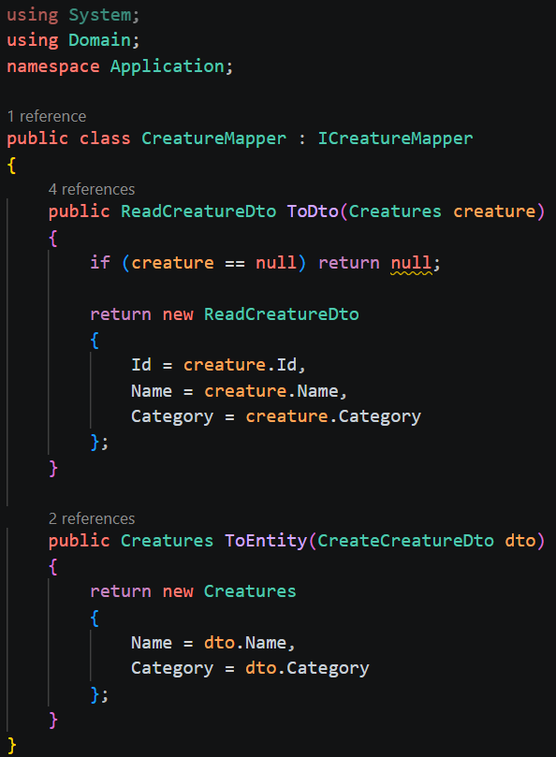
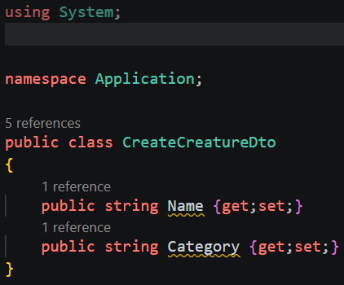
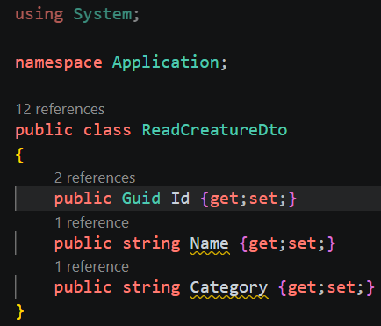
Manual DTOs
Application layer:
DTOs, or Data Transfer Objects, put a barrier in-between our domain models and API layer. This allows us to filter the fields returned to the client and thus, is good for security.
Application layer:
Register in Program.cs:

Slide 5
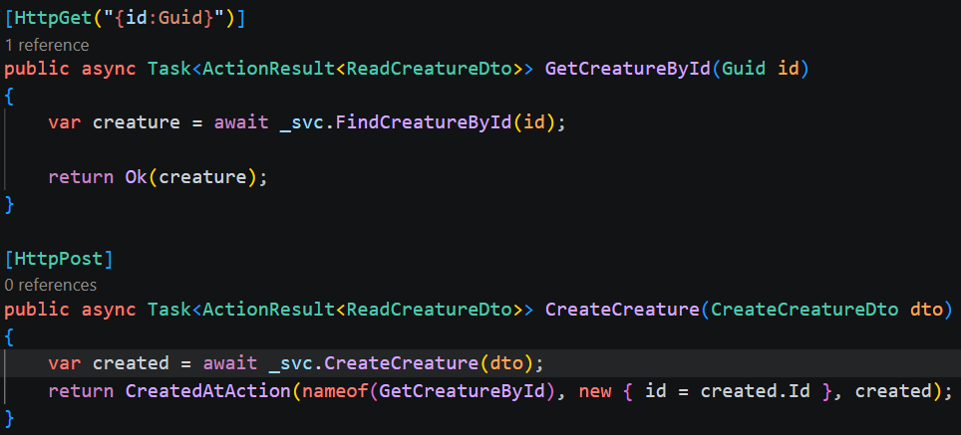
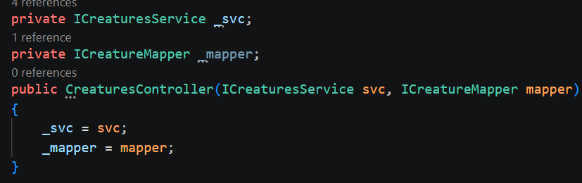
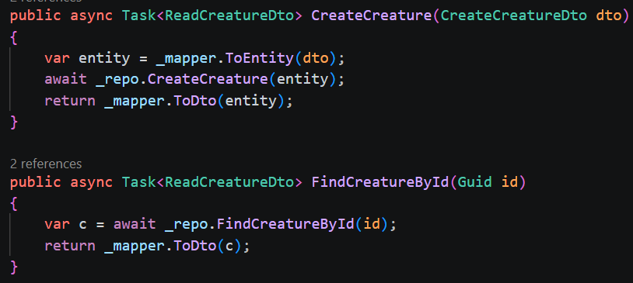
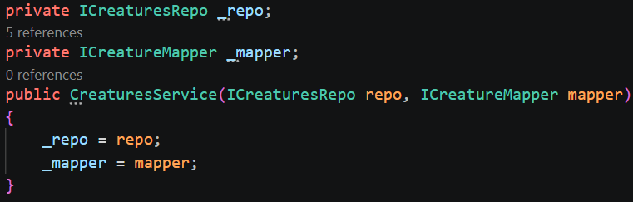
Manual DTOs
Both the controller and service uses the mapper:

Slide 6

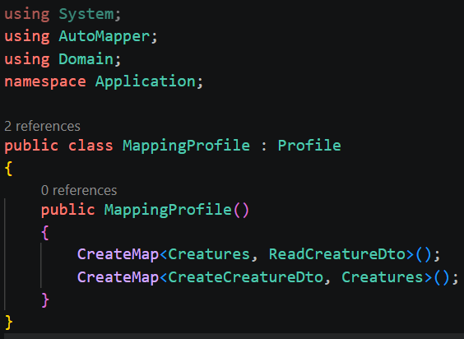
AutoMapper
Install via nuget to the API project. ‘AutoMapper’ also needs installed in application layer:
Create a mapping profile in application layer. (this assumes you have already created the DTOs, such as in our manual example):
Register in program.cs:

Slide 7
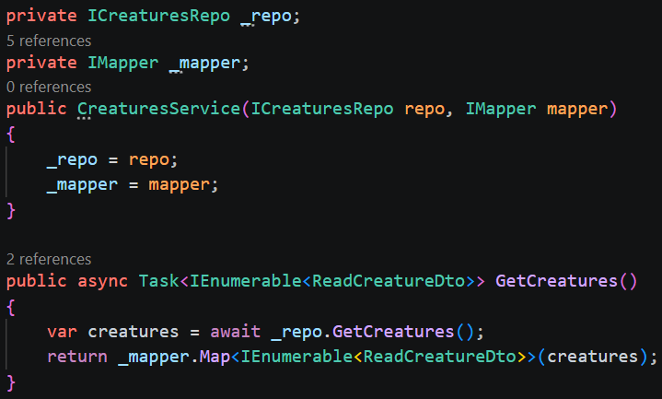
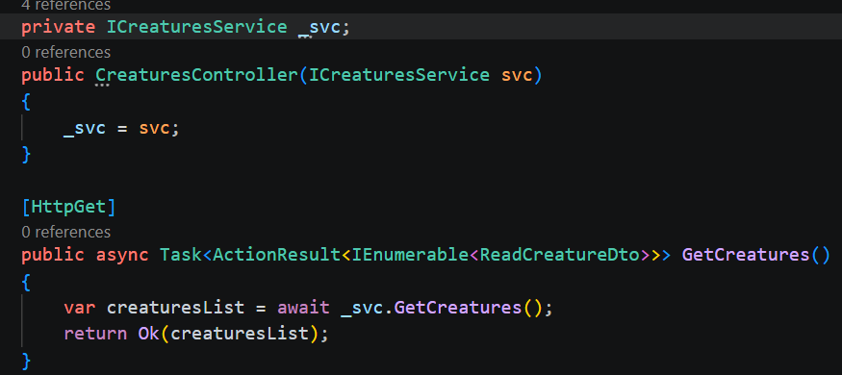
AutoMapper
Our service is responsible for mapping DTOs:
Our controller only sees DTOs:

Slide 8
CORS
Browsers block requests from one origin to another unless the server explicitly allows it
Example:
Front end: http://localhost:3000
API: https://localhost:5001
Without CORS, the browser will block requests to the API because it comes from a different location

Slide 9
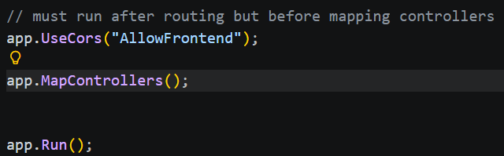
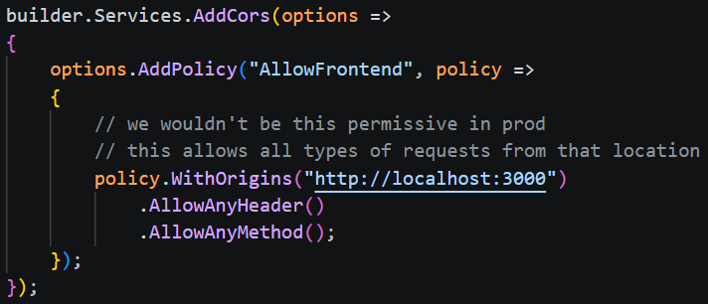
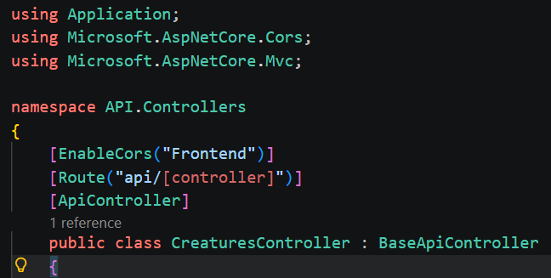
CORS Setup
This sets a GLOBAL fallback (recommended):
Set the options to the builder (you can have more than one policy):
This sets CORS on per controller basis:

Slide 10
HTTPS
HTTPS = Hypertext Transfer Protocol Secure
HTTPS uses Transport Layer Security (TLS) to encrypt traffic (formerly used Secure Sockets Layer – SSL)
The server must present a certificate to verify its identity, this proves that the URL you visit actually owns that domain
Certificates are provided by certificate authorities: Let’s Encrypt, DigiCert, Sectigo, etc.
Protects against man-in-the-middle attacks (data interception/manipulation)
Improves search engine optimization (SEO)
Default port for HTTP = 80, HTTPS = 443

Slide 11
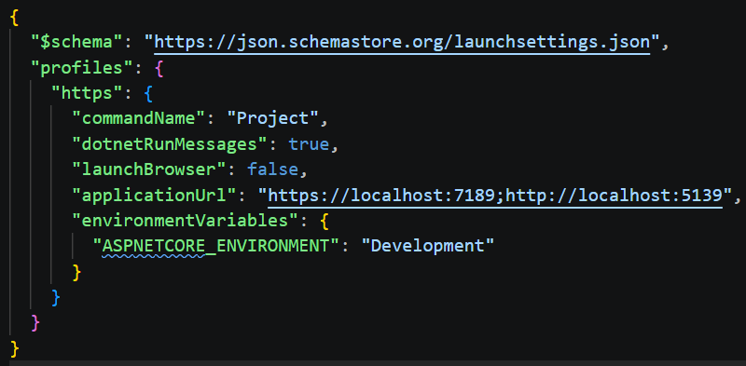
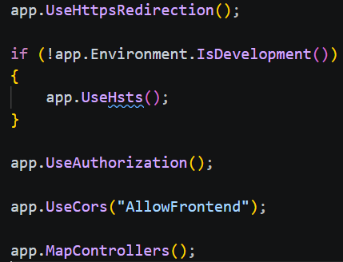
HTTPS Setup
properties/launchsettings.json: Ensure you have a HTTPS profile This file is ONLY used in development. It will be ignored in prod!
In program.cs:UseHttpsRedirection() will route all HTTP calls to HTTPS instead– order matters!
UseHsts() is for prod – it will tell the browser to remember that this site only uses HTTPS for future visits! – order matters!
(HTTP Strict Transport Security - HSTS)

Slide 12
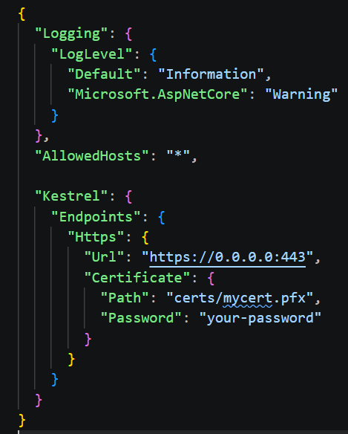
HTTPS Setup
Prod setup only
In appsettings.json:
We set our url ip + https port and provide a path to our downloaded certificate
Certificate .pfx files and its password come from your certificate authority

Slide 13
Middleware
Middleware sits in the HTTP request pipeline and may inspect the request, modify the request, stop the request entirely, call other middleware, or inspect or modify the response on the way back out.
HTTP Request ↓ Middleware A ↓ Middleware B ↓ Middleware C ↓ Endpoint (Controller/API) ↑ Response travels back through middleware
var builder = WebApplication.CreateBuilder(args);
var app = builder.Build();
app.UseHttpsRedirection();
app.UseAuthentication();
app.UseAuthorization();
app.MapControllers();
app.Run();

Slide 14
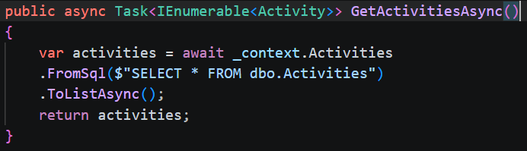
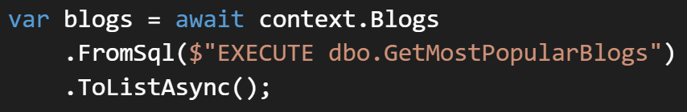
Direct SQL Queries with EF Core
You can also launch stored procedures that return data:

Slide 15
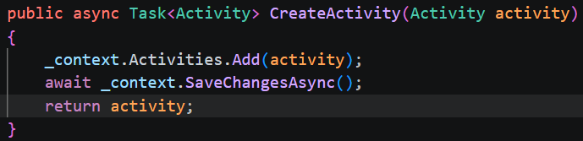
Change Tracking
Repo:

Slide 16
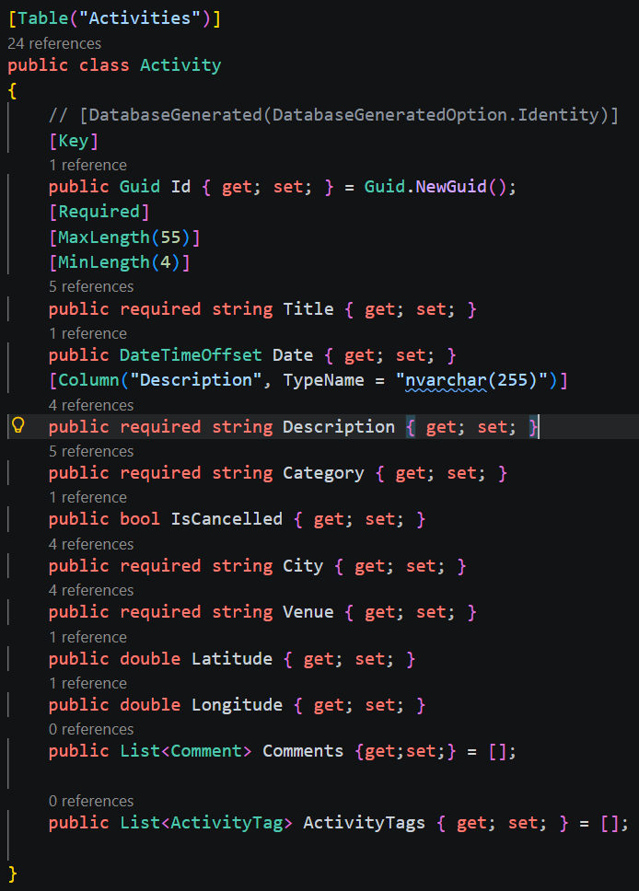
EF Core Data Annotations
Model:
Data Annotations allow us to declaratively set conditions on fields that will apply during migrations
This is NOT a complete list of all annotations, only common ones

Slide 17
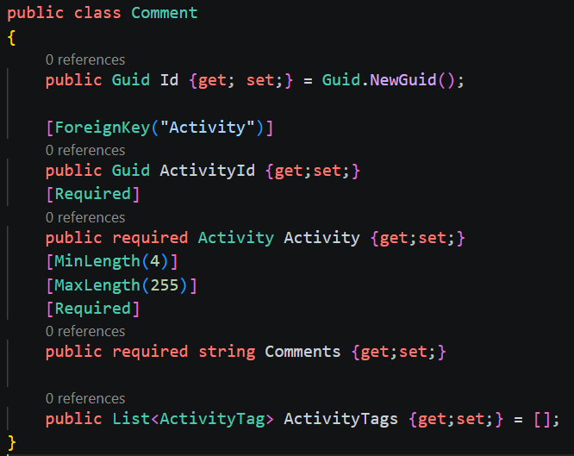
Data Annotations – Relationships & Navigation Properties
1 to many relationship:

Slide 18
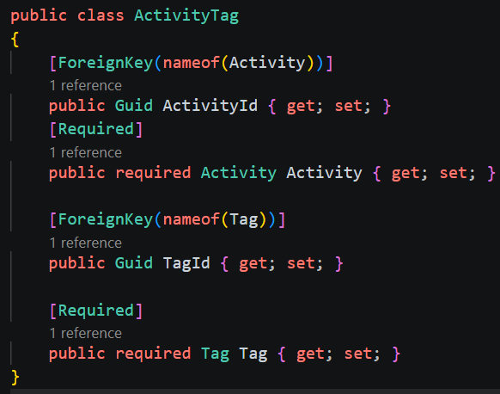
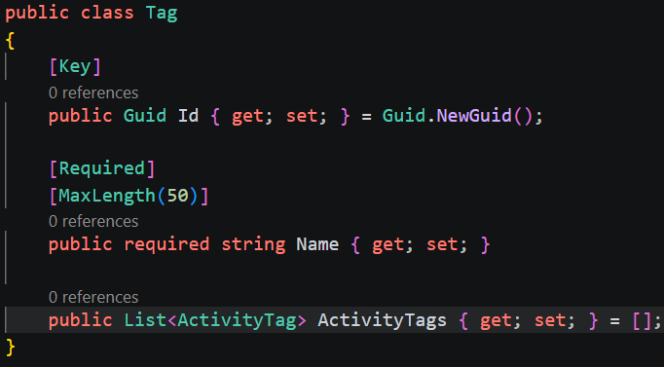
Data Annotations – Relationships & Navigation Properties
many to many relationship (with manual junction table – when inserting records you must create junction table record manually to link records; use when you have fields on the junction table itself outside of the IDs):

Slide 19
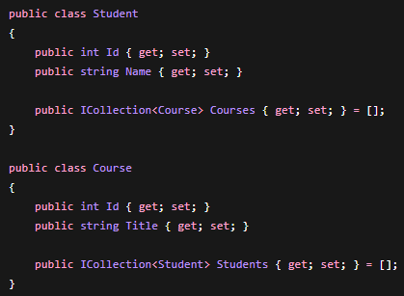
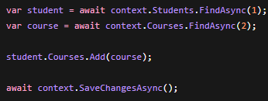
Data Annotations – Relationships & Navigation Properties
many to many relationship (with implicit junction table – no need to manually create junction table records):

Slide 20
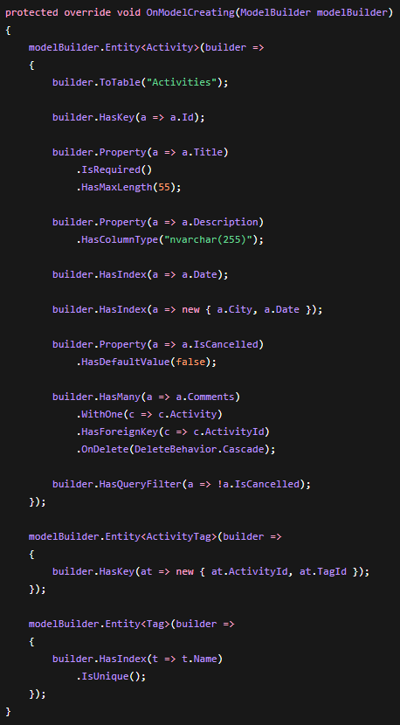
Fluent API
Fluent API is preferred over data annotations for fine-grain control and complex table relationships
This also keeps our Domain models ‘pure’ and thus creates a clean separation of concerns from domain between persistence

Slide 21
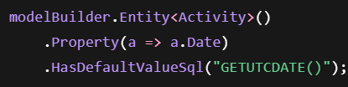

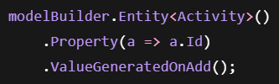

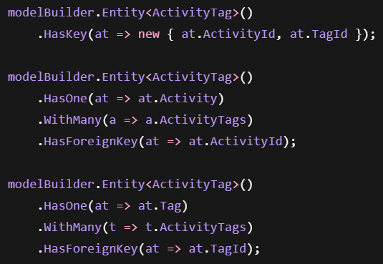
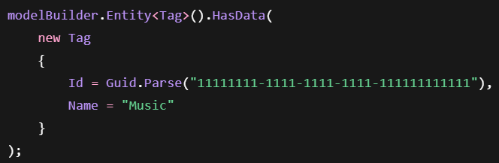
Fluent API – Other Common Methods

Slide 22
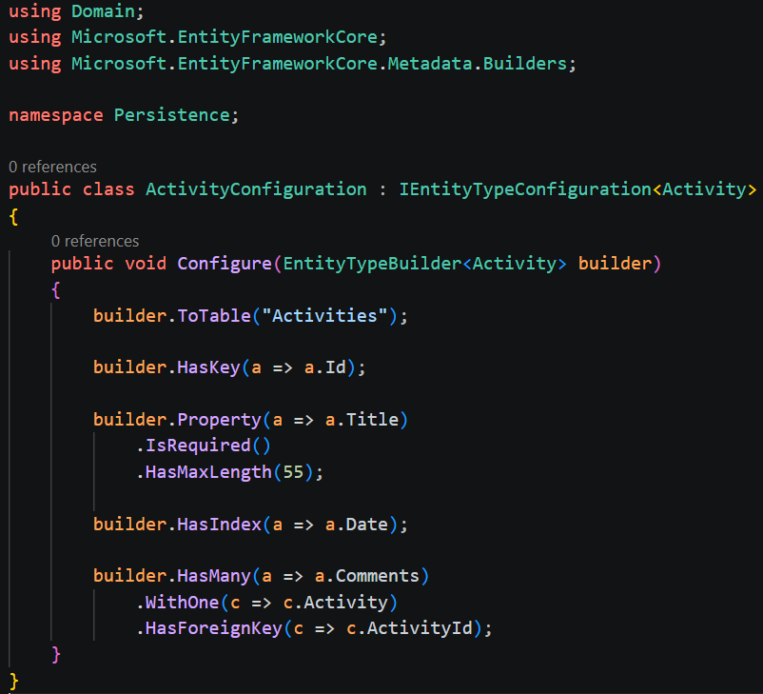
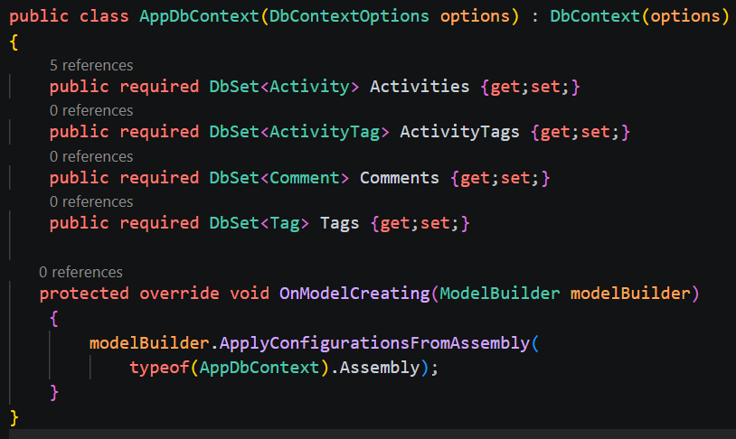
Fluent API – Best Practice
Throwing everything into the DbContext makes for a mess. Instead, we can create separate config classes in the persistence layer and add them to the DbContext with ApplyConfigurationsFromAssemly()

Slide 23
Caching
Caching is the process of storing frequently used data from queries temporarily
This allows user queries to get information from the cache instead of hitting the database
This improves request response times and efficiency
There are 3 main caching types:
In-Memory cache – stores data in API process memory
Distributed cache – shared cache across servers (not beginner friendly)
Response cache – caches the actual HTTP response

Slide 24
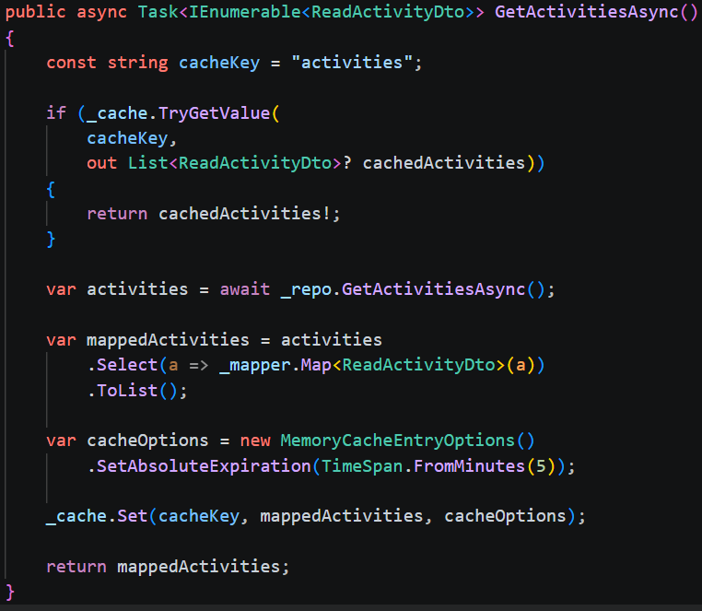

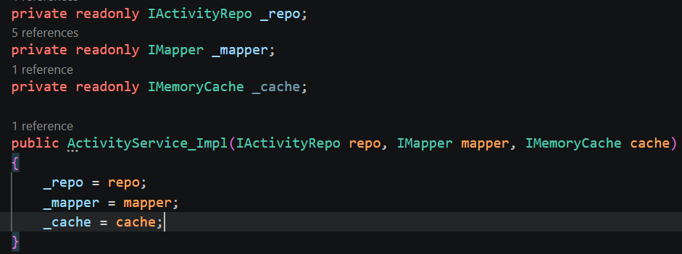

In-Memory Caching
Service layer:
Program.cs:
Service layer:
You can also restart the timer for repeat requests:

Slide 25
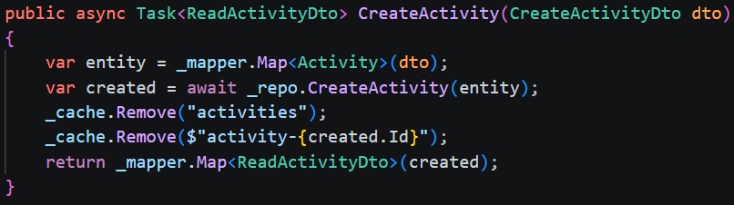
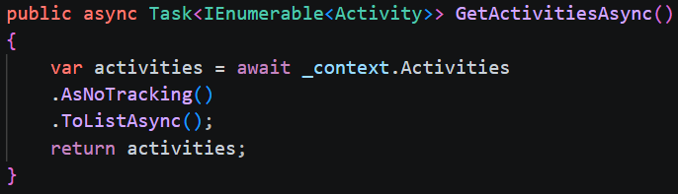
Cache Invalidation
Guard against stale cache data when updating/creating/deleting:
Service layer:
Stop change tracking altogether:
Repo layer:

Slide 26


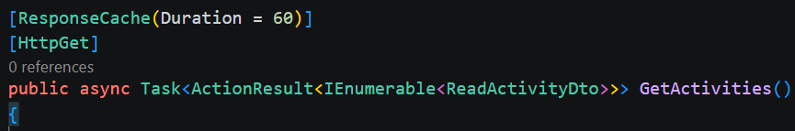
Response Caching
Program.cs:
Program.cs (order matters!):
Controller (response cached for 60 seconds):

Slide 27
Response Cache vs Memory Cache
Feature | IMemoryCache | Response Cache
Stores objects | Yes | No
Stores HTTP responses | No | Yes
Flexible | Very | Limited
Best for | Business logic | Public GET endpoints

