Slide 1
ASP.NET

Slide 2
01
02
03
Agenda
04
What is a Database?
SQL Environment Setup
Database Design
Database Normalization
Database Setup for Development
SQL Starting Commands
SQL Constraints
What is a Database Schema?
Three-Schema Approach
ERD
Table Relationships
Relationship Constraints
1rst
2nd
3rd
^{Data Mapping Algorithm}

Slide 3
01
What is a Database?

Slide 4
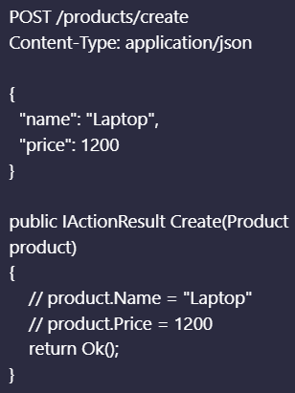
Model Binding
The automatic process by ASP.NET core that maps user requests to controller endpoint parameters

Slide 5
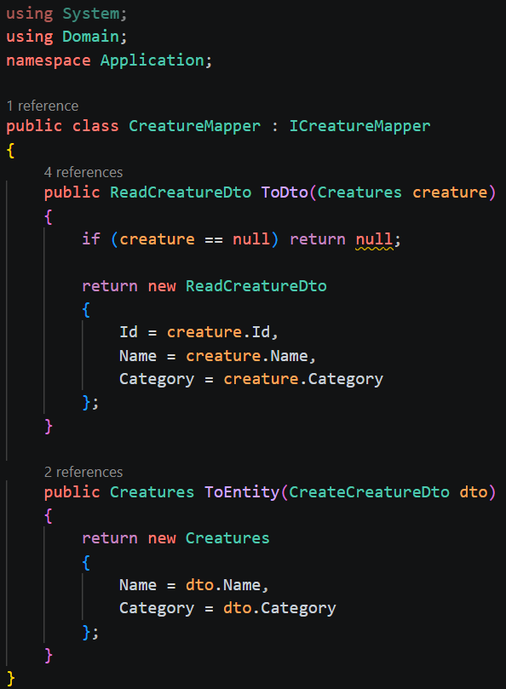
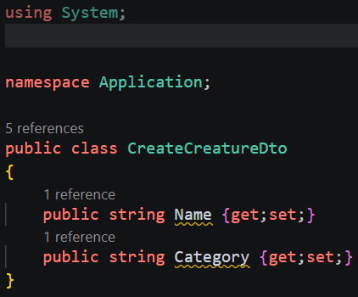
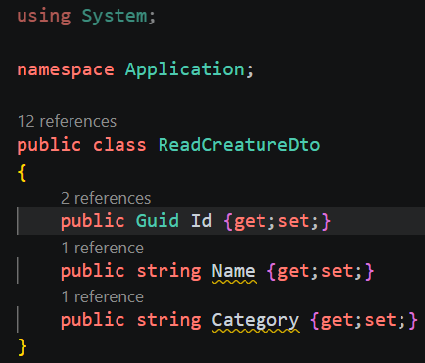
Manual DTOs
DTOs, or Data Transfer Objects, put a barrier in-between our domain models and API layer. This allows us to filter the fields returned to the client and thus, is good for security.
Application layer:
Application layer:
Register in Program.cs:

Slide 6
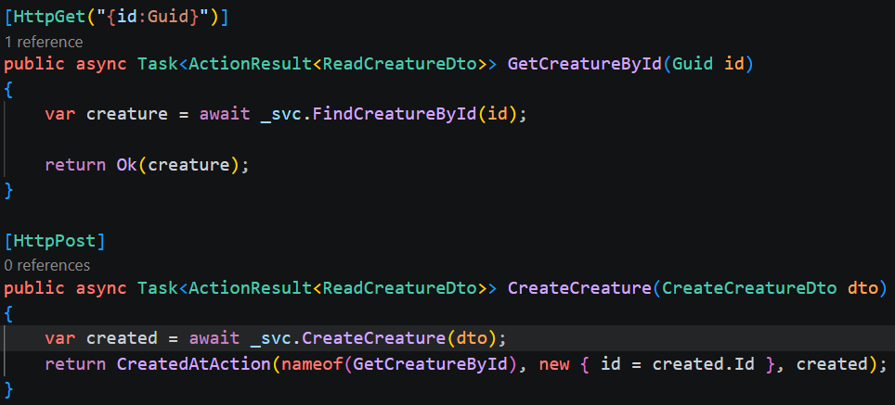
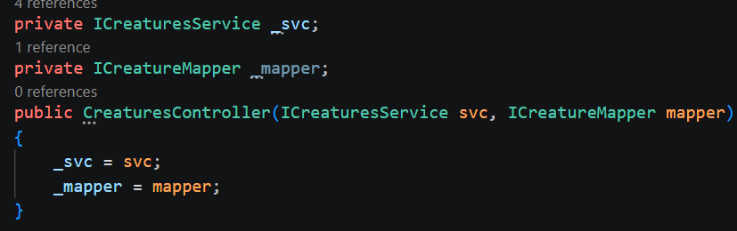
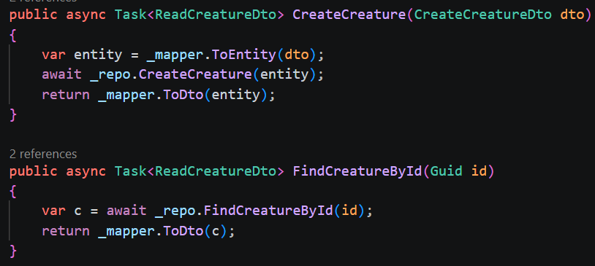
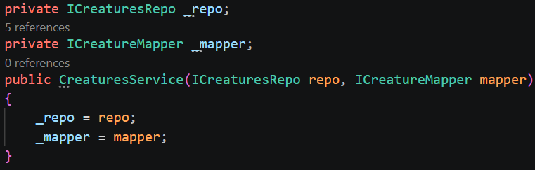
Manual DTOs
Both the controller and service uses the mapper:

Slide 7

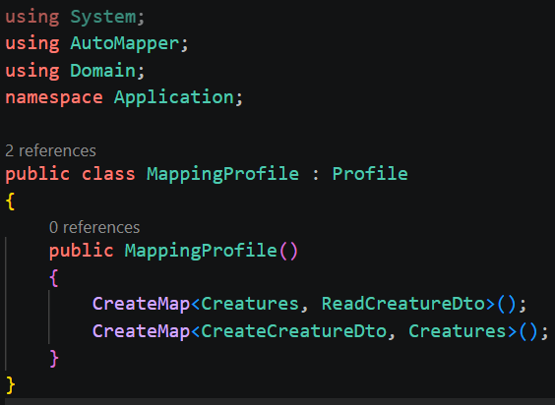
AutoMapper
Install via nuget to the API project. ‘AutoMapper’ also needs installed in application layer:
Create a mapping profile in application layer. (this assumes you have already created the DTOs, such as in our manual example):
Register in program.cs:

Slide 8
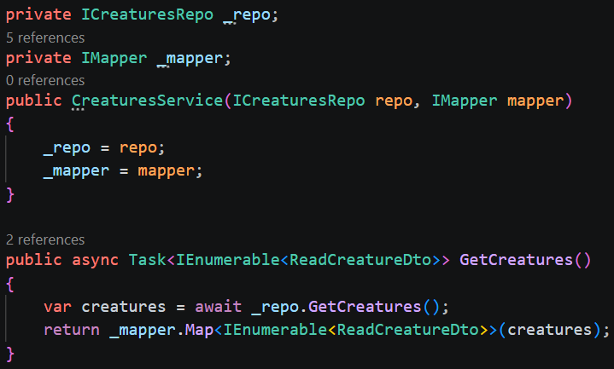
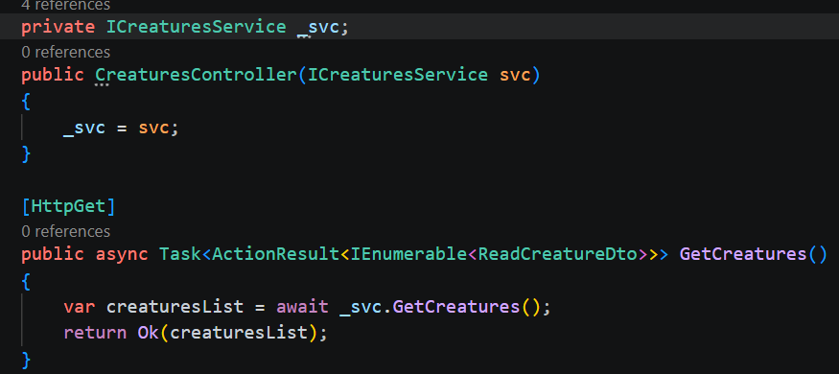
AutoMapper
Our service is responsible for mapping DTOs:
Our controller only sees DTOs:

Slide 9
CORS
Browsers block requests from one origin to another unless the server explicitly allows it
Example:
Front end: http://localhost:3000
API: https://localhost:5001
Without CORS, the browser will block requests to the API because it comes from a different location

Slide 10
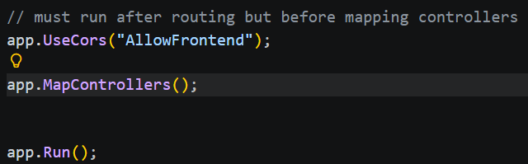
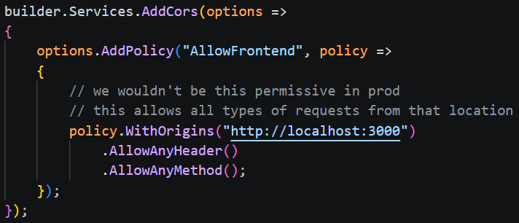
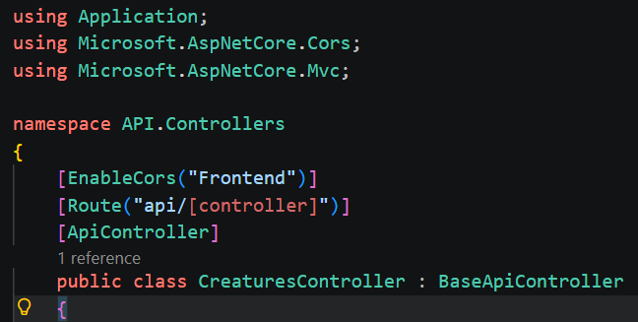
CORS Setup
This sets a GLOBAL fallback (recommended):
Set the options to the builder (you can have more than one policy):
This sets CORS on per controller basis:

Slide 11
HTTPS
HTTPS = Hypertext Transfer Protocol Secure
HTTPS uses Transport Layer Security (TLS) to encrypt traffic (formerly used Secure Sockets Layer – SSL)
The server must present a certificate to verify its identity, this proves that the URL you visit actually owns that domain
Certificates are provided by certificate authorities: Let’s Encrypt, DigiCert, Sectigo, etc.
Protects against man-in-the-middle attacks (data interception/manipulation)
Improves search engine optimization (SEO)
Default port for HTTP = 80, HTTPS = 443

Slide 12
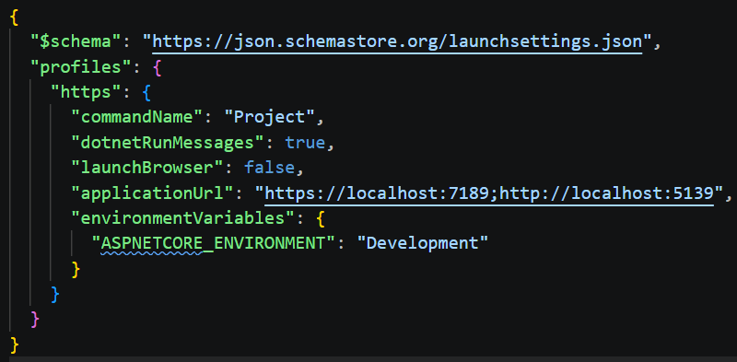
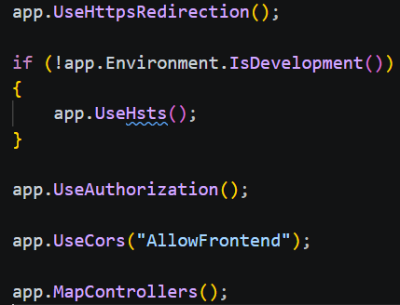
HTTPS Setup
properties/launchsettings.json: Ensure you have a HTTPS profile This file is ONLY used in development. It will be ignored in prod!
Run this to generate dev SSL cert:
dotnet dev-certs https --trust
In program.cs:UseHttpsRedirection() will route all HTTP calls to HTTPS instead– order matters!
UseHsts() is for prod – it will tell the browser to remember that this site only uses HTTPS for future visits! – order matters!
(HTTP Strict Transport Security - HSTS)

Slide 13
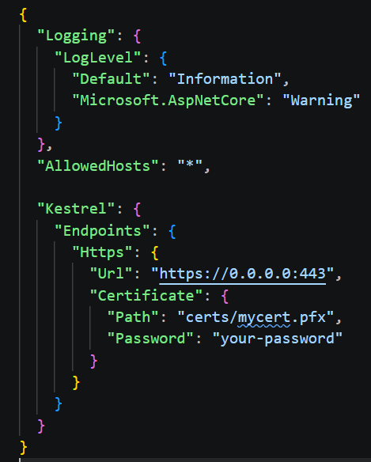
HTTPS Setup
Prod setup only
In appsettings.json:
We set our url ip + https port and provide a path to our downloaded certificate
Certificate .pfx files and its password come from your certificate authority

Slide 14
Middleware
Middleware sits in the HTTP request pipeline and may inspect the request, modify the request, stop the request entirely, call other middleware, or inspect or modify the response on the way back out.
HTTP Request ↓ Middleware A ↓ Middleware B ↓ Middleware C ↓ Endpoint (Controller/API) ↑ Response travels back through middleware
var builder = WebApplication.CreateBuilder(args);
var app = builder.Build();
app.UseHttpsRedirection();
app.UseAuthentication();
app.UseAuthorization();
app.MapControllers();
app.Run();

Slide 15
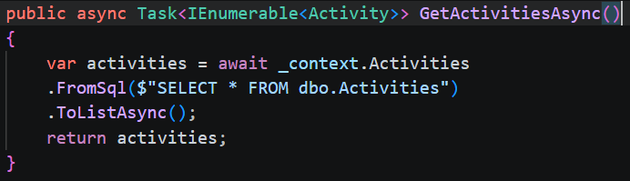
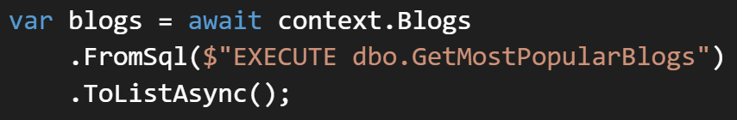
Direct SQL Queries with EF Core
You can also launch stored procedures that return data:

Slide 16
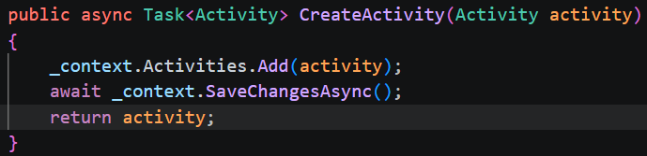
Change Tracking
Repo:

Slide 17
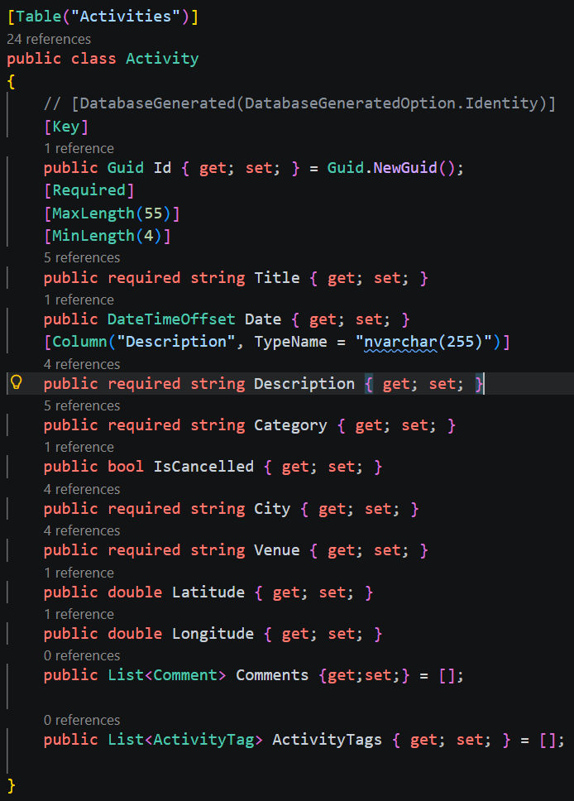
EF Core Data Annotations
Model:
Data Annotations allow us to declaratively set conditions on fields that will apply during migrations
This is NOT a complete list of all annotations, only common ones

Slide 18
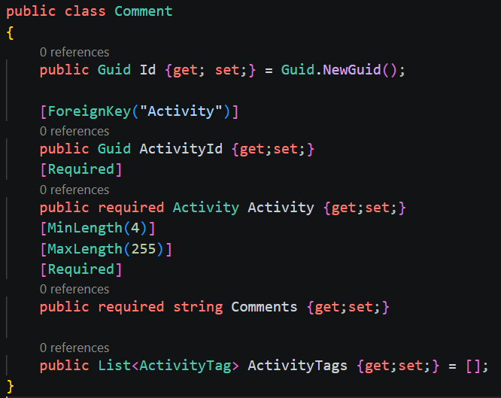
Data Annotations – Relationships & Navigation Properties
1 to many relationship:

Slide 19
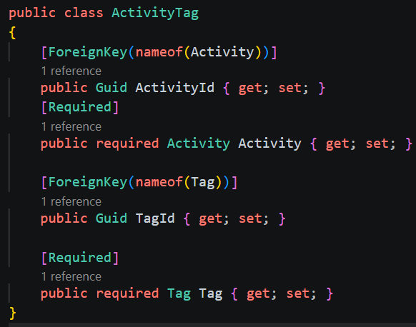
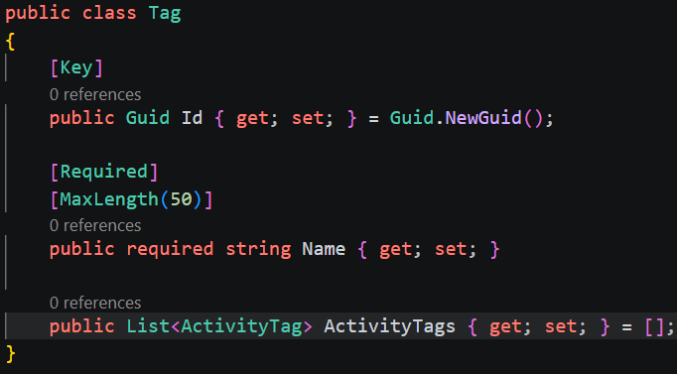
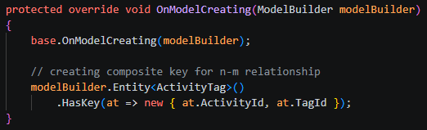
Data Annotations – Relationships & Navigation Properties
many to many relationship (with manual junction table – when inserting records you must create junction table record manually to link records; use when you have fields on the junction table itself outside of the IDs):
Composite key via fluent api:

Slide 20
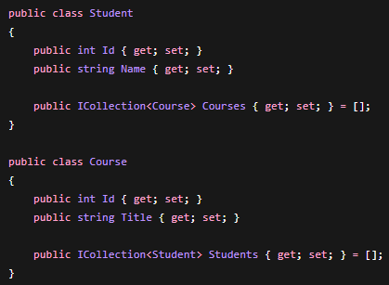
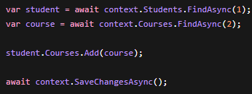
Data Annotations – Relationships & Navigation Properties
many to many relationship (with implicit junction table – no need to manually create junction table records):

Slide 21
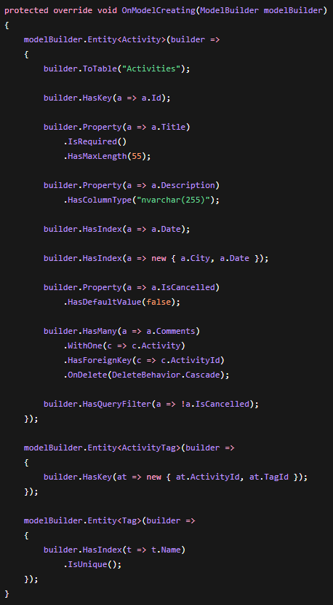
Fluent API
Fluent API is preferred over data annotations for fine-grain control and complex table relationships
This also keeps our Domain models ‘pure’ and thus creates a clean separation of concerns from domain between persistence

Slide 22
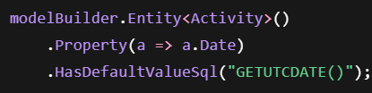

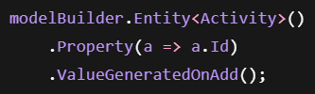

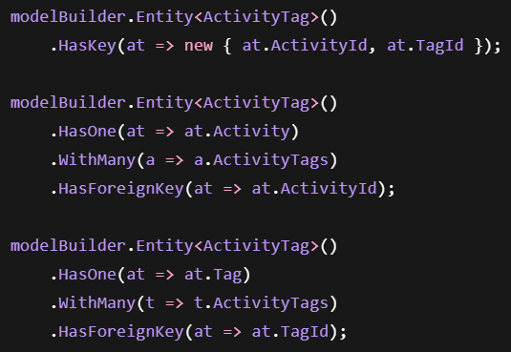
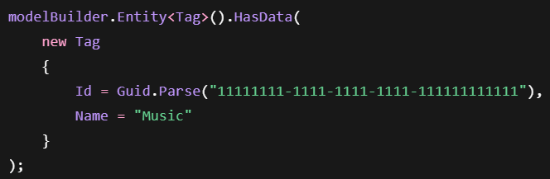
Fluent API – Other Common Methods

Slide 23
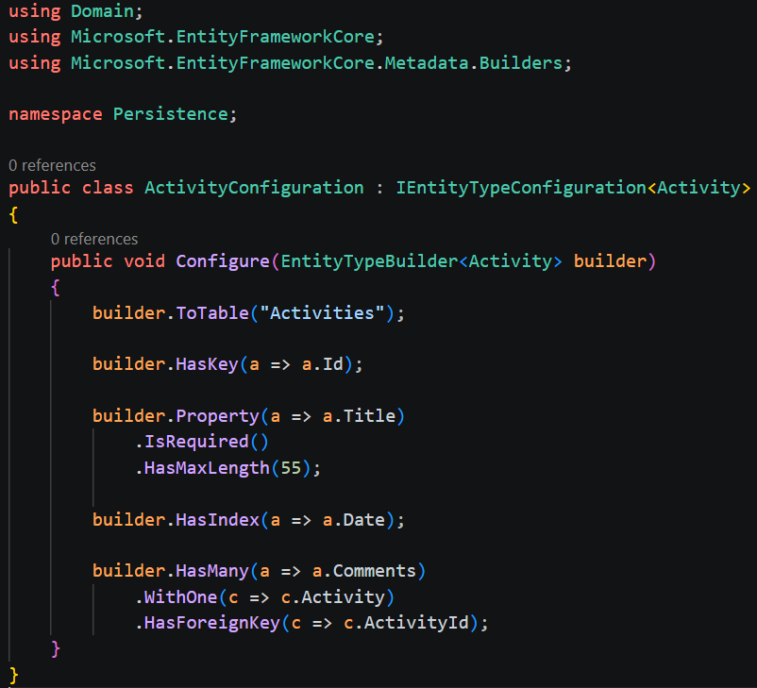
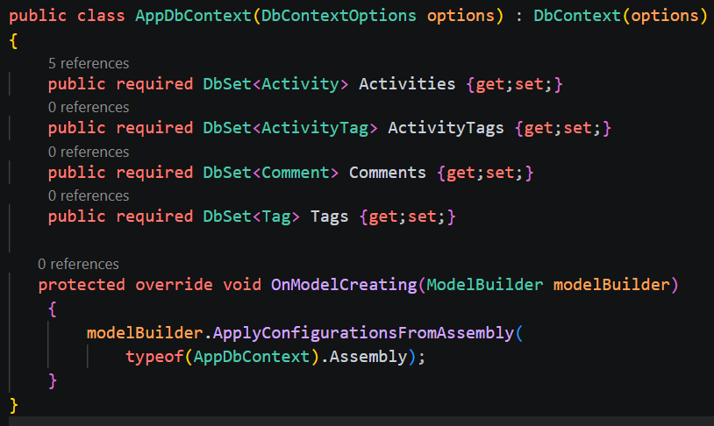
Fluent API – Best Practice
Throwing everything into the DbContext makes for a mess. Instead, we can create separate config classes in the persistence layer and add them to the DbContext with ApplyConfigurationsFromAssemly()

Slide 24
Caching
Caching is the process of storing frequently used data from queries temporarily
This allows user queries to get information from the cache instead of hitting the database
This improves request response times and efficiency
There are 3 main caching types:
In-Memory cache – stores data in API process memory
Distributed cache – shared cache across servers (not beginner friendly)
Response cache – caches the actual HTTP response

Slide 25

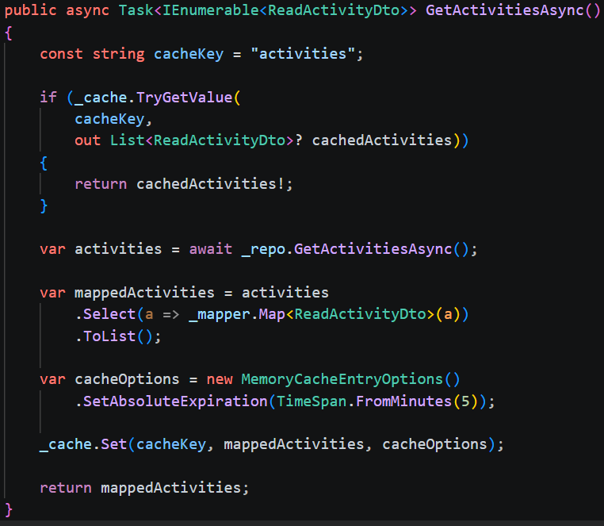
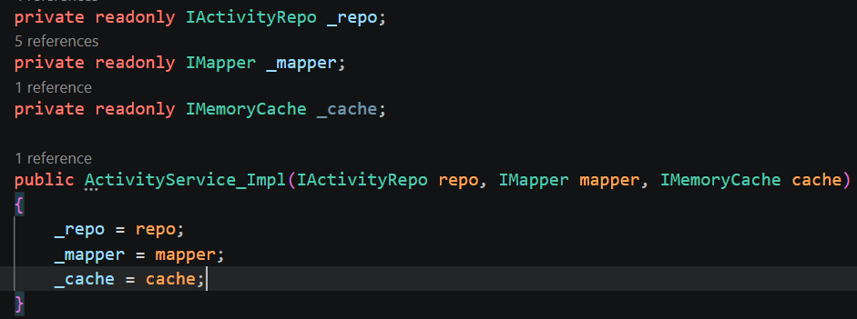

In-Memory Caching
Program.cs:
Service layer:
Service layer:
You can also restart the timer for repeat requests:

Slide 26
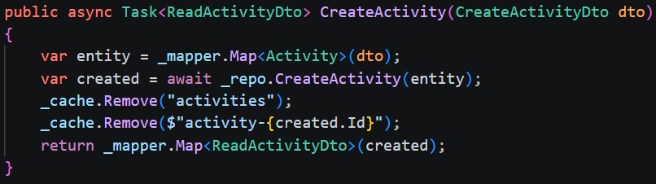
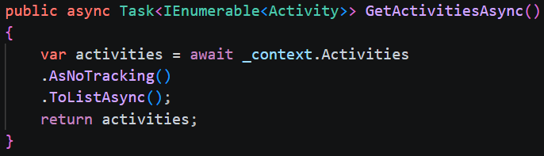
Cache Invalidation
Guard against stale cache data when updating/creating/deleting:
Service layer:
Stop change tracking altogether:
Repo layer:

Slide 27


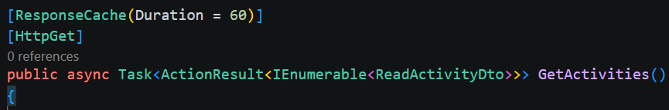
Response Caching
Program.cs:
Program.cs (order matters!):
Controller (response cached for 60 seconds):

Slide 28
Response Cache vs Memory Cache
Feature | IMemoryCache | Response Cache
Stores objects | Yes | No
Stores HTTP responses | No | Yes
Flexible | Very | Limited
Best for | Business logic | Public GET endpoints

Slide 29
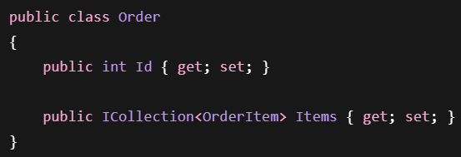

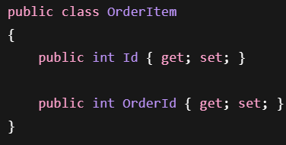
Eager vs Lazy Loading
Eager Loading gets record data for related records as part of the original query.
Eager Loading (Include() method used):

Slide 30


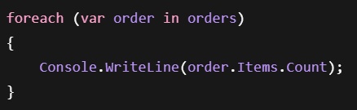
Eager vs Lazy Loading
Lazy Loading gets record data for related records only when needed. (more queries)
Lazy Loading (rare):
If 100 orders, then 101 queries
(1 for orders, 100 for items):

Slide 31
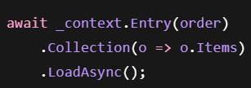
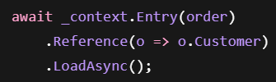
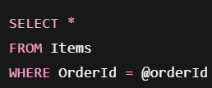
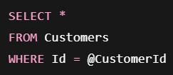
Explicit Loading
Explicit loading uses EF core APIs like Entry(), Collection(), or Reference()
Rarely used – runs into same problem as lazy loading; many queries
Collection() will traverse relationship on to a set (many side of relationship)
Reference() will traverse relationship to a single entity (1 side of relationships)
Roughly becomes:
Roughly becomes:

Slide 32
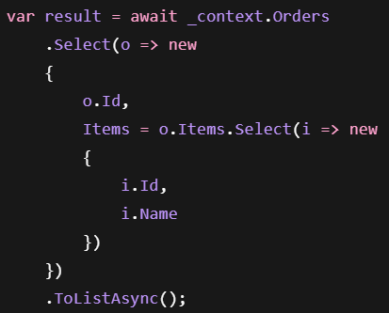
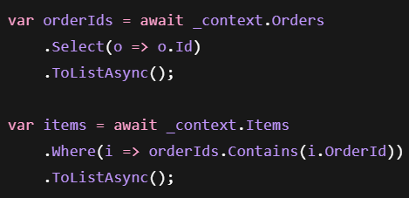
Eager vs Lazy vs Explicit Loading
In general, manual separate queries or projection is often preferred (i.e. no eager, lazy, or explicit loading):
Projection:
Manual separate queries:

Slide 33
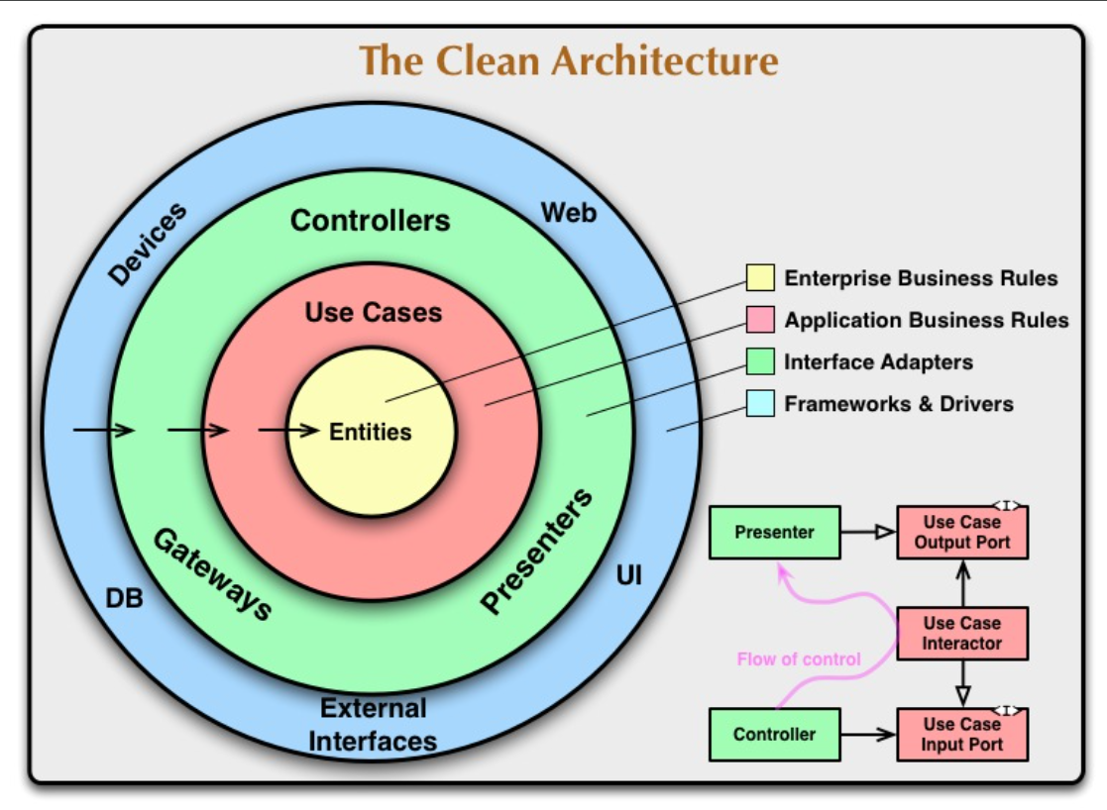
Clean Code

Slide 34
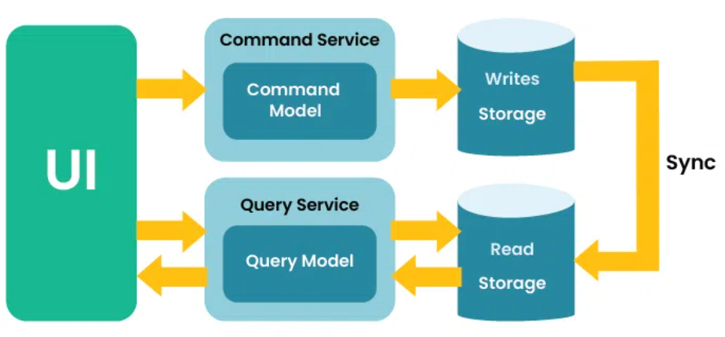
CQRS
Command
Does something
Modifies State
Query
Answers a question
Does not modify State
CQRS = Command Query Responsibility Segregation

Slide 35
Mediator Pattern
API/Endpoints > Controller > Service > Repo > EF
CQRS Handlers
Query Handler >
Command Handler >
API/Endpoints > Controller > Mediator >
Repo/EF

Slide 36


Mediatr & CQRS Setup
Install nuget package to application layer
Instead of services, we now have commands and queries:

Slide 37


Mediatr & CQRS Setup
Command Example:

Slide 38

Mediatr & CQRS Setup
Register MediatR in program.cs
We can then use our Mediator from the controller

Slide 39
Asp.net core Identity
Identity is a user management and authentication system
Provides:
User registration
Login/logout
Password reset
Email confirmations
User roles
2FA
And more…
Can be used with more than just MS SQL. Also available for: PostgreSQL, MySQL, and more…

Slide 40

Important Design Decision !
Microsoft.AspNetCore.Identity.EntityFrameworkCore → Domain
This breaks our CLEAN code architecture because now domain is dependent on something
This is fine (even in prod for small-med orgs); it is a pragmatic choice so we can provide authentication with our sql server instance in docker
In enterprise, the full throttle approach would be to use an Identity Provider such as: Microsoft Entra ID, Auth0, Okta, etc.
In that case we would create abstractions and keep these infrastructure concerns out of the domain layer

Slide 41


Adding the User entity
New Domain Model:
Required when using OnModelCreating

Slide 42


Configure Identity
Order matters!
program.cs

Slide 43


Seeding Users
DbInitializer.cs
Program.cs

Slide 44



Built-in Endpoints
Identity with SPA – Learn.Microsoft Guide:
https://learn.microsoft.com/en-us/aspnet/core/security/authentication/identity-api-authorization?view=aspnetcore-10.0
Sets up built-in endpoints →
Get a bearer token (JWT – best for mobile):
Get a HTTP only cookie (best for web apps):

Slide 45


Authorize and allowanonymous
This endpoint needs an authorized user to make the request:
This endpoint explicitly allows anyone to access

Slide 46

Creating an auth policy
This will ensure all endpoints require authentication by default:

Slide 47



Registering New Users
AccountController.cs:
DTOs in API layer
DataAnnotations help setup
easy validation later

Slide 48

Registering New Users part 2
AccountController.cs:

Slide 49


Getting User Info
AccountController.cs:
Program.cs:

Slide 50

Register Admins and Authorized routes
AccountController.cs:

