Slide 1
.NET Foundations

Slide 2

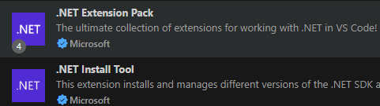
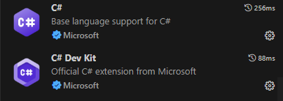


Software Requirements
Docker Desktop
VS Code
.NET (LTS release)
Node (LTS release; nvm for windows)
Microsoft SQL Server Management Studio
VS Code Extensions
Git

Slide 3
Agenda
01
02
03
Platform Overview
C# Foundations
C# Level I
What is .NET?
.NET Versions
Dependency Management
.NET SDK
Common SDK commands
What is C#?
Program Structure & the Main method
Data Types & Type Conversion
Operators
Comments
Input/Output
Value Types vs Reference Types
Stack vs Heap
Selection & Iteration
Custom Types & Collections
OOP
Serialization/Deserialization
File I/O
LINQ
ASP.NET Core overview
Minimal APIs
Entity Framework Core Overview
Testing Minimal APIs

Slide 4
01
Platform Overview

Slide 5
What is .NET?
.NET is a free, open-source developer platform for building many types of applications for multiple different programming platforms.
With .NET, you can use multiple languages, editors, and libraries to build for web, mobile, desktop, games, and IoT (Internet of Things).
In .NET:
We develop with C#, VB, or F#
It has a cross-platform design, i.e. runs on windows, mac, and linux
Multiple .NET versions can run side-by-side on the same machine to run projects concurrently

Slide 6
If you are coming from Java…
Technology | Java | .NET
Language | Java | C#
Dependency Manager | Maven/Gradle | Nuget
Testing | junit | xunit
SQL Vendor | MySQL/PostgreSQL | SQL Server
DB access | jdbc | ADO.NET
ORM | Hibernate | Entity Framework Core
Web Framework | javalin | ASP.NET Core minimal API
 | Spring | ASP.NET Core

Slide 7
.NET versions and naming
Yearly releases, with even numbers being LTS (long term support)
.NET 10 is the latest release
‘.NET Framework’ is the first ever release (legacy)
‘.NET Core’ began cross-platform implementations
Eventually they dropped ‘Core’ and skipped version 4…
So the version history is something like this: .NET Framework > .NET Core 1 > … > .NET Core 3.1 > .NET 5 > Ect.

Slide 8
What is the .NET SDK?
The .NET SDK is a set of libraries and tools that allows developers to create .NET applications and libraries. It contains the following components that are used to build and run applications:
The .NET CLI (command line interface)
The .NET Runtime and libraries
The Common Language Runtime (CLR) handles memory allocation and management. It includes a virtual machine that executes apps but also generates and compiles code on-the-fly using a JIT compiler.
Code is compiled into a Common Intermediate Language (CIL)
CIL will be executed with a JIT compiler
Base Class Library (BCL) is available OOB, and comprises the System namespace
System namespace: console, primitive datatypes, subnamespaces i.e. system.collections, system.linq, system.IO
The .NET driver, which provides an interface to the Microsoft .NET open source software framework for developing applications

Slide 9
Dependency Management
Nuget is responsible for dependency management in .NET, and it comes pre-installed with the .NET SDK. This is how we include further libraries outside of the BCLs.
You can add a new package with:
dotnet add package <package-name>
Dependencies are added to our .csproj file.

Slide 10
Common .NET SDK Commands
dotnet –info – display info on dotnet sdk
dotnet new … - scaffold a new project
dotnet new console –n HelloWorld – scaffold a console app with a project name of ‘HelloWorld’; uses top-level statements
dotnet new console –n HelloWorld –use-program-main – same as above, except it won’t use top level statements or implicit usings, we will get a main method
dotnet new gitignore – create new .NET specific gitignore file
dotnet new list – list all templates available for the dotnet new command
dotnet run –clean, restore, build, and run the project

Slide 11
.NET Overview Challenge 1
Goal:
Create a .NET app.
Scenario: 5 min
Create a Hello World console app and run it.

Slide 12
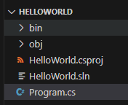
Project Files
Bin is generated when we run the project. Both bin and
Obj folders represent generated project files.
The .csproj file lists project dependencies.
The .sln file (solution file) is responsible for linking multiple
Projects together so they may perform work in tandem.
The .cs is our source code and project entry point.

Slide 13
02
C# Foundations

Slide 14
What is C#?
C# may be described as:
object-oriented
Statically typed
C# program runtime is managed by the CLR (common language runtime).
CLR is the implementation by Microsoft of the common language infrastructure (CLI), an international standard
The CLI is the basis for creating both execution and development environments in which languages and libraries work together seamlessly

Slide 15
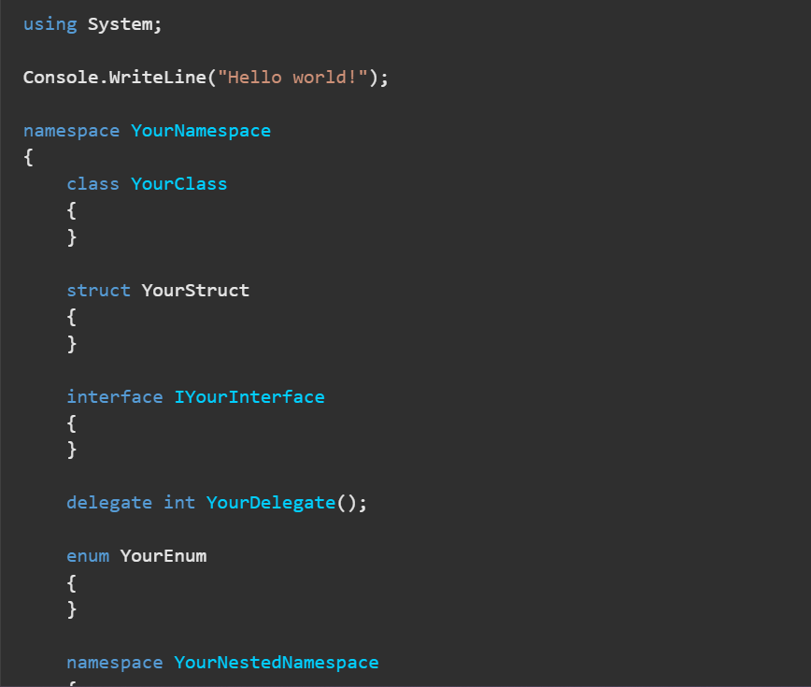
Program Structure
Each C# file contains zero or more namespaces.
A namespace contains types such as classes, structs, interfaces, enums, delegates, and other namespaces.
Namespaces help us organize our code
This example shows block-level namespaces (older, pre .net 6)
More commonly we use file-scoped namespaces e.g. ‘namespace YourNamespace;’

Slide 16
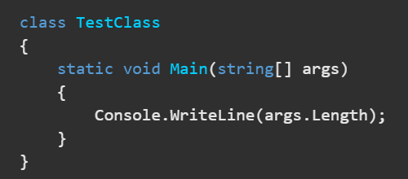
The Main Method
Entry point for application
If multiple classes have main methods, then the StartupObject compiler option may be used to specify which one to use first
Console Apps get Top-Level Statements enabled by default. I.e. no boilerplate class/method, implicit usings, ect.
return 0; in the Main method to exit the application (or even cleaner just let C# handle it and do nothing – the program will end once Main completes
We can use Environment.Exit(0); to exit the application from any method (rare)

Slide 17
Built-In Primitive Data Types
Int num = 123;
Alias | Type Name | Type | Size(bits) | Range
short | System.Int16 | signed integer | 16 | -32768 to 32767
int | System.Int32 | signed integer | 32 | -2³¹ to (2³¹)-1
long | System.Int64 | signed integer | 64 | -2⁶³ to (2⁶³)-1
byte | System.Byte | unsigned integer | 8 | 0 to 255
float | System.Single | floating point number | 32 | ±1.5 × 10⁻⁴⁵ to ±3.4 × 10³⁸
double | System.Double | floating point number | 64 | ±5.0 × 10^{-324 to ±1.7 × 10308}
char | System.Char | Unicode character | 16 | U +0000 to U +ffff
string | System.String | text | N/A | N/A

Slide 18
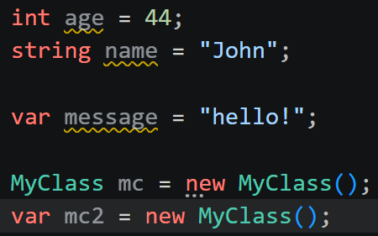
Var
Var allows for implicit typing
Var DOES NOT allow variables to be dynamically typed
Var MUST be initialized when created
Good for shortening syntax on longer declarations, such as class names

Slide 19
Type Conversion
There are 2 types of type conversion in C#:
Implicit Conversions: No special syntax required, type safe, no data loss
Explicit Conversions (Casting): Requires the cast operator (). A cast is required when data might be lost in the conversion, or when failure could occur.
This is implicit conversion:
Int num = 123;
Long biggerNum = num;
This is explicit conversion:
Double x = 123.4;
Int a = (int)x;

Slide 20
Arithmetic Operators
Operator | Description | Example
+ | Adds two operands | A + B
- | Subtracts second operand from the first | A - B
* | Multiplies both operands | A * B
/ | Divides numerator by denominator | B / A
% | Remainder after an integer division | B % A
++ | Increment operator; increases integer value by one | A++
-- | Decrement operator; decreases integer value by one | A--

Slide 21
Relational Operators
Operator | Description | Example
== | Checks if the values of two operands are equal or not, if yes then condition becomes true. | (A == B) is not true.
!= | Checks if the values of two operands are equal or not, if values are not equal then condition becomes true. | (A != B) is true.
> | Checks if the value of left operand is greater than the value of right operand, if yes then condition becomes true. | (A > B) is not true.
< | Checks if the value of left operand is less than the value of right operand, if yes then condition becomes true. | (A < B) is true.
>= | Checks if the value of left operand is greater than or equal to the value of right operand, if yes then condition becomes true. | (A >= B) is not true.
<= | Checks if the value of left operand is less than or equal to the value of right operand, if yes then condition becomes true. | (A <= B) is true.

Slide 22
Logical Operators
Operator | Description | Example
&& | Logical AND operator. If both the operands are non zero then condition becomes true. | (A && B) is false.
|| | Logical OR Operator. If any of the two operands is non zero then condition becomes true. | (A || B) is true.
! | Logical NOT Operator. Use to reverses the logical state of its operand. If a condition is true then Logical NOT operator will make false. | !(A && B) is true.

Slide 23
Assignment Operators
Operator | Description | Example
= | Simple assignment operator, Assigns values from right side operands to left side operand | C = A + B assigns value of A + B into C
+= | Add AND assignment operator, It adds right operand to the left operand and assign the result to left operand | C += A is equivalent to C = C + A
-= | Subtract AND assignment operator, It subtracts right operand from the left operand and assign the result to left operand | C -= A is equivalent to C = C - A
*= | Multiply AND assignment operator, It multiplies right operand with the left operand and assign the result to left operand | C *= A is equivalent to C = C * A
/= | Divide AND assignment operator, It divides left operand with the right operand and assign the result to left operand | C /= A is equivalent to C = C / A
%= | Modulus AND assignment operator, It takes modulus using two operands and assign the result to left operand | C %= A is equivalent to C = C % A

Slide 24
Increment/Decrement Operators
Postfix and Prefix increment
int i = 3;
Console.WriteLine(i); // output: 3
Console.WriteLine(i++); // output: 3
Console.WriteLine(i); // output: 4
double a = 1.5;
Console.WriteLine(a); // output: 1.5
Console.WriteLine(++a); // output: 2.5
Console.WriteLine(a); // output: 2.5
Postfix and Prefix decrement
int i = 3;
Console.WriteLine(i); // output: 3
Console.WriteLine(i--); // output: 3
Console.WriteLine(i); // output: 2
double a = 1.5;
Console.WriteLine(a); // output: 1.5
Console.WriteLine(--a); // output: 0.5
Console.WriteLine(a); // output: 0.5

Slide 25
Bitwise Operators
Bitwise complement operator ~
Left-shift operator <<
Right-shift operator >>
Unsigned right-shift operator >>>
Logical AND operator &
Logical OR operator |
Logical exclusive OR operator ^

Slide 26
Operator Precedence
Category | Operator | Associativity
Postfix | () [] -> . ++ - - | Left to right
Unary | + - ! ~ ++ - - (type)* & sizeof | Right to left
Multiplicative | * / % | Left to right
Additive | + - | Left to right

Slide 27

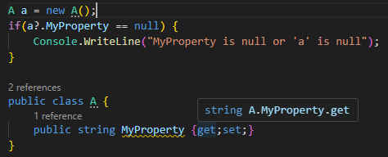
Operator Special Mentions
This is a null-conditional operator, it suppresses nullable reference type warnings
The null-forgiving operator suppresses all nullable warnings for the preceding expression.
The null-conditional operator evaluates the first operand; if that’s null, stop, with a result of null. Otherwise, evaluate the next operand.

Slide 28
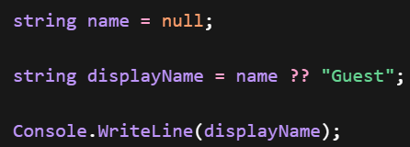
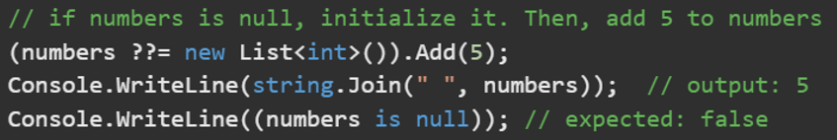
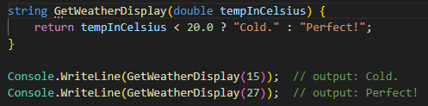
Operator Special Mentions
The null-coalescing operator returns the value of its left-hand operand if it isn’t null; otherwise, it evaluates the right-hand operand and returns its result.
The conditional operator (or ternary conditional operator), evaluates a Boolean expression and returns the result of one of the two expressions, depending on whether the Boolean expression evaluates to true or false.

Slide 29
Comments
// - Represents a single line comment
/* comment */ - Represents a multi-line comment

Slide 30
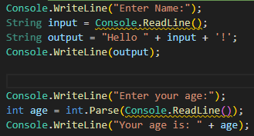
Input/Output
Question Time: What’s the distinction between the single and double quotes on line 3?
Note: Care that Console.ReadLine() returns a string, not an int!

Slide 31
C# Foundations Challenge 1
Goal:
Edit our console app.
Scenario: 5 min
Edit our console app to take in a user email and output it back to the user.

Slide 32
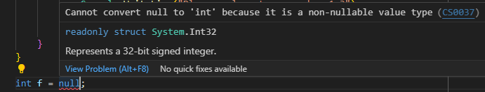
A Note on C# Under-the-hood behavior
Value Types
Reference Types
Represents some data at a memory address
Size is determined up front
You can’t have a null value type
Variable only holds a pointer to a memory address
Size is not determined up front
Can be null

Slide 33
C#, Where memory is always** managed for you!!!
Two areas used to store data for memory management.
The Stack
The Heap
Used for static memory allocation
Stores value types and reference type pointers
Follows LIFO structure
Data is automatically freed once out of scope
Limited in size
Managed by the compiler
Very fast
Used for dynamic memory allocation
Stores Objects, strings, arrays
Structure is just a pile of data, any piece of data can be accessed at any time
Data can exist after method returns
Larger memory space than the stack
Managed by the Garbage Collector
Slow
** Except for unmanaged resources

Slide 34
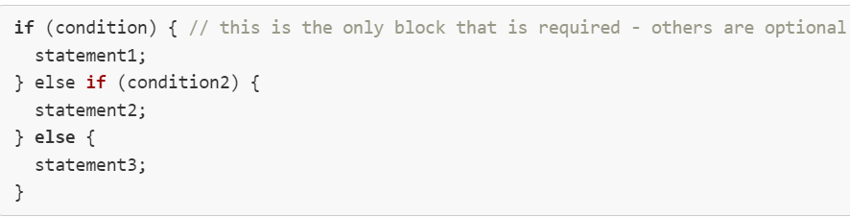
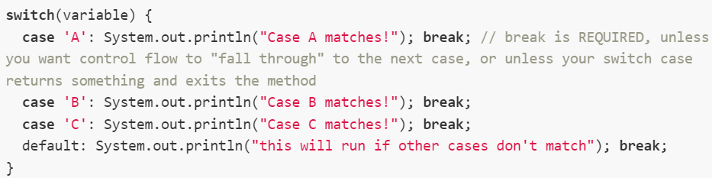
Selection & Iteration

Slide 35
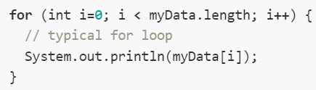

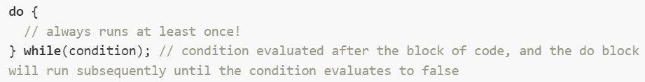
Selection & Iteration

Slide 36
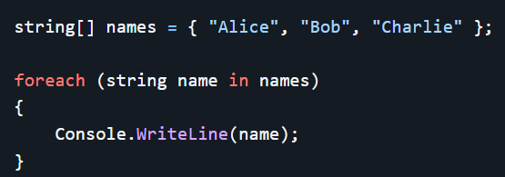
Selection & Iteration
Notes:
Probably pause here as it’s the best stopping point to expand on arrays a bit. The rest of the deck doesn’t expound on arrays to any depth

Slide 37
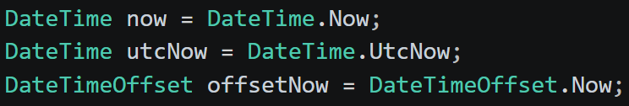






Dates
Your computer’s local time with no timezone info
Coordinated Universal Time – z means ‘zulu time’
No ambiguity across systems
Local time + its offset from UTC (best practice for maximum precision
Notice the difference. The first is preferred, as it contains UTC offset.
Best Practice!

Slide 38
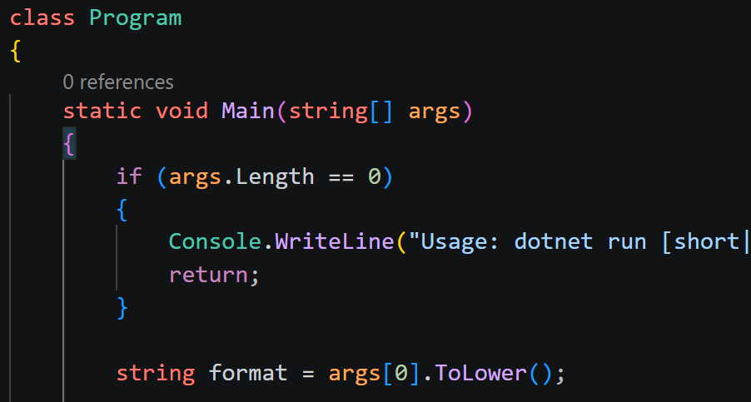
Args

Slide 39
C# Args and Dates Challenge
Goal:
Generate Dates
Scenario: 5 min
Create a console app that prints different date formats based on the args passed into main
DateTimeOffset with “o”
DateTime with a long date format

Slide 40
Custom Types
We use the following to create our own Custom Data Types:
Struct = defined as a value type, good for little or no behavior
Class = defined as a reference type, good for lots of behavior
Interface
Enum
Record
Custom Types Best Practices < Docs

Slide 41
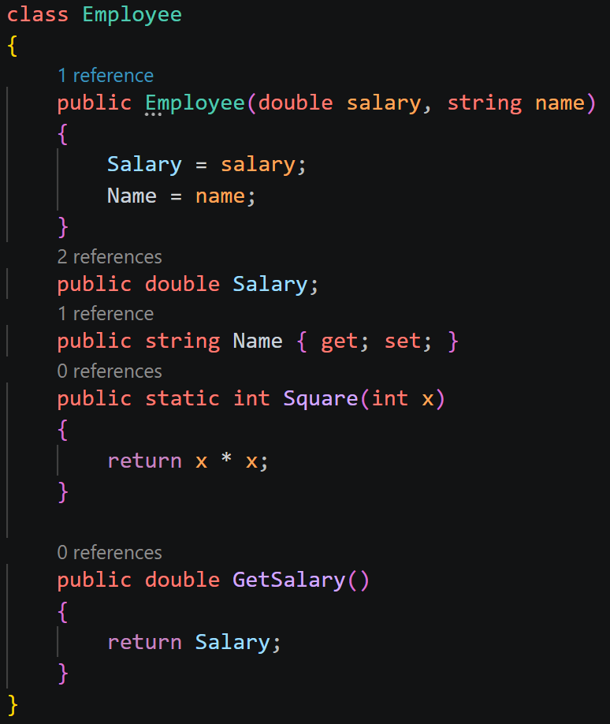
Classes
Classes are blueprints for objects, they have:
Constructors – sets values for fields/properties once the object is created
Fields – variables in a class
Properties – modern syntax to store data
Methods – reusable blocks of code; static class members may be accessed without instantiating the class into an object

Slide 42
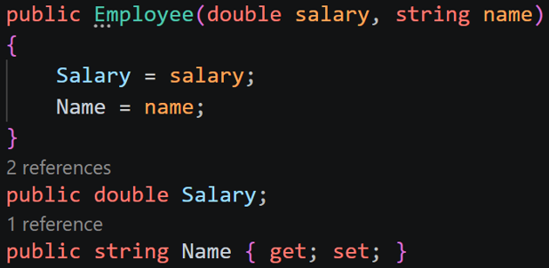
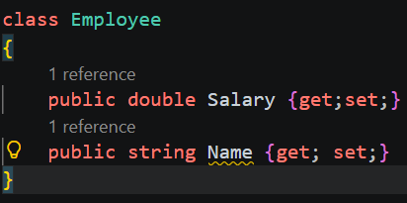
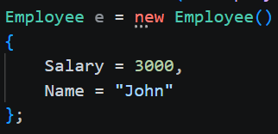
Object instantiation
With a constructor:
Without a constructor and using properties:

Slide 43
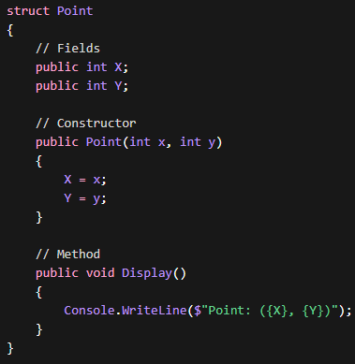
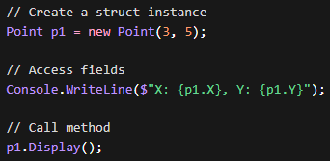
Struct Example
This is called string interpolation

Slide 44





Formatting String Interpolations
F2 → fixed-point with 2 decimals
N → number with commas
E → scientific notation
Currency, percentages, and date formatting are all also available:

Slide 45
String Methods
int len = str.Length; <-property of string class
ToUpper() / ToLower() → casing
Trim() / TrimStart() / TrimEnd() → remove whitespace
Substring(start, length) → extract part of string
IndexOf() / LastIndexOf() → find position
Contains() → check existence
Replace(old, new) → replace characters/words
Split() → break into array
Join() → combine array into string
Equals() / == → compare strings
Reversing a string:
string str = "hello";
char[] arr = str.ToCharArray();
Char[] otherExample = str.Reverse().ToArray();
Array.Reverse(arr);
string reversed = new string(arr);
Console.WriteLine(reversed);

Slide 46

OOB Struct Example
We can use the Guid Struct to create a globally unique identifier (GUID).
For a struct, Guid has a lot of methods.

Slide 47
C# Foundations Challenge 2
Goal:
Create a Car class.
Scenario: 5 min
Create a new class to represent a car.
Let’s include a make, model, year, price, and Id.
Create a ‘display’ method that uses string interpolation to print the ID and formatted price.

Slide 48
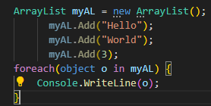

Collections
Lists are indexed collections of the same type(T).
No auto-resize
Not performant/generic
Truly generic & performant
Generic Collections <- Link

Slide 49



Boxing/Unboxing
Boxing:
Unboxing:
Used mostly with non-generic collections:

Slide 50
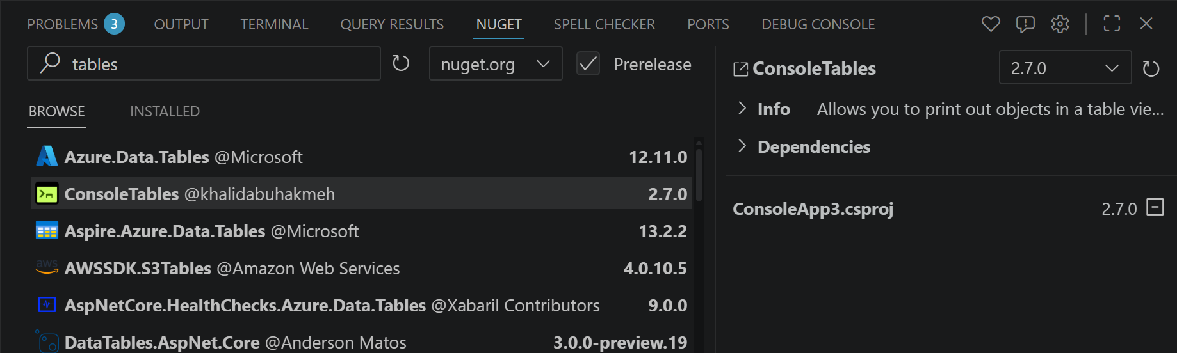
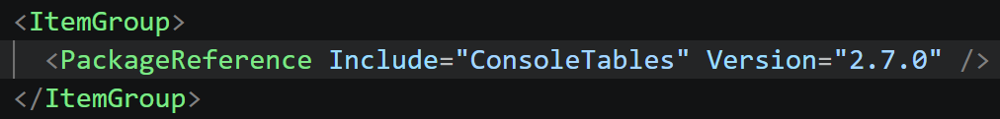
Nuget Gallery
This gets added to csproj for us:

Slide 51
C# Foundations Challenge 3
Goal:
Create a Car management application.
Scenario: 45 min
Edit our existing console app so that it has a menu with three options as soon as it loads:
1. Enter New Car
2. List Cars
3. Exit
We should be able to create new instances of a car and add it to a running list that we may view.

Slide 52
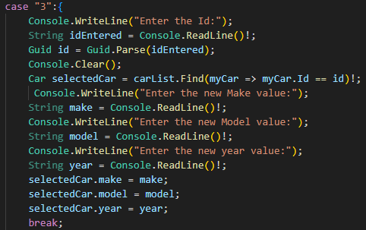
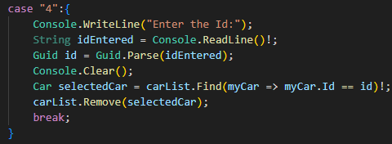
Edit/delete list entry in console app
<- Uses lambda expression!

Slide 53
C# Foundations Challenge 4
Goal:
Edit the Car management application.
Scenario: 15 min
Add the ability to search for a car for update or deletion from a list.

Slide 54
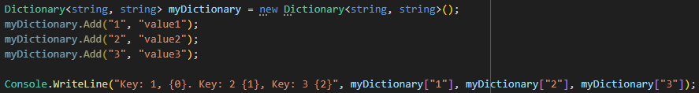
Collections (continued)
Dictionaries are collections of key/value pairs. Each key must be unique. The key and value can be any type(T).
Generic Collections <- Link

Slide 55
Iterating over Dictionaries
Dictionaries may be iterated over with foreach. For each item, the Key property provides access to the key and the Value property provides access to the value.

Slide 56
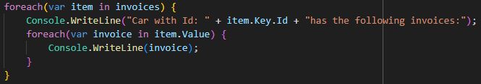
Nested Collections

Slide 57
C# Foundations Challenge 5
Goal:
Edit the Car management application.
Scenario: 15 min
Add the ability to add invoices for a specific car.
Add the ability to print out and view all invoices with the associated car Id.

Slide 58
OOP Concepts
APIE
Abstraction – focus on what something does, rather than how it does it
Polymorphism – many forms; allows objects of different classes to be treated as objects of a common superclass or interface
Inheritance – where subclasses inherit properties and methods from an existing class
Encapsulation – hiding the internal state (properties/methods) of an object and controlling its access

Slide 59
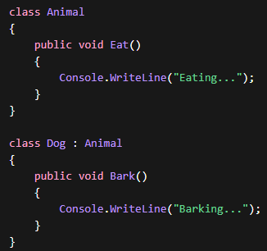

Inheritance

Slide 60
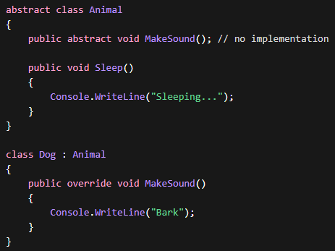
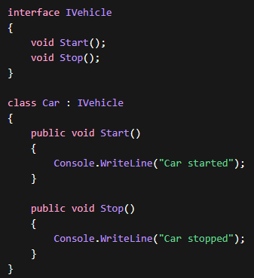
Abstraction
Abstract methods can’t be instantiated directly
Can contain abstract methods, concrete methods, and fields
A class can only derive one abstract class
Interfaces are also used to create abstractions
Interfaces can’t have concrete methods or fields
Classes can implement multiple interfaces

Slide 61
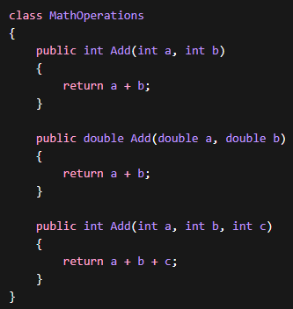
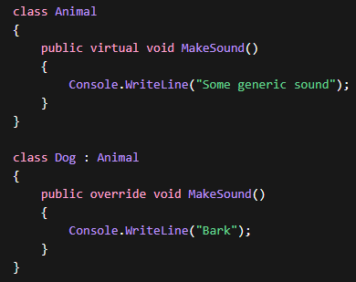
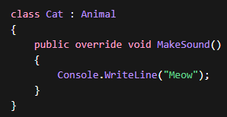
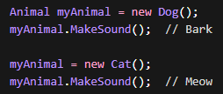
Polymorphism
Method Overloading
Method Overriding

Slide 62
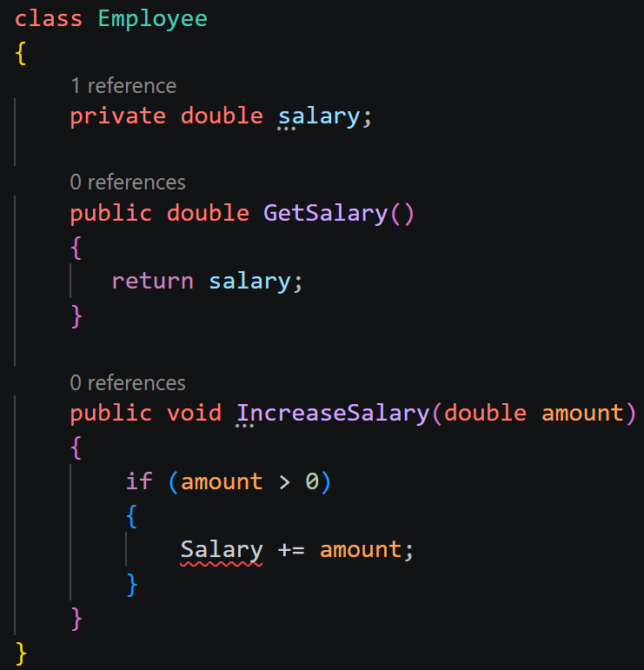
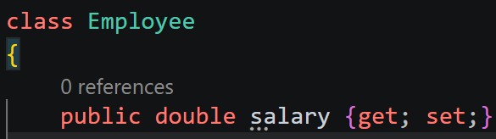
Encapsulation
Constructor with
Getter / Setter methods (traditional):
Properties (modern):
Access modifiers control access to these items from different scopes

Slide 63
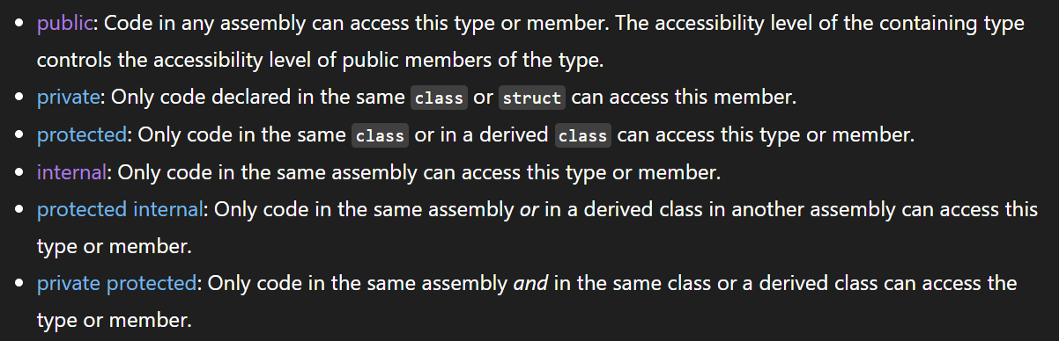
Access Modifiers

Slide 64
03
C# Level I

Slide 65
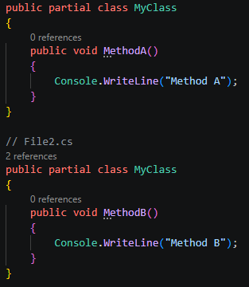
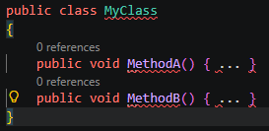
Partial Classes
Both classes will essentially merge at compilation. We won’t use this too much in web apps.

Slide 66
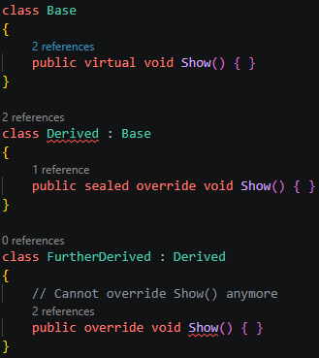
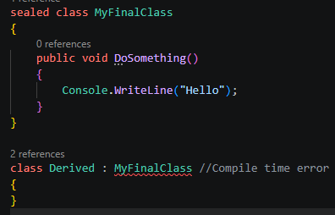
Sealed classes and methods
Sealed classes and methods cannot be inherited

Slide 67
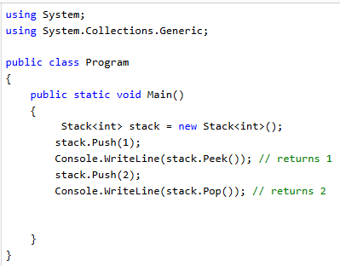
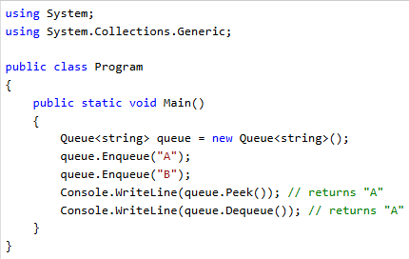
Stacks & Queues
Stacks have a last in first out (LIFO) structure
Queues have a first in, first out (FIFO) structure

Slide 68
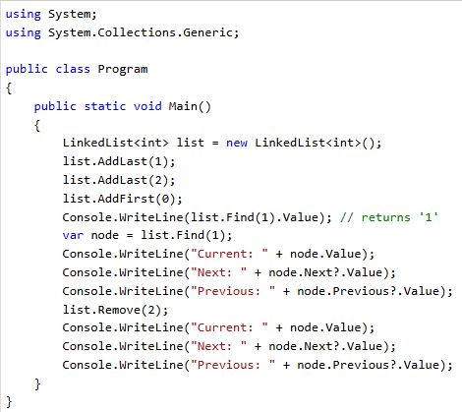

Linked Lists
A linked list is a collection of nodes where each element points to the next (and optionally previous in a doubly linked list)
In C#, LinkedList<T> is a doubly linked list

Slide 69
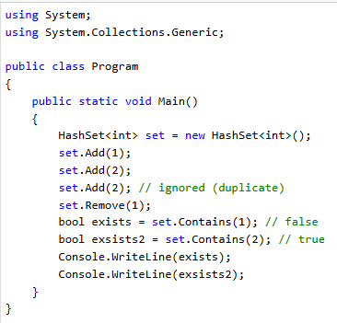
HashSets
No duplicates allowed
Very fast lookup
No guaranteed order

Slide 70

Enum
Enums are like picklists/dropdowns in code
A status code of ‘3’ wouldn’t tell us much
But we could create a reusable enum that clearly defines possible values

Slide 71
Downcasting
Allows us to check for invalid cast exceptions before they happen
if (obj is Dog dog)
{
dog.Bark();
}
Dog dog = obj as Dog;
if (dog != null)
{
dog.Bark();
}

Slide 72

Serialization/Deserialization
Serialization – the process of converting an object into a format that can be readily persisted or transported.
Serialize an Object
Transport it over the internet using HTTP
Deserialize it at the destination machine
Deserialization – Reconstructs an object from a serialized form.

Slide 73
File I/O
Common Synchronous Options
StreamWriter
Write()
WriteLine()
File
WriteAllLines()
WriteAllText()
AppendAllLines()
AppendAllText()
Common Asynchronous Options
StreamWriter
WriteAsync()
WriteLineAsync()
File
AppendText – returns StreamWriter; can add to existing file or create new one
OpenText() – returns StreamReader
ReadAllTextAsync() – returns string of all the text in the file
CreateText() – returns StreamWriter; creates or opens a file for writing, if file already exists, its contents are replaced
File class also contains the Exists property, which returns a Boolean of if a file exists or not.

Slide 74

File I/O
The Garbage Collector doesn’t actually manage everything… Unmanaged Resources must be handled by us.
File I/O, Database Connections
iDisposable interface can release resources
Using keyword can release resources, with or without code blocks

Slide 75
C# Level I Challenge 1
Goal:
Edit the Car management application.
Scenario: 15 min
When quitting the application, we should write all of our cars in JSON format to a local file.
When loading the application, we should read the file to populate our list of cars.

Slide 76

IEnumerable
You can see on the docs, many collections implement the IEnumerable interface:
DOCS Link

Slide 77

LINQ
Language-Integrated Query (LINQ) is the name for the set of technologies based on the integration of query capabilities directly into the C# language.
Works with lists, databases, and many other collections
There are 2 syntax types: query syntax & method syntax, seen below:

Slide 78


LINQ
LINQ is very flexible:
Note: LINQ queries are not always executed immediately.
It uses deferred execution and will run when the results are iterated over or explicitly made manifest with .ToList()
And we can put it all together:

Slide 79



Other LINQ Methods - Examples

Slide 80
C# Level I Challenge 2
Goal:
Edit the Car management application.
Scenario: 15 min
Add a search feature to our application. A user should be able to enter a year for a car and have all the cars of that year print to the console.

Slide 81
Exceptions
using System;
public class InvalidOrderException : Exception
{
public int OrderId { get; }
public InvalidOrderException() { }
public InvalidOrderException(string message)
: base(message) { }
public InvalidOrderException(int orderId, string message)
: base(message)
{
OrderId = orderId;
}
}
try
{
ProcessOrder(0);
}
catch (InvalidOrderException ex)
{
Console.WriteLine($"Custom error: {ex.Message}");
Console.WriteLine($"Order ID: {ex.OrderId}");
}
catch (Exception ex)
{
Console.WriteLine($"General error: {ex.Message}");
}
throw new InvalidOrderException(orderId, "Order ID must be greater than zero.");

Slide 82


What is an API?

Slide 83

Types of APIs
SOAP – Simple Object Access Protocol
Uses XML only, and operates under a formal contract called a WSDL file (web service description language)
REST – Representational State Transfer
Typically uses JSON, and is stateless = each request contains all needed info
Made up of:
Endpoint:
https://api.example.com/users/123
HTTP Method:
GET
Headers:
Authorization: Bearer <token>
Query parameters (optional):
https://api.example.com/users?active=true&limit=10
Request Body (optional):
{
"name": "Alice",
"email": "alice@example.com"
}

Slide 84
What is ASP.NET Core?
ASP.NET Core is a cross-platform, high-performance, open-source framework for building modern, cloud-enabled, internet-connected apps.
With ASP.NET Core, you can:
- Build web apps and services, Azure IoT (Internet of Things) apps, and mobile backends.
- Use your favorite development tools on Windows, macOS, and Linux.
- Deploy to the cloud or on-premises.
- Run on .NET.

Slide 85

ASP.NET Core vs ASP.NET 4.x

Slide 86
API Options in ASP.NET Core
There are 2 approaches: a controller-based approach and Minimal APIs.
Controllers in an API project are classes that derive from ControllerBase
Classes that take dependencies via constructor injection or property injection
Follows more of an Object-Oriented pattern
Minimal APIs define endpoints with logical handlers in lambdas or methods
Less verbose, intended to include less of the files, features, and dependencies of ASP.NET Core

Slide 87



Creating an ASP.NET Application
Create a web app with controllers
The rest of the items are class libraries
We add projects into the solution:

Slide 88


Creating an ASP.NET Application
We can use the solution explorer to setup project dependencies

Slide 89

Installing Nuget Packages
You can use the nuget gallery to install these

Slide 90

Create a Domain
For our nullable reference types, we mark required. Why?
We want them to be required when instantiating the class, but we also consider EF Core
EF Core will look at all properties and consider any that use a nullable reference type to not be required.
e.g. public string? Description {get; set;}

Slide 91
C# Level I Challenge 3
Goal:
Create an API project.
Scenario: 5 min
Create the projects, install the necessary nuget packages, and create the Activities entity.

Slide 92


Connecting the Database
Create the DbContext within the persistence layer:
Add it as a service, and setup the connection string:

Slide 93

Docker Desktop Install
Before install
Check/Enable virtualization in BIOS
Install WSL2 (wsl --install)
Reboot
Install Docker Desktop
Run installer as admin
Use default settings
After install
Ensure:
Docker Desktop starts
docker run hello-world works
If it fails
Check:
wsl -l -v
Docker Desktop running
user in docker-users
Try uninstalling docker desktop first via control panel and restarting if you still have issues. This is the nuclear option:
Remove-Item -Path "C:\ProgramData\DockerDesktop" -Recurse -Force
Windows Subsystem for Linux (WSL) is a Microsoft feature that allows users to run a native GNU/Linux environment—including command-line tools, utilities, and applications—directly on Windows 10/11 or Windows Server
Note it’s PowerShell:

Slide 94

Docker Key Terms
Docker Hub = think of it as similar to github but for Docker Images
Docker Images = are snapshots and instructions bundled together; we use these to create a docker container
Docker container = is a running instance of a docker image
Tags = are different versions (branches)

Slide 95

Database Creation
In a terminal:
MSSQL_PID = license version of MSSQL
MS SQL uses port 1433 by default, here we are just setting the docker container port to match; ‘-p <host_port>:<container_port>
Traffic sent through port 1433 on host is forwarded to port 1433 inside the container
DockerHub link for MS SQL Server

Slide 96


Connecting the Database
The API layer contains these files; development is only used in development mode, the other file is used only after the project is built and in prod
Our connection string includes details from our Docker command:

Slide 97


Install EF Core
EF Core’s CLI tools are installed globally via nuget:

Slide 98
What is Entity Framework Core?
Entity Framework Core is a lightweight, extensible, open source and cross-platform version of the popular Entity Framework data access technology.
EF Core is an O/RM, which:
Enables .NET developers to work with a database using .NET objects
Eliminates the need for most of the data-access code that typically needs to be written
This is the second incarnation. Entity Framework 6 is an O/RM for .NET Framework; no longer being actively developed
Supports LINQ Queries, change tracking, updates, and schema migrations.
It is convention based. The shape of our models help dictate the migrations pushed to our SQL server.

Slide 99
Migrations
Code-first migration
We take c# models and the shape of them is used to create a ‘migration’
The migration is then pushed to the SQL server, and database tables, fields, constraints, etc. are all created for us
Database-first migration
We take a database and its current schema and we create code from it

Slide 100



Creating a Migration
← Create an individual migration
Migration files are generated →
They describe and hold a record of what changes have been made to the db

Slide 101


Apply a migration
← Apply the migration
We can now see the db schema in our vscode extension →

Slide 102

SQL Server Management Studio
And this would be the official GUI tool to view the db and interact with it
Most used by job roles where sole focus is work in the db →

Slide 103
Other EF Core commands
dotnet ef migrations remove → use when you generate a migration but don’t want to apply it
dotnet ef migrations list → shows applied vs pending migrations
dotnet ef database drop → useful for resetting local docker SQL server; dangerous
dotnet ef dbcontext info → view extra information about the connection
dotnet ef migrations bundle→ creates an executable that can run migrations without the SDK installed; this is for use with docker deployments typically
dotnet ef migrations script –idempotent → produces SQL from migration history; idempotent flag makes it safe to run multiple times, used in CI/CD pipelines
Note: use each with the following flags to select your correct projects in a multi-project solution
e.g.
dotnet ef database drop –p Persistence –s API

Slide 104
C# Level I Challenge 4
Goal:
Create a model and database context.
Scenario: 10 min
Create the database context for Activities. Create the database, connect to it, install EF Core and push migrations

Slide 105

Seeding Data
In persistence
DbInitializer.cs →

Slide 106

Seeding Data
Program.cs:
We create a scope that will be disposed of once the app starts running
MigrateAsync() pushes pending migrations automatically to our DB (don’t use in prod)
We call a custom class/method to seed data into db
Logging errors with a logger provided from DI container
(will talk more about logging later)

Slide 107

Create Base Api Controller (for later)
BaseApiController.cs (in controllers folder):

Slide 108



Create a custom controller
Db access (we will change this later):
We inherit the our BaseApiController:
Create our first endpoint:

Slide 109

Get an Activity by ID

Slide 110



Route Params vs Query Params
Style | Example URL | When to use
Route parameter | /api/activities/123 | Resource identification (most REST APIs)
Query parameter | /api/activities?category=running&limit=10 | Filtering, searching, optional parameters
This is a single route param:
With query params:
This is using multiple route params:

Slide 111
What codes to return
Action | Status Code | Method to use in controller
GET success with data | 200 OK | return Ok(ItemReturned);
Created new resource | 201 Created | return CreatedAtAction(nameof(GetById), new { id = activity.Id }, activity);
Deleted / updated (no body) | 204 NoContent | return NoContent();
Invalid input | 400 BadRequest | return BadRequest("Invalid data");
Not found | 404 NotFound | return NotFound();

Slide 112
C# Controller Challenge
Goal:
Create a controller class for Activities
Scenario: 10 min
Create an endpoint that returns all Activities and another that returns a single activity based on its Id. Test with Thunderclient.

Slide 113

Design Patterns
In software engineering, a design pattern is a general, reusable, and conceptual template for solving commonly occurring design problems.

Slide 114

DbContext IS a repo layer and UoW
Even though this is the case, some may still build a repo layer or UoW outside of the DbContext object
Easier mocks for unit tests
UoW needed if you need to make updates to multiple repos that use a separate DbContext object (multiple connection strings)

Slide 115

SOLID

Slide 116


Create a Service with Dependency Injection
The class expects abstractions, not concretions. (dependency inversion)
Interfaces and concretions are registered for our DI container (program.cs):

Slide 117


Create a repo layer
It’s just another layer of abstraction, similar to how we made the service layer with dependency injection:

Slide 118
The Factory Design Pattern
A factory design pattern centralizes object creation logic
It allows us to create objects without exposing the exact class being instantiated
Example:
Under the hood, ASP.net’s DI container acts as a factory:
public static class NotificationFactory
{
public static INotificationService Create(string type)
{
return type.ToLower() switch
{
"email" => new EmailNotificationService(),
"sms" => new SmsNotificationService(),
_ => throw new ArgumentException("Invalid type")
};
}
}
services.AddScoped<INotificationService, EmailNotificationService>();

Slide 119


Primary Constructors
Instead of writing a constructor…
A primary constructor’s params may be used throughout

Slide 120


Logging in ASP.net
Program.cs (before app is made):
SetMinimumLevel overrides setting in appsettings.json files (prefer JSON configuration in general)
Tiny Dragons Investigate Weird Exploding Computers!

Slide 121



Logging
ActivitiesController.cs

Slide 122


Unit Testing
Create a test project and add to sln:
Moq and FluentAssertions are popular packages that make testing easier, you can add them to our test.csproj via nuget gallery →

Slide 123

Unit Testing
[Fact] – required to register a test method
Test method names follow convention of: “MethodWeAreTesting_ThingWeAreChecking_condition”
E.g. GetActivityAsync_ReturnsActivity_WhenIdExists()
We use Moq to mock the repo layer
Arrange, Act, Assert
Assertions – make claims about data/output
Verification – makes claims about behavior
Verify() method comes from Moq

Slide 124
Unit Testing – Assert Types
Equality:
Assert.Equal(expected, actual);
Assert.NotEqual(notExpected, actual);
Boolean:
Assert.True(condition);
Assert.False(condition);
Null:
Assert.Null(object);
Assert.NotNull(object);
Type:
Assert.IsType<T>(object);
Assert.IsNotType<T>(object);
Collection:
Assert.Contains(item, collection);
Assert.DoesNotContain(item, collection);
Assert.Empty(collection);
Assert.NotEmpty(collection);
Exception:
Assert.Throws<TException>(() => method());
Assert.DoesNotThrow(() => method()); // not in xUnit (important!)
String:
Assert.StartsWith(expectedStart, actualString);
Assert.EndsWith(expectedEnd, actualString);
Assert.Matches(pattern, actualString);
Range:
Assert.InRange(value, low, high);
Assert.NotInRange(value, low, high);
Reference:
Assert.Same(expected, actual);
Assert.NotSame(expected, actual);

Slide 125

Creating a Minimal API
Program.cs - Our services are built into the app via Dependency Injection.
- Endpoints are mapped to asynchronous anonymous functions.

Slide 126

Testing Our Minimal API
Program.cs - Swagger is a robust API testing toolkit
- GUI Provided
- Easily see HTTP status codes, response bodies, response headers, and more

Slide 127
C# Level I Challenge 5
Goal:
Finish the application.
Scenario: 15 min
Create and test an API that can create cars, return a list of all cars, and return all cars of a certain year.

Slide 128

Unit Of Work Pattern
Sometimes we may wish to have multiple DbContexts:
When we need to work with a distributed system
To organize access to our entity types
i.e. the AccountDbContext includes the DbSet for Accounts (companies we do business with), but we may also want to include Contacts (employees at those companies)
i.e the SalesDbContext includes the DbSet for Opportunities (potential sales with Accounts), but we may also want to include Invoices (individual sales)
In service layer: This can fail for related records!

Slide 129
Unit Of Work Pattern
Without Unit Of Work:
Account Repo
AccountDbContext
Service Layer
Opportunity Repo
SalesDbContext
With Unit Of Work:
Account Repo
AccountDbContext
Service Layer
Unit Of Work
Opportunity Repo
SalesDbContext

Slide 130


Unit Of Work Pattern

Slide 131

Unit Of Work Pattern
A TransactionScope can encapsulate multiple, individual, transactions to multiple databases simultaneously.
Since a transaction makes a database connection, this is an unmanaged resource that we must make sure to dispose of.

Slide 132


Unit Of Work Pattern
← Our service with business logic now takes in a unit of work instead of repositories.
This uses dependency injection. So don’t forget to add an interface and concretion of your unit of work into the service builder.

Slide 133



versioning

Slide 134




identity
Only domain so far:
Jonathan added this to service layer dotnet add package Microsoft.Extensions.Configuration.Binder

Slide 135



identity

Slide 136

Identity - Edit db contexts

Slide 137

identity
Create service and associated interface:

Slide 138


identity
Create service and associated interface:

Slide 139

Seed roles

Slide 140

Identity – controller setup

Slide 141

Identity – controller setup
[Authorize(Roles = "Admin")]
[HttpPost("registeradmin")]
public async Task<IActionResult> Register(RegisterDto newUser)
{
if (!ModelState.IsValid)
return BadRequest(ModelState);
var user = new ApplicationUser
{
UserName = newUser.Email,
Email = newUser.Email,
FullName = newUser.FullName
};
var result = await _userManager.CreateAsync(user, newUser.Password);
if (!result.Succeeded)
{
return BadRequest(result.Errors);
}
await _userManager.AddToRoleAsync(user, "Admin");
return Ok(new { message = "Registration Successful" });
}

Slide 142

identity
Setup controller then edit program.cs

Slide 143


identity

Slide 144


CORS

Slide 145
Logger Middleware

Slide 146
Filter

Slide 147




Caching

Slide 148

Clean Code

Slide 149

CQRS
CQRS = Command Query Responsibility Segregation
Command
Does something
Modifies State
Query
Answers a question
Does not modify State

Slide 150
Mediator Pattern
API/Endpoints > Controller > Service > Repo > EF
CQRS Handlers
Query Handler >
Command Handler >
API/Endpoints > Controller > Mediator >
Repo/EF

Slide 151

Typescript
Transpile with: tsc script.ts
It will generate:
script.js

Slide 152

React
React native – focused on native mobile apps
React – focused on web apps
Npm install
Npm run dev
Package to enable https during development: https://www.npmjs.com/package/vite-plugin-mkcert

Slide 153
React
React native – focused on native mobile apps
React – focused on web apps

Slide 154




Azure/Docker Setup

Slide 155

Azure/Docker Setup

Slide 156
Multi-Tenant Architecture
Shared Servers
Isolated Environment
All Salesforce customer orgs are in the cloud, so they share server space.
Each org is an isolated environment from other orgs on the cloud.
Shared Resources
Governor Limits
Because orgs share server space, they also share the physical hardware that keeps the server running. i.e. ram, cpu time, ect.
Limits are in place so that no one org can overuse resources and degrade the performance for everyone else.

Slide 157
MVC
Model
View
Controller
Database Tables, field definitions, ect.
UI elements
Business Logic

Slide 158
MVC
No-Code
Pro-Code
Objects, fields, relatioships
Model
APIs
Apps, Pages, Actions
View
Visualforce, LWC, Aura
Flows, approvals, validation rules
Controller
Apex

Slide 159
No-Code vs Pro-Code
01
Pro-Code
Faster than coding
01
Flexibility
02
Easy to maintain
02
Pixel perfect UI
03
Automatic Updates
03
Integrations
No-Code

