Slide 1
Core Java

Slide 2
What is Java?
Java is a general-purpose programming language used to build web applications, Android apps, desktop programs, enterprise systems, and backend services
Object-oriented, Statically typed, & automatic memory management (garbage collection)
Created by Sun Microsystems in the 90s; now maintained by Oracle
Write once, run anywhere:
Java source code → Java compiler → Bytecode → Java Virtual Machine (JVM) → OS
Along with the JVM, you should also know:
JDK (Java Development Kit) – tools needed to develop Java programs, includes the compiler
JRE (Java Runtime Environment) – JVM + libraries needed to run Java applications

Slide 3
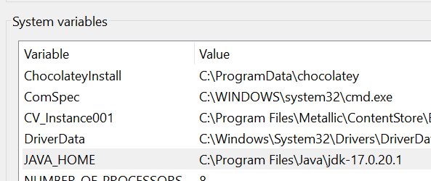
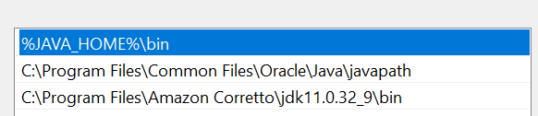
Installing JDK
https://www.oracle.com/java/technologies/downloads/
We will use JDK 17 in this course
LTS – long term support
Environment variables in windows will dictate which version is used, if multiple
JAVA_HOME – points to folder location
The PATH environment variable - %JAVA_HOME%\bin

Slide 4
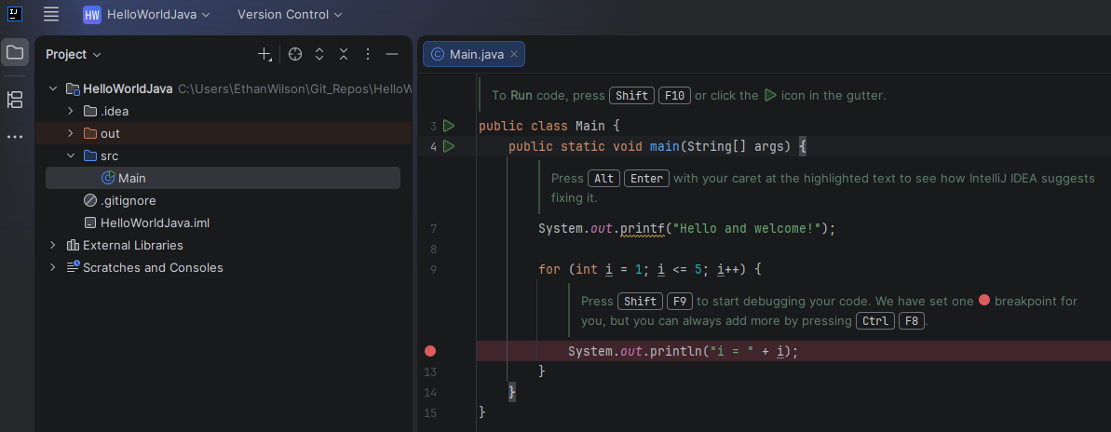
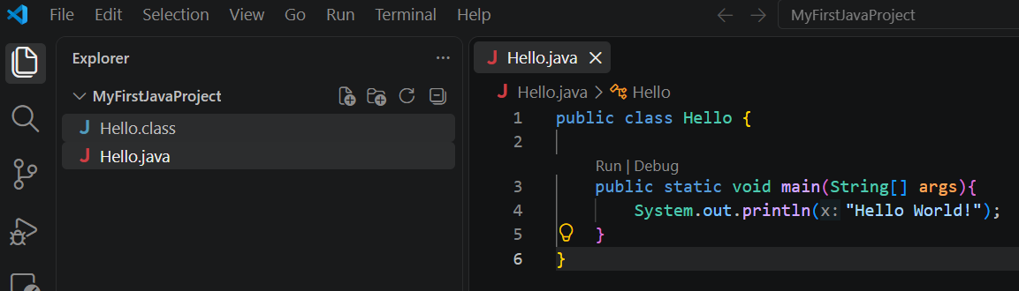
Different development Environments
IntelliJ IDEA – very popular
Eclipse – popular, free, open-source
VS Code – gaining popularity, free, but technically not a true IDE

Slide 5
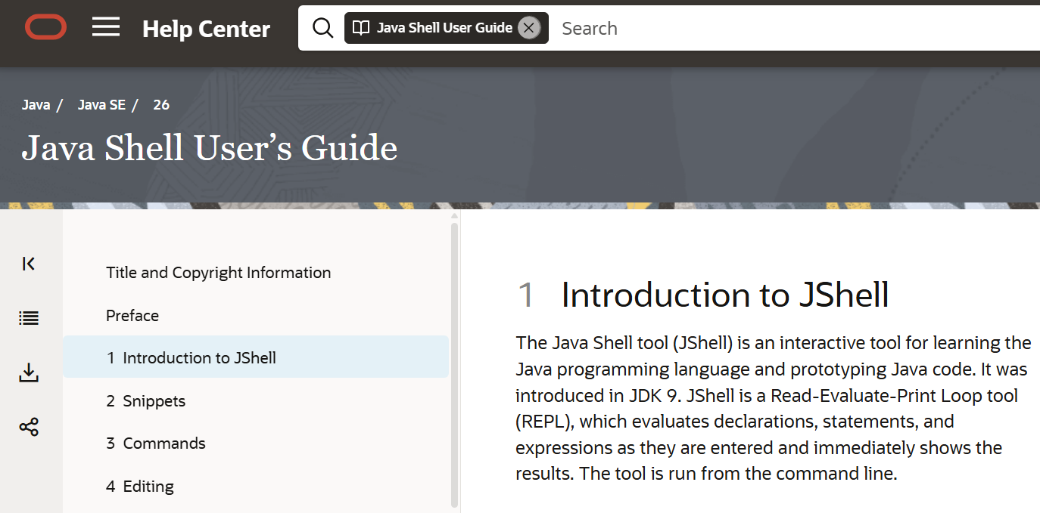
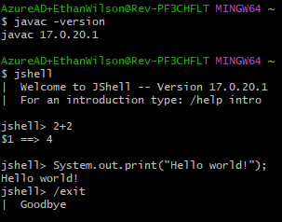
Jshell

Slide 6
Challenge – Hello World
Goal:
Scenario: 5 min
Print Hello World!
Use any development environment you wish to print “Hello World!” to the console

Slide 7
Variables
A variable is a named place in memory that stores a value
int age = 25;
You can define a variable without initializing it, and then initialize it later:
int age;
age = 25;
Variable names cannot start with a number or contain dashes. The following are WRONG:
int 2age;
String something-something;

Slide 8
Data Types
2 categories: Primitives & Reference types
The following are Java primitives:
Type | Used for | Example | Range/Notes
byte | Very small whole numbers | byte x = 100; | -128 to 127
short | Small whole numbers | short x = 30000; | -32,768 to 32,767
int | Whole numbers | int age = 25; | -2.1 billion to 2.1 billion
long | Large whole numbers | long population = 8000000000L; | -9,223,372,036,854,775,808 to 9,223,372,036,854,775,807
float | Decimal numbers | float price = 10.5f; | Approximation
double | More precise decimals | double pi = 3.14159; | Use when precision is required
char | A single character | char grade = 'A'; | ‘A’ NOT “A”
boolean | True/false | boolean passed = true; | True OR False

Slide 9
Reference Types
Reference types refer to objects
Common examples:
String, Array, Object, Scanner
Any instantiations of classes we create
Reference types aren’t the underlying data value, they represent a memory pointer to the value
class Person {
String name;
}
Person a = new Person();
a.name = "Alice";
Person b = a;
System.out.println(a == b); ← true
Person c = new Person();
Person d = new Person();
System.out.println(c == d); ← false
System.out.println(c.equals(d)); ← also false, but we can override this method for more accurate comparison

Slide 10
Final variables
final variables declare that a variable cannot be changed once initialized
final int MAX_SCORE = 100;
final double TAX_RATE; ← This is fine
TAX_RATE = 43.33; ← This is fine
TAX_RATE = 34.3; ← INVALID

Slide 11
Printing
System.out.print() – does not move to a new line after printing
System.out.println() – after printing, moves the cursor to the next line
System.out.printf() – use when we need formatted output
%s → String
%d → integer
%f → floating-point number
%c → character
%b → boolean
%n → new line
String name = "Alex";
int age = 20;
System.out.printf("My name is %s and I am %d years old.%n", name, age);
double price = 19.98765;
System.out.printf("Price: $%.2f%n", price);

Slide 12
More on printing…
Escaping special characters:
System.out.println("He said \"Hello\"");
System.out.println("C:\\Users\\Alex");
System.err – similar to System.out, but is intended for error messages printed to the console

Slide 13
Challenge – Printing output
Goal:
Scenario: 5 min
Print age, height, and name
Declare and initialize the following variables:
An int variable named ’age’ with your age
A double variable named ’height’ with your height
A String variable named ’name’ with your name
Print the values in the exact following format:
Name: Alex, Age: 25, Height: 5.9

Slide 14
Type conversion & Casting
byte b = 127;
int a = 2555;
b = a; ← error
a = b; ← Implicit casting
b = (byte) a; ← explicit casting, data may be lost
What is the value of b now?

Slide 15
Arithmetic Operators
Operator | Name | Description | Example
+ | Addition | Adds together two values | x + y
- | Subtraction | Subtracts one value from another | x - y
* | Multiplication | Multiplies two values | x * y
/ | Division | Divides one value by another | x / y
% | Modulus | Returns the division remainder | x % y
++ | Increment | Increases the value of a variable by 1 | ++x
-- | Decrement | Decreases the value of a variable by 1 | --x
int x = 10;
int y = 3;
System.out.println(x + y); // 13
System.out.println(x - y); // 7
System.out.println(x * y); // 30
System.out.println(x / y); // 3
System.out.println(x % y); // 1
int z = 5;
++z;
System.out.println(z); // 6
--z;
System.out.println(z); // 5

Slide 16
Assignment Operators
Operator | Example | Same As
= | x = 5 | x = 5
+= | x += 3 | x = x + 3
-= | x -= 3 | x = x - 3
*= | x *= 3 | x = x * 3
/= | x /= 3 | x = x / 3
%= | x %= 3 | x = x % 3

Slide 17
Comparison Operators
Operator | Name | Example
== | Equal to | x == y
!= | Not equal | x != y
> | Greater than | x > y
< | Less than | x < y
>= | Greater than or equal to | x >= y
<= | Less than or equal to | x <= y
int age = 18;
System.out.println(age >= 18); // true, old enough to vote
System.out.println(age < 18); // false

Slide 18
Logical Operators
Operator | Name | Description | Example
&& | Logical and | Returns true if both statements are true | x < 5 && x < 10
|| | Logical or | Returns true if one of the statements is true | x < 5 || x < 4
! | Logical not | Reverse the result, returns false if the result is true | !(x < 5 && x < 10)
boolean isLoggedIn = true;
boolean isAdmin = false;
System.out.println("Regular user: " + (isLoggedIn && !isAdmin));
System.out.println("Has access: " + (isLoggedIn || isAdmin));
System.out.println("Not logged in: " + (!isLoggedIn));

Slide 19
Challenge – operators
Expected Output:
Scenario: 10 min
Addition: 30
Subtraction: 10
Multiplication: 200
Division: 2
Is a greater than b? true
Is a > b and b > 0? true
Declare two integer variables a = 20 and b = 10.
Perform the following operations:
Add, subtract, multiply, and divide a and b
Compare if a is greater than b and store the result in a boolean variable
Check if a > b and b > 0 using a logical operator and store the result
Print the results of all operations using System.out.println() in the specified format.

Slide 20
Control Flow: Conditional Statements
boolean isRaining = true;
if (isRaining) {
System.out.println("Bring an umbrella!");
}
If, else, else if….
int weather = 2; // 1 = raining, 2 = sunny, 3 = cloudy
if (weather == 1) {
System.out.println("Bring an umbrella.");
} else if (weather == 2) {
System.out.println("Wear sunglasses.");
} else {
System.out.println("Just go outside normally.");
}
// Outputs "Wear sunglasses."
if (20 > 18) {
System.out.println("20 is greater than 18");
}
boolean isRaining = false;
if (isRaining) {
System.out.println("Bring an umbrella!");
} else {
System.out.println("No rain today, no need for an umbrella!");
}

Slide 21
Control Flow: Ternary Operators
int time = 20;
String result = (time < 18) ? "Good day." : "Good evening.";
System.out.println(result);

Slide 22
Control Flow: Switch Statements
int day = 4;
switch (day) {
case 1:
System.out.println("Monday");
break;
case 2:
System.out.println("Tuesday");
break;
case 3:
System.out.println("Wednesday");
break;
case 4:
System.out.println("Thursday");
break;
case 5:
System.out.println("Friday");
break;
default:
System.out.println("Looking forward to the Weekend");
}
// Outputs "Thursday" (day 4)
Notice we use break statements to avoid logic falling through and continuing execution

Slide 23
Challenge – Control flow
Expected Output:
Scenario: 10 min
Passed
Grade: B
Write a Java program to evaluate a student's performance using if-else and else-if statements.
You are given the following:
An integer variable score = 75
A character variable grade = 'B’
Your task is to:
Use if-else to check if the student passed or failed.
A score of 50 or above is considered a pass.
Print "Passed" or "Failed" accordingly.
Use else-if conditions to assign and print a grade based on the score:
A for 90 and above
B for 75 to 89
C for 60 to 74
D for below 60
Use System.out.println() to clearly display the output.

Slide 24
Control Flow: Loops
While – execute until condition is false
do while – execute at least once, and until condition is false
int i = 0;
while (i < 5) {
System.out.println(i);
i++;
}
int i = 0; do {
System.out.println(i);
i++;
}
while (i < 5);

Slide 25
Control Flow: For Loops
Print 0-4
Print even numbers
for (int i = 0; i < 5; i++) { System.out.println(i); }
for (int i = 0; i <= 10; i = i + 2) { System.out.println(i); }
Print sum from 1-5
int sum = 0; for (int i = 1; i <= 5; i++) { sum = sum + i; } System.out.println("Sum is " + sum);

Slide 26
Control Flow: For-each Loops
String[] cars = {"Volvo", "BMW", "Ford", "Mazda"};
for (String car : cars) {
System.out.println(car);
}
Note: More on Arrays later!

Slide 27
Challenge – Loops
Expected Output:
Scenario: 10 min
For Loop: 1 2 3 4 5
While Loop: 1 2 3 4 5
Do-While Loop: 1 2 3 4 5
Write a Java program that prints the numbers from 1 to 5 using three different loop types:
for loop
while loop
do-while loop
Each loop should run independently and print its result on a single line, clearly labeled. Numbers should be printed with spaces between them and no trailing space at the end.

Slide 28
Challenge – Calculator
Expected Output:
Scenario: 20 min
Result: 10.0
Thank you for using the calculator.
Create a minimal console-style calculator in Java that uses predefined values instead of reading input from the user.
Initialize two numbers (e.g., double num1 = 7;, double num2 = 3;) and an operator (e.g., char operator = '+').
Use a while loop controlled by String again = "y". Inside the loop, perform exactly one calculation and then set again = "n" so the loop ends after the first run.
Use if-else statements to handle the operator: +, -, *, /.
For division, if num2 is 0, print Cannot divide by zero. and do not perform the division.
Print the result using the exact format: Result: <value>
After the loop ends, print a closing message: Thank you for using the calculator.

Slide 29
Arrays
Arrays can store multiple values in a single variable, instead of declaring separate variables for each value.
Arrays in Java are statically sized, i.e. once size is set it cannot be changed
String[] cars = {"Volvo", "BMW", "Ford", "Mazda"};
int[] myNum = {10, 20, 30, 40};
System.out.println(cars[0]);
// Outputs Volvo
cars[0] = “Toyota";
System.out.println(cars[0]);
// Now outputs Toyota instead of Volvo
System.out.println(cars.length);
// Outputs 4
String[] cars = new String[4]; // size is 4

Slide 30
Code Comments
// single line comment
/* This is a multi-line comment */

Slide 31
Strings
String txt = "ABCDEFGHIJKLMNOPQRSTUVWXYZ";
System.out.println("The length of the txt string is: " + txt.length());
Find the length of a string
String txt = "Hello World";
System.out.println(txt.toUpperCase()); // Outputs "HELLO WORLD"
System.out.println(txt.toLowerCase()); // Outputs "hello world"
Transform string case
String txt = "Please locate where 'locate' occurs!";
System.out.println(txt.indexOf("locate")); // Outputs 7
Locate the index of a string value

Slide 32
Strings…
String txt1 = "Hello";
String txt2 = "Hello";
String txt3 = "Greetings";
String txt4 = "Great things";
System.out.println(txt1.equals(txt2)); // true
System.out.println(txt3.equals(txt4)); // false
Make string comparisons
String Method Reference
String txt = " Hello World ";
System.out.println("Before: [" + txt + "]");
System.out.println("After: [" + txt.trim() + "]");
Trim whitespace

Slide 33
Strings……..
Strings are immutable
The following may appear to modify s, but that’s not what’s happening:
String s = "hello";
s = s + " world";
A new string object is created under-the-hood
Strings are placed in a String Pool, a special place in memory
The JVM can check the String Pool and reuse similar strings if it makes sense to do so

Slide 34
Strings……………..
Suppose you do the following (every concatenation will produce a new string, and thus degrade performance):
String result = "";
for (int i = 0; i < 10000; i++) {
result = result + i;
}
Instead, we can use StringBuilder to create a string which can grow dynamically (mutable)
StringBuilder sb = new StringBuilder();
sb.append("Hello");
sb.append(" ");
sb.append("world");
String result = sb.toString();
NOTE: There is also the StringBuffer object. The main difference between StringBuilder and StringBuffer is that the former isn’t thread-safe, while StringBuffer is.

Slide 35
Classes & Objects
Classes – a blueprint for an object
It has: State + Behavior
State – properties/data that describe an object
Behavior – the behavior/actions that an object can perform
Objects – instantiations of a class
Object state – Specific values to describe the object; unique to itself
Object behavior – what this object can do; defined by the class
Class: Car
State: color, make, model
Behavior: accelerate(), brake(), turn()
Object: myCar
State: color = “red’, make = “Toyota”
Behavior: accelerate(), brake(), turn()

Slide 36
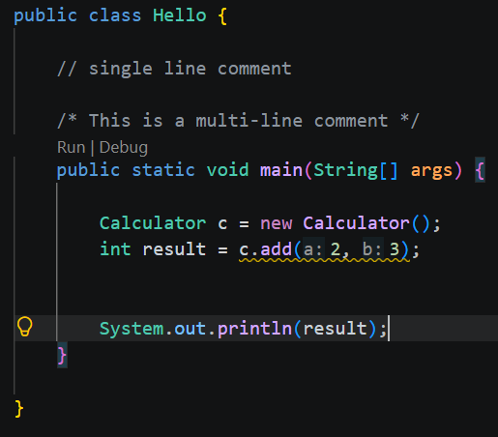
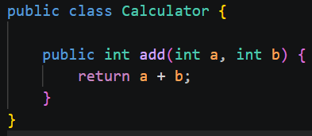
Class, method, Method arguments example
A method signature has: an access modifier, static keyword (optional), a return type, method name, and a list of parameters (optional)
Note: these need to be separate .java files

Slide 37
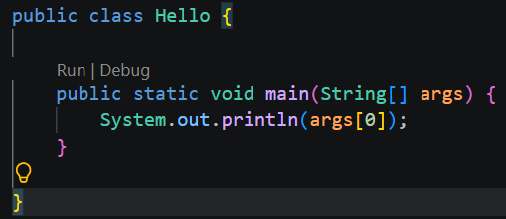
The main method
The main method is the entry point to our application

Slide 38
Stack & HEap
When a Java program runs, the JVM manages memory in several areas
Stack – keeps track of method calls, local variables, reference pointers
Heap – stores instantiated objects, arrays, & the String Pool
public class Main {
public static void main(String[] args) {
int age = 25;
Person person = new Person("Alex");
person.sayHello();
}
}
Stack
Main()
Age = 25
person
Heap
Person object
name = “Alex”
The String Pool

Slide 39
Packages
Packages allow us to organize related classes, interfaces, and more into namespaces
This helps keep our code organized and prevent naming conflicts
We have a default unnamed package, but we should strive to create named packages in fully featured applications
Imagine a project with many classes: Student, Teacher, Course, Login, Database, Email, etc.
With packages we can group these up:
Models: Student.java, Teacher.java, Course.java
Database: Database.java
Etc.

Slide 40
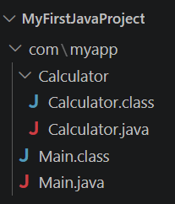
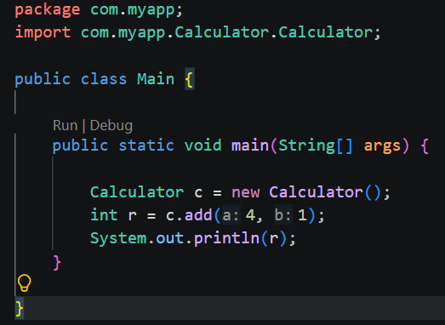
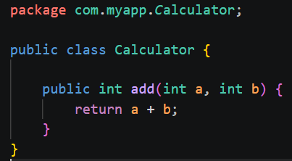
Packages
The naming convention for packages is typically a reverse domain
So if your website is: example.com
Your package becomes: com.example
We use the package keyword declared at the top of the file to declare a files content within a package
We use the import keyword to reference items from one package to another
You can import multiple classes from a package like so: import pacakgename.*;

Slide 41
Java built-in package examples
Package | Purpose
java.lang | Core classes (automatically imported)
java.util | Collections, Scanner, Random
java.io | File input/output
java.nio | Modern file and network I/O
java.time | Date and time API
java.net | Networking

Slide 42
Access Modifiers
public: Members with public modifiers can be accessed by any class. Public methods, variables, or classes have the widest scope.
protected: The protected modifier is used within the same package. It can be accessed outside the package but only through inheritance.
default: When we do not mention any access modifier, it is treated as default. It is accessible only within the same package.
private: Private methods, variables, and constructors are not accessible to any other class. It is the most restrictive access modifier. A class cannot be private unless it is a nested class.

Slide 43
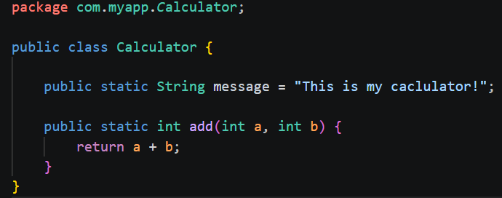
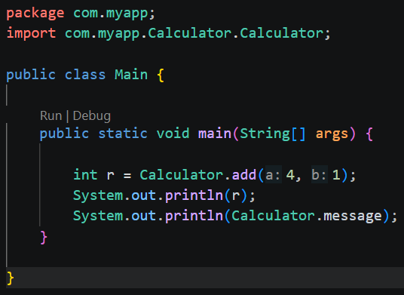
The static keyword
In Java, a static member is a member of a class that isn’t associated with an instance of a class. Instead, the member belongs to the class itself. As a result, you can access the static member without first creating a class instance.
The Static keyword may be used with code blocks, variables, methods, & classes
Notice we no longer need to use the new keyword to instantiate a Calculator object, we instead call the class method directly:

Slide 44
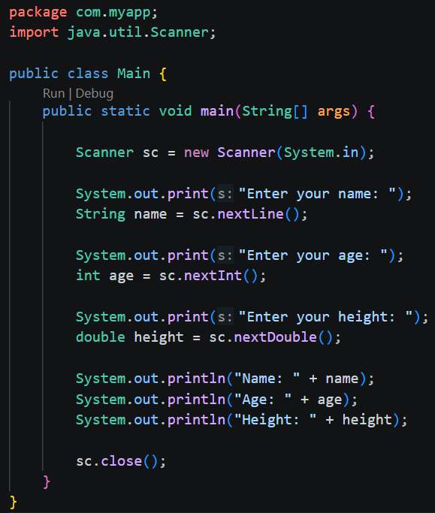
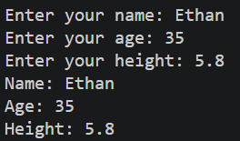
Taking user input - scanner

Slide 45
Common scanner methods
Method | Takes input as
nextInt() | int
nextDouble() | double
nextFloat() | float
nextBoolean() | boolean
next() | One word (String)
nextLine() | Entire line (String)

Slide 46
Challenge – Calculate 5 test scores
Expected Output:
Scenario:
If the 5 test scores entered are: 100, 90, 60, 75, 20
Then:
Total: 345
Average: 69
Highest: 100
Lowest: 20
Your values were:
100 – A
90 – A
60 – D
75 – C
20 - F
Ask for 5 test scores and calculate:
Total
Average
Highest Score
Lowest Score
Then assign a letter grade.

Slide 47
Challenge – REPL
Expected Output:
Scenario:
Check Balance
Deposit
Withdraw
Exit
The user can then select a command and be given instructions for entering the data. The program doesn’t terminate until they select ‘4’ at the start of the loop
Create a small REPL application where a user can:
Check account balance (start at 0)
Deposit into their account
Withdraw from their account
Exit
You don’t need actual account functionality or to keep anything in persistence, just the basic commands
Do not allow negative account balances. Block withdraws that would put the account balance under $0.

Slide 48
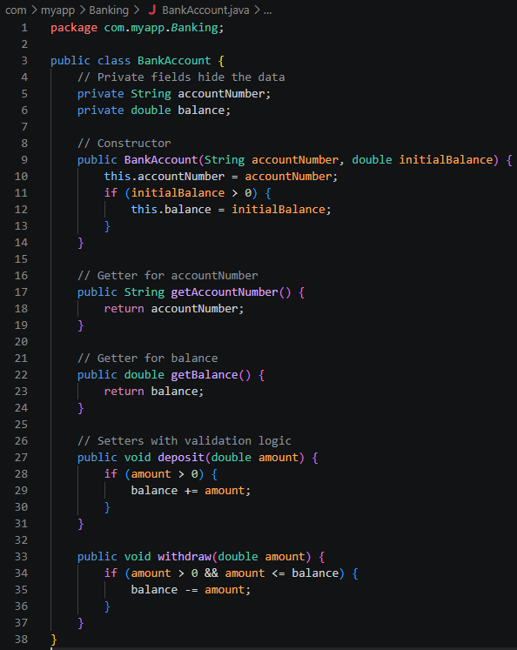
Encapsulation
Constructors – a special method used to initialize a newly created object. It is used when an instance of the class is created using the ‘new’ keyword.
Encapsulation – restricts direct access to an object’s fields, and provides controlled access via getters and setters
This allows the internal implementation to change without breaking any code that may use the class

Slide 49
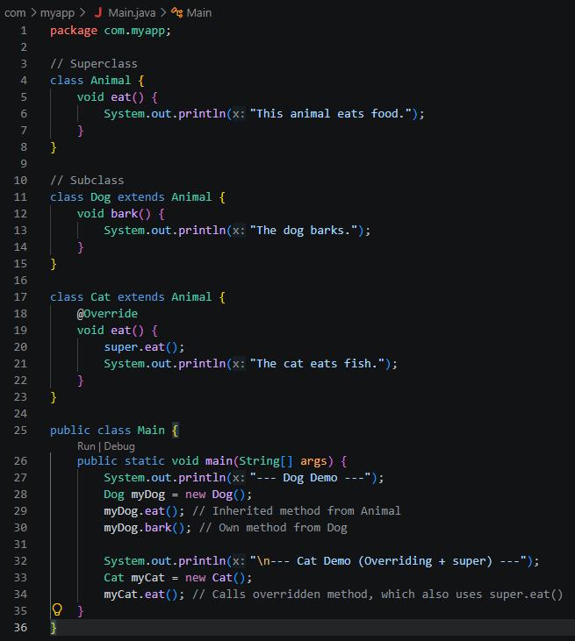
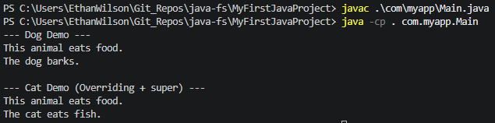
Inheritance
Inheritance – allows one class to acquire the fields and methods from another
Superclass (parent/base class) – The class whose features are inherited
Subclass (child/derived class) – The class that inherits from the superclass
Method Overriding – change the behavior of a method inherited from a parent class
Java supports: Single, Multilevel, and Hierarchical inheritance but NOT multiple class inheritance. i.e. extending more than one class directly

Slide 50
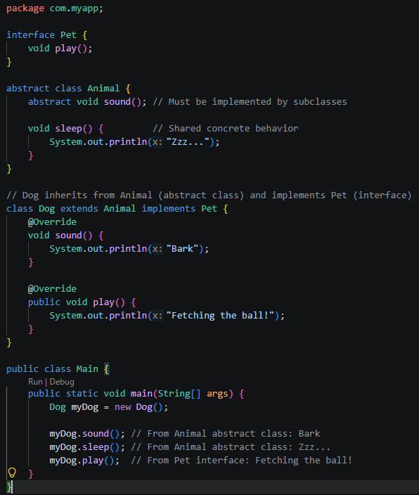
Abstraction
Abstraction – hides complex implementation details and exposes only the essential features of an object
Abstraction in Java is achieved through Abstract classes and Interfaces
Abstract Classes – are defined with the abstract keyword and cannot be instantiated directly, they must be extended by a subclass. They can contain a mix of abstract and concrete methods.
Interfaces – are defined with the interface keyword and can be used with the implements keyword. Java allows a class to implement more than one interface.

Slide 51
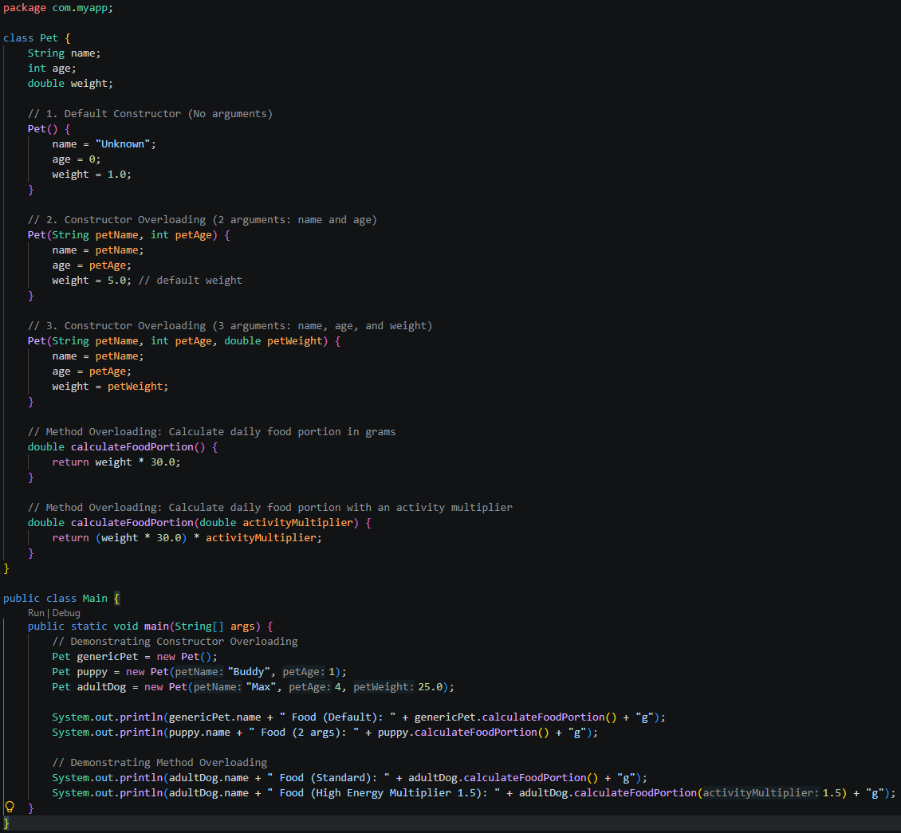
Polymorphism
Polymorphism – many forms; allows us to write code that can behave differently based on context provided
Achieved through Method Overriding and Method Overloading
Method Overriding – we’ve seen this in our last example with Abstraction; they go hand-in-hand
Method Overloading – calling methods that share the exact same name but differ in their parameter list

Slide 52
Challenge – OOP
Task:
Complete Java Hackerank OOP coding challenges

Slide 53
Exceptions
An exception is an event that occurs that disrupts the normal flow of program execution
You may see:
Compile Time errors: errors that prevent the compiler from building the program
Runtime errors: errors that halt a program as it runs
Logical errors: errors that may not stop the program or produce anything to the error output, but can still negatively impact the application

Slide 54
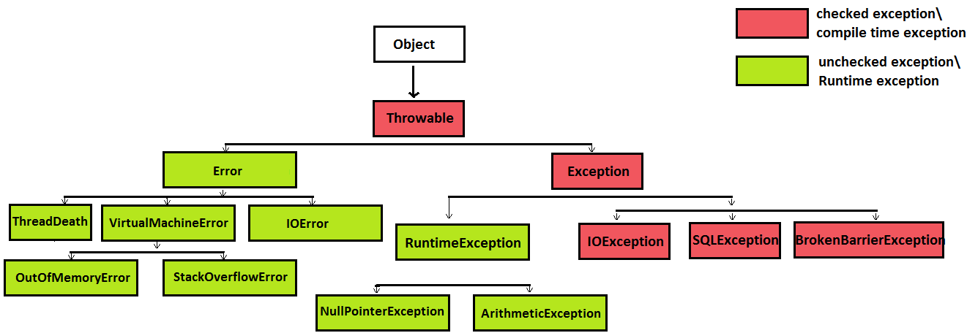
Exception Hierarchy
Checked – The code will not compile unless handled or declared. How to solve? Handle with try-catch.
Unchecked – The compiler does not intervene. How to solve? Fix the underlying program logic.

Slide 55
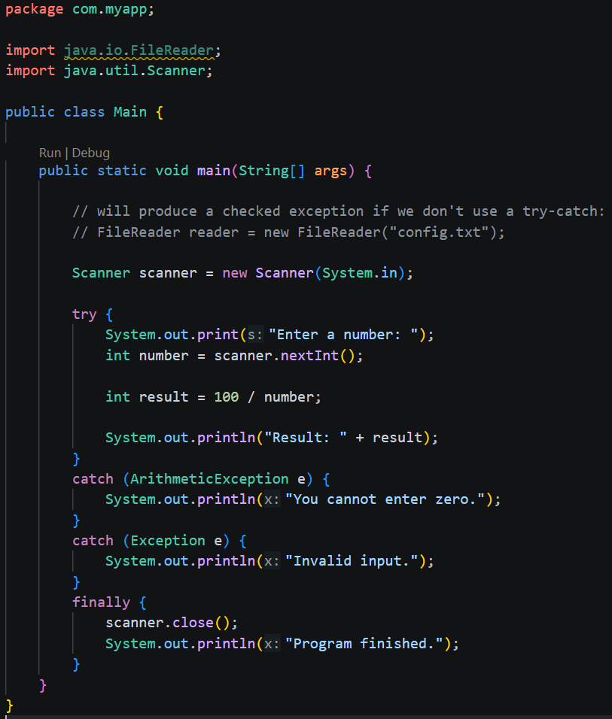
Exceptions
Common Java exceptions (unchecked – subclasses of RuntimeException):
ArithmeticException
NullPointerException
ArrayIndexOutOfBoundsException
InputMismatchException
There is another variant of try-catch, often called try-with-resources (we will discuss this later)

Slide 56
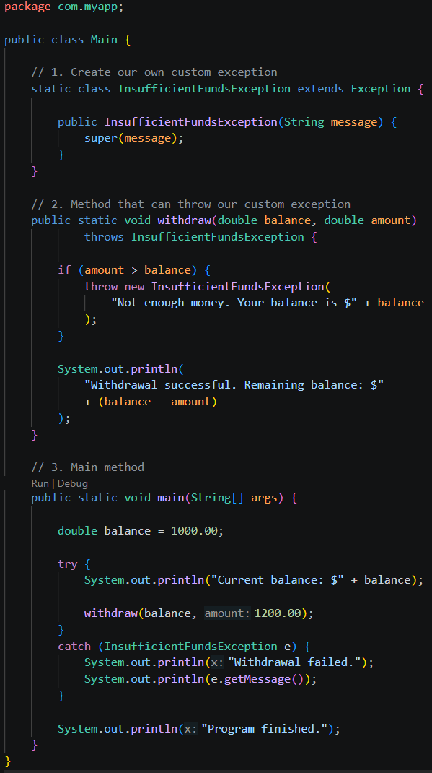
Exceptions
Notice:
Custom exceptions extend from base Exception class
We declare that a method may throw a specific type of exception via ‘throws’ keyword
We throw exceptions manually via the ‘throw’ keyword
We have methods inherited from the base Exception class, such as getMessage()

Slide 57
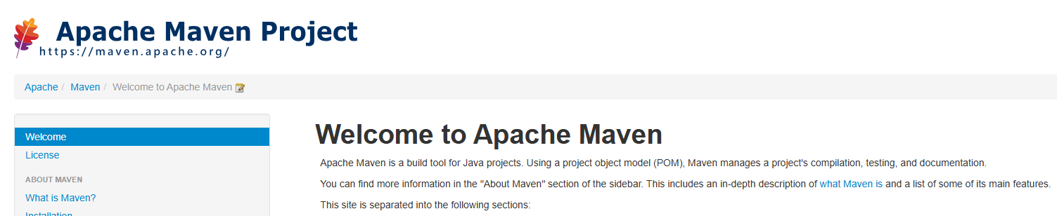
Maven
We can add libraries to our Java applications – code that other developers have written
These libraries can add functionality to our apps. For example, we may want a Postgres connector so our application can communicate with a Postgres database
Instead of manually downloading .jar files for these libraries, Maven helps provide automation for library management (as well as dependency management)
So… Maven is a build and dependency management tool for Java projects

Slide 58
Maven & CLasspath
The Java classpath is a list of places where Java looks for classes and other resources our program needs
For example, if we use: import io.bretty.console.table.TableBuilder;
Then our Java program needs to know where to look for the TableBuilder.class file
The classpath tells Java where to find it
Some dependencies may be transitive. This is very difficult to manage manually.
We’d have to get the right versions of the jar files manually and compiling/running would need to be done manually:
javac -cp "lib/*" -d out src/Main.java
java -cp "out:lib/*" Main
Instead, Maven handles setting up the classpath for us

Slide 59
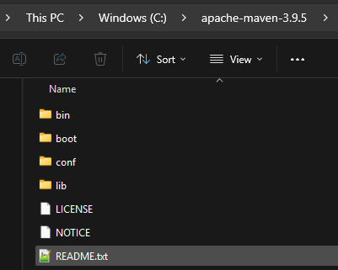
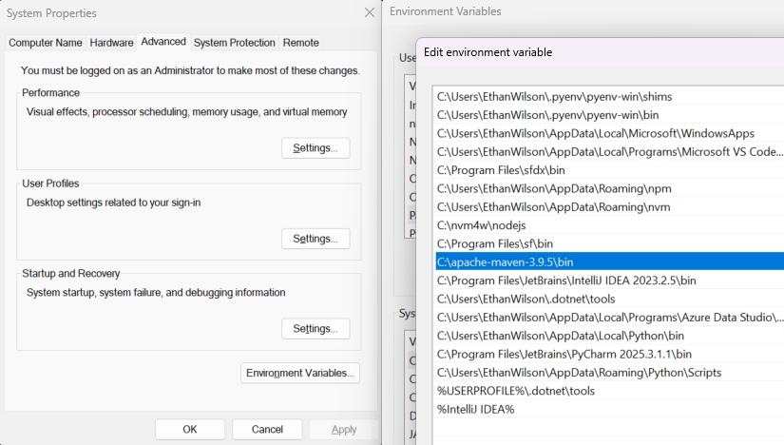
Maven manual install
You can download the binaries directly from their website
Then you can add the ‘bin’ folder to your PATH environment variable

Slide 60
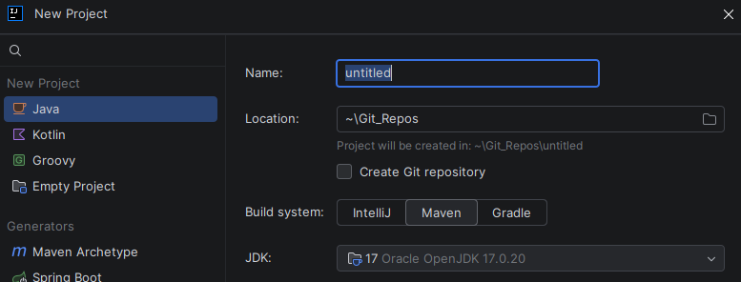

Maven - POM
POM.xml – Project Object Model – Think of this as your Maven project’s instruction manual. It tells Maven:
This is a Java project. Here’s its name, version, dependencies, and here is how I want it built.
It’s easy to setup Maven projects in most IDEs
In Intellij, just create a Maven project after selecting ‘New Project’ – you will see the option
For VS Code – use the command palette to launch the guided process

Slide 61
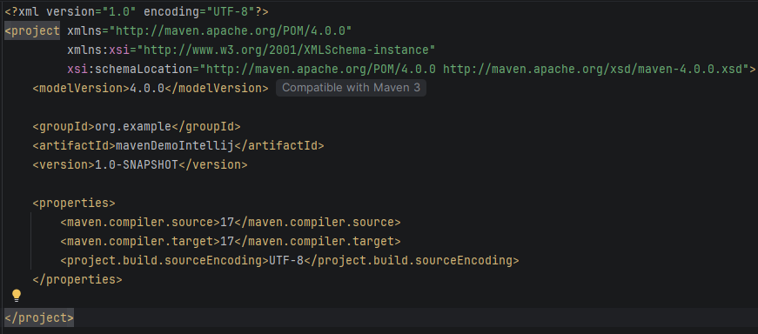
POM - breakdown
groupId – organization/project group; usually a reverse domain
artifactId – Name of the project
Version – our own version scheme we can control; SNAPSHOT suggests it is still in development
All three of these: ‘groupId : artifactId : version’ – make up what is called the artifact coordinates

Slide 62
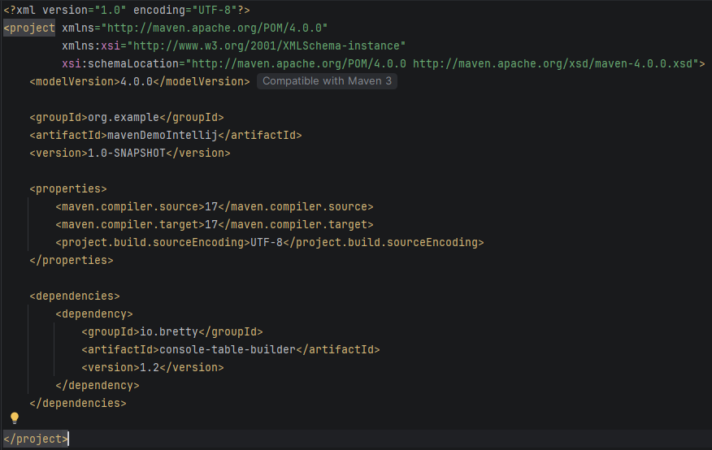
Pom – adding dependencies
Note: this exact library/artifact will be used in an upcoming demo
In IntelliJ, you may need to sync Maven from the UI to download and begin using the artifact

Slide 63
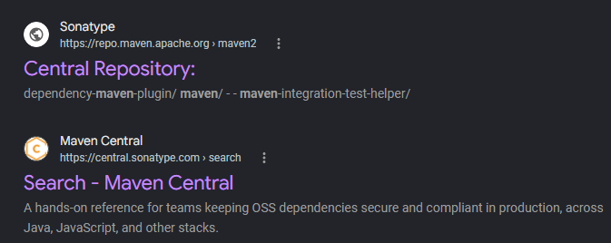
Maven Central
The Maven Central repository is where libraries live
There are a handful of websites that essentially just add a layer to browse Maven Central

Slide 64
Maven Lifecycle
You may hear these referred to as phases:
Validate – Checks that the project is valid and ready to be built
Compile – compiles your main Java source into bytecode
Test – compiles your test code and runs your tests
Package – takes the compiled application and packages it into its distributable format i.e. likely a .jar
Verify – runs checks that verify the packaged project meets additional quality/integration requirements. E.g. plugins may run integration tests
Install – installs your built artifact into your local Maven repository
Deploy – publishes the artifact to a remote Maven repository
Plugins – a Maven plugin is a collection of executable build functionality that Maven can use to perform tasks
Plugin Goals – a specific action a plugin knows how to perform

Slide 65
Putting it together
mvn package
↓
package PHASE
↓
JAR-related plugin
↓
JAR creation goal
↓
my-app.jar

Slide 66
Using a library
Please see ‘MavenDemo.java’ in your course materials

Slide 67
The Reflection API
Reflection in Java is a feature that allows a program to examine and manipulate its own structure, behavior, and metadata at runtime.
It provides a way to inspect and modify classes, interfaces, fields, methods, and constructors at runtime, even if they are private or inaccessible through normal means.
Reflection is particularly useful for building generic code, implementing frameworks, and writing debugging tools. The API can be found in the java.lang.reflect package.
Frameworks like Spring use reflection heavily to discover annotations, create objects, inject dependencies, and call methods without the application code explicitly wiring everything together.
For the purposes of this course, and for preparing for interviews, we really just need to know all the above – no one is expecting you to create your own framework.

Slide 68
Challenges – DateTime API
Tasks:
Example Inputs/Outputs:
Write a program that prints:
Today’s date
The current year
The current month
The current day of the month
Calculate your Age.
Days until your birthday.
Date: 2026-09-04
Year: 2026
Month: SEPTEMBER
Day: 4
Enter your birth date: 2000-05-15
You are 26 years old.
Enter your birthday: 1998-12-20
Days until your next birthday: 107

