Slide 1
Hibernate, JPA, & REST

Slide 2
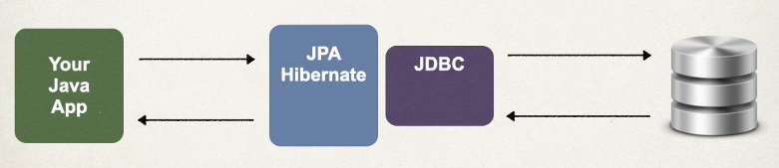
What is hibernate?
A framework for saving /persisting java objects in a database
Object-Relational Mapping (ORM): Bridges the gap between the object-oriented world of Java and the relational world of SQL databases. It allows developers to store and retrieve Java objects directly as database tables and rows without writing complex, boilerplate SQL queries.
  Productivity Boost: Eliminates massive amounts of tedious JDBC code, connection management, and manual result-set mapping.
  Database Independence: By abstracting SQL dialects, Hibernate allows your application to switch underlying databases with minimal configuration changes.
  Built-in Caching: Features a first-level cache (associated with the Session) and an optional second-level cache (shared across sessions) to significantly reduce database round-trips and improve performance.
  Automatic Transaction Management: Handles database transactions and connection pooling efficiently, ensuring data integrity.

Slide 3
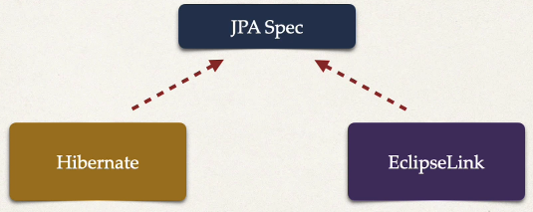
What is JPA?
Jakarta Persistence API (JPA) – previously known as Java Persistence API
  Standard API for Object Relational Mapping
  Is a specification
  Includes interfaces
  Requires implementations to use
  Hibernate is one way we can implement JPA

Slide 4
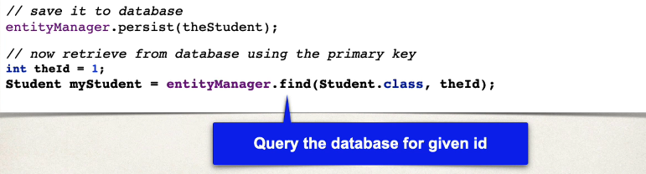
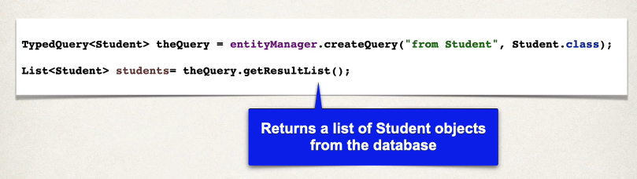
Hibernate/JPA – concrete benefit
No JDBC required! It happens under the hood!

Slide 5
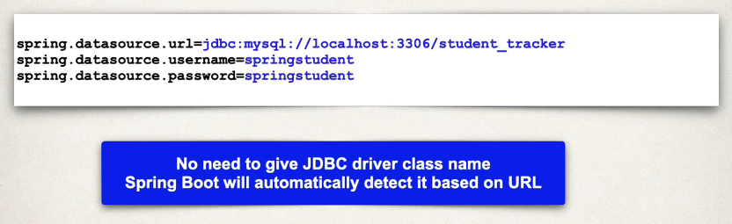

Setup Overview
In Spring Boot, Hibernate is the default implementation of JPA
With Spring Initializr:
  Postgres Driver: org.postgresql:postgresql
  Spring Data JPA: spring-boot-starter-data-jpa
Spring Boot will automatically configure our data source for us based on the above
  Also, our connection details in ‘application.properties’
OR for postgres:

Slide 6
EntityManager vs JpaRepository
EntityManager is the low-level JPA API for directly managing entities and interacting with the persistence context.
JpaRepository is a Spring Data abstraction that gives you a ready-made repository with CRUD, pagination, sorting, and query methods—without writing most of the boilerplate yourself.
We will cover BOTH, starting with EntityManager
Java Persistence Query Language (JPQL) – used for querying entities and their fields, rather than database tables and columns, part of JPA standard and can be used by any JPA provider, i.e. Hibernate, EclipseLink, etc.
Hibernate Query Language (HQL) – Operates similar as above, but is Hibernate specific and thus may come with features unique to Hibernate
We will cover BOTH, starting with JPQL…. And… BOTH are accessible from EntityManager OR JpaRepository
 | EntityManager | JpaRepository
Comes from | JPA | Spring Data JPA
Abstraction level | Low | High
CRUD boilerplate | You write it | Mostly provided
Custom JPQL | Directly | @Query, specifications, etc.
Persistence-context control | Excellent | Limited/direct access not its purpose
Pagination/sorting | Manual | Built in
Derived queries | No | Yes
JPA portability | Yes | Tied to Spring Data
Best for | Complex/custom persistence logic | Typical application CRUD

Slide 7
Typical stack
Spring Data JPA
↓
JpaRepository
↓
EntityManager
↓
Hibernate
↓
Session
↓
Database
More abstracted
Less absracted

Slide 8
JQPL
In SQL you may write:
In JPQL you may write:
HQL is very similar conceptually!
Because we are querying against our entity!
@Entity
public class Student {
private int id;
private String firstName;
private String lastName;
private String email;
}
SELECT *
FROM students
ORDER BY id;
SELECT student
FROM Student student
ORDER BY student.id

Slide 9
Stereotype annotations
@Component
  @Component is the main stereotype annotation. It is a class-level annotation. @Component is used across the application to mark the beans as Spring's managed components.
@Service
  It is a specialization of @Component. The business logic of an application exists in the service layer, and the @Service annotation is used to indicate that a class belongs to the service layer.
@Repository
  It is a specialization of @Component and is very similar to the DAO pattern. DAO classes provide CRUD operations for database tables.
@RestController
  It is a specialization of @Component. The @RestController annotation (which inherits @Controller) indicates that a particular class is a web service controller that returns data. It is mostly used with Spring MVC applications and is used in combination with @RequestMapping annotation. The dispatcher scans the class and detects methods with HTTP annotations:
    @GetMapping, @PostMapping, @PutMapping, & @DeleteMapping

Slide 10
Jackson
Java Library for converting between Java objects and JSON
Built right into Spring
Java Object ──────→ JSON
serialization
JSON ──────→ Java Object
deserialization
It all happens under the hood for us!
Request is made → we prepare a POJO (plain old java object) → Jackson coverts to JSON → client gets JSON
Request is made → we receive JSON (e.g. record to be created) → Jackson converts to POJO → use POJO in app

Slide 11
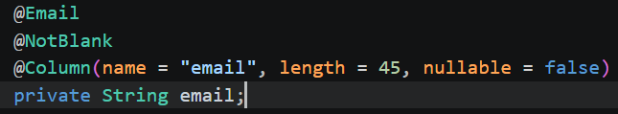
Request Validation & schema enforcement
@NotNull - not null
@NotEmpty - not null or empty such as ""
@NotBlank - not null, empty, or whitespace
@Size
@Min
@Max
@Positive
@PositiveOrZero
@Email
@Pattern
Nullable – enforces schema/db level validation
Often, we use nullable + annotations for maximum protection
@Valid – ensure our endpoints enforce our validations on the application-level

Slide 12
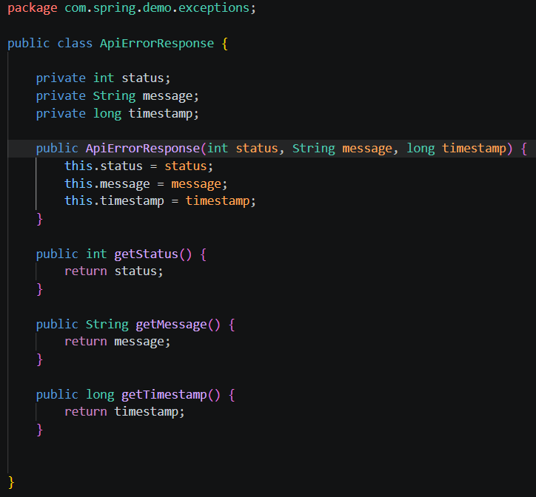
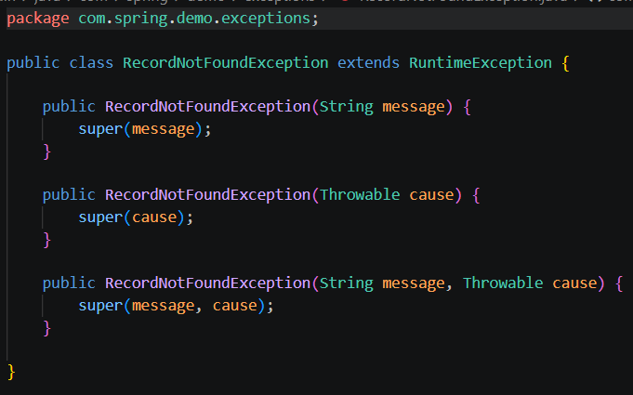
Exception handling
This defines our custom exception, so we have full control to describe the issue:
This defines what our error output should look like
i.e. we define a contract for what returned HTTP errors look like:

Slide 13
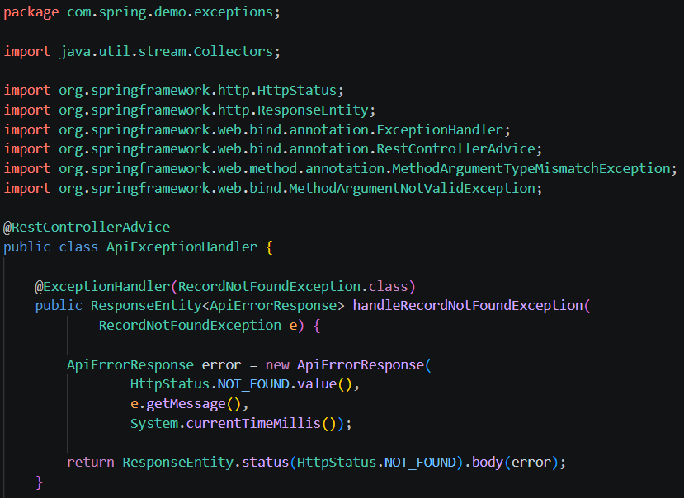
Exception Handling
@RestControllerAdvice – let’s us setup a global handler for exceptions
@ExceptionHanlder – defines a single way to handle a particular exception
For web service applications, we typically want to return a ResponseEntity that includes the relevant error status code and body
We can have more than one @ExceptionHandler methods
This lets us handle/manage many types of exceptions, and their responses, in a single location

Slide 14
@transactional
What is a transaction?
The @Transactional annotation provides declarative transaction management in Spring, simplifying the process. When you apply it to a method or class, it instructs Spring to manage the transaction automatically:
  Method-level: Runs only the annotated method within a transactional context.
  Class-level: Runs all public methods within the class in a transactional context.
You can customize @Transactional to control aspects of transaction behavior:
  Propagation: Defines how transactions behave when a method calls another transactional method. The propagation attribute supports values such as REQUIRED, REQUIRES_NEW, and NESTED.
  Isolation Level: Sets how isolated a transaction is from other concurrent transactions. The isolation attribute supports values such as READ_COMMITTED, REPEATABLE_READ, and SERIALIZABLE.
  Rollback Rules: Define the conditions under which the system rolls back a transaction. The rollbackFor and noRollbackFor attributes specify which exception types trigger or skip a rollback.

Slide 15
@transactional propagation strategies
REQUIRED – Joins an active transaction if one exists, otherwise starts a new one. (Default behavior)
SUPPORTS – Joins an active transaction if one exists; runs without a transaction otherwise.
MANDATORY – Joins an active transaction if one exists; throws an exception if there is none.
NEVER – Throws an exception if an active transaction exists.
NOT_SUPPORTED – Pauses any active transaction and runs without a transactional context.
REQUIRES_NEW – Always starts a new transaction. If an active transaction exists, Spring suspends it until this method completes.
NESTED – Starts a new transaction if none exists. If one exists, Spring creates a savepoint and can roll back to that savepoint if an exception occurs.
@Transactional(propagation = Propagation.REQUIRES_NEW)
public void updateAssociateNameTransaction() {
Associate associate = associateRepository.findById(10).get();
associate.setName("name");
}

Slide 16
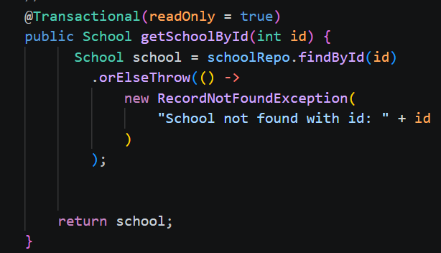
@transactional
As you’ve seen, there are many options for @Transactional
We don’t commonly need all these options
It’s more common to just use ‘readOnly’
This disallows create, update, or delete operations and improves the performance of read-only transactions

Slide 17
STOP
Let’s put theory into practice with a code-along
Please see the completed CRUD app “EntityMangerApp” with code comments in your course materials
We will stick with EntityManager for now, and later create other files in our DAO layer that uses JpaRepository

Slide 18
Mapping JPA relationships
We supply these on @Entity fields to map relationships between entities
@OneToOne
@OneToMany
@ManyToOne
@ManyToMany

Slide 19
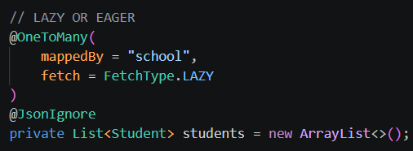

1-n relationship
mappedBy – allows us to use dot notation to reach a student’s school. E.g. someStudent.school
A single school has many students, we don’t necessarily want to load all those into memory when we query a school, so we can fetch it lazily (only when needed/called for)
@JoinColumn + name – defines the database field to use to tie the primary key of the other table
We initialize @OneToMany collections with ArrayList so that it can never be null (best practice pattern)
Domain/School.java
Domain/Student.java

Slide 20
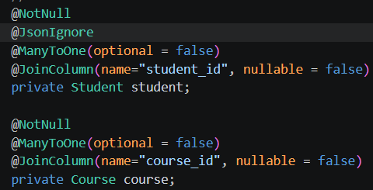
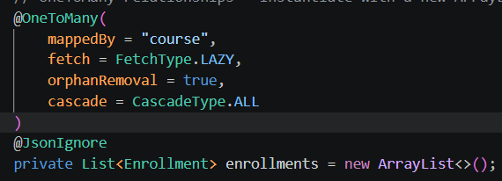
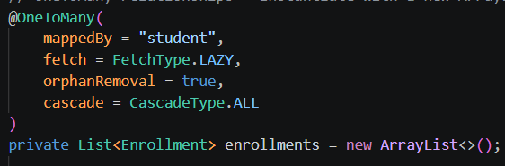
N-M
Many to many relationships may certainly be mapped with @ManyToMany
This doesn’t allow us to create fields on the underlying junction table however
For that reason, it is common to create a domain model for the junction object manually, and then use @ManyToOne and @OneToMany to tie all three tables together!
orphanRemoval – Remove an enrollment from this collection -> delete it from the database.
CascadeType.ALL – if we add or remove an enrollment, then the change is also saved to the db for the parent record
Domain/Course.java
Domain/Enrollment.java
Domain/Student.java

Slide 21
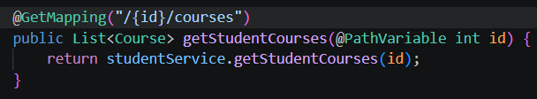
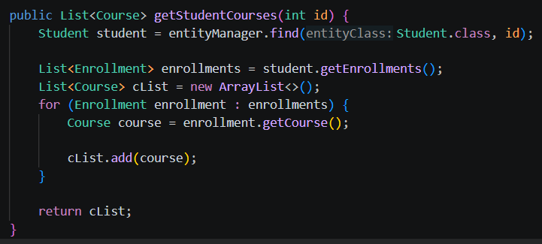
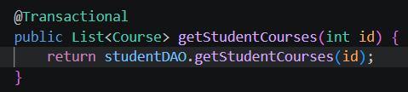
Using entitymanager to traverse relationships
Controller class:
DAO class:
Service class:

Slide 22
JpaRepository
Recap:
  EntityManager is one API to interact with our database, it has a lower level of abstraction and thus, more control
  JpaRepositry is another API to interact with our database, it has a higher level of abstraction and thus, less control
Benefits of JpaRepository:
  We simply create an interface that extends JpaRepository, and then we get CRUD methods out of the box
  E.g. before we had: Service → DAOInterface → Concretion (We had to write boilerplate here for CRUD)
  Now we will have: Service → RepoInterface that extends JpaRepository
  No extra code required for common CRUD tasks!

Slide 23
Jparepository – out-of-the-box methods
Method | Parameters | Return type | What it does
existsById(123) | Integer id | boolean | Checks whether a record exists
count() | none | long | Counts all records
findAll() | none | List<Student> | Gets all students
findById(123) | Integer id | Optional<Student> | Gets one student by ID
save(student) | Object: Student student | Student | Inserts or updates
delete(student) | Object: Student student | void | Deletes a student
deleteById(123) | Integer id | void | Deletes by primary key
deleteAll() | none | void | Deletes all students

Slide 24
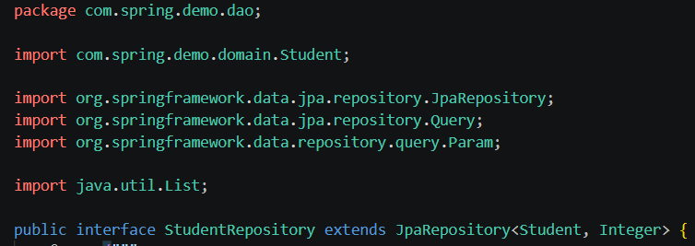
Creating a jparepository
We create an interface that extends JpaRepository
The type provided is: <Entity, EntityIdDataType>
Now our service can simply make calls to this interface!

Slide 25
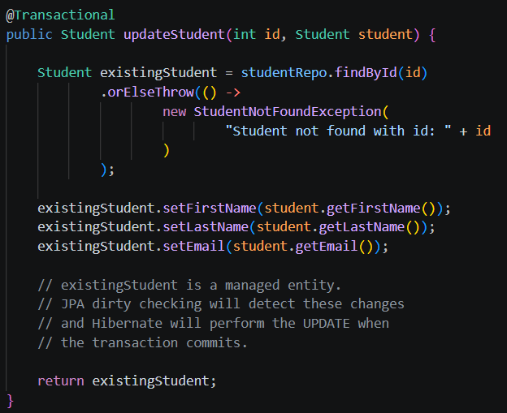
Jparepository – Optional<T>
The following shows our service layer, now calling a JpaRepository
Not that some OOB methods return a type of Optional<T>
That’s because it may or may not find the record
We commonly handle this with: orElseThrow()
We could throw a RuntimeException, or a custom one!

Slide 26
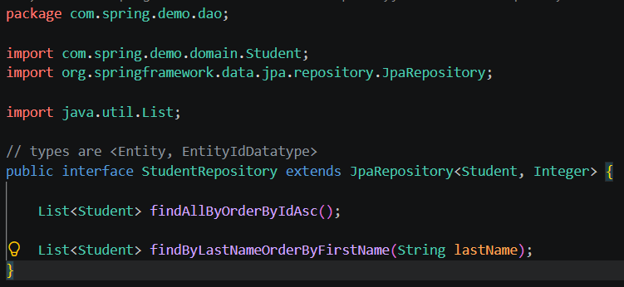
Jparepository – derived query methods
Derived Query Methods - Spring Data JPA parses the method name according to strict naming conventions and automatically generates the underlying JPQL (Java Persistence Query Language) and SQL at runtime.
We simply need to create the method in our Repo interface:

Slide 27

Jparepository – derived query methods
Every derived query method is split into two major parts: the Subject (what the query does) and the Predicate (the criteria/filters)

Slide 28
Jparepository – derived query methods
Introducer modifiers:
  Data Retrieval: find...By, read...By, query...By, get...By
  Counting: count...By (returns a long)
  Existence Checks: exists...By (returns a boolean)
  Result Limiting Modifiers: You can inject First or Top to limit records
User findFirstByOrderByRegistrationDateDesc();
List<User> findTop5ByStatus(String status);

Slide 29
Jparepository – derived query methods
Everything after the keyword By maps directly to the entity's properties and filtering criteria.
  Equality (Default): If you just name a field, Spring assumes an exact match comparison.
  Logical Operators: Combine multiple fields using And or Or.
  Property Expressions: Keywords that change the comparison type (e.g., LessThan, Like, Containing).

Slide 30
Jparepository – derived query methods
Keyword / Condition | Method Example
Equality | findByEmail(String email)
And | findByFirstNameAndLastName(String f, String l)
Or | findByStatusOrRole(String s, String r)
Between | findByAgeBetween(int start, int end)
LessThan / GreaterThan | findByPriceLessThan(double price)
Like / Containing / In | findByTitleContaining(String keyword)
Null Checks | findByDeletedAtIsNull()
IgnoreCase | findByUsernameIgnoreCase(String user)
Sorting | findByStatusOrderByLastNameAsc(String s)

Slide 31
Pitfalls of Derived Query methods
Avoid complex relationship traversal
Avoid long method names:
  Instead of this (in repo):
  We could do this (in repo):
  Then our service can:
List<Student> findByLastNameOrderByFirstNameAsc();
List<Student> findByLastName(
String lastName,
Sort sort
);
studentRepository.findByLastName(
"Smith",
Sort.by("firstName").ascending()
);

Slide 32
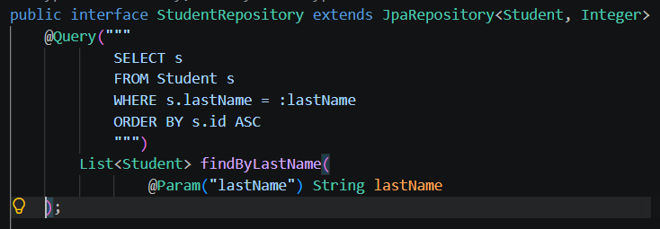
@query
When derived query methods aren’t enough, we can always use @Query to write JPQL
This is great for more complex queries

Slide 33

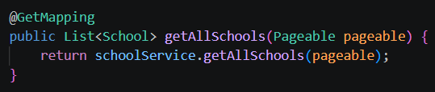
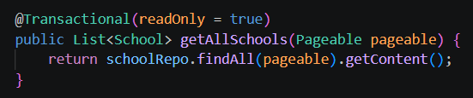
Pagination
Imports:
In our controller:
In our service:
Query Params example:

Slide 34
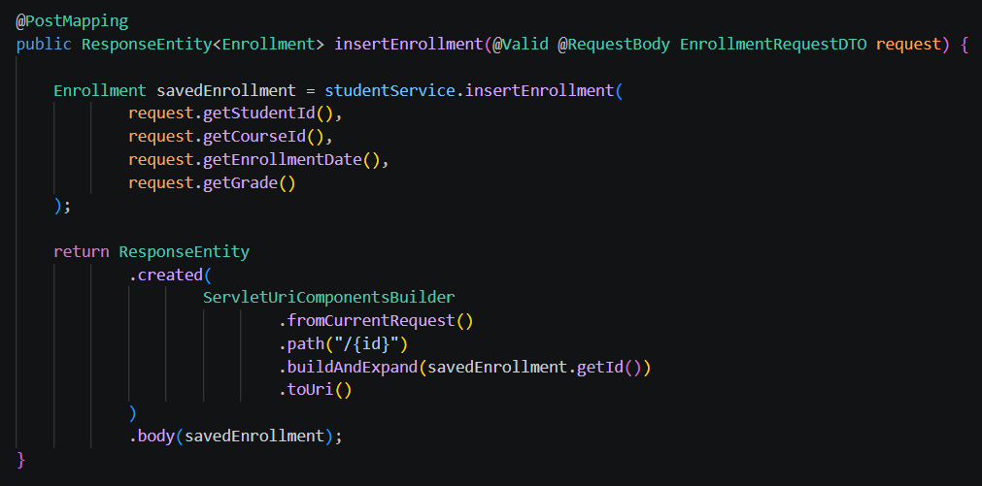
DTO – data transfer objects
DTOs allow us to format the requests and response as they enter/leave our web service
Example: Student Enrollments
  We need to assign a course + a student to an enrollment record
  We shouldn’t send an entire course or student record nested inside an enrollment insert
  Instead, our DTO formats the request, and we can use the provided IDs to retrieve and persist the records dynamically

Slide 35
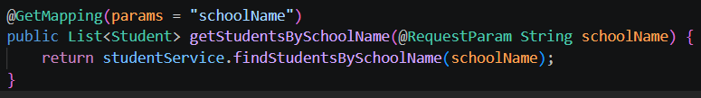
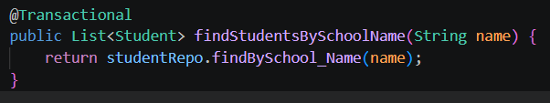

Using jparepository to traverse relationships
controller class:
Underscores allow us to traverse relationships
You can traverse through multiple levels of relationships
Remember, we can always use @Query to create custom solutions when relationship traversal gets too complicated via derived query methods
Service layer class:
dao/repo layer class:

Slide 36
STOP
Let’s put theory into practice with a code-along
Please see the completed CRUD app “JpaRepoApp” with code comments in your course materials

Slide 37
Overview/recap on database interactions
Approach | Definition | Common APIs in Spring | Queries against
HQL | Hibernate Query Language | Session, EntityManager, @Query | Entity classes and their properties
JPQL | Jakarta Persistence Query Language | EntityManager, @Query | Entity classes and their properties
Native SQL | Database's actual SQL dialect | EntityManager, Session, @Query(nativeQuery = true) | Database tables and columns
Criteria API | Java API for building queries programmatically | EntityManager, CriteriaBuilder, CriteriaQuery | Entity classes and their properties

Slide 38
Native SQL
Example with EntityManager:
Example with Spring Data JPA:
String sql = """
SELECT *
FROM employees
WHERE salary > :salary
""";
List<Employee> employees = entityManager
.createNativeQuery(sql, Employee.class)
.setParameter("salary", 50000)
.getResultList();
public interface EmployeeRepository
extends JpaRepository<Employee, Long> {
@Query(
value = "SELECT * FROM employees WHERE salary > :salary",
nativeQuery = true
)
List<Employee> findHighEarners(
@Param("salary") BigDecimal salary
);
}

Slide 39
Criteria API
CriteriaBuilder cb = entityManager.getCriteriaBuilder();
CriteriaQuery<Employee> cq =
cb.createQuery(Employee.class);
Root<Employee> employee = cq.from(Employee.class);
Predicate salaryCondition =
cb.greaterThan(employee.get("salary"), new BigDecimal("50000"));
cq.select(employee).where(salaryCondition);
List<Employee> employees = entityManager
.createQuery(cq)
.getResultList();

Slide 40
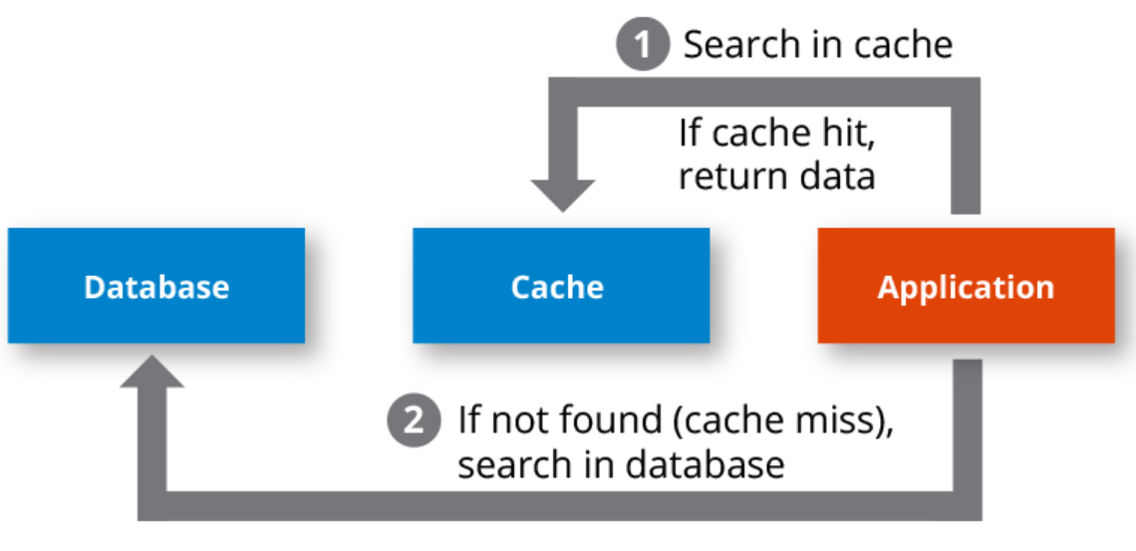
Caching
Client / Browser Level
  HTTP cache — may reuse an HTTP response
Spring Boot REST API
  Controller → Service
  Spring Cache
    Caffeine or Redis — can cache method results in memory with caffeine or externally with Redis
Hibernate / JPA
  L1 cache
  Managed entities in one persistence context (enabled by default)
  L2 cache
  Optional entity state shared across persistence contexts/sessions
  Query cache
  Optional cached results of selected Hibernate queries
Caching can happen at many levels, but this is the basic benefit:

Slide 41
L2 vs Spring cache with caffeine
Your use case | Recommendation
Repeated findById() calls for stable entities | Hibernate L2
Frequently requested DTOs or projections | Caffeine
Expensive service computations | Caffeine
Many application instances needing a shared cache | Consider Redis or another distributed cache
Reference entities reused across many sessions | Hibernate L2
Need a quick cache for a specific service method | Caffeine
Need to avoid both repeated SQL and repeated DTO mapping | Caffeine, potentially alongside L2

Slide 42
Enabling l2 cache
Step 1: Bring in necessary dependencies
The hibernate-jcache dependency connects Hibernate to the JCache API, while Ehcache provides the actual cache implementation.
<dependency>
<groupId>org.hibernate.orm</groupId>
<artifactId>hibernate-jcache</artifactId>
</dependency>
<dependency>
<groupId>org.ehcache</groupId>
<artifactId>ehcache</artifactId>
<classifier>jakarta</classifier>
</dependency>

Slide 43
Enabling l2 cache
Step 2: Set configurations in application.properties:
# Enable Hibernate second-level cache
spring.jpa.properties.hibernate.cache.use_second_level_cache=true
# Use JCache as the cache integration
spring.jpa.properties.hibernate.cache.region.factory_class=jcache
# Specify the JCache provider configuration
spring.jpa.properties.hibernate.javax.cache.provider=org.ehcache.jsr107.EhcacheCachingProvider
# Optional: enable query cache
spring.jpa.properties.hibernate.cache.use_query_cache=true

Slide 44
Enabling l2 cache
Step 3: Mark entities we’d like to cache
@Cacheable — opts the entity into JPA shared-cache eligibility.
@Cache(usage = CacheConcurrencyStrategy.READ_WRITE) — configures Hibernate's cache concurrency strategy.
@Entity
@Table(name = "products")
@Cacheable
@Cache(usage = CacheConcurrencyStrategy.READ_WRITE)
public class Product {
@Id
private Long id;
private String name;
// Getters and setters
}
Strategy | Best use case
READ_ONLY | Reference data that never changes
READ_WRITE | Data that changes occasionally and needs Hibernate-managed consistency
NONSTRICT_READ_WRITE | Data where occasional stale reads are acceptable
TRANSACTIONAL | Transactional caching supported by the chosen provider

Slide 45
Enabling service-level caching (Spring cache) with caffeine
Step 1: Add dependencies
<!-- Spring caching abstraction -->
<dependency>
<groupId>org.springframework.boot</groupId>
<artifactId>spring-boot-starter-cache</artifactId>
</dependency>
<!-- Actual in-memory cache implementation -->
<dependency>
<groupId>com.github.ben-manes.caffeine</groupId>
<artifactId>caffeine</artifactId>
</dependency>

Slide 46
Enabling service-level caching (Spring cache) with caffeine
Step 2: Create a configuration class
@EnableCaching tells Spring to intercept calls to eligible methods and apply the caching annotations.
Without it, adding @Cacheable to a method does not activate the expected caching behavior.
package com.example.demo.config;
import org.springframework.cache.annotation.EnableCaching;
import org.springframework.context.annotation.Configuration;
@Configuration
@EnableCaching
public class CacheConfig {
}

Slide 47
Enabling service-level caching (Spring cache) with caffeine
Step 3: Enable application.properties configuration
  products: stores individual products.
  productLists: stores product list responses.
  maximumSize=1000: limits each cache to 1,000 entries.
  expireAfterWrite=300s: expires entries five minutes after they are written or refreshed.
# Names of caches used by the application
spring.cache.cache-names=products,productLists
# Maximum number of entries and expiration policy
spring.cache.caffeine.spec=maximumSize=1000,expireAfterWrite=300s

Slide 48
Enabling service-level caching (Spring cache) with caffeine
Step 4: annotate service method we’d like to cache
This example assumes we have a JpaRepo + Product domain model
  cacheNames = "products" specifies which cache stores the result.
  key = "#id" uses the method's id argument as the cache key.
  unless = "#result == null" prevents a null result from being cached.
  The key expression is Spring Expression Language (SpEL).
@Cacheable(
cacheNames = "products",
key = "#id",
unless = "#result == null"
)
public Product getById(Long id) {
System.out.println("Fetching product from database");
return repository.findById(id).orElse(null);
}

Slide 49
caffeine cache invalidation
@CachePut(cacheNames = "products", key = "#result.id")
@CacheEvict(cacheNames = "productLists", allEntries = true)
@Transactional
public Product update(Product product) {
return repository.save(product);
}
@Caching(evict = {
@CacheEvict(cacheNames = "products", key = "#id"),
@CacheEvict(cacheNames = "productLists", allEntries = true)
})
@Transactional
public void delete(Long id) {
repository.deleteById(id);
}
Suppose we update or delete a record, but our queries still return the old(stale) data
This is where we need to consider cache invalidation
This example showcases methods in a ProductService class
  @CachePut
  Always execute the method, then store its result under the specified key. Useful for successful updates.
  @CacheEvict
  Remove one cached entry or clear an entire cache, typically after a successful update or delete.

Slide 50
Challenge – let’s check our understanding
Goal:
Scenario: 5 min
Create endpoints for different types of coaches
Example: One endpoint uses a ‘baseBallCoach’ and prints ‘Practice Baseball’
Another endpoint uses a ‘basketballCoach’ and prints ‘Practice Basketball’
Hint: You can inject more than one item, with multiple @Qualifier(s)!

