Slide 1
AWS Deployment & GitHub Actions

Slide 2


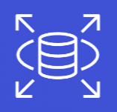



Service Overview
S3 (Simple Storage Service) – A cloud storage service used to store and retrieve files, images, videos, backups, and other data.
CloudFront – A content delivery network (CDN) that delivers websites, images, videos, and other content to users quickly by using servers located around the world.
Aurora and RDS (Relational Database Service) – AWS database services used to store, organize, and manage structured data. RDS supports database engines such as MySQL and PostgreSQL, while Aurora is an AWS-built relational database compatible with MySQL and PostgreSQL.
Elastic Container Registry (ECR) – A managed container image registry used to store, manage, and retrieve Docker and other OCI container images.
  OCI (Open Container Initiative) – An organization that creates open standards for container technology, helping ensure that container images and runtimes work consistently across different platforms and tools, such as Docker and AWS.
Elastic Container Service (ECS) – A container orchestration service that runs, manages, and scales containerized applications without requiring you to manage the orchestration infrastructure yourself.
Route 53 – AWS's domain name system (DNS) service that translates domain names (such as example.com) into IP addresses and routes users to websites and applications.

Slide 3
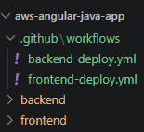
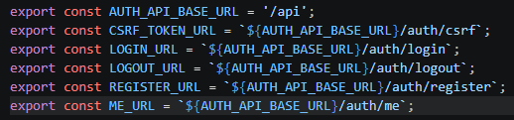

Project structure & a few adjustments
We will create a mono-repo to hold the frontend & backend projects
The Dockerfile we write on the next slide will be placed in the ‘backend’ folder, at the root of our java app
We will work with the github workflows later, once we automate the app
  For now, we will deploy all the infrastructure manually before we automate anything
In frontend code, we remove all references to ‘localhost’ our interceptors and routes will end up resolving to the URL provided from AWS CloudFront
In our backend ‘application.properties’ file, we will accept environment variables that we will later set with AWS ECS (elastic container service)

Slide 4
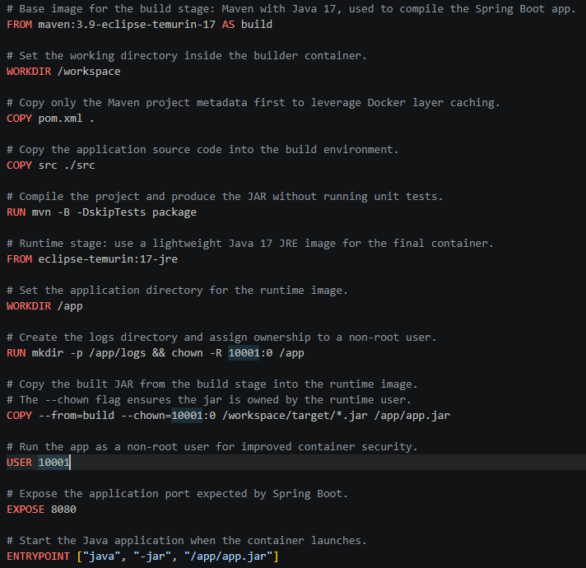
Write Dockerfile
This is a multi-stage Dockerfile (same filename) in the ‘backend’ folder of our mono-repo
Dockerfiles – are used to create a docker image
Docker image – used to create a docker container

Slide 5
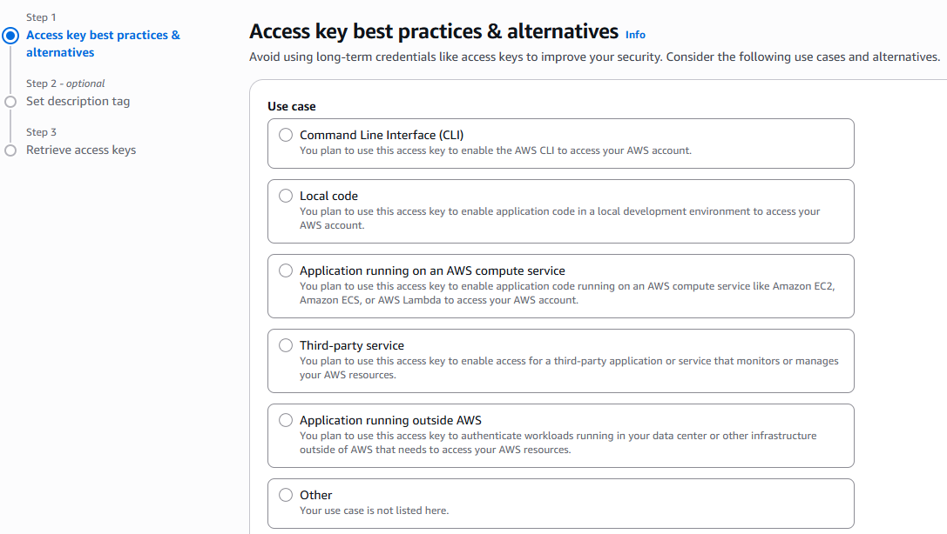
Create Access Keys
Navigate to IAM > Users > (user) > Create Access Key
Choose CLI
Copy details/download csv

Slide 6
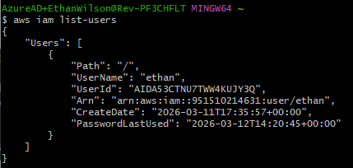
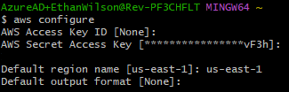
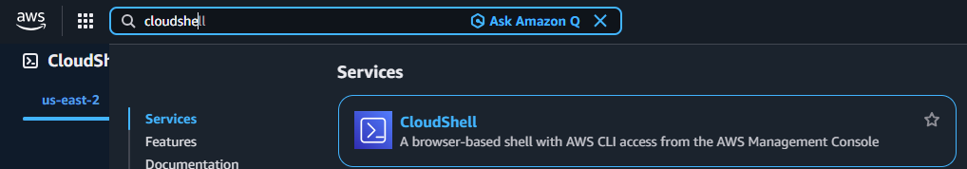
Setup AWS CLI
Download and run the installer (google it)
Run aws configure (output format may be left blank)
Now we can run commands, such as getting a list of our users
CloudShell available for browser-based CLI access

Slide 7
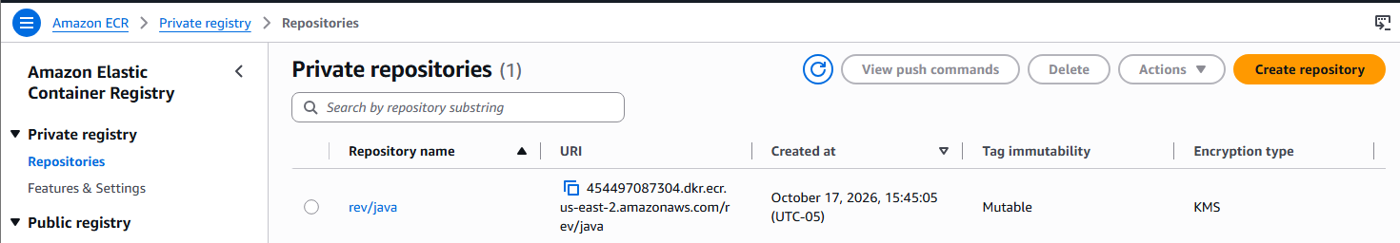

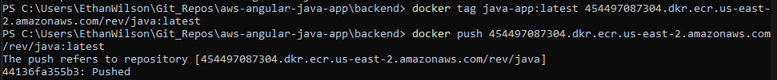
ECR manual setup – first time setup (will automate after)
Step 1: Create ECR repo
Step 2: Login to docker/ECR (you must be signed into AWS CLI already for this to work – with ‘aws configure’)
Step 3: Build an image from your app (your Dockerfile is used for this)
Step 4: Tag and then push your image to ECR

Slide 8
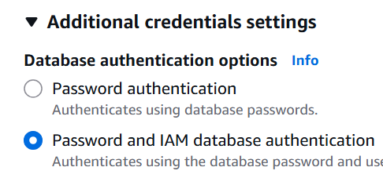
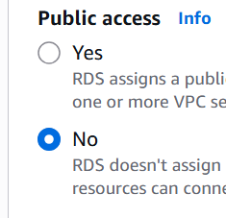
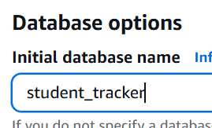
Connecting with RDS - Postgres
Navigate to Aurora and RDS > Databases > Create Database
Walk through the wizard to choose your settings
Recommended changes:
  Choose PostgreSQL for database type
  Choose sandbox template
  Credentials Management: Managed in AWS Secrets Manager
    Select encryption key: default
Set public access: no (it will only be accessed by other services within the same virtual private cloud - VPC)
Set the initial db name to what you like, our jdbc connection string in ‘application.properties’ will use it later!

Slide 9
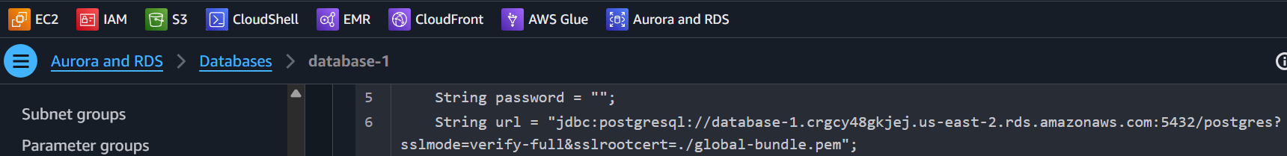
Connecting with RDS - Postgres
On the ‘Connectivity & Security’ tab within RDS, they provide code snippets
Check out the JDBC code snippet to get your unique server URL
We can inject this later into application.properties as an environment variable supplied by AWS ECS – elastic container service

Slide 10
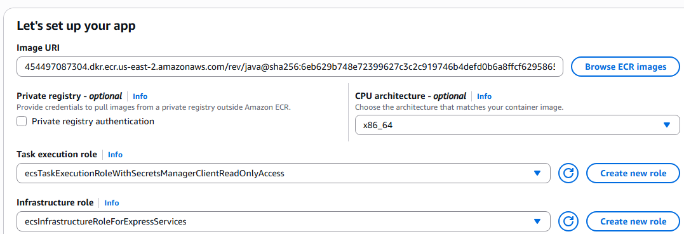
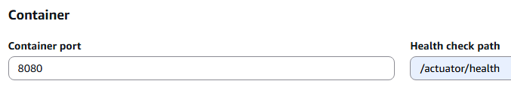
ECS Configuration
Navigate to the ECS service - we can use ‘Express Mode’ to have AWS setup a load balancer, and many other pieces of infrastructure for us
Choose your container from ECR
The task execution role determines what services our container can do on our behalf, we will need to create a custom role that includes read permissions to AWS Secrets Manager (so our container can get secrets to RDS)
Set Infrastructure role to the provided default role
Set our container port & health check route
More config on next slide…

Slide 11
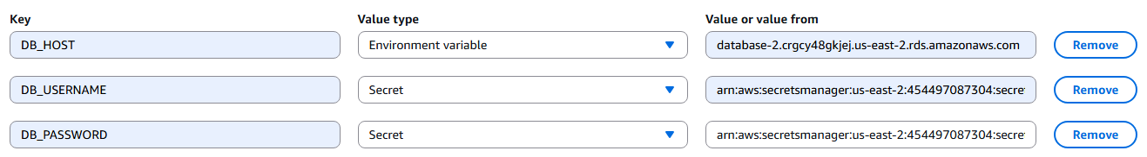

ECS configuration continued…
Next, we add environment variables that will be supplied to our ‘application.properties’ file
Get the DB_HOST from your RDS url
The username & password come from AWS secrets manager and follow this format:
  <AWS_RESOURCE_NAME_FOR_SECRET>:<username/password>::
  Example:
  arn:aws:secretsmanager:us-east-2:454497087304:secret:rds!db-a35660af-9513-4bda-818c-72d23276a2d6-POWCEB:username::
It’s recommended we cap our tasks as the last setting to change before clicking ‘create’

Slide 12
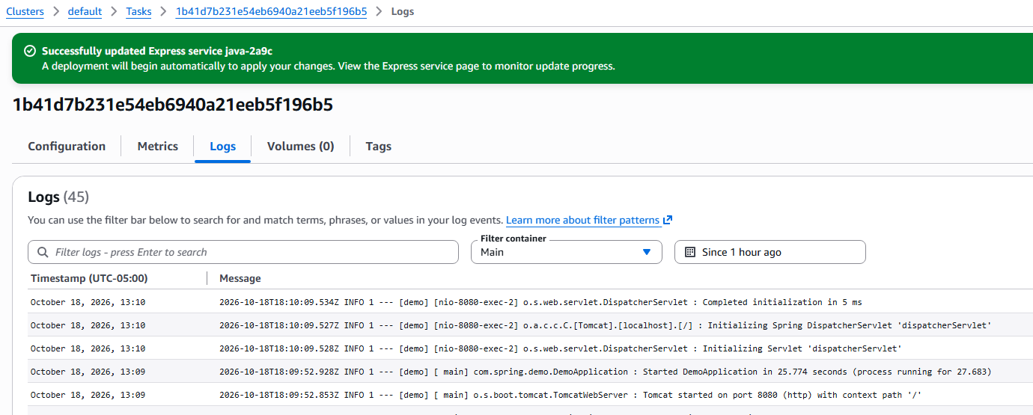
ECS configuration - troubleshooting
Watch your deployment resources, all should show a green checkmark eventually
You can navigate to ‘clusters > nameOfCluster > Tasks’ to see running tasks and diagnose issues
Click on the task and then its ‘Logs’ tab to see our java logs running in ECS:

Slide 13
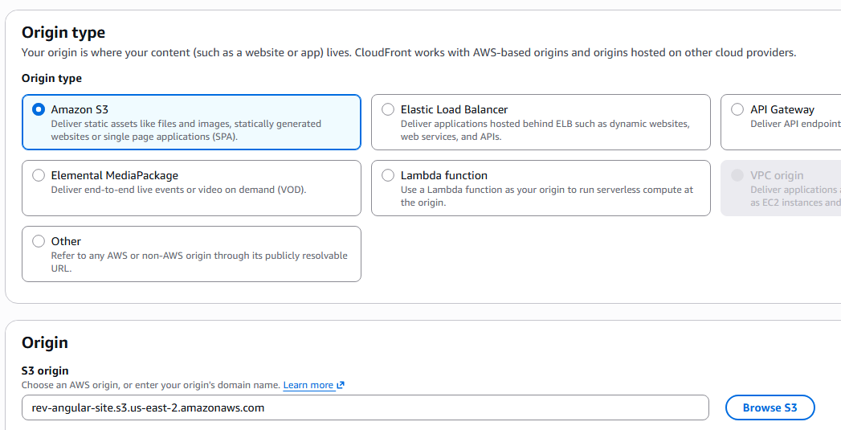
Cloudfront configuration
Navigate to Cloudfront and create a new distribution using the free-tier
For the origin, choose Amazon S3, and select a general-purpose bucket
  This bucket will hold our front-end code
All other settings may remain at default when you create the distribution

Slide 14
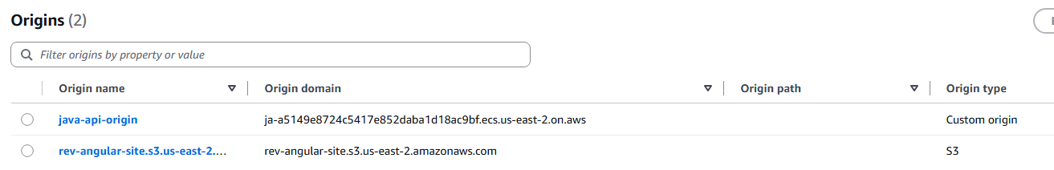
Cloudfront configuration
An origin tells CloudFront where to fetch content from when it needs to forward a request.
  Our frontend and backend are separate services, so CloudFront needs to know about both.
  Frontend origin: An S3 bucket containing your front-end build files.
  API origin: Our Application Load Balancer (ALB), which sits in front of our java app and routes requests to our backend.
On the distribution, let’s setup 2 origins:
  Java-api-origin – this domain will point to the ALB SSL/TLS certificate location (due to HTTPS:443 listener rules – this is admittedly hacky and maybe a better way to do this)
  Rev-site – this domain will point to our S3 bucket that stores our build artifacts from the front-end app

Slide 15
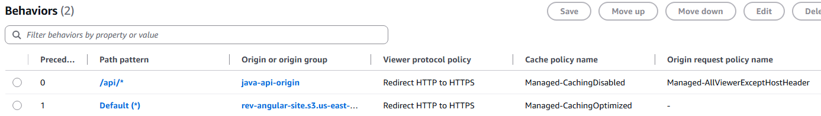
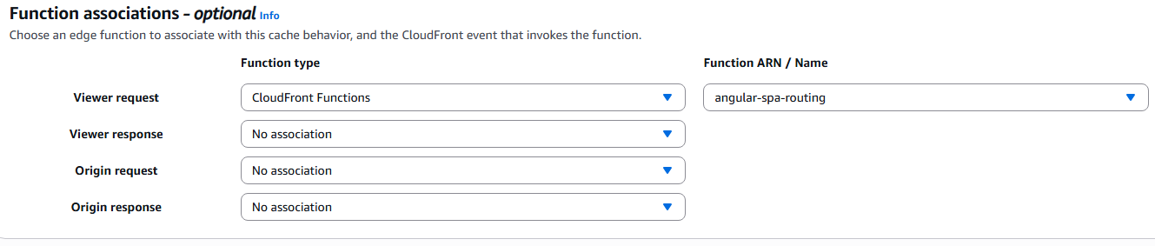
Cloudfront configuration
Next, we will create behaviors with the origins we made
Behaviors describe what paths will be redirected to use our origins
Notice for all ‘/api/*’ requests – we are NOT sending along the host header as we are connecting to the SSL/TSL cert endpoint directly (it is already set as the host via our origin – again this is hacky and probably a better way to do this)
With the default behavior, we should create a cloudfront function so if a user tries to navigate to a view directly, they are consistently served the root of the spa app instead ‘index.html’ (not doing this will causes page refreshes to 404, as it will try and get something from the S3 bucket with an invalid location)

Slide 16
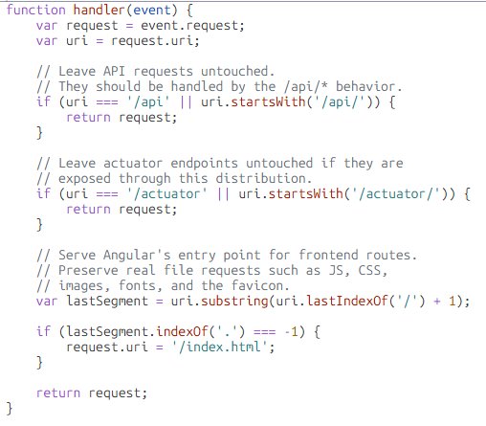
Creating the cloudfront function
‘Functions’ found on the CloudFront menu, create a new one
Make sure to publish it or you can’t use it!

Slide 17
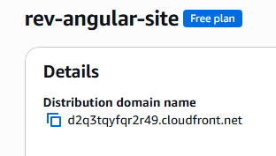
Complete!
If you’ve done everything correctly, you can now navigate to your live site!
You can find the URL on the CloudFront distribution page

Slide 18
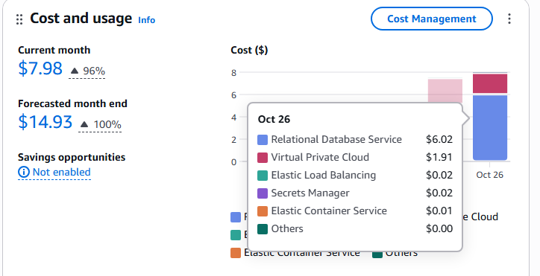
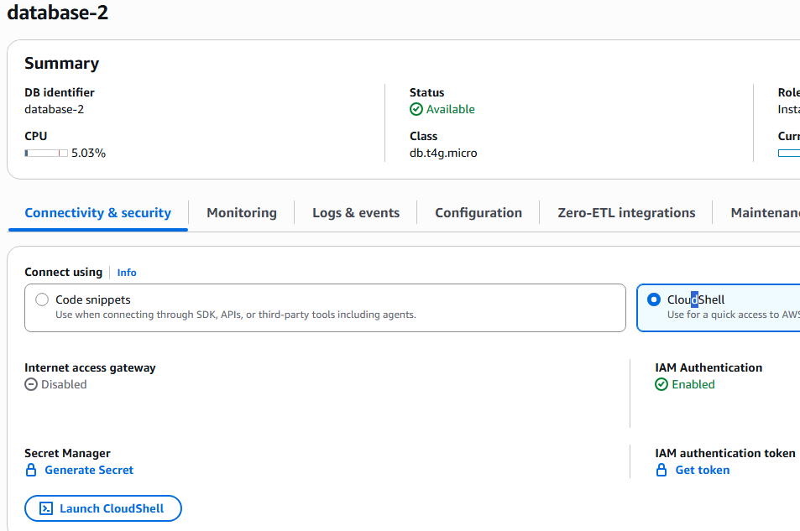
Final note/reminder
Keep an eye on billing!
RDS costs a fair bit, even for a small sandbox
Recommend to remove all these items when no longer needed: RDS databases, ECS clusters, S3 buckets, etc.
You can always connect to RDS via CloudShell if you need to populate your DB with sample data
  I.e. generate some users with varying roles

Slide 19
Challenge Demo – How to Excel in this course
Goal:
Scenario: 5 min
Complete a hands-on challenge
Your organization needs to relay technical concepts to you. Clients often need to do the same. Take a few moments to get some pen and paper ready to take notes.

