Slide 1
Nosql & MongoDB

Slide 2
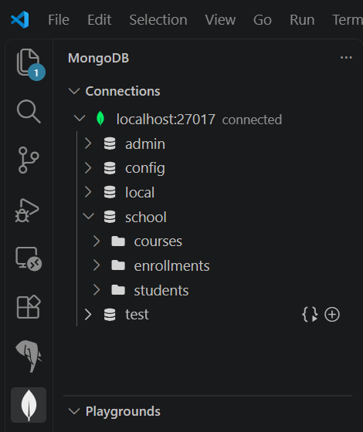
Docker – creating a mongodb sandbox
We can use the MongoDB VS code extension to interact with our database
Files ending with the ‘.mongodb.js’ extension will be recognized as a ‘MongoDB Playground’

Slide 3
Note
All examples and a deeper dive on the options/syntax can be found in your course materials
‘sandbox.mongodb.js’ in your course materials

Slide 4
What is MongoDB?
MongoDB is a popular, open-source NoSQL database designed to store data in flexible, JSON-like documents rather than traditional rows and tables. This architecture makes it highly scalable, fast, and adaptable for modern applications handling unstructured or rapidly evolving data.

Slide 5
MongoDB constructs
To understand how MongoDB organizes information, it helps to look at its fundamental building blocks and how they function:
  Database: A physical container for collections. Each database occupies its own set of files on the file system, and a single MongoDB instance can host multiple independent databases.
  Collection: A grouping of MongoDB documents. Collections are analogous to tables in relational databases. However, unlike tables, collections do not enforce a rigid schema, meaning documents within the same collection can have entirely different structures.
  Document: The basic unit of data in MongoDB, consisting of field-value pairs. Documents are stored in BSON (Binary JSON) format and are equivalent to rows in relational databases. They can easily represent complex hierarchical relationships using embedded sub-documents and arrays.
  Field: A key-value pair within a document. A field name is a string, and its value can range from standard data types (strings, numbers, booleans) to arrays or nested documents. Fields are equivalent to columns.
  _id Field: A mandatory unique identifier required for every document in a collection. It functions as the primary key and defaults to a 12-byte ObjectId if no custom ID is provided during creation.

Slide 6
Mongodb Schema concerns
Because MongoDB is schema-less, your application code manages the data structure, offering incredible flexibility when your application requirements change over time.
This means that fields can be added dynamically (with the option to create defined, enforced schemas if needed)
So, by default: MongoDB operates on a dynamic schema (often called schema-less). You do not need to alter a table definition or pre-define columns before inserting data.
  Here is how MongoDB handles your data and subsequent CRUD operations when fields change:
  During Insertion: If you insert a document with a brand-new field (e.g., adding twitterHandle: "@johndoe" to one user document while others don't have it), MongoDB accepts it immediately without complaints.
  During Reads (Queries): If you run a query looking for a field that doesn't exist in a particular document, MongoDB won't crash or throw an error. It simply ignores that document or treats the missing field as null or undefined.
  During Updates: You can add new fields to existing documents on the fly using update operators like $set, or remove them using $unset.

Slide 7
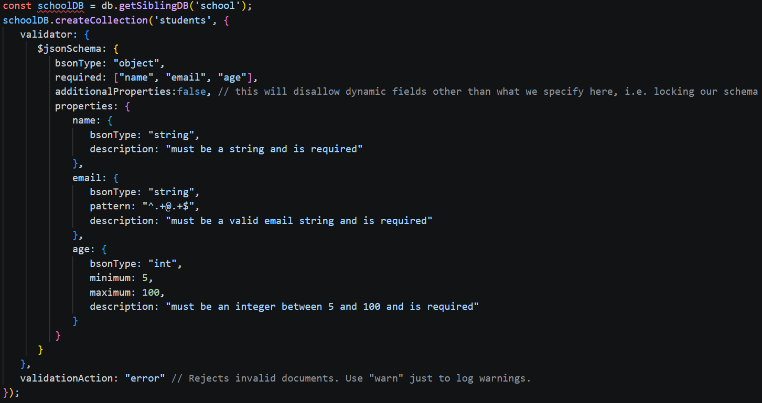
Enforcing Shema validation
We can either enforce validation while creating a collection, or add validation after the collection already exists
additonalProperties + validationAction – work in tandem to enforce the schema

Slide 8
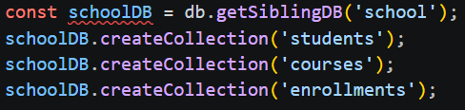

Creating a collection that is completely dynamic
These types of collections have no validation
We can also list the collections on a particular database

Slide 9
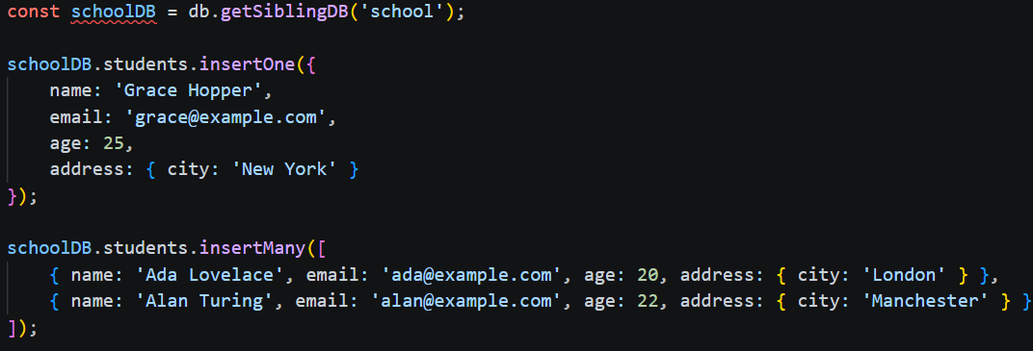
Insert basics

Slide 10
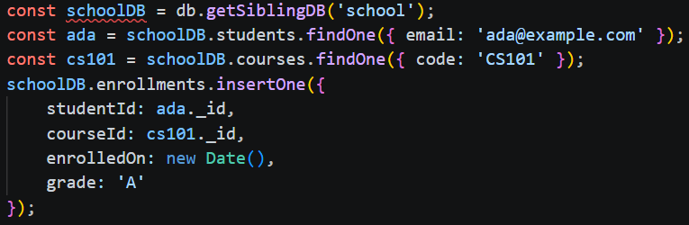
Reference basics – analogous to foreign keys

Slide 11
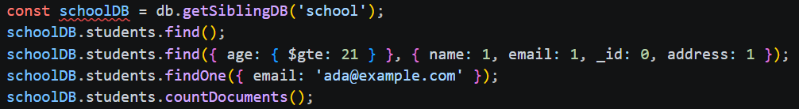
Query basics & comparison operators
Aside from $gte, there are many other comparison operators:
    $gt: Greater than (e.g., { age: { $gt: 21 } })
    $lt: Less than (e.g., { age: { $lt: 18 } })
    $lte: Less than or equal to (e.g., { age: { $lte: 30 } })
    $ne: Not equal to (e.g., { status: { $ne: 'graduated' } })
    $in: Matches any value in an array. Perfect for checking multiple options at once.
    Example: find students whose major is Computer Science or Mathematics
    schoolDB.students.find({ major: { $in: ['Computer Science', 'Mathematics'] } });

Slide 12
Logical Operators
Find students who are either majoring in CS or are older than 25
schoolDB.students.find({ $or: [{ major: 'Computer Science' }, { age: { $gt: 25 } }] });
There is also:
  $and: Joins query clauses with a logical AND (though MongoDB implicitly uses an AND if you list multiple fields, $and is helpful when you need to apply multiple conditions to the same field).
  $not: Inverts the effect of a query expression.

Slide 13
Element Operators
Find all students who have a twitter handle saved
schoolDB.students.find({ twitterHandle: { $exists: true } });
There is also:
  $type: Matches documents where a field is of a specific BSON data type (like "string" or "int").

Slide 14
Querying nested objects
Imagine a document like this:
{
name: "Alice",
address: {
city: "Boston",
zip: "02115"
}
}
We can use dot notation to find all students living in boston:
schoolDB.students.find({ "address.city": "Boston" });

Slide 15
Querying nested arrays
Find any student who has 'CS101' anywhere in their enrolledCourses array
schoolDB.students.find({ enrolledCourses: "CS101" });
Find students who are enrolled in BOTH CS101 and MATH201
schoolDB.students.find({ enrolledCourses: { $all: ["CS101", "MATH201"] } });

Slide 16
Querying arrays of objects
We could find a student who has a course matching both criteria (course is "CS101" and score is greater than 80), a regular query might accidentally match across different elements in the array. To guarantee the conditions are met by the same single object inside the array, you use $elemMatch
schoolDB.students.find({
grades: {
$elemMatch: { course: "CS101", score: { $gt: 80 } }
}
});
Consider the following document:
{
name: "Alice",
grades: [
{ course: "CS101", score: 75 },
{ course: "MATH201", score: 92 }
]
}

Slide 17
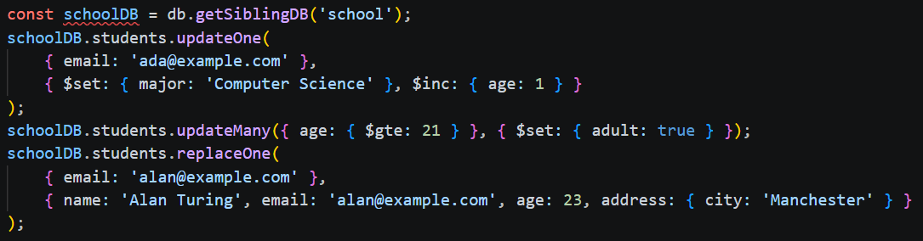
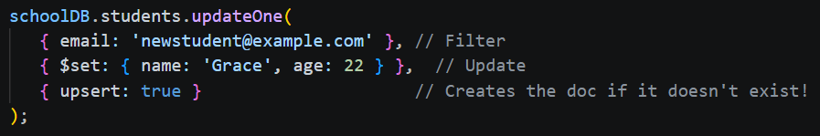
Update basics

Slide 18
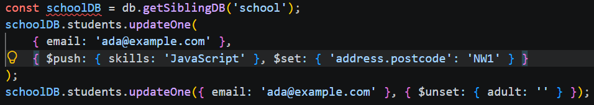
Working with arrays
$push = adds items to arrays (and creates the array if it doesnt's exist and JSON validation allows it)
$addToSet = adds an item to an array only if it doesn't already exist, i.e. prevents duplicates
$pull = { $pull: { enrolledCourses: 'CS101' } } --- removes specific item from array by value or condition
$pullAll = remove more than one item ex: { $pullAll: { enrolledCourses: ['CS101', 'MATH201'] } }
$pop = removes items from front of array with '-1' or end of array with '1'

Slide 19
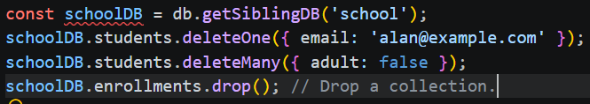
Delete basics + dropping a collection

Slide 20
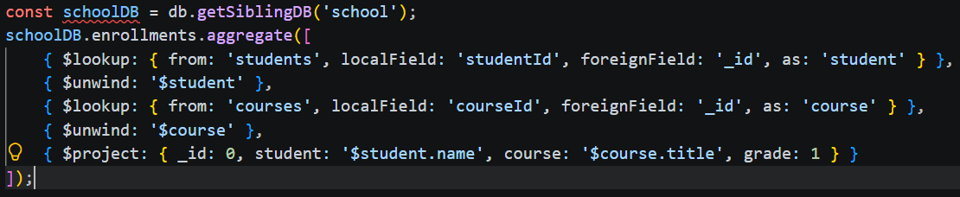
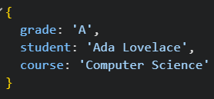
Performing joins
$lookup – left join
$unwind – flattens array
$project - decides what fields appear in final output
Note: other JOIN types discussed in provided course materials: ‘sandbox.mongodb.js’
  TLDR: Mongo has no equivalent RIGHT JOIN or FULL OUTER JOIN. We could do a CROSS JOIN (expensive) or INNER JOIN (with $match)

Slide 21
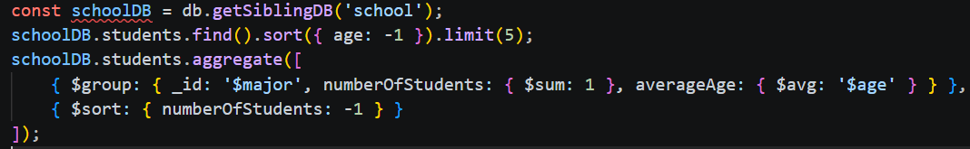
Sort, limit, & aggregate basics

Slide 22
Measuring query performance
schoolDB.students.find(...).explain()
  What it does: Shows you the planned path (e.g., whether it chose a collection scan COLLSCAN or an index scan IXSCAN) without actually running the query.
schoolDB.students.find(...).explain('executionStats')
  What it does: Runs the query, measures the exact time, and shows execution metrics. This is the one you will use 90% of the time to tune performance.
schoolDB.students.find(...).explain('allPlansExecution')
  What it does: Runs the winning plan plus all the other candidate plans MongoDB considered, showing why it chose the one it did.

Slide 23
Challenge – mini-project
Goal:
Requirements:
To test everything you've learned, you are now the lead database architect for GadgetGalaxy, a fast-growing online tech store. You will build and manage a new database called gadgetStore.
Create a collection named products with a JSON Schema validator requiring:
  name (must be a string)
  price (must be an integer or double)
  inStock (must be a boolean)
Use insertMany() to add at least three different gadgets (e.g., Wireless Mouse, Mechanical Keyboard, Gaming Monitor).
Make sure they match your schema, and include a nested specs sub-document with a brand field (e.g., specs: { brand: "Logitech" }).
Test your validation by trying to insertOne() a product that violates your rules (like missing the price field or giving it the wrong data type).

Slide 24
Challenge - continued
Requirements - continued:
Choose one product and use updateOne() with $set to add a new top-level field called category with the value "Accessories".
Use $inc to increase its price by 15 dollars.
Add an array field called tags to that product using $push to add "wireless". Then, use $push again to add "bestseller".
Decide you don't want "wireless" after all, and use $pull to remove it from the tags array.
Find all products priced greater than or equal to a certain amount using $gte.
Find all products made by a specific brand using dot notation (e.g., "specs.brand").
Find products whose category matches one in a list using $in.
Create a second collection named orders.
Insert a document into orders that links a product's _id to an order (e.g., { productId: <ObjectId_from_product>, quantity: 2 }).
Write an aggregation pipeline on the orders collection using $lookup and $unwind to join orders with products.
Use $project to output a clean customer receipt showing:
  The product name ($product.name)
  The ordered quantity (quantity)
  Hiding the _id field.

