Slide 1
Java Unit Testing & Logging

Slide 2
Unit Testing
Unit testing is the practice of testing a small, isolated piece of software
  Isolation – dependencies are often replaced with mocks to only test the method/class itself. i.e. test a service & mock the repo/DAO it uses
  Automation – tests can be run repeatedly and automatically, such as when build the project or deploy
  Fast feedback – since unit tests are small, they run quickly, allowing us to get fast feedback after code changes

Slide 3
Test example
import static org.junit.jupiter.api.Assertions.assertEquals;
import org.junit.jupiter.api.Test;
class CalculatorTest {
@Test
void add_shouldReturnSum() {
Calculator calculator = new Calculator();
int result = calculator.add(2, 3);
assertEquals(5, result);
}
}
public class Calculator {
public int add(int a, int b) {
return a + b;
}
}

Slide 4
Types of tests
Test type | What it tests | Typical speed | Example
Unit | One small unit of code | Very fast | Test Calculator.add()
Integration | Multiple components working together | Medium | Service + database
System / end-to-end | The complete application or a major workflow | Slow | Log in → buy product → receive confirmation
Acceptance | Whether the system meets specified business/user requirements | Often slower | "A customer can successfully check out"

Slide 5
Why write unit tests?
Unit tests help us catch regressions
For example, imagine we write a test that checks whether a $100 purchase receives a $10 discount
  Later, someone changes the implementation, and the test fails as a result
  Without the test, the bug might not be discovered until much later
Tests should be self-documenting, with clear naming conventions:
public double calculateDiscount(double price) {
return price * 0.10;
}
@Test
void calculateDiscount_for100Dollars_returns10Dollars() {
assertEquals(10.0, calculator.calculateDiscount(100.0));
}

Slide 6
Design decisions, and why they make testing easier
Injecting dependencies into service classes, allows us to mock dependencies, rather than needing to test data access code directly
public class OrderService {
private final PaymentService paymentService;
private final EmailService emailService;
public OrderService(
PaymentService paymentService,
EmailService emailService) {
this.paymentService = paymentService;
this.emailService = emailService;
}
// ...
}
public class OrderService {
public void placeOrder(Order order) {
// directly connects to database
// directly sends email
// directly charges credit card
// ...
}
}

Slide 7
Junit
There are several Unit Testing frameworks for Java, we will use Junit
Junit 5 is the modern implementation; it is made up of:
  Junit platform – the foundations for launching tests
  Junit Jupiter – the programming model and APIs most developers use to write Junit 5 tests
  Junit vintage – support for running older Junit 3 or 4 tests
Maven Surefire – the Maven plugin that discovers and runs tests during a Maven build
You can think of the hierarchy like this:
  Maven → Surefire Plugin → Junit Platform → Junit Jupiter → Your @Test methods

Slide 8
Junit – basic structure of a test
Arrange – Set up what the test needs
  Calculator calculator = new Calculator();
Act – Perform the operation you are testing
  int result = calculator.add(2, 3);
Assert – Check the result
  assertEquals(5, result);
import static org.junit.jupiter.api.Assertions.*;
import org.junit.jupiter.api.Test;
class CalculatorTest {
@Test
void add_shouldReturnSum() {
Calculator calculator = new Calculator();
  int result = calculator.add(2, 3);
assertEquals(5, result);
}
}

Slide 9
Common types of JUNIT assertions
assertEquals(expected, actual);
assertNotEquals(unexpected, actual);
assertTrue(condition);
assertFalse(condition);
assertNull(value);
assertNotNull(value);
assertThrows(
SomeException.class,
() -> someOperation()
);

Slide 10
Inmemory mocks vs Mockito
You can check out ‘InMemoryJunitExample.java’ for examples WITHOUT Mockito
Mockito is a Java mocking framework used to create fake or simulated versions of objects that our code depends on
  This helps us test classes in isolation

Slide 11
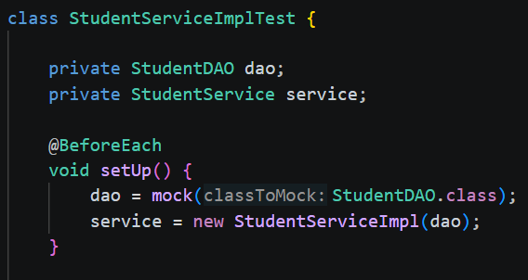
Junit lifecycle annotations
Annotation | Runs
@BeforeEach | Before each test
@AfterEach | After each test
@BeforeAll | Once before all tests in the class
@AfterAll | Once after all tests in the class
Oten used in tandem with Mockito to create mocks for each test method. But these lifecycle annotations are part of Junit!

Slide 12
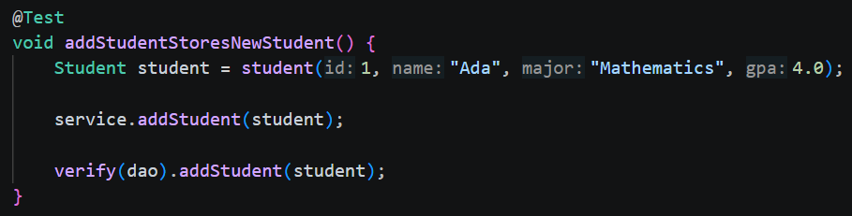
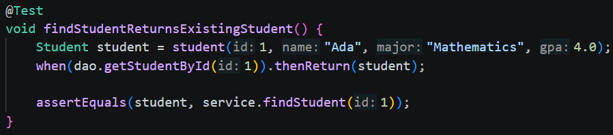
Mockito – stubs & Mocks
Stub – provides predefined answers so your test can focus on behavior
Mock – lets you verify interactions such as whether a method was called, what it returned, and with what arguments it used
Common methods:
  Mock() – creates the mock (as seen on previous slide)
  When() – configures the mock / sets up a stub
  verify() – verifies interactions with the mock (sometimes we only need this and no assertions, sometimes we could use both)
    General rule: use assertions when you care about the result/state. Use verify() when you care about what the code did to a dependency

Slide 13
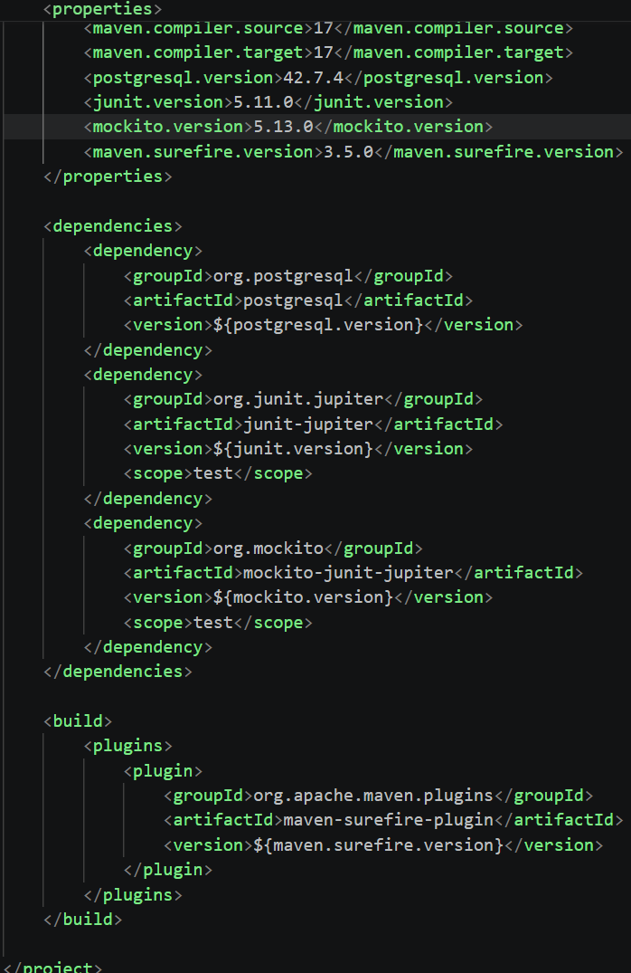

Naming tests, project directory placement, & POM config
Tests are placed in the directory as shown
Test classes are named like: NameOfClassWeAreTestingTest.java
We must also add dependencies and plugin configuration to our Maven pom file, a complete solution is included in your course materials

Slide 14
Testing best practices
To ensure we write tests that are logically sound, consider the following different types of unit tests (non-exhaustive, this is just how your trainer likes to think about it):
  Positive: verifies code works when given valid inputs
  Negative: verifies the code works as expected with invalid inputs
  Bulk: verifies the code works when CRUD is performed on many records
  Single: verifies the code works when CRUD is performed on a single record
  Access Control (positive/negative): verifies users do or do not have expected access to perform an action

Slide 15
STOP
Please see the ‘cleancodeWithJDBC’ project in your course materials
This showcases Junit & Mockito concepts

Slide 16
Logging
Logging is the process of recording information about what happens inside an application as it runs
Instead of using System.out.println() to print messages, applications typically use a logging framework to record events such as:
  Application startup and shutdown
  User actions
  Errors and exceptions
  Database or network operations
  Debugging information
  Warnings about potential problems

Slide 17
SLF4j
SLF4J stands for Simple Logging Facade for Java.
It is not itself a logging implementation. Instead, it provides a common API that Java applications can use to write logs without being tied to a particular logging framework.
SLF4J is the interface we use for logging.
  This allows you to change the underlying logging implementation without changing all of your application's logging code.
import org.slf4j.Logger;
import org.slf4j.LoggerFactory;
public class MyService {
private static final Logger logger =
LoggerFactory.getLogger(MyService.class);
public void doSomething() {
logger.info("Doing something");
}
}

Slide 18
LOGback
Logback is a logging implementation/framework for Java.
It performs the work of processing log messages and deciding things such as:
  Where logs should go
  Which log levels should be recorded
  How logs should be formatted
  Whether logs should be written to files
  When log files should be rotated

Slide 19
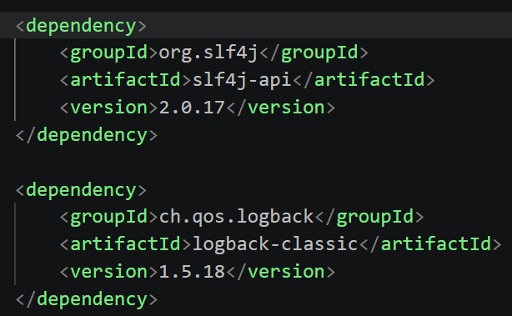
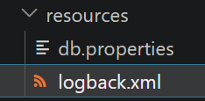
SLF4J + LOGback setup
Maven: we add the required dependencies
  slf4j-api – found on maven central, this is the api that we can directly interact with
  logback-classic – found on maven central, this extends logback-core (so core will be added as a transitive dependency)
In maven central, you may also see: logback-access, a third component of Logback that we aren’t using here; used for servlet containers (Tocat/Jetty) for HTTP-access logging (operates at server/container level instead of application code)
Then for Logback, we setup the XML file to configure settings

Slide 20
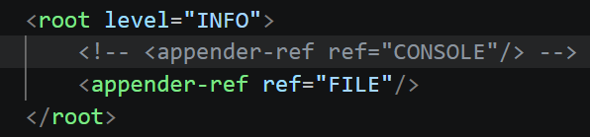
Logback xml
In the Logback XML, we configure settings for the logging implementation
  File or Console output?
  The log pattern printed to each line
  File rollover behavior
  Set minimum captured log levels
  See the file in your course materials for more info (cleancodeWithJDBC project)

Slide 21
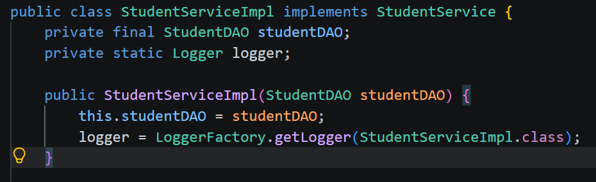
Where should we log?
Most logging occurs at the service layer (with the business logic)
  “Order #1234 successfully placed”
  “User password reset initiated for User ID: 1”
Repository/DAO level logging:
  Keep it lean
  Avoid boilerplate such as “Saving User to database”
  Log custom complexity such as performance bottlenecks or specific database recovery logic

Slide 22
STOP
Demo logging here
Please see the cleancodeWithJDBC project in your course materials for examples

Slide 23
Challenge Demo – How to Excel in this course
Goal:
Scenario: 5 min
Complete a hands-on challenge
Your organization needs to relay technical concepts to you. Clients often need to do the same. Take a few moments to get some pen and paper ready to take notes.

