Slide 1
HTML

Slide 2
What is HTML?
Definition: HTML – HyperText Markup Language is the standard markup language used to create and structure content on the web.
It tells browsers what to display (text, images, links, forms, etc.) and how to organize the content.
Markup Language != Programming Language – HTML doesn’t do any logic, it structures information.

Slide 3
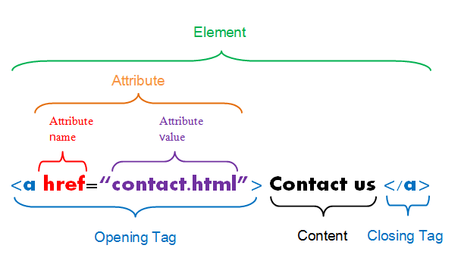
Elements & Tags
Definition: Elements and Tags – define different parts of a webpage, they are the building blocks of the page.
Definition: Attributes – modifiers that either apply identification to an element or alter the elements behavior or styling.

Slide 4
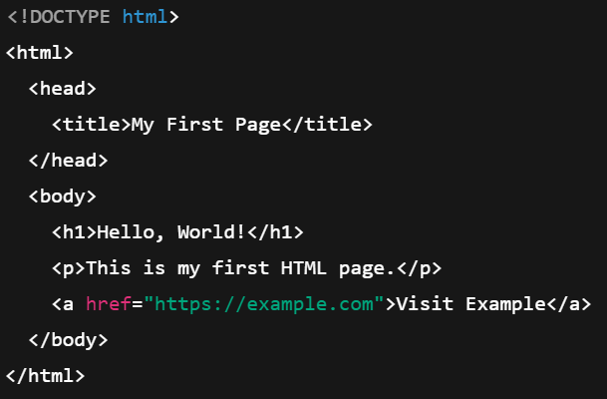
HTML Page Structure
<!DOCTYPE html> defines the page document type and version
<html> is the root element
<head> is where metadata is defined
<body> is where we include content that will be visible to the user

Slide 5
Common Elements
<title> - sets the name in browser tab
<h1> - header 1 (largest) - 6 (smallest)
<p> - paragraph
<a> - anchor (links; notice the href attribute)

Slide 6
Challenge – Create A basic HTML page
Goal:
Scenario: 10 min
Create a HTML page
Your organization needs a static site to advertise their new product. Get started by making your first HTML document.

Slide 7
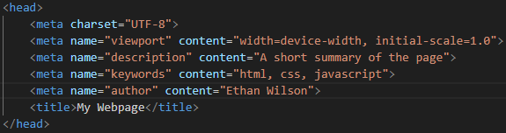
Setting the head
meta elements describe the page and help search optimization
Setting the width of the content to the device viewport width is key to rendering content in a consistent way

Slide 8
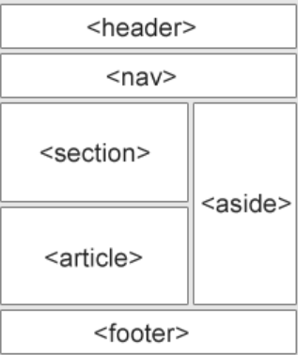
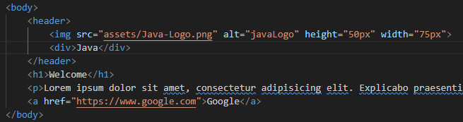
Semantic elements
Definition: Semantic Elements are elements that clearly describe their meaning and role in the structure of a webpage.
Used by screen readers
Examples: header, nav, main, section, article, aside, footer, figure, mark, time

Slide 9
Img & Self-closing elements
The img element renders images, using the src attribute to specify the path
The ‘alt’ attribute specifies the help text for the image, and is read by screen readers
img is an example of a ‘self-closing element’, meaning it does not require an ending tag

Slide 10




Block vs inline
div takes up all of the available width of its container element
span does NOT take up all the width of its container element

Slide 11
Challenge – Create a header
Create a header with a company logo
Goal:
Scenario: 15 min
Your organization needs a static site to advertise their new product.
Further develop the site by creating a header with a logo, next to the logo, include the company name
Make sure your site is responsive to different sized screens by making the initial width consistent with the device viewport

Slide 12
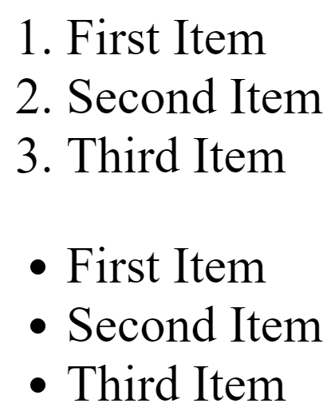
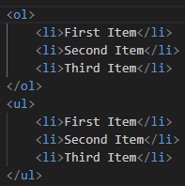
lists
ol – ordered lists
ul – unordered lists
li – list item

Slide 13
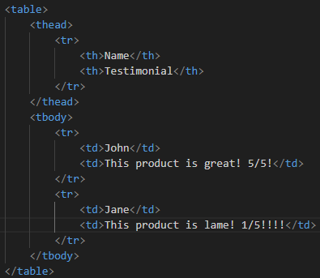
Tables
Table – defines the whole table
Thead – defines the table header
Tr – table row
Th – table header value
Tbody – defines the table body
Td – table data

Slide 14



Other Less common HTML Elements

Slide 15

Code Comments
Code comments help by:
Explaining functionality
Crediting an author
Helping other developers digest the code

Slide 16
Challenge – Create Marketing Content
Goal:
Scenario: 20 min
Create some marketing content for the HTML document
Your organization needs a static site to advertise their new product.
Further develop the site by creating a header that captures the attention of the viewer and sells the product (think of a tagline)
Create a short paragraph that further describes what the product offers.
Create a list that highlights key features
Create a table that showcases key data points
Create a footer that links to a separate HTML document – the company profile page (which contains a short paragraph about the company’s history and values)

Slide 17
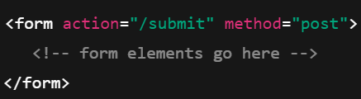

Forms
Action – where the form data goes
Method – how data is sent (get, post)
Input element – different types of input elements may be used to collect different types of data
Text Input (single line)
Password Input (hidden)

Slide 18
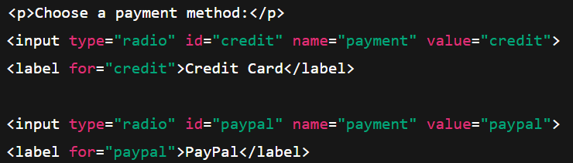
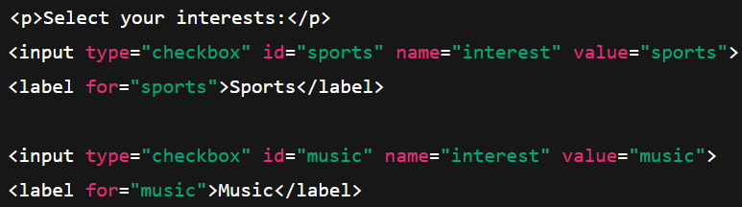
Forms Continued
Radio Selection
Checkboxes

Slide 19
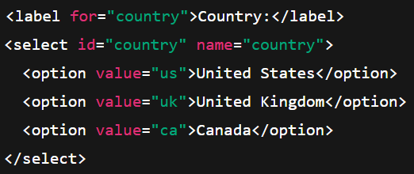

Forms Continued
Dropdown Menu
Text Input (multi-line)

Slide 20
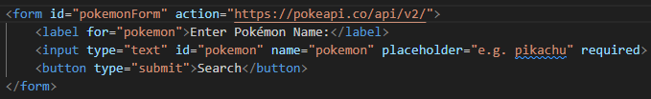
Forms Continued
A button of type ‘submit’ is required for the form
The ‘name’ attribute on our inputs correlate to string query parameters within the request URL:
https://pokeapi.co/api/v2/?pokemon=pikachu

Slide 21
Challenge – Create a form
Goal:
Scenario: 10 min
Create a form to take in a user’s contact information
Your organization needs a static site to advertise their new product.
Further develop the site by creating a form that can accept user input:
A name
Email
Dropdown to select which product they are interested in
The form doesn’t need to submit to a backend

Slide 22
CSS

Slide 23
What is CSS?
Definition: CSS – Cascading Style Sheets (CSS) is used to describe the presentation of HTML elements on a web page.
Controls how things look – layout, colors, fonts, spacing, and more
This provides separation of concerns. i.e. HTML for structure and CSS for styling

Slide 24
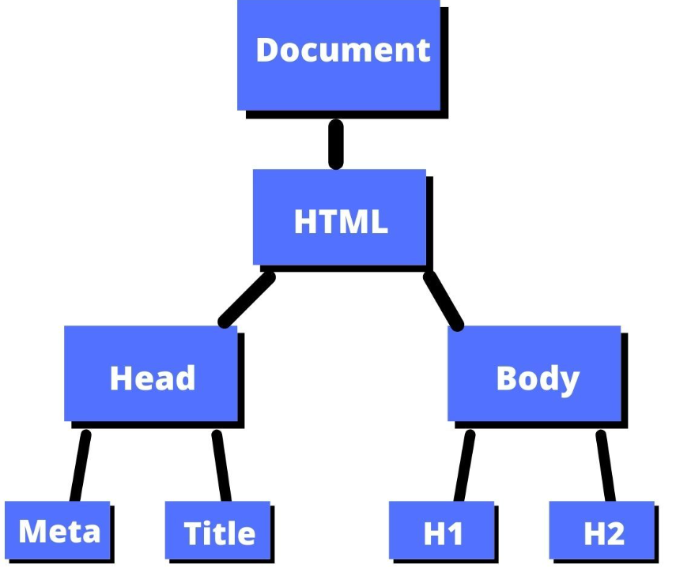
How is CSS Applied?
When the browser loads a page, it first looks to HTML to render the structure of the page, and a DOM is created
Definition: The Document Object Model (DOM) – represents a web page as a tree of objects, allowing CSS & JavaScript to access, manipulate, and modify the content and styling
CSS rules are applied to nodes within the DOM

Slide 25
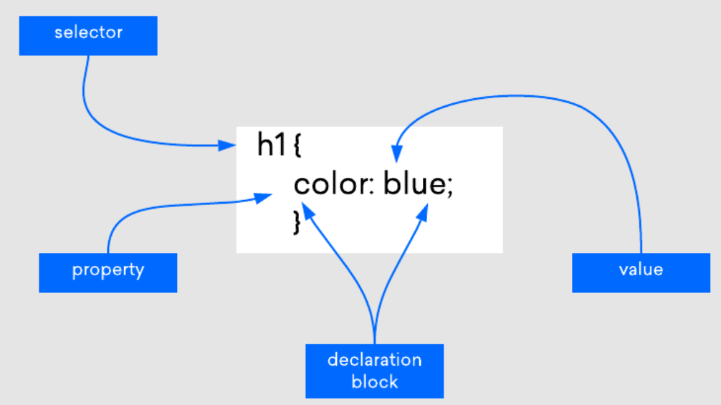
CSS Rules

Slide 26

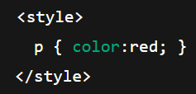
Where is CSS Applied?
Inline – directly on an element
Internal – inside a <style> tag in HTML
External – separate .css file using <link>

Slide 27

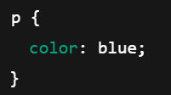
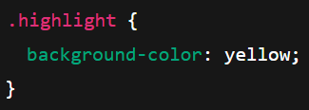
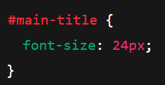
Different Types of Selectors
Element Selector
Class Selector
Id Selector

Slide 28
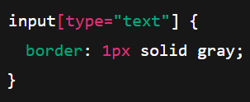
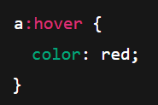
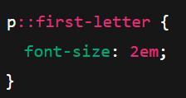
Different Types of Selectors
Attribute Selector
Pseudo-class Selector
Pseudo-element Selector

Slide 29

Different Types of Selectors
Combinator Selectors – targets elements based on their relationship

Slide 30
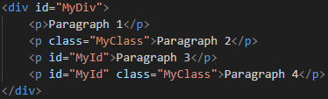
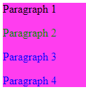

Specificity
Definition: Specificity - rules that determine which style to apply when an element has multiple conflicting styles

Slide 31
Specificity with multiple sources
We could use inline, internal, and external CSS all on the same page
Specificity in this scenario looks like this:
Inline > Internal > External

Slide 32
Challenge – Create A Css file
Goal:
Scenario: 10 min
Create a CSS file
Your organization needs a static site to advertise their new product.
Further develop the site by creating a CSS document to style your page
Include a background color for your header, change the text color as necessary to match your header
Set an appropriate font size for all text on our page

Slide 33
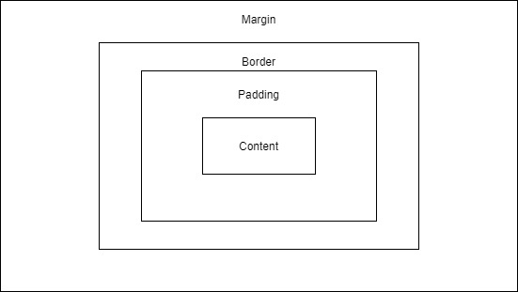
The Box Model
Definition: The Box Model – responsible for controlling the spacing between elements and their neighboring elements
Margin – the space between an element and other elements on the page
Border – a perimeter around content which can be customized
Padding – the space between the content of an element and the border
Content – The actual content of the element - could be text, another element, etc.

Slide 34

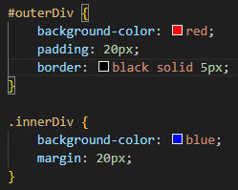
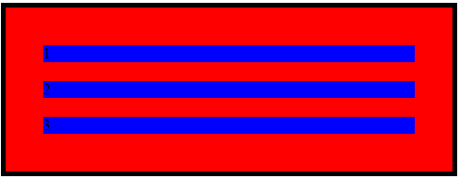
The Box Model

Slide 35
The Box Model
Property | Description | Variants | Shorthand
Border | Line surrounding the element’s padding (inside margin) | border-width, border-style, border-color border-top, border-right, border-bottom, border-left | border: width style color; Example: border: 2px solid black;
Margin | Space outside the element, separating it from other elements | margin-top, margin-right, margin-bottom, margin-left | margin: top right bottom left; Examples: margin: 10px; (all sides) margin: 10px 20px; (top/bottom 10px, left/right 20px)
Padding | Space inside the element, between the content and the border | padding-top, padding-right, padding-bottom, padding-left | padding: top right bottom left; Examples: padding: 5px; padding: 5px 10px; (top/bottom 5px, left/right 10px)

Slide 36
Challenge – Use the Box model
Goal:
Scenario: 10 min
Format our header and main content
Your organization needs a static site to advertise their new product.
Further develop the site by formatting your header so that it takes up all the available width of its container
Format all other content so that it is 80% the width of the viewport, and center it on the page

Slide 37
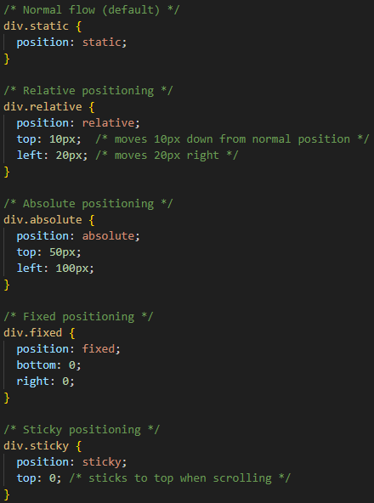
Position
The position property in CSS determines how an element is positioned in the document and how it behaves relative to other elements.
Static – default position for all elements; Elements flow naturally.
Relative – Element is shifted relative to normal position with the top, left, right, and bottom properties.
Absolute – Element is positioned relative to its parent with the top, left, right, and bottom properties.
Fixed – Element is positioned relative to the viewport; stays in place when scrolling.
Sticky – Element is relative until a scroll threshold, then it becomes fixed; requires a top, left, right, or bottom value to work.

Slide 38
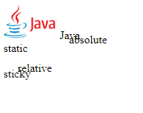
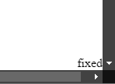
Position
Static – we see that it follows normal flow
Relative – we see that it is shifted 20 px to the right and 10 px down from its normal position
Absolute – shifted not from its original position but that of its parent
Fixed – stuck to the bottom right at all times
Sticky – acts as relative until you scroll past it, then it will be stuck to the top of the page

Slide 39
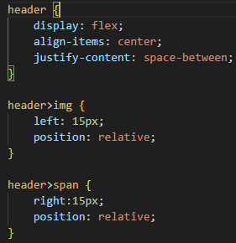
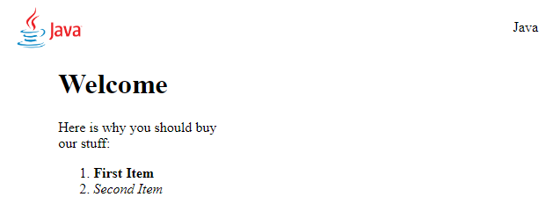
Flexbox
Definition: Flexbox – is a CSS layout system designed to make it easier to arrange and align elements inside a container.
Let's us control how items grow, shrink, and align within a parent container.

Slide 40
Flexbox
Flex Container – where we apply { display: flex; }
Flex Items – The child elements inside the flex container
Items in a container are either in a row or column layout
Justify-content property is used to align items on the X-axis when set to row, it will align items on the Y-axis when set to column.
Align-items is used to align items on the opposite axis of the justify-content property.

Slide 41
Challenge – Use Flexbox
Goal:
Scenario: 10 min
Fix our header
Your organization needs a static site to advertise their new product.
Further develop the site by formatting your header so that the logo is positioned on the left and the company name on the right.

Slide 42
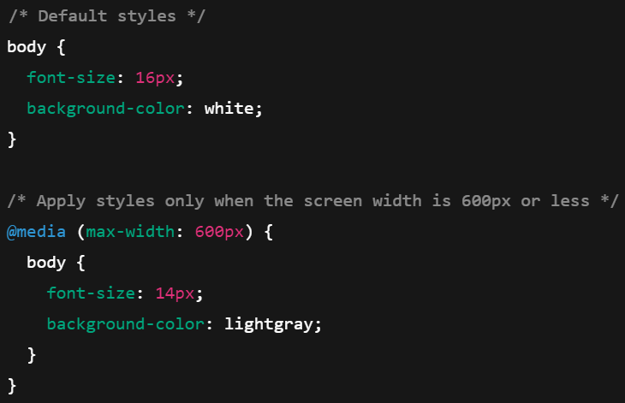
Media Queries
Definition: Media Queries – let us apply different styles depending on the host device’s characteristics, such as screen size, resolution, or orientation.
Used to make site more responsive

Slide 43
Other Common CSS Properties
Property | Function
background-image | Adds an image as a background.
font-size | Controls the size of text.
font-family | Defines the typeface (e.g., Arial, Times New Roman).
font-weight | Sets the thickness of text (e.g., normal, bold, 400).
text-align | Aligns text horizontally (left, center, right, justify).
text-decoration | Adds effects like underline, overline, line-through, or removes them.
line-height | Controls vertical spacing between lines of text.
letter-spacing | Adjusts spacing between characters.
word-spacing | Adjusts spacing between words.
max-width / min-width | Restricts how wide an element can grow or shrink.
overflow | Controls what happens to content that overflows a box (visible, hidden, scroll, auto).
z-index | Sets the stacking order of elements (higher = in front).
opacity | Controls transparency (0 = fully transparent, 1 = fully visible).
cursor | Changes the mouse cursor when hovering over an element.
transition | Defines animation effects when properties change (e.g., hover effects).
transform | Rotates, scales, skews, or moves elements.
box-shadow | Adds shadow effects around an element’s box.
text-shadow | Adds shadow effects to text.
border-radius | Rounds the corners of an element.

Slide 44
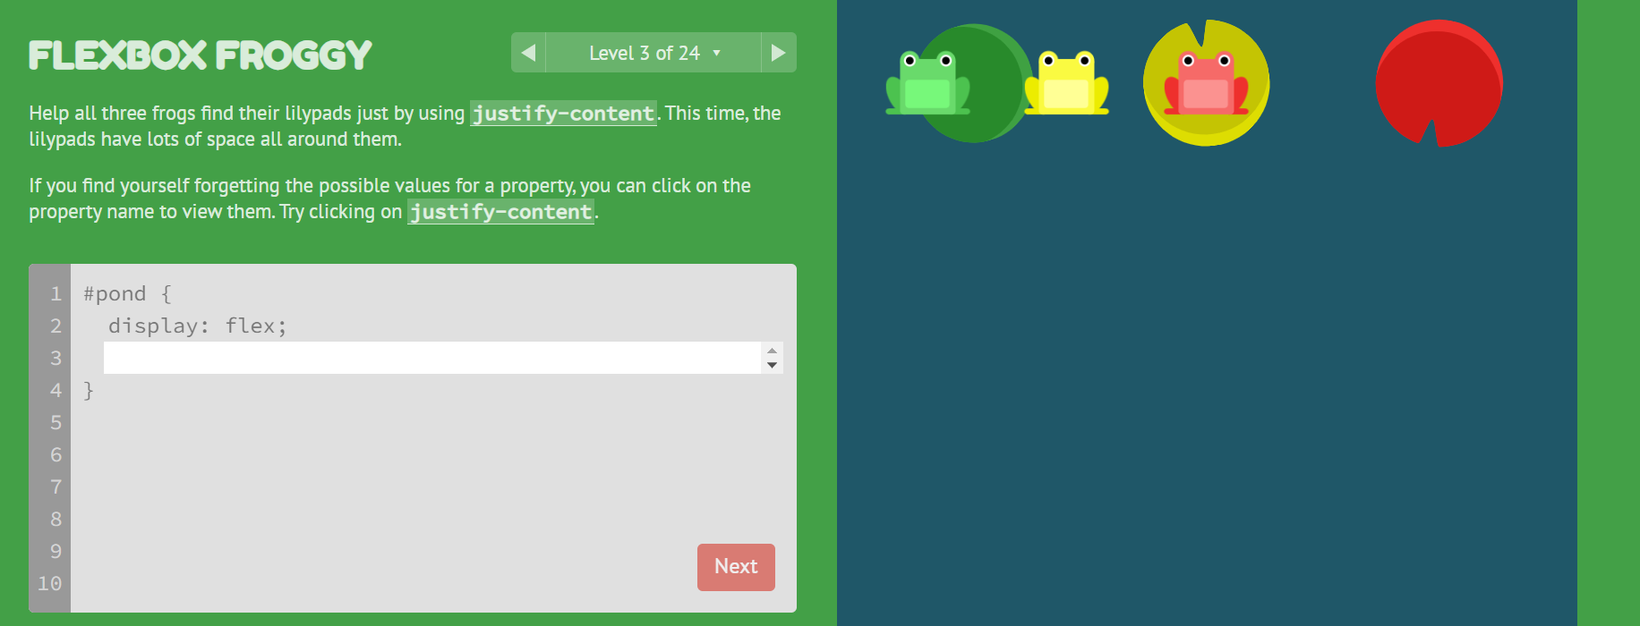
Additional CSS Resource

