Slide 1
JavaScript

Slide 2
What is JavaScript?
Definition: JavaScript is a high-level, interpreted programming language primarily used to make web pages interactive and dynamic.
It runs directly in the browser
Allows developers to manipulate content, respond to user actions, control multimedia, and communicate with servers
Case sensitive
Loosely typed – we don’t declare the type of variable
Dynamically typed – the type of variables are determined at runtime

Slide 3
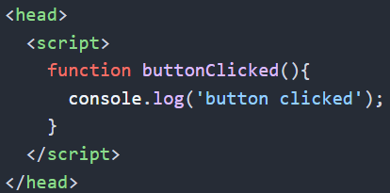
How to Include JavaScript
Inline
Internal
External

Slide 4
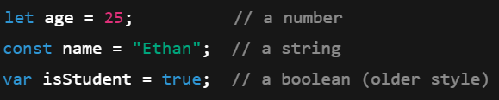
Variables
Definition: Variable – a container for storing data values, such as numbers, text, objects or more.
Variables let us label and reuse data within our application
Let – declares a variable that can be reassigned
Const – declares a variable that cannot be reassigned
Var – old way of declaring variables (not commonly used now)

Slide 5






Primitive Data Types
Definition: Primitive Data Type – these data types comprising simple and single values, are held in memory
String – text values
Number – integers and decimals
Boolean – true or false
Undefined – variables that are declared but never assigned a value
Null – intentional ‘empty’ value
Symbol – unique identifier (rarely used in beginners’ code)
BigInt – for very large integers beyond Number’s limit (notice the ‘n’ at the end of the integer)

Slide 6
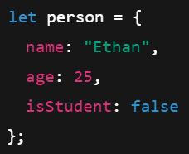
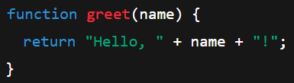
Reference Data Types
Object – collection of key/value pairs, where keys are usually string (or symbols) and values can be any type
Array – A special type of object used for ordered lists of values
Function – A reusable block of code that can be executed (called) when needed
Other – some less common examples include Date, Map, Set, etc.

Slide 7
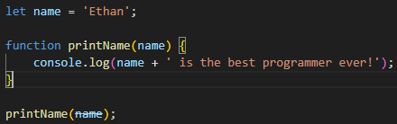
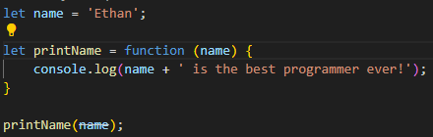

More on Functions
We pass data into a function via parameters
Functions are called by their name
Functions can also be ‘anonymous’ – meaning they have no name but can still be referenced by the variable they are stored in
Anonymous functions may often be converted to ‘Arrow Functions’

Slide 8
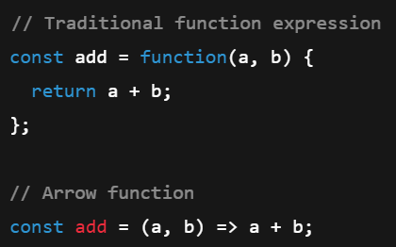
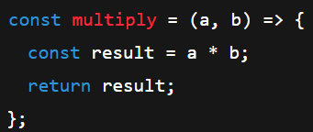
Arrow Functions
Arrow Functions are a concise way to write functions compared to traditional function expressions
If the function body is a single expression, you can omit the curly braces and the return keyword
If the body has multiple statements, you must use curly braces and the return keyword if needed

Slide 9
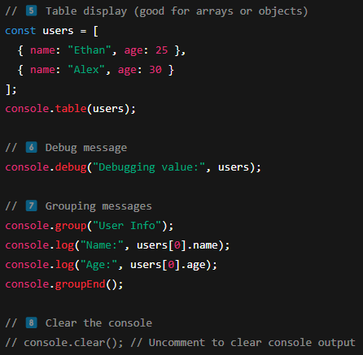
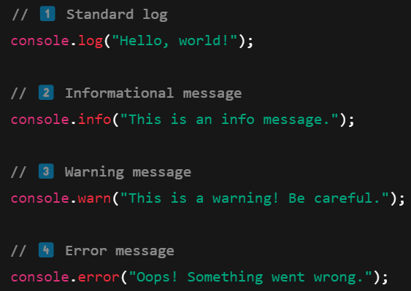
Console Commands

Slide 10
Challenge – Setup JavaScript
Goal:
Scenario: 10 min
Add JavaScript to our application
Your organization is still building its product launch page. We need to introduce some dynamical functionality.
Create an external JavaScript file and link it to your HTML page
Define a variable that stores your name
Define a function that takes the name variable as a parameter and then prints to the console: “{your name here} is the best programmer ever!”

Slide 11
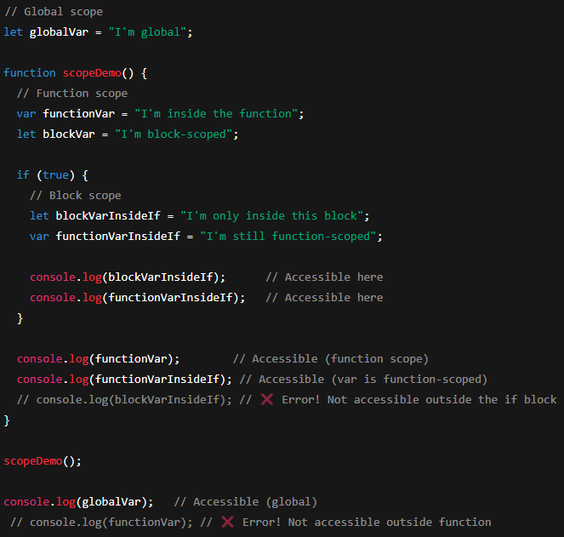
Variable Scope
Definition: Variable Scope determines where a variable may be referenced
Var – Either global or function scope, depending on location
Let – Block level scope, meaning that it can be referenced within its code block or any inner code blocks
Const – Also has block scope

Slide 12
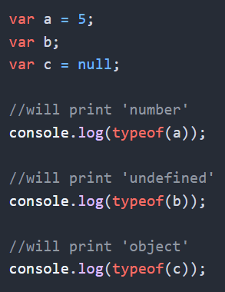
Check Data Types of Variables
We can check the data type of a variable with the ‘typeof’ operator

Slide 13
JavaScript Arithmetic Operators
+ (addition)
- (subtraction)
* (multiplication)
** (exponentiation)
/ (division)
% (modulus)
++ (increment)
-- (decrement)
+= example: x+=y same as x = x + y
-= example: x-=y same as x = x - y
*= example: x*=y same as x = x * y
/= example: x/=y same as x = x / y
%= example: x%=y same as x = x % y
**= example: x**=y same as x = x ** y

Slide 14
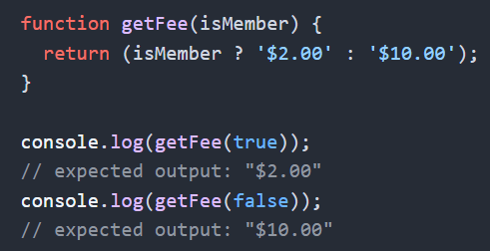
JavaScript Comparison Operators
== equal to
=== equal to and equal data type
!= not equal
!== not equal value or not equal type
> greater than
< less than
>= greater than or equal to
<= less than or equal to
? ternary operator

Slide 15
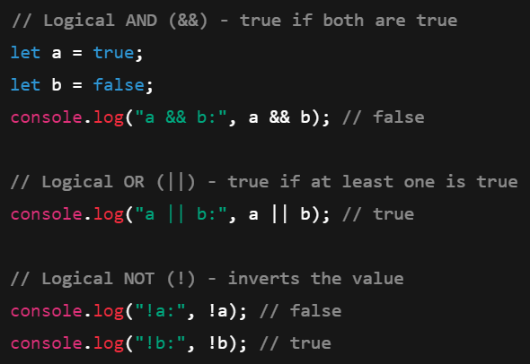
JavaScript Logical Operators
&& (and)
|| (or)
! (not)

Slide 16

Falsey Values
False
0
‘’ OR “”
Null
Undefined
NaN – not a number

Slide 17
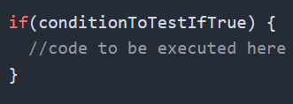
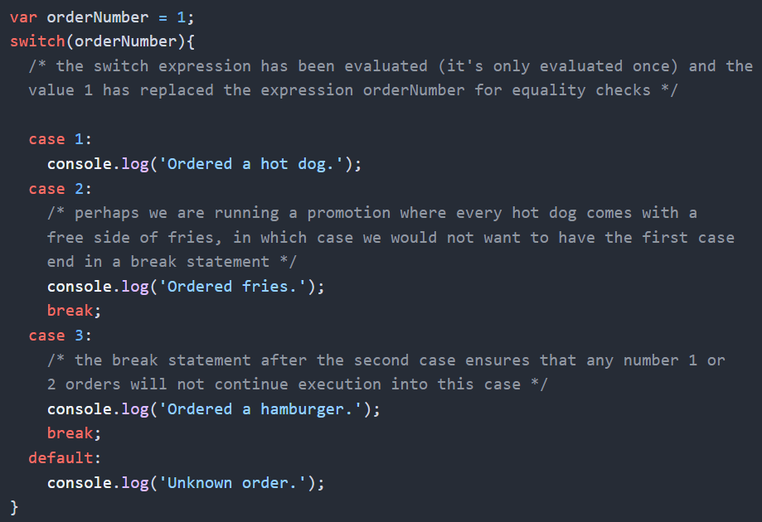
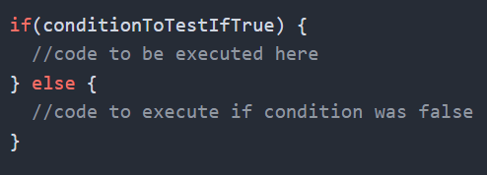
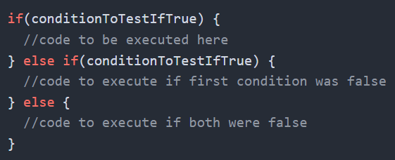
Control Flow
Important: switch will ‘fall through’ without break statements!

Slide 18
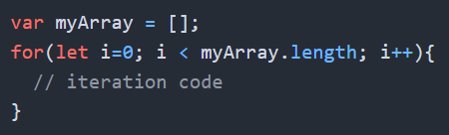
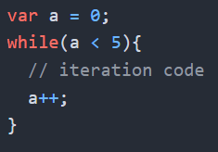
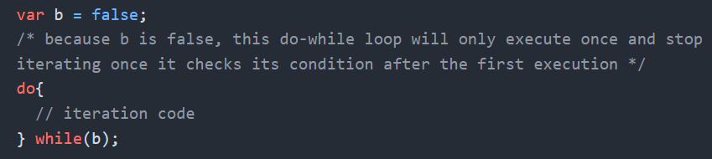
Loops

Slide 19
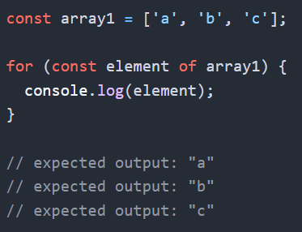
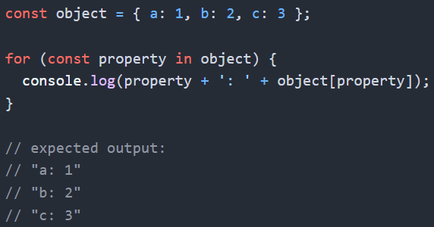
Loops
for-of loops iterate over iterable objects
for-in loops iterates over enumerable properties of an object

Slide 20
Challenge – Knowledge Check
Goal:
Scenario: 10 min
Complete the knowledge check
Navigate to the following links and complete the assignments one by one:
https://www.w3schools.com/js/exercise.asp?x=xrcise_assignment1
https://www.w3schools.com/js/exercise.asp?x=xrcise_if_else1
https://www.w3schools.com/js/exercise.asp?x=xrcise_switch1
https://www.w3schools.com/js/exercise.asp?x=xrcise_loop_for1

Slide 21
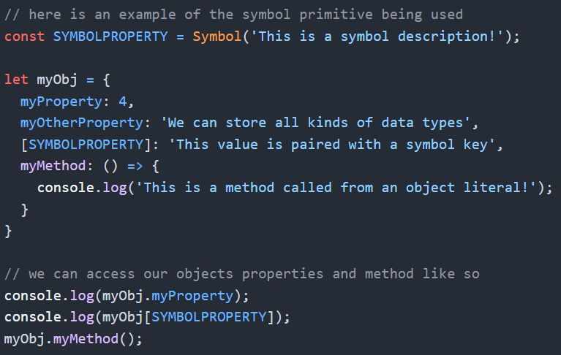
Working With Objects
Objects can hold multiple data types, even functions
Property keys can be named text, or symbols
Property values can be primitives or functions

Slide 22
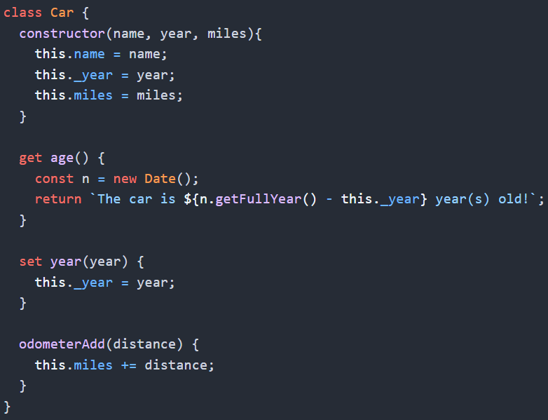
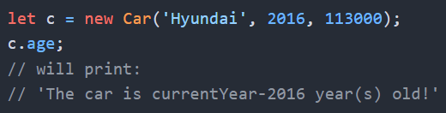
Working With Classes
Classes are blueprints for objects
Getters return data in the object
Setters change data in the object

Slide 23
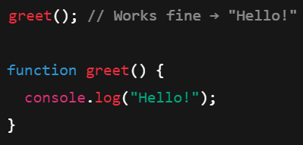
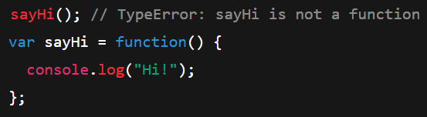

Hoisting
Definition: Hoisting is a behavior in which variables and function declarations are moved (or hoisted) to the top of their containing scope during compilation, before the code is executed.
This means that we can sometimes use functions or variables before they are declared
Var = hoisted, but initialized to undefined
Let/const = hoisted but not initialized
Function expressions/arrow functions = only the variable is hoisted, not the function definition

Slide 24

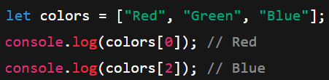

Working With Arrays
Definition: Array is a special type of variable that can store multiple values in a single container
Arrays are ordered, and elements have an index starting at 0
Arrays are dynamic, we can add and remove items

Slide 25
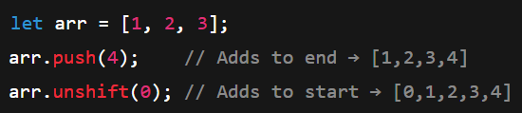

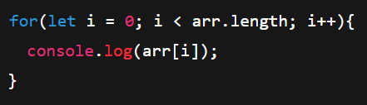

Working With Arrays

Slide 26
Challenge – Knowledge Check
Goal:
Scenario: 10 min
Complete the knowledge check
Navigate to the following links and complete the assignments one by one:
https://www.w3schools.com/js/exercise.asp?x=xrcise_classes1
https://www.w3schools.com/js/exercise.asp?x=xrcise_arrays1
https://www.w3schools.com/js/exercise.asp?x=xrcise_objects1

Slide 27


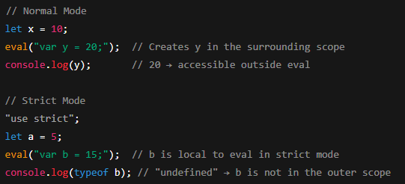

Strict Mode
Strict Mode is a way to opt in to a stricter set of rules that help us write cleaner and safer code.
Can be used at the top of a JS file
Can be used at the top of a function to only apply to a single function

Slide 28
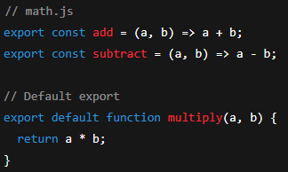
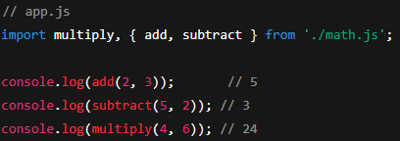
JavaScript Modules
Definition: A JavaScript Module is a JavaScript file that can be imported into another JavaScript file.
It may contain variables, functions, etc.
Allows developer to organize code into separate, reusable pieces instead of writing everything in a single script
Each module has its own scope (variables/functions inside are not automatically global)
Prevents naming conflicts between different parts of code
Named Exports vs Default Exports
Strict Mode is enabled by default
Need to apply ‘type’ attribute with a value of ‘module’

Slide 29
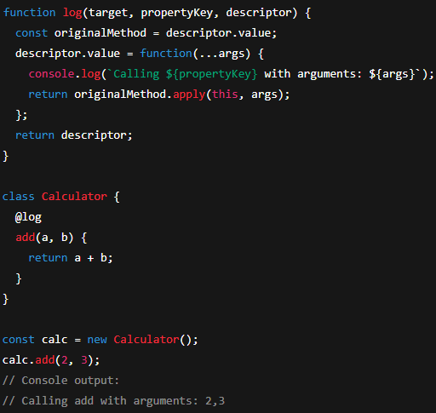
Decorators
Definition: Decorators are a special kind of syntax that allows us to modify or enhance classes and class members.
This is still experimental
Not fully implemented yet into the ECMAscript standard
Often used by larger frameworks such as Angular

Slide 30
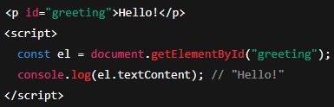
Targeting Elements with JavaScript
getElementById() – returns single element
getElementsByClassName() – returns a HTML collection
getElementsByTagName() – returns a HTML collection
querySelector() – returns first matching element based on CSS selector
querySelectorAll() – returns a NodeList with all matching elements using a CSS selector

Slide 31
Events
JavaScript events are actions that happen in the browser, usually because of human action.
Some examples include:
UI events: load, resize, scroll
Mouse events: click, dblclick, mouseover, mousemove
Keyboard events: keydown, keyup, keypress
Form events: submit, change, focus, blur
Clipboard events: copy, paste, cut

Slide 32
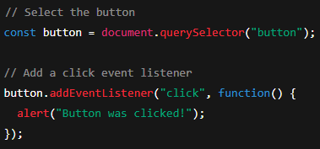

Events
Event Listeners “listen” for events and execute a function when they occur
When an event occurs, an Event Object is automatically passed to the event handler
The Event Object contains important information such as the type of event, the element that triggered it, mouse position, key pressed, etc.
Inline event handlers are possible, but not recommended (it’s more maintainable to keep everything in the JS file)

Slide 33
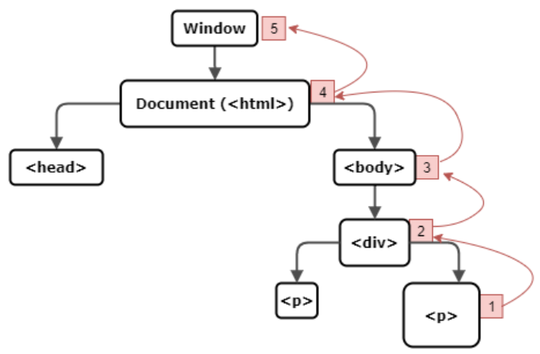
Event Propagation
When an event occurs, it goes through 3 phases
First, the event starts at the root of the DOM (document) and traverses down to the element that triggered the event. This is called the Capturing Phase.
Then, when at the element that triggered the event, we are in the Target Phase.
Finally, the event moves back up the DOM towards the root, this is the Bubbling Phase.
Our event listeners operate during the bubbling phase by default

Slide 34
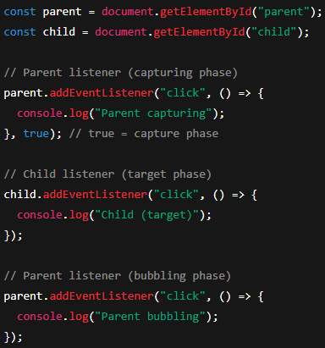

Event Propagation – What is the output?

Slide 35
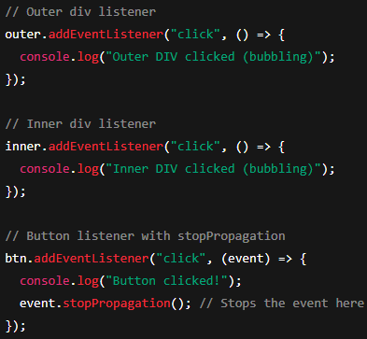
Stopping Events
event.stopPropagation() – stops the event from continuing further (either in bubbling or capturing)
event.stopImmediatePropagation() – also stops other listeners on the same element
event.preventDefault() – prevents the default action (like following a link or submitting a form)
What is the expected output when a user clicks the button?

Slide 36
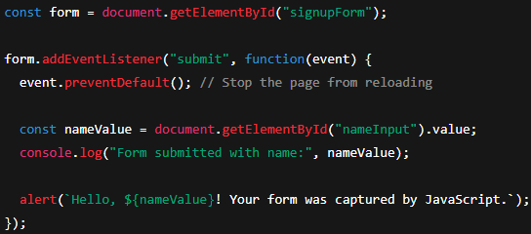
preventDefault()

Slide 37
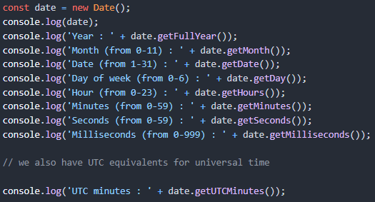
Working With Dates

Slide 38
Challenge – Make a Module
Goal:
Scenario: 20 min
Create a JavaScript module that has a function called from a button click
Your organization needs you to continue work on the product launch page.
Create a JavaScript module that returns the current date formatted as ‘YYYY-MM-DD’
Call this method and print the results to the console whenever a button is clicked

Slide 39
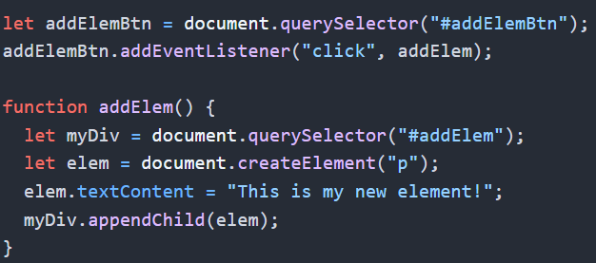
DOM Manipulation
createElement() – creates an element with specified tag
appendChild() – attaches an element as a child of the specified element
removeChild() – removes a specified element from the DOM
replaceChild(newElement, oldElement) – swaps one element for another on a parent

Slide 40
Challenge – Display The Date
Goal:
Scenario: 15 min
Edit your JavaScript so that the current date appears within a div on the page when your button is clicked
Your organization needs you to continue work on the product launch page.
Ensure the date appears on the page, within a div, when the button is clicked
You may not create a div within the html, use only JavaScript to solve the challenge
Ensure that no duplicate dates appear on the page, you should replace the old value with the new value if a div currently exists

Slide 41
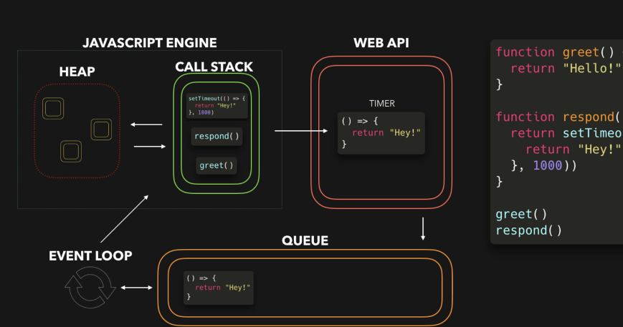
The JavaScript Event Loop
JavaScript is considered a ‘blocking’ or ‘single-threaded’ language
The call stack – first in, last out structure
The event queue – first in, first out structure
Our event loop supplies jobs to the call stack from our event queue
If an asynchronous job appears, it is sent to the browser’s web APIs for processing

Slide 42
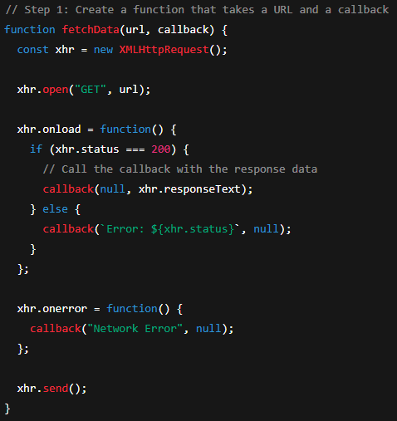
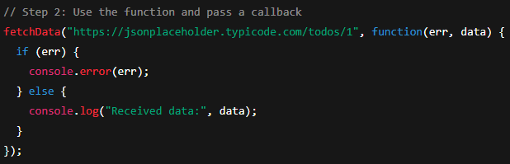
XMLHttpRequests and callbacks
Definition: A Callback Function is a function that is passed as an argument to another function, and is meant to be called later, usually after an operation has completed

Slide 43
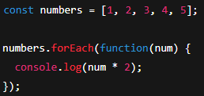
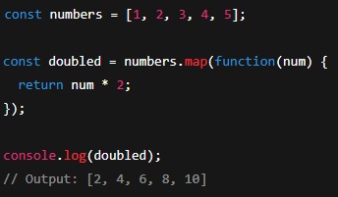
Other scenarios with callback functions
forEach() - executes a callback for each item
map() – creates a new array while executing the callback for each item

Slide 44
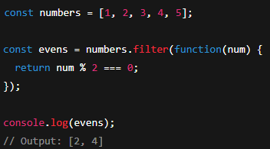
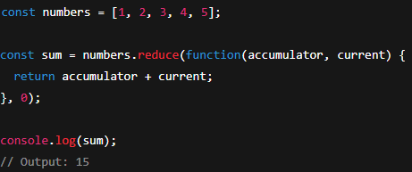
Other scenarios with callback functions
filter() – returns a new array containing only the elements for which the callback returns true
reduce() – accumulates a single value by applying the callback to each element

Slide 45


Promises
Definition: A Promise is an object that represents the eventual result of an asynchronous operation
These allow us to handle success and failures of these operations in a cleaner way
Promises may be pending, fulfilled, or rejected

Slide 46

The Fetch API
Definition: The Fetch API is a modern JavaScript interface for making HTTP requests to servers
Let's us send and retrieve data asynchronously
Uses promises

Slide 47

Asnyc/Await
Async/Await – is a modern syntax for working with asynchronous code in a way that looks and behaves more like synchronous code
Syntactical Sugar

Slide 48
Challenge – Complete Your mini-Project
Goal:
Scenario: ?? min
Use your knowledge of fetch to include a public API in your project
Your organization needs you to continue work on the product launch page.
Use a public API to include data on the page

