Slide 1
Spring Boot – modules

Slide 2
Overview
Each of these are separate Spring projects or technologies we will discuss in this section
Spring MVC – architecture pattern, server-side rendering
Swagger – testing & development module
Spring for GraphQL – Spring project for making queries of different shapes of data
Spring Security – Spring project for Authentication/Authorization, RBAC
Spring AI – Spring project to connect AI models from providers such as OpenAI, Anthropic, and Ollama using familiar Spring programming patterns

Slide 3
MVC
Model
Represents application data and business rules.
Examples: entities, services, repositories, domain logic
Controller
Handles input, coordinates application operations, and determines the response.
Examples: Spring @Controller or @RestController
View
Presents information to the user.
Examples: HTML templates, JSON consumed by a UI, or a rendered interface

Slide 4
MVC implementations
Spring Boot app that returns JSON + React/Angular
Spring Boot MVC + thymeleaf
BOTH follow a MVC pattern

Slide 5
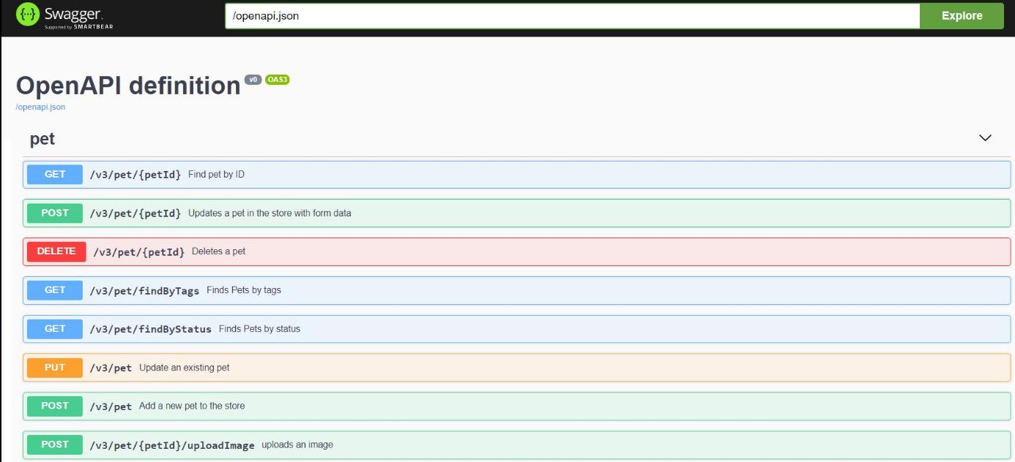
Swagger
Swagger is a set of tools and conventions for describing, documenting, and testing REST APIs.
In a Spring Boot application, it helps you expose your API endpoints in an interactive web page so developers can understand your API and try requests without needing Postman or writing a client first.

Slide 6
Swagger Annotations
Annotation | Purpose
@Tag | Groups related endpoints under a named section.
@Operation | Provides a summary and detailed endpoint description.
@ApiResponse | Documents possible HTTP responses.
@Parameter | Describes a path, query, or other parameter.
@Schema | Documents a DTO's fields, constraints, and example values.

Slide 7
Swagger annotation example
Controller:
DTO:
@GetMapping("/{id}")
@Operation(
summary = "Get a product",
description = "Returns a product by its ID"
)
@ApiResponse(
responseCode = "200",
description = "Product found"
)
@ApiResponse(
responseCode = "404",
description = "Product not found"
)
public ProductDto getProduct(
@Parameter(description = "Unique product ID")
@PathVariable Long id
) {
return productService.getById(id);
}
}
import io.swagger.v3.oas.annotations.media.Schema;
@Schema(description = "Product information")
public class ProductDto {
@Schema(
description = "Unique product identifier",
example = "101"
)
private Long id;
@Schema(
description = "Display name",
example = "Wireless Keyboard"
)
private String name;
// Constructors, getters and setters
}

Slide 8
Spring for Graphql
GraphQL is an API query language and runtime that lets clients request exactly the data they need. When you combine it with Spring Boot, you can build APIs that are flexible, strongly typed, and easy to evolve as your application grows.
The difference with REST?
  REST typically exposes multiple endpoints, while GraphQL typically exposes one endpoint through which clients request different shapes of data.
Rest may have:
  GET /api/customers/1
  GET /api/customers/1/orders
  GET /api/orders/101/items
While a GraphQL query may look like this:
query {
customer(id: "1") {
name
orders {
id
total
}
}
}

Slide 9
Graphql setup for spring boot
Step 1: Include the dependencies (Maven shown)
Step 2: Create a file to store the schema
  src/main/resources/graphql/schema.graphqls
  Spring Boot automatically discovers .graphqls and .gqls schema files in the default src/main/resources/graphql/ location. (the file types are equivalent)
<dependency>
<groupId>org.springframework.boot</groupId>
<artifactId>spring-boot-starter-graphql</artifactId>
</dependency>
Schema example:
Syntax | Meaning
type Customer | Defines an object type
type Query | Defines read operations
type Mutation | Defines write operations
ID | Represents an identifier
String | Represents text
! | The value cannot be null
[Customer!]! | A non-null list containing non-null customers
type Customer {
id: ID!
name: String!
email: String!
}
type Query {
customers: [Customer!]!
customerById(id: ID!): Customer
}
type Mutation {
createCustomer(name: String!, email: String!): Customer!
}

Slide 10
Graphql setup for spring boot
@Controller
public class CustomerGraphQLController {
@QueryMapping
public List<Customer> customers() {
return List.of(
new Customer(1L, "Alice", "alice@example.com"),
new Customer(2L, "Bob", "bob@example.com")
);
}
@QueryMapping
public Customer customerById(@Argument Long id) {
return new Customer(id, "Alice", "alice@example.com");
}
@MutationMapping
public Customer createCustomer(
@Argument String name,
@Argument String email) {
return new Customer(3L, name, email);
}
}
Step 3: Create Models/DTOs (we've done this before)
Step 4: Implement a GraphQL controller
  @Controller — registers the Spring controller.
  @QueryMapping — maps a Java method to a field under the schema's Query type.
  @MutationMapping — maps a Java method to a field under the schema's Mutation type.
  @Argument — binds a GraphQL argument to a Java method parameter.
Note: our controller is small for demo purposes. You should have a service/repo layer, however.

Slide 11
Graphql setup for spring boot
Step 4: Call the API
We typically use POST for endpoints
This example fetches all customers
POST http://localhost:8080/graphql
JSON Body of request:
Response
{
"data": {
"customers": [
{
"id": "1",
"name": "Alice"
},
{
"id": "2",
"name": "Bob"
}
]
}
}
{
"query": "query { customers { id name } }"
}
Note that GraphQL queries do not require commas between field names

Slide 12
Graphql more example queries
Fetch a single customer:
Response:
{
"data": {
"customerById": {
"id": "1",
"name": "Alice",
"email": "alice@example.com"
}
}
}
POST http://localhost:8080/graphql
JSON body:
{
"query": "query { customerById(id: \"1\") { id name email } }"
}

Slide 13
Graphql more example queries
Create a customer:
POST http://localhost:8080/graphql
JSON body:
{
"query": "mutation { createCustomer(name: \"Charlie\", email: \"charlie@example.com\") { id name email } }"
}
Response:
Id, name, email

Slide 14
GraphQL config
We can change settings in either of these files:
src/main/resources/application.yml
src/main/resources/application.properties
For example, in src/main/resources/application.yml:
spring:
graphql:
path: /api/graphql
Your endpoint is now:
http://localhost:8080/api/graphql
The equivalent application.properties configuration is:
spring.graphql.path=/api/graphql
BONUS (enabling CORS):
spring:
graphql:
cors:
allowed-origins: "http://localhost:3000"
allowed-methods: GET, POST

Slide 15
Challenge
Goal:
Scenario:
Implement Swagger & GraphQL
Setup Swagger for a single REST endpoint, include proper annotations so Swagger can include them in documentation
Setup GraphQL and create a single query + mutation
Recommended to do this on a copy of our starter projects

Slide 16
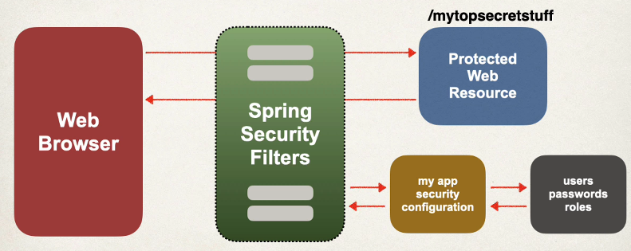
Spring security
Implemented using servlet filters in the background
  They are used to pre-process / post-process web request
  They can route web requests based on security logic
  Spring provides a bulk of security functionality with servlet filters
Two ways to secure an app: declarative & programmatic

Slide 17
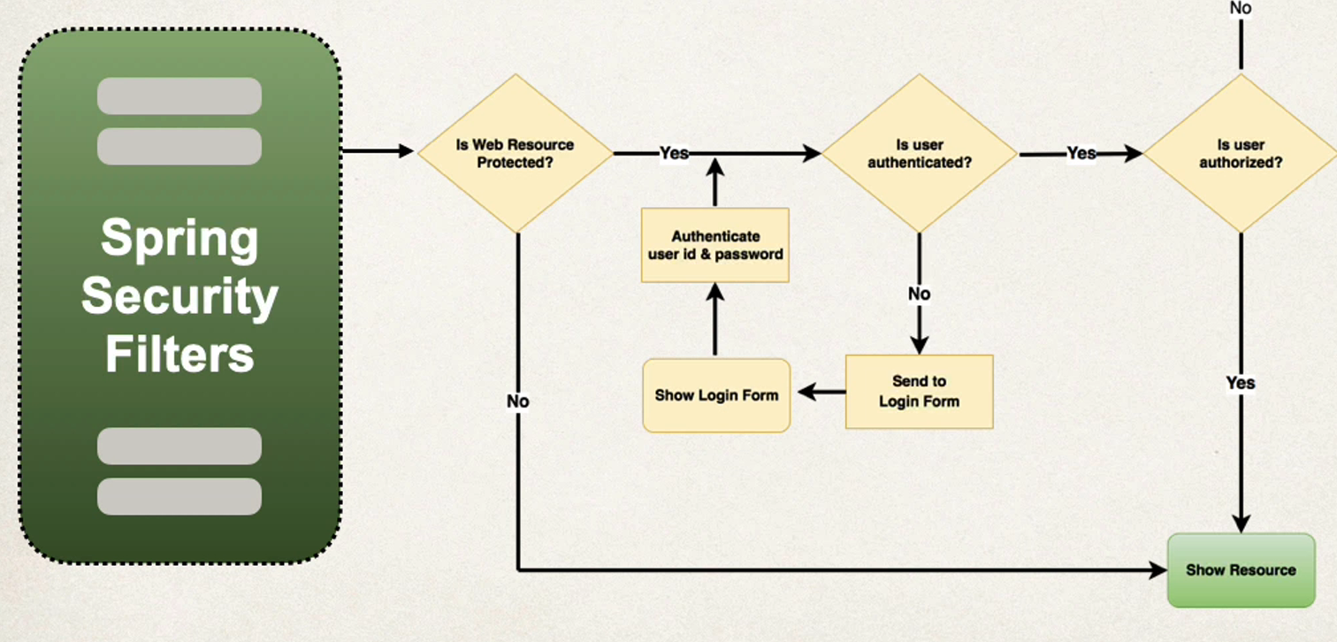
Authentication vs authorization
Authentication: Who are you?
Authorization: What can you do?
Usually defined by roles
RBAC – role-based access control

Slide 18
Declarative vs programmatic spring security
Declarative
  Built-in interfaces & concretions for UserDetailsManager, UserDetailsService, DaoAuthenticationProvider, etc.
  Less customizable, but there are built-in user tables, roles, etc.
Programmatic
  Spring Security provides an API for custom app code
  Provides great customization for specific app requirements
  We just need to implement some of the interfaces listed above
  This way we can make custom tables for users & roles, as well as more customizations available

Slide 19
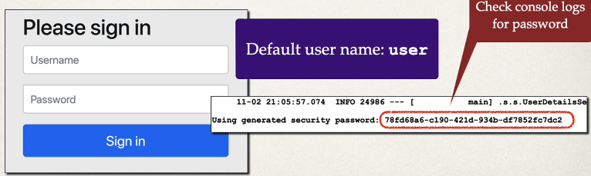

Enabling Spring Security
Edit the pom.xml and add ‘spring-boot-starter-security’
This will automatically secure all endpoints
Out-of-the-box, Spring Security will redirect and prompt for a username and password (that is generated in the logs)
We can override the default username/password in our application.properties file

Slide 20
Major Interfaces to be aware of

Slide 21
CORS (Cross-Origin Resource Sharing)
CORS is a browser security mechanism that controls whether a web page is allowed to access resources from a different origin. It's one of the most common concepts you'll encounter when building frontend applications that communicate with APIs.
An origin is the combination of three things:
  Protocol: http or https
  Hostname: example.com, api.example.com, etc.
  Port: 3000, 8080, etc.
  Two URLs have the same origin only if all three match.
Browsers enforce the Same-Origin Policy (SOP), which restricts how scripts running on one origin can interact with resources from another origin.
For example, imagine your frontend runs on:
http://localhost:3000
Your backend API runs on:
http://localhost:8080
Your frontend makes a request:
fetch("http://localhost:8080/api/users")
.then(response => response.json())
.then(data => console.log(data));
Even though both applications run on your machine, their ports differ, so they are different origins.
The browser checks whether the API server permits the frontend's origin. If the server doesn't provide the appropriate CORS headers, the browser blocks JavaScript from accessing the response.

Slide 22
Cross-Site Scripting (XSS) Attacks
Cross-Site Scripting (XSS) is a web security vulnerability that allows an attacker to inject malicious client-side code—usually JavaScript—into a web page that other users visit. When the browser executes that code in the context of the vulnerable website, the attacker may be able to manipulate the page, access sensitive information, or perform actions as the victim.
XSS is a major web application security concern because it exploits the trust a user's browser places in a website.
XSS attacks can:
  Steal accessible information: Read sensitive data exposed to JavaScript, such as account details or page content.
  Hijack sessions in some circumstances: Abuse session credentials or other authentication material that JavaScript can access. HttpOnly cookies cannot be read directly by JavaScript, which helps limit this risk.
  Perform actions as the victim: Trigger requests or change account settings using the victim's existing authenticated session, subject to application controls.
  Create convincing phishing pages: Replace legitimate page content with fake login prompts.
  Modify transactions or user data: Alter information displayed or submitted through the compromised page.
  Spread malicious content: In applications that allow persistent user-generated content, affect other users who view it.

Slide 23
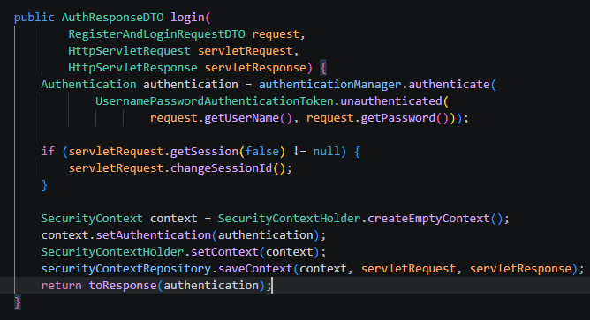
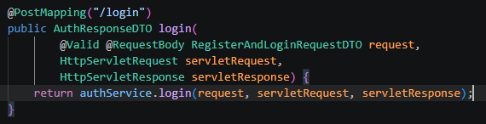
Avoiding XSS attacks
For browser-based applications, the easiest way is to enable HttpOnly cookies
These cookies can’t be accessed or edited by client-side JavaScript
Spring can do this for us automatically with the AuthenticationManager interface, which we will include as a Bean in our SecurityConfig class, and will be used in our AuthService class for login

Slide 24
CSRF (Cross-Site Request Forgery)
CSRF (Cross-Site Request Forgery) is a web security vulnerability in which an attacker tricks a user’s browser into sending an unwanted request to a website where the user is already authenticated.
The key idea is that the browser may automatically include a user's authentication cookies with a request, even when the user didn't intend to perform that action.
CSRF is also known as session riding.
Suppose a banking application uses this endpoint to transfer money:
POST /transfer HTTP/1.1
Host: bank.example
Cookie: session=abc123
Content-Type: application/x-www-form-urlencoded
recipient=attacker&amount=500
The application checks whether the session is authenticated but doesn't verify that the request originated from a legitimate form or action.
CSRF attacks could:
  Financial fraud: Initiate transfers or purchases.
  Account changes: Change an email address, shipping address, or other account settings.
  Security changes: Modify account recovery settings or potentially weaken account security.
  Administrative actions: Change permissions or create accounts if the victim has administrative privileges.
  Unauthorized actions: Publish content, modify records, or delete resources.

Slide 25
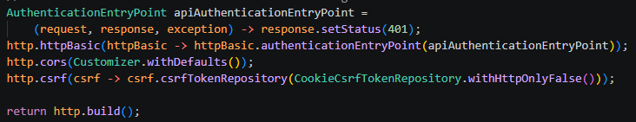
Avoiding CSRF attacks
Generate an unpredictable token and validate it on the server for every protected state-changing request. An attacker on another site generally cannot read the legitimate token because of browser same-origin restrictions.
Set session cookies to SameSite=Lax or, where compatible, SameSite=Strict. This limits when browsers send cookies with cross-site requests.
With a csrfTokenRepository (built-in with Spring Security) – we can automatically send randomly generated csrf tokens to clients via an exposed endpoint
  Clients will include this token in future request headers whenever they want to login or make state changes like PUT, DELETE, etc.

Slide 26
Stop
Please see ‘java_student_backend_RBAC’ in your course materials for the full example
First, hit the ‘api/auth/csrf’ endpoint to get a csrf token and include the token in your header for future requests
You can then create a user with the ‘api/auth/register’ endpoint: provide a userName + password
You can add roles to users with the ‘api/auth/assign-role’ endpoint.
  Valid roles are ADMIN, MANAGER, or USER
  Note this endpoint is NOT protected by default. (Just so you can elevate a user to admin to test other protected routes)
Hit the ‘api/auth/login’ endpoint to get an HttpOnly cookie that allows you to make subsequent requests to protected routes

