Slide 1
Langchain

Slide 2
What is Langchain?
Imagine we want to build an AI assistant that can:
  Answer questions using a local model, GPT, or Claude.
  Read PDF documents and answer questions about them.
  Remember previous conversations.
  Search the internet for information.
  Query a SQL database.
  Call Python functions and external APIs.
  Autonomously execute multi-step tasks.
We could write all of this ourselves using Python and individual APIs.
But we'd have to manage a lot of plumbing:
Connecting to language models.
Formatting prompts.
Managing conversation history.
Processing documents.
Searching relevant information.
Connecting tools to models.
Managing execution flows.
LangChain is a Python framework that helps us connect these components to build LLM-powered applications.

Slide 3
Langchain setup
We could use models running in the cloud
  Much more powerful
  Uses way more RAM you could fit in your PC – RIP PC/console prices
  Paid
We will instead run a local model
  Much weaker compared to cloud models
  Uses less RAM – some models only need 4-8 GB
  Free

Slide 4

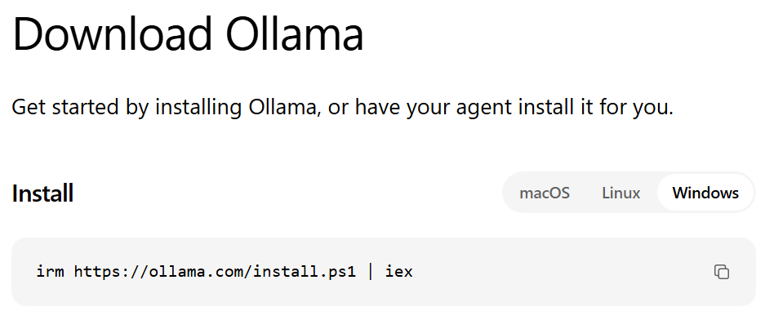
Langchain Setup - Ollama
Ollama – open-source platform for running and managing LLMs on local GPUs and through hosted cloud environments
  Provides a CLI & GUI
  https://ollama.com/search - we can search for models that fit our RAM requirements and project needs; Ollama can download and help us run these local models

Slide 5
Ollama cli commands
Command | What it does
ollama list | Lists downloaded models
ollama pull llama3.2 | Downloads a model
ollama run llama3.2 | Starts an interactive chat
ollama ps | Shows currently loaded models
ollama stop llama3.2 | Unloads a model
ollama show llama3.2 | Shows model information
ollama rm llama3.2 | Deletes a downloaded model
ollama serve | Starts the Ollama server
ollama --version | Shows installed version
ollama help | Shows CLI help
Note: Ollama servers on a default port of 11434

Slide 6
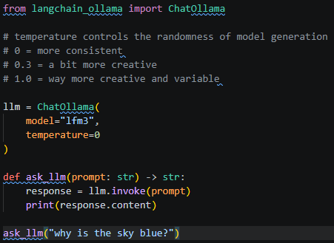
Langchain setup - ollama
Install the dependencies
Pull a model to use locally
  The lfm3 model is very small, around one GB
You can then create a py file to test it out!
  uv run nameOfFIle.py

Slide 7
STOP
Let’s look at the ‘python_fast_api_langchain_app’ to see how we can create endpoints that respond to llm requests, and answer questions about Postgres database records

Slide 8
Challenge Demo – How to Excel in this course
Goal:
Scenario: 5 min
Complete a hands-on challenge
Your organization needs to relay technical concepts to you. Clients often need to do the same. Take a few moments to get some pen and paper ready to take notes.

