Slide 1
Angular

Slide 2
MPA vs SPA
A Single-Page Application is a web application that loads one main HTML page and dynamically updates its content as the user interacts with it, without fully reloading the page.
  How it works:
  The browser initially loads the application.
  JavaScript retrieves and displays new data as needed.
  Navigation usually happens without a complete page refresh.
  Frameworks such as React, Angular, and Vue are commonly used.
A Multi-Page Application is a web application consisting of multiple HTML pages. When the user navigates to a different section, the browser generally requests a new page from the server and reloads the document.

Slide 3
Getting started
Install NPM
npm install -g npm@latest
ng new my-angular-app
cd my-angular-app
npm run start
Generating components (always us camelCase when generating components):
  Within app folder: ng generate component componentName
  Nested within app folder: ng generate component nested/componentName

Slide 4
What is a component?
In Angular, a component is a building block of an application that controls a specific part of the user interface (UI).
A component typically consists of three main things:
  HTML template — defines what appears on the screen.
  TypeScript class — contains the component's data and behavior.
  CSS styles — defines how the component looks.

Slide 5
Angular components
Selector – determines how we can reference the component inside other components
  E.g. <app-user></app-user>
Template – the markup for the component
  More commonly, we may use templateUrl instead to point to a separate template file
Styles – css for the component
  More commonly, we may use styleUrl instead to point to a separate CSS stylesheet
import { Component } from '@angular/core';
@Component({
selector: 'app-user',
template: `
<h1>Hello, {{ name }}!</h1>
<button (click)="changeName()">Change Name</button>
`,
styles: [`
h1 {
color: blue;
}
`]
})
export class UserComponent {
name = 'John';
changeName() {
this.name = 'Jane';
}
}

Slide 6
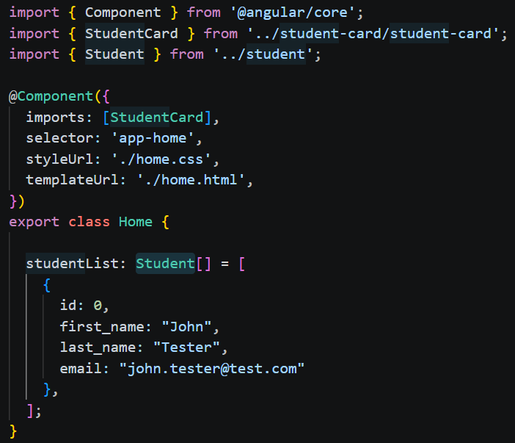
Another look at angular components
Here we are using separate files for the template and CSS
We are also including ‘StudentCard’ – another component
  Note that if we want to use one component inside another, we must import a reference to it in the parent component
Component Composition – the term we use to describe how components are nested and structured to compose our application
Inside the class, we will have functions and variables that may be referenced in the component

Slide 7
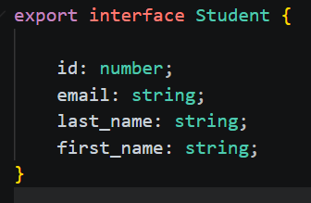
interfaces
We use interfaces to define custom datatypes we’d like to use in our app
You may have noticed ‘Student’ in our last example – that is an interface
To generate: npm run ng generate interface Student

Slide 8
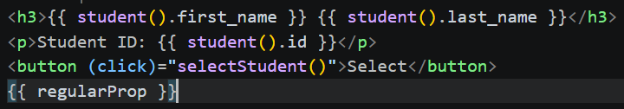
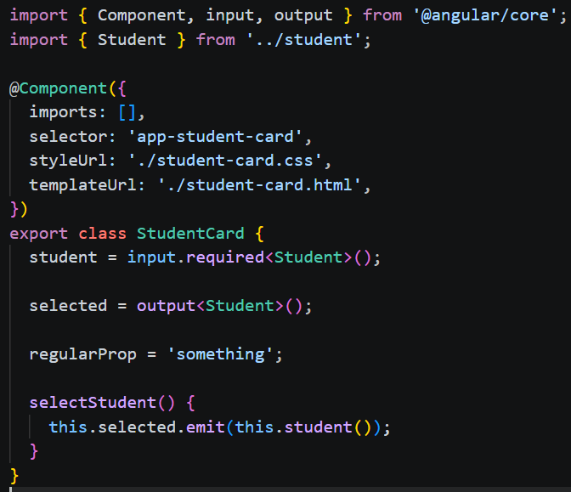
Student card & Component communication
Template (html file):
{{ student().name }} – this is interpolation
Interpolation – is the process of reading data from component logic, i.e. the ts file
Since the data is coming from an input, we use ‘signal’ syntax, i.e. ‘student()’ (more on signal later)
Regular properties may be called directly, i.e. ‘regularProp’
Input – allows us to take in data from a parent component
Output – allows us to emit data to a parent component
@Input & @Output – in older code you may see this syntax, it won’t benefit however from Angular’s signal API and reactivity (more on that later)
StudentCard ts file:

Slide 9
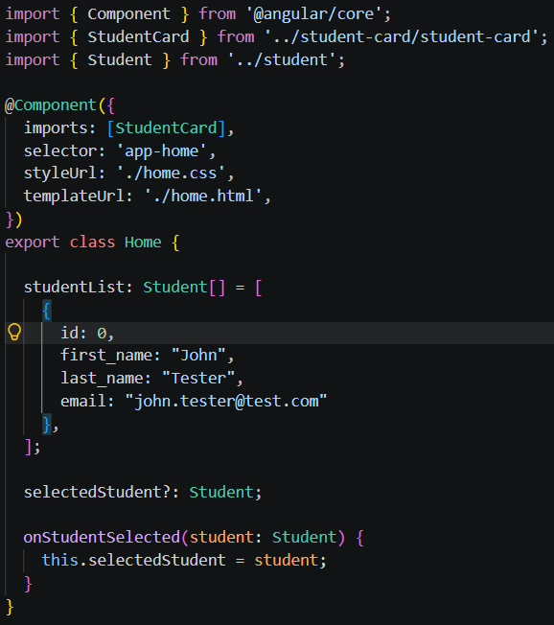
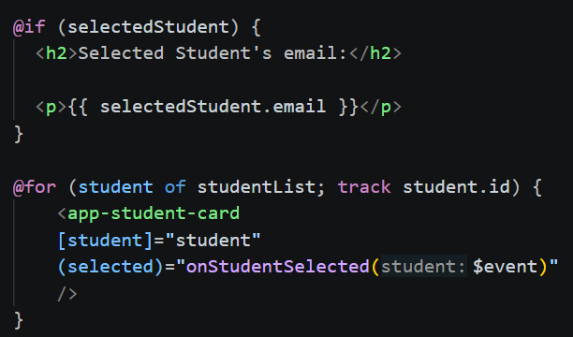
Home component & component communication
[student]=“student” – this is property binding, it is passing the value of student down to the input expected in the child component
(selected)=“onStudentSelected” – this is event binding, it is listening for the ‘selected’ even emitted in the child component
@if – control flow block for conditional rendering
@for – control flow block for iteration; important to use ‘track’ on unique elements so Angular can make changes to single items and doesn’t need to rebuild/regenerate the entire list when the collection changes
Home.ts:
Home.html:

Slide 10
Angular Control flow
1. @if — conditional rendering
@if (isLoggedIn) {
<p>Welcome!</p>
} @else {
<p>Please log in.</p>
}
if / else if / else
@if (user) {
<p>{{ user.name }}</p>
} @else if (loading) {
<p>Loading...</p>
} @else {
<p>No user found.</p>
}
2. @for — looping
@for (user of users; track user.id) {
<p>{{ user.name }}</p>
}
for each item in a collection.
You'll commonly see:
@for (item of items; track item.id) {
{{ item.name }}
} @empty {
<p>No items found.</p>
}

Slide 11
Angular control flow
@switch (status) {
@case ('loading') {
<p>Loading...</p>
}
@case ('success') {
<p>Success!</p>
}
@case ('error') {
<p>Error!</p>
}
@default {
<p>Unknown status</p>
}
}

Slide 12
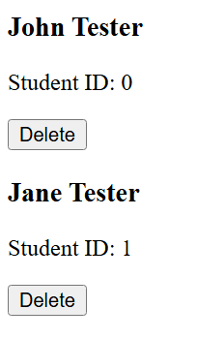

Challenge – components, control flow, & communication
Goal:
Scenario: 5 min
Delete students from the student list
You can use our previous examples to build off of
Instead of a ‘Select’ button, use a ‘Delete’ button instead on the student card
If no students are in the list, then print to the page: ‘No students found…’
Hint: use the standard JavaScript filter() method to help remove items from the list

Slide 13
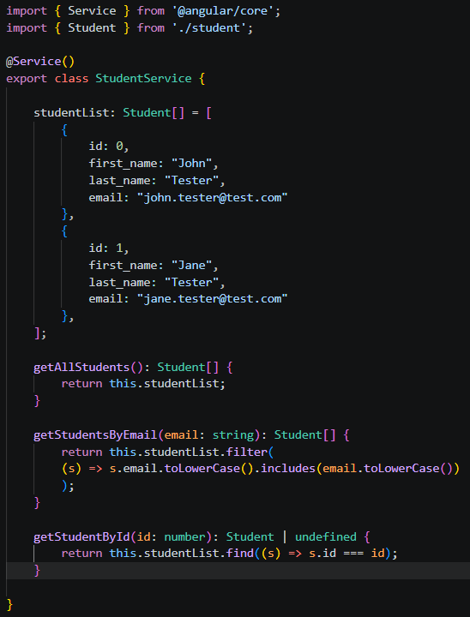
Angular services
Angular services provide a way for you to separate Angular app data and functions that can be used by multiple components in your app. To be used by multiple components, a service must be made injectable.
Dependency injection is the mechanism that manages the dependencies of an app's components and the services that other components can use.
npm run ng generate service studentService
We are hardcoding data into our service; we will build on this later - we can use our service to fetch the data dynamically!

Slide 14
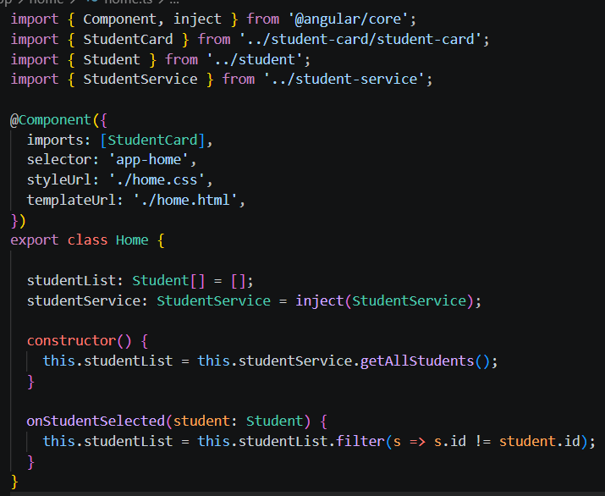
Injecting our service into home.ts
We now get our students from our service!

Slide 15
What is angular Routing? What is Deep linking?
Definition: Routing is the process to provide easy navigation between different views based on the browser URL
  This enables deep linking
  Handle URL parameters and query strings
  Manage browser history & navigation
  Create nested routes and layouts
  Implement protected routes for authentication
Definition: Deep Linking is the practice of using hyperlinks to send users directly to specific content within our applications
1-2 levels deep: most apps
  /dashboard
  /products/45
3-4 levels deeps: common for structured apps
  /dashboard/reports/weekly
  /shop/products/46/reviews
5+ levels deep: Rare but possible, usually in enterprise
  /orgs/12/projects/55/tasks/34/comments/2

Slide 16
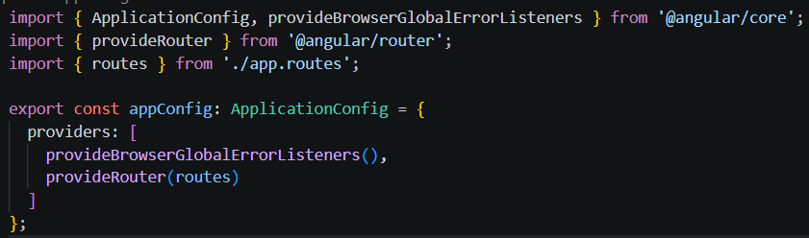
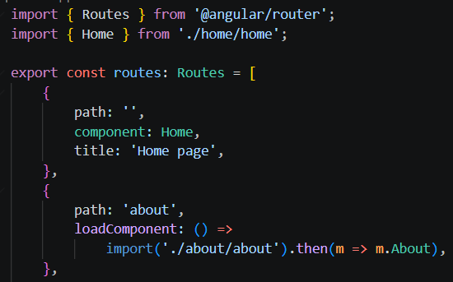
Implementing angular routing
App.config.ts:
Your build tool will typically autogenerate app.config.ts & app.routes.ts which pre-configures routing
We just need to add routes to app.routes.ts
The path represents your endpoint, i.e. localhost:1234/about
‘Home’ showcases eager loading, ‘about’ showcases lazy loading
Lazy loading ensures the client doesn’t need to download the JavaScript until they visit that page
This is great for optimization of large sites & rarely used views
App.routes.ts:

Slide 17
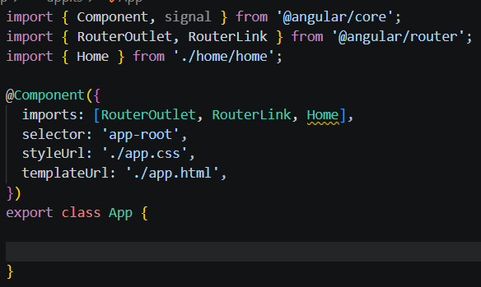
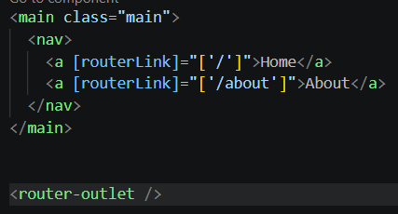
Implementing angular routing
Now we can use ‘routerLink’ to set our activated route
We need to bring in ‘RouterLink’ to create router linked anchor tags for the component
The activated route will render the view(component) in the <router-outlet>
App.ts:
App.html:

Slide 18
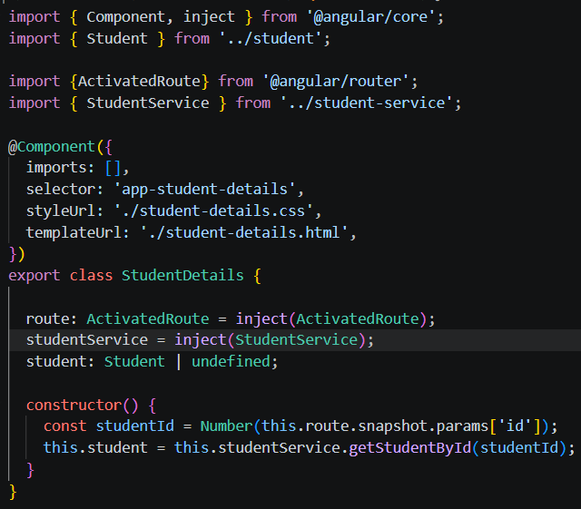

Angular routing with route parameters
Student-details.ts:
This is a new component that reads route params and then uses our service to get details about the student (it’s really just showing an extra field compared to our card - email)
Student-details.html:

Slide 19

Angular routing with route parameters
Now our StudentCard component can have a link to details for that particular student!
Don’t forget to bring in ‘RouterLink’ in its associated TypeScript file!
And if you have nested routes:
  For example, if your route is:
  { path: 'students/:studentId/courses/:courseId', component: ... }
  Your routerLink would be:
  <a [routerLink]="['/students', student().id, 'courses', course.id]">Course Details</a>

Slide 20
Challenge – catch-up
Goal:
Scenario: 5 min
Make sure to stop here and catch up
Implement StudentService
Create an ‘About’ component to act as a view to describe our website
Create a ‘StudentDetails’ component that displays all fields of student
  It should use route parameter routing to dynamically populate this info

