Slide 1
Advanced Java, Design Patterns, & JDBC

Slide 2
Collections
A collection is an object that stores multiple objects together
Collections are accompanied by ‘Generics’ – which tell Java the datatype the collection stores i.e. List<Integer>
Why not List<int>?
  That’s because collections store objects, not primitive types
  Wrapper classes are provided such as: Integer, Long, Double, Boolean, etc.
Instead of this:
We can do this:
String student1 = "Alice";
String student2 = "Bob";
String student3 = "Charlie";
List<String> students = new ArrayList<>();
students.add("Alice");
students.add("Bob");
students.add("Charlie");

Slide 3
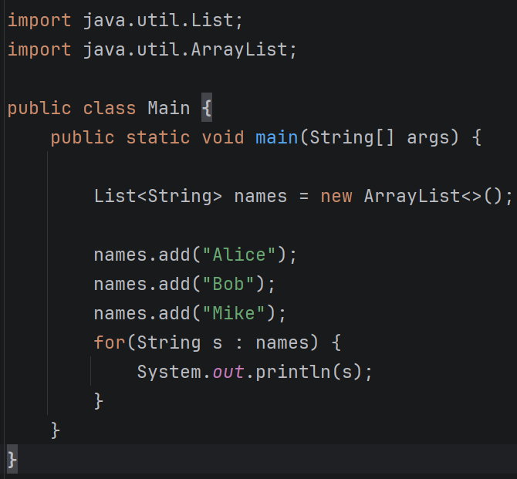
Collections API
We have many types of collections, which usually inherit the Collection interface, except for Map
  Map is still considered to be part of the Collections API however
Collections from the API are imported from ‘java.util’
Prefer interfaces over concretions
  I.e. List<String> names = new ArrayList<>();
  NOT ArrayList<String> names = new ArrayList<>();

Slide 4
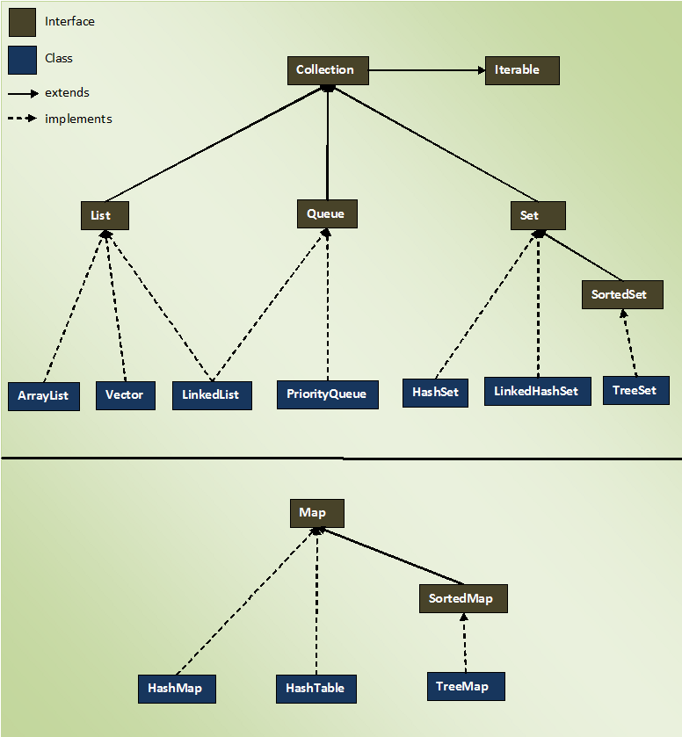
Collection API Hierarchy

Slide 5
Iterable
Many collections implement the Iterable interface
This defines data structures that can be traversed using the .iterator() method, which returns an Iterator data type
These types of collections can be traversed using enhanced for loop syntax
List<String> names = new ArrayList<>();
names.add("Hal");
names.add("John");
Iterator<String> it = names.iterator();
while (it.hasNext()) {
String name = it.next();
System.out.println(name);
}

Slide 6
List
List are:
  Ordered
  Allow duplicate values
List<String> names = new ArrayList<>();
names.add("Alice");
names.add("Bob");
names.add("Alice");
System.out.println(names.get(0)); // Alice
names.set(0, "Hal");
System.out.println(names.get(0)); // Hal
names.remove(0);
System.out.println(names.get(0)); // Bob
System.out.println(names.size()); // 2
System.out.println(names.contains("Bob")); // true
names.clear();
System.out.println(names.size()); // 0

Slide 7
LinkedList – queue, deque, & stack
LinkedLists are:
  A collection that stores elements via connected nodes
  Java LinkedLists are ‘doubly linked’ – meaning each node has private properties that refer to the previous and next nodes
  Queue (FIFO):
    Offer() – add to a queue (at the end)
    Poll() – remove from the front
    Peek() – look at the front
  Deque – short for double-ended queue; extends from Queue, so we get all its implementation + methods from Deque, this allows to add/remove from both ends simultaneously
    addFirst() – add to start; throws exception on fail
    addLast() – add to end; throws exception on fail
    removeFirst() – remove from start; throws exception on fail
    removeLast() – remove from end; throws exception on fail
    offerFirst, offerLast, pollFirst, pollLast, peekFirst – returns Boolean false on failure
  Deqeue can also behave like a stack with push()/pop() methods
List<Integer> list = new LinkedList<>();
Queue<Integer> queue = new LinkedList<>();
Deque<Integer> deque = new LinkedList<>();
deque.offerLast(10);
deque.offerLast(20);
deque.offerLast(30);
System.out.println(deque.pollFirst()); // 10
deque.offerFirst(5);
System.out.println(deque.pollFirst()); // 5
deque.offerLast(4);
System.out.println(deque.pollLast()); // 4

Slide 8
Set
Set<Integer> numbers = new HashSet<>();
numbers.add(10);
numbers.add(20);
numbers.remove(20);
System.out.println(numbers.contains(10)); // true
Set<String> names = new LinkedHashSet<>();
names.add("Charlie");
names.add("Alice");
names.add("Bob");
for(String s : names) {
System.out.println(s); // Charlie, Alice, Bob
}
Set<Integer> numbers2 = new TreeSet<>();
numbers2.add(50);
numbers2.add(10);
numbers2.add(30);
numbers2.add(20);
for(Integer i : numbers2) {
System.out.println(i); // 10, 20, 30, 50
}
Sets are:
  Collections that store unique elements
  Not indexed
  Only ordered based on implementation
    HashSet – not ordered
    LikedHashSet – ordered based on how elements were inserted
    TreeSet – sorted

Slide 9
Map
Maps are:
  Collections of key/value pairs
Map<Integer, String> students = new HashMap<>();
students.put(101, "Alice");
students.put(102, "Bob");
System.out.println(students.get(101)); // Alice
students.put(101, "Hal");
System.out.println(students.get(101)); // Hal
System.out.println(students.containsKey(101)); // true
System.out.println(students.containsValue("Bob")); /true
students.remove(102);
System.out.println(students.containsValue("Bob")); // false
System.out.println(students.size()); // 1
System.out.println(students.isEmpty()); // false

Slide 10
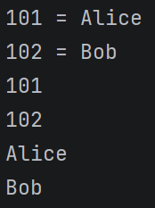
Map - iteration
Map<Integer, String> students = new HashMap<>();
students.put(101, "Alice");
students.put(102, "Bob");
for (Map.Entry<Integer, String> entry : students.entrySet()) {
System.out.println(entry.getKey() + " = " + entry.getValue());
}
for (Integer id : students.keySet()){
System.out.println(id);
}
for (String name : students.values()){
System.out.println(name);
}

Slide 11
Map
LinkedHashMap – retains insertion order
TreeMap – keeps keys sorted
Map<String, Integer> ages = new LinkedHashMap<>();
ages.put("Charlie", 22);
ages.put("Alice", 25);
ages.put("Bob", 30);
Map<Integer, String> students = new TreeMap<>();
students.put(103, "Charlie");
students.put(101, "Alice");
students.put(102, "Bob");

Slide 12
Further reading
Check out the following:
  ArrayDeque and PriorityQueue
  Comparable + Comparator Interface

Slide 13
Equals() & Hashcode()
equals() – are these two objects logically equal?
hashCode() – which hash bucket should this object belong to?
If equals() = true, then so should their hashCodes
String a = new String("hello");
String b = new String("hello");
System.out.println(a.equals(b)); // true
System.out.println(a.hashCode()); // same value
System.out.println(b.hashCode()); // same value

Slide 14
Equals() & Hashcode()
equals() – based on object identity
Notice the previous example with strings showed true, this is because it’s pulling the same string from the String Pool
Here we are showing false, because its checking equality based on the memory address
class Person {
String name;
}
Person p1 = new Person();
Person p2 = new Person();
p1.name = "John";
p2.name = "John";
System.out.println(p1.equals(p2)); // false

Slide 15
Equals() & Hashcode()
We can override both equals() + hashCode()
Here we override equals() so that the name of the person determines equality, not the default implementation which only looks at the memory address
class Person {
String name;
@Override
public boolean equals(Object obj) {
if (this == obj) return true;
if (!(obj instanceof Person)) return false;
Person other = (Person) obj;
return name.equals(other.name);
}
}

Slide 16
Equals() & Hashcode()
Why does Java need both methods?
Consider HashMaps/HashSets
If we implemented equals(), and ‘Alice’ defines equality, then we’d expect a size of 1
But if we only implemented equals(), and not also hashCode(), size() may return 2
As a result, if we override equals(), it is best practice to also override hashCode()
Set<Person> people = new HashSet<>();
Person p1 = new Person();
p1.name = "Alice";
Person p2 = new Person();
p2.name = "Alice";
people.add(p1);
people.add(p2);
System.out.println(people.size());

Slide 17
Lambda Expressions
Some methods accept Lambda Expressions as input, such as the Iterable interface .forEach() method
For multiple parameters, parenthesis are required
Curly braces are required if using multiple statements
Return keyword is optional if using a single statement because that is what will be returned
List<String> names = new ArrayList<>();
names.add("Alice");
names.add("Bob");
names.add("Charlie");
names.forEach(str -> System.out.println(str));

Slide 18
Functional interfaces
Functional interfaces are interfaces that have exactly one abstract method.
A lambda expression can be used as an implementation of that abstract method. The lambda's parameters and return value must be compatible with the functional interface's method declaration.
Functional interfaces allow us to pass not only data into a method, but also behavior. This allows a method to receive instructions about what it should do, rather than having that behavior hardcoded inside the method.
We don’t often need to create our own (although we can), instead you will likely run into these common built-in functional interfaces:
Interface | Input | Output | Example
Predicate<T> | 1 | boolean | name -> name.startsWith("A")
Function<T,R> | 1 | anything | name -> name.length()
Consumer<T> | 1 | void | name -> System.out.println(name)
Supplier<T> | 0 | 1 value | () -> "Hello"
UnaryOperator<T> | 1 | same type | n -> n * 2
BinaryOperator<T> | 2 | same type | (a,b) -> a + b

Slide 19
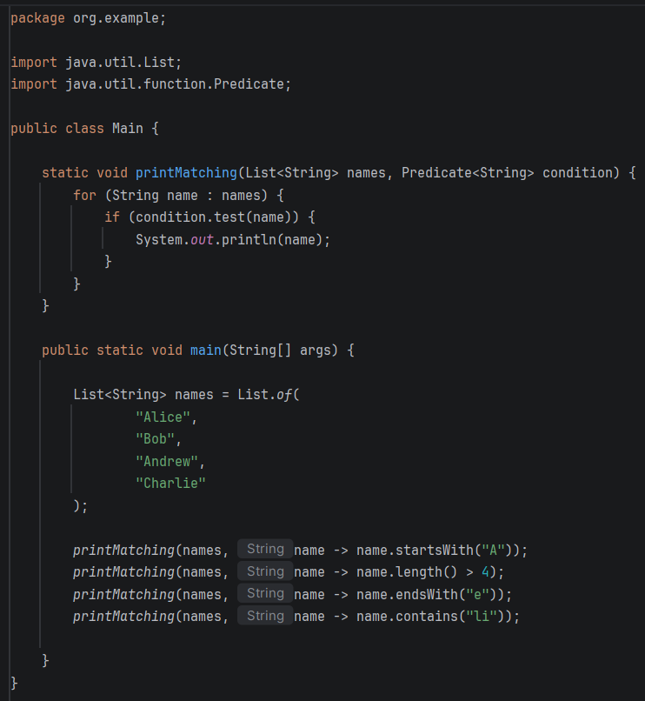
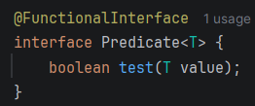
Functional Interface
Predicate
Built-in – essentially looks like this:

Slide 20
Functional Interfaces
Function<T, R>
Function<String, Integer> getLength = text -> text.length();
int length = getLength.apply("Hello");
System.out.println(length); // 5
Supplier<T>
Supplier<String> greeting = () -> "Hello!";
String message = greeting.get();
System.out.println(message);
Consumer<T>
Consumer<String> print = text -> System.out.println(text);
print.accept("Hello");

Slide 21
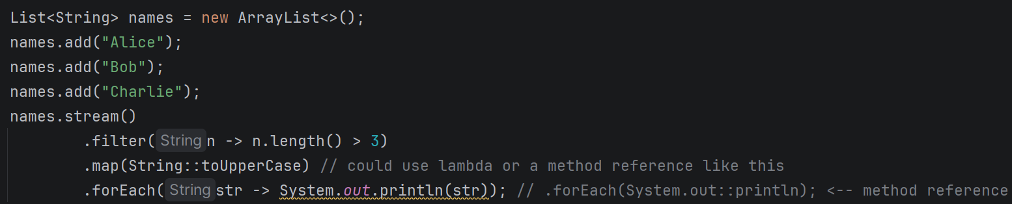
Stream API
A Java Stream is a way to process a sequence of data declaratively
Stream Pipeline: Source → Intermediate Operations → Terminal Operations
names.stream() ← source
Filter(), map(), sorted(), distinct(), limit(), skip(), etc. ← intermediate operations
forEach(), toList(), collect(), reduce() ← terminal operations; toList() more modern than collect()

Slide 22
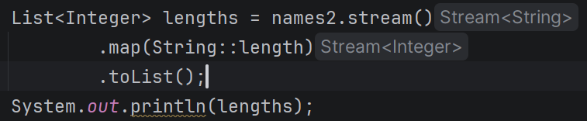

Stream API – another example with toList()

Slide 23
Big O notation
Big O notation is a tool to describe the efficiency and scalability of an algorithm
It measures how the execution time (Time Complexity) or memory usage (Space Complexity) of your code grows as the input size (usually denoted as ‘n’) increases
Big O doesn’t measure exact time to completion – it focuses on a worse-case scenario and how many operations are required to complete an algorithm

Slide 24
O(1) – constant time
The runtime does not change, no matter how large the output grows
public int getFirstElement(int[] array) {
return array[0];
}

Slide 25
O(logn) – logarithmic Time
The problem is cut in half with each step
Such as with a binary search on a sorted array
public int binarySearch(int[] sortedArray, int target) {
int left = 0;
int right = sortedArray.length - 1;
while (left <= right) {
int mid = left + (right - left) / 2;
if (sortedArray[mid] == target) return mid;
if (sortedArray[mid] < target) left = mid + 1;
else right = mid - 1;
}
return -1; // Halves the search space each iteration
}

Slide 26
O(n) – linear time
The execution time grows proportionally with the input size
If your data doubles, the time doubles
// A simple loop visiting every item in an array is O(n)
public void printAllItems(int[] array) {
for (int item : array) {
System.out.println(item);
}
}

Slide 27
O(n^2) – quadratic time
Performance is dependent on the square of the input size
Examples include nested loops
If data doubles, execution time quadruples
// Nested loops results in O(n^2)
public void printAllPairs(int[] array) {
for (int i : array) {
for (int j : array) {
System.out.println(i + ", " + j);
}
}
}

Slide 28
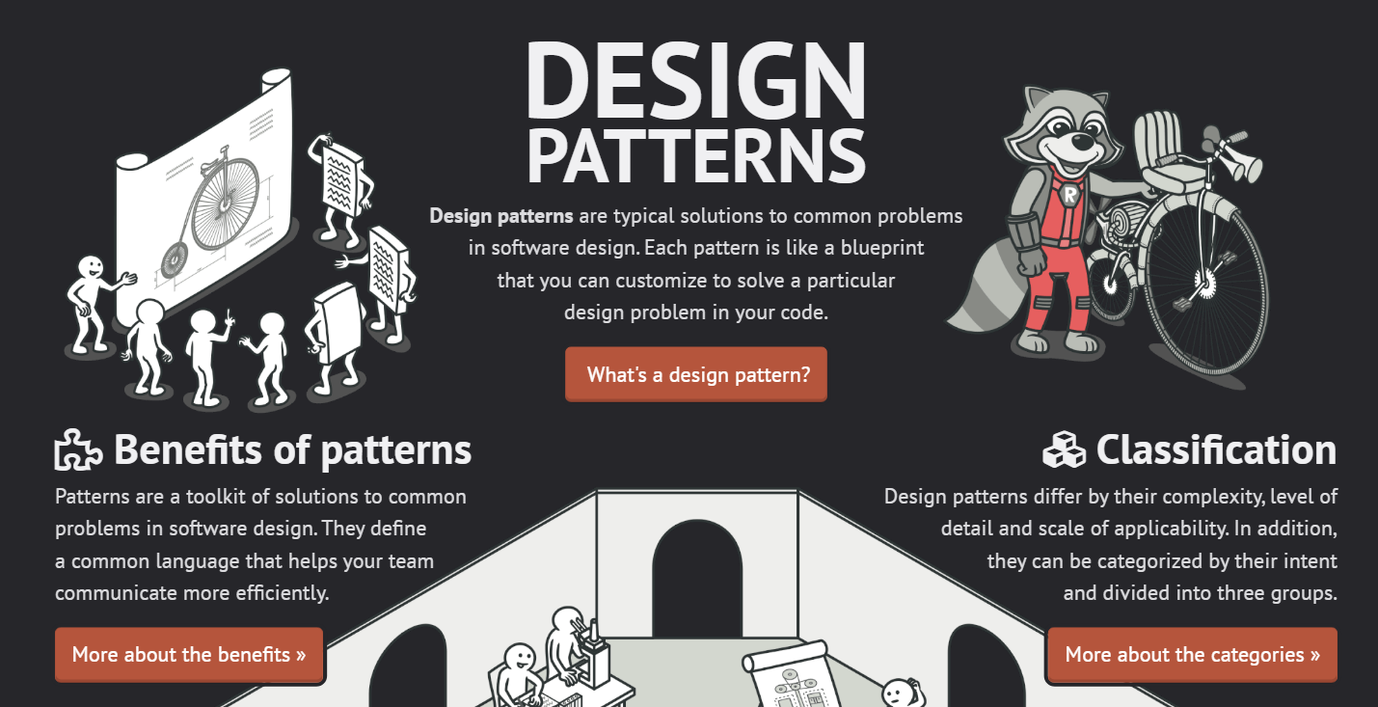
Design Patterns
From refactoring.guru:

Slide 29
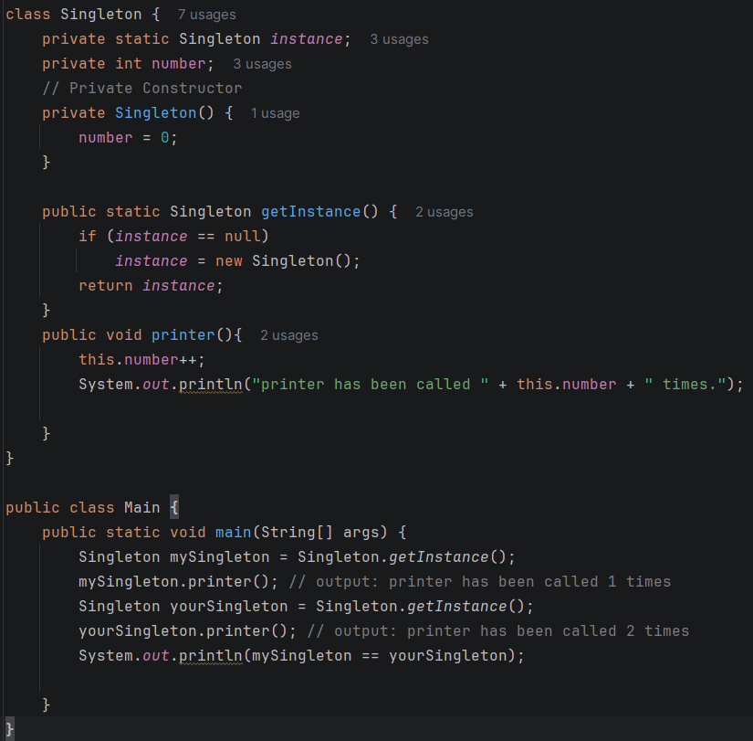
Singleton
A Singleton allows the creation of an object in memory that is shared across the application
We don’t often create these ourselves, but instead consume pre-built singletons as part of frameworks
For example, in Spring, as part of dependency injection, a singleton will automatically be provided when needed

Slide 30
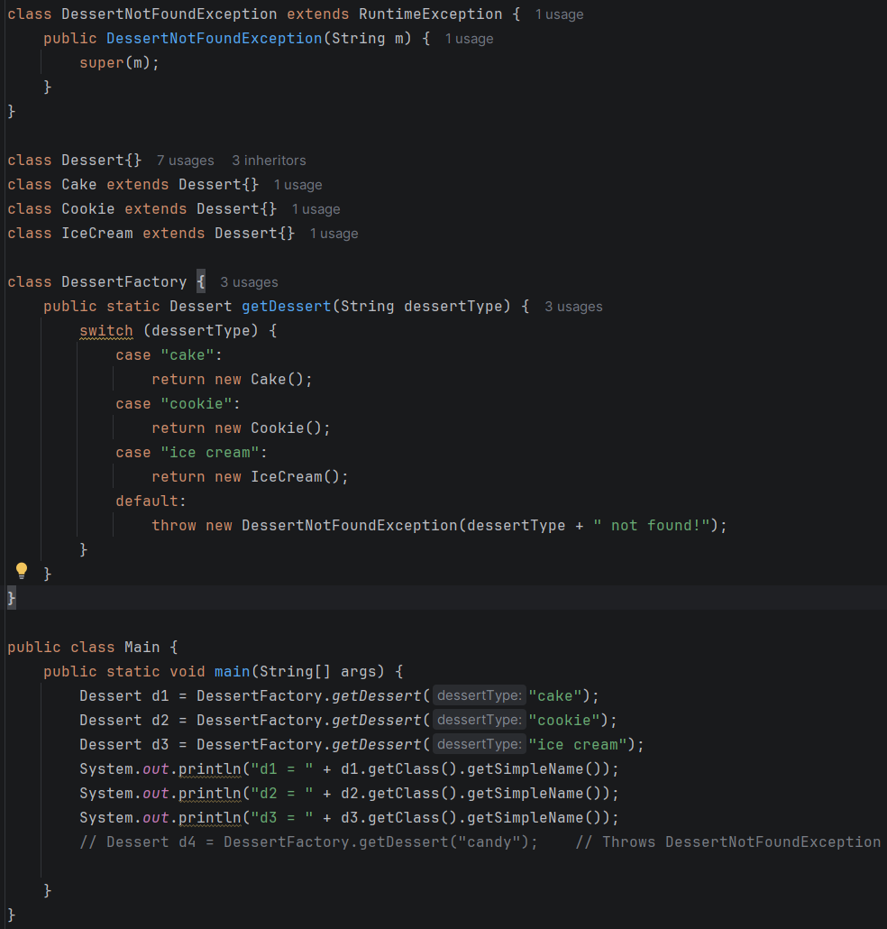
FACTORY Design Pattern
This is also rare for standard CLEAN code Java API applications. We wouldn’t often need this, but one good example is payment processors.
I.e. Stripe vs PayPal vs Debit transactions may need a different concretion based on what the user selects at runtime

Slide 31
Observer Pattern
public interface Observer {
void update(String message);
}
public class EmailNotifier implements Observer {
@Override
public void update(String message) {
System.out.println("Sending email: " + message);
}
}
import java.util.ArrayList;
import java.util.List;
public class Order {
private final List<Observer> observers = new ArrayList<>();
public void addObserver(Observer observer) {
observers.add(observer);
}
public void removeObserver(Observer observer) {
observers.remove(observer);
}
public void ship() {
// change state
System.out.println("Order shipped");
notifyObservers("Order has shipped");
}
private void notifyObservers(String message) {
for (Observer observer : observers) {
observer.update(message);
}
}
}
The Observer pattern is useful for pub/sub designs – still rare for most Java API CLEAN code apps.
Use Observer when the publisher shouldn’t need to know who is interested in its state changes, and the set of interested parties can vary.
public class AuditLogger implements Observer {
@Override
public void update(String message) {
System.out.println("AUDIT: " + message);
}
}
Order order = new Order();
order.addObserver(new EmailNotifier());
order.addObserver(new AuditLogger());
order.ship();

Slide 32
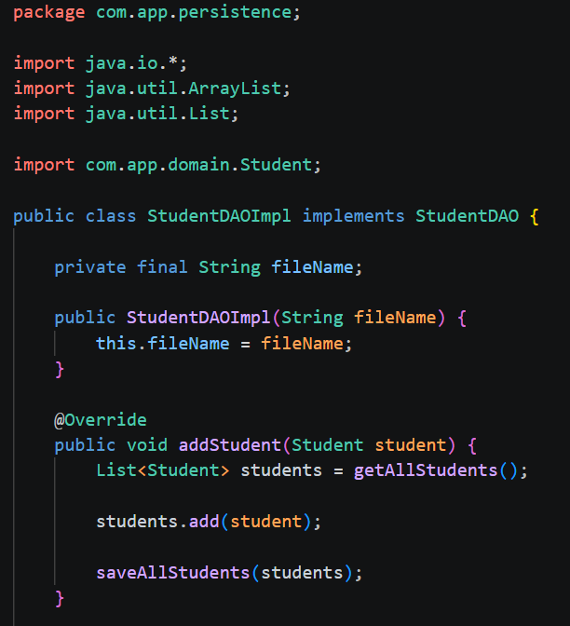
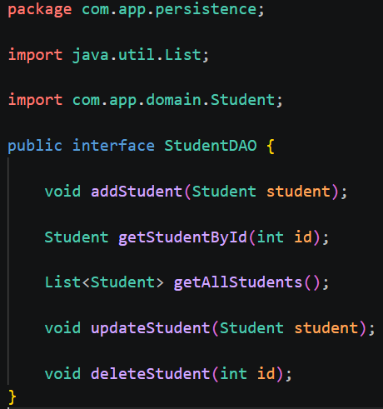
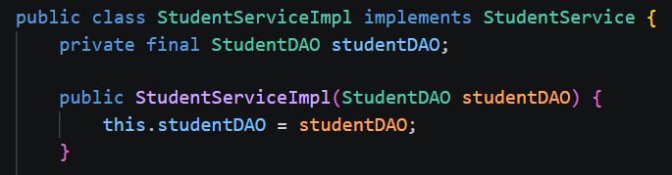
DAO (data access object) Pattern
The DAO pattern separates data-access code from the rest of the application
Very close conceptually to the repository design pattern, but emphasis varies:
  DAO – an abstraction over how you access the database;
  i.e. Service → DAO → JDBC
  Repository – an abstraction over the collection of Domain objects;
  i.e. Service → Repo → JPA/Hibernate

Slide 33
I/o
2 broad categories:
  Streams – read/write bytes
  Reader/Writer – read/write characters
FileInputStream - reads raw bytes from a file
FileOutputStream - writes raw bytes to a file
FileReader - reads characters from a file
FileWriter - writes characters to a file
BufferedReader - reads a file line by line, needs an instance of a FileReader with a path to the resource to be read in the constructor
BufferedWriter - writes to a file line by line, needs an instance of a FileWriter with a path to the destination file in the constructor
Scanner - can read from an InputStream, useful methods for character reading

Slide 34
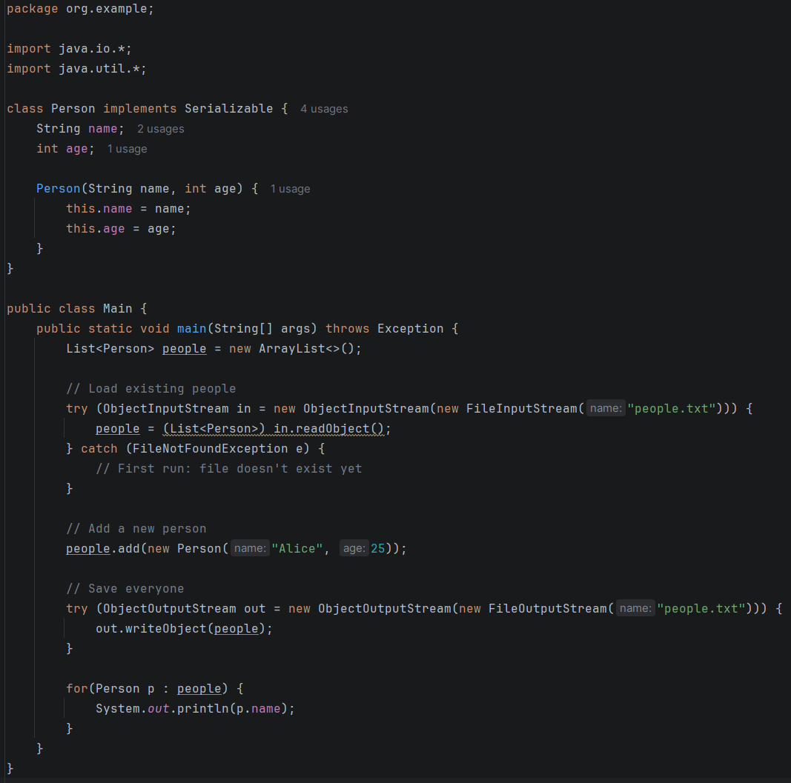
Serialization & Deserialization
Serialization – turning an object in memory into bytes so we can save/send it somewhere (we don’t necessarily need to save things in bytes, we could use normal text, this is just one option)
Deserialization - turning those bytes back into an object

Slide 35
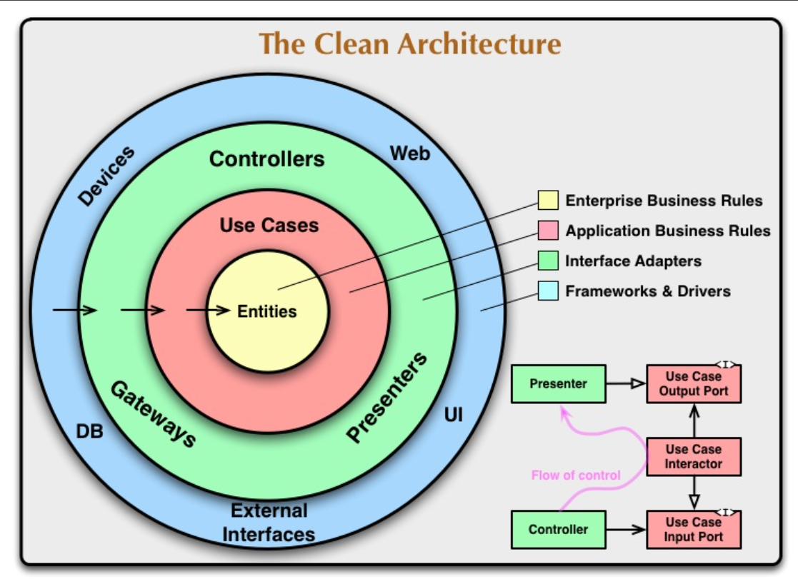
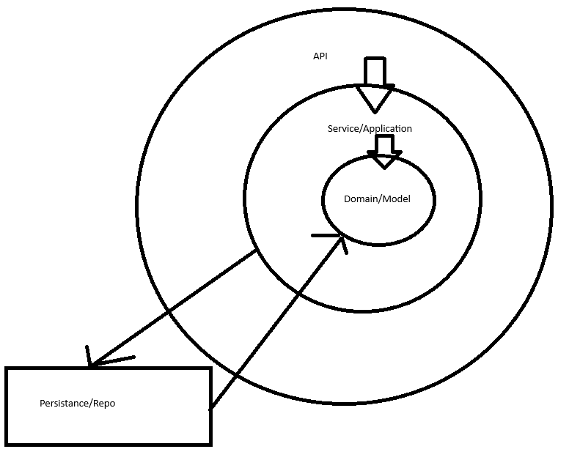
CLEAN Code

Slide 36
STOP
This is a checkpoint
Create a CLEAN code app that reads/writes to files here
See the ‘cleancode’ project in your course materials as reference
To run app with an interactive console (VSCODE won’t automatically do this):
mvn exec:java "-Dexec.mainClass=com.cleancode.api.Main"

Slide 37
JDBC
Java Database Connectivity, or JDBC, is a Java API that allows our applications to connect and interact with different databases, such as PostgreSQL, MySQL, Microsoft SQL, etc.
It consists of classes and interfaces that enable the application to access and send requests to the database made by users.
JDBC has four main components used to connect to the database.
  JDBC API
    A collection of various classes, methods, and interfaces to communicate with a database, packaged in the java.sql and javax.sql packages.
  JDBC Driver Manager
    A class within the JDBC API that loads database-specific drivers in the Java application to establish a connection with the database by making a call to a specific database to process a user's request.
  JDBC Test Suite
    Used to test operations performed on the database using the JDBC drivers.
  Database Server
    The database server that the JDBC client will communicate with.

Slide 38
JDBC interfaces
Driver
  An interface that is the base interface for every driver class. If you want to create your own driver class, you would implement this interface. Loading a driver class will create an instance of itself and register it with the DriverManager.
Statement
  An interface that represents a static SQL statement, allowing you to execute that statement and obtain the results.
PreparedStatement
  Represents a pre-compiled statement that you can execute multiple times. You can get an object from this interface using the method of the connection interface prepareStatement(). It allows you to get and set values for the variables of the prepared statement.
CallableStatement
  This object allows for the execution of stored procedures. It returns a single or multiple results and will accept input parameters as well. It is created using the prepareCall() method of the Connection interface. Like the PreparedStatement interface, it provides get and set methods for those variable values to pass input parameters.
Connection
  An interface that represents the connection with a specific database, through which SQL statements are executed. It includes additional transactional methods to handle commits and rollbacks.
ResultSet
  Represents the database result set, a table generated by executing the SQL statements, and provides getter and update methods to retrieve and update its content, respectively.
ResultSetMetaData
  An interface used to get information about the result set, such as the number of columns, the names of the columns, data types of the columns, etc.

Slide 39
Execute, excetuteQUery, & executeupdate
Method | SQL | Returns
executeQuery() | SELECT | ResultSet
executeUpdate() | INSERT, UPDATE, DELETE | int (rows affected)
execute() | SQL where result type may vary | boolean

Slide 40
Resultlset methods
next()
  Moves the cursor to the next row in the result set and returns true if a valid row exists. This method is typically used in a loop to iterate through all rows.
previous()
  Moves the cursor to the previous row in the result set and returns true if a valid row exists.
first()
  Moves the cursor to the first row in the result set and returns true if a valid row exists.
last()
  Moves the cursor to the last row in the result set and returns true if a valid row exists.
absolute(int row)
  Moves the cursor to the specified row number, where the first row is 1. Returns true if the specified row is valid.
relative(int rows)
  Moves the cursor forward or backward by the specified number of rows. The argument can be positive or negative, indicating the direction and magnitude of movement.
isFirst()
  Returns true if the cursor is currently positioned at the first row in the result set.
isLast()
  Returns true if the cursor is currently positioned at the last row in the result set.

Slide 41
Callable statement example – in & out param
CallableStatement statement =
connection.prepareCall("{call calculate_gpa(?, ?)}");
statement.setInt(1, 42);
statement.registerOutParameter(2, Types.DOUBLE);
statement.execute();
double gpa = statement.getDouble(2);

Slide 42
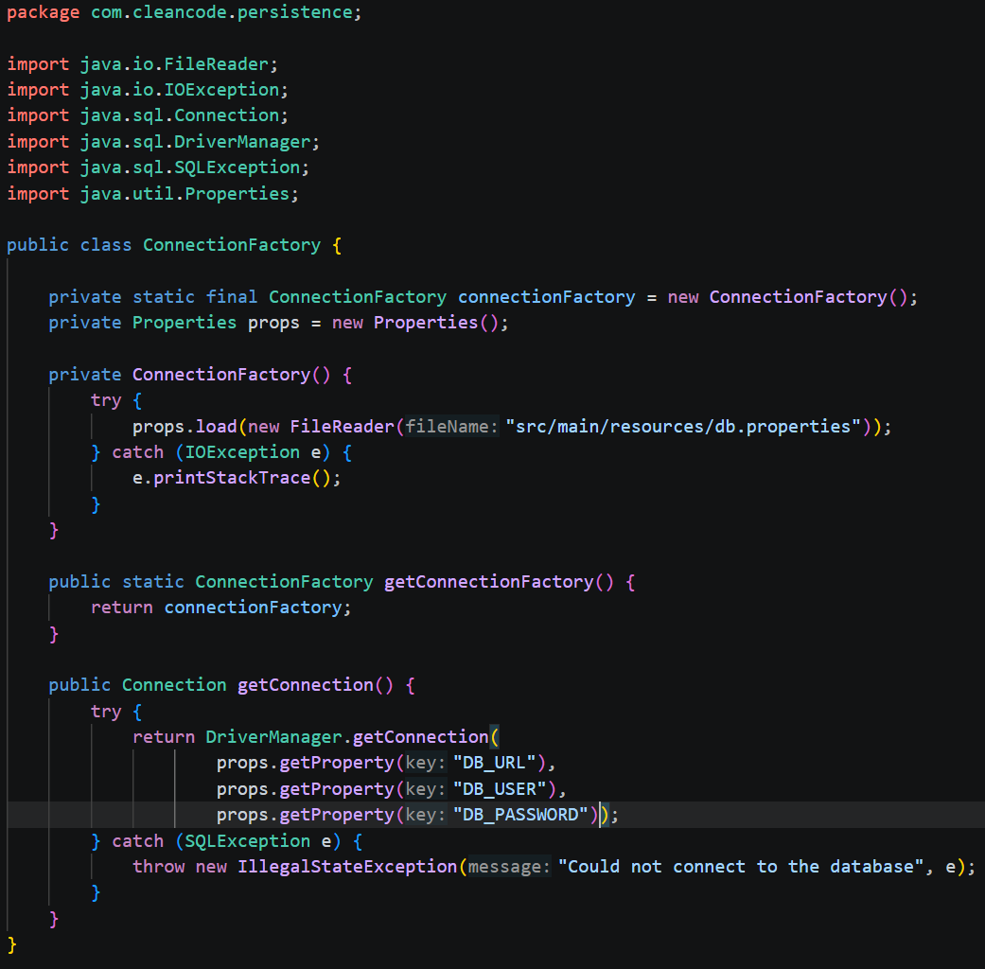
Creating a connectionfactory utility class
java.util.Properties – allows us to keep secrets safe in a db.properties file
We can use this utility class to generate a connection whenever we need to execute commands against our database
If using AWS RDS:
  The user/password is your RDS master user + master password
  We will see how to find the URL later

Slide 43
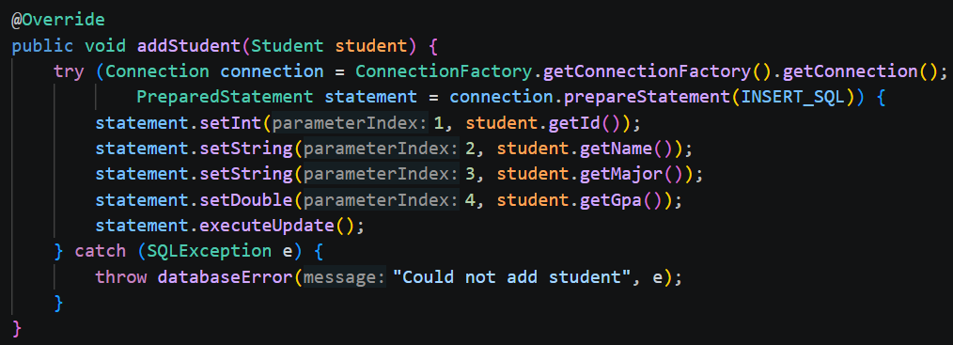
Using our utility class, preparedstatements, & SQL Injection
In our DAO concretion, we can get a connection from our factory
Prepared statements let us dynamically inject values into SQL queries while treating the injected data as data, and not more SQL code
  THIS HELPS PREVENTS SQL INJECTION
  Statement is more prone to SQL injection attacks because SQL is constructed as a complete string before execution, allowing user input to become part of the SQL syntax
  PreparedStatement separates SQL from user-supplied data, preventing this

Slide 44
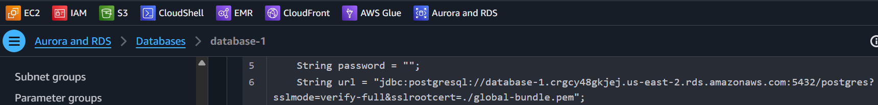
Connecting JDBC with RDS - Postgres
Get PEM public key so we can enable encrypted traffic (place in project root)
  https://truststore.pki.rds.amazonaws.com/global/global-bundle.pem
  We can see when AWS will rotate these at ‘Aurora and RDS → Certificate update’
On the ‘Connectivity & Security’ tab within RDS, they provide code snippets
You can find the link for the above on some of those snippets
Check out the JDBC code snippet to get your unique server URL, with enabled encryption

Slide 45
STOP
This is a checkpoint
Create a CLEAN code app that reads/writes to Postgres here
See the ‘cleancodeWithJDBC’ project in your course materials as reference
To run app with an interactive console (VSCODE won’t automatically do this):
mvn exec:java "-Dexec.mainClass=com.cleancode.api.Main"

Slide 46
Challenge Demo – How to Excel in this course
Goal:
Scenario: 5 min
Complete a hands-on challenge
Your organization needs to relay technical concepts to you. Clients often need to do the same. Take a few moments to get some pen and paper ready to take notes.

