Slide 1
TypeScript

Slide 2
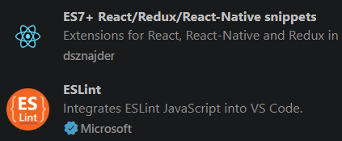
TypeScript
TypeScript is JavaScript + Types
Made by Microsoft
Makes larger apps scale easier
Gives our linters warnings when we make typos / use incorrect types
VS Code extensions:

Slide 3
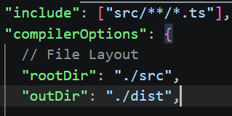
Typescript – Intro Commands & tsconfig intro
npm install -g typescript
tsc --version
compile files:
  tsc app.ts -> compiles into .js file
  tsc --build src (to build included files in src via tsconfig)
tsc --init -> generates tsconfig.json file (compiler settings)

Slide 4
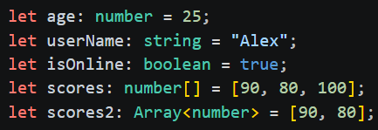
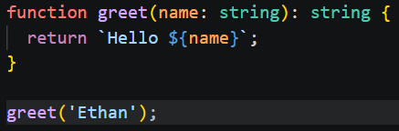
TypeScript
With TypeScript we assign types ☺
Variables, functions, classes, etc may now all accept type definitions

Slide 5
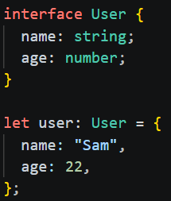
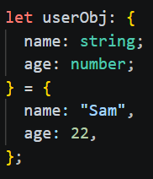
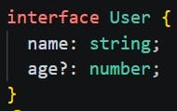
TypeScript – Objects & Interfaces
We can define object literals with types
We use interfaces to define reusable types
We typically use interfaces over classes when defining new types because interfaces define only a contract and will not generate any runtime code like a class would
We can mark a field as nullable with ‘?’ when defining interfaces
The readonly keyword may be used to mark properties as constants

Slide 6
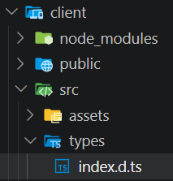
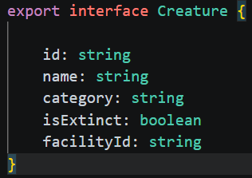
TypeScript – Definition Files
‘.d.ts.’ file extension
Contains no runtime code, only definitions for types used elsewhere

Slide 7

Typescript – Type Aliases & Type Unions
We can create type aliases with the ‘type’ keyword: ID is either a string OR a number
Type union = when we have a new type made from 2 or more other types;
  i.e. ‘string | number’ syntax

Slide 8
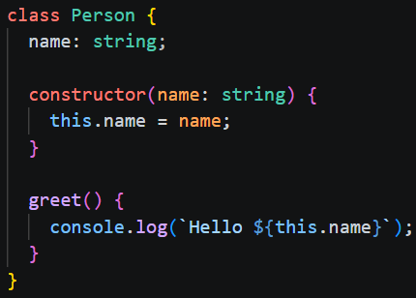
Typescript Classes

Slide 9
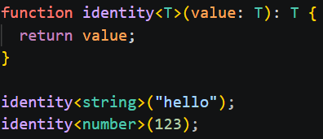
Typescript – Generic Types
‘T’ represents a generic type

Slide 10
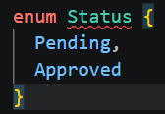
Typescript - Enum
We typically use ‘type’ syntax instead of defining an actual enum with ‘enum’ keyword
Doing it this way generates zero runtime cost (less bundled code after compilation)

Slide 11

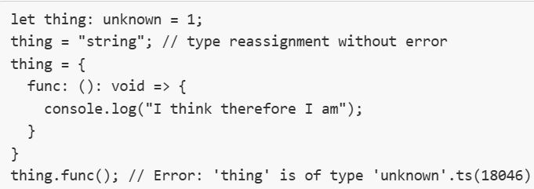
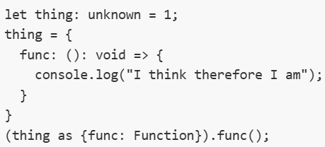
Special Types
We should really avoid ‘any’
‘Unknown’ is a bit better. It behaves like any, but we must still cast it before using it

