Slide 1
Vagrant
Developing complex environments locally

Slide 2
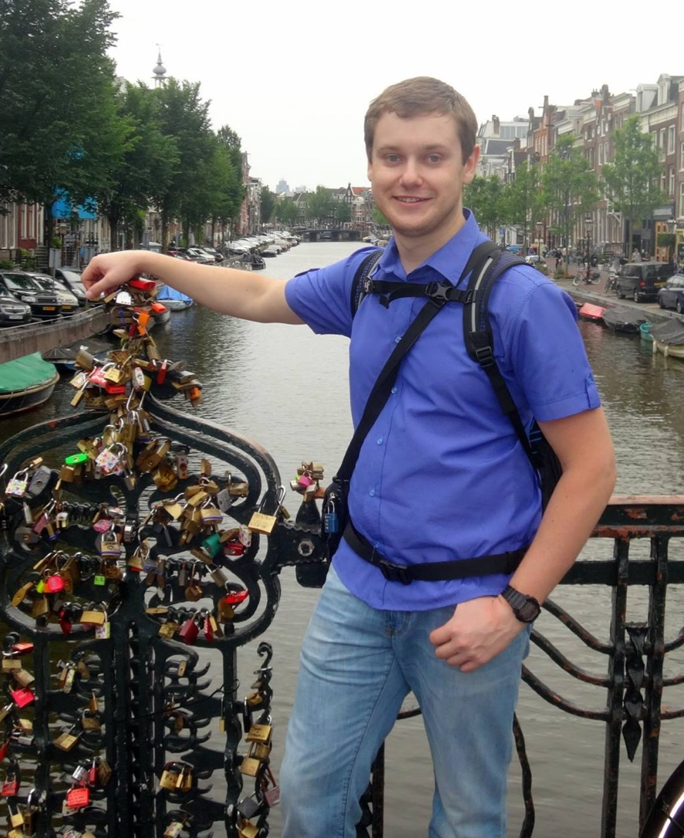



About me
Nikolay Labinskiy
PHP @ Levi9
Karting
Arduino
Raspberry Pi

Slide 3
Agenda
Vagrant – what is it?
Vagrantfile
Provisioning
Application

Slide 4

Vagrant – what is it?

Slide 5
Vagrant – what is it?
Have you ever work with:
Multiple projects with different software dependencies
Different versions of the same software
All in one development machine
Simultaneously?

Slide 6
Vagrant – what is it?
Existing developer with
(partial and not up to date) information
how to reproduce dev environment
+
New developer (with a shiny new machine)
=
Issues to reproduce the same dev environment

Slide 7
Vagrant – what is it?
Dev environment
!=
Production/acceptance environment
=
Works on my machine!11 issues

Slide 8
Vagrant – what is it?
Vagrant == VMM CLI
vagrant up
vagrant provision
vagrant ssh
vagrant halt

Slide 9

Vagrantfile

Slide 10
Vagrantfile
Box template (Debian, Ubuntu, … )
VM configuration (RAM, CPU, …)
Shared folders
Network configuration
Port forwarding

Slide 11
Vagrantfile
Vagrant.configure("2") do |config|
config.vm.box = “ubuntu/trusty64“
config.vm.provider "virtualbox" do |vbox|
vbox.memory = 1024
vbox.cpus = 2
end
config.vm.synced_folder "src/", "/srv/website"
config.vm.provision “shell”, path: “provision.sh“
config.vm.network "forwarded_port", guest: 80, host: 8080
config.vm.network "private_network", ip: "192.168.50.10"
end

Slide 12

Provisioning

Slide 13
Provisioning
Supported provisioners
Shell script
Puppet
Ansible
Chef
Online generators
PuPHPet
Protobox
Phansible
Rove.io

Slide 14
Provisioning
#!/bin/bash
apt-get update
apt-get install -y apache2 libapache2-mod-php5
# php configuration
cat << EOF > /etc/php5/apache2/conf.d/30-node.ini
date.timezone = "Europe/Kiev"
EOF
# apache virtual hosts
# ...
a2enmod rewrite
a2ensite <your-vhost-file>
a2dissite 000-default.conf
service apache2 restart

Slide 15
Provisioning
#!/bin/bash
debconf-set-selections <<< \
'mysql-server mysql-server/root_password password admin’
debconf-set-selections <<< \
'mysql-server mysql-server/root_password_again password admin'
apt-get update && apt-get install -y mysql-server nginx
# nginx configuration
# ...
# db configuration
cat << EOF | mysql -uroot –padmin
CREATE DATABASE IF NOT EXISTS symfony;
GRANT ALL ON symfony.* TO 'dbuser'@'%' IDENTIFIED BY 'dbuser’;
EOF
cat << EOF > /etc/mysql/conf.d/application.cnf
[mysqld]
bind-address = 0.0.0.0
EOF
service nginx restart
service mysql restart

Slide 16
Application
Real app
Internet
Reverse proxy
Load balancer
Media
PHP node
PHP node
Cache
PHP node
PHP node
Session
Database cluster configuration
DB node
DB node
DB node

Slide 17



Application
Our app
Internet
vm 1
vm 2
vm 3

Slide 18

Vagrant share

Slide 19
Vagrant share
Vagrant Share allows you to share your Vagrant environment with anyone in the world with just a single command:
Register on https://atlas.hashicorp.com/
Run “vagrant share”
Use generated public URL

Slide 20
One Common Goal

