Slide 1
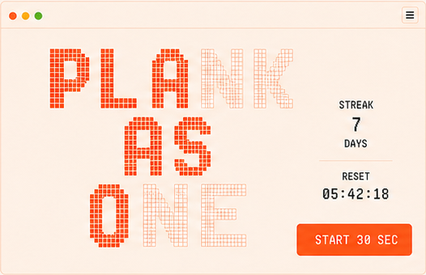
PRODUCT EXPERIENCE
The Plank
Canvas
A daily personal challenge that reveals one shared work of art.
PLANK → COMPLETE → PLACE → LIVE
MVP 1 · DESKTOP JOURNEY

Slide 2
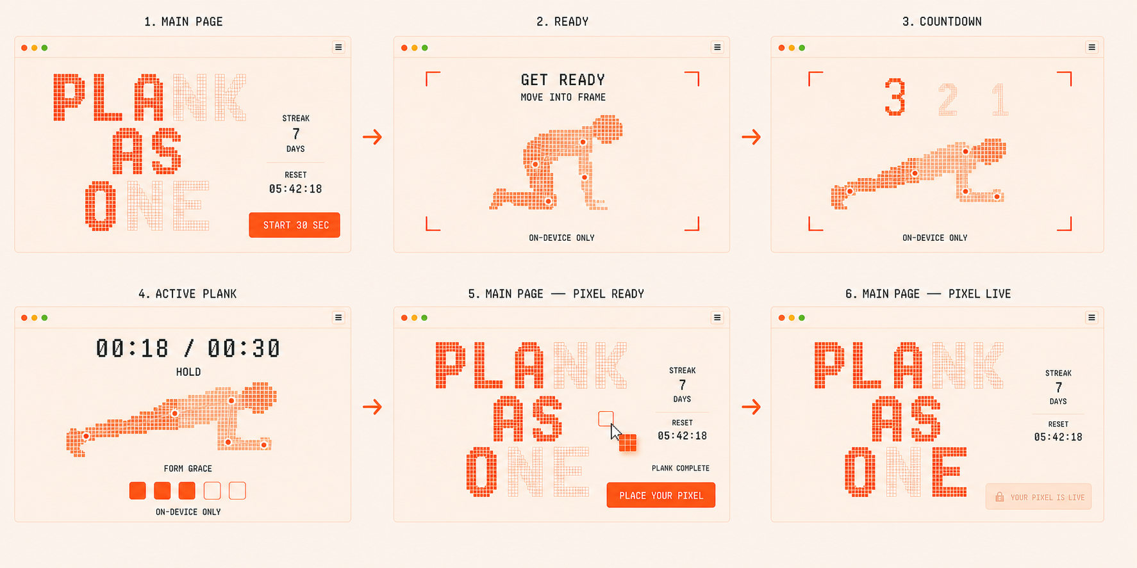
THE DAILY RITUAL
One session becomes one visible contribution
THE PLANK CANVAS
JOURNEY OVERVIEW
02

Slide 3
01 · ARRIVE
Shared progress makes today’s effort matter
The canvas is the invitation.
A partially revealed artwork, seven-day streak, and reset countdown turn a solitary exercise into a shared daily ritual.
PRIMARY ACTION · START 30 SEC
THE PLANK CANVAS
MAIN PAGE
03

Slide 4
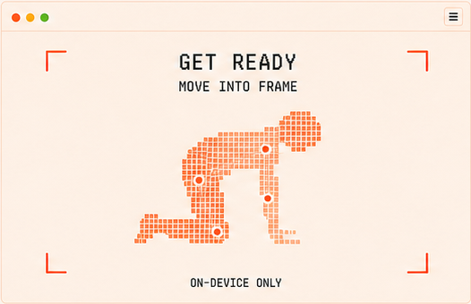
02 · PREPARE
Privacy is explicit before the camera starts
The browser waits for a usable pose.
The framing guide helps the participant position the required joints while reinforcing that camera processing remains on-device.
CAMERA FRAMES NEVER LEAVE THE DEVICE
THE PLANK CANVAS
CAMERA READY
04

Slide 5
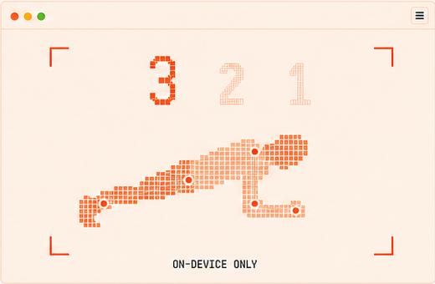
03 · COMMIT
Three seconds separate readiness from effort
A clear start removes ambiguity.
The 3–2–1 transition begins only after the pose is visible. Exercise time has not started yet.
COUNTDOWN FIRST · TIMER SECOND
THE PLANK CANVAS
COUNTDOWN
05

Slide 6
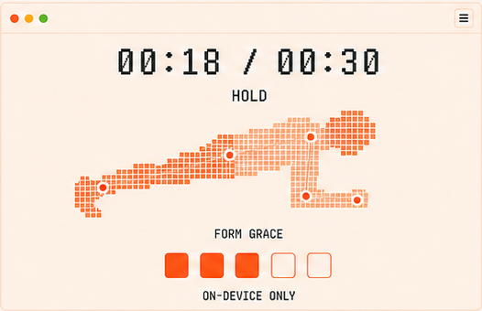
04 · HOLD
Only valid form advances the 30-second timer
Feedback is immediate and private.
TensorFlow.js evaluates pose keypoints in the browser. Invalid time does not count, and the timer pauses after the five-second grace period.
ON-DEVICE AI · FIVE-SECOND GRACE
THE PLANK CANVAS
ACTIVE PLANK
06

Slide 7
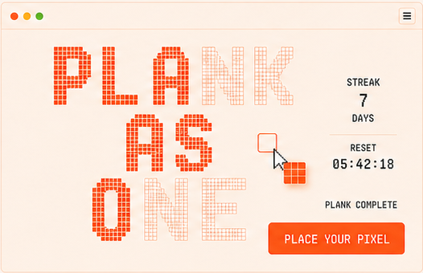
05 · CONTRIBUTE
Completion unlocks exactly one pixel
The participant returns to the shared canvas.
START 30 SEC becomes PLACE YOUR PIXEL. The earned square automatically takes the artwork color of an available target cell.
ONE COMPLETION · ONE PLACEMENT
THE PLANK CANVAS
PIXEL READY
07

Slide 8
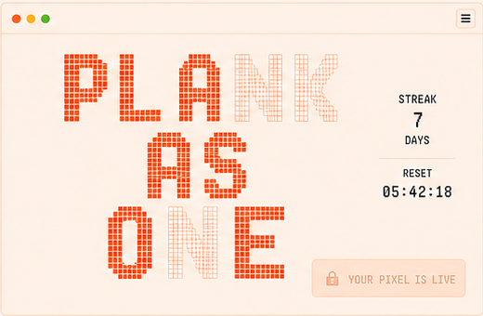
06 · BELONG
The day ends with a permanent community result
The pixel is small. The shared outcome is not.
The chosen cell becomes visible to everyone in realtime. The locked YOUR PIXEL IS LIVE state closes the loop until tomorrow.
PERSONAL DISCIPLINE BECOMES SHARED ART
THE PLANK CANVAS
PIXEL LIVE
08

