Slide 1
Analyzing World Data to Determine Problem Areas for Effective Altruism Initiatives and See Which Cities Offer High Impact Jobs
Applied Data Science Capstone
IBM Data Science Professional Certificate
October 2018

Slide 2

What is
?
Effective altruism is a philosophy and social movement that uses evidence and reasoning to determine the most effective ways to benefit others. Effective altruism (EA) encourages individuals to consider all causes and actions and to act in the way that brings about the greatest positive impact, based upon their values.
Image is from this site: https://www.geo-viz.com/blog/business-aspects-recommender-systems<

Slide 3
Synopsis
Part 1: Problem Description
Say I am a recent graduate willing to join the EA movement. What I need to ask myself is:
What are the world’s biggest challenges?
How can I contribute to solve at least one of them?
What career path should I choose to be able to contribute either financially or through research and impactful work?

Slide 4
Synopsis
Part 2: Data
1) I will use the World Development Indicators Database to see which areas need more attention of the EA community, not just organizations but individuals willing to contribute to solving some of these challenges either through donations or working in NGOs in those areas.
Link: https://www.kaggle.com/worldbank/world-development-Indicators
I will also need world countries coordinates to visualize the data.

Slide 5
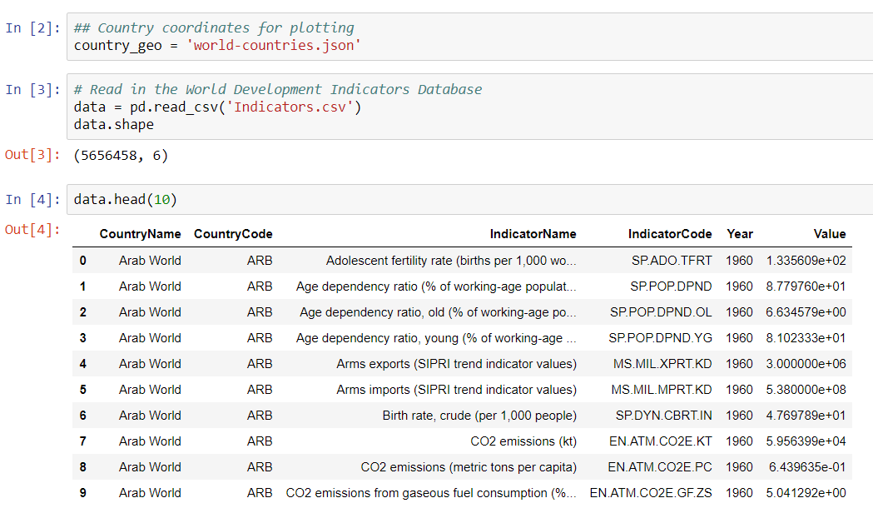
Synopsis
Part 2: Data

Slide 6
Synopsis
Part 2: Data
2) I will scrape the High impact job board created by 80,000 Hours Initiative, geocode the data and visualize it to see where high impact jobs are available. For this I use Selenium (which I run locally via Anaconda Spyder).
Link: https://80000hours.org/job-board/
We will also need world countries coordinates to visualize the data.

Slide 7

Synopsis
Part 3: Data
2) Finall I use Foursquare API to return the list of venues in the city center. I will also use Foursquare API to see which venues are trending at the moment.

Slide 8
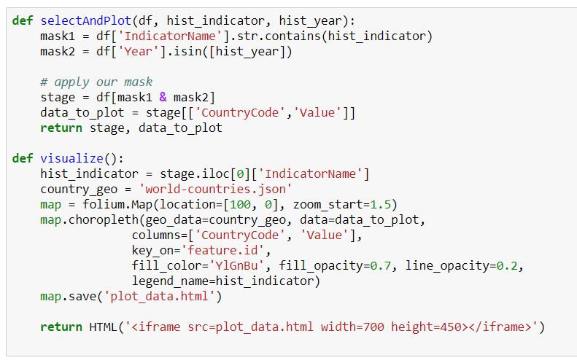
Methodology
Having retrieved the data from World Indicators dataset, I created a couple of functions so as not repeat my code:

Slide 9
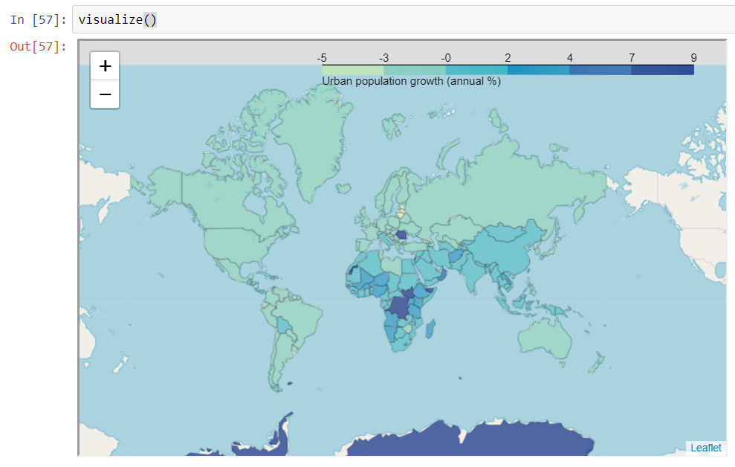
Population Growth
First, let’s look at the population growth.

Slide 10
Discussion
Analyzing other indicators, we can conclude that the higher the death rate for children in a region, the higher the birthrate.
Addressing global poverty and keeping children alive is crucial for reducing overpopulation.
Poverty and the lack of access to education leads to higher birthrates and overpopulation.

Slide 11
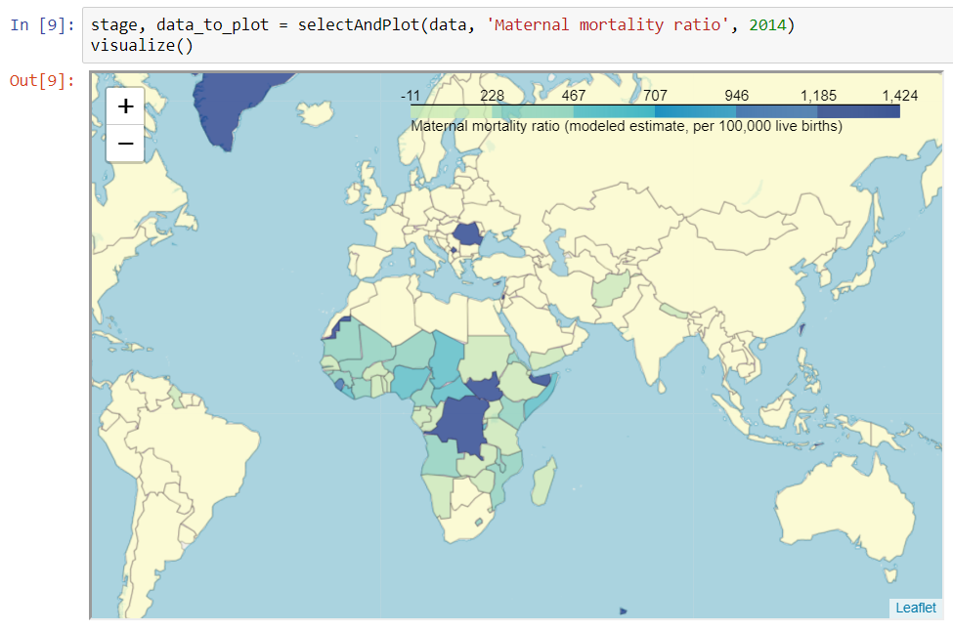
Maternal Mortality Ratio

Slide 12
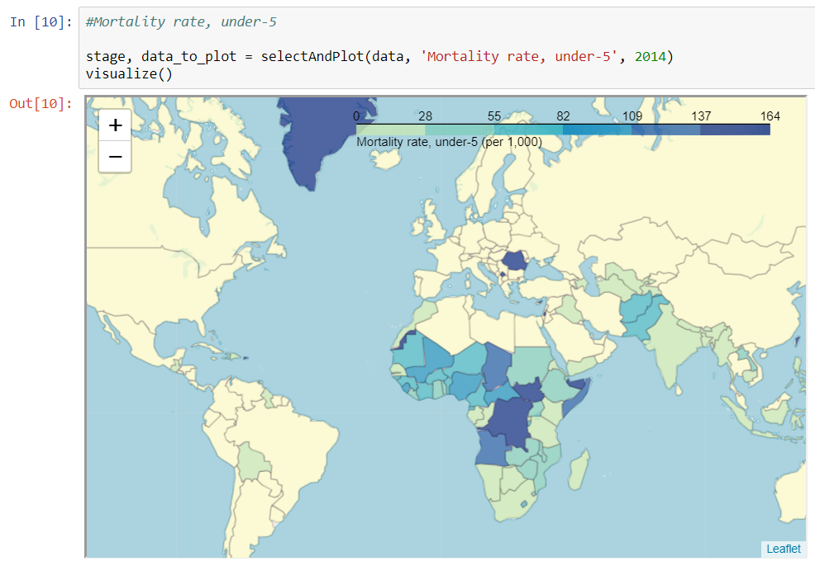
Mortality rate, under-5

Slide 13
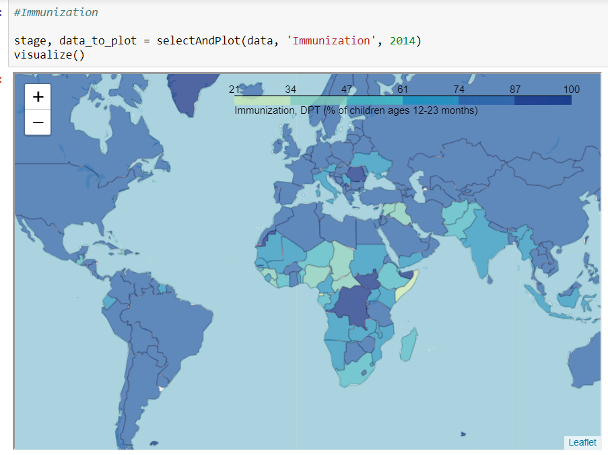
Immunization

Slide 14
Discussion
As we have seen on the maps (and further analysis, not included here), EA activists willing to do good for the areas where it is needed the most should probably pay attention to some of the countries located on African continent. Hence, I will single out this region for further analysis.
To do that I will scrape a list of African countries and apply it to our dataset. To get the country list I have chosen to scrape a table from this page: https://en.wikipedia.org/wiki/List_of_African_countries_by_population

Slide 15
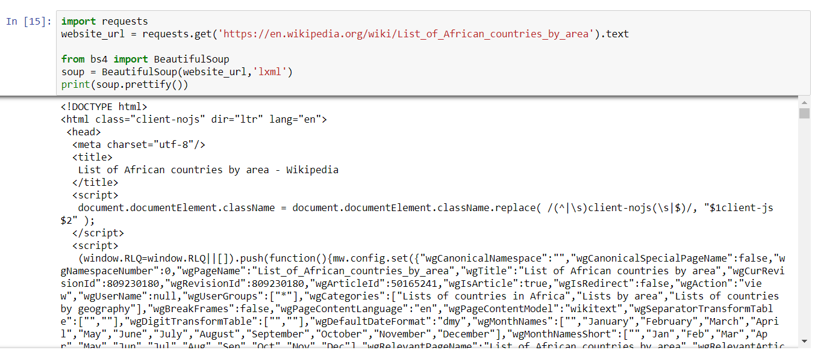
Scraping the county list from Wikipedia

Slide 16
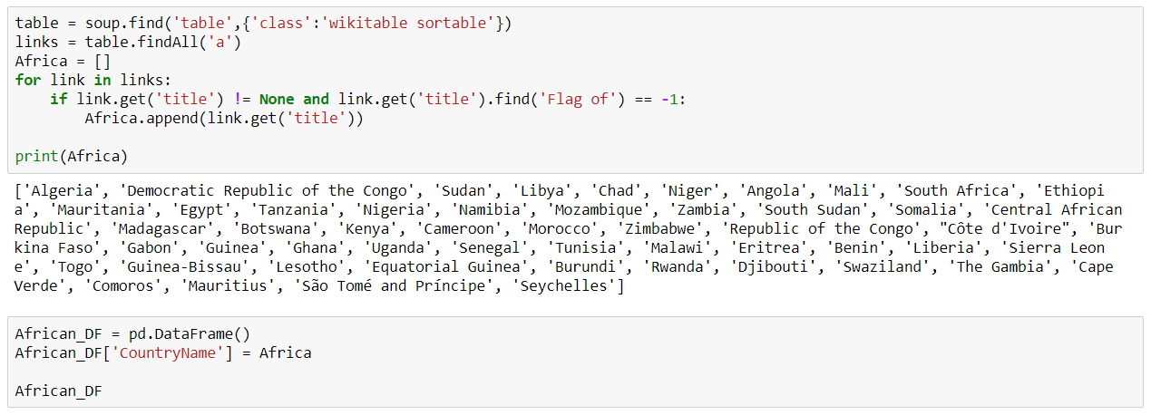
Scraping the county list from Wikipedia

Slide 17
Immunization Dat
Let’s focus on immunization data. Getting immunized is important for at least two reasons: to protect yourself and to protect those around you. Vaccines are the best way we have to prevent infectious disease. A successful immunization program depends on the co-operation of every person.
Vaccinations prevent you or your child from getting diseases for which there are often no medical treatments. These illnesses can result in serious complications and even death. A small number of people may be susceptible to diseases, such as those with impaired immune systems. These people may not be able to get vaccinations or may not develop immunity even after having been vaccinated. Their only protection against certain diseases is for others to get vaccinated so the illnesses are less common. If exposure to a disease occurs in a community, there is little to no risk of an epidemic if people have been immunized.

Slide 18
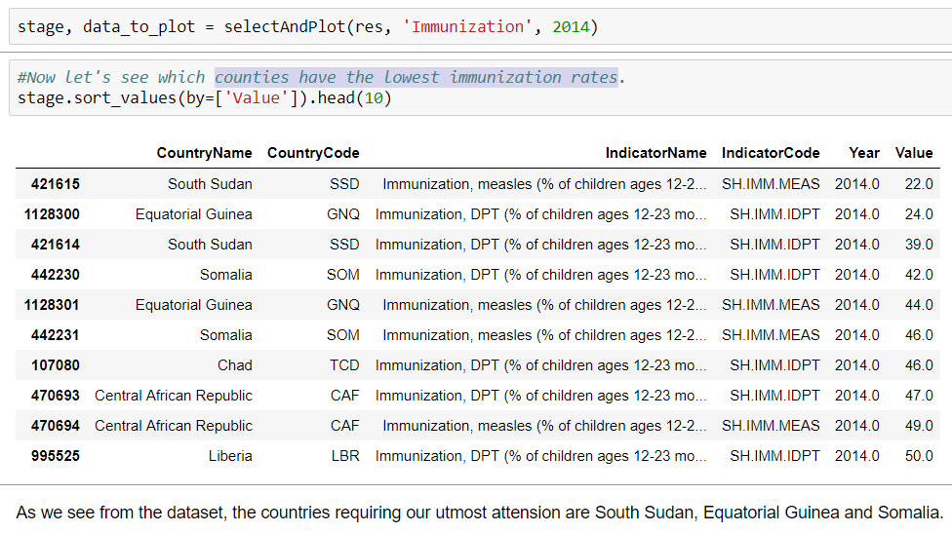
Countries with the lowest immunization rates

Slide 19
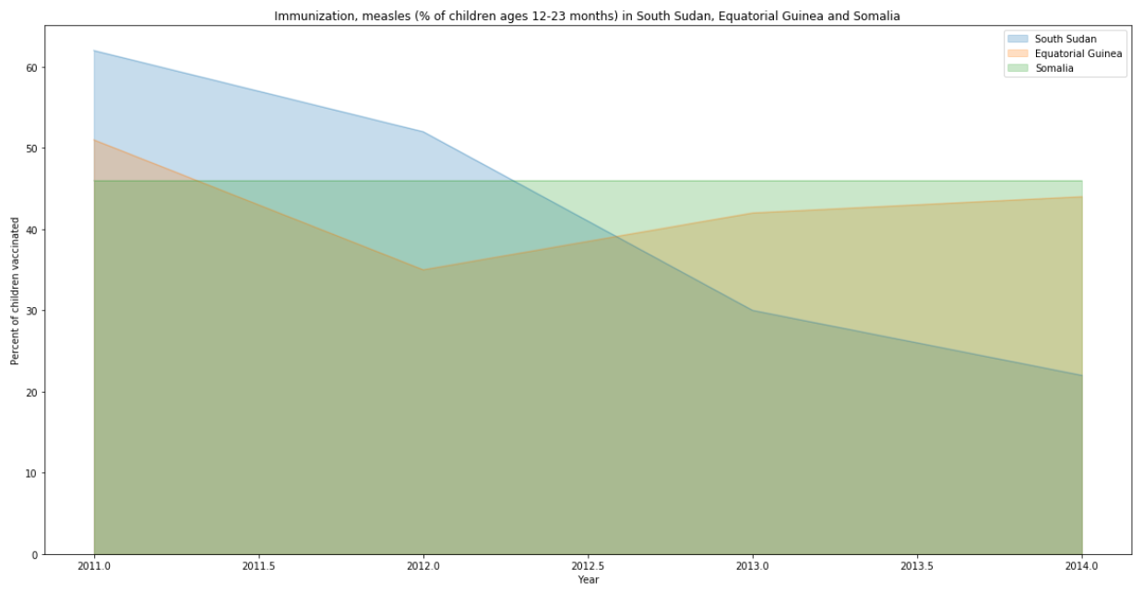
Vaccination from Measles

Slide 20
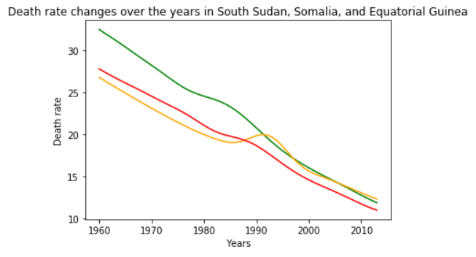
Mortality Rates and Health Expenditure
As seen on Folium maps higher in this project, these countries also have high mortality rates. Let's see if we can find correlation between health expenditures and mortality rates. But to see a larger picture, let's focus on all African countries in the dataset.

Slide 21
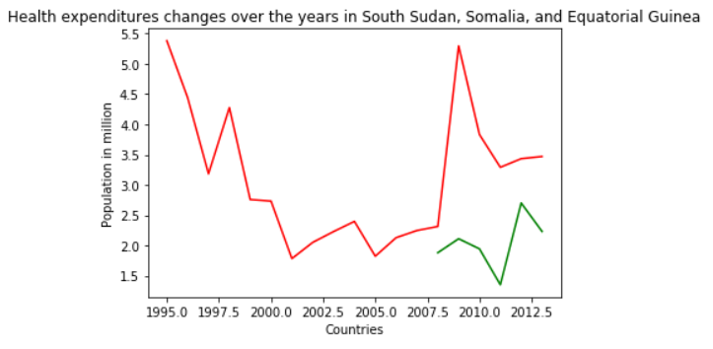
As we can see the data on health expenditures are insufficient to draw conclusions.

Slide 22
Which countries are the poorest?
Moral philosopher Peter Singer started his TED talk, “A Ripple Effect?” with a shocking video of a 2-year-old girl in China who was hit by a van — and then a second van — and ignored by passers-by as she lay dying in an alley. He asks of the audience: Would you have stopped and helped this girl? Not surprisingly, the unanimous response was yes. Well, every day that we don’t help others, he says, it’s like leaving this girl crippled in the alley. In 2012, Singer says, UNICEF reported that 6.9 million children under 5 died from preventable poverty-relatable diseases like malaria. Does it really matter that we’re not walking past these children in the street, that they’re far away? According to Singer, there is no morally relevant difference.
So let's now analyze our global dataset to single out 20 poorest countries.

Slide 23
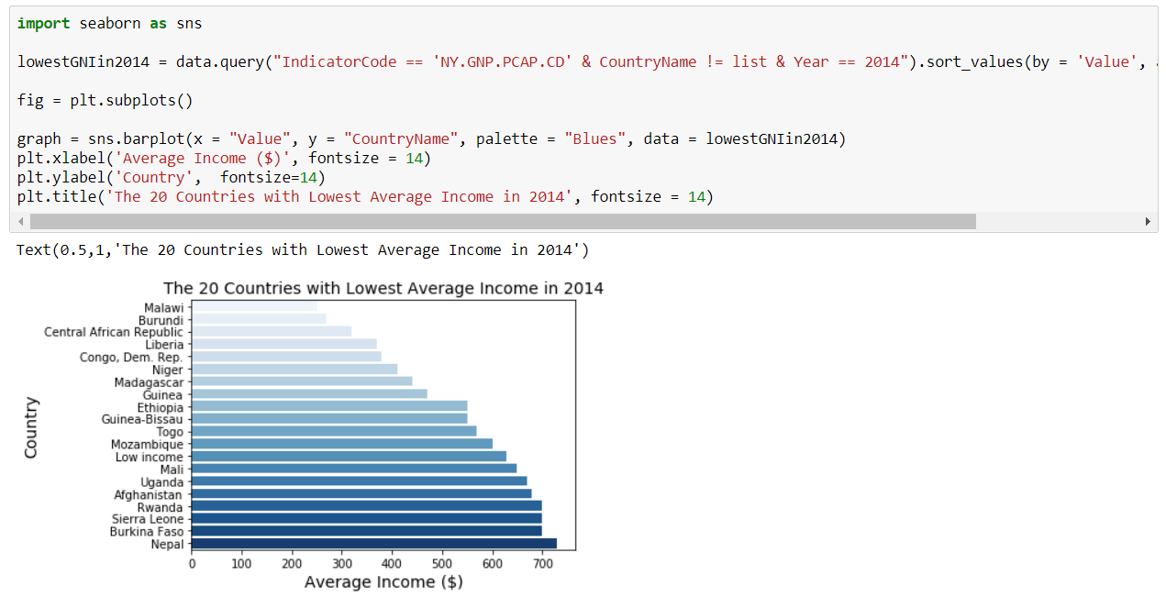
Which countries are the poorest?

Slide 24
High Impact Jobs: Battle of Cities
80,000 Hours is one of the best websites for anyone interested in Effective Altruism. They have their own job board. This board contains a short, curated list of the most promising publicly advertized vacancies they know about right now. They’re all high-impact opportunities at organisations that are working on some of the world’s most pressing problems.
Given that our capstone has to adhere to a theme of a battle of neighborhoods, I thought, why not scrape all the job locations they currently have and see which location might be a good bet for a person looking for a high impact career, which, given the right motivation, can allow an applicant to contribute to resolving some of the world's biggest challenges, for instance through invididual donations to causes like immunization programs where they are needed the most (as we discussed above).

Slide 25
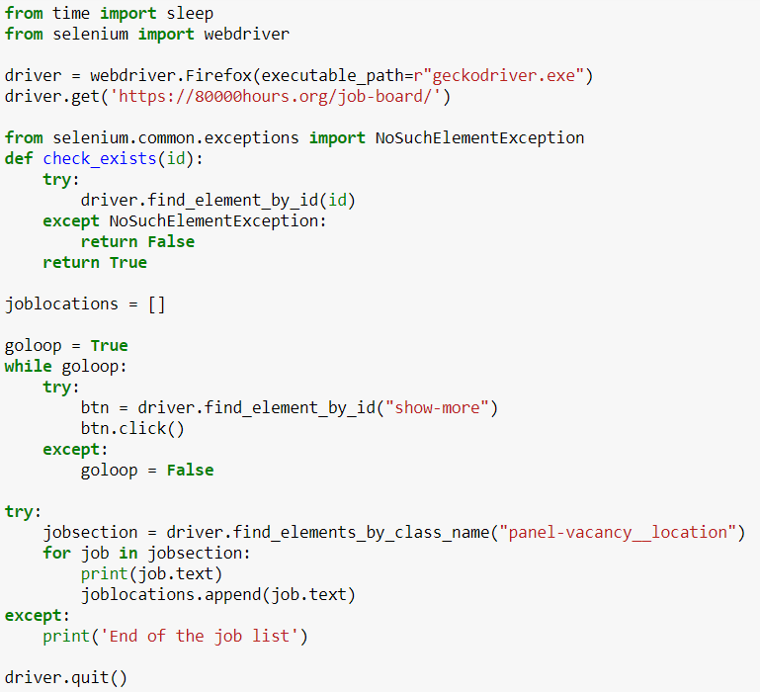

Slide 26
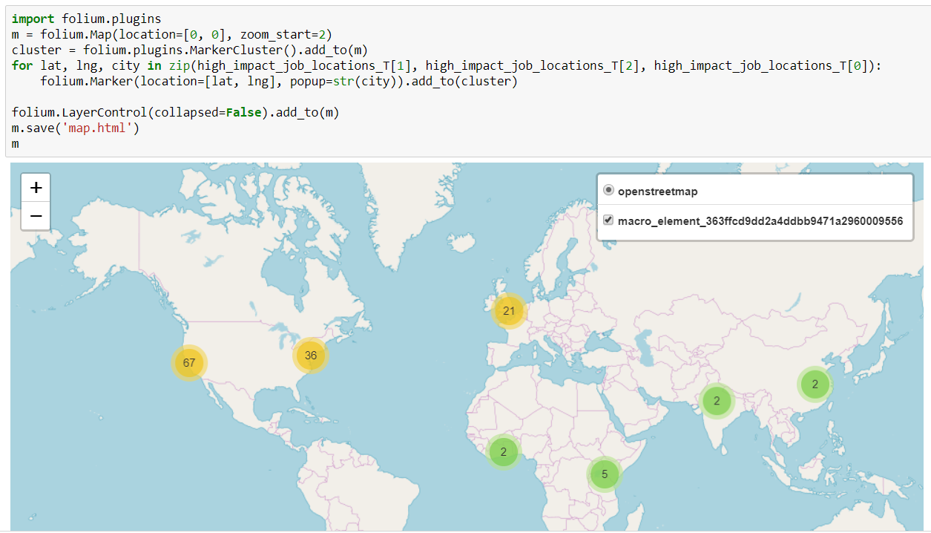
After cleaning the data, let’s visualize it

Slide 27

Our top city for EA job seeker is…

Slide 28
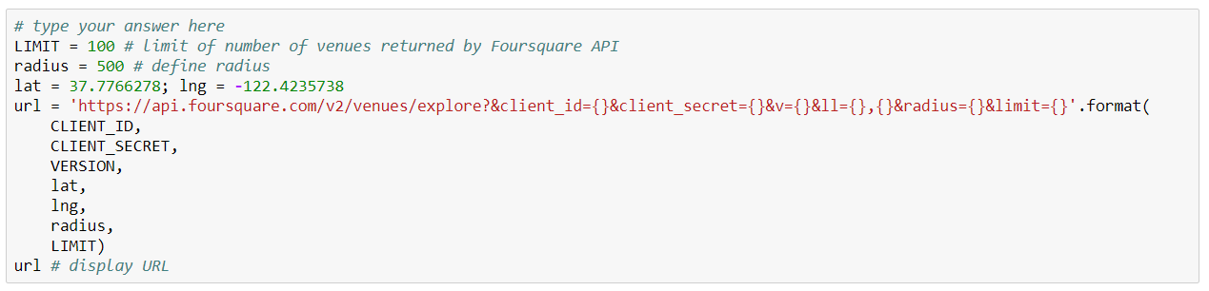
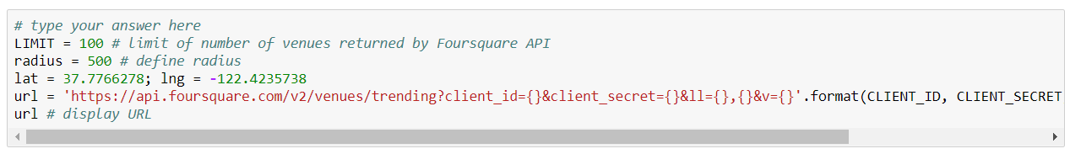
Now let’s use Foursquare API to see which venues are available
and which are trending…

Slide 29
Thank you!
Andrei Khrapavitski, 2018

