Slide 1

Earthquake Database
CSE 111 – Project – Phase 3
Zachary Harry, Eshant Prakash
GitHub Link: https://github.com/e-prakash/fall2020-cse111-project/tree/main/phase_3

Slide 2
System Description
Earthquake Database
Prefilled with Data from USGS and Nuclear Database
Used for the cataloguing and management of Earthquake Data
Can View and Generate Reports on the Data

Slide 3
Use-Case Description
View Earthquakes on a Map
Filter Earthquakes by Year and Magnitude Range, Location, and Source
Addition Filtering for Earthquakes Caused by Nuclear Explosions (Yield and Sources)
Generate Reports (Bar and Trend Graphs) from the Data comparing different Locations over Time
Same Filtering Options Available
Manage Earthquakes
Edit Existing Data
Add New Earthquakes

Slide 4
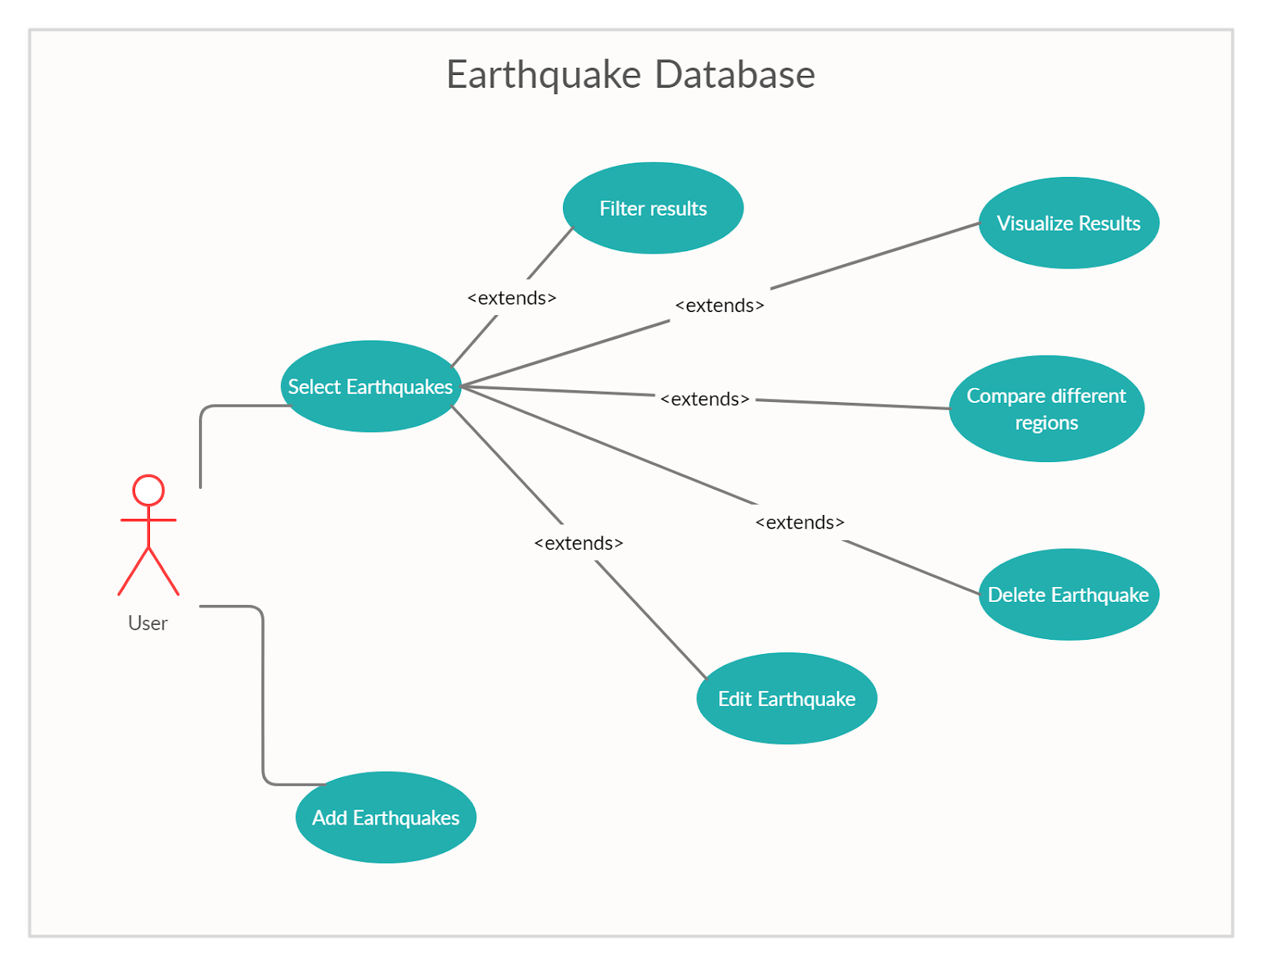
Use-Case Diagram

Slide 5
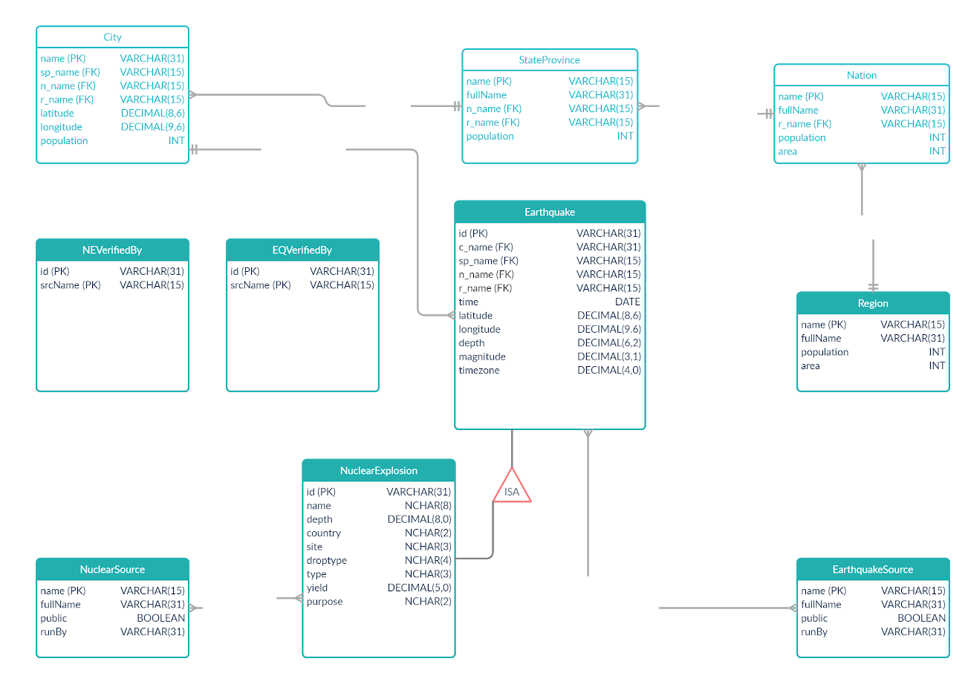
E/R and Relation Diagram

Slide 6
Implementation Details
SQLite Database
Data stored in “data/data.sqlite”
Python for Application
Tkinter for GUI
matplotlib to Generate Graphs
folium to Generate Maps

Slide 7
Demo
Generate Map of 2011 Earthquakes in Asia
Generate Map of Nuclear Explosions by USA
Generate Aggregate Graph of Earthquakes per Population in Oceania
Generate Trend Graph of Earthquake Count in All Regions
Edit 2011 Japan Earthquake (30209)
Add Earthquake for 2020 in Merced (Long, Lat: -120.4830, 37.3022) as Nuclear Explosion
View changes 5 and 6 in new maps

