Slide 1
Input & output of data within AvNav
GPS
AvNav
AIS
USB
serial (RS485 etc)
Seatalk 1/NG
CANbus /NMEA2K
LAN/ WiFi
Interfaces
Seatalk 1
Seatalk NG
NMEA0183
NMEA2000
format
Interface
Autopilot
format
e.g.
NMEA0183
e.g.
WiFi
wind sonar log
Other sensors

Slide 2
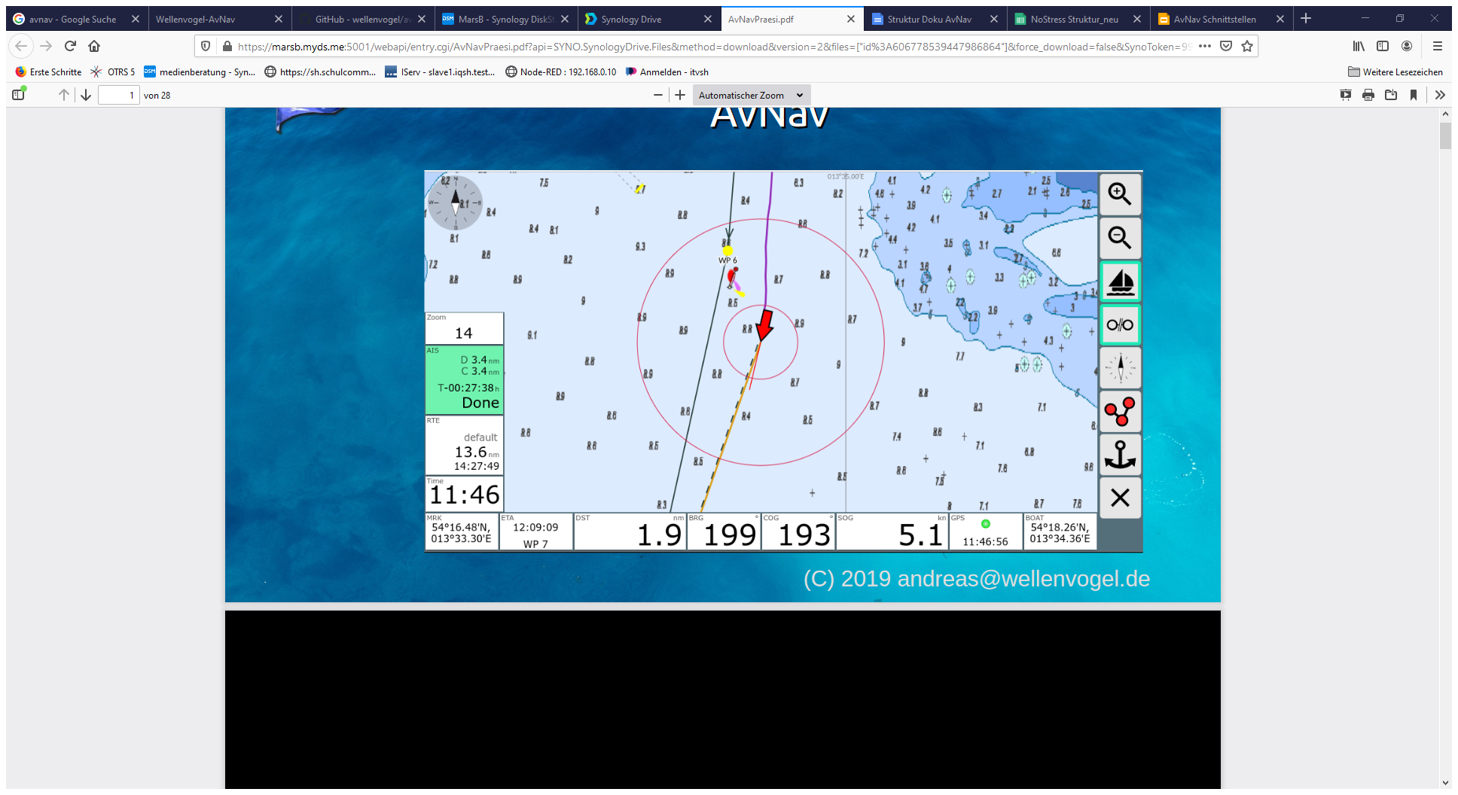
AvNav
GPS
Autopilot
AIS
USB
serial (RS485 etc)
Seatalk 1/NG
CANbus / NMEA2K
LAN/ WiFi
SignalK
LAN/ WiFi
SignalK
CANBus/ NMEA2k
Webbrowser: Android, IOS, Windows
interfaces
interfaces
wind sonar log
Other APPs
other sensors

