Slide 1
GoTriple metadata cleaning
Two data-quality gaps, what fixes them, and what fixing them costs
Draft · 21 August 2026 · Paulo Pimenta
Generated from main.ipynb — every figure is a measured run
Notes:
Draft deck generated from the notebook. Populations are live Elasticsearch counts; recovery rates and timings come from the notebook's own runs (1,000-profile samples for the author work, 100 documents for licenses).

Slide 2
WHAT THIS COVERS
Two unrelated problems, one pipeline
• Broken author names — an ORCID sitting in the name field, empty names, URLs and bare digits
• Duplicate author identities — many profiles, one person, and no id to join them on
• Missing licenses — 95% of documents carry no usable license value
• For each: the strategy, the measured yield, and the wall-clock cost of running it for real
The short version
Names with an ORCID are essentially solved (100% recovered). Empty and junk names are not recoverable from the outside. Licenses recover at 68% but the full population is months of runtime.
GoTriple metadata cleaning · draft · 2
Notes:
Set the frame: these are two different problems that happen to share a pipeline and an index.

Slide 3
THE TWO INDEXES
The scale of it
23.8M
6,740
40.2M
38.3M
author profiles
triple-profiles-prod
profiles whose name is broken
0.03% of the index
documents
triple-documents-prod
documents with no usable license
95% of the index
Different orders of magnitude, different responses
6,740 broken names is a finite, one-off repair job. 38.3M missing licenses is a population no end-to-end run can clear — it has to be scoped.
GoTriple metadata cleaning · draft · 3
Notes:
Counts are live from Elasticsearch on 21 Aug 2026 and move a little between runs.

Slide 4
1. AUTHORS
A name breaks in three distinct ways
§ | what is wrong | profiles | what the run settled | outlook
1.1 | an ORCID sits inside the name | 2,869 | 100 of 100 recovered | almost all recoverable
1.2 | the name is empty | 2,039 | 0 of 100 recovered | rarely recoverable
1.3 | the name is a URL or bare digits | 1,832 | 100 of 100 are repository ids | not people at all
Three problems, three different answers
An ORCID in the name is an identifier we can resolve. An empty name is an absence — nothing in the record points at the person. And a bare number is not a broken name at all: it is a repository's own author id, which no amount of looking up will turn into a person.
GoTriple metadata cleaning · draft · 4
Notes:
Populations are live counts; the recovered column is the notebook's 1,000-profile run per problem.

Slide 5
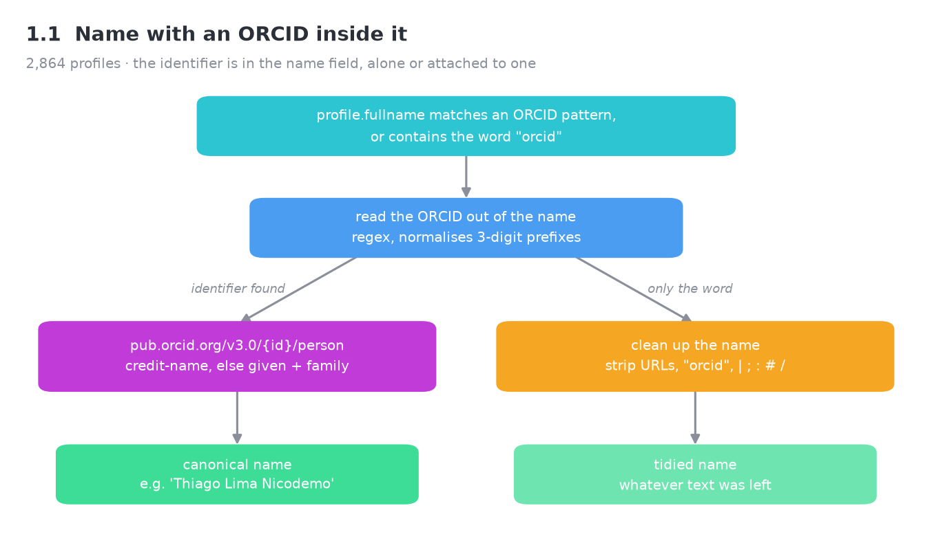
1. AUTHORS
1.1 The name contains an ORCID
100 of 100
99 names came back from the ORCID API; 1 was cleaned in place.
At 0.184s a profile, the whole population of 2,869 is a nine-minute job.
GoTriple metadata cleaning · draft · 5
Notes:
The highest-yield repair in the project: the identifier is already in the field, it just has to be resolved. 0.209s per profile, so the whole 2,869 is a ten-minute job.

Slide 6
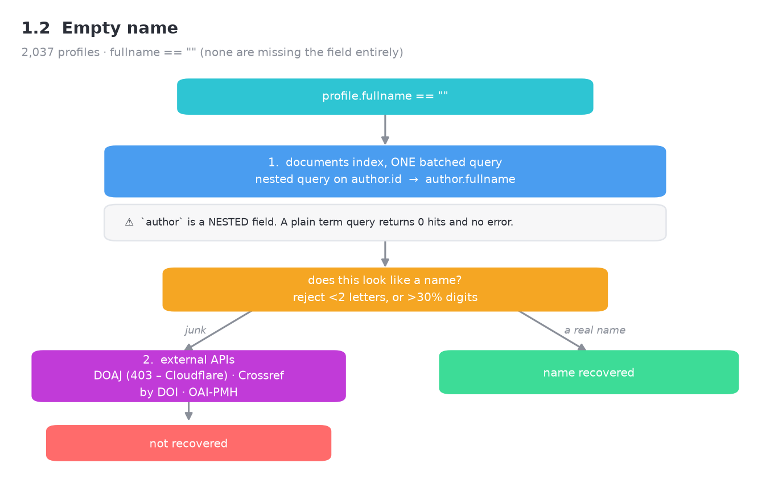
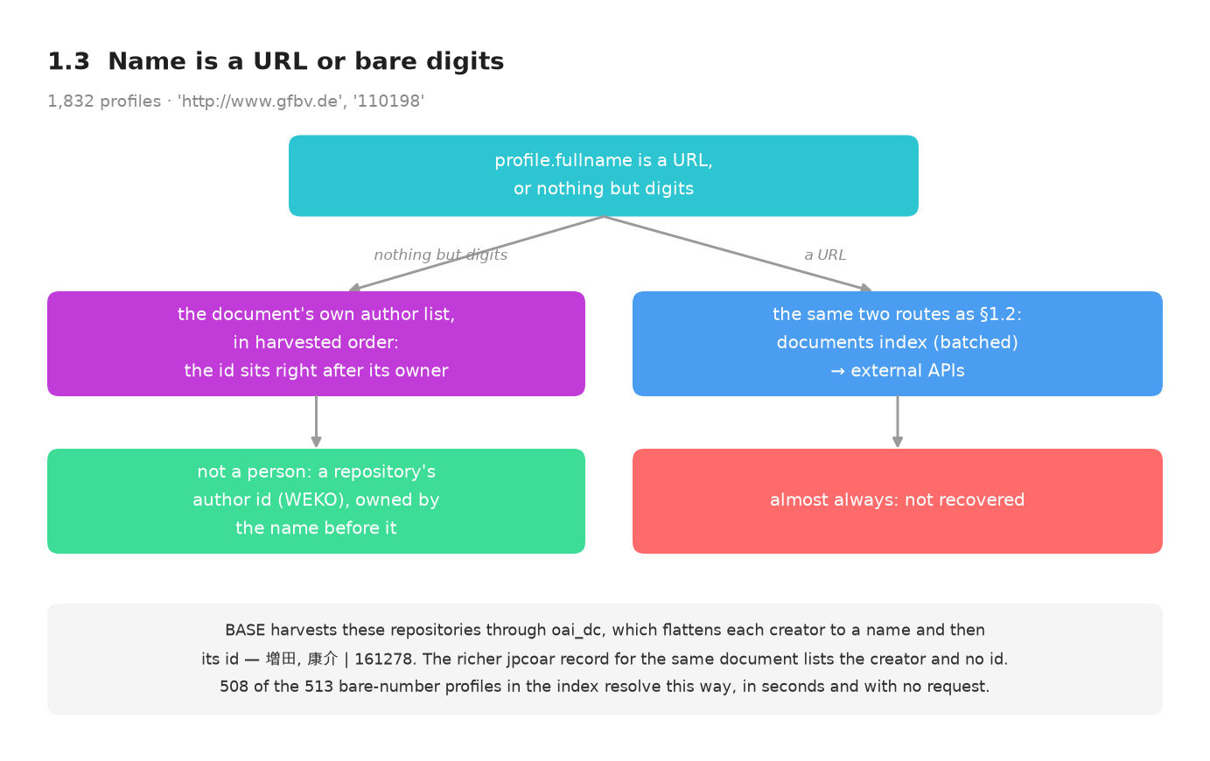
1. AUTHORS
1.2 / 1.3 Empty names, and numbers that are not names
Different problems, not one
Empty names: 0 of 100 recovered — the record carries nothing that identifies the person. Bare digits: 100 of 100 are a repository's author id published as a second dc:creator, so the owner is the name beside it and the profile should be removed, not repaired.
GoTriple metadata cleaning · draft · 6
Notes:
The point of the slide: this is a source-data problem, not an algorithm problem. Escalate to the providers rather than spending more runtime here.

Slide 7
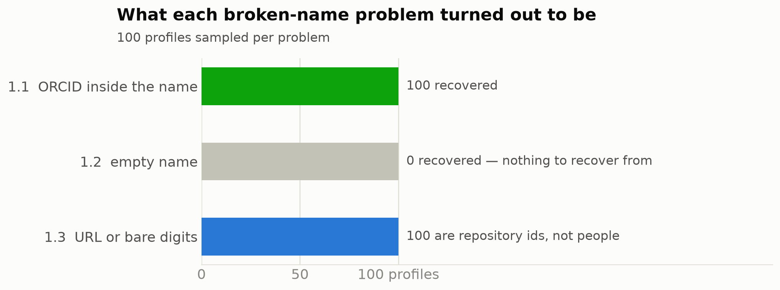
1. AUTHORS
What that adds up to
Where the effort pays
§1.1 is worth running at scale today. §1.3 is a deletion job, not a repair job. Only §1.2 needs the data fixed upstream, at the provider.
GoTriple metadata cleaning · draft · 7
Notes:
Same 1,000-profile sample for each problem, so the three bars are comparable.

Slide 8
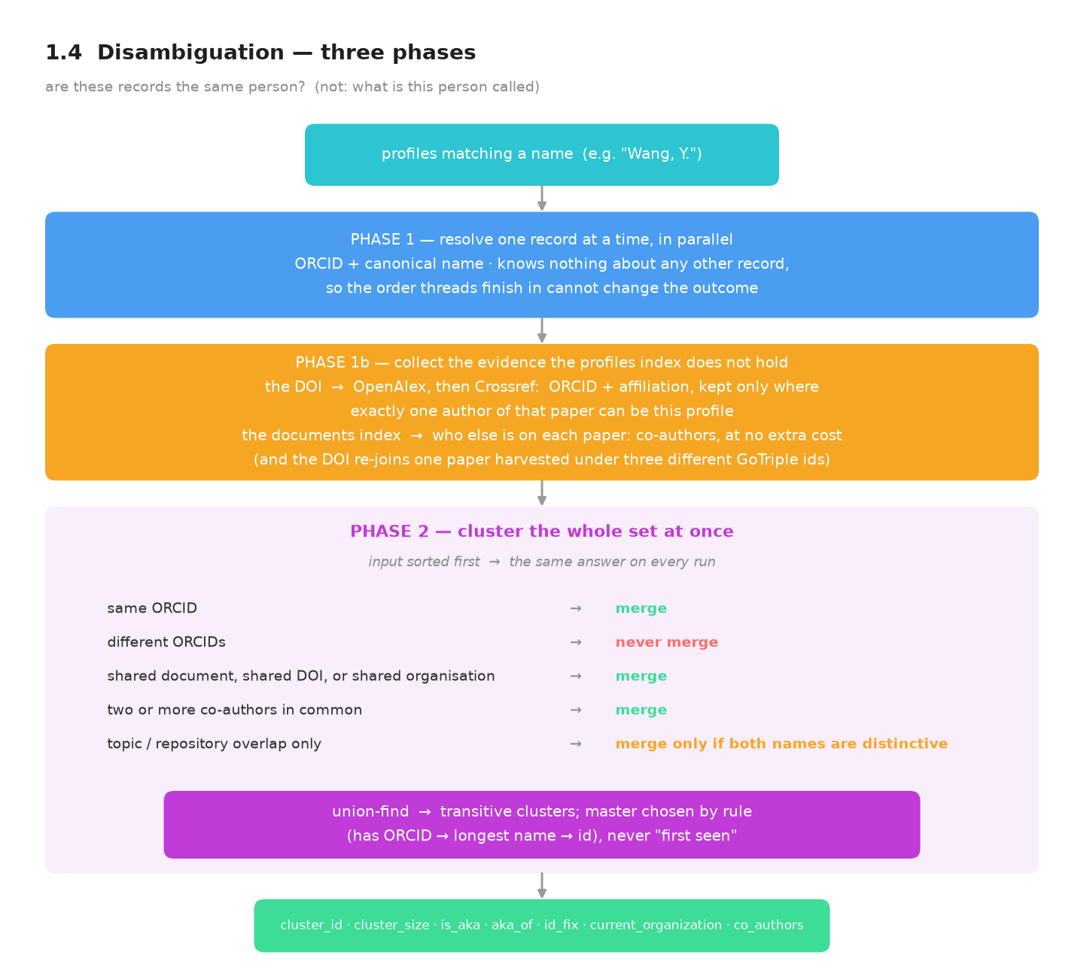
1. AUTHORS
1.4 Disambiguation is a different question
Not "what is this person called" but "are these records the same person" — so it is solved by clustering, not by lookups.
Three phases, on purpose
Phase 1 resolves each record alone, in parallel — thread order cannot change the answer.
Phase 1b collects what the index does not hold: ORCID and affiliation from the DOI, co-authors from the documents index.
Phase 2 sees the whole set at once and merges only on evidence.
GoTriple metadata cleaning · draft · 8
Notes:
The old registry walked a shared list inside the thread pool, so the answer depended on which future finished first. Splitting the phases is what makes the result reproducible.

Slide 9
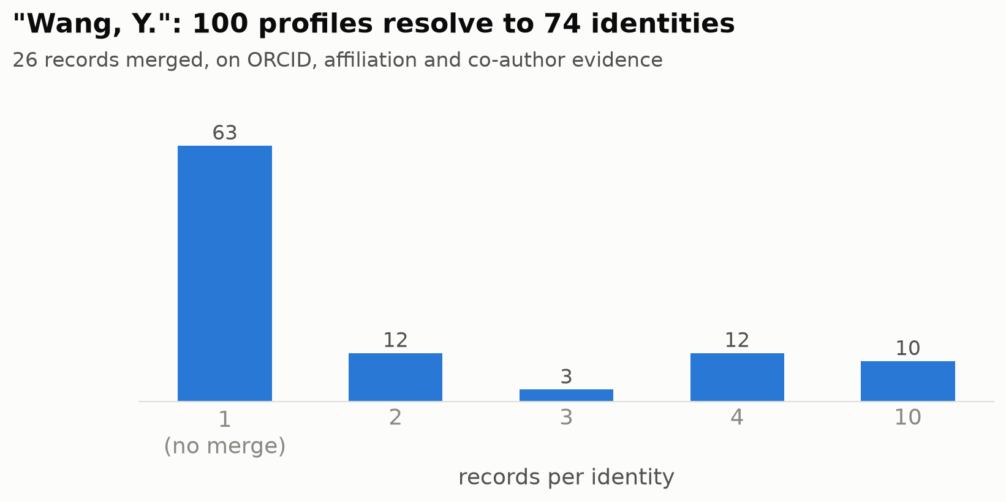
1. AUTHORS
1.4 What clustering decided
74 identities from 100 profiles
26 records merged. On the index alone the same 100 profiles produced 100 identities and not one merge — there was nothing to merge on.
Where evidence is still absent the pipeline splits: a false merge fuses two researchers' publication lists.
GoTriple metadata cleaning · draft · 9
Notes:
Sampling matters: report the sample size with the result. The same 100 profiles produced 100 identities before the DOI and co-author evidence existed.

Slide 10
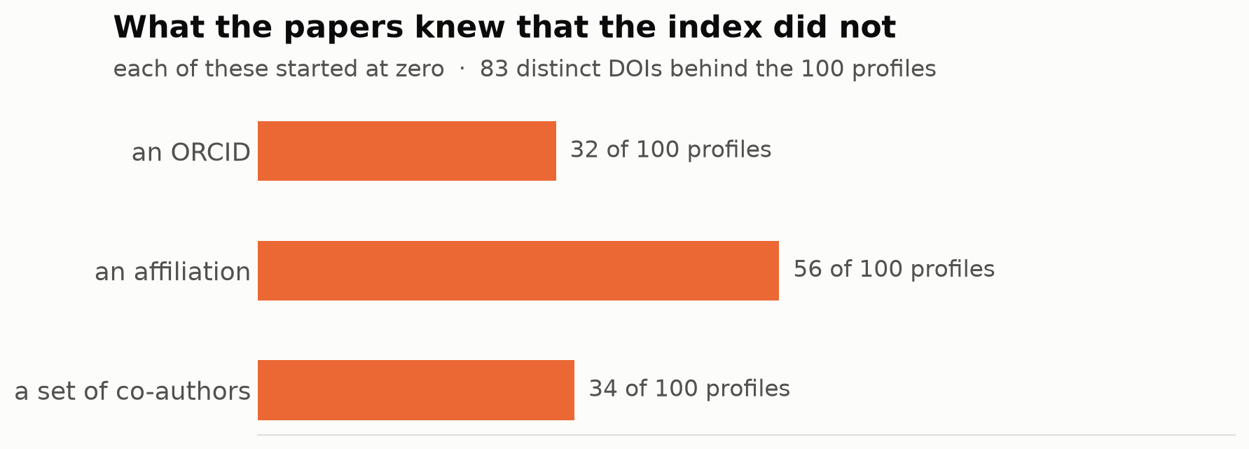
1. AUTHORS
Where that evidence came from
None of it is in the index
The profiles index holds no ORCID and no organisation for these people.
One lookup per distinct DOI — 83 for 100 profiles — plus the author lists already in the documents index.
GoTriple metadata cleaning · draft · 10
Notes:
The DOI is asked once per distinct DOI and cached, so the cost grows with the number of papers, not with the number of profiles.

Slide 11
1. AUTHORS
Why co-authors settle it
Two people who share a name do not share a circle of collaborators. The same person usually does.
two records named Wang, Y. | co-authors in common | verdict
Flight delays during solar flares · Effects of space weather on flight delays | 14 | one person
…either of those · Estimation of soil organic carbon (Koc) | 0 | different people
• The two space-weather papers arrived under different GoTriple ids and carry different DOIs — neither the document id nor the DOI would have joined them.
• The Koc paper's Wang, Y. turns out to be Ya-nan Wang: a different person, and no shared collaborator says so.
• The rule asks for two shared co-authors, never one, and ignores papers with more than 25 authors — inside a large collaboration everybody shares everybody.
GoTriple metadata cleaning · draft · 11
Notes:
Sampling matters: at 100 profiles nothing merged at all. At 1,000 a single cluster of 94 appears. Report the sample size with the result.

Slide 12
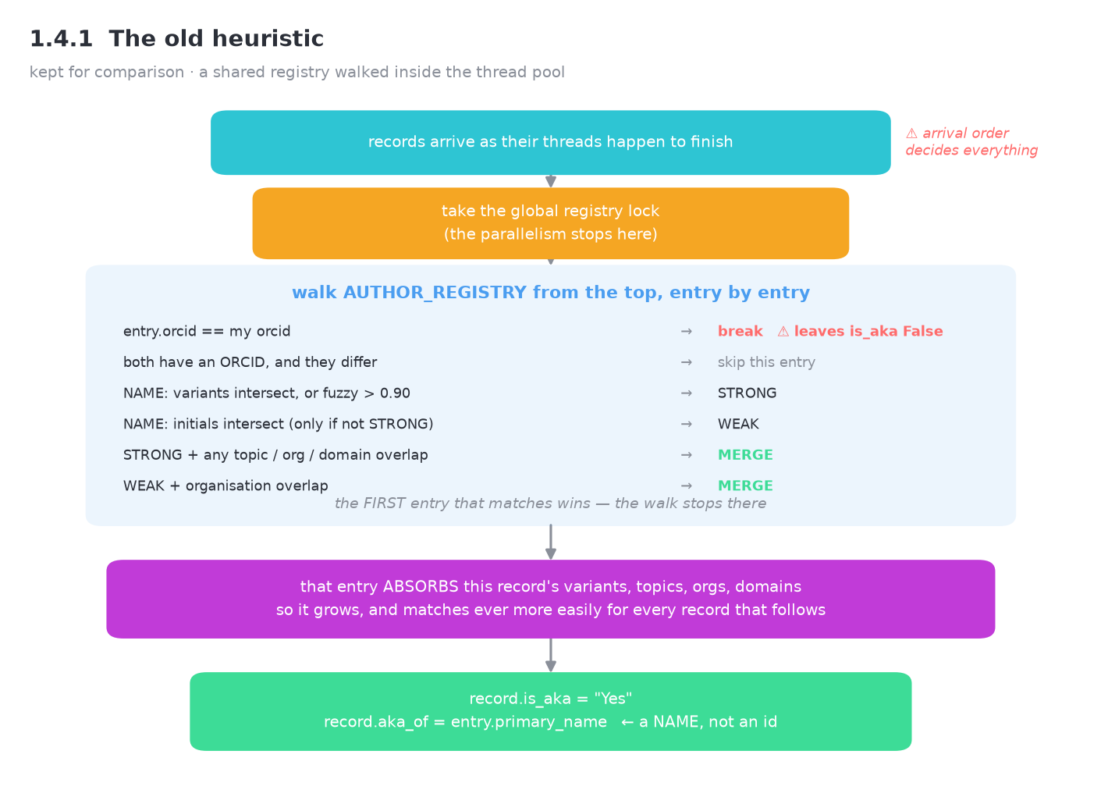
1. AUTHORS
Why the old heuristic was replaced
• First match wins, so the arrival order of threads decides the grouping
• Groups are keyed by the master's *name* — two different people with one name collapse
• Entries absorb every variant they touch, so they match ever more easily
• Its ORCID shortcut was an empty `break`: two records with the same ORCID became two authors. Fixed.
GoTriple metadata cleaning · draft · 12
Notes:
Clustering emits a cluster_id; the heuristic only recorded aka_of as a name. An identity key has to be an id.

Slide 13
2. LICENSES
38.3M documents carry no usable license
license value | documents
undefined | 37,151,960
other | 1,715,493
"" (empty string) | 0
field absent entirely | 167
carry both other and undefined | 538,188
One population, not three
538,188 documents sit in two buckets at once, so the values cannot be added up. The pipeline treats the whole set as a single "unresolved" group of 38,329,432 documents — 95% of the index.
GoTriple metadata cleaning · draft · 13
Notes:
This is the single largest data-quality gap in GoTriple.

Slide 14
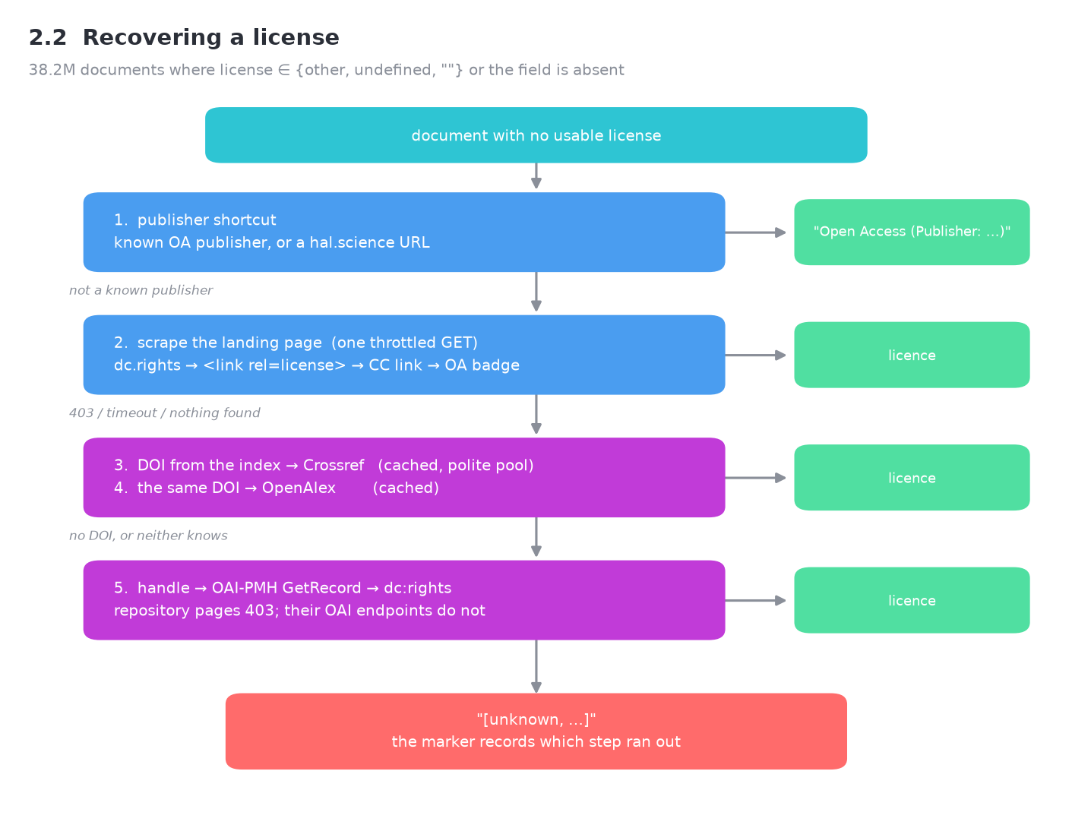
2. LICENSES
The recovery ladder
• Known OA publisher or a hal.science URL — answered without a request
• Scrape the landing page: dc.rights, <link rel=license>, a CC link, an OA badge
• The DOI through Crossref, then OpenAlex — both cached, both polite-pool
• The handle through OAI-PMH, whose endpoints answer when the page 403s
• Failing all five, record which step ran out, not just "unknown"
GoTriple metadata cleaning · draft · 14
Notes:
Each rung is cheaper than the one below it, so the ladder is ordered by cost as well as by reliability.

Slide 15
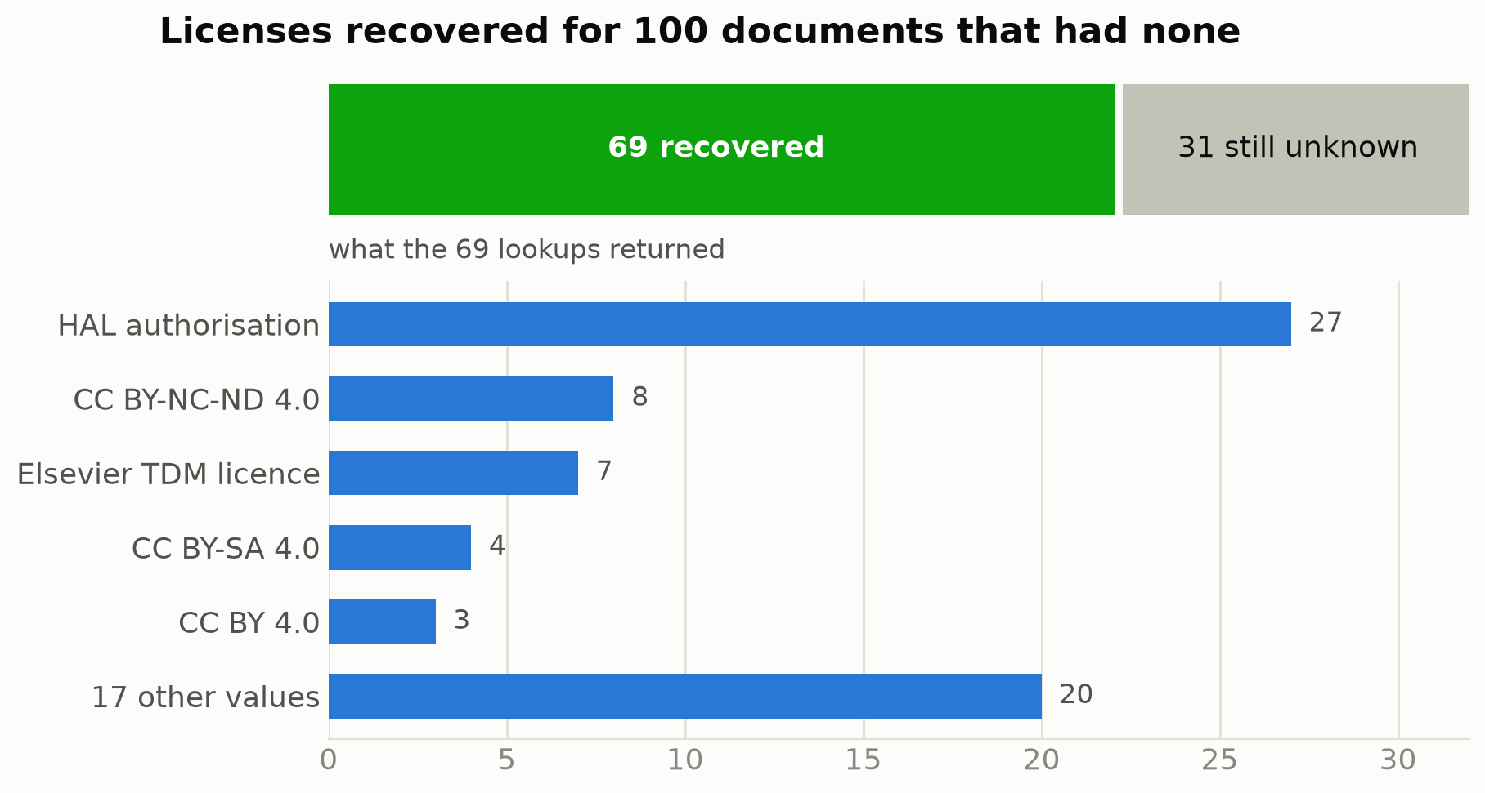
2. LICENSES
Two thirds of them can be recovered
68 of 100
HAL alone accounts for 27 — a single provider rule covers a quarter of the sample.
Of the 32 that failed: 24 had no license anywhere on the page, 5 were blocked with HTTP 403, 2 timed out, 1 had no usable URL.
GoTriple metadata cleaning · draft · 15
Notes:
Sample of 100 documents drawn from the unresolved population. The failure reasons are recorded per document, so the 32 can be triaged rather than guessed at.

Slide 16
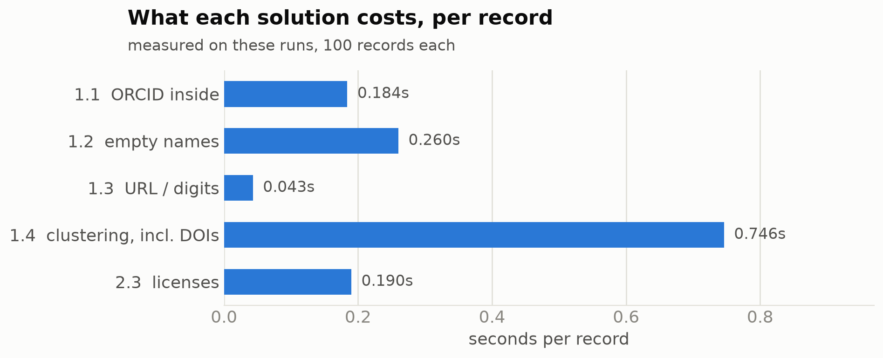
3. COST
What running it for real costs
~84 days for the license population
38.3M documents at the measured 0.190s each.
§1.3 fell from 0.305s to 0.043s a record: recognising a repository id costs one batched query, where chasing a name for it cost a lookup per profile.
GoTriple metadata cleaning · draft · 16
Notes:
Timings are wall clock from the notebook's runs — 1,000 profiles for 1.1, 100 records for the rest, licenses with 10 workers.

Slide 17
RECOMMENDATIONS
What to do with this
• Run 1.1 across all 2,869 profiles now — nine minutes of runtime, ~100% yield.
• Delete the 513 bare-number profiles: they are repository ids, and each one's owner is already known.
• Raise the empty names with the providers — nothing downstream can recover them.
• Adopt clustering, with the DOI and co-author evidence: on the index alone it merges nothing.
• Scope the license job by provider or by license value. Start with HAL — 27 of the 69 hits.
Open question
None of this has ground truth. A false merge is worse than a missed one, so the pipeline splits when the evidence is thin — that trade-off deserves a decision, not a default.
GoTriple metadata cleaning · draft · 17
Notes:
The recommendations follow from the measured yields; the open question is a judgement call for the team.

Slide 18
APPENDIX
Reproducing any of this
• main.ipynb — every strategy, the Elasticsearch query actually executed, and a timed live run
• AUTHOR_SAMPLE and DOCUMENT_SAMPLE at the top drive every number in the notebook
• run_pipeline.py — the same pipelines, prompt-driven, for a scoped production run
• data/output/ — one Excel report per job, with the per-record reason it succeeded or failed
• tests/test_clustering.py — the merge rules and a determinism check, offline, in a second
Credentials live in .env (git-ignored). Counts in this deck were taken on 21 August 2026 against triple-profiles-prod and triple-documents-prod.
GoTriple metadata cleaning · draft · 18
Notes:
Anyone can re-run the notebook and get today's numbers; the tables in it are rendered from the run rather than typed in.

