Slide 1
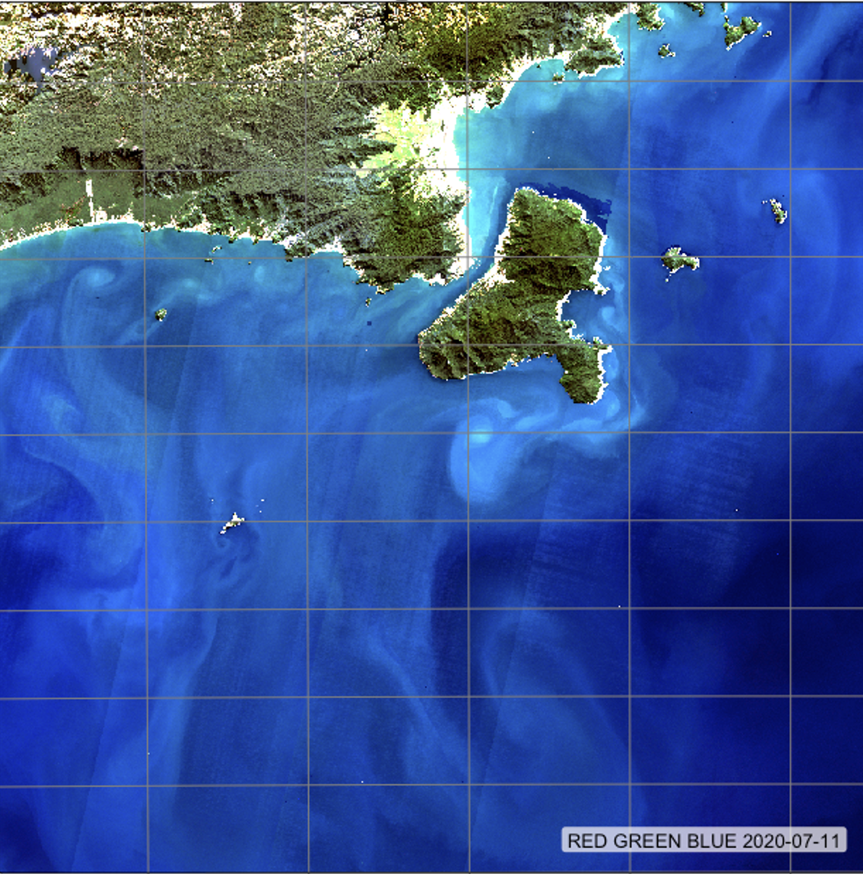
SITS: Satellite image time series analysis on Earth observation data cubes

