Slide 1

CSCI E-25 Computer Vision
Convolutional Neural Networks and Feature Learning
Steve Elston
Copyright 2021, 2022, 2023, 2024, 2025 Stephen F Elston. All rights reserved.

Slide 2
Convolutional Neural Networks
CNNs are a powerful alternative to constructing hand engineered features
Convolutional neural networks (CNNs) learn complex feature maps
Parameters of the feature maps are learned from the data
Features are learned by reducing a loss function
Feature maps created by CNNs are rich and complex
Feature maps have many layers or channels
More complex feature maps have greater capacity
Almost always outperform hand-engineered features

Slide 3
Convolutional Neural Networks
CNNs learn complex feature maps
Model complex interactions between pixel values
Invariant to translation and distortion of features
Reduce the dimensionality of input tensors
Share weights and are relatively easy to train
CNNs have a long history in CV
LeCun et. al. (1989) first employed CNNs for automatic check handling
Era of general use in CV started when AlexNet, developed by Krizhevsky et. al. (2012), won an ImageNet object recognition competition
Now commonly used for image problems

Slide 4
Convolutional Neural Networks
Key points for this lesson
CNNs learn complex feature maps
Feature maps have many layers or channels
CNNs have strong inductive biases for CV
Deeper CNNs create feature maps with higher capacity
Training very deep NNs with ResNets
Reducing complexity of convolutional layers
Multi-scale architectures use parallel feature map paths
State of the art CNN architectures combine multiple improvements

Slide 5
Convolutional Neural Networks
Representation
Inference
Input = X
Output = Y
Learning

Slide 6
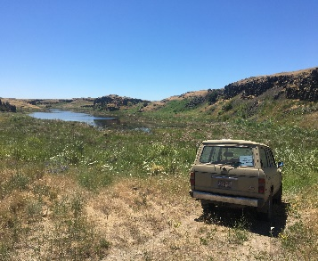
Convolutional Neural Networks
CNN creates feature map in inference pipeline
Backbone Network
CNN Layers
Flatten feature map
Inference
Input Image
Each of K output channels is a part of feature map
Task-specific head
NN
SVM
Etc.

Slide 7
Convolution in 2 and higher dimensions

Slide 8
2-D Convolution
Example:
4 x 4 input tensor
3 x 3 convolution operator
2 x 2 output tensor
Input
Output

Slide 9
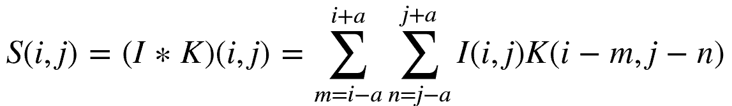
2-D Convolution
Mathematically, we express 2-d convolution as a weighted sum over a discrete rectangular kernel:
Where S, I and K are tensors:
I is the input tensor
K is the convolutional kernel tensor
S is the output tensor of the convolution operation

Slide 10
Convolution in Higher Dimensions
Creating rich feature maps requires applying convolution to large multidimensional tensors
Tensor notation allows easy extension to higher dimensions
Input tensor has multiple input channels
3-D for color image
4-D for video
Transform input tensor dimensions with sampling layer
Typically convolutional layer
Create rich multiple channel feature maps
Convolution kernel tensor has multiple output channels
Each channel is a different feature map with different kernel weights
Features in a channel might be vertical lines, horizontal lines, corners, etc., but are often highly abstracted

Slide 11
Convolution in Higher Dimensions
Tensor of L output channels
Each channel is a part of feature map
Convolution kernel tensor
of M x L x A x A
weights
M input channels
I x J spatial dimensions

Slide 12
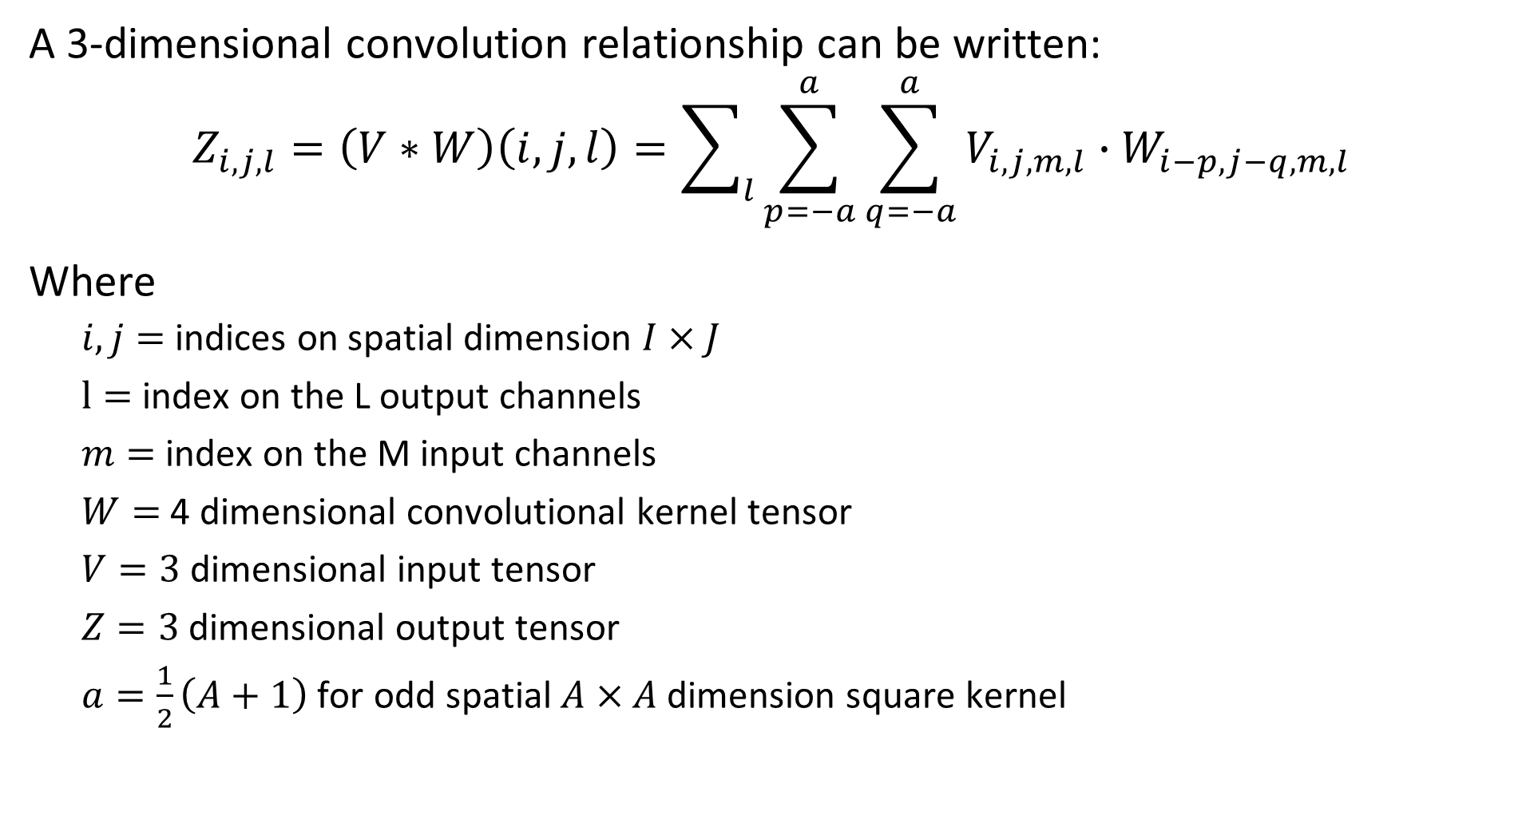
Convolution in Higher Dimensions
A 3-dimensional convolution relationship can be written:
$$Z_{i,j,l}=\left(V∗W\right)\left(i,j,l\right)=\sum_{l}{\sum_{p=−a}^{a}{\sum_{q=−a}^{a}{V_{i,j,m,l}∙W_{i−p,j−q,m,l}}}}$$
Where
$i,j=$ indices on spatial dimension $I×J$
$l=$ index on the L output channels
$m=$ index on the M input channels
$W=$ 4 dimensional convolutional kernel tensor
$V=3$dimensional input tensor
$Z=3$dimensional output tensor
$a=\frac{1}{2}\left(A+1\right)$ for odd spatial $A×A$dimension square kernel

Slide 13
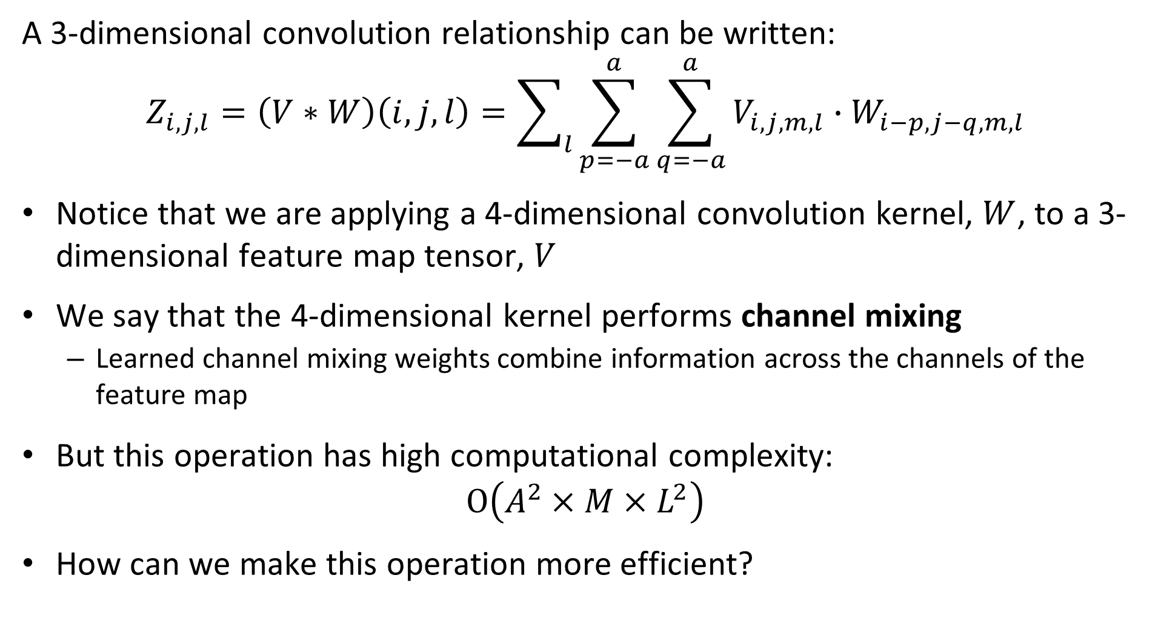
Convolution in Higher Dimensions
A 3-dimensional convolution relationship can be written:
$$Z_{i,j,l}=\left(V∗W\right)\left(i,j,l\right)=\sum_{l}{\sum_{p=−a}^{a}{\sum_{q=−a}^{a}{V_{i,j,m,l}∙W_{i−p,j−q,m,l}}}}$$
Notice that we are applying a 4-dimensional convolution kernel, $W$, to a 3-dimensional feature map tensor, $V$
We say that the 4-dimensional kernel performs channel mixing
Learned channel mixing weights combine information across the channels of the feature map
But this operation has high computational complexity:
$$O\left(A^{2}×M×L^{2}\right)$$
How can we make this operation more efficient?

Slide 14
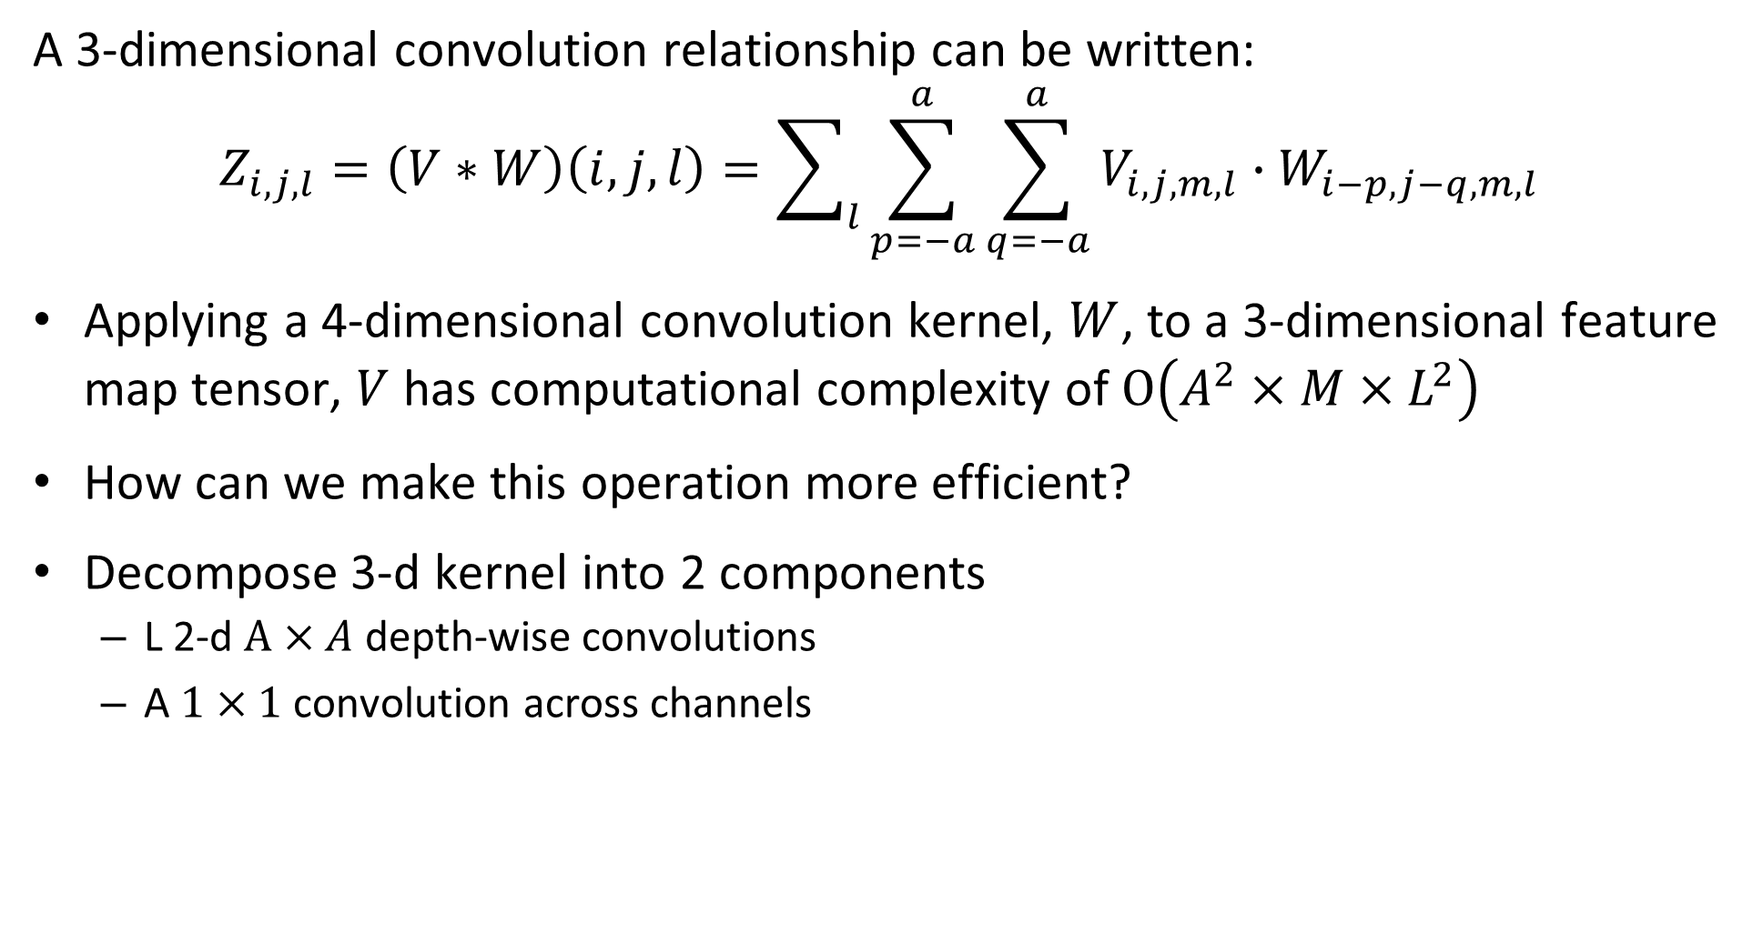
Convolution in Higher Dimensions
A 3-dimensional convolution relationship can be written:
$$Z_{i,j,l}=\left(V∗W\right)\left(i,j,l\right)=\sum_{l}{\sum_{p=−a}^{a}{\sum_{q=−a}^{a}{V_{i,j,m,l}∙W_{i−p,j−q,m,l}}}}$$
Applying a 4-dimensional convolution kernel, $W$, to a 3-dimensional feature map tensor, $V$ has computational complexity of $O\left(A^{2}×M×L^{2}\right)$
How can we make this operation more efficient?
Decompose 3-d kernel into 2 components
L 2-d $A×A$ depth-wise convolutions
A $1×1$ convolution across channels

Slide 15
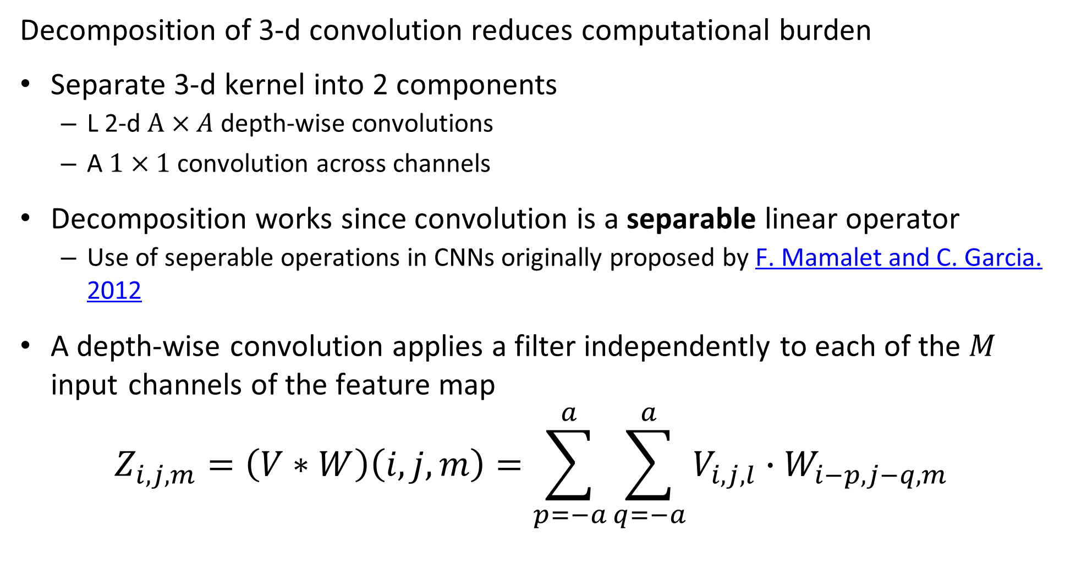
Convolution in Higher Dimensions
Decomposition of 3-d convolution reduces computational burden
Separate 3-d kernel into 2 components
L 2-d $A×A$ depth-wise convolutions
A $1×1$ convolution across channels
Decomposition works since convolution is a separable linear operator
Use of seperable operations in CNNs originally proposed by F. Mamalet and C. Garcia. 2012
A depth-wise convolution applies a filter independently to each of the $M$ input channels of the feature map
$$Z_{i,j,m}=\left(V∗W\right)\left(i,j,m\right)=\sum_{p=−a}^{a}{\sum_{q=−a}^{a}{V_{i,j,l}∙W_{i−p,j−q,m}}}$$

Slide 16
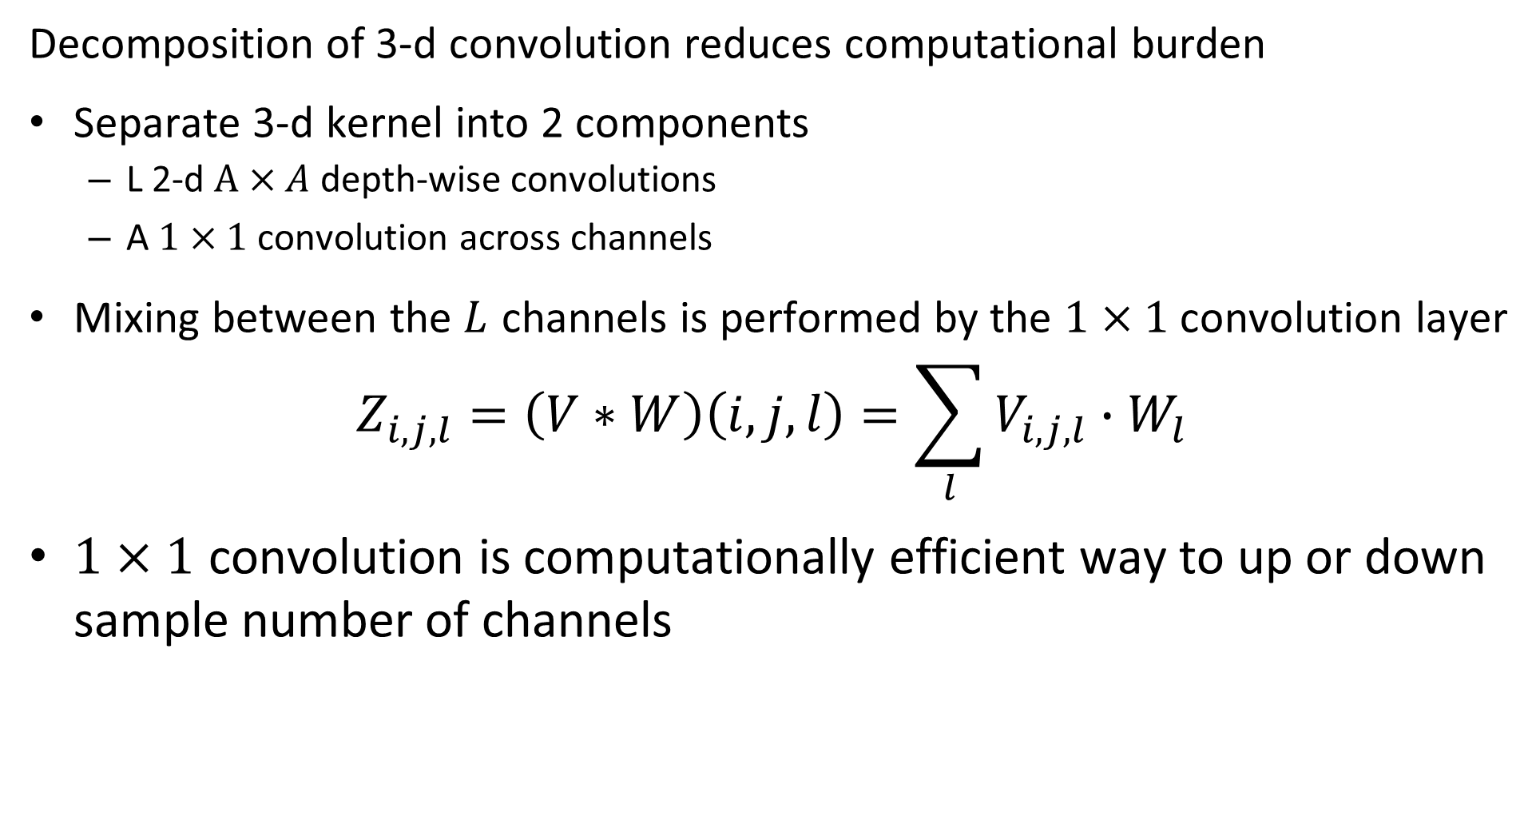
Convolution in Higher Dimensions
Decomposition of 3-d convolution reduces computational burden
Separate 3-d kernel into 2 components
L 2-d $A×A$ depth-wise convolutions
A $1×1$ convolution across channels
Mixing between the $L$ channels is performed by the $1×1$ convolution layer
$$Z_{i,j,l}=\left(V∗W\right)\left(i,j,l\right)=\sum_{l}{V_{i,j,l}∙W_{l}}$$
$1×1$ convolution is computationally efficient way to up or down sample number of channels

Slide 17
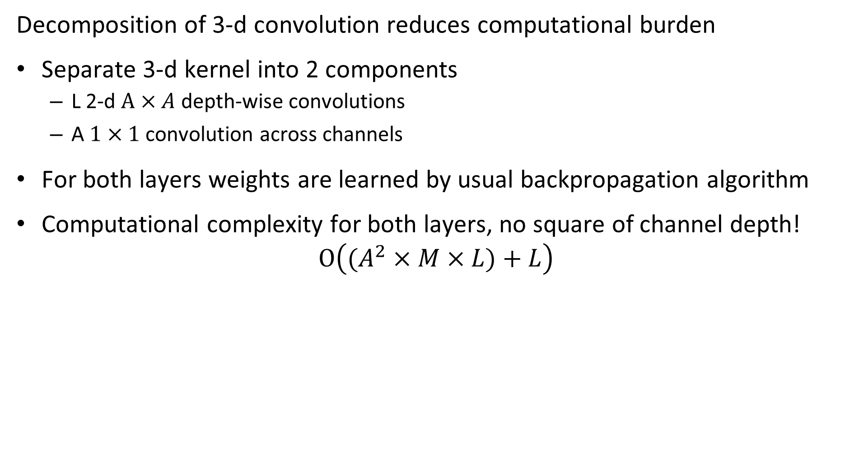
Convolution in Higher Dimensions
Decomposition of 3-d convolution reduces computational burden
Separate 3-d kernel into 2 components
L 2-d $A×A$ depth-wise convolutions
A $1×1$ convolution across channels
For both layers weights are learned by usual backpropagation algorithm
Computational complexity for both layers, no square of channel depth!
$$O\left((A^{2}×M×L)+L\right)$$

Slide 18
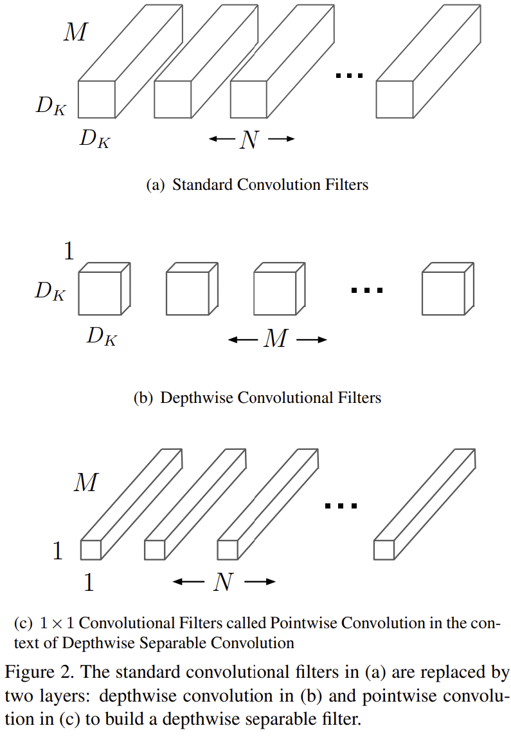
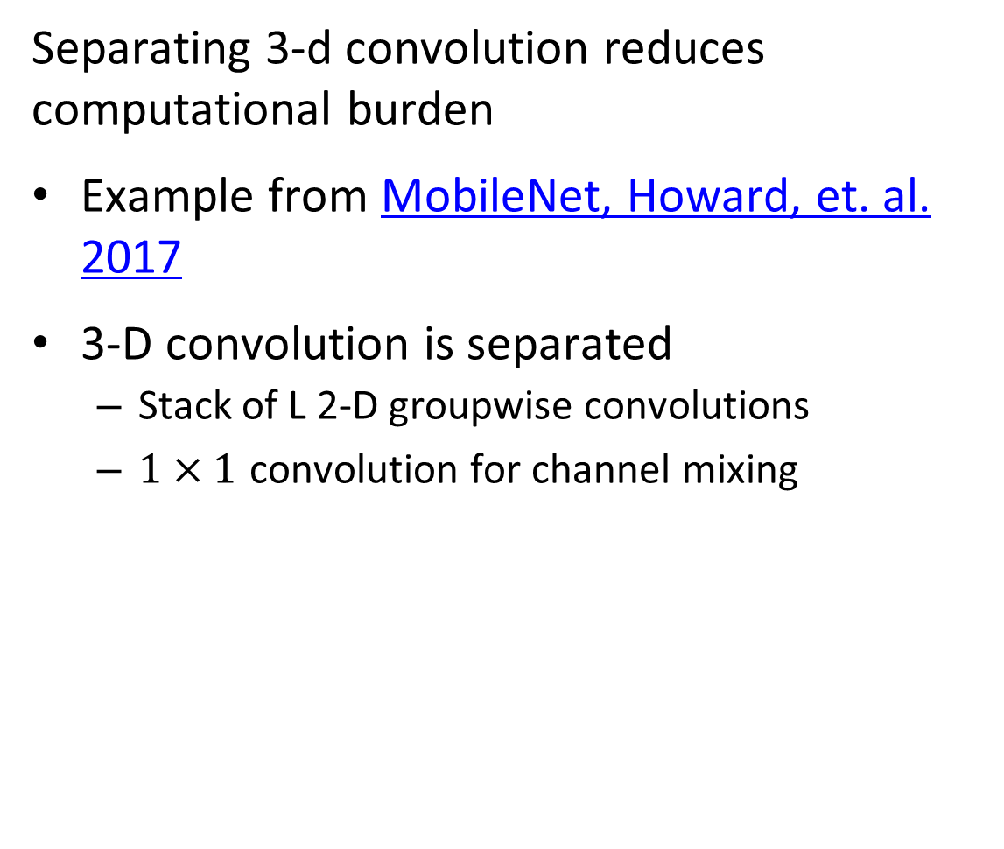
Convolution in Higher Dimensions
Separating 3-d convolution reduces computational burden
Example from MobileNet, Howard, et. al. 2017
3-D convolution is separated
Stack of L 2-D groupwise convolutions
$1×1$ convolution for channel mixing

Slide 19
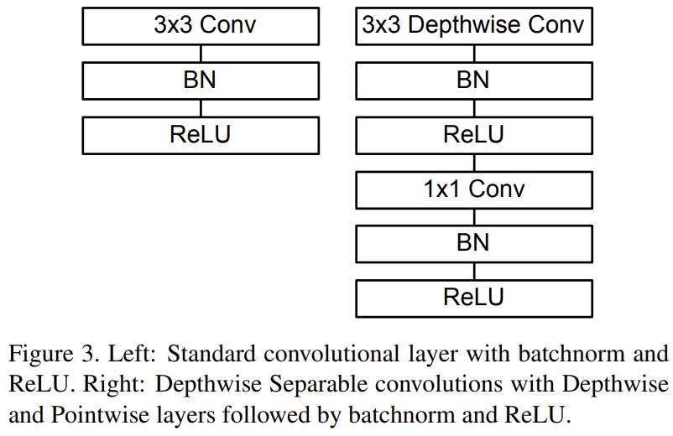
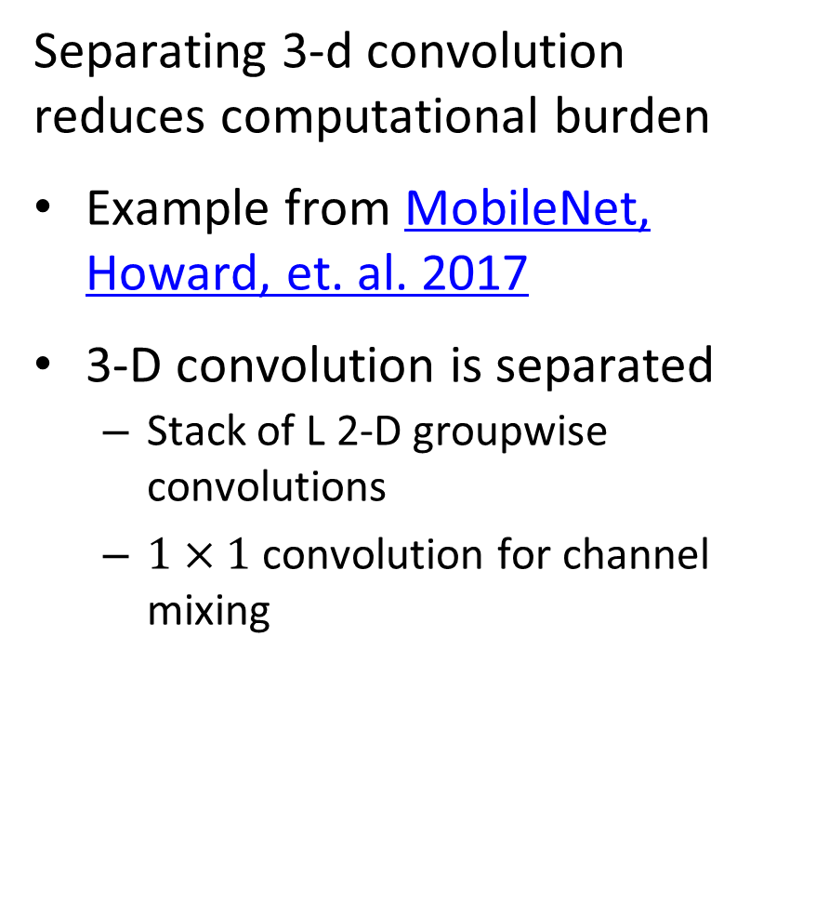
Convolution in Higher Dimensions
Separating 3-d convolution reduces computational burden
Example from MobileNet, Howard, et. al. 2017
3-D convolution is separated
Stack of L 2-D groupwise convolutions
$1×1$ convolution for channel mixing

Slide 20
Inductive Bias

Slide 21
Inductive Bias of CNNs
Inductive bias is a major reason CNNs have been spectacularly successful at CV tasks
Inductive bias properties of CNNs include:
Locality: Closely placed pixels have strong interactions or dependency
Spatial structure: Over the image surface, features exhibit different pixel intensity
Translational invariance: Response of convolution operator does not change with position on the image surface
Weight sharing: Convolution operator does not change with position on the image surface

Slide 22
Inductive Bias of CNNs
Locality and spatial structure with CNNs
Images have considerable dependency between adjacent pixel values
CNNs take advantage of image pixel redundancy within the receptive field of the kernels
Features are identified within the span of the kernel
Operator response to feature is well defined spatially on image surface
But, CNNs not sensitive to features larger the receptive field!
Size of receptive field determines spatial scale of convolution operation
Receptive field grows with depth in CNN

Slide 23
Inductive Bias of CNNs
Convolution uses pooling and has translational invariance
The response of convolution operator is invariant with respect to position on image
Convolutional operator uses same weights regardless of location, parameter sharing
The same feature generates identical response regardless of location
Convolutional operations are not invariant to rotation!

Slide 24
Inductive Bias of CNNs
Pooling reduces dimensionality and improves invariance
How can we obtain greater reduction in dimensionality?
Pooling of convolution kernel output values reduces dimensionality
e.g. 2x2 operator pools 4 values into 1
How to pool?
Average pooling? Fast with linear response
Max pooling? Finds highest activation
Both approaches are used in practice
Choice may require some experimentation

Slide 25
Inductive Bias of CNNs
Max pooling provides invariance to small shifts of the input tensor:
0.3
1.0
0.3
0.3
1.0
0.2
0.3
0.1
1.0
0.2
0.1
0.3
0.2
0.3
0.1
1.0
0.2
0.1
Original
Shift Right by One

Slide 26
Inductive Bias of CNNs
Weights or parameters are shared within each convolutional layer
CNNs are efficient to train, since fewer parameters
Weights are learned using backpropagation and gradient descent methods
CNNs use parameter sharing
Statistical strength from more samples per weight
Reduced variance of parameter estimates
Also called tied weights or sparse interaction

Slide 27
Inductive Bias of CNNs
Weights of fully connected network are independent
e.g. requires 5² = 25 weights

Slide 28
Inductive Bias of CNNs
Weights are shared in CNN
W₁
W₃
W₁
W₃
W₁
W₃
W₂
W₂
W₂
Requires 3 weights

Slide 29
Deep Architectures

Slide 30
Deeper Architectures
Deeper architectures create richer feature maps
Rich feature maps have a high number of channels
Deep neural net architectures learn more powerful and abstracted features
Models trained on very large benchmark datasets
Generally, classification accuracy found to improve with depth
But, training deep networks is problematic

Slide 31
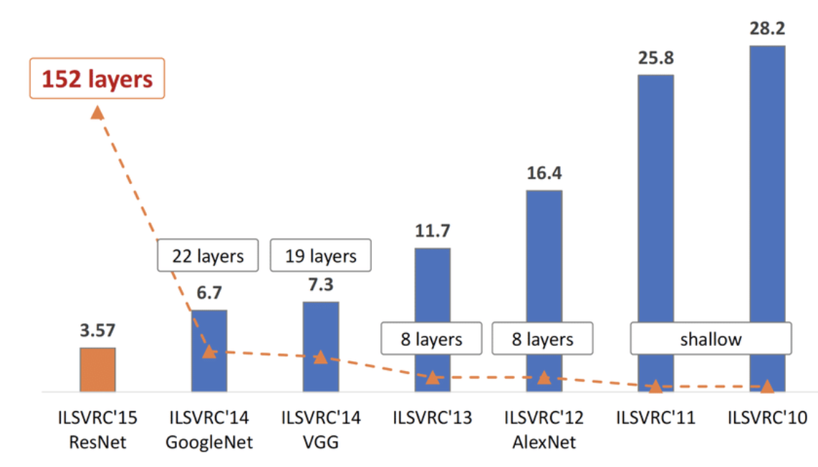
Deep Architectures
Introduction of deep architectures for the ImageNet Large Scale Visual Recognition challenge in 2012 marked a major advance in error rate
Subsequent improvements have resulted from deeper NNs
Similar improvements in object localization – we discuss this later

Slide 32
Deep and Multi-Scale Architectures
VGG11 - Simanyan and Zdisserman, 2015
Feature map channels Increasing with depth, decreasing dimensionality per channel
Max pool
Max pool
Max pool
1000 Fully connected
3x3 conv, 256 channel
3x3 conv, 128 channel
3x3 conv, 64 channel
3x3 conv, 256 channel
Max pool
3x3 conv, 512 channel
3x3 conv, 512channel
3x3 conv, 512 channel
3x3 conv, 512channel
4096 Fully connected
4096 Fully connected
Max pool
Softmax
Convolution and max-pool create feature map
Classifier layers use feature map

Slide 33
Training Very Deep Networks and ResNet

Slide 34
Deep and Multi-Scale Architectures
Very deep CNNs can provide significant improvements in accuracy
But, learning is hard in very deep networks

Slide 35
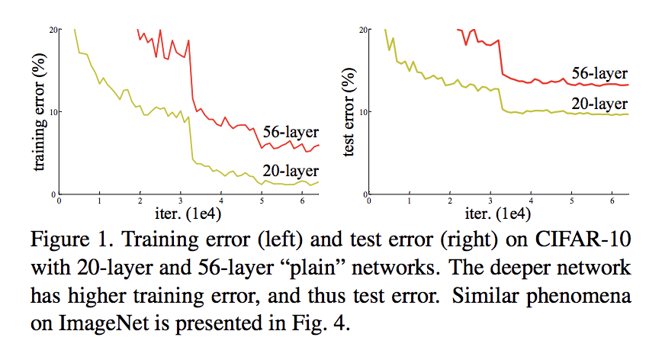
How Deep a Stack of Layers Can We Train
Try backpropagation to train deep NNs with larger number of layers:
Possible explanations for these results:
Vanishing gradients?
Exploding gradients?
Overfitting?
None of the above!
Vanishing gradients – batch normalization
Exploding gradients – gradient clipping
Overfitting – dropout regularization
From He, et.al., 2015

Slide 36
How Deep a Stack of Layers Can We Train
Possible explanations for these results:
The learning with backpropagation on stacked layers no longer learns useful features past a certain depth!
From He, et.al., 2015

Slide 37
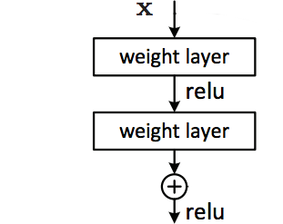
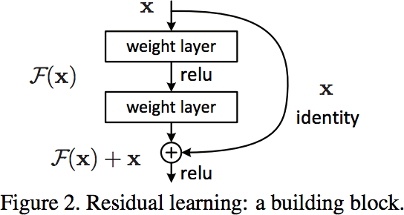
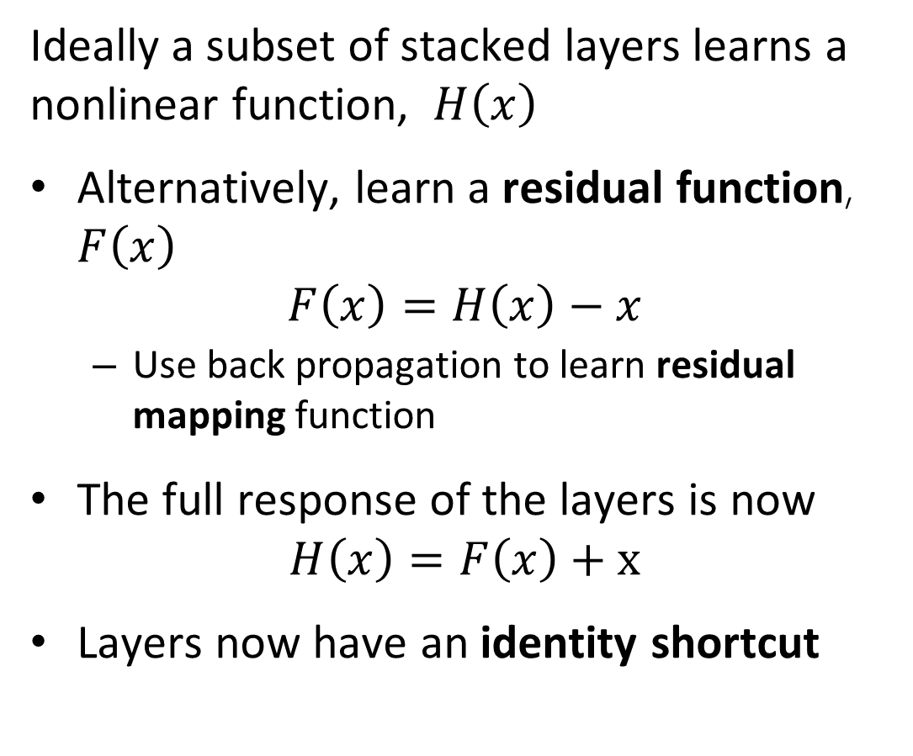
How Deep a Stack of Layers Can We Train?
Ideally a subset of stacked layers learns a nonlinear function, $H\left(x\right)$
Alternatively, learn a residual function, $F\left(x\right)$
$$F\left(x\right)=H\left(x\right)−x$$
Use back propagation to learn residual mapping function
The full response of the layers is now
$$H\left(x\right)=F\left(x\right)+x$$
Layers now have an identity shortcut
From He, et.al., 2015

Slide 38
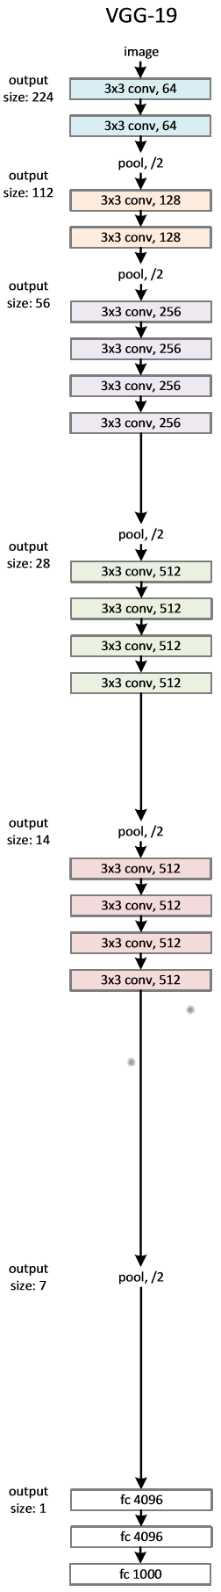
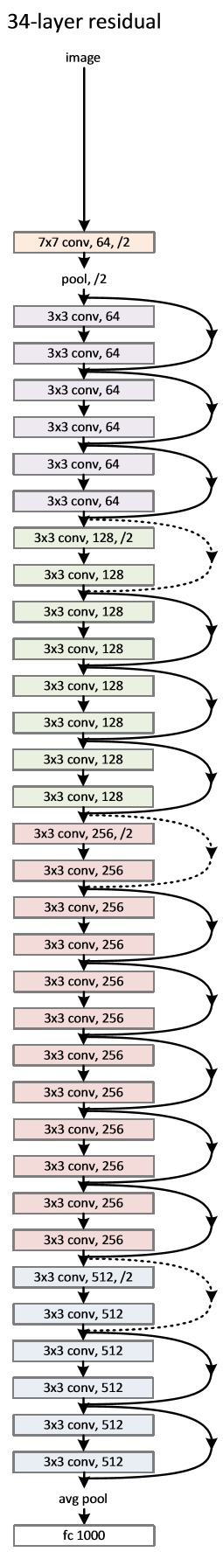
ResNet Representation with Residuals
Start with VGG19 architecture
34 stacked layer network – poor training characteristics
34 layer ResNet with identity shortcuts
From He, et.al., 2015

Slide 39
ResNet Representation with Residuals
How does computational complexity compare?
Notice ResNet has only 2 max pooling filters!
Forward propagation with VGG19 requires 19.6 B Floating Point Operations (GFLOPs)
Forward propagation with ResNet-34 requires 3.6 GFLOPs!
From He, et.al., 2015

Slide 40
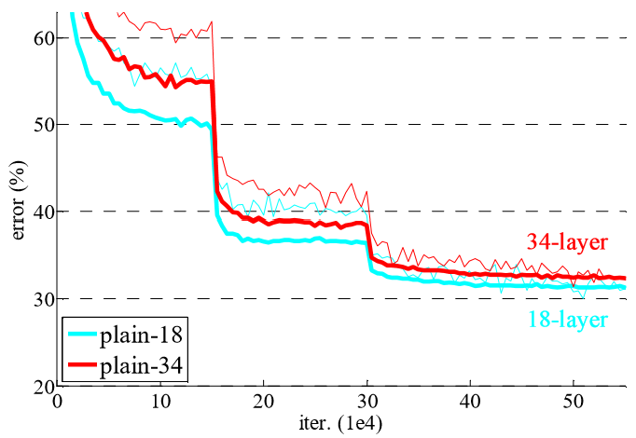
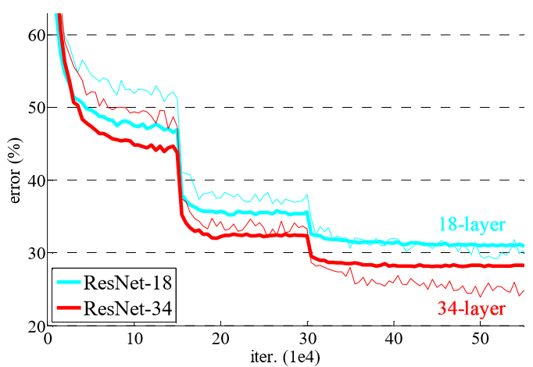
ResNet Representation with Residuals
How well does ResNet work?
18 and 34 layers stacked network performance
18 and 34 layer ResNets
From He, et.al., 2015

Slide 41
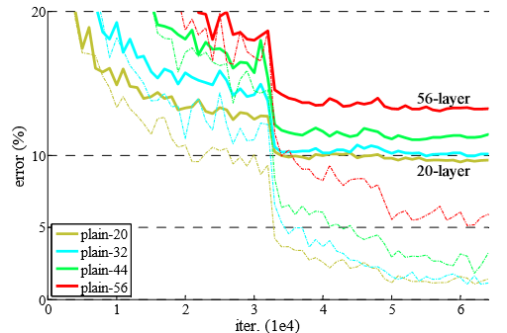
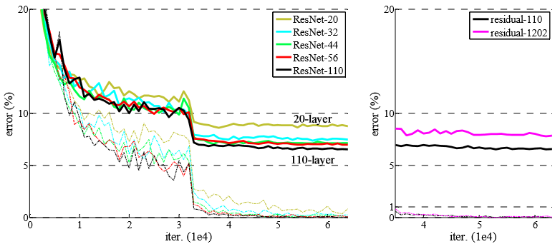
ResNet Representation with Residuals
What are the limits of ResNet Learning?
Compare stacked network performance drops past about 20 layers
ResNets allow greater depth and accuracy, but with limits!
From He, et.al., 2015

Slide 42
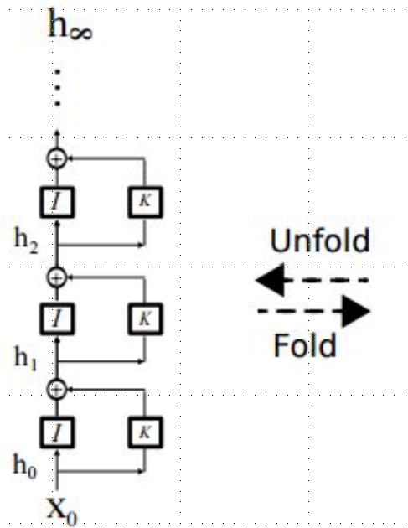
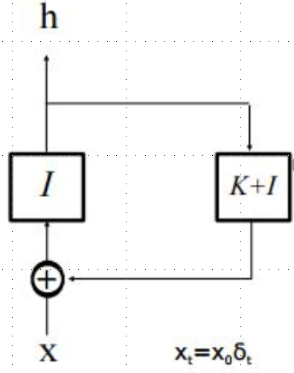
Why do ResNets work?
What makes learning easier for ResNets?
Start with ResNet feed-forward layers
Now, unroll the recurrence for several learning steps
Learning in the unrolled model resembles ensemble learning
From He, et.al., 2015

Slide 43
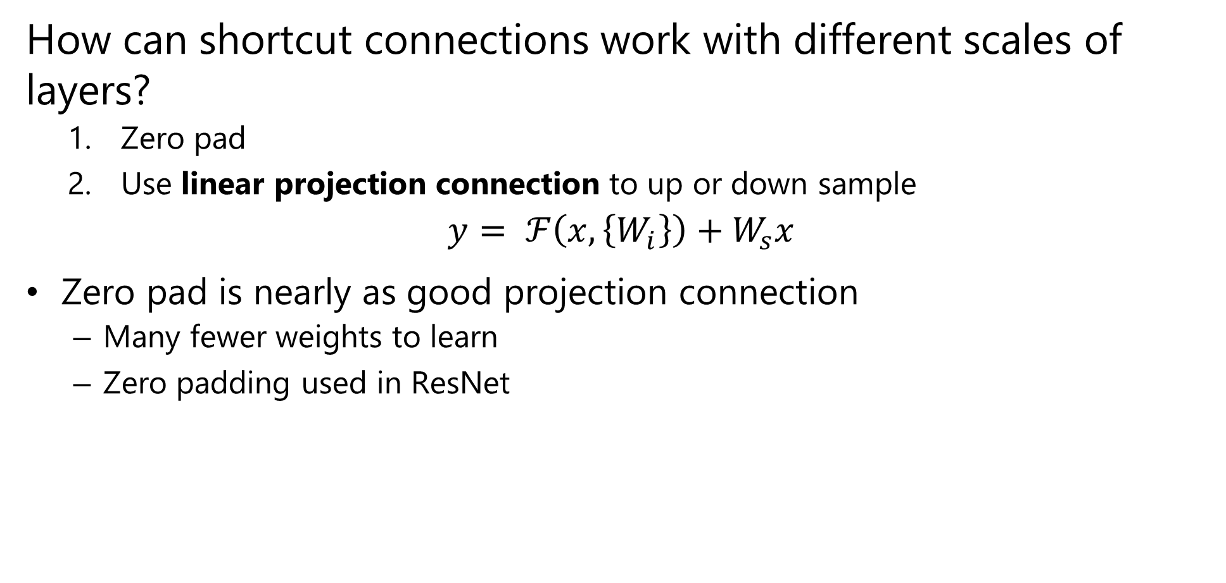
Scaling and ResNets
How can shortcut connections work with different scales of layers?
Zero pad
Use linear projection connection to up or down sample
$$y= ℱ\left(x,\left\{W_{i}\right\}\right)+W_{s}x$$
Zero pad is nearly as good projection connection
Many fewer weights to learn
Zero padding used in ResNet

Slide 44
Multi-Scale Architectures

Slide 45
Multi-Scale Architectures
How can convolutional layers be expanded to multiple scales
Single convolutional layers work at single scale
But, real-world images contain objects with different scales
Need architecture that supports multiple scales
CNN layers with different scales in parallel
Concatenate the results
Numerous pretrained models, using complex architectures, are now available
Trained on very large benchmark datasets
Built into deep learning frameworks; Keras, PyTorch, etc.

Slide 46
Example: Multi-Scale Architecture
Xception Chollet, 2017
Input tensor
1x1 Conv
Ave Pool
1x1 Conv
1x1 Conv
3x3 Conv
3x3 Conv
3x3 Conv
3x3 Conv
Concatenated multi-scale feature map

Slide 47
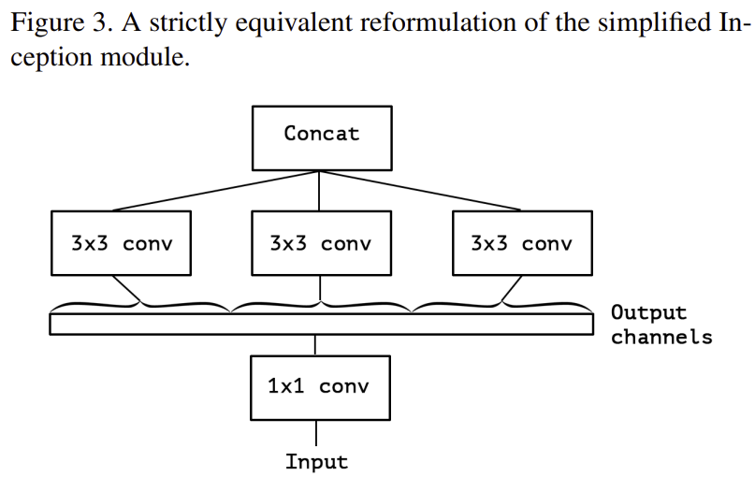
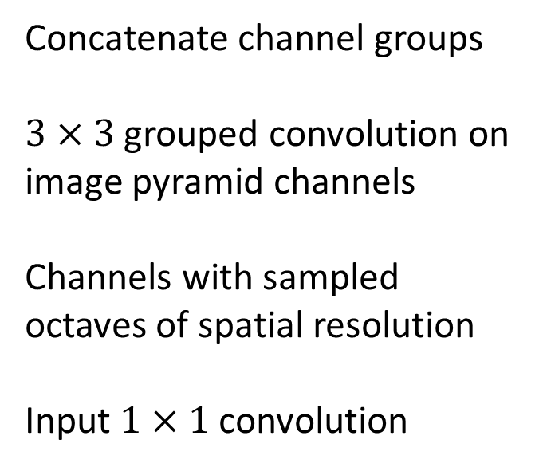
Example: Multi-Scale Architecture
Concatenate channel groups
$3×3$ grouped convolution on image pyramid channels
Channels with sampled octaves of spatial resolution
Input $1×1$ convolution
Figure from Xception Chollet, 2017

Slide 48
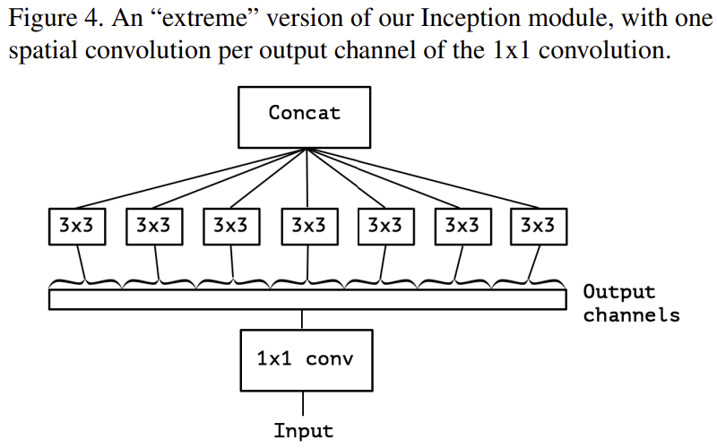
Example: Multi-Scale Architecture
Concatenate channel groups
$3×3$ grouped convolution on image pyramid channels
Channels with sampled octaves of spatial resolution
Input $1×1$ convolution
Figure from Xception Chollet, 2017

Slide 49
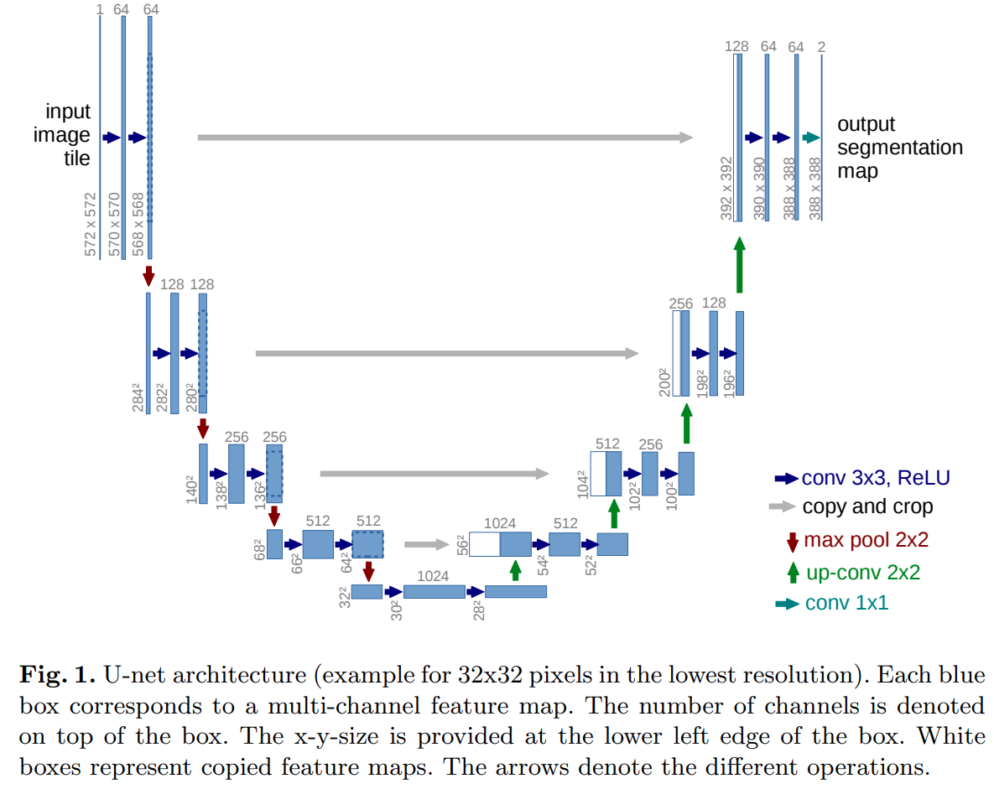
Example: U-Net Multi-Scale Architecture
U-Net architecture creates feature map at multiple scales
U-Net comprises two scale pyramids
Fine to coarse scale down-sampling pyramid
Coarse to fine scale up-sampling pyramid
Figure from Ronneberger, Fishcher and Brox, 2015

Slide 50
Example: U-Net Multi-Scale Architecture
U-Net architecture creates feature map at multiple scales
Input image
Finest scale, highest resolution, convolution
Down sample to larger scale, lower resolution, layers with increasing channel count
Largest scale, lowest resolution layer
Figure from Ronneberger, Fishcher and Brox, 2015

Slide 51
Example: U-Net Multi-Scale Architecture
U-Net architecture creates feature map at multiple scales
Output map concatenates features at all scale
Features of each resolution
Concatenated with the channels of next lower resolution
Up-sample between resolutions
Figure from Ronneberger, Fishcher and Brox, 2015

Slide 52
Squeeze and Expand Layers

Slide 53
Why Squeeze and Expand Layers?
Squeeze and excitation (SE) layers learn interactions between channels
Squeeze aggregates information from each channel of the feature map
Creates a lower dimensional embedding
Excitation creates weights to emphasize important aspects of the feature map
Scale applies excitation to channels

Slide 54
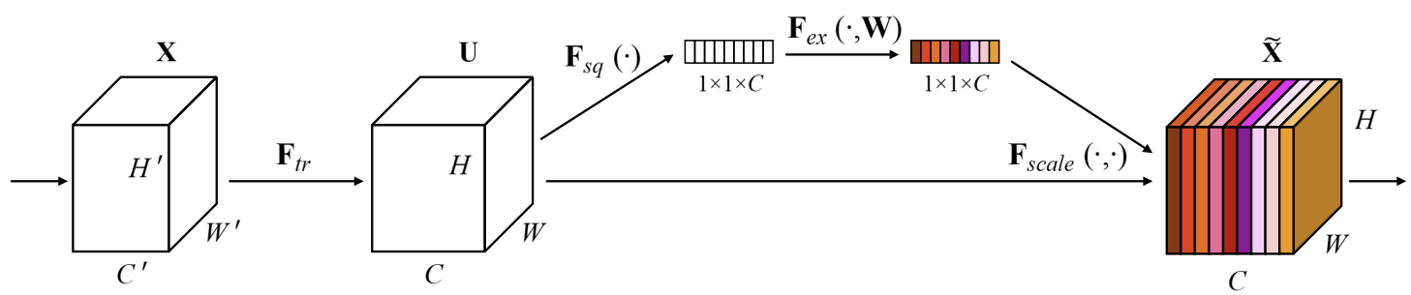
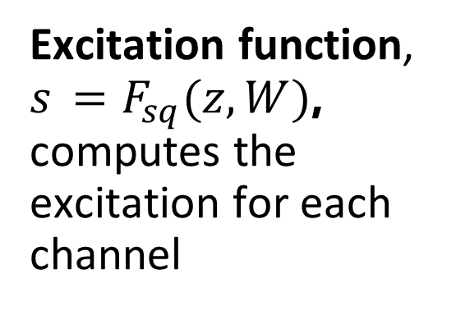
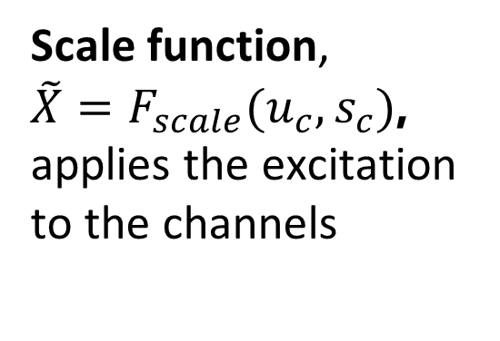
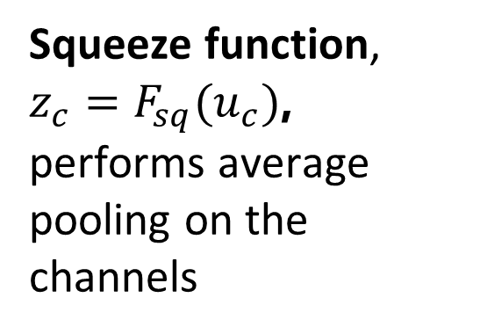
Why Squeeze and Expand Layers?
Squeeze and expand (SE) layers model interactions between channels
Excitation function, $s_{ }=F_{sq}(z,W)$, computes the excitation for each channel
Scale function, ${\tilde{X}=F}_{scale}(u_{c},s_{c})$, applies the excitation to the channels
Squeeze function, $z_{c}=F_{sq}(u_{c})$, performs average pooling on the channels
From Hu, et.al., 2019

Slide 55
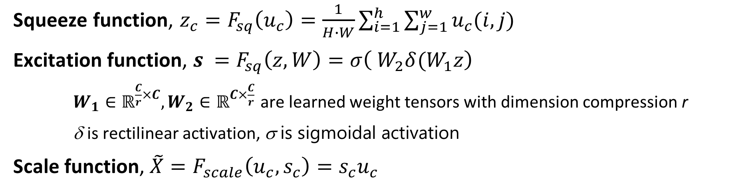
Why Squeeze and Expand Layers?
Squeeze and expand (SE) layers model interactions between channels
Squeeze function, $z_{c}=F_{sq}\left(u_{c}\right)=\frac{1}{H∙W}\sum_{i=1}^{h}{\sum_{j=1}^{w}{u_{c}(i,j)}}$
Excitation function, $s_{ }=F_{sq}\left(z,W\right)=σ\left( W_{2}δ(W_{1}z\right)$
$W_{1}∈ℝ^{\frac{C}{r}×C},W_{2}∈ℝ^{C×\frac{C}{r}}$ are learned weight tensors with dimension compression r
δ is rectilinear activation, σ is sigmoidal activation
Scale function, ${\tilde{X}=F}_{scale}\left(u_{c},s_{c}\right)=s_{c}u_{c}$
From Hu, et.al., 2019

Slide 56
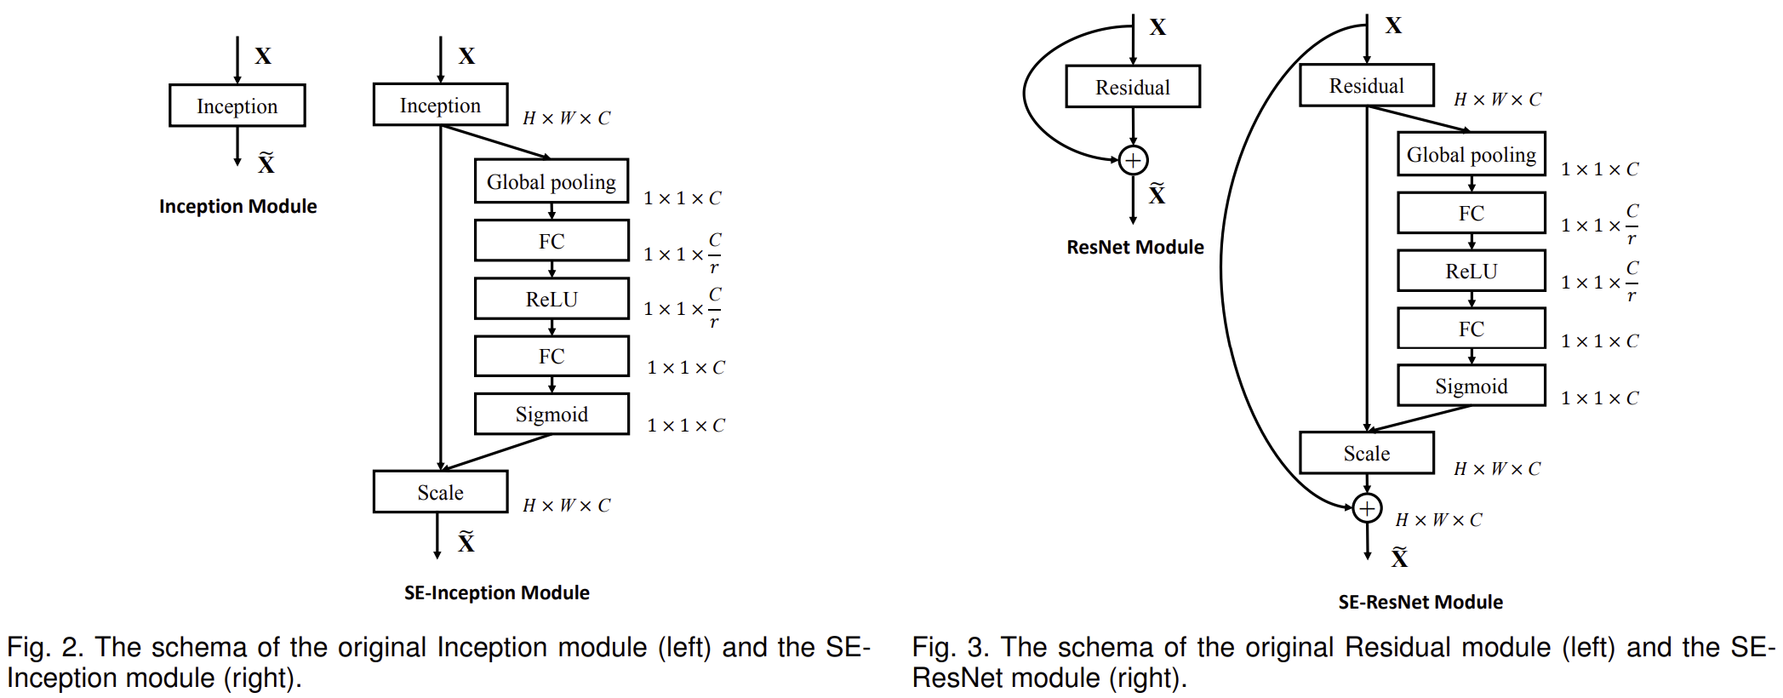
Integrate SE Layers with CNN Architectures
From Hu, et.al., 2019

Slide 57
Scaling and EfficientNet

Slide 58
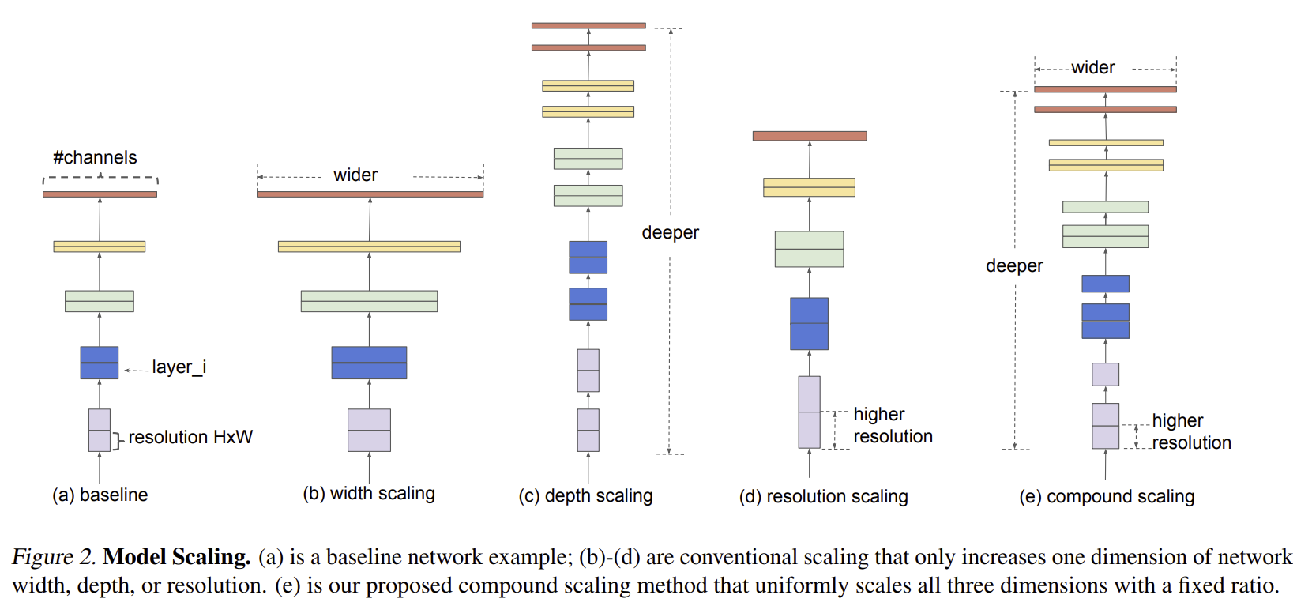
How Can We Scale Deep CNNs
Three dimensions of scale improve CNN accuracy
Width – Channels
Depth – number of layers
Resolution – Height and width
From Tan and Le, 2020

Slide 59
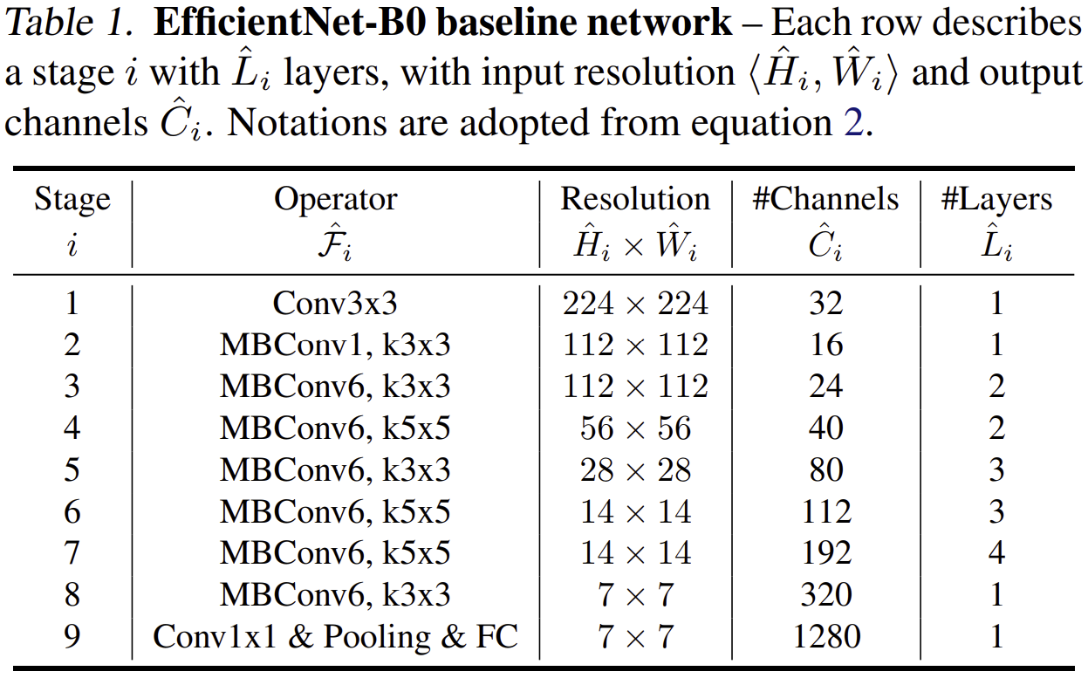
How Can We Scale Deep CNNs
Base MobileNetB0 architecture
Scale up for MobileNetB1 – MobileNetB7
Uses Squeeze and Expand connections
From Tan and Le, 2020

Slide 60
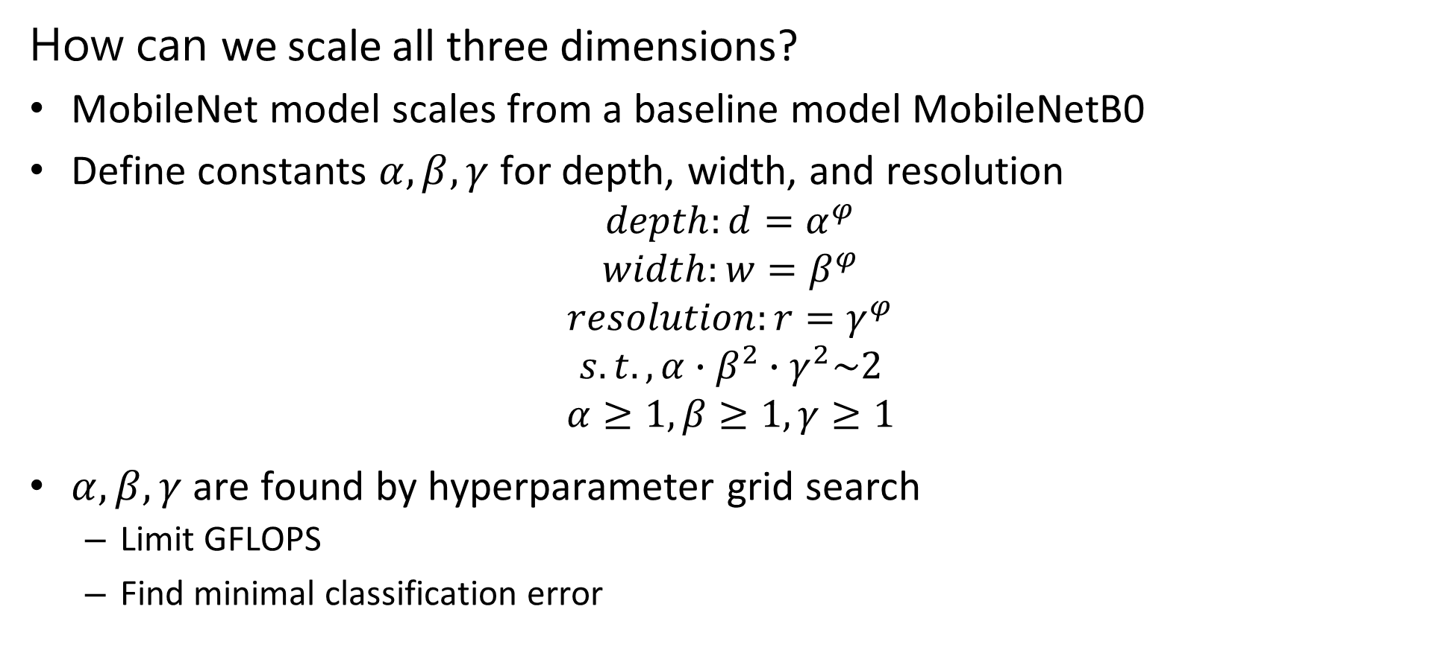
How Can We Scale Deep CNNs
How can we scale all three dimensions?
MobileNet model scales from a baseline model MobileNetB0
Define constants $α,β,γ$ for depth, width, and resolution
$$depth:d=α^{φ}$$
$$width:w=β^{φ}$$
$$resolution:r=γ^{φ}$$
$$s.t., α∙β^{2}∙γ^{2}\sim 2$$
$$α≥1,β≥1,γ≥1$$
$α,β,γ$ are found by hyperparameter grid search
Limit GFLOPS
Find minimal classification error

Slide 61
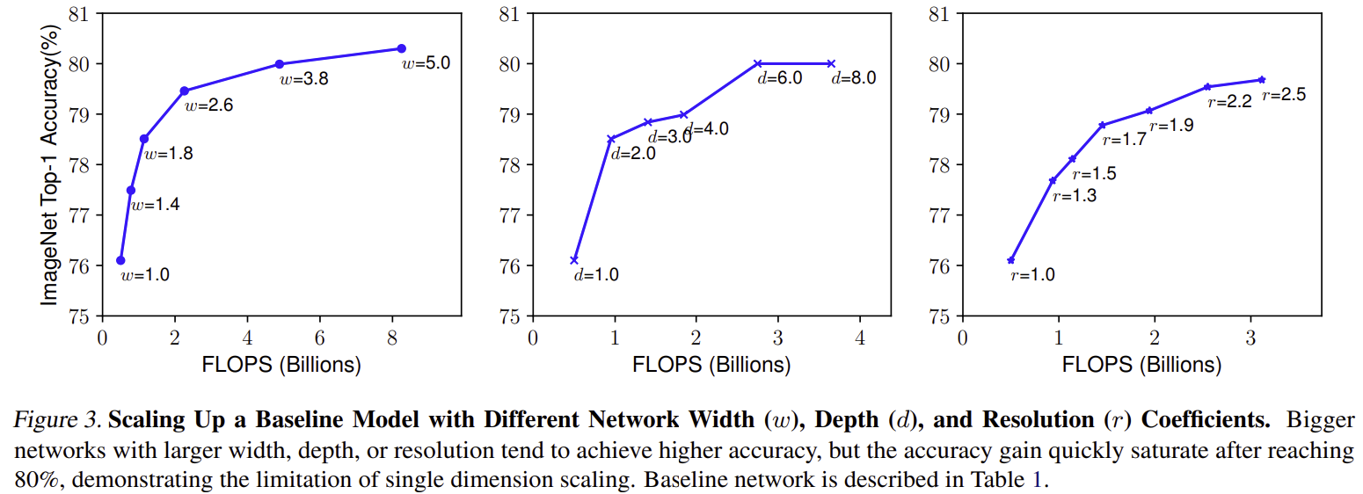
How Can We Scale Deep CNNs
Limits on all 3 dimensions of scaling
Width – Channels
Depth – number of layers
Resolution – number of channels per layer
From Tan and Le, 2020

Slide 62
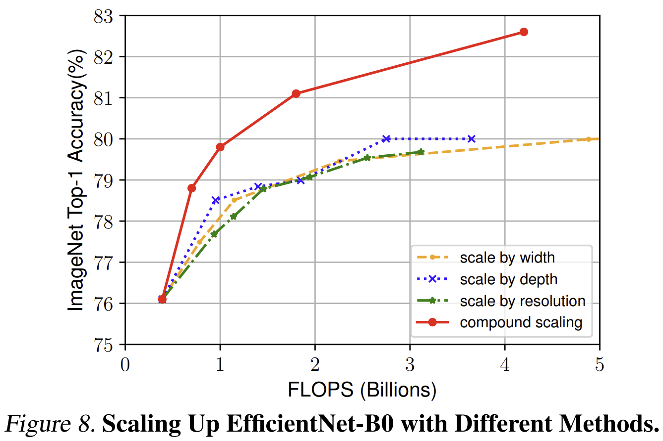
How Can We Scale Deep CNNs
Three simultaneous dimensions of scale improve CNN accuracy
Width – Channels
Depth – number of layers
Resolution – Height and width
From Tan and Le, 2020

Slide 63
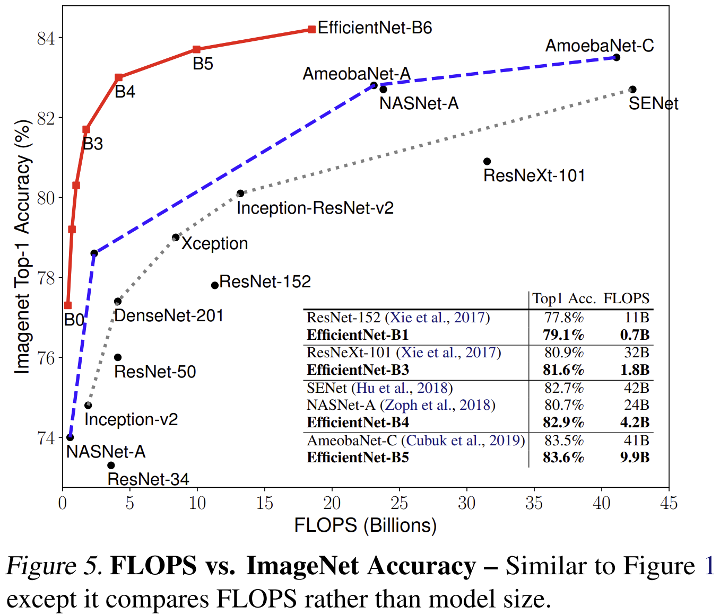
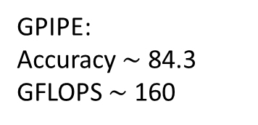
How Can We Scale Deep CNNs
EfficientNet is a significant improvement in scaling CNNs
Compare to hand-engineered scaling
GPIPE:
Accuracy $\sim$ 84.3
GFLOPS $\sim$ 160
From Tan and Le, 2020

Slide 64
State Of The Art CNNs

Slide 65
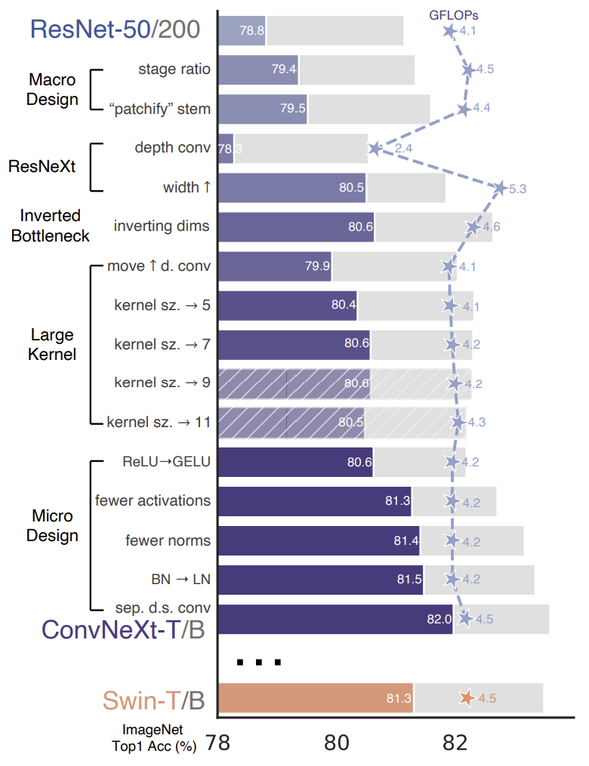
State of the Art CNNs
Recent CNN architectures, such as ConNeXt, Liu, et. al, 2022, provide significant improvements in backbone performance
Significant improvement over ResNet architecture at same computation load
Better performance than SwinFormer at lower computation load

Slide 66
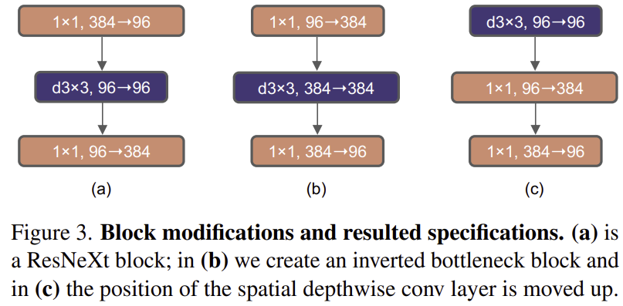
State of the Art CNNs
ConNeXt, Liu, et. al, 2022, combines state of the art architecture and training
Patchify in stem layer, more on this next week
Use of inverted bottleneck layers – expand and then squeeze

Slide 67
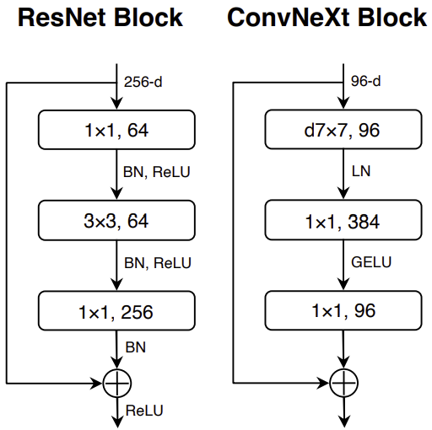
State of the Art CNNs
ConNeXt, Liu, et. al, 2022, combines state of the art architecture and training
Large convolutional kernels improve performance
Several small improvements

Slide 68
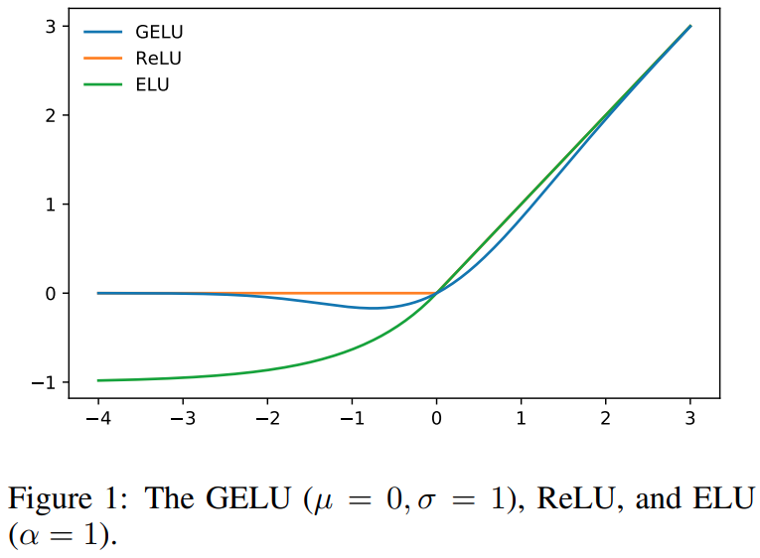
Gaussian Error Linear Units
Gaussian Error Linear Units (GELU), Hendrycks and Gimple, 2023, are an alternative nonlinear activation function
GELU activation is smooth around 0, with a continuous derivative
ReLU activation has a discontinuity at 0, with undefined derivative

Slide 69
Transfer Learning

Slide 70
Transfer Learning
Transfer learning transfers the training of deep NNs from one problem to another
Large scale models are trained on massive data sets
For examples see the pretrained models available in Keras
The pre-trained models often learn considerable general information which applies to other situations
Edges, corners, etc.
Textures and colors
Etc…
An example of using a pretrained MobileNet model in Kares, including data augmentation
Assignment 7 used pretraining on EfficientNet B0

Slide 71
Transfer Learning
Pretrained backbone network
creates feature map
Task-specific head
Stem Layer
Inference
Input Image
Each of K output channels is a part of feature map
Classification
Object detection
Semantic segmentation
Etc.

Slide 72
Transfer Learning
Transfer learning work flow
Start with pre-trained backbone with frozen weights
Pre-trained on large datasets
Add untrained task-specific head (top)
Train task-specific head using task-specific dataset
Use pre-trained backbone feature map
Unfreeze backbone weights and fine-tune all weights using task-specific dataset
Both backbone and head weights fine-tuned
Feature map can become more task-specific

Slide 73
Transfer Learning
Freeze weights
One possible transfer learning workflow
Workflow must fit problem!
First test is model is adequate as is
If not, try tuning the classifier alone – feature map frozen
Finally tune convolutional and classifier layers together if required
Is performance Adequate?
Yes
Done
Unfreeze weights classifier weights only
Tune classifier weights
Is performance Adequate?
Yes
Done
Unfreeze all weights
Tune model
Done
Notes:
Data small but similar. Can’t fine tune, we will overfit. Just learn the top layers using a linear classifier.
Data large and similar. No concern with overfitting. Fine tune the whole network.
Data small and not similar. Overfitting problems if we were to finetune the whole network. Data not similar, so only earlier filters are applicable, not the later ones. Fine tune from somewhere in the middle.

Slide 74
Transfer Learning
Transfer learning: example using learned feature map
from tensorflow.keras.applications import EfficientNetB0
inputs = layers.Input(shape=(IMG_SIZE, IMG_SIZE, 3))
x = img_augmentation(inputs)
model = EfficientNetB0(include_top=False, input_tensor=x,
weights="imagenet")
# Freeze the pretrained feature map
model.trainable = False
# Rebuild top by training output classifier layers on specific dataset
x = layers.GlobalAveragePooling2D(name="avg_pool")(model.output)
x = layers.BatchNormalization()(x)
top_dropout_rate = 0.2
x = layers.Dropout(top_dropout_rate, name="top_dropout")(x)
outputs = layers.Dense(NUM_CLASSES, activation="softmax", name="pred")(x)
Notes:
Data small but similar. Can’t fine tune, we will overfit. Just learn the top layers using a linear classifier.
Data large and similar. No concern with overfitting. Fine tune the whole network.
Data small and not similar. Overfitting problems if we were to finetune the whole network. Data not similar, so only earlier filters are applicable, not the later ones. Fine tune from somewhere in the middle.

Slide 75
Guide to Regularization

Slide 76
Guide to Regularization of Deep NN Models
Determining proper training and regularization of deep NN models can be time consuming and frustrating
Regularization | Behavior | Interaction
Notes:
Data small but similar. Can’t fine tune, we will overfit. Just learn the top layers using a linear classifier.
Data large and similar. No concern with overfitting. Fine tune the whole network.
Data small and not similar. Overfitting problems if we were to finetune the whole network. Data not similar, so only earlier filters are applicable, not the later ones. Fine tune from somewhere in the middle.

Slide 77
Data Augmentation

Slide 78
Data Augmentation
Data Augmentation applies a collection of methods to the generation of new labelled training examples
Generative models create new cases given randomized input
Generate completely new cases with known labels
Complex to create and evaluate
Transformation of existing cases
Can apply one or more transformations to create unique cases

Slide 79
Data Augmentation
A few image transformation examples
Projective transforms: rotation, translation, scale..
Resampling and cropping – random patches, crop left, crop right
Flip image right to left – mirror images
Blurring filters – e.g. Gaussian filter
Color – Change intensity ratio of color channels
Random noise – add random noise to one or more color channels
Combine several of the above….
Etc….

Slide 80
Data Augmentation
Keras/TensorFlow supports data augmentation
Example, of augmentation
from tensorflow.keras.models import Sequential
from tensorflow.keras import layers
img_augmentation = Sequential([
layers.RandomRotation(factor=0.15),
layers.RandomTranslation(height_factor=0.1,
width_factor=0.1),
layers.RandomFlip(),
layers.RandomContrast(factor=0.1),
],
name="img_augmentation",)

Slide 81
Summary
Key points for this lesson
CNNs learn complex feature maps
Feature maps have many layers or channels
Inductive biases of CNNs
Deeper CNNs create feature maps with higher capacity
Training very deep NNs with ResNets
Multi-scale architectures use parallel feature map paths
Modern CNN architectures combine multiple improvements
Speed training with transfer learning

