Slide 1
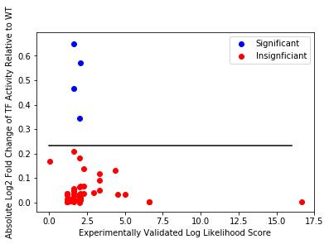
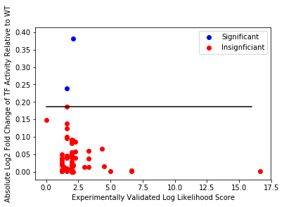
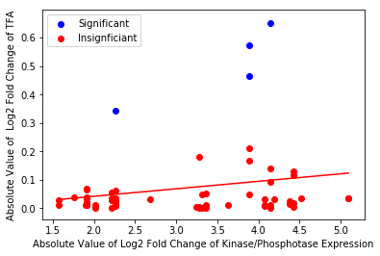
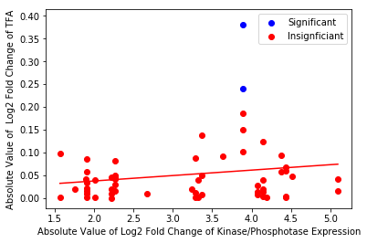
|Log2(FC)|
p = 0.12
p = 0.15
Sign Constraints
No Sign Constraints

Slide 2
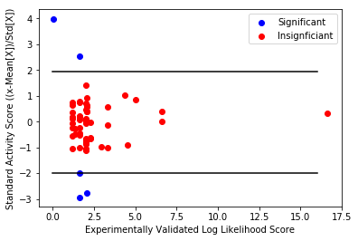
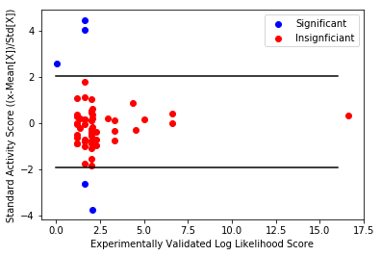
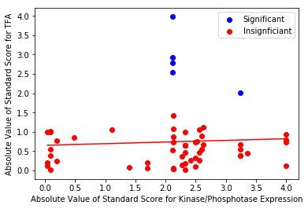
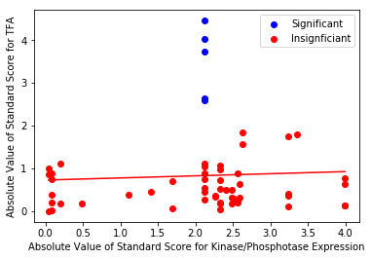
Standard Score
(x-Mean[X])/std[X]); X = row of TFA
p = 0.67
p = 0.64
Sign Constraints
No Sign Constraints

Slide 3
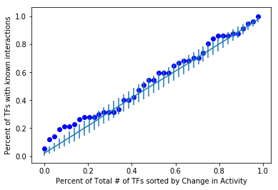
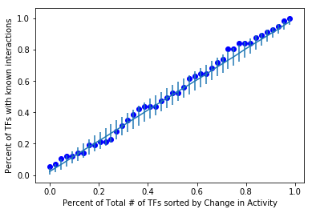
Ranking Change
AUC = 0.535 (84.1%)
AUC = 0.518 (67.7%)
Sign Constraints
No Sign Constraints

Slide 4
Found Validated TF-Kinase/Phosphatase Interactions
Kinase | TF | # of Times Found Significant | YK Score | Evidence
CTK1 | SEP1 | 8 | 2.06 | Affinity Capture
CKA2 | ASH1 | 3 | 2.06 | Deletion/inhibition of kinase shows reduced phosphorylation of target in vivo by mass spectrometry.
CTK1 | ASH1 | 8 | 1.6 | Deletion/inhibition of kinase shows reduced phosphorylation of target in vivo by mass spectrometry.
CTK1 | ZAP1 | 5 | 1.6 | Deletion/inhibition of kinase shows reduced phosphorylation of target in vivo by mass spectrometry.
CTK1 | VMA22 | 3 | 1.6 | Deletion/inhibition of kinase shows reduced phosphorylation of target in vivo by mass spectrometry.
PHO85 | ASH1 | 2 | N/A | Liu et al, 2010 showed phosphophoryation of Transcription represser ASH1 causes elimination
CTK1 | CRZ1 | 4 | 0.038 | Low throughout put yeast proteome microarray using kinases to tag interactions, this gene also found affinity for 7 other kinases

Slide 5
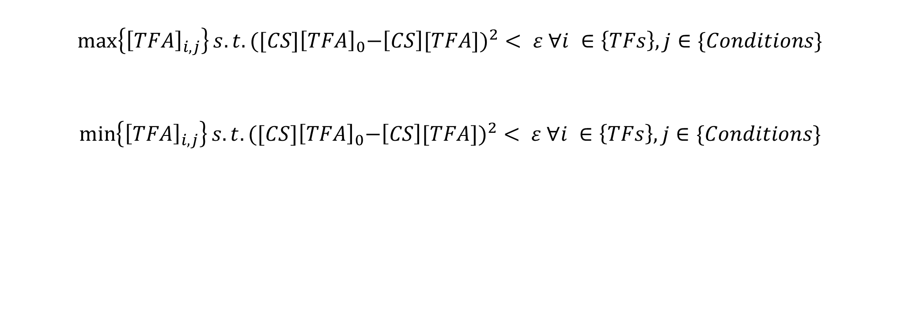
Identifying TFA Extrema
Outputs:
Closed Interval of TFA for all TFs in all conditions
Mean value of the closed interval
The difference between the residual of the original TFA and the TFA extrema for each found solution

Slide 6

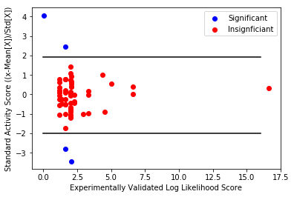
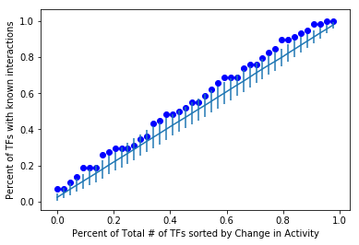
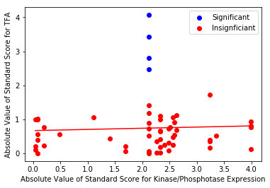
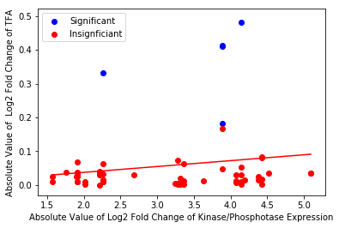
Standard Score
|Log2(FC)|
p = 0.72
p = 0.19
AUC = 0.554 (92.92%)

Slide 7
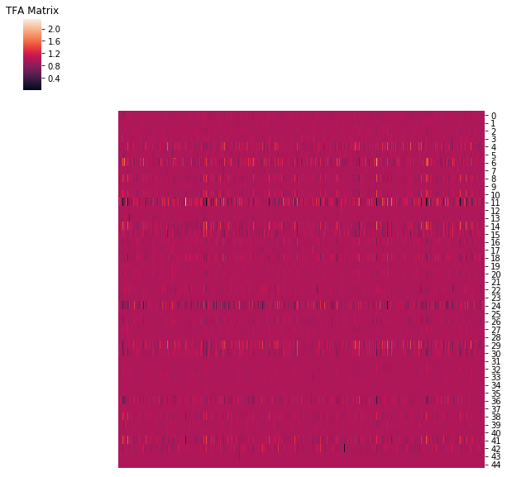
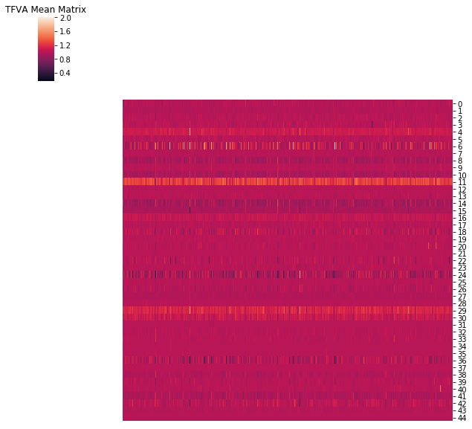
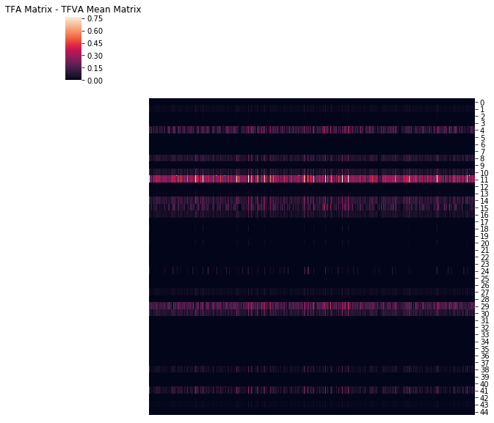
Comparing TFA Variability in Sign Constrained Model
TFs
TFs
=
TFs
-
Conditions
Conditions
Conditions

Slide 8
Comparing TFA Variability in Sign Constrained Model
TF, Mean Difference, Std Difference, row #
['ygl071w', -0.2827893586264173, 0.1184170770537337, 11]
['ylr256w', -0.1359459523864028, 0.08288902908418283, 29]
['yhr124w', 0.09527626320911971, 0.05585866504561443, 14]
['ylr403w', -0.08077035594625824, 0.043522619849904104, 30]
['ydr034c', -0.07920698797748152, 0.09285870721160316, 4]
['yel009c', 0.07046773823331606, 0.039910683931022664, 8]
['yfr034c', 0.06530254089605043, 0.036972626768900514, 10]
['ypl202c', 0.059568981351043715, 0.05420276645706867, 41]
['yil101c', -0.04884971987256557, 0.027020303646247596, 16]
['yhr178w', 0.047050220760802786, 0.09381679120249302, 15]
['yor358w', 0.03376452729576598, 0.030722828002511946, 38]
['ylr176c', 0.025424591524509085, 0.014905978453337809, 27]
['ycr065w', 0.018764168095993947, 0.01142989388135822, 1]
['ypr065w', 0.01314558081364963, 0.007598515804323389, 43]
['yhr084w', -0.00930799608785878, 0.005148540104978729, 13]
['ykl185w', -0.0038723194088667455, 0.030327510033780074, 24]
['yjl056c', -0.0015295810963443209, 0.007308219912153549, 20]
['yir013c', -0.0012710917927310037, 0.00807590831713581, 18]
['ydl020c', -0.0005947542060147935, 0.0027870026157299746, 2]
['ynl027w', 0.0002692636037558857, 0.0015699453980715775, 32]
['ypl248c', -0.00010078040467249057, 0.003885143432725074, 42]
['yjr060w', -5.975473153127122e-05, 0.00034413796622820915, 22]
['yol108c', -3.172591122865116e-05, 0.0010471797266919027, 36]
['ydr146c', 2.0955162618025845e-05, 0.00012235314109573358, 5]
['ykr034w', 6.850504367181584e-06, 4.0208400416135896e-05, 25]
['ylr013w', -4.032272648959151e-06, 2.722134036899052e-06, 26]
['yir017c', -1.035542983190813e-06, 1.8323306376090466e-06, 19]
['ypl177c', 4.2103537928817584e-07, 9.270388009182667e-07, 40]
['yor337w', 2.401480181585187e-07, 2.63481437808055e-07, 37]
['ypl139c', 1.8023497041120898e-07, 2.916680304652341e-07, 39]
['ylr228c', -1.6046094552474608e-07, 1.545450453780826e-07, 28]
['yjl110c', -9.862627505181481e-08, 9.801960751348079e-08, 21]
['ykl109w', 8.874376059235167e-08, 2.0079472167328144e-07, 23]
['ynl199c', -7.680466577100284e-08, 1.0626073238797125e-07, 35]
['ynl167c', 7.05835850667698e-08, 2.784907044382303e-07, 34]
['yal051w', 5.910539004622364e-08, 2.9806877980379577e-07, 0]
['yil131c', 5.692998184048697e-08, 2.4293756843421873e-07, 17]
['ydr213w', -2.8481691996355483e-08, 1.500995117516297e-07, 6]
['ynl068c', -2.7158832547981055e-08, 2.0916763187094196e-07, 33]
['yfl031w', -1.8773512443337508e-08, 2.4545657234874817e-07, 9]
['yml007w', 1.4884295225762013e-08, 1.7525701757978804e-07, 31]
['ydl106c', -1.0478694683235029e-08, 1.211736695745559e-07, 3]
['yhl020c', -3.923470744960547e-09, 1.8381069411138267e-07, 12]
['ydr310c', 1.0216186995227842e-09, 2.1162461379766026e-07, 7]
TFs
TFs
Conditions
Conditions

Slide 9
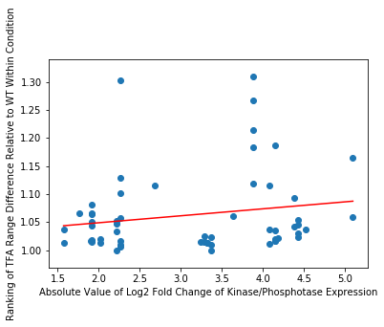
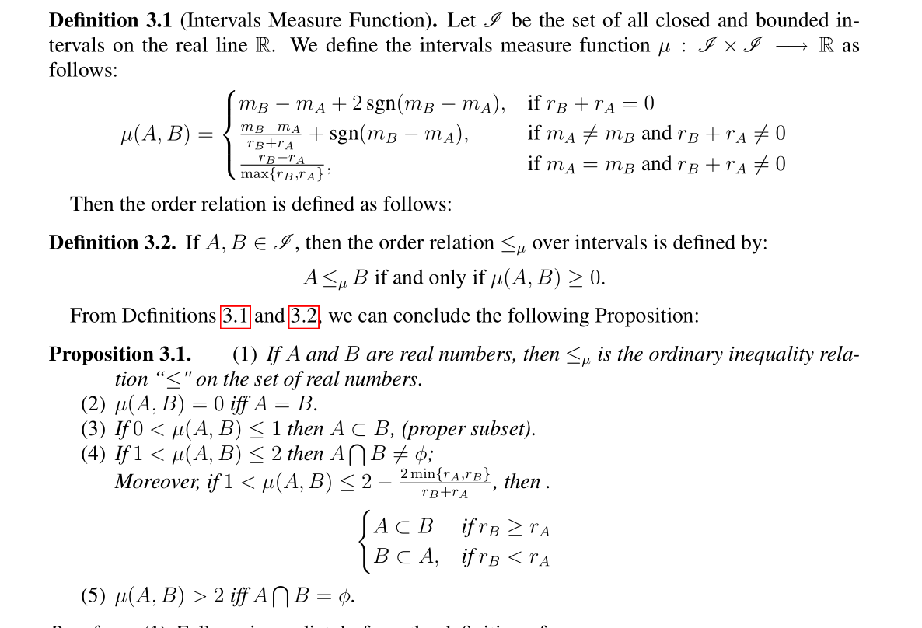
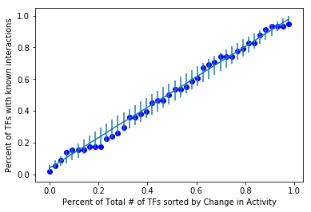
|µ(M,WT)|
p = 0.18
AUC = 0.501 (56.3%)
(ALOLYAN, 2011)

Slide 10
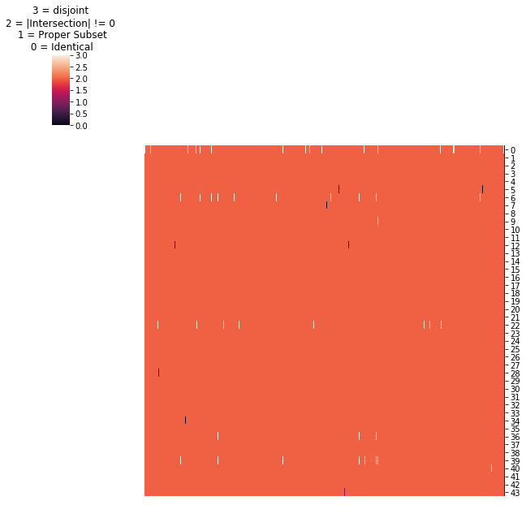
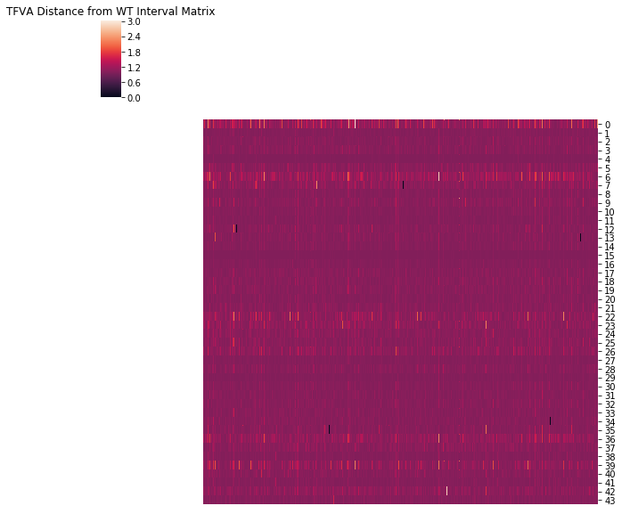
TFs
TFs
Conditions
Conditions

Slide 11
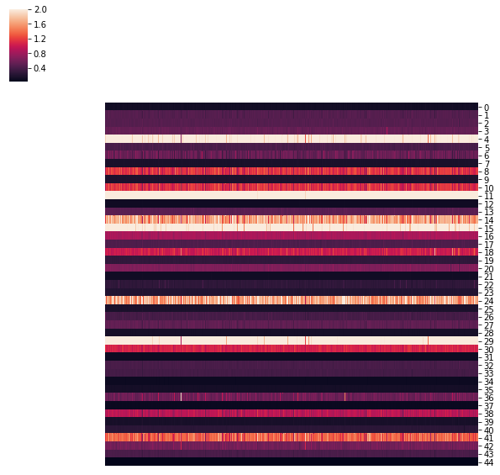
TFs
Conditions

Slide 12



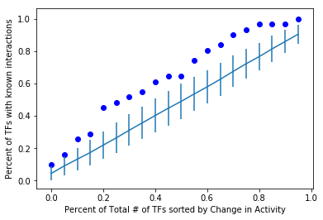
TF, Row Mean, Row Std, Row #, # of Interactions
['ygl071w', 1.9993356041646588, 0.015852980516663003, 11, 1]
['ylr256w', 1.9922344122894609, 0.05642092634724537, 29, 0]
['yhr178w', 1.9827394895927832, 0.06891200053123155, 15, 0]
['ydr034c', 1.9787073179470964, 0.07882959687070326, 4, 0]
['ykl185w', 1.6578861071800852, 0.212053940252311, 24, 3]
['yhr124w', 1.621859199768584, 0.22704187757796768, 14, 0]
['ypl202c', 1.3455158771465867, 0.1832017869216162, 41, 0]
['yel009c', 1.1439768467692235, 0.14163918803970735, 8, 1]
['yfr034c', 1.1291586960001503, 0.12890915540810957, 10, 5]
['ylr403w', 1.0713859540960429, 0.05373156815583778, 30, 4]
['yir013c', 1.0292460184074428, 0.09167089957810141, 18, 0]
['yor358w', 0.9253782788700989, 0.09380613733878193, 38, 0]
['yil101c', 0.8475011262642012, 0.03780695581925715, 16, 1]
['yjl056c', 0.6626022013037882, 0.024884653222346502, 20, 2]
['ypl248c', 0.6090441239714873, 0.06033127126592642, 42, 1]
['yol108c', 0.5872825878579596, 0.10666975332412383, 36, 1]
['ydr213w', 0.5540916998421493, 0.08407240319974715, 6, 0]
['ydl106c', 0.5324198769534775, 0.024613097332021217, 3, 0]
['ylr176c', 0.5115553531009202, 0.03475702877493368, 27, 0]
['yhr084w', 0.48607781019966895, 0.01747771055728044, 13, 3]
['ydl020c', 0.4627015233677122, 0.013624028871723195, 2, 0]
['ycr065w', 0.45513302163312186, 0.026029940408703753, 1, 1]
['yil131c', 0.42612386293475685, 0.013787185451561552, 17, 2]
['ypr065w', 0.40371096756911584, 0.017247851461809394, 43, 1]
['ydr146c', 0.40247680522928403, 0.03885930091529732, 5, 1]
['ynl027w', 0.3967159233003578, 0.012982587958819597, 32, 9]
['ylr013w', 0.38996694701570106, 0.024130357086039535, 26, 0]
['ynl068c', 0.37556911573880936, 0.010512774293124584, 33, 2]
['yir017c', 0.27579385201111234, 0.0065089941357618164, 19, 0]
['yjr060w', 0.2699519447033254, 0.019750208775713683, 22, 1]
['ypl177c', 0.24609727355301364, 0.005679964323550791, 40, 2]
['ykl109w', 0.20045384364699165, 0.006171074710992962, 23, 0]
['yfl031w', 0.1803759674205352, 0.003614621028743238, 9, 3]
['ykr034w', 0.16218480523526171, 0.002890985431240053, 25, 0]
['ydr310c', 0.1570597527693169, 0.003924778935197901, 7, 0]
['ypl139c', 0.14590585460666988, 0.005347333286021054, 39, 3]
['ylr228c', 0.13761144722706817, 0.0014726833655712003, 28, 0]
['ynl199c', 0.12869698251750902, 0.0016196941152934543, 35, 1]
['yal051w', 0.11546644580435533, 0.00471215483149232, 0, 0]
['yjl110c', 0.110705043741801, 0.0011027004772424238, 21, 2]
['yhl020c', 0.10185759837858205, 0.0011101397298856877, 12, 4]
['yml007w', 0.09101849482119403, 0.0005491757836918053, 31, 0]
['ynl167c', 0.08267303869443923, 0.000511696645959092, 34, 3]
['yor337w', 0.07411589880278457, 0.000535753274597334, 37, 0]
Range[TFA]/
Mean[TFA]
# of Interactions TF participates in
Remove rows where the row mean > 0.43: 21 Tfs and 34/58 Interactions
AUC = 0.647 (99.8%)

