Slide 1
MedicalDoctor
By Justin Jiang, Samir Leal, Phi Nguyen, and Eric Sullivan

Slide 2
Introduction
Hello! We are Andrew’s Honor Squad 2: High Honors. Our members are:
Justin Jiang
Samir Leal
Phi Nguyen
Eric Sullivan

Slide 3
Purpose
Our program is designed to assist hospital personnel with managing patient visits.
The software allows hospital staff to access and update patient information, request lab work, prescribe treatments, and schedule follow up visits.

Slide 4
Overall Features
Our program stores data in a MySQL database
Intuitive Graphical User Interface
Each section of our program features user authentication
On first use, the program prompts the user to create a new administrator account.

Slide 5
GUI Concept
We created our GUI do follow the design principles discussed in class.
GUI should be intuitive and easy to use
GUI is divided into sections to limit the amount of information displayed at any given time so the user is not overwhelmed.
Similar items are grouped together
Top-down data organization (page title > forms > buttons)

Slide 6
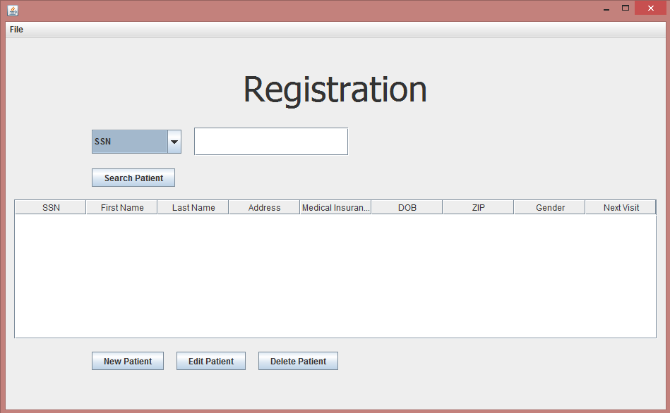
GUI Examples – Registration Search

Slide 7
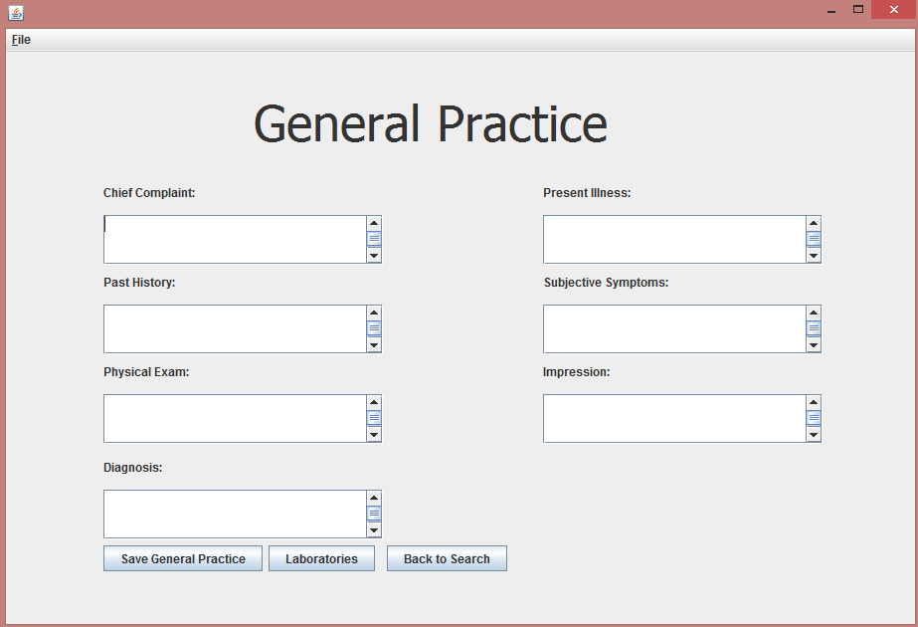
GUI Examples – General Practice

Slide 8
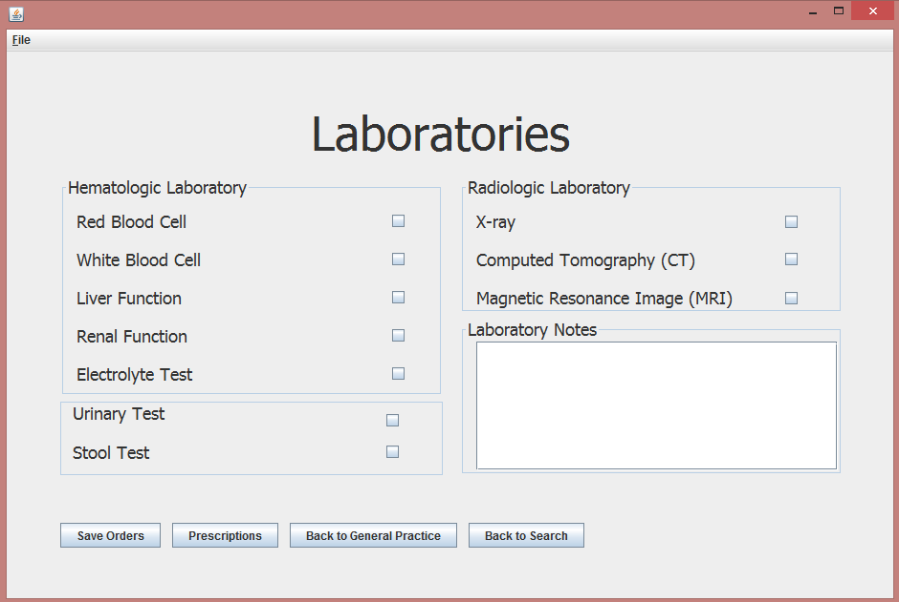
GUI Examples - Laboratories

Slide 9
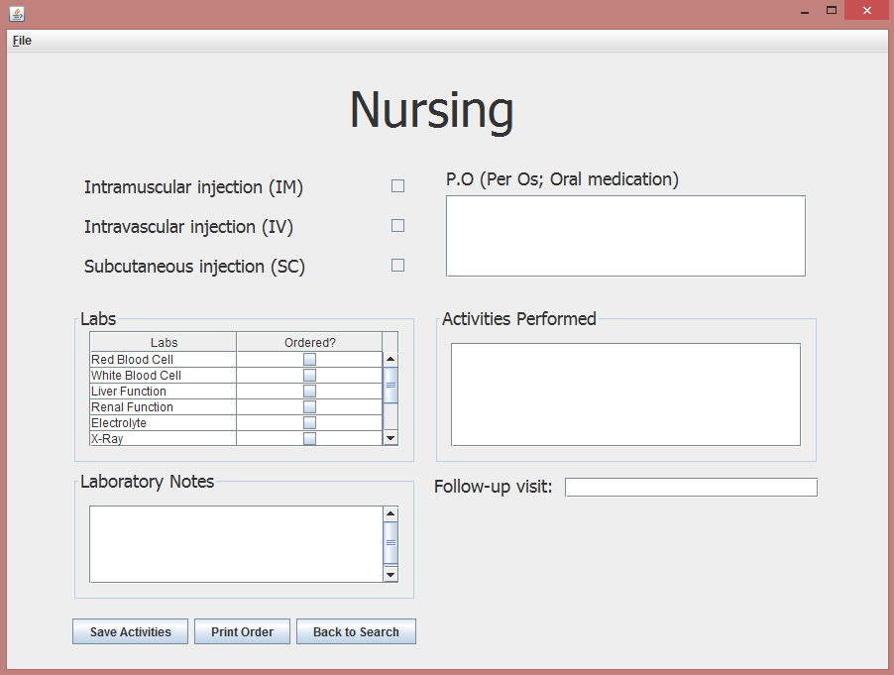
GUI Examples - Nursing

Slide 10
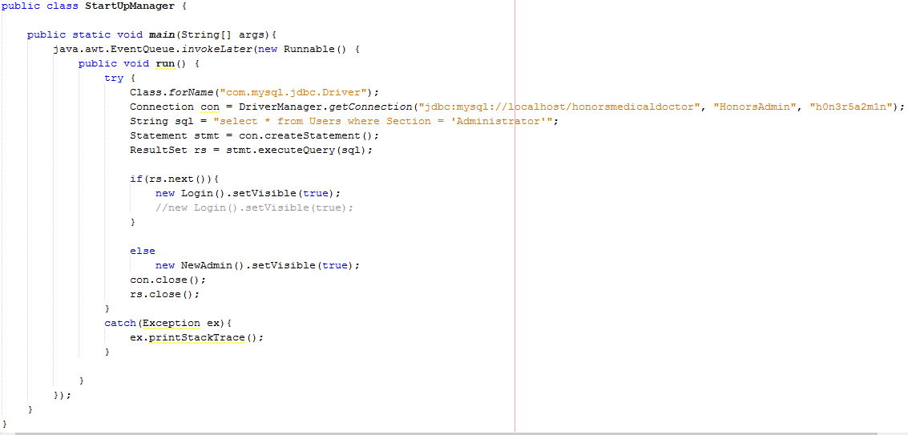
Algorithms - StartUpManager

Slide 11
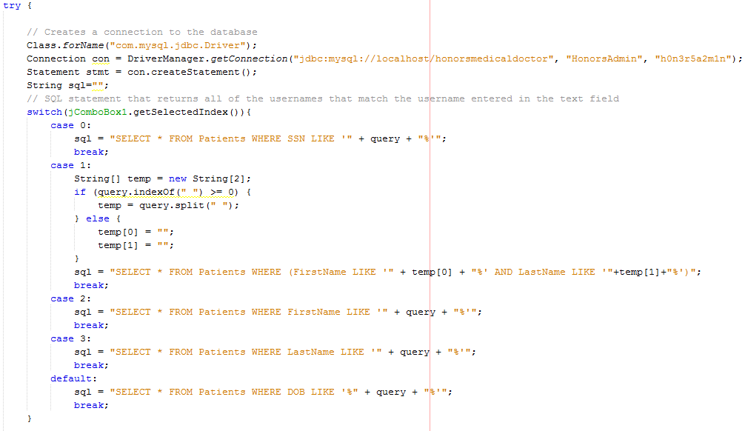
Algorithms – Patient Search

Slide 12
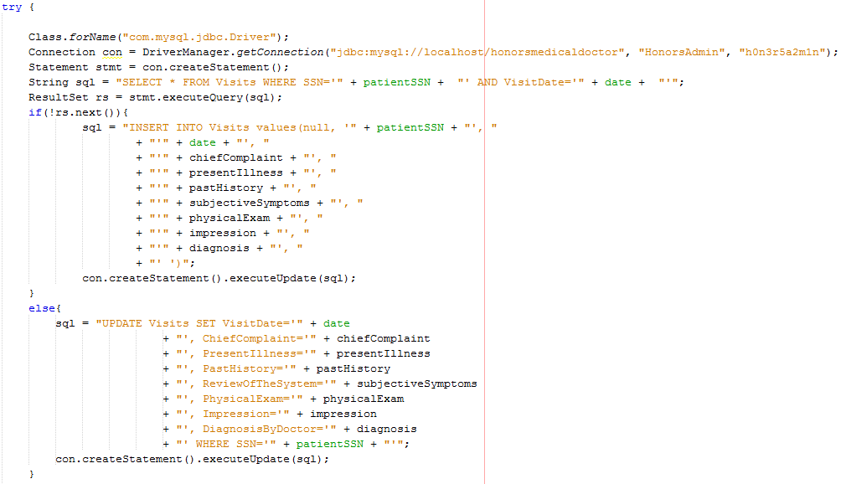
Algorithms – Inserting/Updating Patient

Slide 13
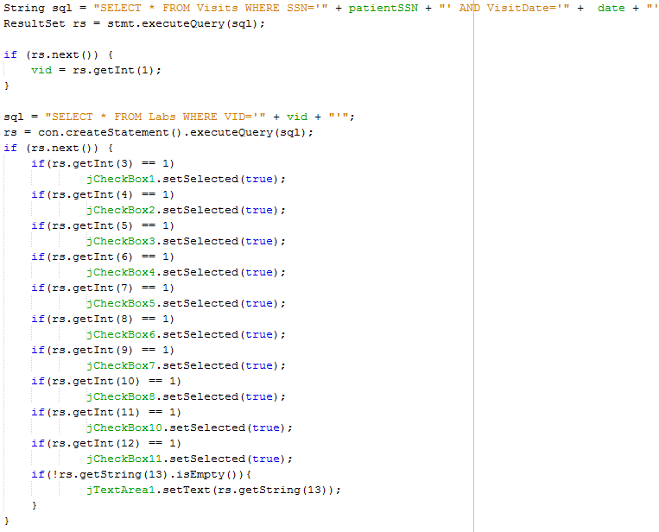
Algorithms – Retrieving Patient data

Slide 14

Demonstration

Slide 15
Conclusion
This project gave us experience implementing a MySQL database using java GUIs.
We designed and created our database using SQL DDL and DML and built a GUI application following the guidelines of proper GUI design for users to interact with the database.

Slide 16
Future Works
More ways to search for patients
Database tables for lab results

