Slide 1
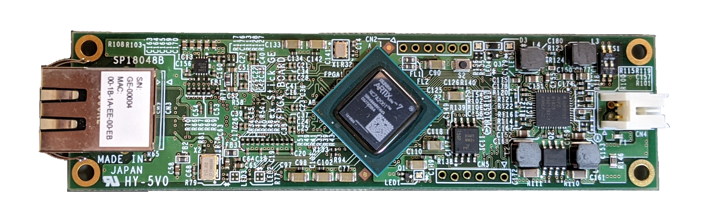
Ethernetポート
FPGA: XC7A200T
PMOD
User LED
JTAG
5V DC

Slide 2
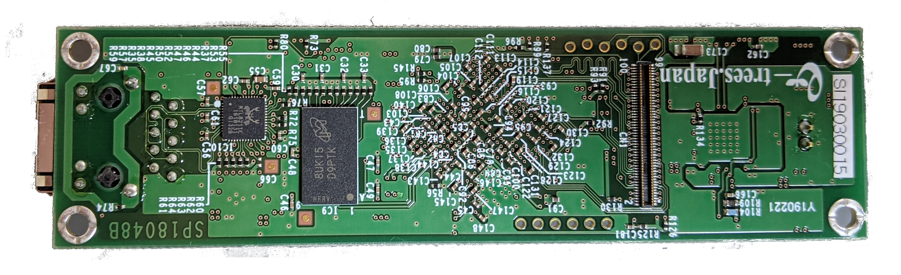
DDR 256MB
拡張コネクタ

Slide 3
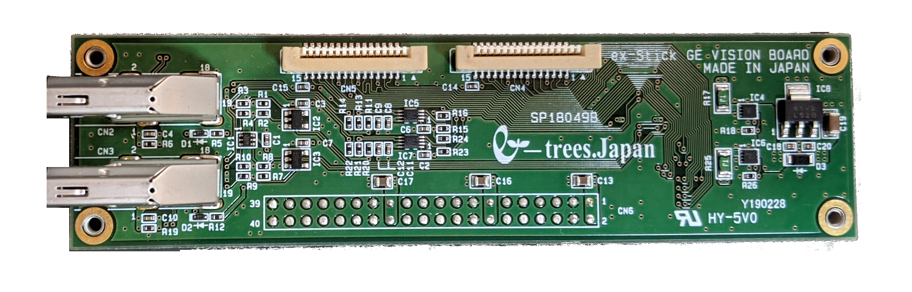
MIPI CSI-2
HDMI
GPIO

Slide 4
2: GND
1: +5V
CN4: 5V DC

Slide 5
2: GND
1: +5V
VCC
TMC
CN4: 5V DC
GND
TDI
TDO
TCK

