Slide 1
SANTAFALL
Cattaruzza Alexis, Debin Pierre-Alexandre, Devos Thibaut,
Massart Xavier, Ubah Chisom

Slide 2
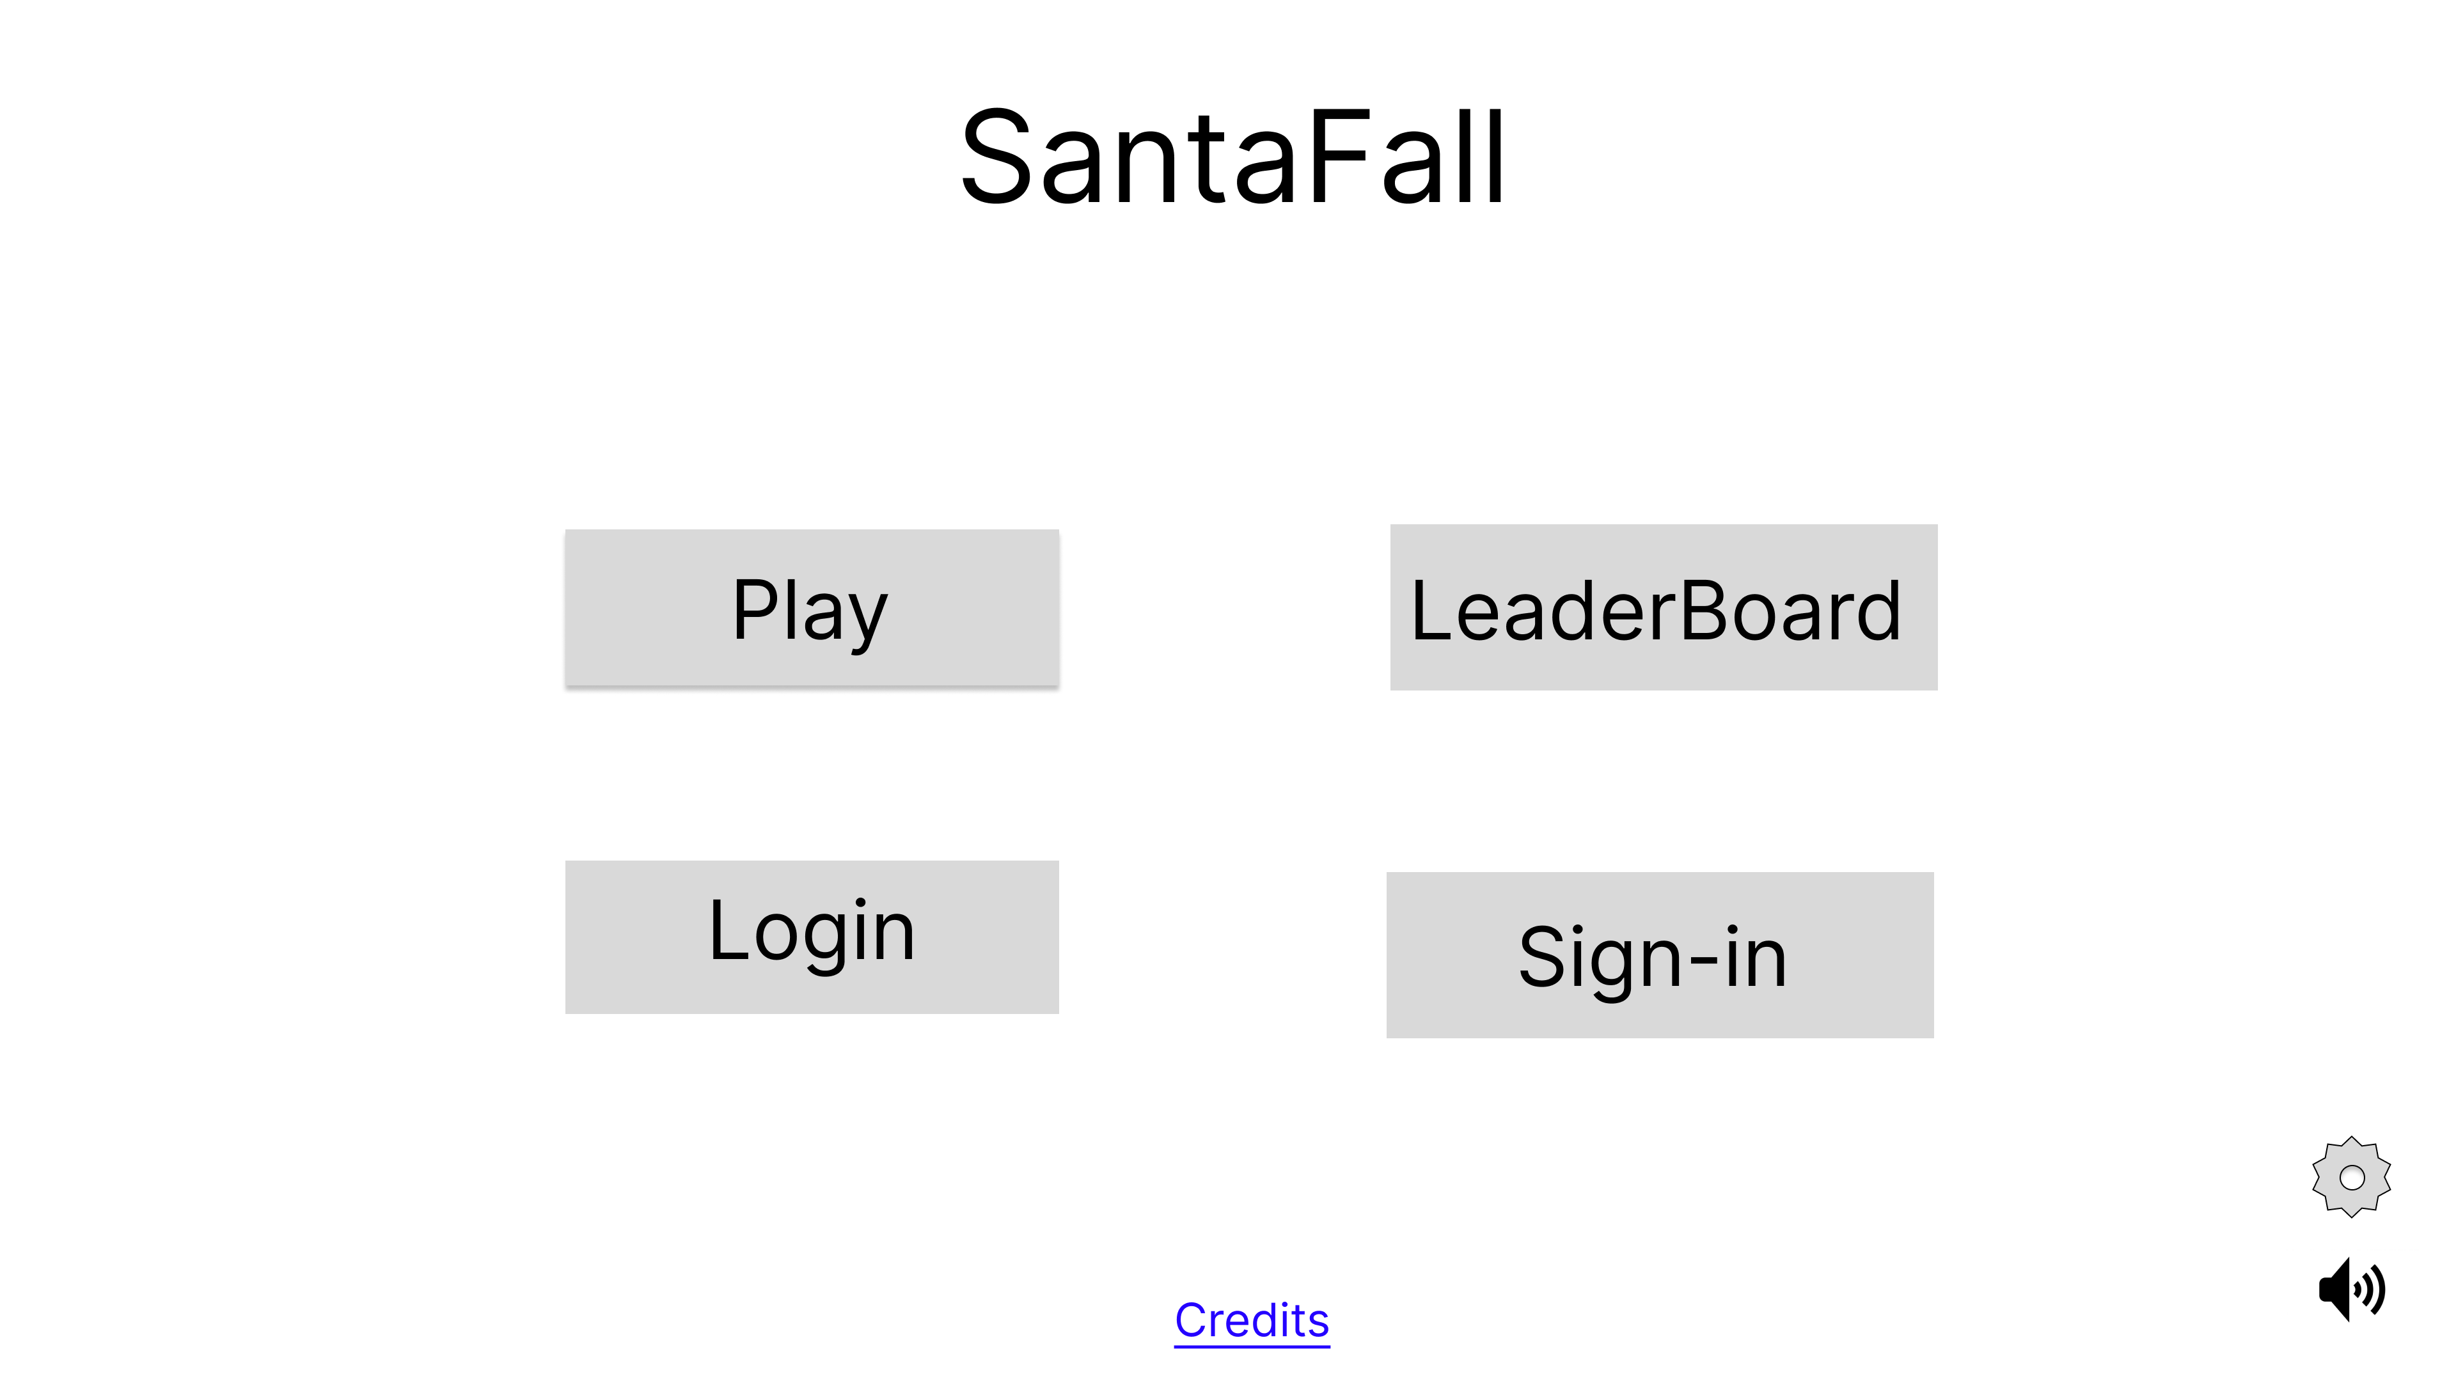
Home Page
To the stage game page
To the leaderboard page
To the login page
To the register page
To the settings
Mute/
Turn on music
To the credits page

Slide 3
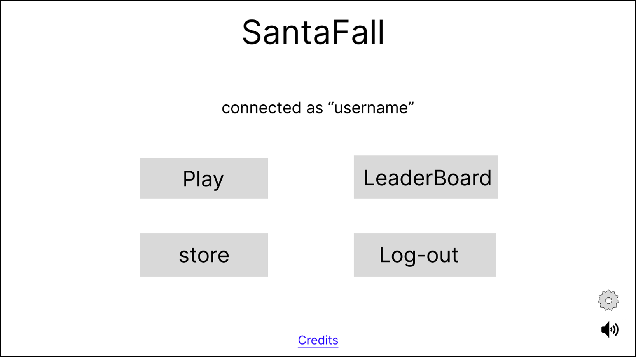
Home Page as connected
To the leaderboard page
To the stage game page
To the store page
To the home page
To the settings
Mute/
Turn on music
To the credit page

Slide 4
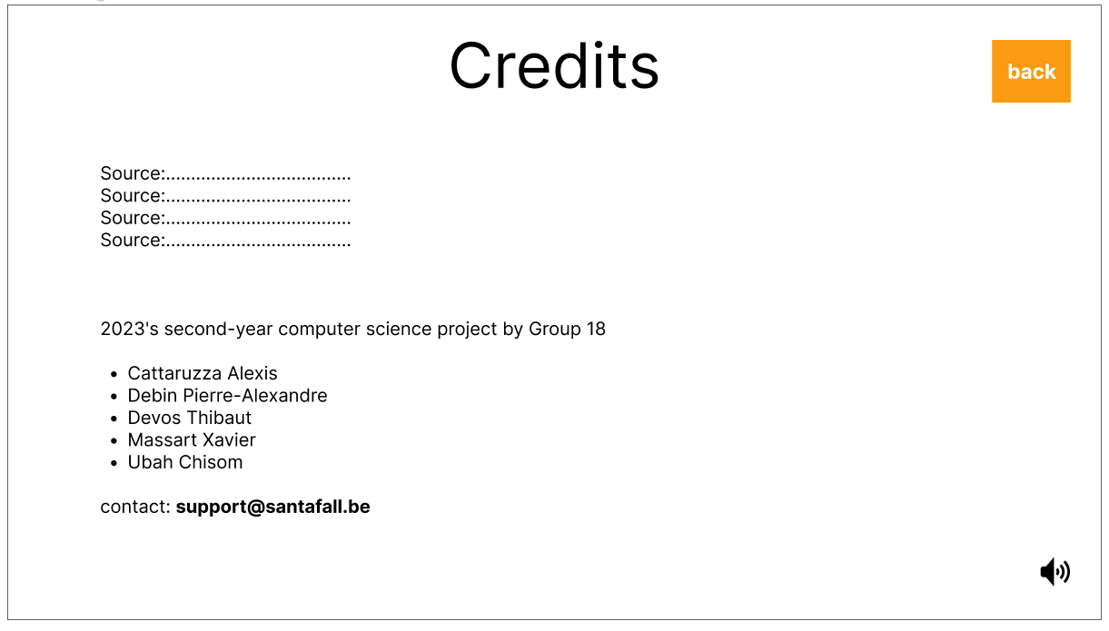

Credit Page
Back to home page
Mute/
Turn on music
To email box

Slide 5
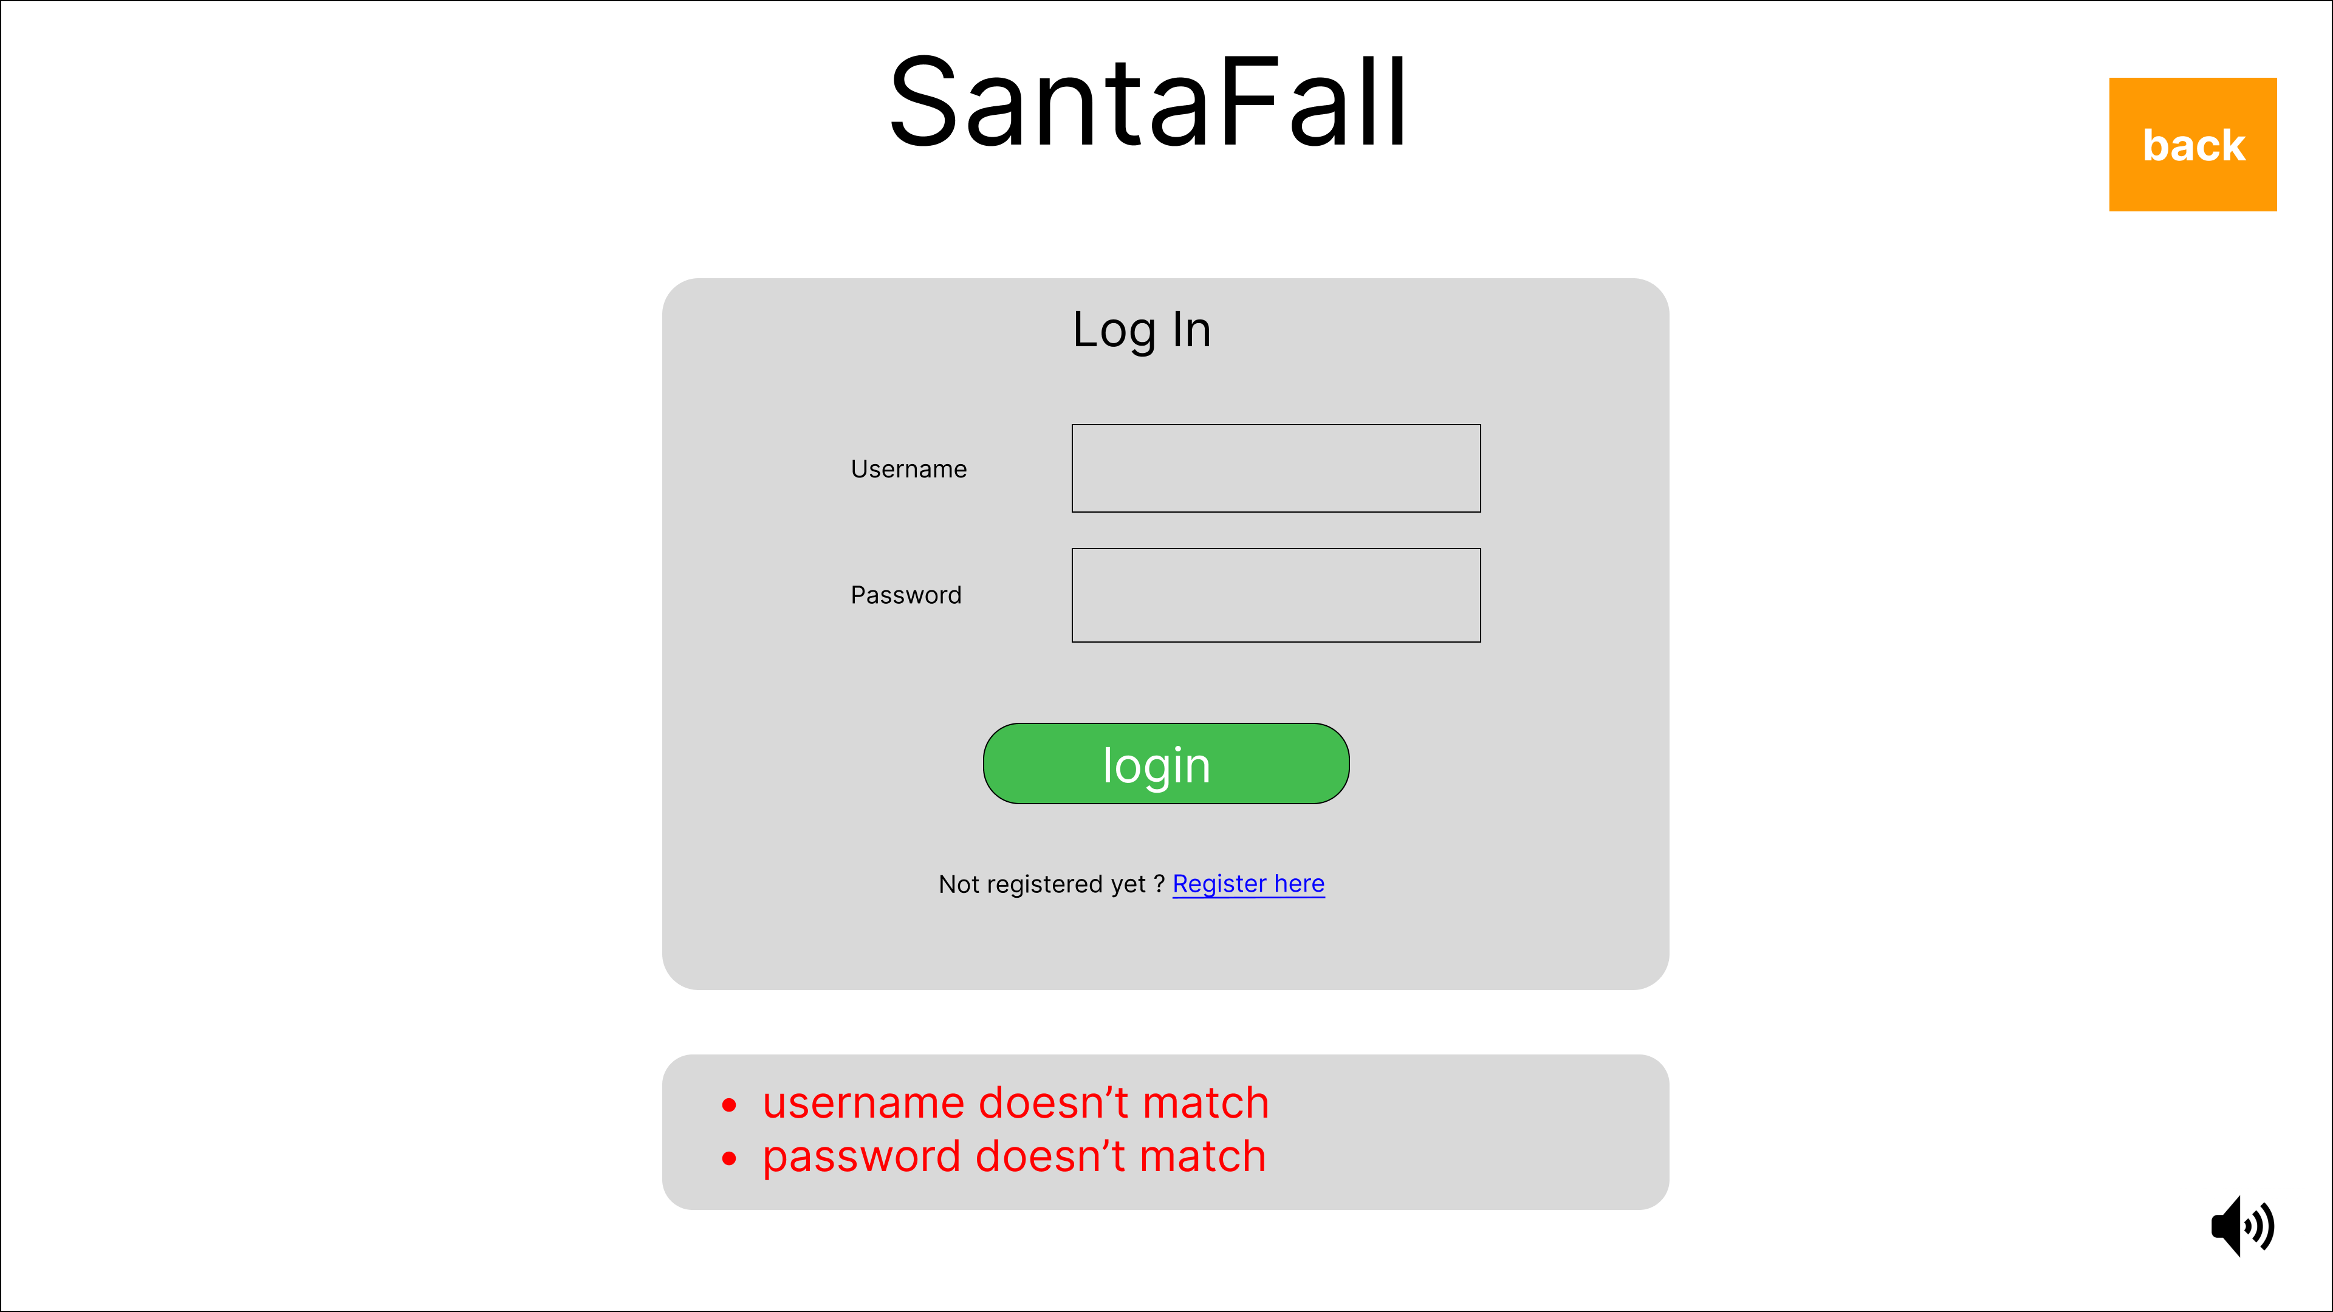
Login Page
Back to home page
To stage
Game page
To register page
Mute/
Turn on music

Slide 6
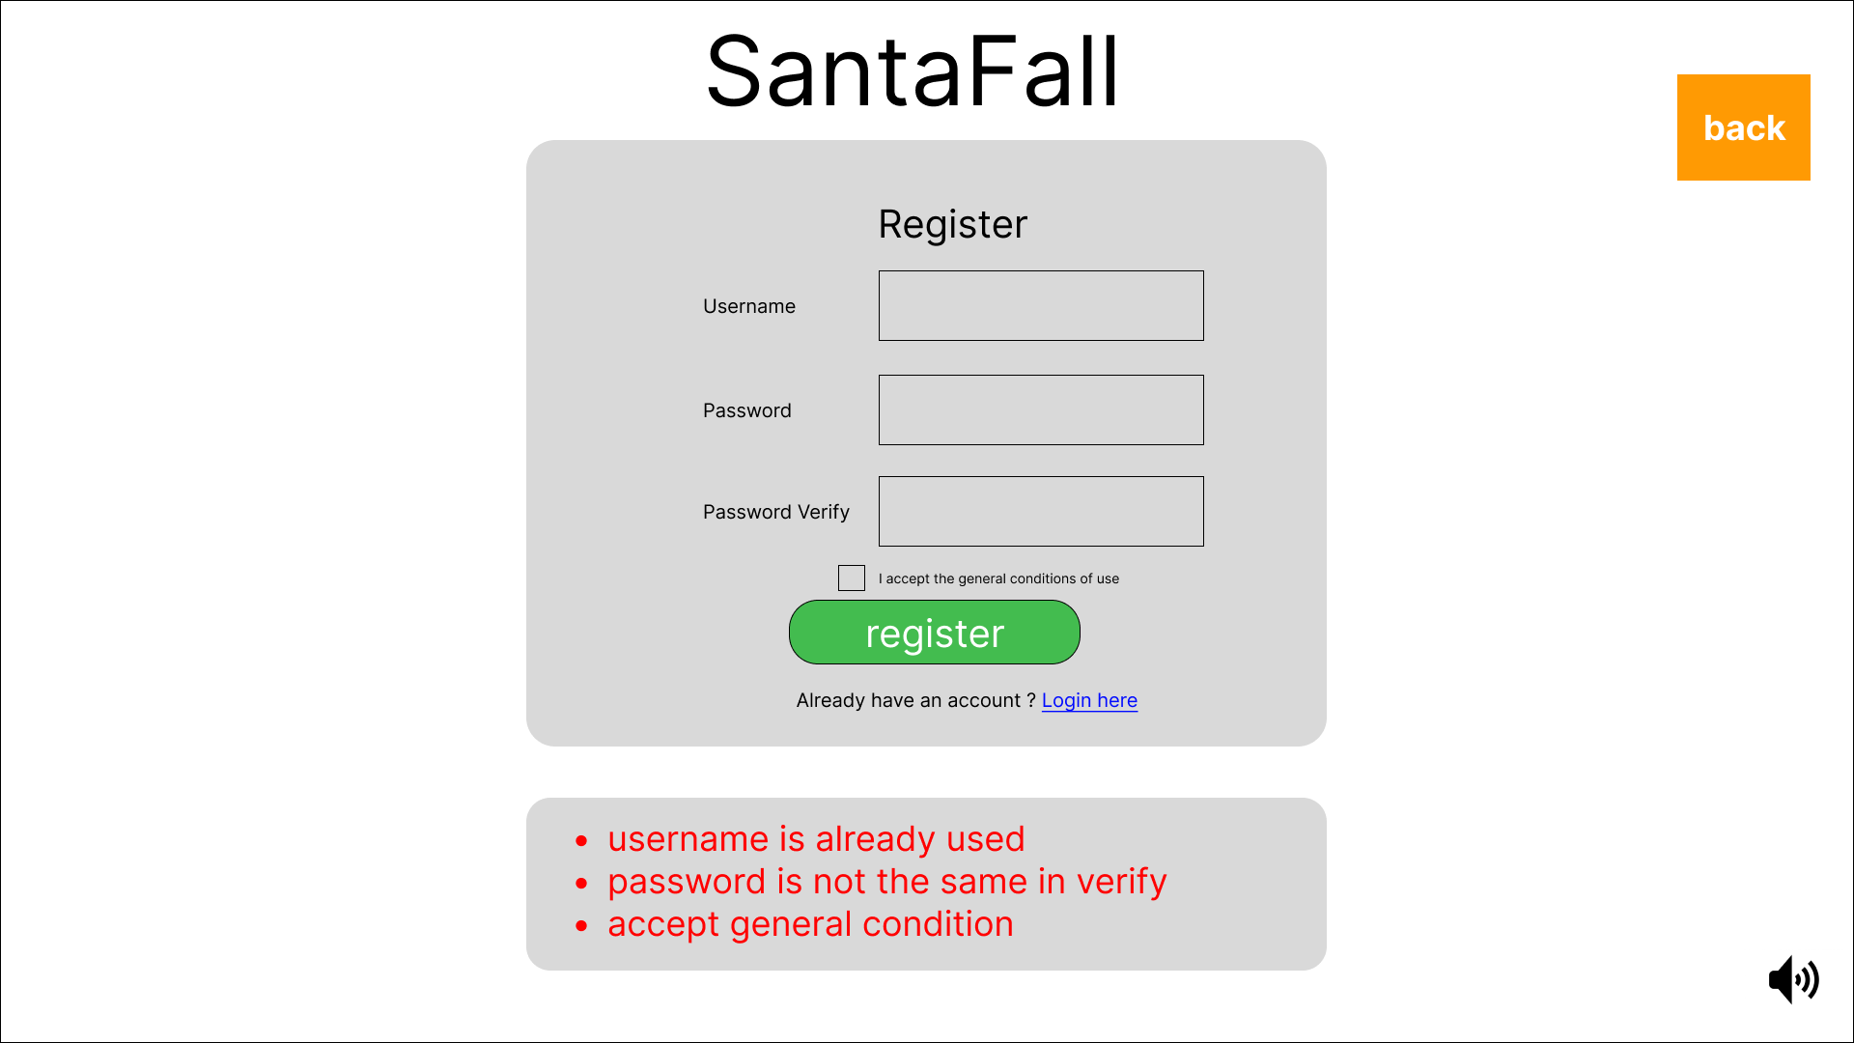
Register Page
Back to home page
To stage
Game page
To login page
Mute/
Turn on music

Slide 7
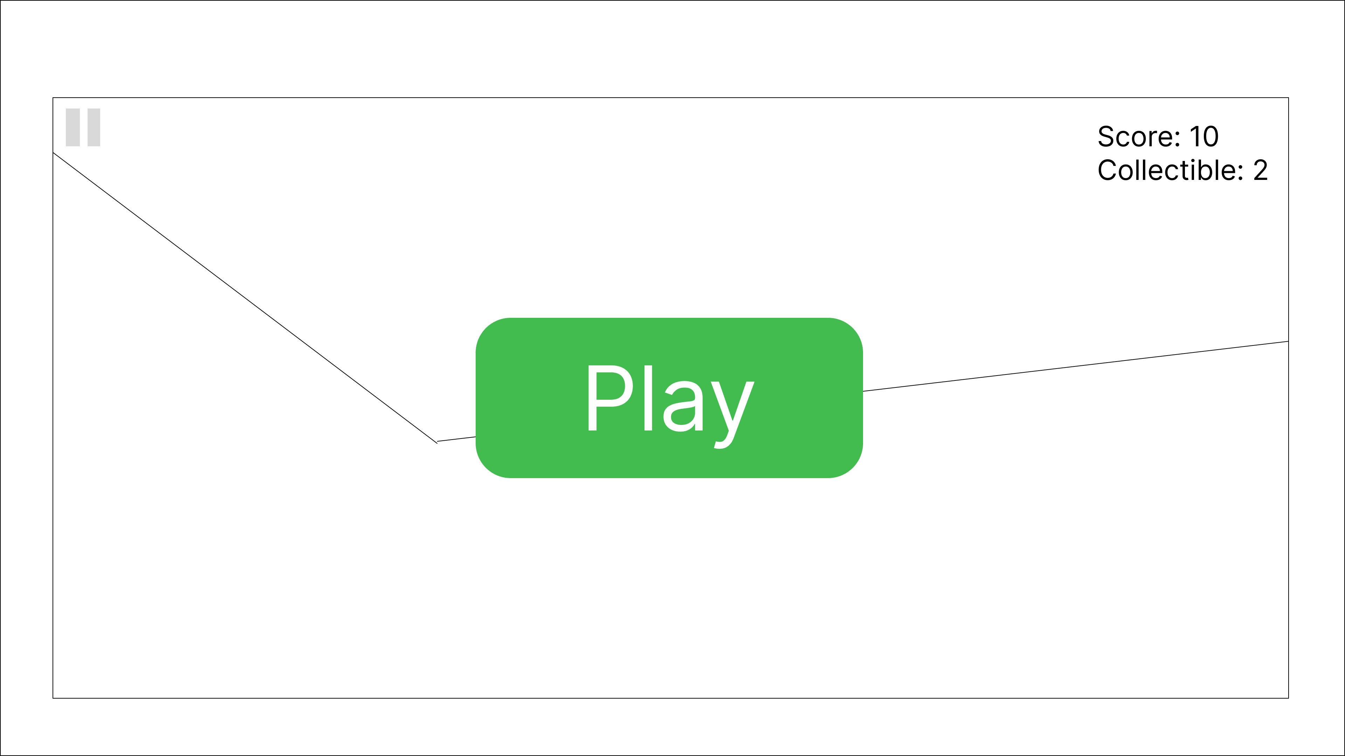
Stage Game Page
Display pause page
Start game

Slide 8
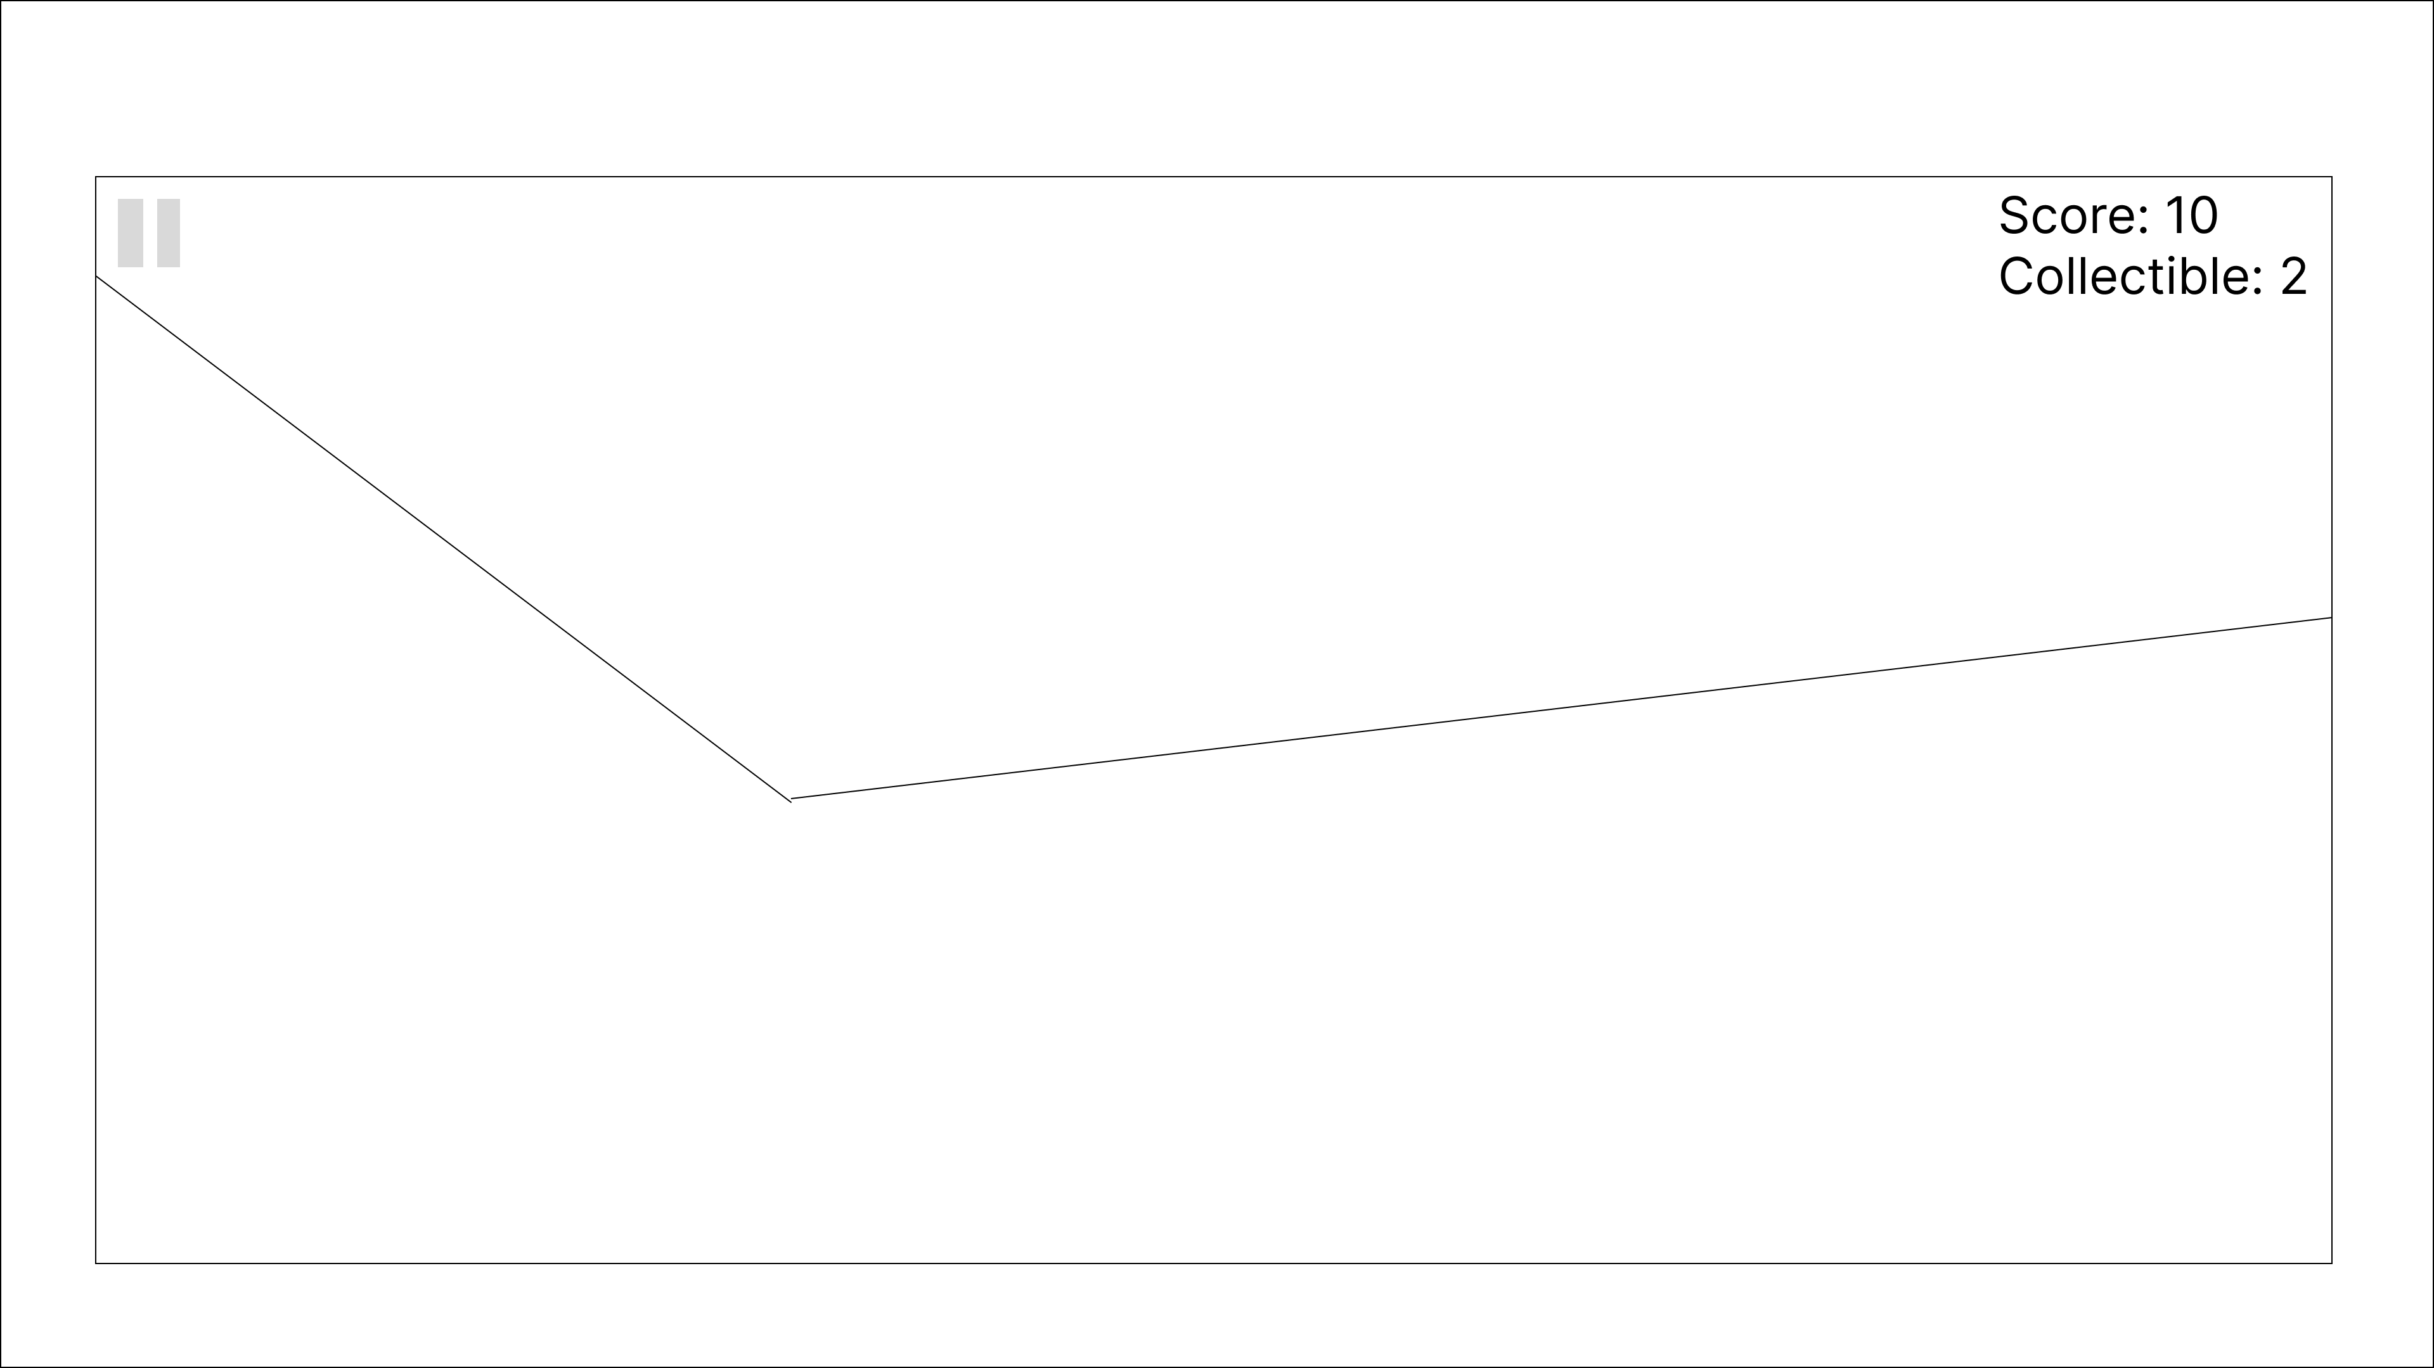
Game Page
Display pause page

Slide 9
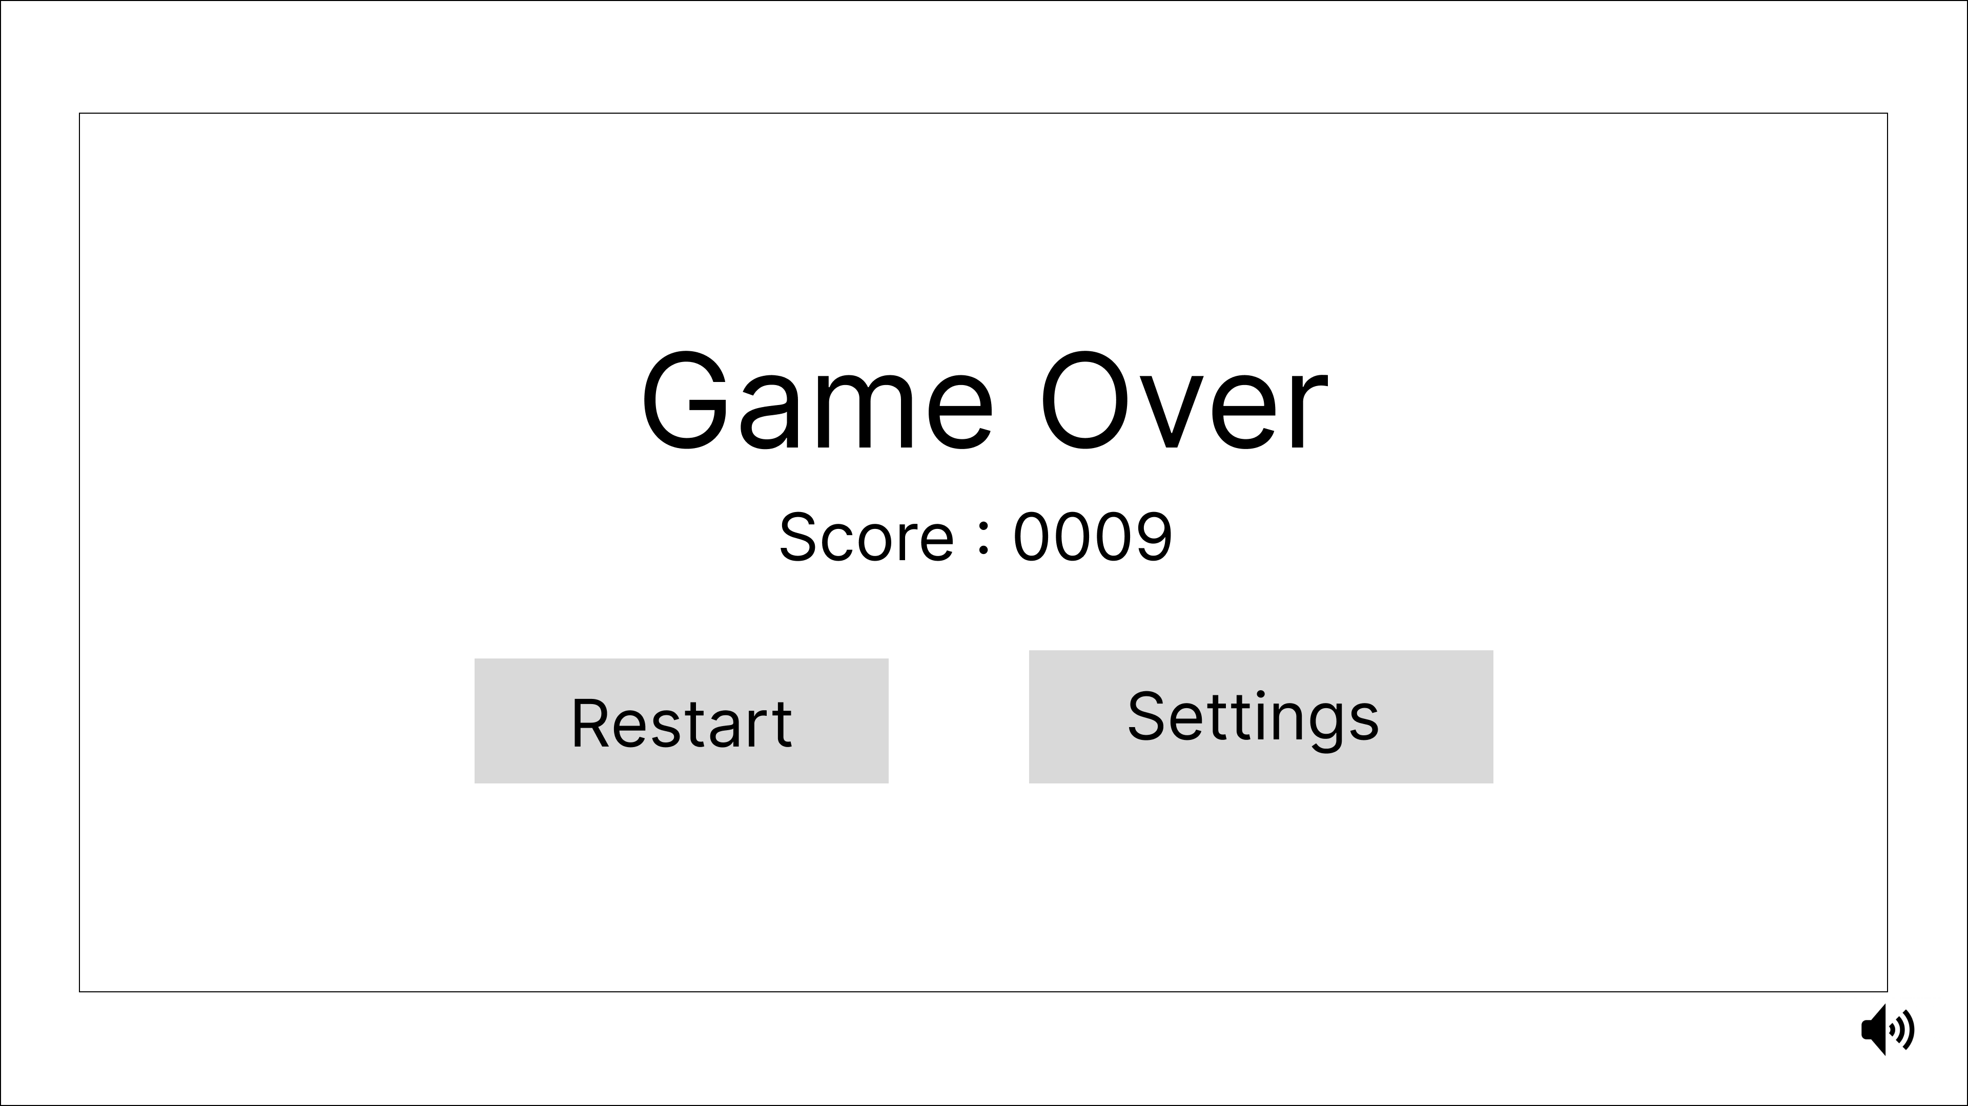
Game Page Dead Screen
Start a new game
To the settings page
Mute/
Turn on music

Slide 10
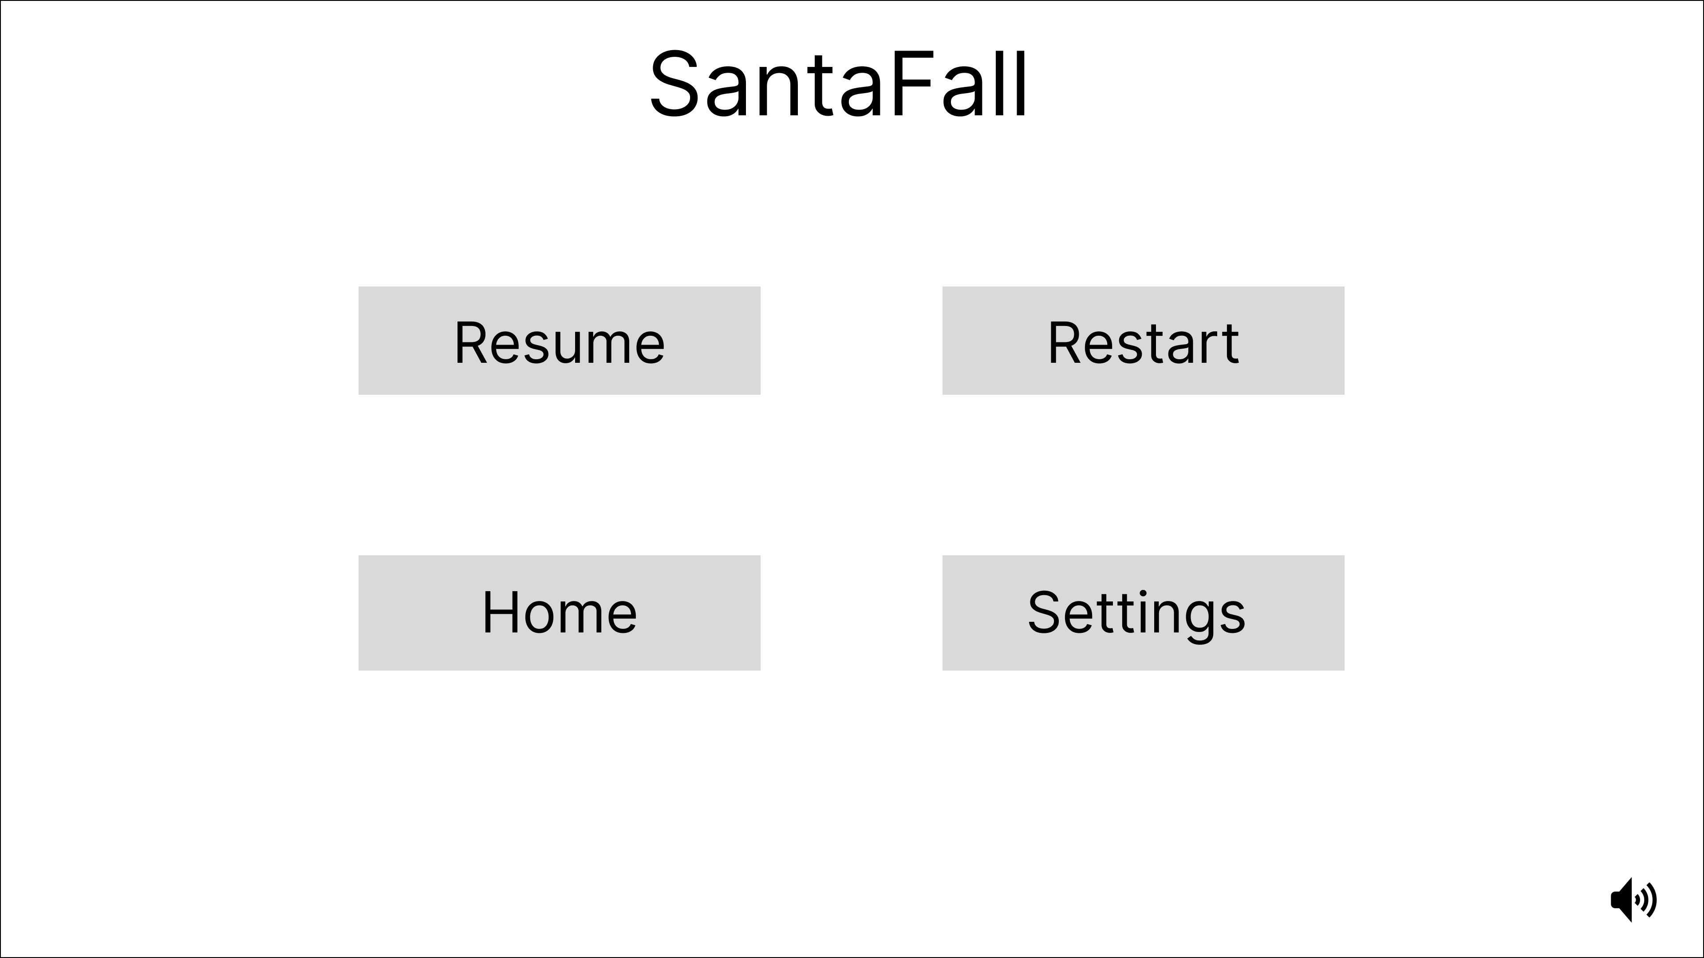
Pause Menu Page
Resume the game
Start a new game
To the home page
To the settings page
Mute/
Turn on music

Slide 11
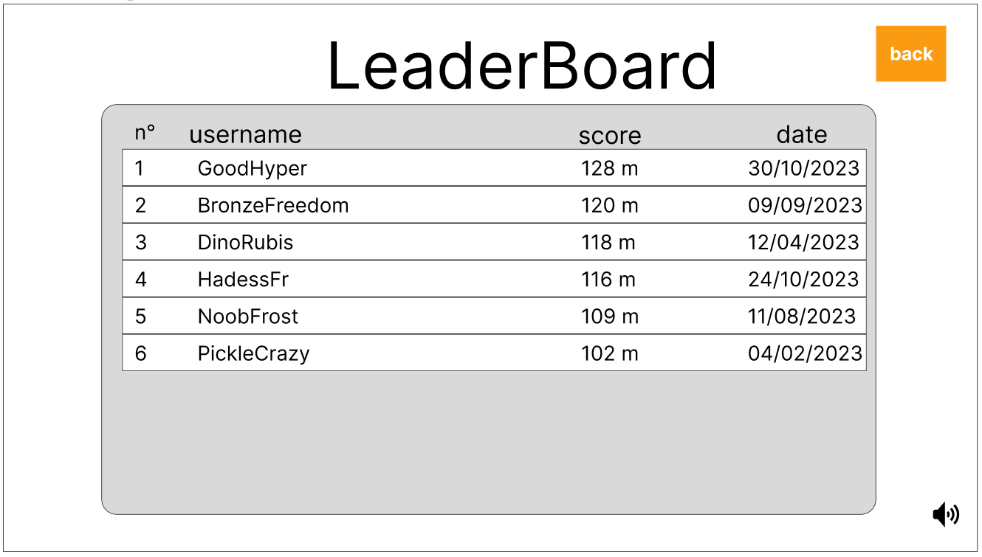
Leaderboard Page
Back to home page
Mute/
Turn on music

Slide 12
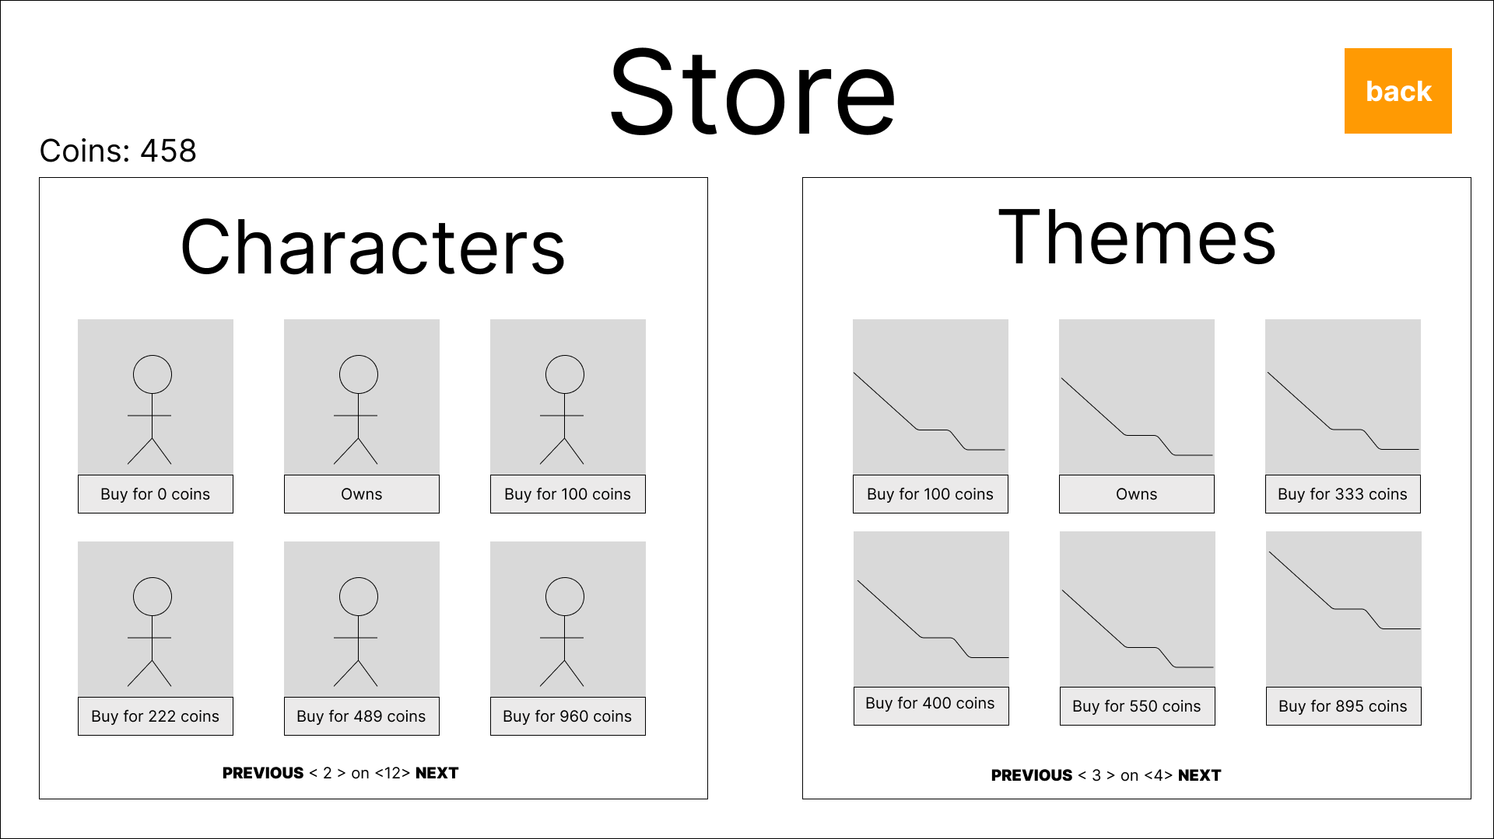



Store Page
Back to home page
Buy new theme background
Buy new skin
Change skin
character
Change skin background
To previous store
page character
To next store
page character
To previous page theme
To next
page theme

