Slide 1
Wireframes
Touché-coulé
web2-2023-project-groupe-28

Slide 2

HomePage

Slide 3
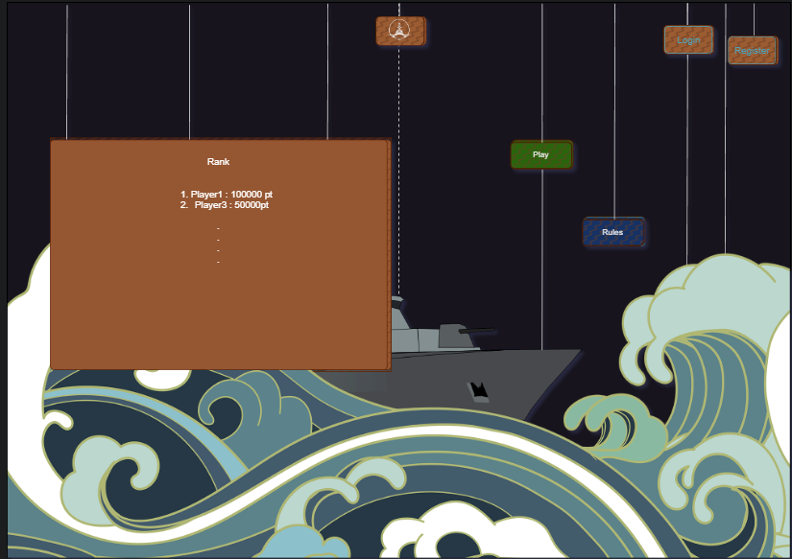
Rank

Slide 4
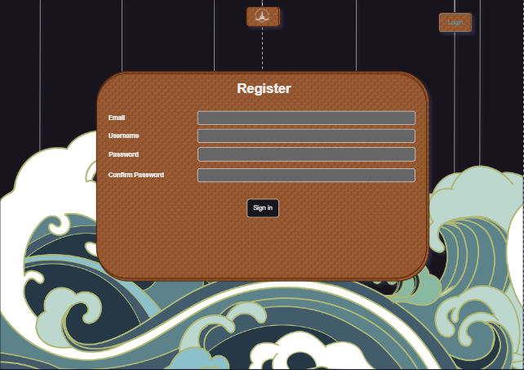
RegisterPage

Slide 5
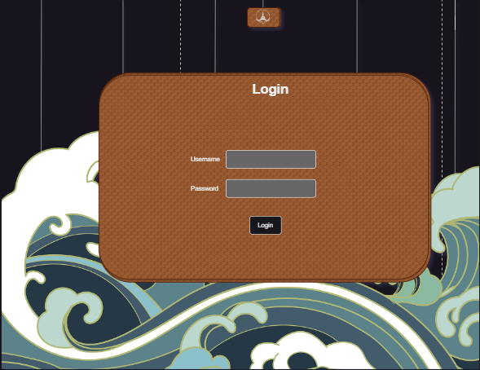
LoginPage

Slide 6
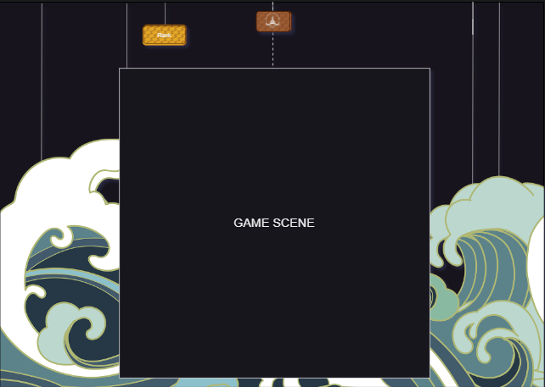
GamePage

