Slide 1
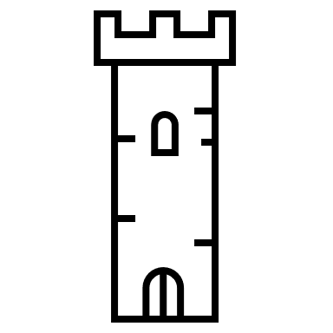

Home page
Leaderboard Login/Register
Login
Play area
Email
Password
Login

Slide 2
Leaderboard Login/Register
Register
Firstname
Play area
Lastname
Email
Password
Register

Slide 3
Leaderboard Login/Register
Leaderboard
Entity kill wave
Rayane 255 25
Trinité 366 35
Mohamed M 260 26
Mohamed T 165 15
Gabriel 420 40
Play area

