Slide 1

Notes:
Speaker Notes: • Welcome to lesson 4 - big leap forward today • Transforming simple expense tracker into multi-user application • Two main areas: backend modernization + frontend state management • Moving from prototype to production-ready architecture

Slide 2
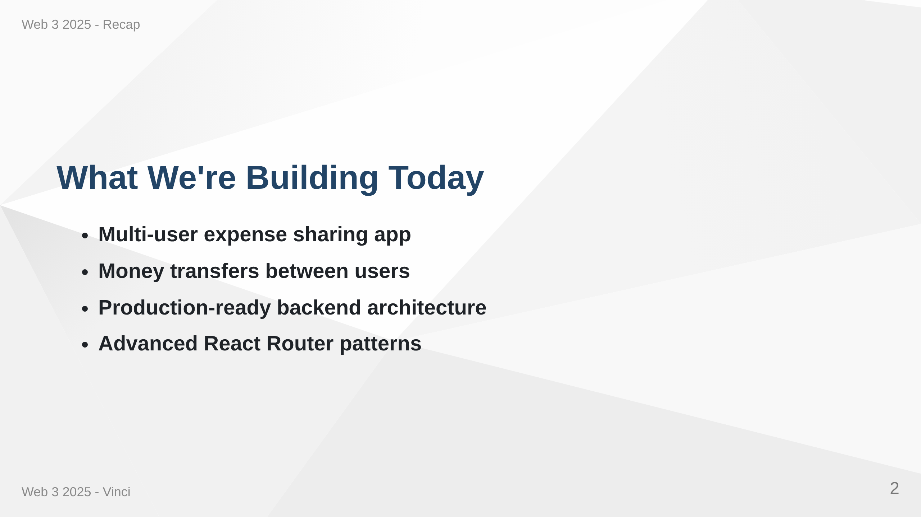
Notes:
Speaker Notes: • Users can create accounts and share expenses with friends • Transfer money to settle debts between users • Moving from simple CRUD to real-world application • Learning patterns used in professional development

Slide 3
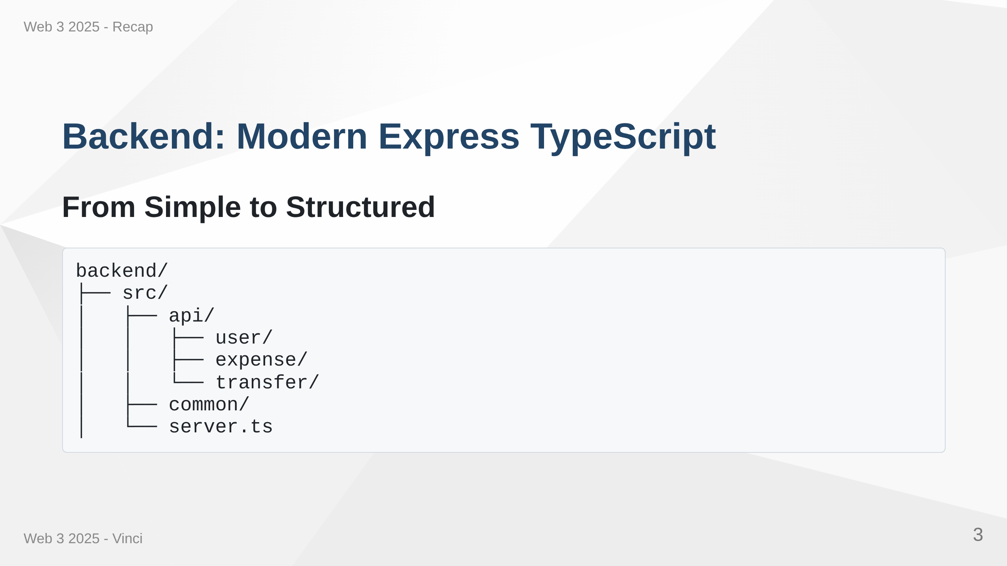
Notes:
Speaker Notes: • Replacing Express generator with modern TypeScript setup • Better organization, type safety, built-in security • Testing infrastructure included • Each feature gets own folder - clear separation of concerns

Slide 4
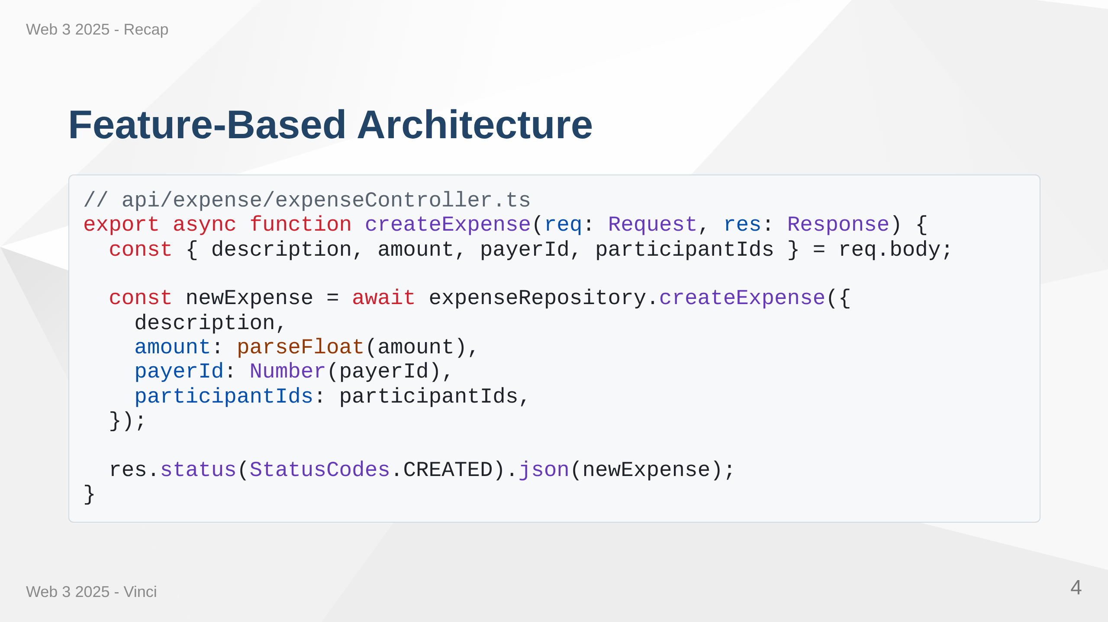
Notes:
Speaker Notes: • Consistent pattern: Router → Controller → Repository • Controllers handle HTTP concerns, repositories handle data access • Makes code predictable and testable • TypeScript catches errors at compile time • Notice proper status codes and type conversions

Slide 5
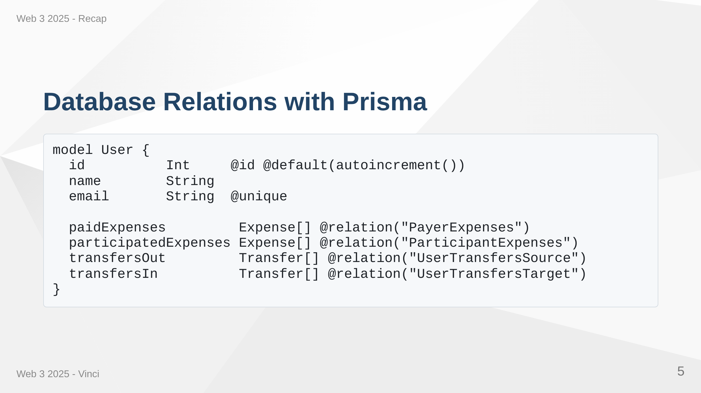
Notes:
Speaker Notes: • Introducing proper relational data modeling • One user has many relationships: pays, participates, sends, receives • Relation names required when multiple relations between same models • Much better than storing comma-separated strings • Database enforces referential integrity

Slide 6
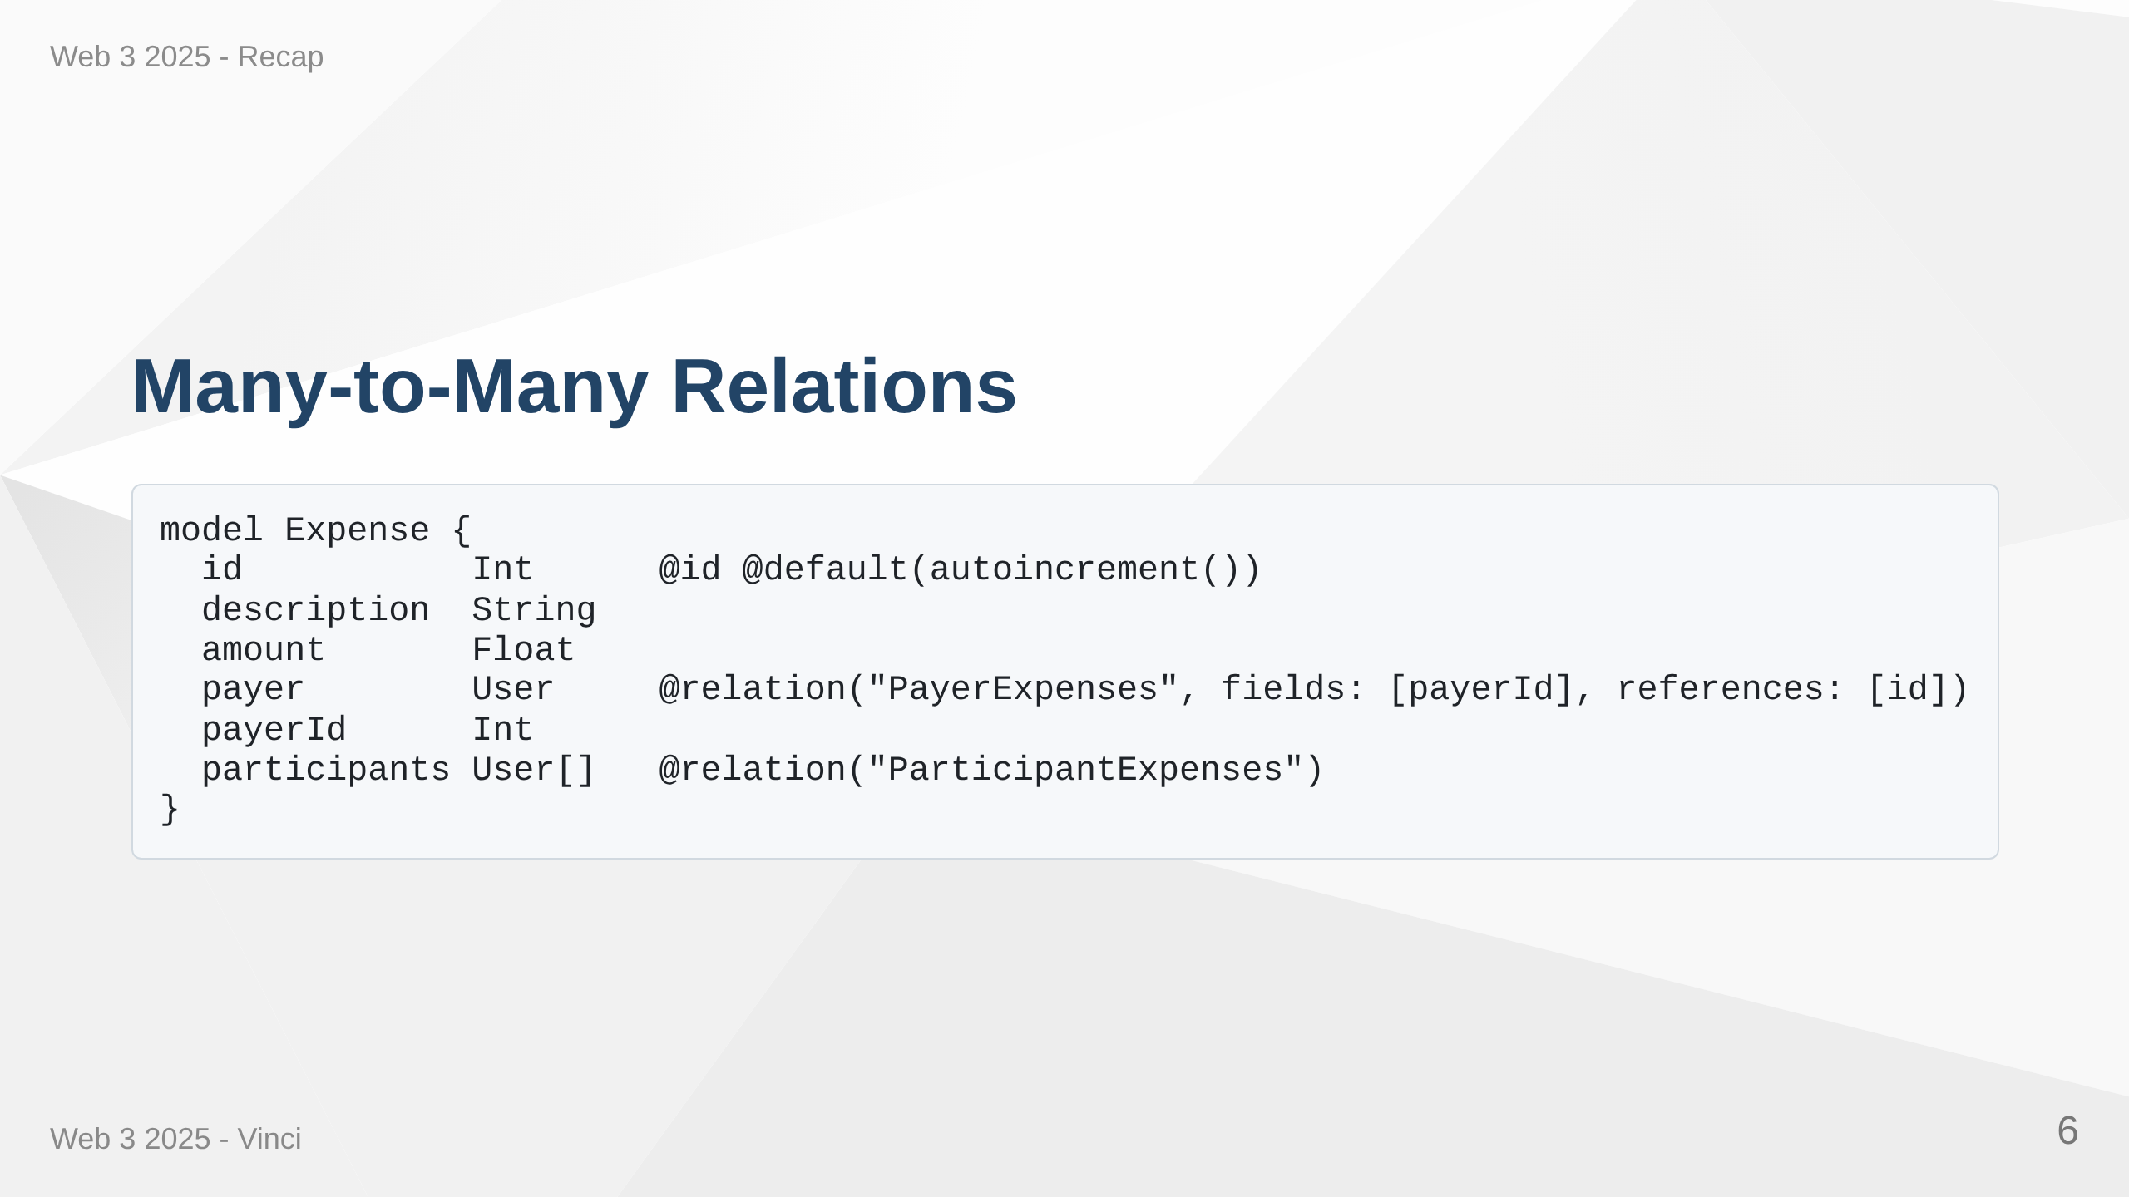
Notes:
Speaker Notes: • One expense has one payer but multiple participants • Prisma creates implicit join table for many-to-many relation • Much cleaner than storing comma-separated participant names • Database handles the complexity of relationships • Can query participants easily with include

Slide 7
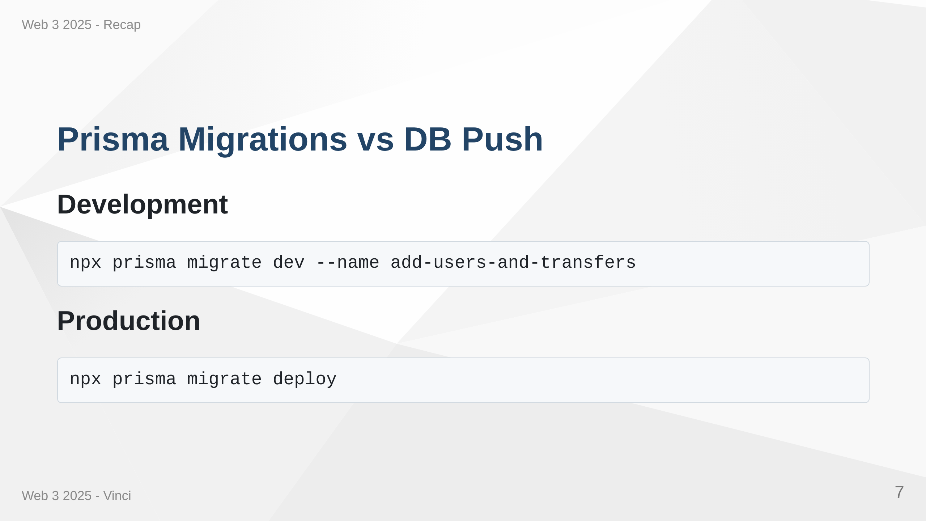
Notes:
Speaker Notes: • Moving from db push to proper migrations • Migrations give version control for database schema • Can preserve data during schema changes • Ensures consistent deployments across environments • Dev creates and applies migrations, deploy only applies existing ones • Critical for production applications

Slide 8
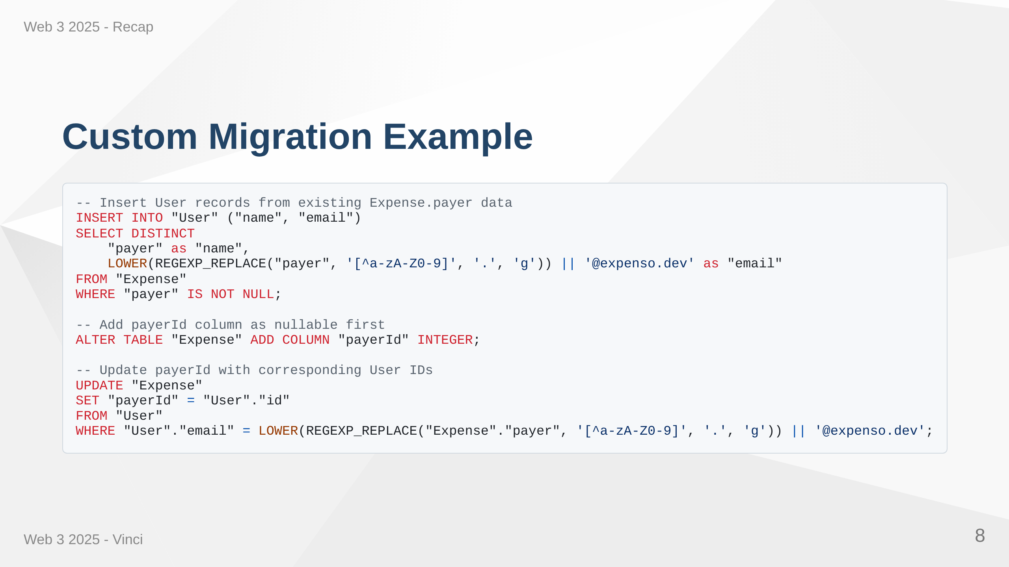
Notes:
Speaker Notes: • Sometimes need custom migration logic to preserve data • Converting string payers to User references • Create users from existing data first • Add foreign key column as nullable, populate it, then make required • Prevents data loss during schema evolution • SQL gives us fine control over migration process

Slide 9
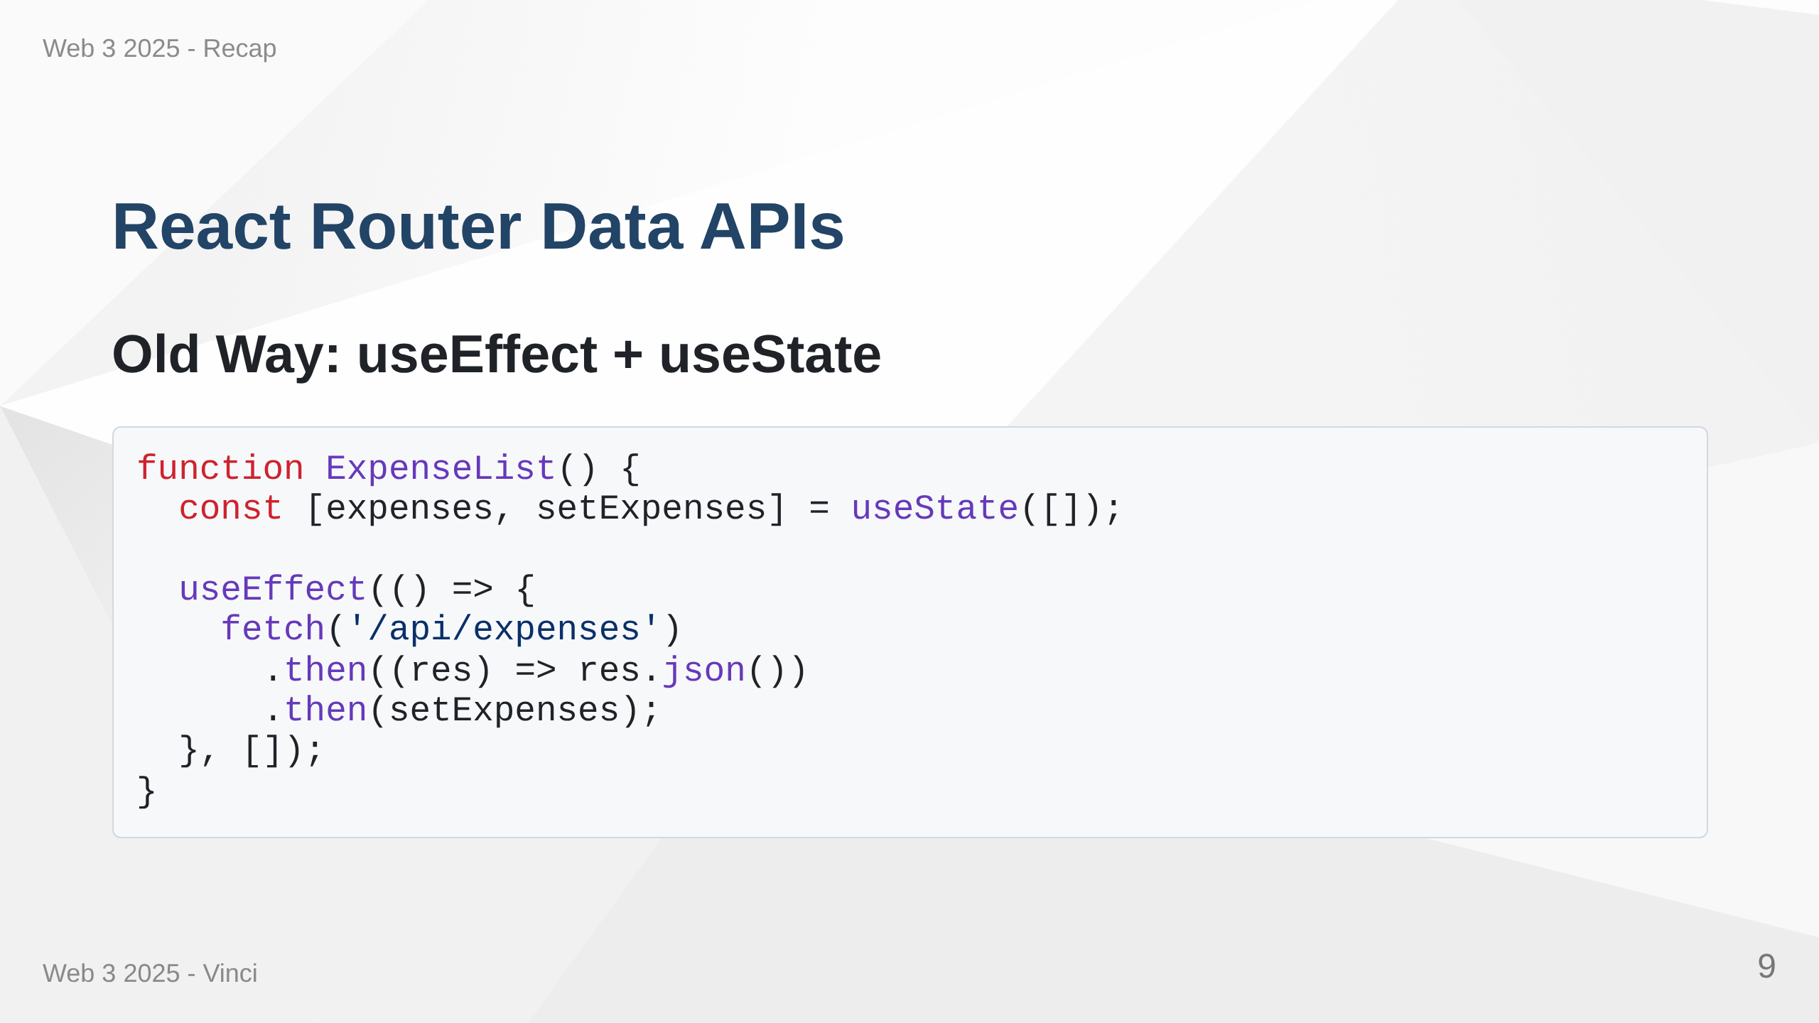
Notes:
Speaker Notes: • Traditional approach puts data fetching inside components • Creates loading states and error handling complexity • Makes components less focused on presentation • Data fetching mixed with UI logic • Harder to cache and prefetch data

Slide 10
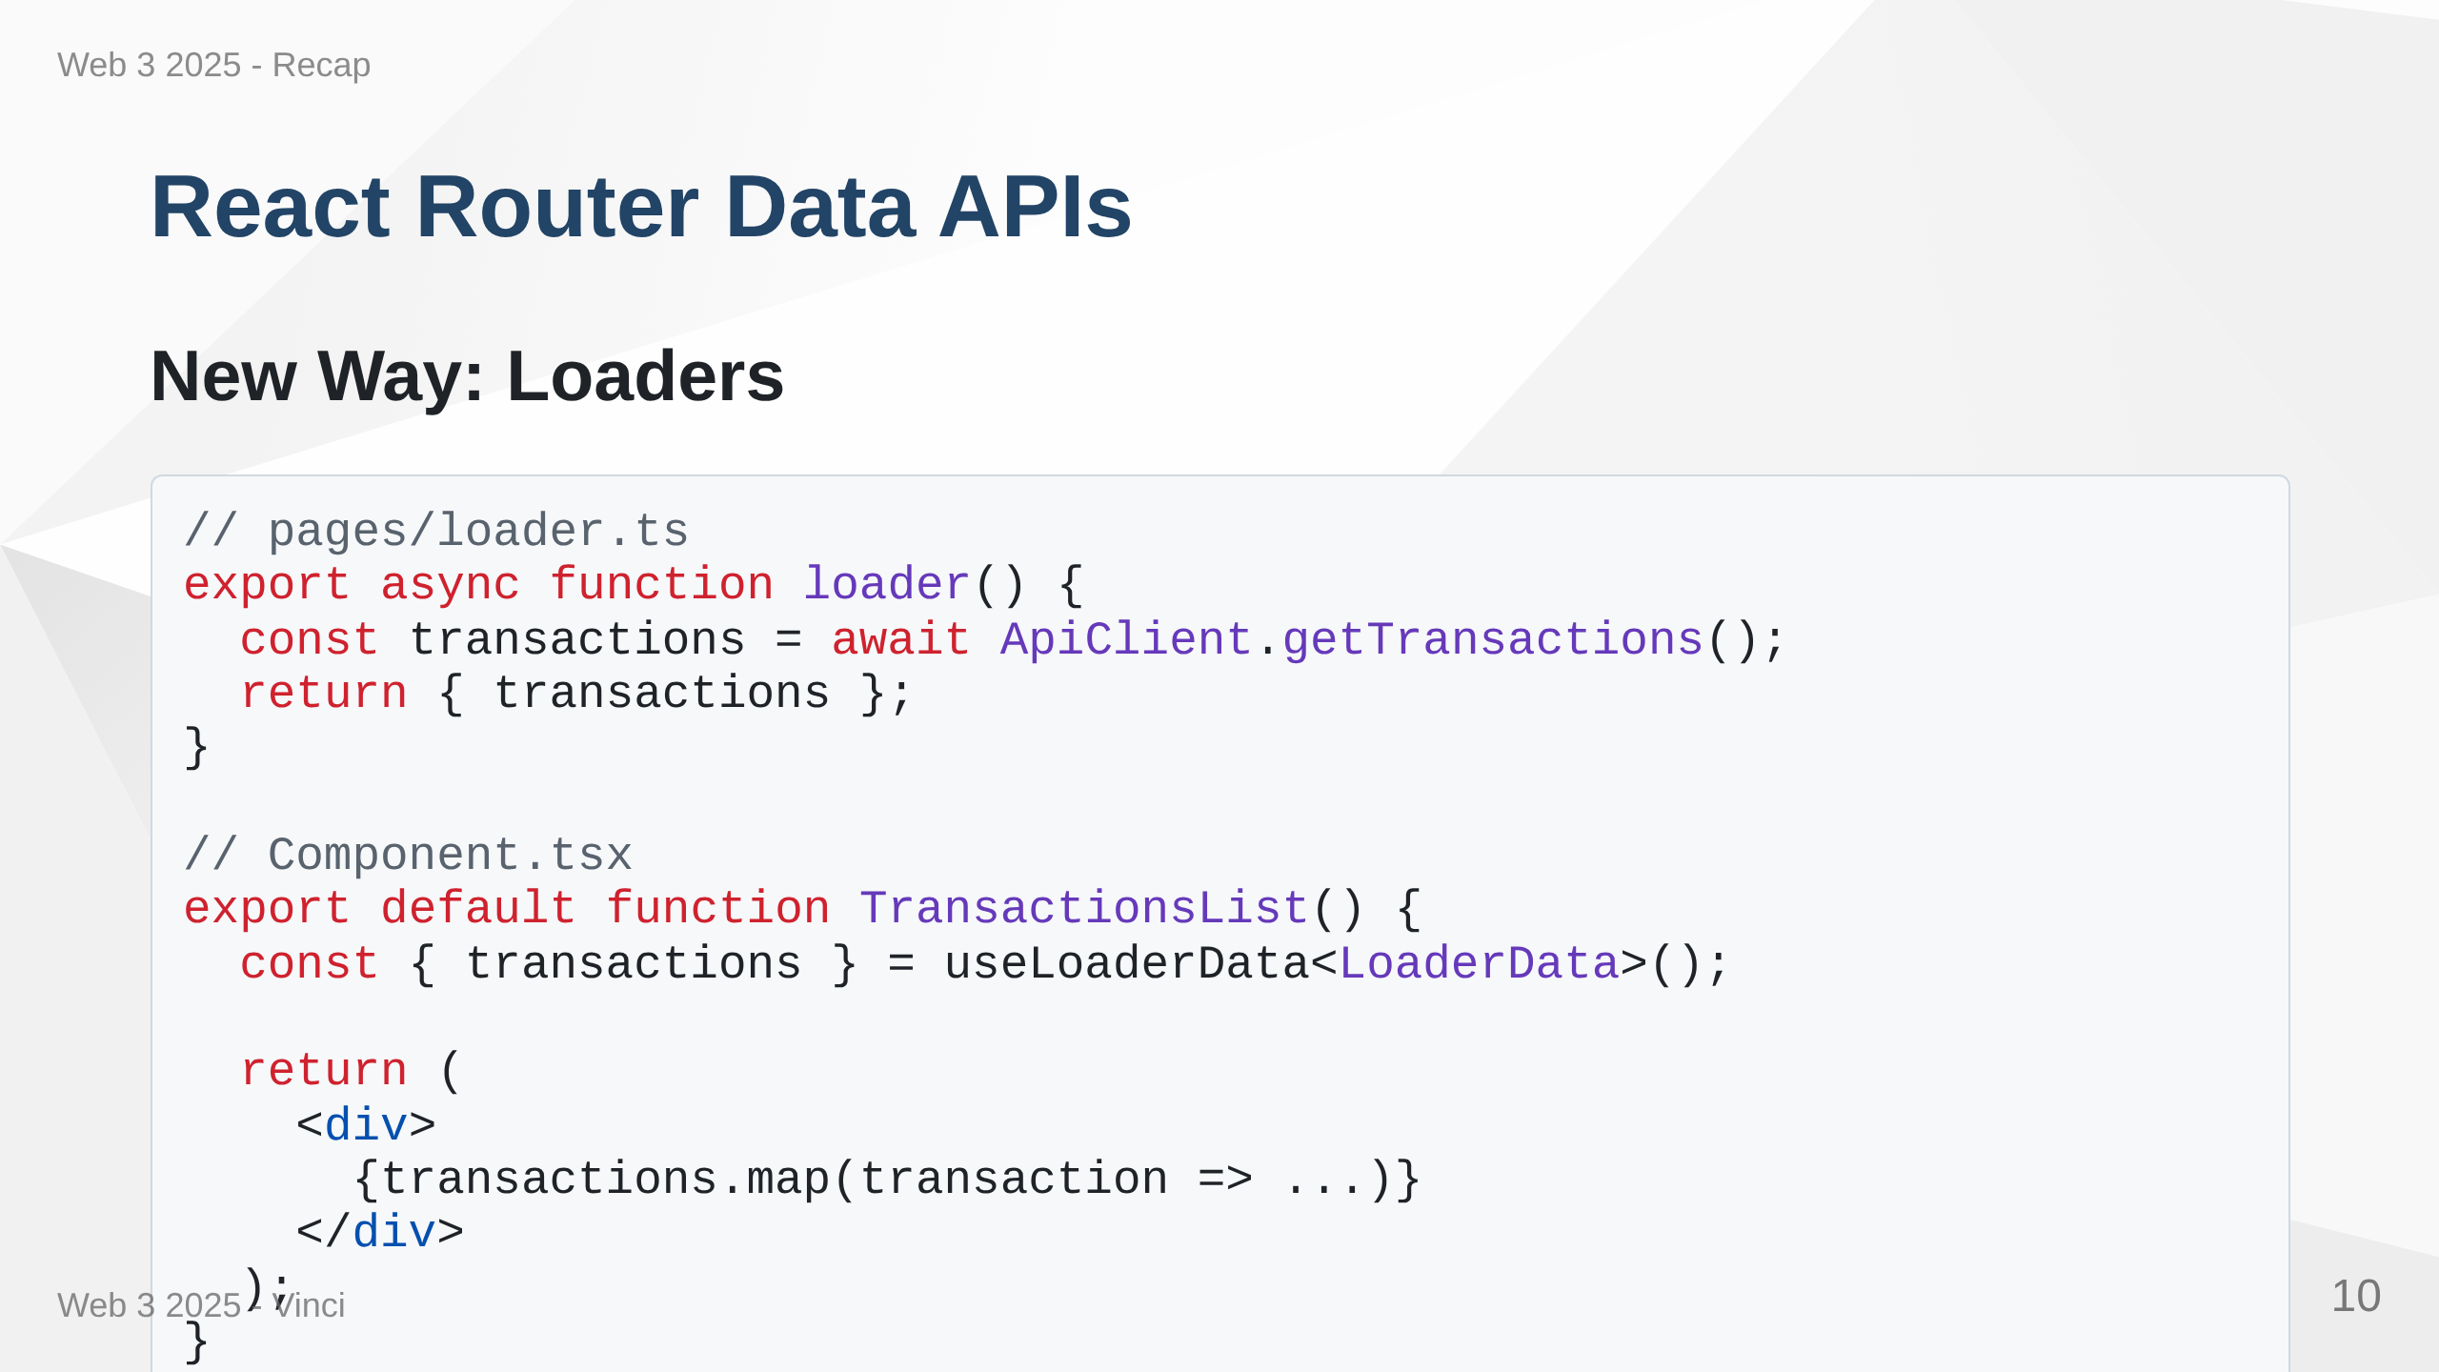
Notes:
Speaker Notes: • Loaders move data fetching out of components • Data fetched before route renders - eliminates loading states • Components become pure presentation logic • Better separation of concerns • Enables caching and prefetching • React Router handles the data flow

Slide 11
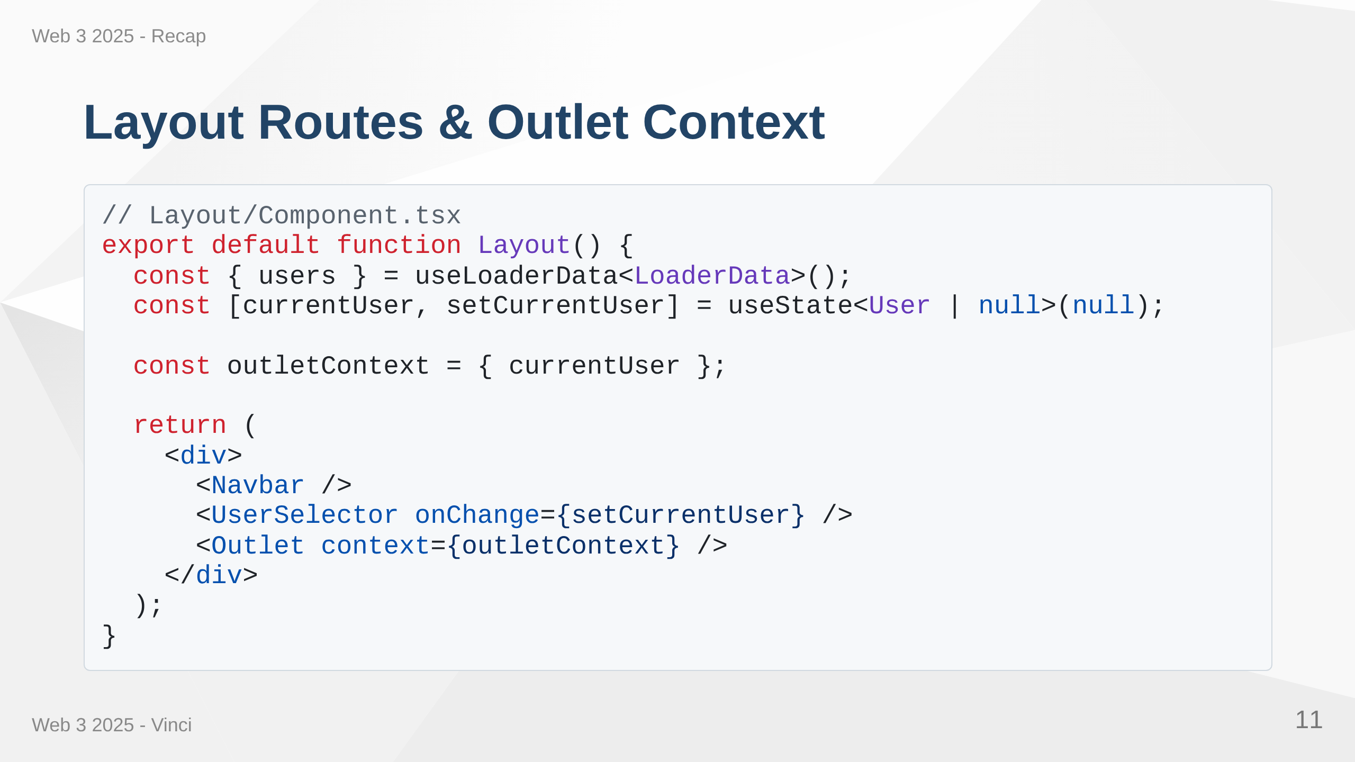
Notes:
Speaker Notes: • Layout routes share UI and state across multiple pages • Outlet renders child routes with shared context • Perfect for user selection, navigation, global UI elements • Avoids prop drilling for common state • Clean way to structure multi-page applications

Slide 12
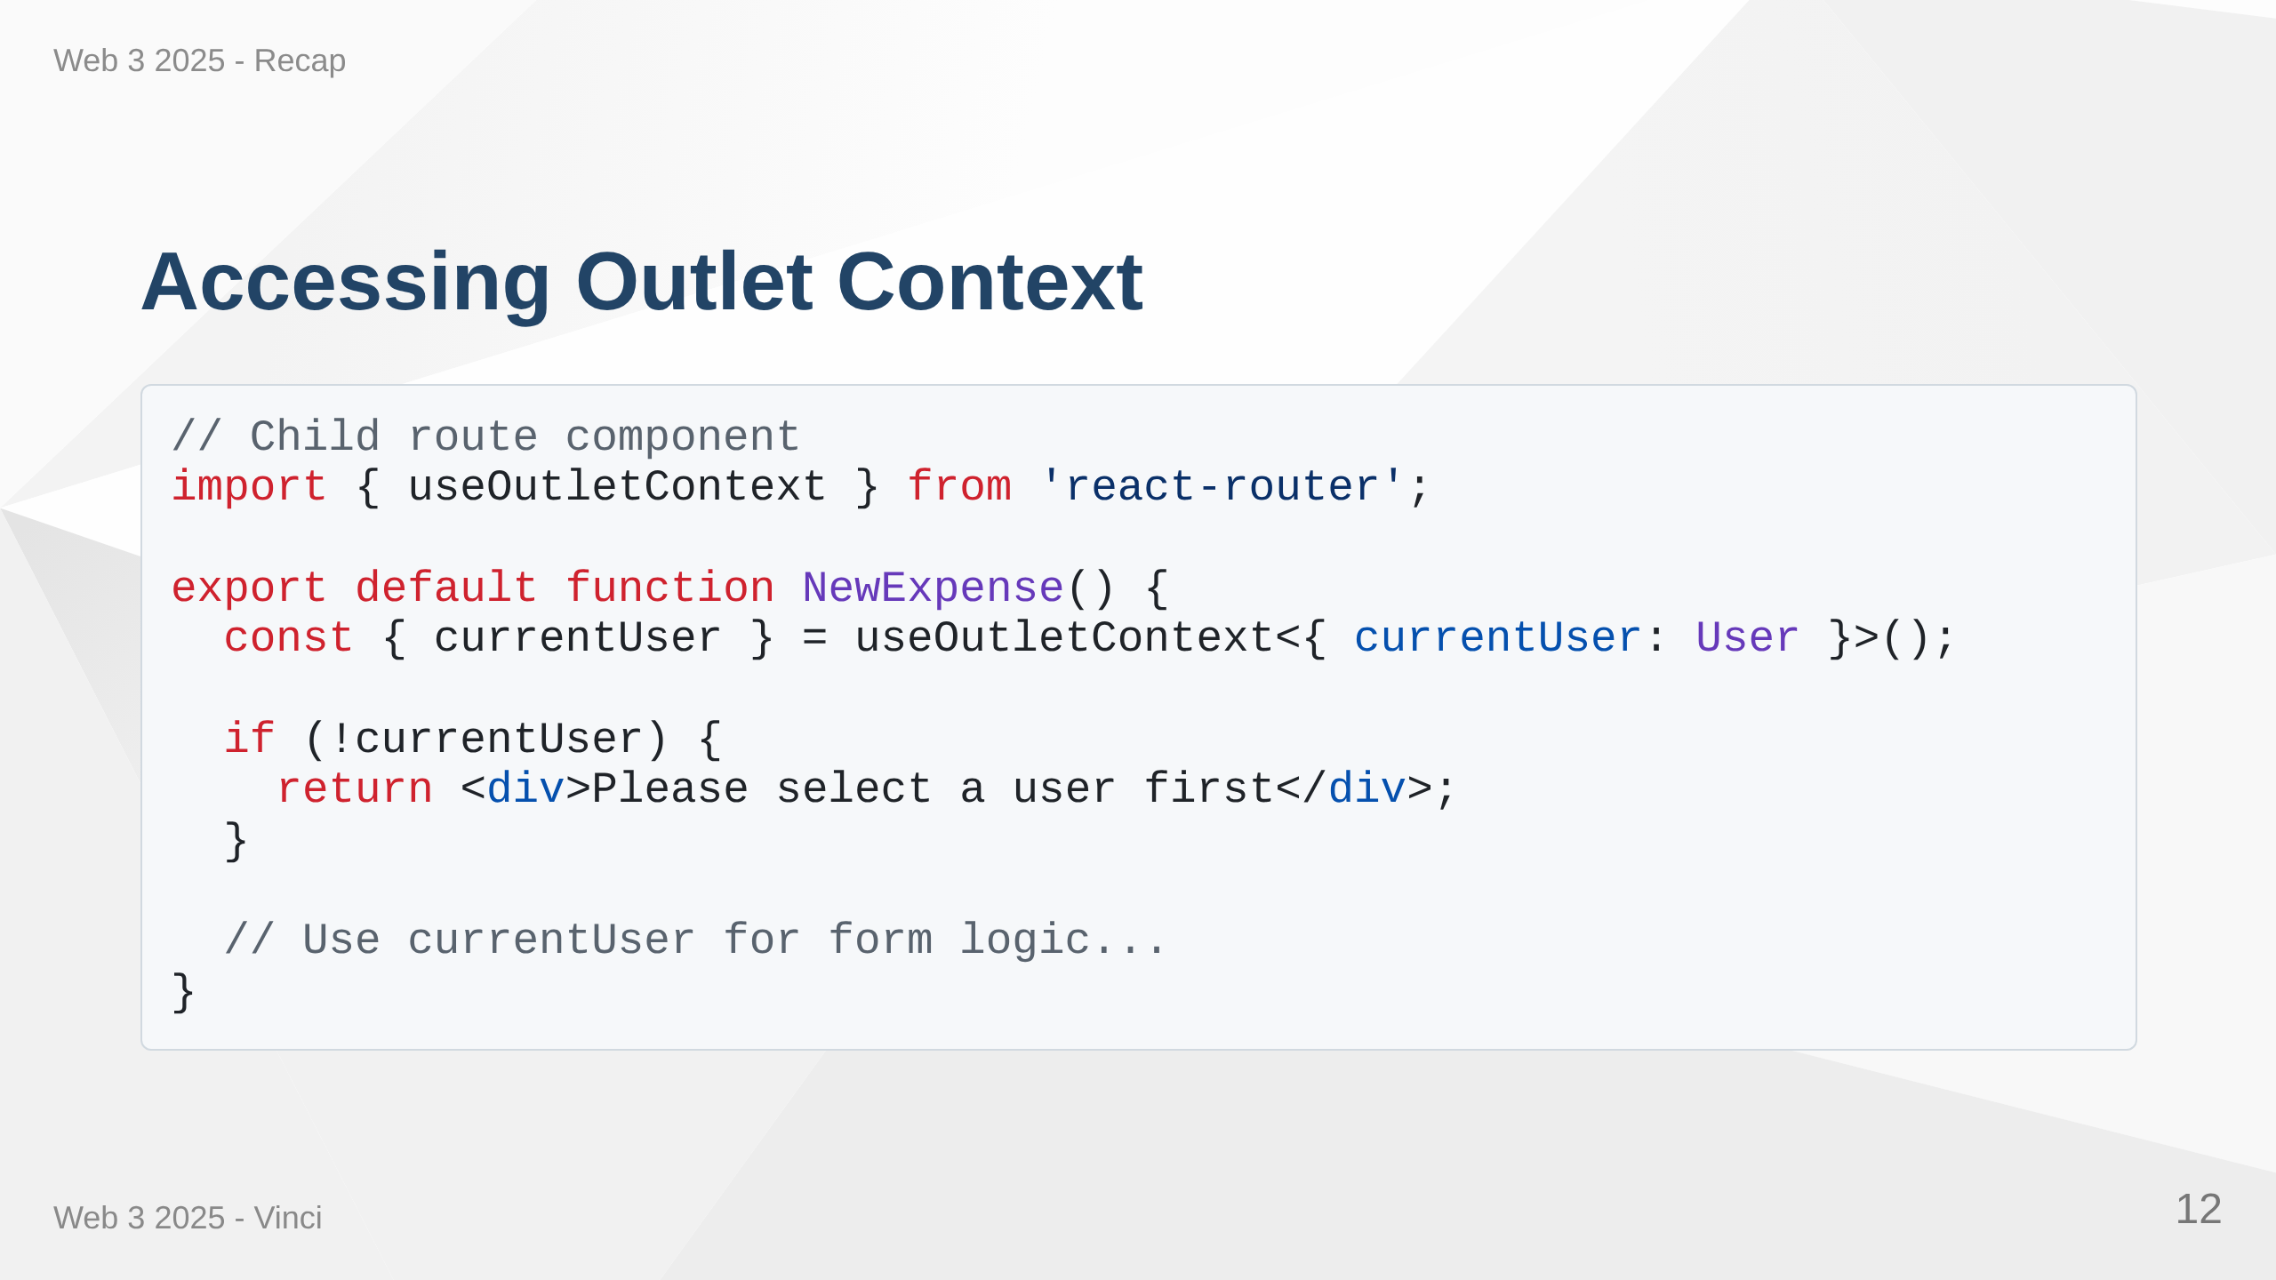
Notes:
Speaker Notes: • Child routes access outlet context with useOutletContext hook • Clean way to share state without prop drilling • Type-safe access to shared data • Can conditionally render based on context • Alternative to React Context for route-specific state

Slide 13
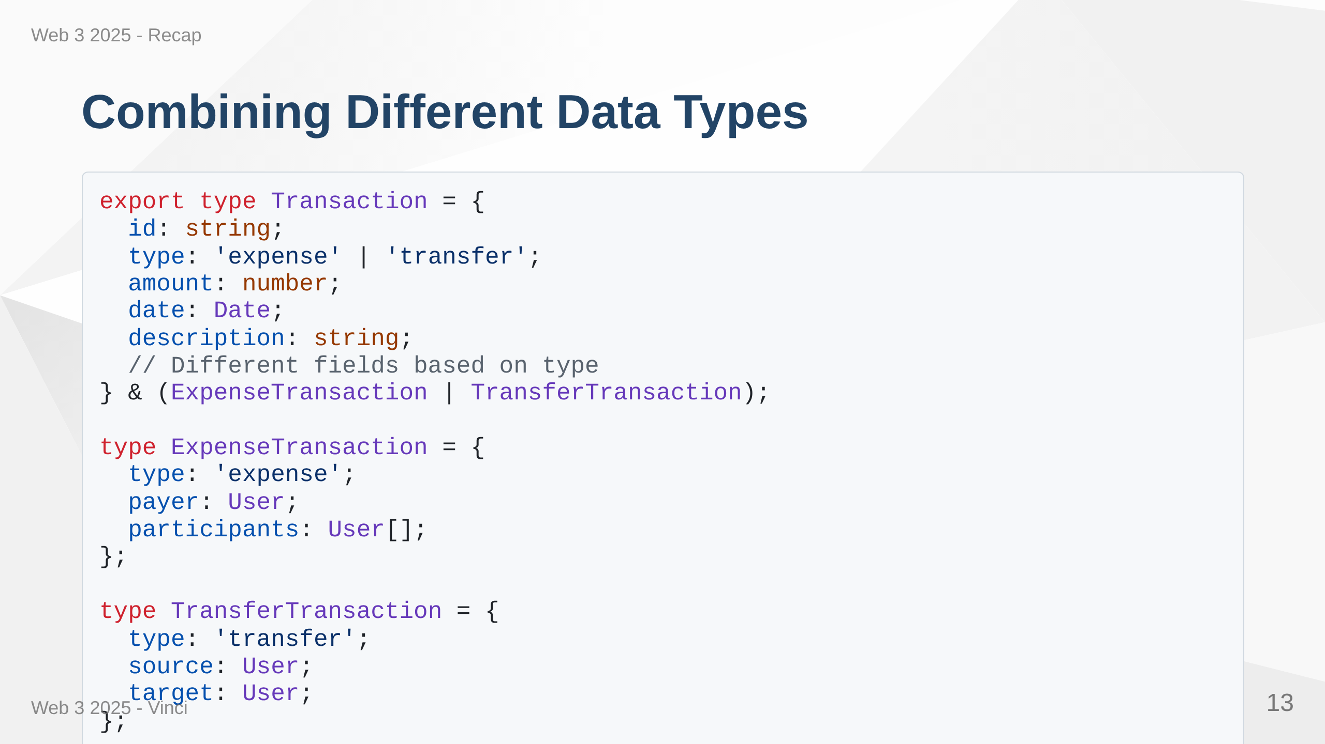
Notes:
Speaker Notes: • Combining expenses and transfers into unified Transaction type • Using discriminated unions for type safety • Display different types together in one list • TypeScript knows which fields available based on type field • Clean way to handle heterogeneous data

Slide 14
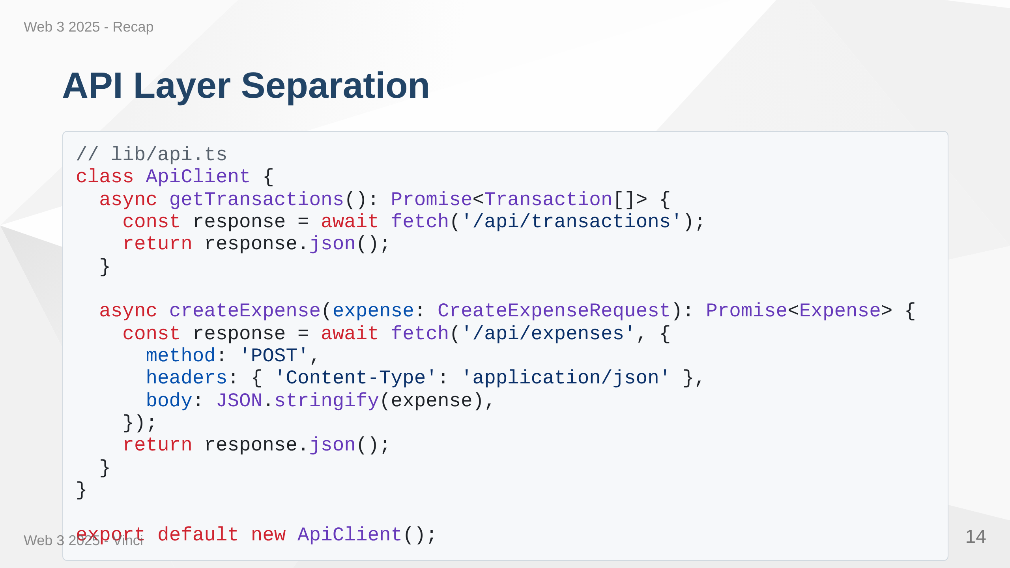
Notes:
Speaker Notes: • Centralize all API calls in dedicated module • Easy to add error handling, authentication in one place • Request/response transformation centralized • Components don't need to know about HTTP details • Better testing and mocking capabilities • Consistent API patterns across app

Slide 15
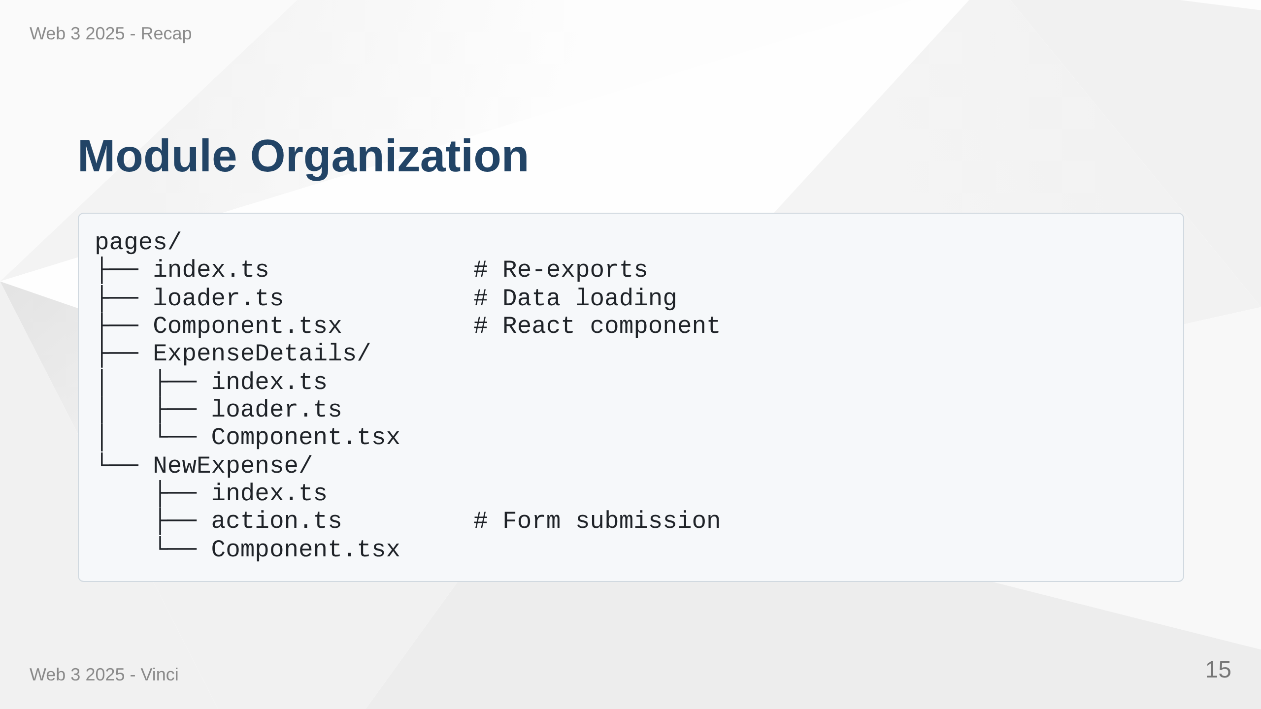
Notes:
Speaker Notes: • Organize code by feature, not by file type • Each page gets own folder with loader, component, action files • Index.ts files provide clean imports • Scales much better than all components in one folder • Easy to find related files • Supports feature-based development teams

Slide 16
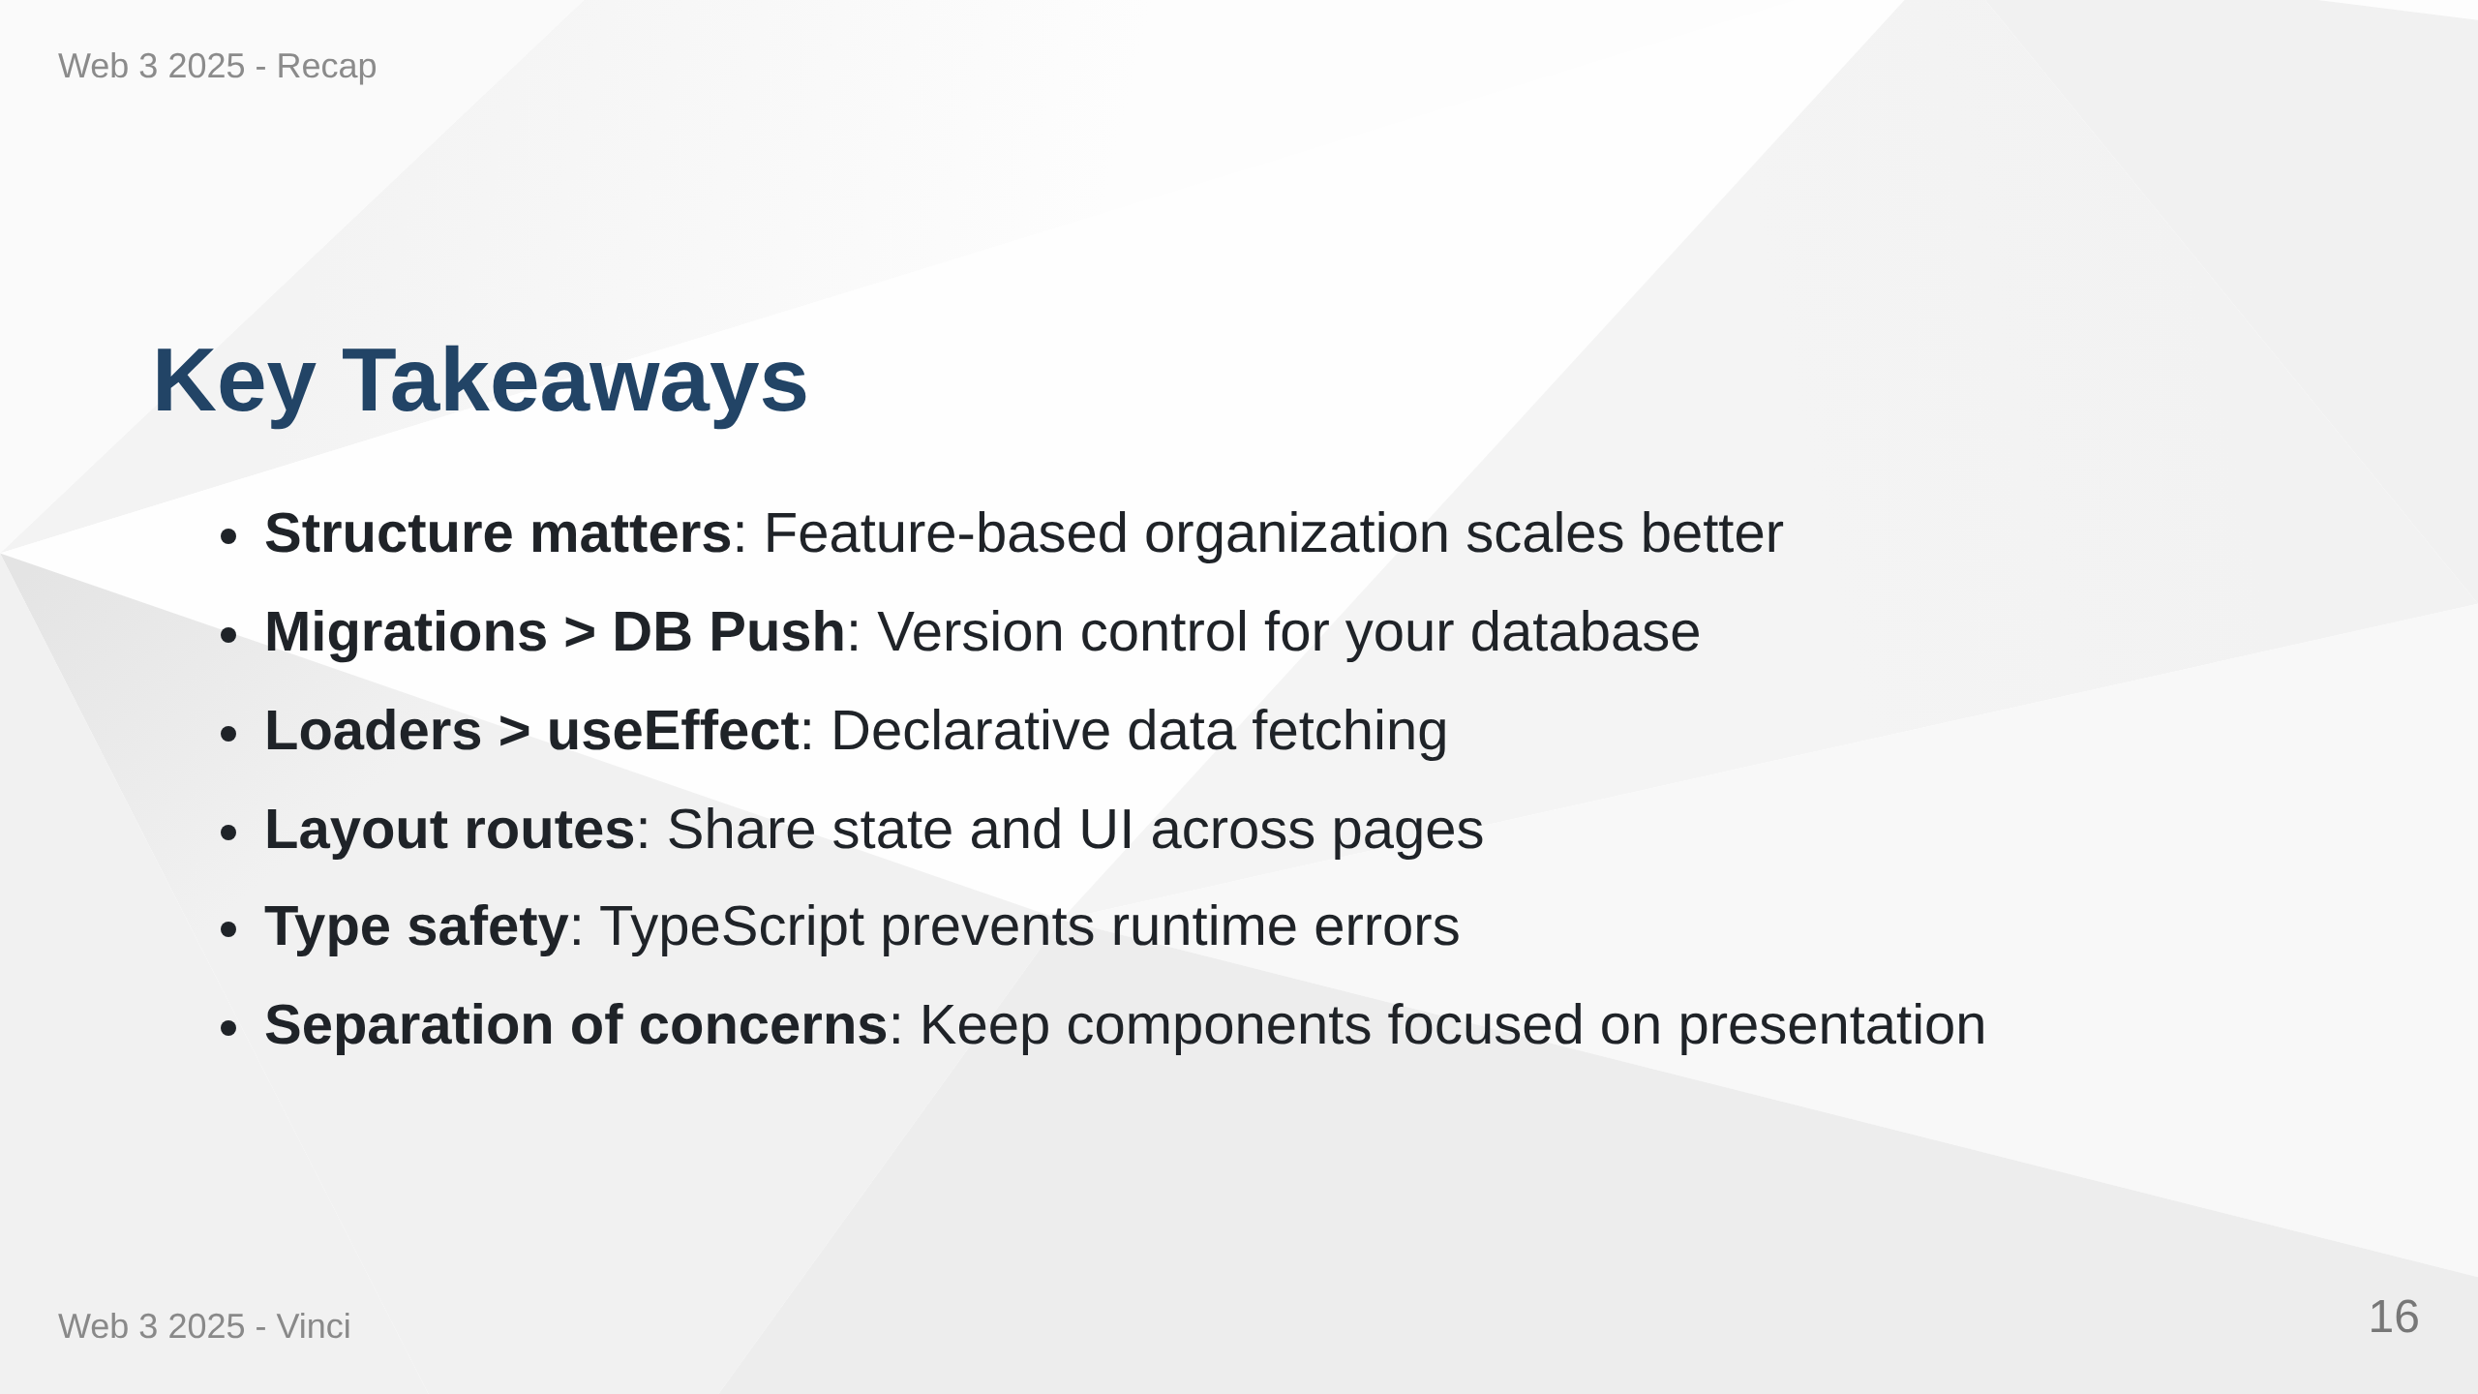
Notes:
Speaker Notes: • These patterns might seem like extra work now • Pay dividends as application grows • Make code more predictable, testable, maintainable • Building habits for professional development • Foundation for scaling to larger teams • Industry best practices

Slide 17

Notes:
Speaker Notes: • Any questions before diving into exercises? • Transforming from simple prototype to production-ready architecture • Big step but each piece builds on concepts you already know • Focus on understanding the patterns, not memorizing syntax • Apply these concepts in the hands-on exercises

