Slide 1
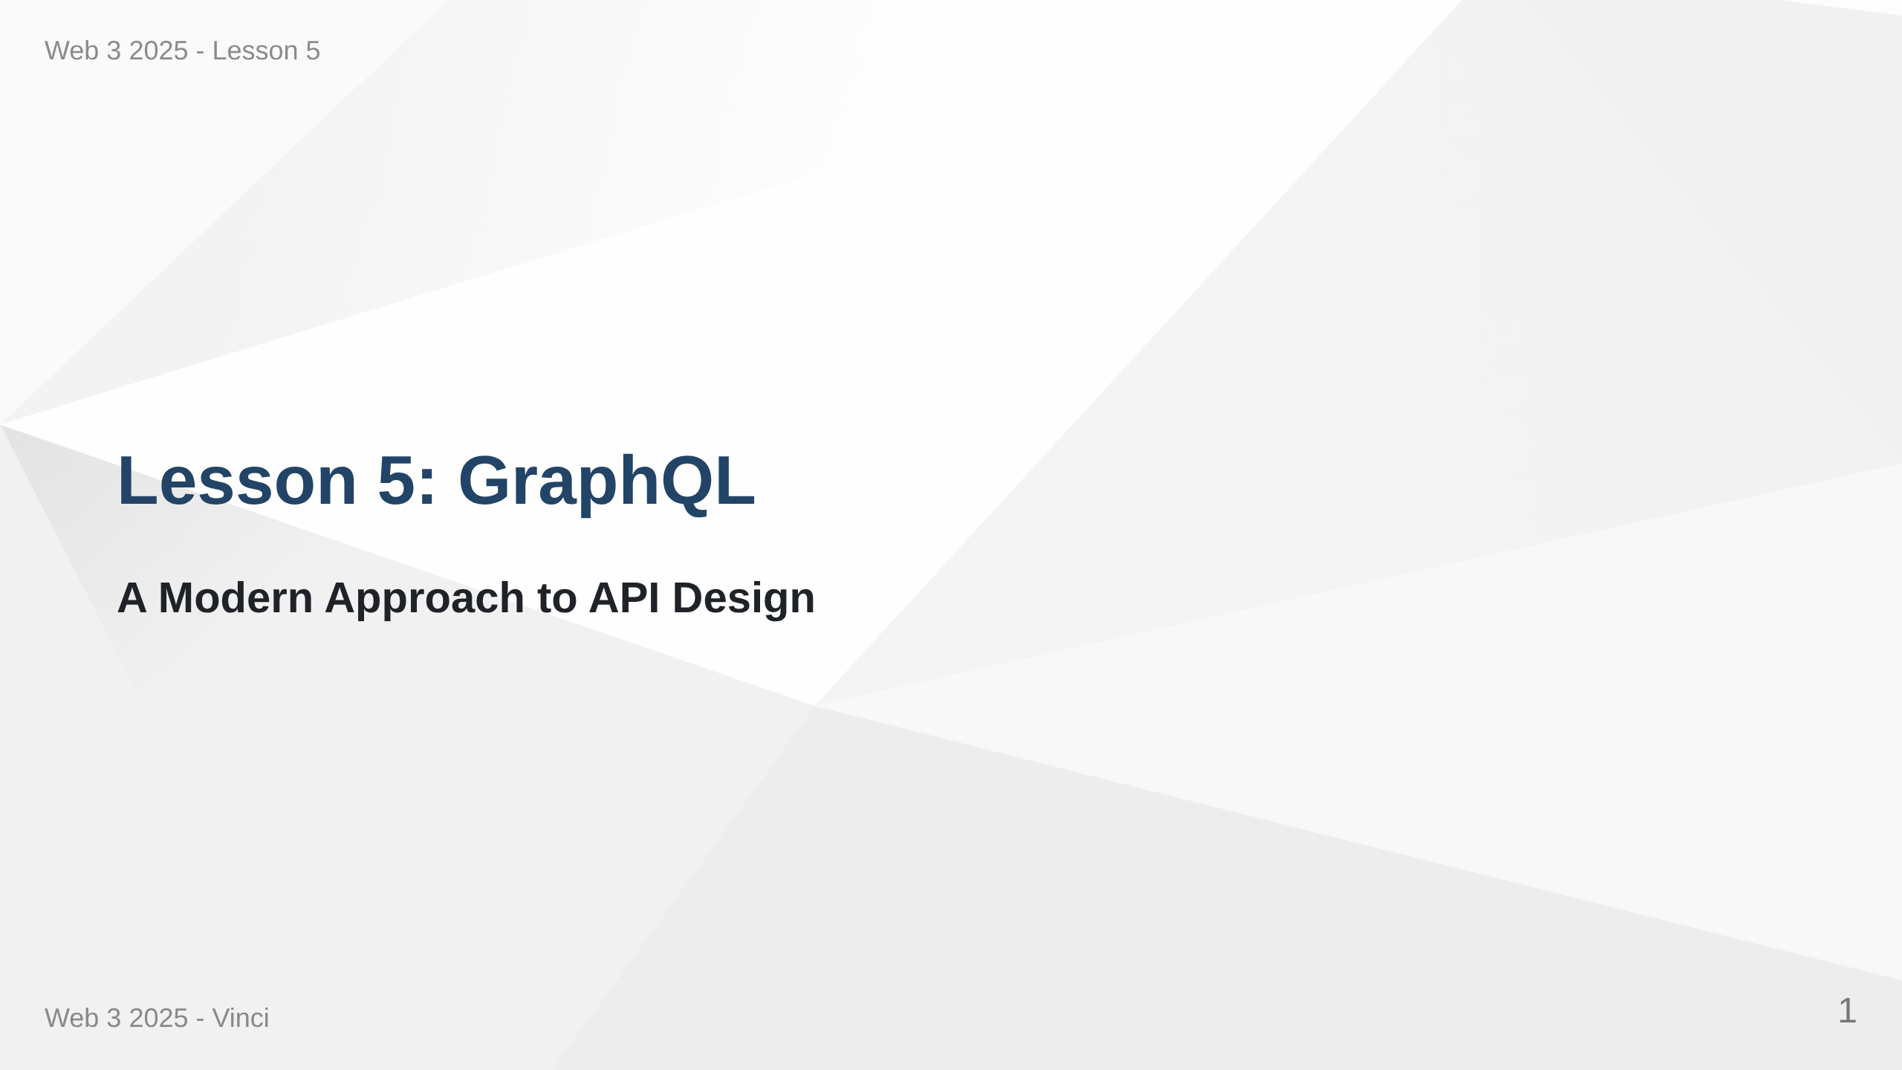
Notes:
Speaker Notes: • Welcome to Lesson 5 - GraphQL • Moving beyond traditional REST APIs • Learning industry-standard query language • Building flexible, efficient APIs

Slide 2
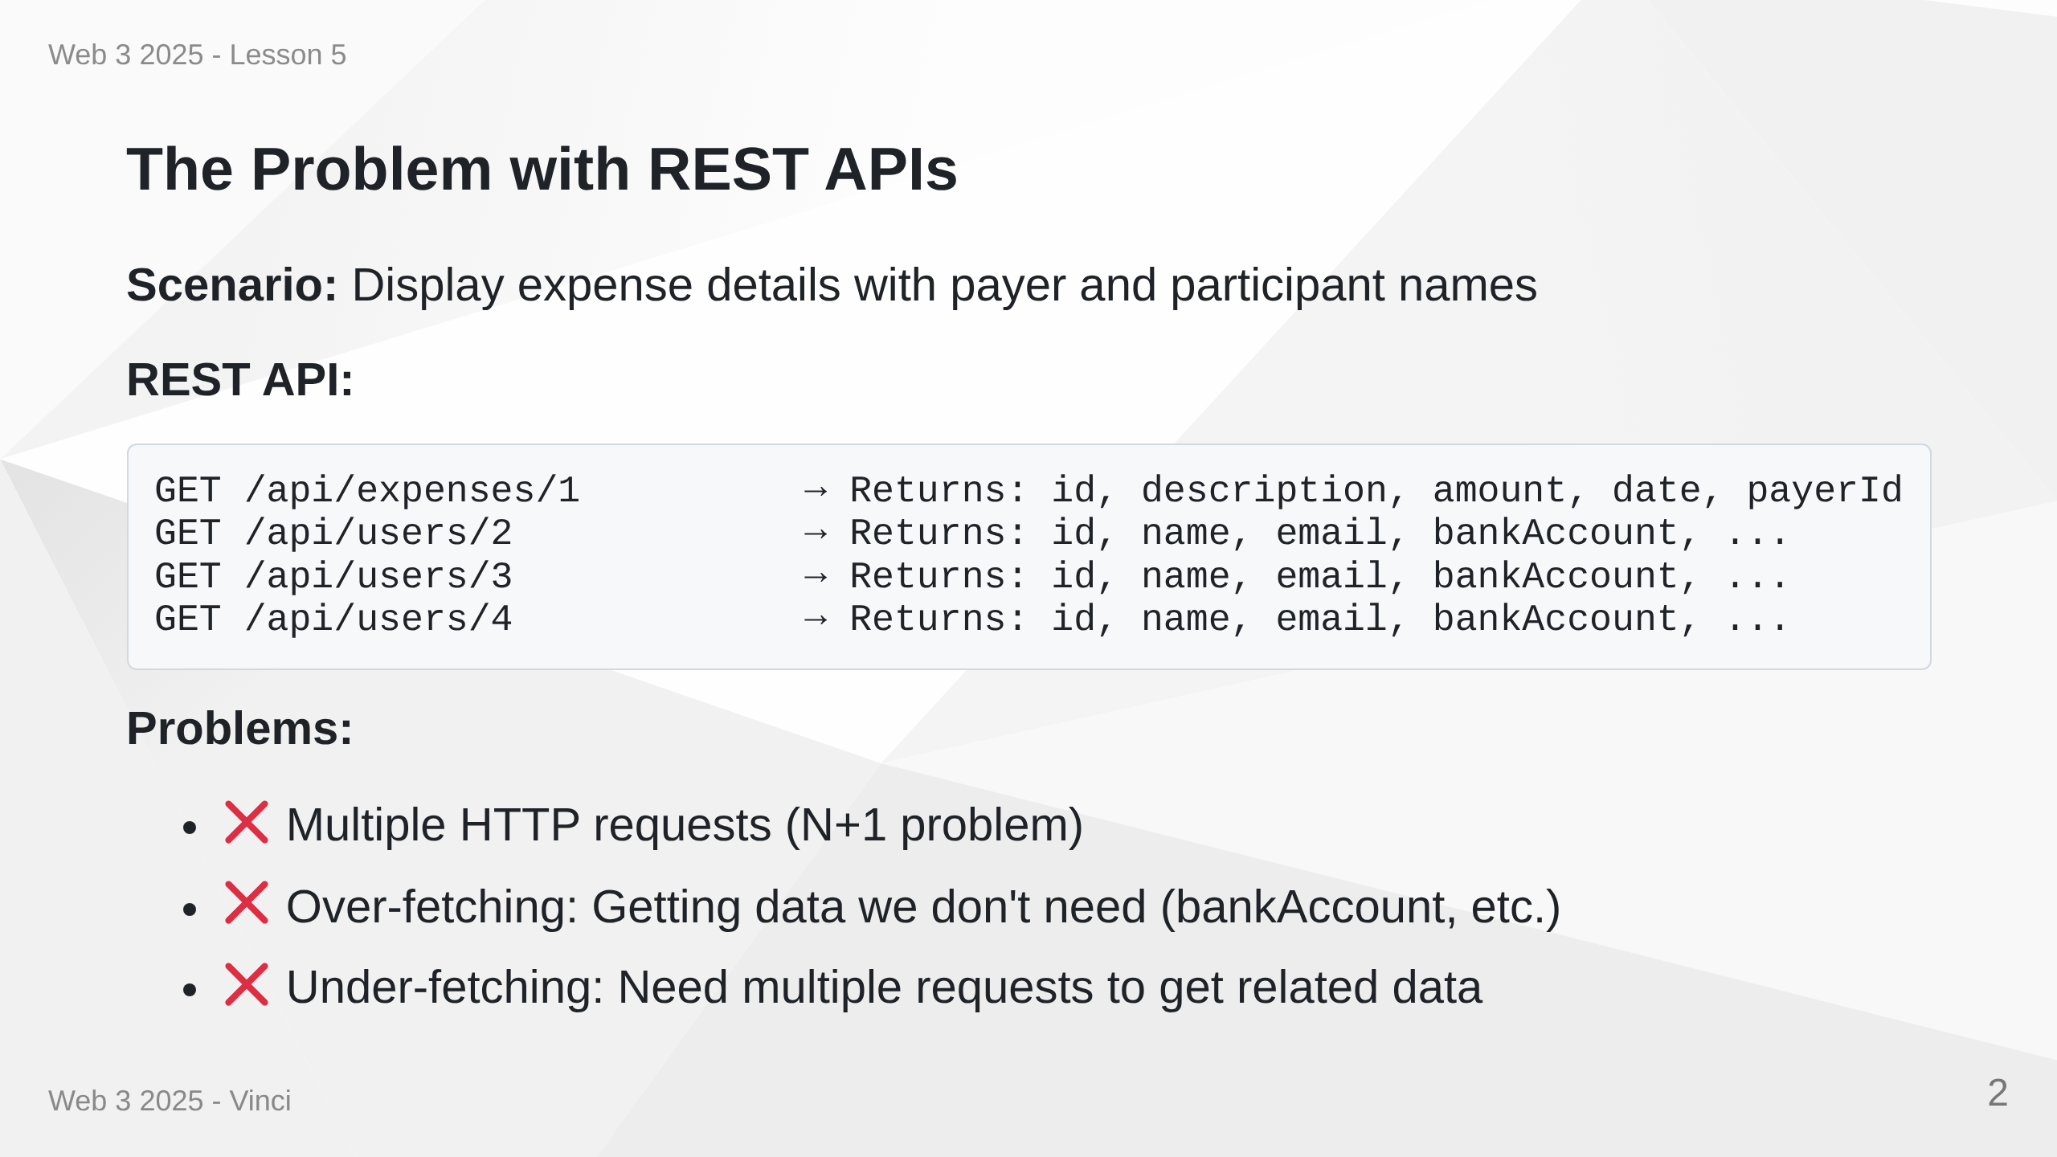
Notes:
Speaker Notes: • REST forces us to make multiple round trips • Each request has latency overhead • We get all user fields even though we only need names • N+1 problem: 1 query for expense + N queries for participants • This becomes worse with nested data

Slide 3
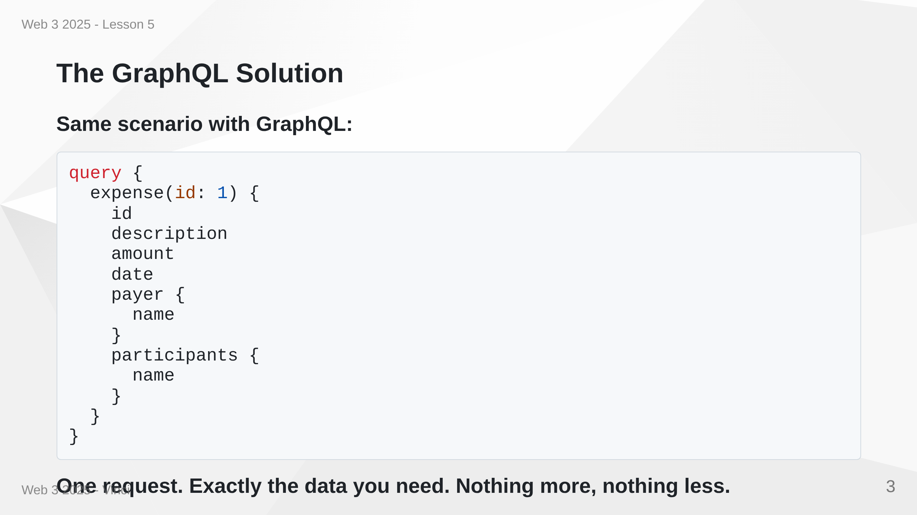
Notes:
Speaker Notes: • Single HTTP request to get everything • Client specifies exactly what fields it needs • No over-fetching - only name, not email or bankAccount • Server knows relationships and fetches efficiently • Solves both over-fetching and under-fetching

Slide 4
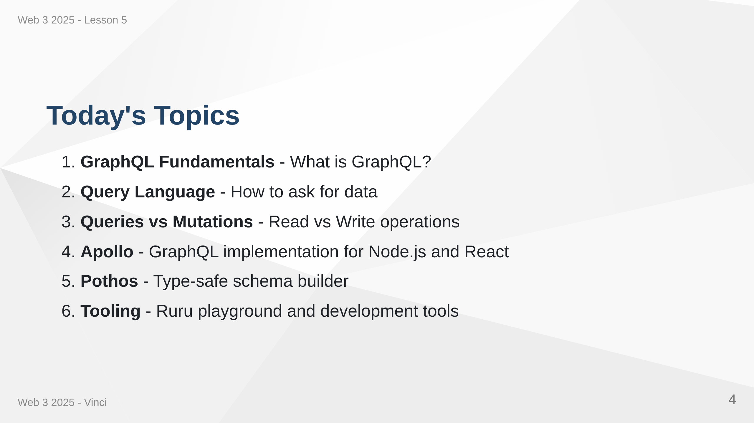
Notes:
Speaker Notes: • Comprehensive introduction to GraphQL • Theory and practical implementation • Industry-standard tools and libraries • Building production-ready GraphQL APIs

Slide 5
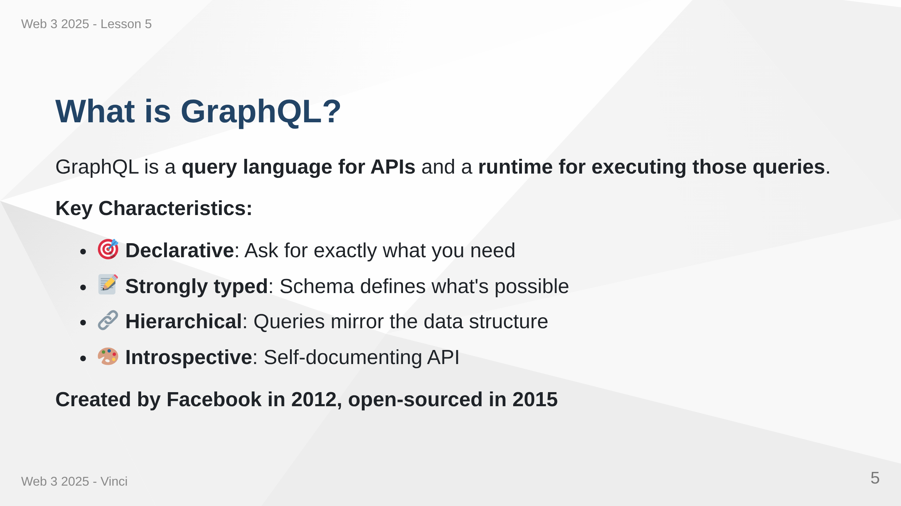
Notes:
Speaker Notes: • GraphQL is both a specification and a runtime • Query language lets clients describe their data needs • Runtime executes queries against your schema • Not tied to any specific database or programming language • Works with your existing code and data

Slide 6
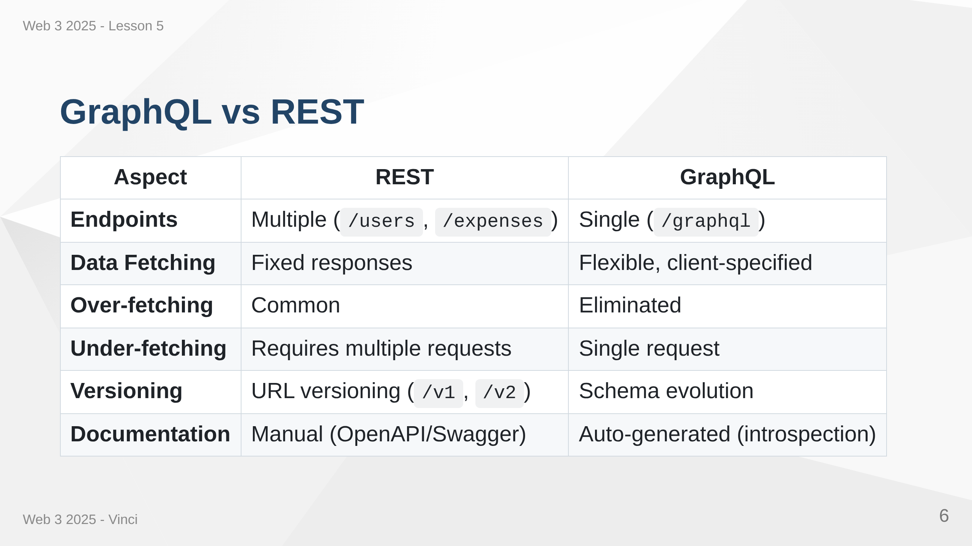
Notes:
Speaker Notes: • REST uses multiple endpoints, GraphQL uses one • REST returns fixed data structure, GraphQL returns what you ask for • REST often requires multiple requests for related data • GraphQL schema is self-documenting through introspection • Both have their place - not one-size-fits-all

Slide 7
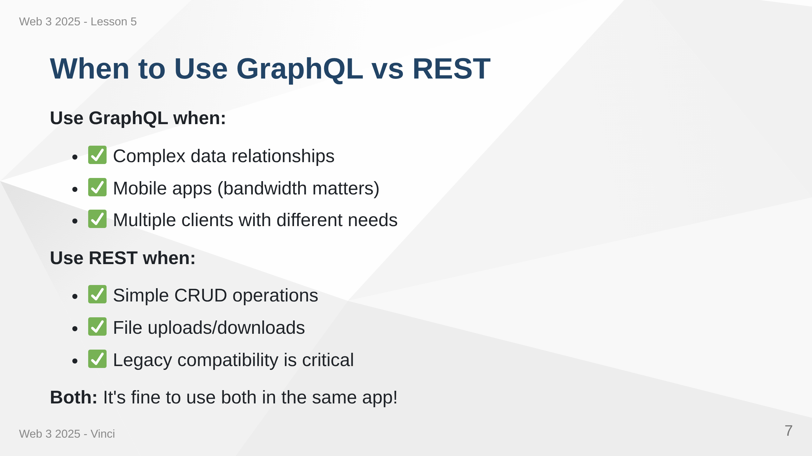
Notes:
Speaker Notes: • GraphQL excels with complex, interconnected data • REST is simpler for basic operations • Can use both together - GraphQL for complex queries, REST for uploads • Consider team experience and project requirements • Not an either/or decision

Slide 8
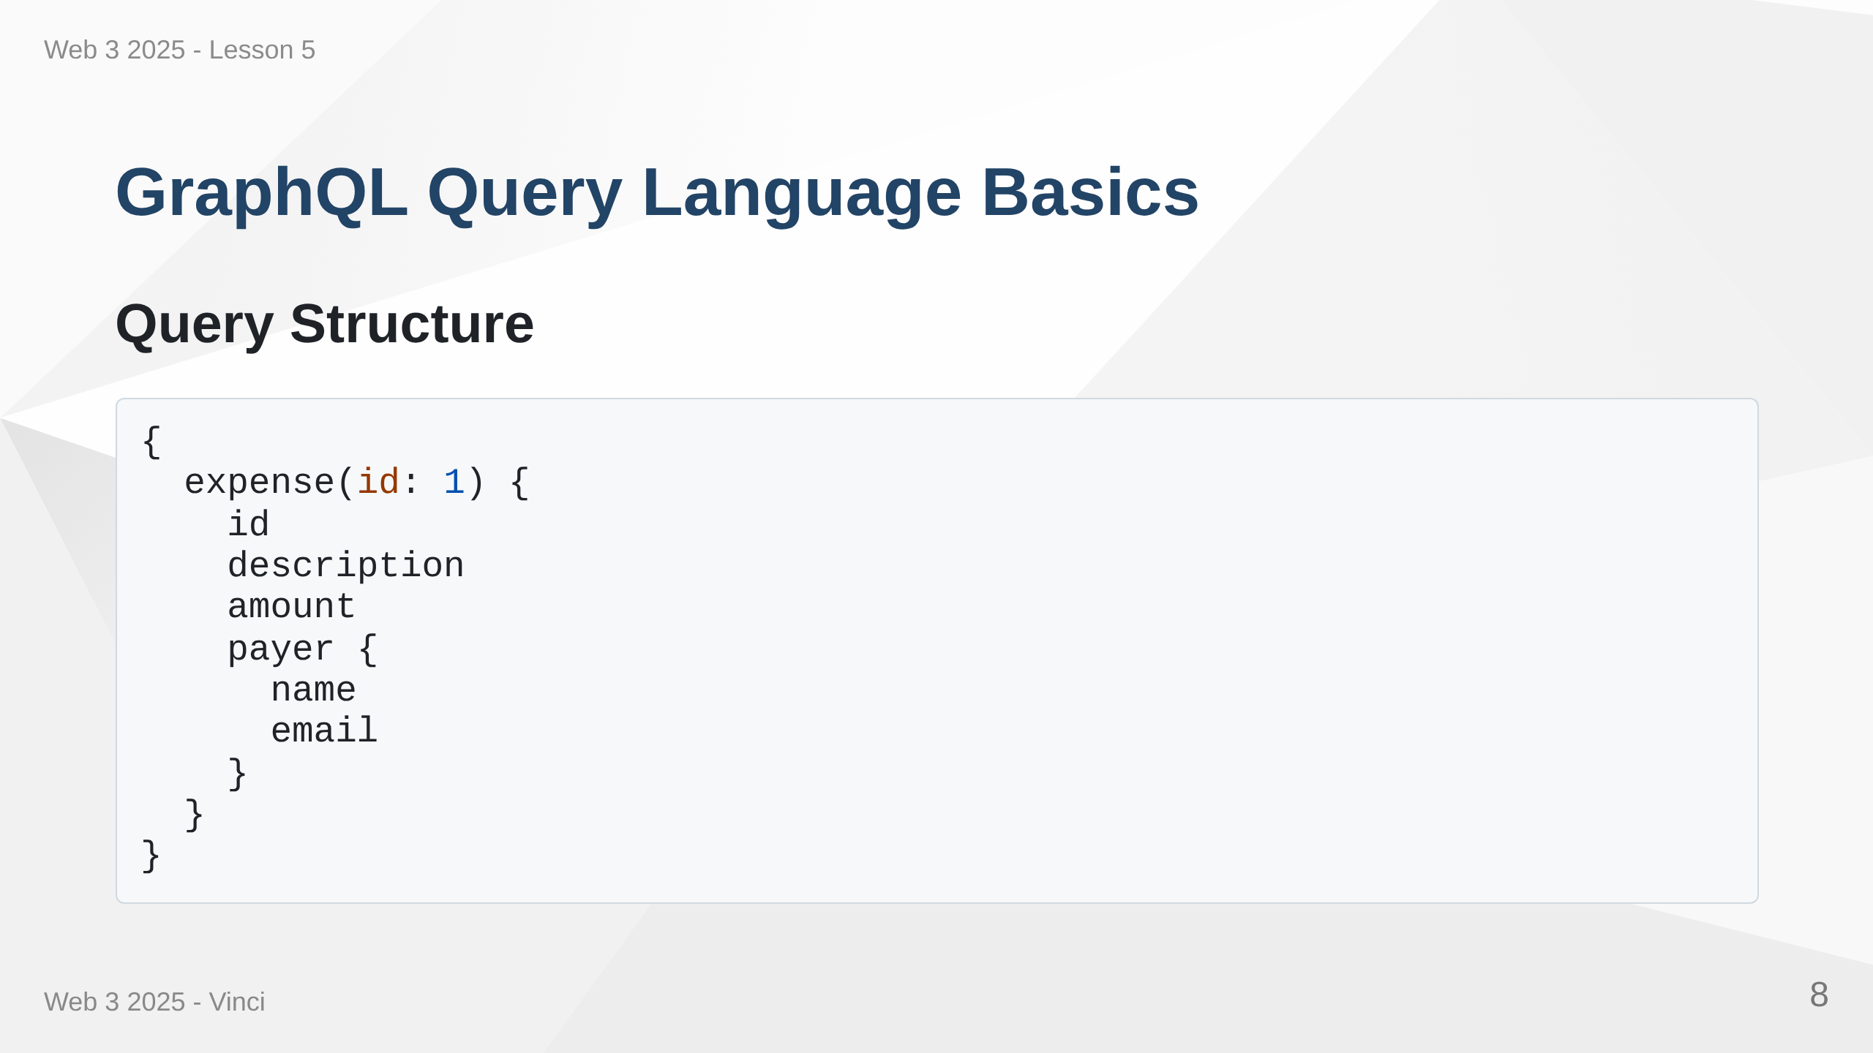

Slide 9
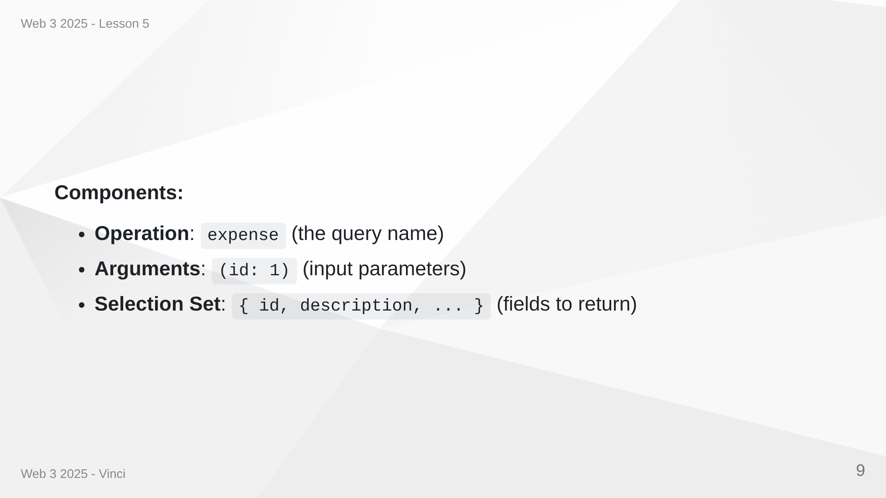
Notes:
Speaker Notes: • Queries look similar to JSON but without values • Curly braces define what fields you want • Arguments in parentheses filter or specify data • Nested objects let you traverse relationships • Response mirrors the query structure

Slide 10
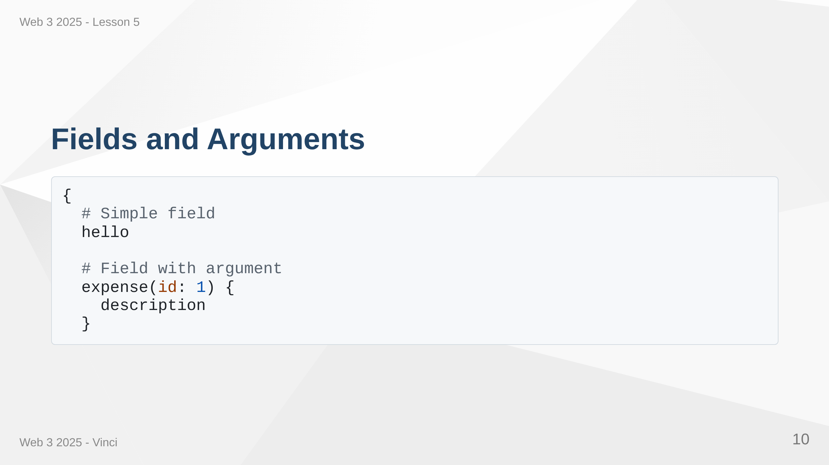

Slide 11
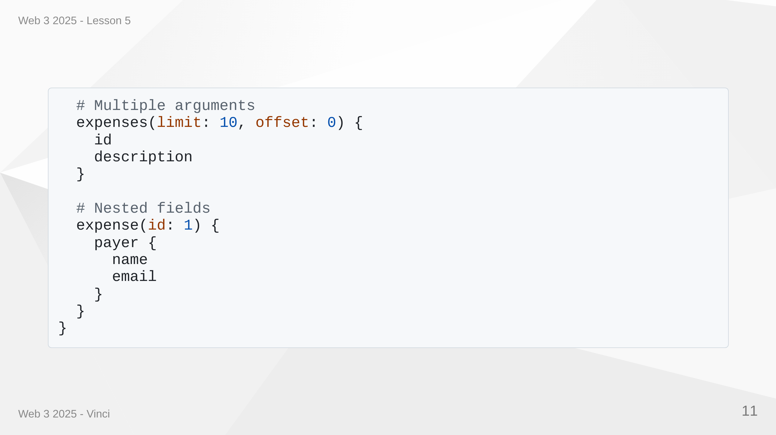
Notes:
Speaker Notes: • Fields are the basic unit - properties you want to fetch • Arguments filter or customize the query • Can have multiple arguments (limit, offset, etc.) • Nested fields traverse relationships • Server resolves each field independently

Slide 12
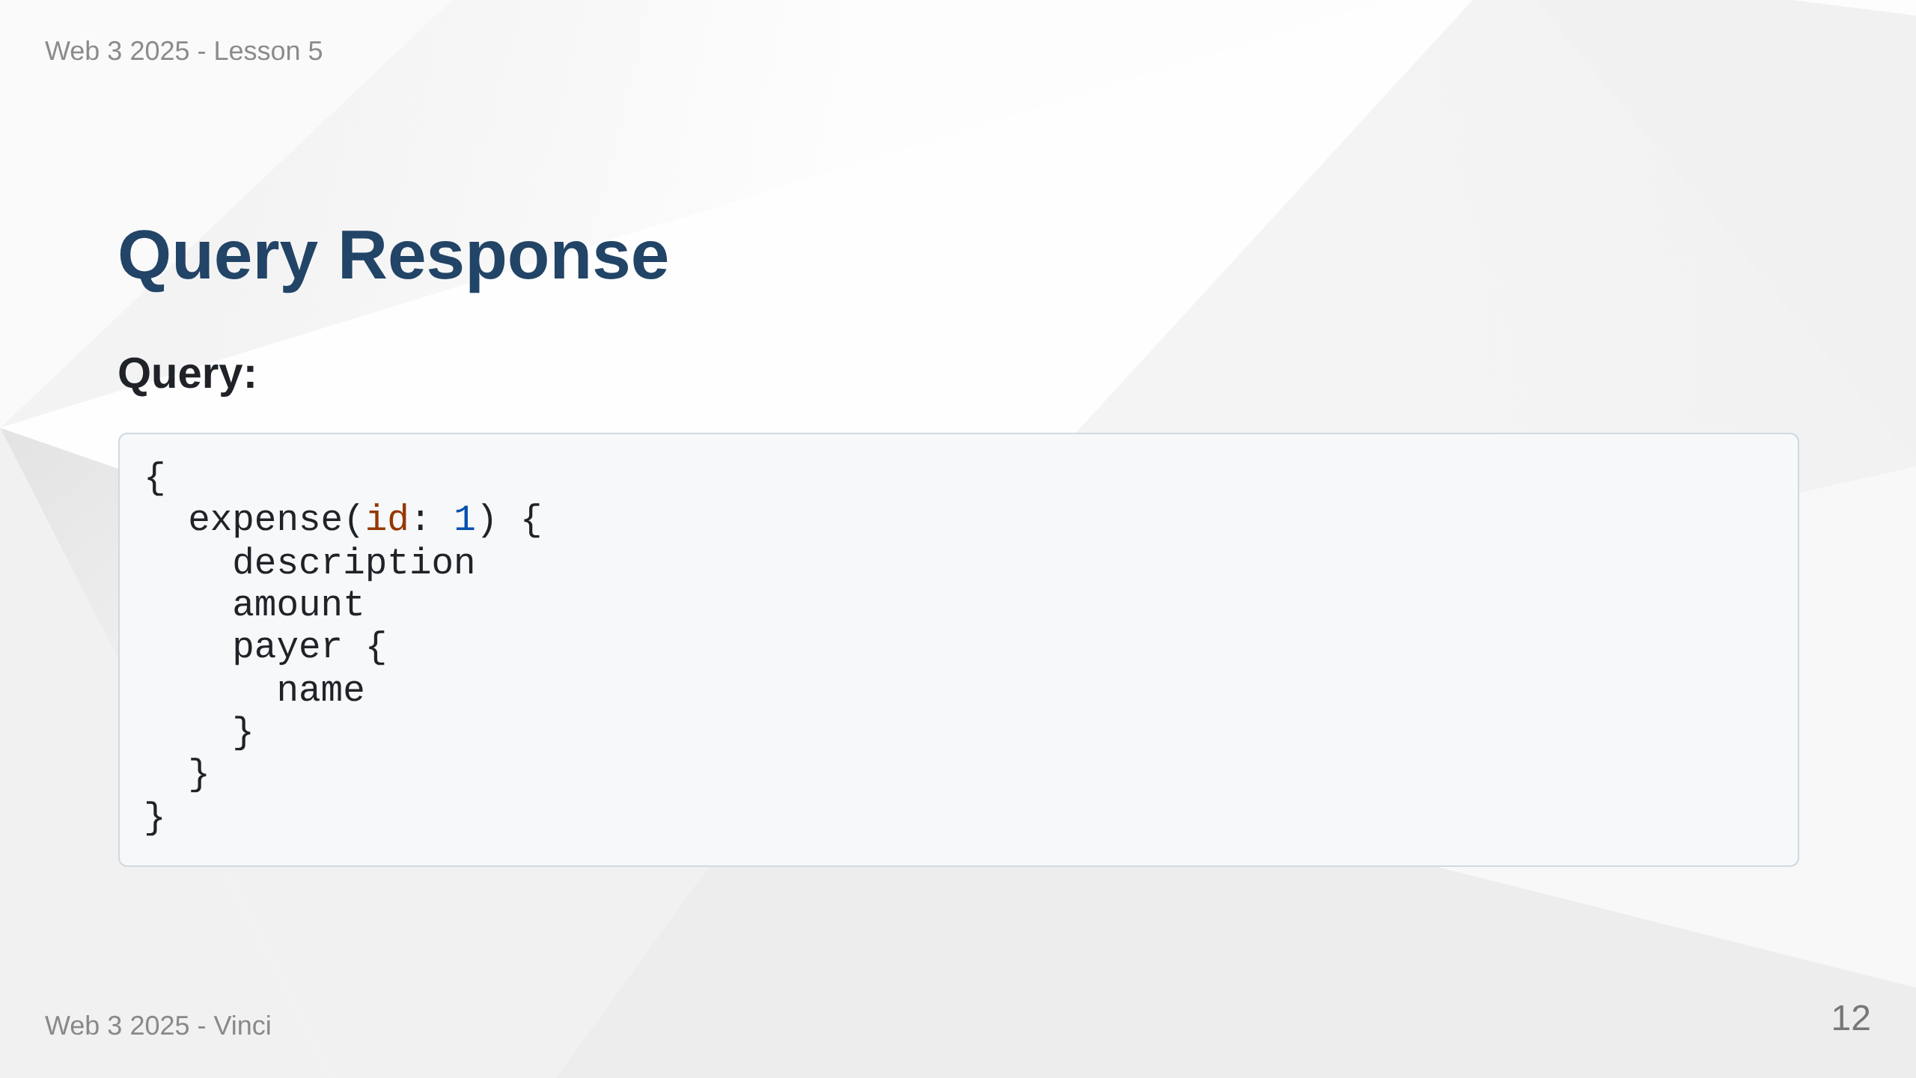

Slide 13
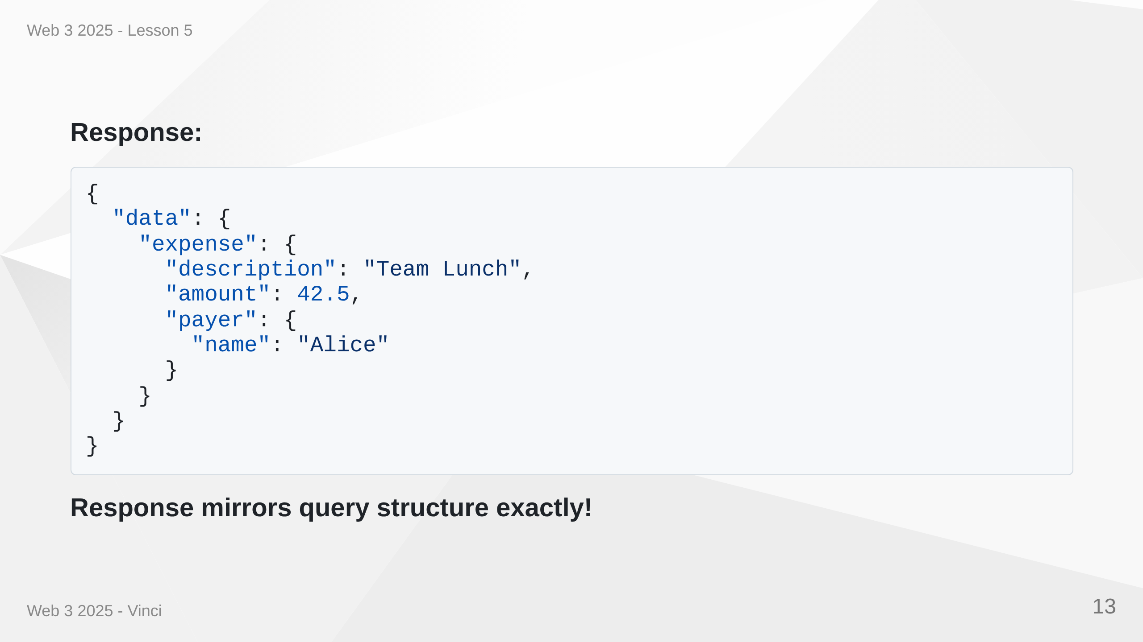
Notes:
Speaker Notes: • Response JSON structure matches query structure • Only requested fields are included • Null if field doesn't exist or is null • Errors separate from data in errors array • Predictable response format

Slide 14
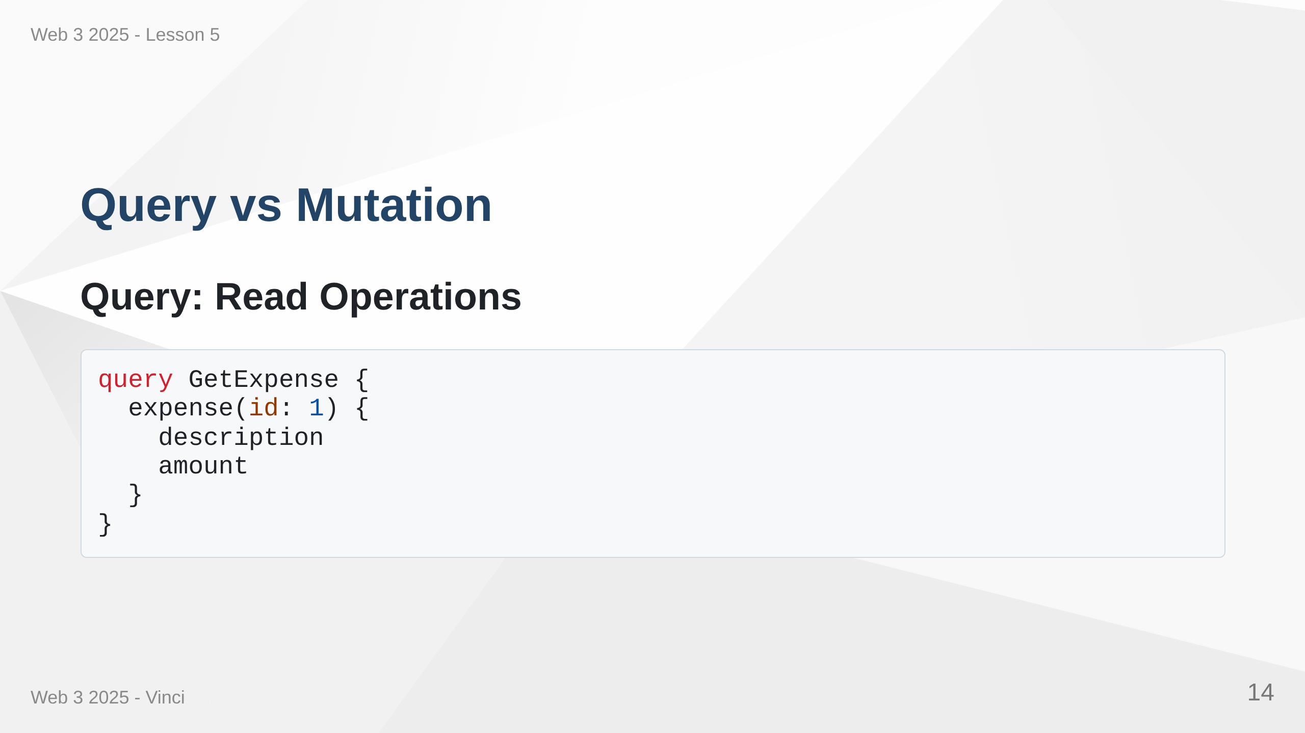

Slide 15
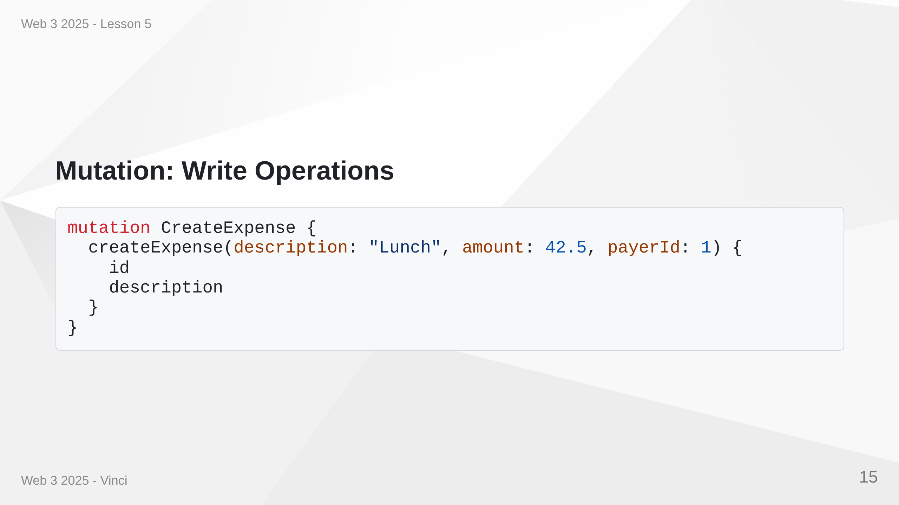
Notes:
Speaker Notes: • Queries are for reading data (like GET in REST) • Mutations are for changing data (like POST, PUT, DELETE) • Semantic distinction helps with caching and optimization • Mutations run sequentially, queries can run in parallel • Both can return data - mutations often return created/updated object

Slide 16
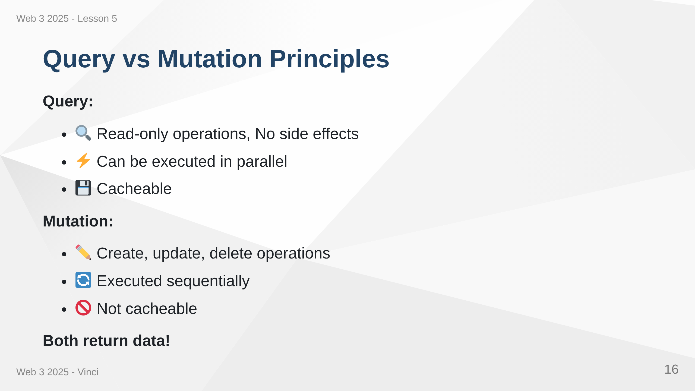
Notes:
Speaker Notes: • Clear semantic distinction • Queries should be side-effect free • Mutations change state • GraphQL guarantees mutations run one after another • Queries can be optimized and cached • Return data helps avoid additional queries

Slide 17
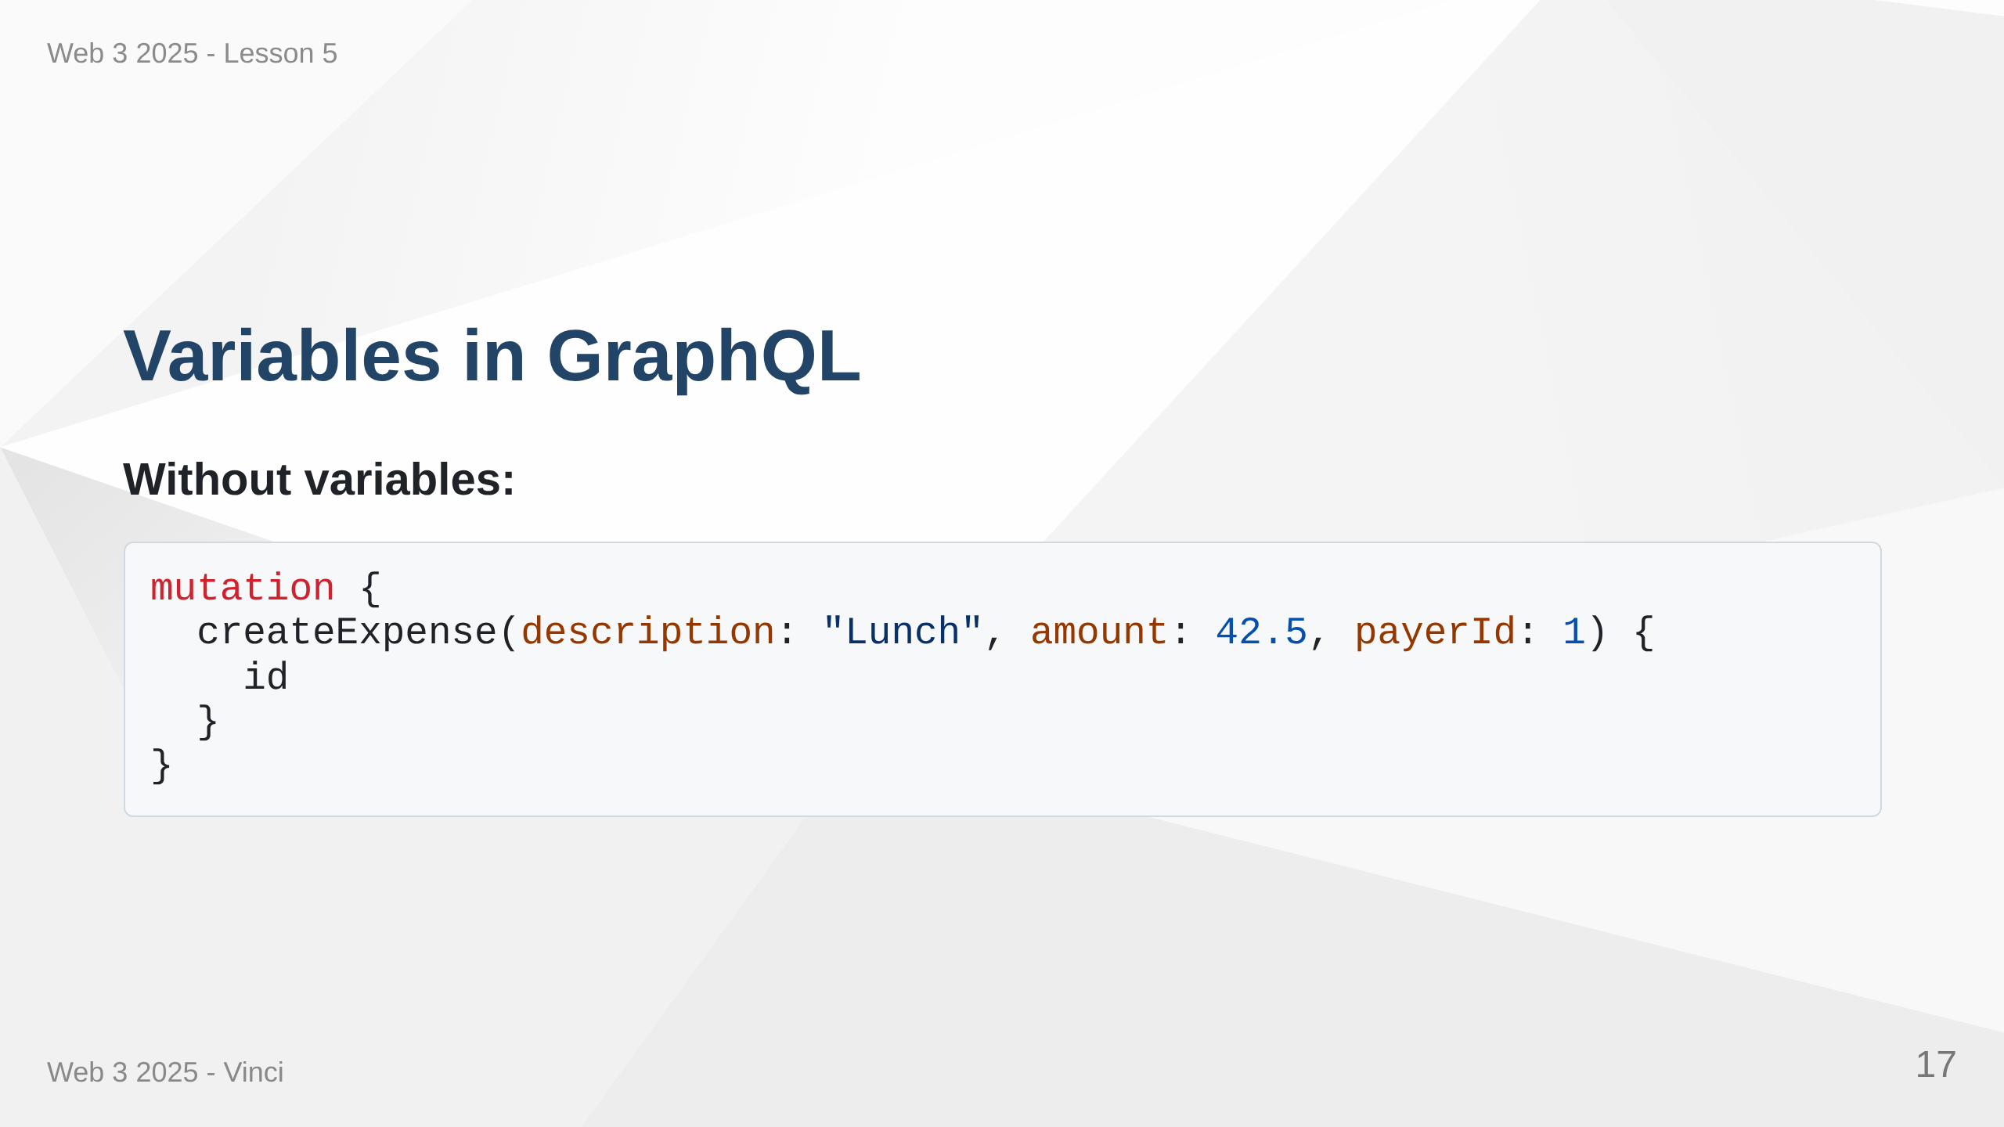

Slide 18
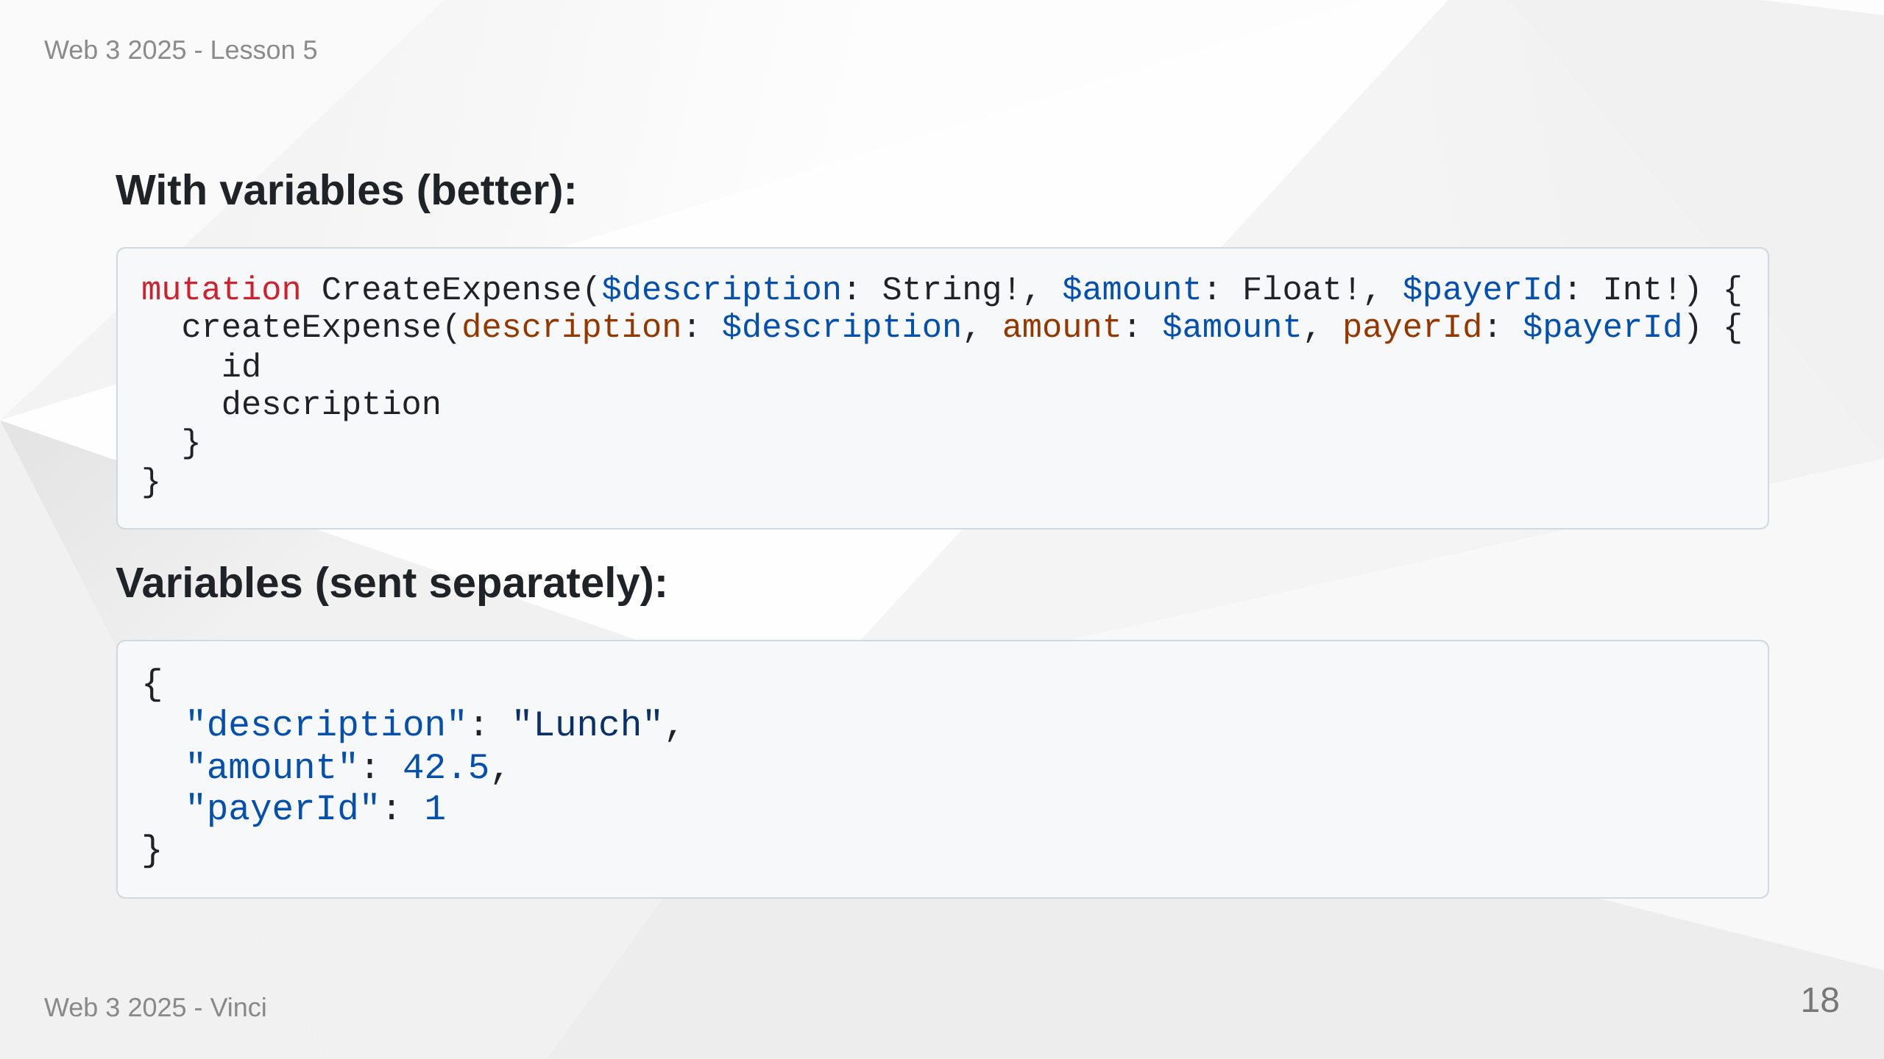
Notes:
Speaker Notes: • Variables separate query structure from values • Reusable queries with different inputs • Better for client-side code • Type-safe with validation • $ prefix denotes variables • ! suffix means required (non-nullable)

Slide 19
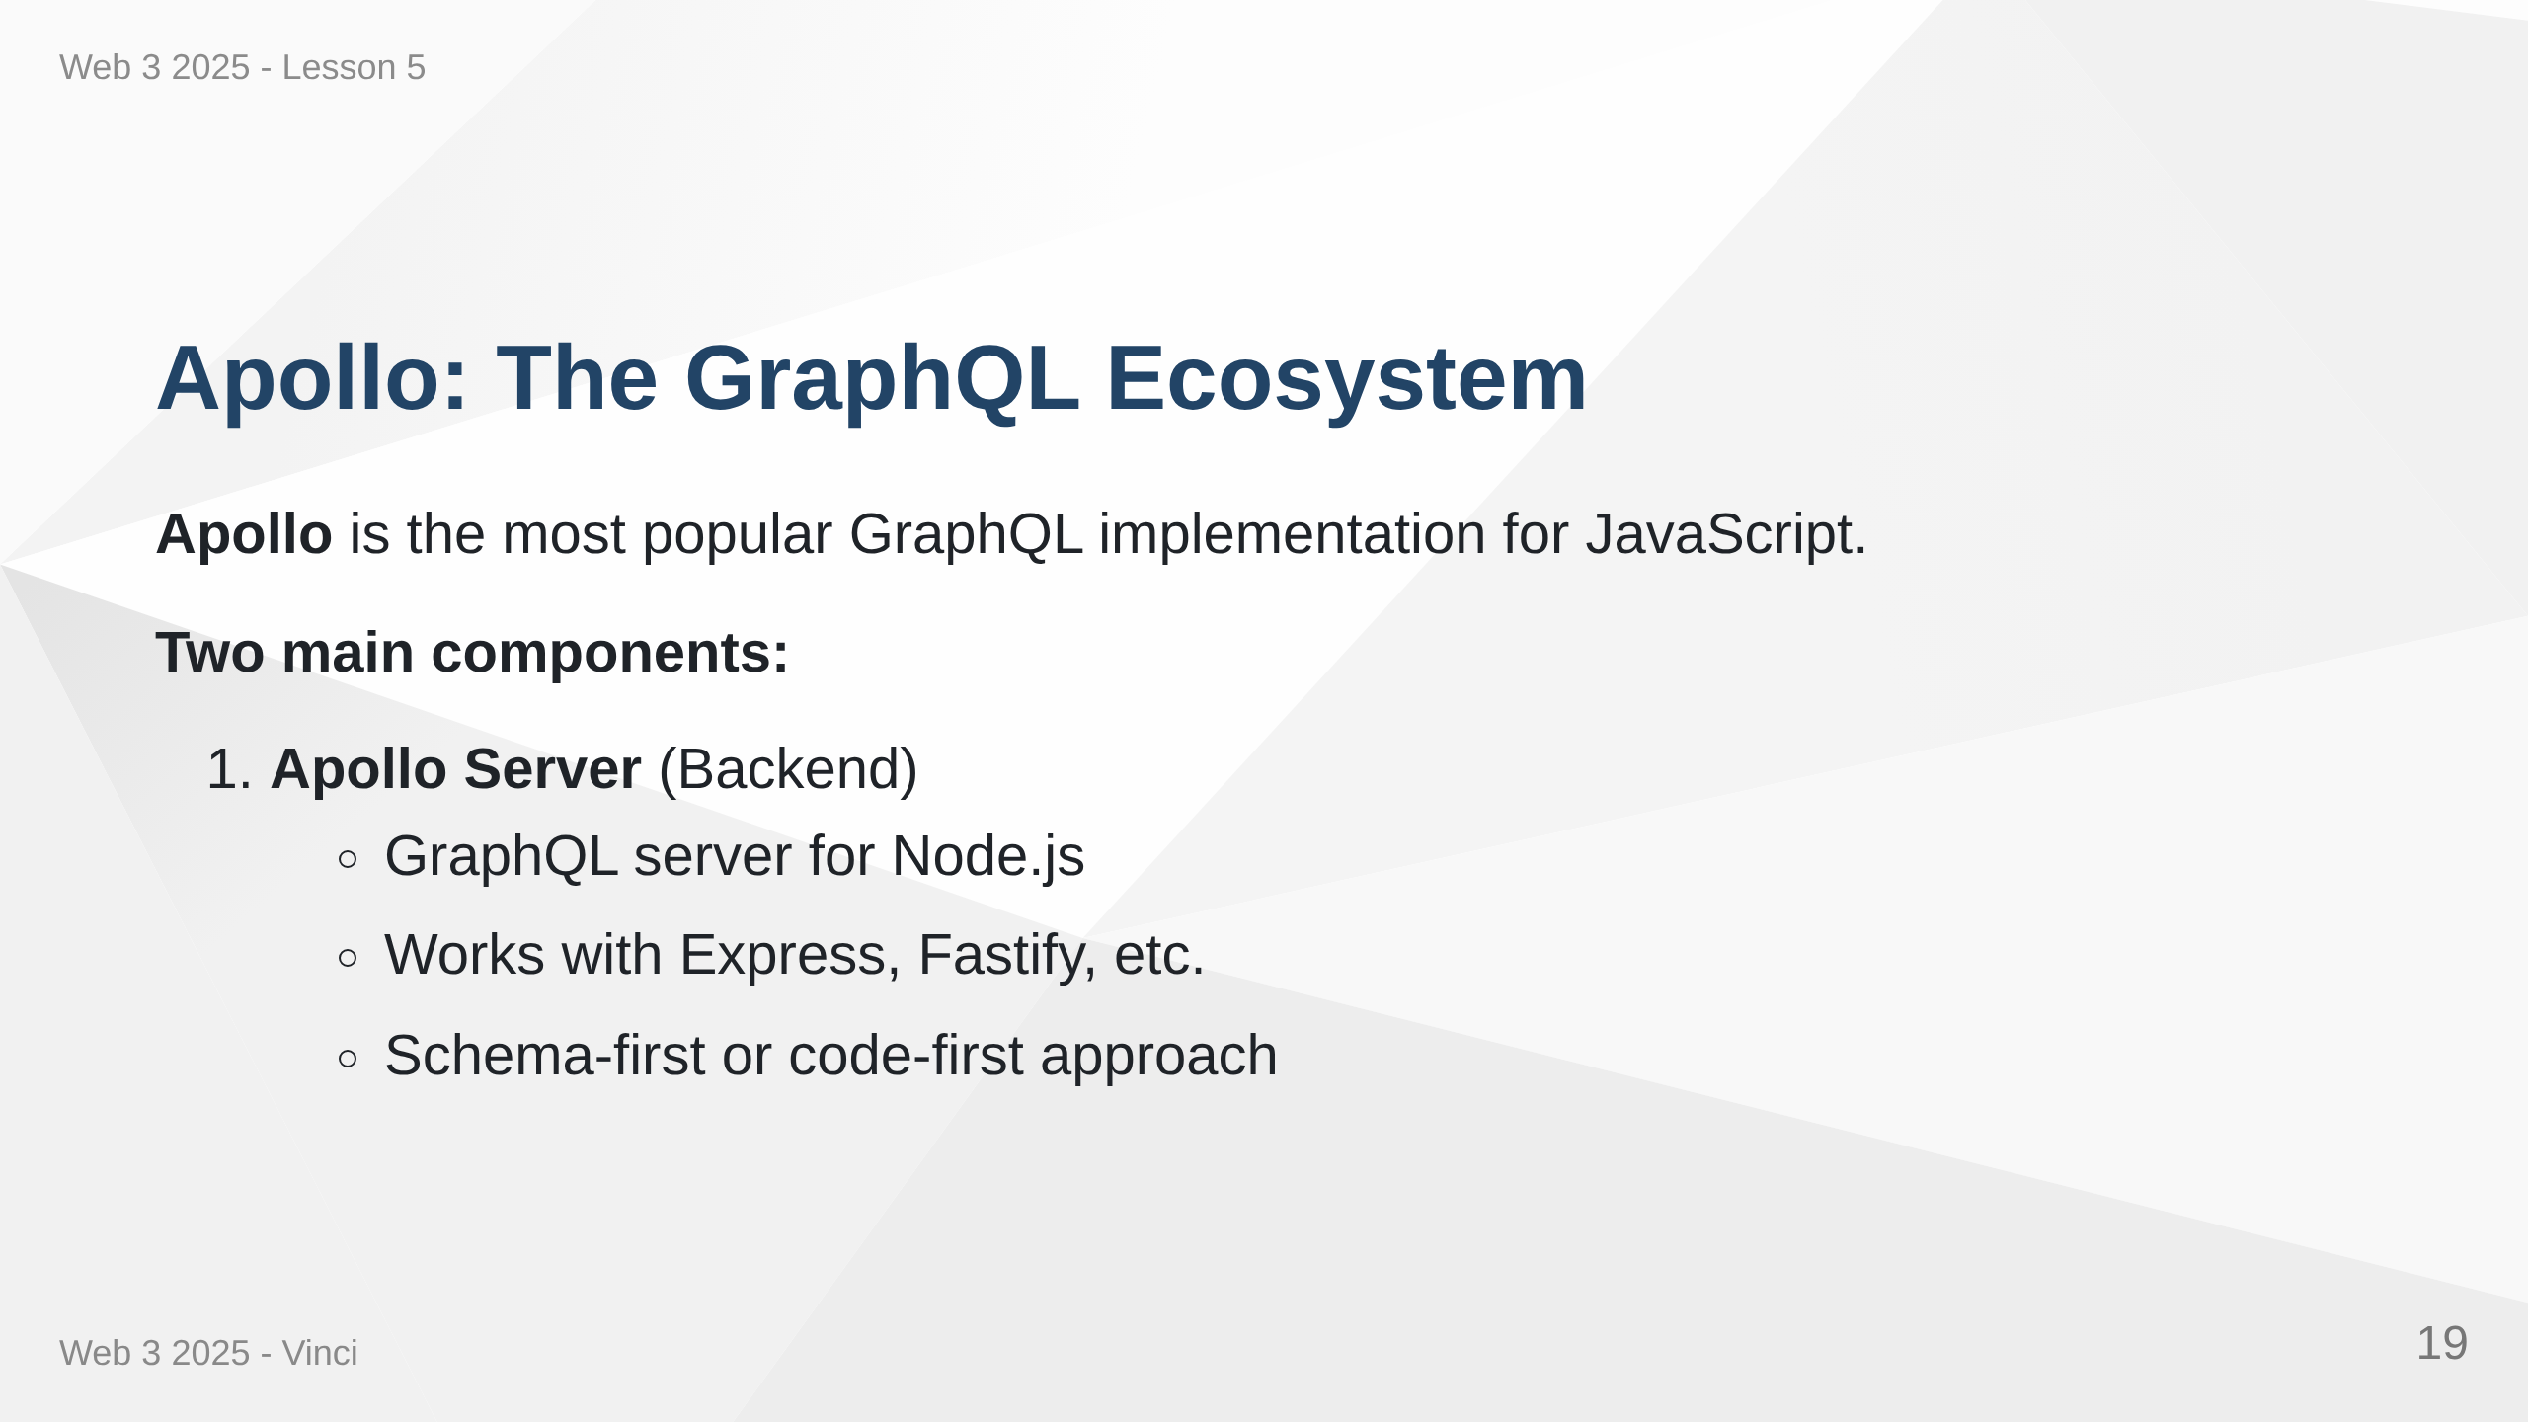

Slide 20
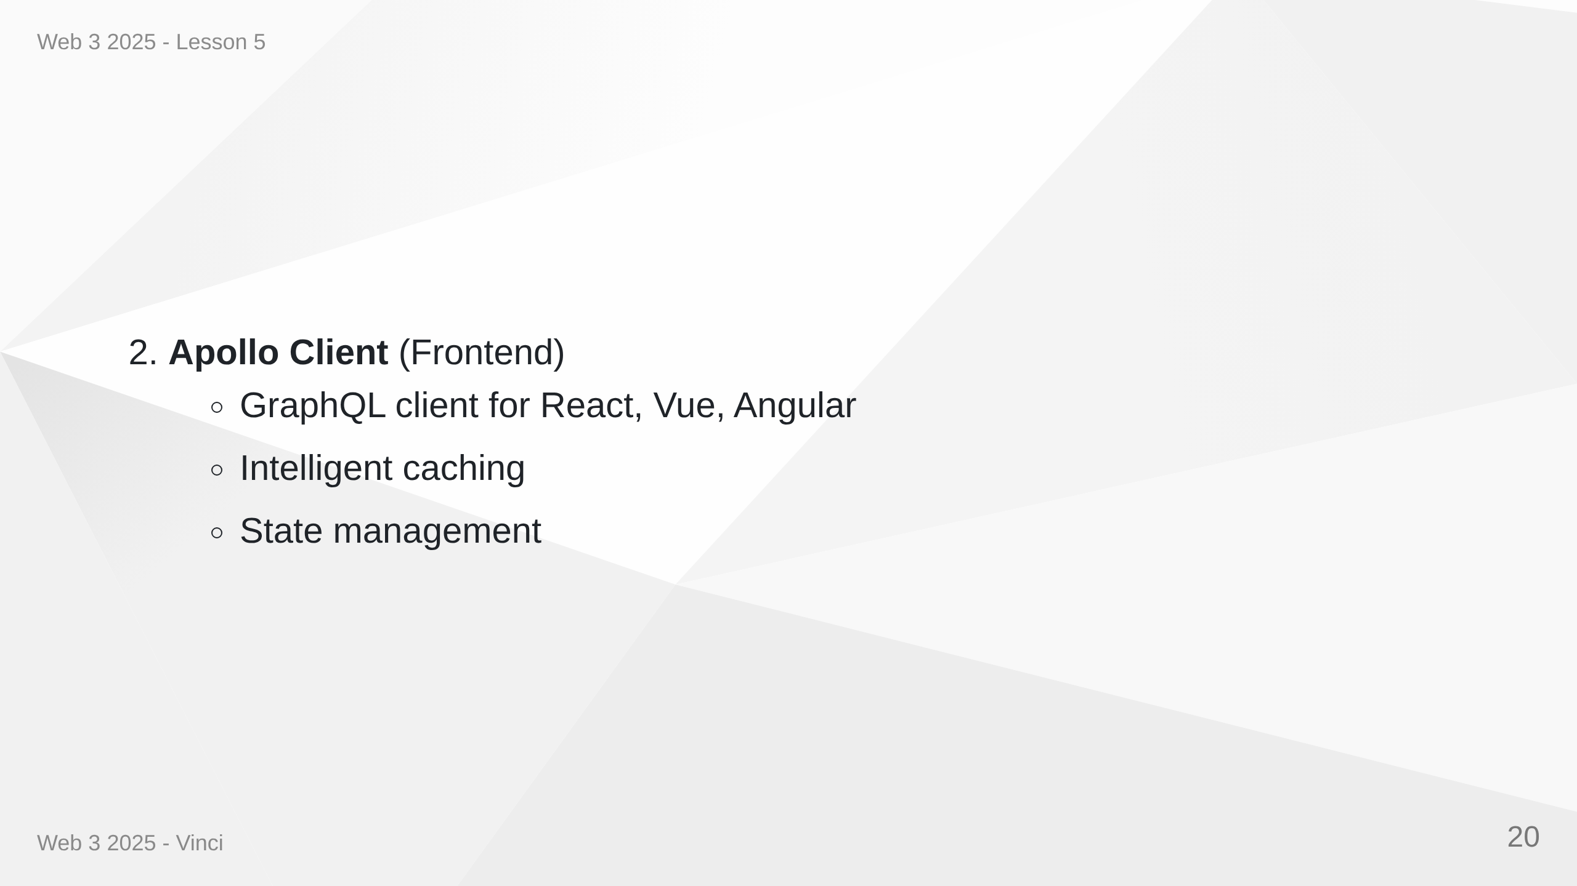
Notes:
Speaker Notes: • Apollo is to GraphQL what Express is to REST • Not the only implementation but most popular • Server and client work together but can be used separately • Production-ready with great documentation • Active community and ecosystem

Slide 21
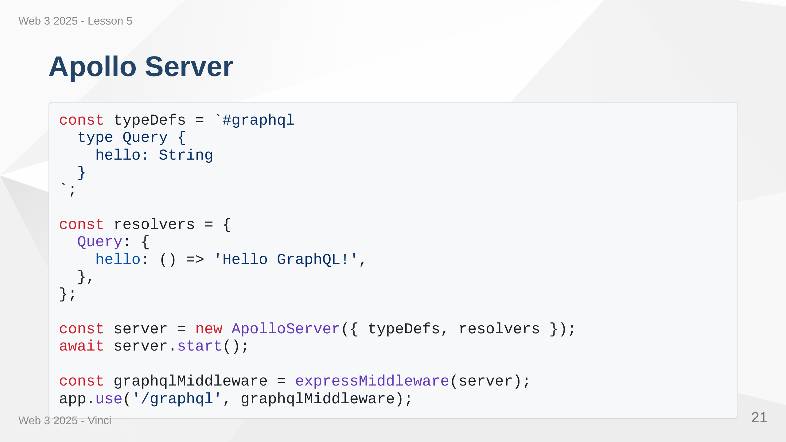
Notes:
Speaker Notes: • Apollo Server integrates with Express as middleware • typeDefs define the schema (what's possible) • resolvers implement the logic (how to fetch data) • Single /graphql endpoint handles all queries • Works alongside existing REST routes

Slide 22
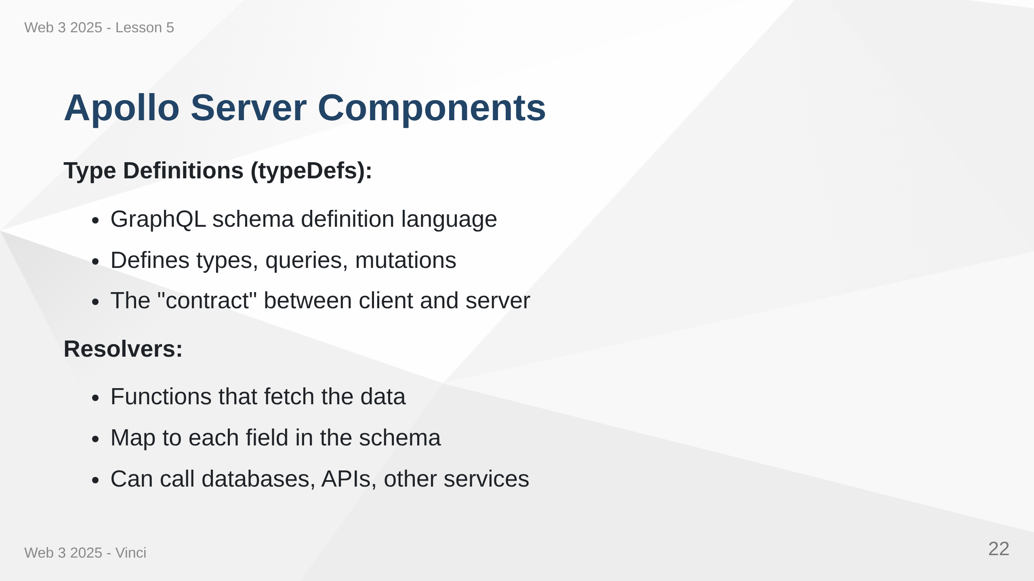

Slide 23
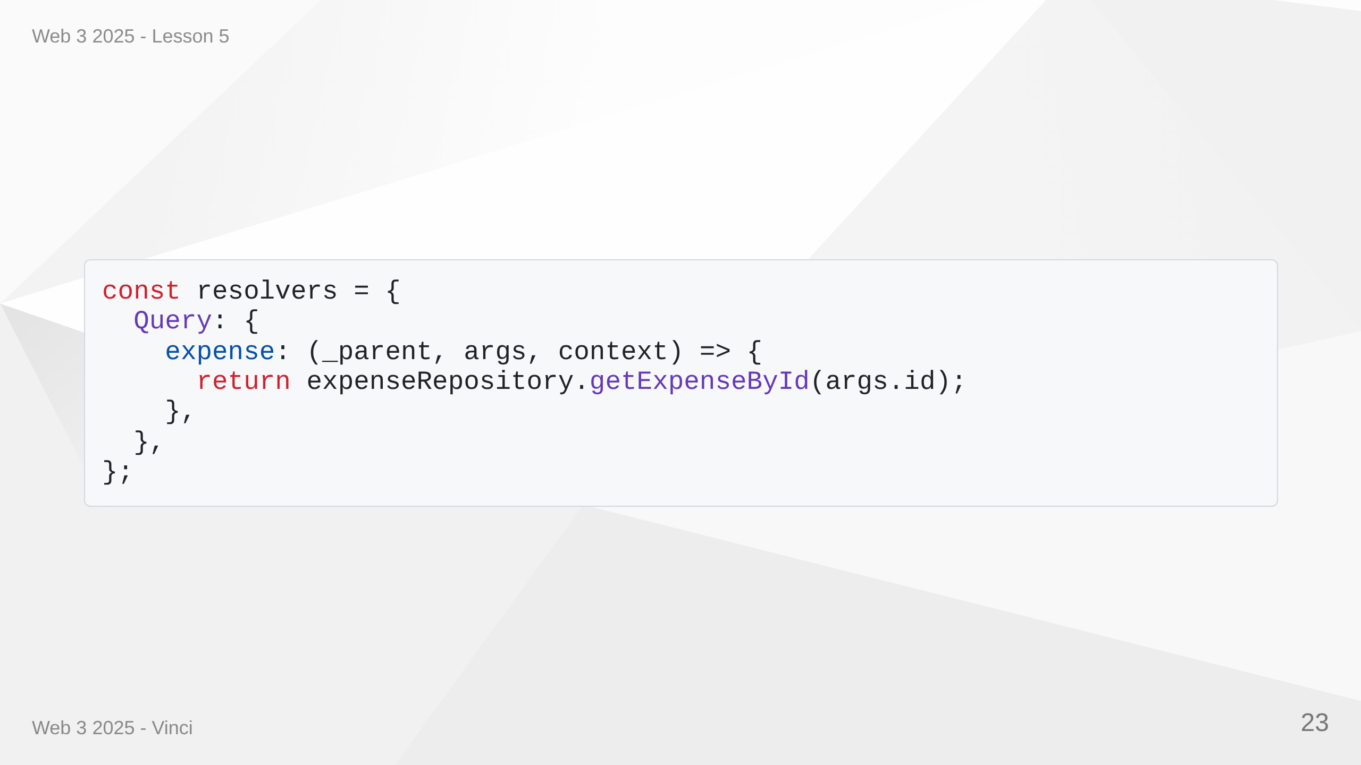
Notes:
Speaker Notes: • Schema defines what's possible • Resolvers define how to get the data • Each field can have its own resolver • Resolvers receive parent, args, context, info • Can call existing code - no need to rewrite everything

Slide 24
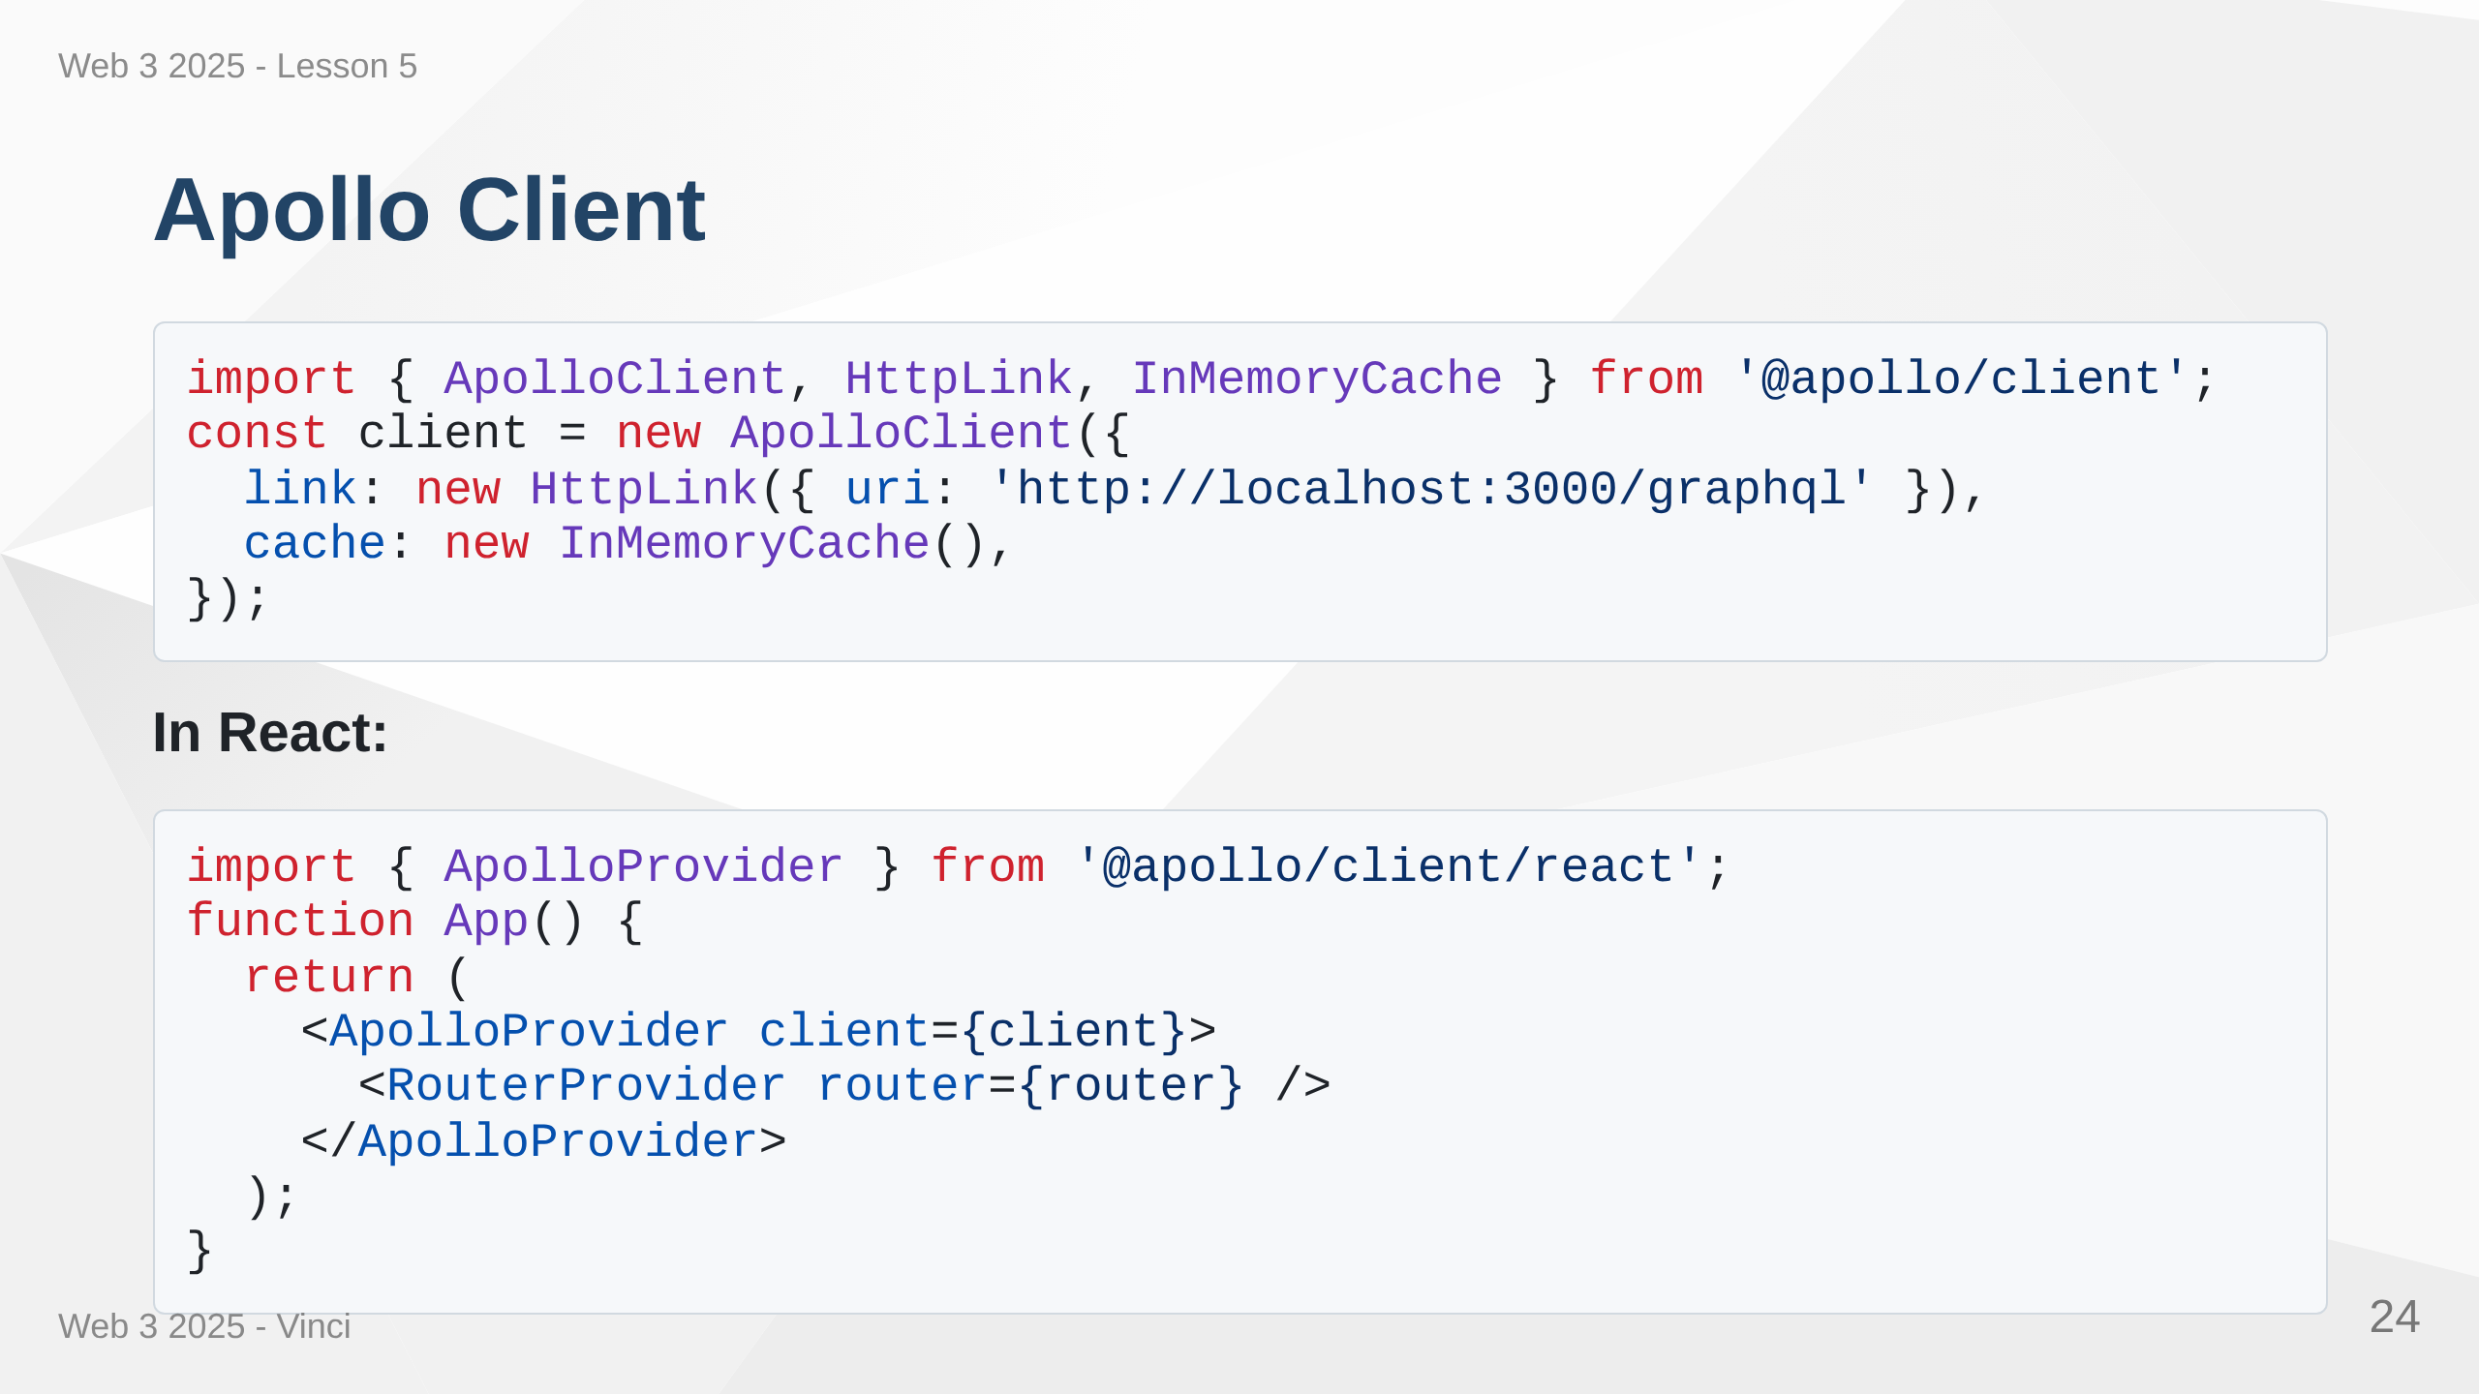
Notes:
Speaker Notes: • Apollo Client handles GraphQL requests • Intelligent caching reduces requests • Works with React hooks • Similar to React Query but GraphQL-specific • Provider makes client available to all components

Slide 25
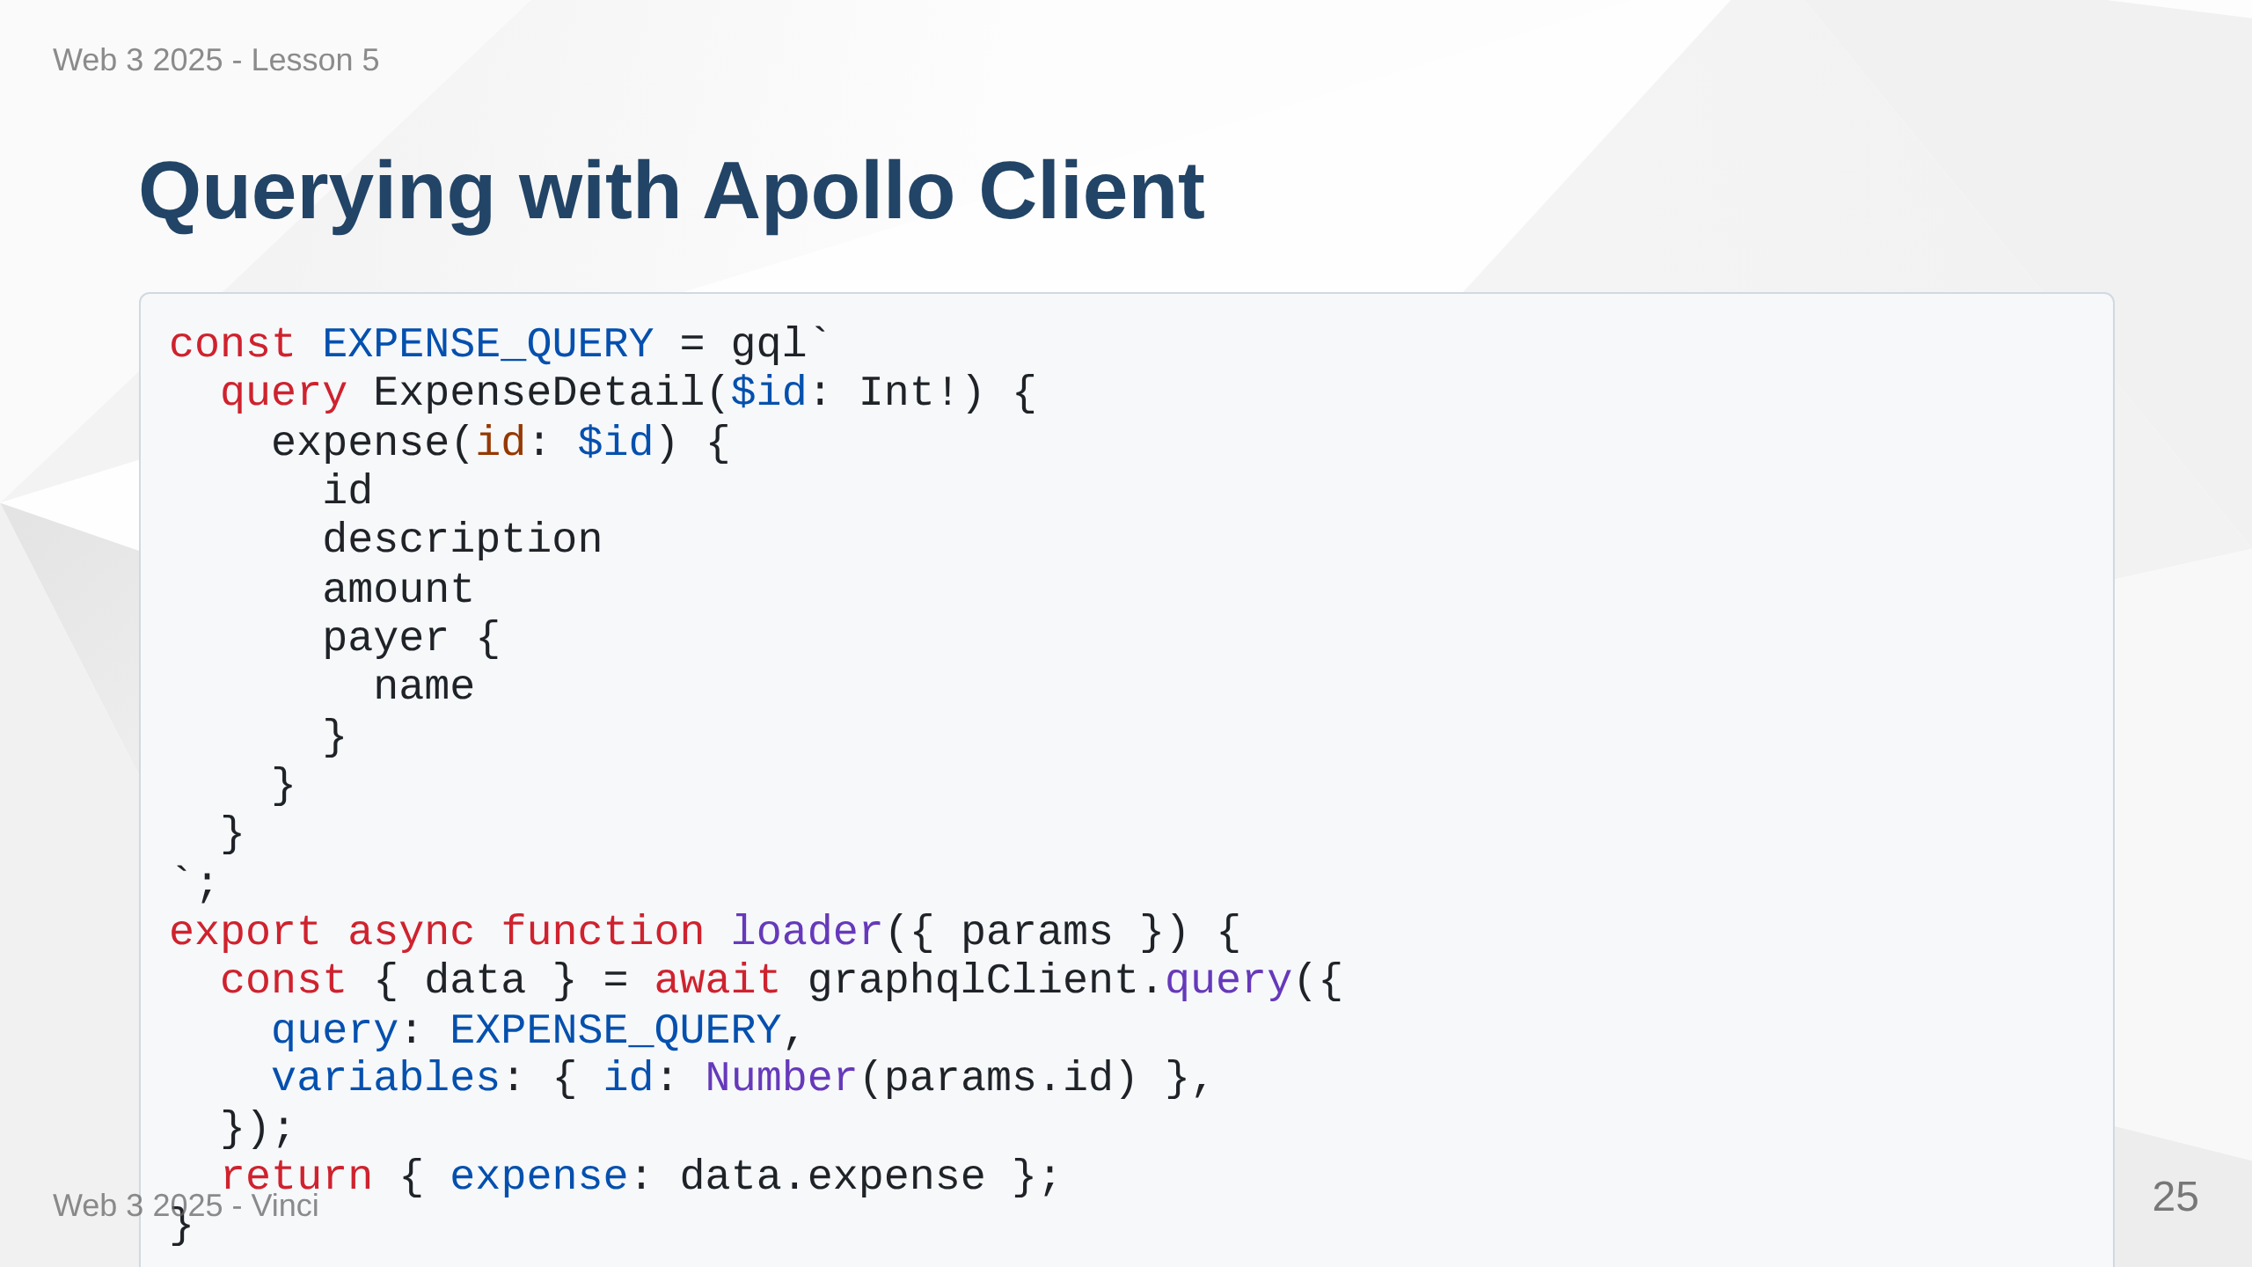
Notes:
Speaker Notes: • gql tag parses GraphQL strings at build time • Type-safe with TypeScript • Integrates with React Router loaders • Cache automatically manages results • Same data from cache if queried again

Slide 26
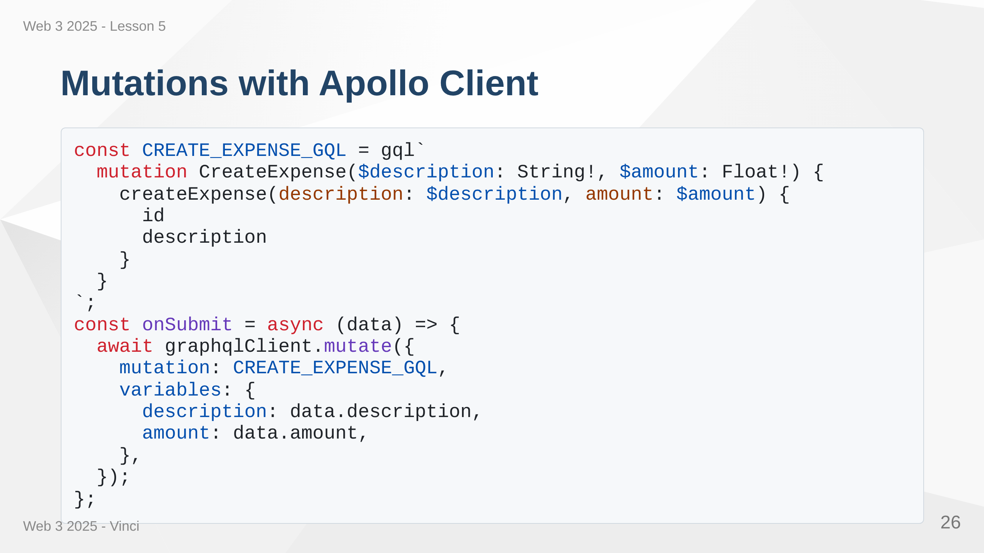
Notes:
Speaker Notes: • Mutations similar to queries but use mutate method • Returns created/updated object • Can specify what fields to return • Cache automatically updates with results • Consistent pattern across app

Slide 27
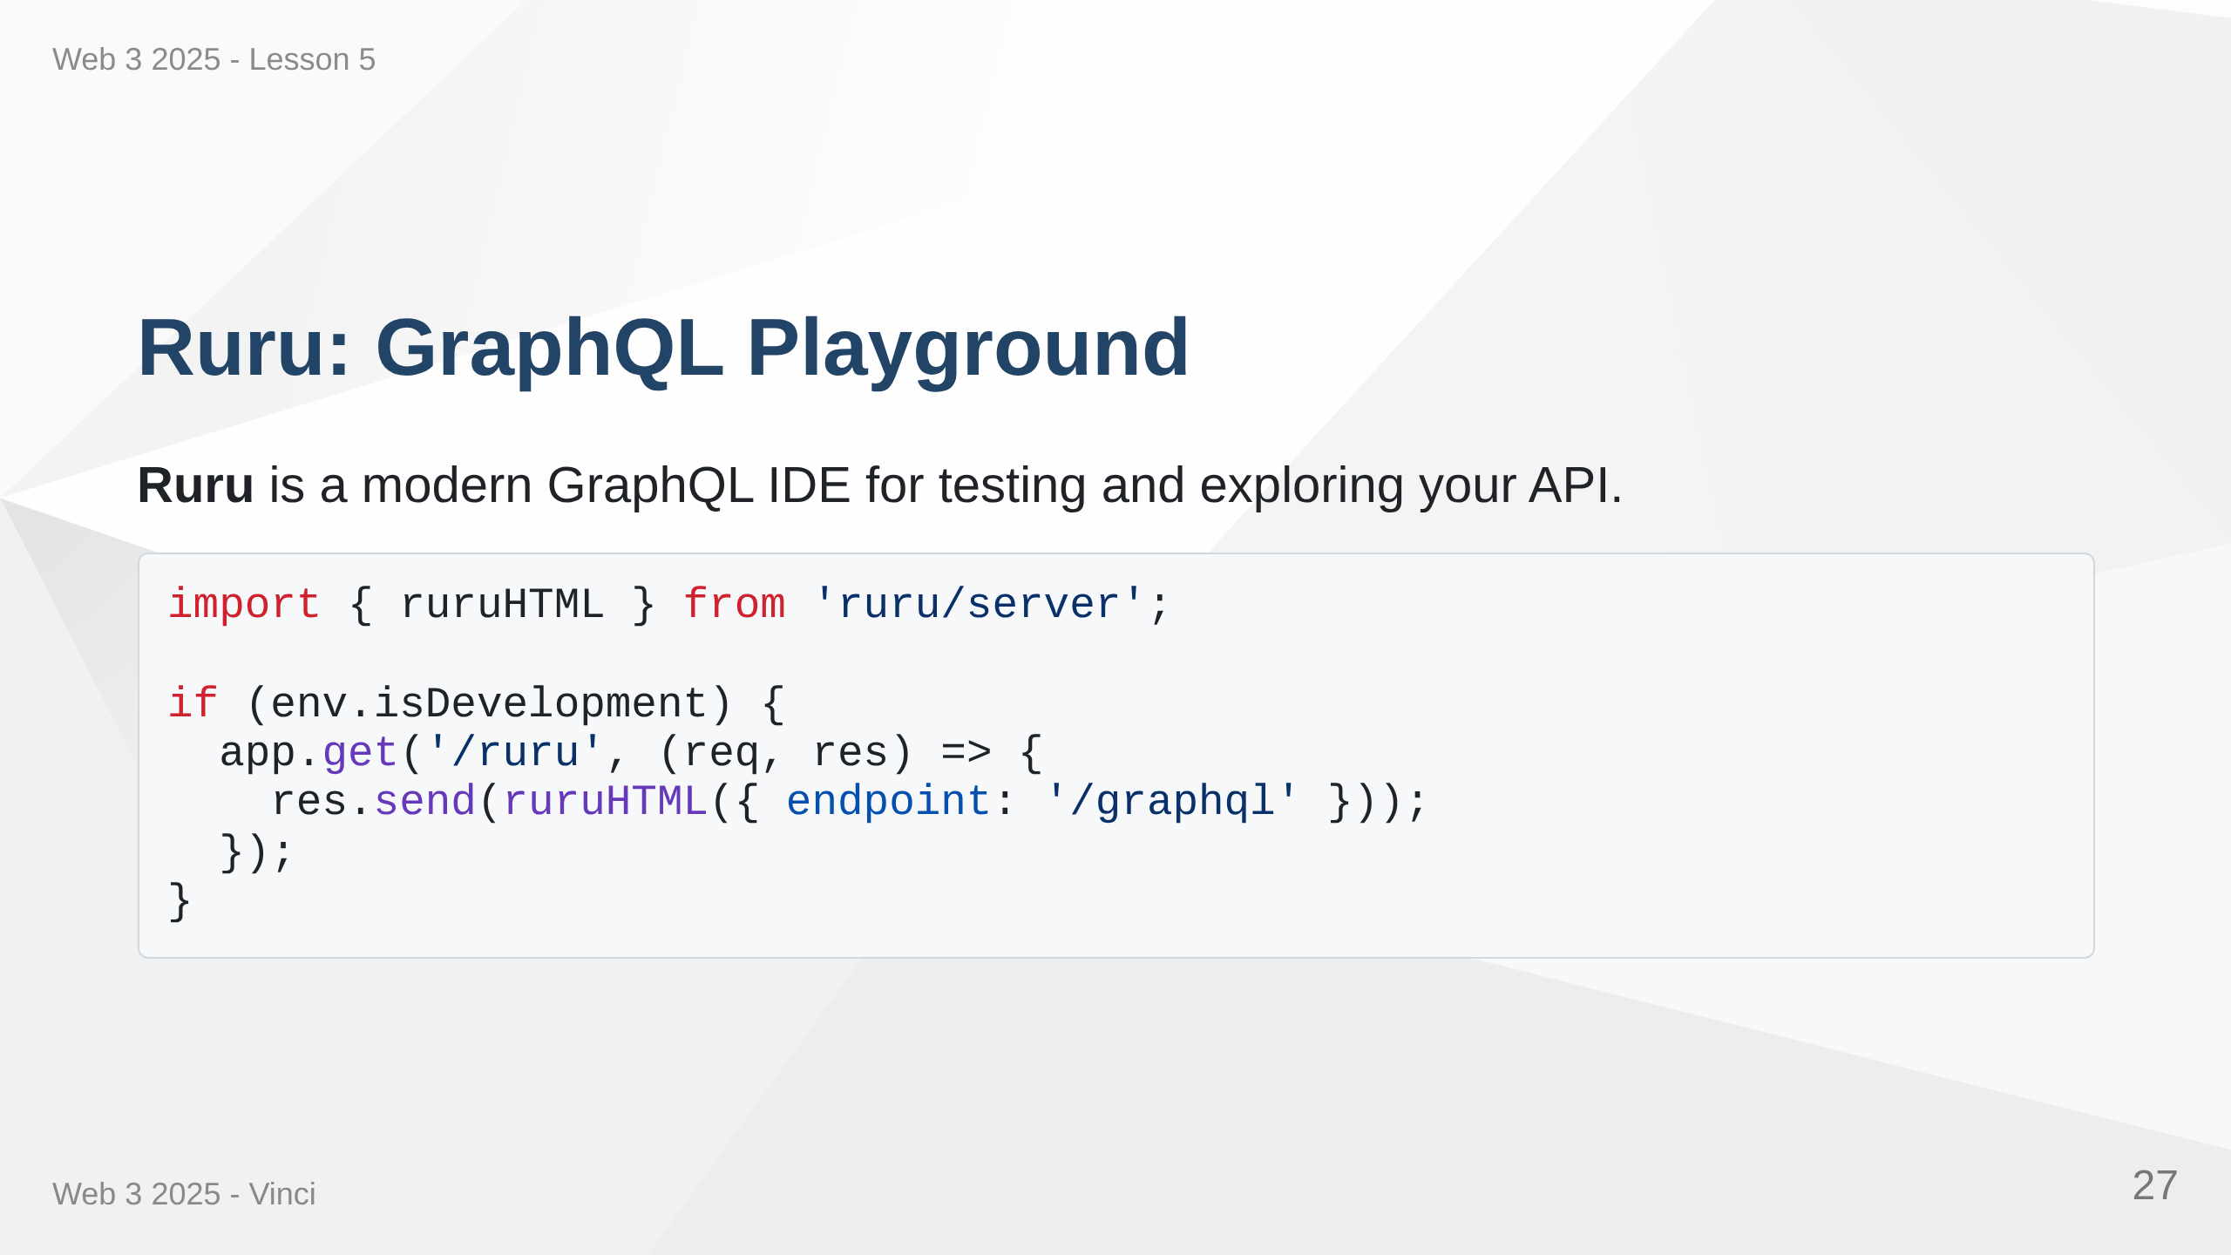

Slide 28
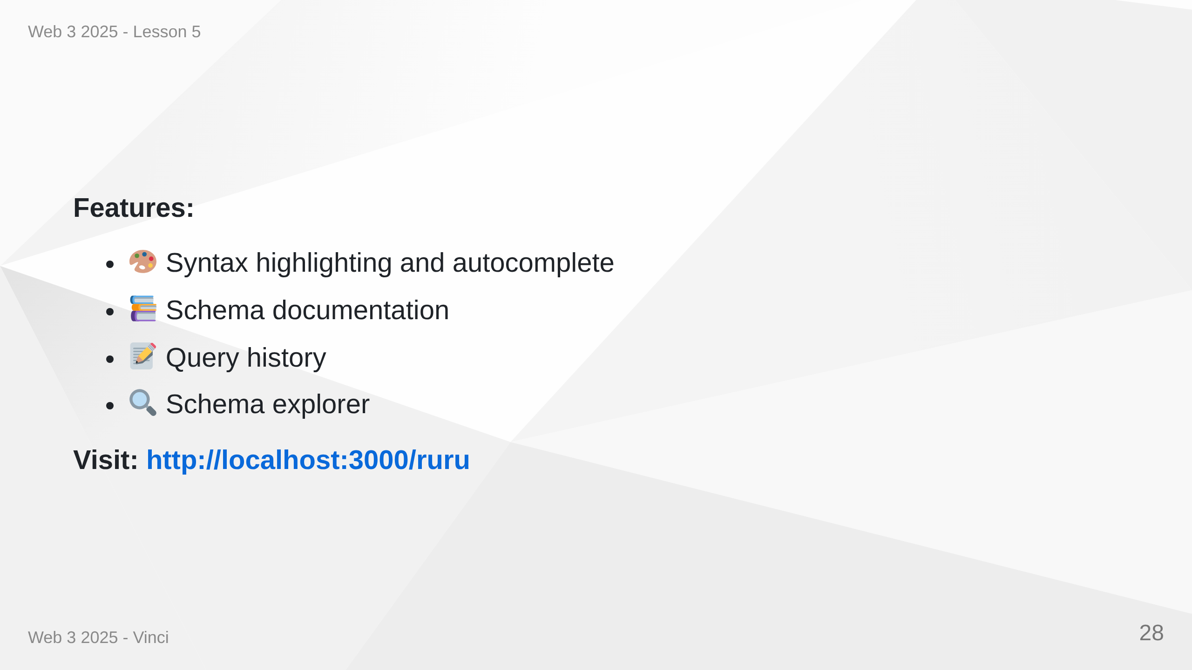
Notes:
Speaker Notes: • Essential development tool • Interactive query editor with autocomplete • Explore schema and types • Test queries before implementing in code • Like Postman but for GraphQL • Only enable in development!

Slide 29
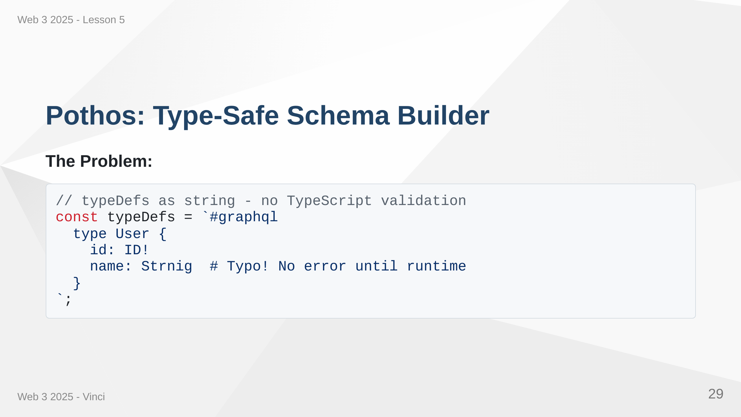

Slide 30
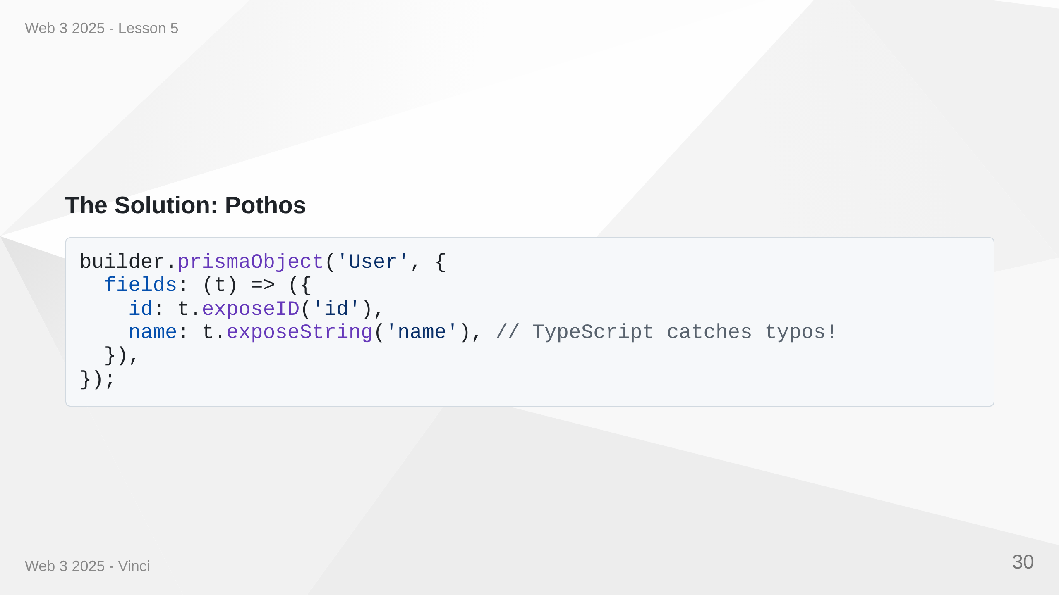
Notes:
Speaker Notes: • Raw GraphQL schema is strings - no type safety • Pothos builds schema with TypeScript • Catch errors at compile time, not runtime • Better IDE support with autocomplete • Integrates with Prisma for automatic types

Slide 31
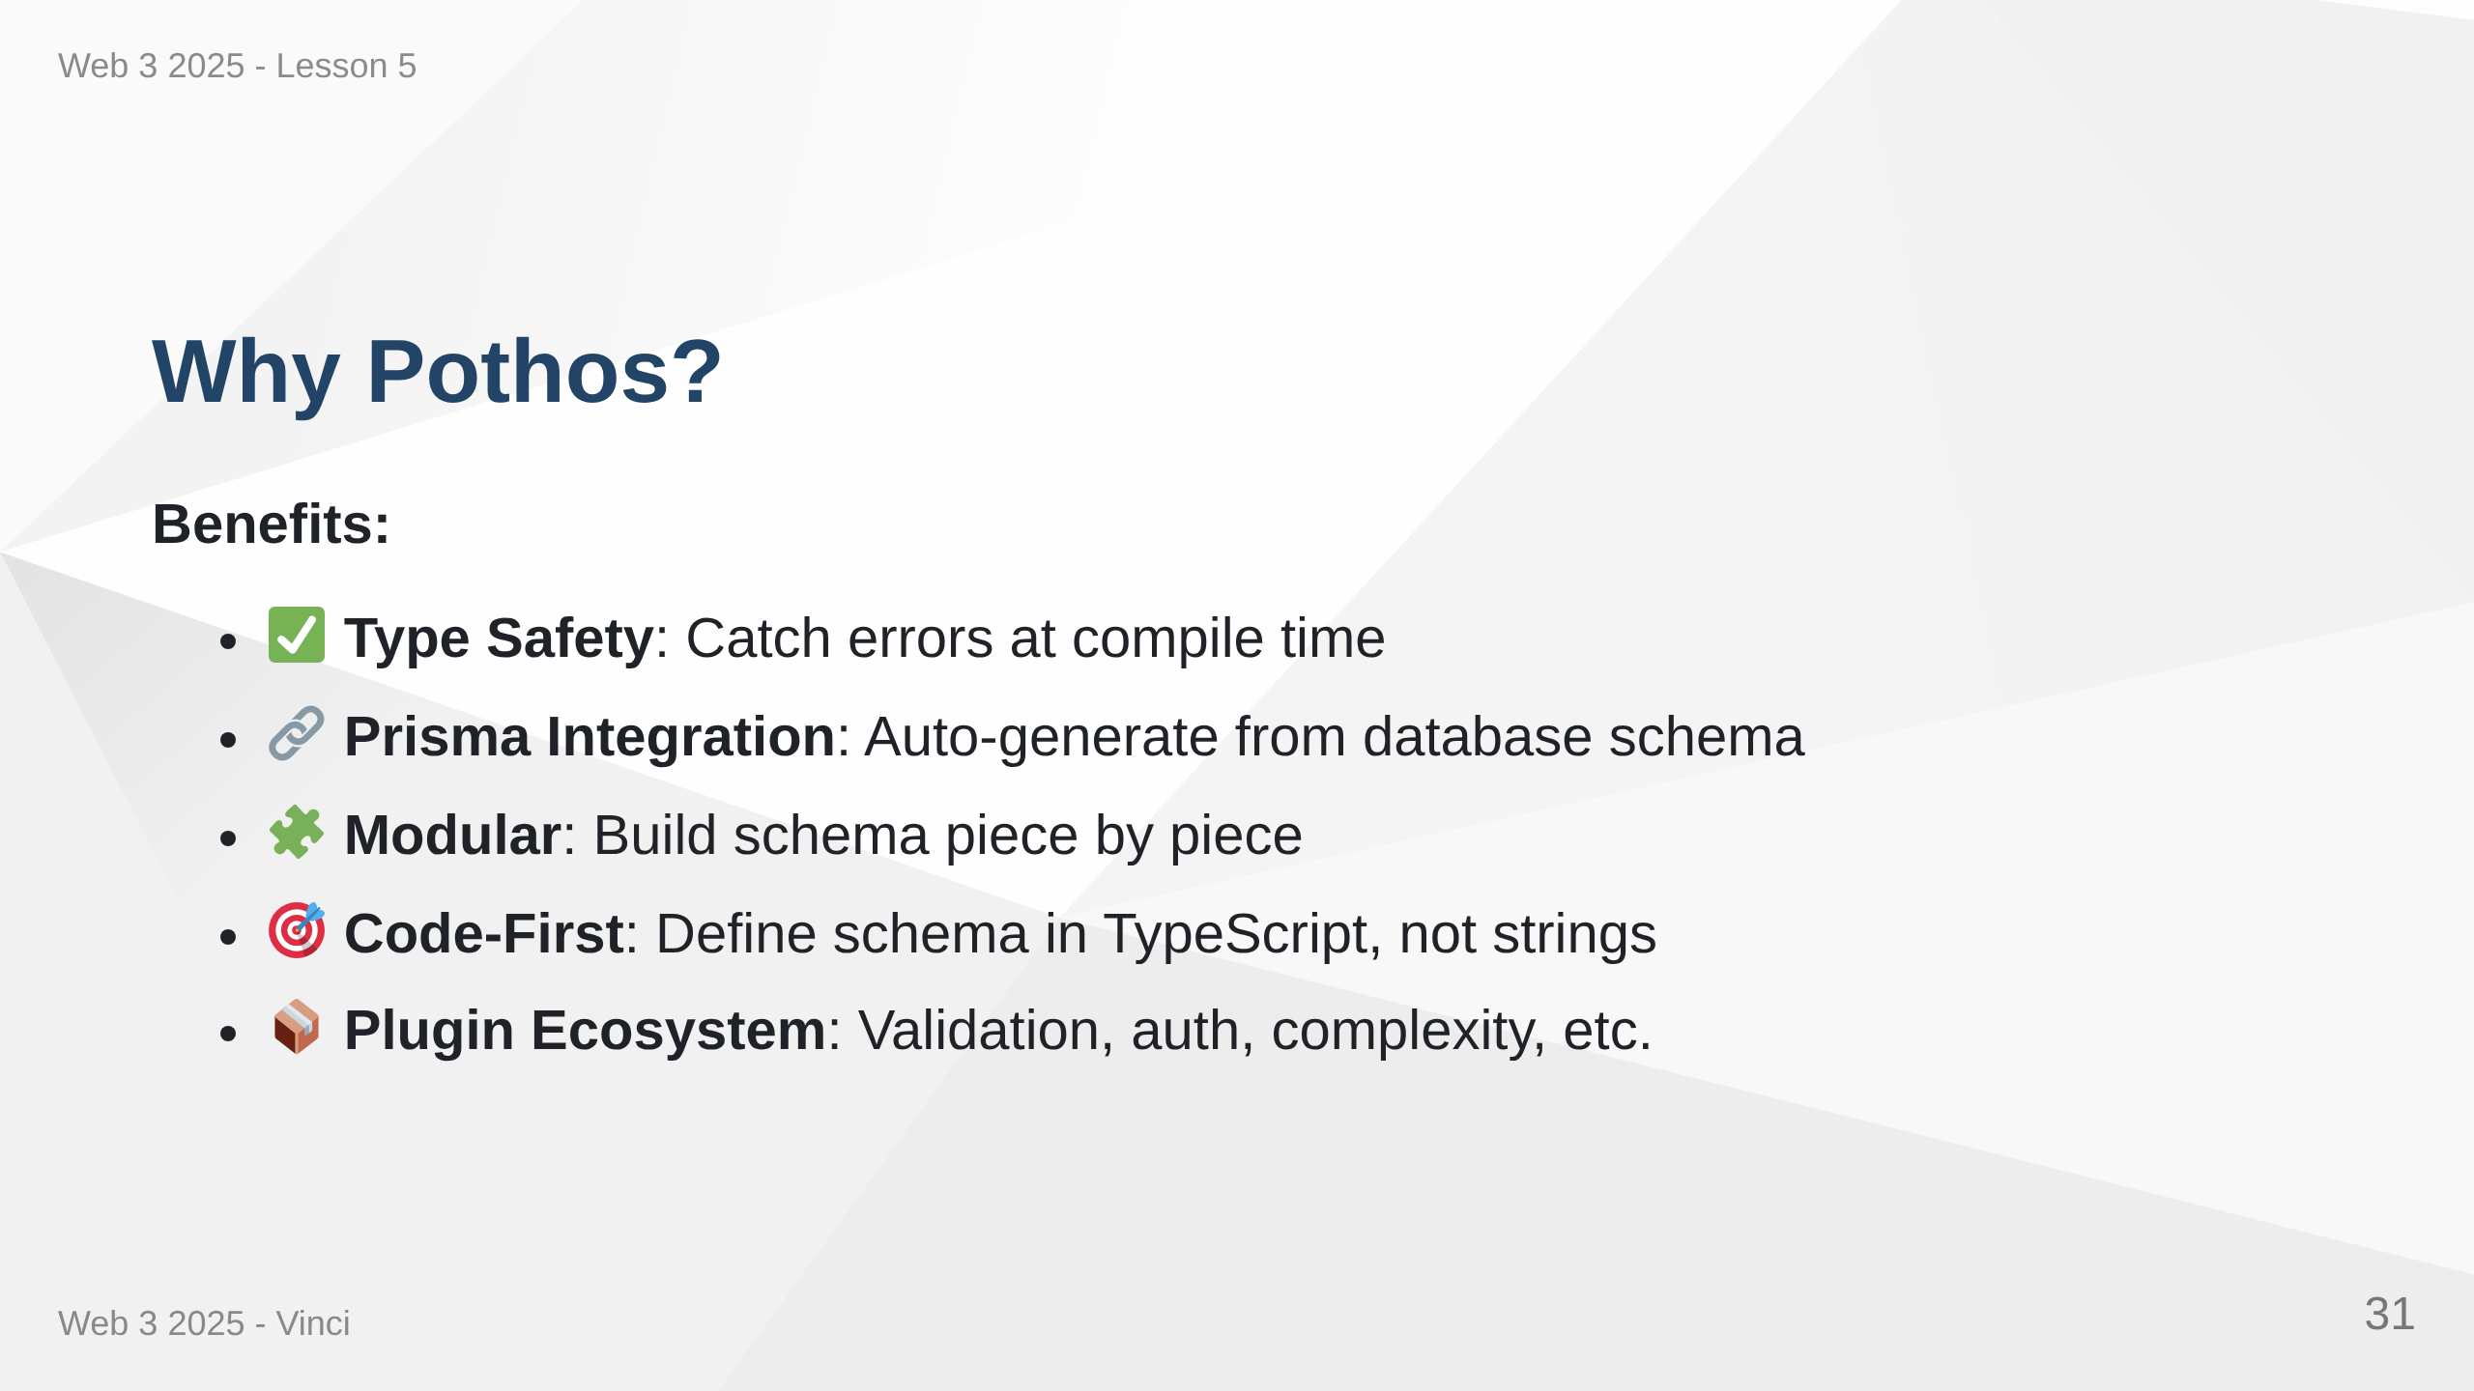

Slide 32
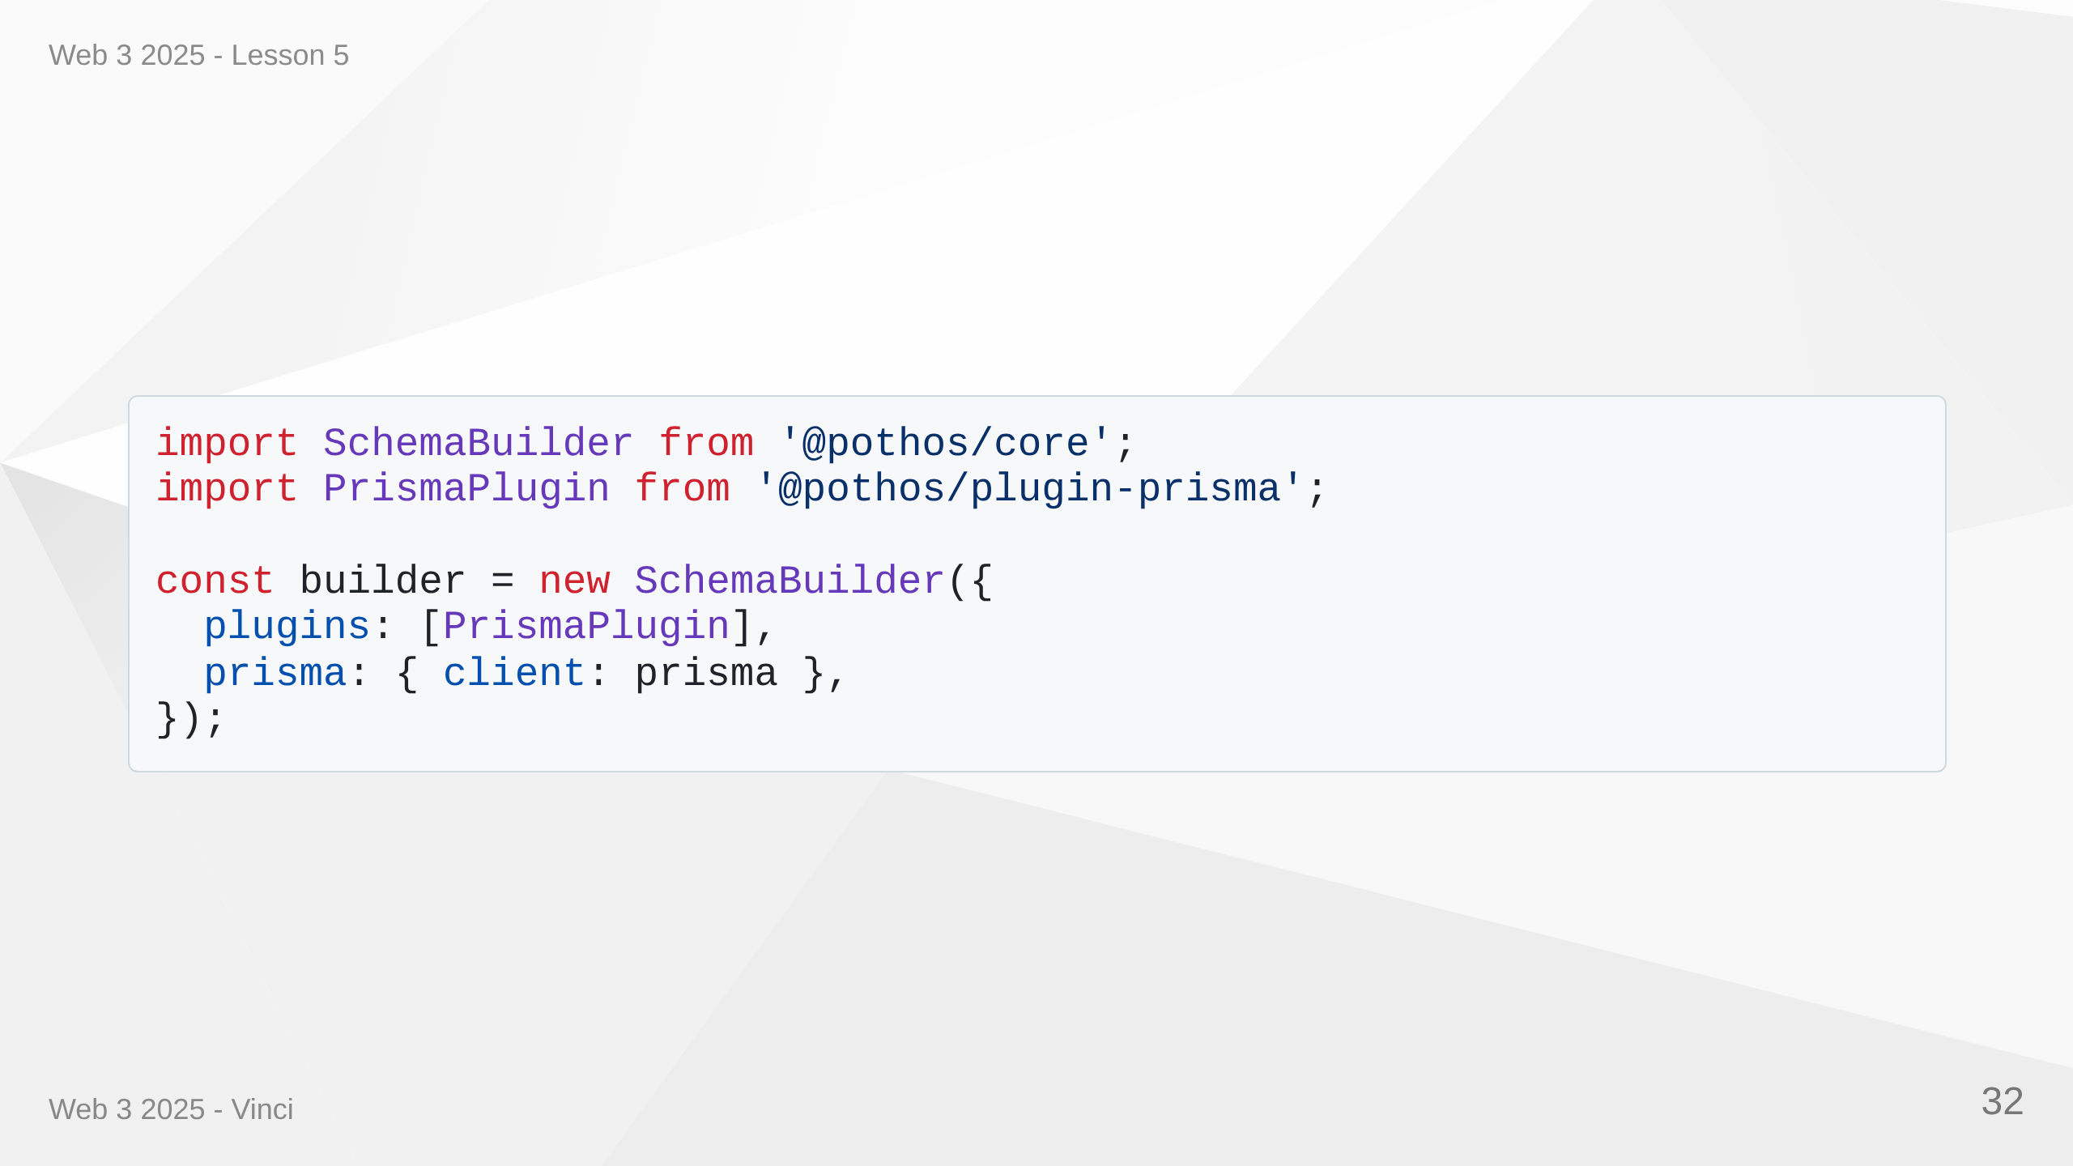
Notes:
Speaker Notes: • Pothos is code-first vs schema-first approach • Better developer experience with TypeScript • Catches errors early in development • Plugins add powerful features • Prisma plugin generates types from database

Slide 33
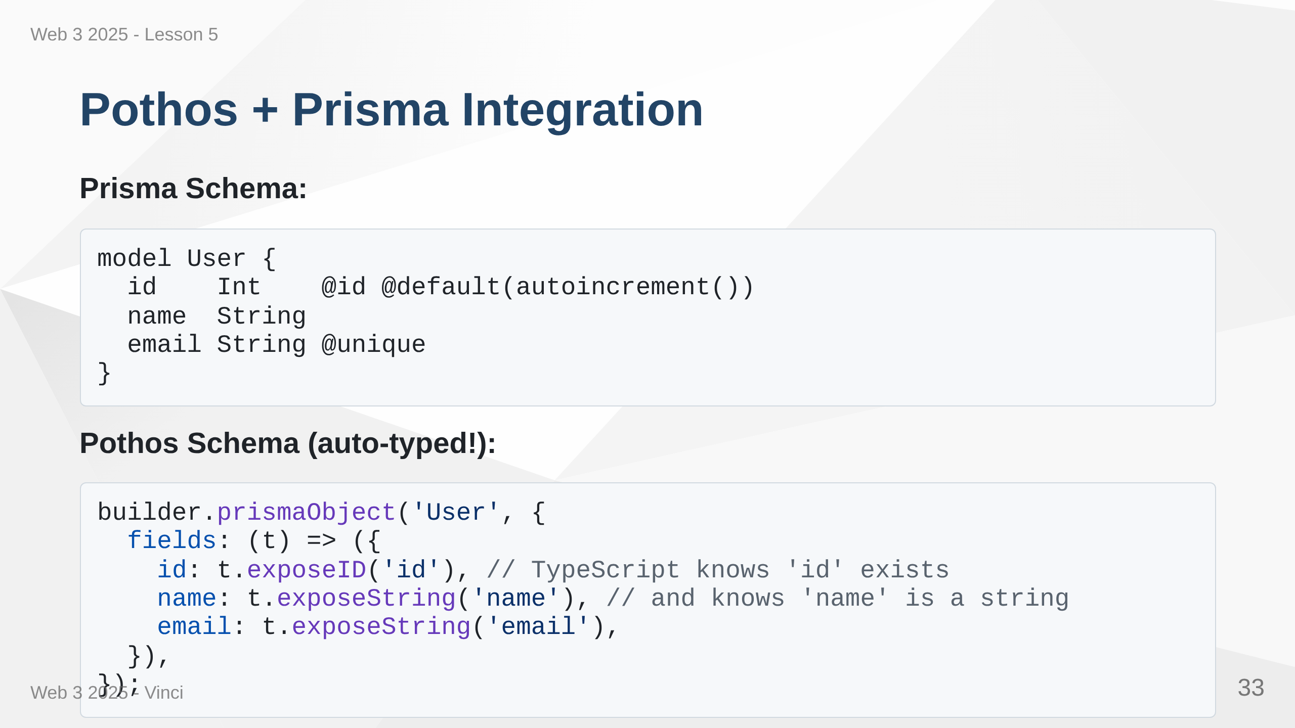
Notes:
Speaker Notes: • Prisma generates TypeScript types from database • Pothos uses those types for GraphQL schema • End-to-end type safety: Database → API → Frontend • Change database schema, TypeScript catches GraphQL issues • No manual type duplication

Slide 34
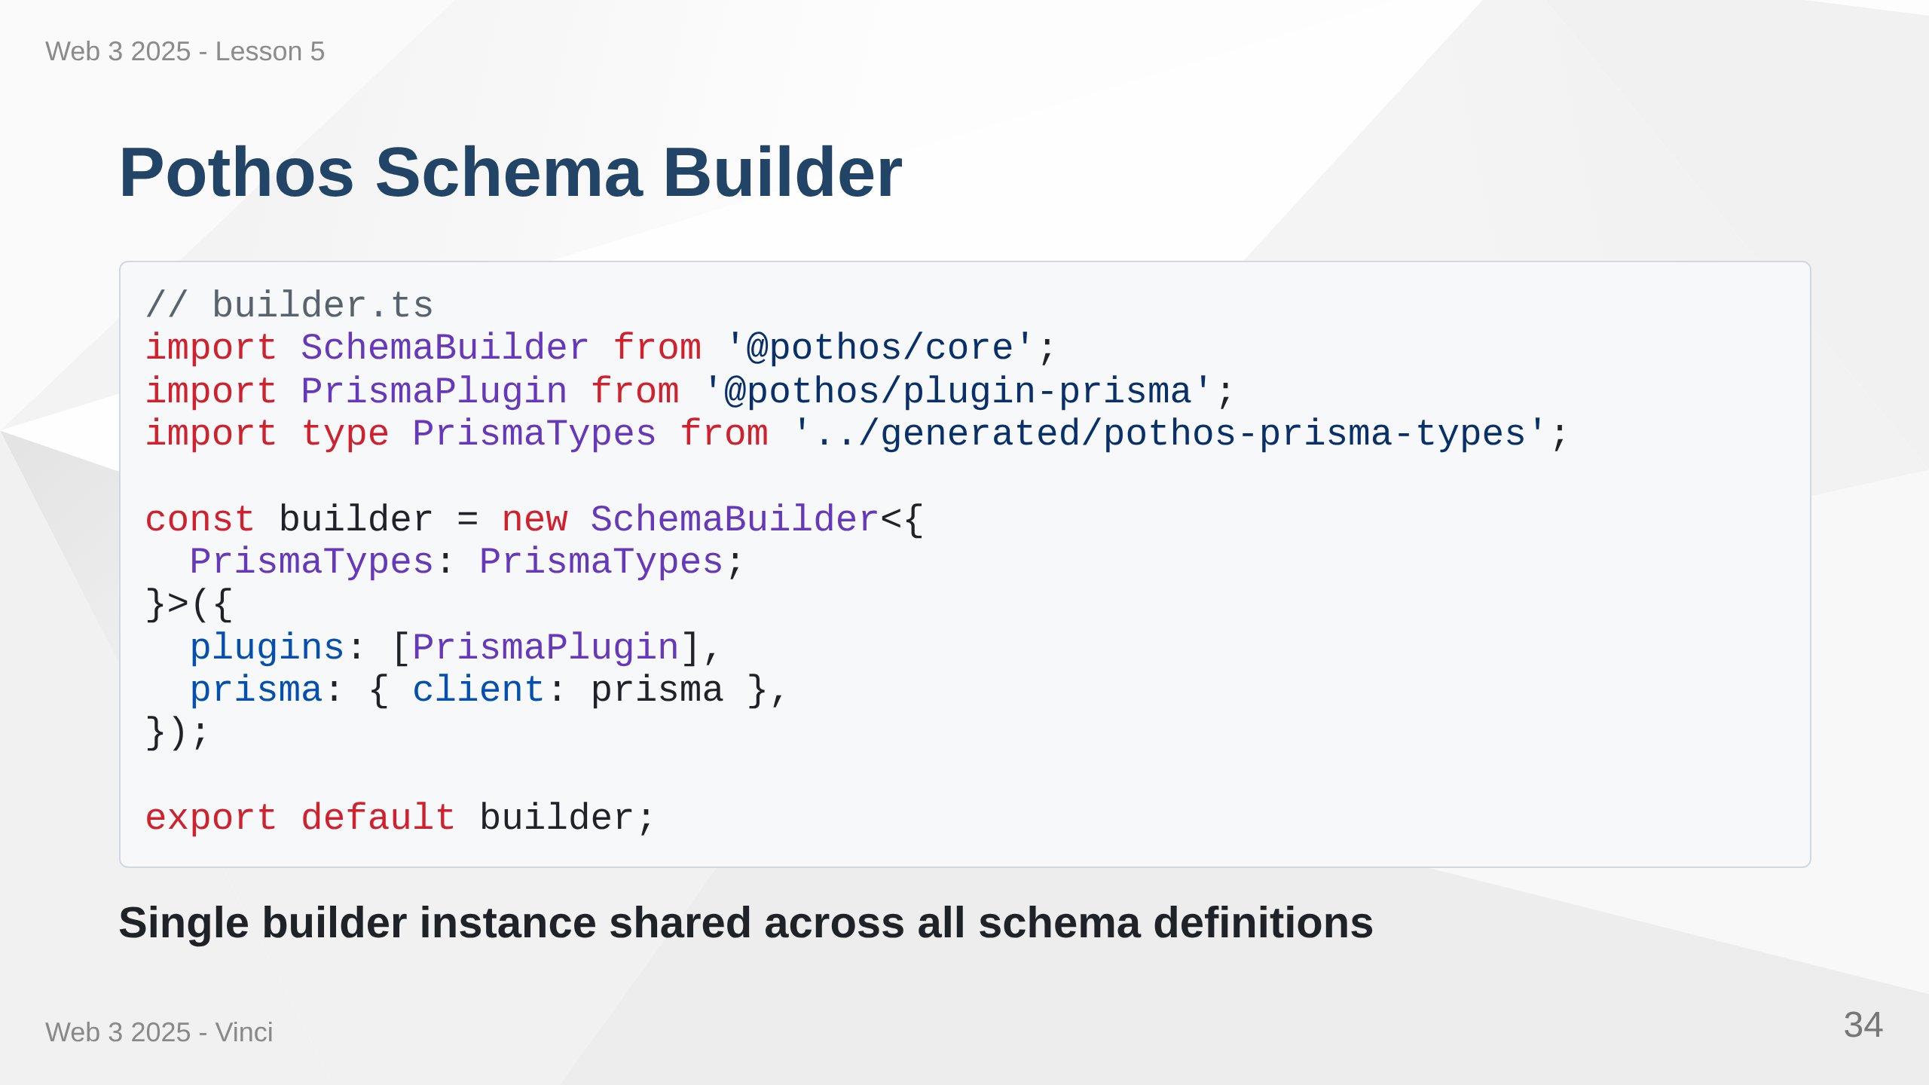
Notes:
Speaker Notes: • Builder is central to Pothos • Configure once, use everywhere • PrismaTypes generated automatically • Plugins extend functionality • Export and reuse in all schema files

Slide 35
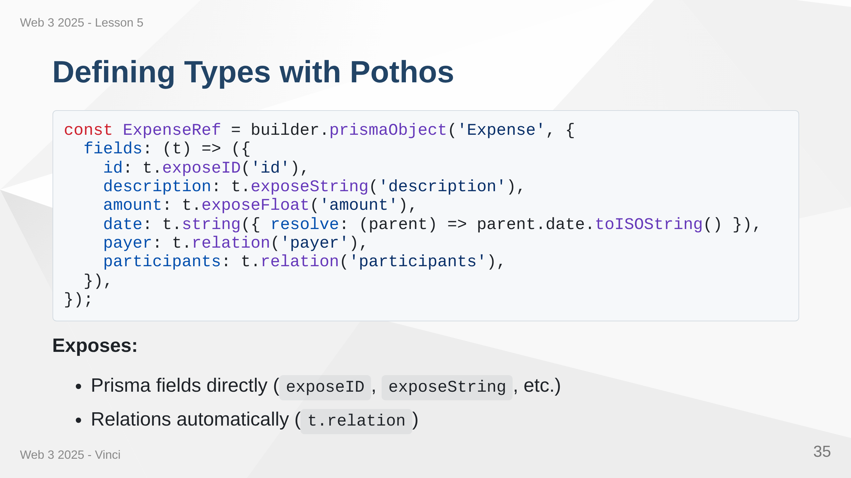
Notes:
Speaker Notes: • prismaObject maps GraphQL type to Prisma model • t.expose methods for simple fields • t.relation for relationships - Pothos handles joins • Type parameter ensures type safety • Can add computed fields not in database

Slide 36
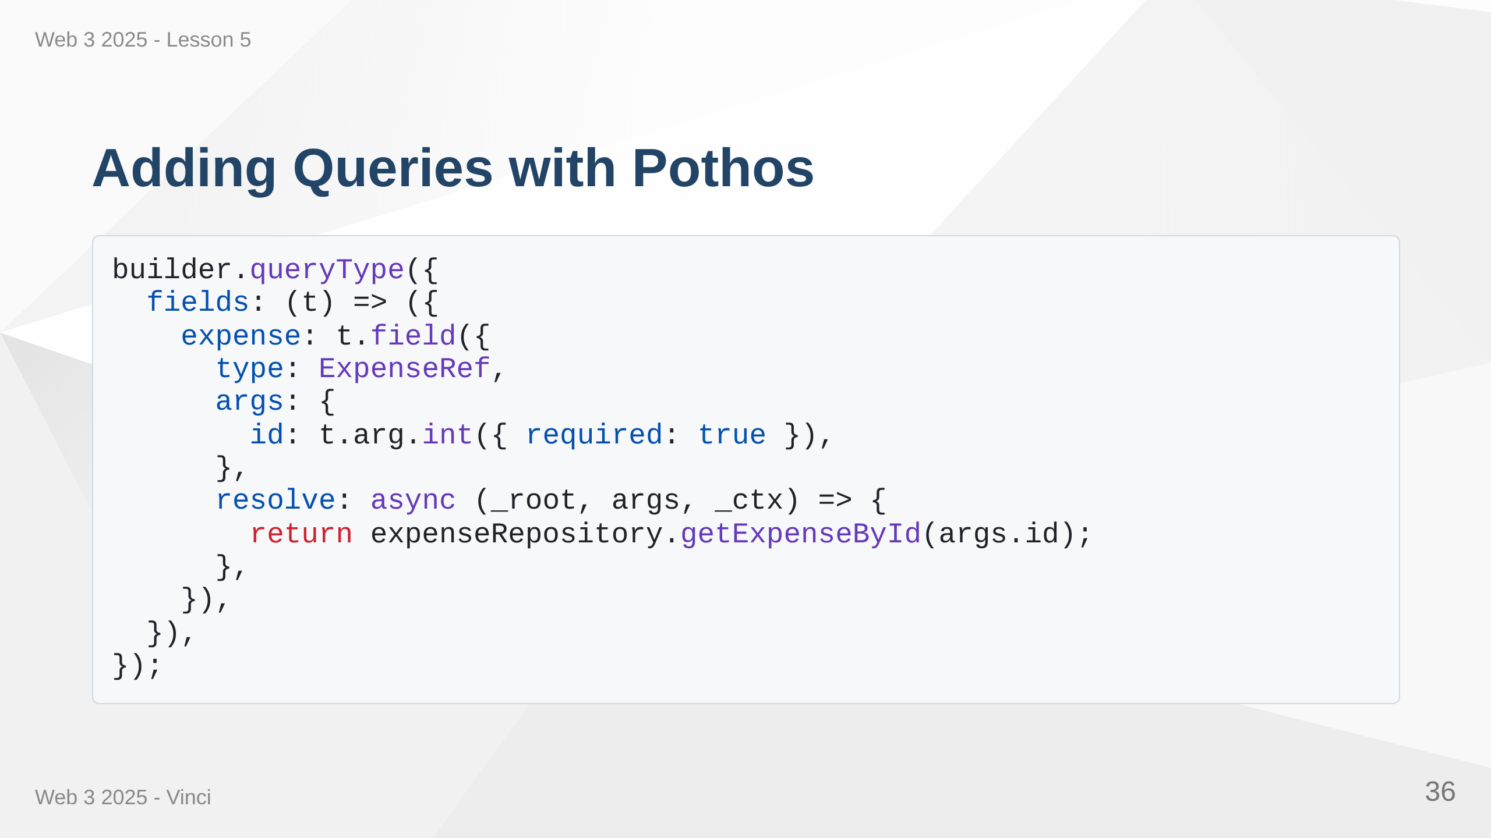

Slide 37
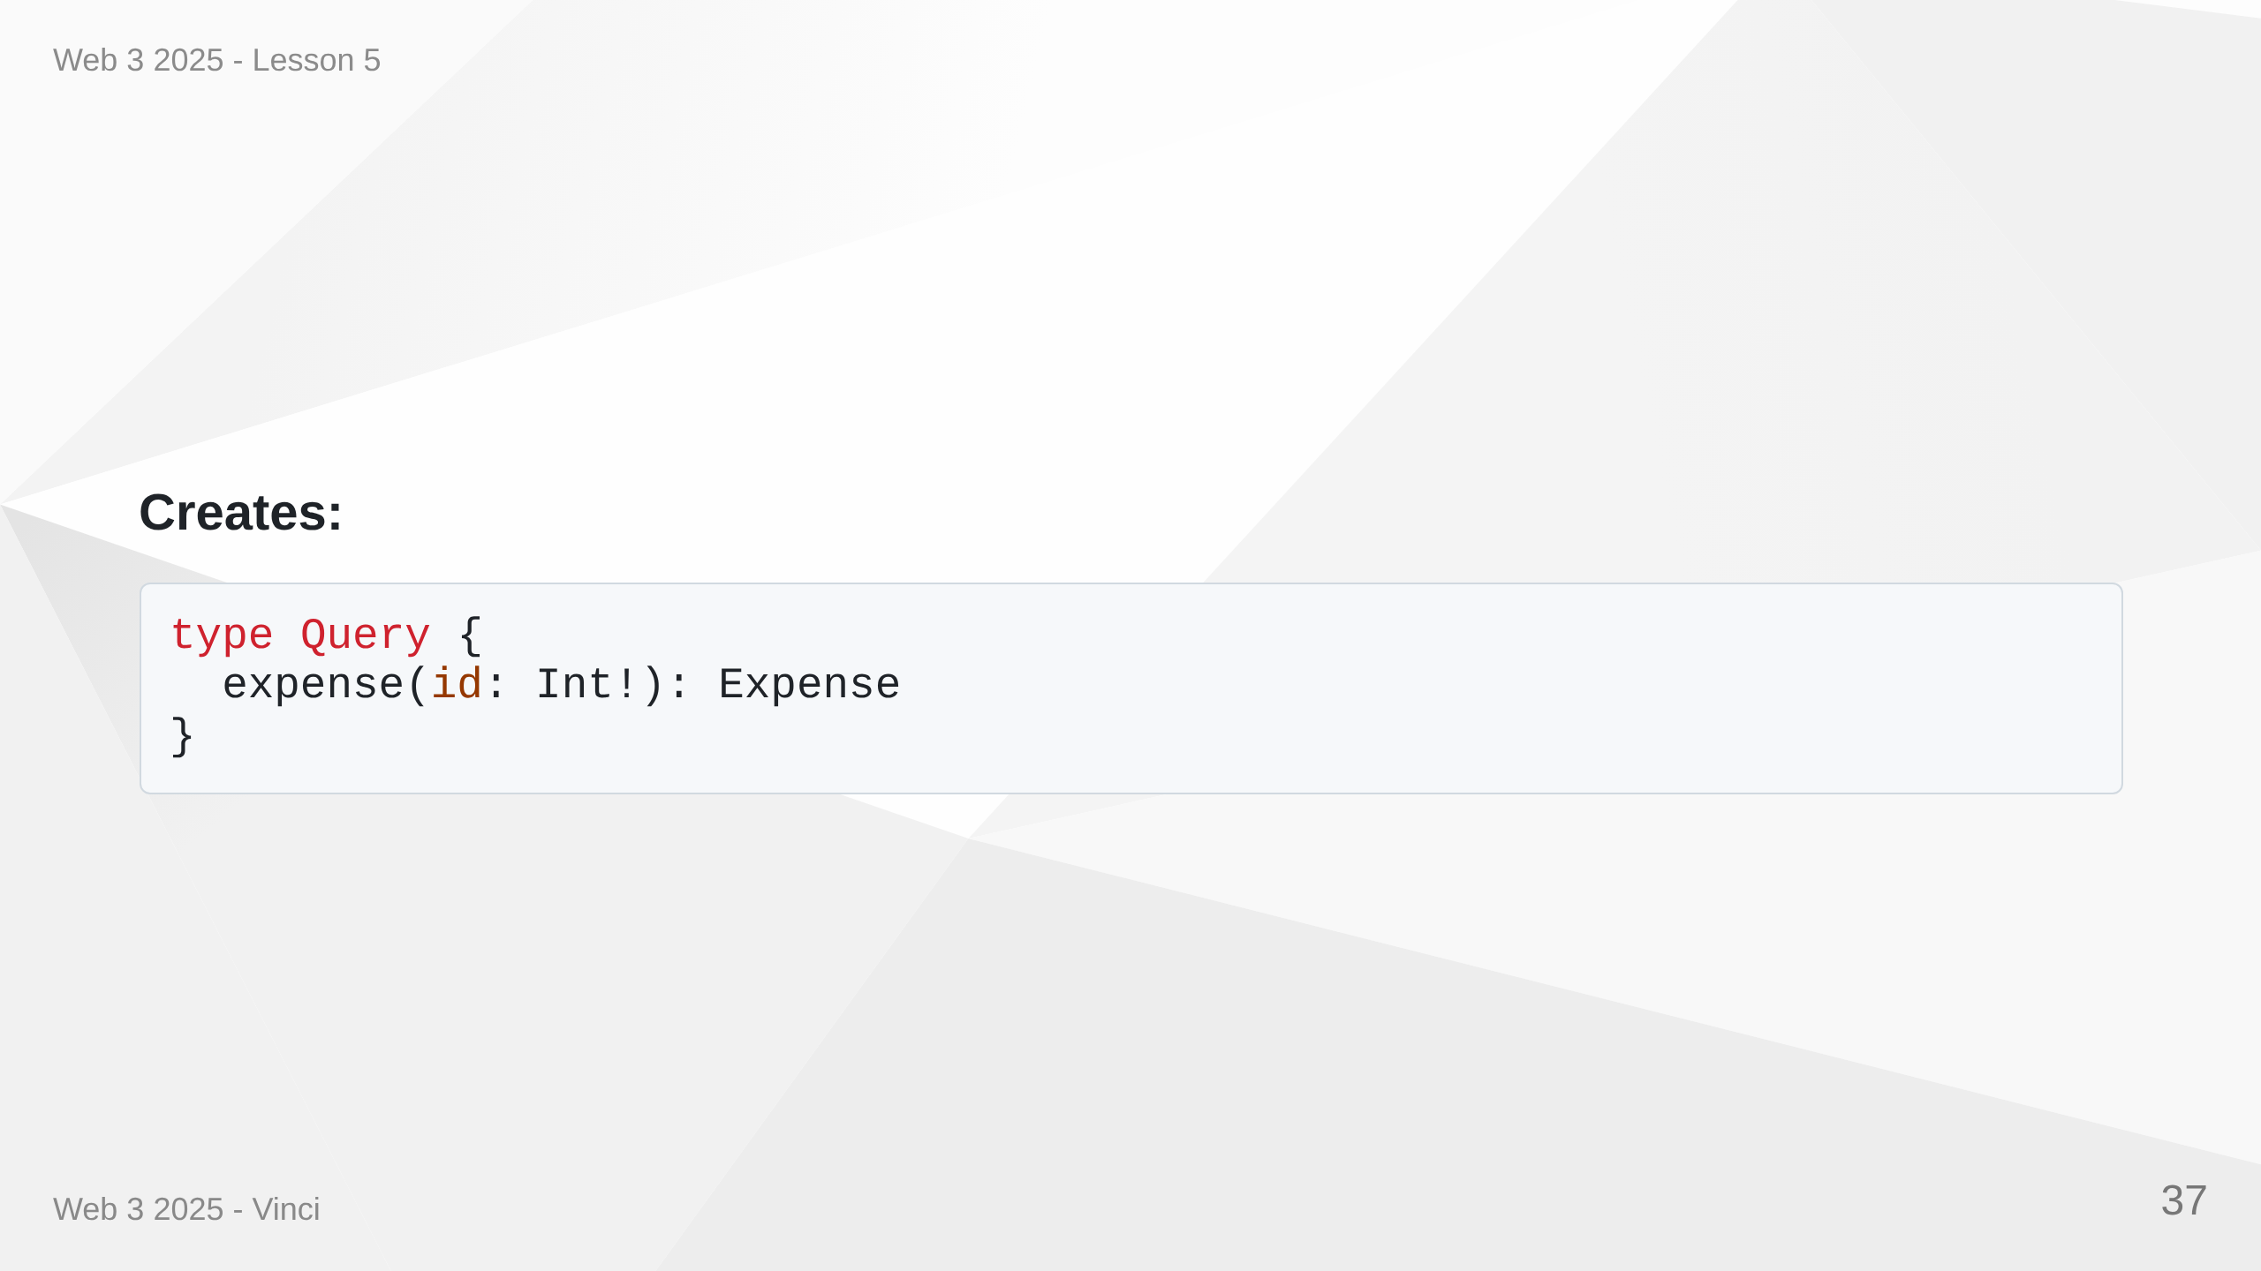
Notes:
Speaker Notes: • queryType adds to Query type • t.field defines individual query • args define input parameters with types • resolve function fetches the data • Can call existing repository code

Slide 38
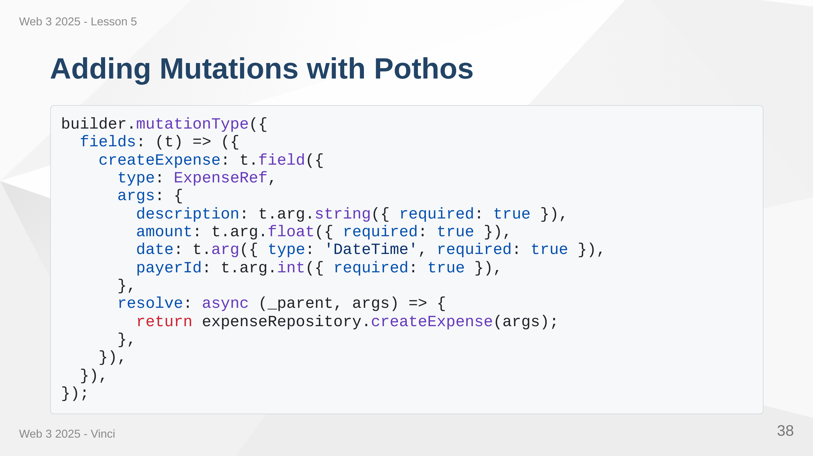
Notes:
Speaker Notes: • mutationType adds to Mutation type • Same pattern as queries • Multiple arguments with types • Returns created object • Type-safe args object

Slide 39
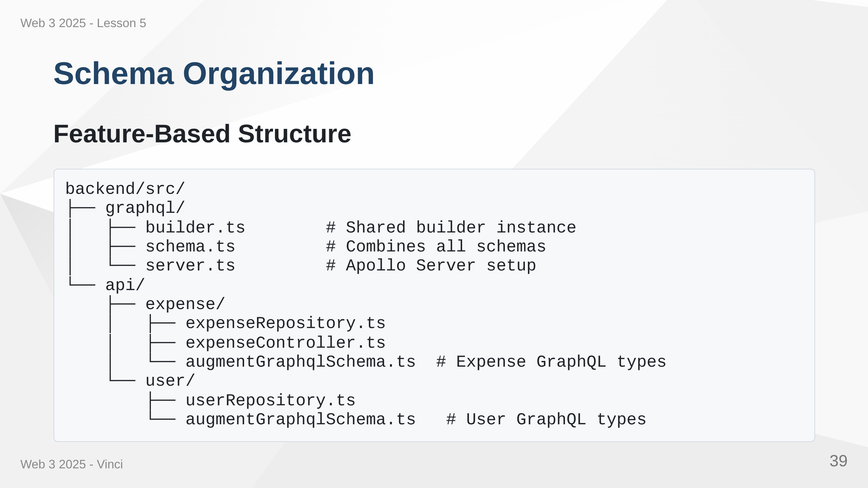
Notes:
Speaker Notes: • Organize by feature, not by layer • Each feature defines its own GraphQL types • Keeps related code together • Easy to find and modify • Scales better than one large schema file

Slide 40
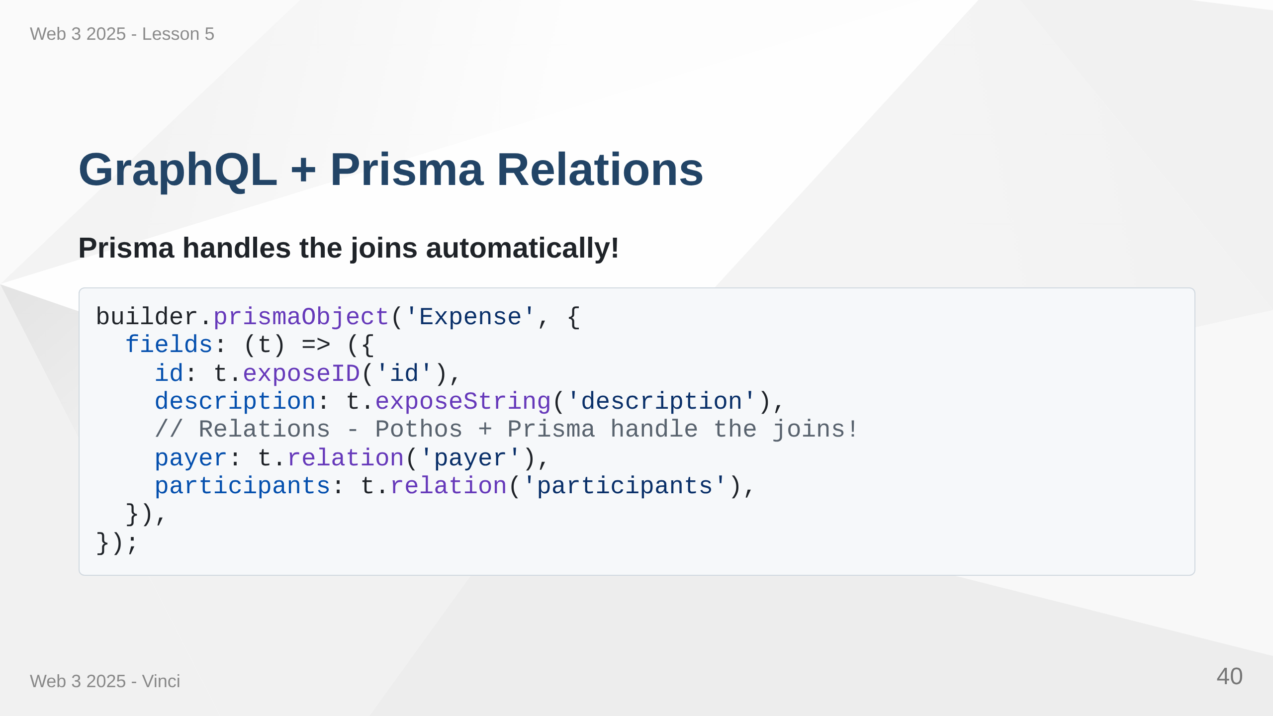

Slide 41
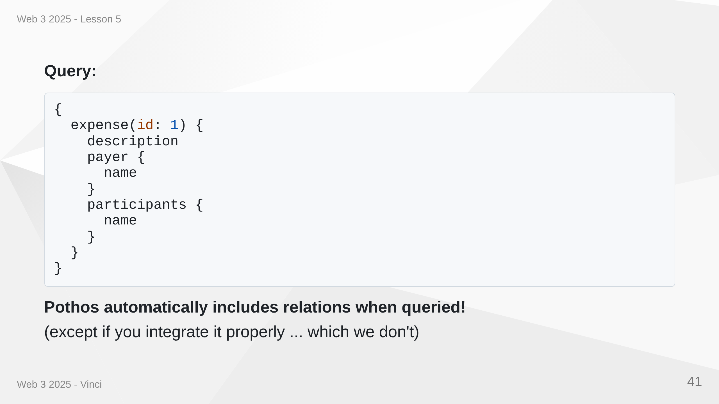
Notes:
Speaker Notes: • t.relation leverages Prisma relationships • Pothos generates efficient database queries • Only fetches relations when requested in query • Includes necessary joins automatically • No N+1 queries - optimized by default

Slide 42
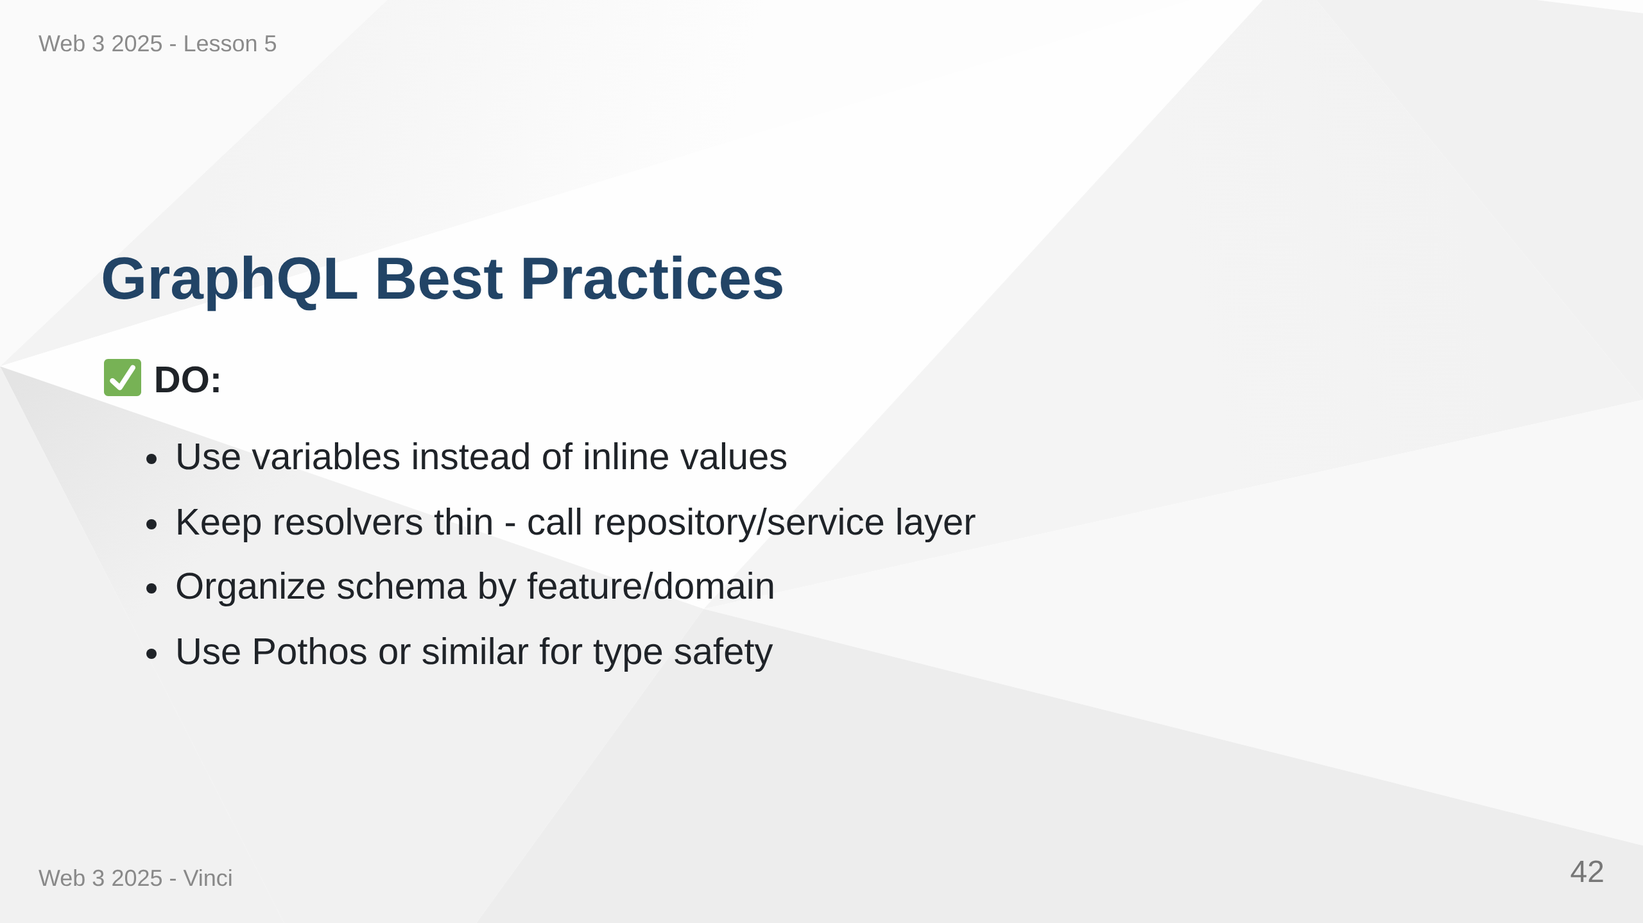

Slide 43
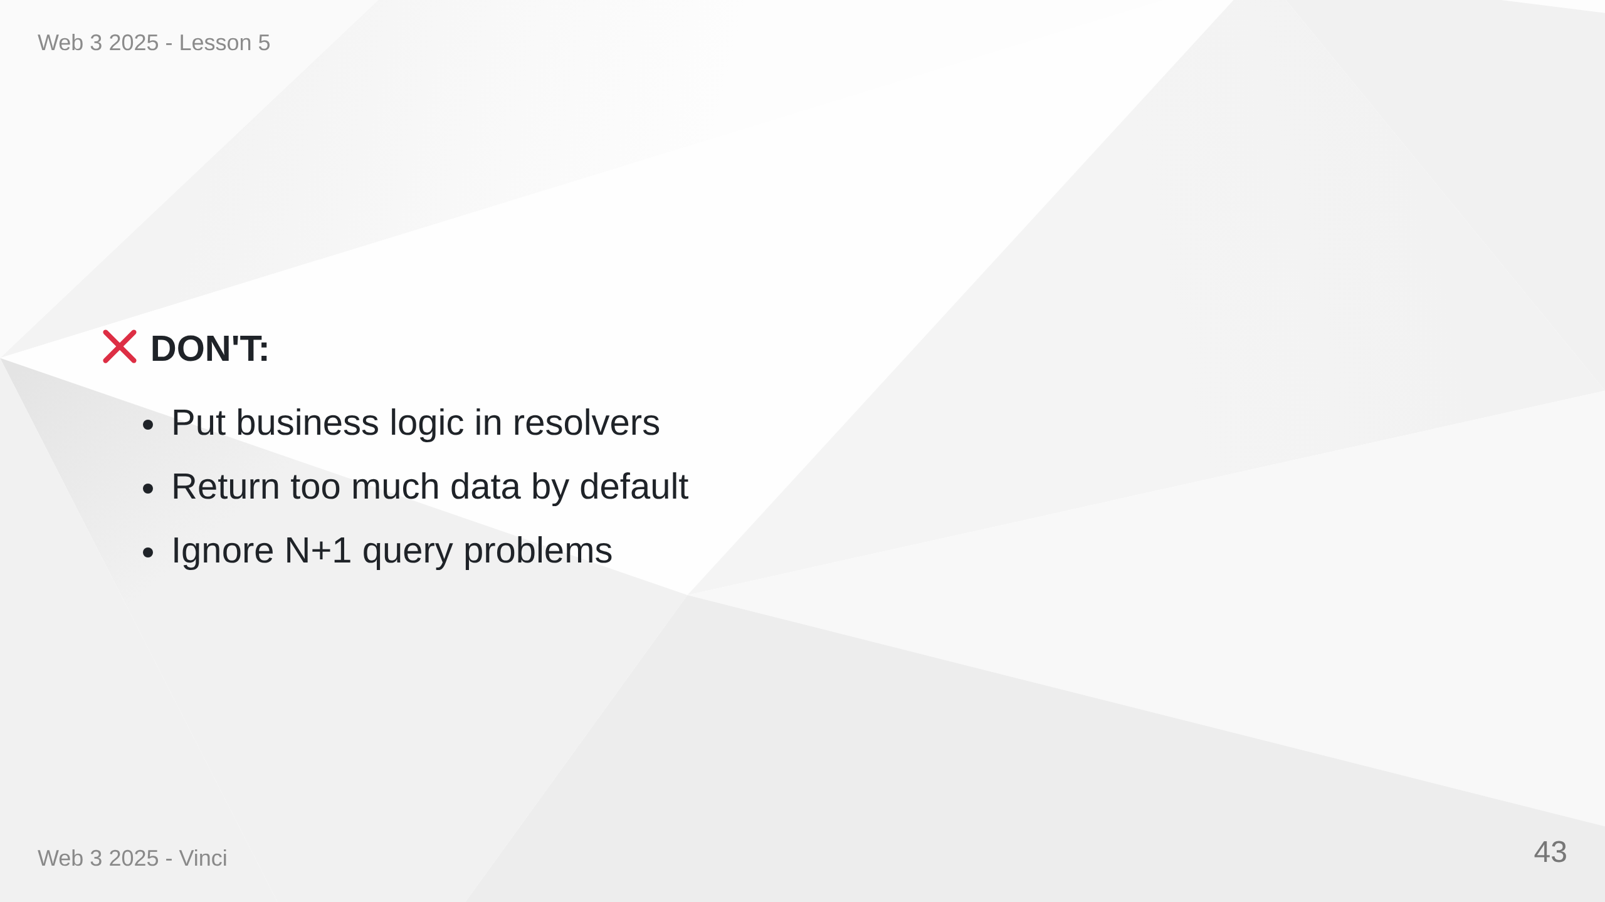
Notes:
Speaker Notes: • Resolvers should delegate to business logic • Schema organization matters as it grows • Type safety prevents entire classes of bugs • Documentation helps frontend developers • Security and performance are ongoing concerns

Slide 44
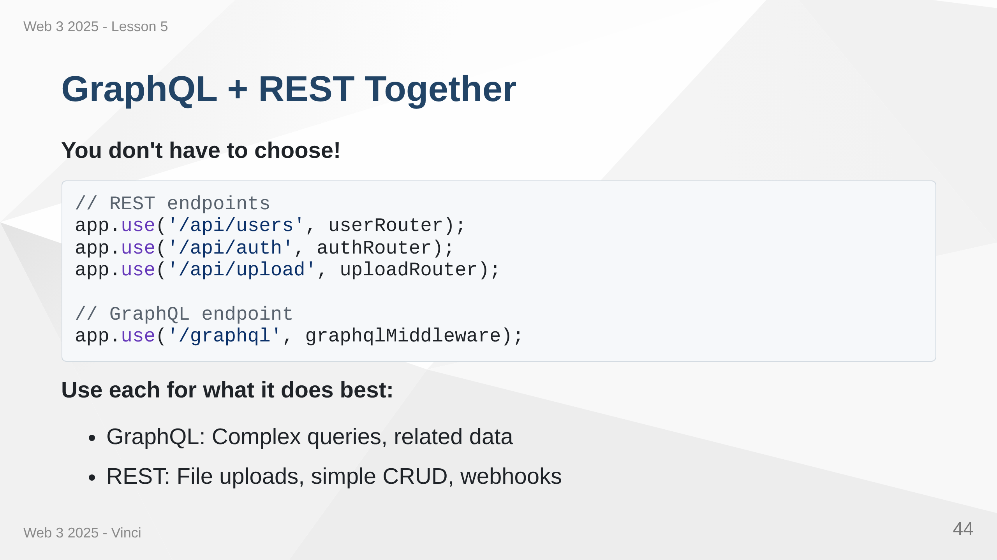
Notes:
Speaker Notes: • Both can coexist in same application • Use GraphQL for complex data fetching • Keep REST for file uploads, downloads, webhooks • Gradual migration possible • Start with GraphQL for new features • No need to rewrite everything at once

Slide 45
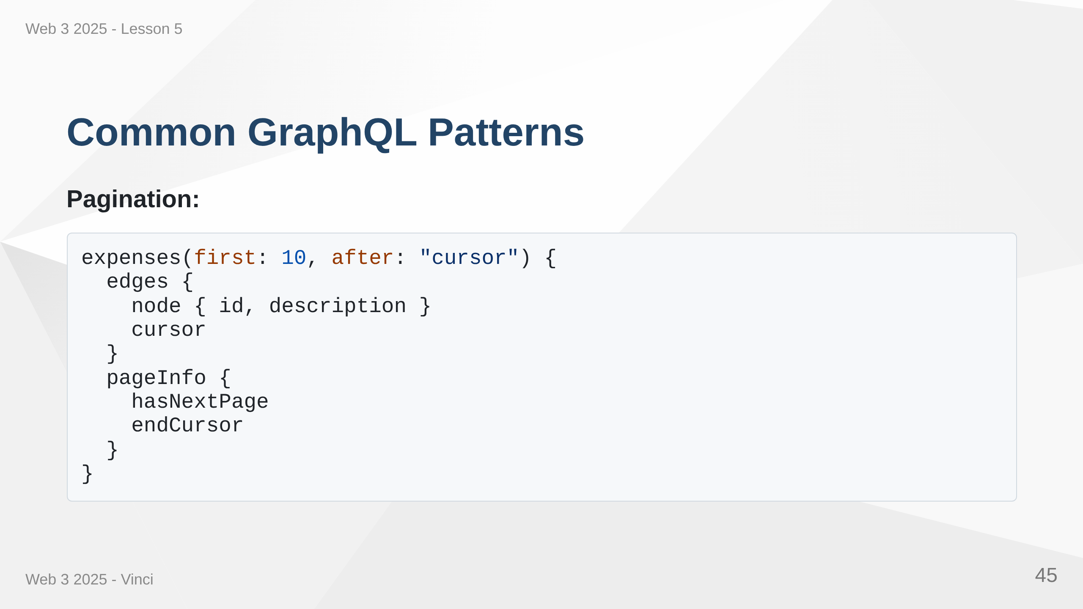

Slide 46
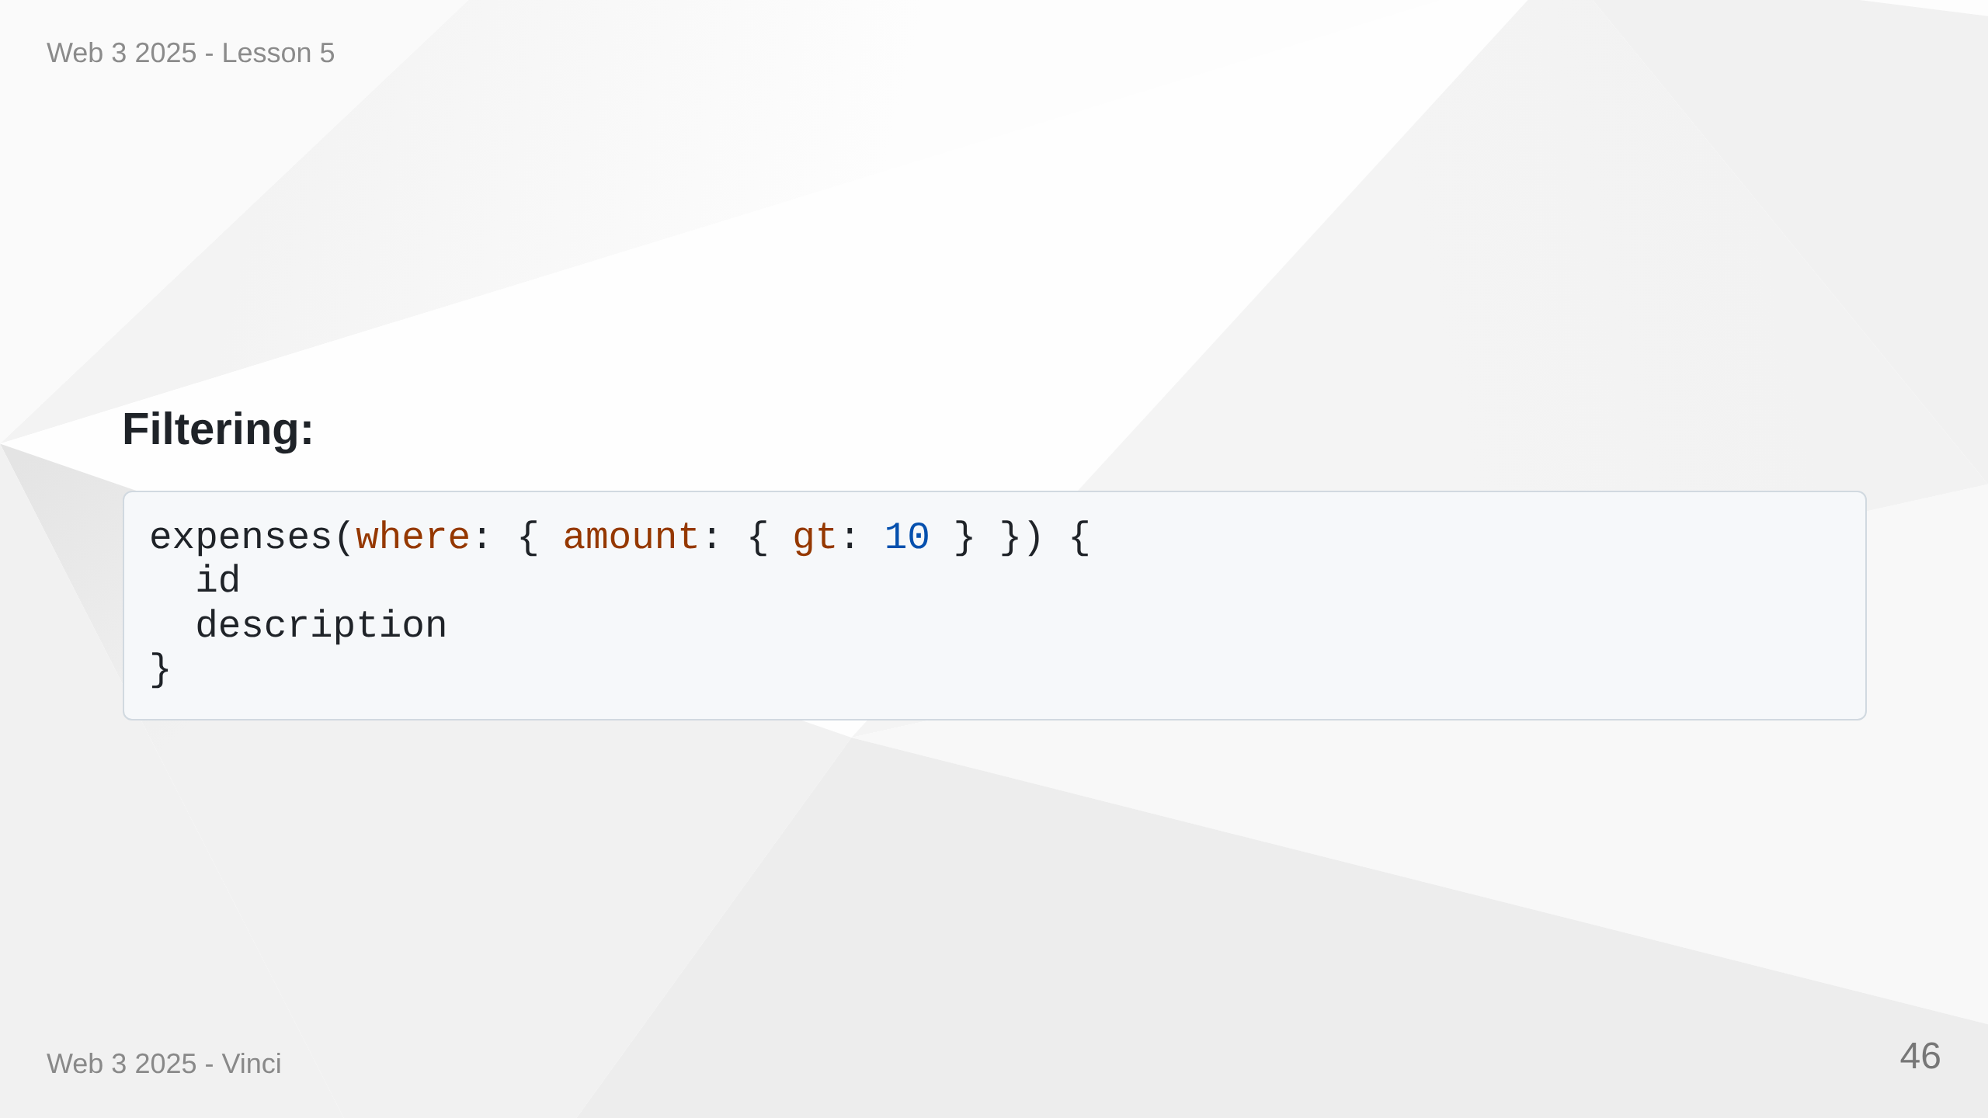
Notes:
Speaker Notes: • Cursor-based pagination for large datasets • Relay-style connections common pattern • Filtering through where argument • Can build complex query capabilities • GraphQL specification doesn't mandate these • Community conventions for consistency

Slide 47
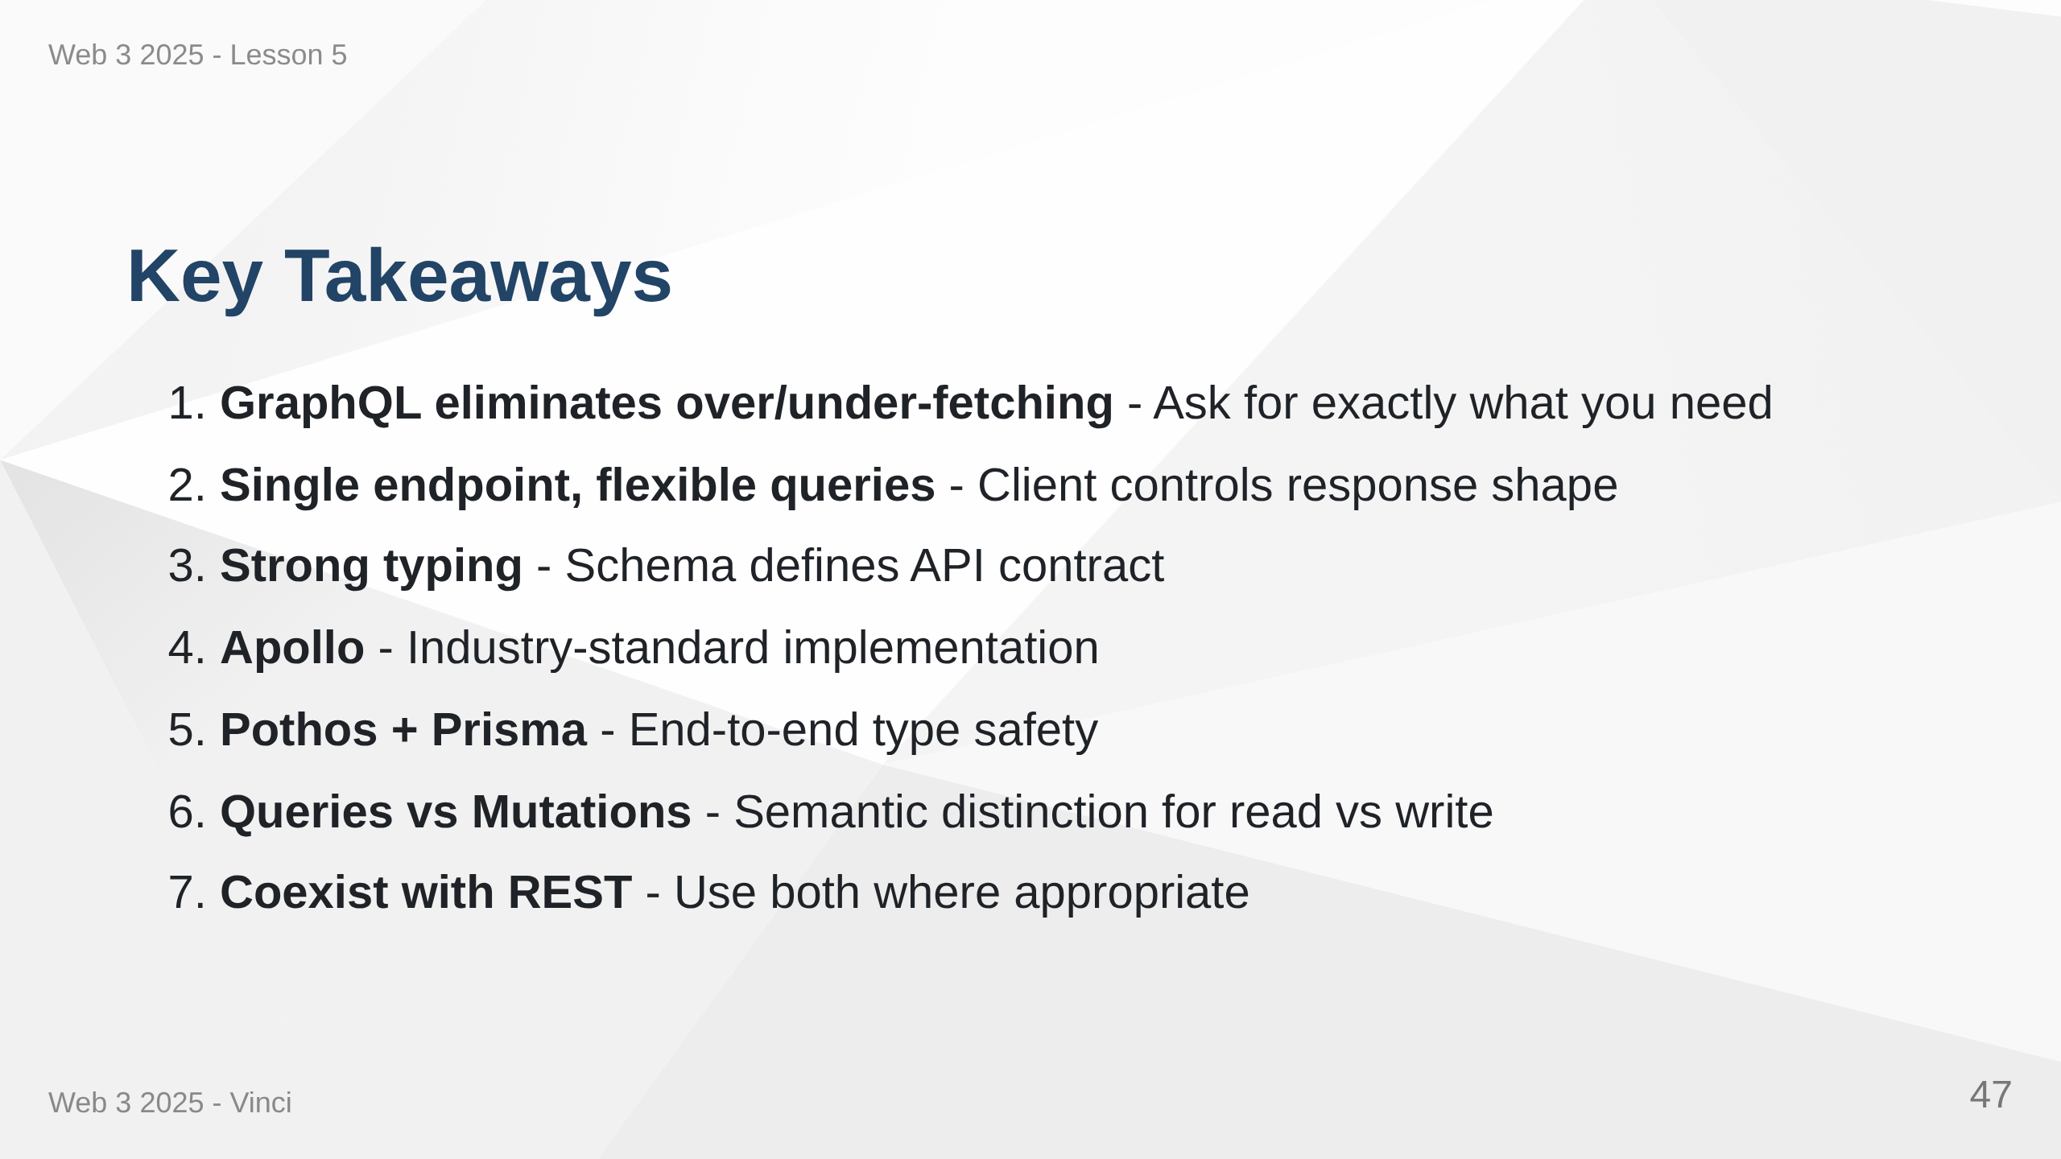
Notes:
Speaker Notes: • GraphQL solves real problems with REST • Not a replacement but a complement • Type safety from database to frontend • Tools and ecosystem are mature • Production-ready for most use cases • Consider team experience and project needs

Slide 48
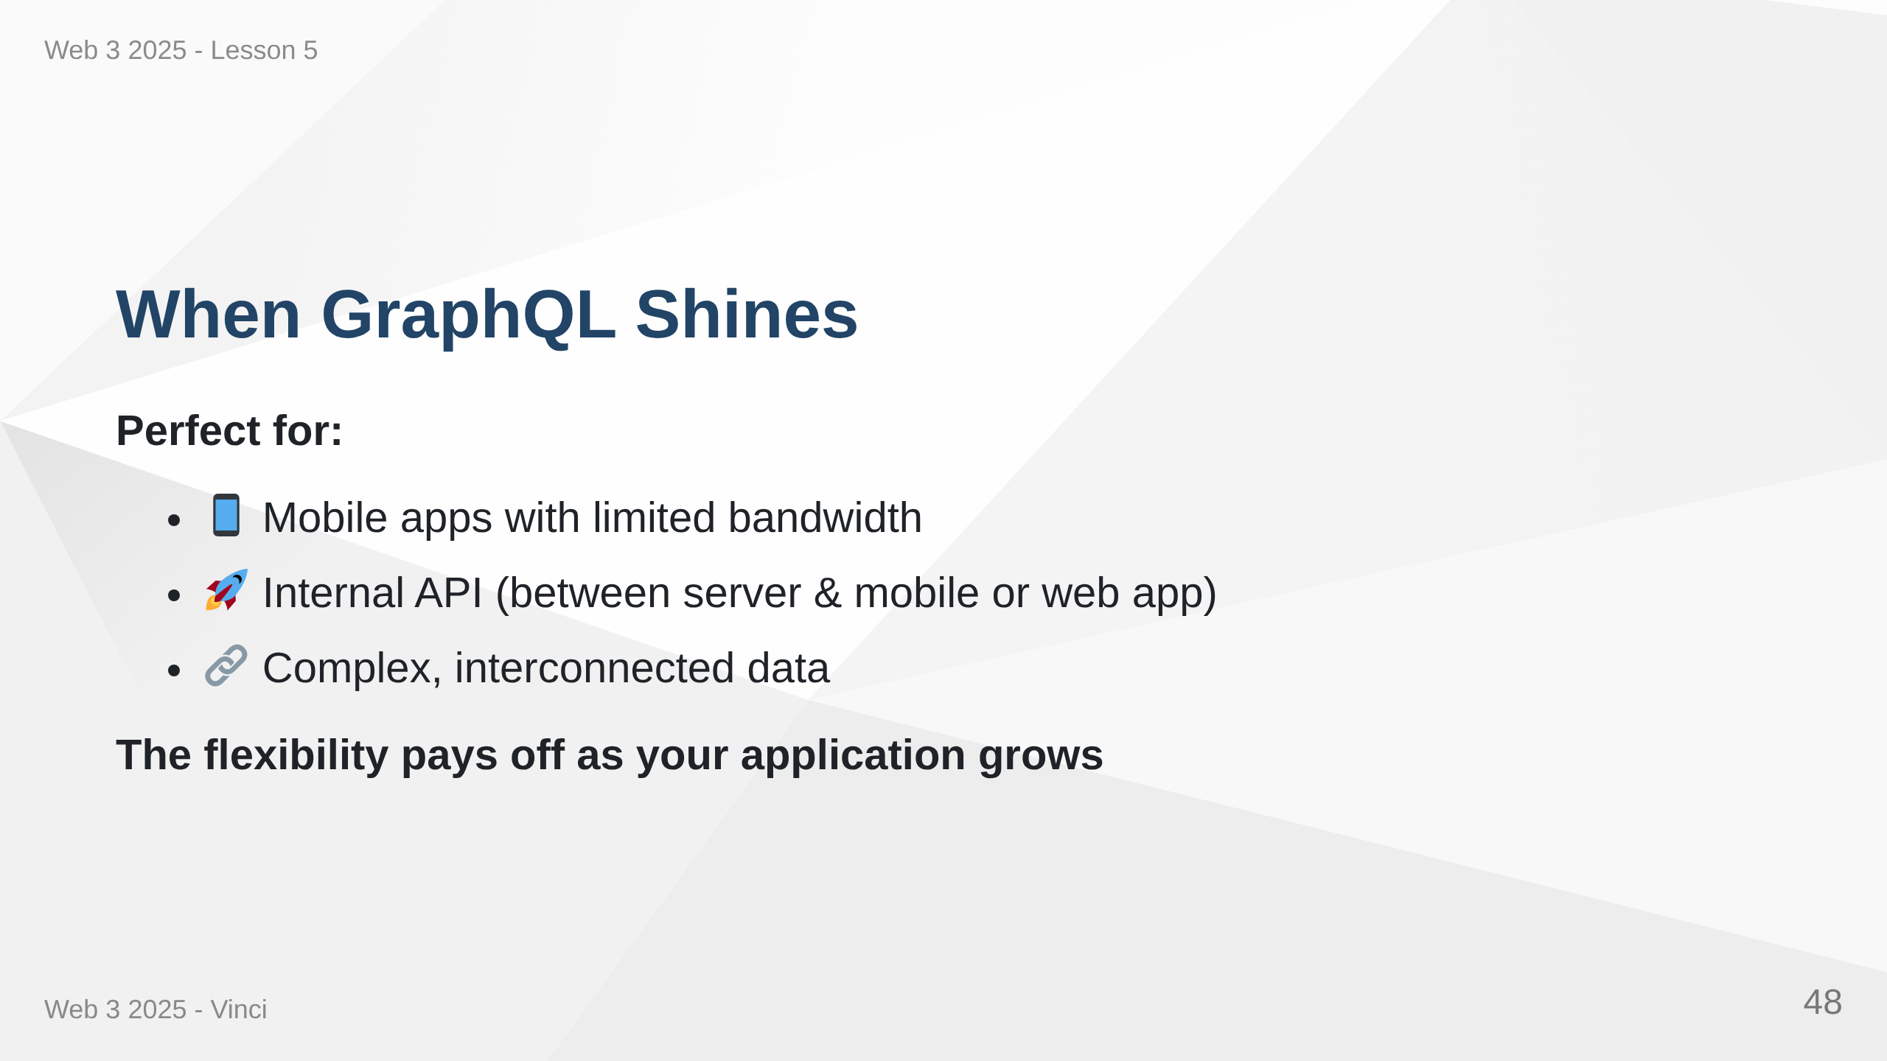
Notes:
Speaker Notes: • Mobile benefits from reduced data transfer • Different clients can request different fields • Natural fit for graph-like data structures • Frontend can evolve without backend changes • GraphQL can aggregate multiple services • Initial setup overhead worth it for complex apps

