Slide 1


Slide 2
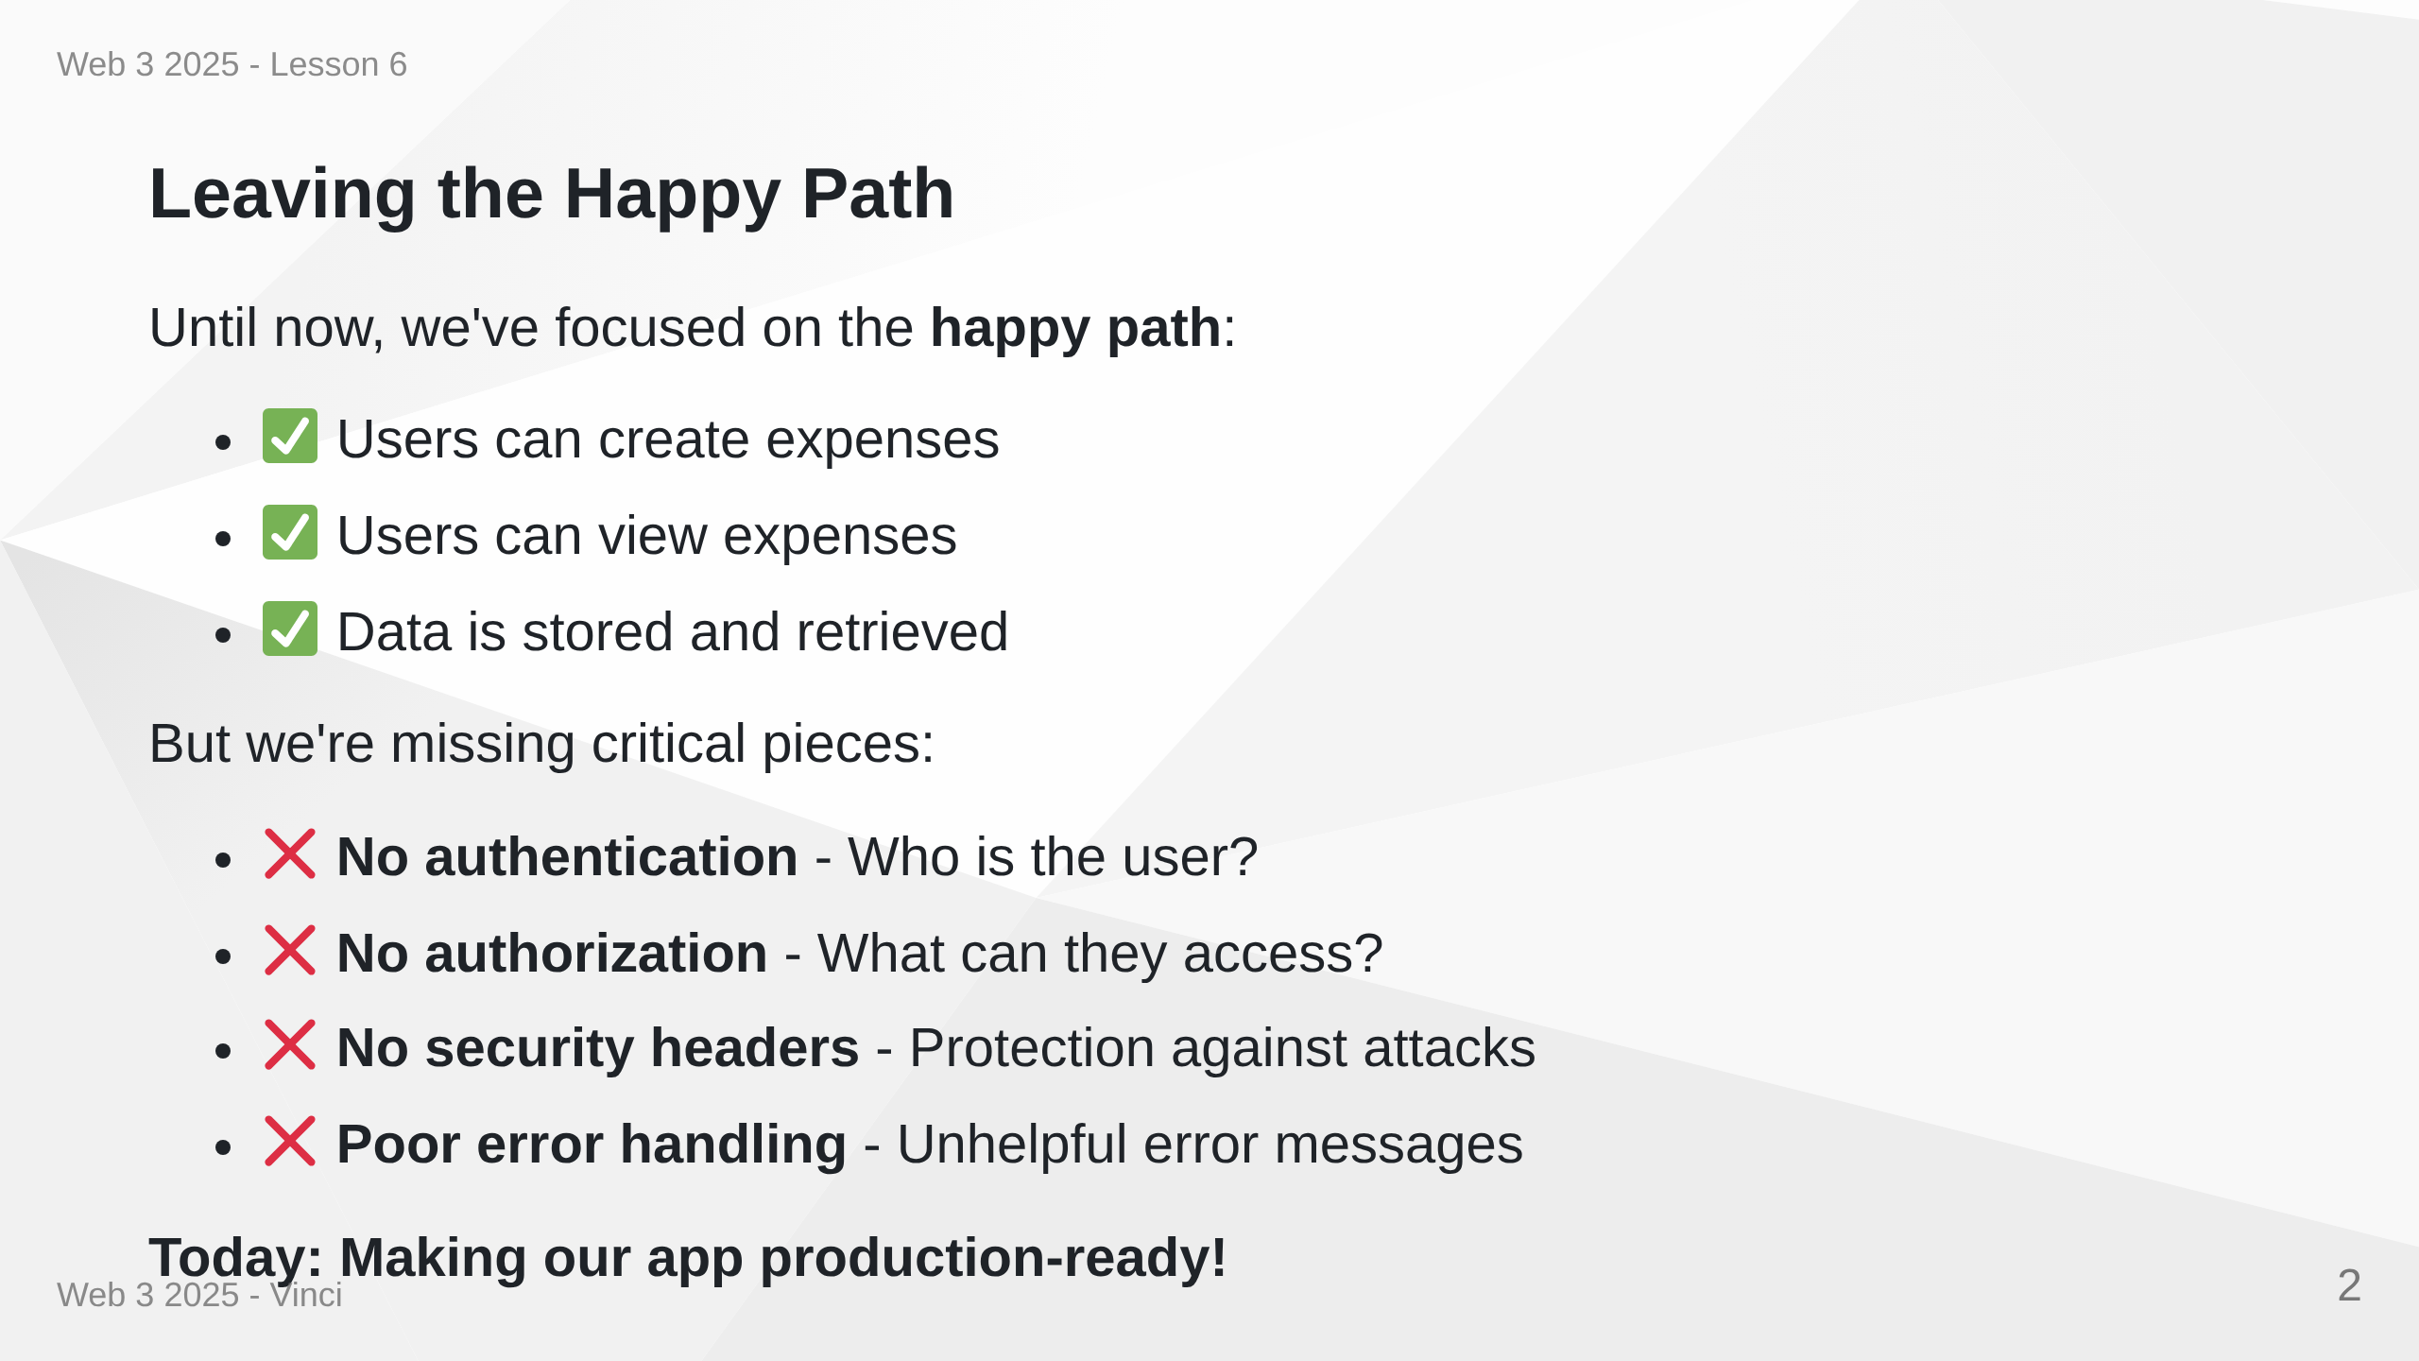
Notes:
Speaker Notes: • Welcome to lesson 6 - security and error handling • Up until now, anyone can do anything • No protection against common web attacks • Time to implement production-ready security • These aren't optional features - they're essential

Slide 3
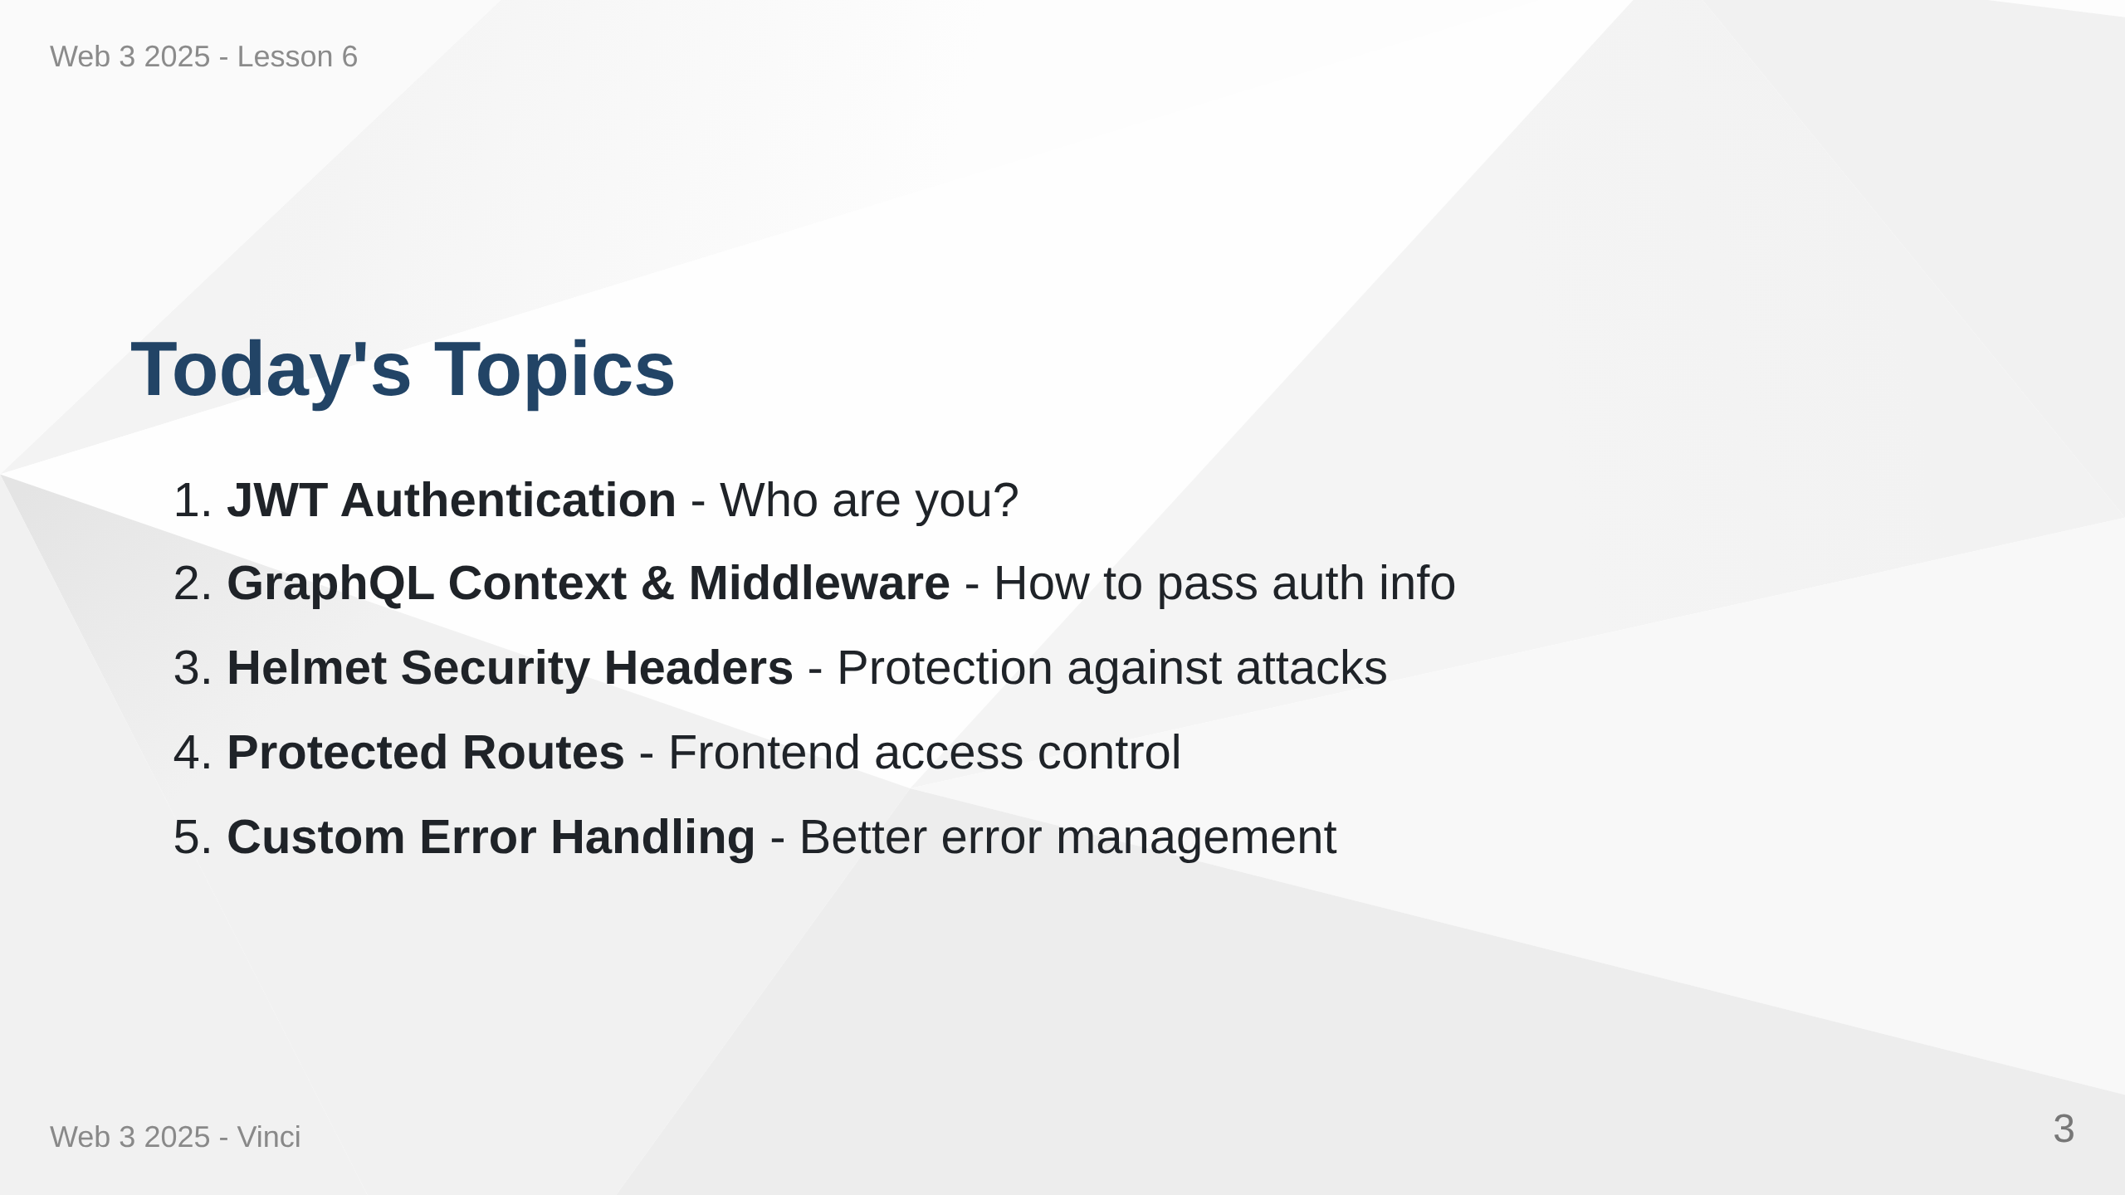
Notes:
Speaker Notes: • Comprehensive security implementation • Each layer protects against different threats • Authentication identifies users • Authorization controls access • Error handling provides good UX

Slide 4
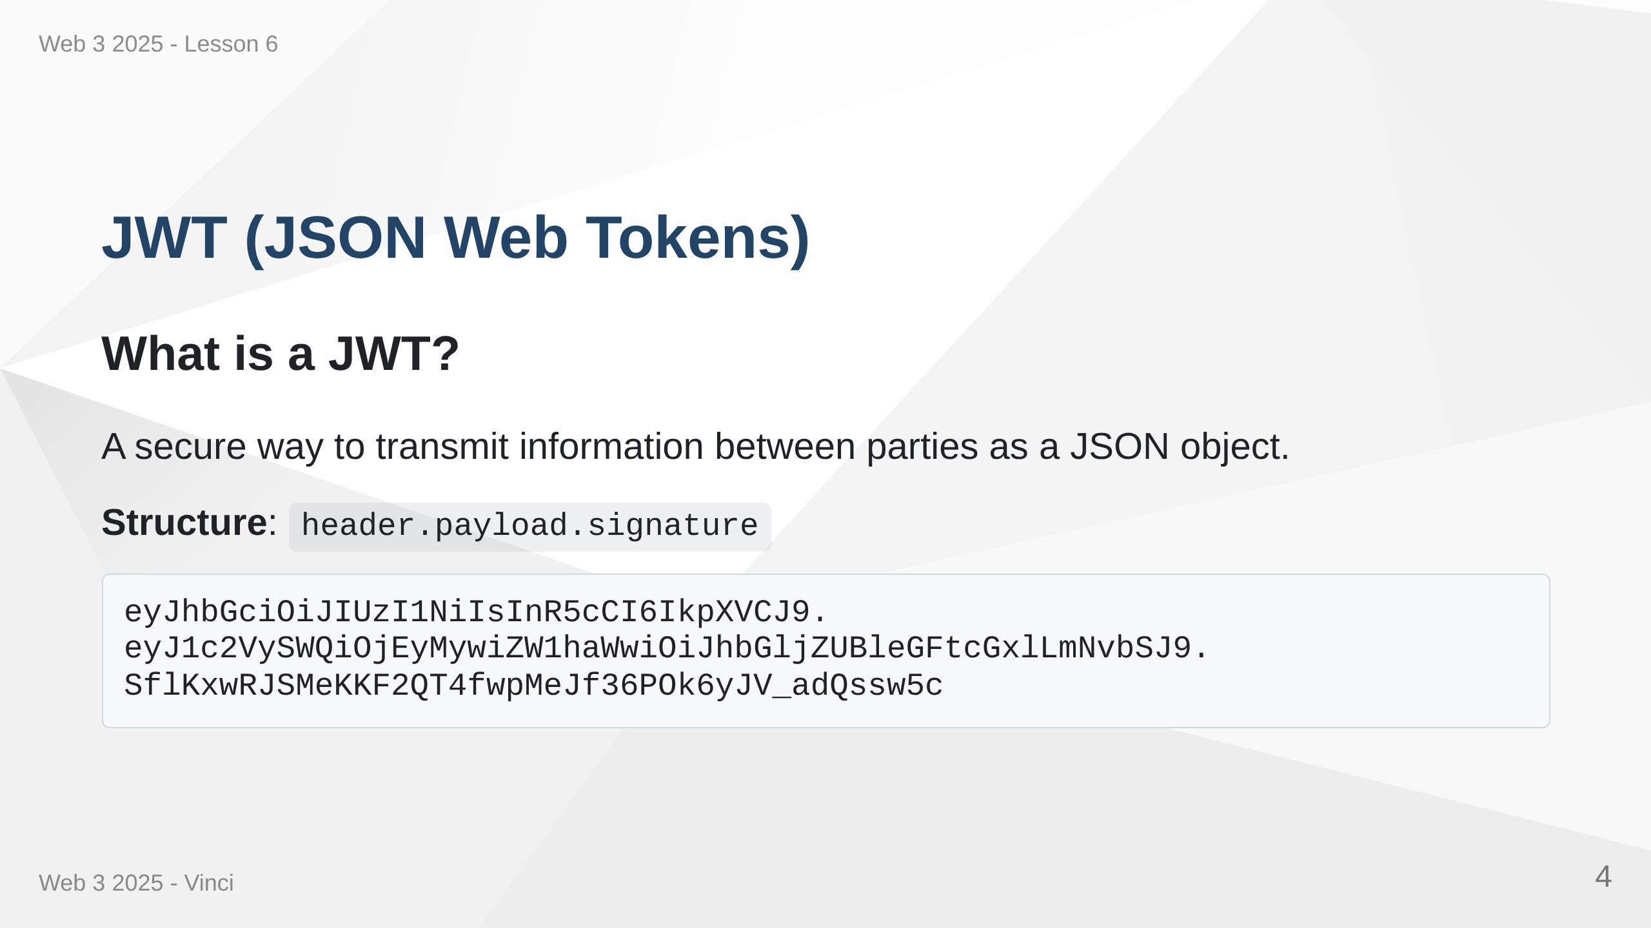
Notes:
Speaker Notes: • Three parts separated by dots • Header: algorithm and token type • Payload: claims (user data) • Signature: verification that token hasn't been tampered with • Stateless - server doesn't need to store sessions

Slide 5
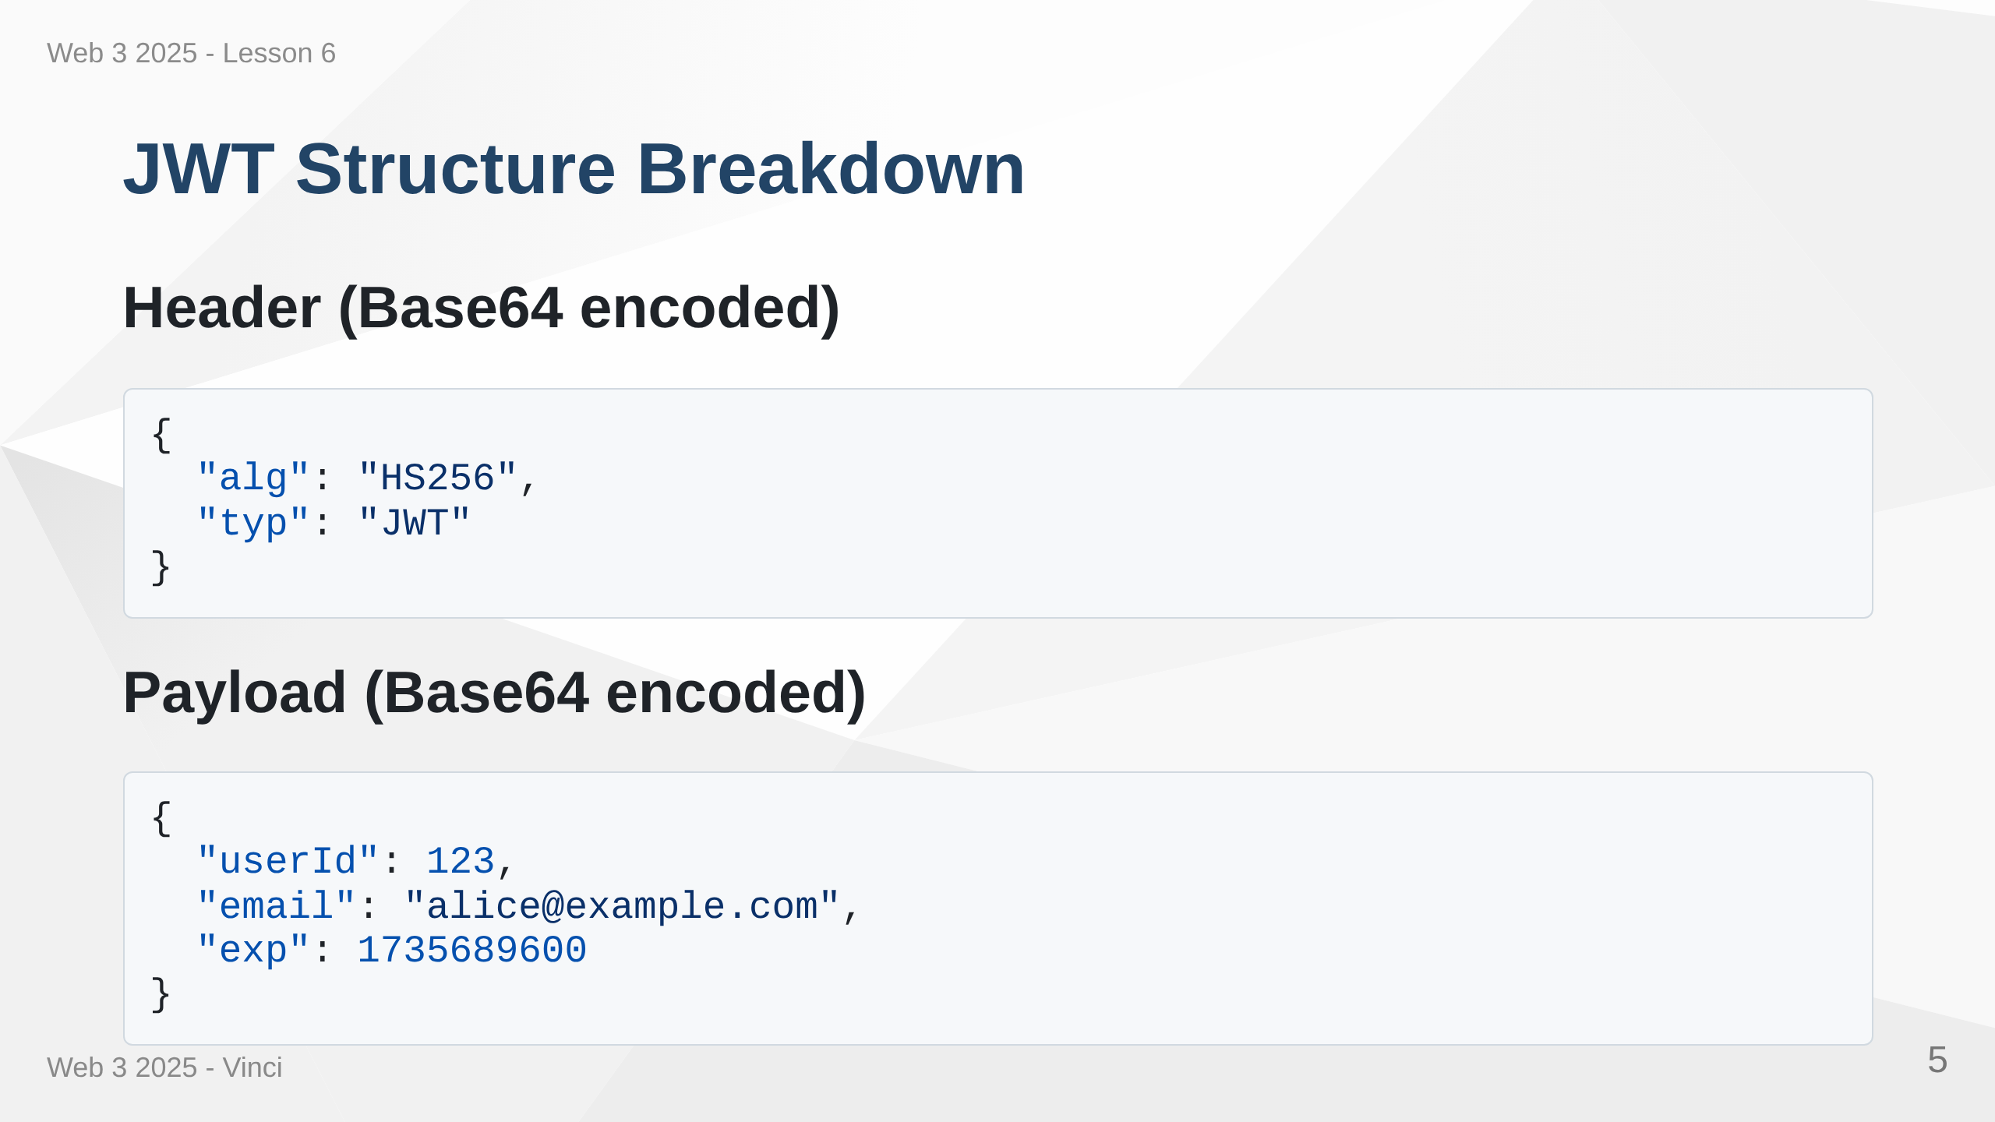

Slide 6
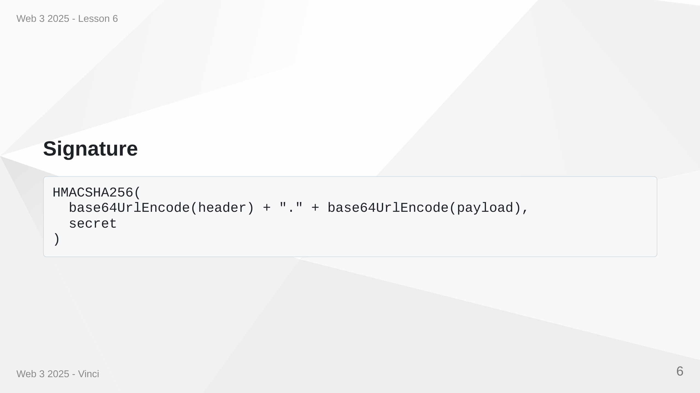
Notes:
Speaker Notes: • Header specifies signing algorithm • Payload contains claims - user data we want to transmit • exp is expiration timestamp - tokens should expire • Signature verifies token authenticity using secret key • Only server with secret key can create valid signatures

Slide 7
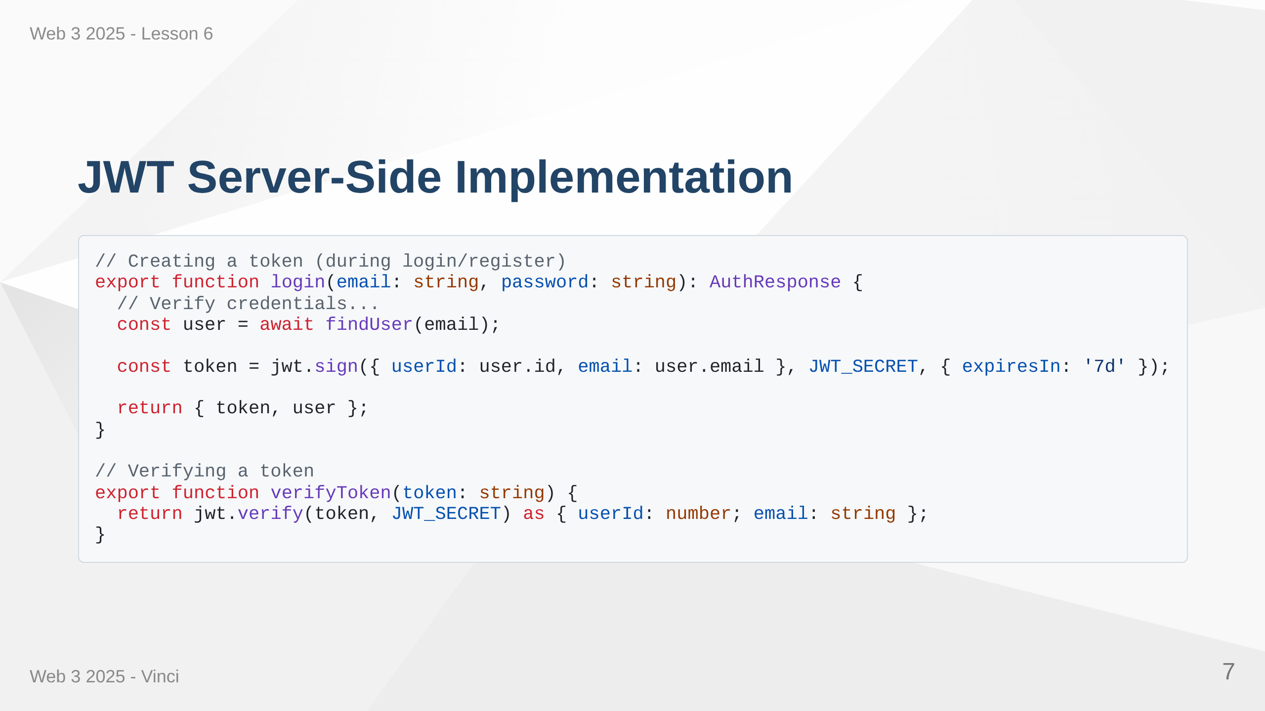
Notes:
Speaker Notes: • jwt.sign creates the token with payload and secret • expiresIn ensures tokens don't live forever • jwt.verify checks signature and returns payload • Throws error if token is invalid or expired • Never expose JWT_SECRET - keep it in environment variables

Slide 8
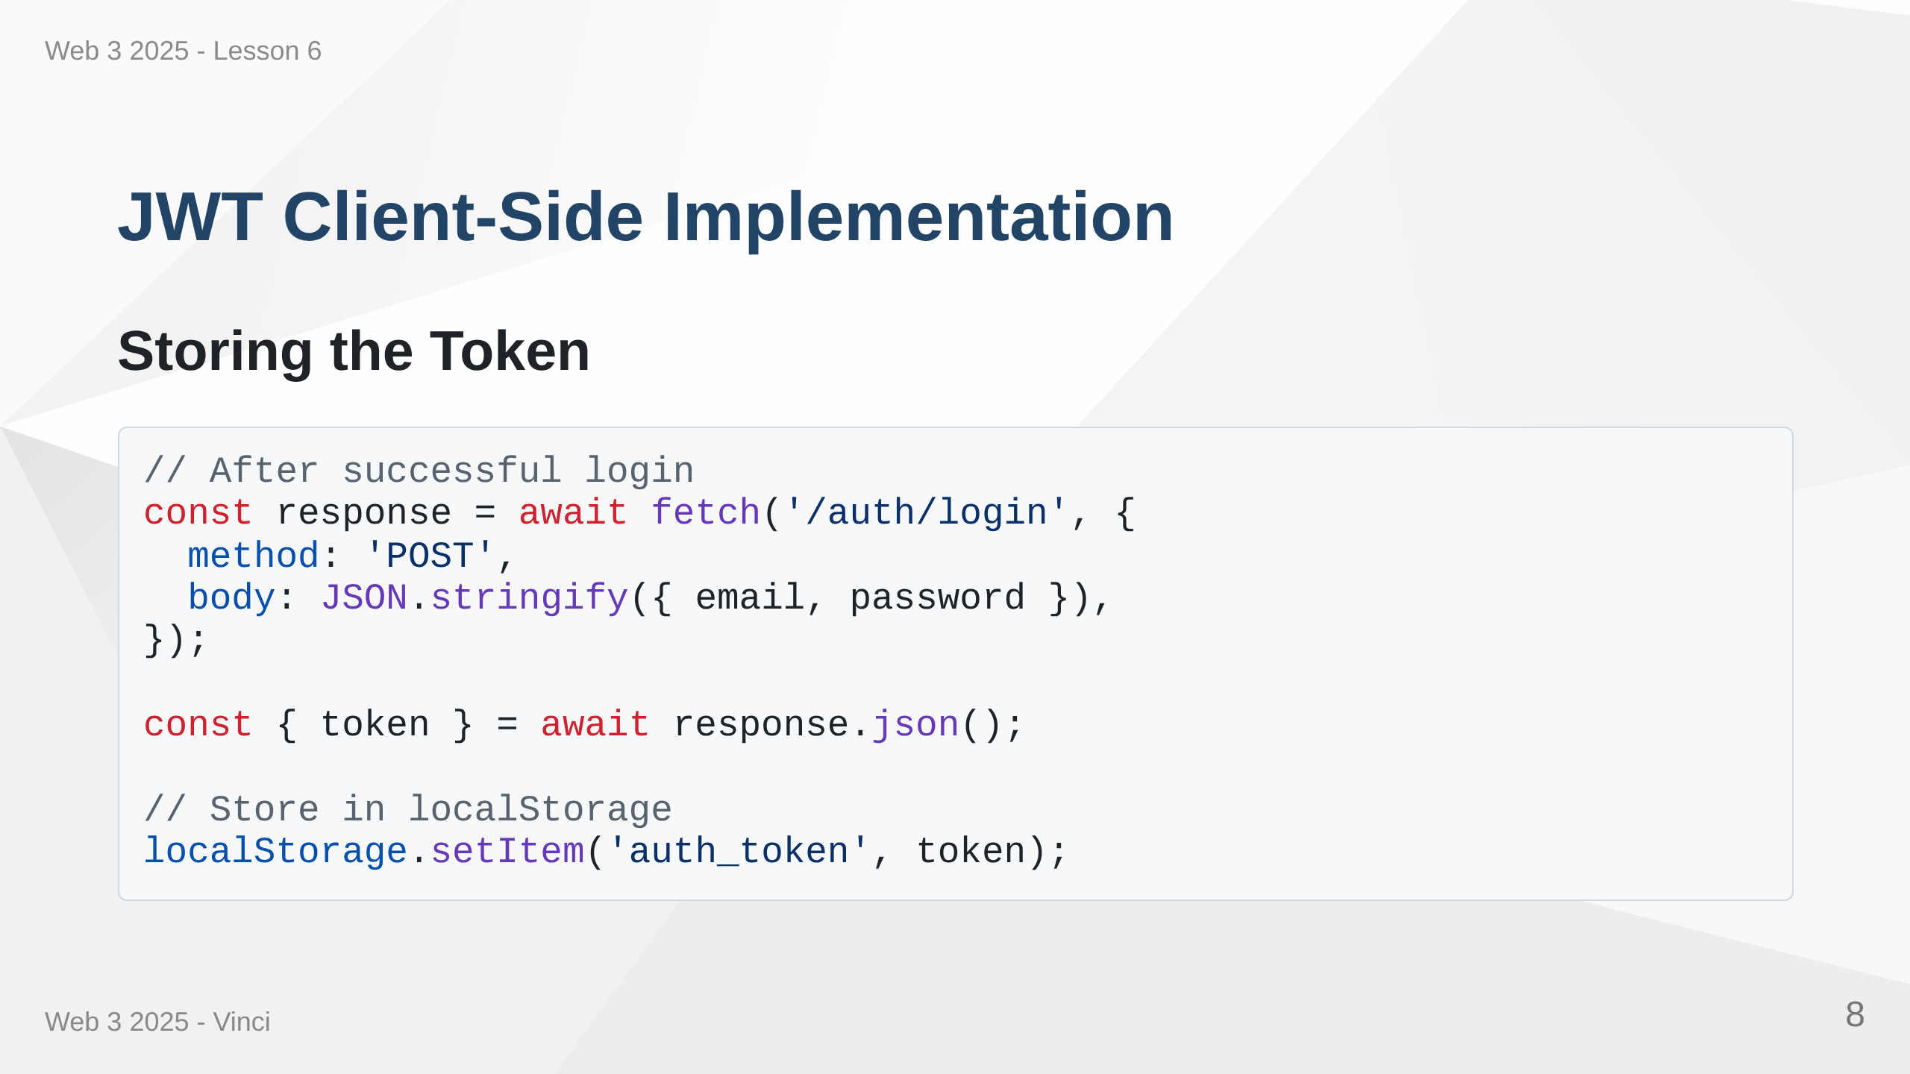

Slide 9
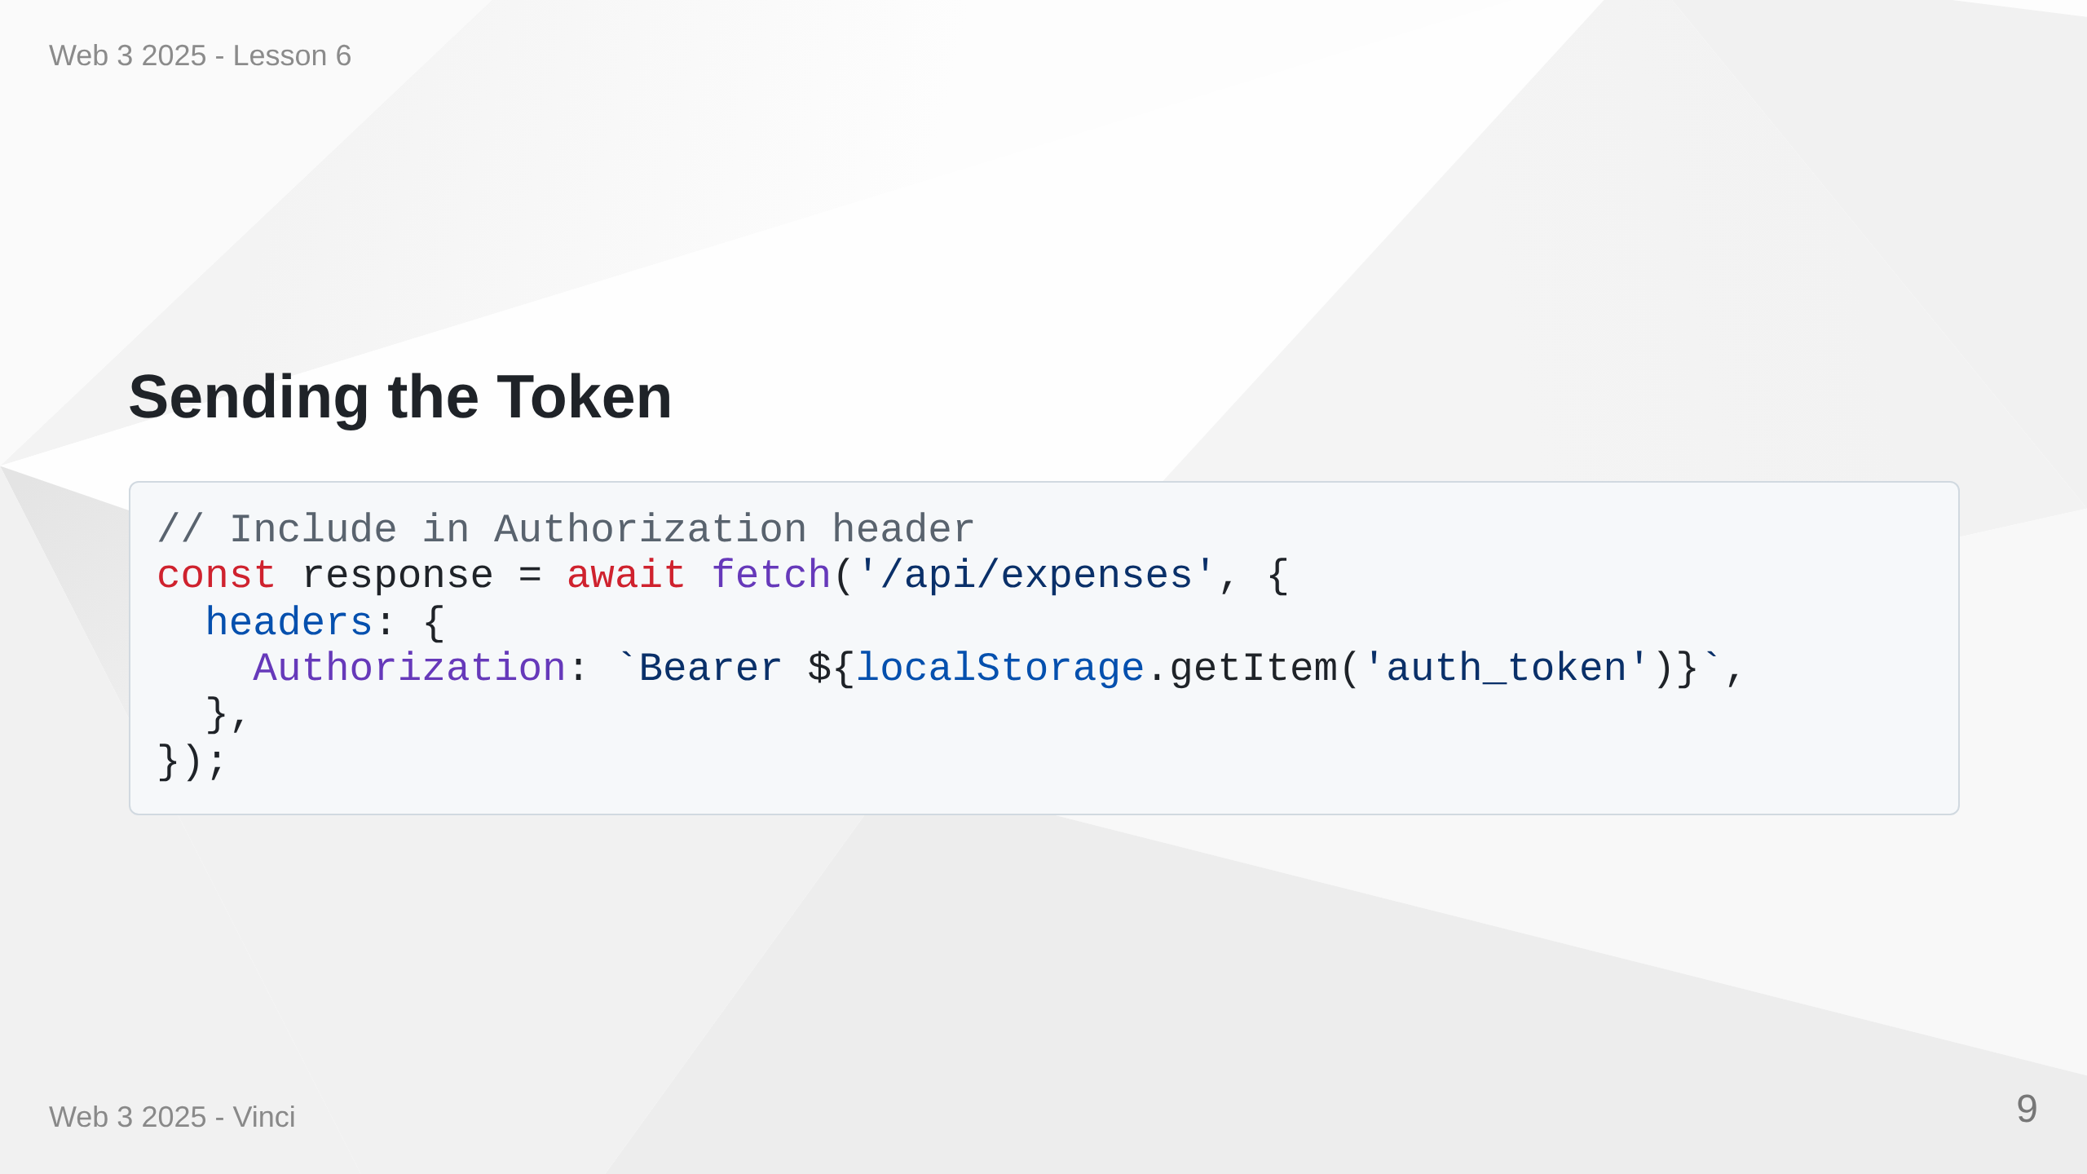
Notes:
Speaker Notes: • Client receives token after successful authentication • Store in localStorage for persistence across page refreshes • Send with every API request in Authorization header • Bearer scheme is standard for JWT • Alternative: httpOnly cookies (more secure but less flexible)

Slide 10
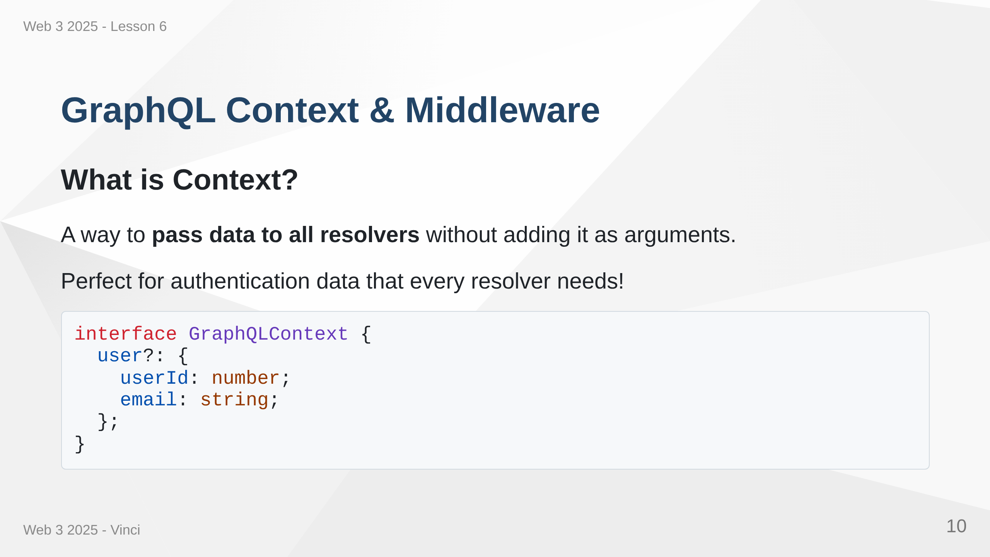
Notes:
Speaker Notes: • Context available in every resolver • Avoids repeating auth logic in each resolver • Set up once in middleware • TypeScript interface ensures type safety • Optional user - might not be authenticated

Slide 11
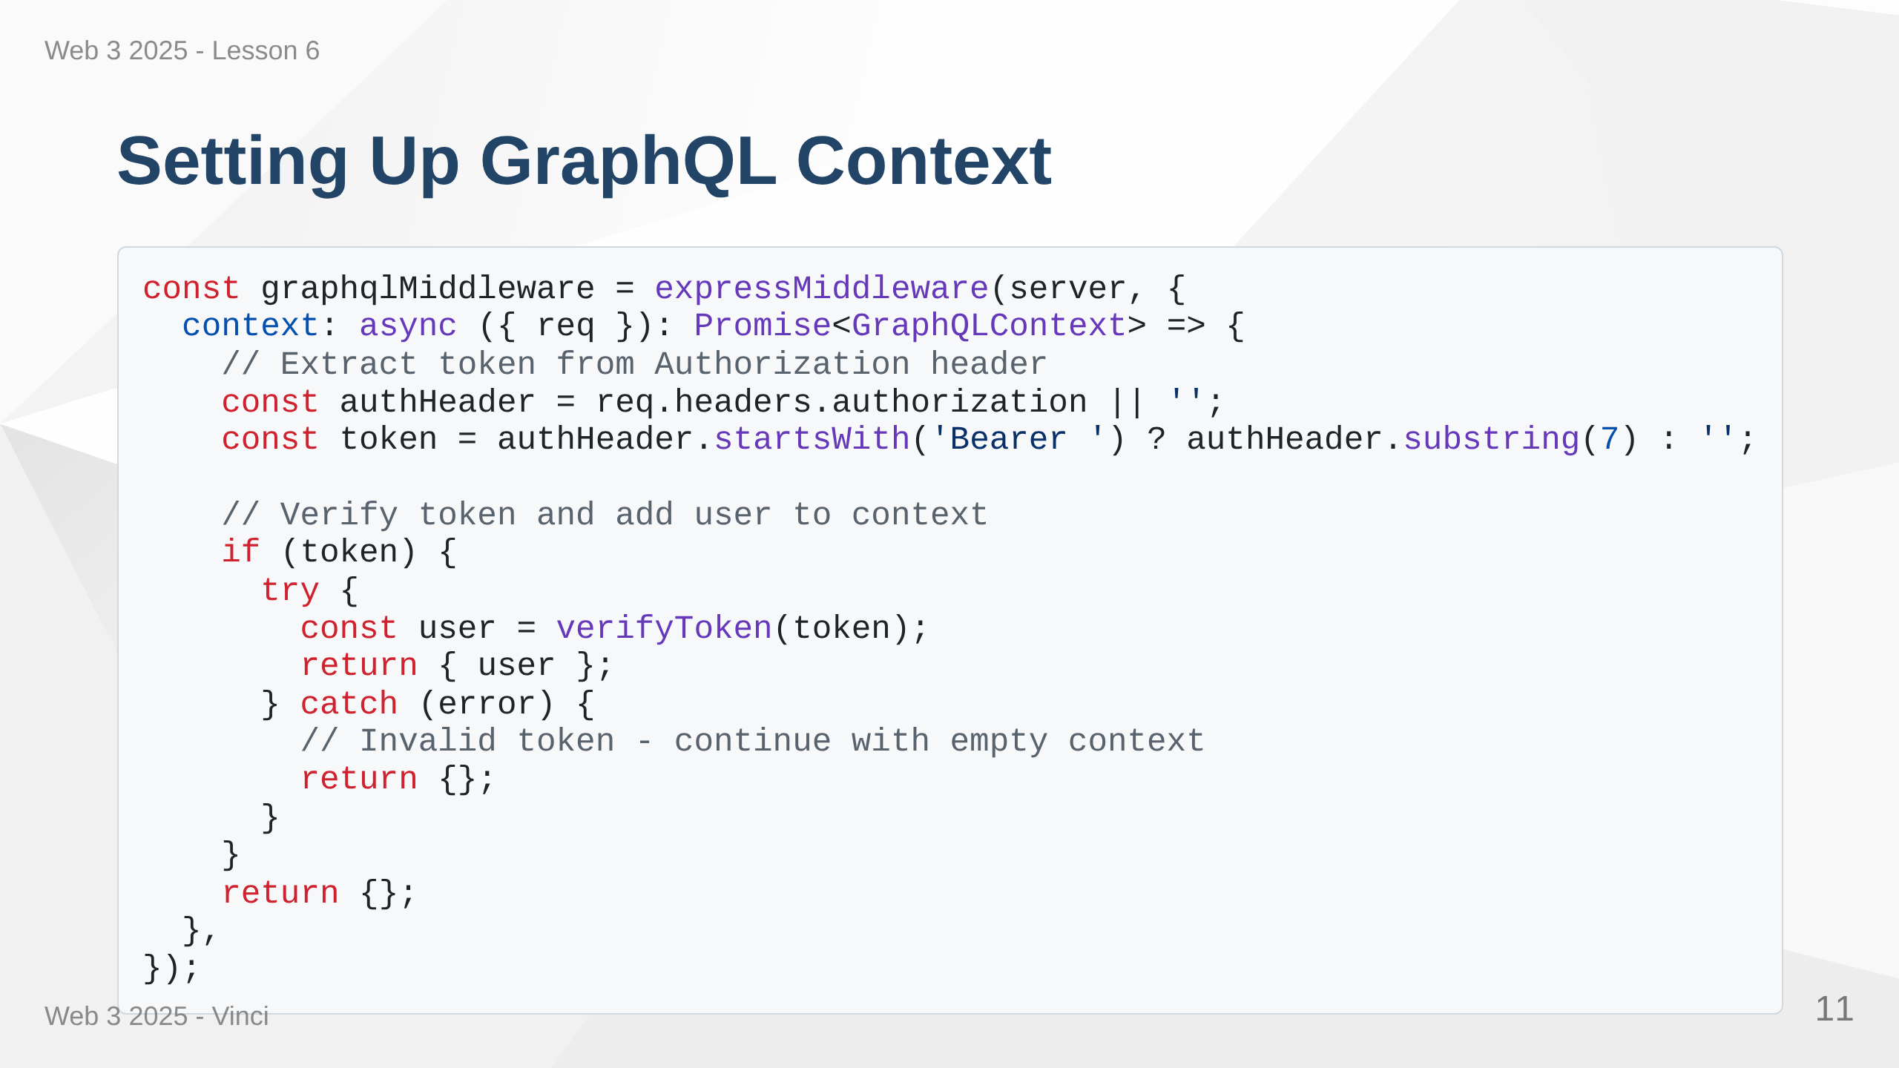
Notes:
Speaker Notes: • Runs before every GraphQL request • Extracts JWT from Authorization header • Verifies token and decodes payload • Adds user to context if valid token • Returns empty context if no token or invalid • All resolvers receive this context as parameter

Slide 12
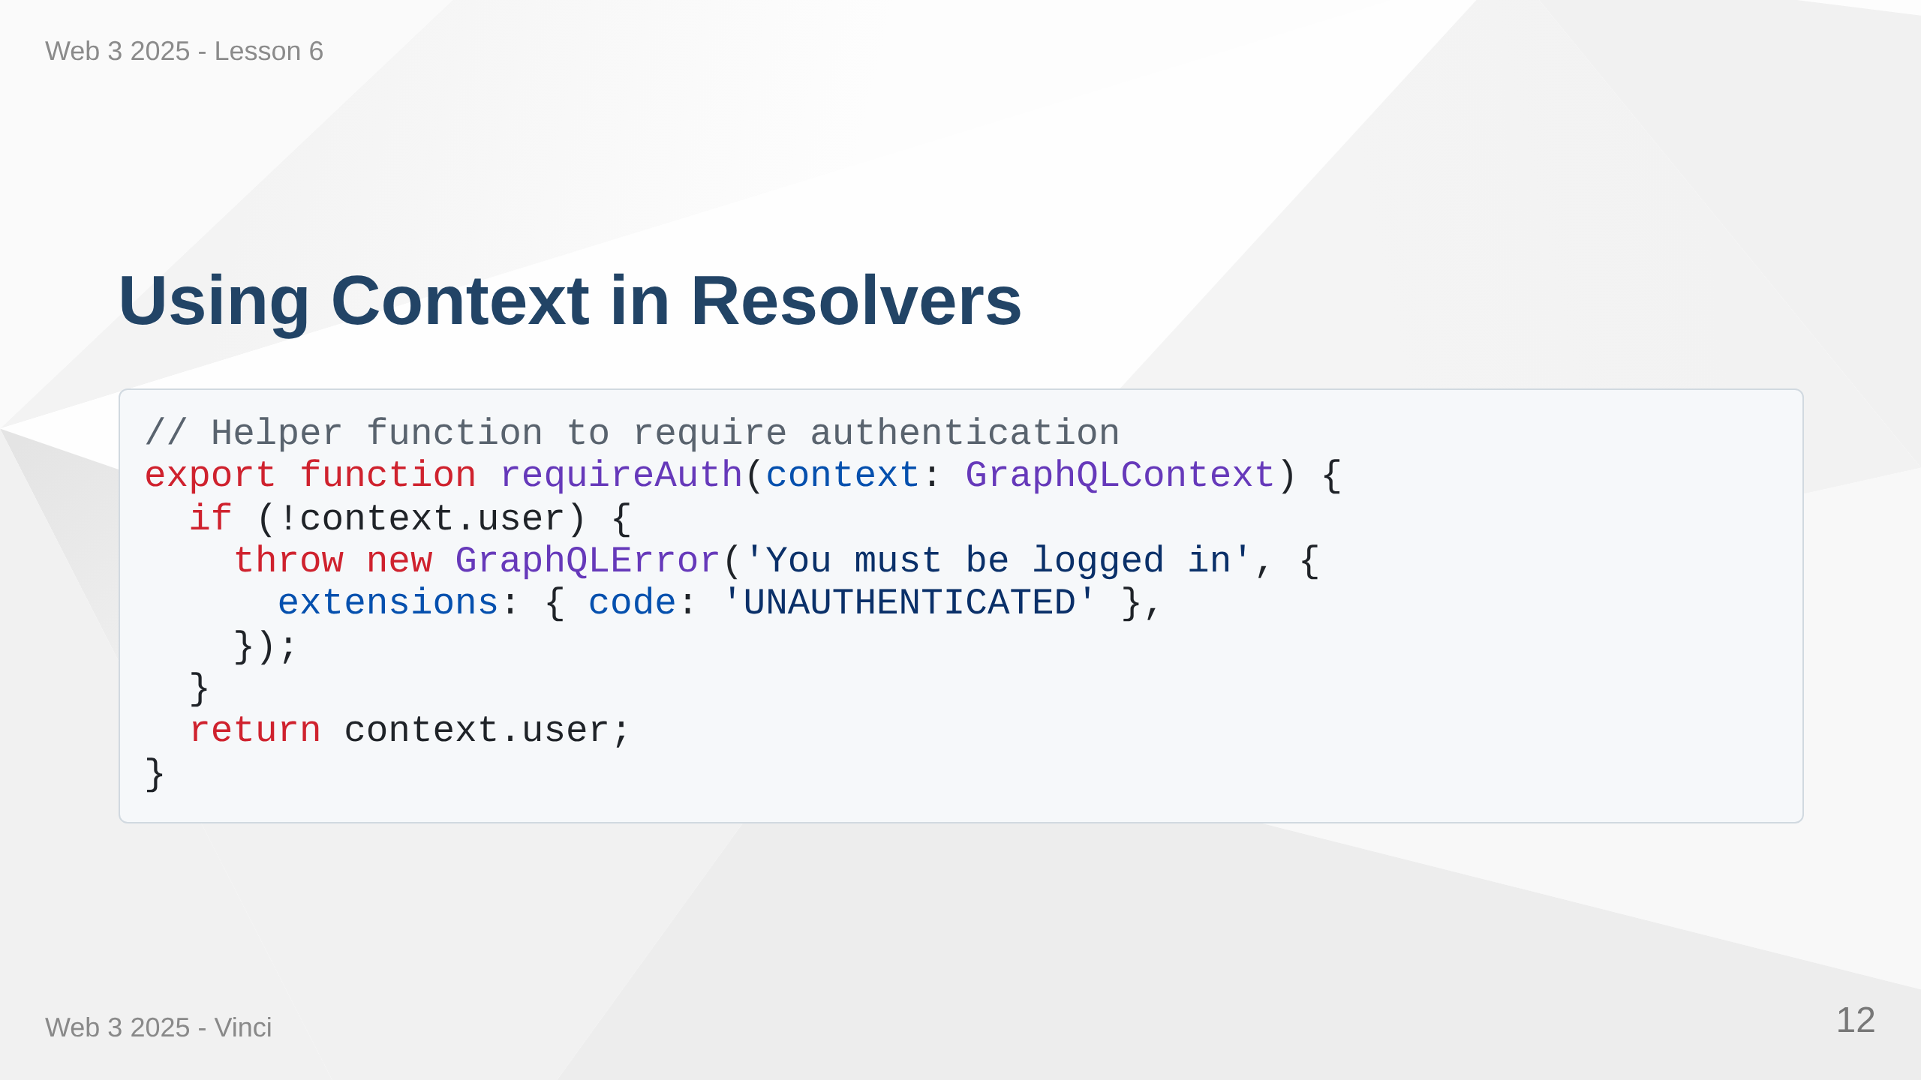
Notes:
Speaker Notes: • requireAuth checks if user exists in context • Throws UNAUTHENTICATED if not logged in • Throws FORBIDDEN if logged in but not authorized • Separation of authentication (who are you) and authorization (what can you do) • Context makes this pattern clean and reusable

Slide 13
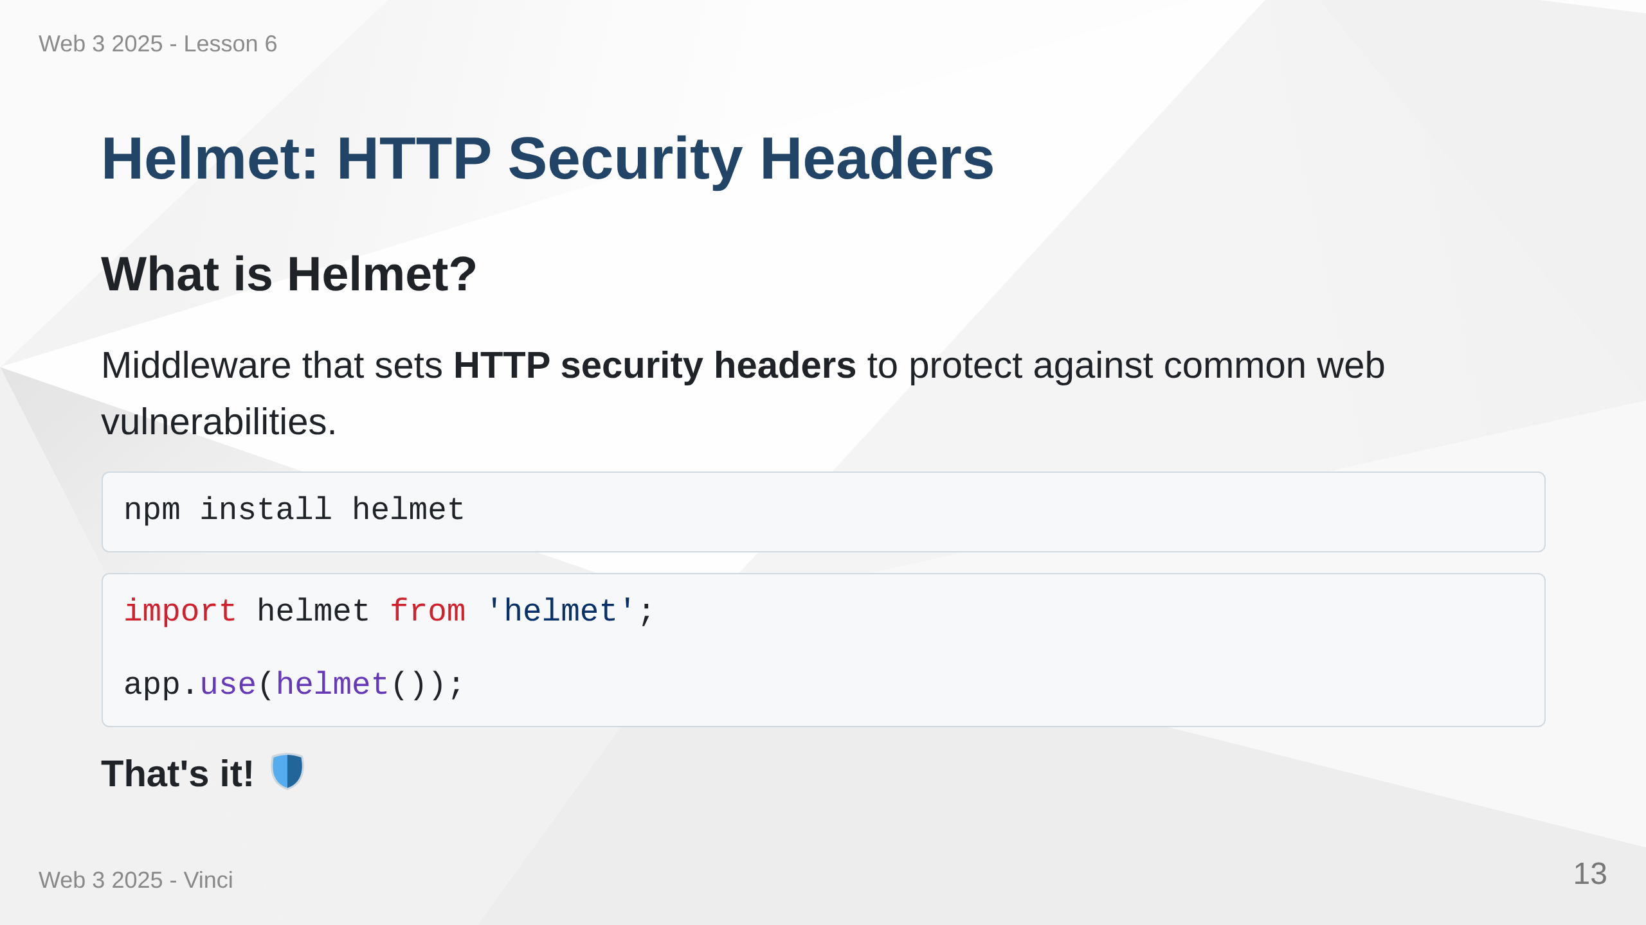
Notes:
Speaker Notes: • Helmet is Express middleware • Sets multiple security-related HTTP headers • Protects against common attacks • One line of code for significant security improvement • Industry standard for Express apps • Let's look at what it actually does

Slide 14
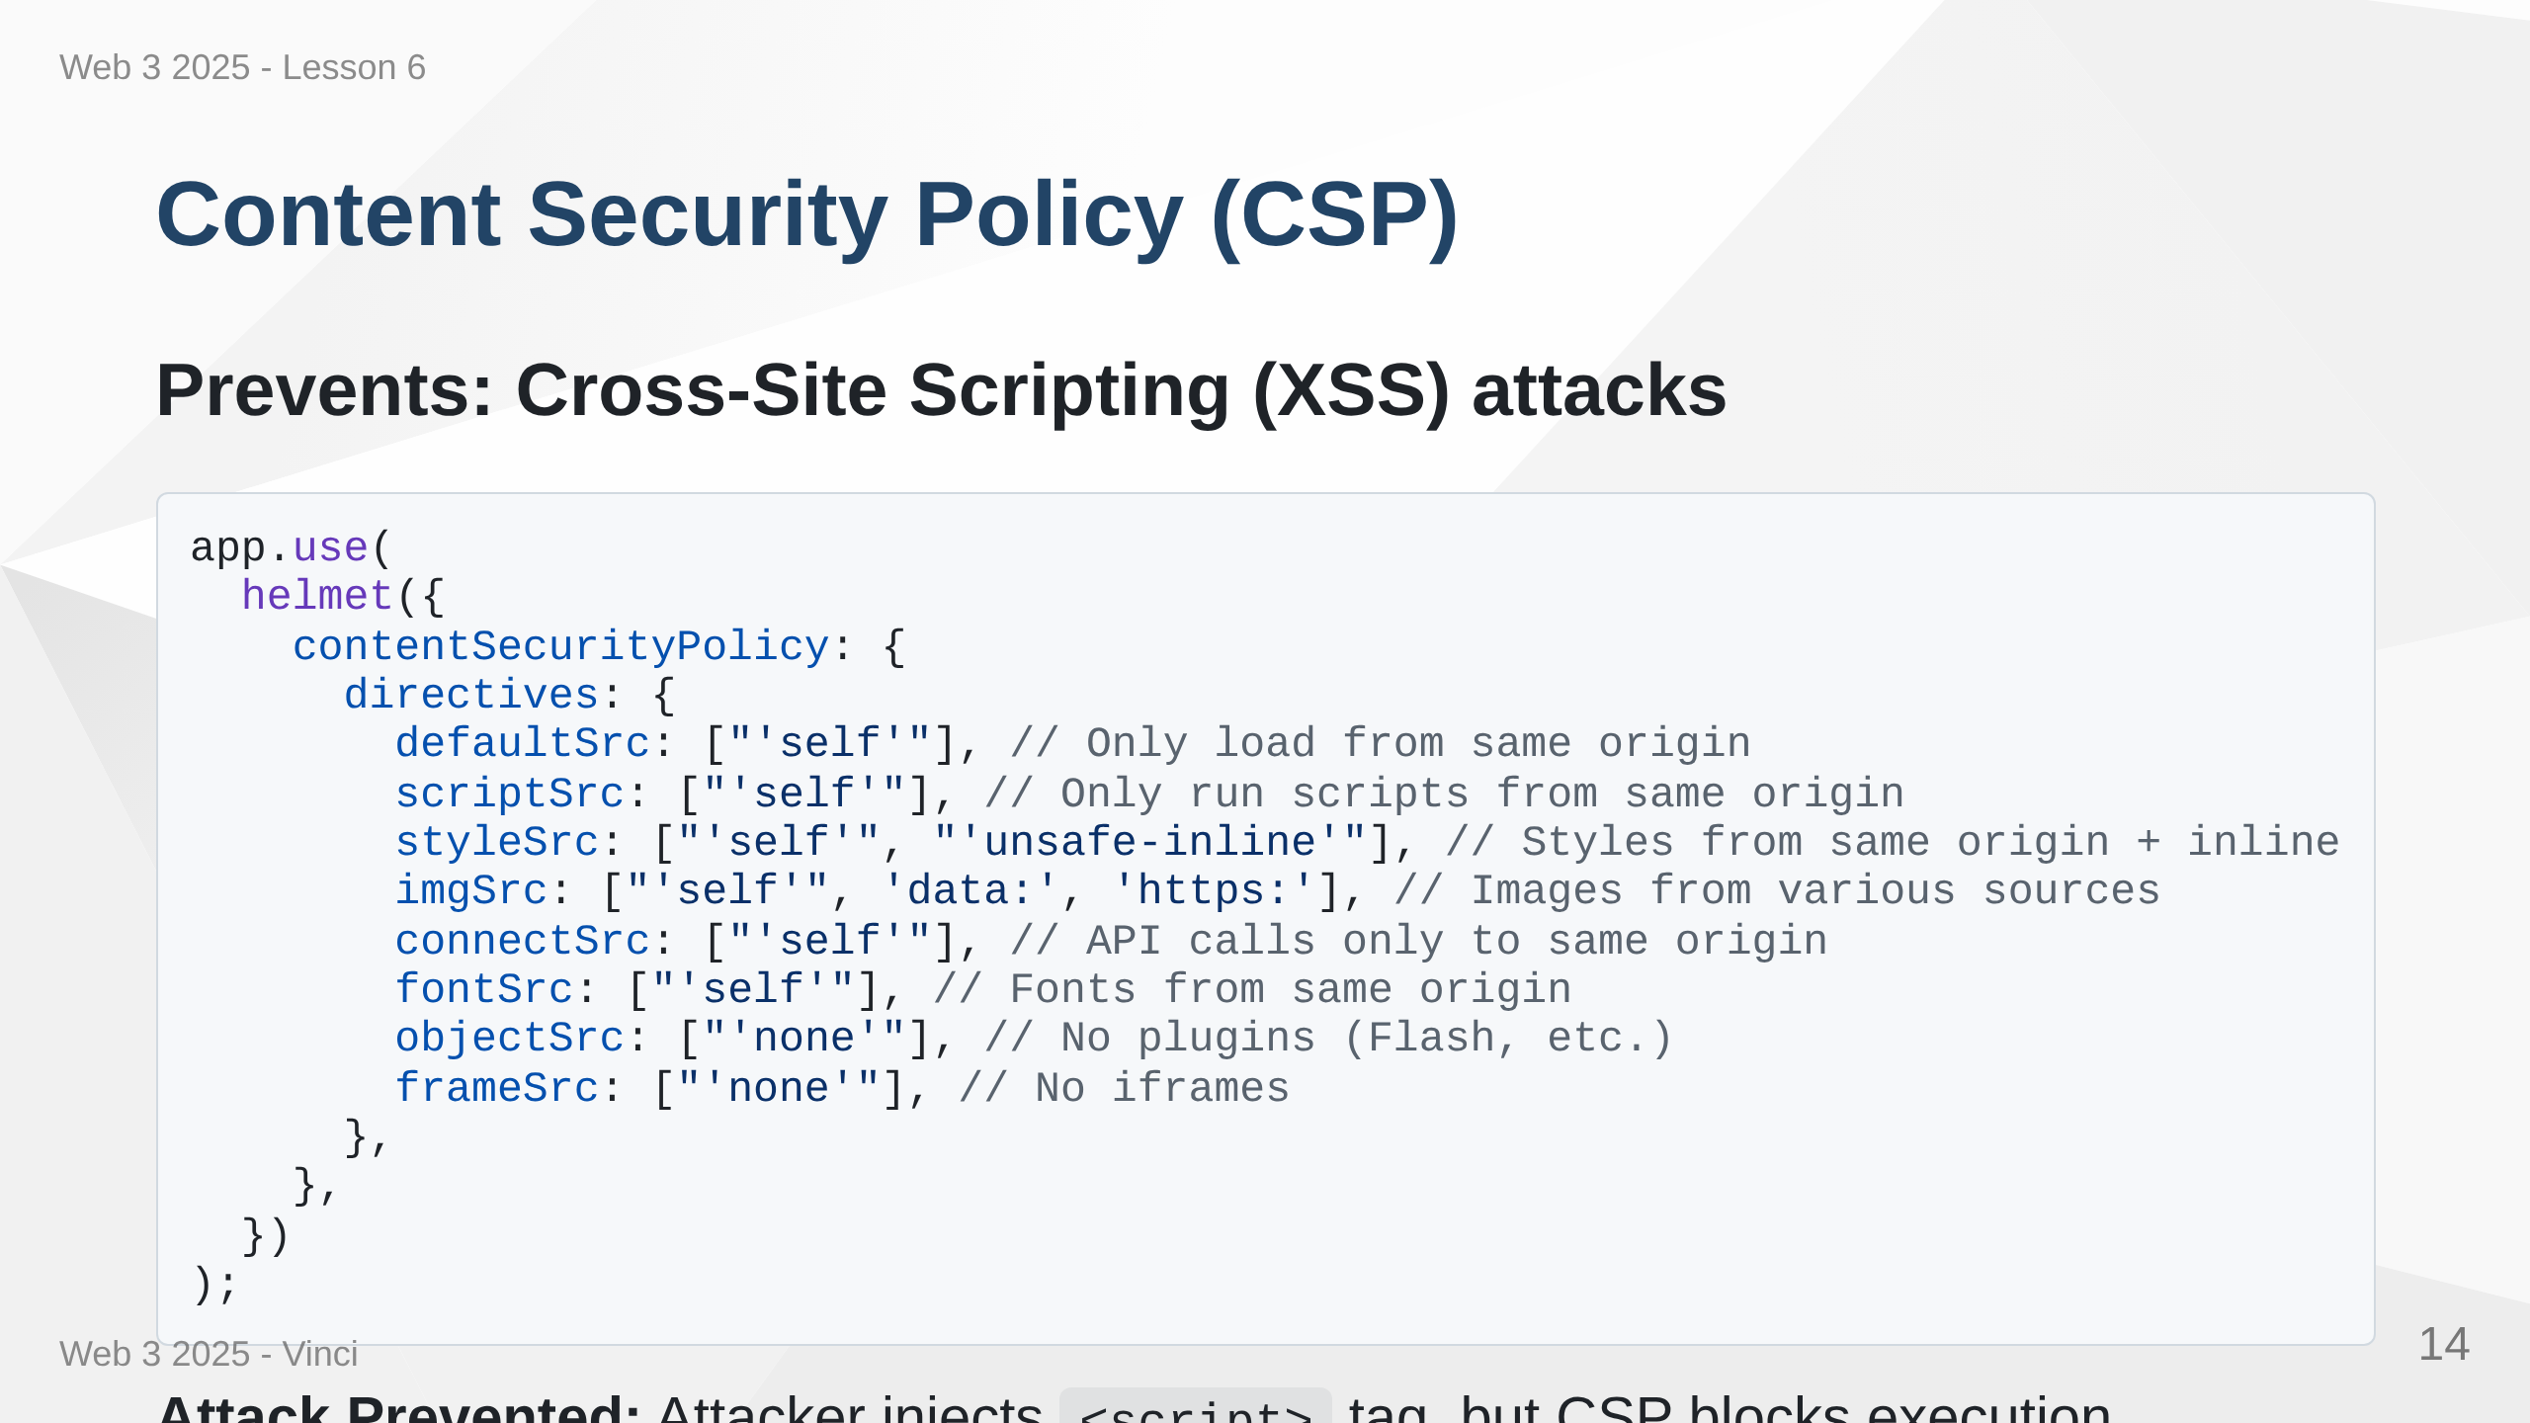
Notes:
Speaker Notes: • CSP defines trusted sources for different content types • Browser enforces these policies • defaultSrc is fallback for unspecified directives • scriptSrc prevents malicious script injection • unsafe-inline needed for some frameworks but risky • connectSrc controls where fetch/XMLHttpRequest can connect • Significantly reduces XSS attack surface

Slide 15
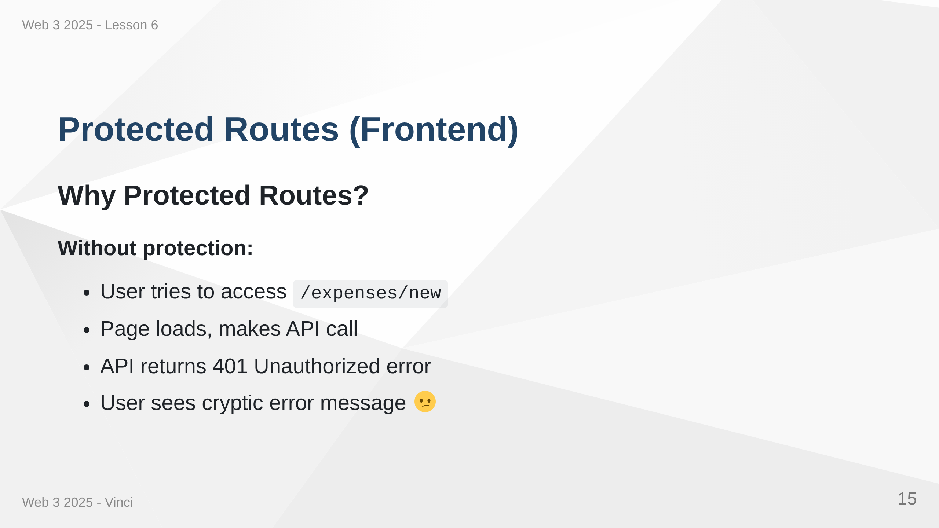

Slide 16
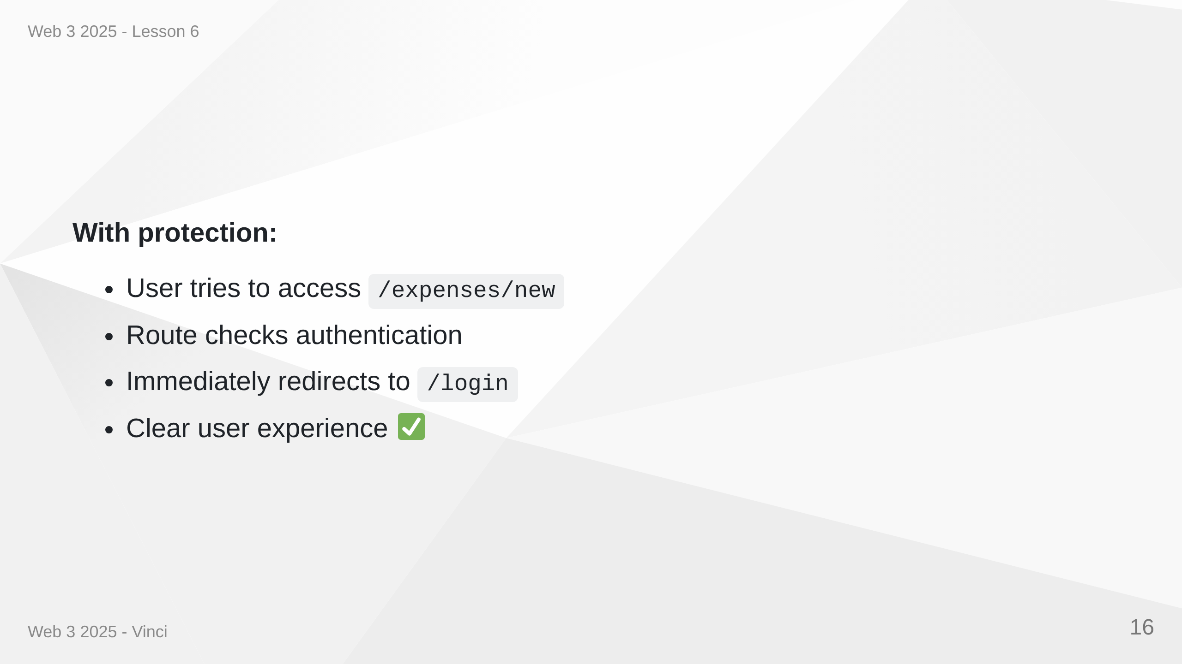
Notes:
Speaker Notes: • Frontend protection is UX, not security • Real security happens on backend • Protected routes improve user experience • Redirect before loading page components • Prevents loading data for unauthenticated users • Clearer flow for users

Slide 17
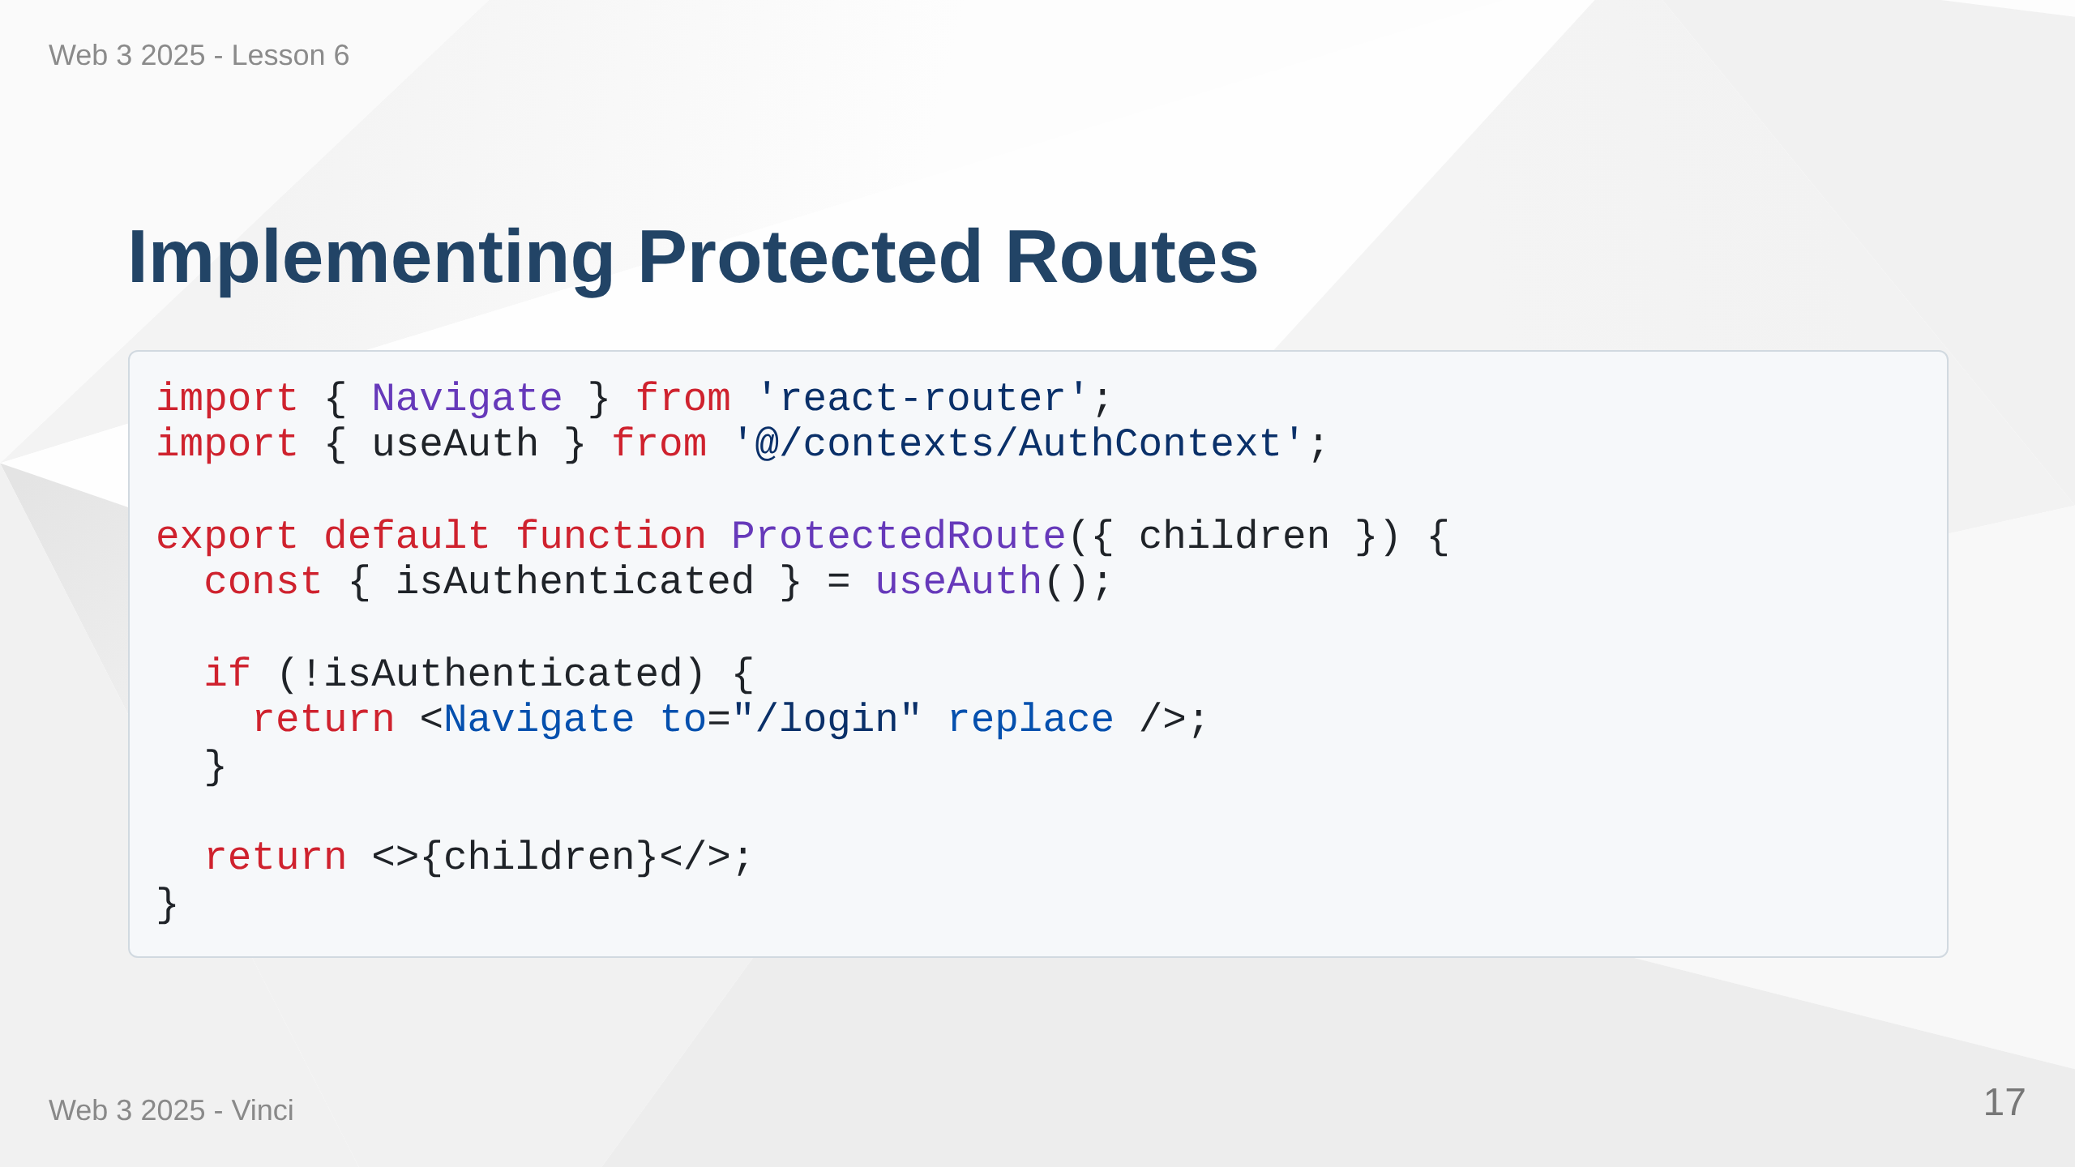

Slide 18
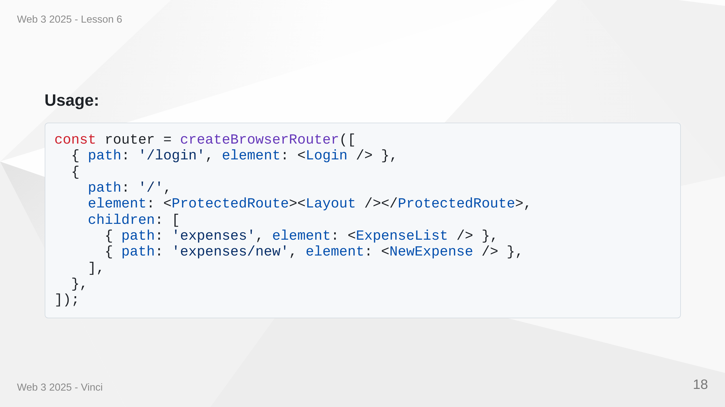
Notes:
Speaker Notes: • Simple component that checks authentication • Wraps protected pages/layouts • Navigate with replace prevents back button issues • All nested routes inherit protection • Clean, declarative route structure • useAuth hook accesses authentication context

Slide 19
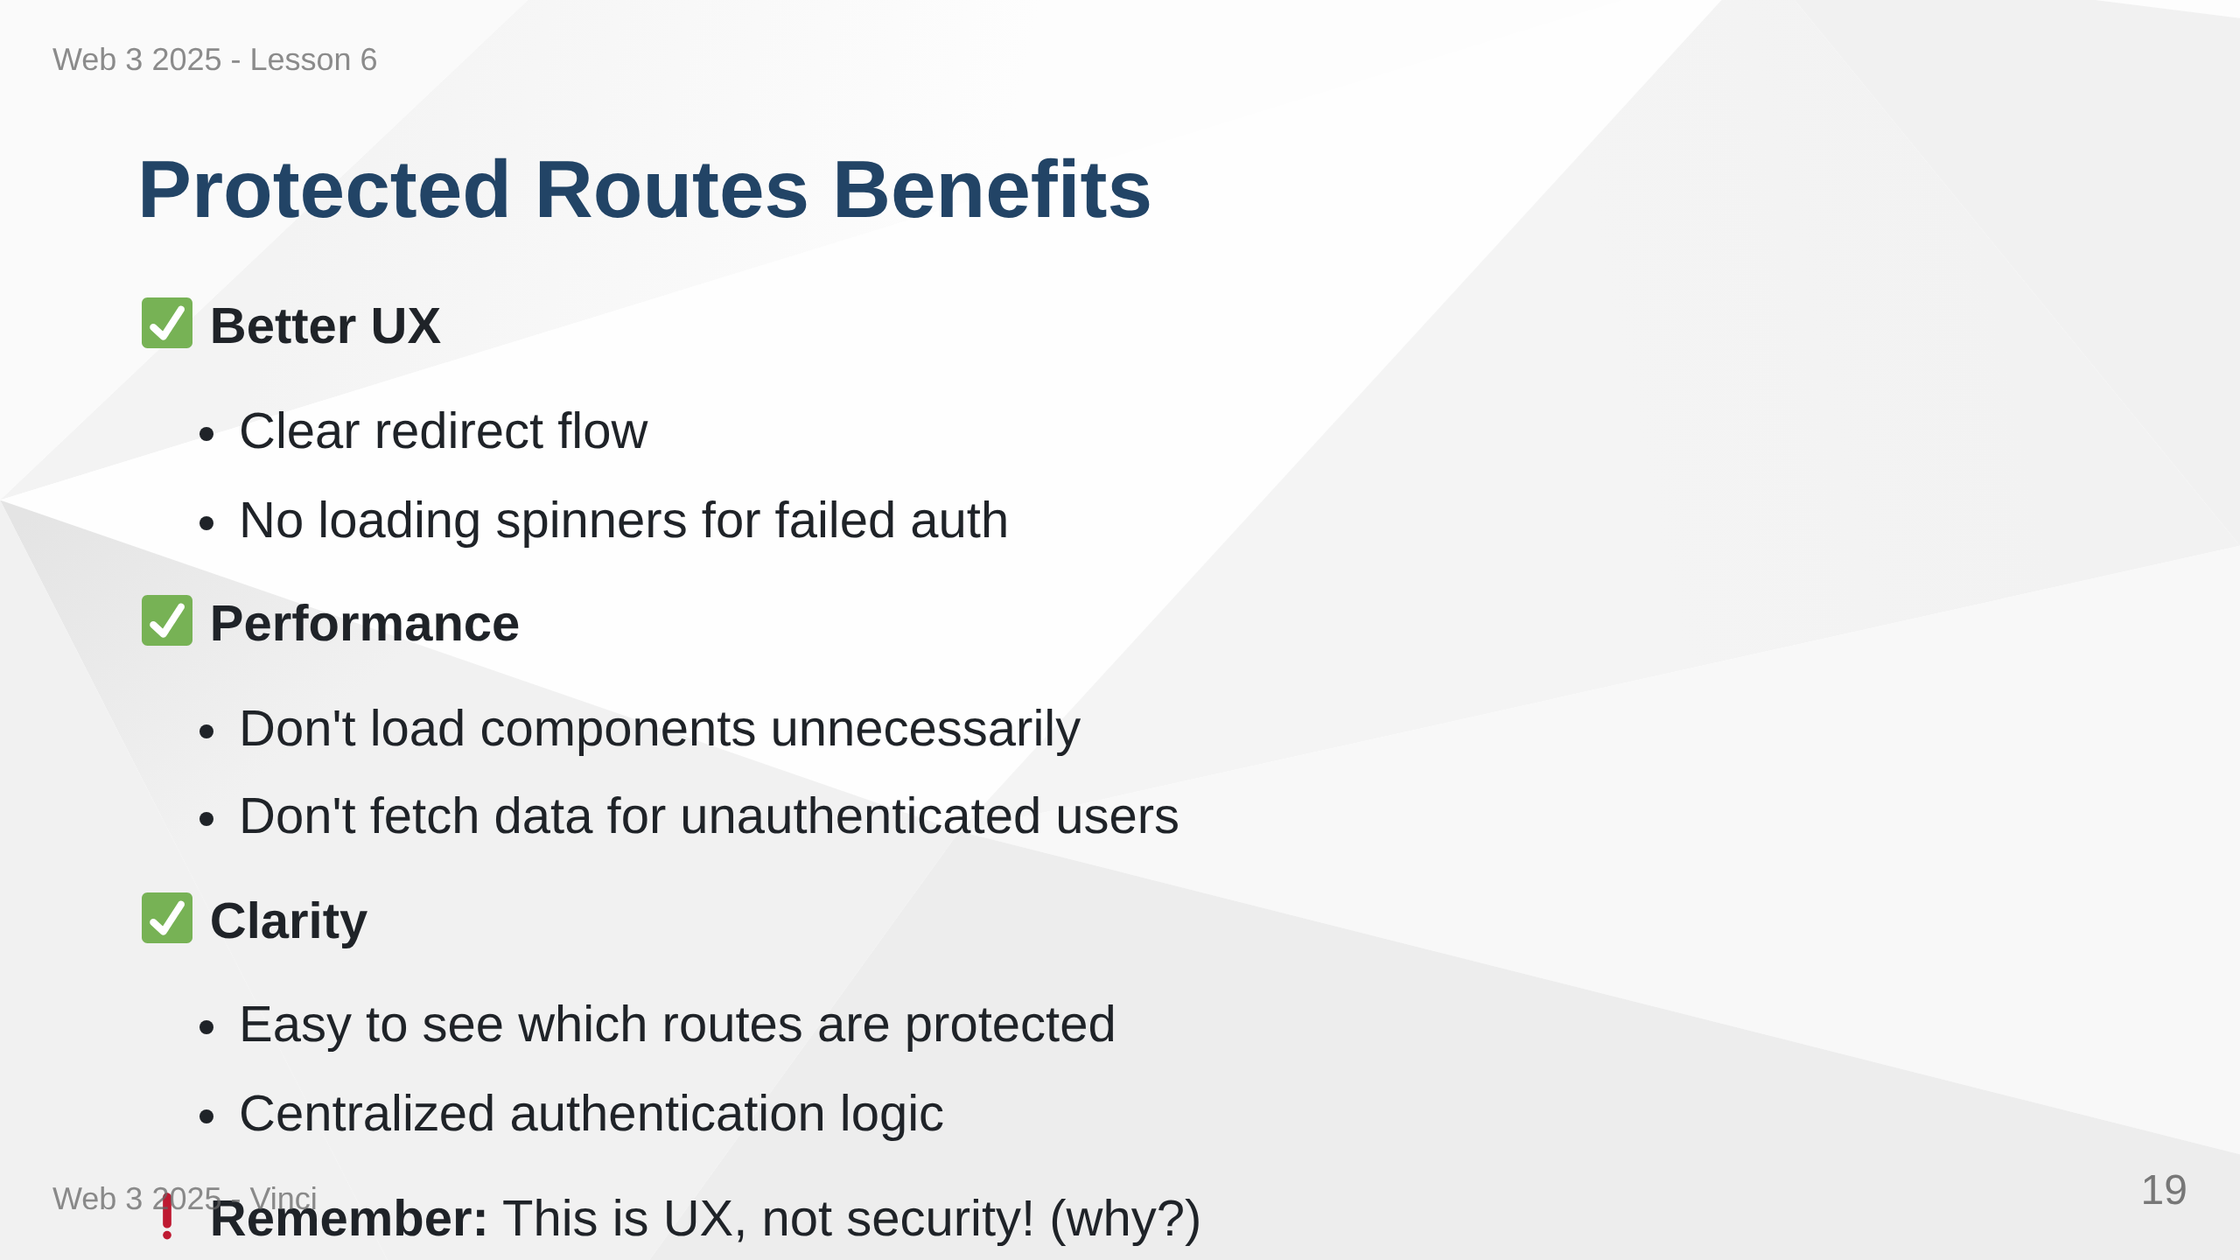
Notes:
Speaker Notes: • Frontend protection about user experience • Backend protection about actual security • Can't rely on client-side checks alone • Attackers can bypass frontend entirely • Always authenticate and authorize on backend • Frontend routes just provide nice UX

Slide 20
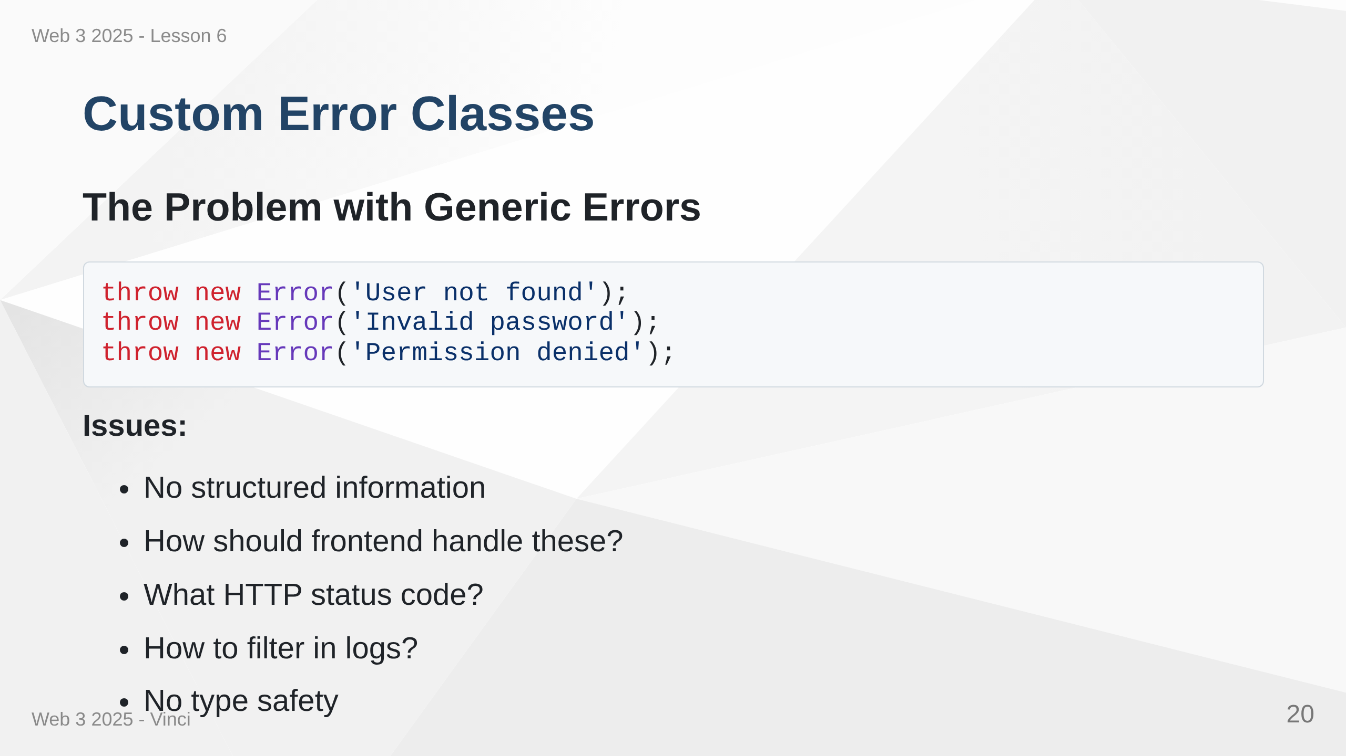
Notes:
Speaker Notes: • Generic Error class lacks semantic meaning • All errors look the same • Hard to handle different errors differently • No standard for status codes • Difficult to log and monitor effectively

Slide 21
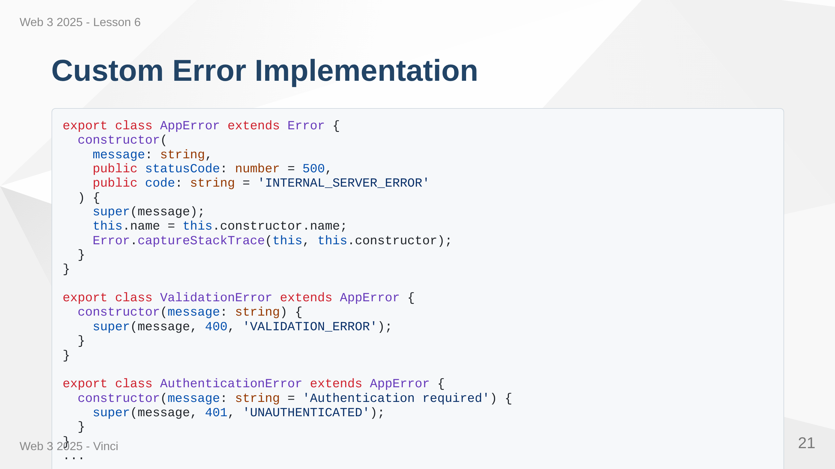
Notes:
Speaker Notes: • Base AppError class with common properties • Specific error classes for different scenarios • Each error has appropriate HTTP status code • Code property for programmatic error handling • captureStackTrace preserves error origin • Easy to add new error types • TypeScript provides type safety

Slide 22
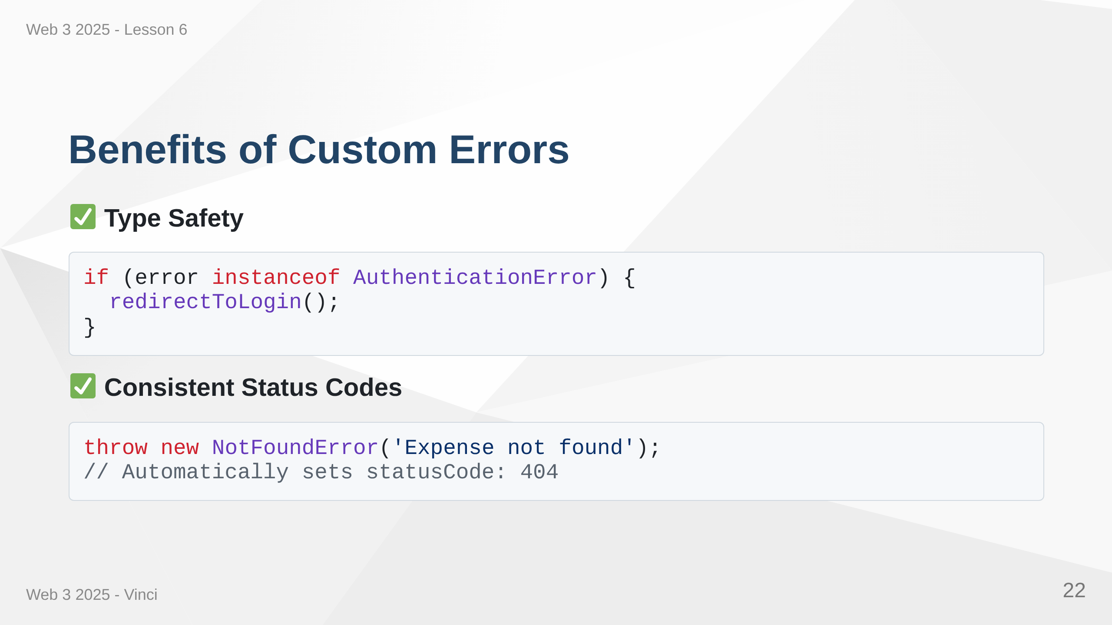

Slide 23
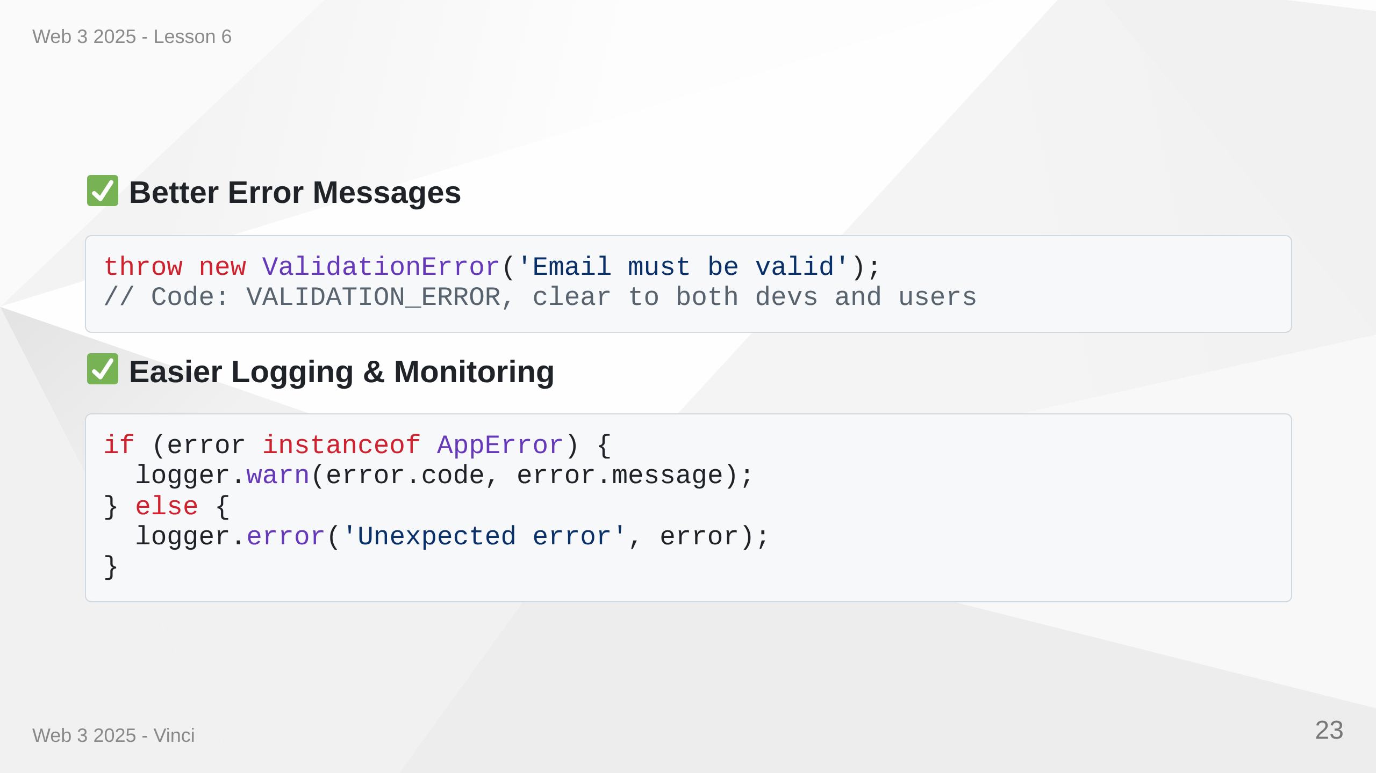
Notes:
Speaker Notes: • Type checking enables smart error handling • No manual status code management • Clear error categories • Easy to filter and search logs • Monitoring tools can group by error type • Better debugging experience • Consistent error handling across application

Slide 24
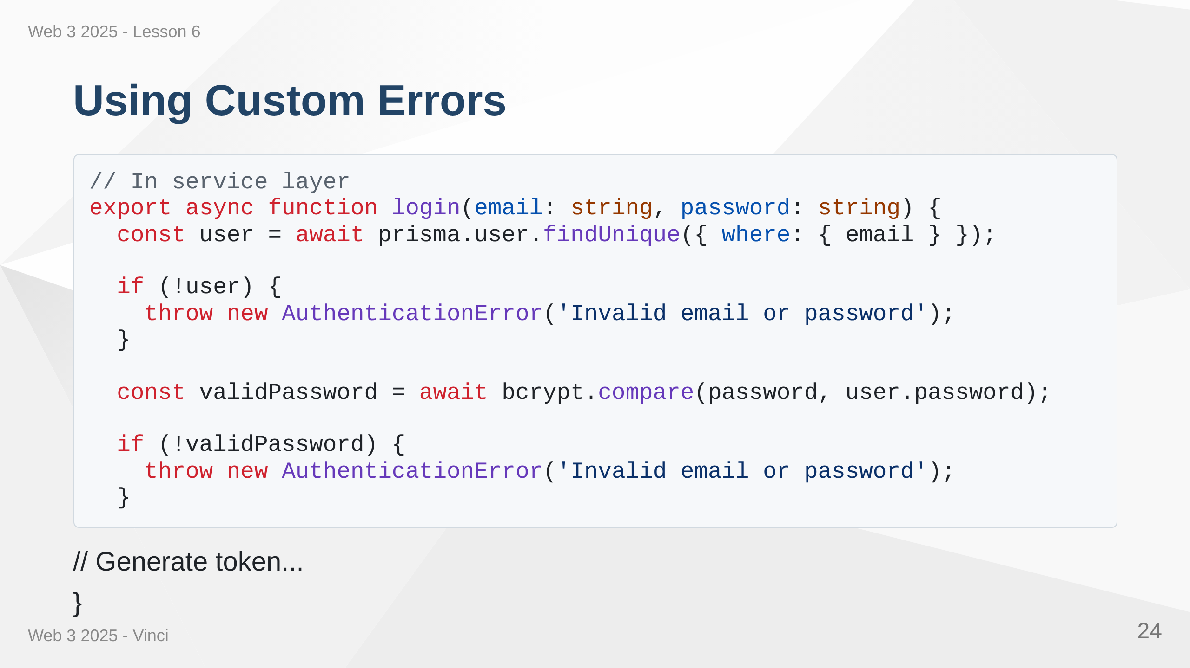

Slide 25
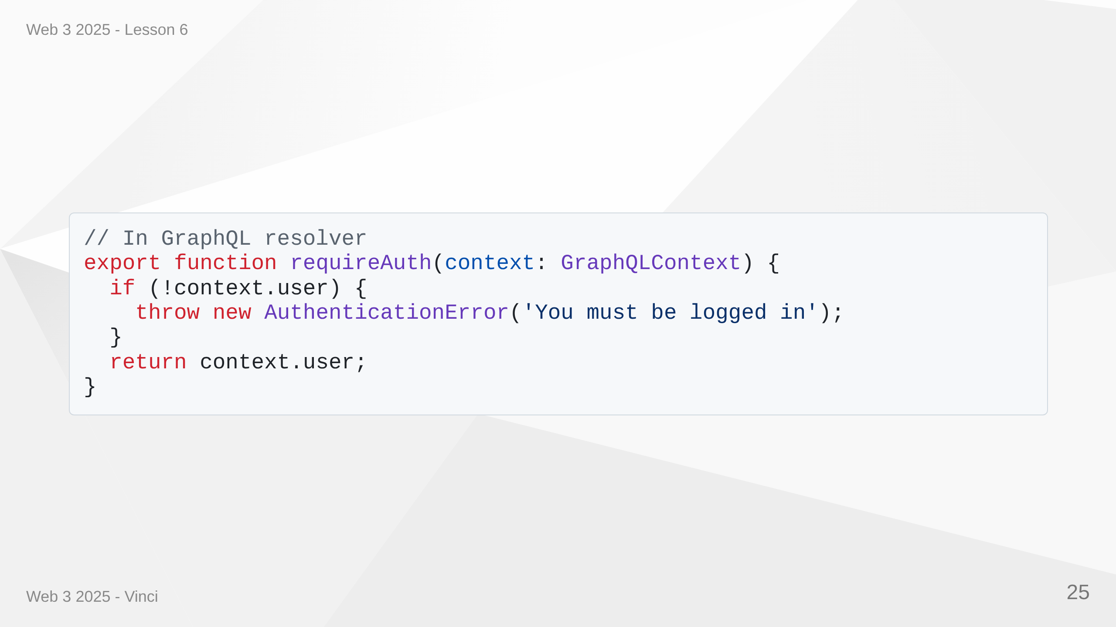
Notes:
Speaker Notes: • Throw specific error types in business logic • Clear intent from error class name • Consistent error codes across application • Frontend can distinguish error types • Better logging and monitoring • Easier to write error handling middleware

Slide 26
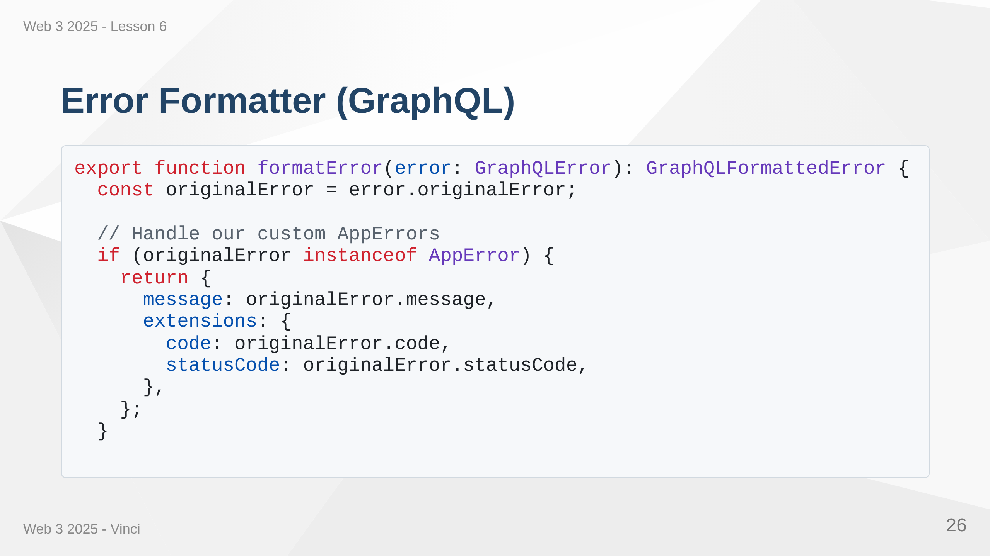

Slide 27
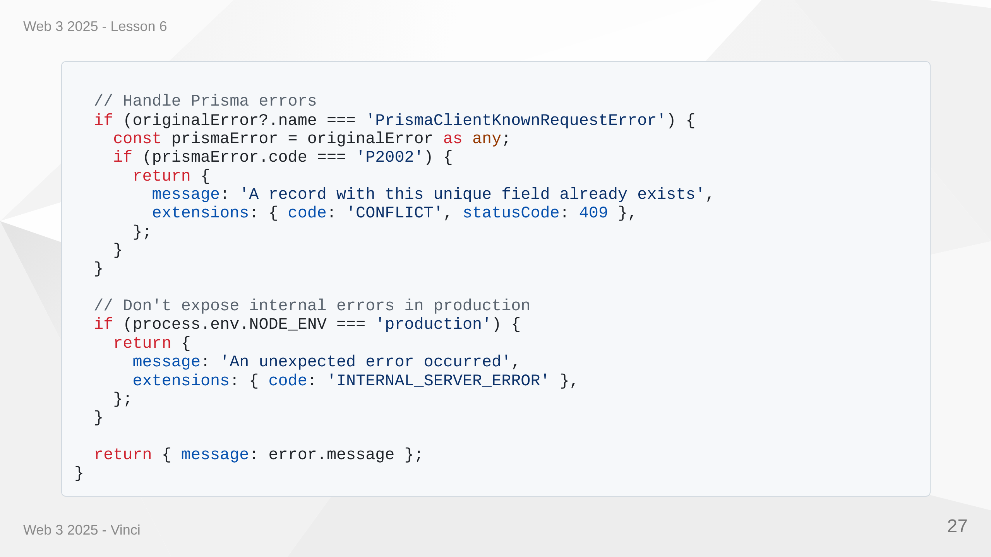
Notes:
Speaker Notes: • Converts all errors to consistent format • Extracts error codes and status codes • Handles Prisma database errors • Hides implementation details in production • Provides useful error info in development • Integrated with Apollo Server • Single place to control error responses

Slide 28
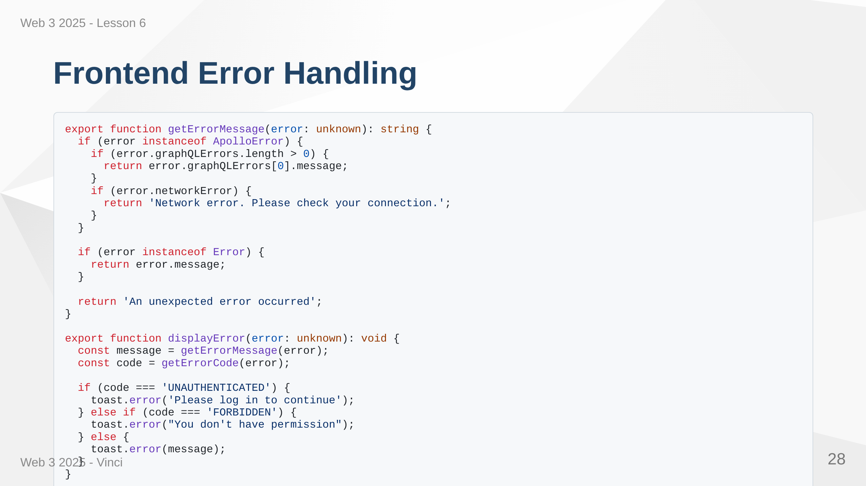
Notes:
Speaker Notes: • Utility functions for consistent error handling • Extracts user-friendly messages • Special handling for different error codes • Uses toast notifications for better UX • Centralized error display logic • Easy to customize error presentation • Type-safe with unknown type

Slide 29
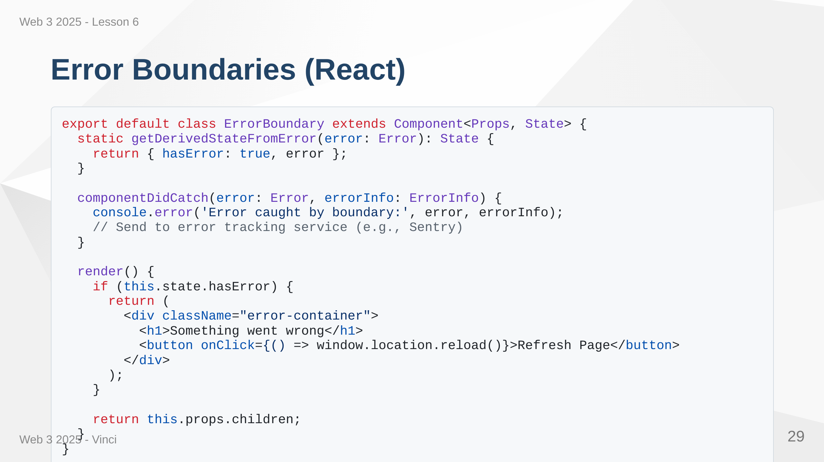
Notes:
Speaker Notes: • Error boundaries catch React component errors • Prevents entire app from crashing • Shows fallback UI instead • Can log errors to monitoring service • Class component required - no hook alternative yet • Place at strategic points in component tree • User can recover without losing all work

Slide 30
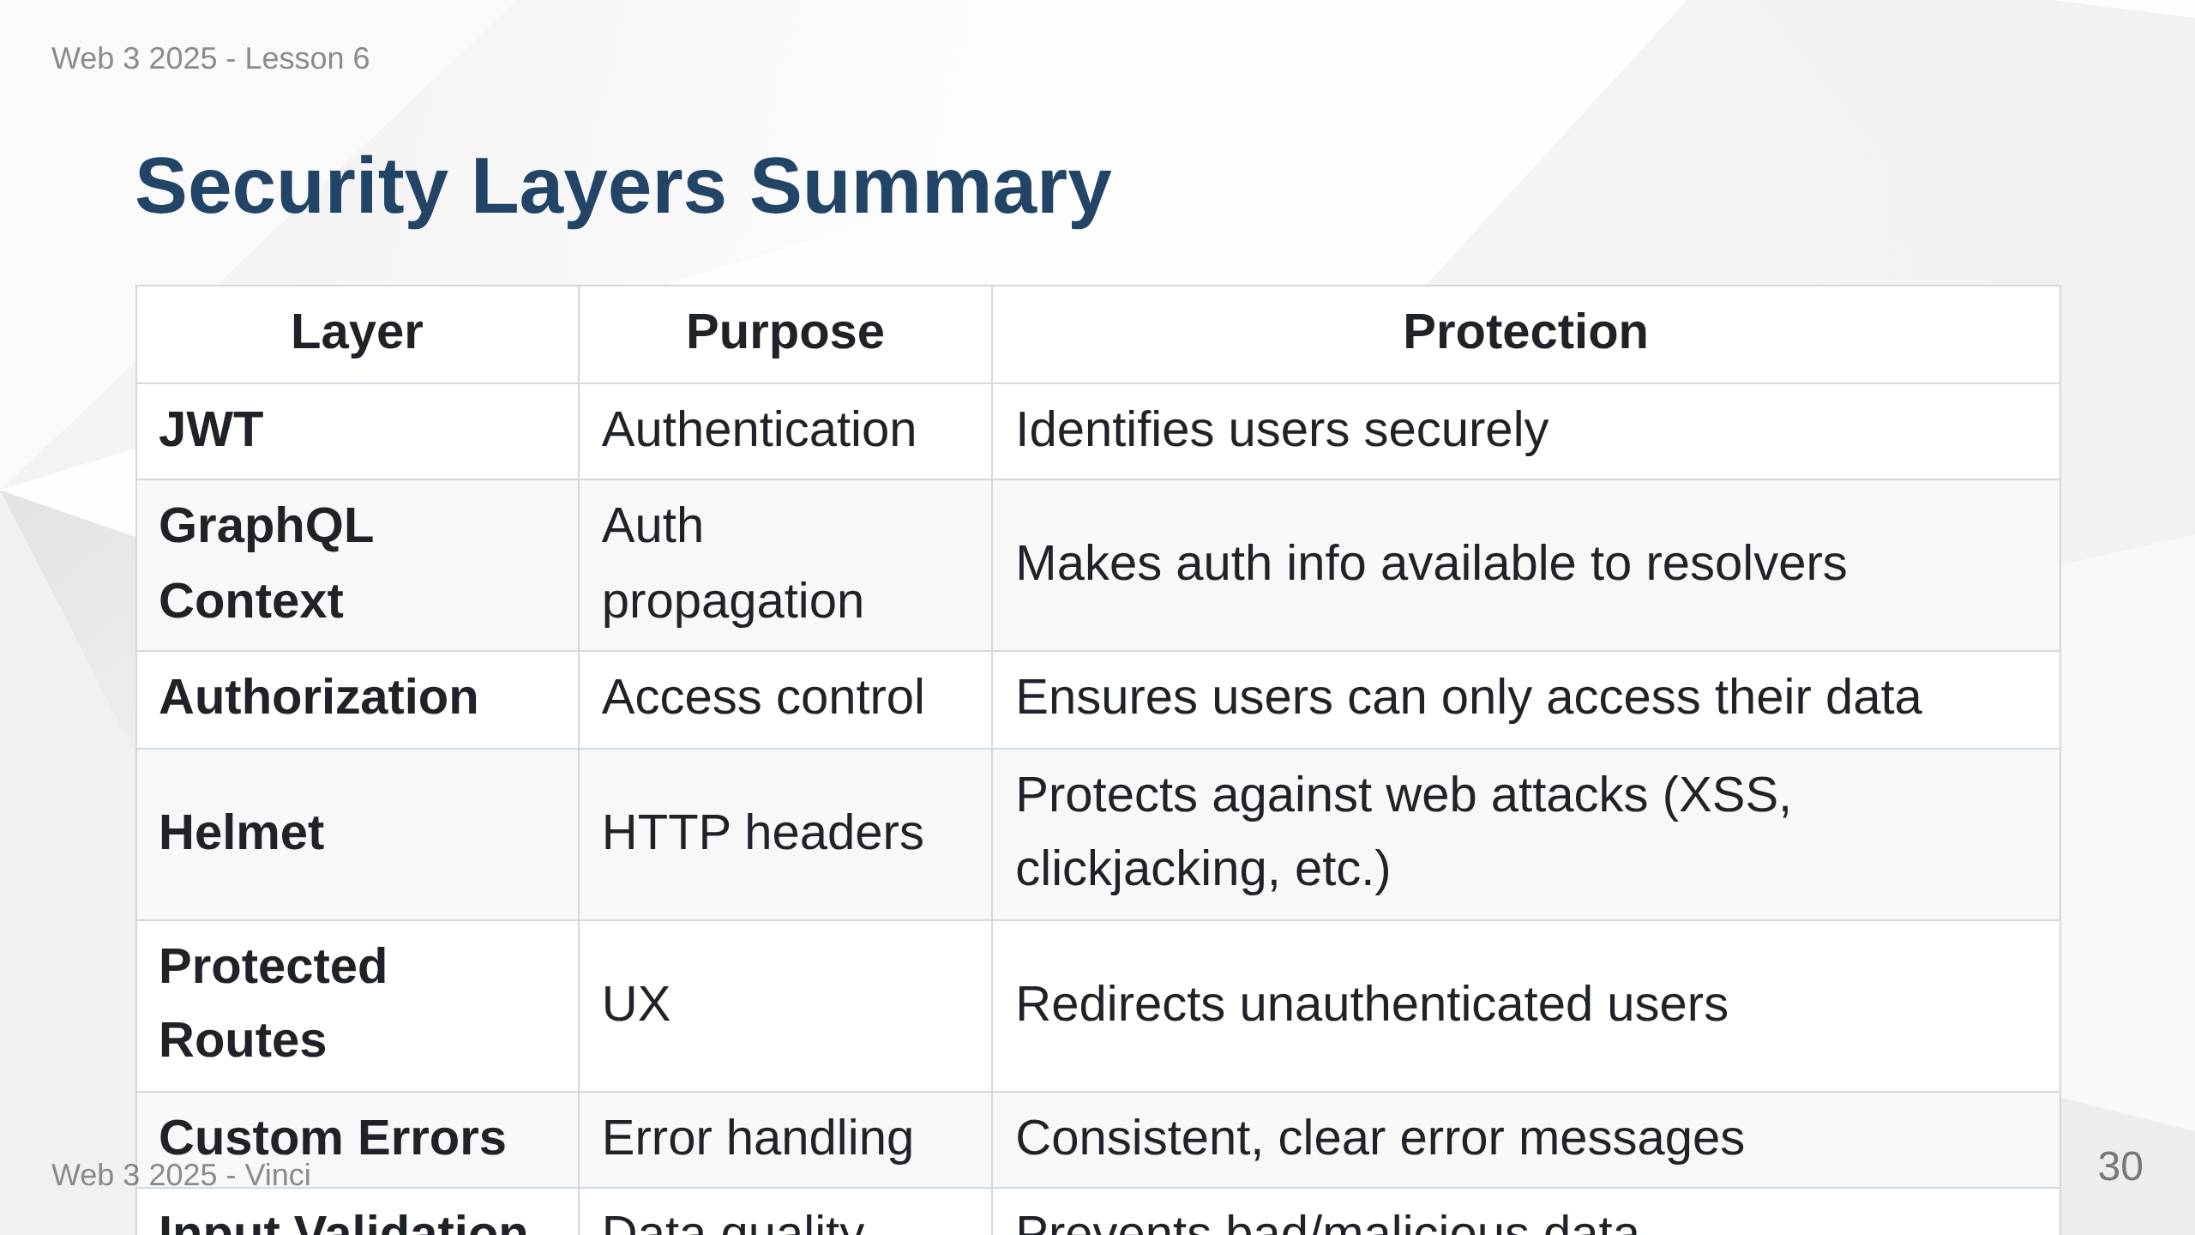
Notes:
Speaker Notes: • Each layer addresses different security concerns • If one layer fails, others provide backup • Defense in depth is security best practice • Never rely on single security measure • Frontend and backend security work together • Comprehensive security requires all layers

Slide 31
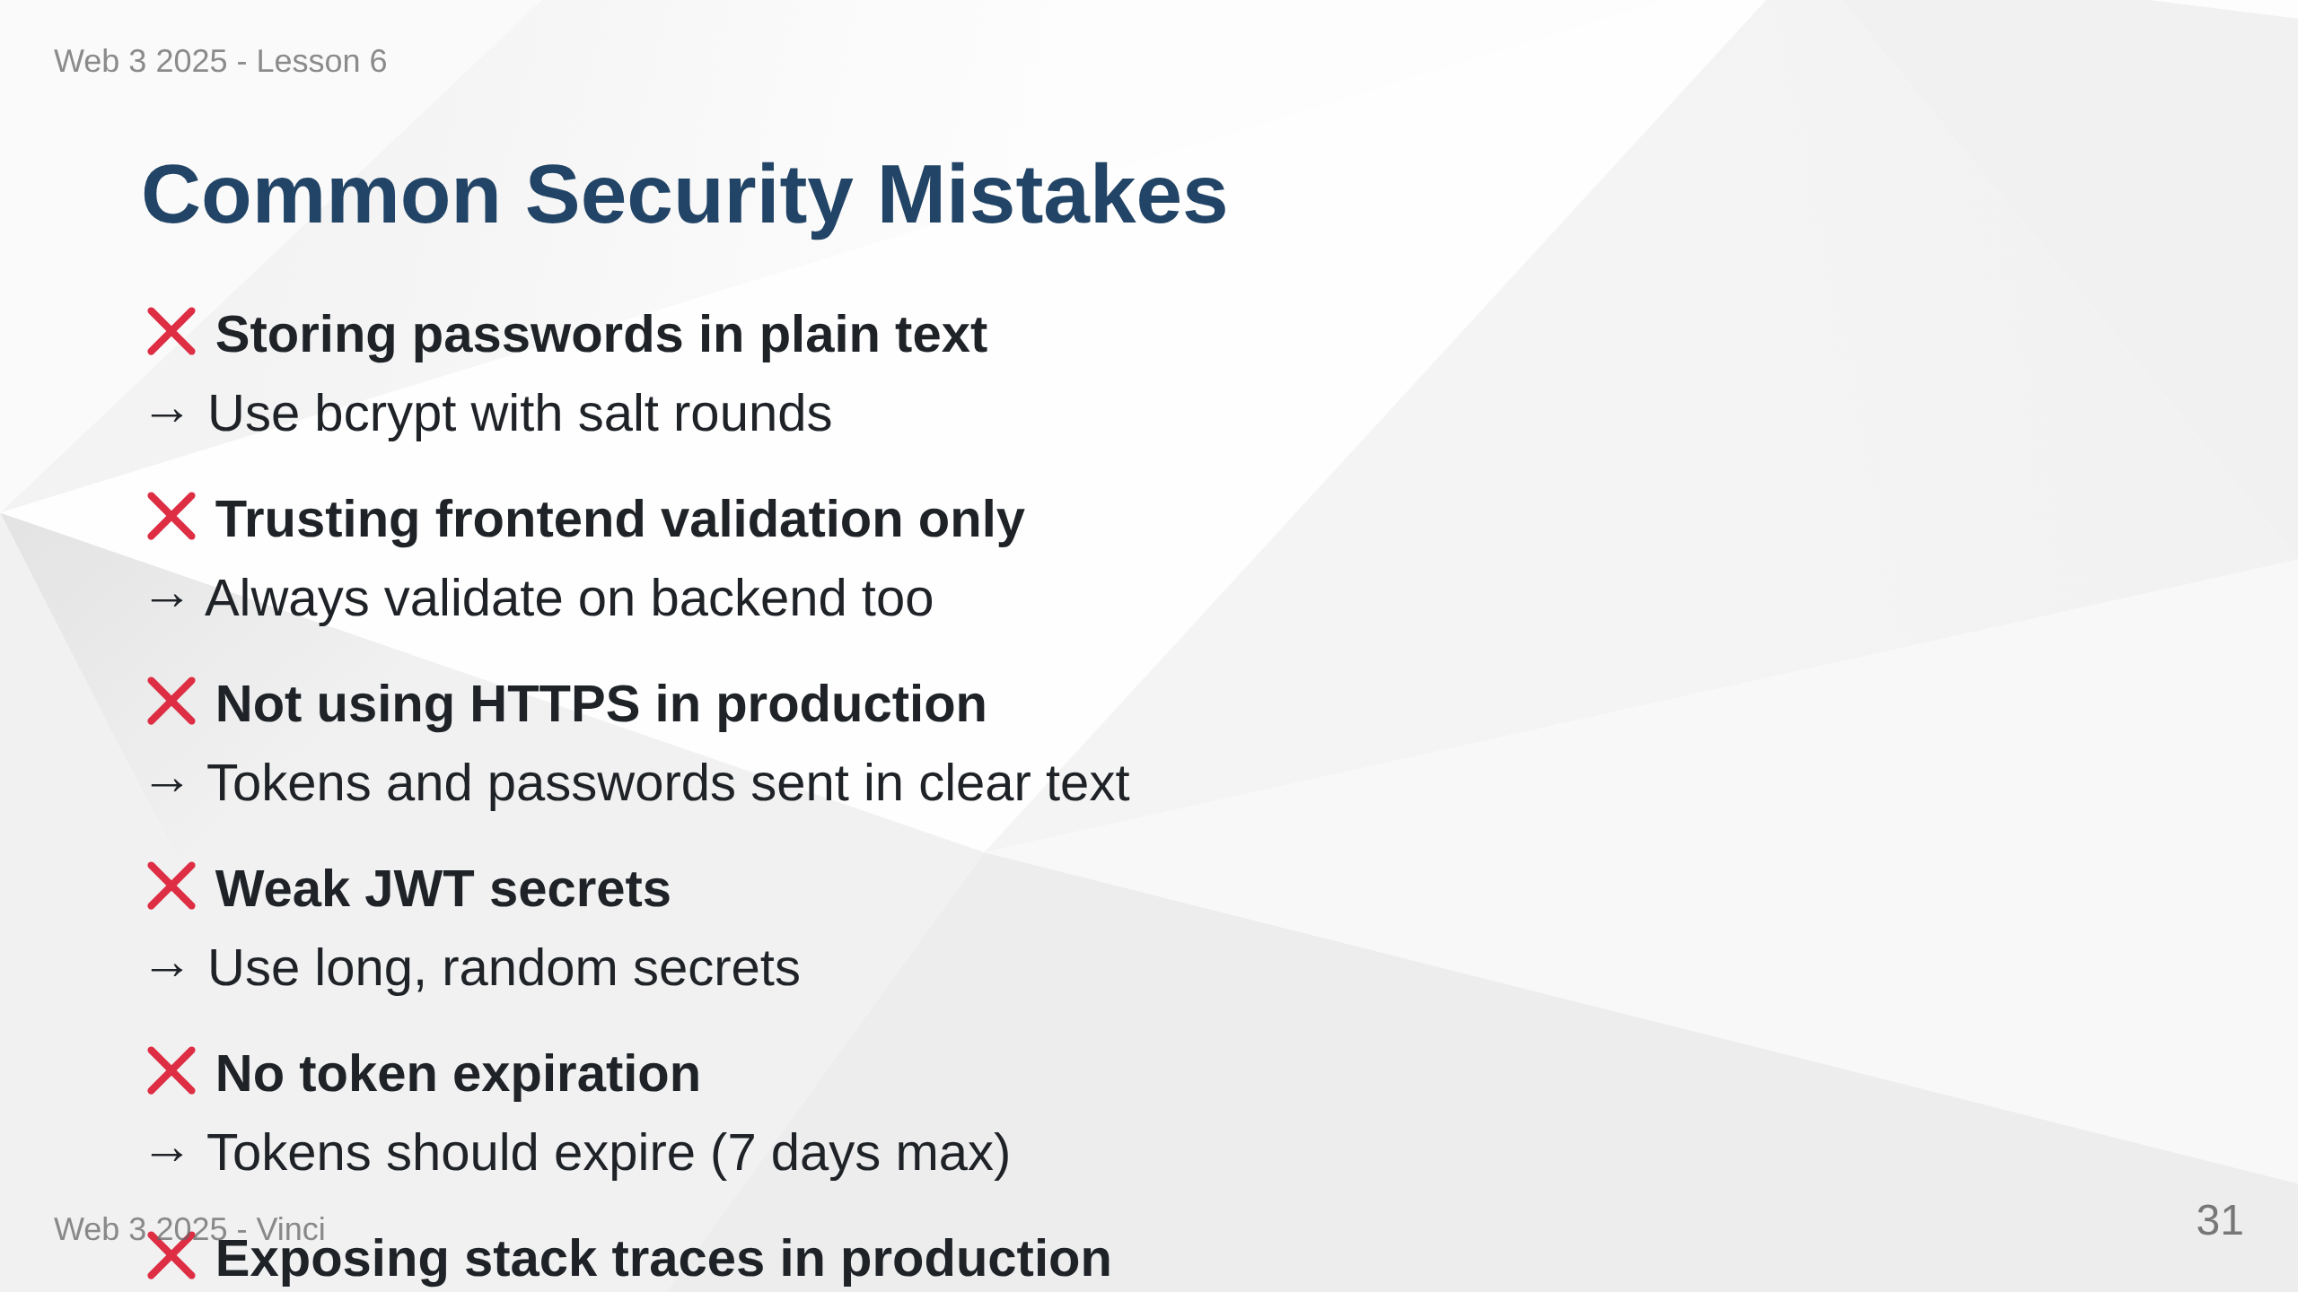
Notes:
Speaker Notes: • These are common mistakes we must avoid • Frontend validation is UX, not security • HTTPS absolutely required for production • Weak secrets can be brute forced • Long-lived tokens increase risk if compromised • Stack traces reveal implementation details • Always assume attackers have technical knowledge

Slide 32
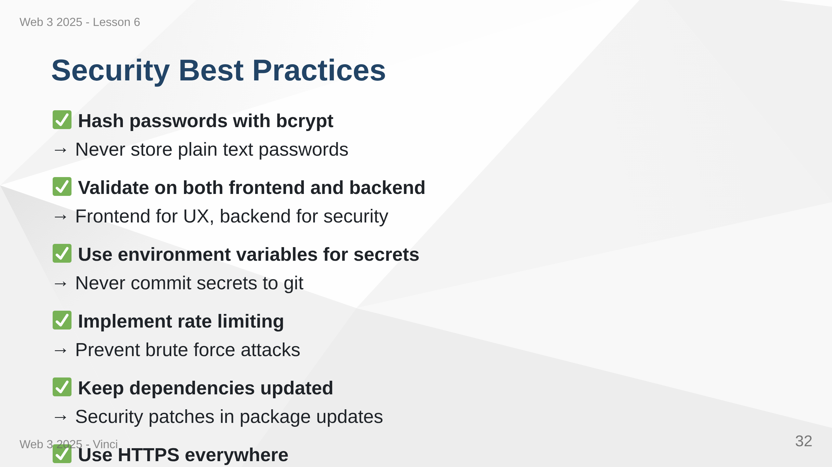
Notes:
Speaker Notes: • bcrypt automatically handles salt and hashing • Backend validation is security boundary • .env files keep secrets out of code • Rate limiting prevents automated attacks • npm audit finds known vulnerabilities • HTTPS isn't just for production anymore • Logging helps detect and respond to attacks

Slide 33
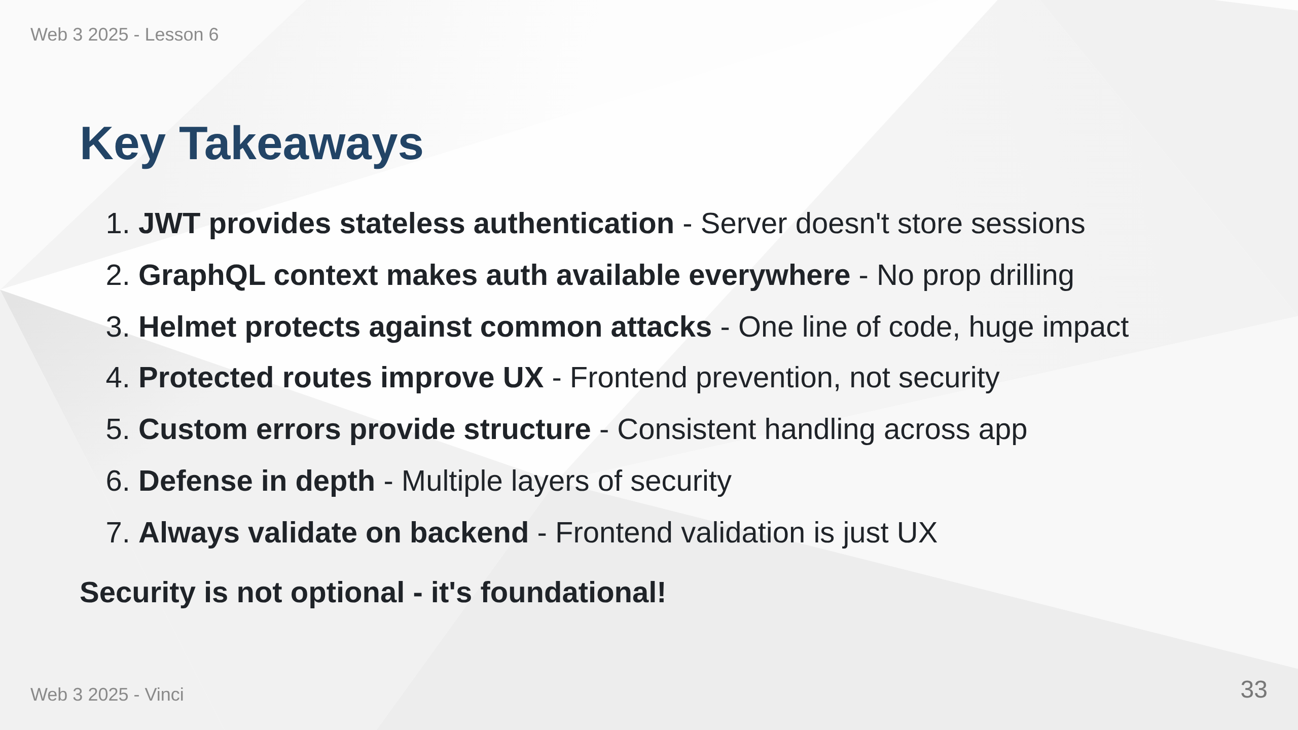
Notes:
Speaker Notes: • These concepts work together to create secure application • Each piece addresses specific security concern • Don't skip security - add it from the start • Harder to add security later than build it in • These patterns are industry standard • Understanding security makes you better developer

Slide 34


