Slide 1
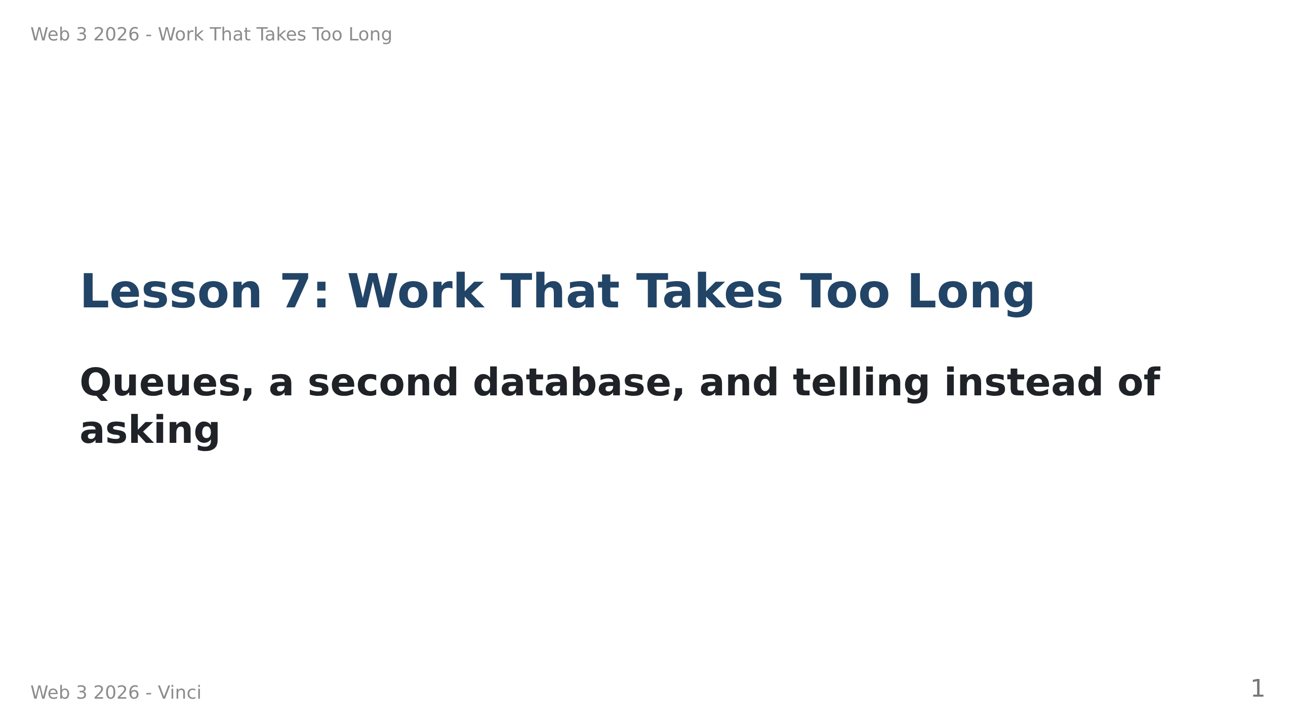
Notes:
Speaker notes:
• The live demo on slide 4 is the whole lesson. Run it, do not describe it.
• Have the backend running BEFORE the room fills up, with two terminals open
side by side and the font already large enough to read from the back.
• Today has one big idea (two stores, two promises) and one small one (push
beats poll). If they leave with only the first, the day worked.

Slide 2
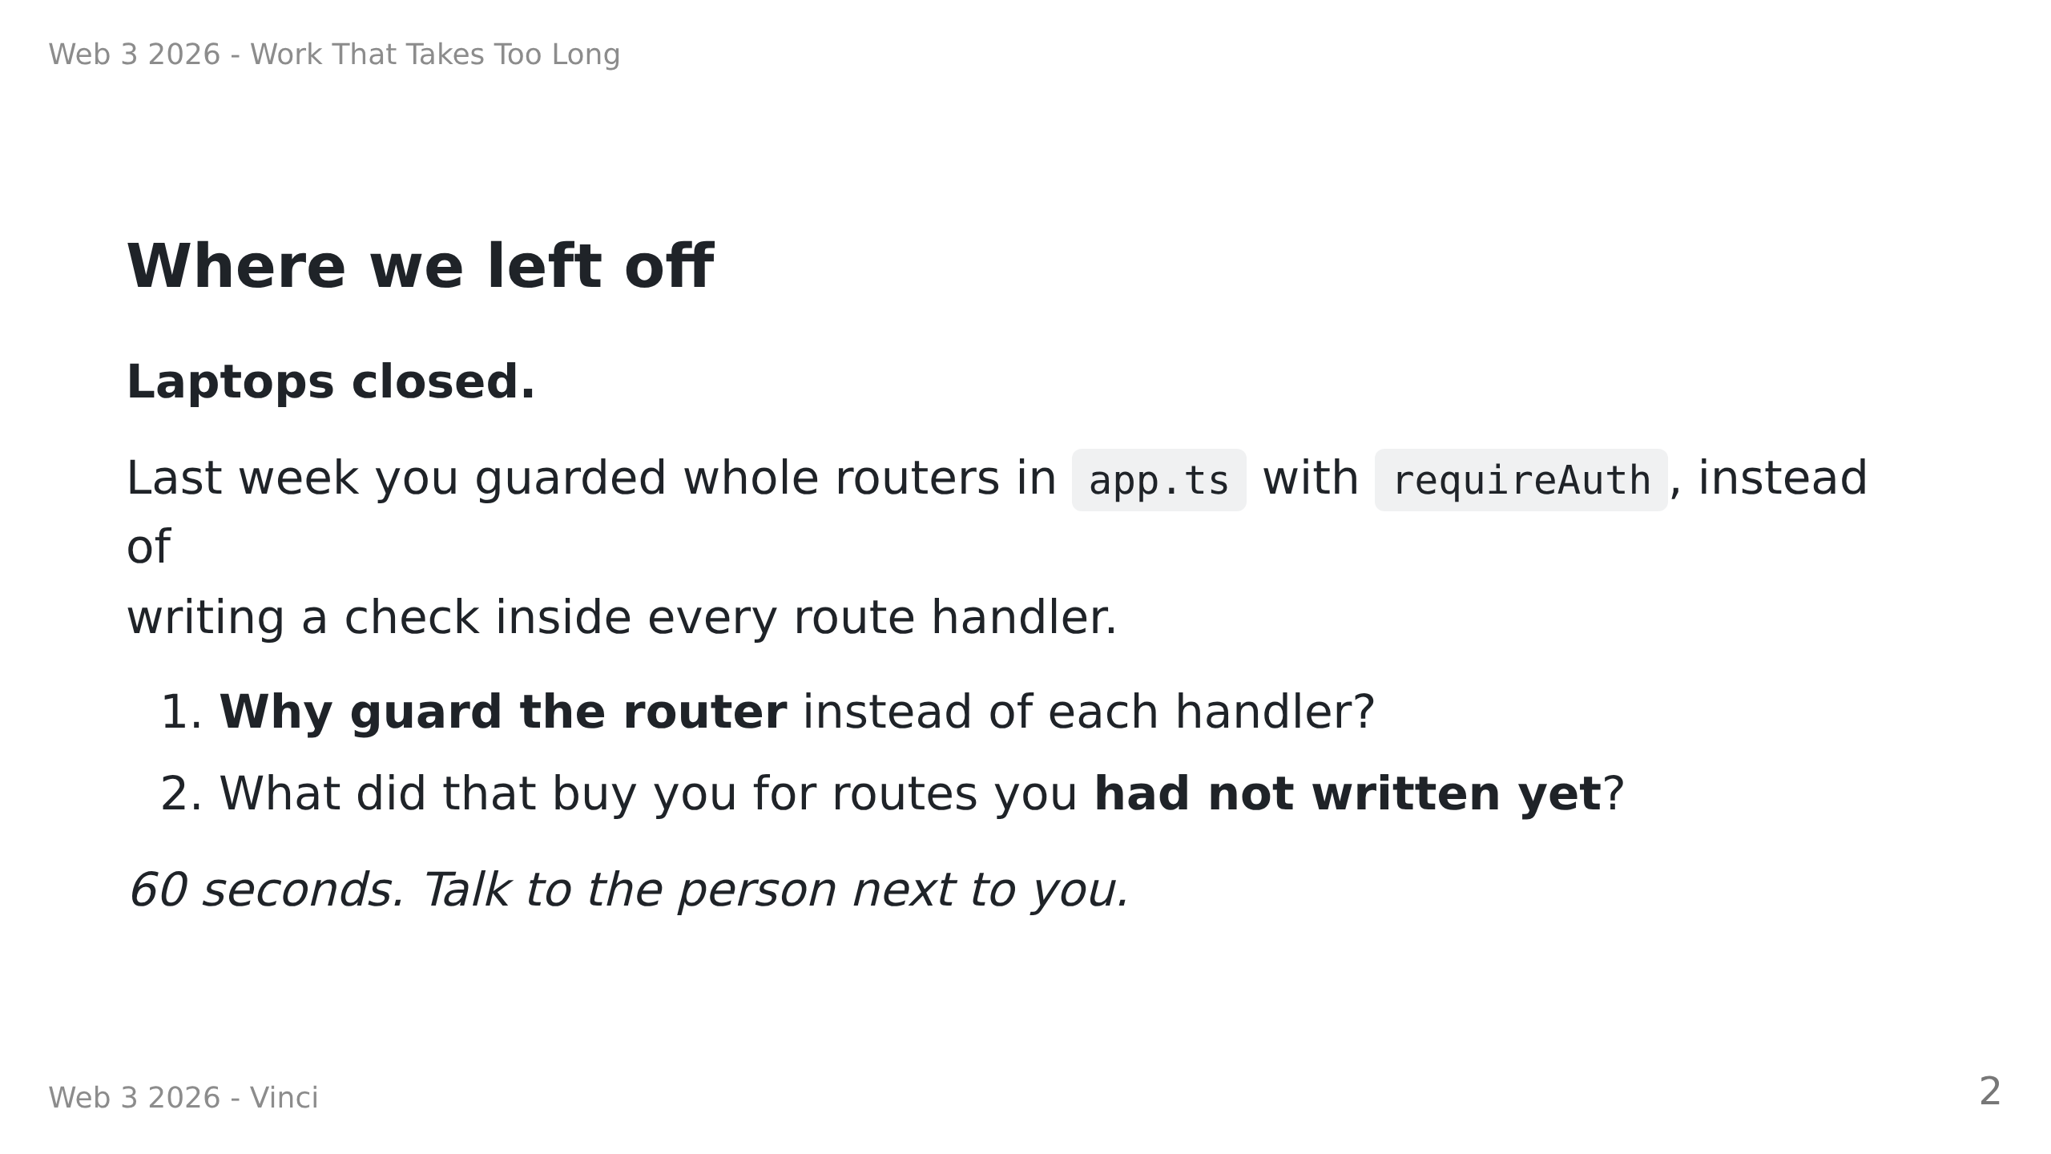
Notes:
Speaker notes — RETRIEVAL, not revision. Do not answer for them.
Answers: (1) one decision, one file, no drift between handlers.
(2) a route added next month is guarded the day it is added.
Why open here: today they edit that same file again, and for a reason that
is new — the middleware will start *remembering who* the caller is, not just
*whether* there is a token. The contrast lands better if the old version is
fresh in their heads.

Slide 3
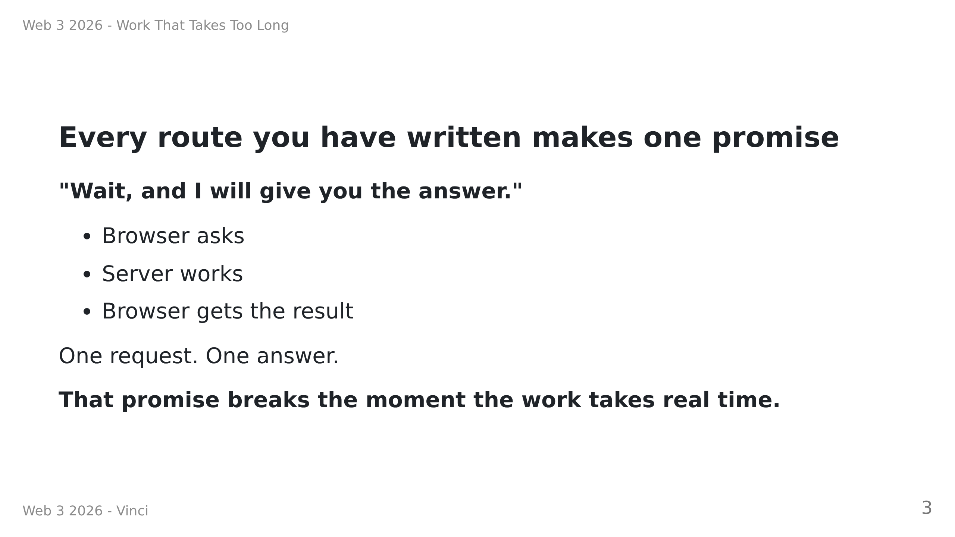
Notes:
Speaker notes:
• Say this slowly. It is the framing for everything after it.
• Ask: "how long is too long?" Let them argue. There is no number — the point
is that the *shape* is wrong, not the duration.

Slide 4
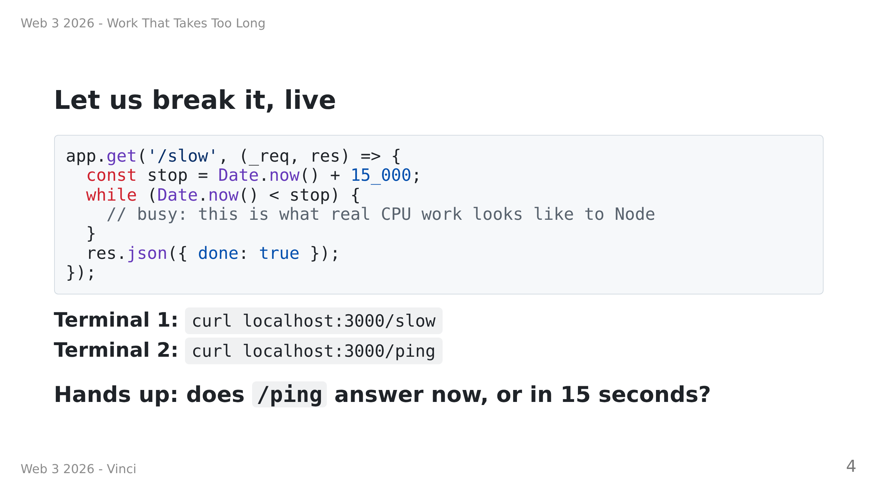
Notes:
Speaker notes — HINGE QUESTION. Take the vote before running it.
Most will say "immediately, Node is async". Let them commit out loud.
Then run it. /ping hangs. The room should be surprised.
Then show the OTHER version (await setTimeout) where /ping IS immediate, and
draw the distinction: waiting is cheap, WORK is not. Node has one thread for
your JavaScript.
Do not rush past the surprise. The confusion is doing the teaching.

Slide 5
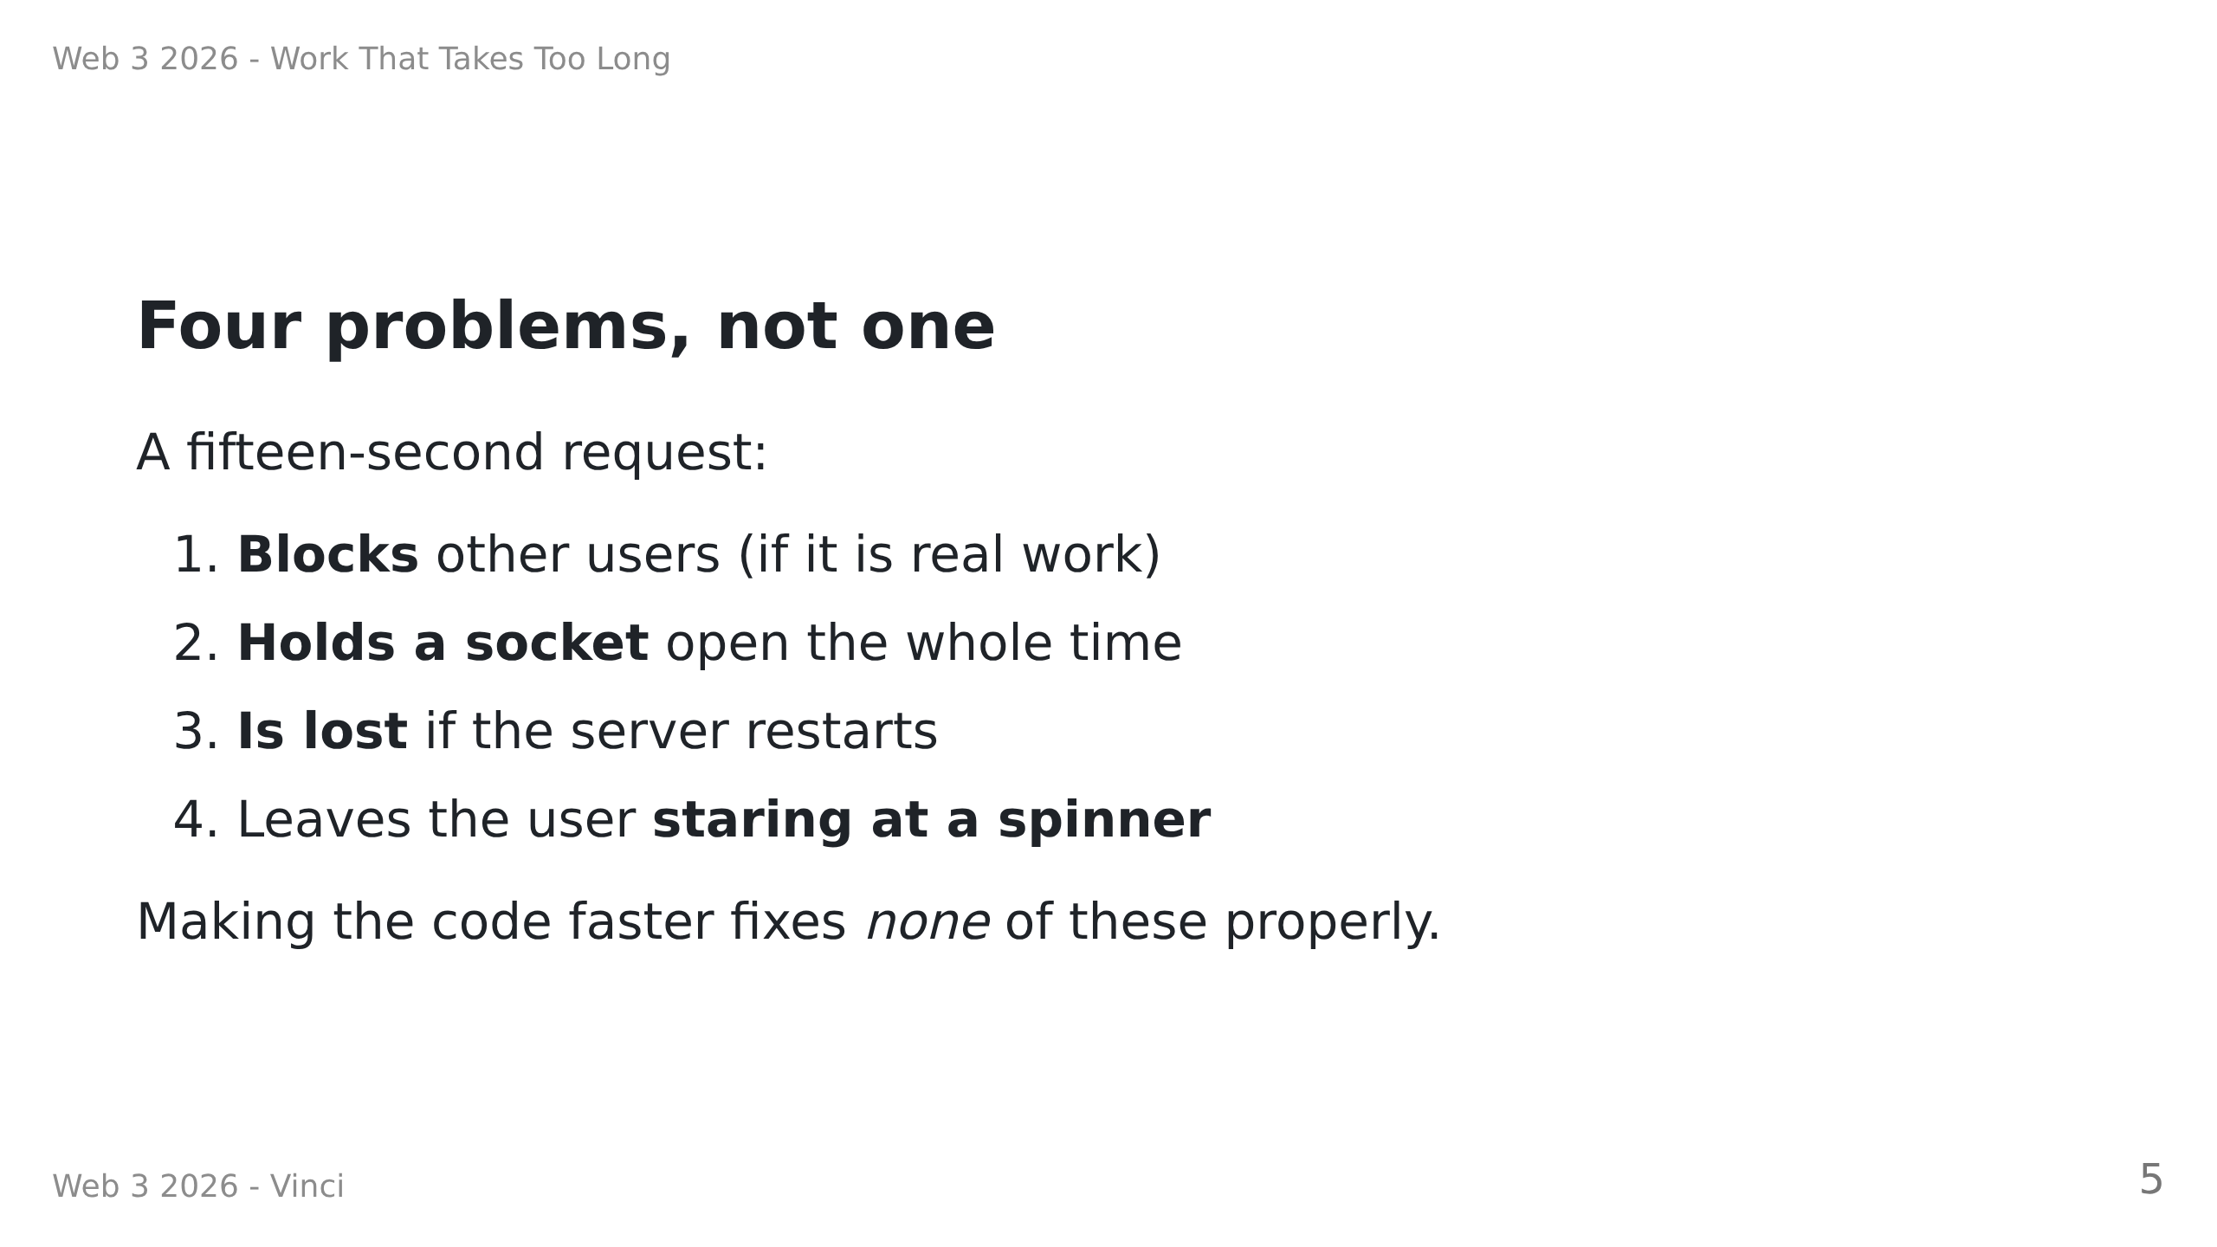
Notes:
Speaker notes:
• Point at 3 especially. Students consistently under-rate it. A deploy in the
middle of a 30s job silently loses a user's work, and nothing logs an error.
• The fix is not optimisation. The fix is changing what you promise.

Slide 6
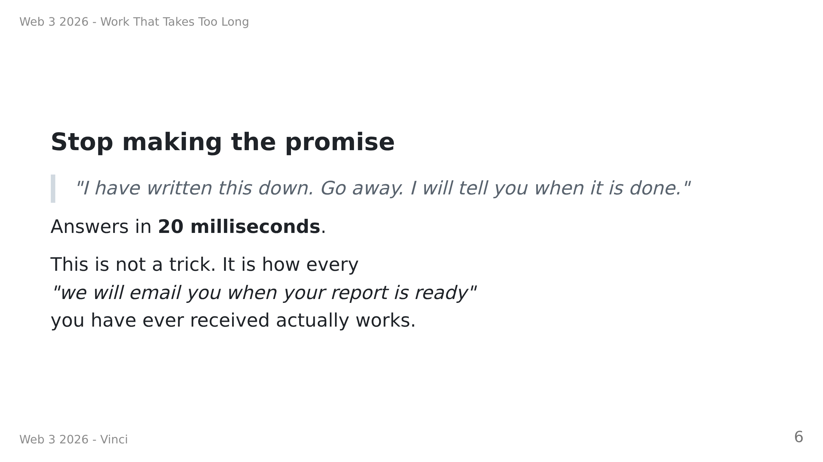
Notes:
Speaker notes:
• Ask for examples they have seen: bank statement exports, Spotify Wrapped,
"your data archive is ready" from any big platform, CI pipelines.
• Normalising it matters. This is not an advanced pattern, it is the default
one for anything slow.

Slide 7
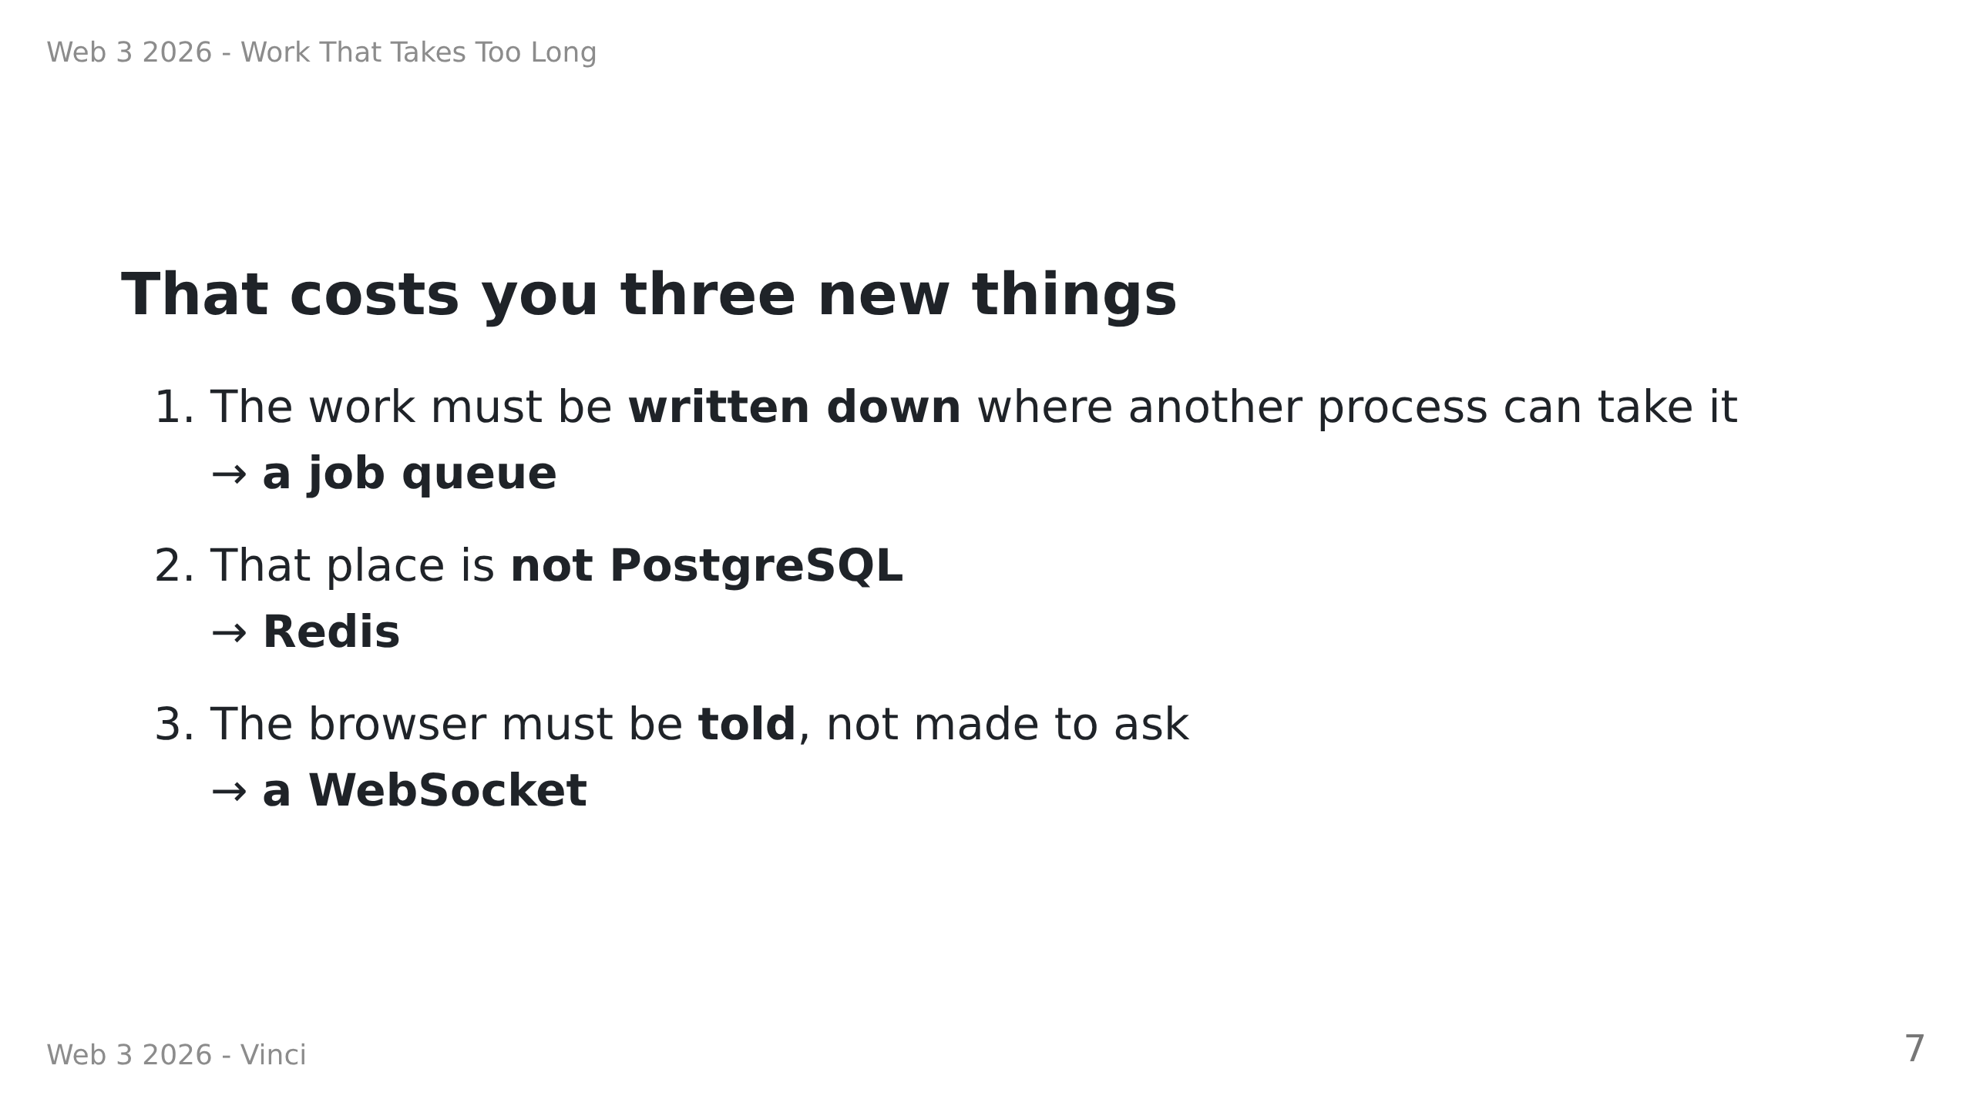
Notes:
Speaker notes:
• This is the map of the day. Put it back up whenever they look lost.
• Item 2 is the one they will resist. Spend the time.

Slide 8
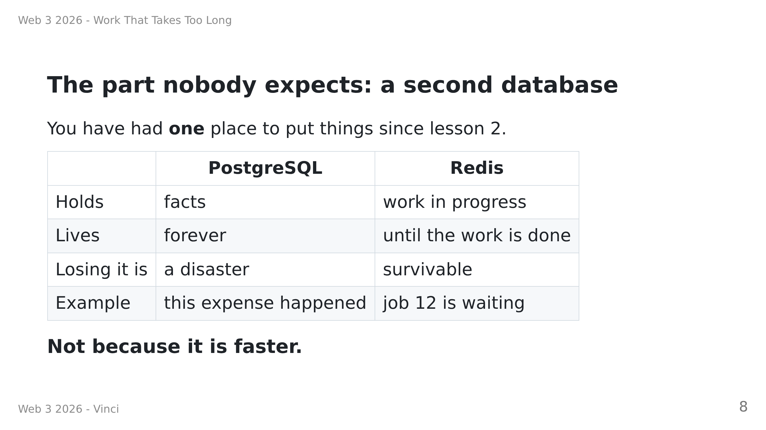
Notes:
Speaker notes:
• Have them read the "Losing it is" row out loud. That row is the model.
• Do NOT say "Redis is the fast one". It leads straight to "so should I put
everything in Redis?", and the answer is no.
• Redis is the new thing today. Postgres they know. Spend the time on what
Redis is FOR, not on comparing query languages.

Slide 9
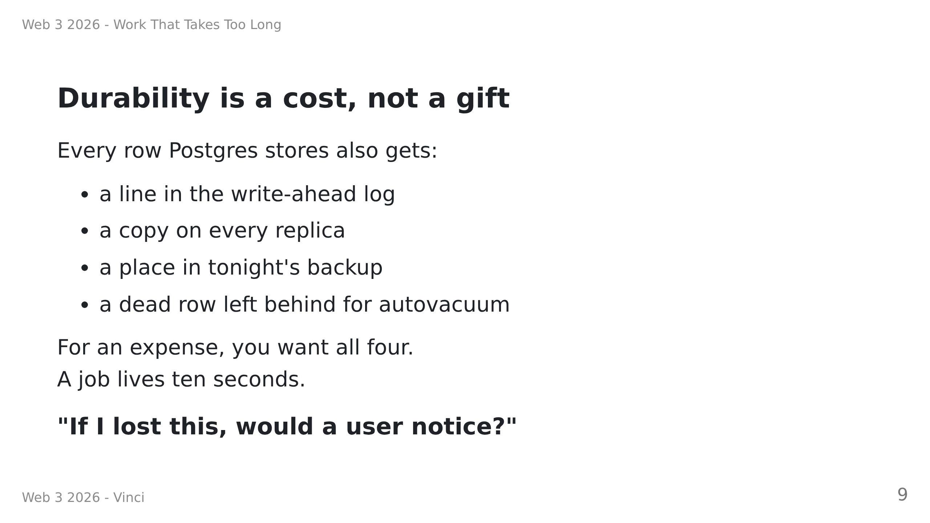
Notes:
Speaker notes:
• THIS is why we are not using Postgres for the queue, and it is not about
speed. Say that out loud.
• One sentence of MVCC if they want it: an UPDATE in Postgres does not edit
a row, it writes a new version and leaves the old one for autovacuum. One
job is four versions -- insert, claimed, progress, delete.
• The vivid one is the backup. Ask "what is in your 3am backup?" Answer: a
snapshot of which jobs happened to be pending at 3am. Useless, and you
paid fsync for it.
• Then the closing question, applied: the expense, the export row and the
CSV all go in Postgres. A pending job and a progress event go in Redis.
Make them answer each one before you say it.
• The free Render Key Value instance is NOT persistent. Ask "is our app
broken?" No -- only the two survivable things live there.
IF SOMEONE ASKS "but Postgres could do this, couldn't it?" -- good question,
answer it honestly, no slide needed:
- Yes. SELECT ... FOR UPDATE SKIP LOCKED is a real queue, and pg-boss
ships exactly that. For modest throughput it is a fine choice and one
less thing to run.
- What it gives up: Postgres has no "wait until a job appears". pg-boss
polls on a timer and uses LISTEN/NOTIFY to wake early -- but NOTIFY is
fire-and-forget, so the poll stays as a backstop. Redis workers truly
block: an idle worker costs nothing and picks up in under a millisecond.
- What Postgres does BETTER: you can enqueue inside the same transaction
as the write that caused it. Redis cannot. In TODO 4 they write the row
and THEN queue the job -- two steps, two chances to fail. If the process
dies between, the row sits on `queued` forever. That is a dual write,
and it is the price of a second system. It is survivable here precisely
because the row is written FIRST. The real fix is the outbox pattern;
name it, do not teach it.

Slide 10
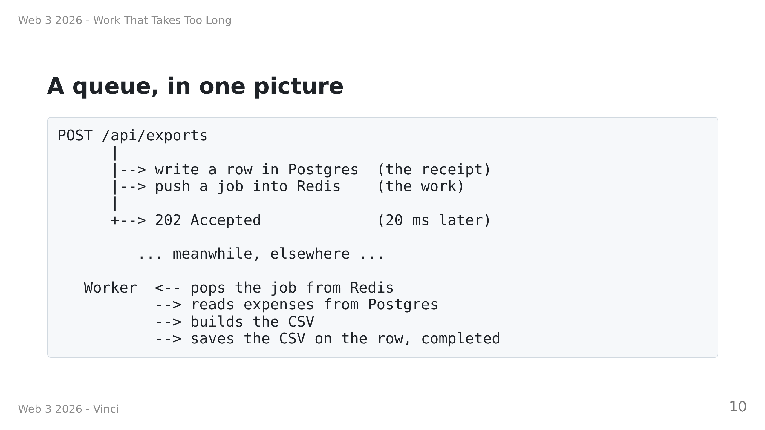
Notes:
Speaker notes:
• Walk the arrows with a finger. Slowly.
• The key visual: the request handler and the worker NEVER touch each other.
Redis sits between them. That is what lets the worker move to another
machine later without changing a line.

Slide 11
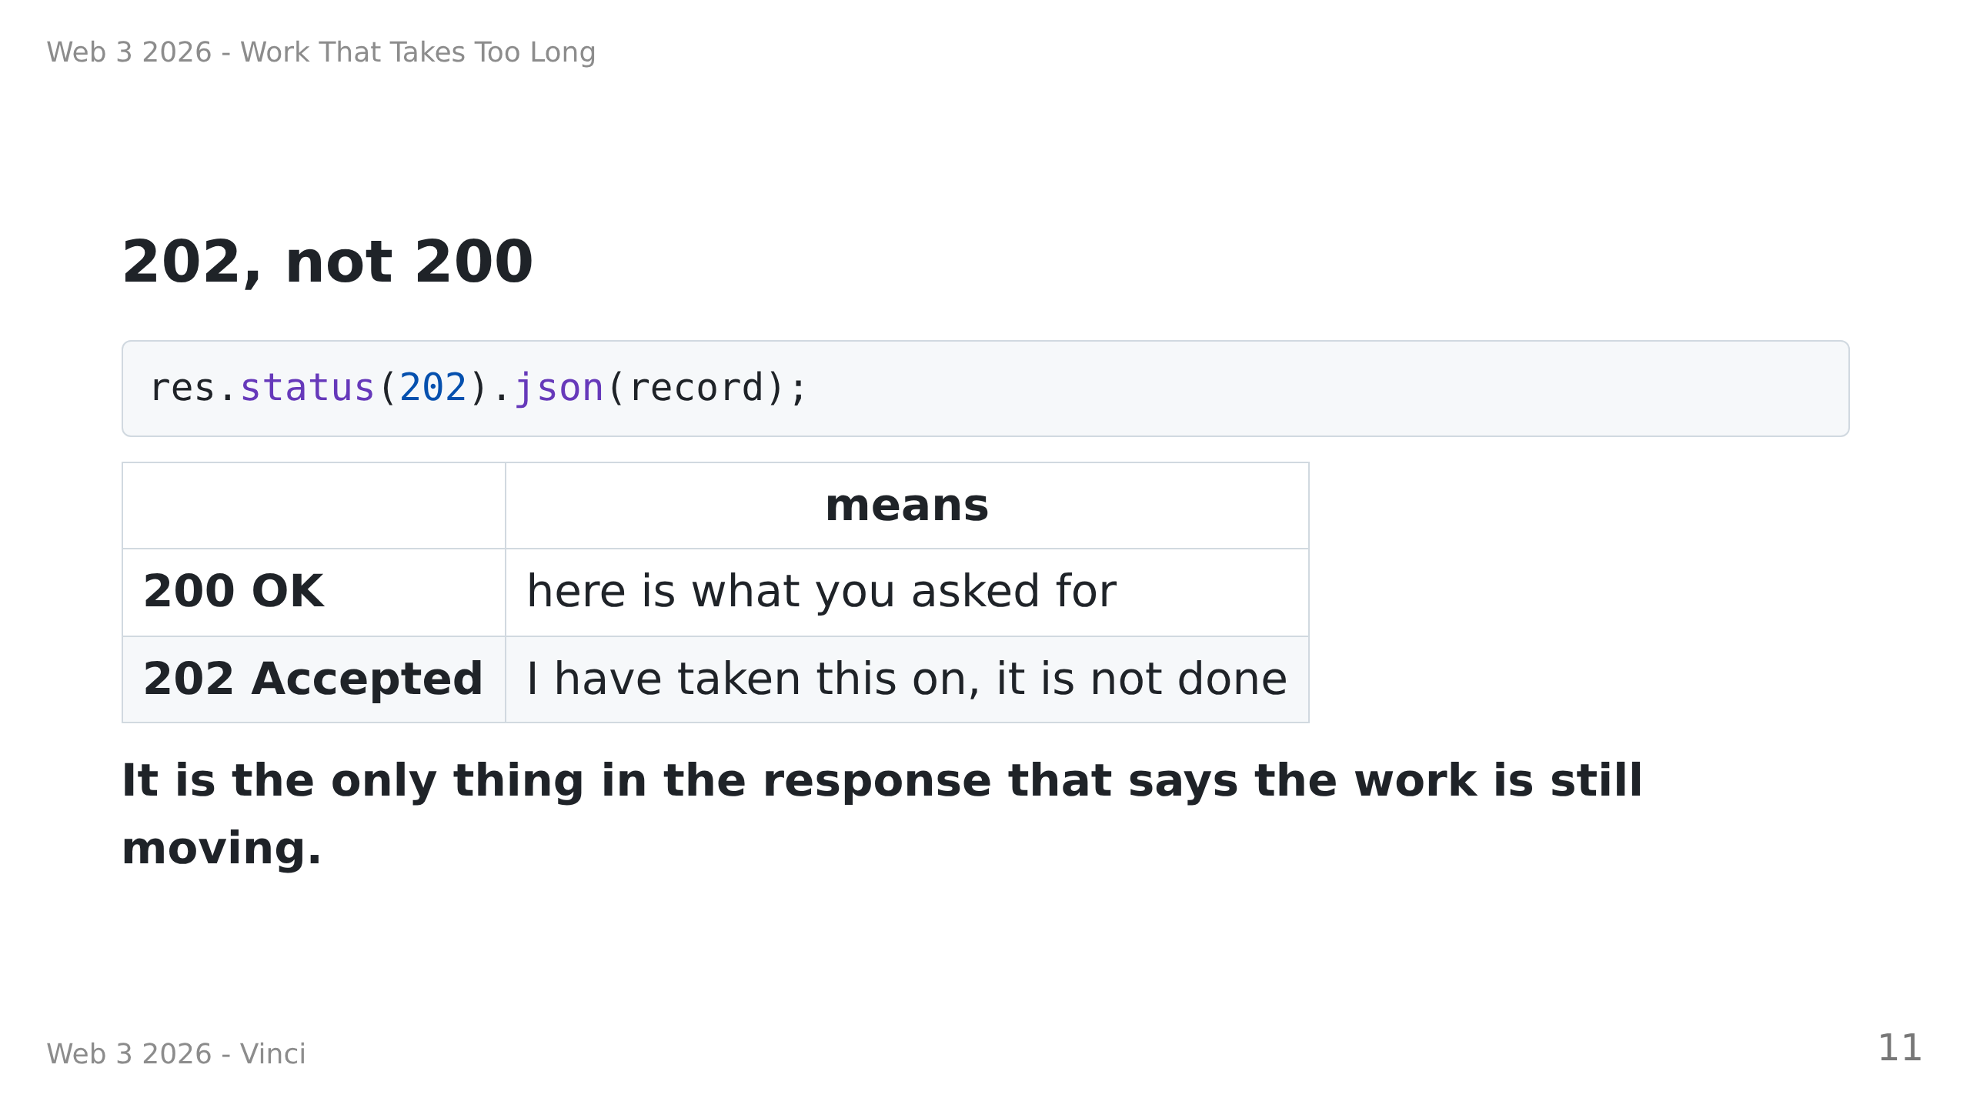
Notes:
Speaker notes:
• Small slide, real point. A client that sees 200 is ENTITLED to think it has
the finished thing.
• Ask: "what does the body contain then?" Answer: the receipt — an id and a
status — which is the thing they can come back with.

Slide 12
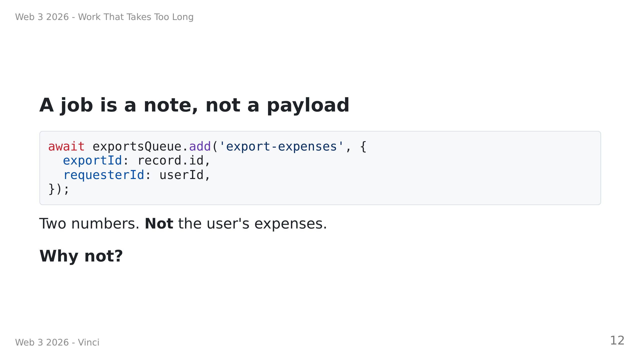
Notes:
Speaker notes — ask, do not tell. Wait for it.
Answer: a job can sit in the queue for a while. Data copied at click time is
stale by the time anyone reads it. The job says WHAT TO DO; the worker reads
the data fresh.
Second answer, if someone gets the first: payload size. Redis is memory, and
a queue of fat jobs fills it.

Slide 13
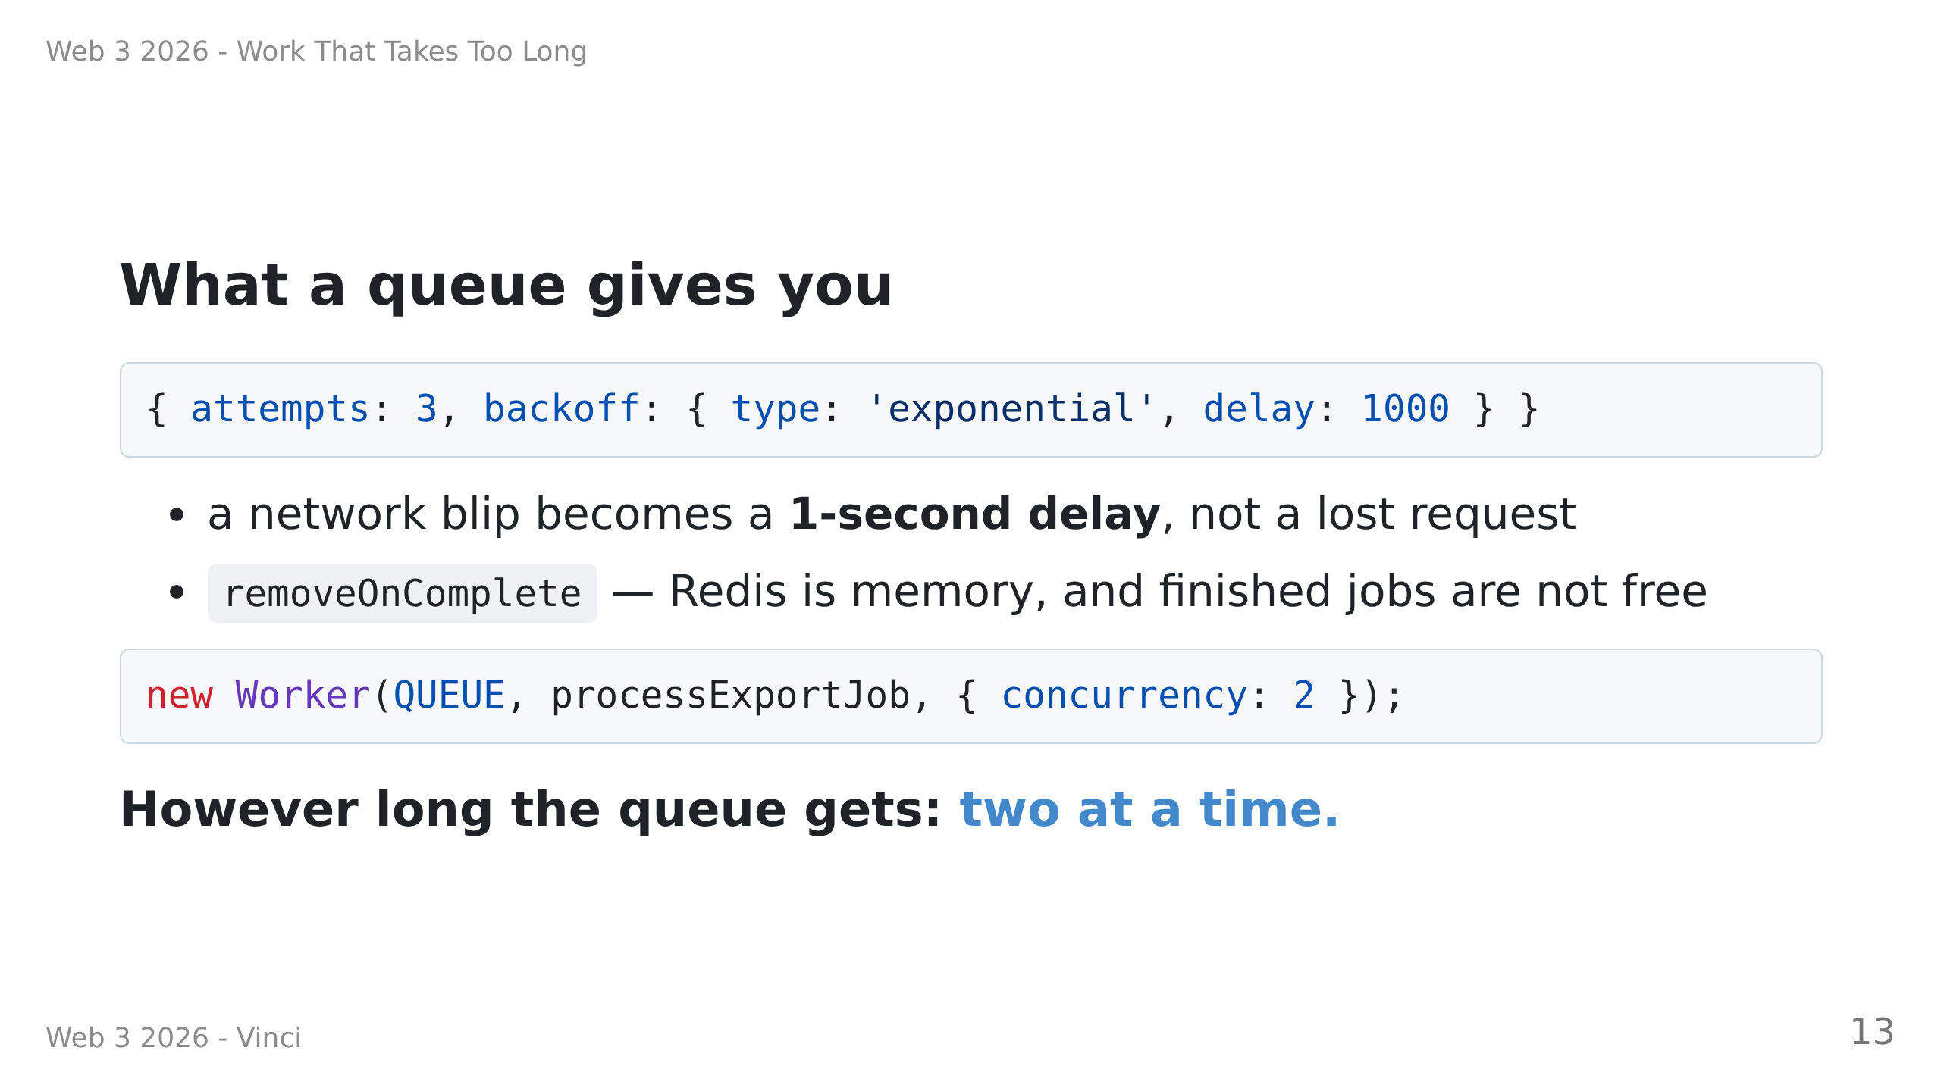
Notes:
Speaker notes:
• "Write retry-with-exponential-backoff yourself, correctly, including the
case where the process dies mid-retry." That is the sell for a queue over
a plain function call.
• concurrency is a promise to the REST of the system, not to the user. Ask
"what breaks without it?" -- connection pool exhausted, memory, the API
starved of CPU. A queue with no limit is a slower way to fall over.
• Hold the number 2. The next two slides are them watching it be true.
• removeOnComplete they will skip and regret: the free instance is 25 MB.
• NOT on a slide, say it if asked: worker.on('failed') fires after EVERY
attempt, queueEvents.on('failed') fires once at the end. That trap is
TODO 3, and the exercise makes them measure it -- three log lines, one
browser message. Do not pre-empt it here.

Slide 14
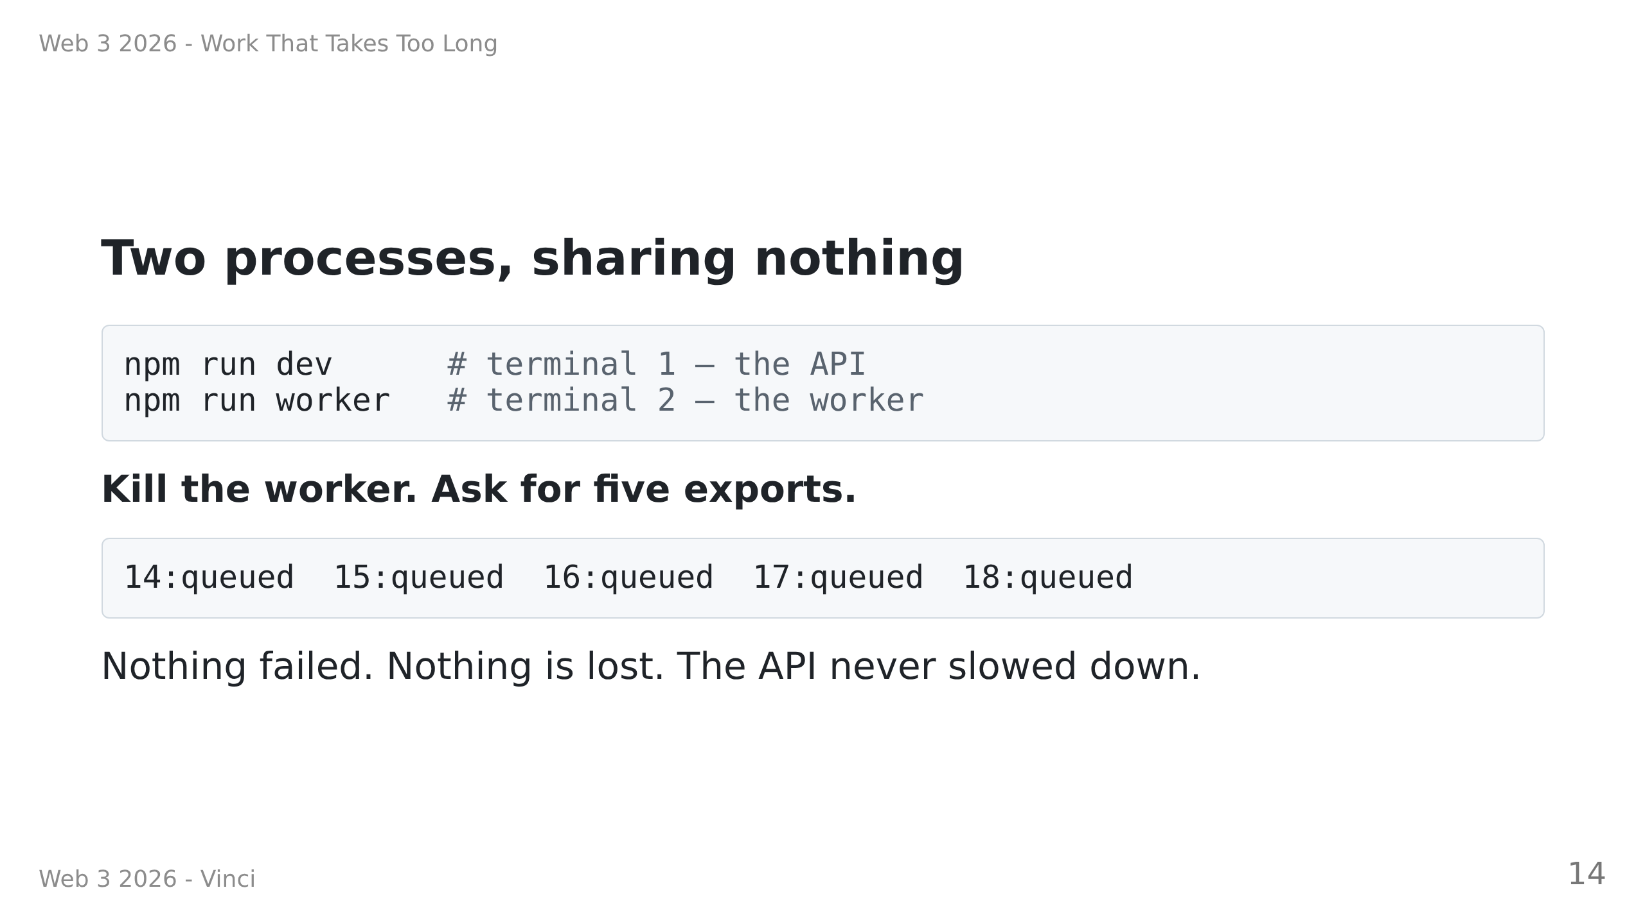
Notes:
Speaker notes:
• Do this live if you can. It takes 40 seconds and it is the most convincing
thing in the deck.
• They do not import each other. They do not know each other's port. They do
not share a variable. Redis is the whole interface.
• Ask: "where is the work right now?" Answer: in Redis, as a list. Then ask
"what happens if I deploy the API now?" Answer: nothing, the jobs are fine.
That is item 3 from the "four problems" slide, solved.

Slide 15
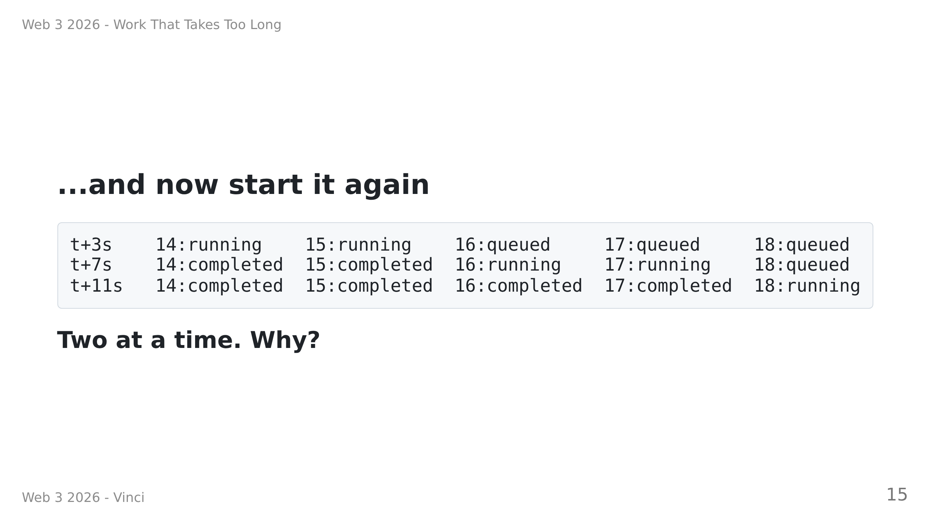
Notes:
Speaker notes — ask, wait, then page back two slides.
Answer: concurrency: 2, which they saw on "What a queue gives you".
That was an assertion. This is them watching it be true. Invite them to set
it to 5 and re-run — the exercise tells them how.
Real output from a real run; this table is not invented.

Slide 16
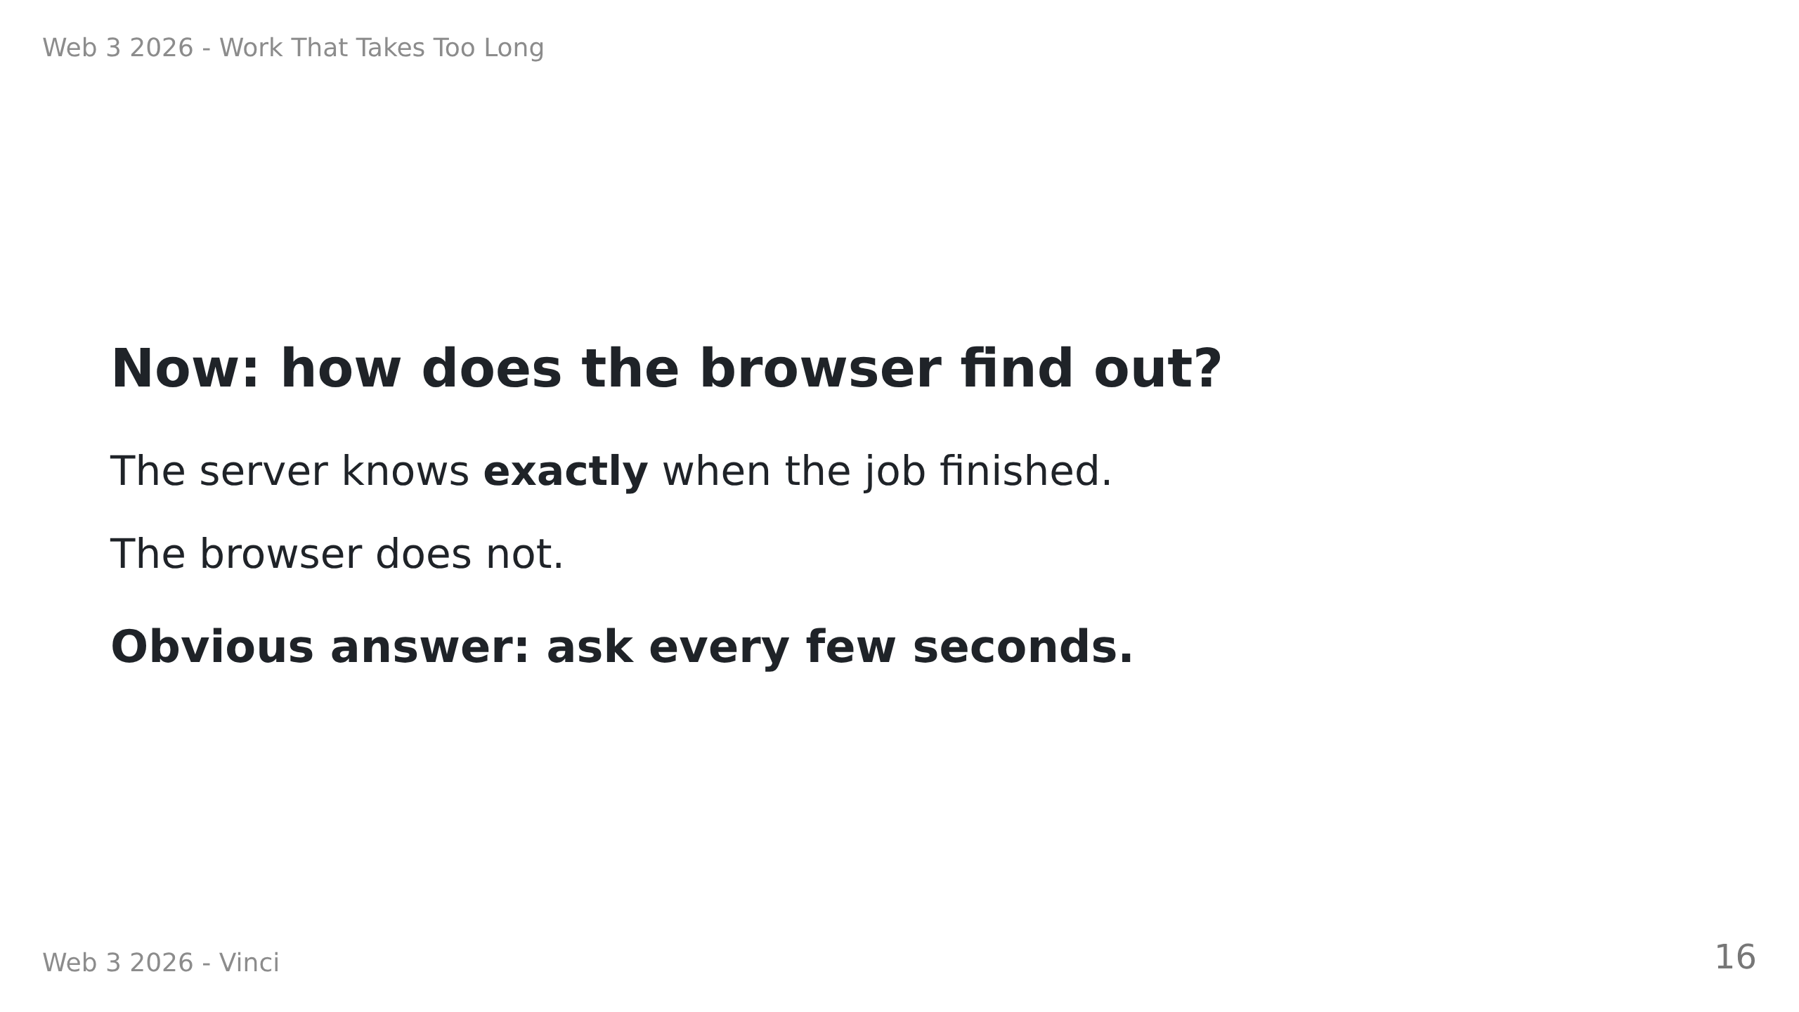
Notes:
Speaker notes:
• Let them propose polling. They will. It is the natural answer.
• Do not call it wrong yet. Make them cost it on the next slide.

Slide 17
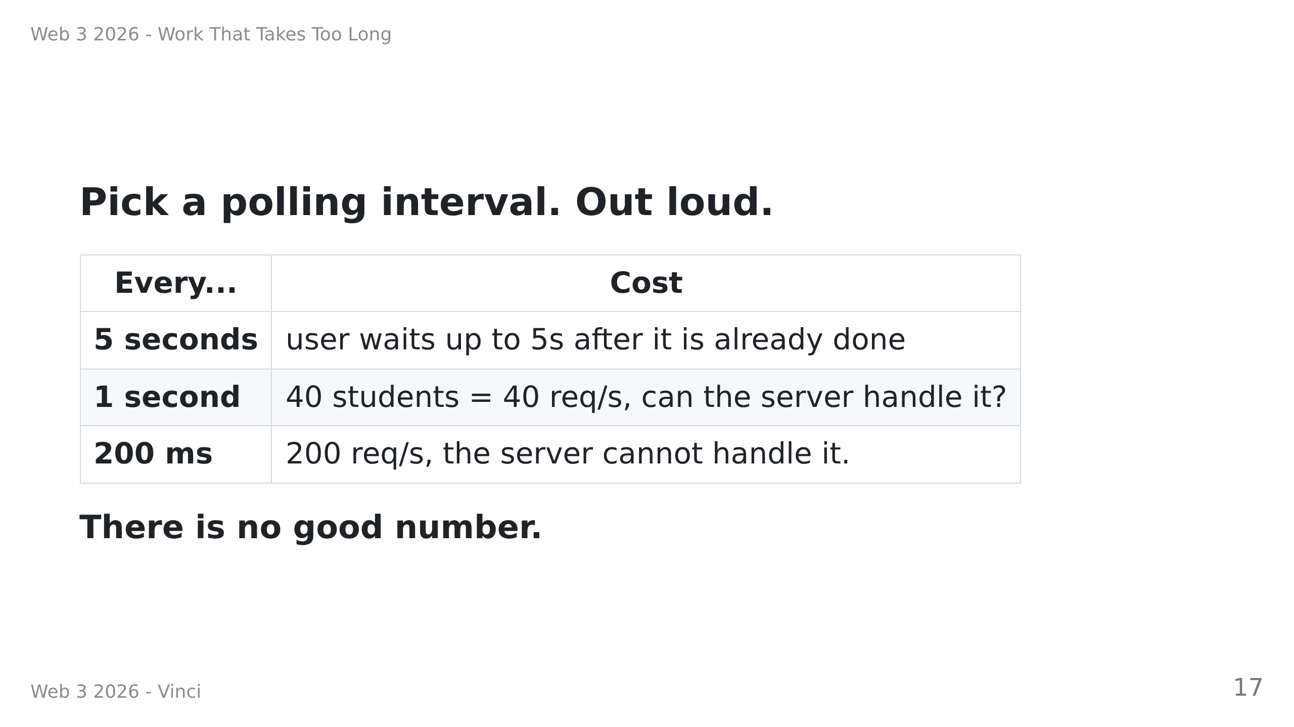
Notes:
Speaker notes — HINGE. Take an actual vote on an interval first, then show
this table.
The punchline: the badness is not in the number, it is in the SHAPE. The
server already knows. Asking it repeatedly is the wrong question.

Slide 18
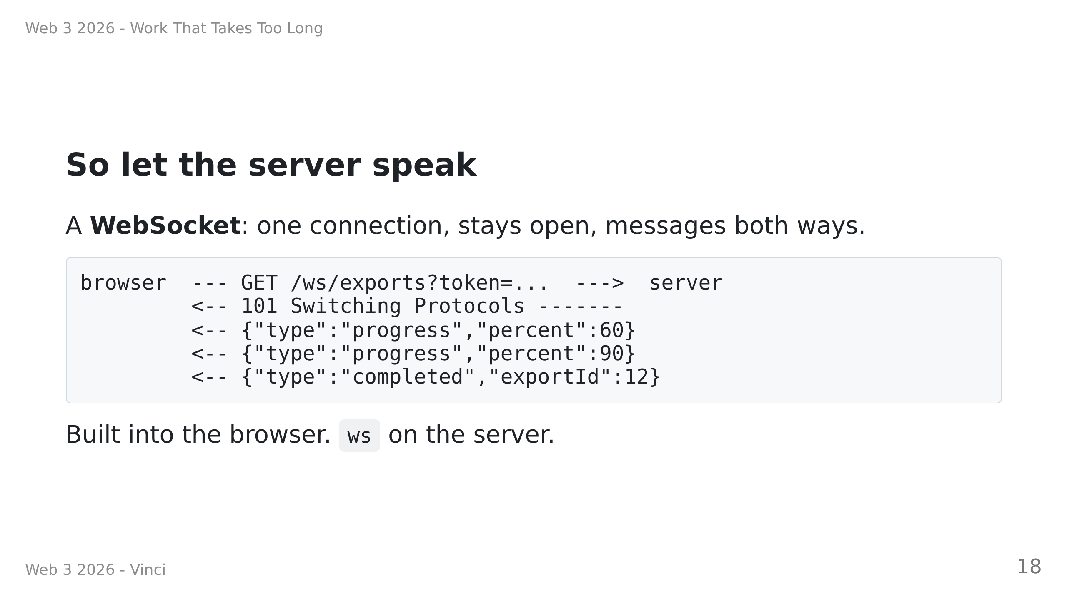
Notes:
Speaker notes:
• The upgrade is an ordinary HTTP request that stops being HTTP halfway
through. That is why a rejected one is answered by writing a raw
"HTTP/1.1 401 Unauthorized" to the socket -- at that instant there is no
`res` object yet.
• Point at ?token= and park it. Two slides from now it gets its own.
• They do NOT write the handshake; it is in the boilerplate. They write who
receives each message.

Slide 19
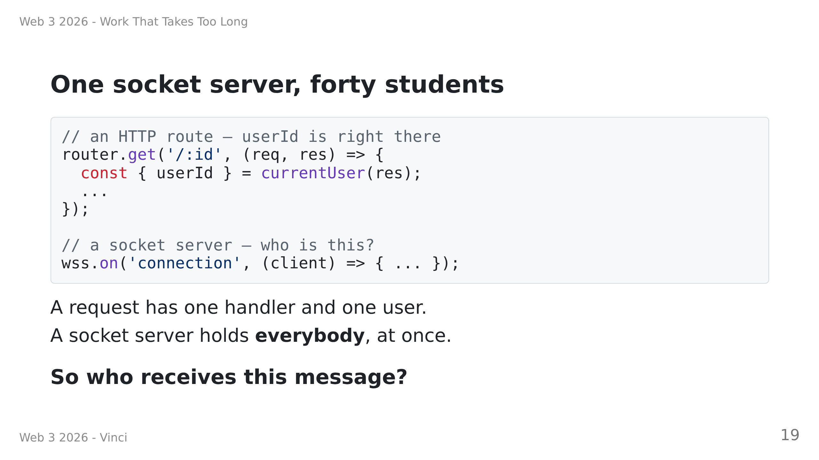
Notes:
Speaker notes:
• Do NOT answer it. This is TODO 5, and working out that you need a
user -> socket map is the exercise.
• Ask instead: "what happens if you skip the question and send to every
client?" Answer: every student watches every other student's progress
bar. Funny in a classroom; a data breach at work.
• The client has the mirror-image problem (TODO 6): one socket carries every
export this user owns, so the hook filters on exportId too. Two filters,
one at each end, same reason.

Slide 20
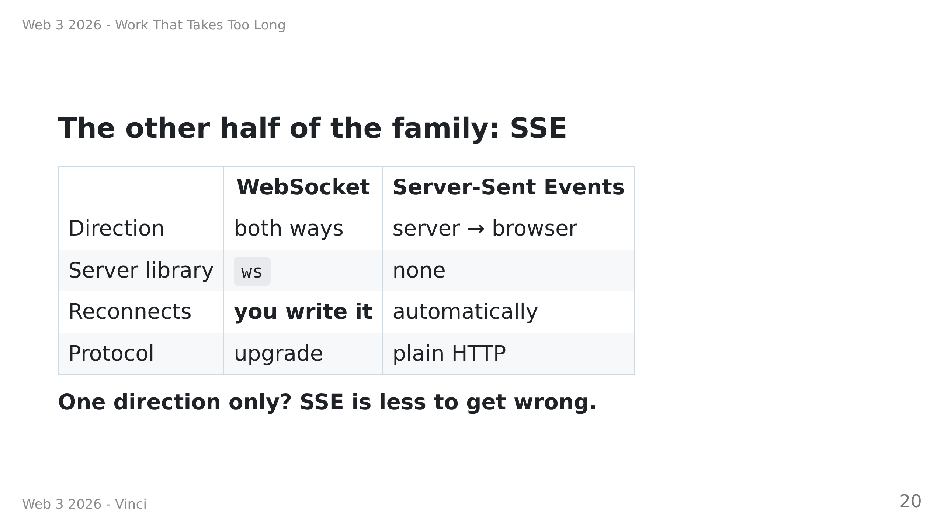
Notes:
Speaker notes:
• Be honest: for THIS feature SSE would have been enough, and would have
given them reconnection for free. We built WebSockets because they are the
general tool and the one they will be asked about in interviews.
• Reach for WebSockets when the BROWSER also has something to say: chat,
cursors, collaborative editing, games. A job notification is one-way.
• Optional exercise A makes them write reconnection by hand. That is the
concrete way to feel what the SSE column hands you.
• No exercise on SSE this week. This slide is the whole coverage.

Slide 21
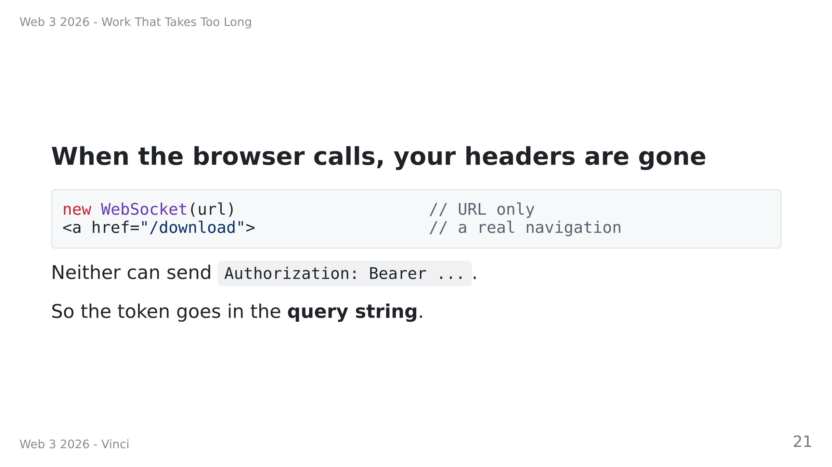
Notes:
Speaker notes:
• Make them feel the compromise, do not wave it away:
URLs reach access logs, browser history, and the Referer header.
You would never put a password there.
• Ask: "why is this fine for fetch()?" Because YOUR JavaScript makes that
call. The moment the BROWSER makes it, headers are not yours.
• That is the rule worth keeping. Two instances today, same cause.
• If they ask "so what DO you do?" -- two real answers, neither built today:
a cookie (the browser attaches those to both automatically), or a
single-use ticket valid for one connection and expiring in seconds.
Optional exercise B builds the ticket. Name them and move on.

Slide 22
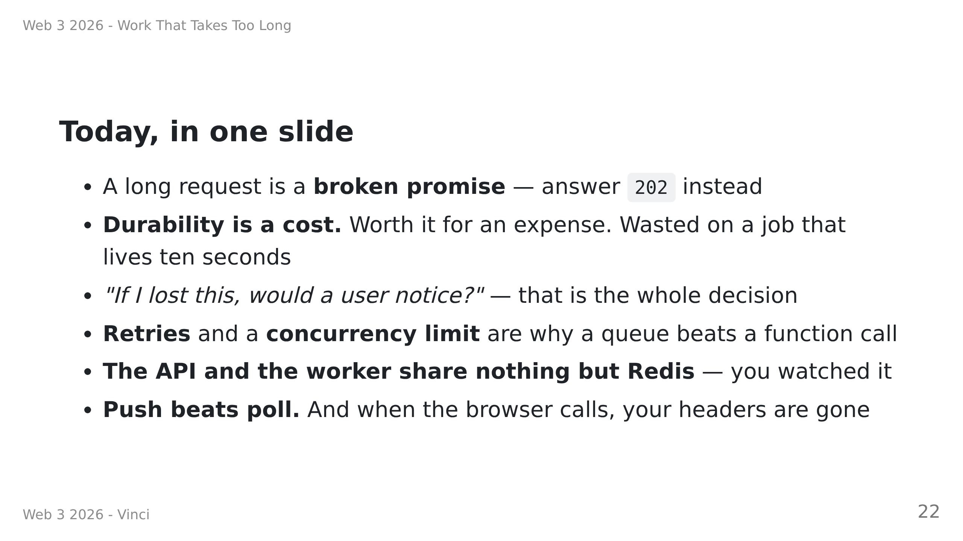
Notes:
Speaker notes:
• Read the second and third bullets last if you only have time for two.
• If one student remembers one thing, make it this: we did not pick Redis
because it is fast. We picked it because we did not want this data in the
backups.
• Then send them to the exercises. Exercise 0 repeats the live demo from
slide 4 on their own machines — that is deliberate, they need to feel it,
not just have watched it.

Slide 23
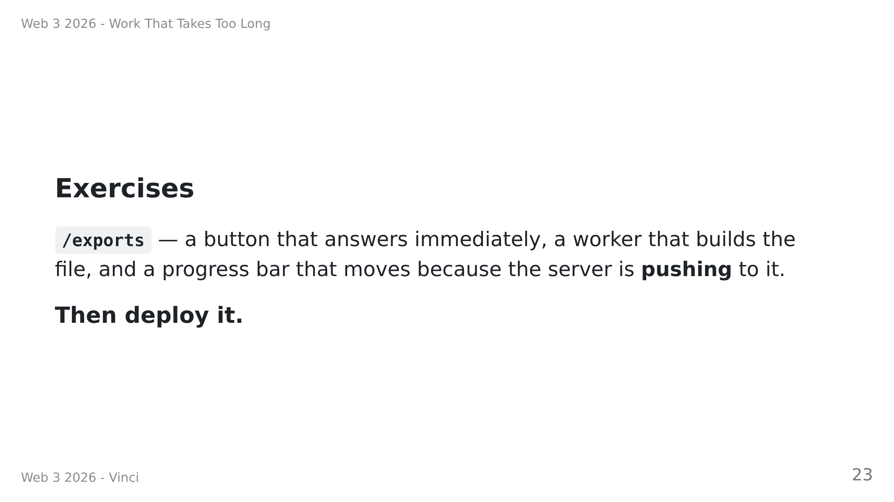
Notes:
Speaker notes:
• THEY DOWNLOAD A BOILERPLATE this week, not last week's solution. Put the
link on the board. It is the finished lesson 6 with six gaps in it.
• `grep -rn "TODO [0-9]" backend/src frontend/src` finds all six. Everything
else -- Tailwind, type modules, migrations, the WebSocket handshake -- is
written for them, on purpose. None of it is the lesson.
• Time shape: ex 0-3 (queue + worker) 50 min, ex 4 (the route) 15,
ex 5 (the socket) 30, ex 6 (deploy) 25.
• The two-terminal demo in exercise 4 is the one everybody must actually
run -- stop the worker, queue five, start it, watch them drain in pairs.
Walk the room during it.
• Optional at the end: make the socket reconnect, mint single-use tickets,
or build the history list.
THE RENDER BITS (exercise 6 walks them through it; flag these three so
nobody loses twenty minutes to them):
• No free background-worker instance type -- so RUN_WORKER_IN_API=true
folds the worker into the API there. One `if` in app.ts. On a paid plan
it is a Background Worker service running `npm run worker`, and their
worker.ts runs there unchanged.
• A free web service SLEEPS after 15 min idle and takes ~1 min to wake.
WebSocket messages count as traffic, so an open page keeps it alive.
• The Key Value instance is NOT persistent. Ask them: is our app broken?
No -- the rows and the CSV are in Postgres. Only pending jobs are lost.
That is the decision rule from earlier, paying off in production.

