Slide 1
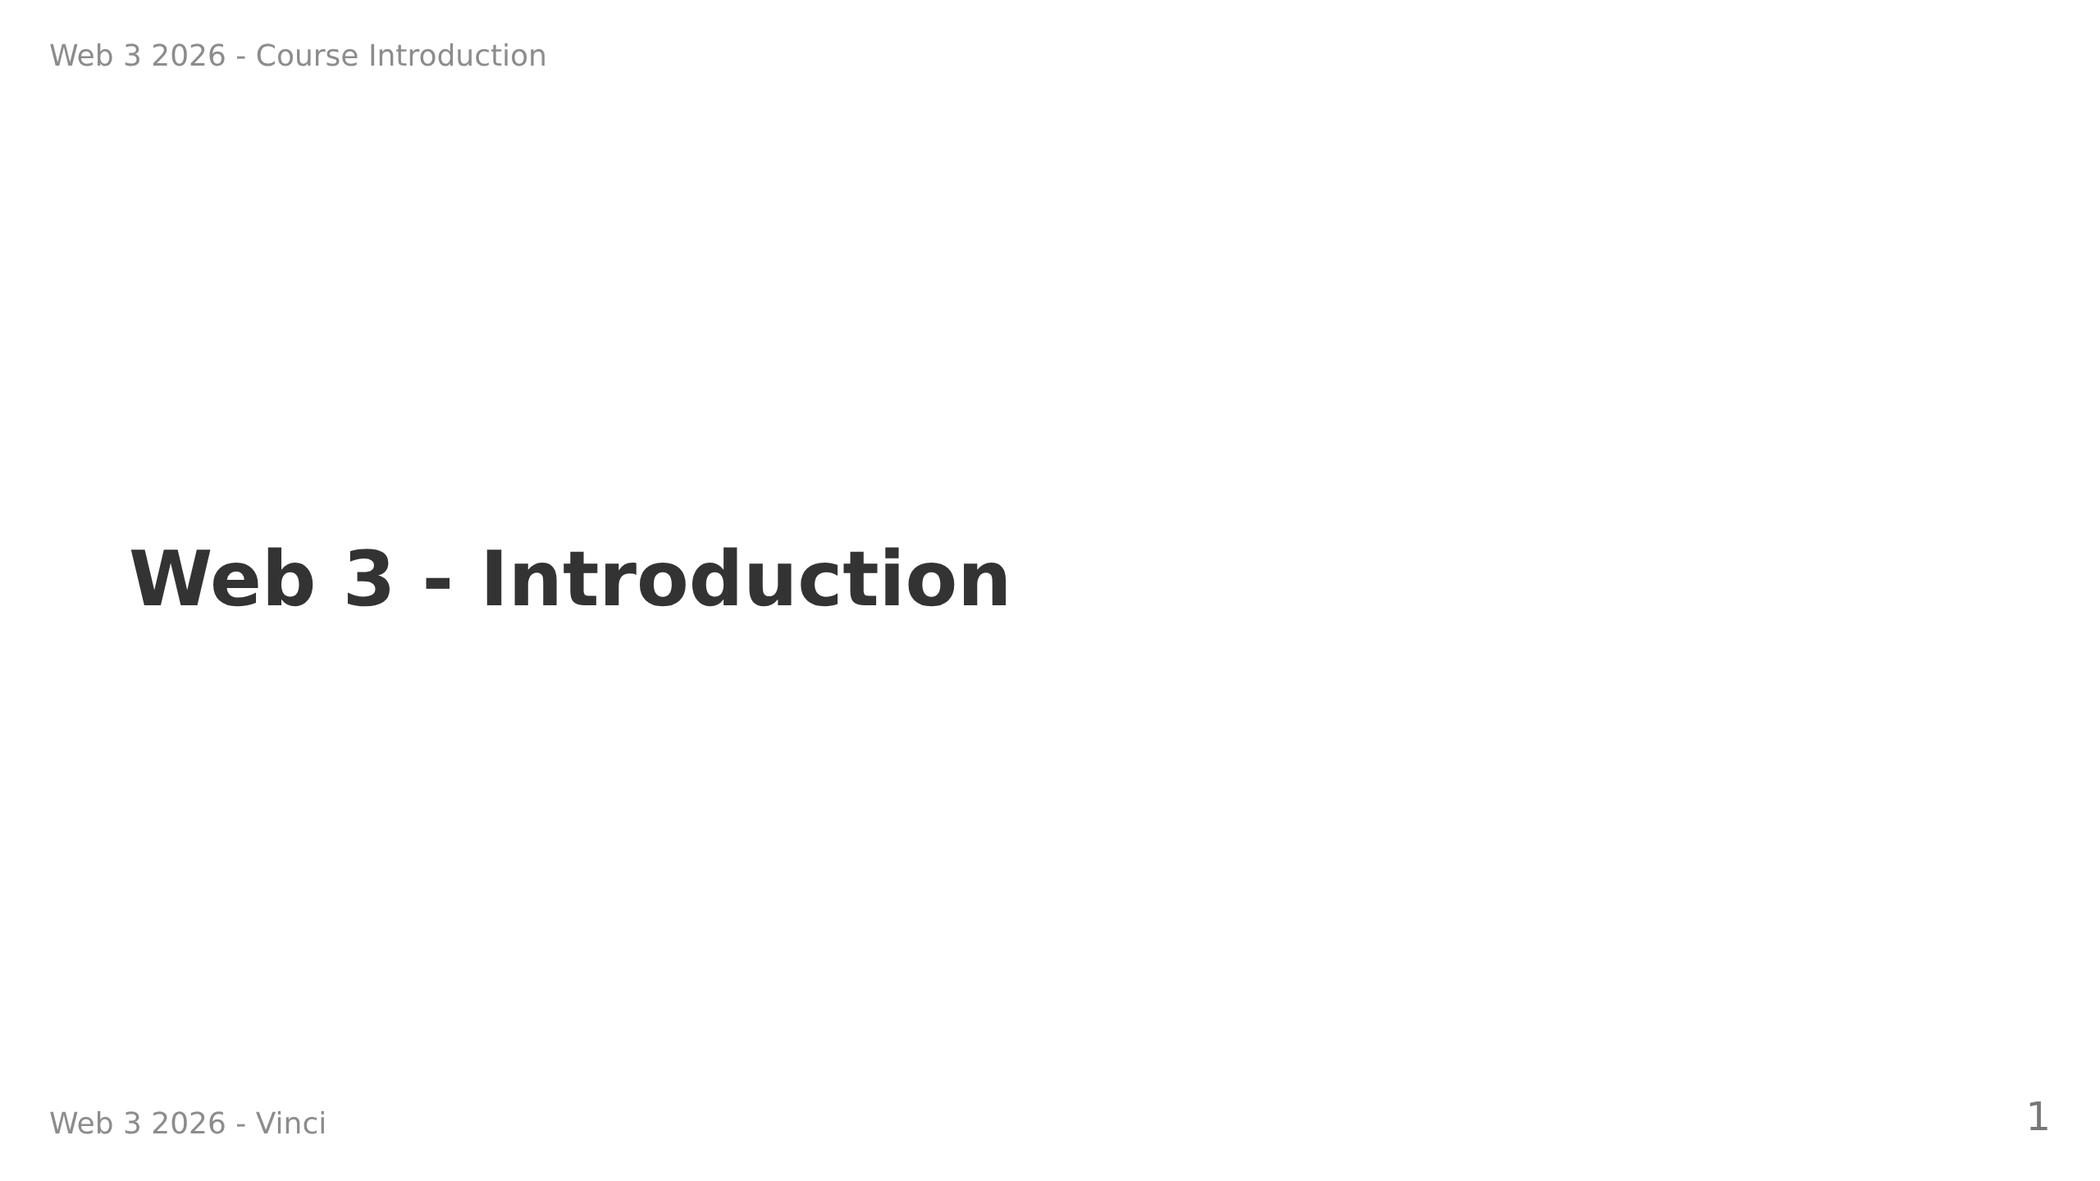

Slide 2
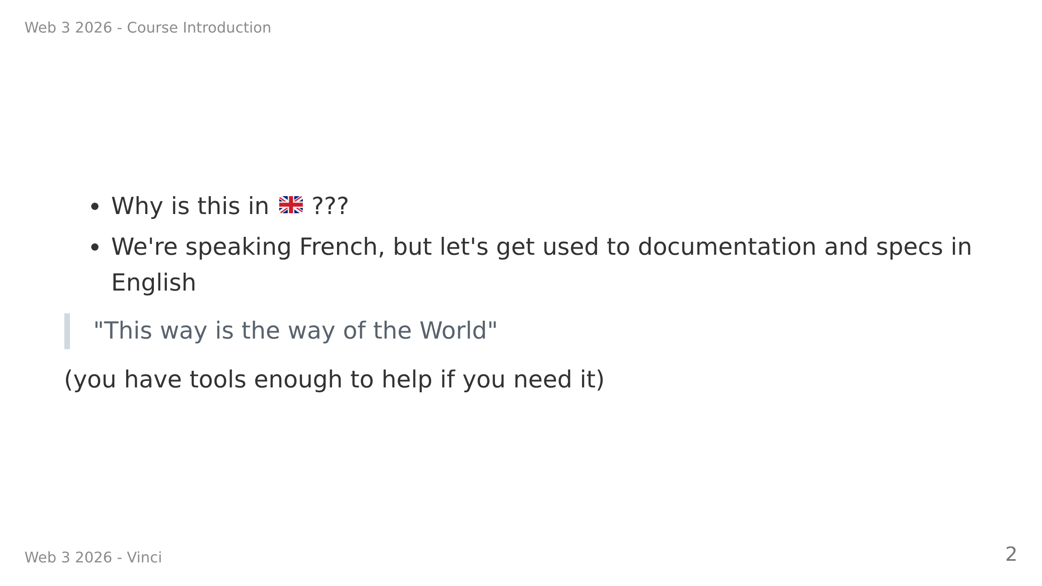

Slide 3
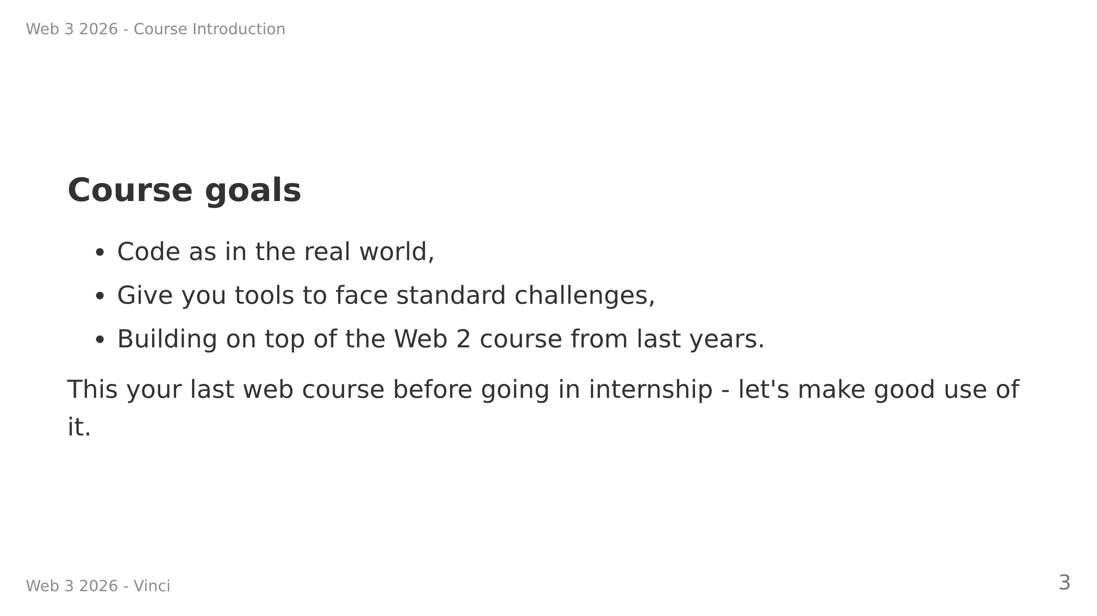

Slide 4
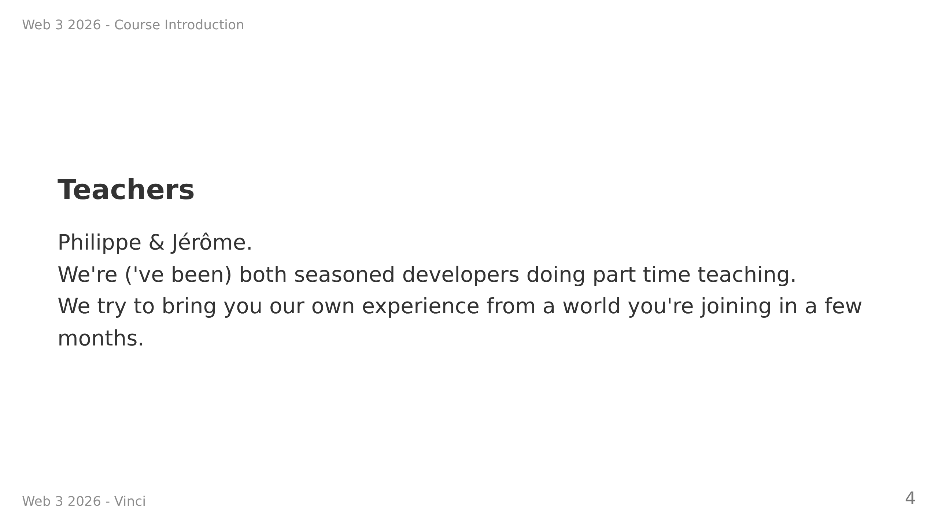

Slide 5
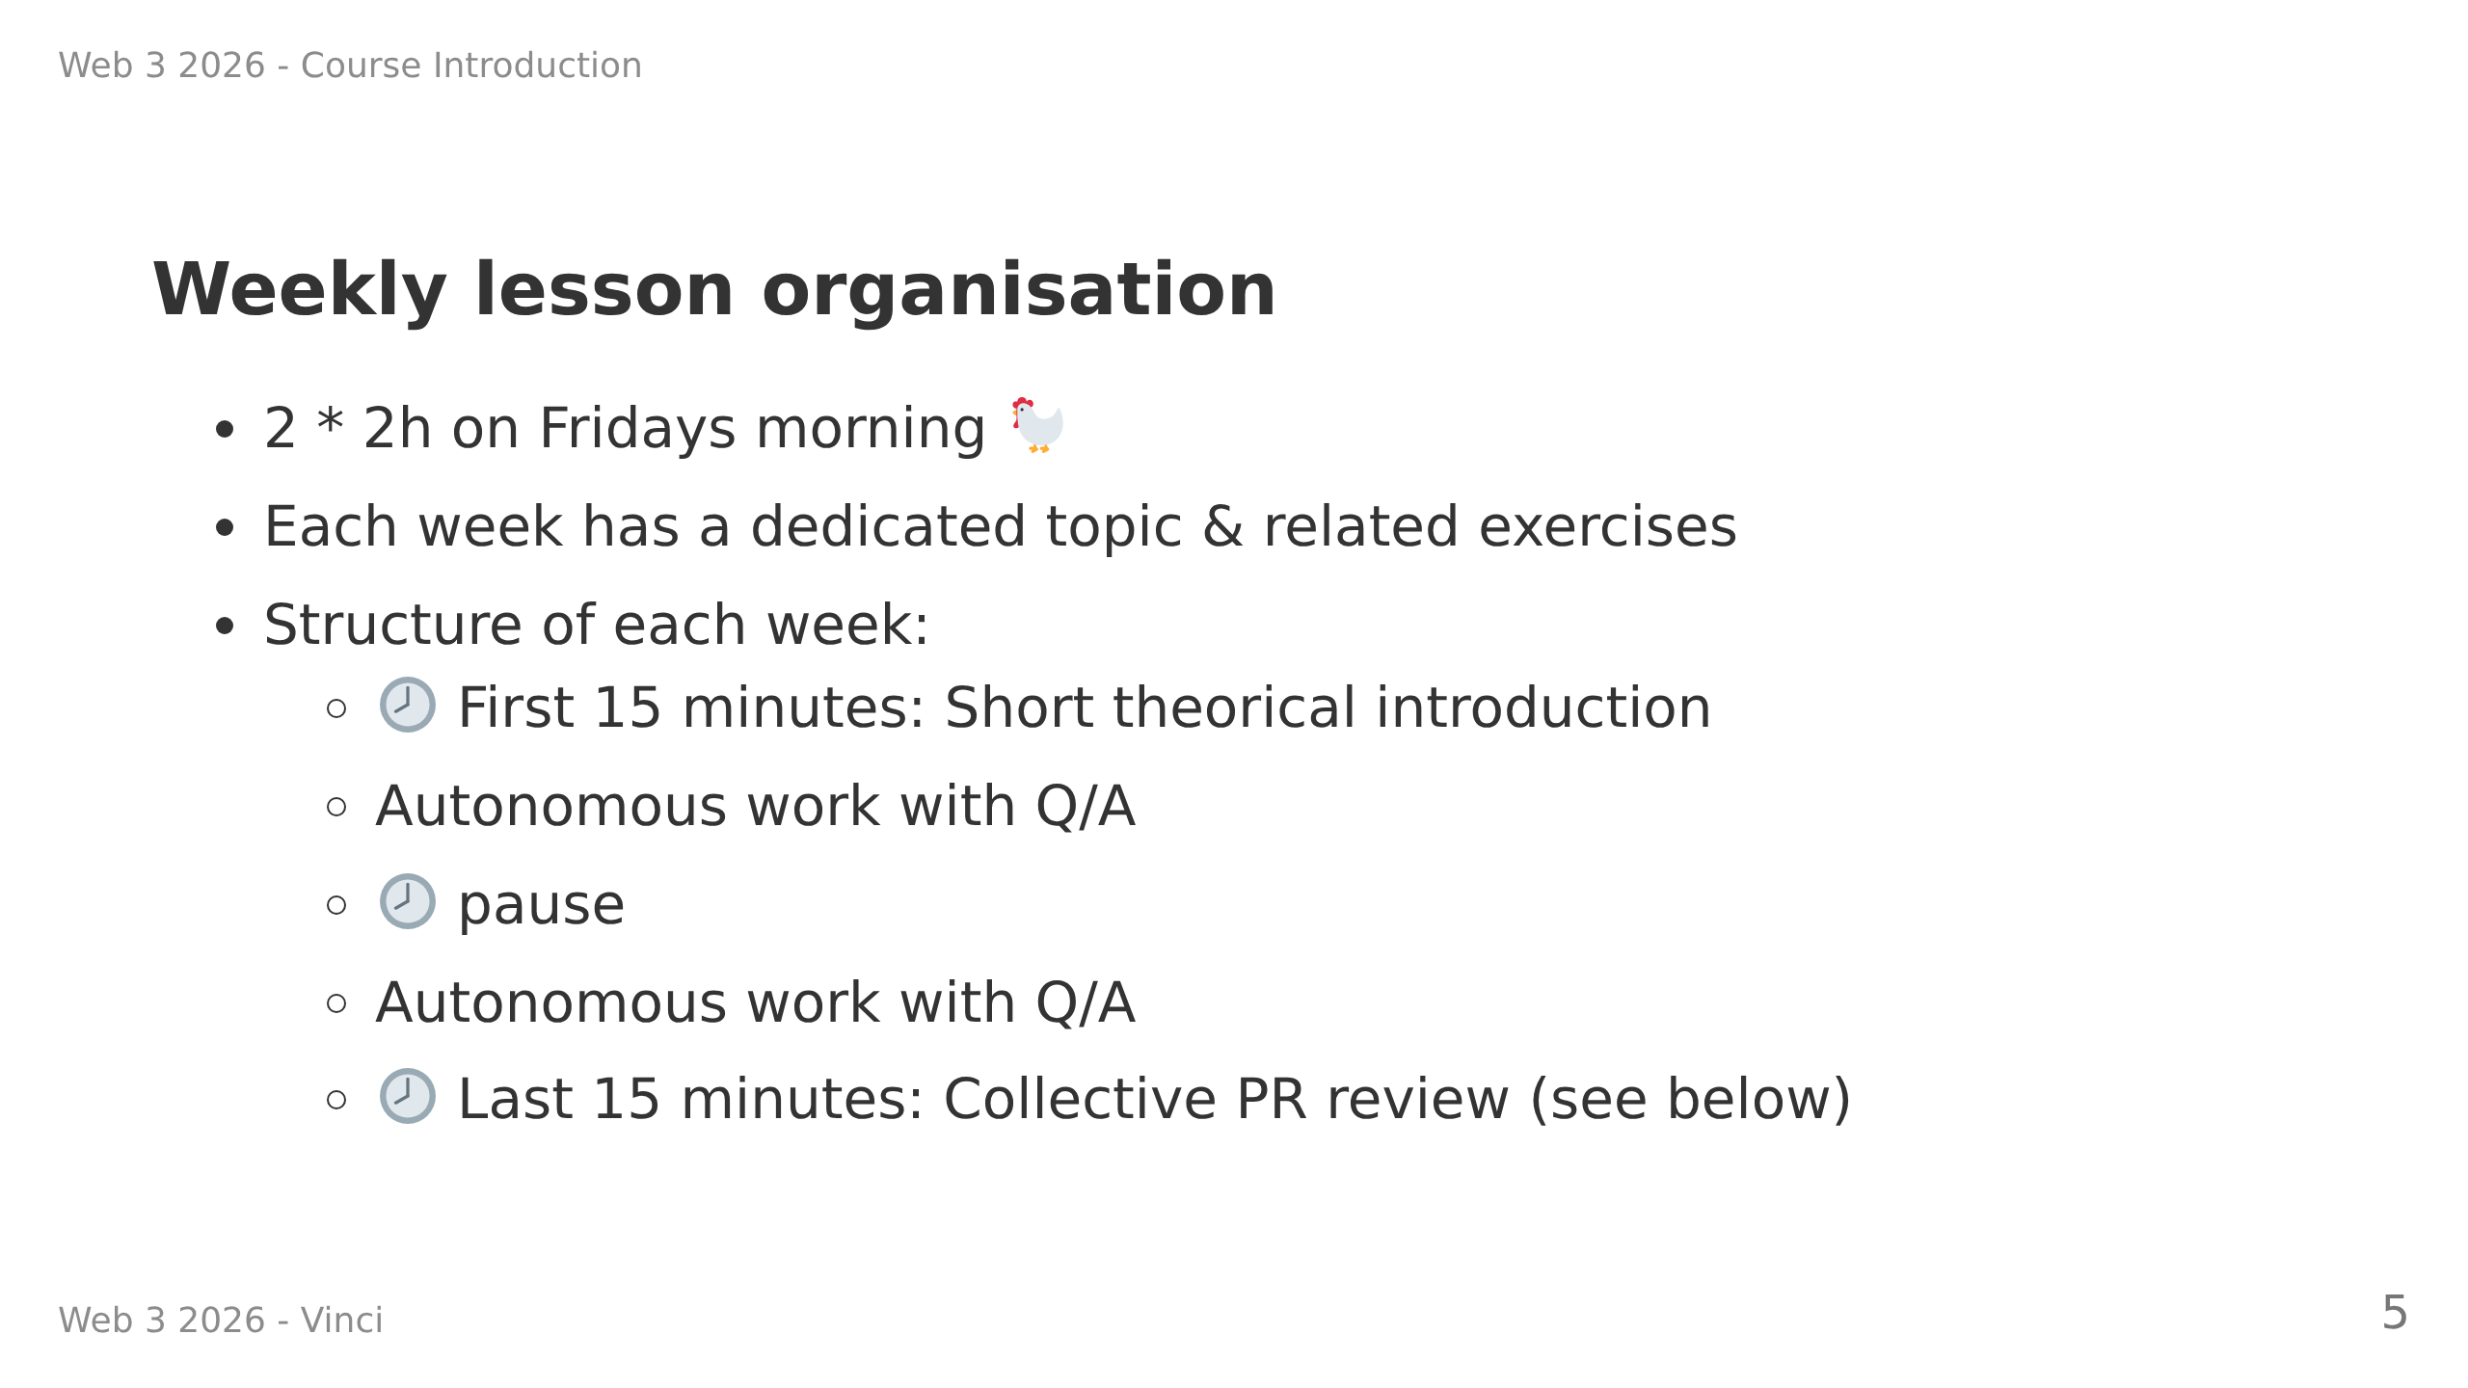

Slide 6
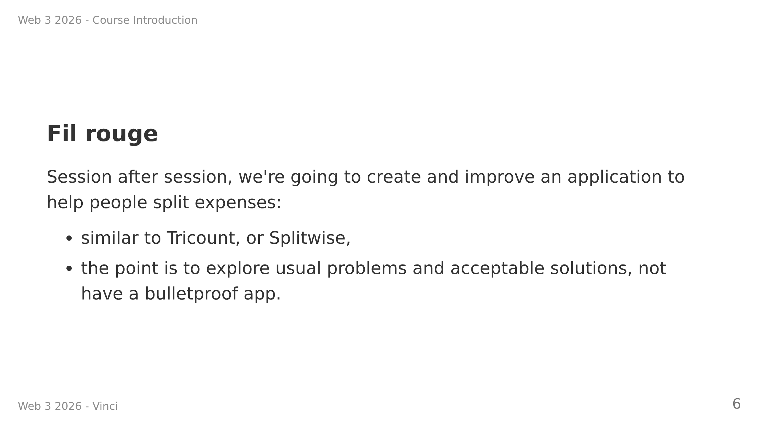

Slide 7
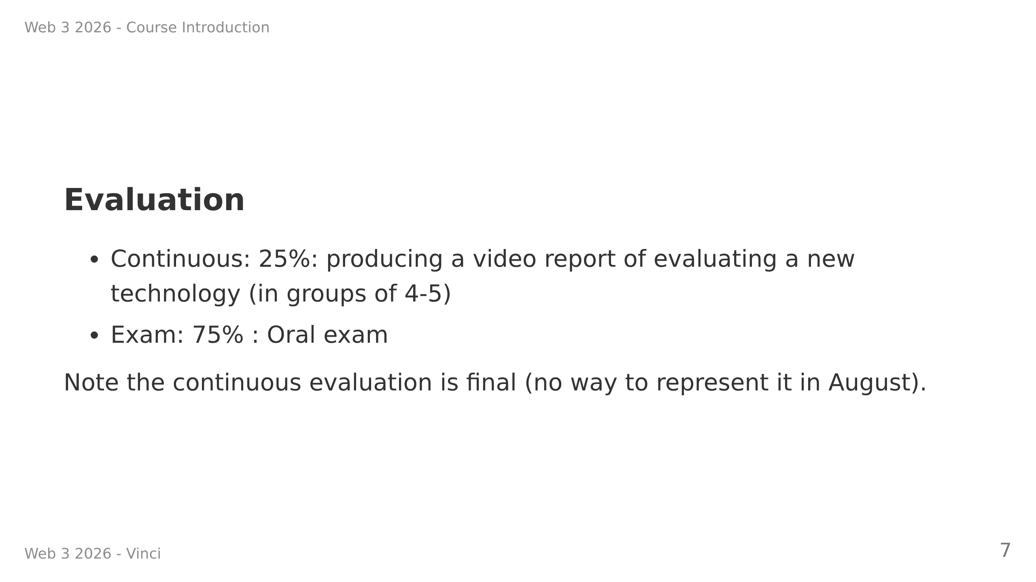

Slide 8
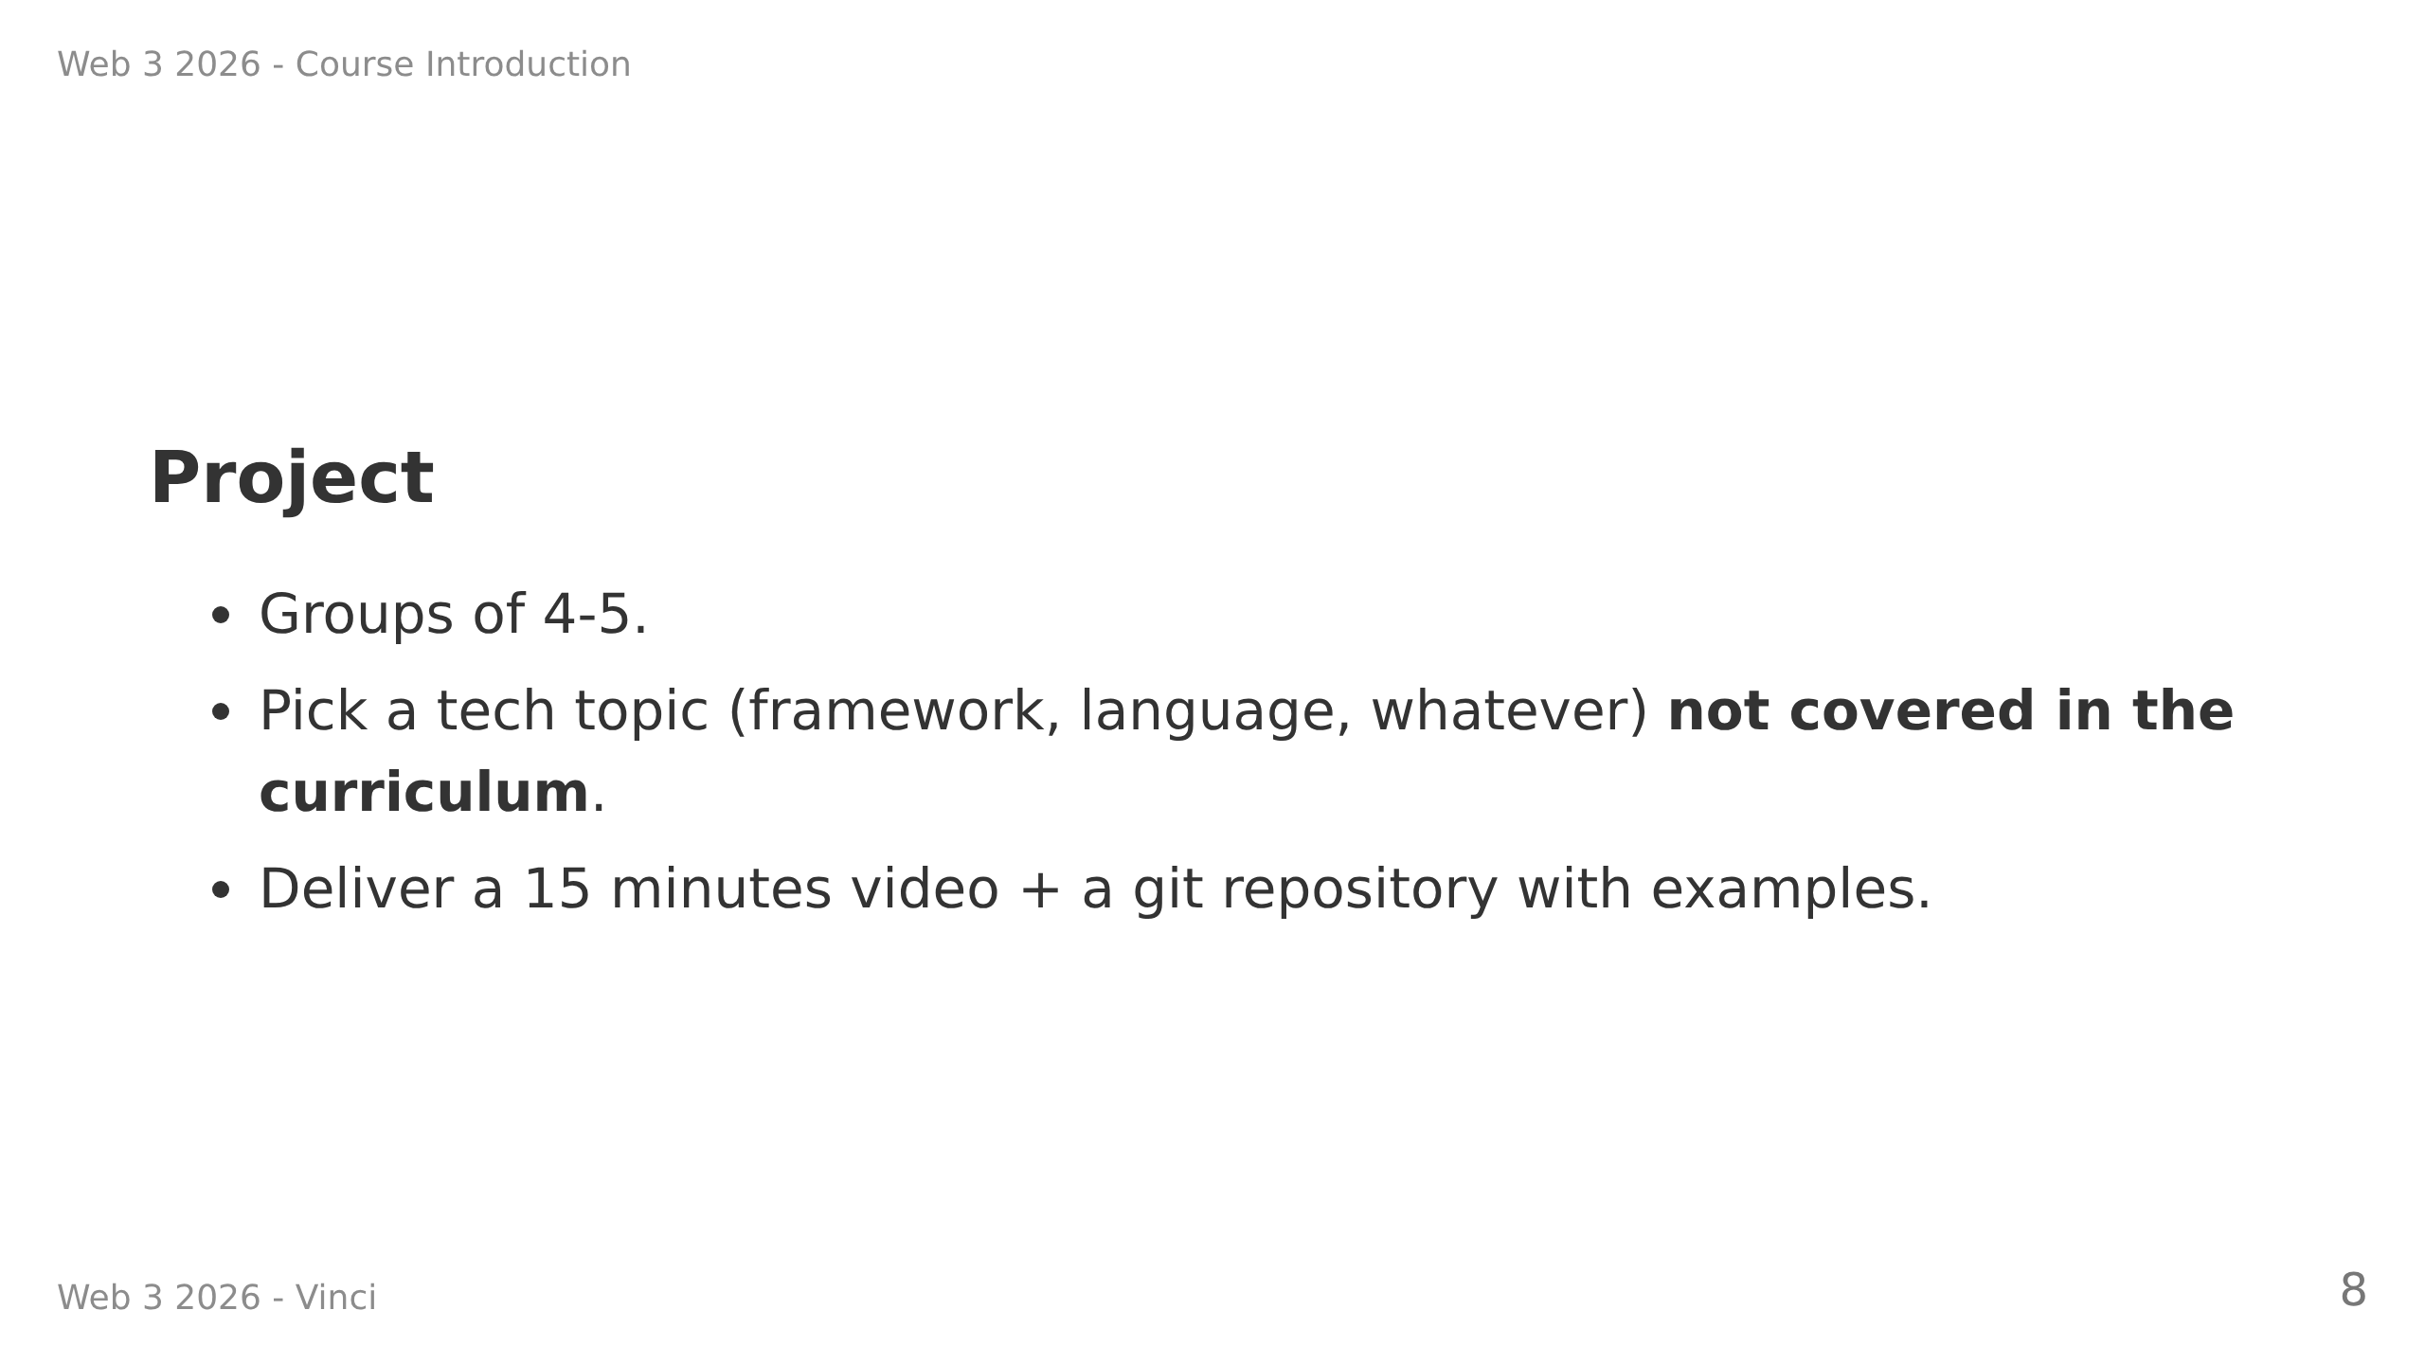

Slide 9
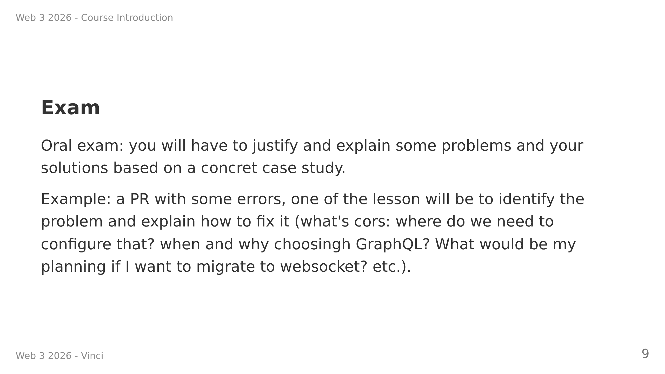
Notes:
- What's a Pull Request?
- We want you to exercise **reading code** and giving **meaningful feedback**
- There will be no AI nor Internet at your disposal but any code you write will not be evaluated on being runnable.
- We're going to practice this every week together

Slide 10
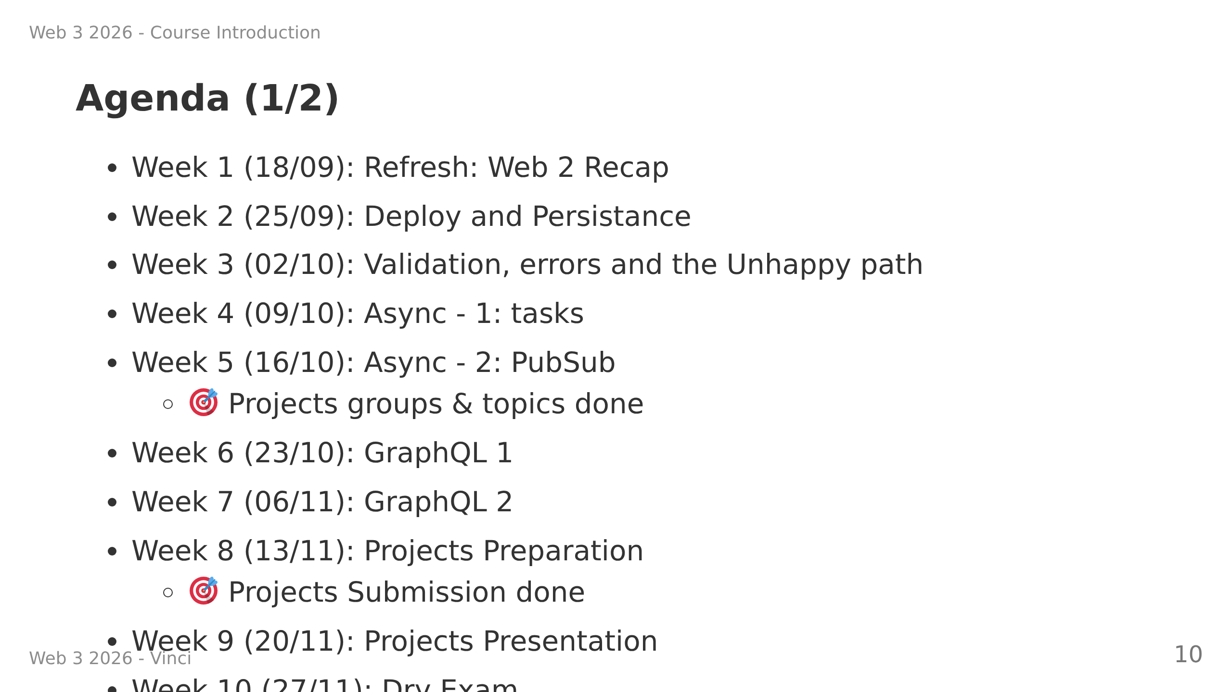
Notes:
---
## Agenda (2/2)
TBD

Slide 11
