Slide 1
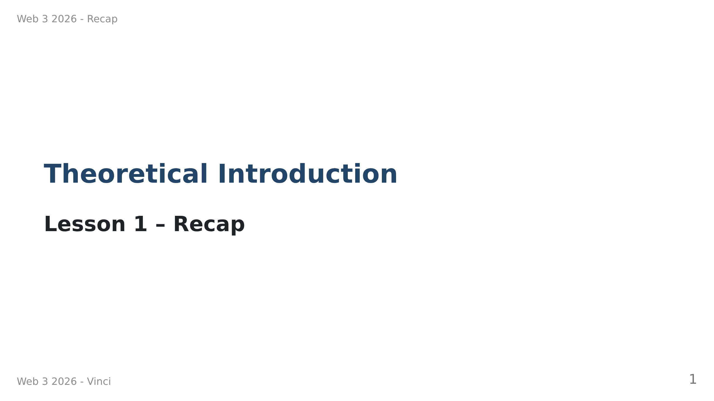

Slide 2
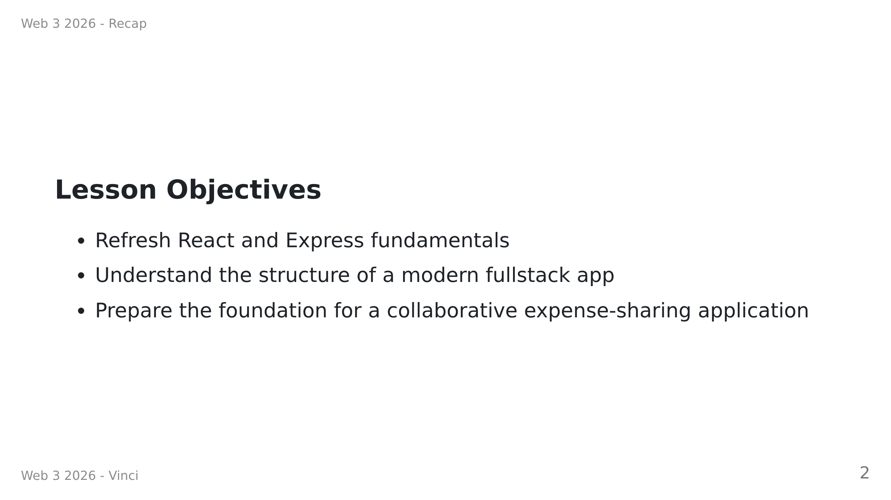

Slide 3
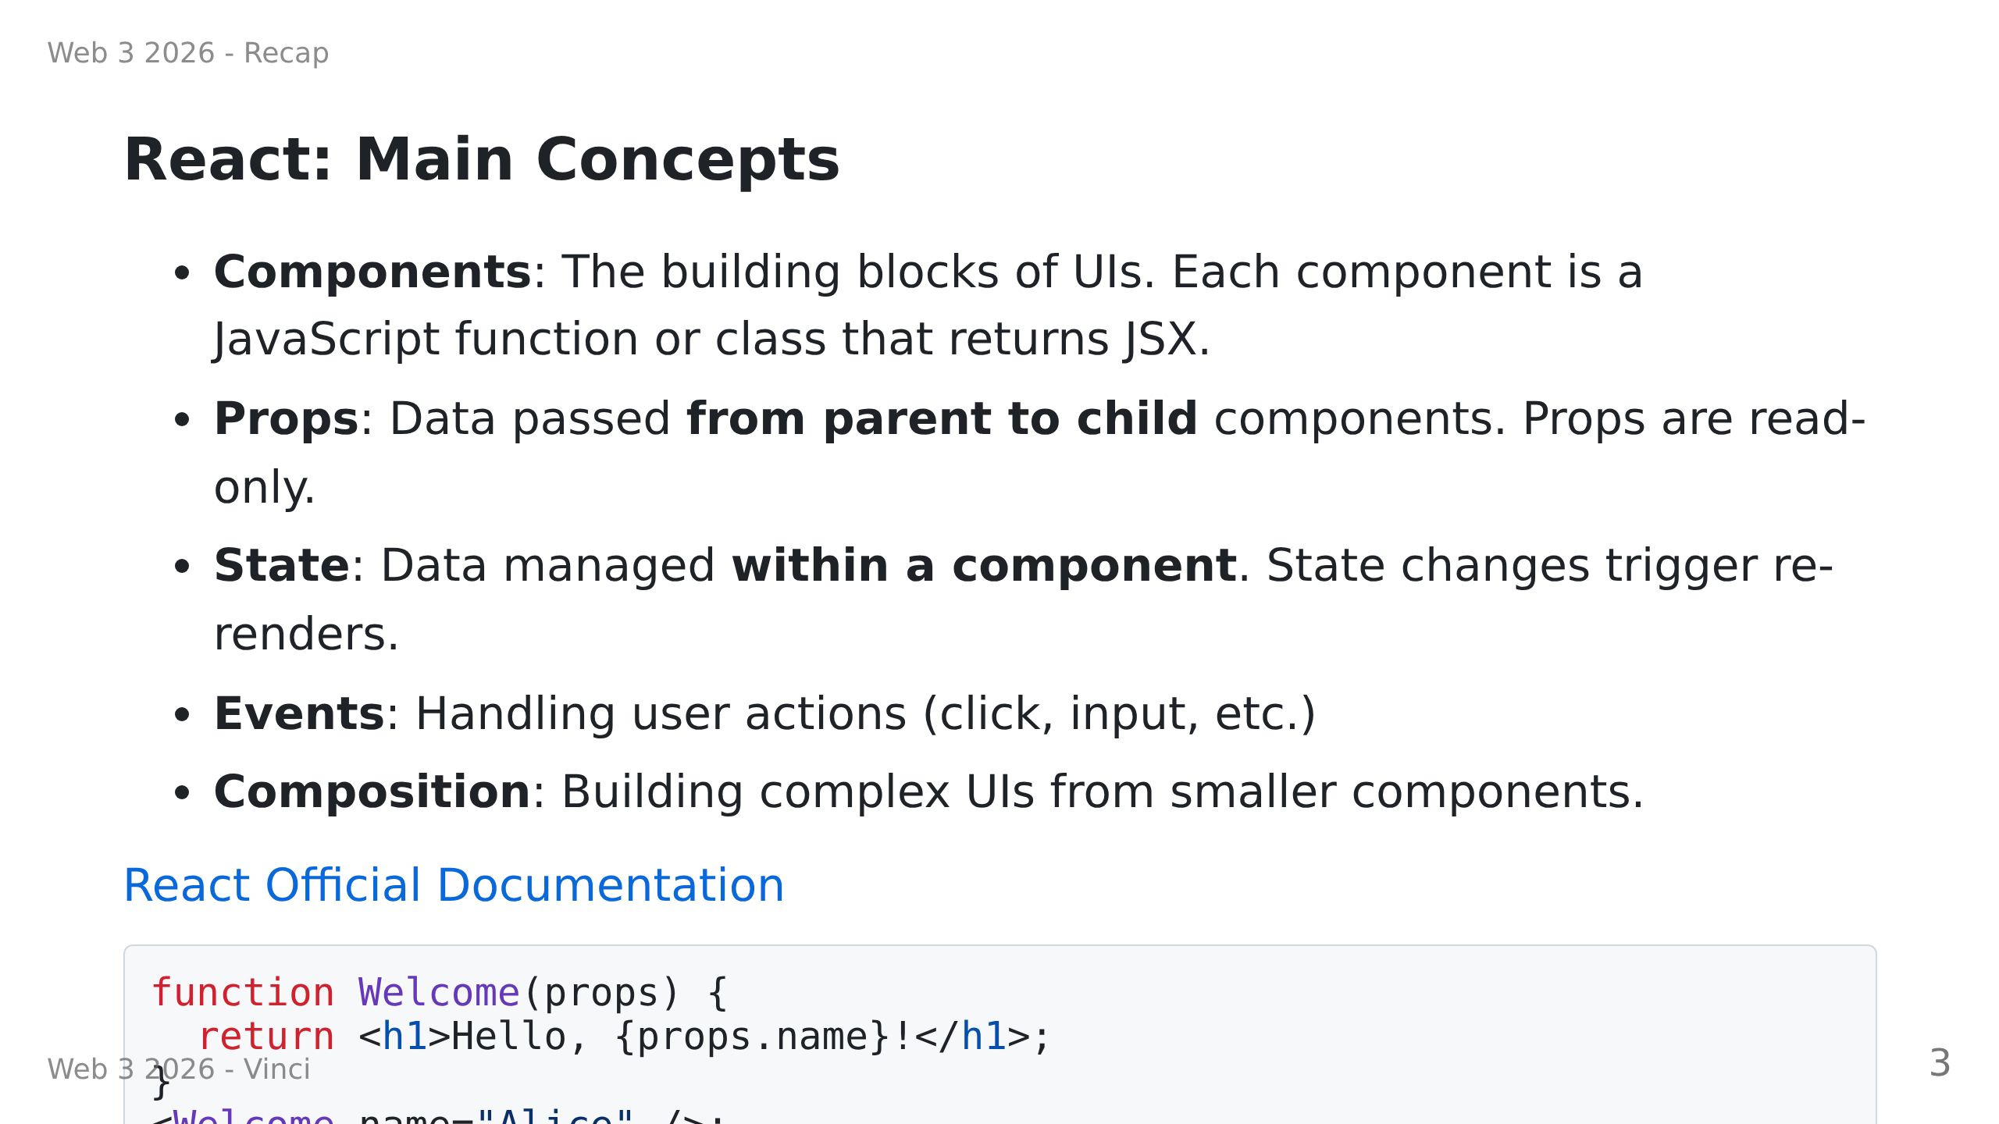

Slide 4
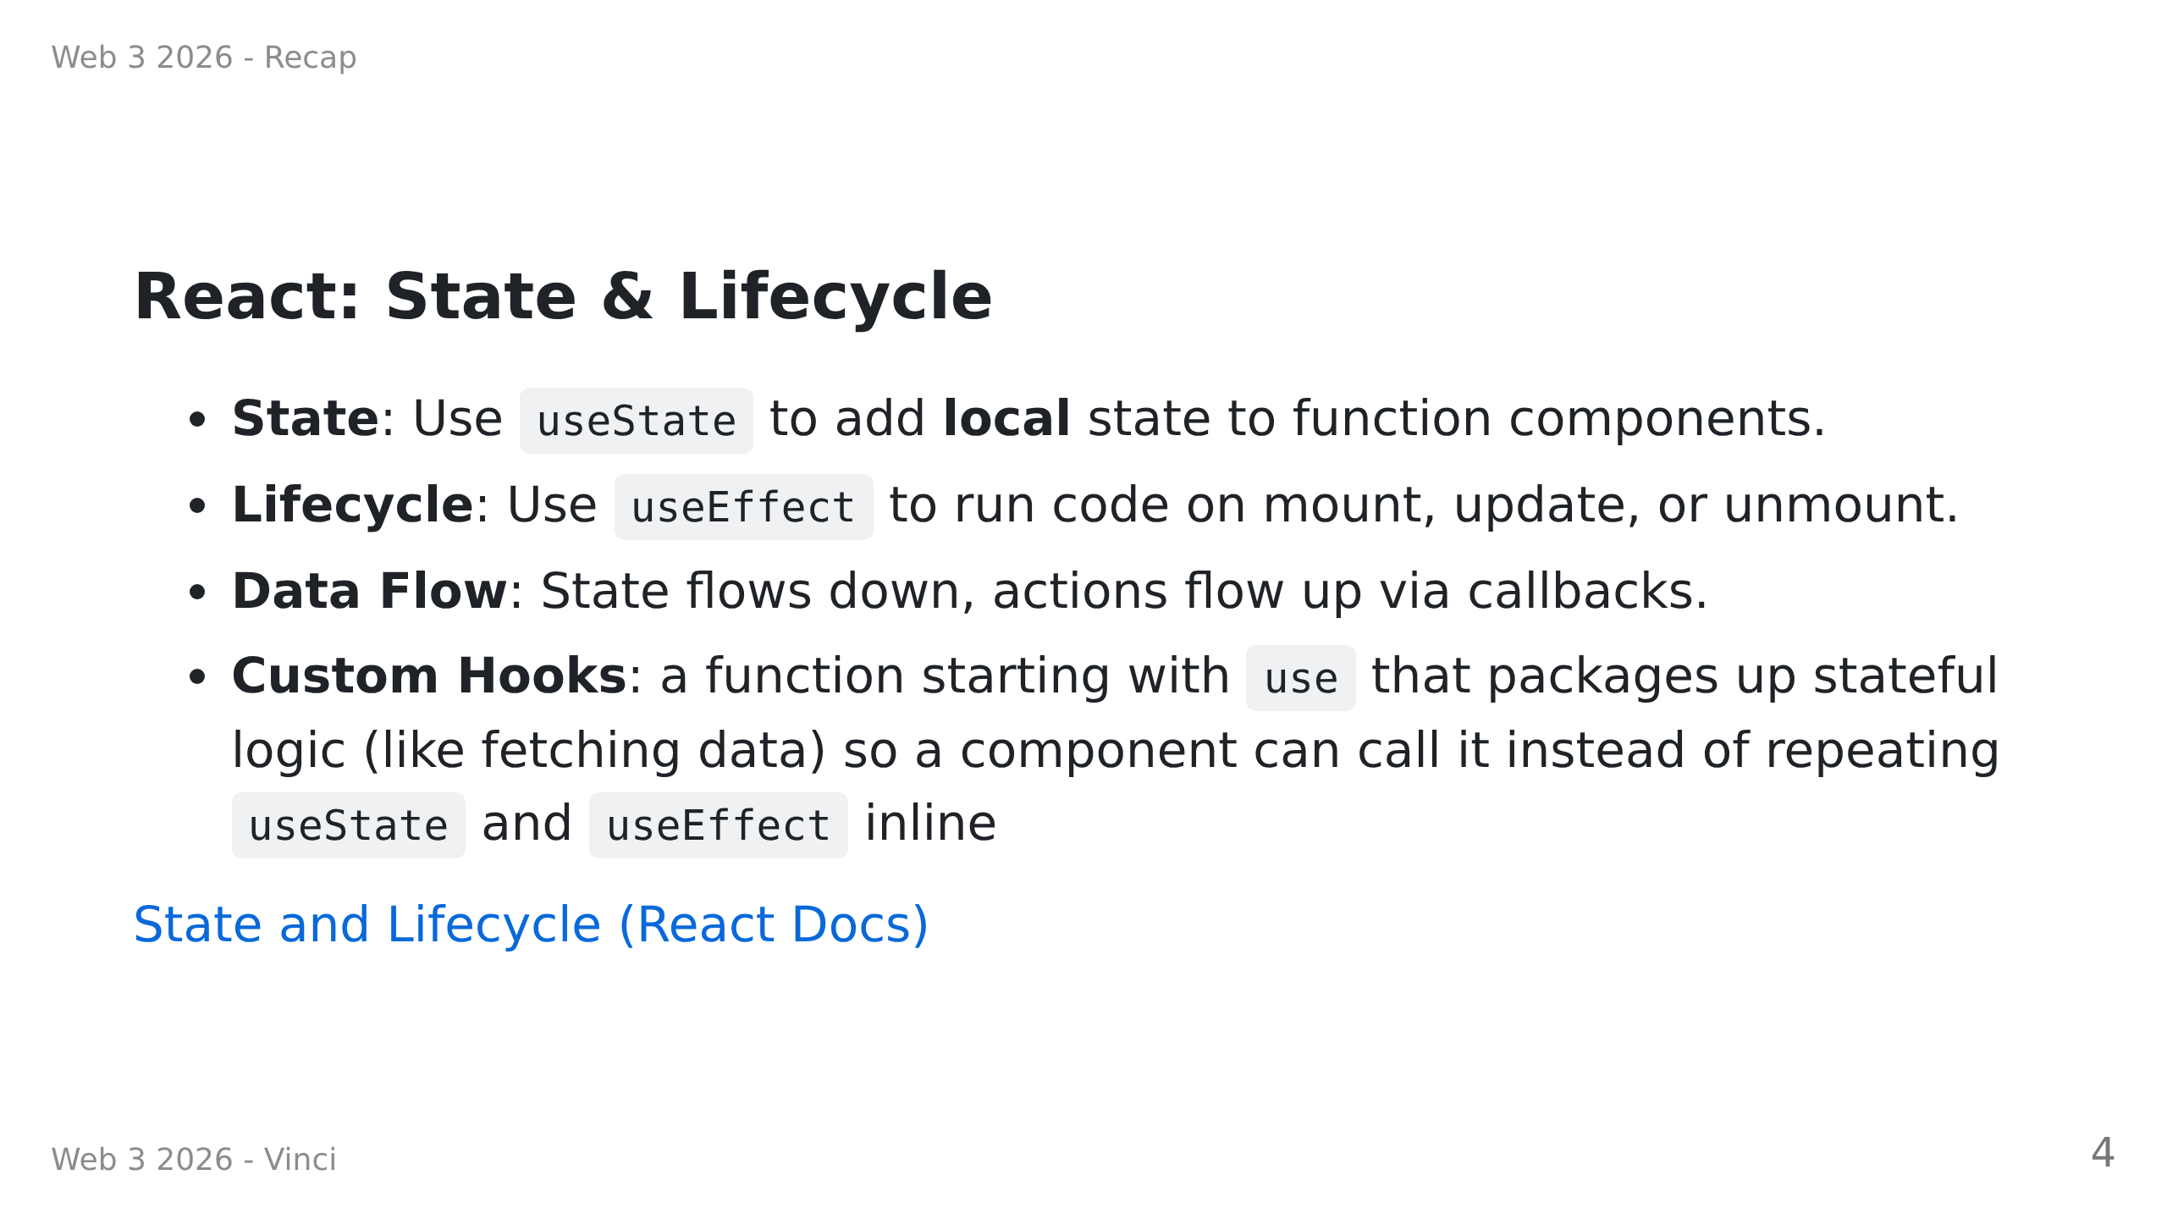
Notes:
I don't really understand this point, it may deserve deeper explanations

Slide 5
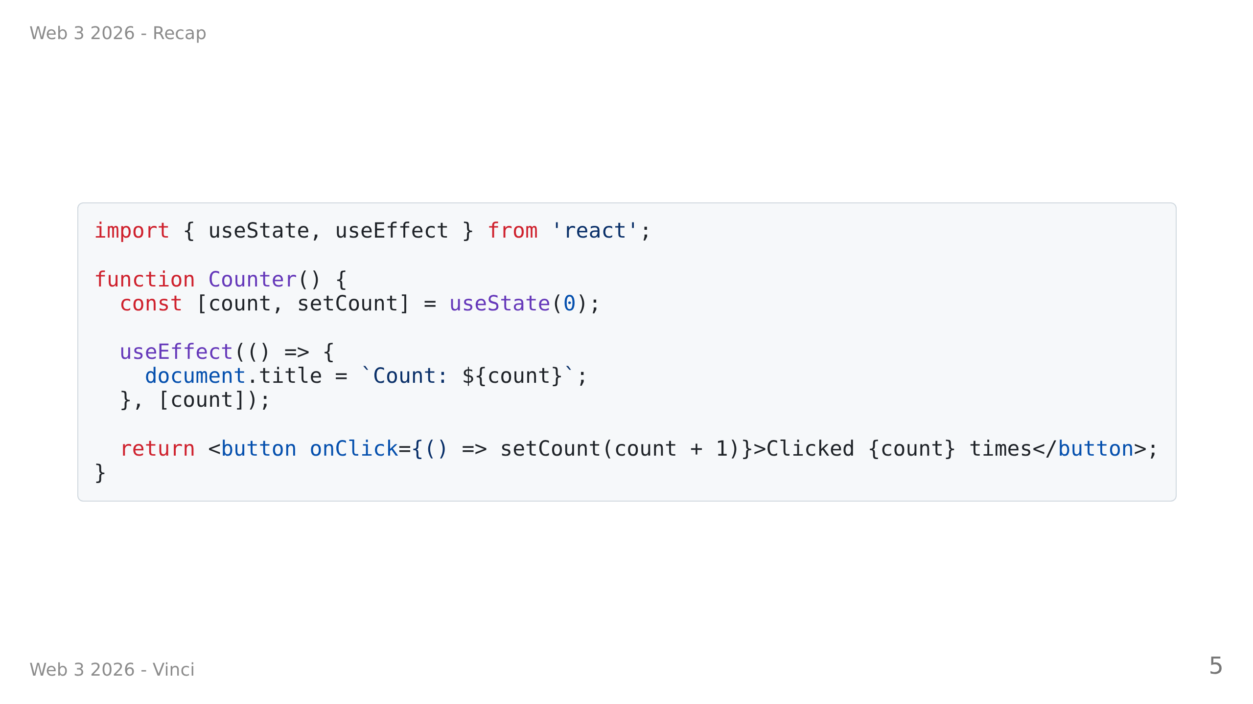

Slide 6
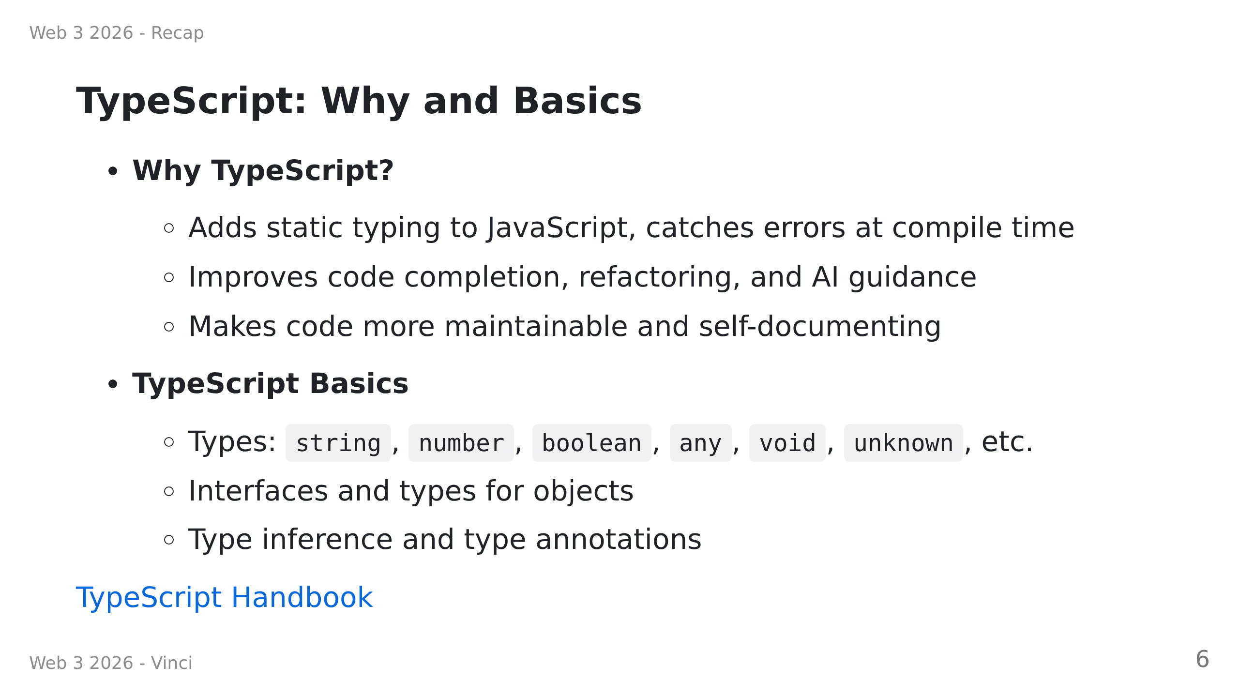

Slide 7
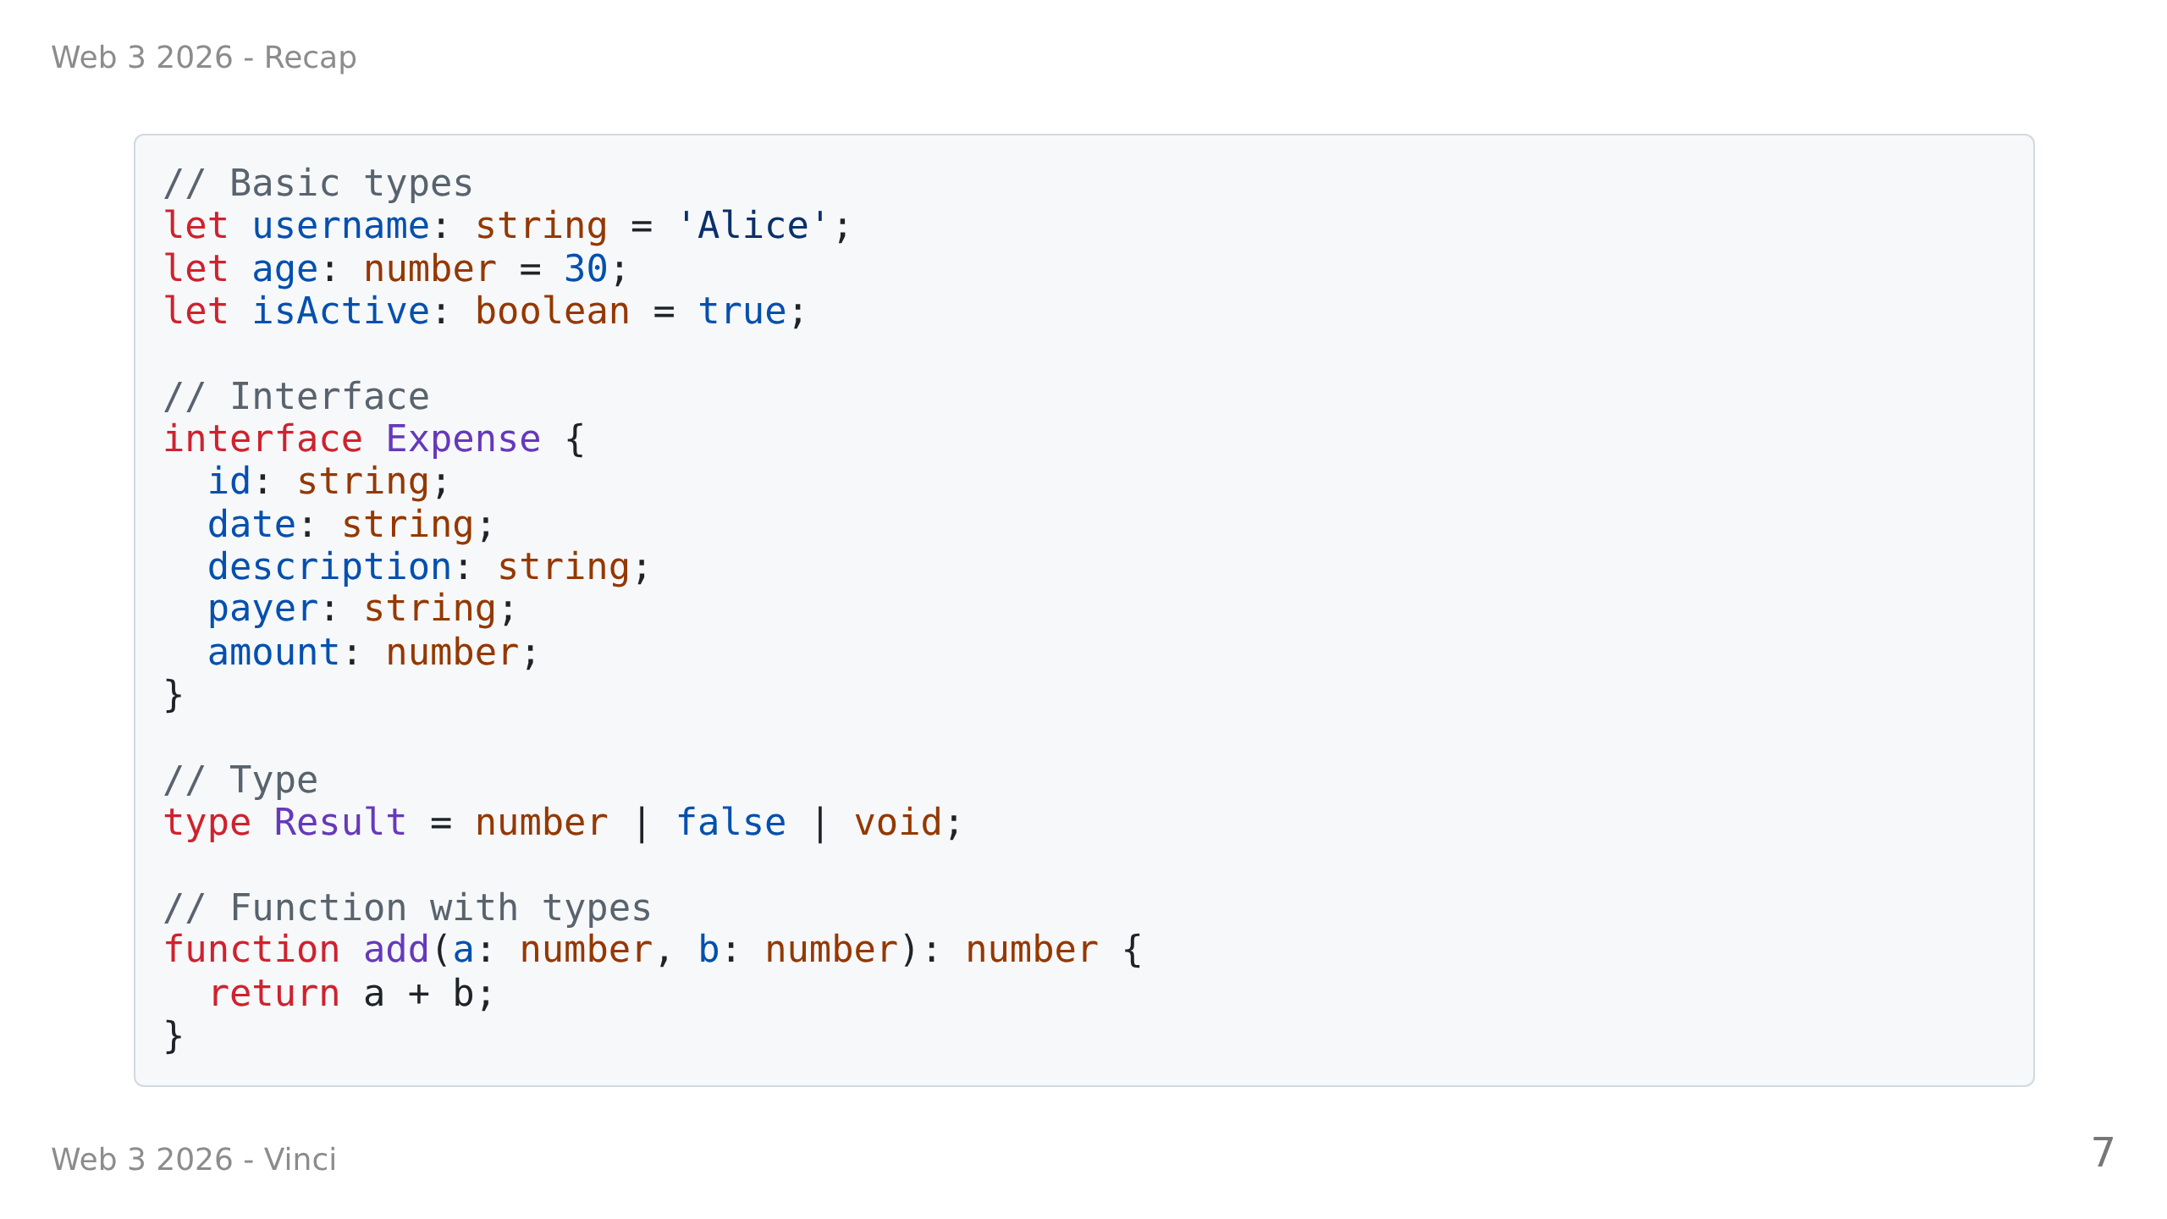

Slide 8
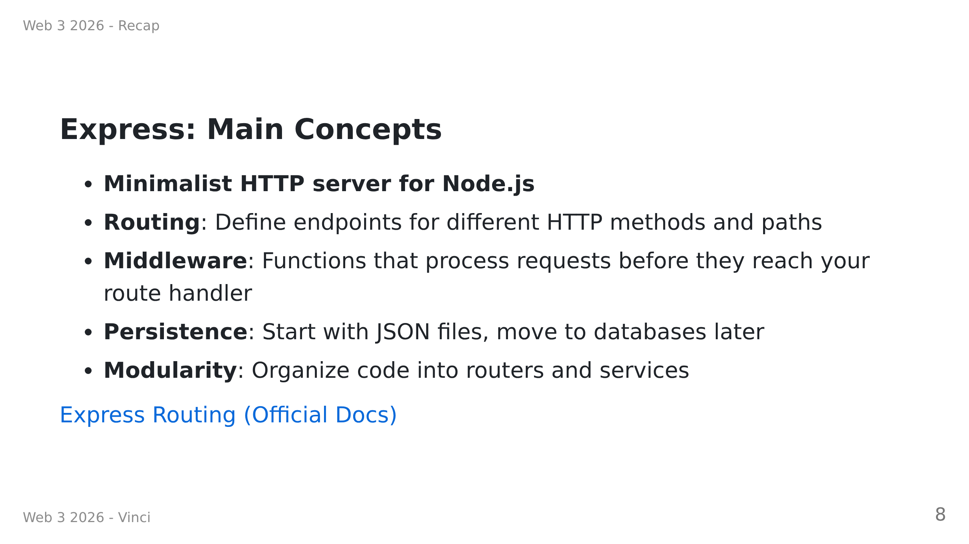

Slide 9
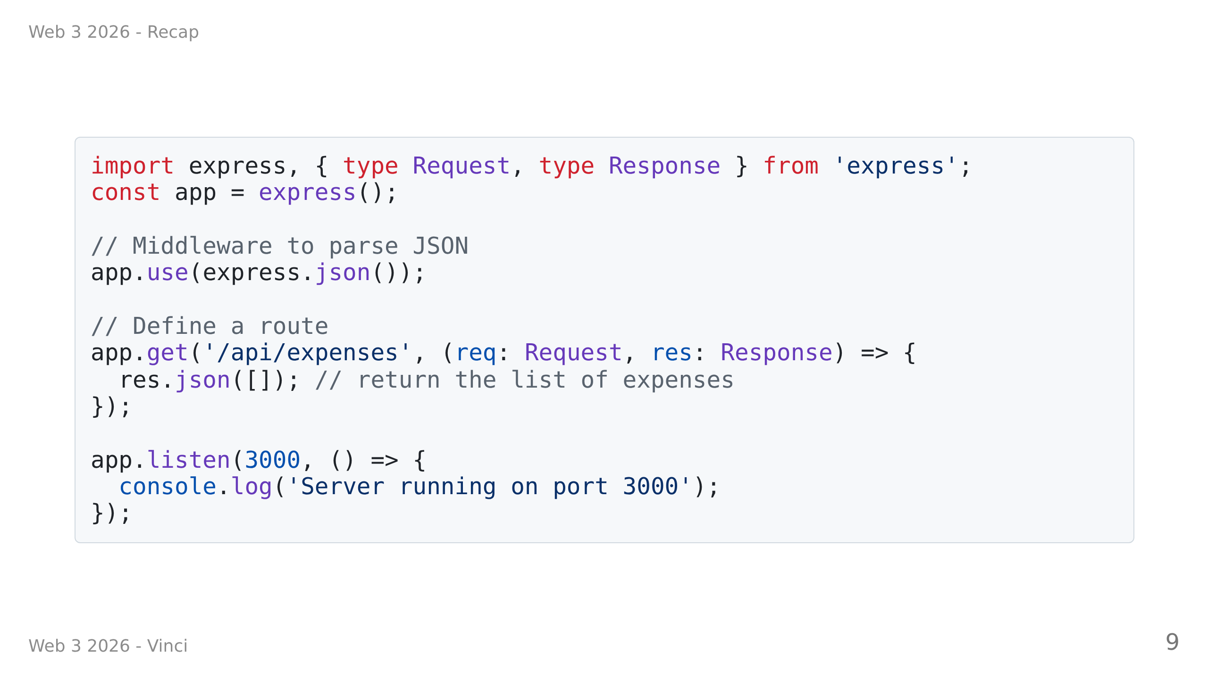

Slide 10
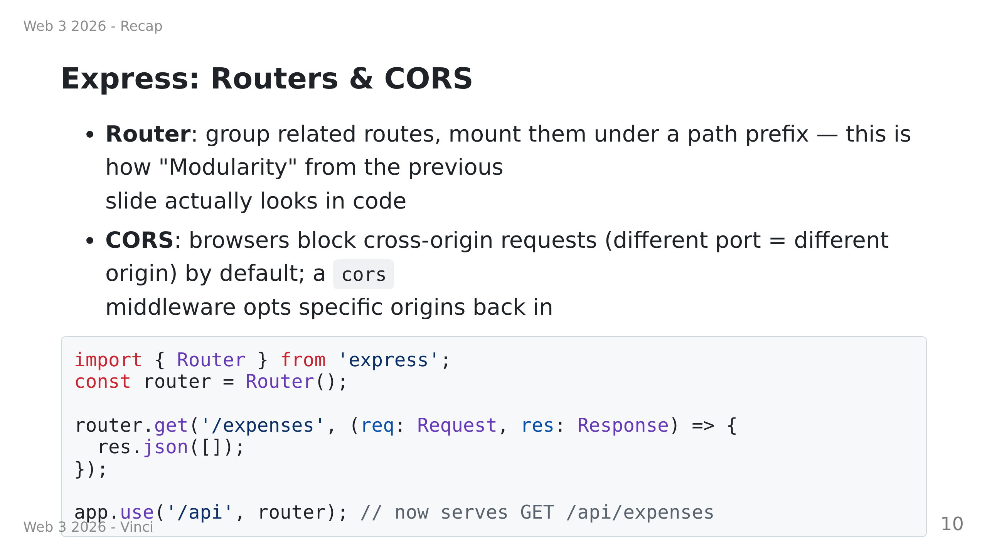

Slide 11
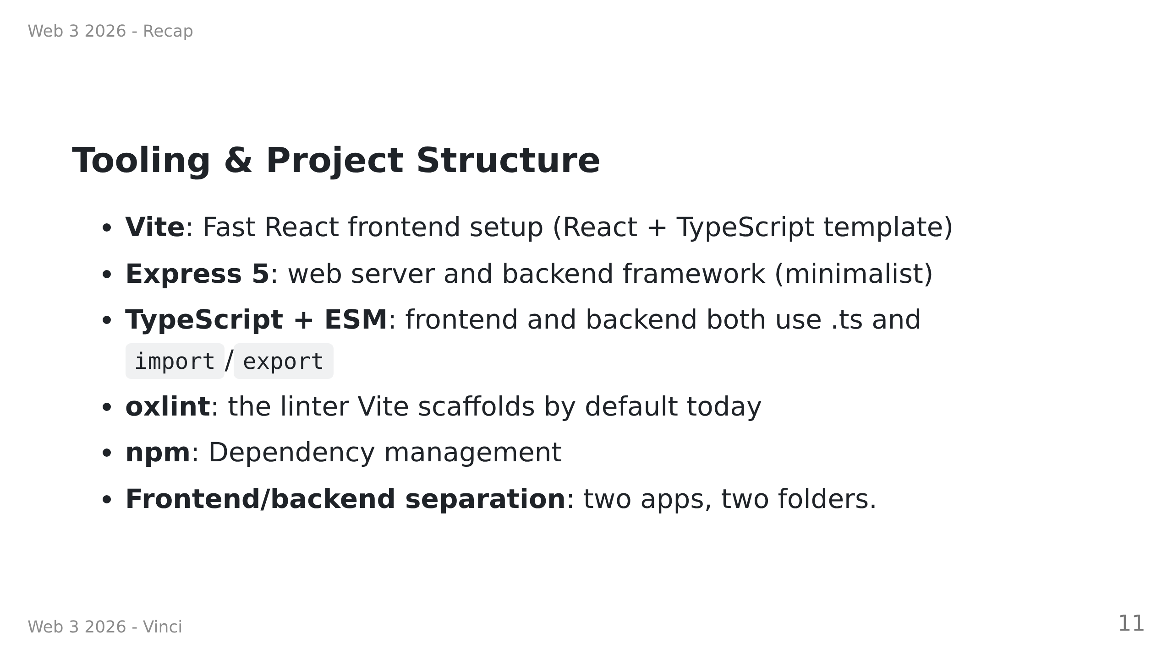

Slide 12

Notes:
Discussion moment

Slide 13
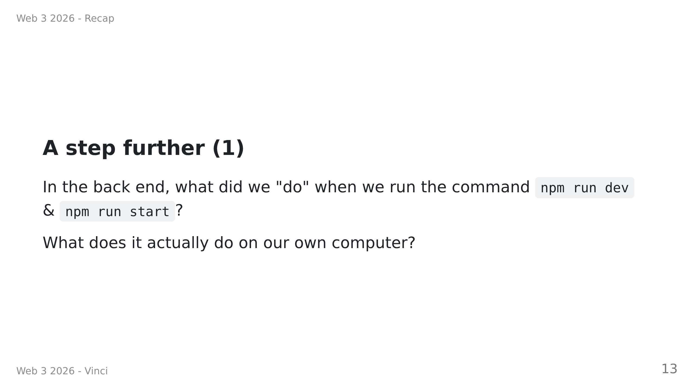
Notes:
dev VS start :
- define in package.json in "scripts" section
- dev : uses nodemon to watch for changes, could "rebuild" the server and restart the server, very useful for development but quite resource consuming
- start : just runs the server on "build" files -> JS
- note: node24+ can run ts files directly, no need to compile to js anymore
proposition : more like a discussion with students, we need to mention at least :
- what's a server
- what's a port
- ISO TCP/IP layers
may be listed ideas/concept on the board.

Slide 14
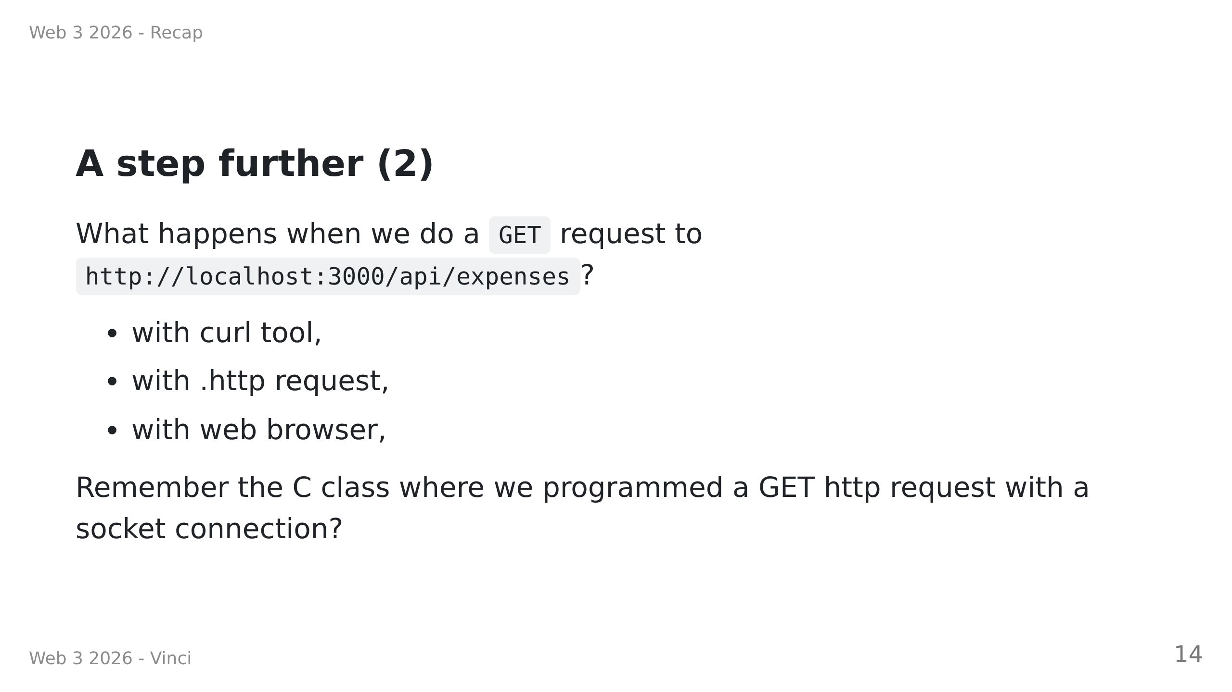

Slide 15
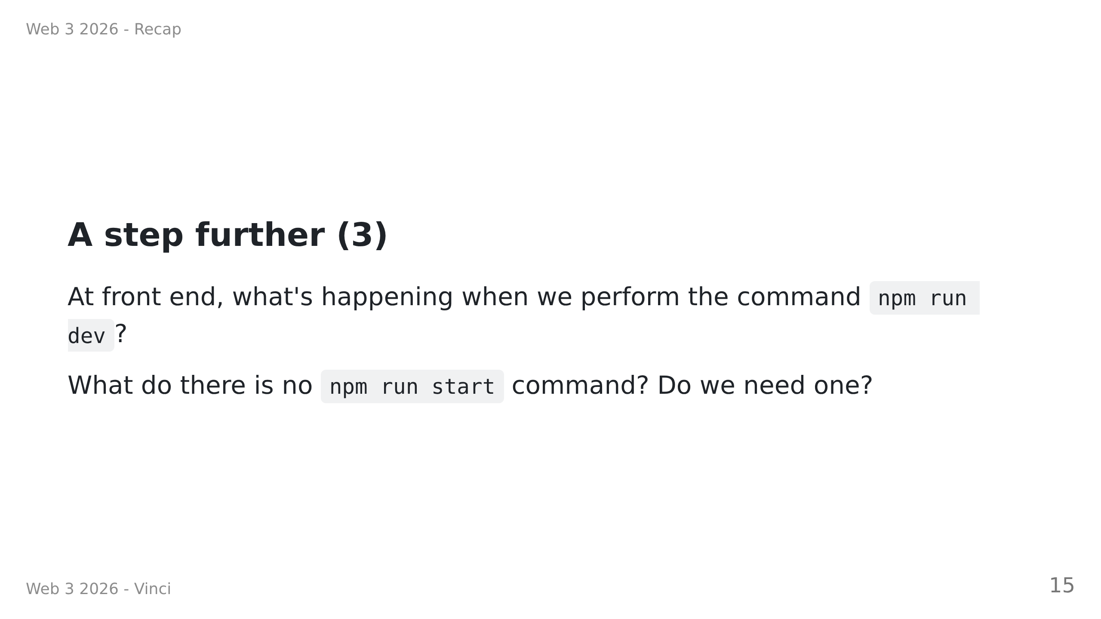
Notes:
Explain that Vite is a dev server that serves the frontend and hot-reloads the code when it changes.
We do need a server to serve the built files in production, typical examples are Nginx or Apache. We provide to this server a "build" folder with an entry point (`index.html`). The build is made of html and JS code.
We could use a simple HTTP server like `http-server` or `serve` but it's not necessary for now.

Slide 16
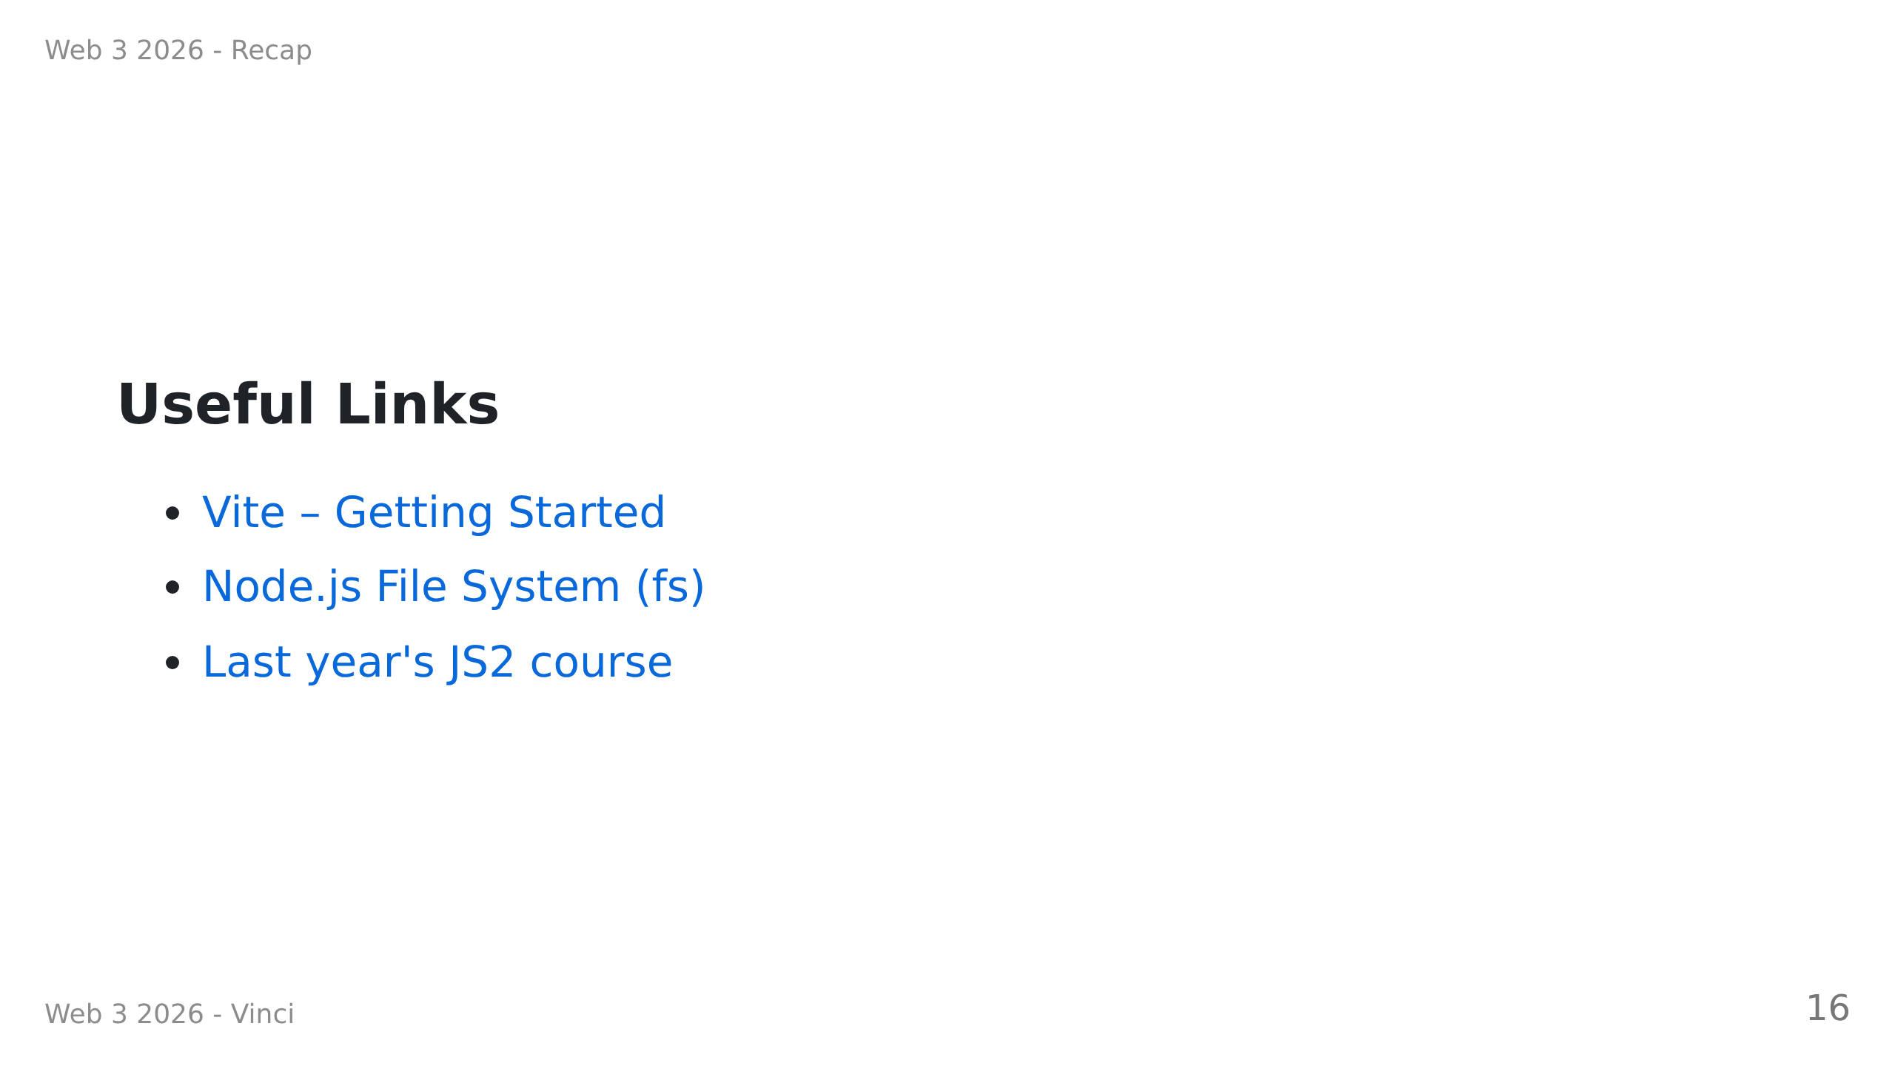

Slide 17
