Slide 1
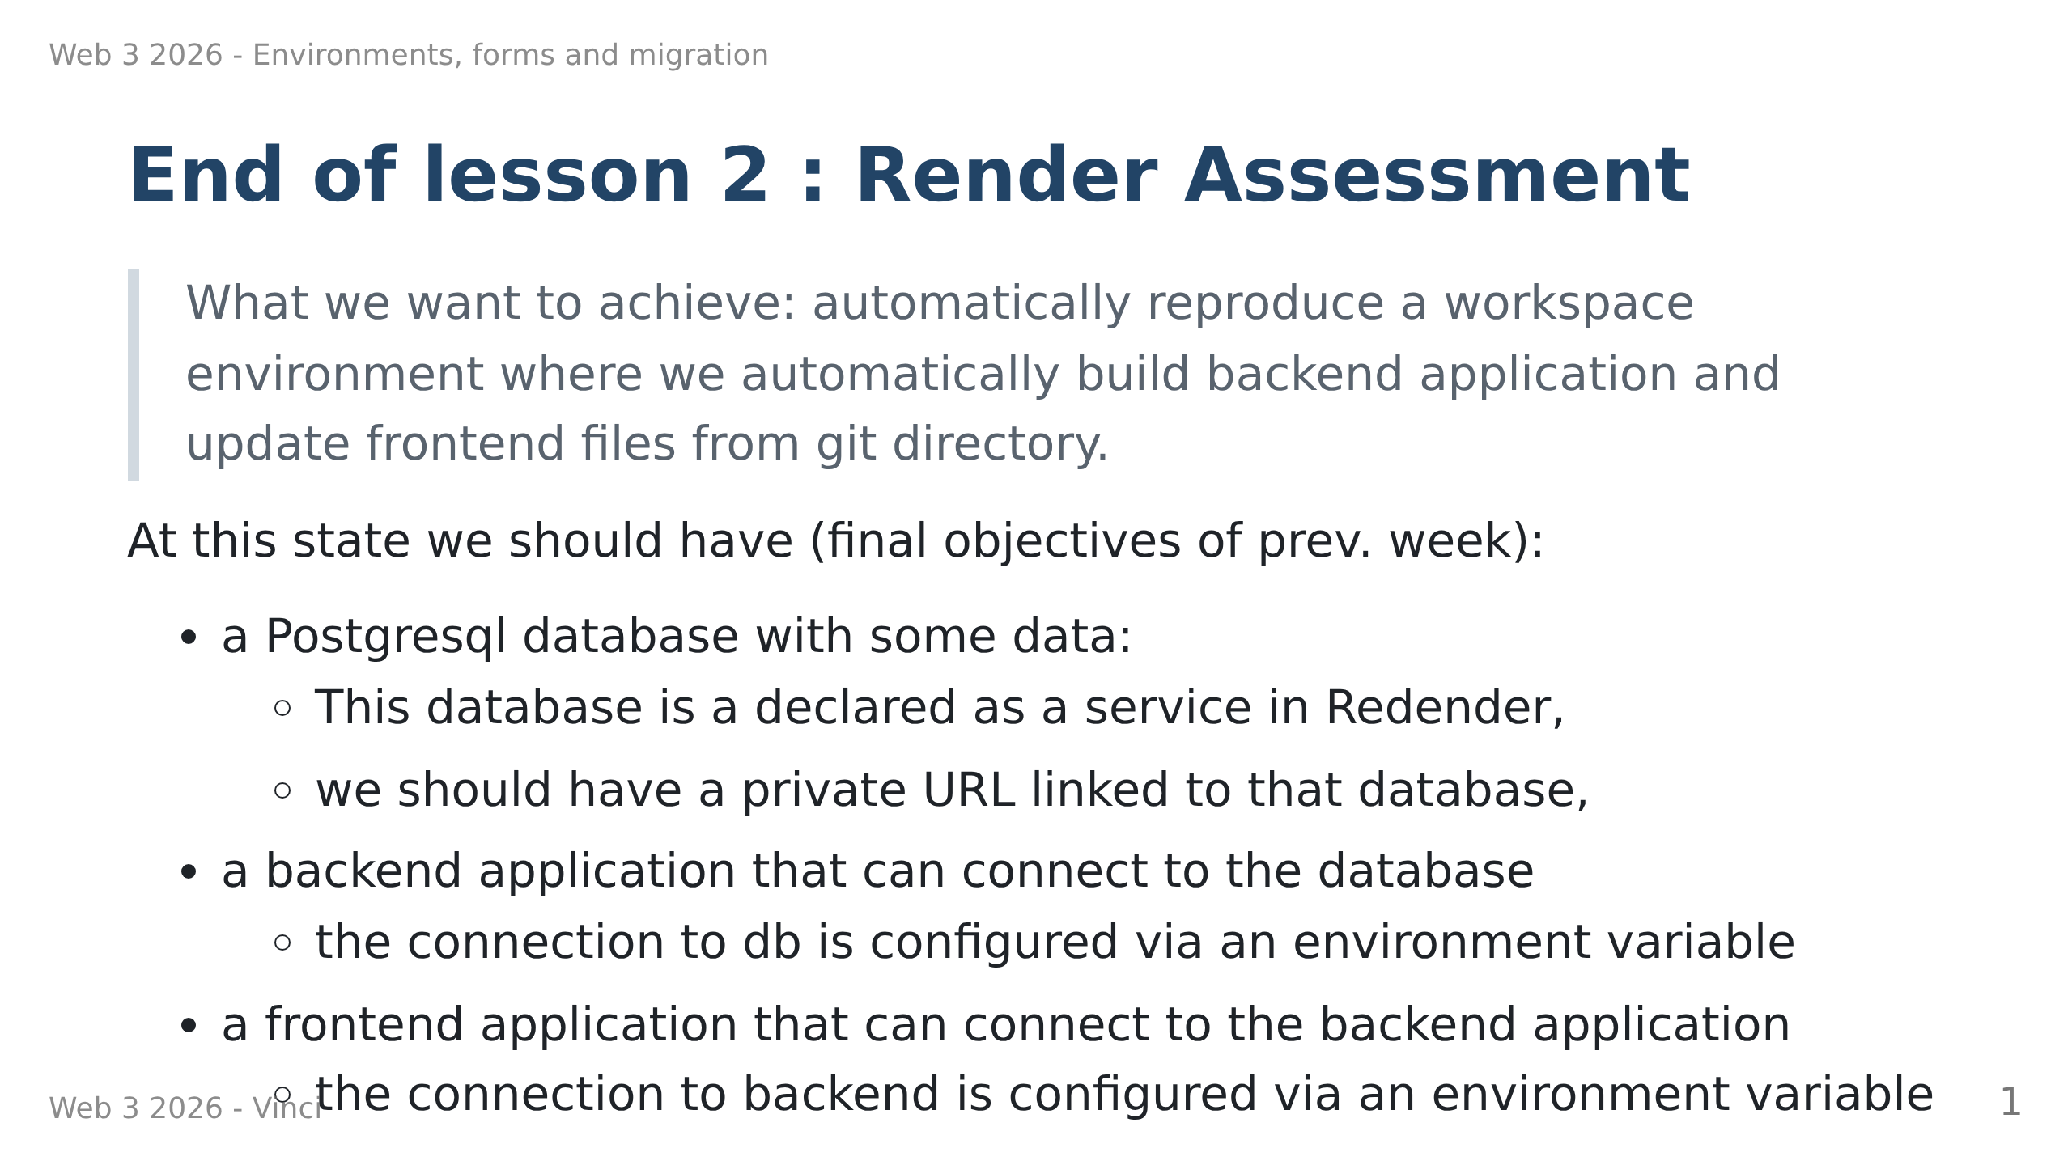

Slide 2
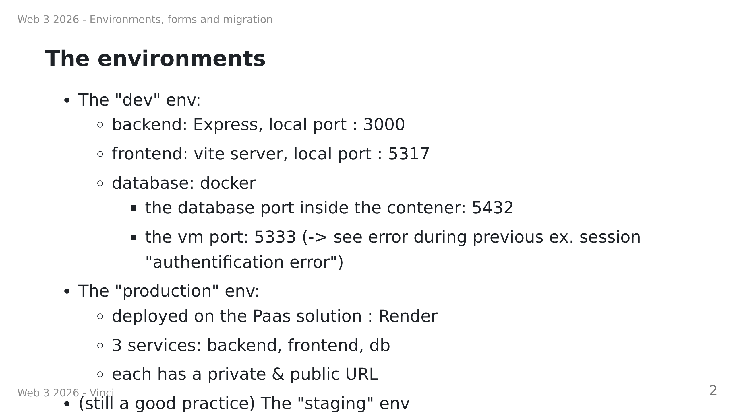
Notes:
The staging env is the environment where we test the application before deploying it to the production environment. We are "as close as possible" to the production environment with dummy data.

Slide 3
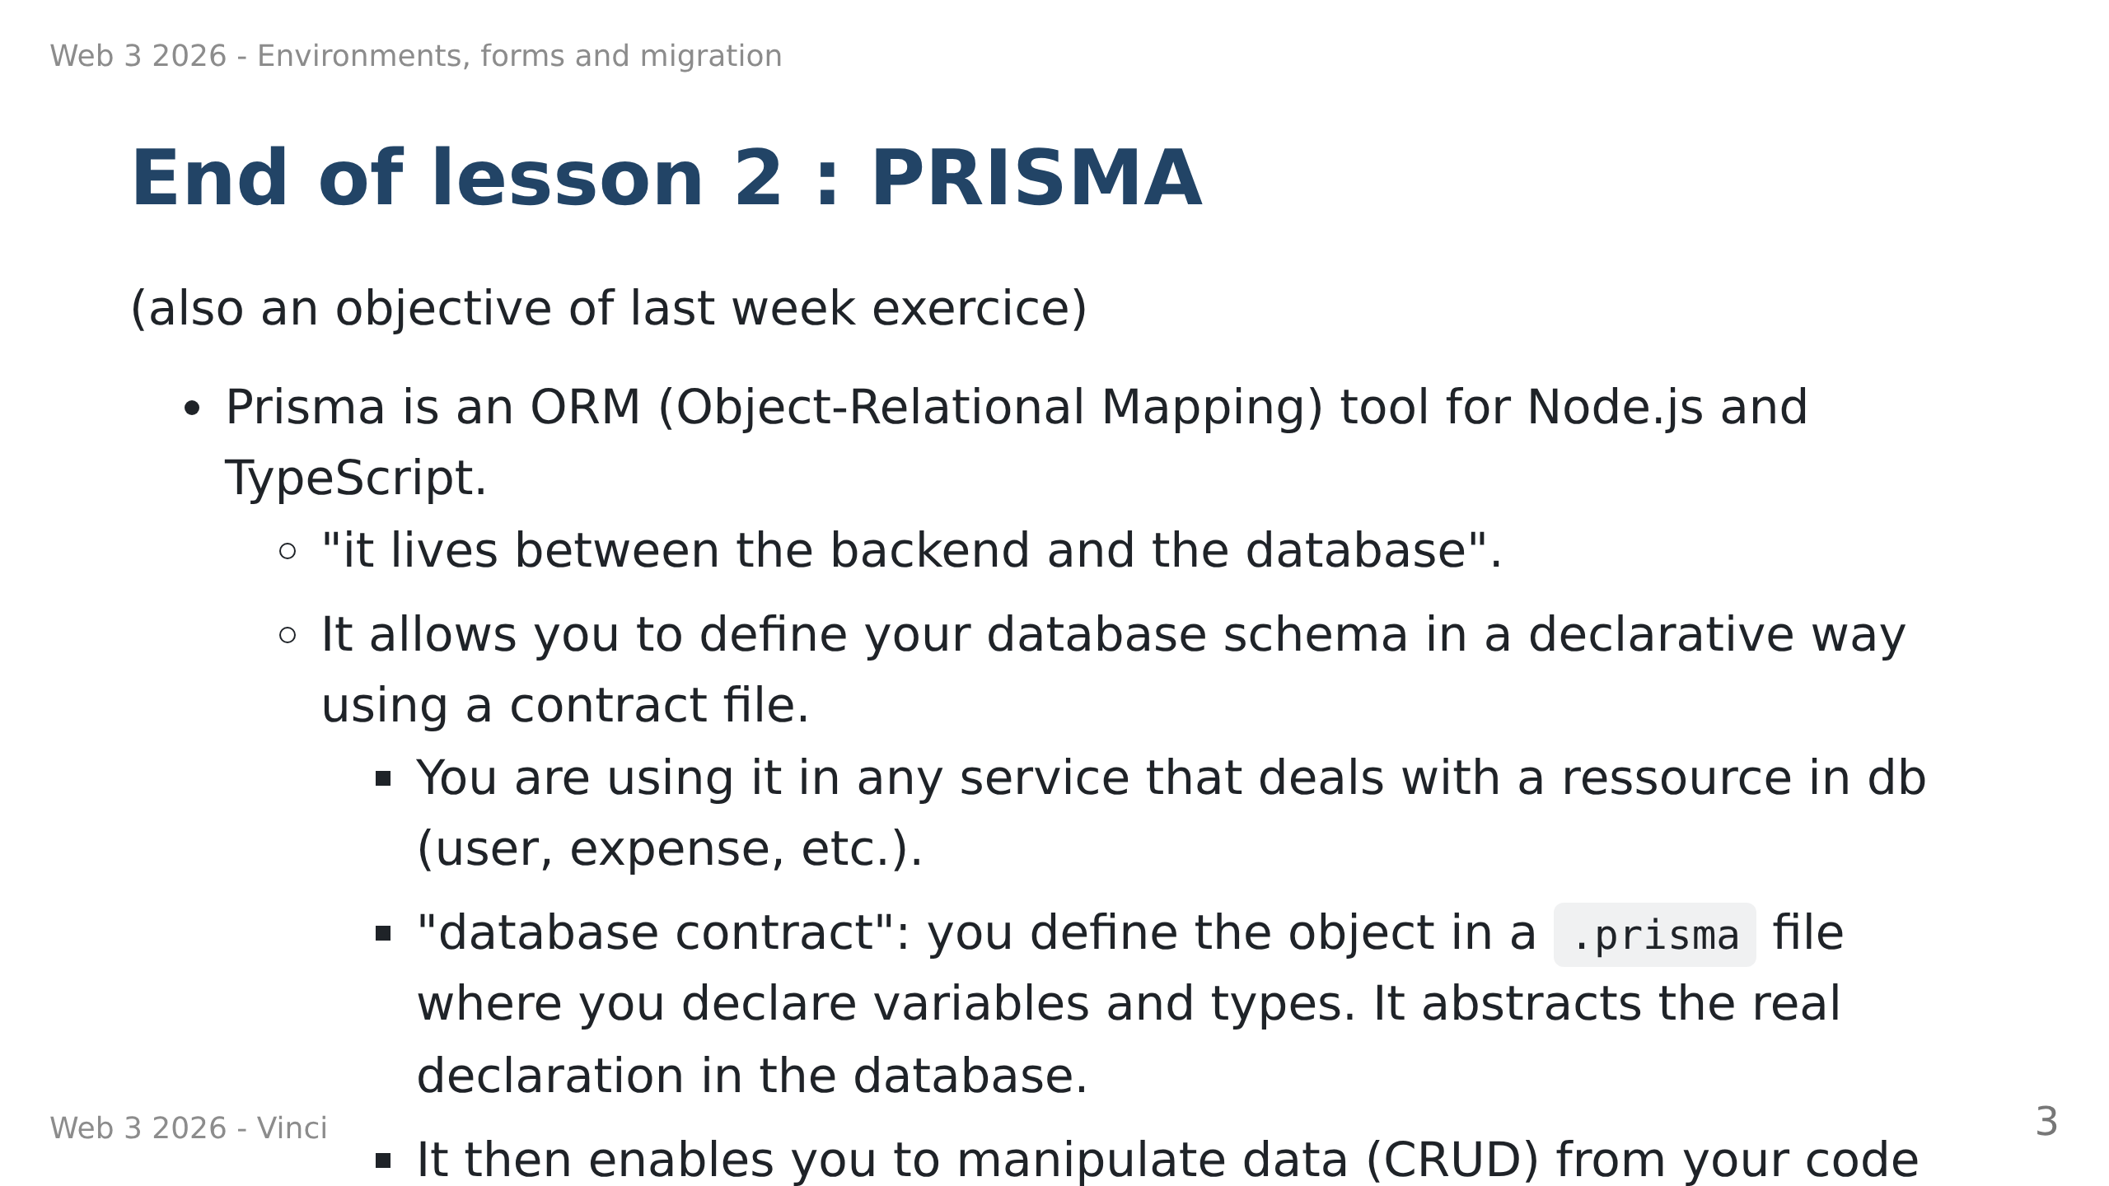

Slide 4
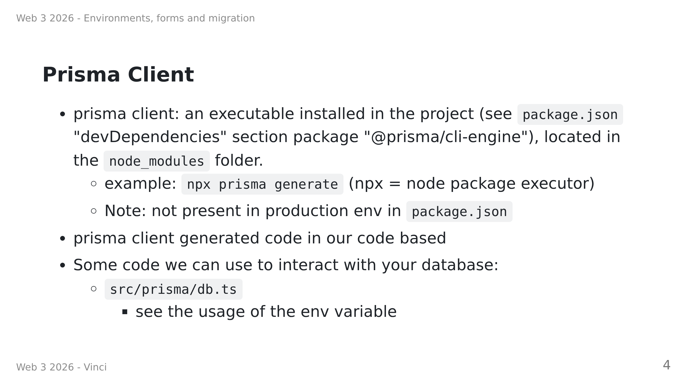

Slide 5
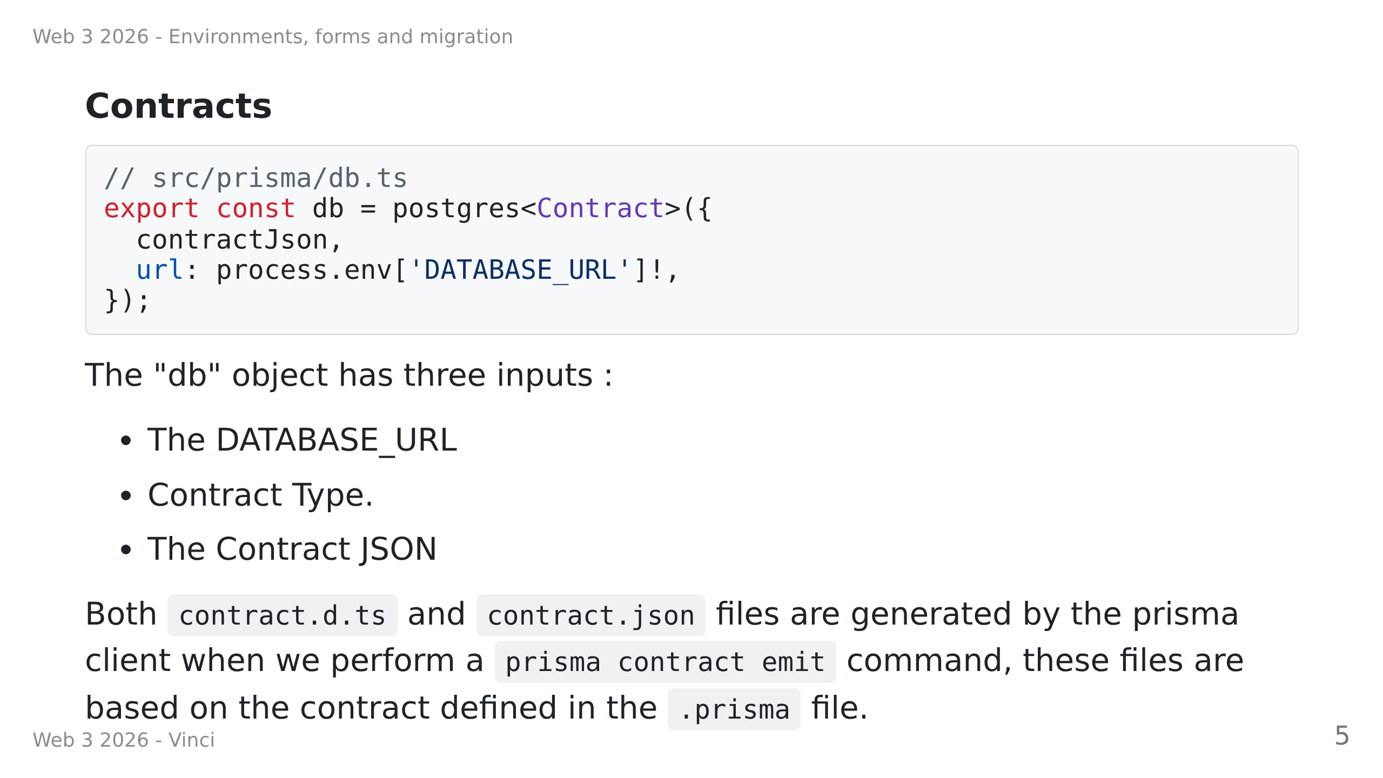

Slide 6
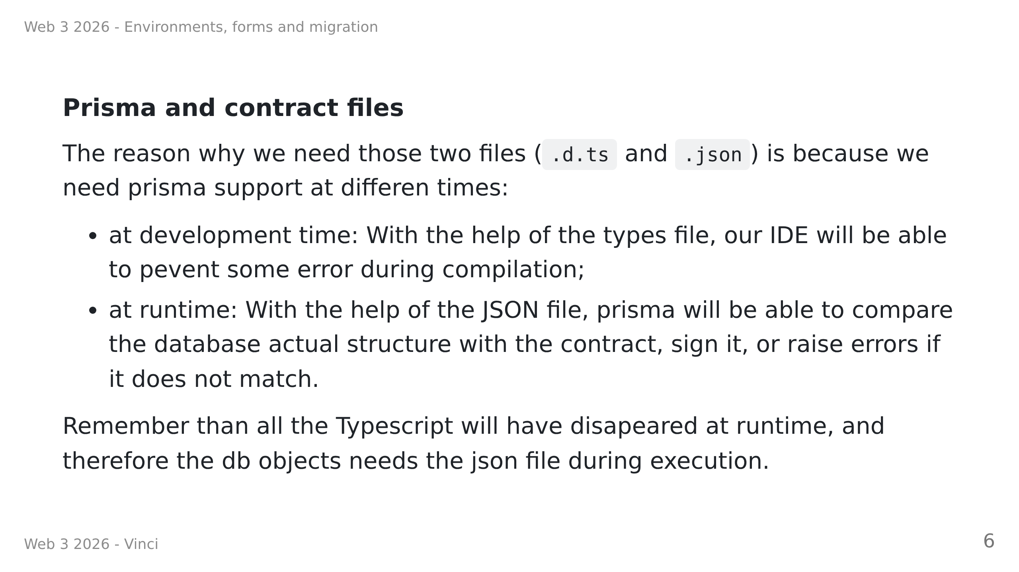

Slide 7
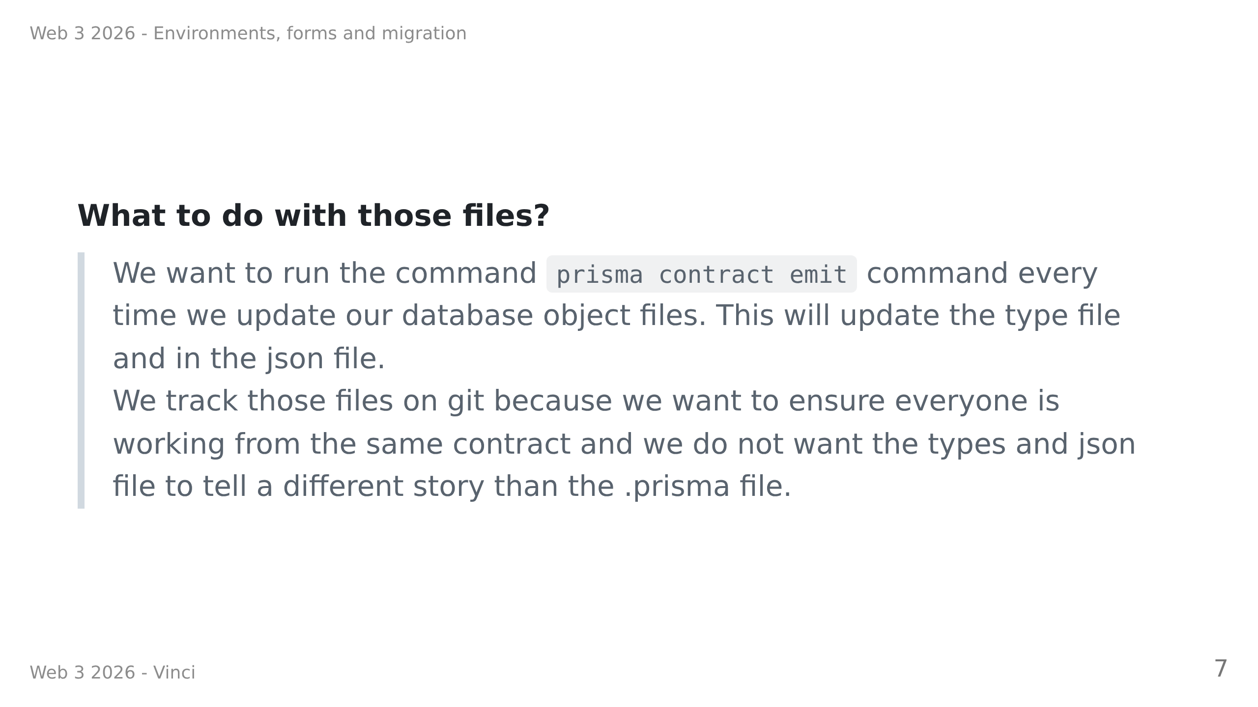

Slide 8
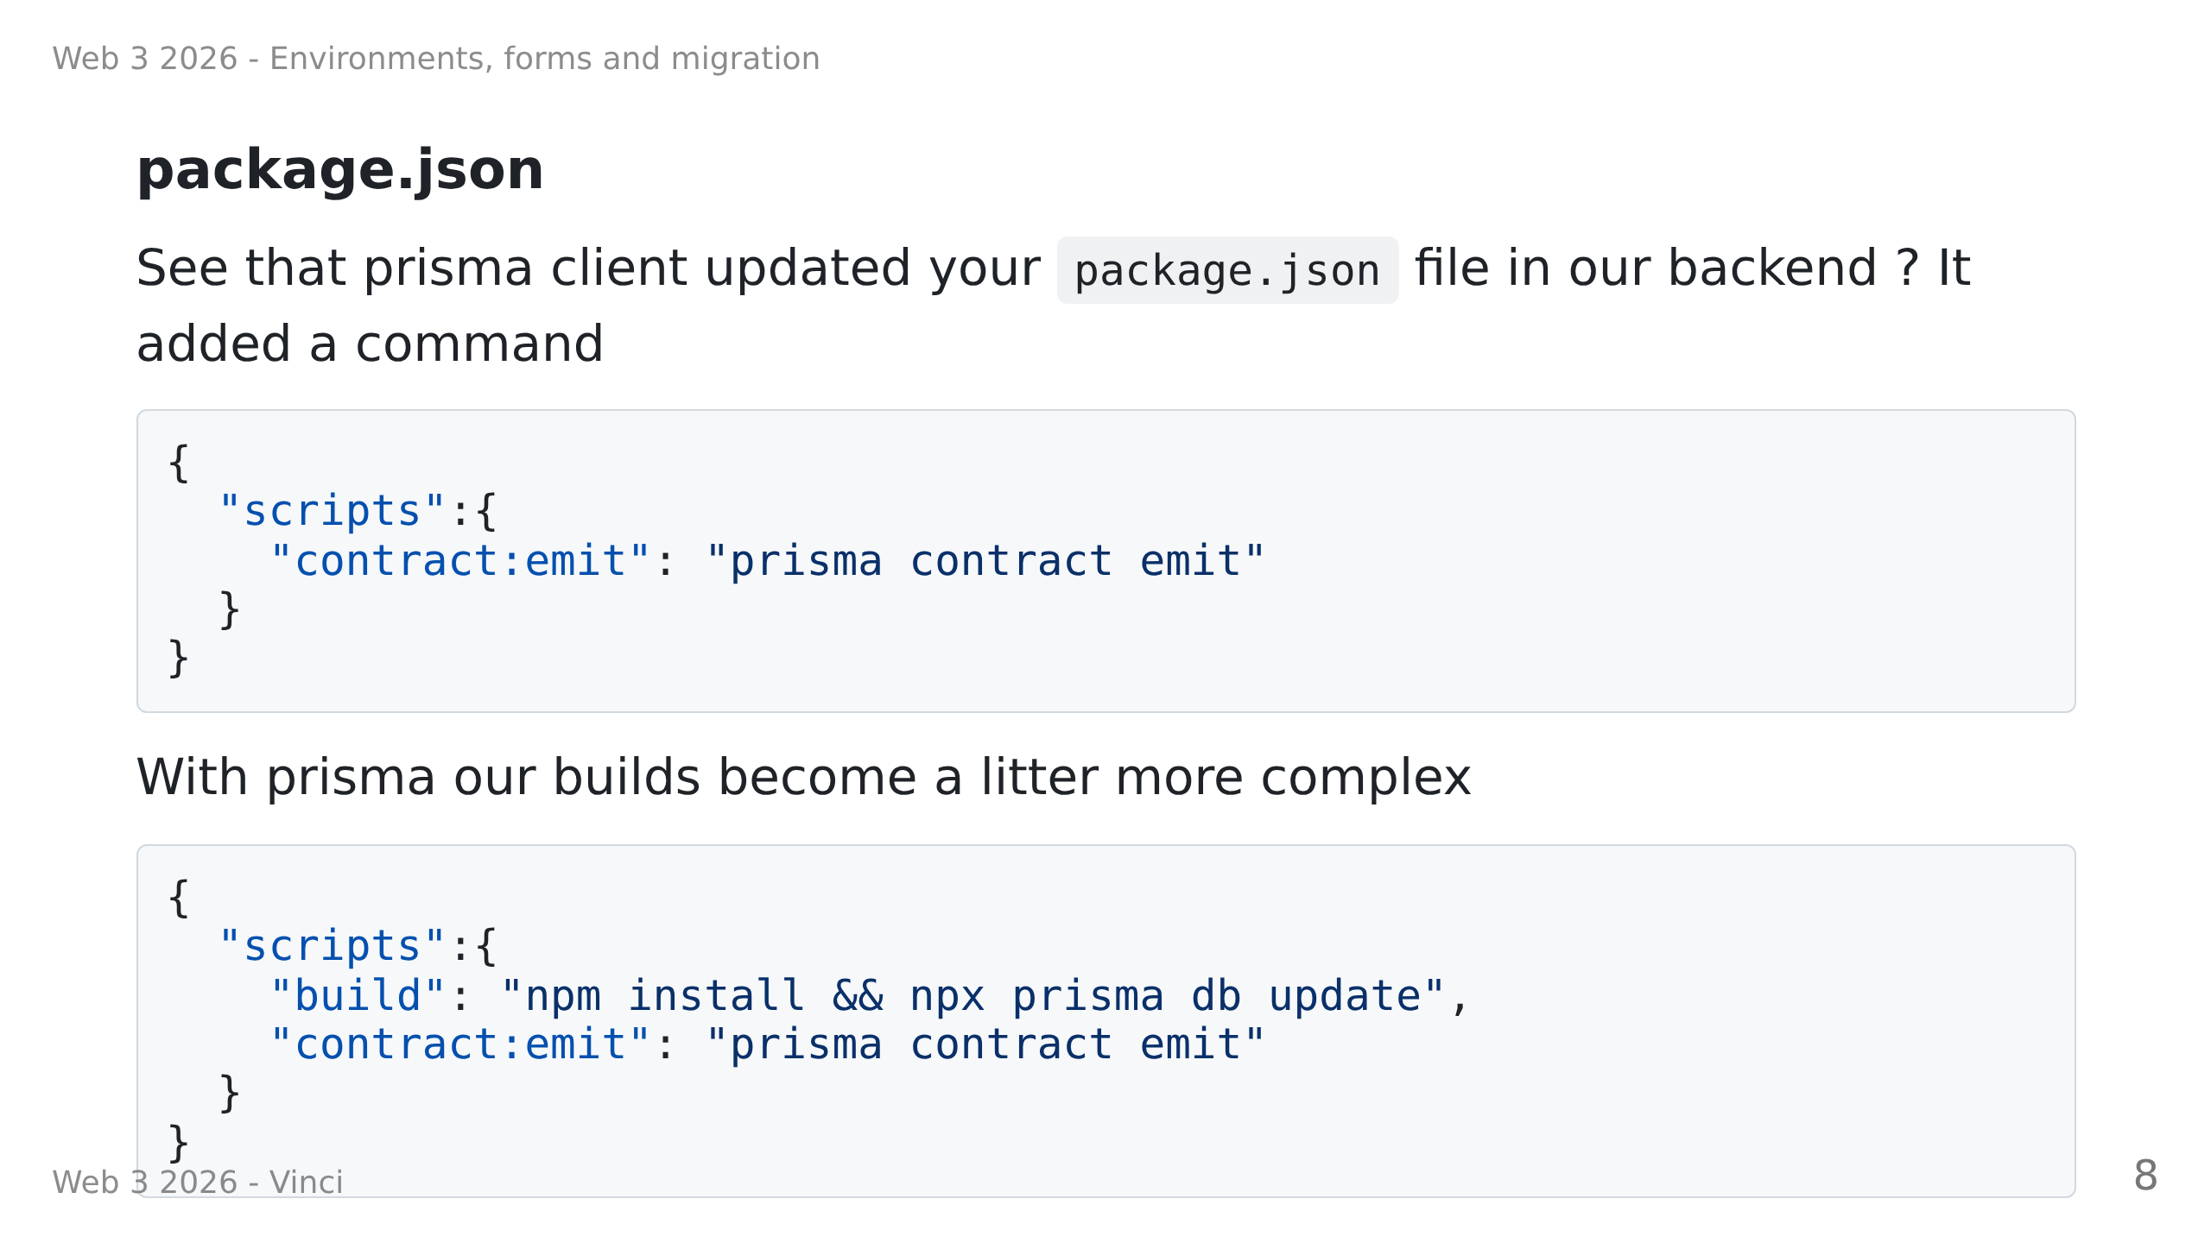
Notes:
TODO: find a valid template, this is just mine.

Slide 9
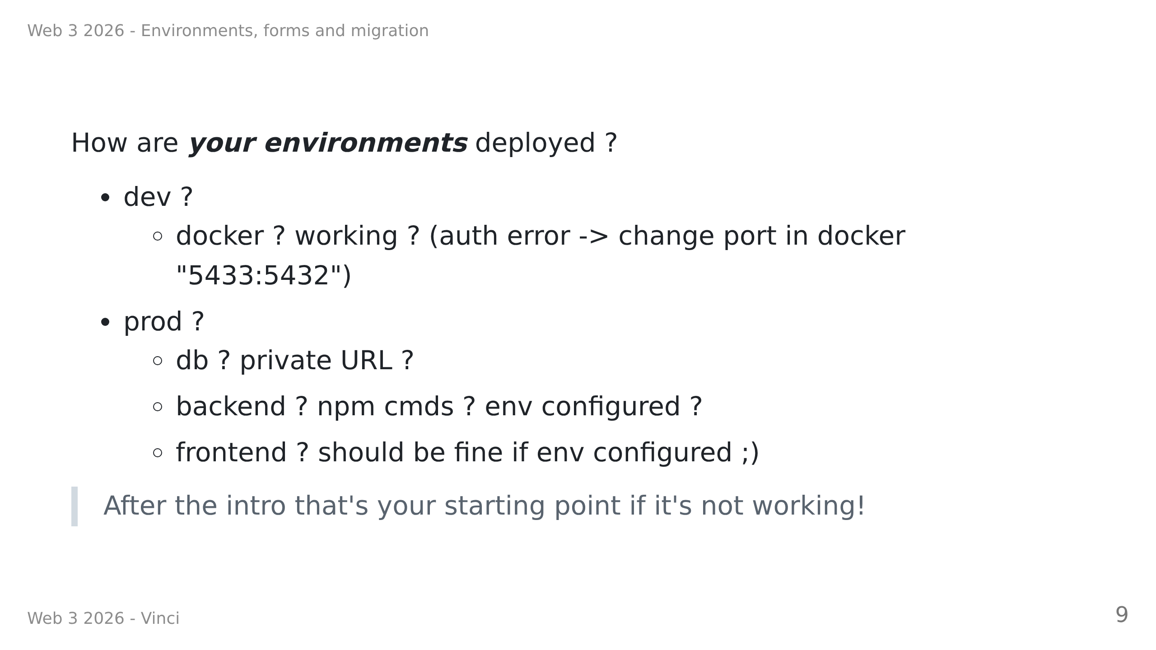
Notes:
- In Red
Rise your hands if it's working in dev ? Prod ?

Slide 10
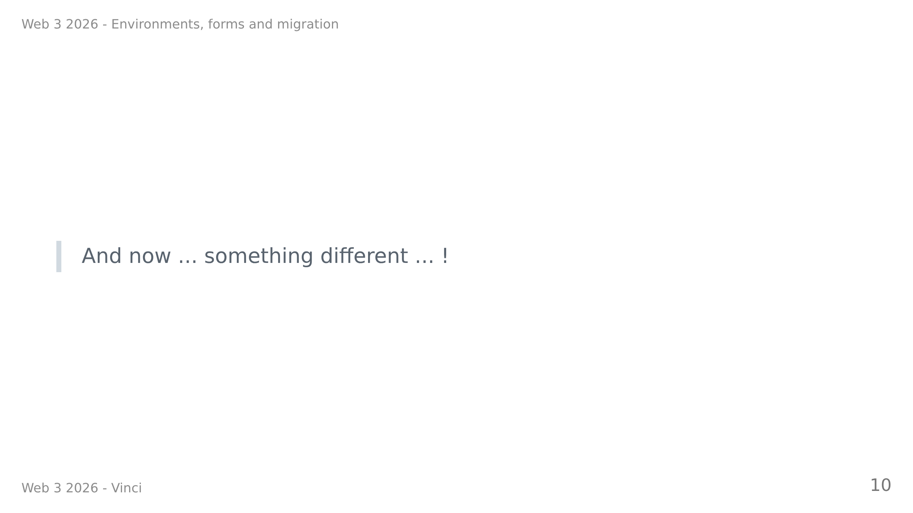

Slide 11
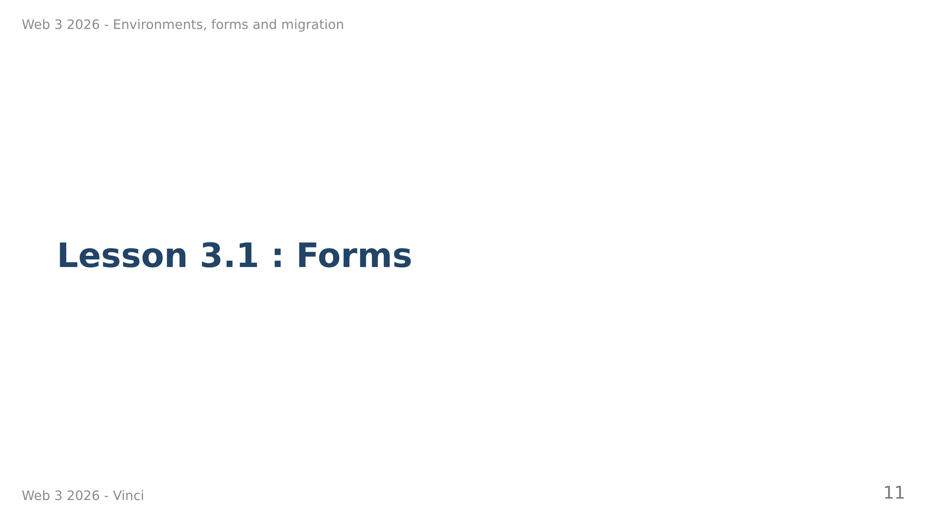

Slide 12
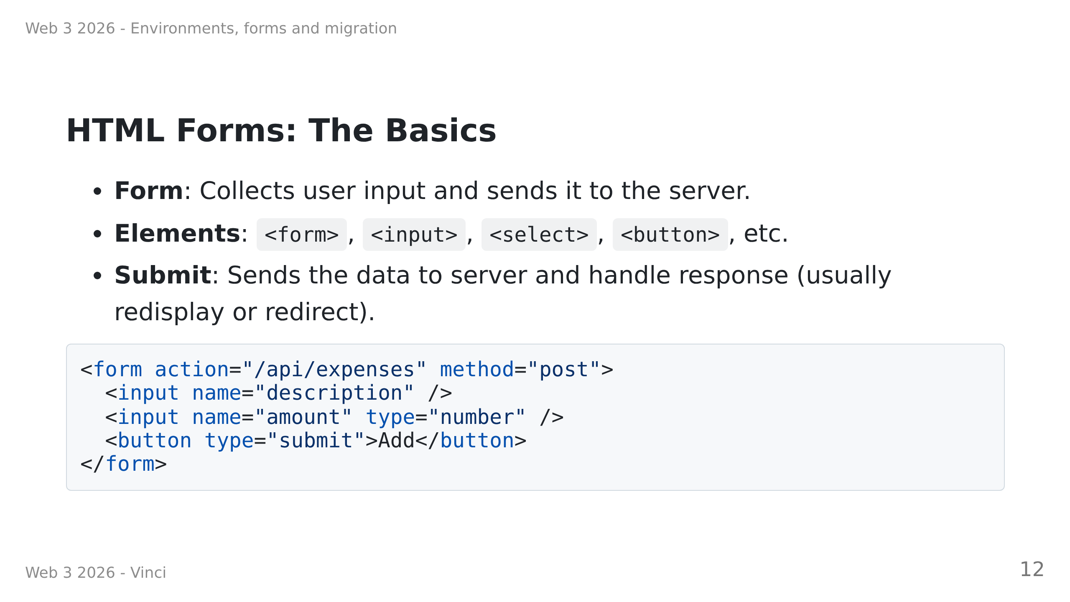

Slide 13
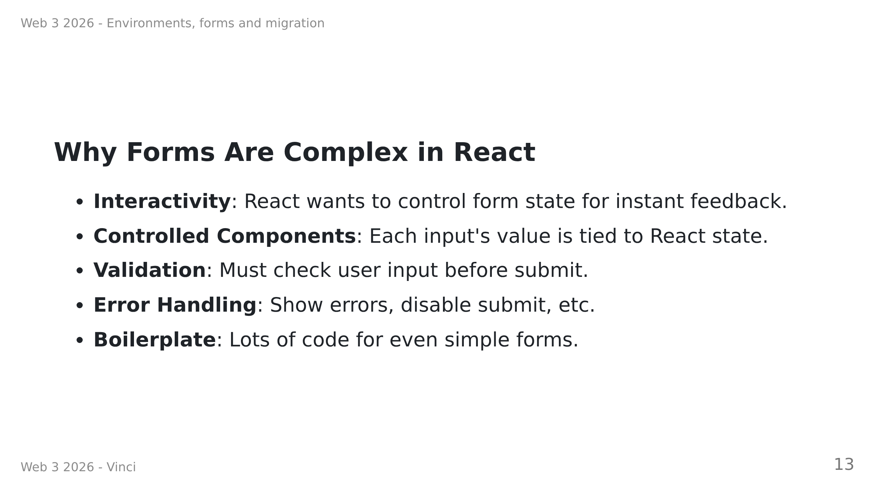

Slide 14
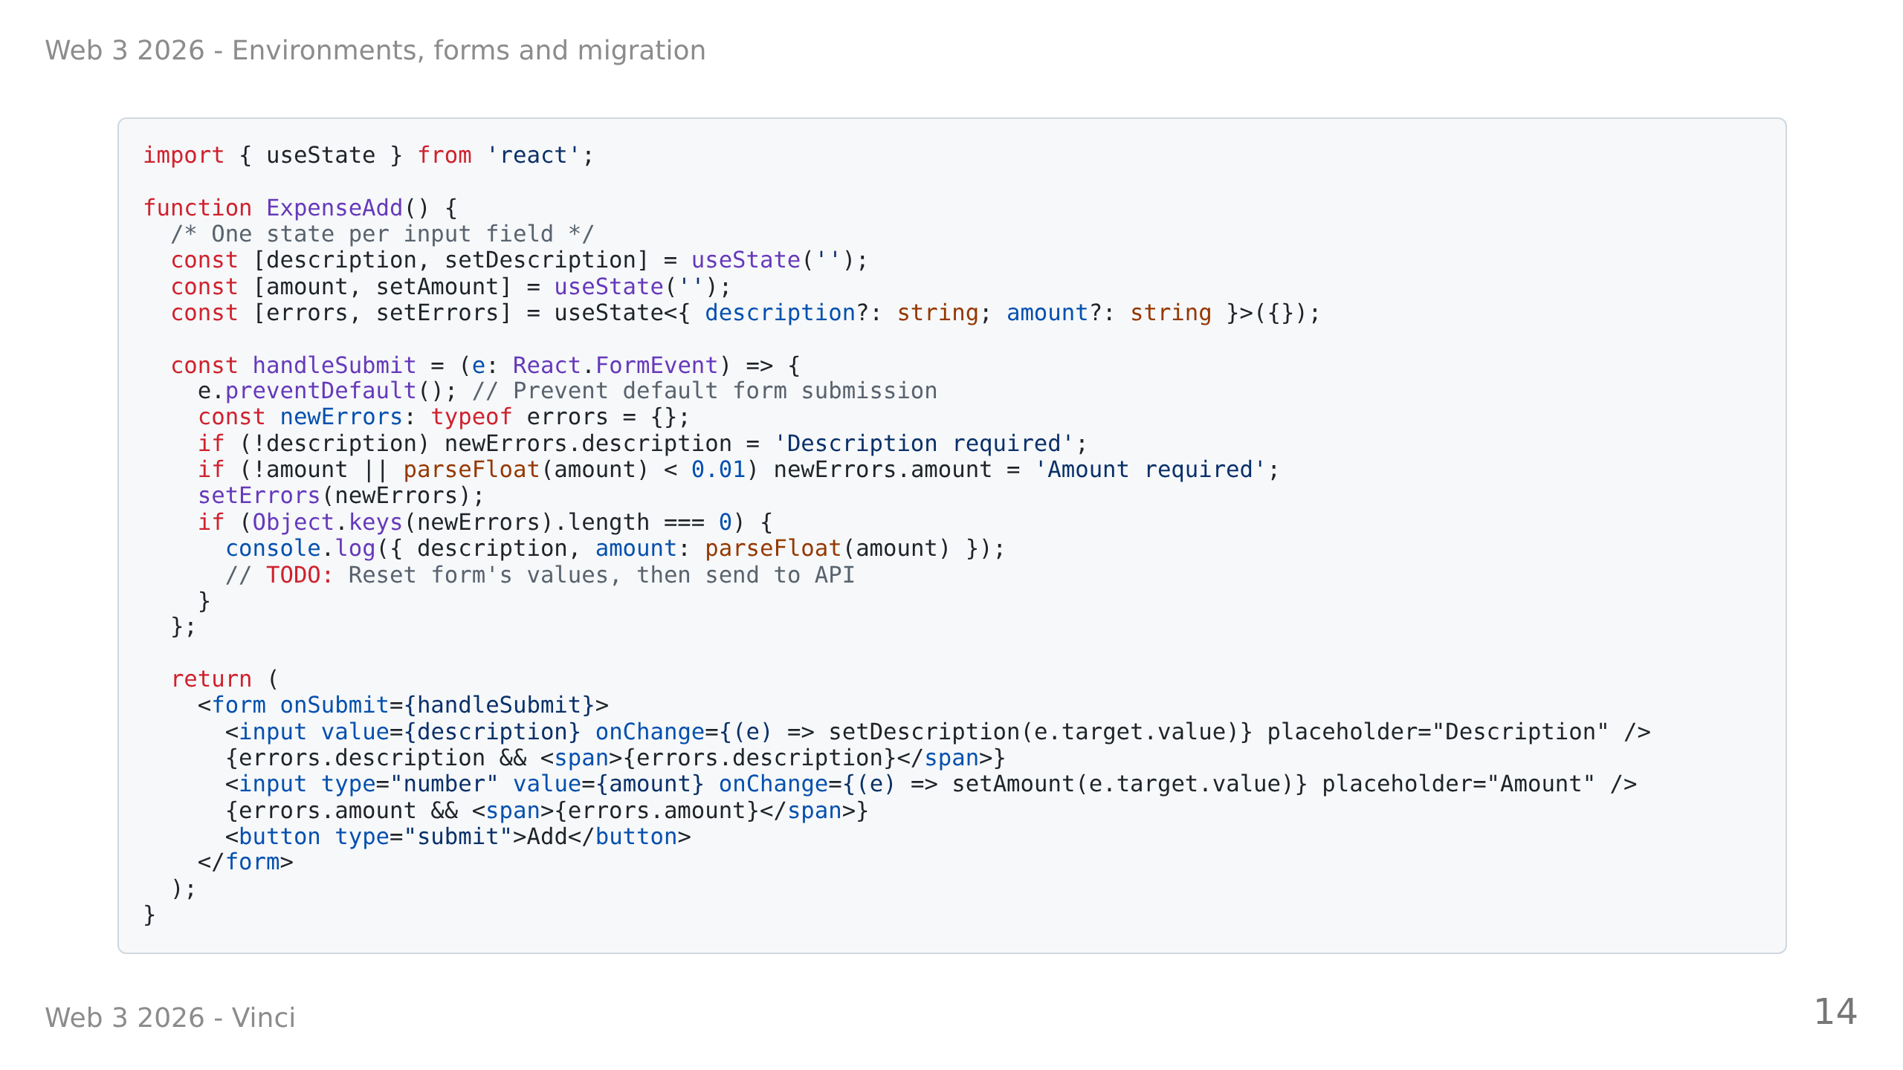

Slide 15
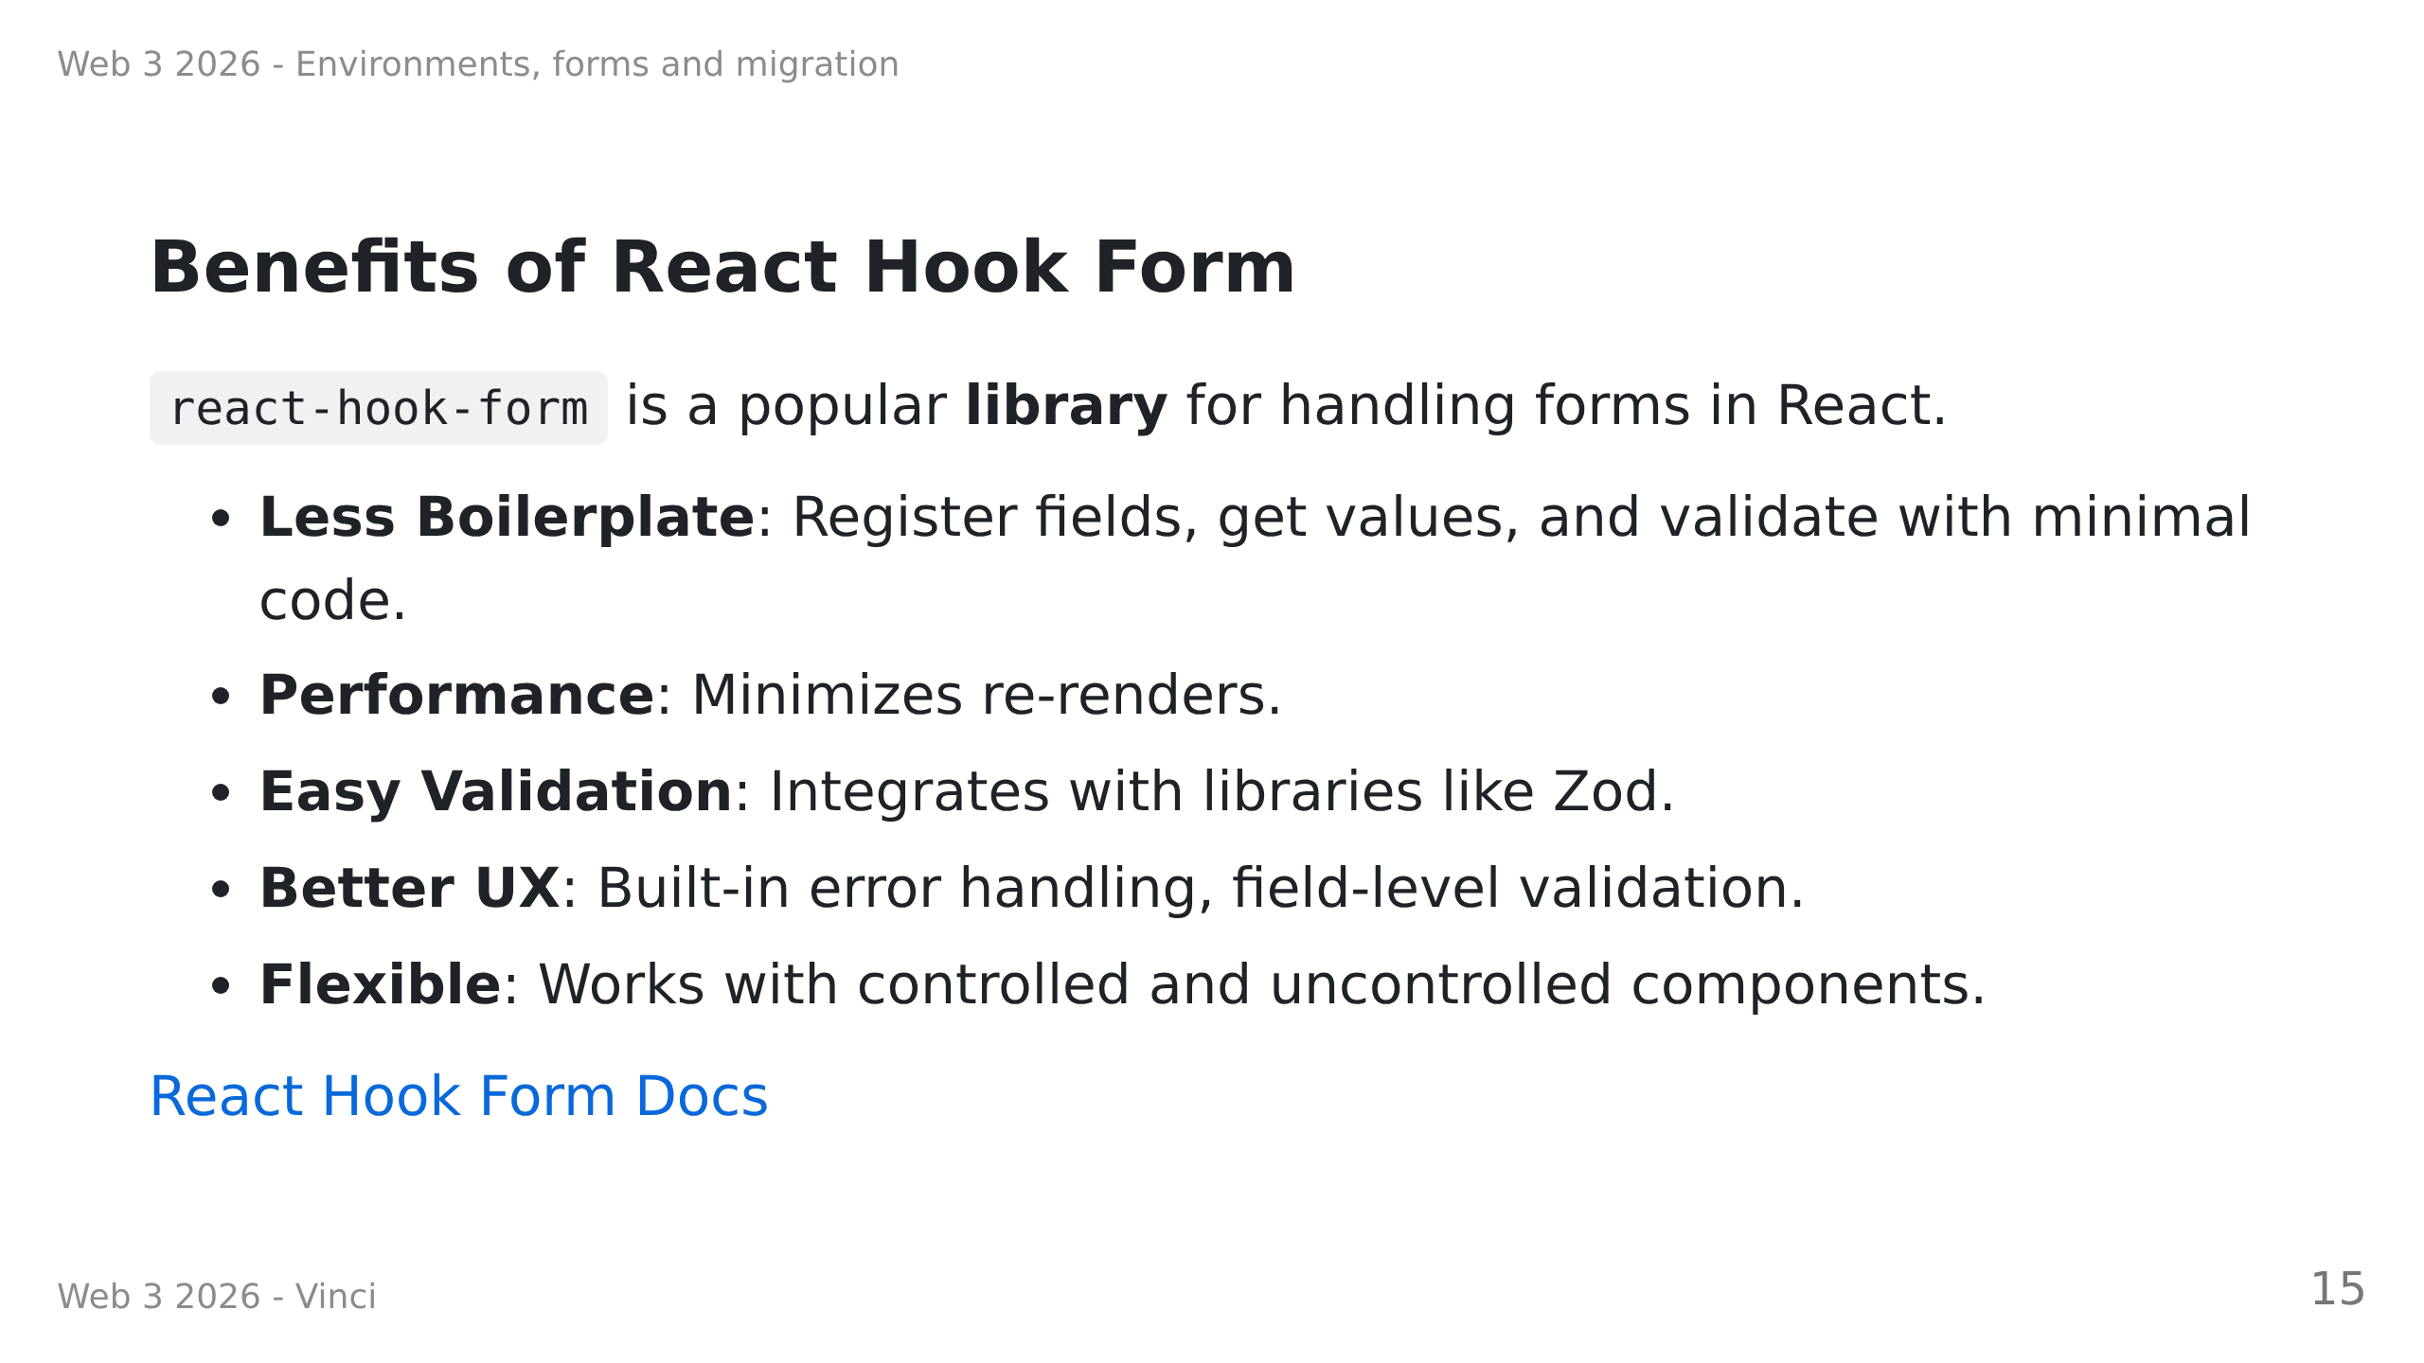

Slide 16
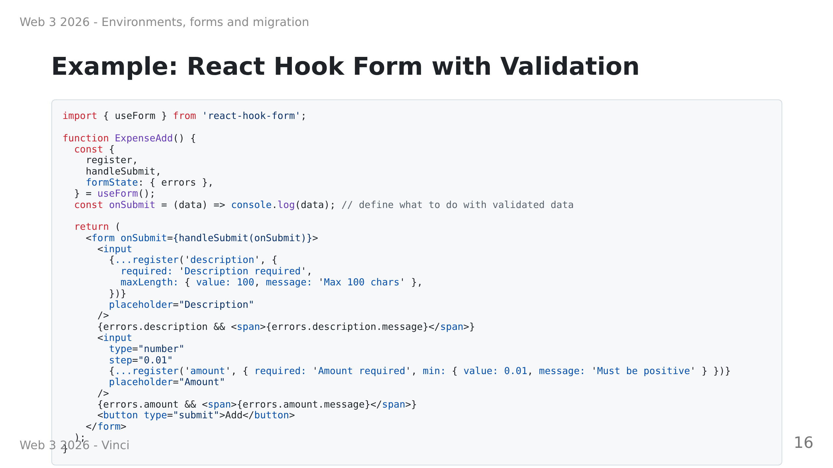

Slide 17
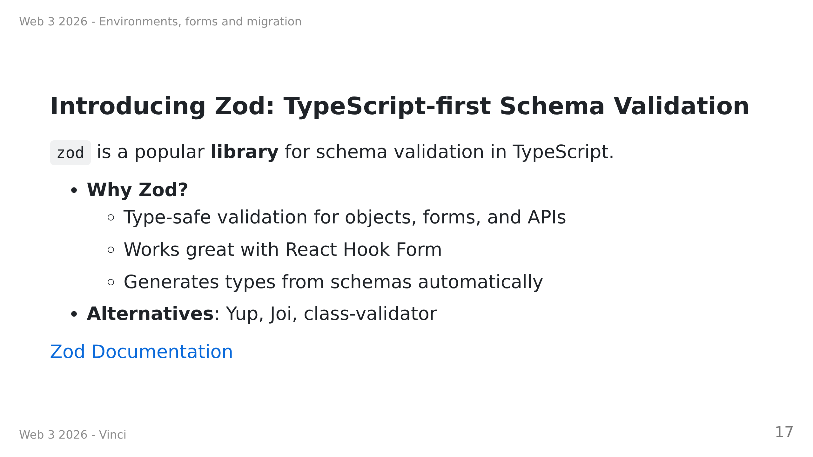
Notes:
- **Zod** is a TypeScript-first schema declaration and validation library

Slide 18
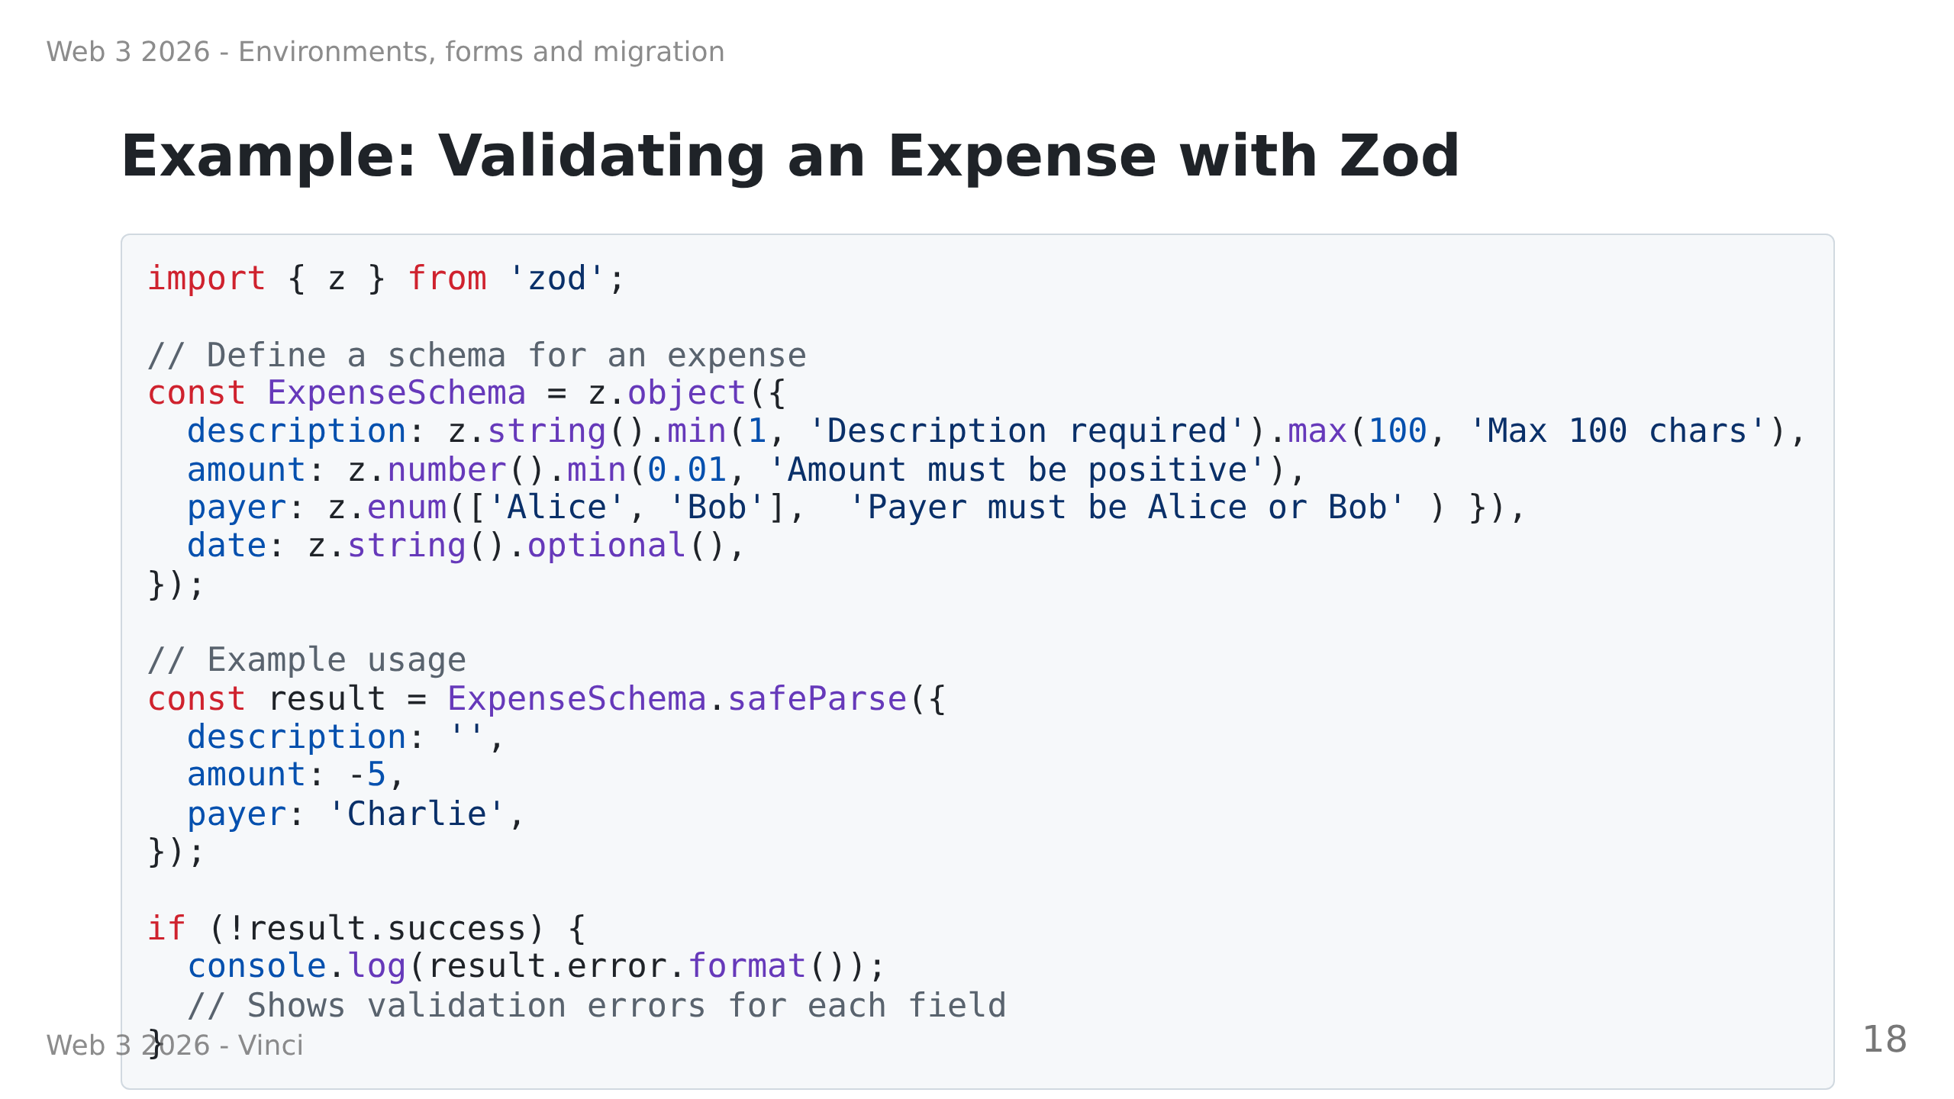
Notes:
Mention discriminated union related to success and error fields

Slide 19
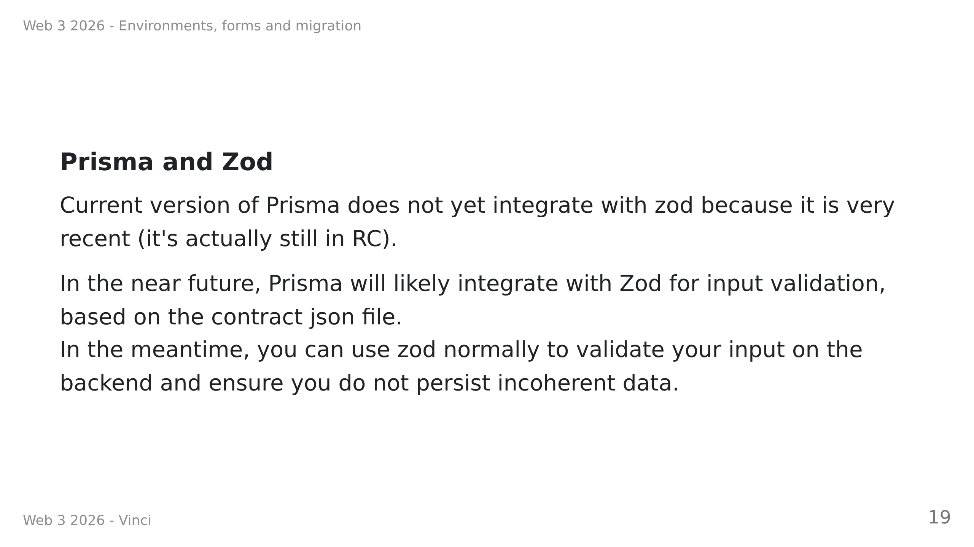

Slide 20
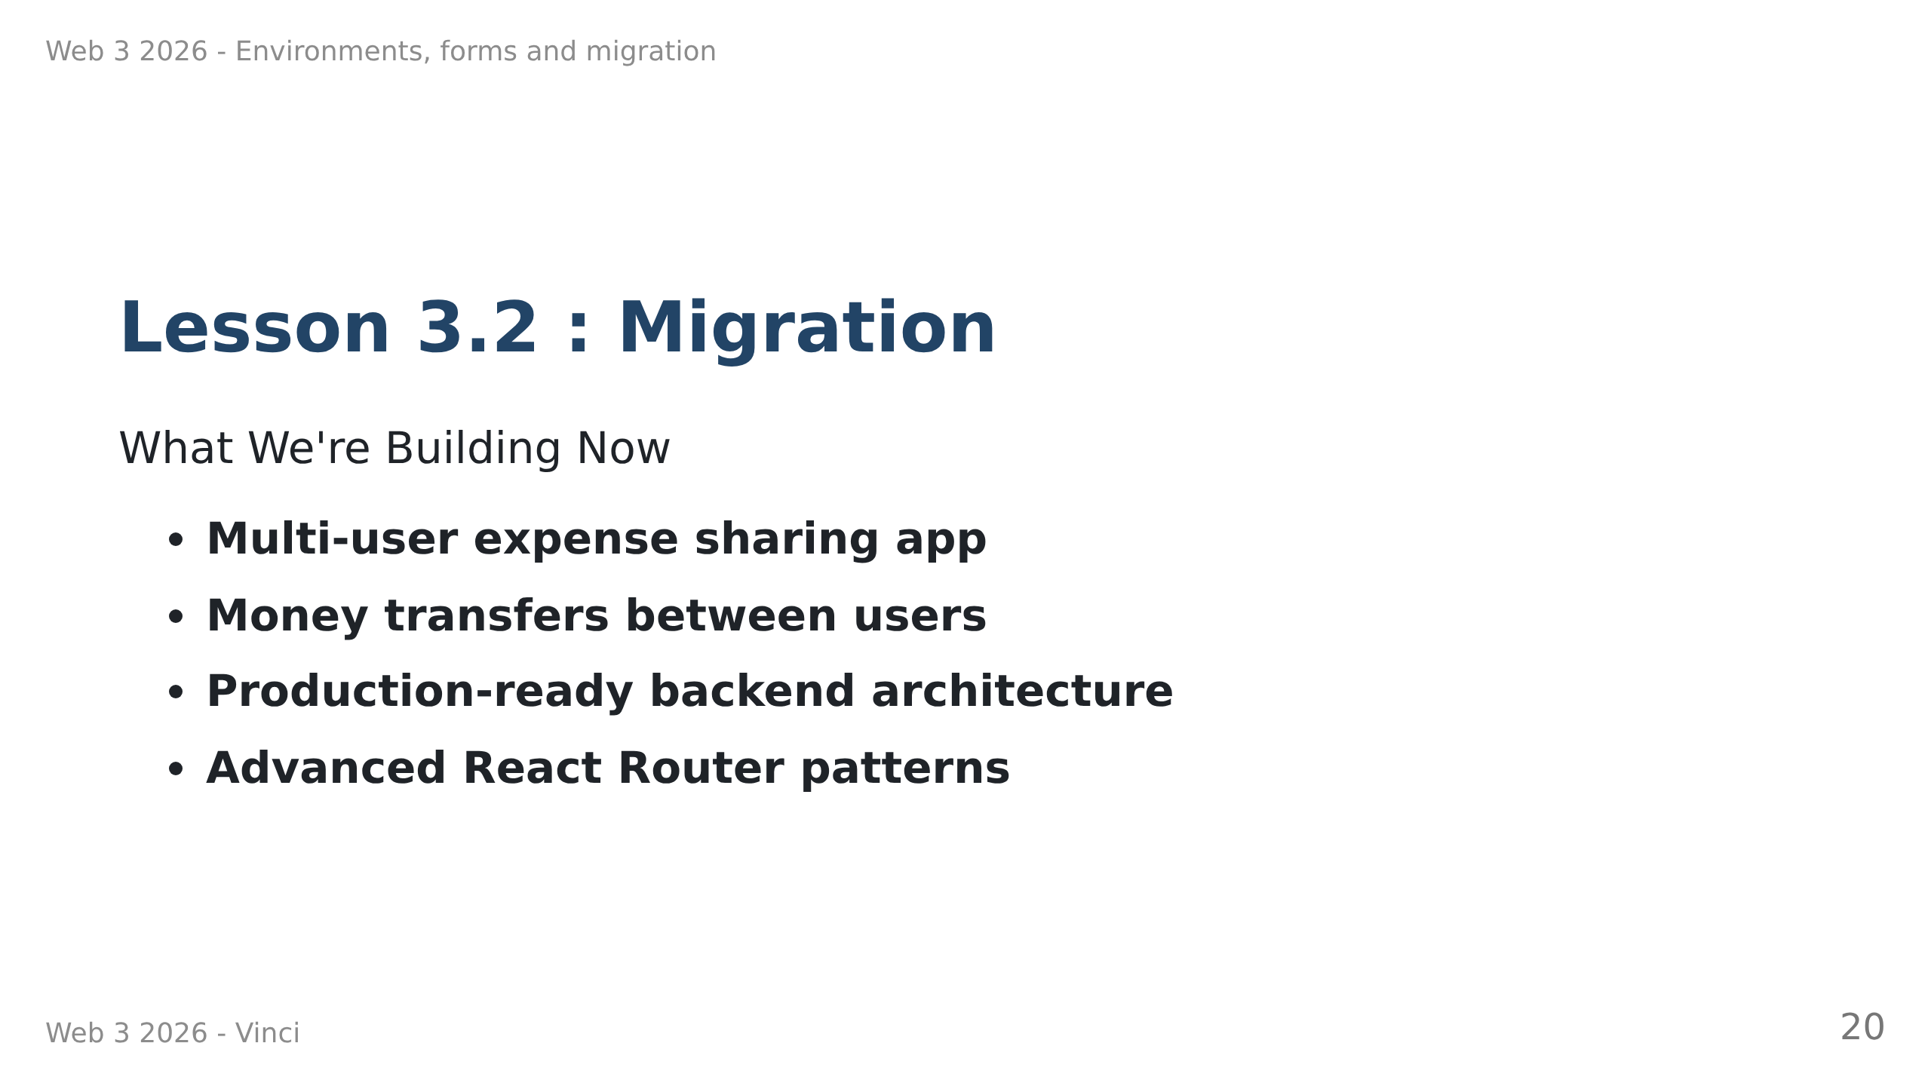
Notes:
Speaker Notes:
• Users can create accounts and share expenses with friends
• Transfer money to settle debts between users
• Moving from simple CRUD to real-world application
• Learning patterns used in professional development

Slide 21
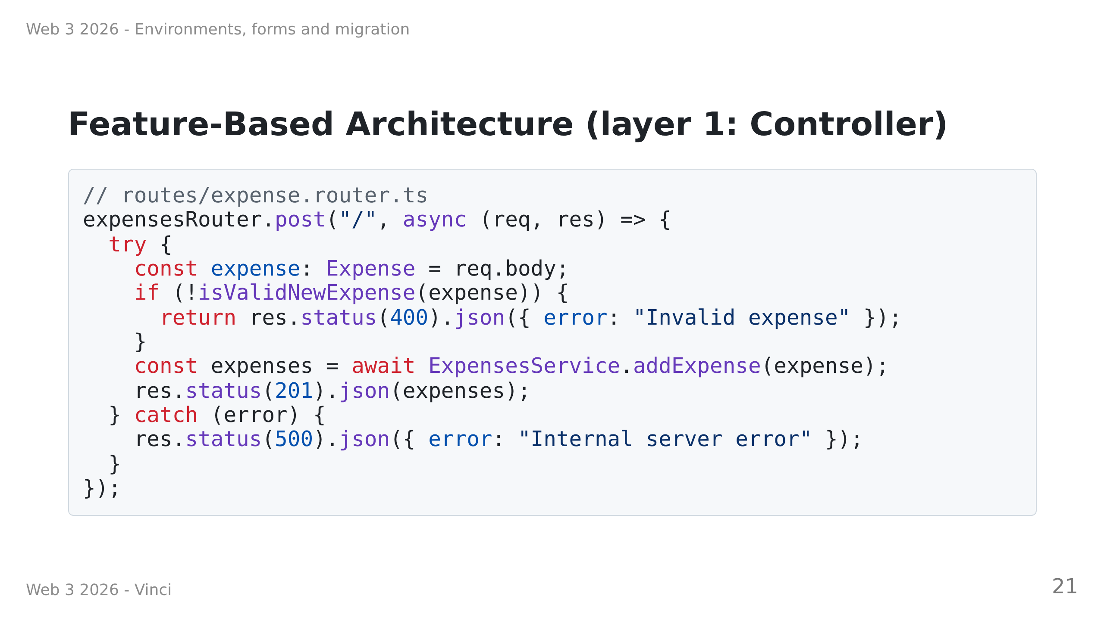
Notes:
Speaker Notes:
• Consistent pattern: Router → Controller → Repository
• Controllers handle HTTP concerns, repositories handle data access
• Makes code predictable and testable
• TypeScript catches errors at compile time
• Notice proper status codes and type conversions

Slide 22
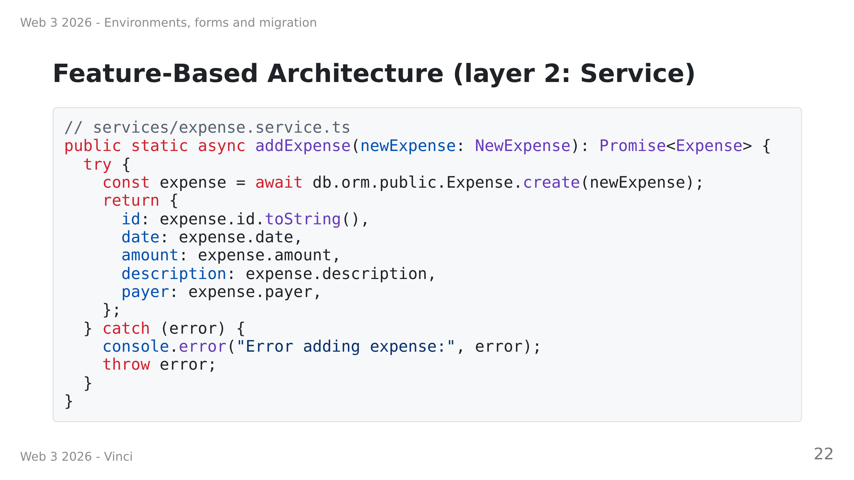
Notes:
Speaker Notes:
• Service handles business logic
• Keeps controllers thin and focused on HTTP concerns
• Makes code more testable and maintainable
Repositories handle data access
• Managed by Prisma

Slide 23
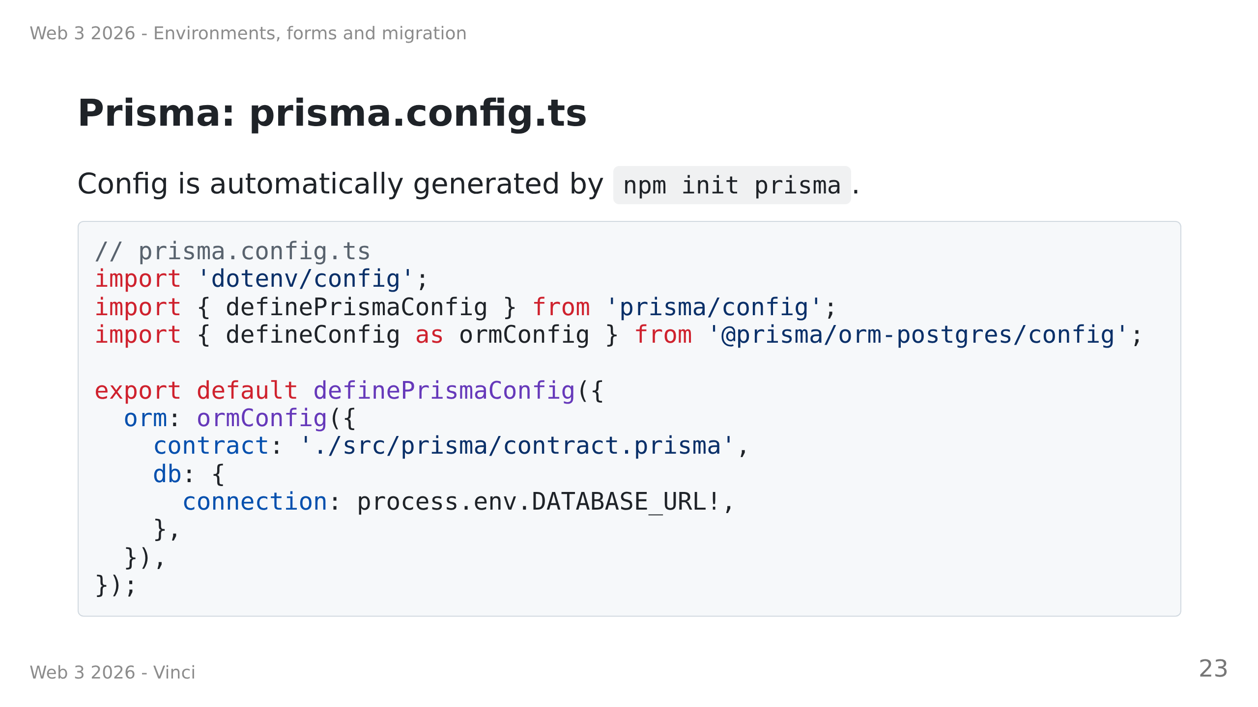
Notes:
Speaker Notes:
• Connection string and file paths live in prisma.config.ts
• Import from @prisma/orm-postgres/config — this is what selects PostgreSQL
• Run: npm install @prisma/orm-postgres
• The contract key points at your contract.prisma file

Slide 24
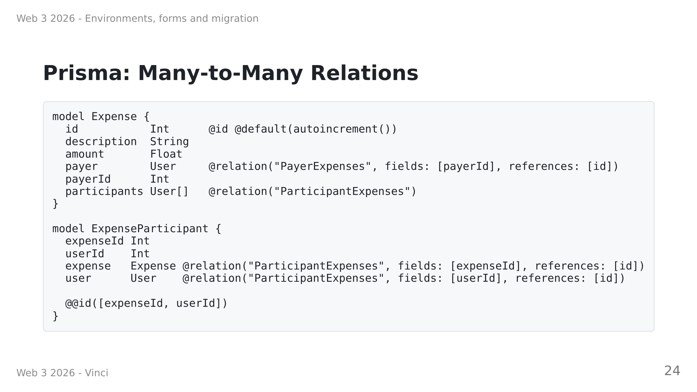
Notes:
Speaker Notes:
• One expense has one payer but multiple participants
• Prisma 8 requires an explicit join model — no more implicit many-to-many
• ExpenseParticipant is the join table; its @@id must be exactly the two foreign keys
• Relation names disambiguate: User has two relations to Expense
• Query participants with .include("participants") — join model is transparent

Slide 25
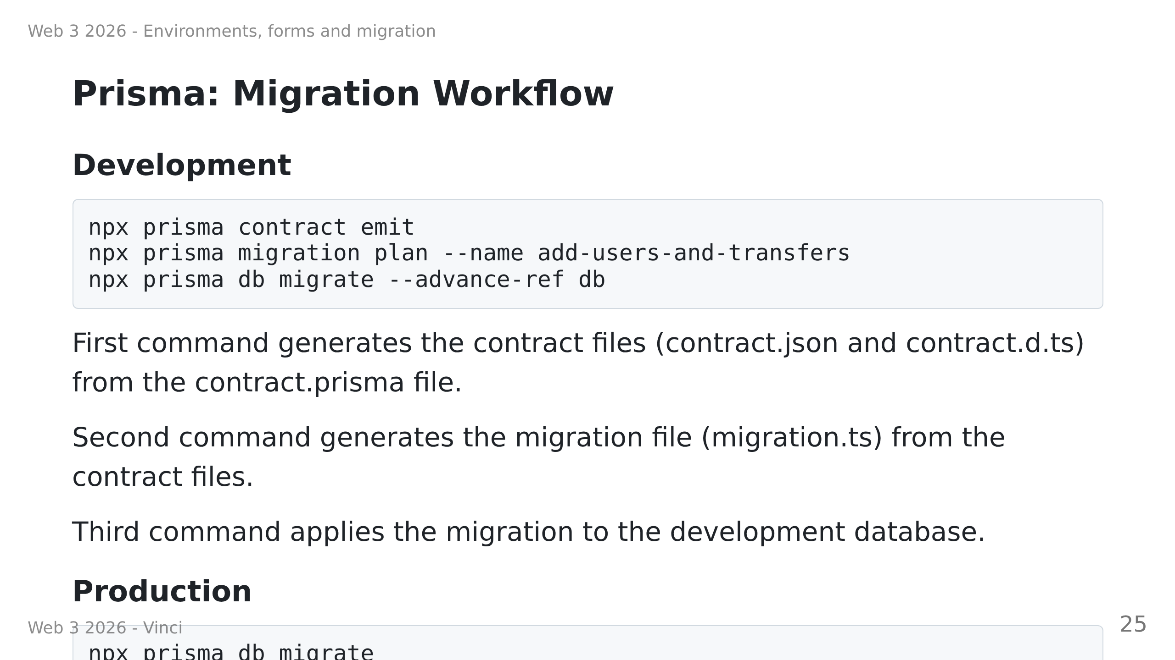
Notes:
Speaker Notes:
• Three-step loop: emit → plan → migrate
• prisma contract emit reads contract.prisma, writes contract.json + contract.d.ts
• prisma migration plan generates a TypeScript migration.ts file to review
• prisma db migrate applies pending migrations to the database
• --advance-ref db records which contract state was applied (for dev)
• No more db push — use db init (new DB) or db update (existing DB) instead

Slide 26
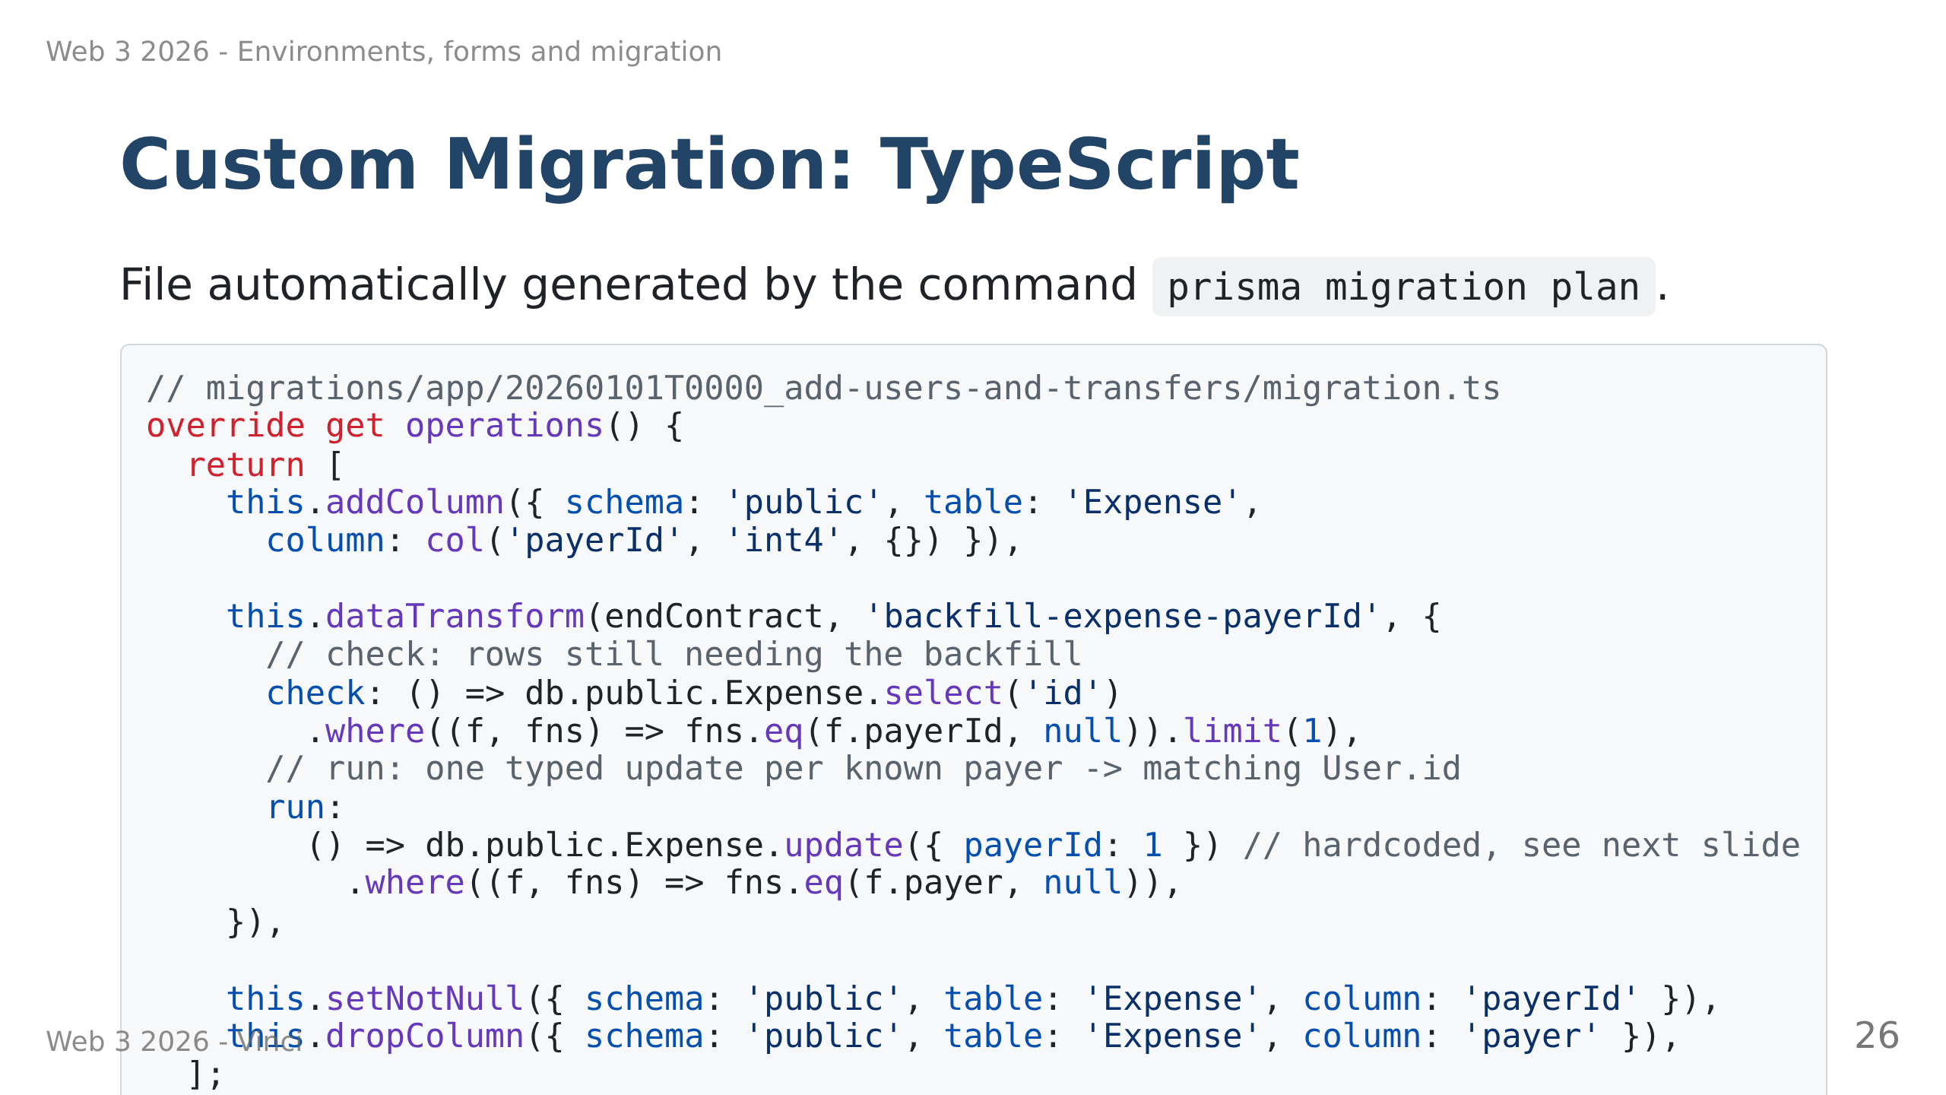
Notes:
Speaker Notes:
• Prisma migrations are TypeScript files
• migration plan auto-generates the skeleton with placeholders
• dataTransform handles the backfill: check finds remaining rows, run fixes them
• addColumn → dataTransform → setNotNull is the safe 3-step pattern for required cols
• Edit migration.ts then recompile: node migrations/app/<dir>/migration.ts
• Commit migration.ts, ops.json, migration.json, and snapshot dirs

Slide 27
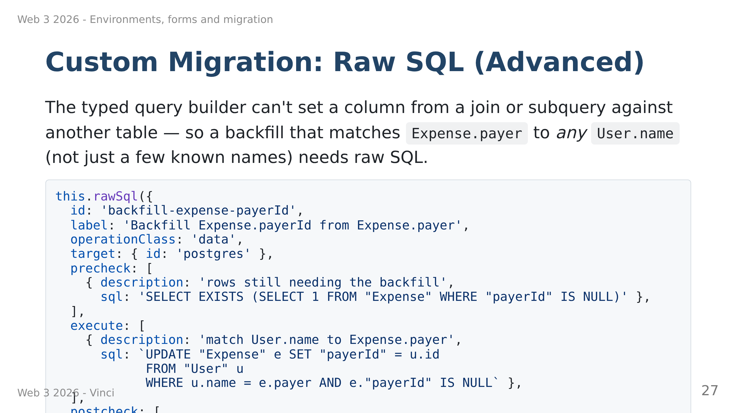
Notes:
Speaker Notes:
• This is the technically correct fix for the real Expense.payer -> User.id backfill: it matches
any name to any user.
• Why not dataTransform: setting a column from a join/subquery isn't expressible with the typed
builder today (open limitation in Prisma's migration tooling) — run must return a typed query
plan, not SQL text, so there is no "just make run raw SQL" option
• rawSql replaces dataTransform's check/run with precheck/execute/postcheck — all plain SQL
• Trade-off worth calling out: raw SQL isn't validated against the contract the way a typed
dataTransform is — Prisma's own migration guide treats it as a last resort for exactly that
reason, since nothing checks it matches the schema
• Too advanced to be the first migration pattern students see — most of their migrations will
look like the previous slide; this one is here so the deck doesn't lie about what a real,
arbitrary-data backfill requires

