Slide 1

Notes:
Speaker Notes:
• Welcome to lesson 4 - big leap forward today
• Transforming simple expense tracker into multi-user application
• Two main areas: backend modernization + frontend state management
• Moving from prototype to production-ready architecture

Slide 2
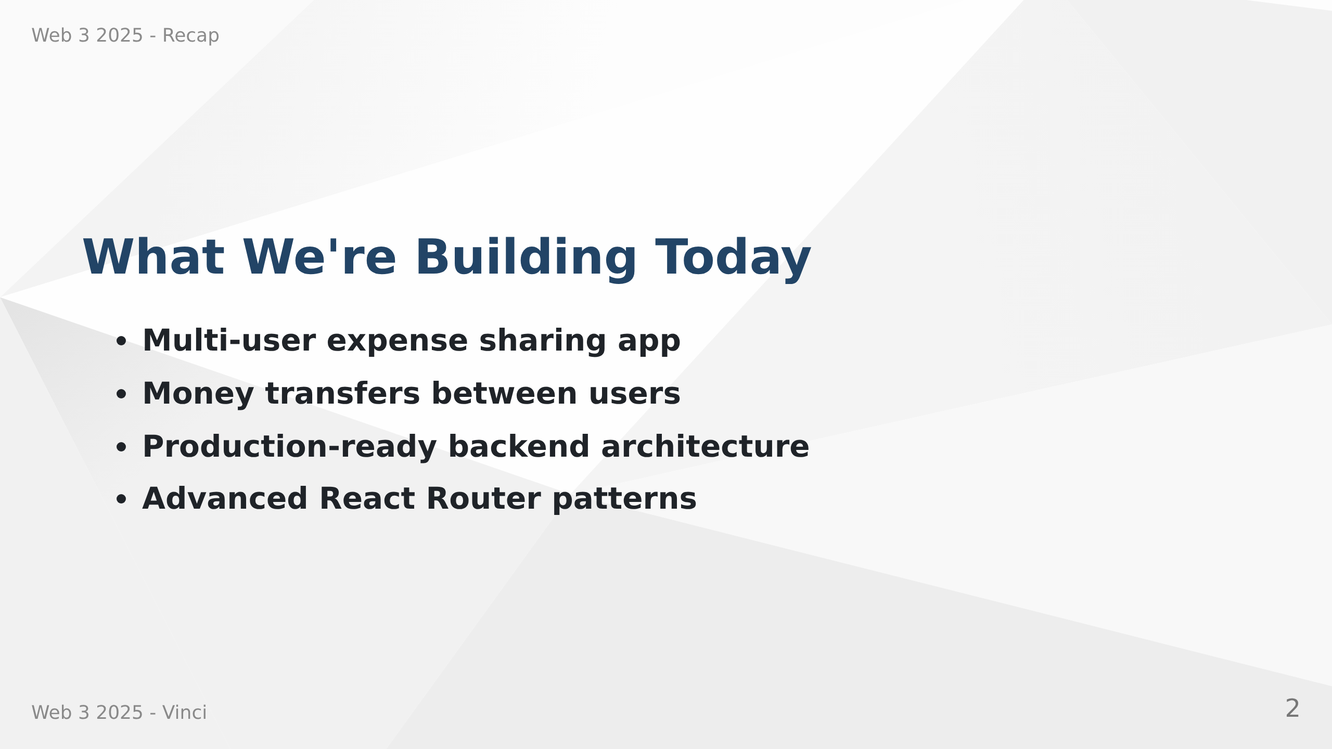
Notes:
Speaker Notes:
• Users can create accounts and share expenses with friends
• Transfer money to settle debts between users
• Moving from simple CRUD to real-world application
• Learning patterns used in professional development

Slide 3
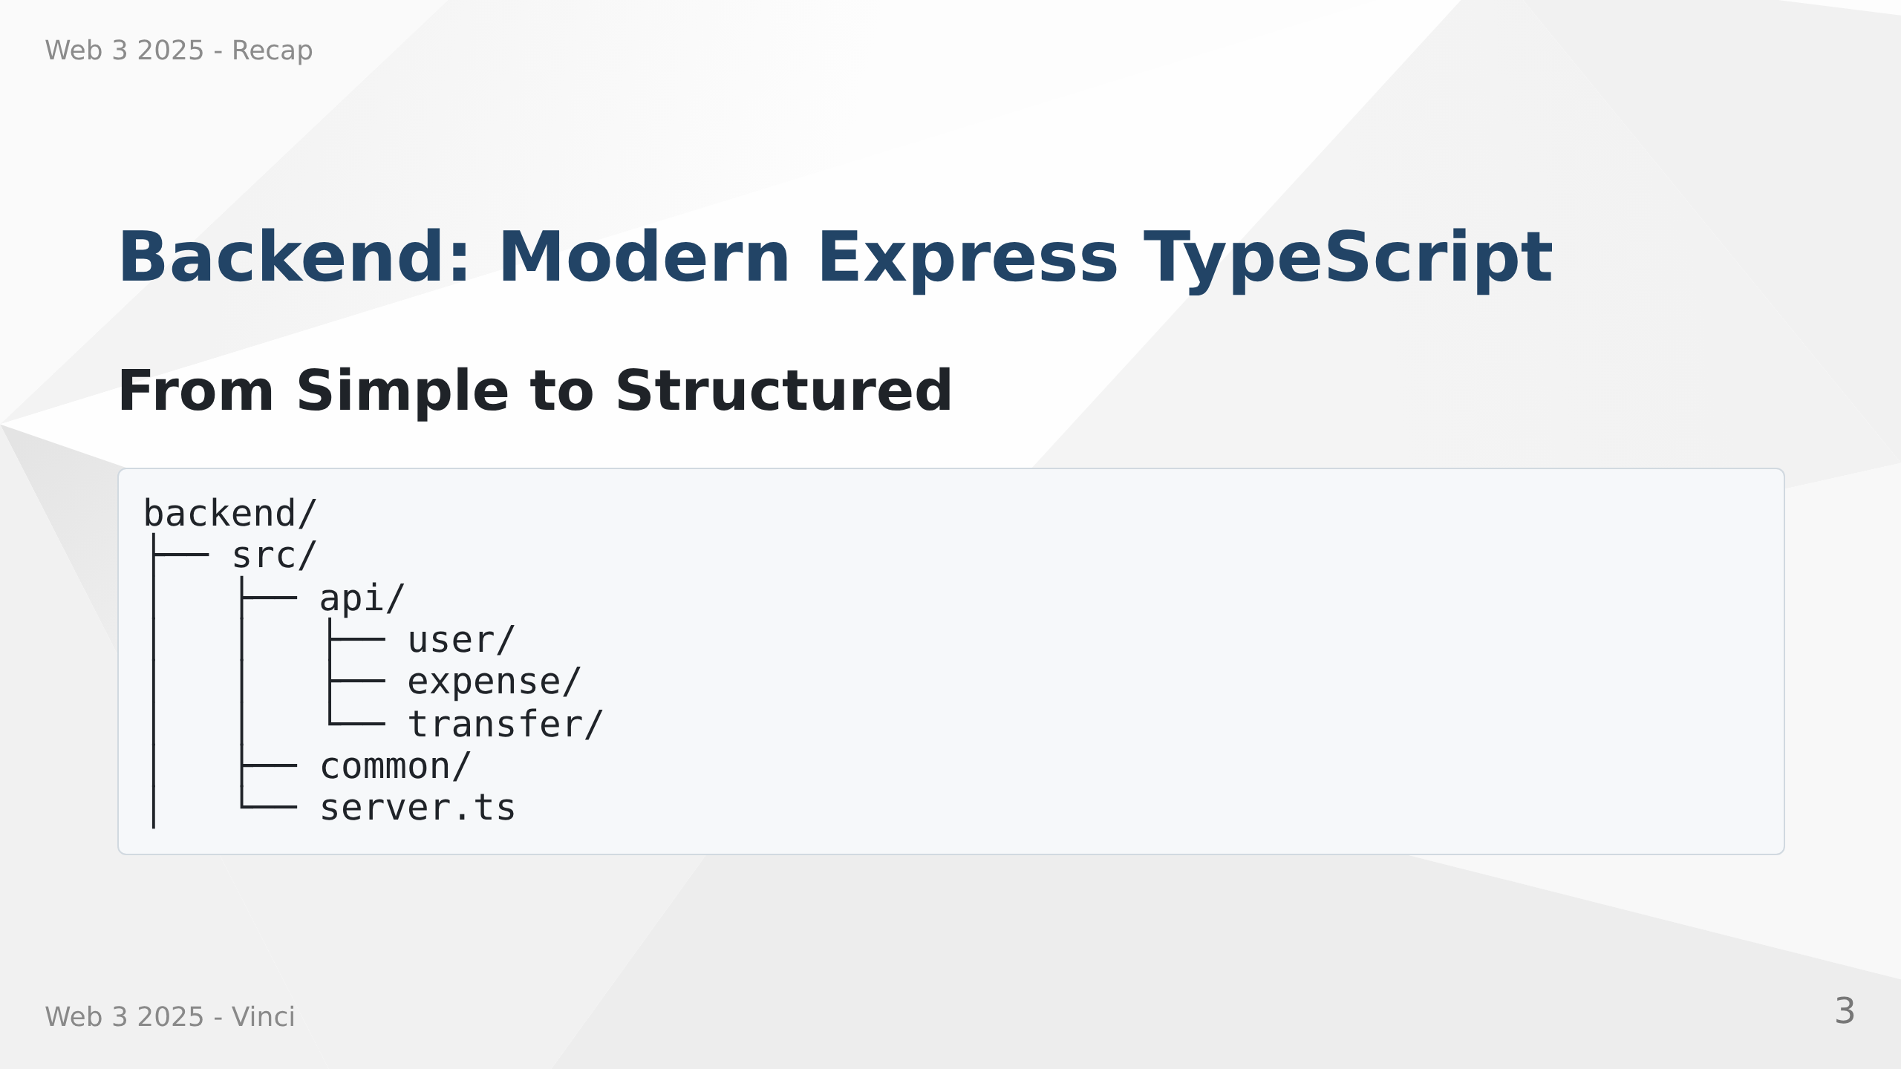
Notes:
Speaker Notes:
• Replacing Express generator with modern TypeScript setup
• Better organization, type safety, built-in security
• Testing infrastructure included
• Each feature gets own folder - clear separation of concerns

Slide 4
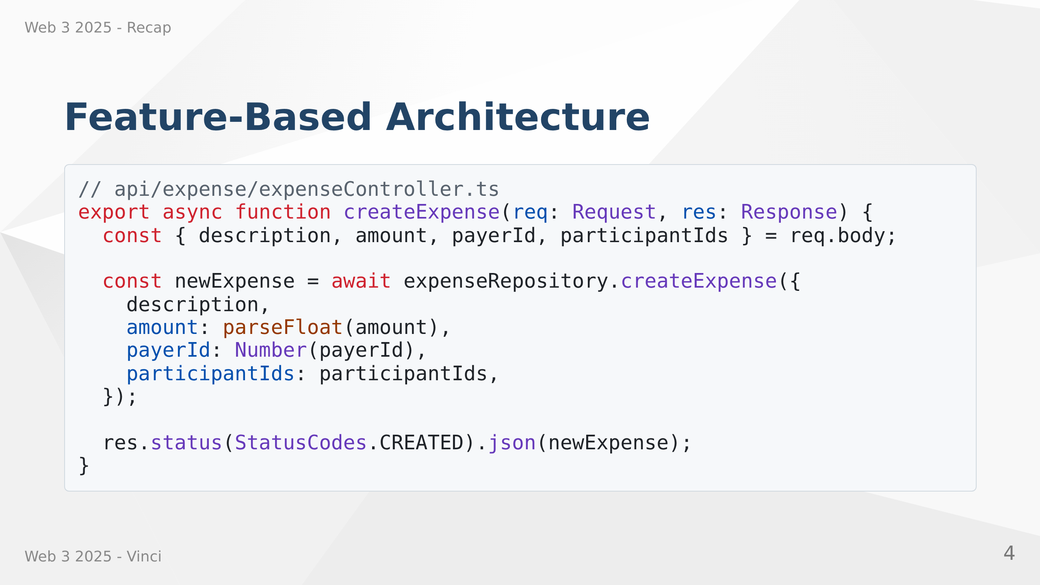
Notes:
Speaker Notes:
• Consistent pattern: Router → Controller → Repository
• Controllers handle HTTP concerns, repositories handle data access
• Makes code predictable and testable
• TypeScript catches errors at compile time
• Notice proper status codes and type conversions
---
# Database Relations with Prisma 8
Why this is usefull ? Strange pattern... putting paidExpenses and participatedExpenses in the User model...?
What's the objective of this slide?
```prisma
// use prisma-8 ← required first line in every contract file
model User {
id Int @id @default(autoincrement())
name String
email String @unique
paidExpenses Expense[] @relation("PayerExpenses")
participatedExpenses Expense[] @relation("ParticipantExpenses")
transfersOut Transfer[] @relation("UserTransfersSource")
transfersIn Transfer[] @relation("UserTransfersTarget")
}
```
Speaker Notes:
• Every contract file must start with "// use prisma-8"
• Relation names still required when multiple relations between same models
• One user has many relationships: pays, participates, sends, receives

Slide 5
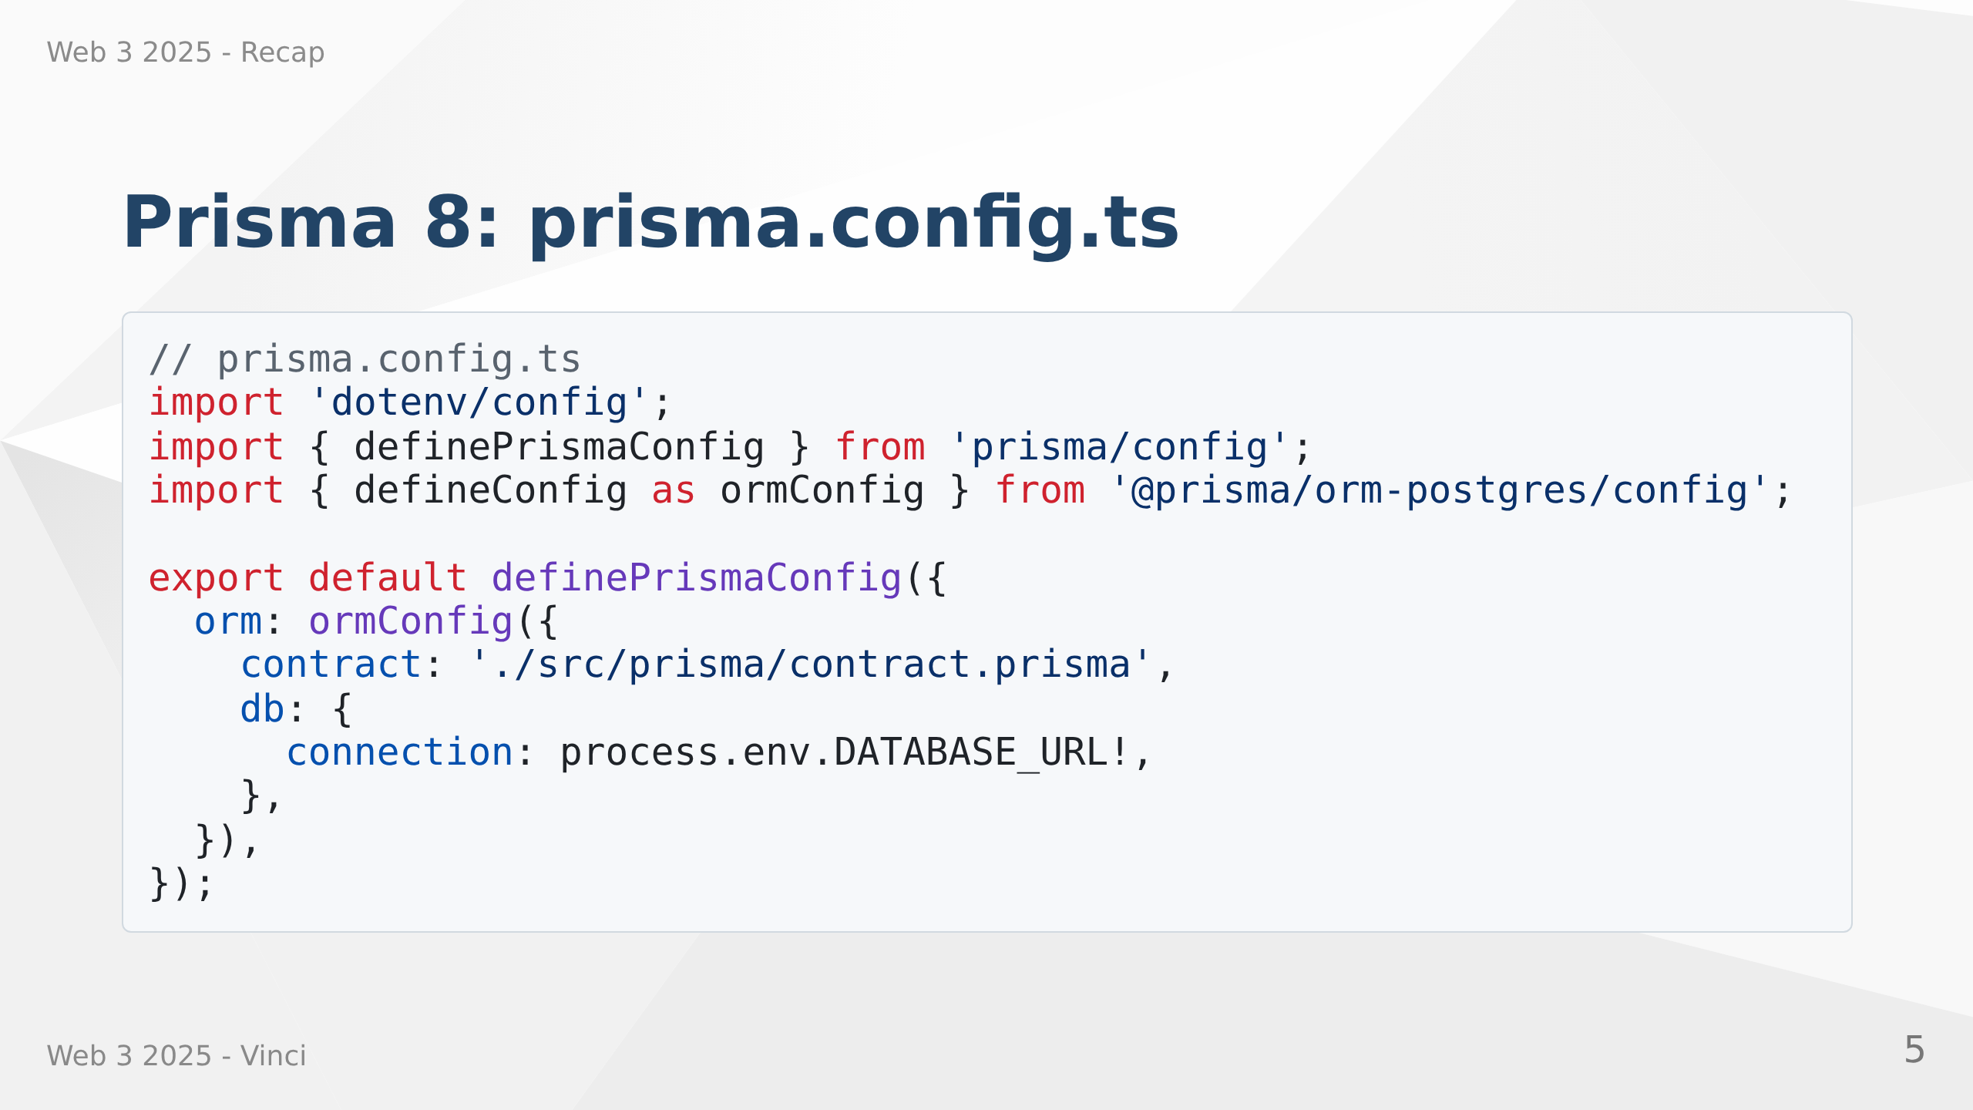
Notes:
Speaker Notes:
• Connection string and file paths live in prisma.config.ts
• Import from @prisma/orm-postgres/config — this is what selects PostgreSQL
• Run: npm install @prisma/orm-postgres
• The contract key points at your contract.prisma file

Slide 6
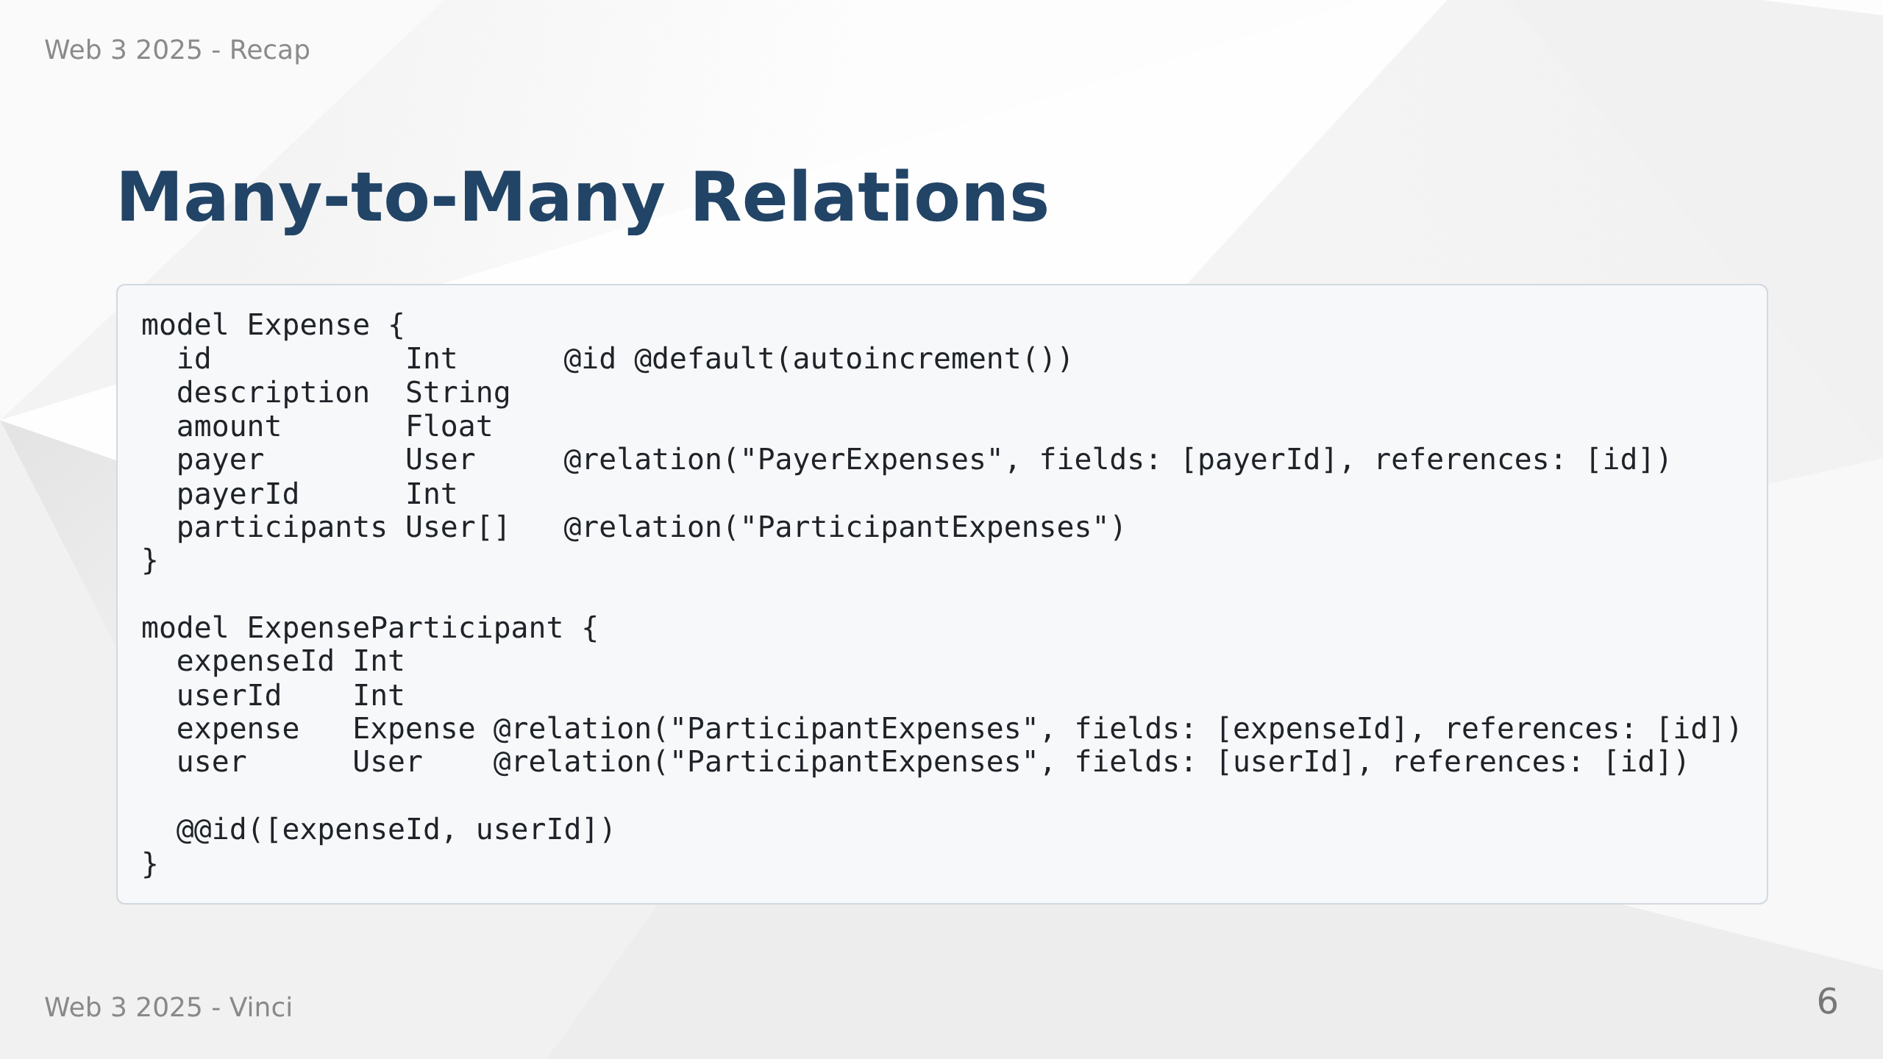
Notes:
Speaker Notes:
• One expense has one payer but multiple participants
• Prisma 8 requires an explicit join model — no more implicit many-to-many
• ExpenseParticipant is the join table; its @@id must be exactly the two foreign keys
• Relation names disambiguate: User has two relations to Expense
• Query participants with .include("participants") — join model is transparent

Slide 7
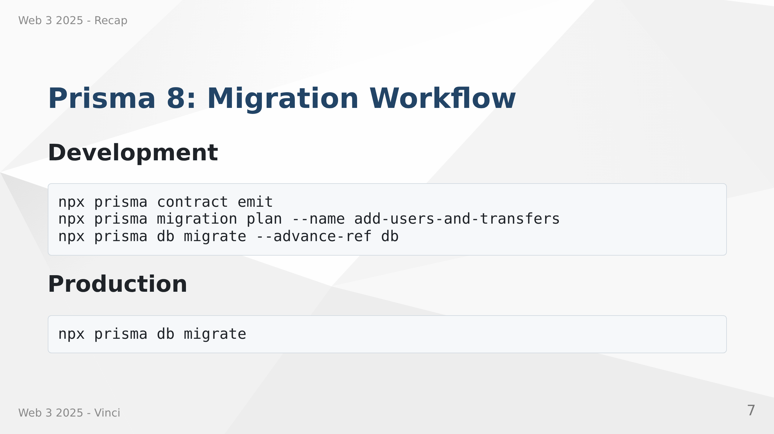
Notes:
Speaker Notes:
• Three-step loop replaces migrate dev: emit → plan → migrate
• prisma contract emit reads contract.prisma, writes contract.json + contract.d.ts
• prisma migration plan generates a TypeScript migration.ts file to review
• prisma db migrate applies pending migrations to the database
• --advance-ref db records which contract state was applied (for dev)
• No more db push — use db init (new DB) or db update (existing DB) instead

Slide 8
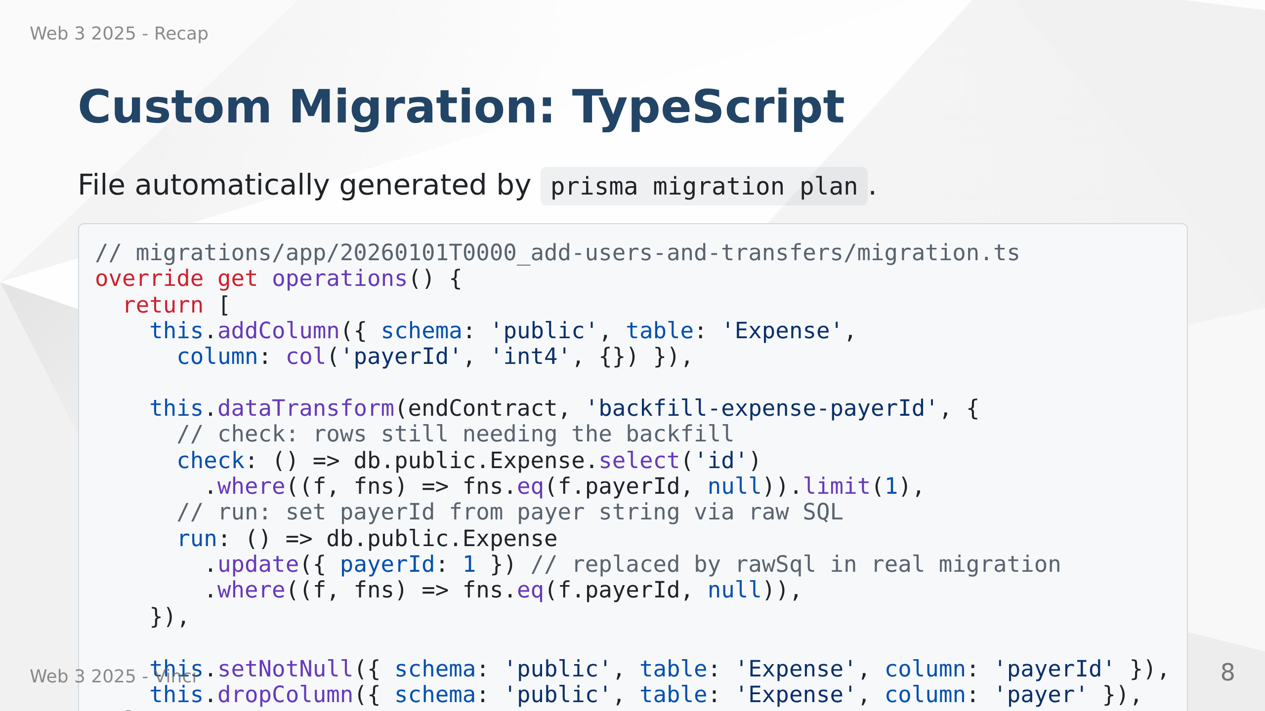
Notes:
Speaker Notes:
• Prisma migrations are TypeScript files
• migration plan auto-generates the skeleton with placeholders
• dataTransform handles the backfill: check finds remaining rows, run fixes them
• addColumn → dataTransform → setNotNull is the safe 3-step pattern for required cols
• Edit migration.ts then recompile: node migrations/app/<dir>/migration.ts
• Commit migration.ts, ops.json, migration.json, and snapshot dirs

Slide 9
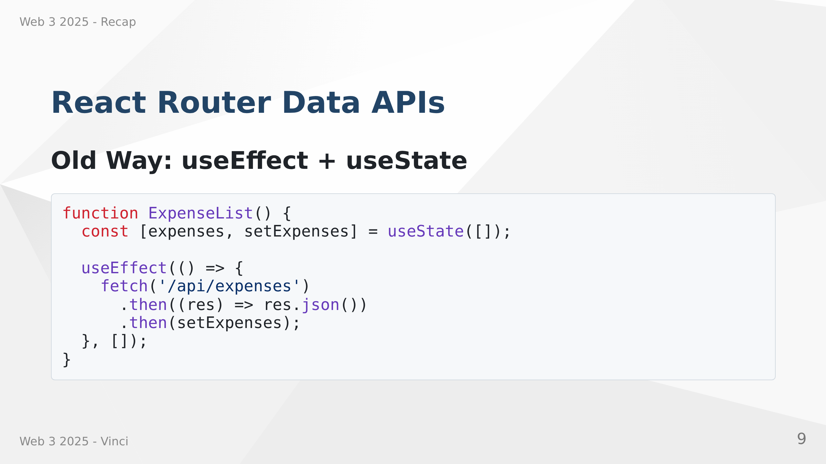
Notes:
Speaker Notes:
• Traditional approach puts data fetching inside components
• Creates loading states and error handling complexity
• Makes components less focused on presentation
• Data fetching mixed with UI logic
• Harder to cache and prefetch data

Slide 10
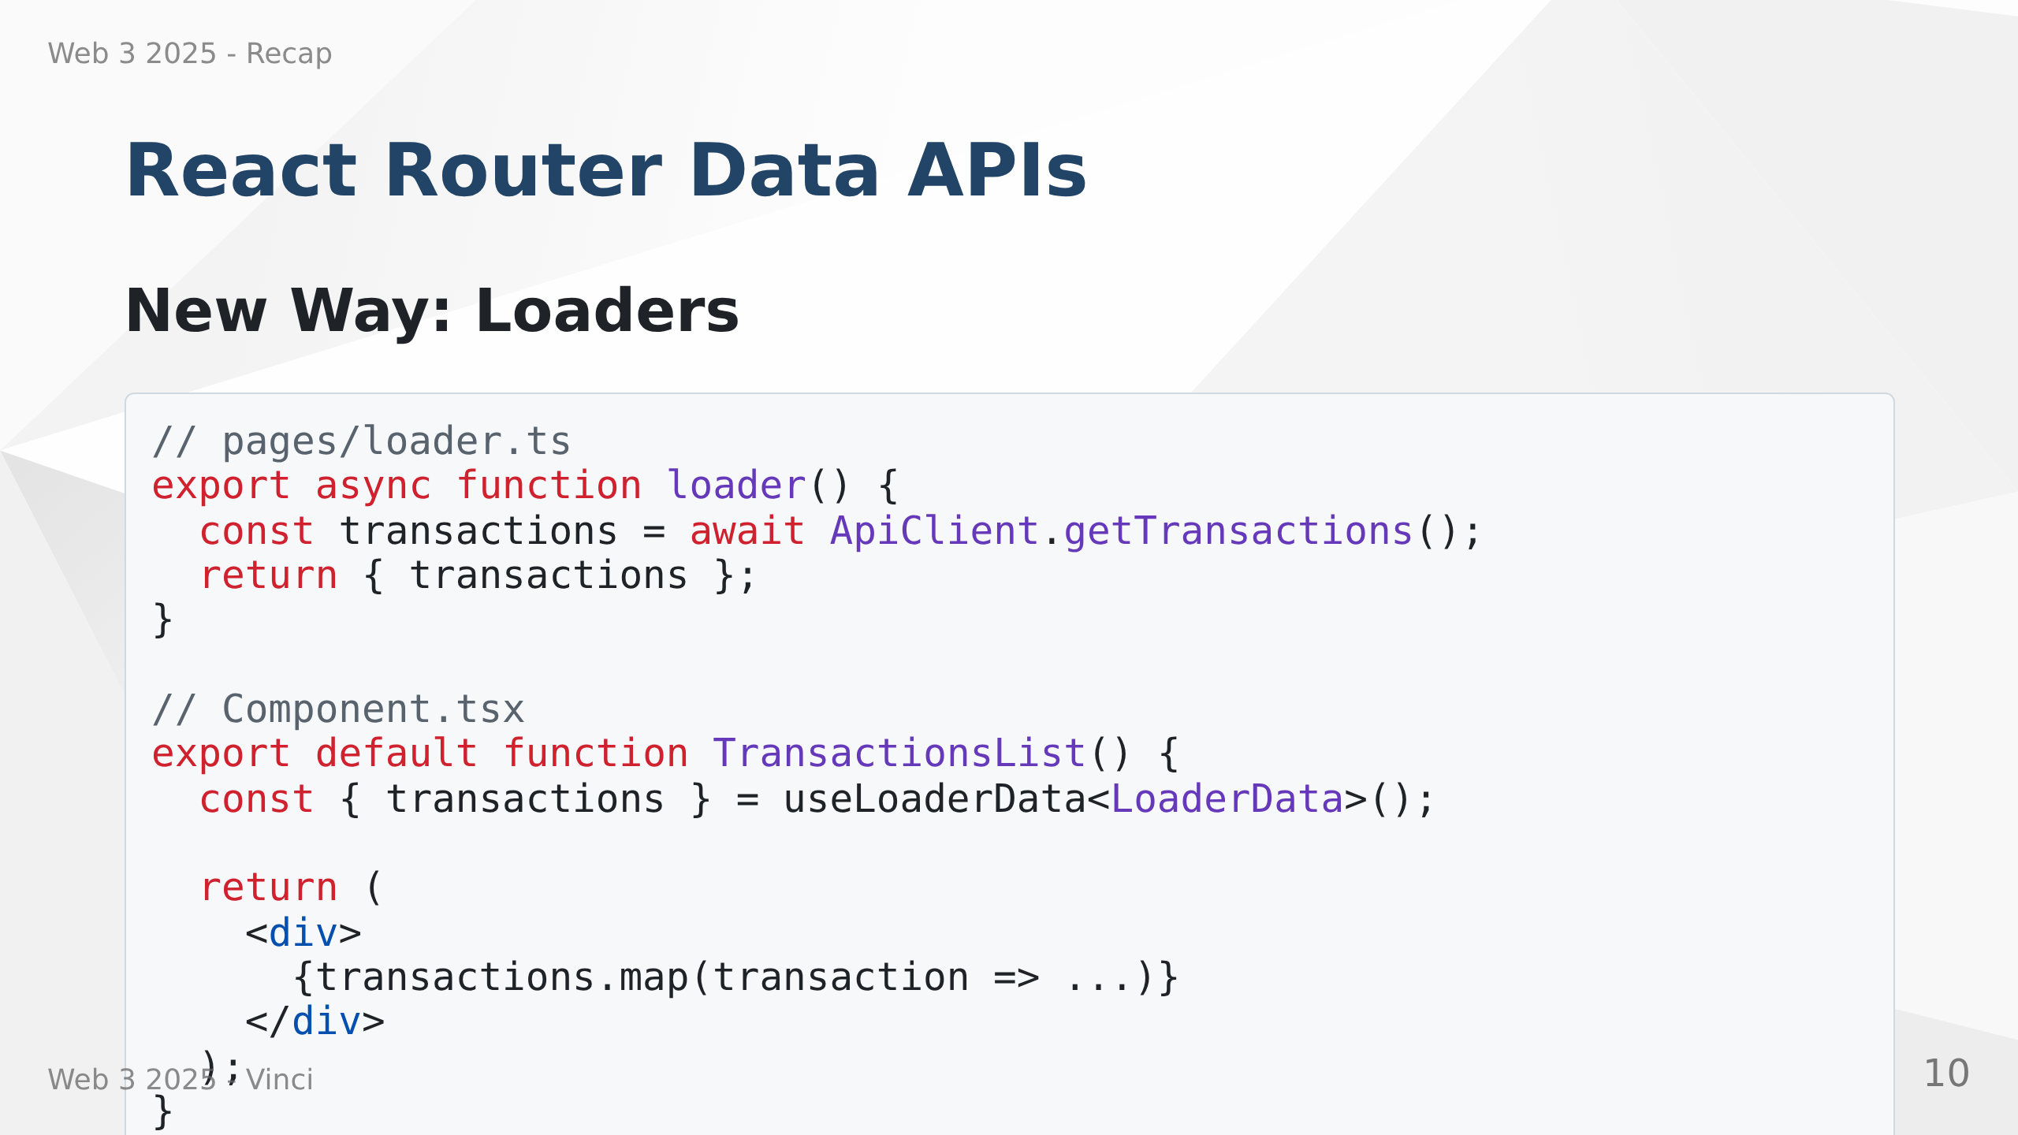
Notes:
Speaker Notes:
• Loaders move data fetching out of components
• Data fetched before route renders - eliminates loading states
• Components become pure presentation logic
• Better separation of concerns
• Enables caching and prefetching
• React Router handles the data flow

Slide 11
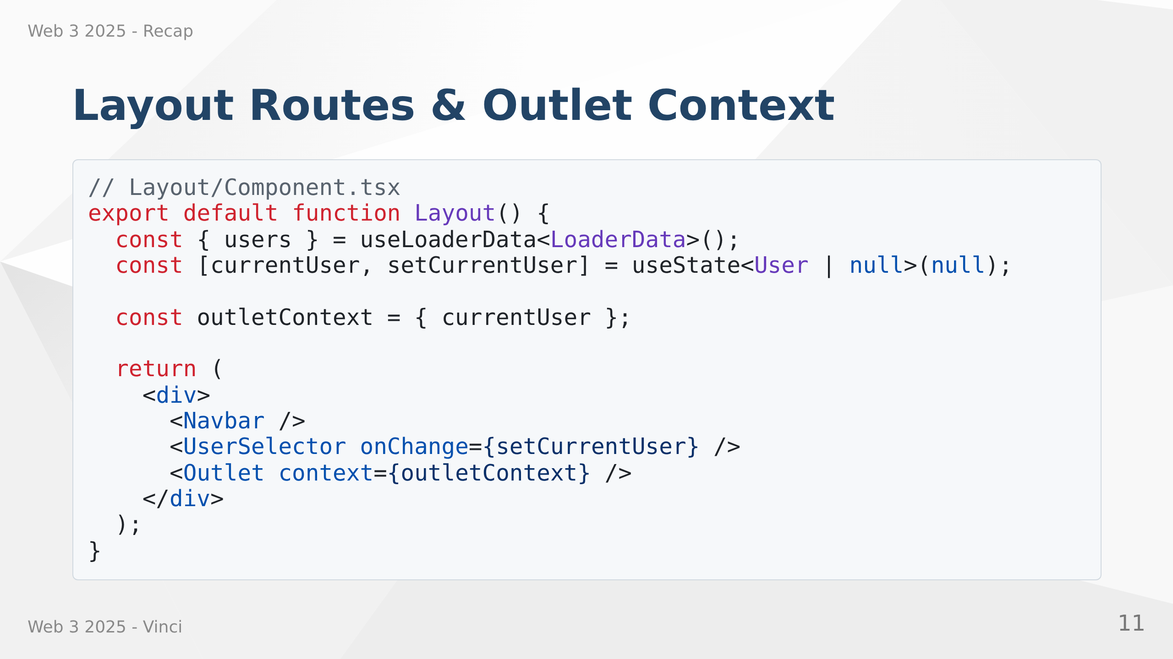
Notes:
Speaker Notes:
• Layout routes share UI and state across multiple pages
• Outlet renders child routes with shared context
• Perfect for user selection, navigation, global UI elements
• Avoids prop drilling for common state
• Clean way to structure multi-page applications

Slide 12
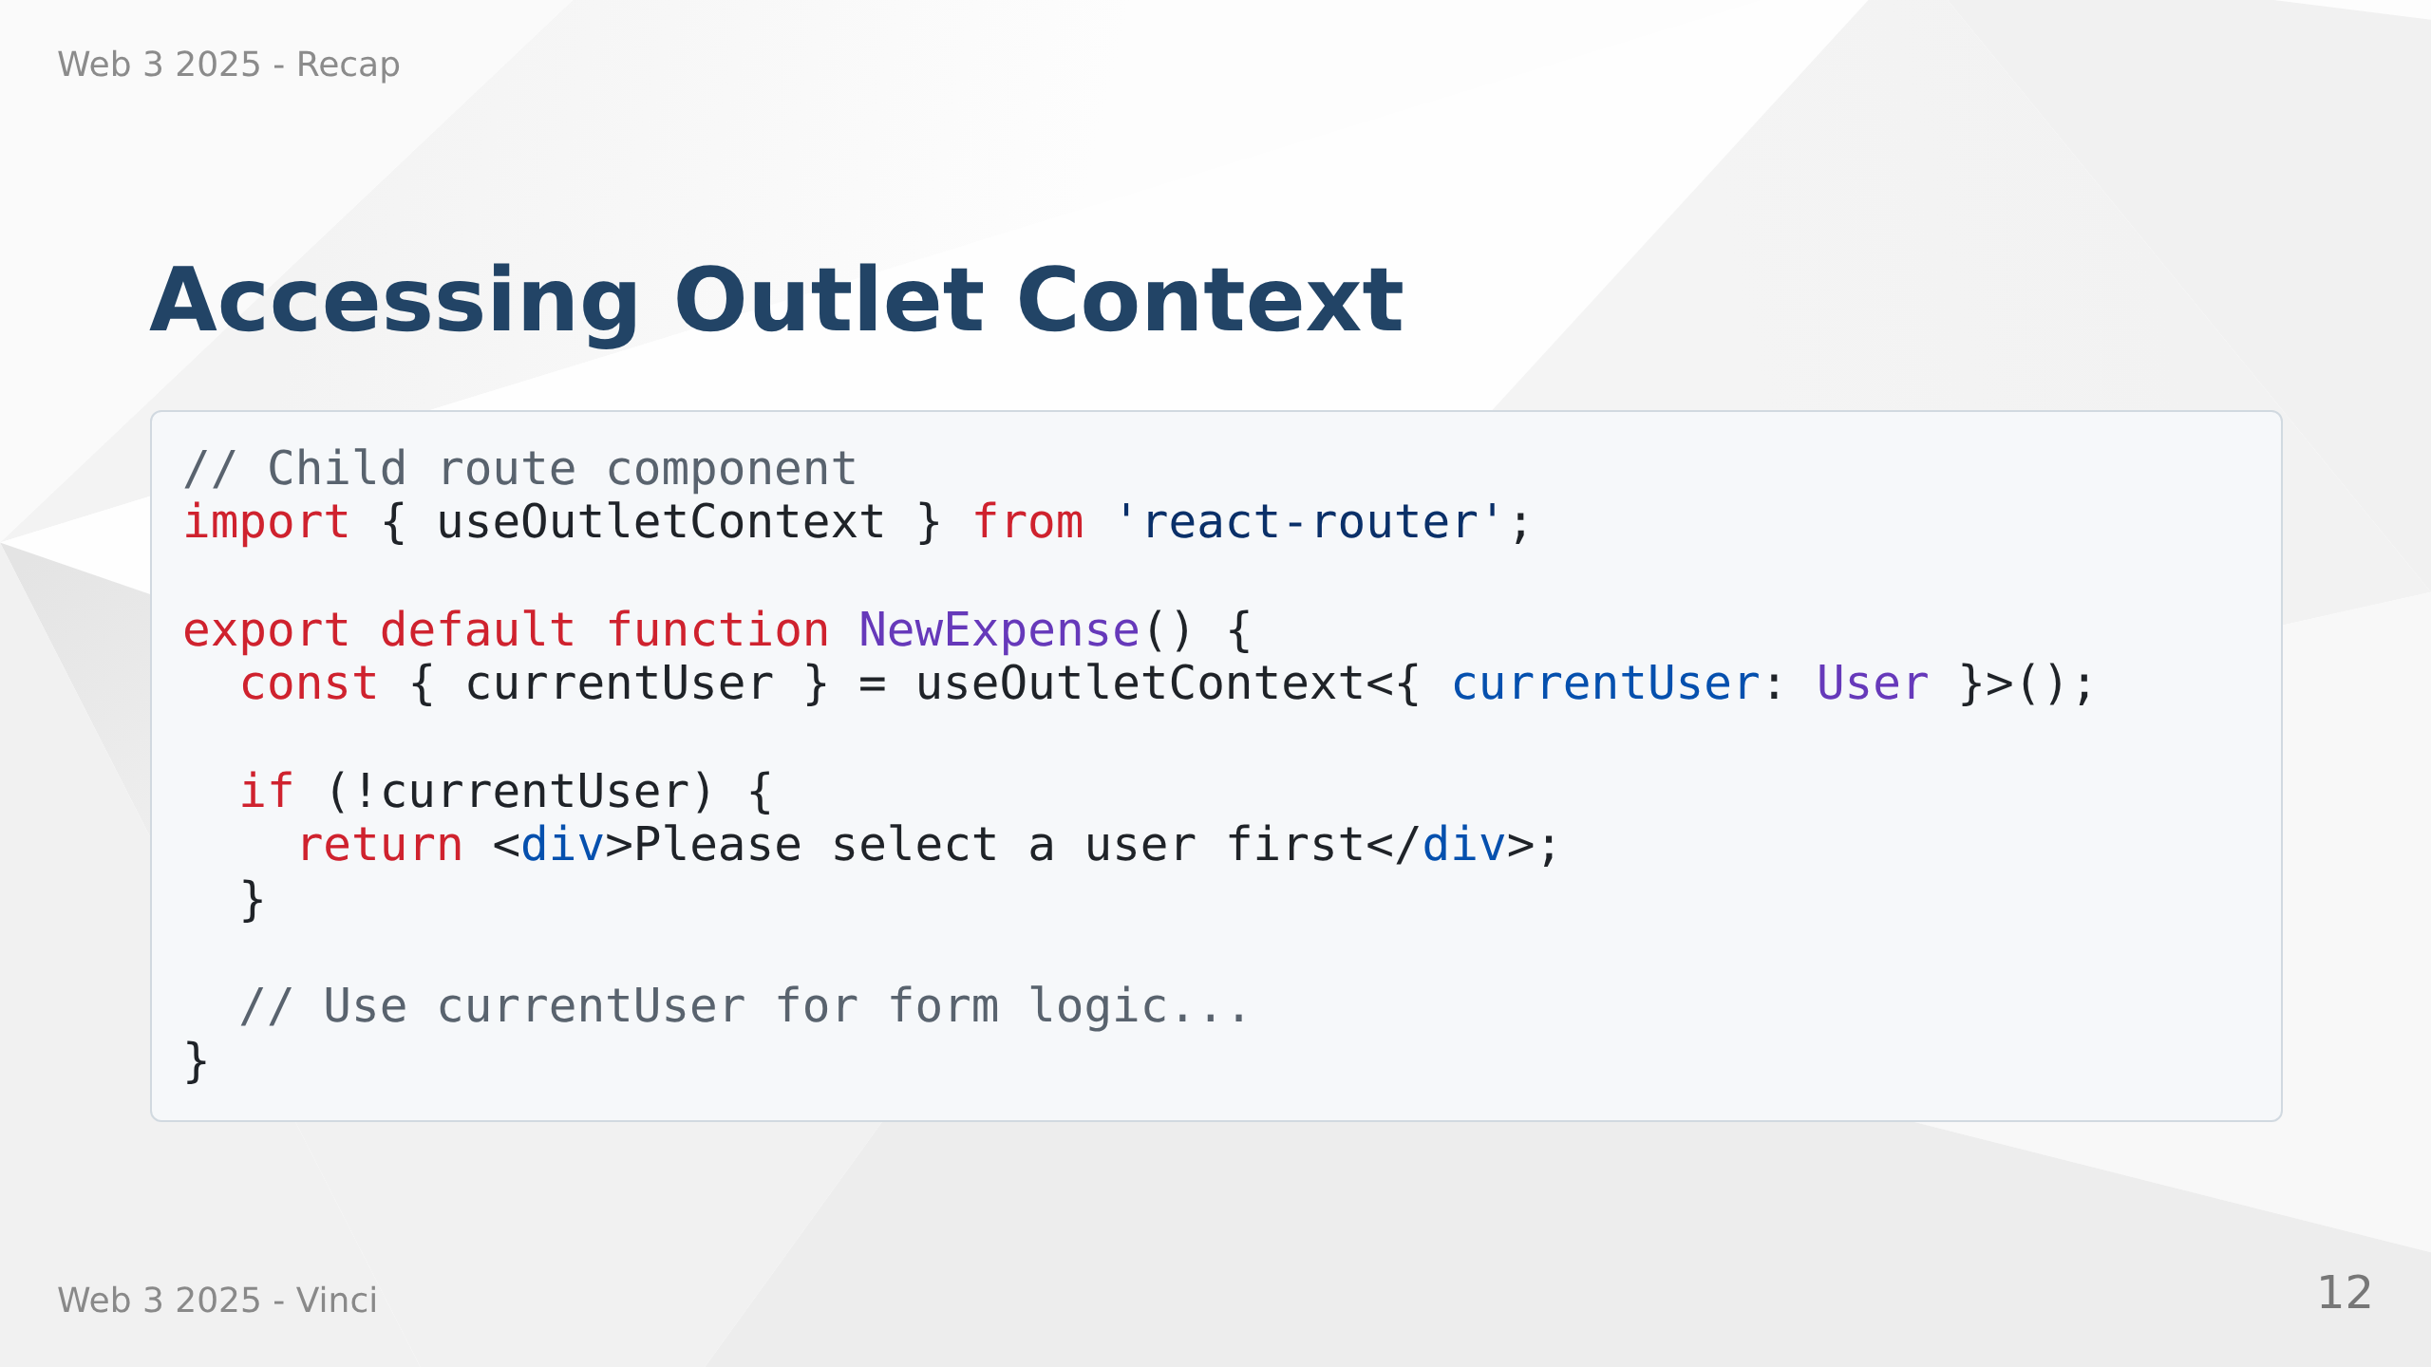
Notes:
Speaker Notes:
• Child routes access outlet context with useOutletContext hook
• Clean way to share state without prop drilling
• Type-safe access to shared data
• Can conditionally render based on context
• Alternative to React Context for route-specific state

Slide 13
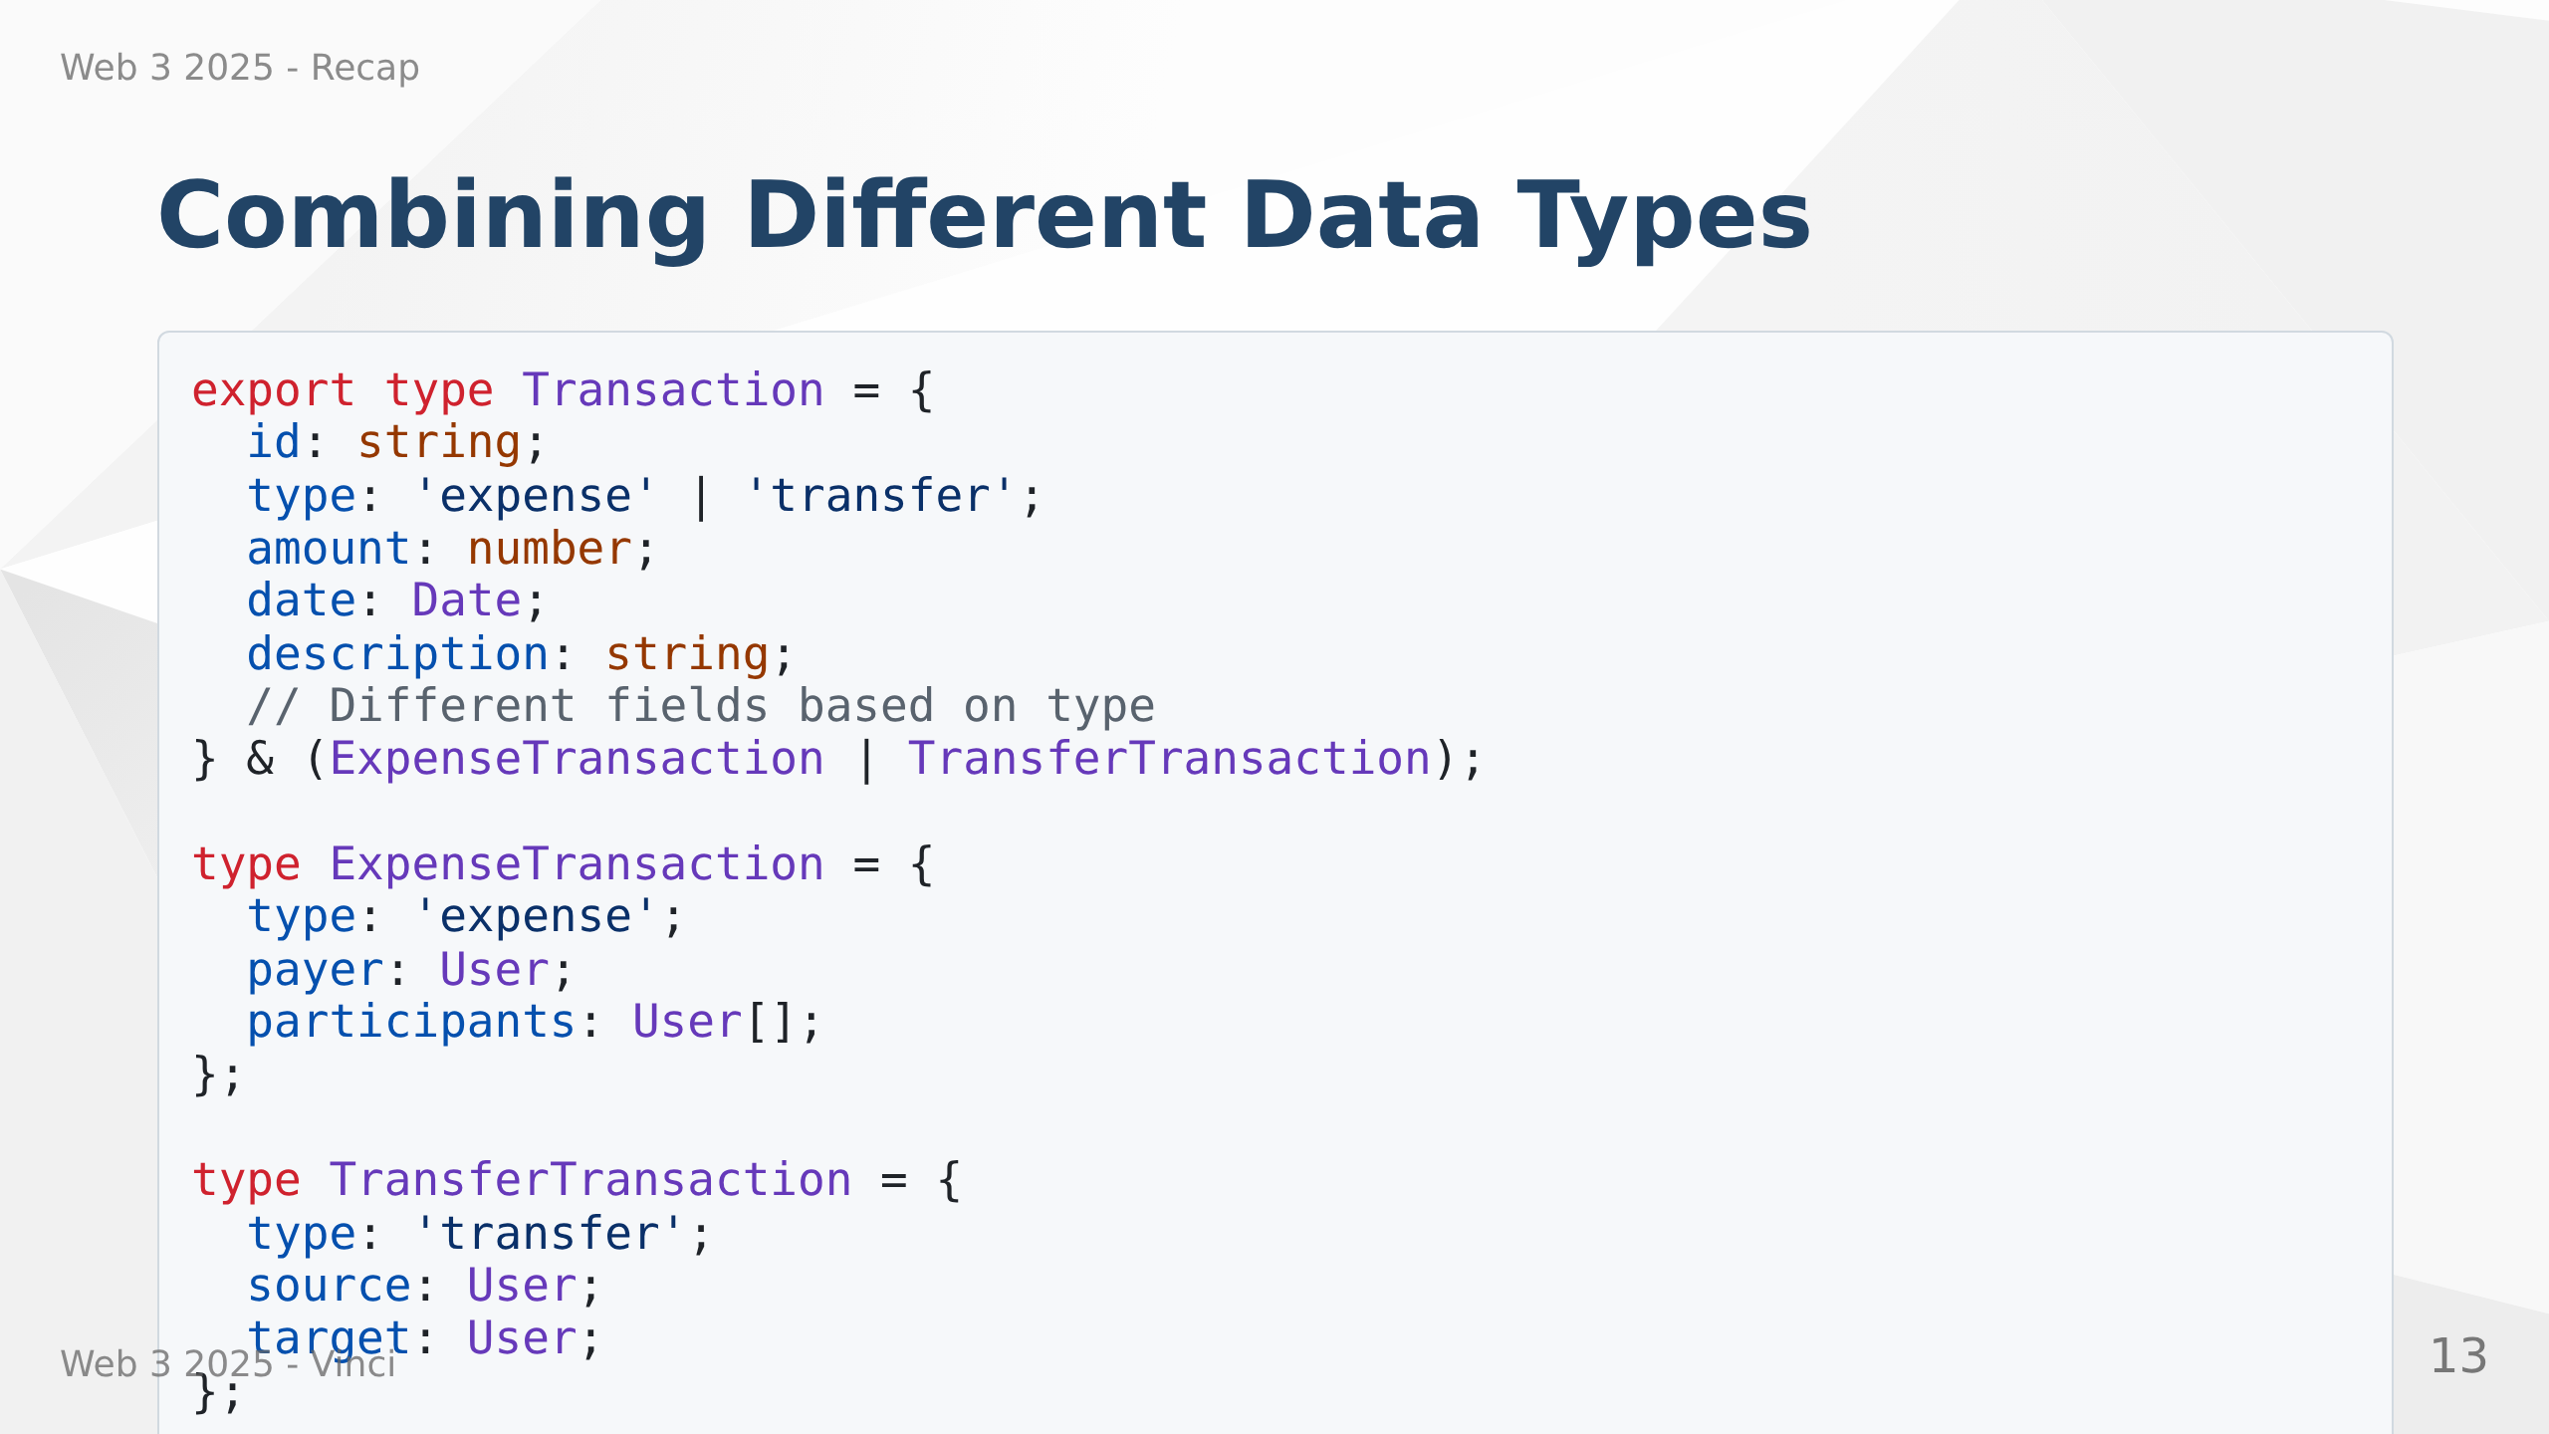
Notes:
Speaker Notes:
• Combining expenses and transfers into unified Transaction type
• Using discriminated unions for type safety
• Display different types together in one list
• TypeScript knows which fields available based on type field
• Clean way to handle heterogeneous data

Slide 14
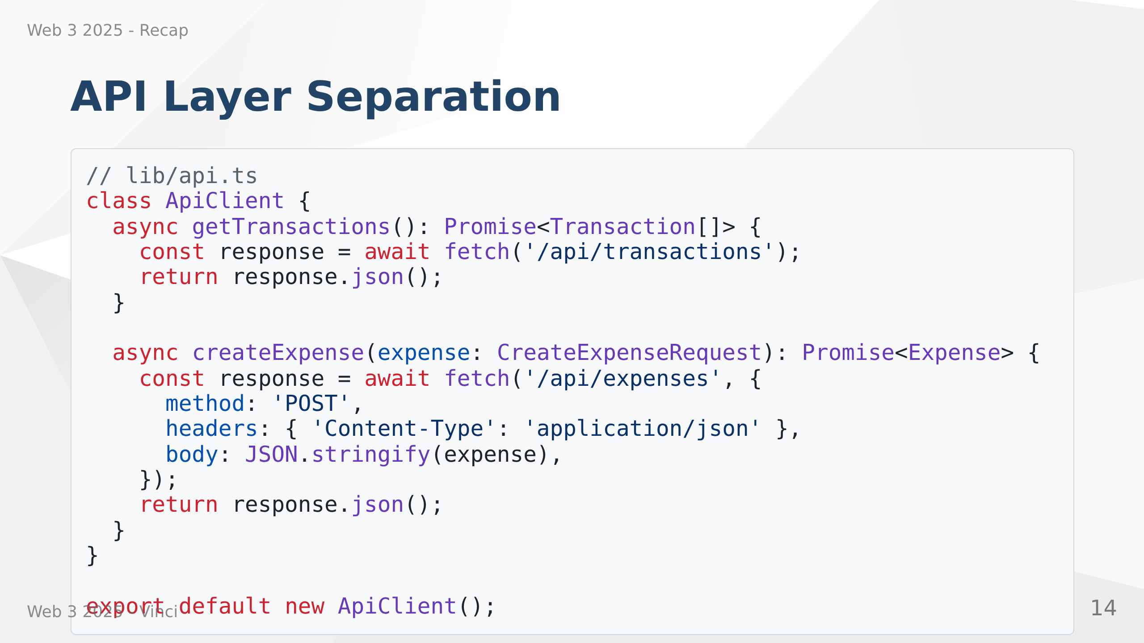
Notes:
Speaker Notes:
• Centralize all API calls in dedicated module
• Easy to add error handling, authentication in one place
• Request/response transformation centralized
• Components don't need to know about HTTP details
• Better testing and mocking capabilities
• Consistent API patterns across app

Slide 15
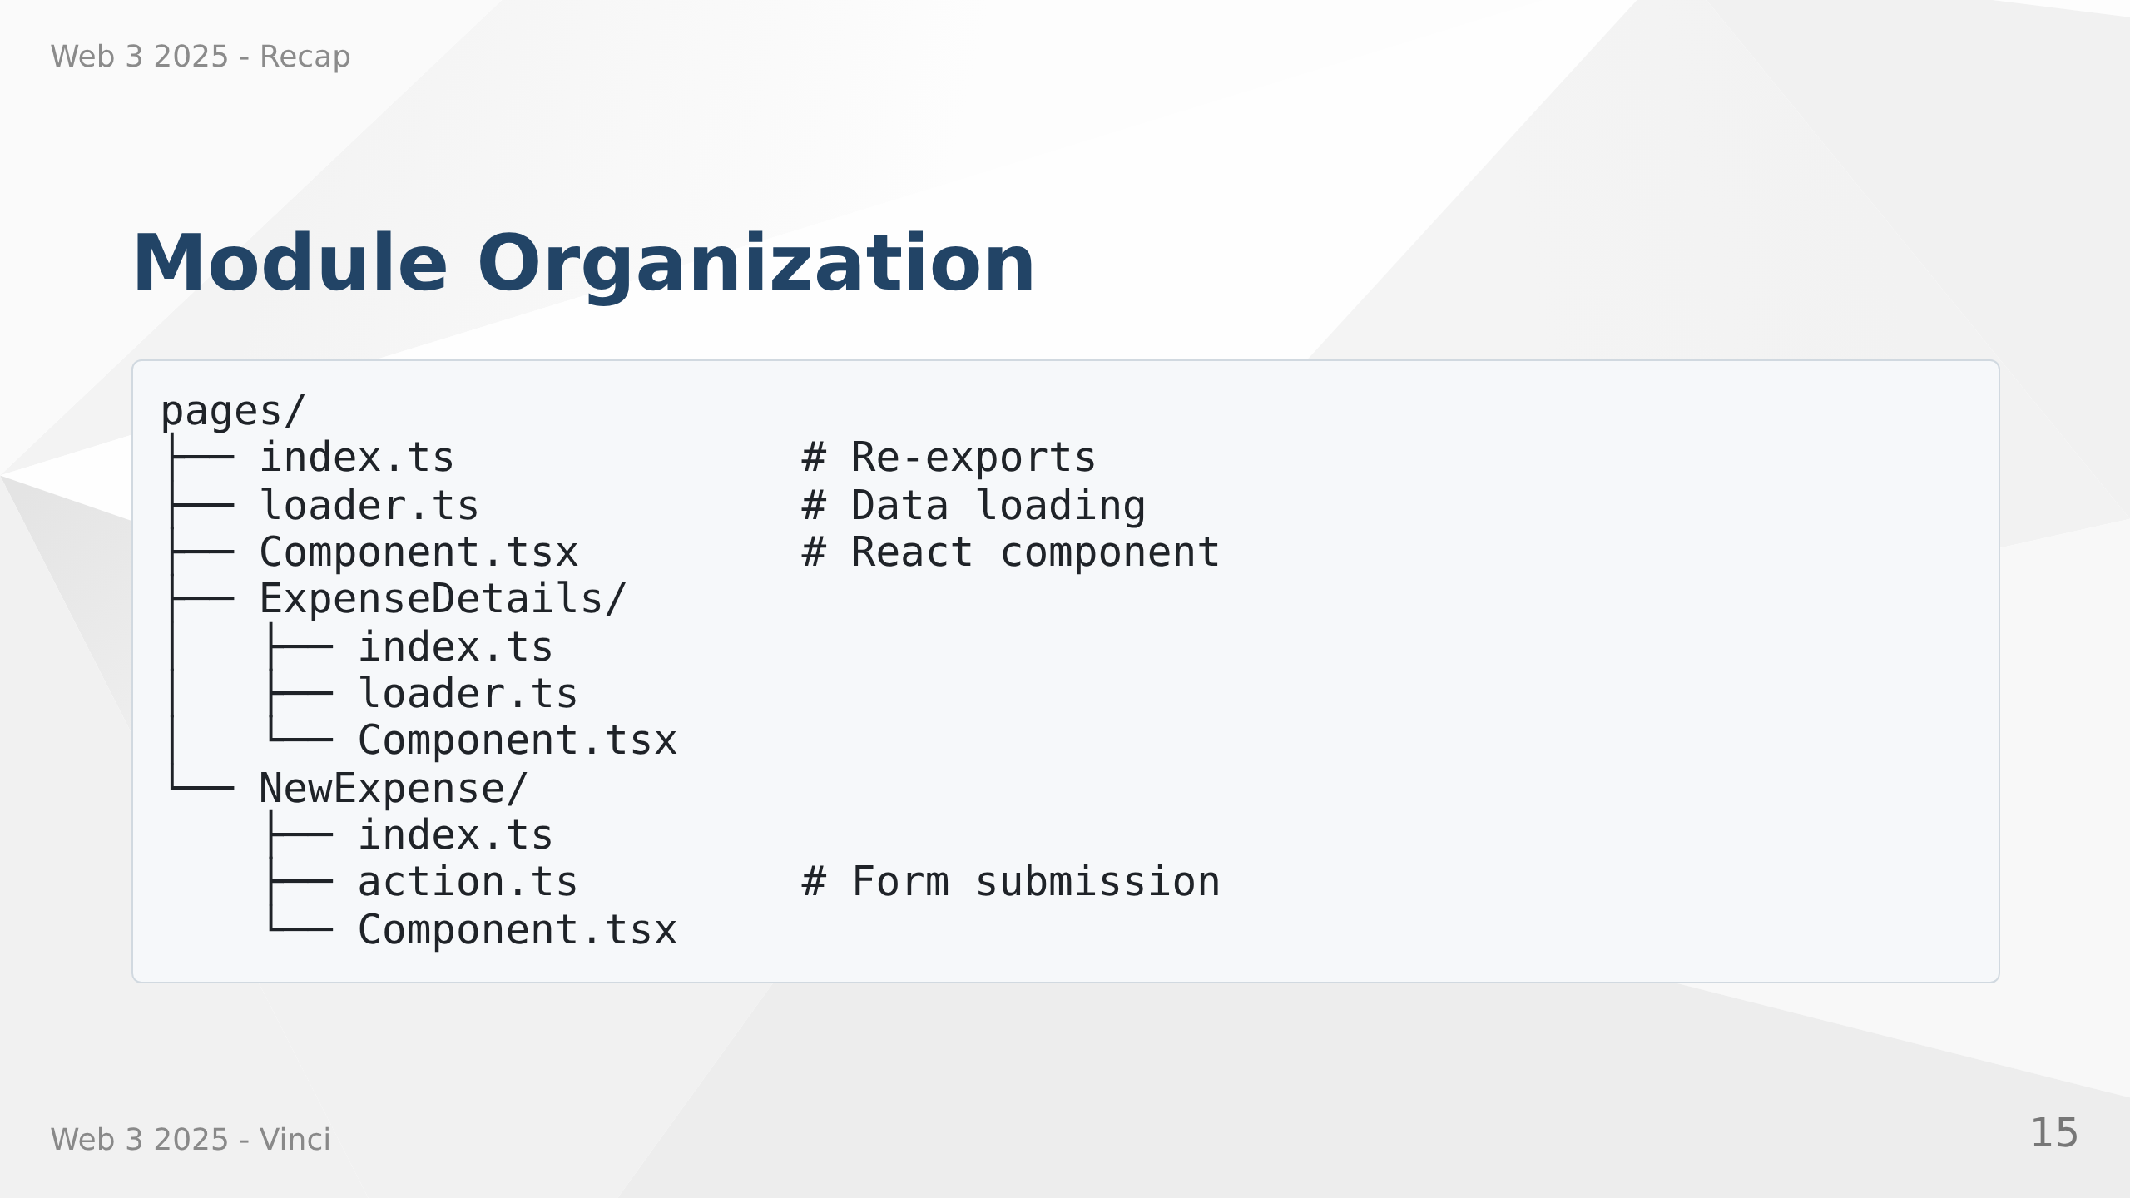
Notes:
Speaker Notes:
• Organize code by feature, not by file type
• Each page gets own folder with loader, component, action files
• Index.ts files provide clean imports
• Scales much better than all components in one folder
• Easy to find related files
• Supports feature-based development teams

Slide 16
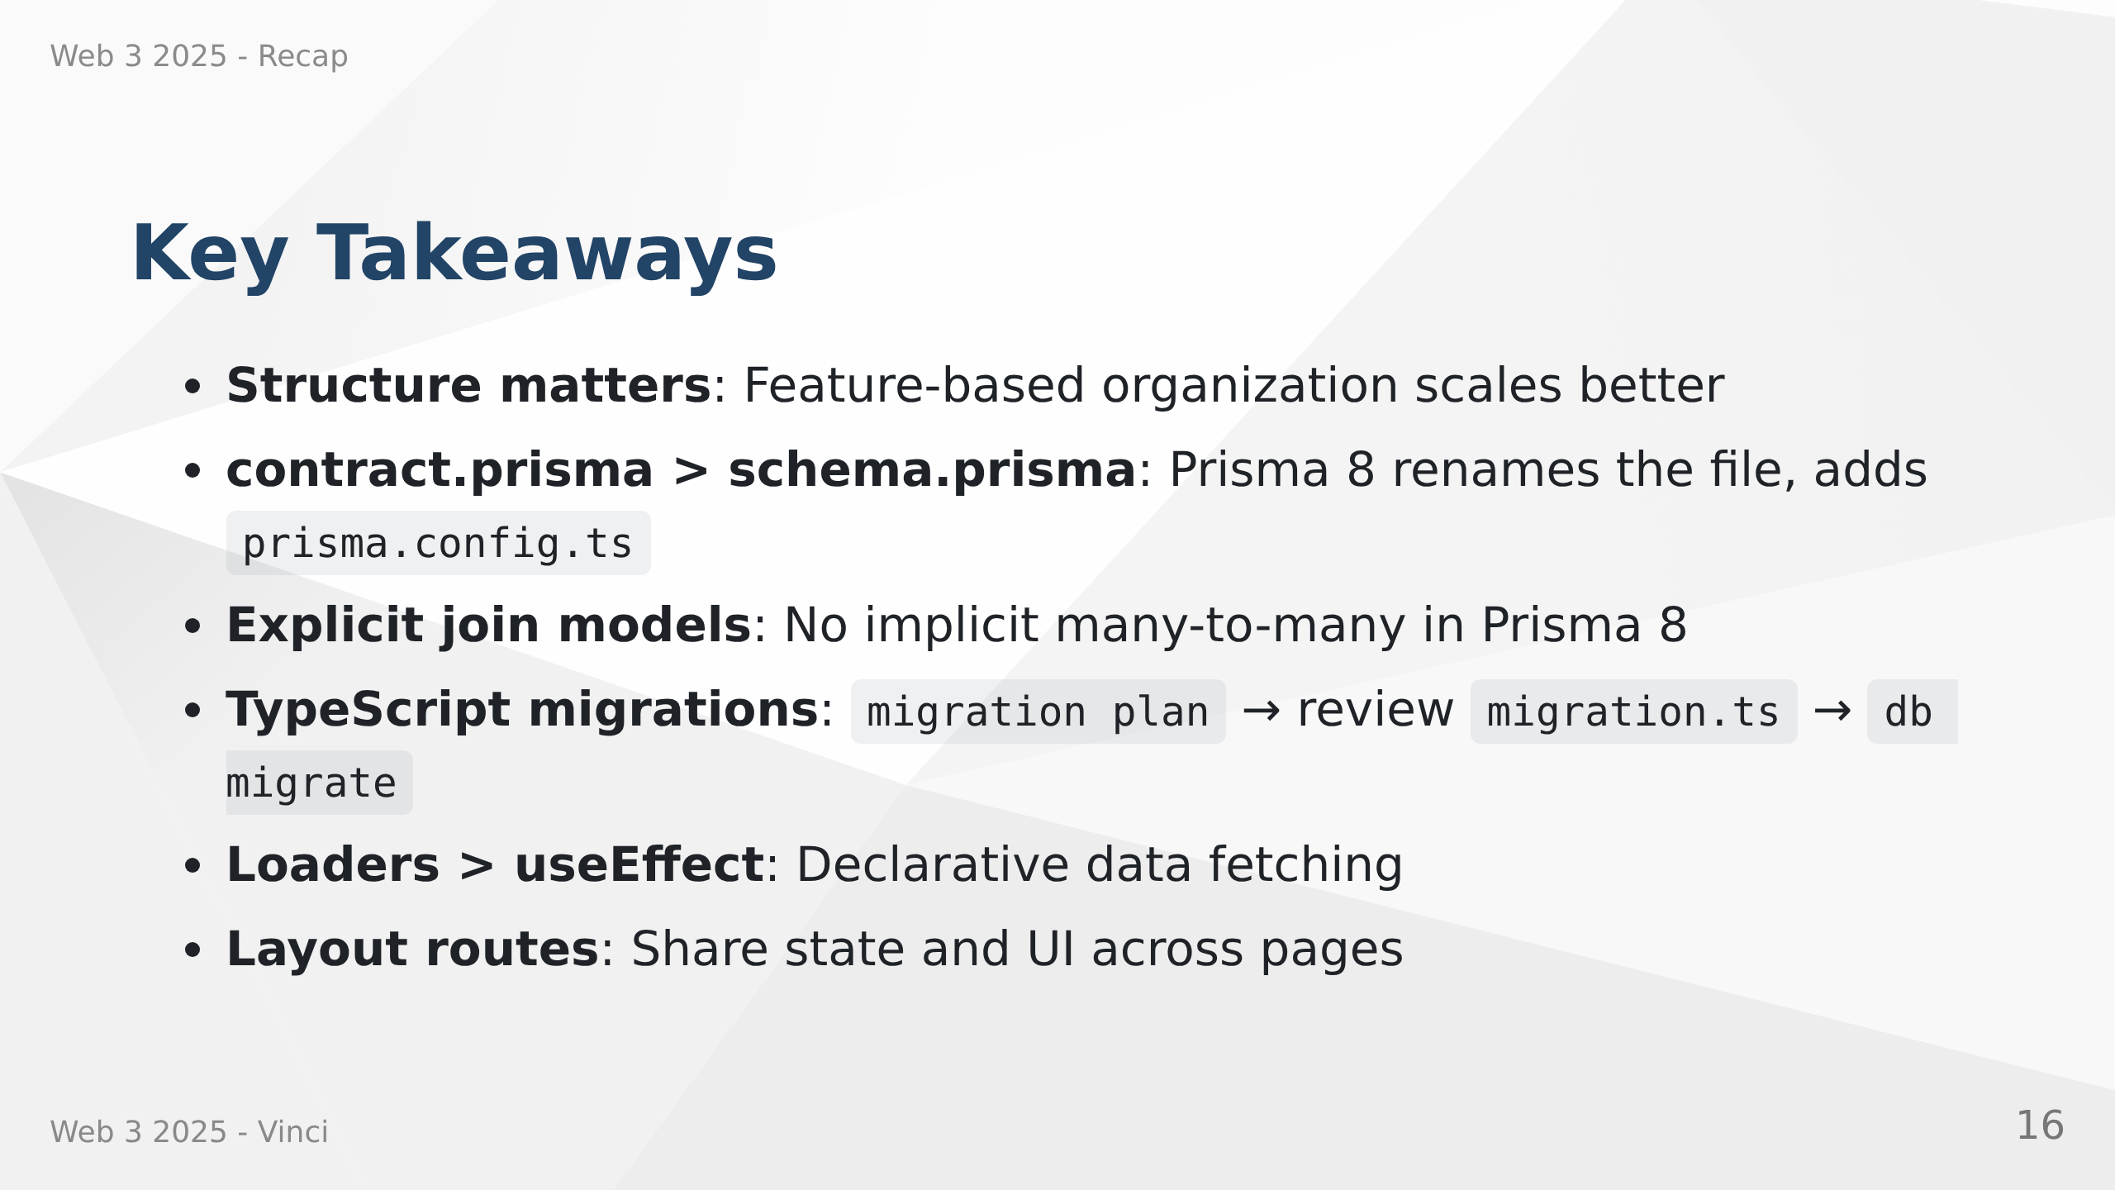
Notes:
Speaker Notes:
• These patterns might seem like extra work now
• Pay dividends as application grows
• Prisma 8 migration workflow: emit → plan → migrate (replaces migrate dev/deploy)
• Explicit join tables give you full control over many-to-many relations
• TypeScript migrations are type-checked against your contract
• Industry best practices

Slide 17

Notes:
Speaker Notes:
• Any questions before diving into exercises?
• Transforming from simple prototype to production-ready architecture
• Big step but each piece builds on concepts you already know
• Focus on understanding the patterns, not memorizing syntax
• Apply these concepts in the hands-on exercises

