Slide 1


Slide 2
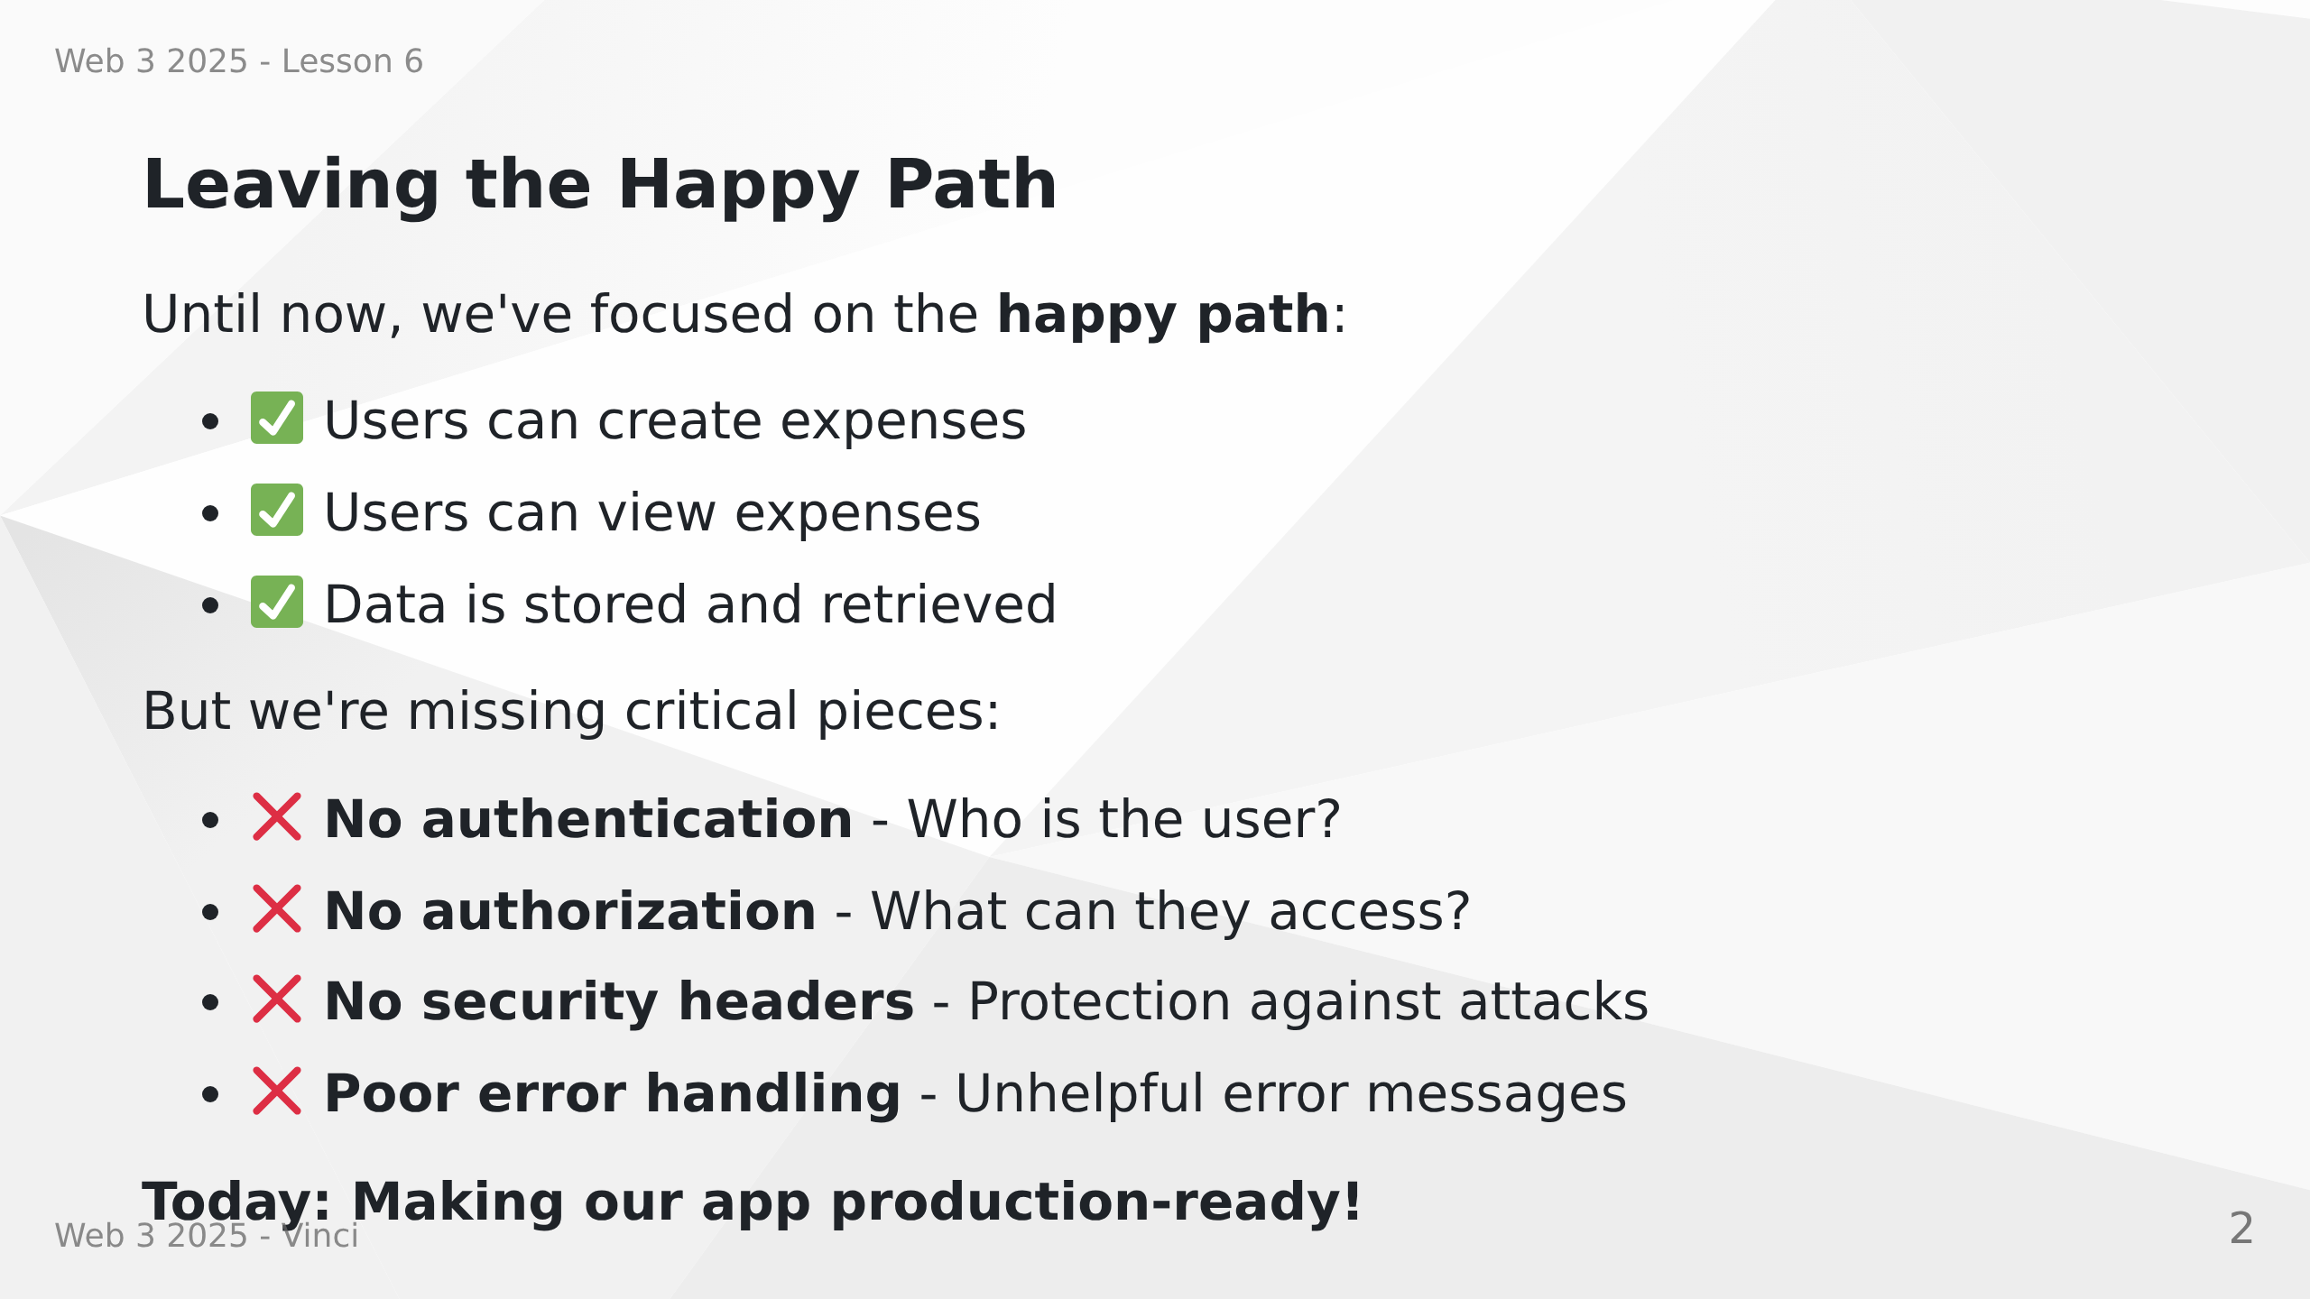
Notes:
Speaker Notes:
• Welcome to lesson 6 - security and error handling
• Up until now, anyone can do anything
• No protection against common web attacks
• Time to implement production-ready security
• These aren't optional features - they're essential

Slide 3
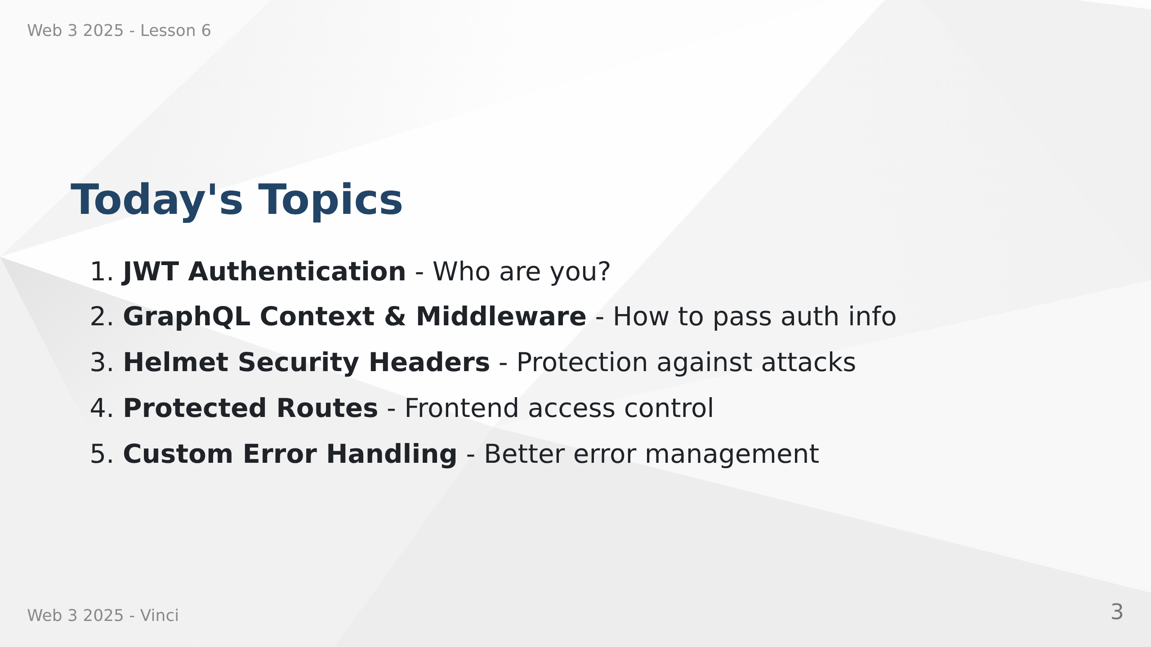
Notes:
Speaker Notes:
• Comprehensive security implementation
• Each layer protects against different threats
• Authentication identifies users
• Authorization controls access
• Error handling provides good UX

Slide 4
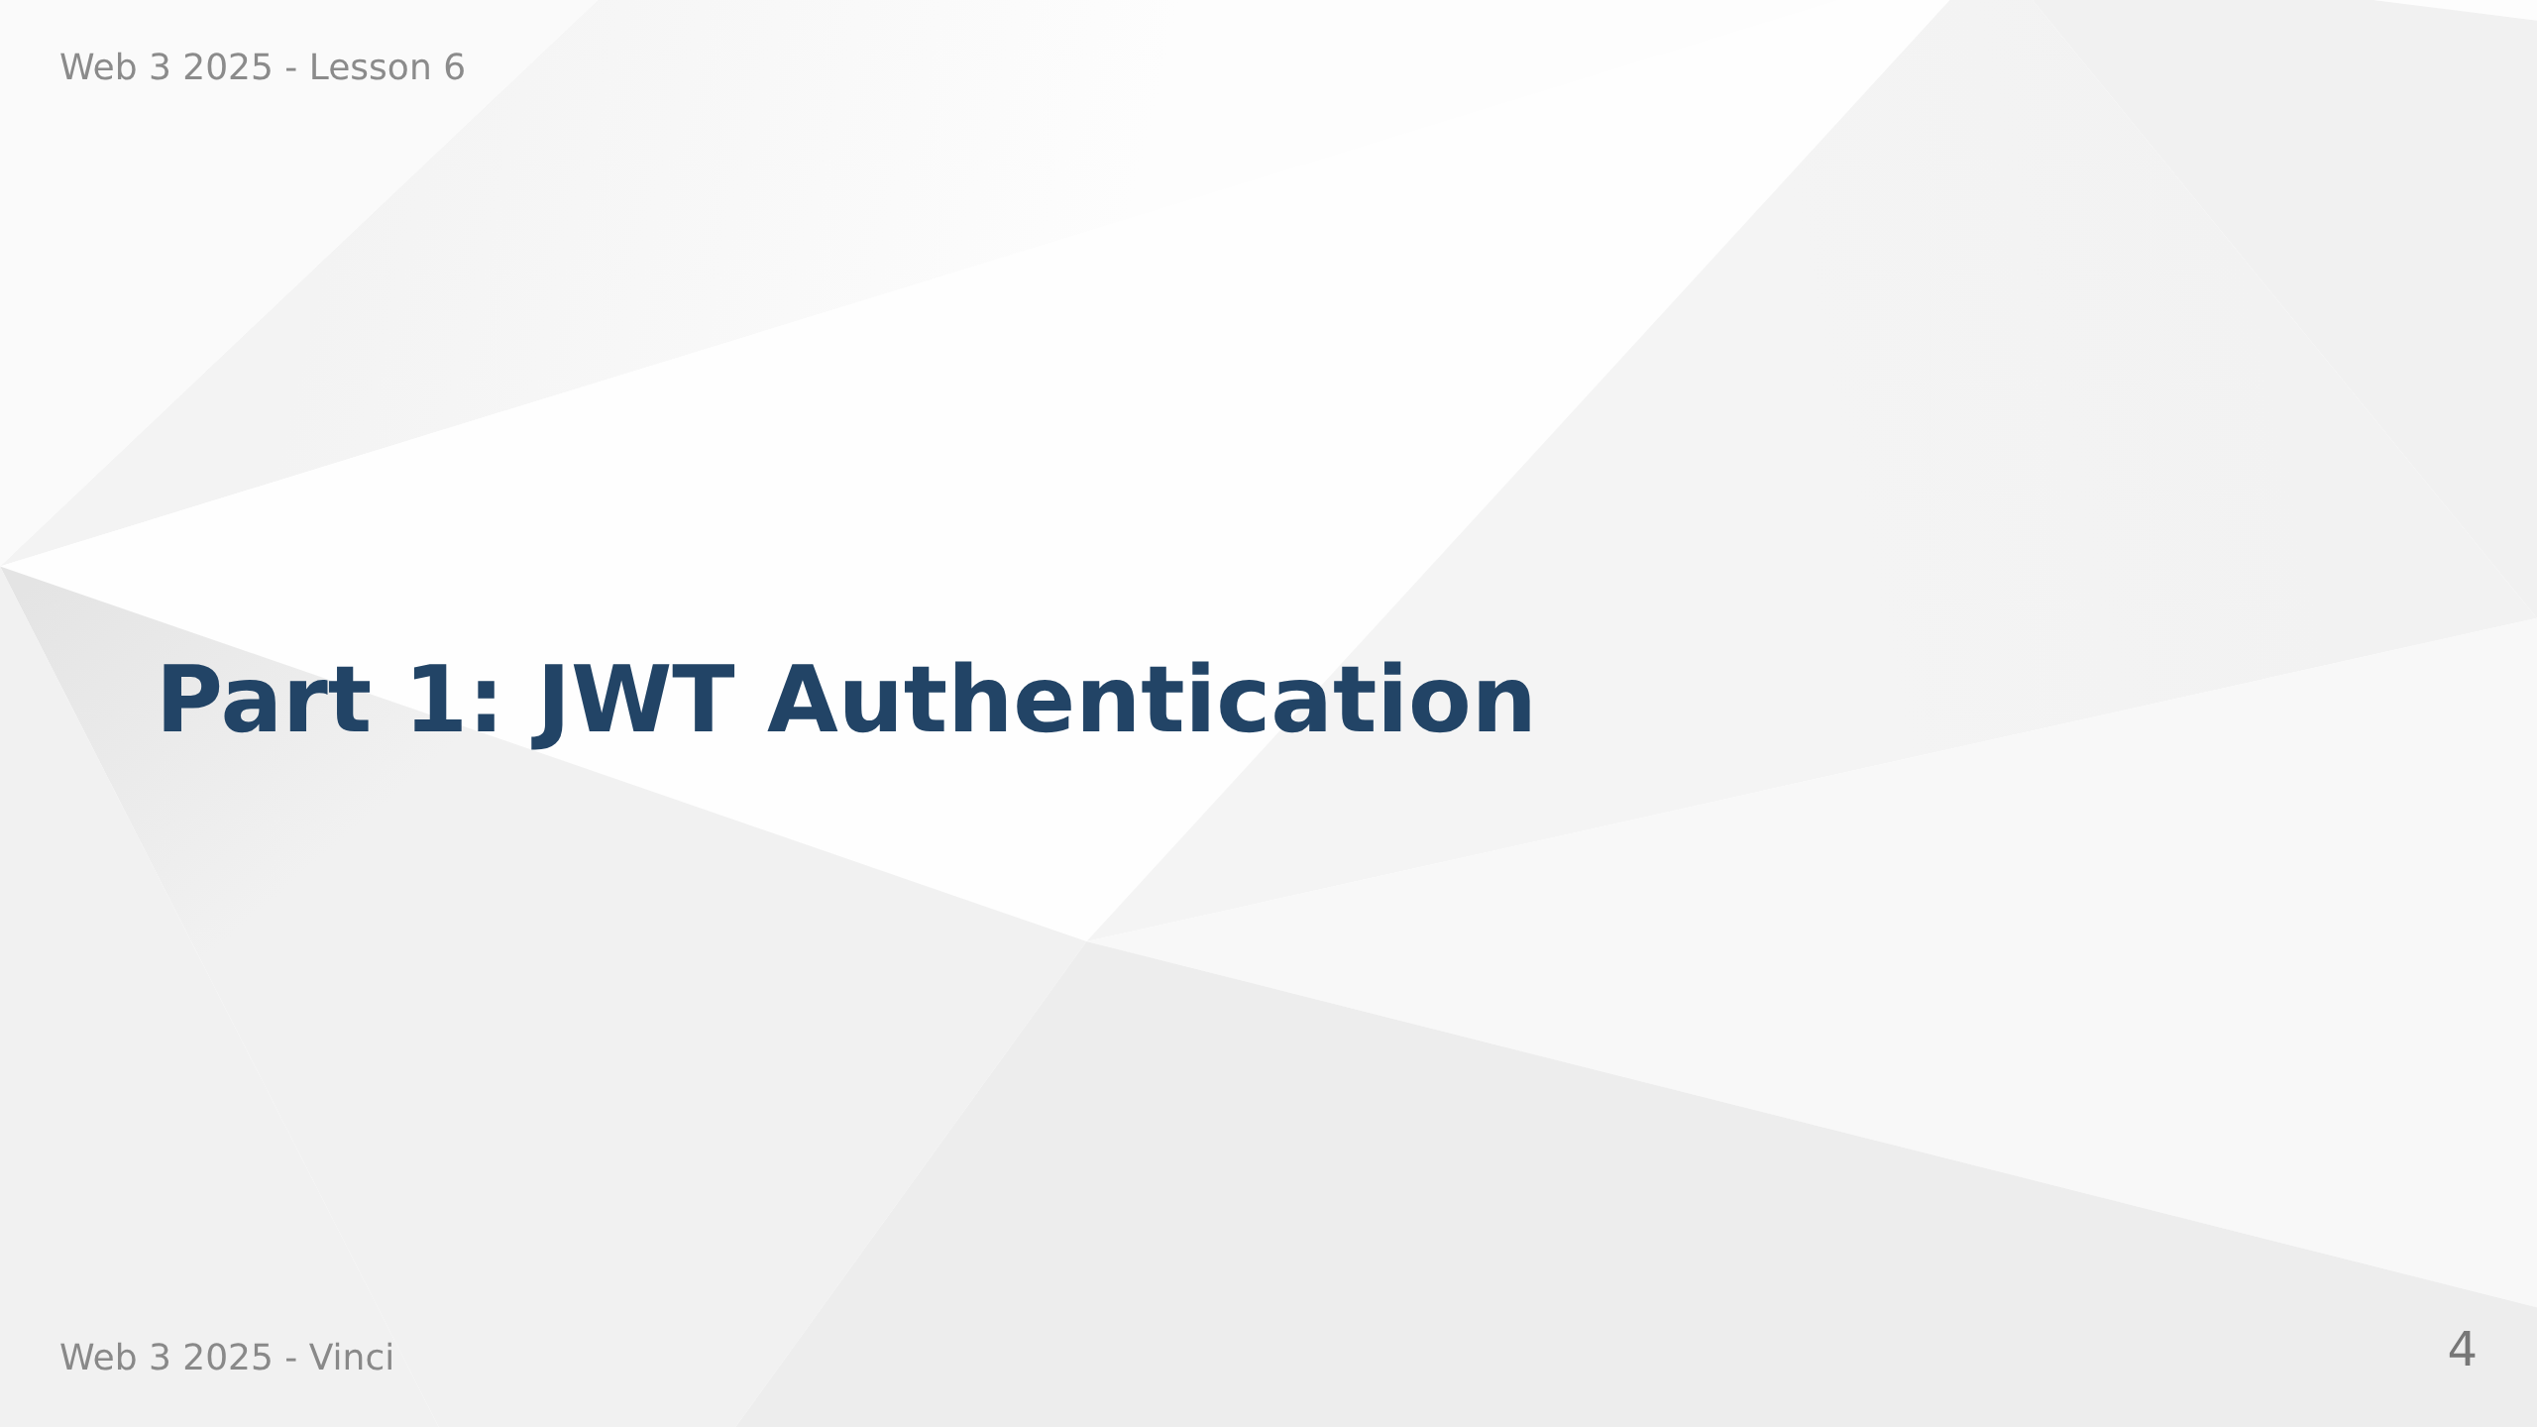

Slide 5
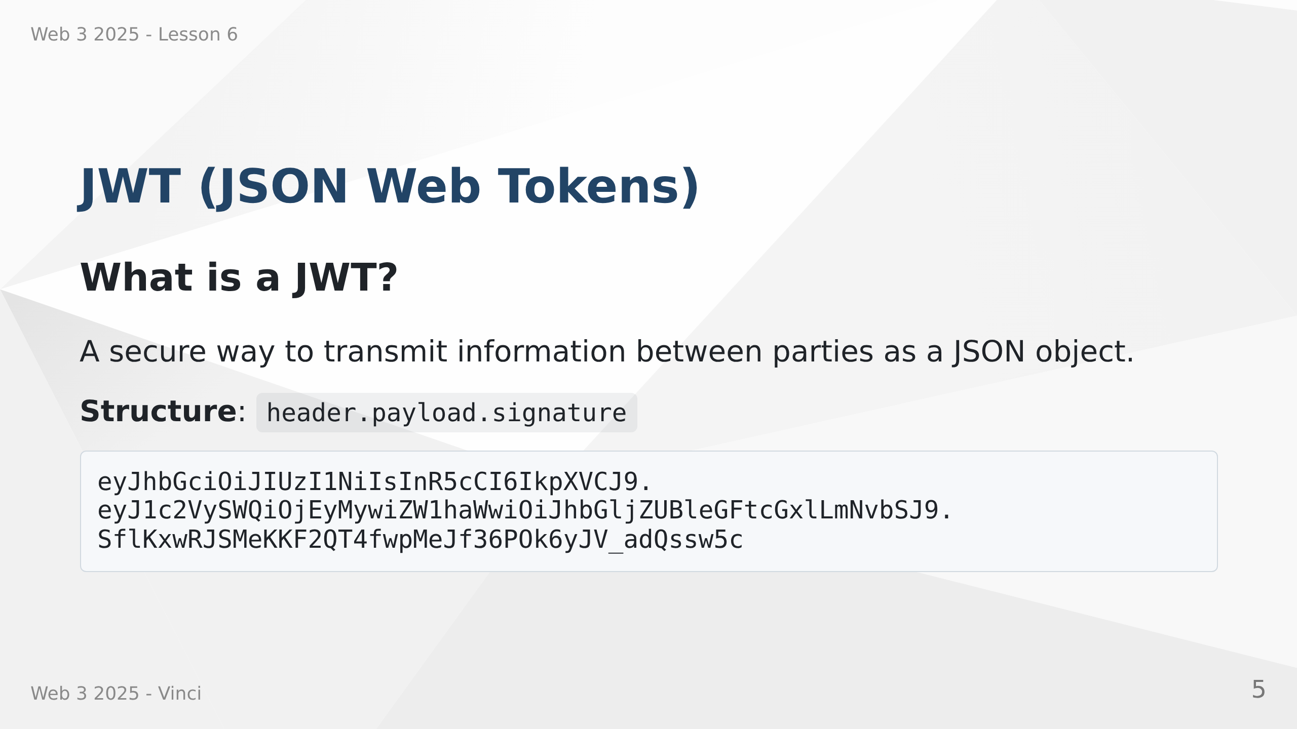
Notes:
Speaker Notes:
• Three parts separated by dots
• Header: algorithm and token type
• Payload: claims (user data)
• Signature: verification that token hasn't been tampered with
• Stateless - server doesn't need to store sessions

Slide 6
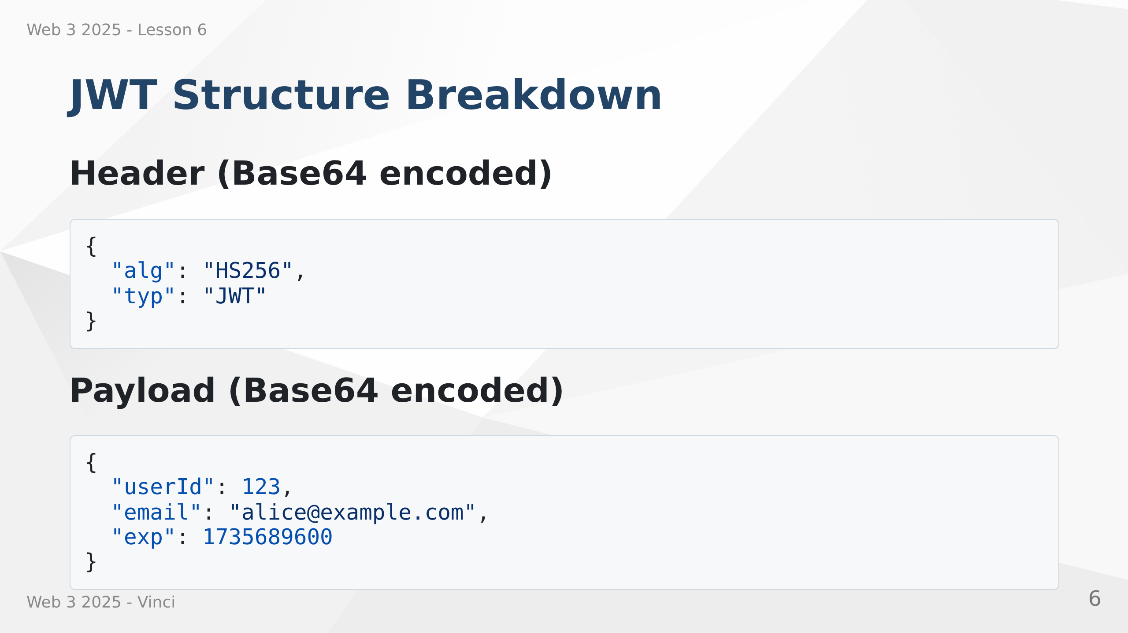
Notes:
Speaker Notes:
• Header specifies signing algorithm
• Payload contains claims - user data we want to transmit
• exp is expiration timestamp - tokens should expire

Slide 7
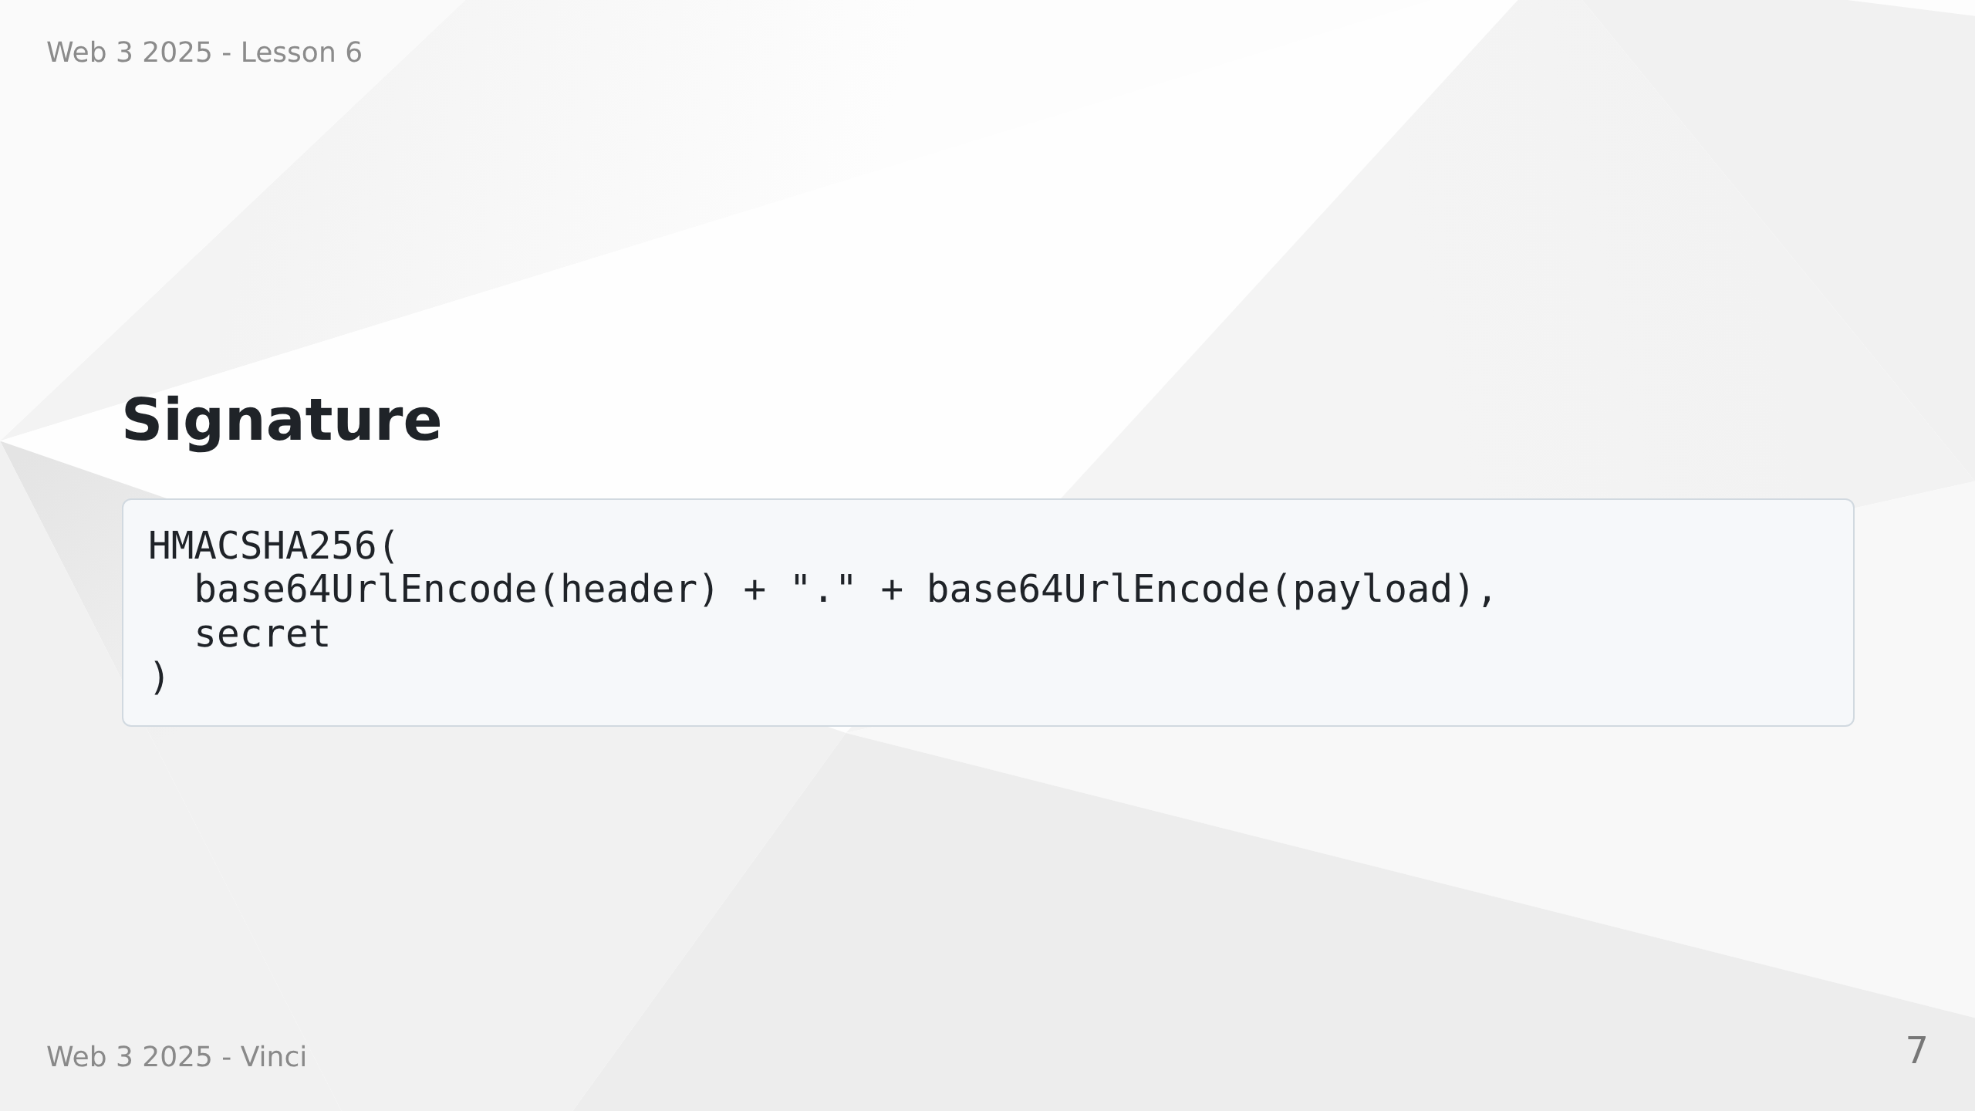
Notes:
Speaker Notes:
• Signature verifies token authenticity using secret key
• Only server with secret key can create valid signatures

Slide 8
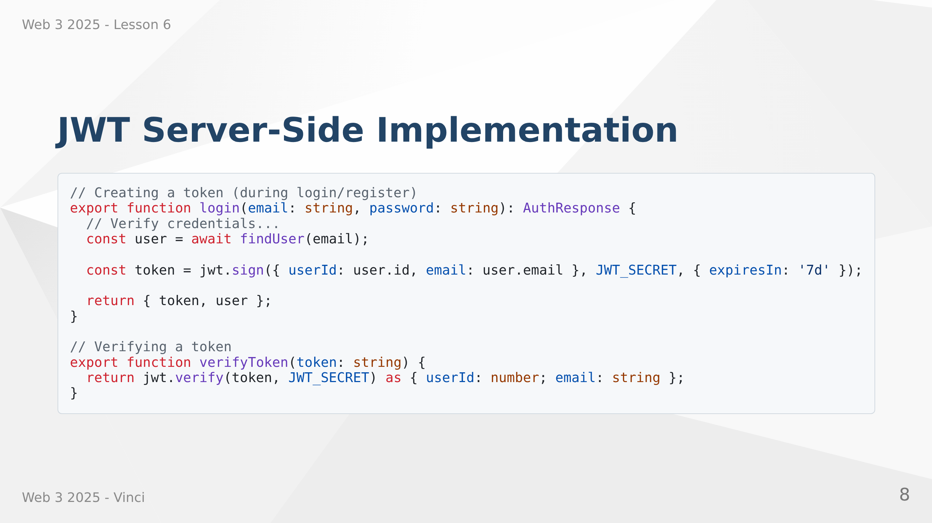
Notes:
Speaker Notes:
• jwt.sign creates the token with payload and secret
• expiresIn ensures tokens don't live forever
• jwt.verify checks signature and returns payload
• Throws error if token is invalid or expired
• Never expose JWT_SECRET - keep it in environment variables

Slide 9
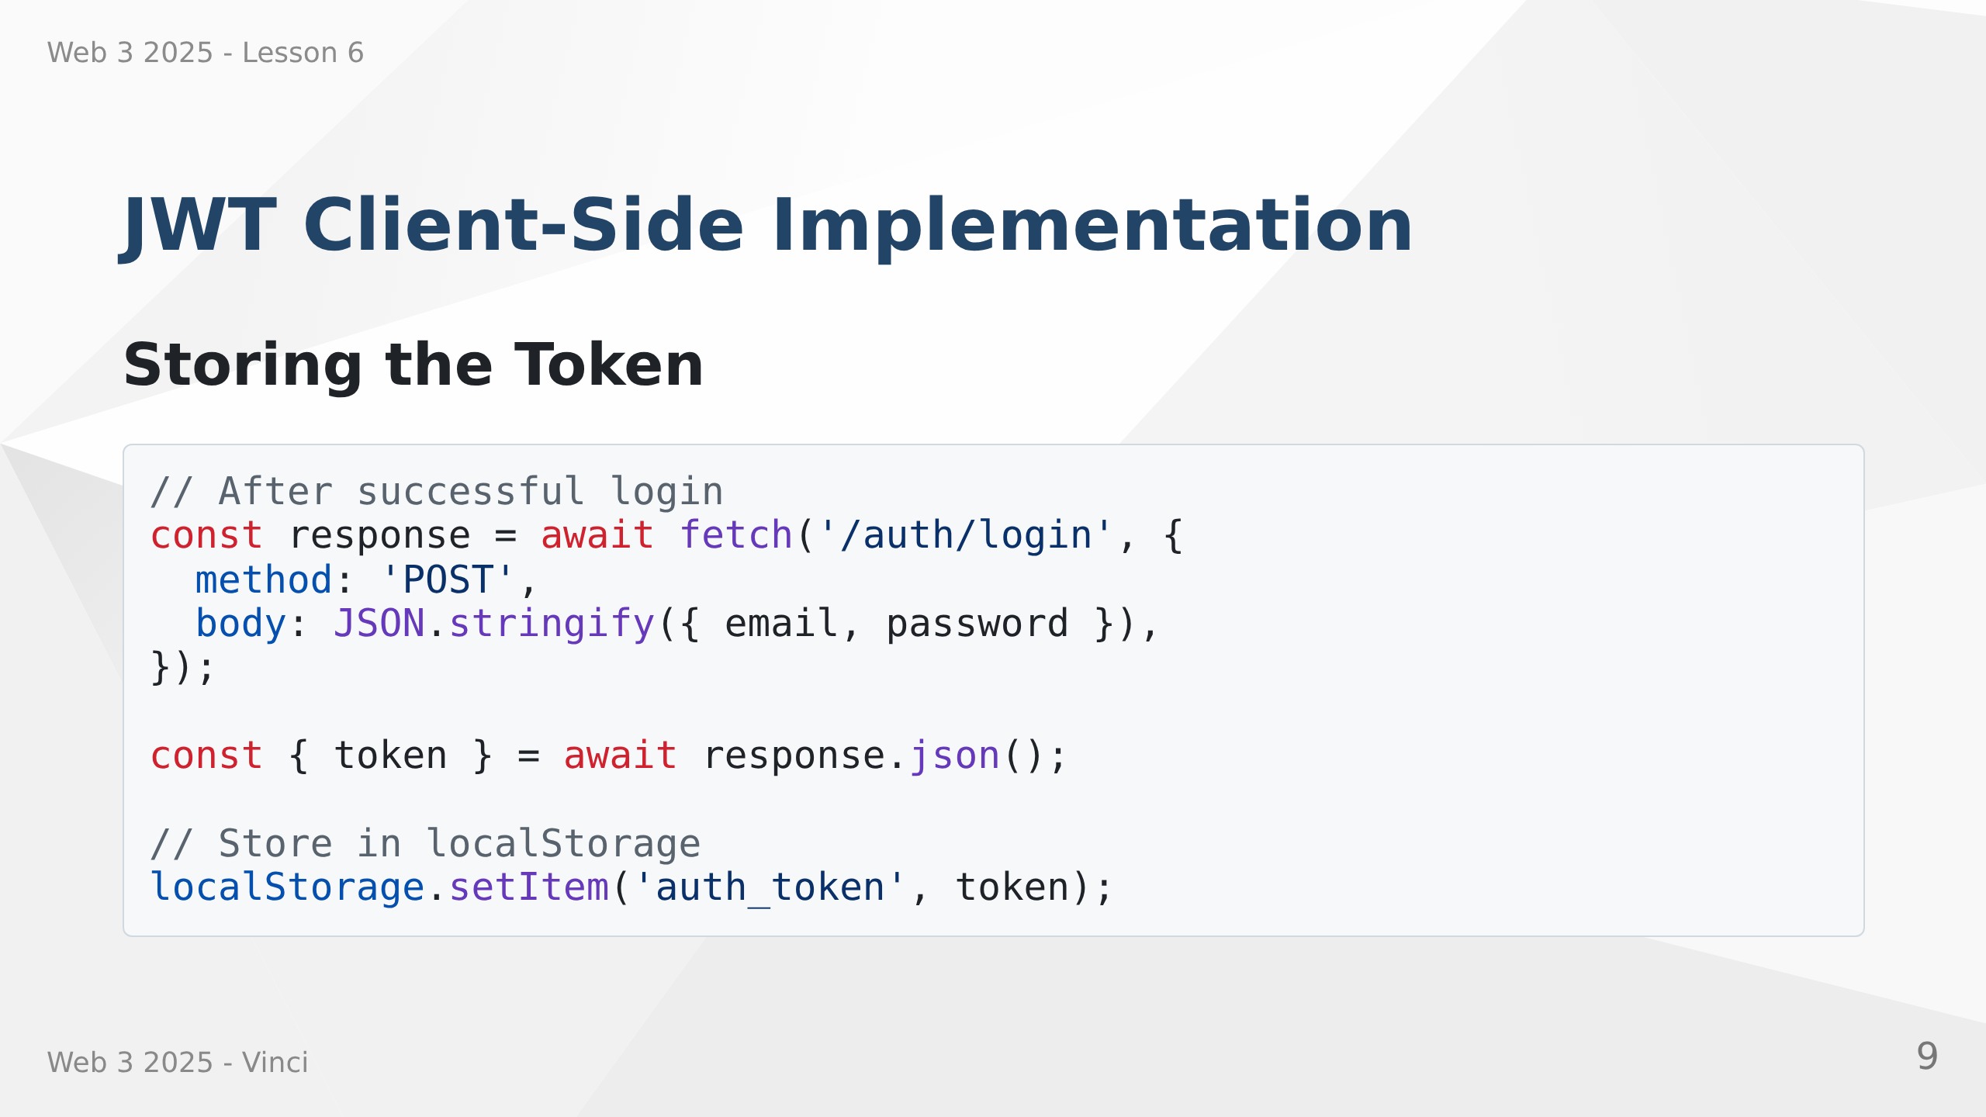

Slide 10
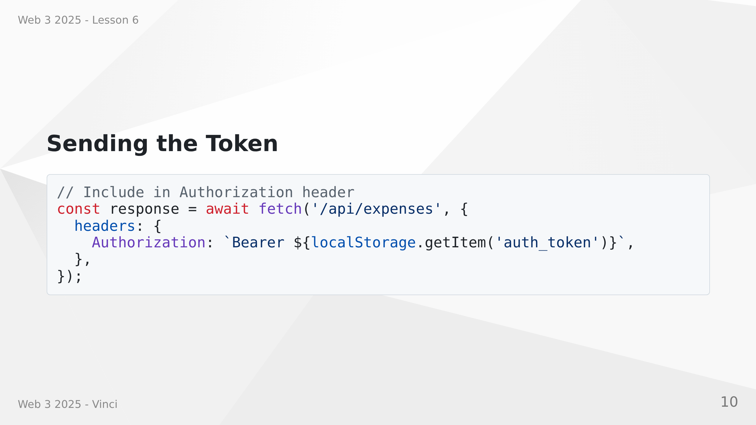
Notes:
Speaker Notes:
• Client receives token after successful authentication
• Store in localStorage for persistence across page refreshes
• Send with every API request in Authorization header
• Bearer scheme is standard for JWT
• Alternative: httpOnly cookies (more secure but less flexible)

Slide 11
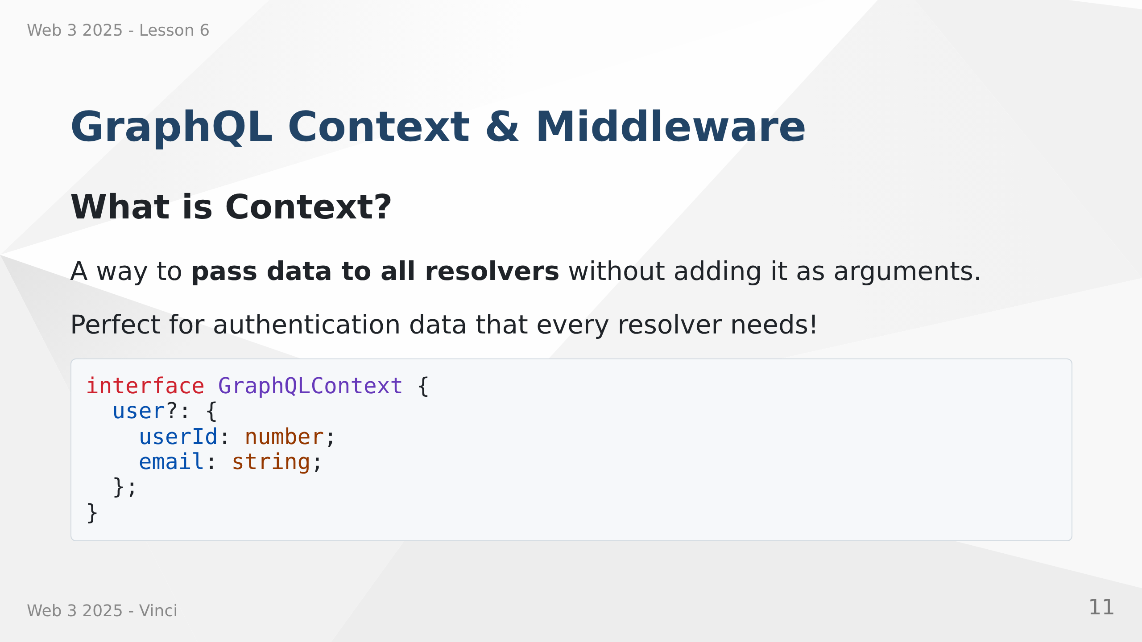
Notes:
Speaker Notes:
• Context available in every resolver
• Avoids repeating auth logic in each resolver
• Set up once in middleware
• TypeScript interface ensures type safety
• Optional user - might not be authenticated

Slide 12
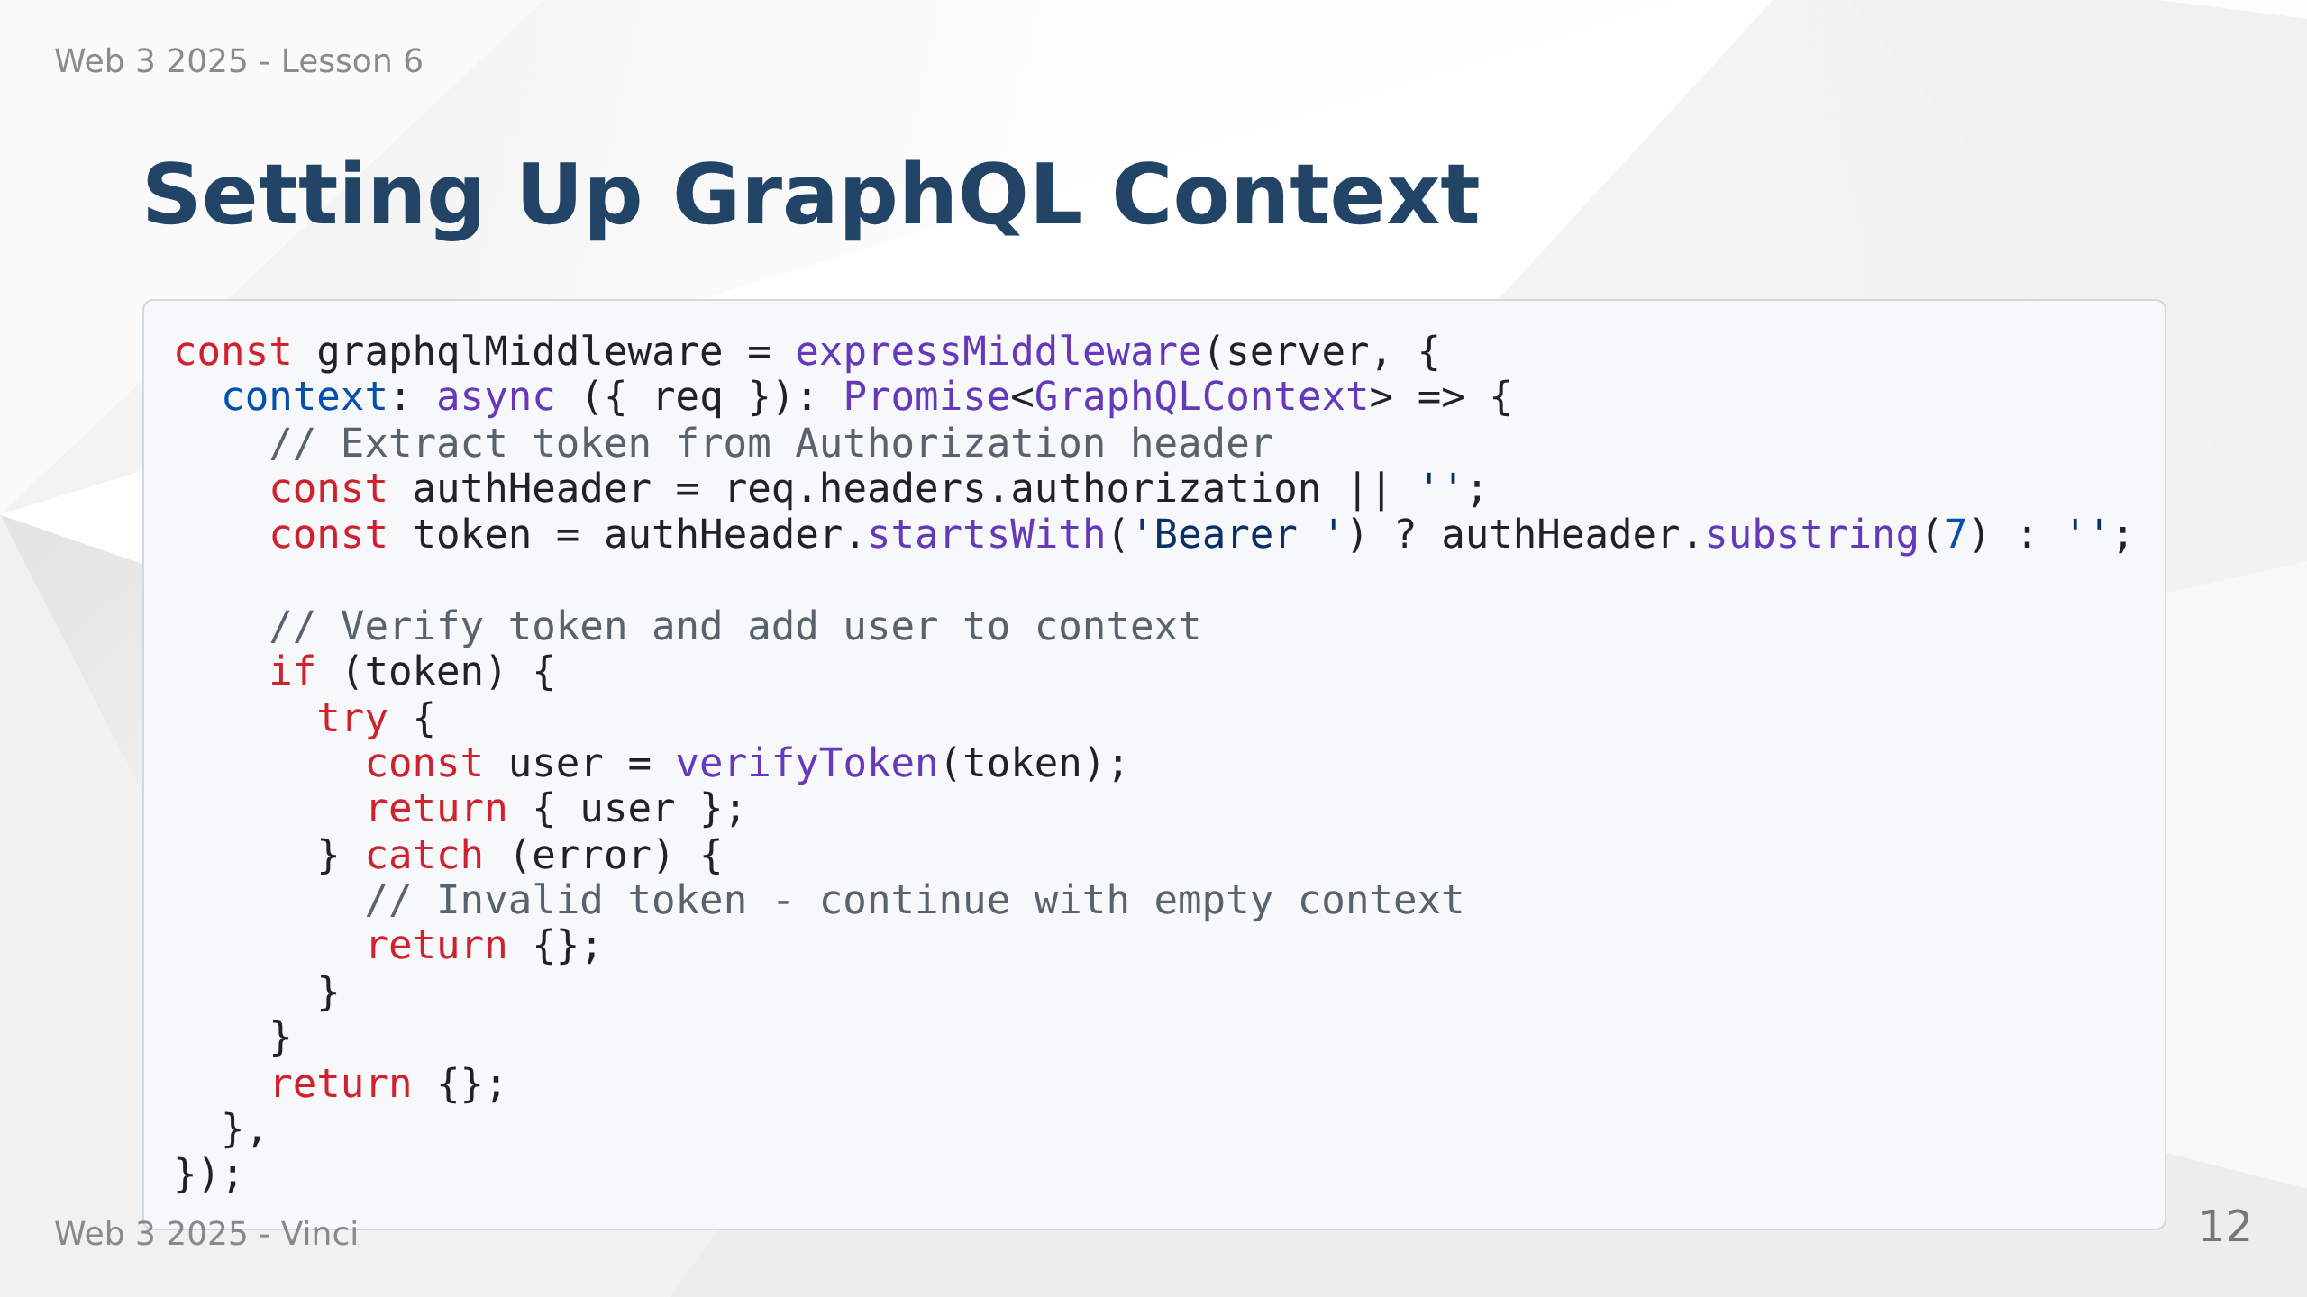
Notes:
Speaker Notes:
• Runs _before_ every GraphQL request
• Extracts JWT from Authorization header
• Verifies token and decodes payload
• Adds user to context if valid token
• Returns empty context if no token or invalid
• All resolvers receive this context as parameter

Slide 13
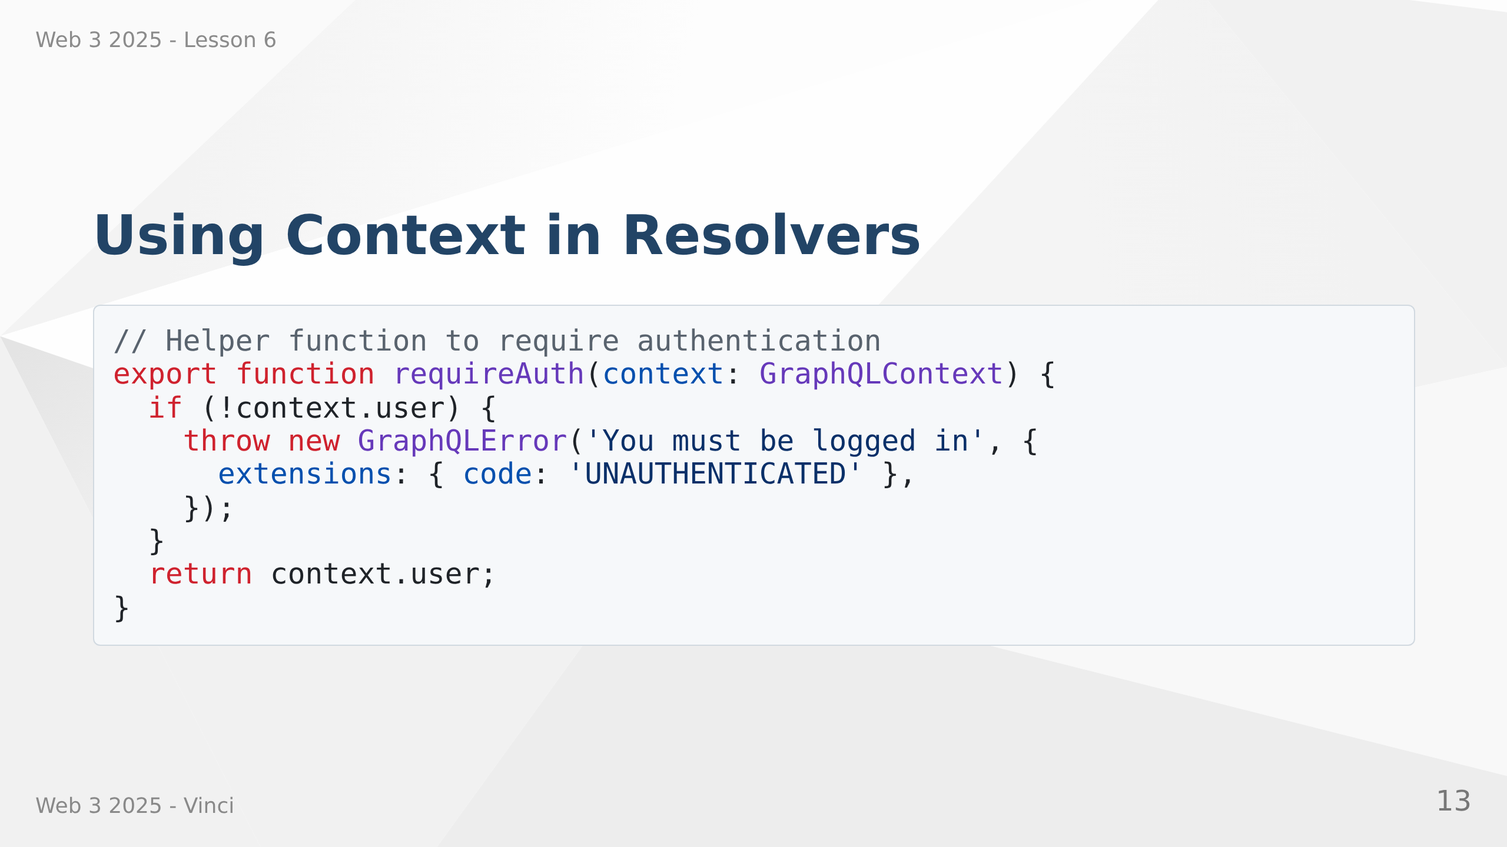
Notes:
Speaker Notes:
• requireAuth checks if user exists in context
• Throws UNAUTHENTICATED if not logged in
• Throws FORBIDDEN if logged in but not authorized
• Separation of authentication (who are you) and authorization (what can you do)
• Context makes this pattern clean and reusable

Slide 14


Slide 15
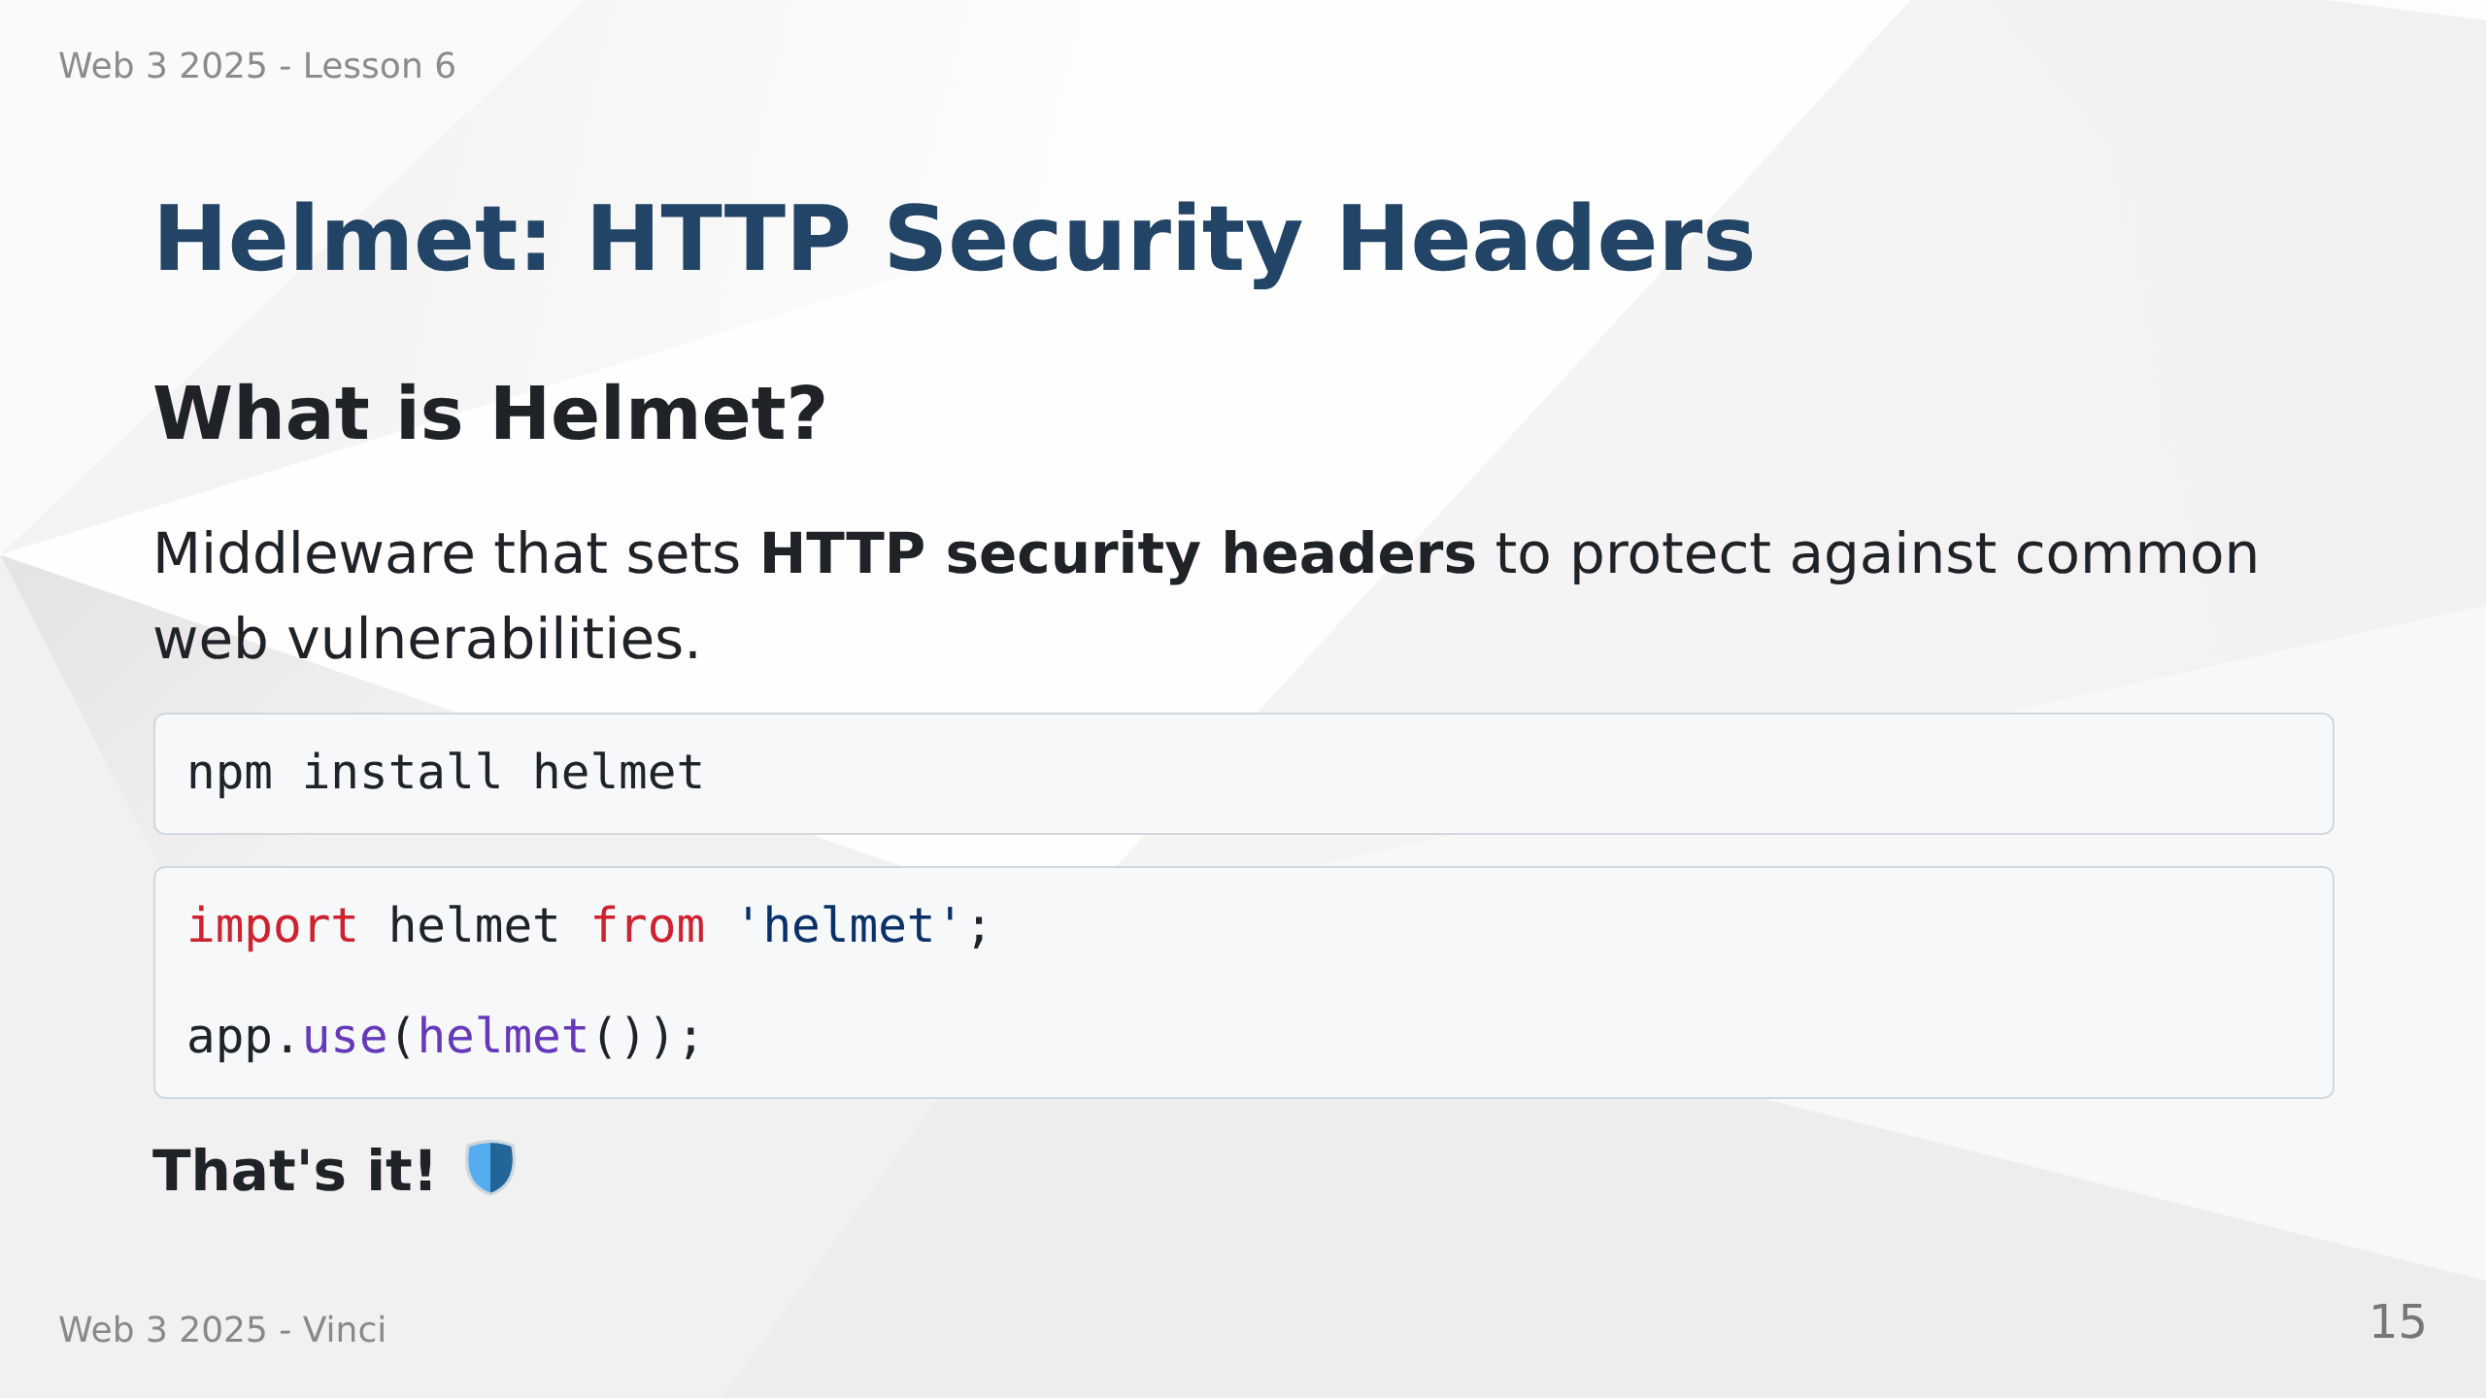
Notes:
Speaker Notes:
• Helmet is Express middleware
• Sets multiple security-related HTTP headers
• Protects against common attacks
• One line of code for significant security improvement
• Industry standard for Express apps
• Let's look at what it actually does

Slide 16
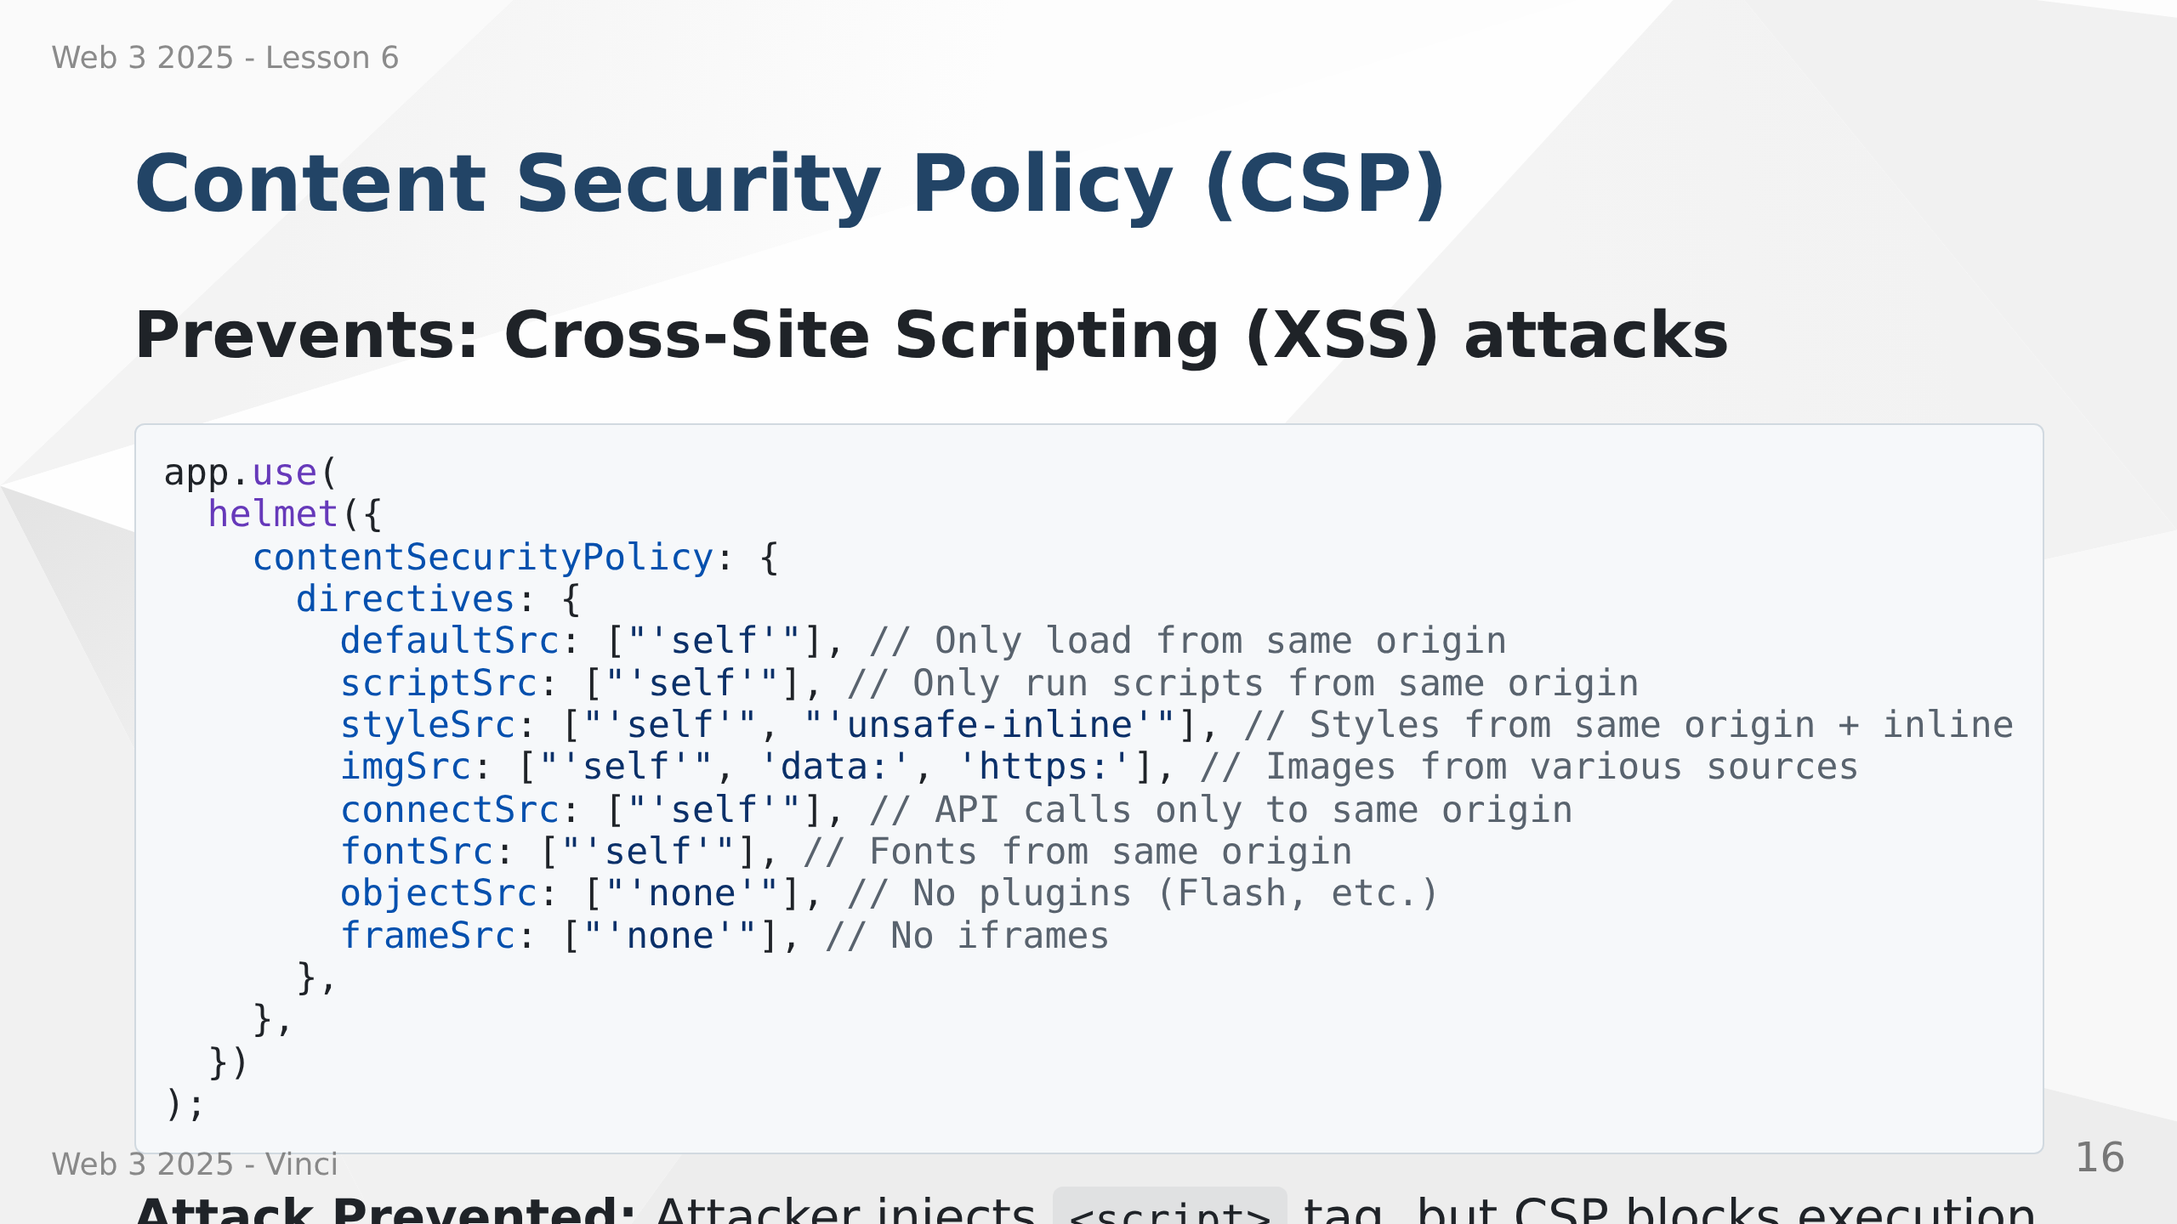
Notes:
Speaker Notes:
• CSP defines trusted sources for different content types
• Browser enforces these policies
• defaultSrc is fallback for unspecified directives
• scriptSrc prevents malicious script injection
• unsafe-inline needed for some frameworks but risky
• connectSrc controls where fetch/XMLHttpRequest can connect
• Significantly reduces XSS attack surface

Slide 17
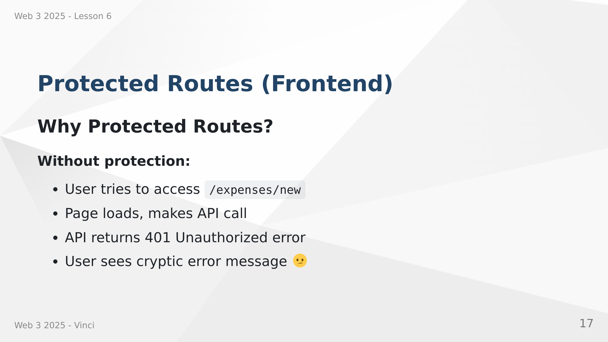

Slide 18
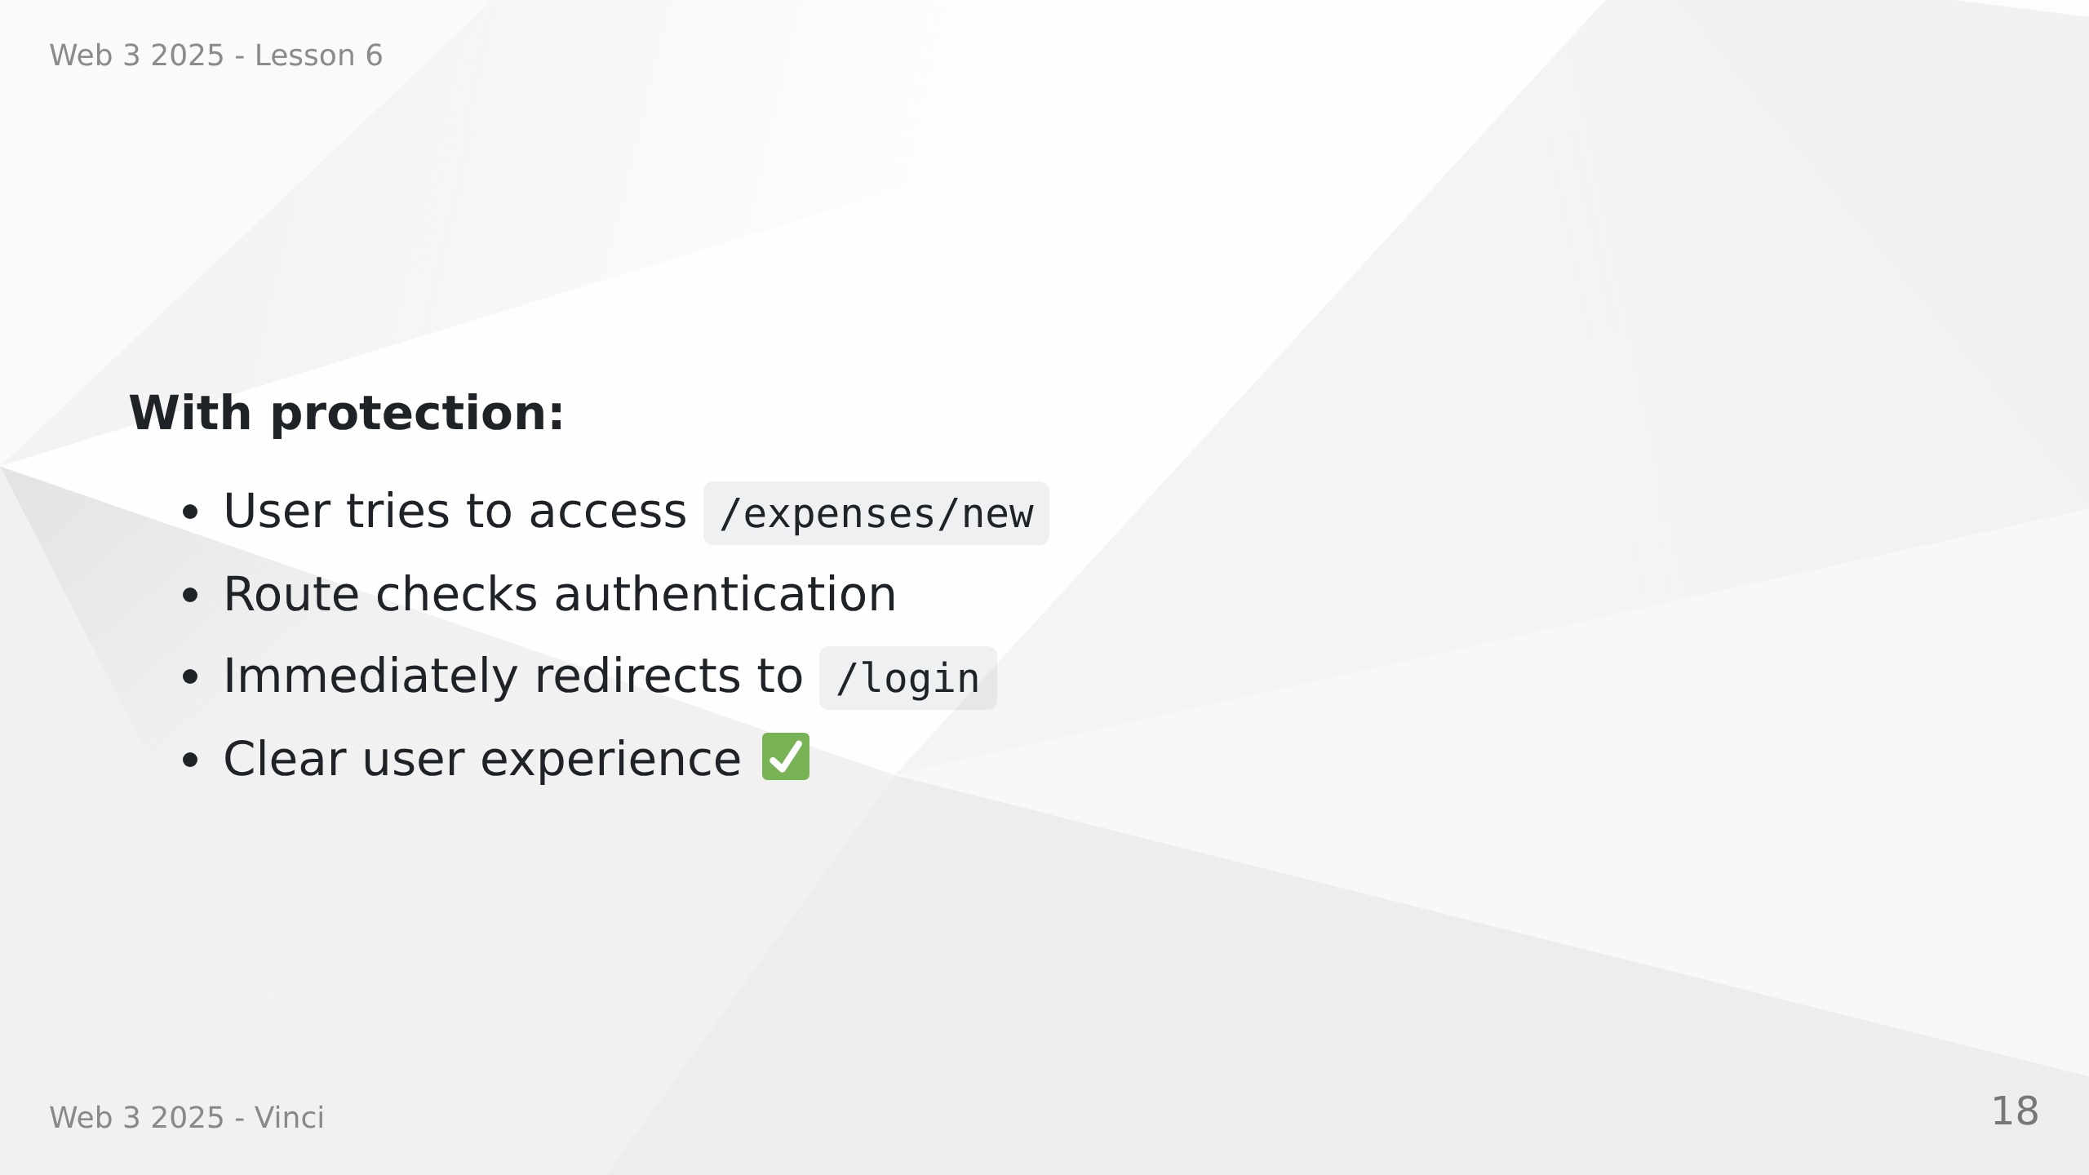
Notes:
Speaker Notes:
• Frontend protection is UX, not security
• Real security happens on backend
• Protected routes improve user experience
• Redirect before loading page components
• Prevents loading data for unauthenticated users
• Clearer flow for users

Slide 19
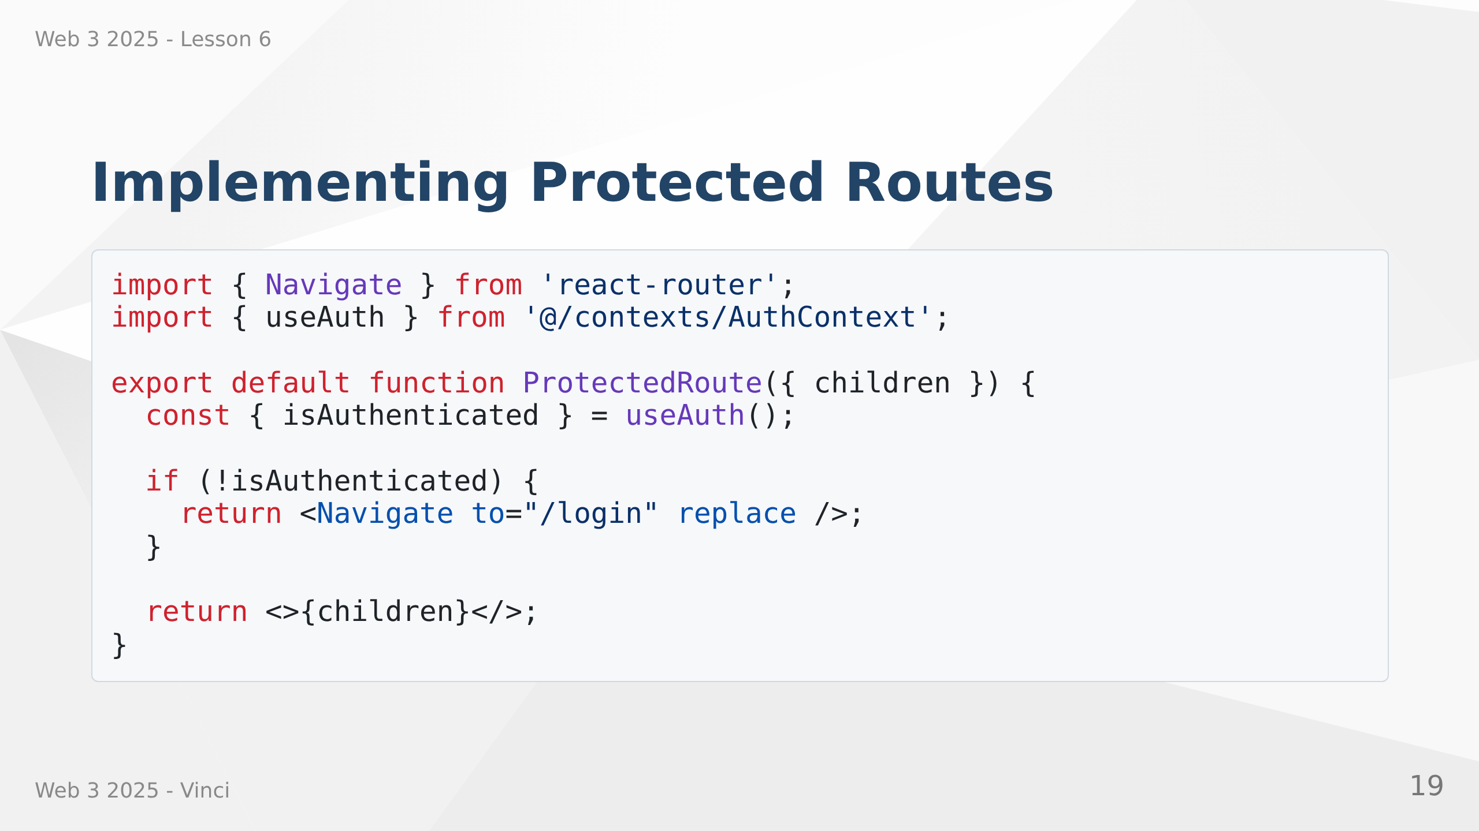

Slide 20
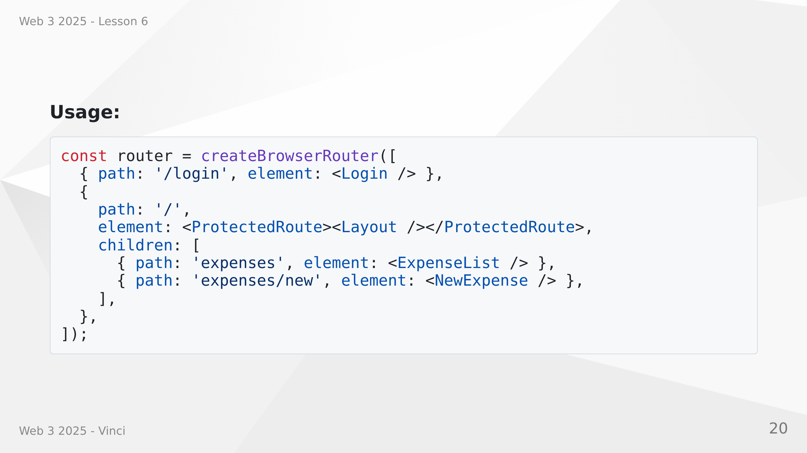
Notes:
Speaker Notes:
• Simple component that checks authentication
• Wraps protected pages/layouts
• Navigate with replace prevents back button issues
• All nested routes inherit protection
• Clean, declarative route structure
• useAuth hook accesses authentication context

Slide 21
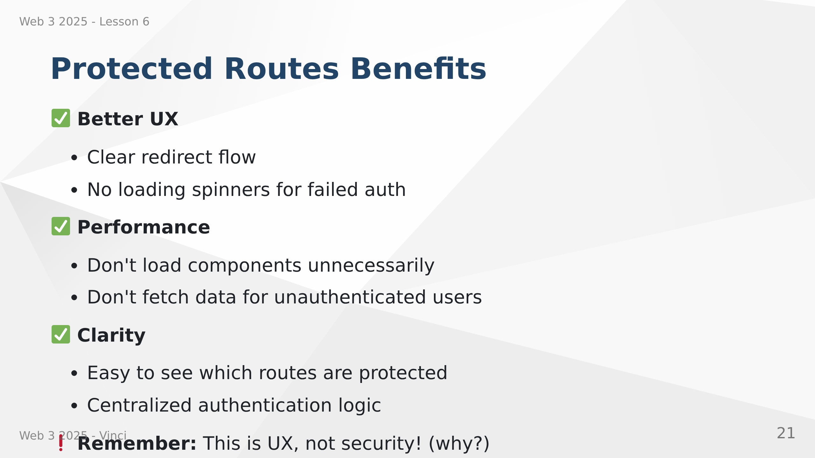
Notes:
Speaker Notes:
• Frontend protection about user experience
• Backend protection about actual security
• Can't rely on client-side checks alone
• Attackers can bypass frontend entirely
• Always authenticate and authorize on backend
• Frontend routes just provide nice UX

Slide 22


Slide 23
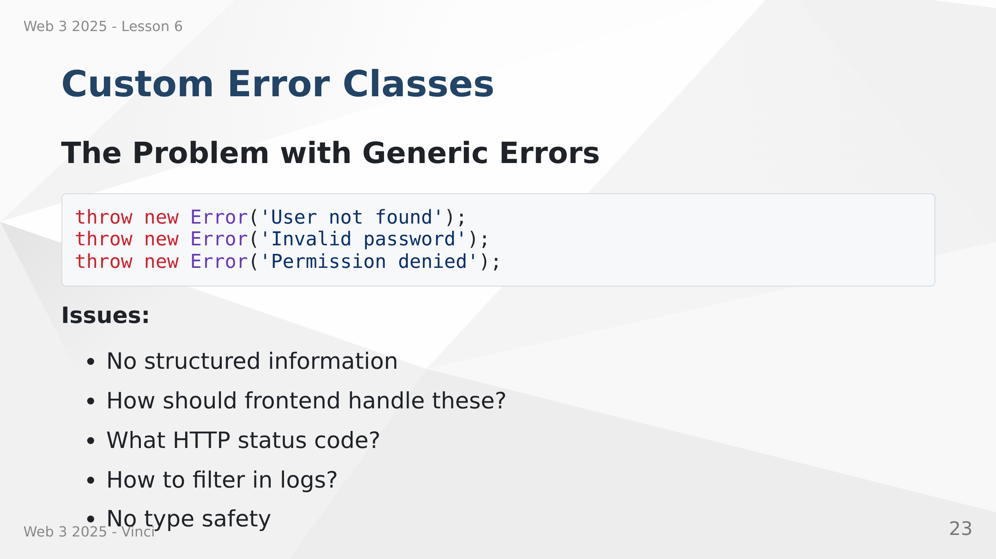
Notes:
Speaker Notes:
• Generic Error class lacks semantic meaning
• All errors look the same
• Hard to handle different errors differently
• No standard for status codes
• Difficult to log and monitor effectively

Slide 24
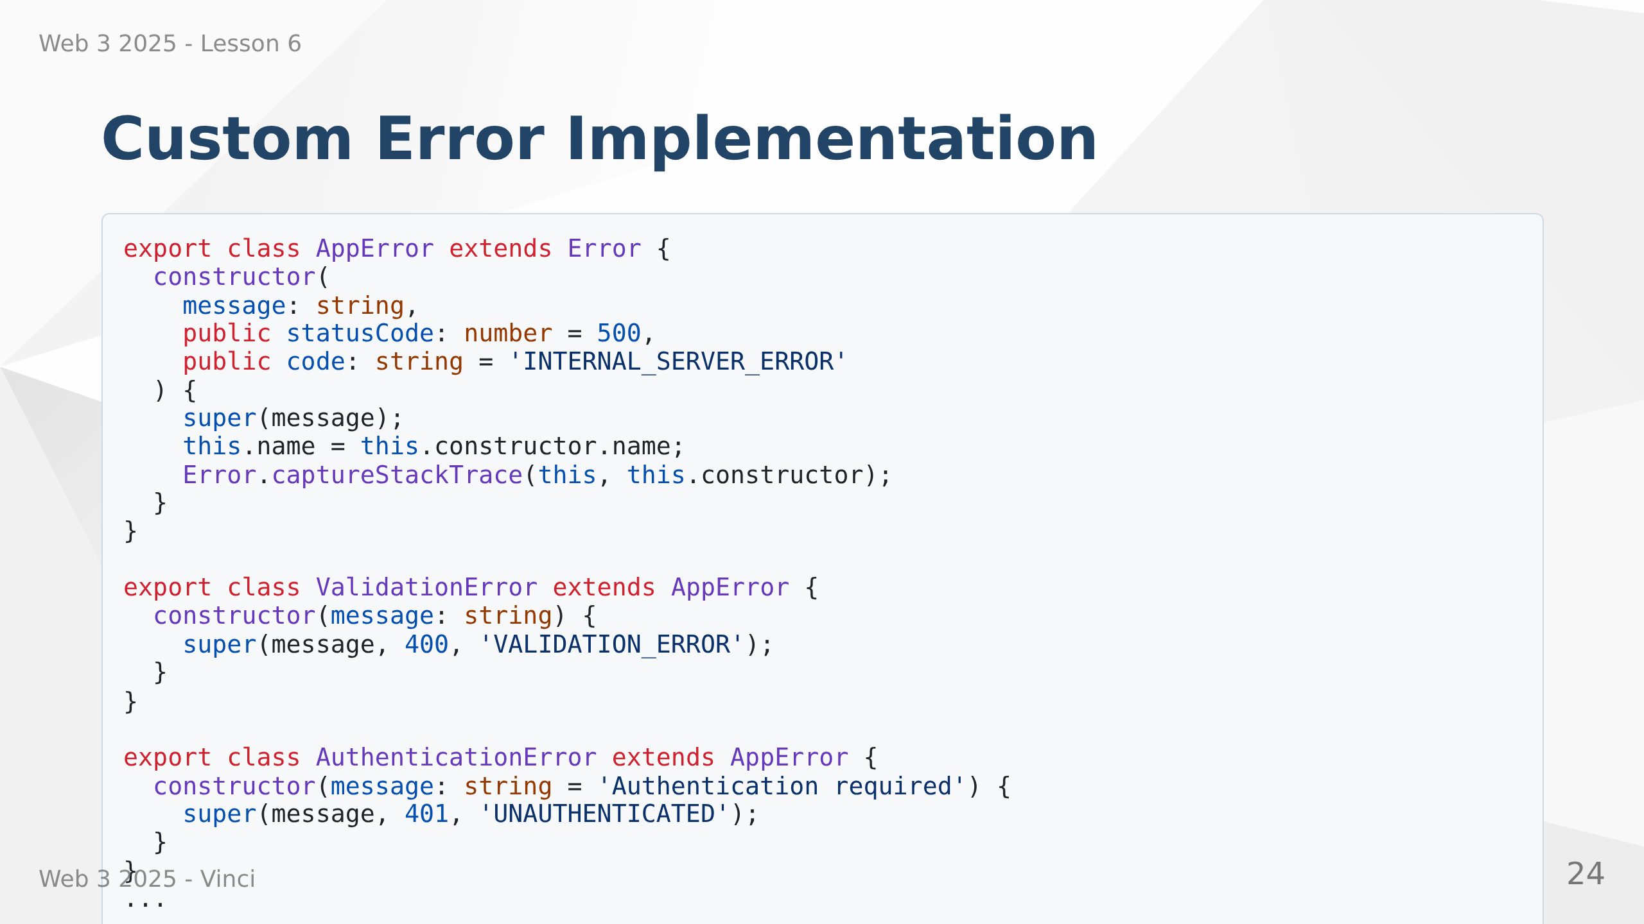
Notes:
Speaker Notes:
• Base AppError class with common properties
• Specific error classes for different scenarios
• Each error has appropriate HTTP status code
• Code property for programmatic error handling
• captureStackTrace preserves error origin
• Easy to add new error types
• TypeScript provides type safety

Slide 25
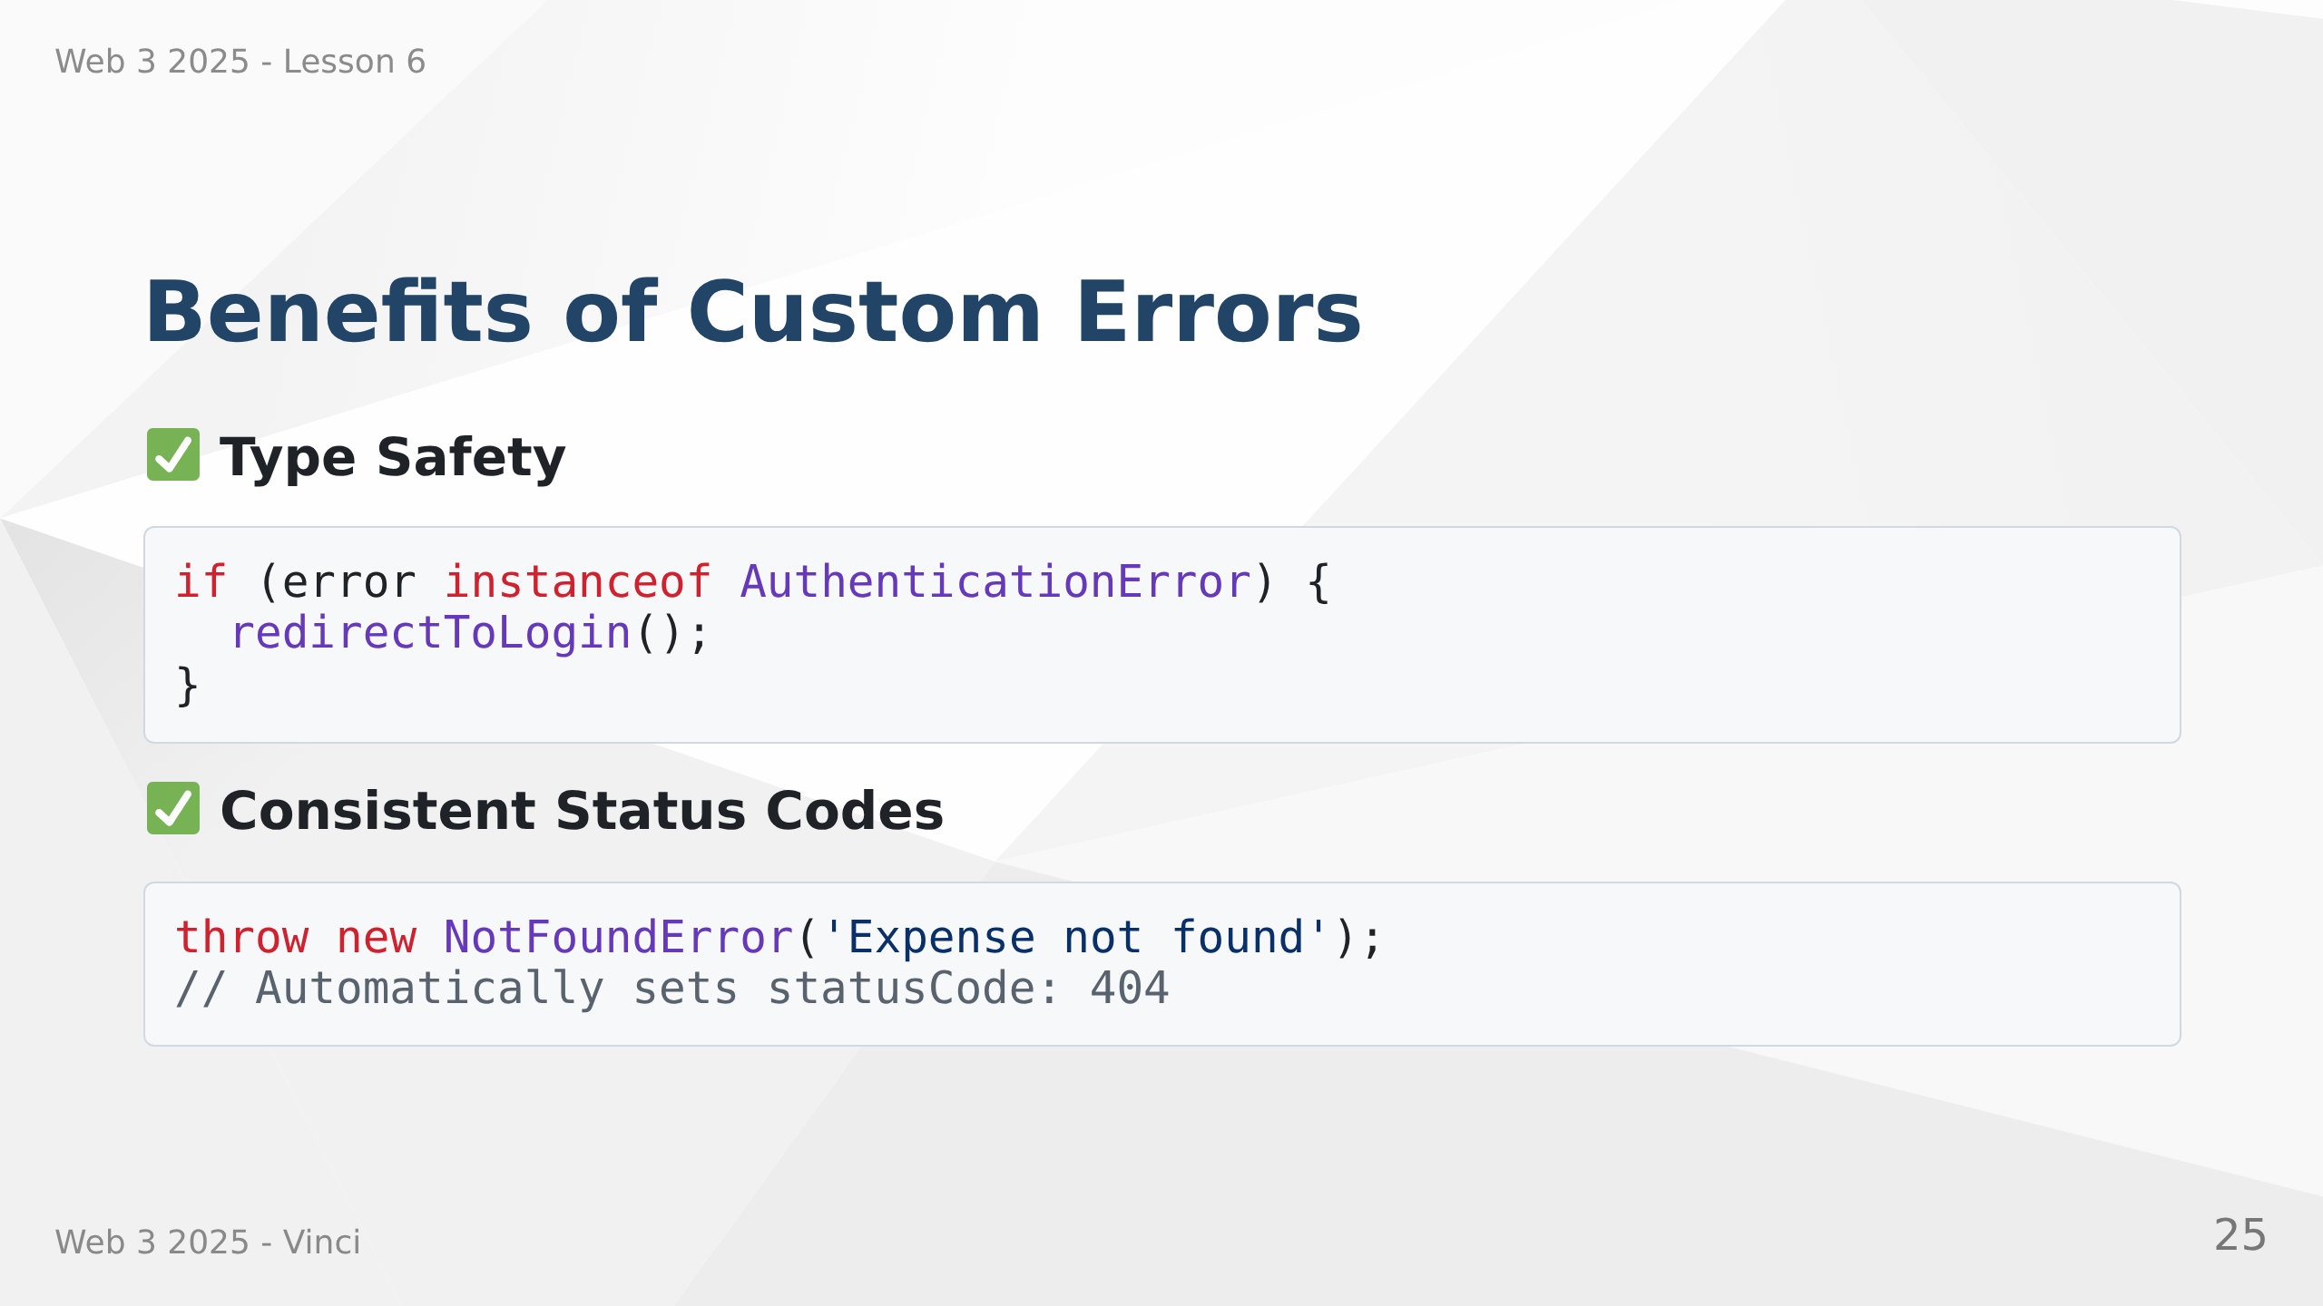

Slide 26
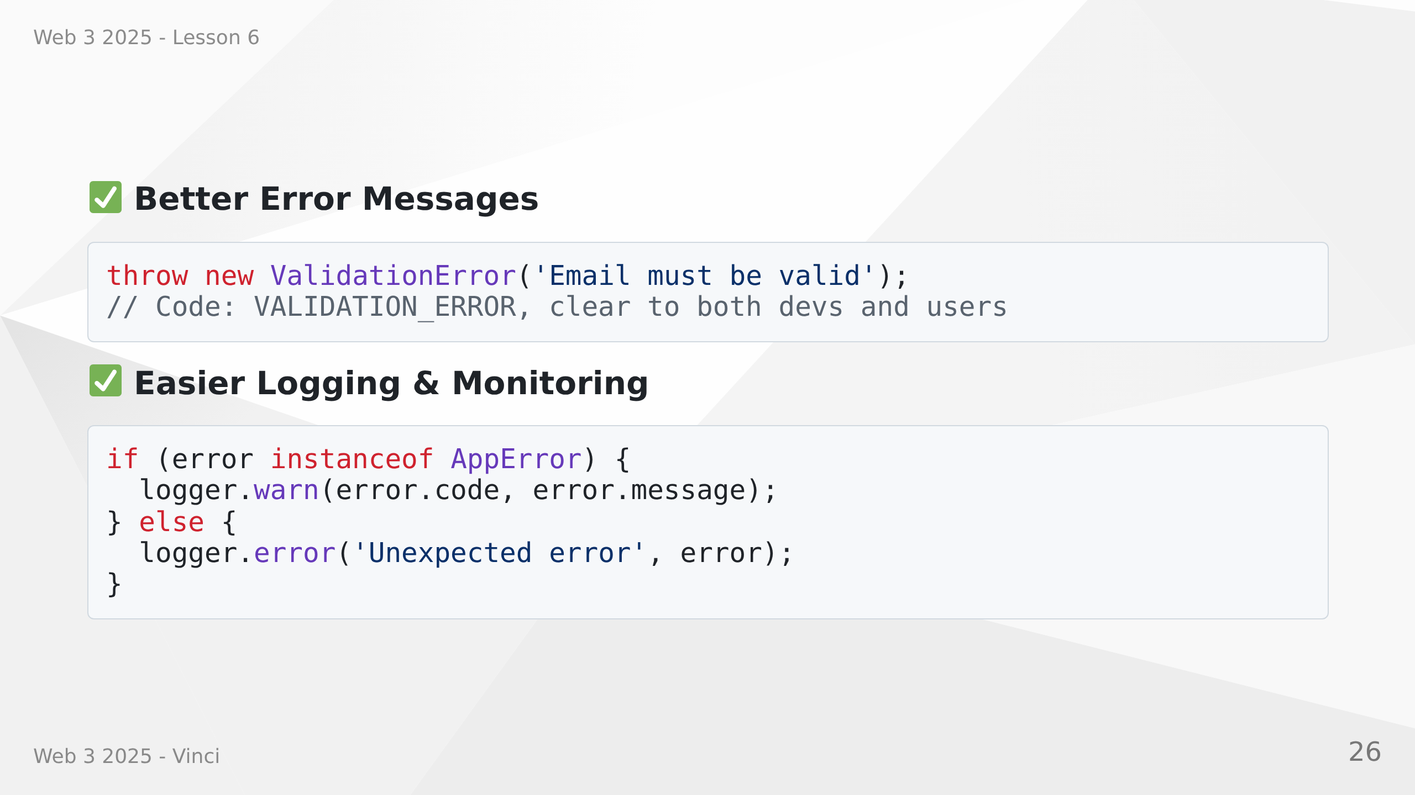
Notes:
Speaker Notes:
• Type checking enables smart error handling
• No manual status code management
• Clear error categories
• Easy to filter and search logs
• Monitoring tools can group by error type
• Better debugging experience
• Consistent error handling across application

Slide 27
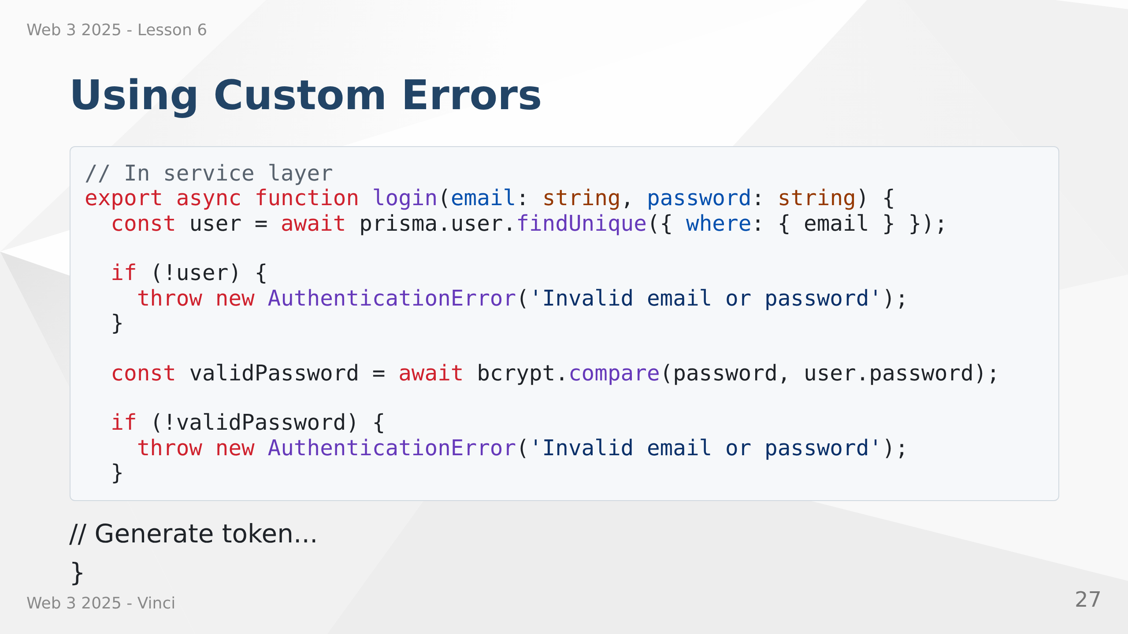

Slide 28
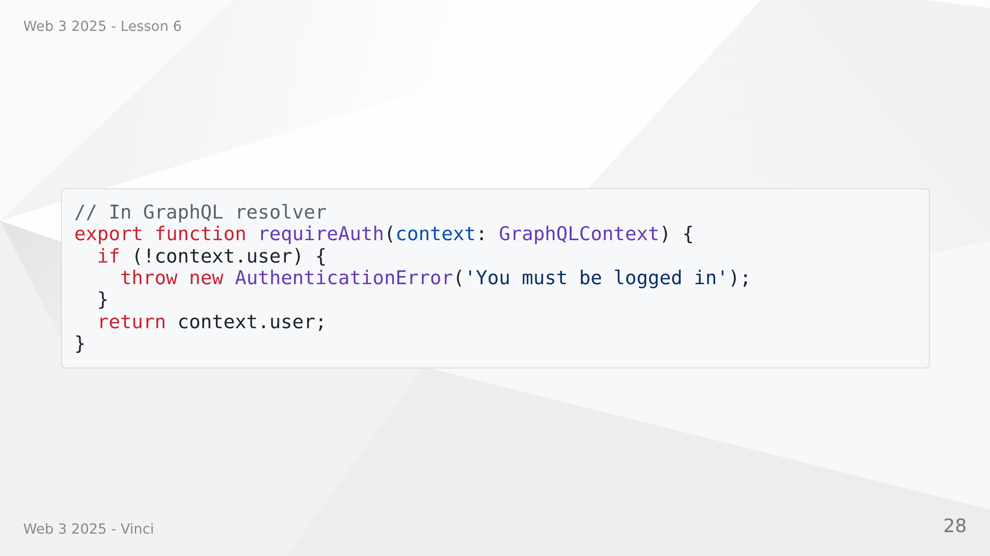
Notes:
Speaker Notes:
• Throw specific error types in business logic
• Clear intent from error class name
• Consistent error codes across application
• Frontend can distinguish error types
• Better logging and monitoring
• Easier to write error handling middleware

Slide 29
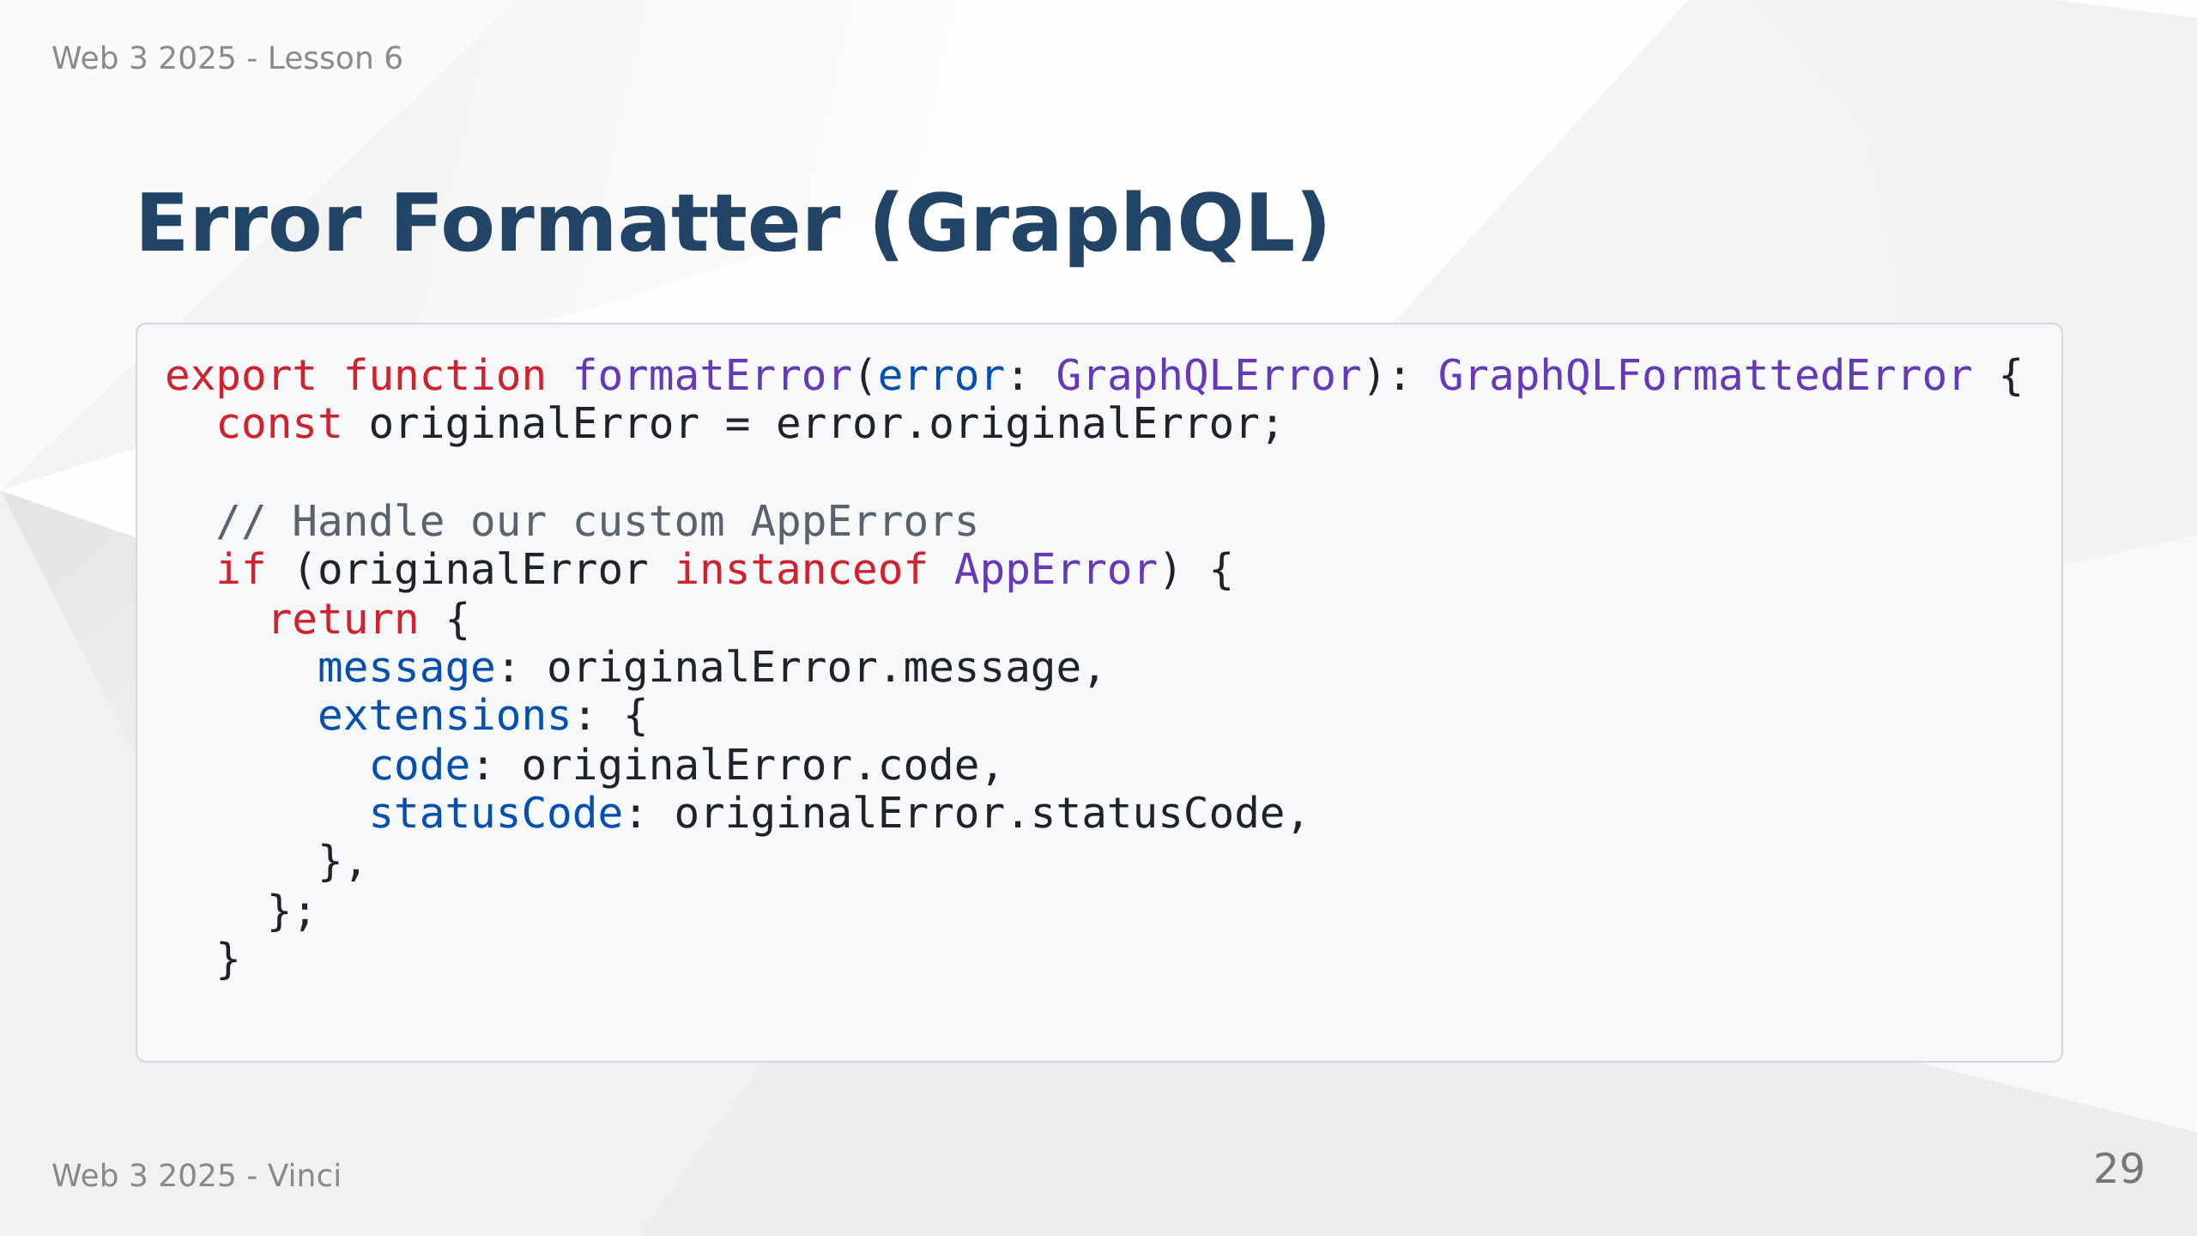

Slide 30
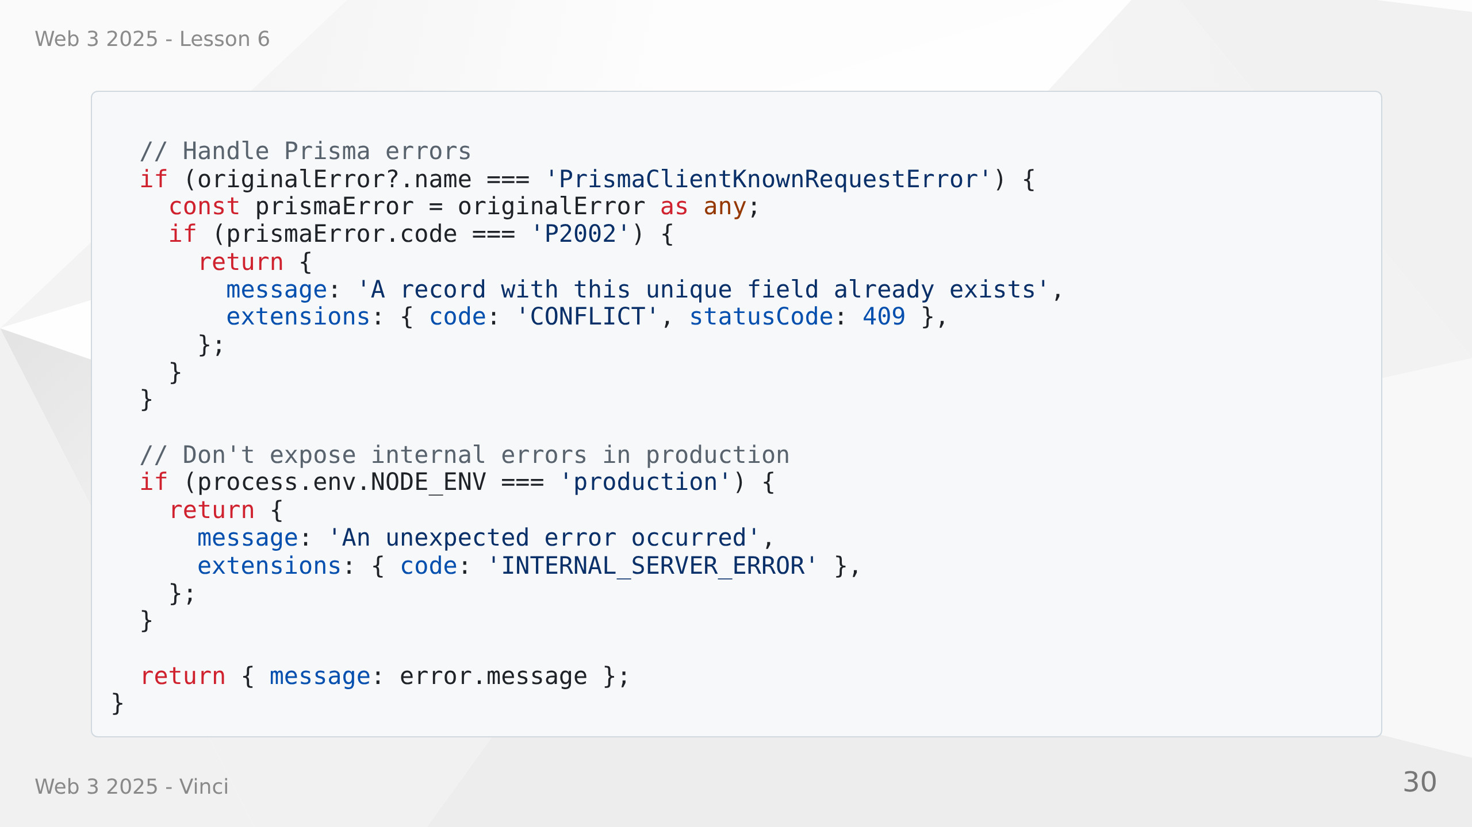
Notes:
Speaker Notes:
• Converts all errors to consistent format
• Extracts error codes and status codes
• Handles Prisma database errors
• Hides implementation details in production
• Provides useful error info in development
• Integrated with Apollo Server
• Single place to control error responses

Slide 31
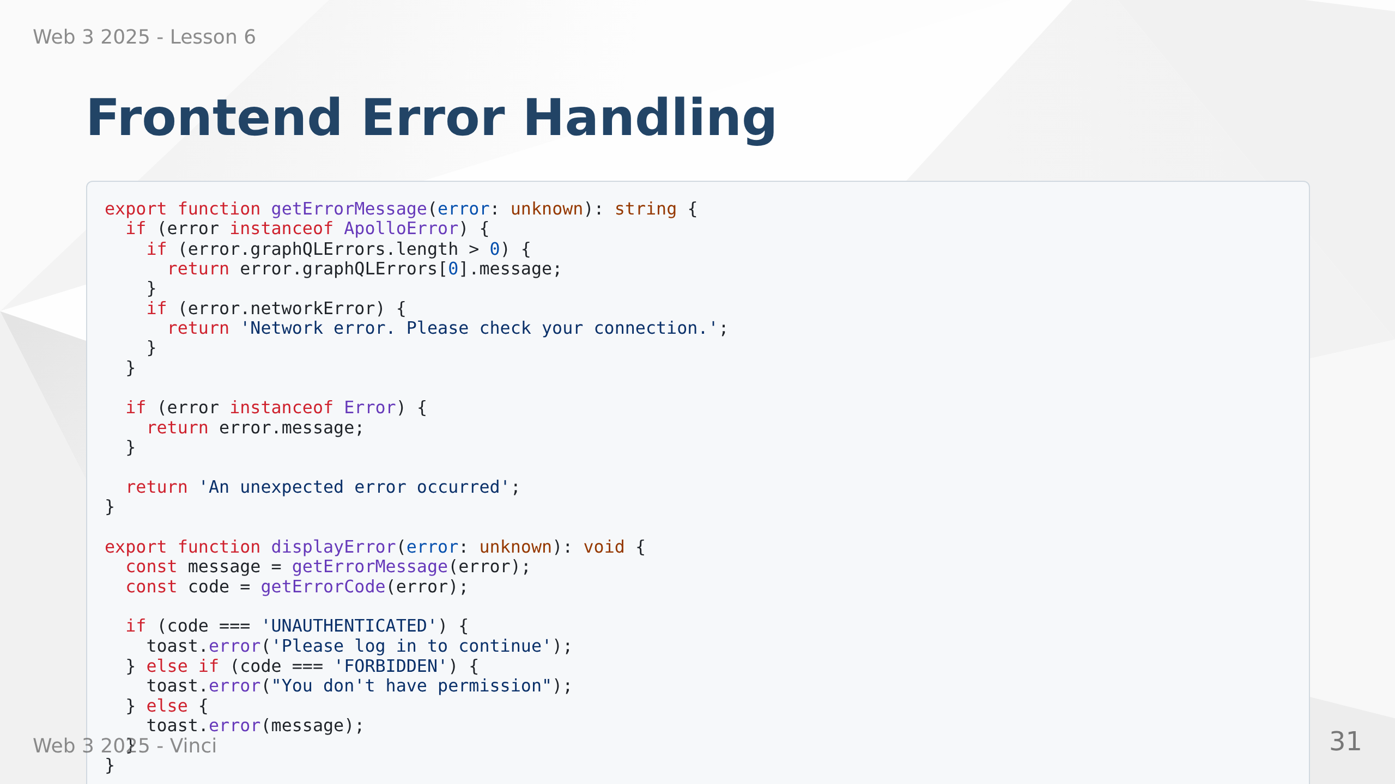
Notes:
Speaker Notes:
• Utility functions for consistent error handling
• Extracts user-friendly messages
• Special handling for different error codes
• Uses toast notifications for better UX
• Centralized error display logic
• Easy to customize error presentation
• Type-safe with unknown type

Slide 32
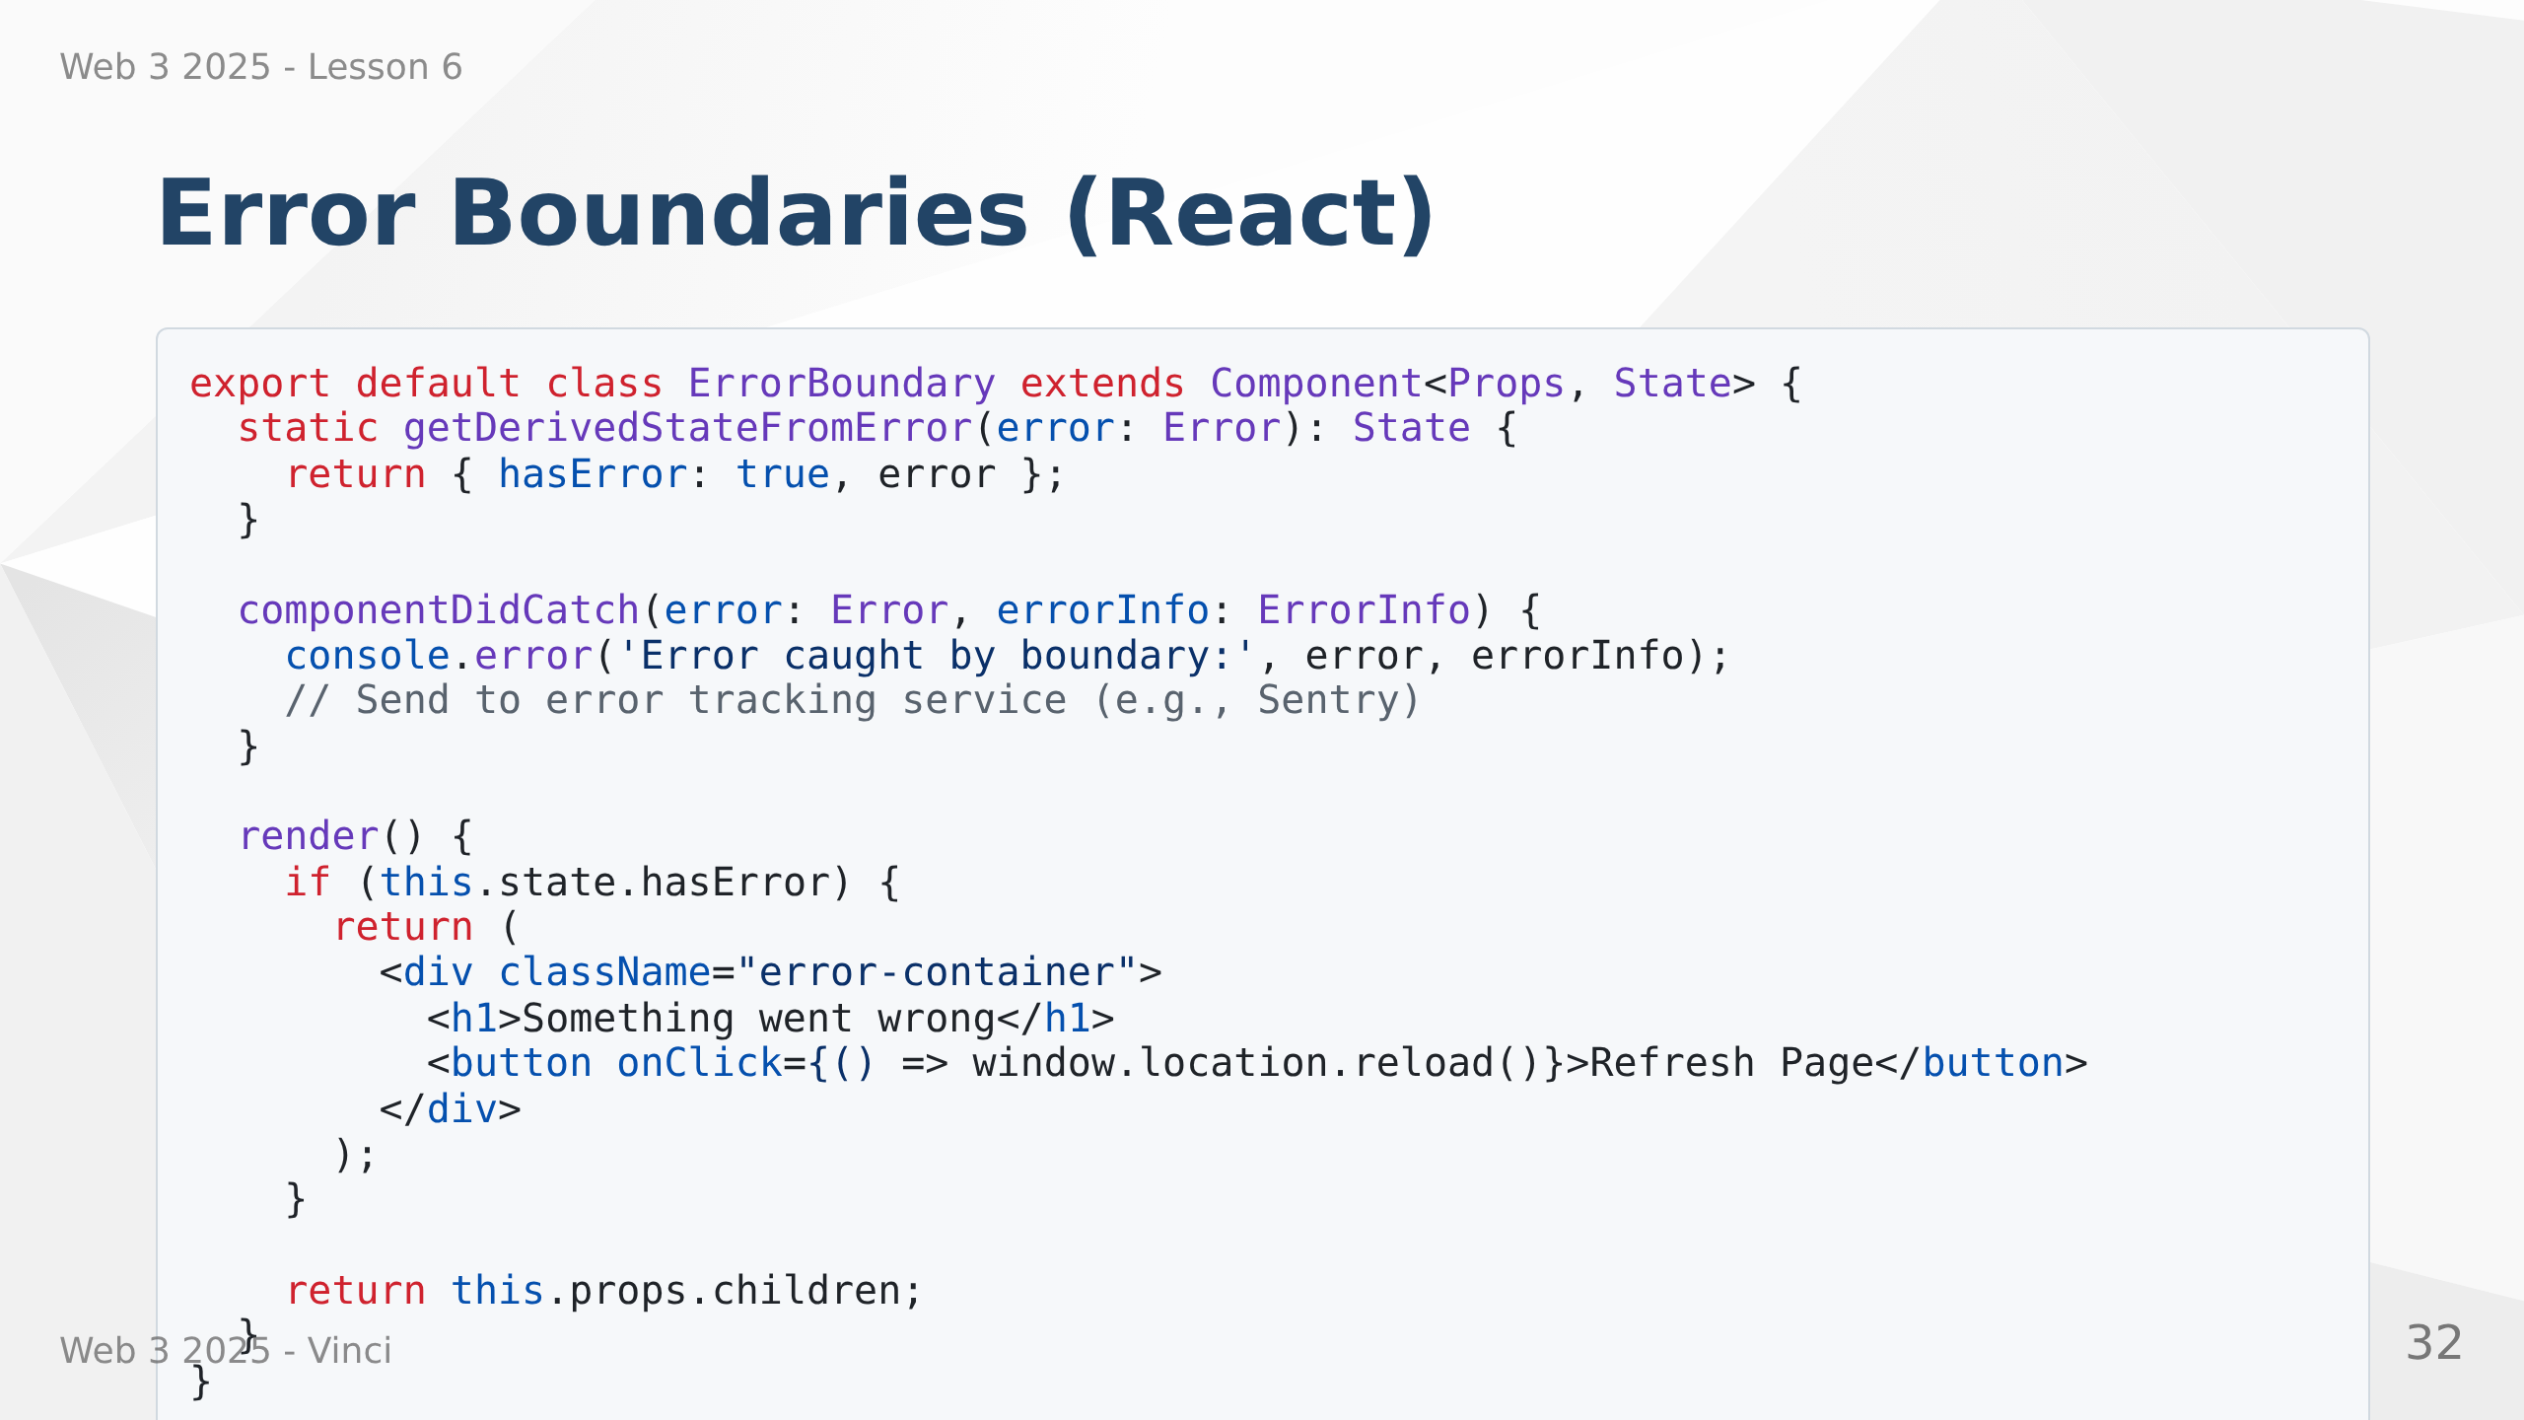
Notes:
Speaker Notes:
• Error boundaries catch React component errors
• Prevents entire app from crashing
• Shows fallback UI instead
• Can log errors to monitoring service
• Class component required - no hook alternative yet
• Place at strategic points in component tree
• User can recover without losing all work

Slide 33


Slide 34
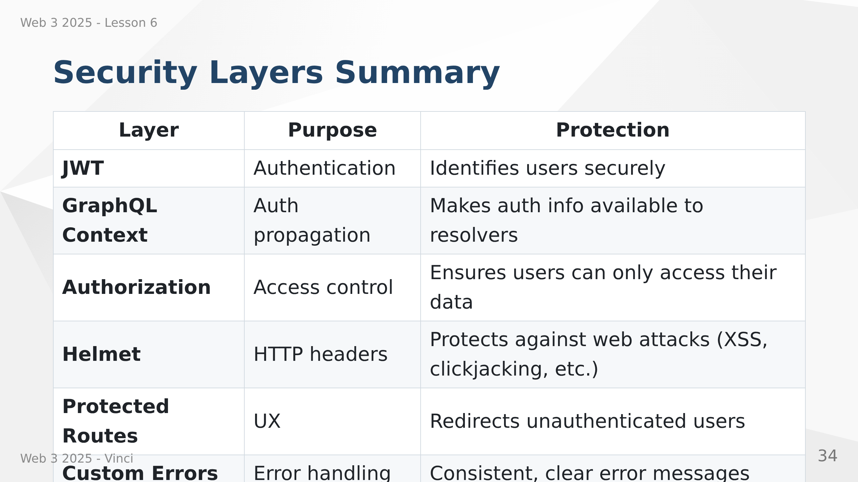
Notes:
Speaker Notes:
• Each layer addresses different security concerns
• If one layer fails, others provide backup
• Defense in depth is security best practice
• Never rely on single security measure
• Frontend and backend security work together
• Comprehensive security requires all layers

Slide 35
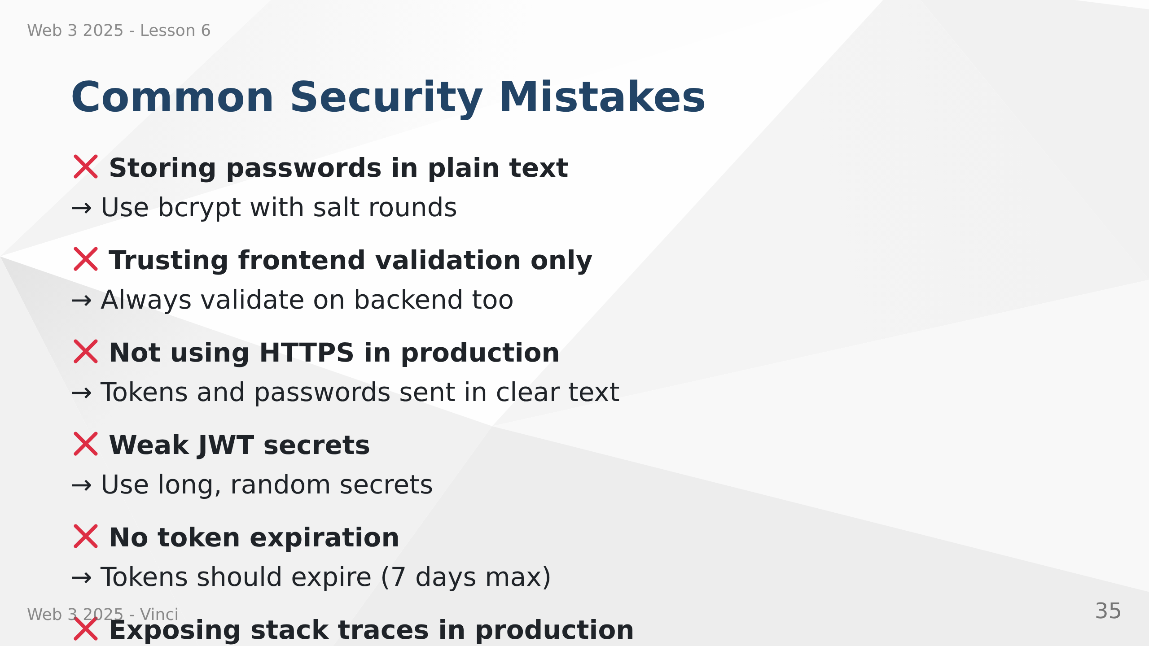
Notes:
Speaker Notes:
• These are common mistakes we must avoid
• Frontend validation is UX, not security
• HTTPS absolutely required for production
• Weak secrets can be brute forced
• Long-lived tokens increase risk if compromised
• Stack traces reveal implementation details
• Always assume attackers have technical knowledge

Slide 36
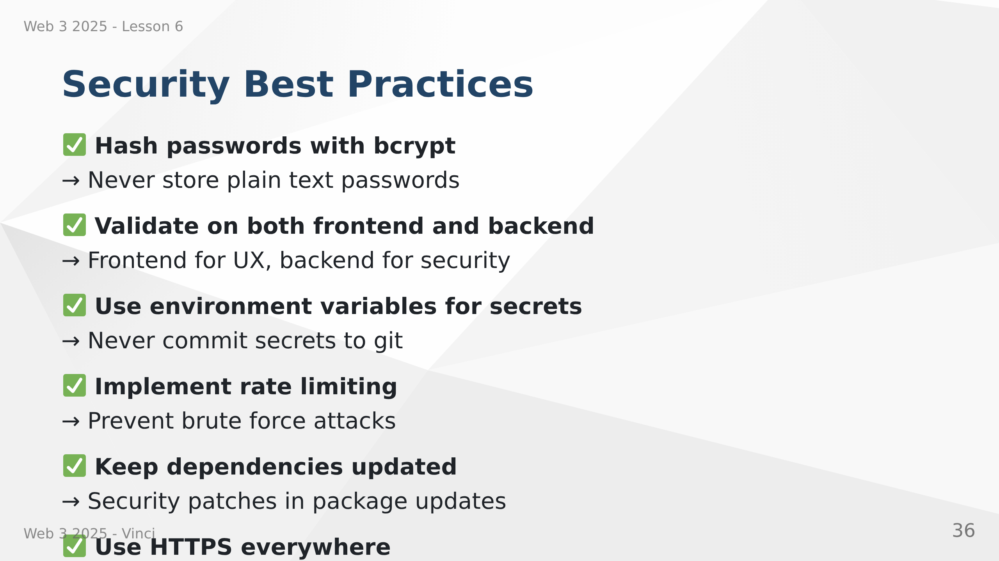
Notes:
Speaker Notes:
• bcrypt automatically handles salt and hashing
• Backend validation is security boundary
• .env files keep secrets out of code
• Rate limiting prevents automated attacks
• npm audit finds known vulnerabilities
• HTTPS isn't just for production anymore
• Logging helps detect and respond to attacks

Slide 37
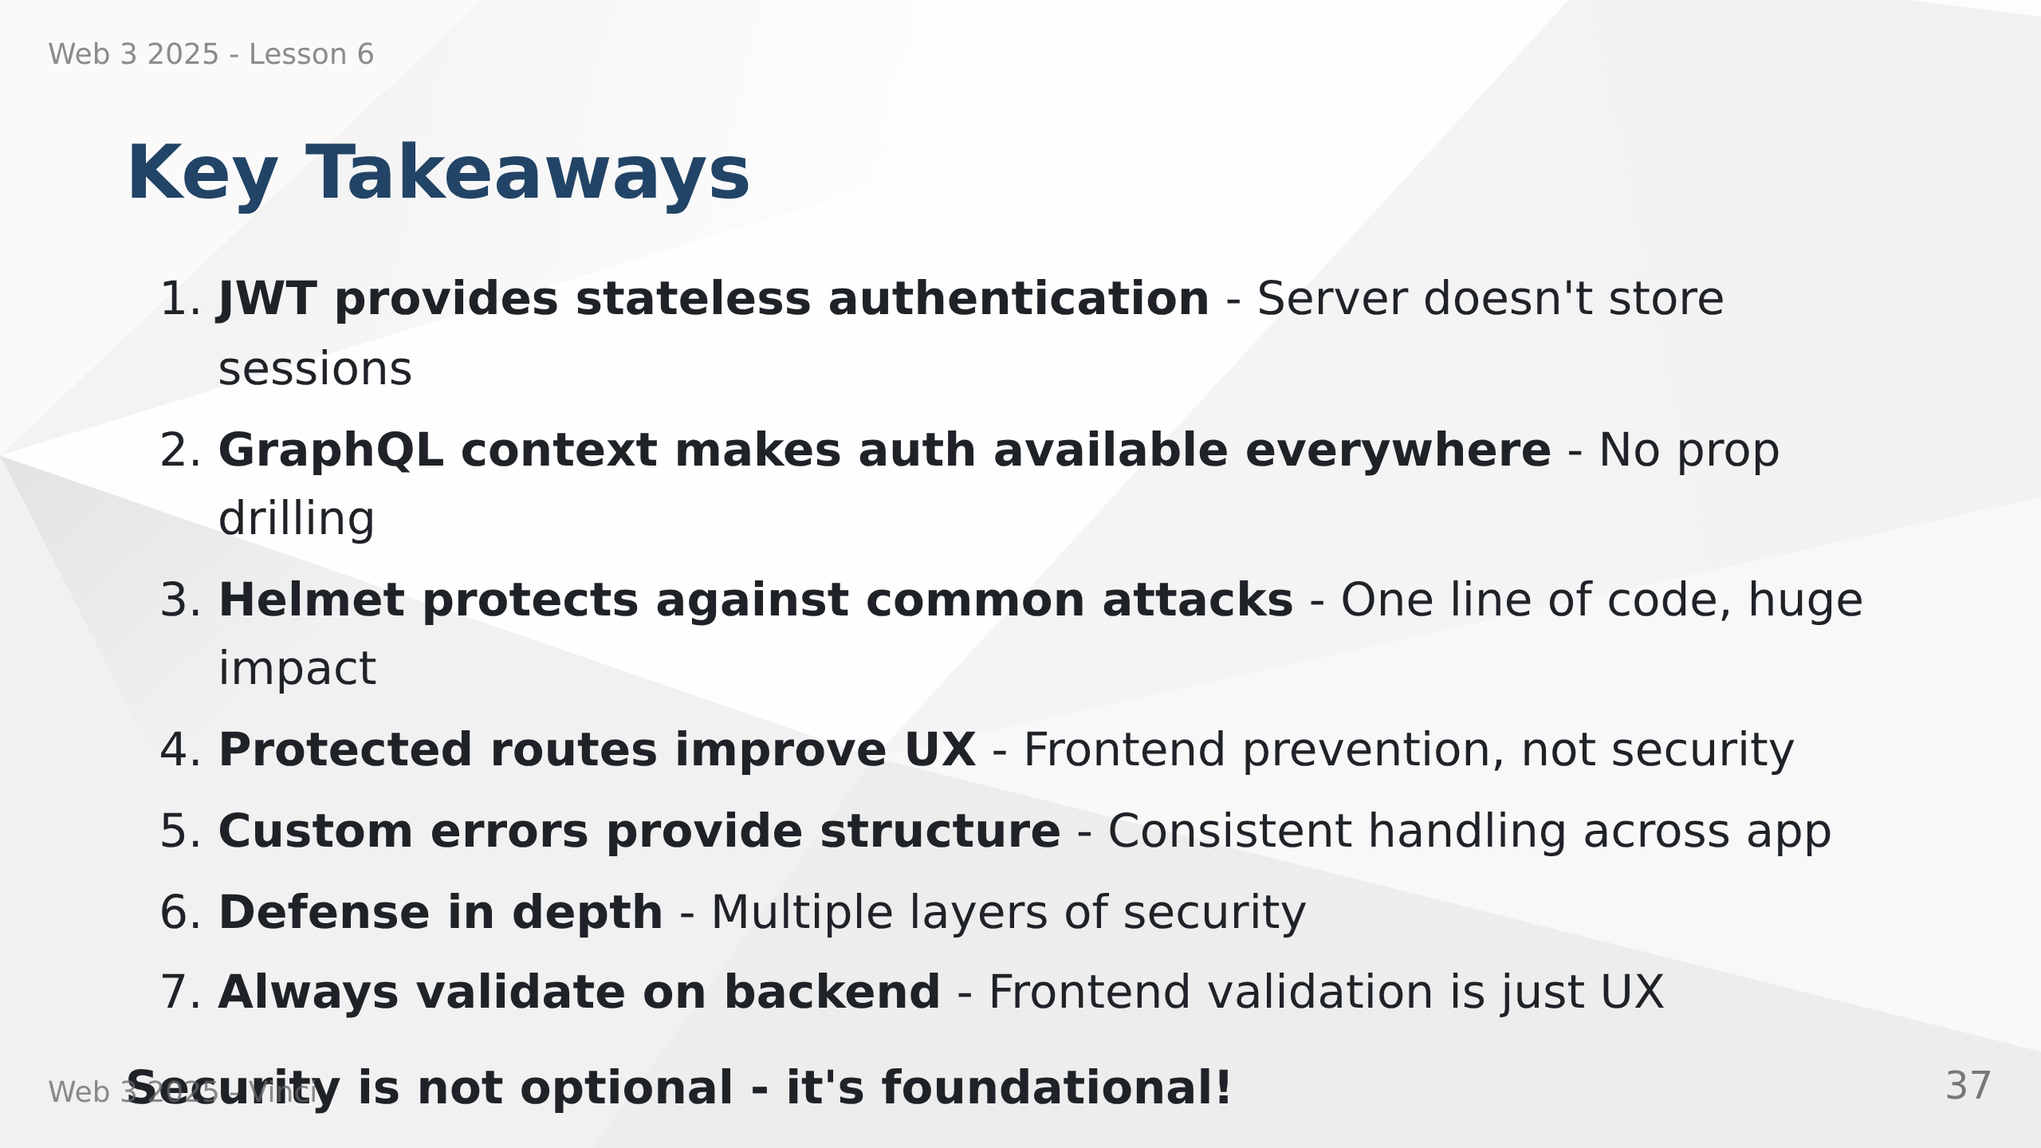
Notes:
Speaker Notes:
• These concepts work together to create secure application
• Each piece addresses specific security concern
• Don't skip security - add it from the start
• Harder to add security later than build it in
• These patterns are industry standard
• Understanding security makes you better developer

Slide 38


