Slide 1
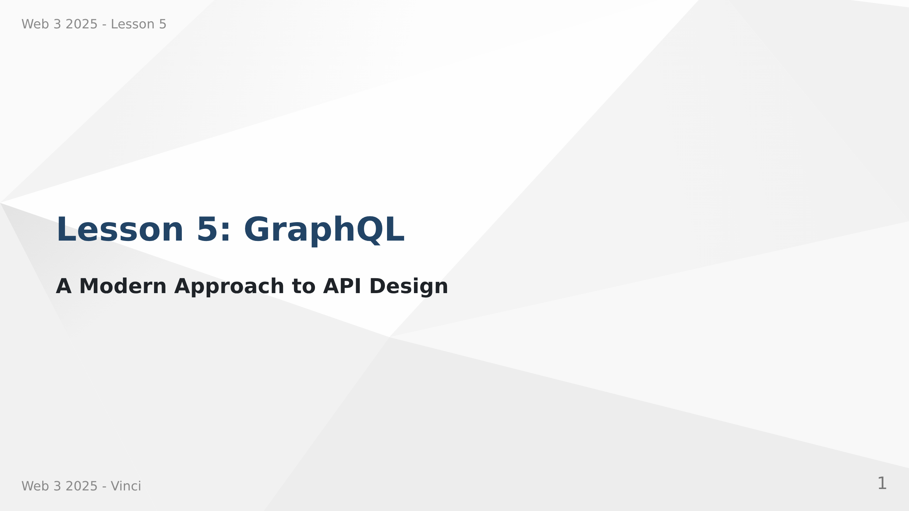
Notes:
Speaker Notes:
• Welcome to Lesson 5 - GraphQL
• Moving beyond traditional REST APIs
• Learning industry-standard query language
• Building flexible, efficient APIs

Slide 2
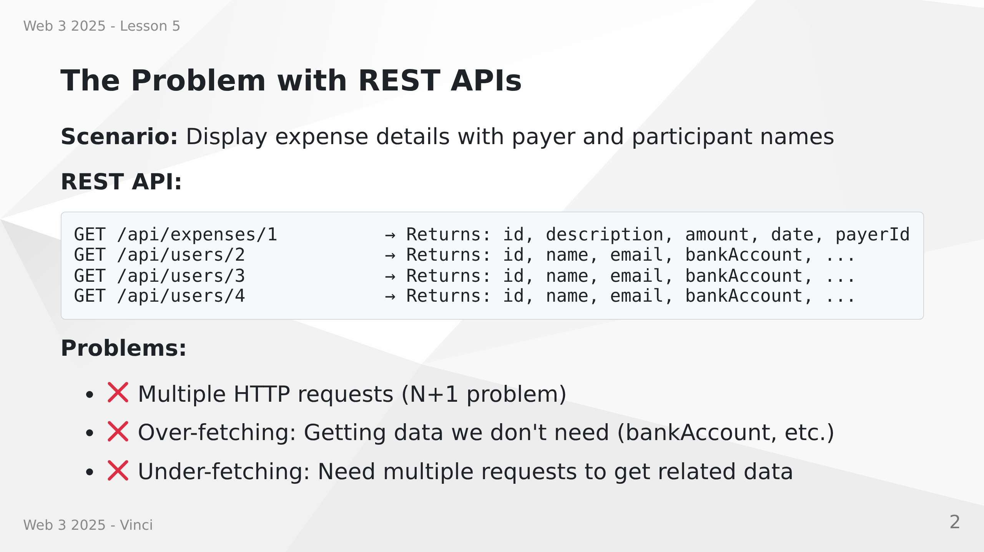
Notes:
Speaker Notes:
• REST forces us to make multiple round trips
• Each request has latency overhead
• We get all user fields even though we only need names
• N+1 problem: 1 query for expense + N queries for participants
• This becomes worse with nested data

Slide 3
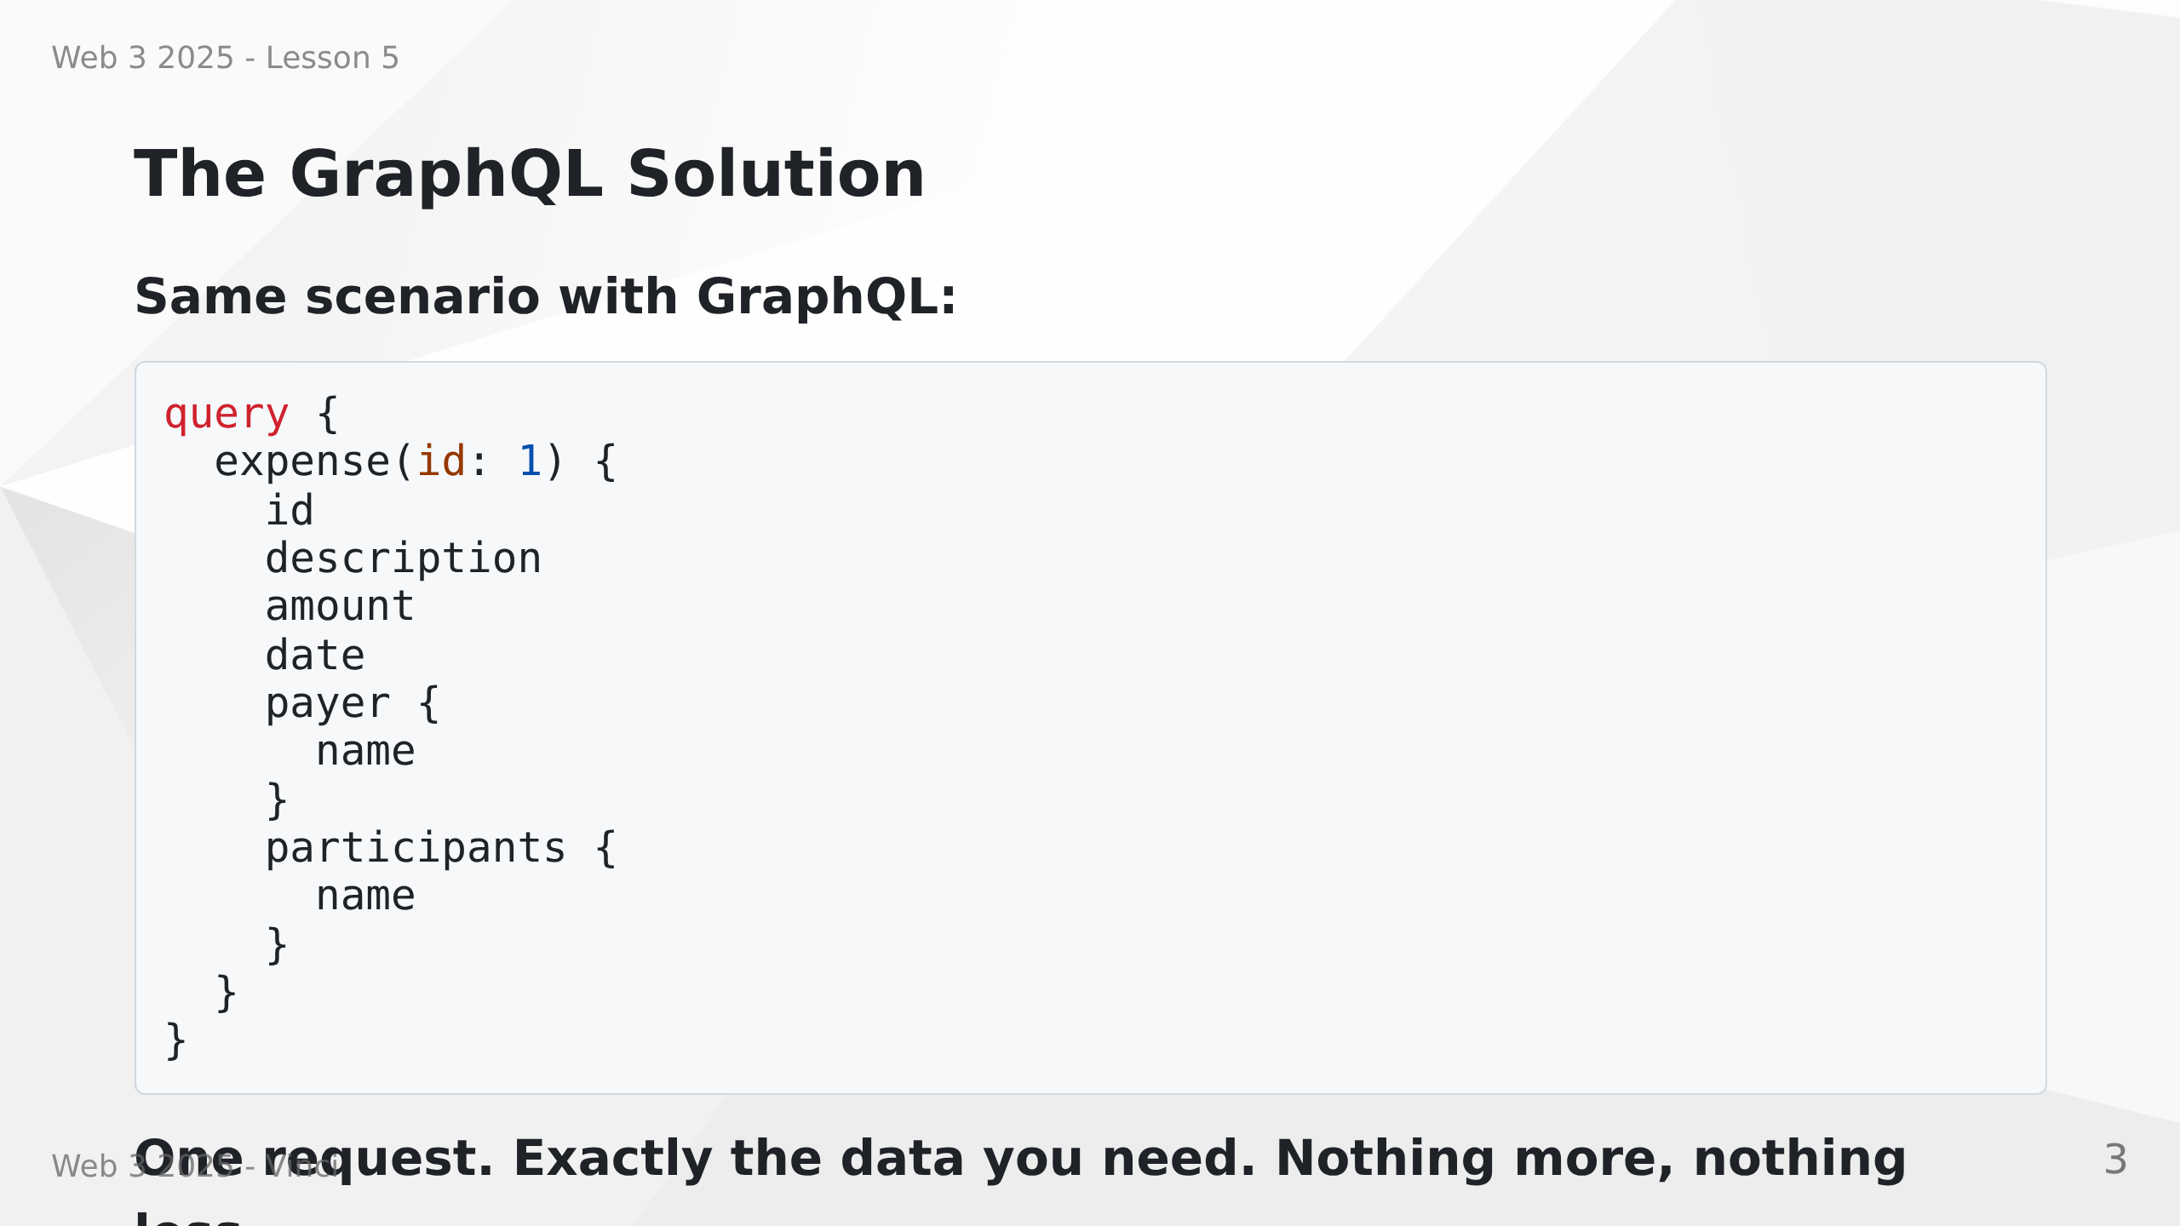
Notes:
Speaker Notes:
• Single HTTP request to get everything
• Client specifies exactly what fields it needs
• No over-fetching - only name, not email or bankAccount
• Server knows relationships and fetches efficiently
• Solves both over-fetching and under-fetching

Slide 4
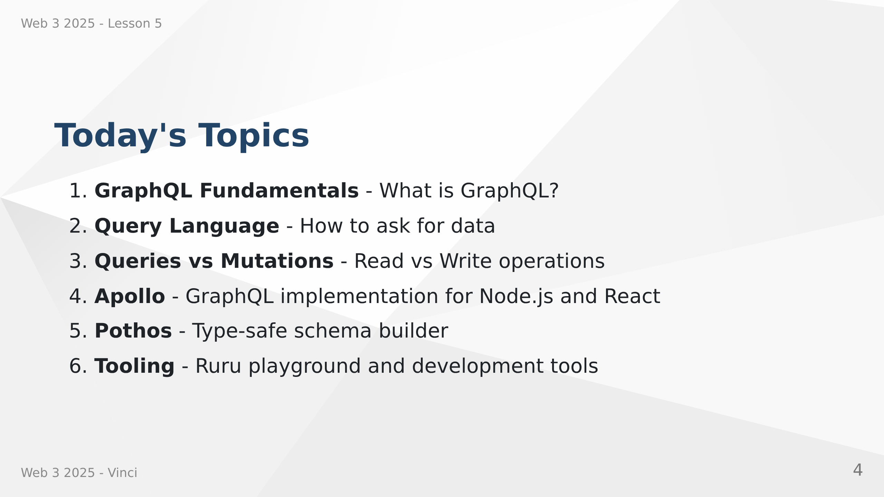
Notes:
Speaker Notes:
• Comprehensive introduction to GraphQL
• Theory and practical implementation
• Industry-standard tools and libraries
• Building production-ready GraphQL APIs

Slide 5
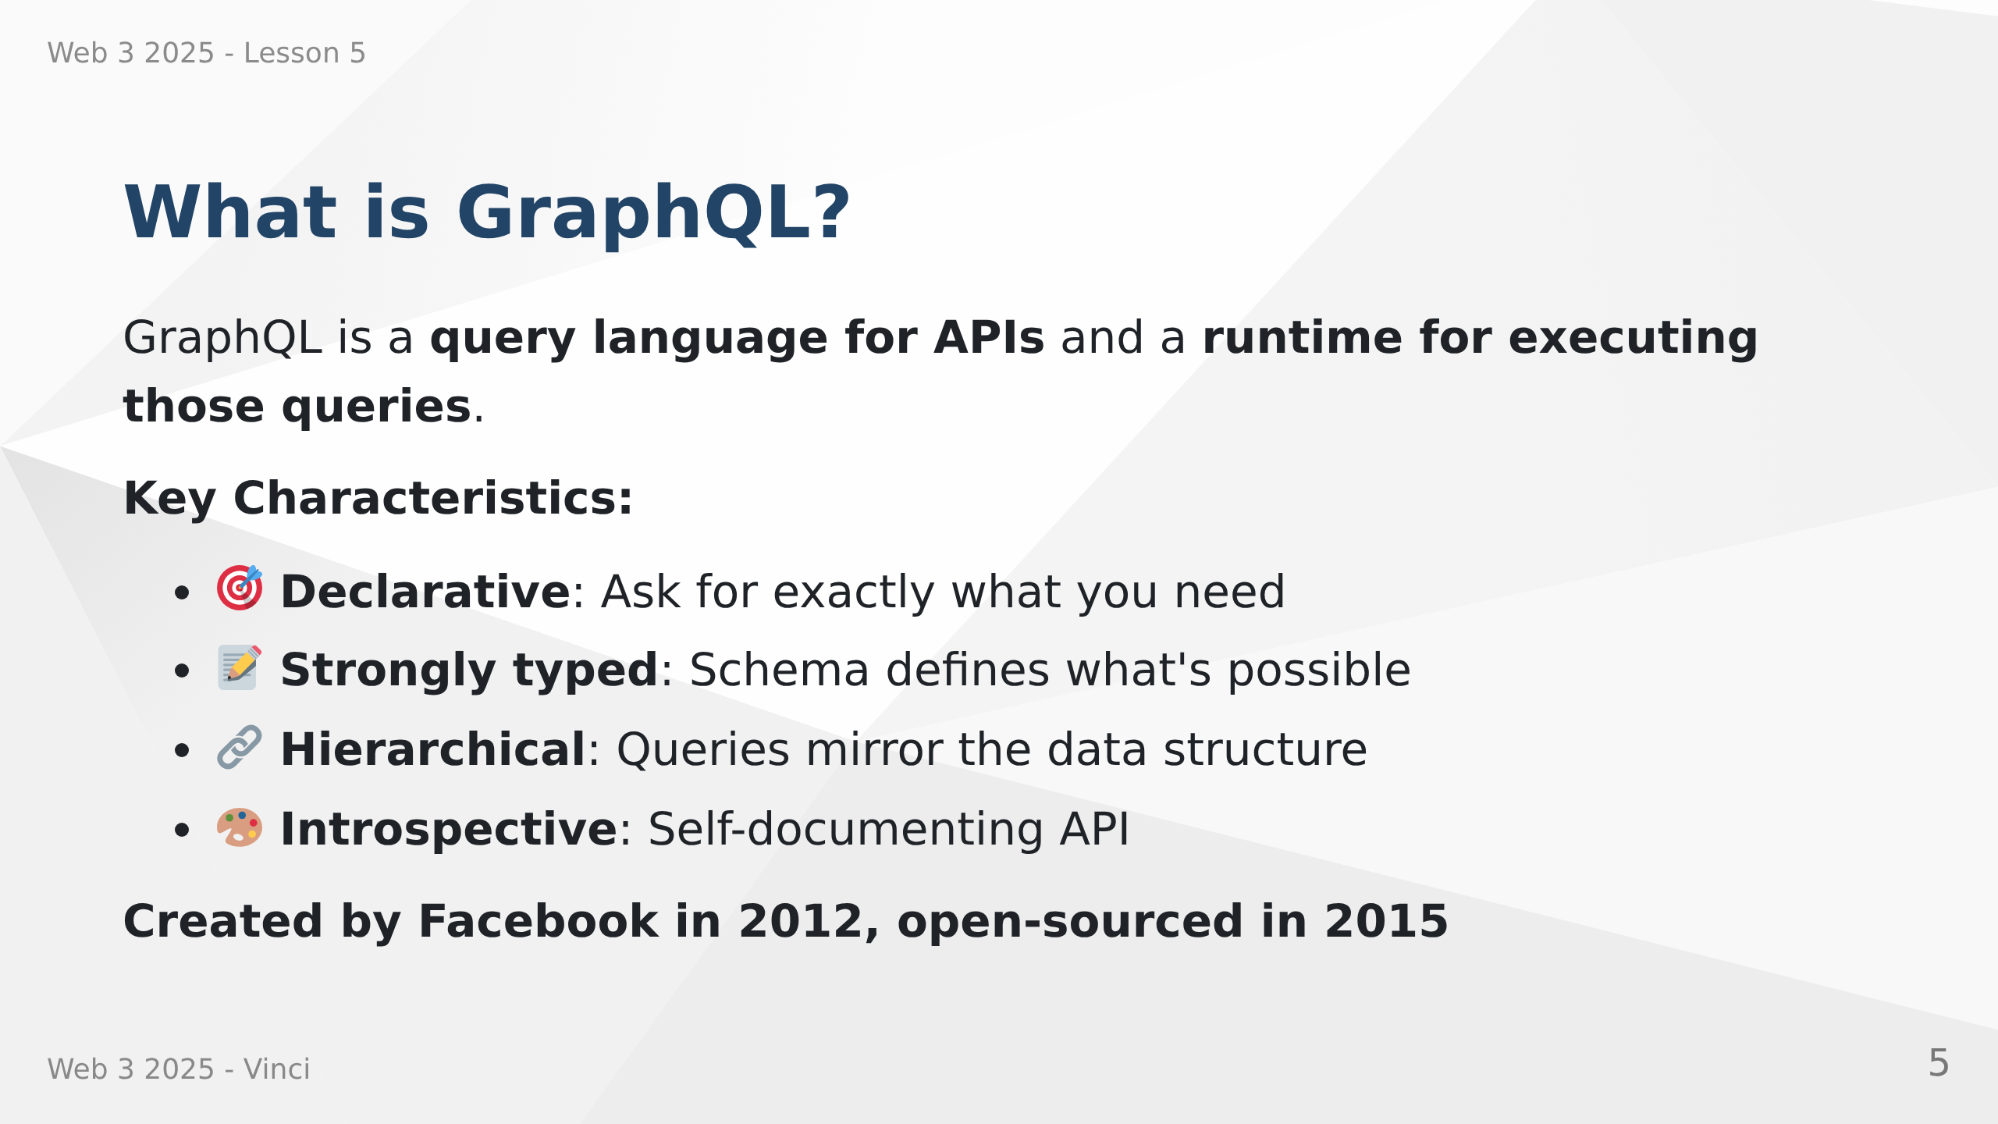
Notes:
Speaker Notes:
• GraphQL is both a specification and a runtime
• Query language lets clients describe their data needs
• Runtime executes queries against your schema
• Not tied to any specific database or programming language
• Works with your existing code and data

Slide 6
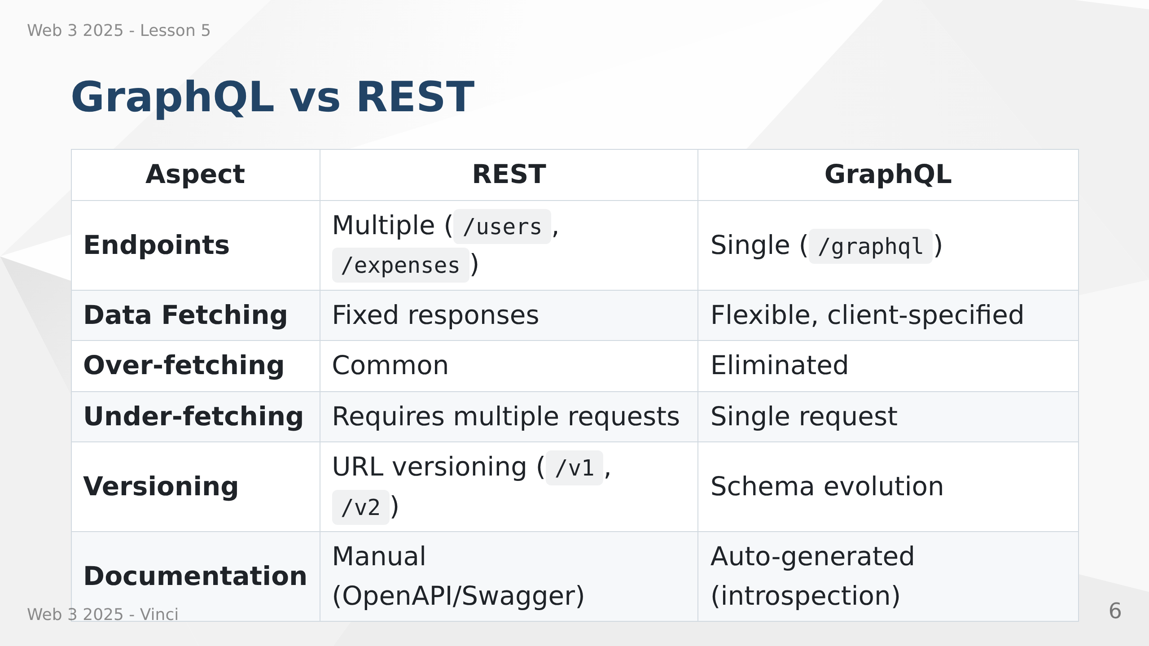
Notes:
Speaker Notes:
• REST uses multiple endpoints, GraphQL uses one
• REST returns fixed data structure, GraphQL returns what you ask for
• REST often requires multiple requests for related data
• GraphQL schema is self-documenting through introspection
• Both have their place - not one-size-fits-all

Slide 7
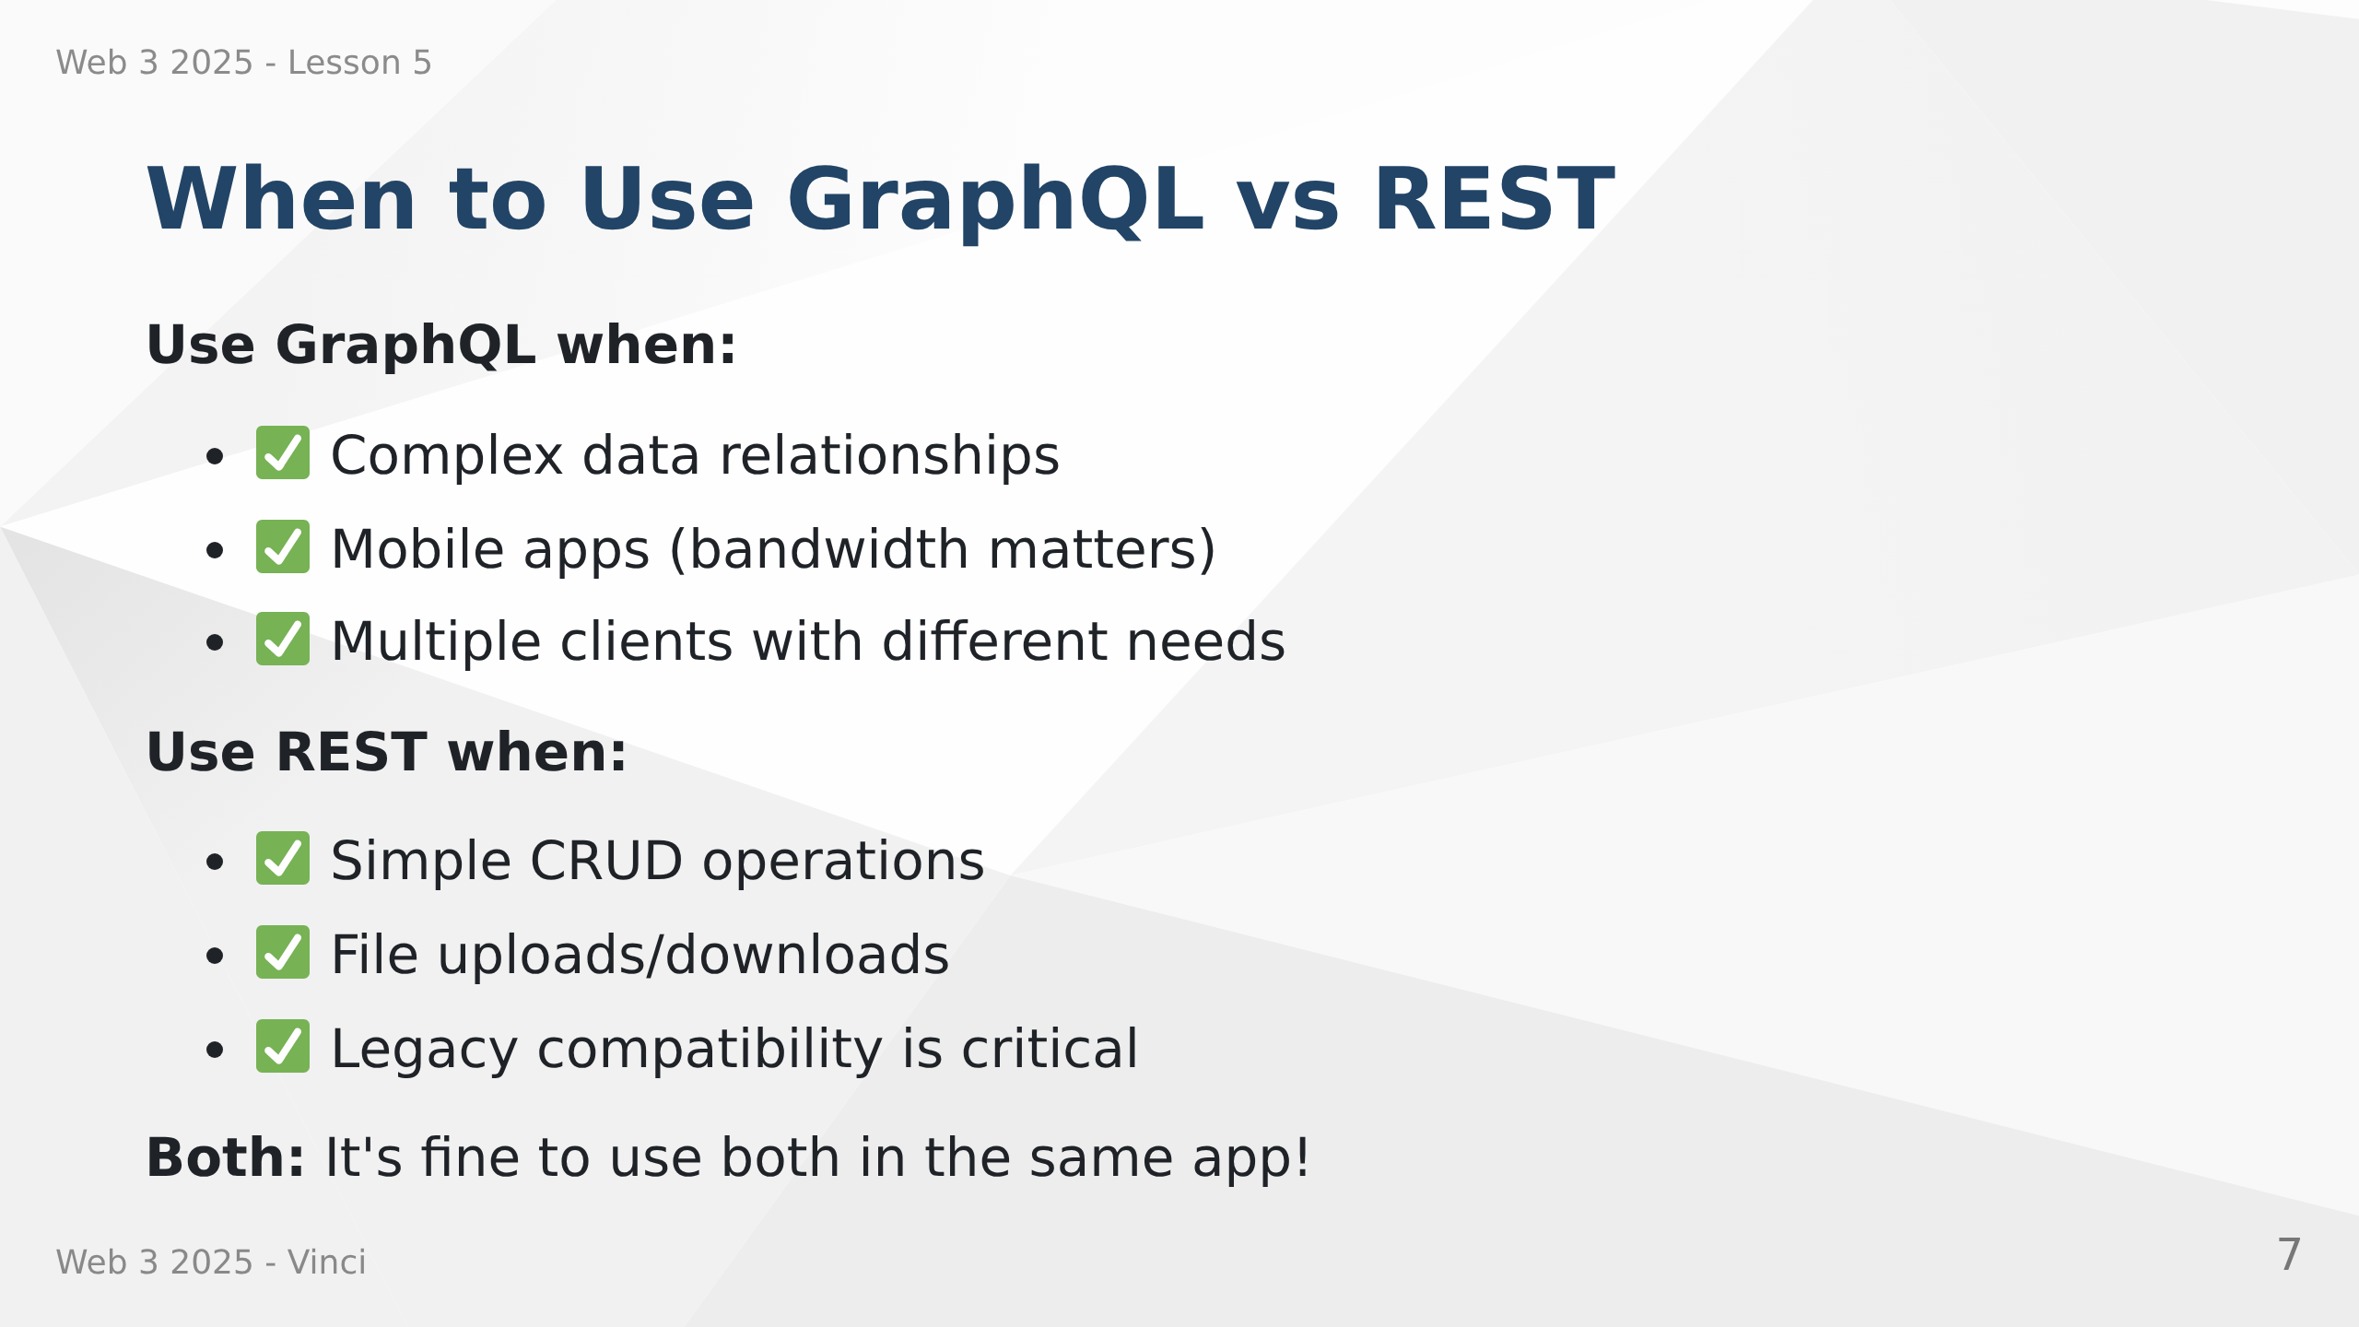
Notes:
Speaker Notes:
• GraphQL excels with complex, interconnected data
• REST is simpler for basic operations
• Can use both together - GraphQL for complex queries, REST for uploads
• Consider team experience and project requirements
• Not an either/or decision

Slide 8
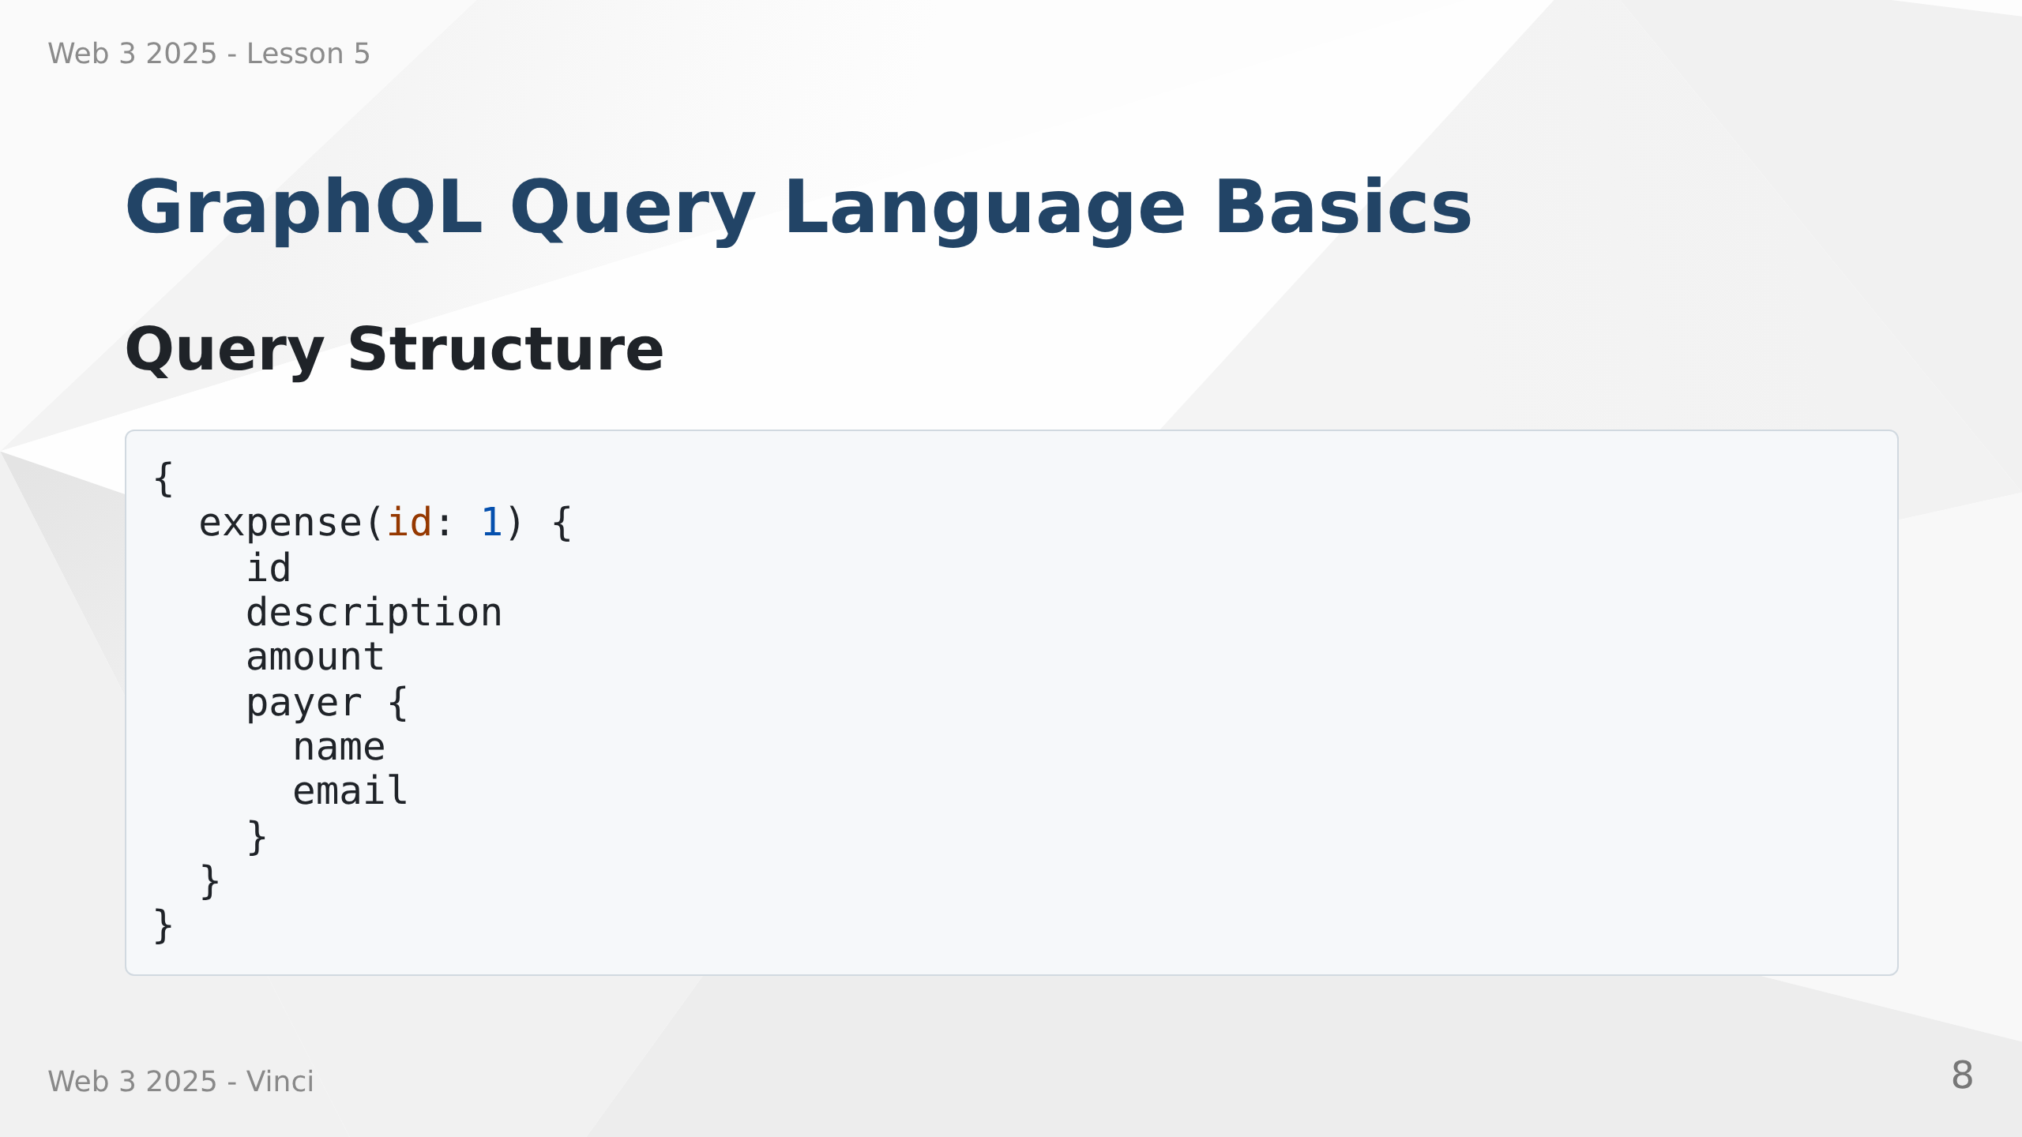

Slide 9
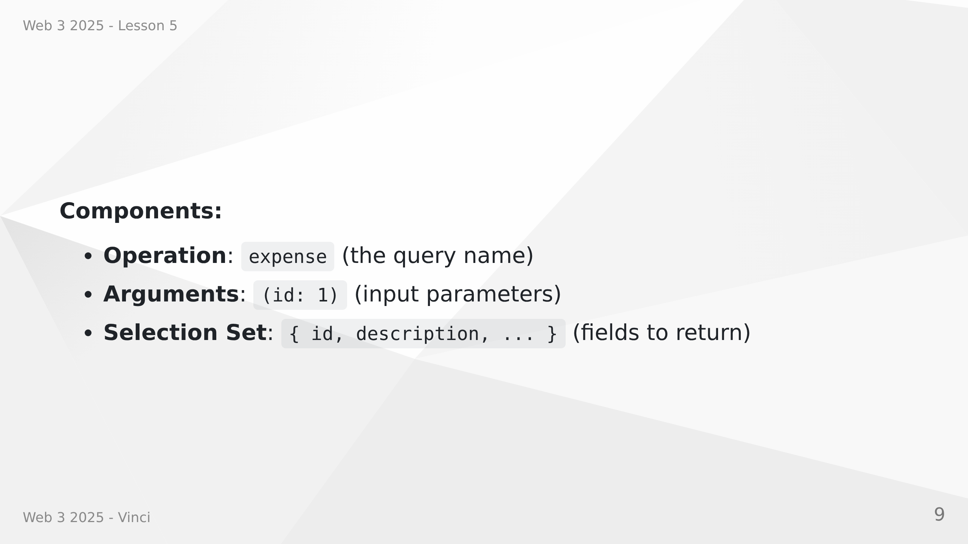
Notes:
Speaker Notes:
• Queries look similar to JSON but without values
• Curly braces define what fields you want
• Arguments in parentheses filter or specify data
• Nested objects let you traverse relationships
• Response mirrors the query structure

Slide 10
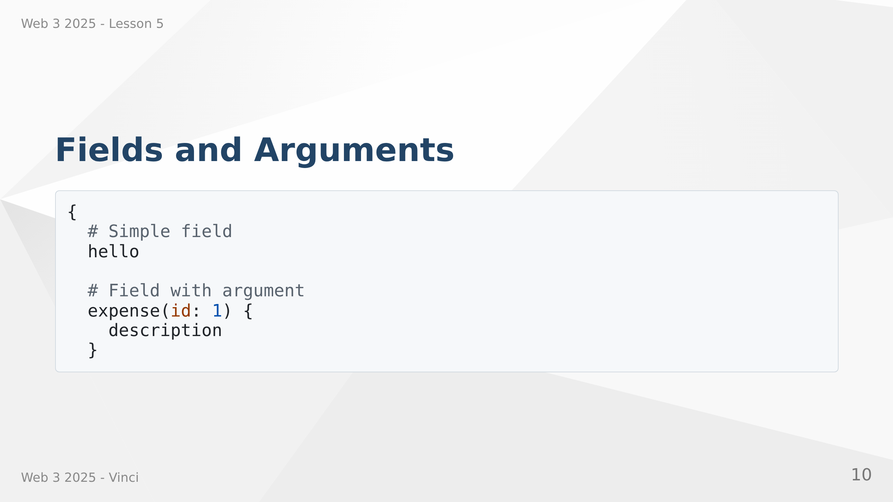

Slide 11
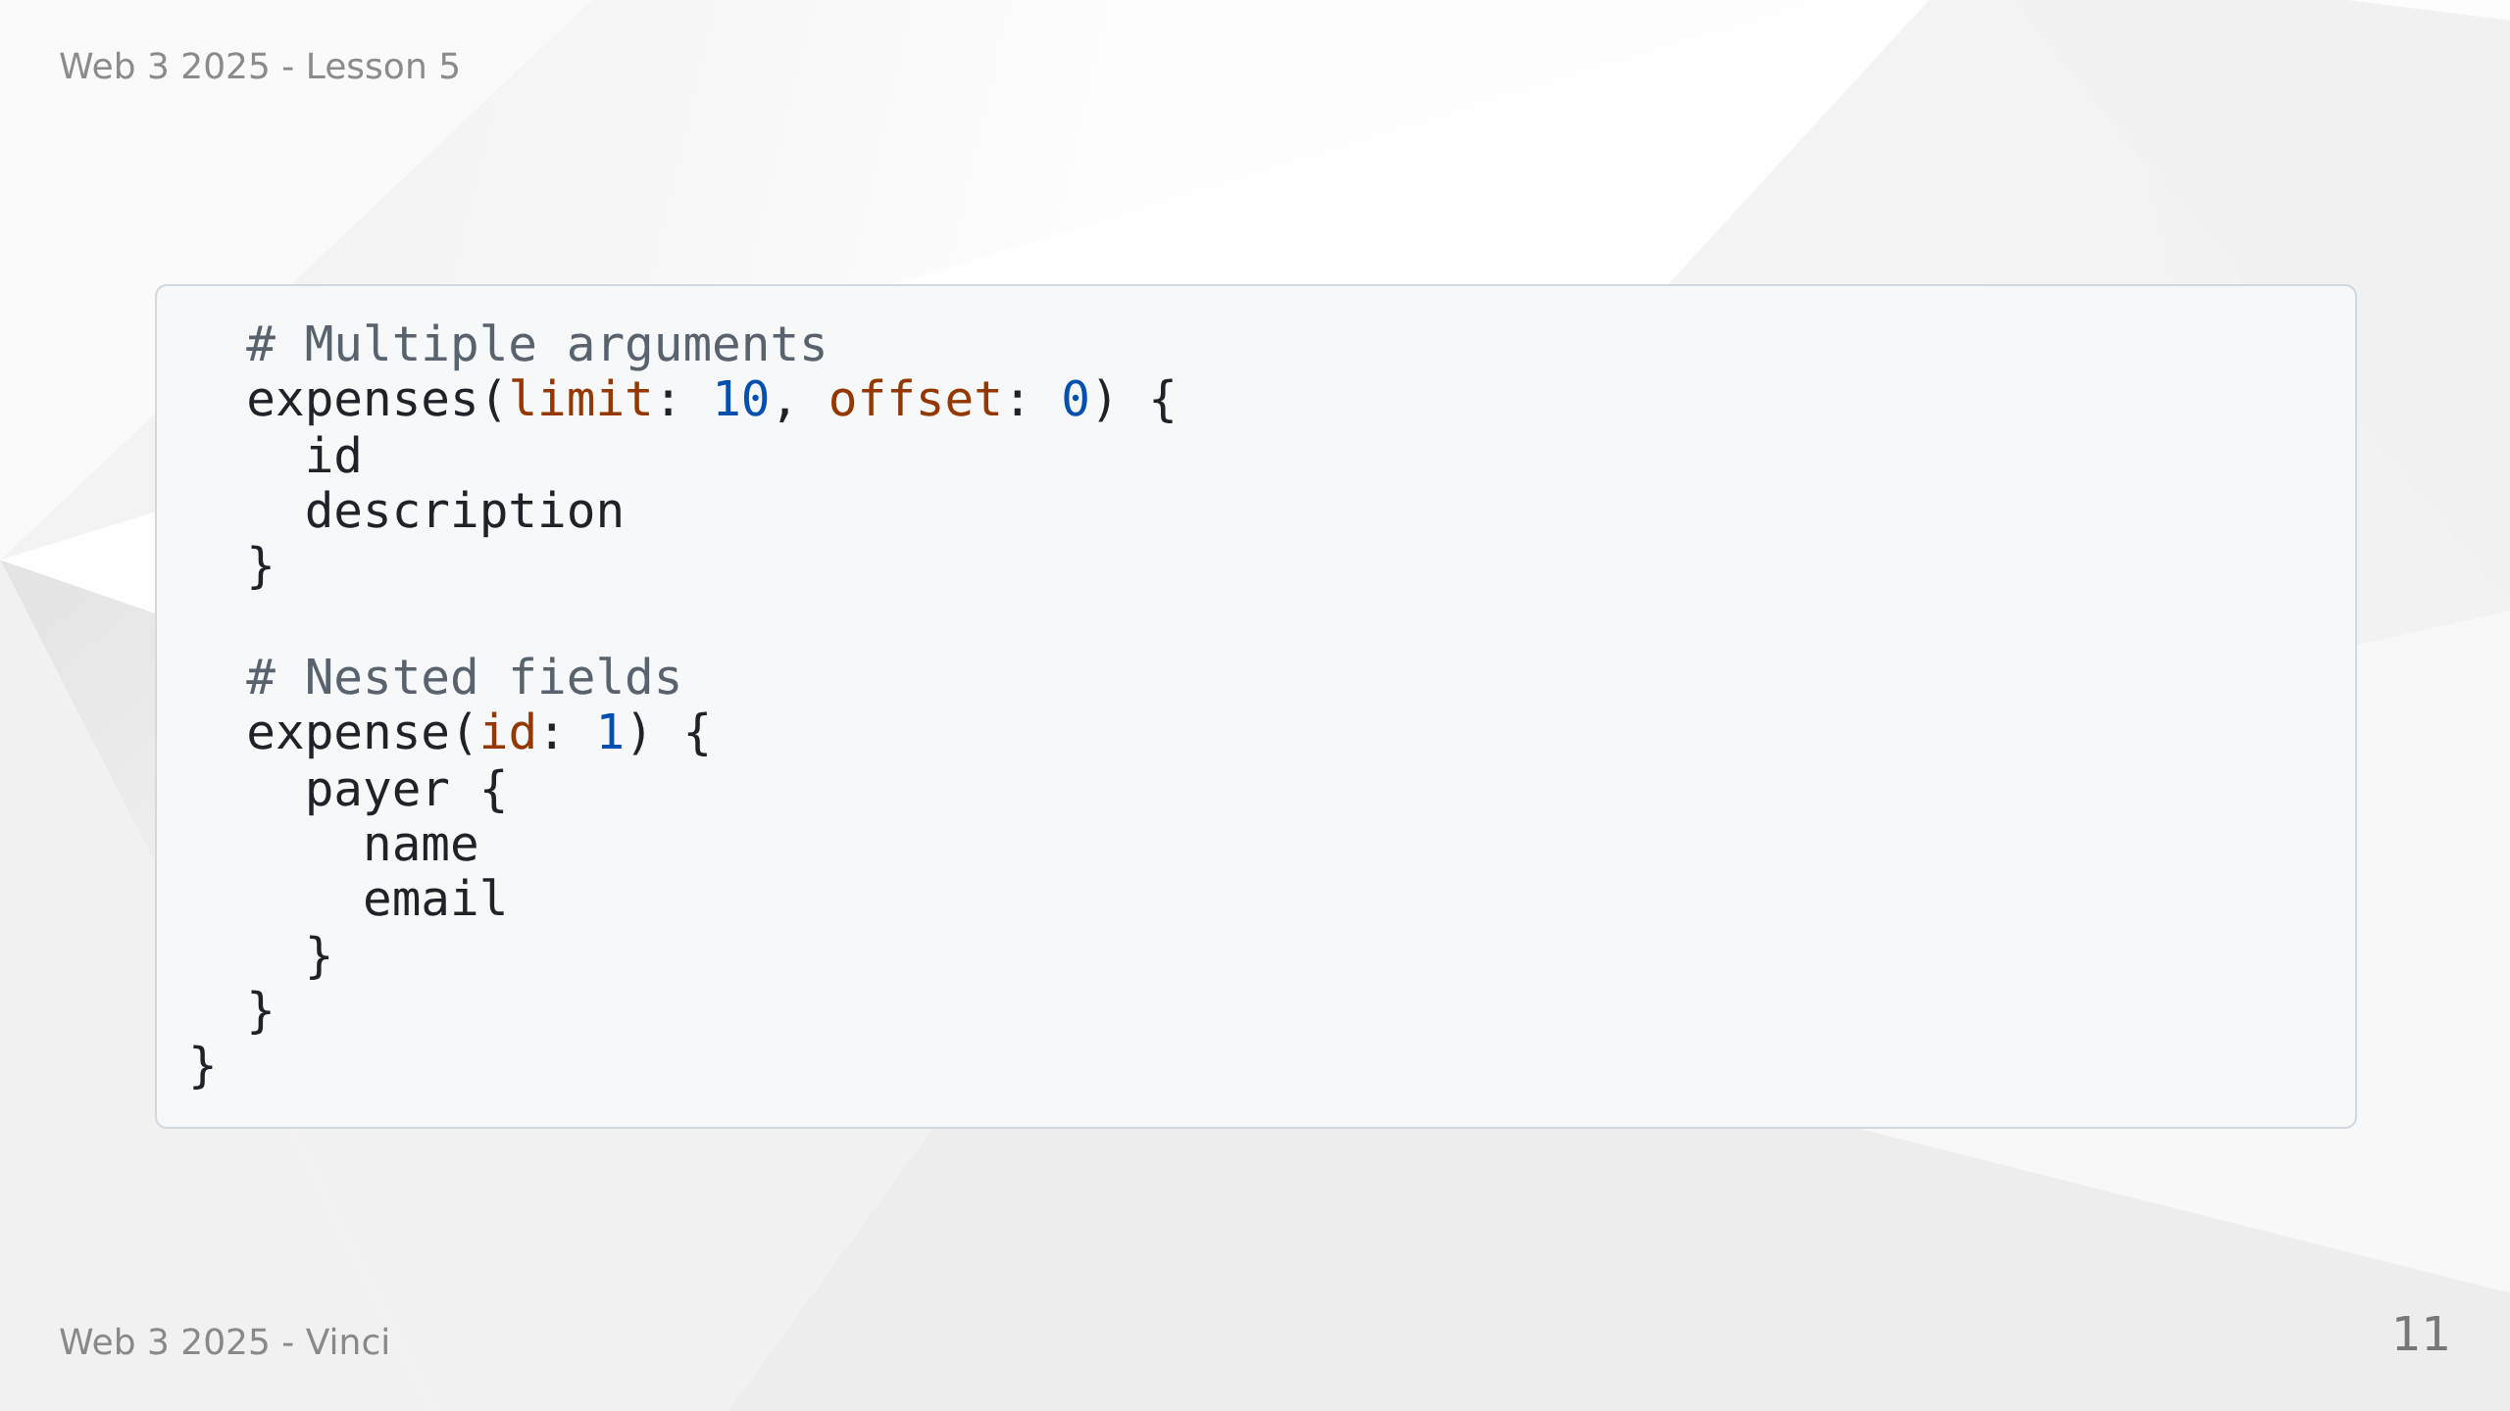
Notes:
Speaker Notes:
• Fields are the basic unit - properties you want to fetch
• Arguments filter or customize the query
• Can have multiple arguments (limit, offset, etc.)
• Nested fields traverse relationships
• Server resolves each field independently

Slide 12
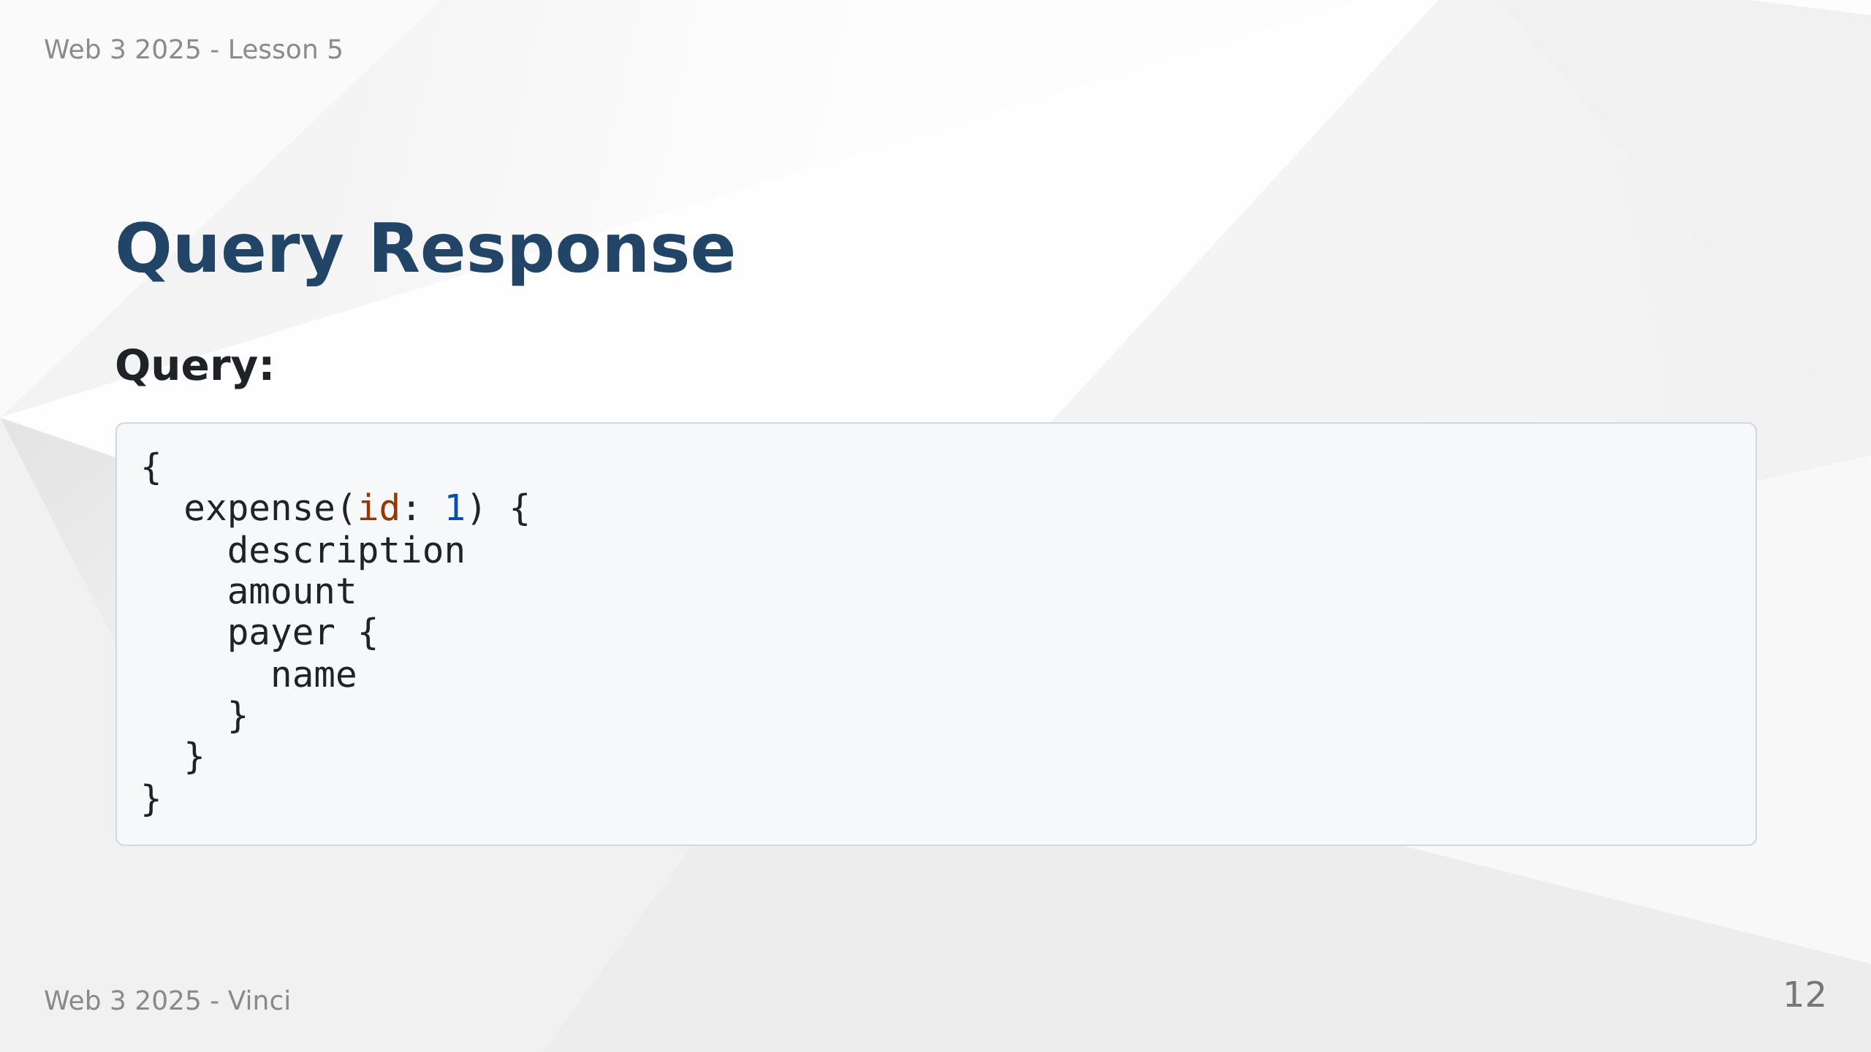

Slide 13
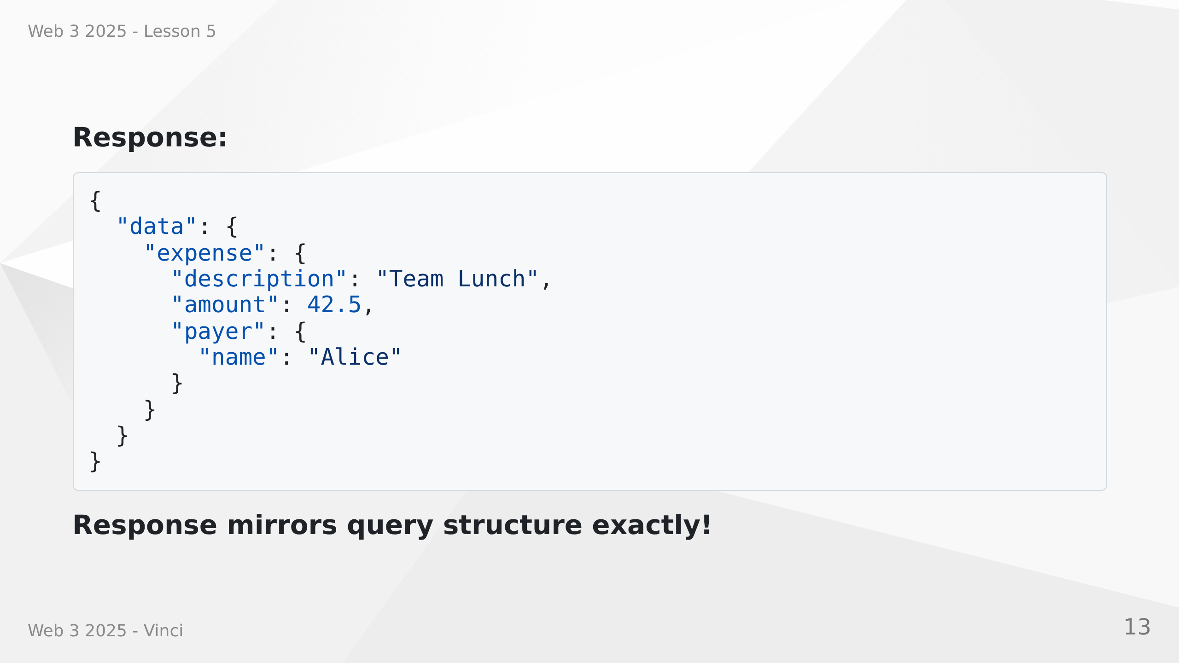
Notes:
Speaker Notes:
• Response JSON structure matches query structure
• Only requested fields are included
• Null if field doesn't exist or is null
• Errors separate from data in errors array
• Predictable response format

Slide 14
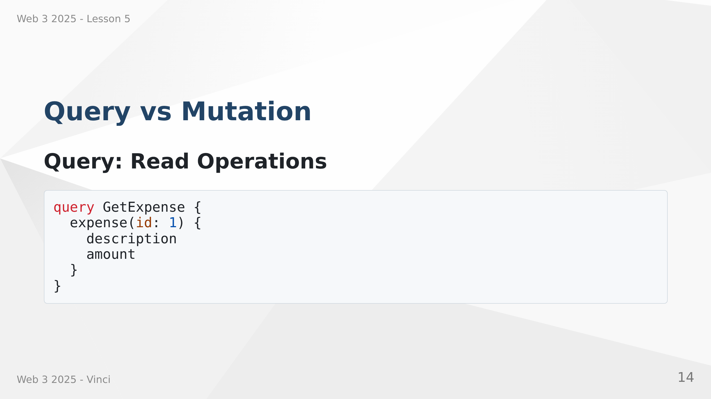

Slide 15
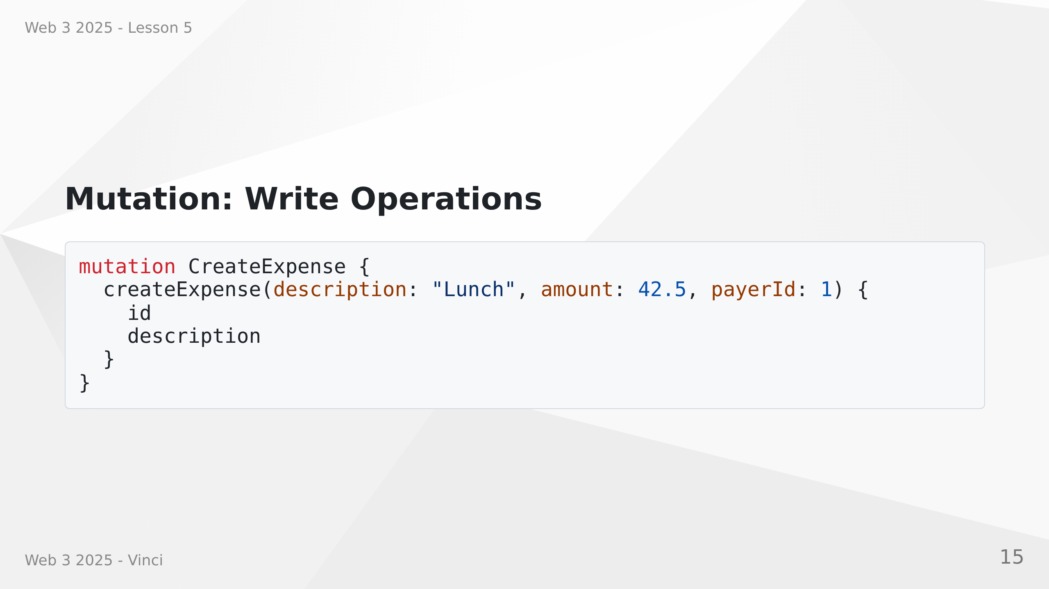
Notes:
Speaker Notes:
• Queries are for reading data (like GET in REST)
• Mutations are for changing data (like POST, PUT, DELETE)
• Semantic distinction helps with caching and optimization
• Mutations run sequentially, queries can run in parallel
• Both can return data - mutations often return created/updated object

Slide 16
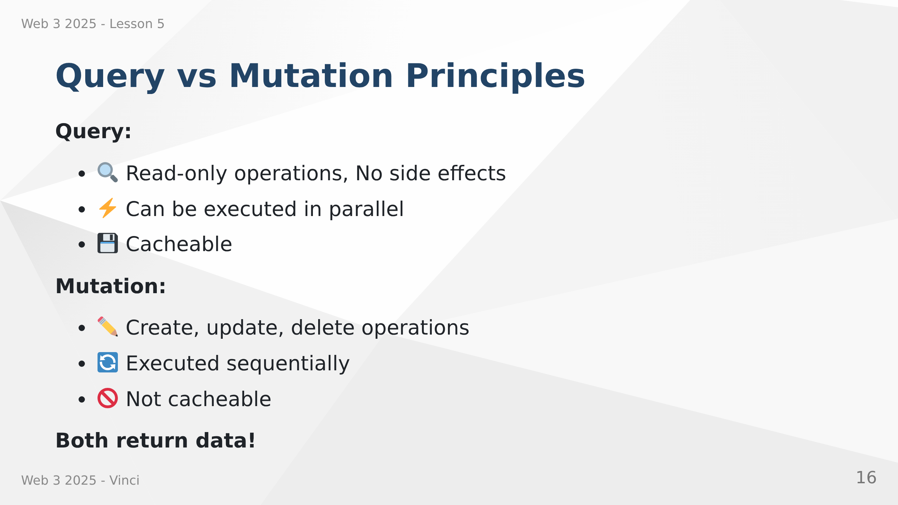
Notes:
Speaker Notes:
• Clear semantic distinction
• Queries should be side-effect free
• Mutations change state
• GraphQL guarantees mutations run one after another
• Queries can be optimized and cached
• Return data helps avoid additional queries

Slide 17
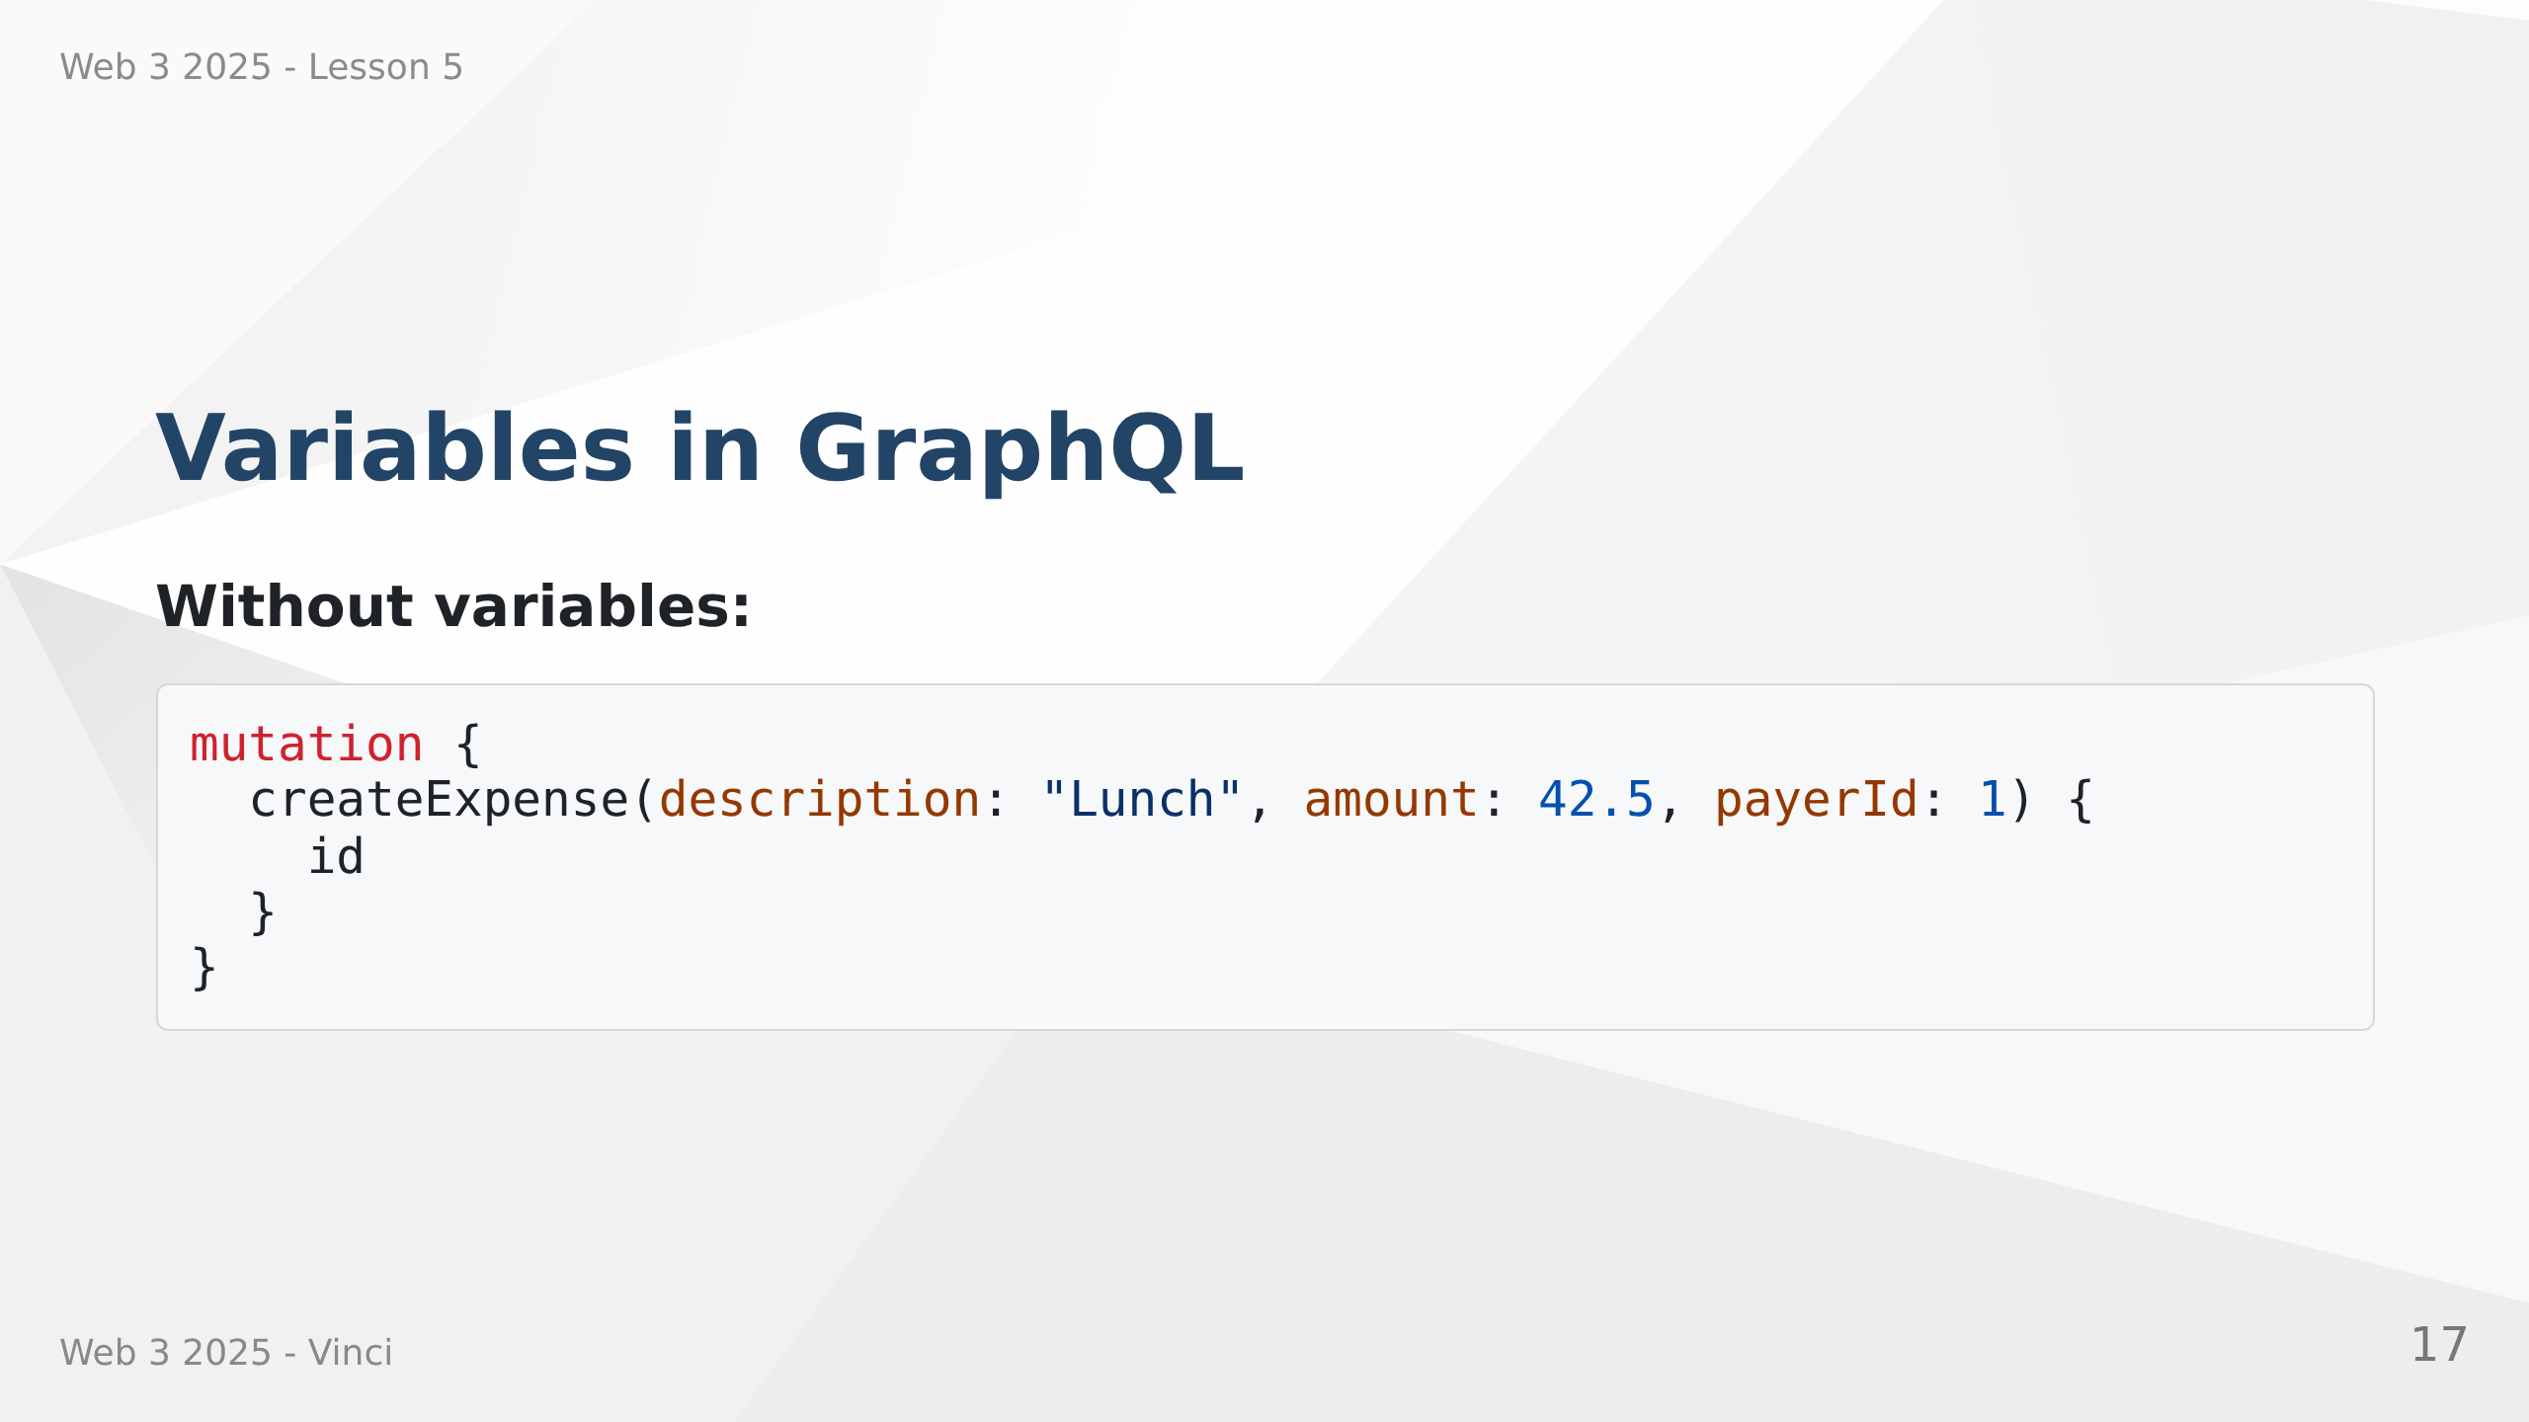

Slide 18
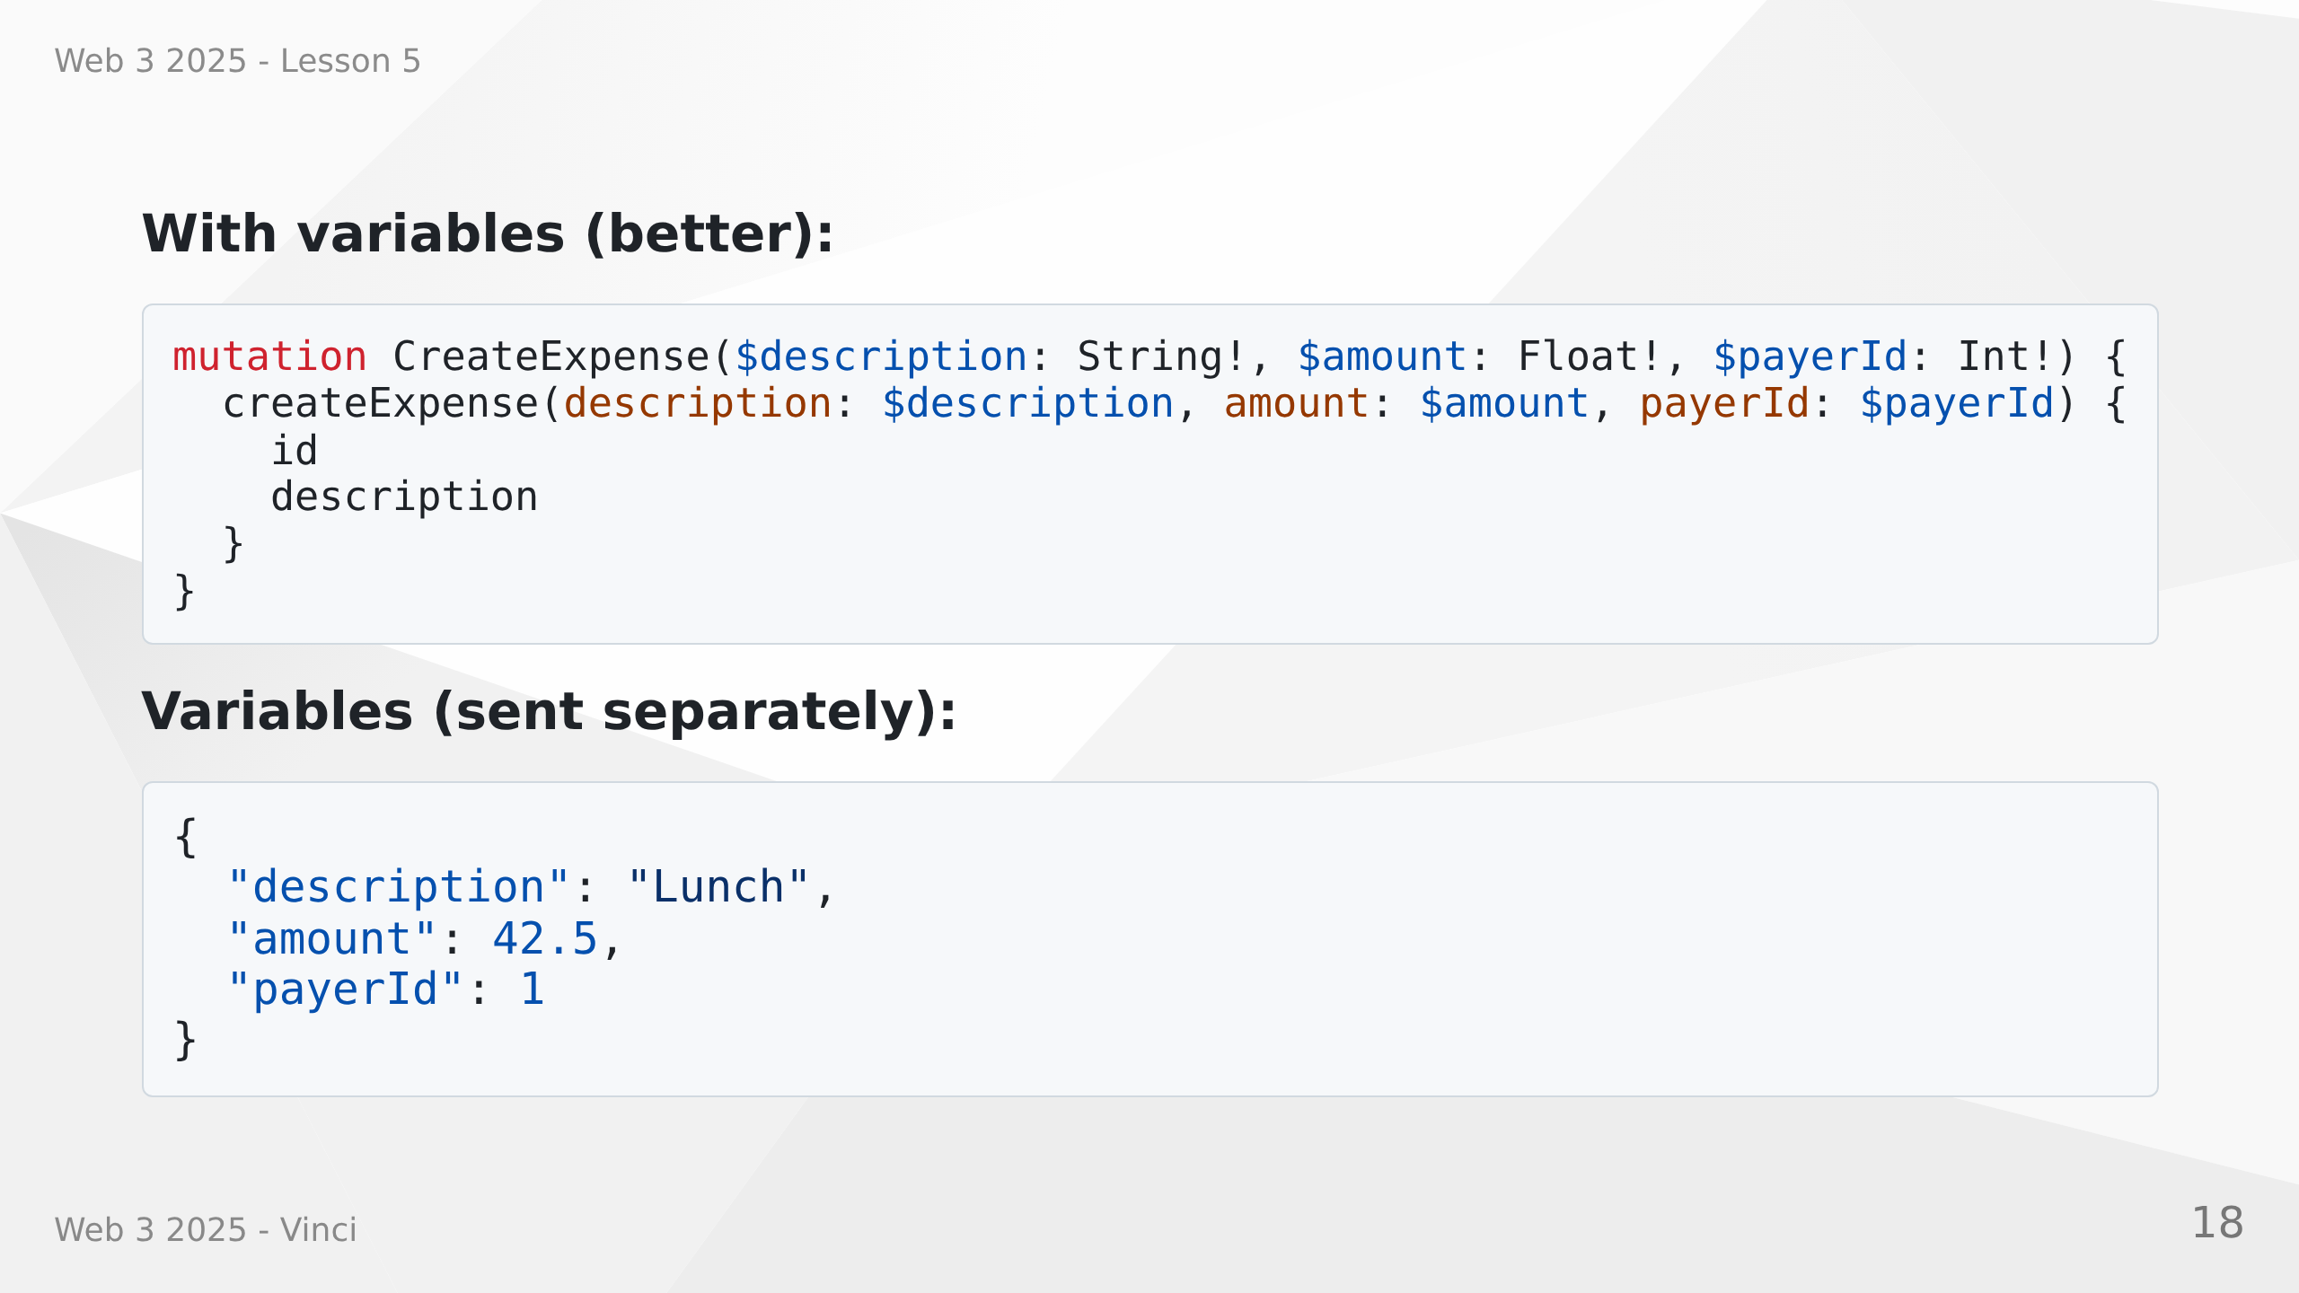
Notes:
Speaker Notes:
• Variables separate query structure from values
• Reusable queries with different inputs
• Better for client-side code
• Type-safe with validation
• $ prefix denotes variables
• ! suffix means required (non-nullable)

Slide 19
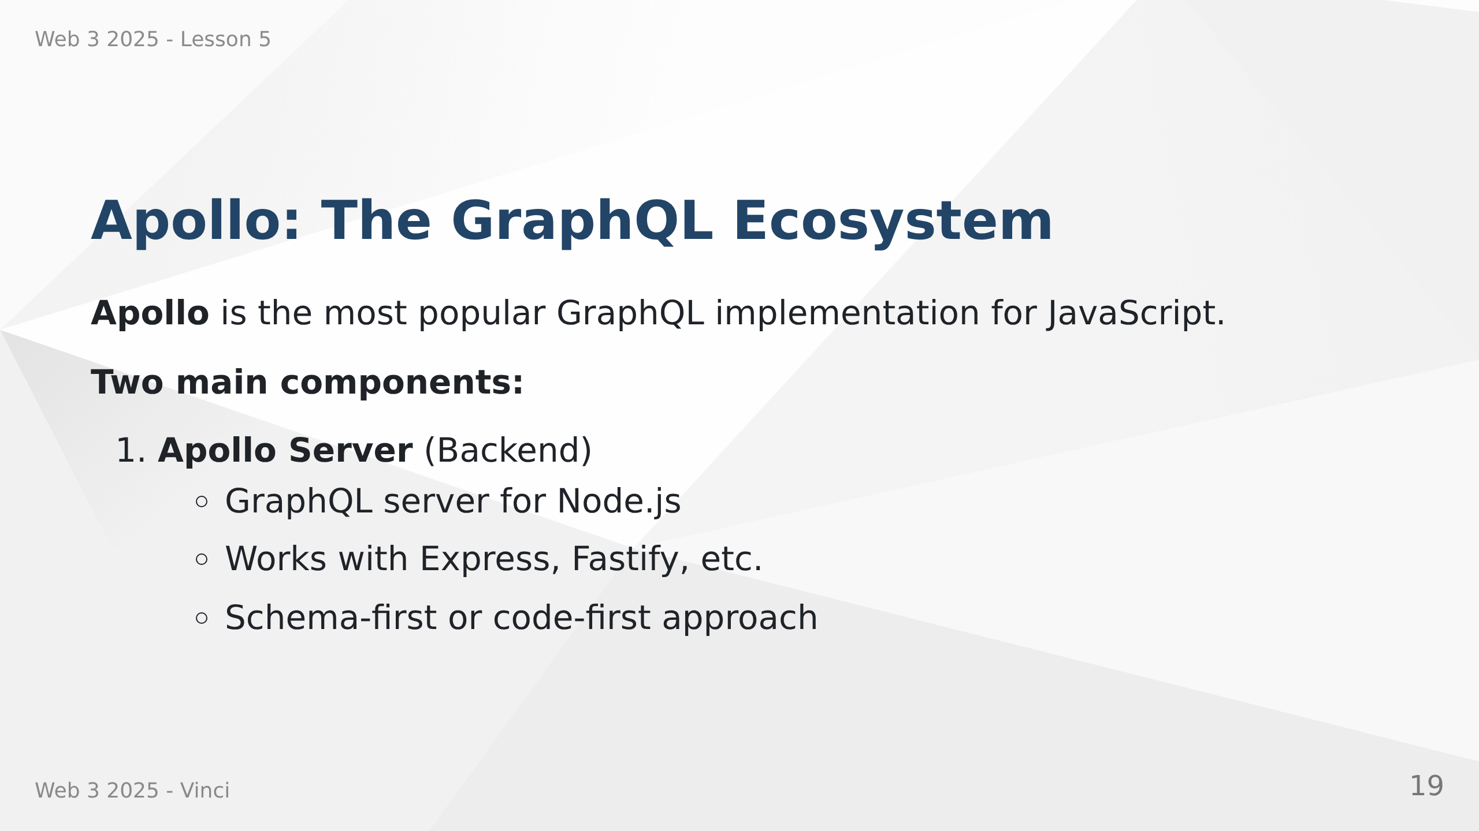

Slide 20
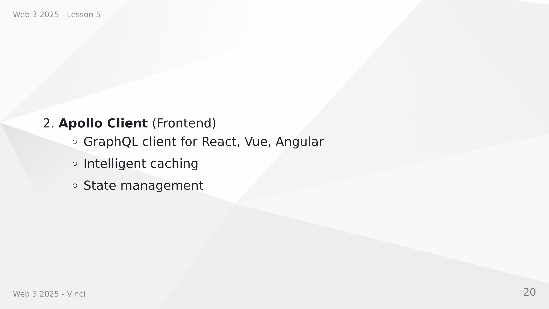
Notes:
Speaker Notes:
• Apollo is to GraphQL what Express is to REST
• Not the only implementation but most popular
• Server and client work together but can be used separately
• Production-ready with great documentation
• Active community and ecosystem

Slide 21
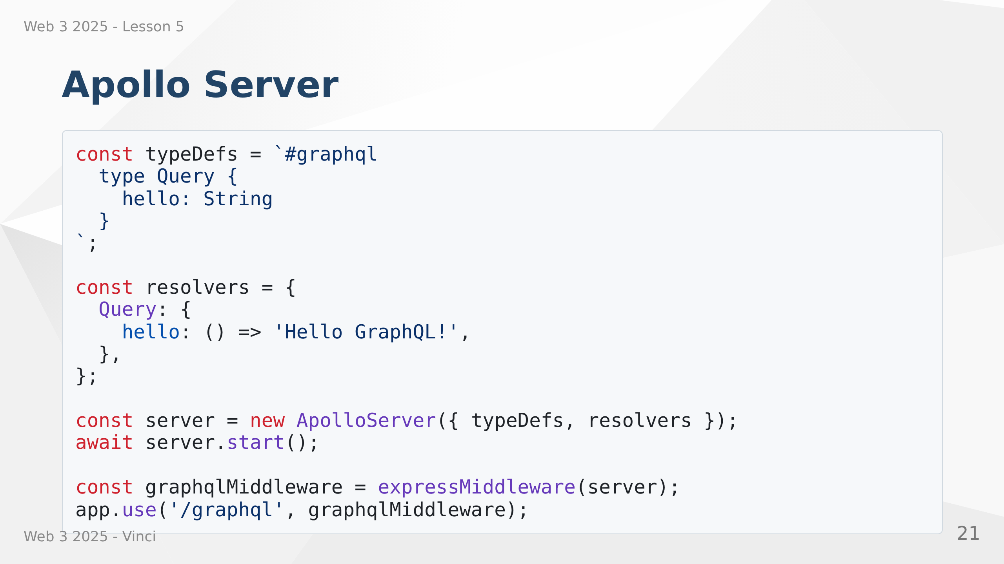
Notes:
Speaker Notes:
• Apollo Server integrates with Express as middleware
• typeDefs define the schema (what's possible)
• resolvers implement the logic (how to fetch data)
• Single /graphql endpoint handles all queries
• Works alongside existing REST routes

Slide 22
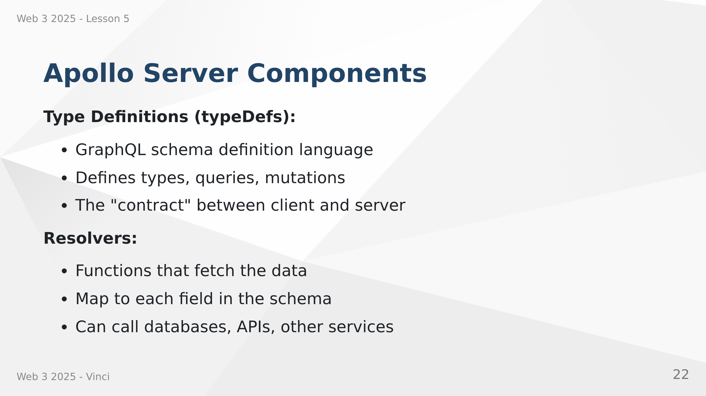

Slide 23
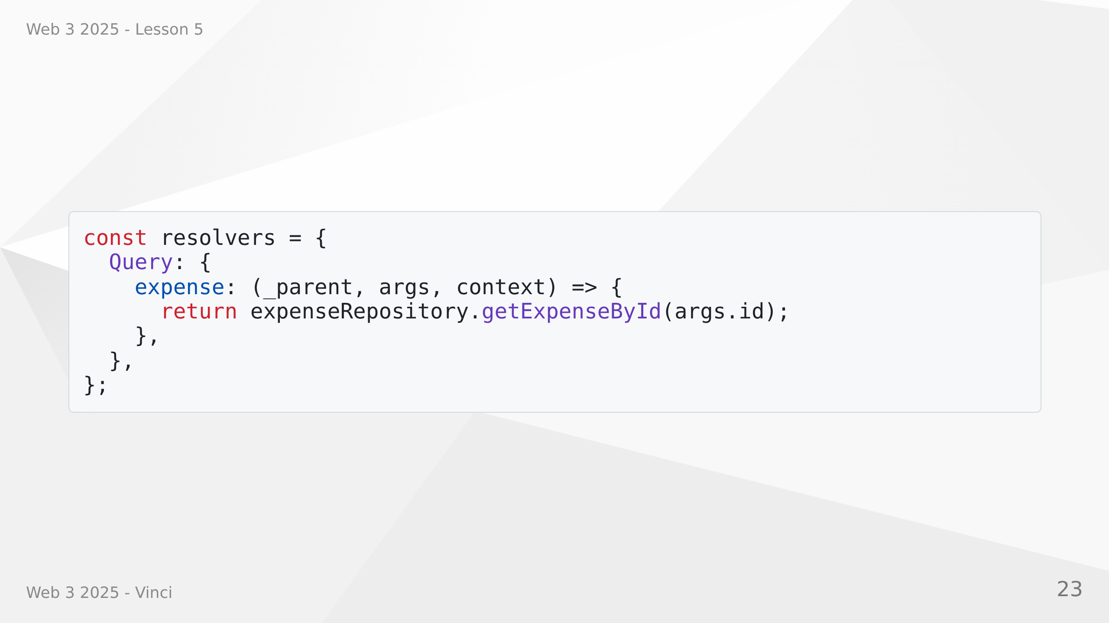
Notes:
Speaker Notes:
• Schema defines what's possible
• Resolvers define how to get the data
• Each field can have its own resolver
• Resolvers receive parent, args, context, info
• Can call existing code - no need to rewrite everything

Slide 24
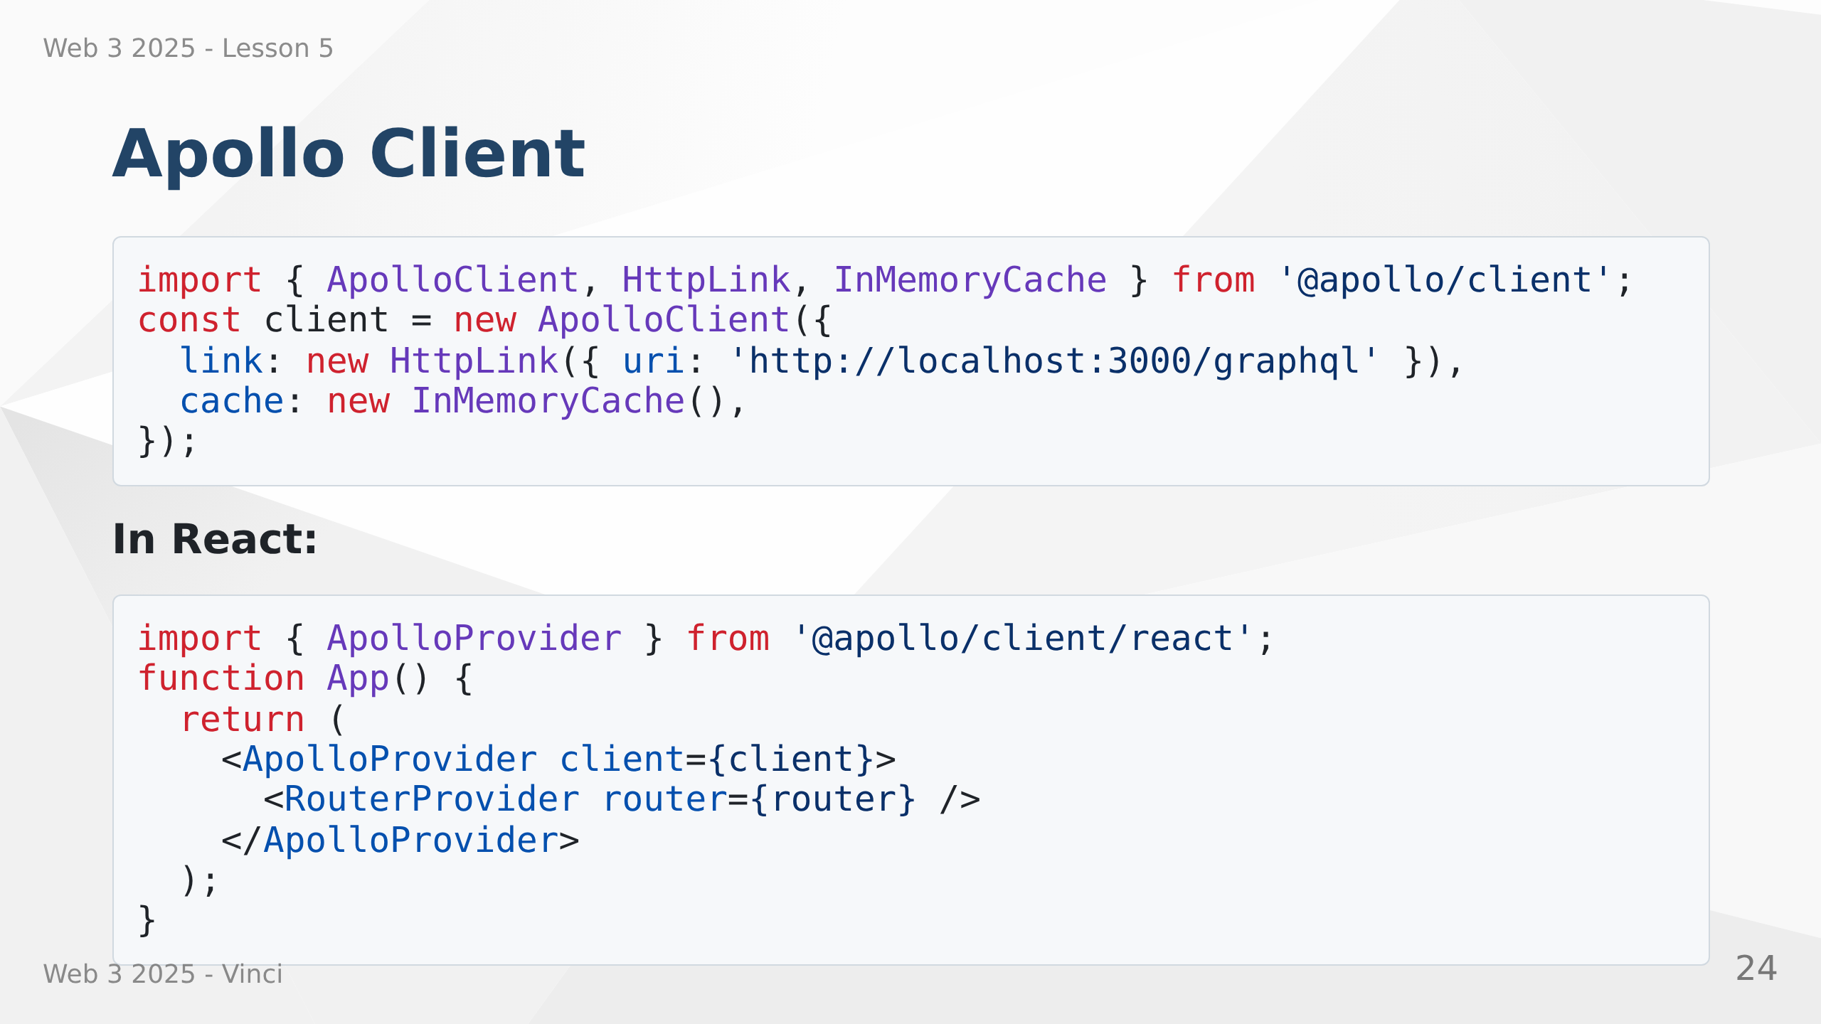
Notes:
Speaker Notes:
• Apollo Client handles GraphQL requests
• Intelligent caching reduces requests
• Works with React hooks
• Similar to React Query but GraphQL-specific
• Provider makes client available to all components

Slide 25
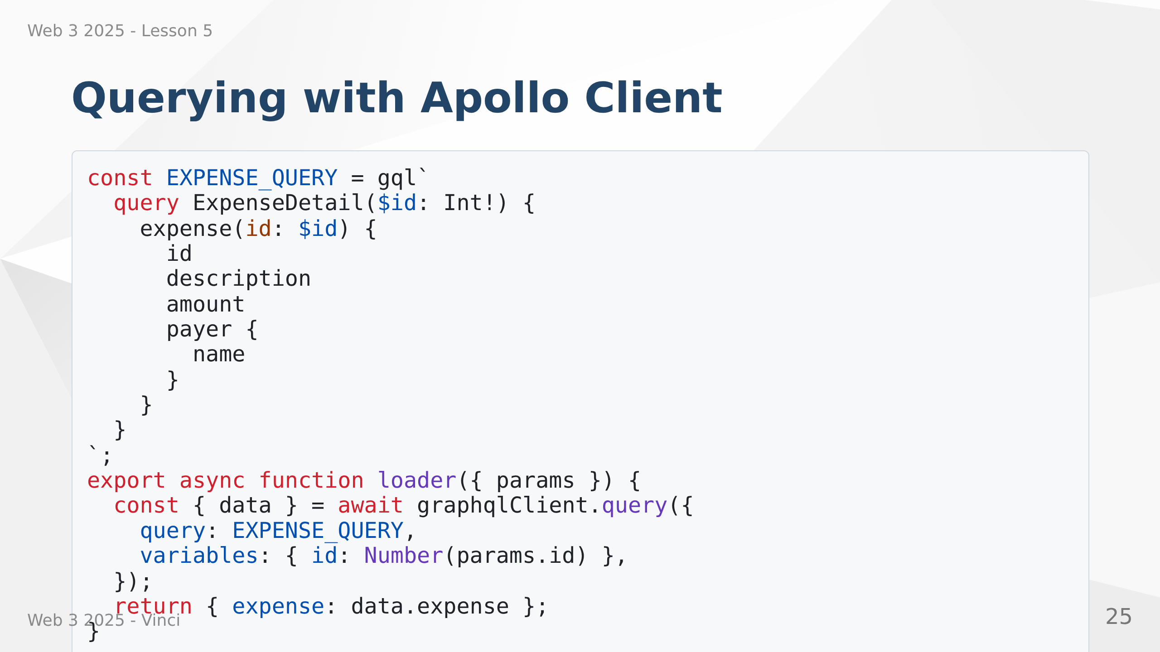
Notes:
Speaker Notes:
• gql tag parses GraphQL strings at build time
• Type-safe with TypeScript
• Integrates with React Router loaders
• Cache automatically manages results
• Same data from cache if queried again

Slide 26
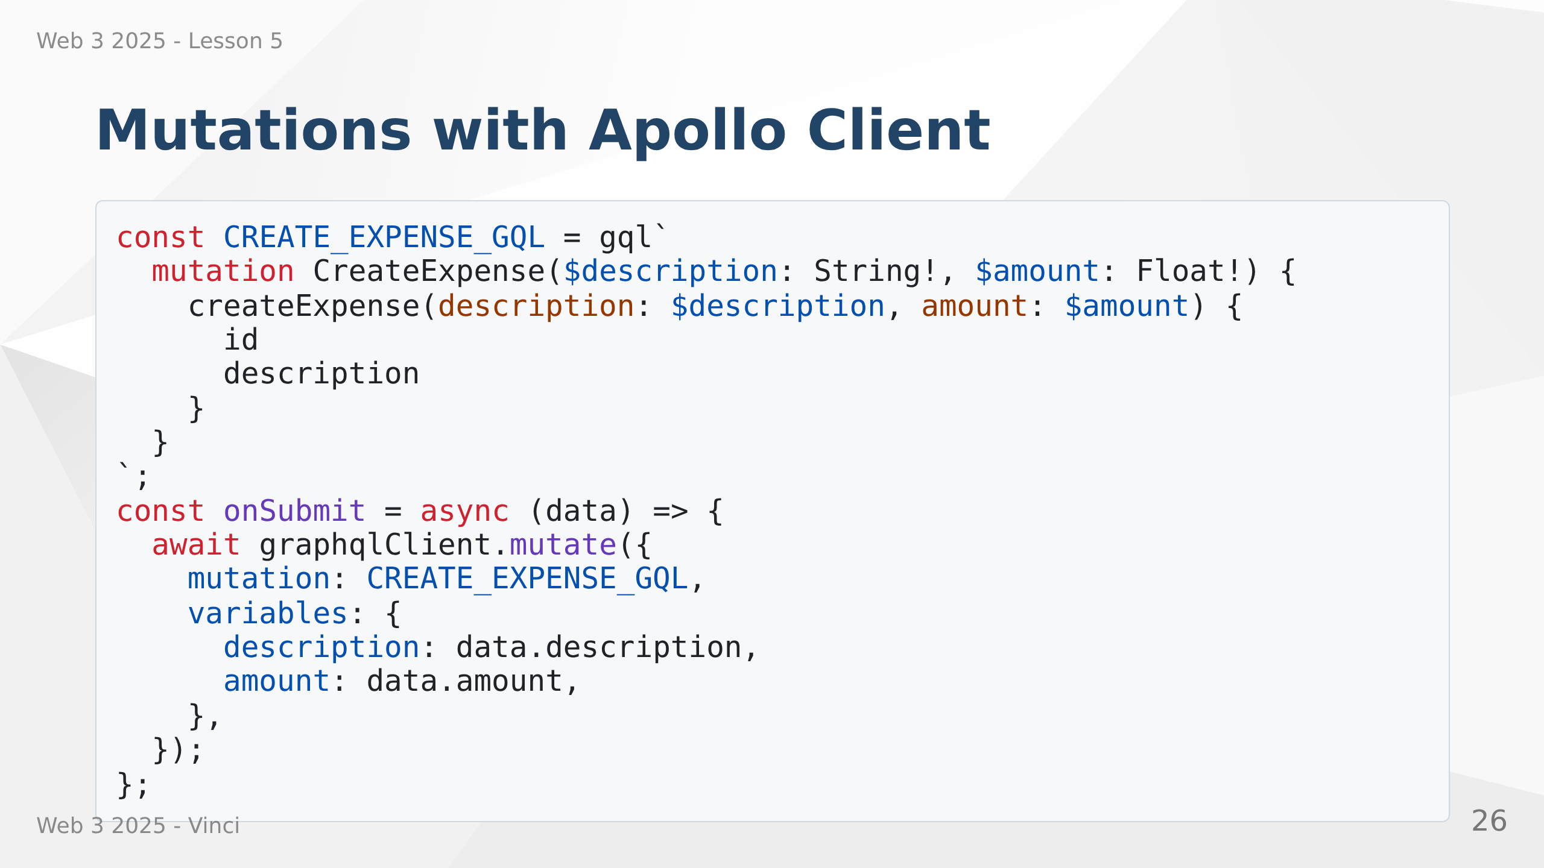
Notes:
Speaker Notes:
• Mutations similar to queries but use mutate method
• Returns created/updated object
• Can specify what fields to return
• Cache automatically updates with results
• Consistent pattern across app

Slide 27
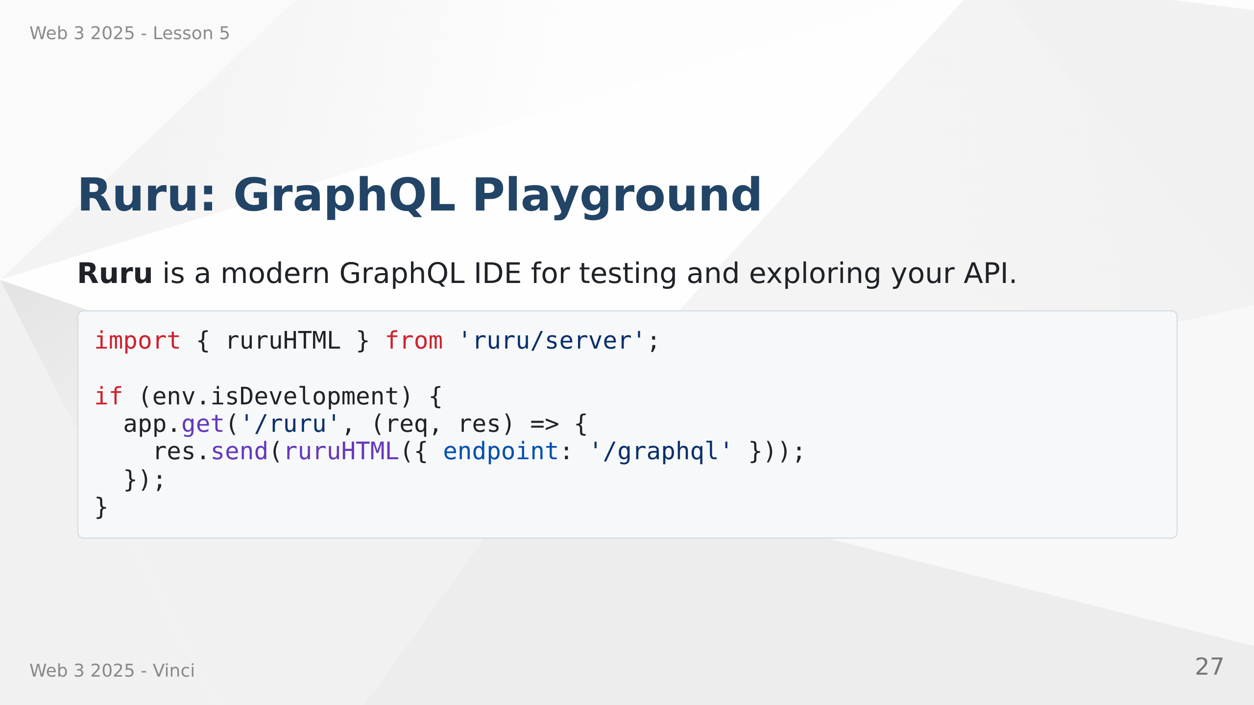

Slide 28
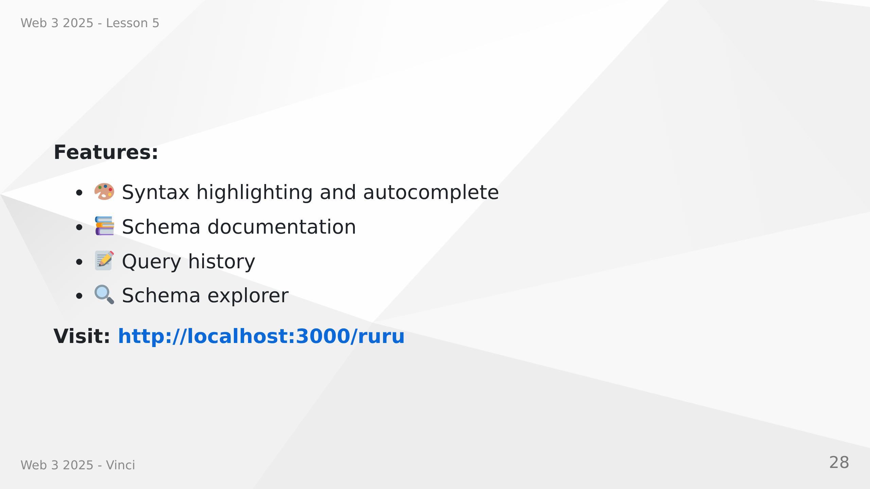
Notes:
Speaker Notes:
• Essential development tool
• Interactive query editor with autocomplete
• Explore schema and types
• Test queries before implementing in code
• Like Postman but for GraphQL
• Only enable in development!

Slide 29
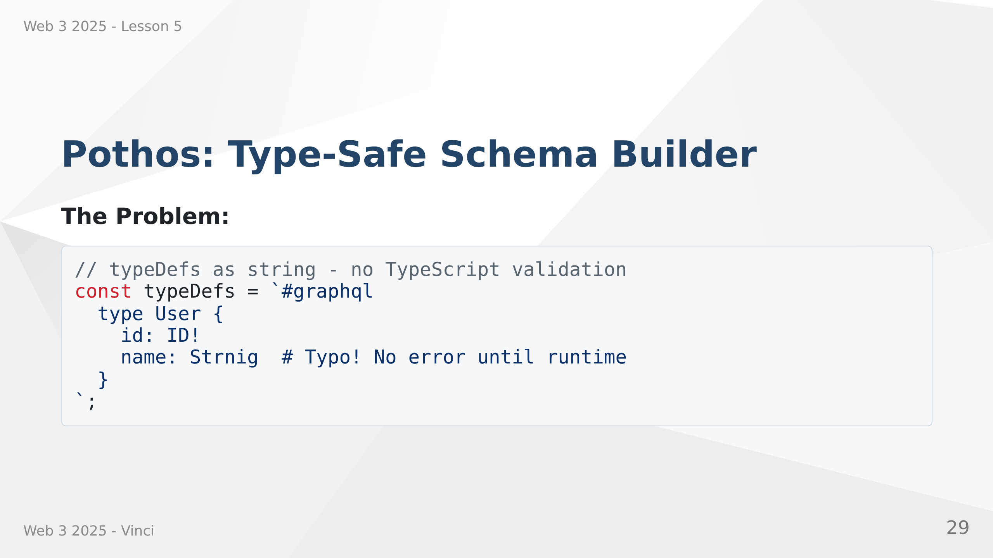

Slide 30
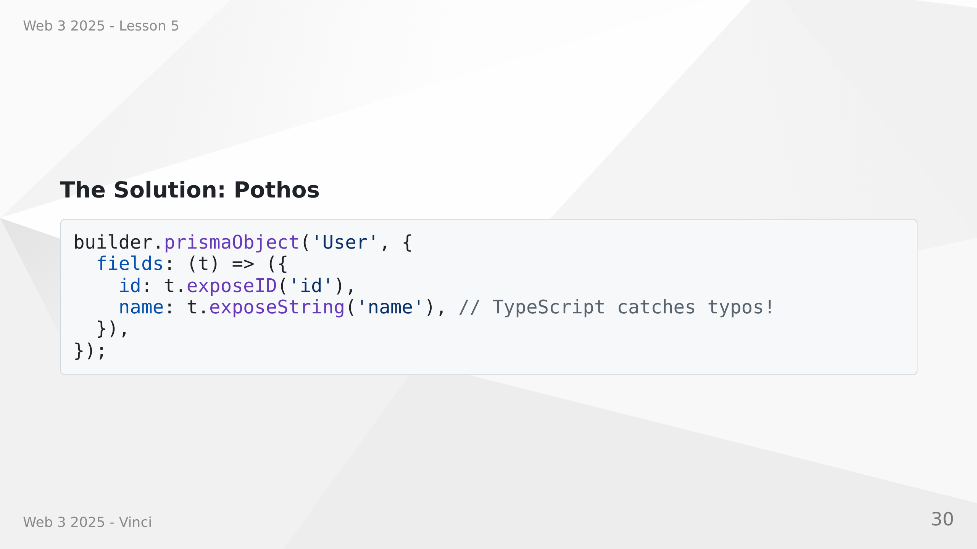
Notes:
Speaker Notes:
• Raw GraphQL schema is strings - no type safety
• Pothos builds schema with TypeScript
• Catch errors at compile time, not runtime
• Better IDE support with autocomplete
• Integrates with Prisma for automatic types

Slide 31
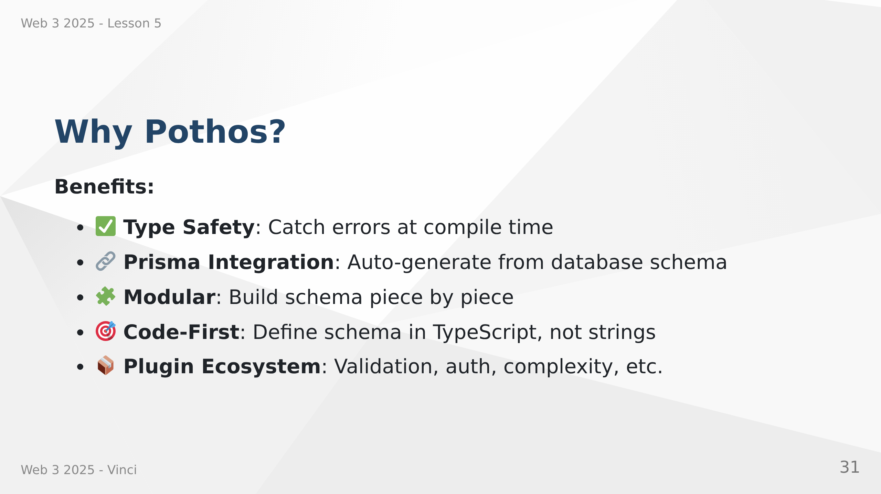

Slide 32
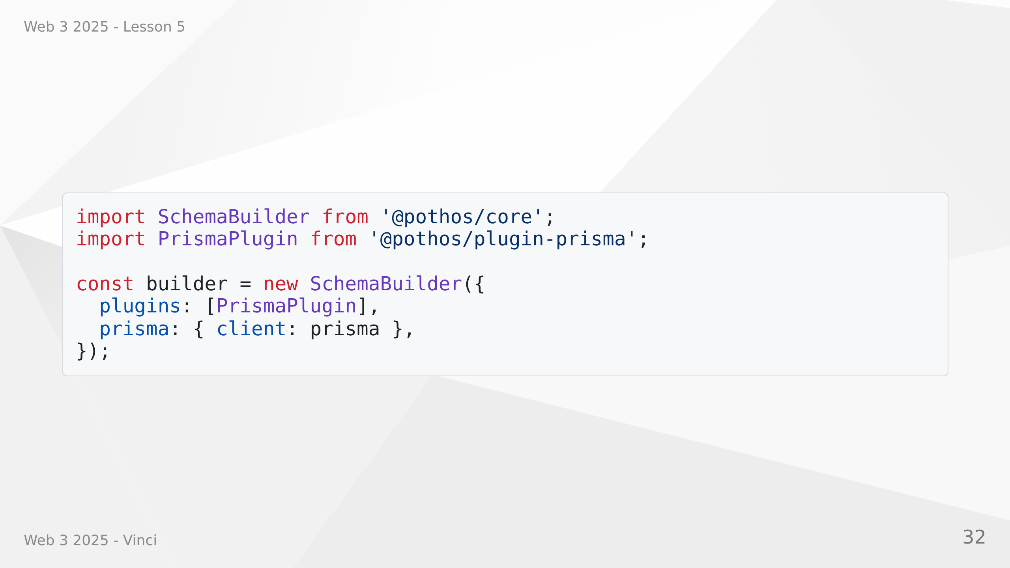
Notes:
Speaker Notes:
• Pothos is code-first vs schema-first approach
• Better developer experience with TypeScript
• Catches errors early in development
• Plugins add powerful features
• Prisma plugin generates types from database

Slide 33
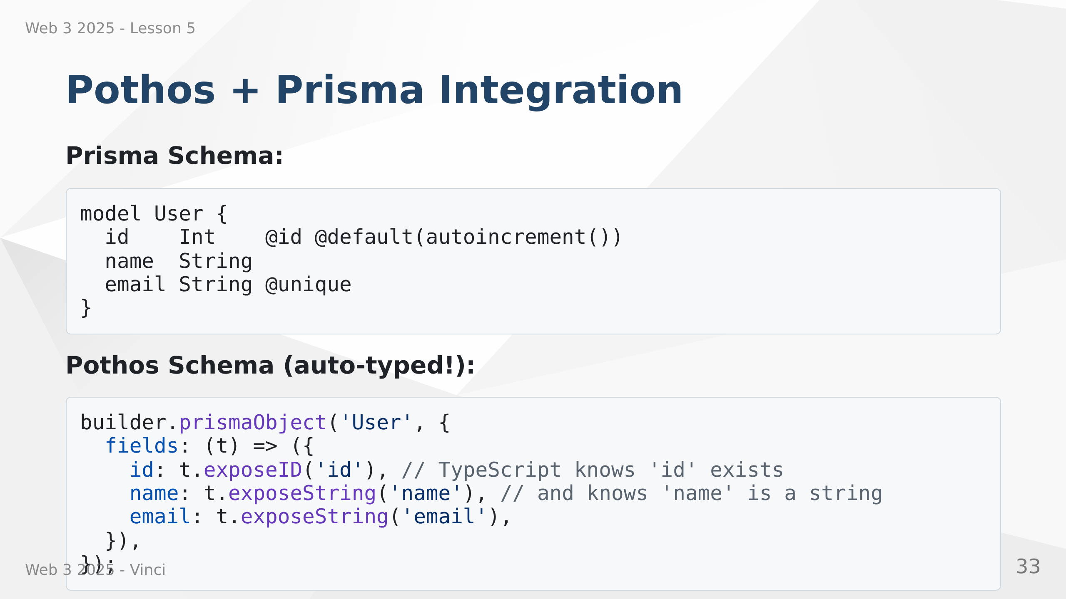
Notes:
Speaker Notes:
• Prisma generates TypeScript types from database
• Pothos uses those types for GraphQL schema
• End-to-end type safety: Database → API → Frontend
• Change database schema, TypeScript catches GraphQL issues
• No manual type duplication

Slide 34
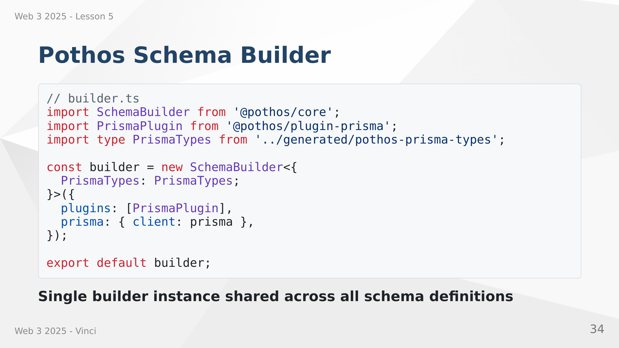
Notes:
Speaker Notes:
• Builder is central to Pothos
• Configure once, use everywhere
• PrismaTypes generated automatically
• Plugins extend functionality
• Export and reuse in all schema files

Slide 35
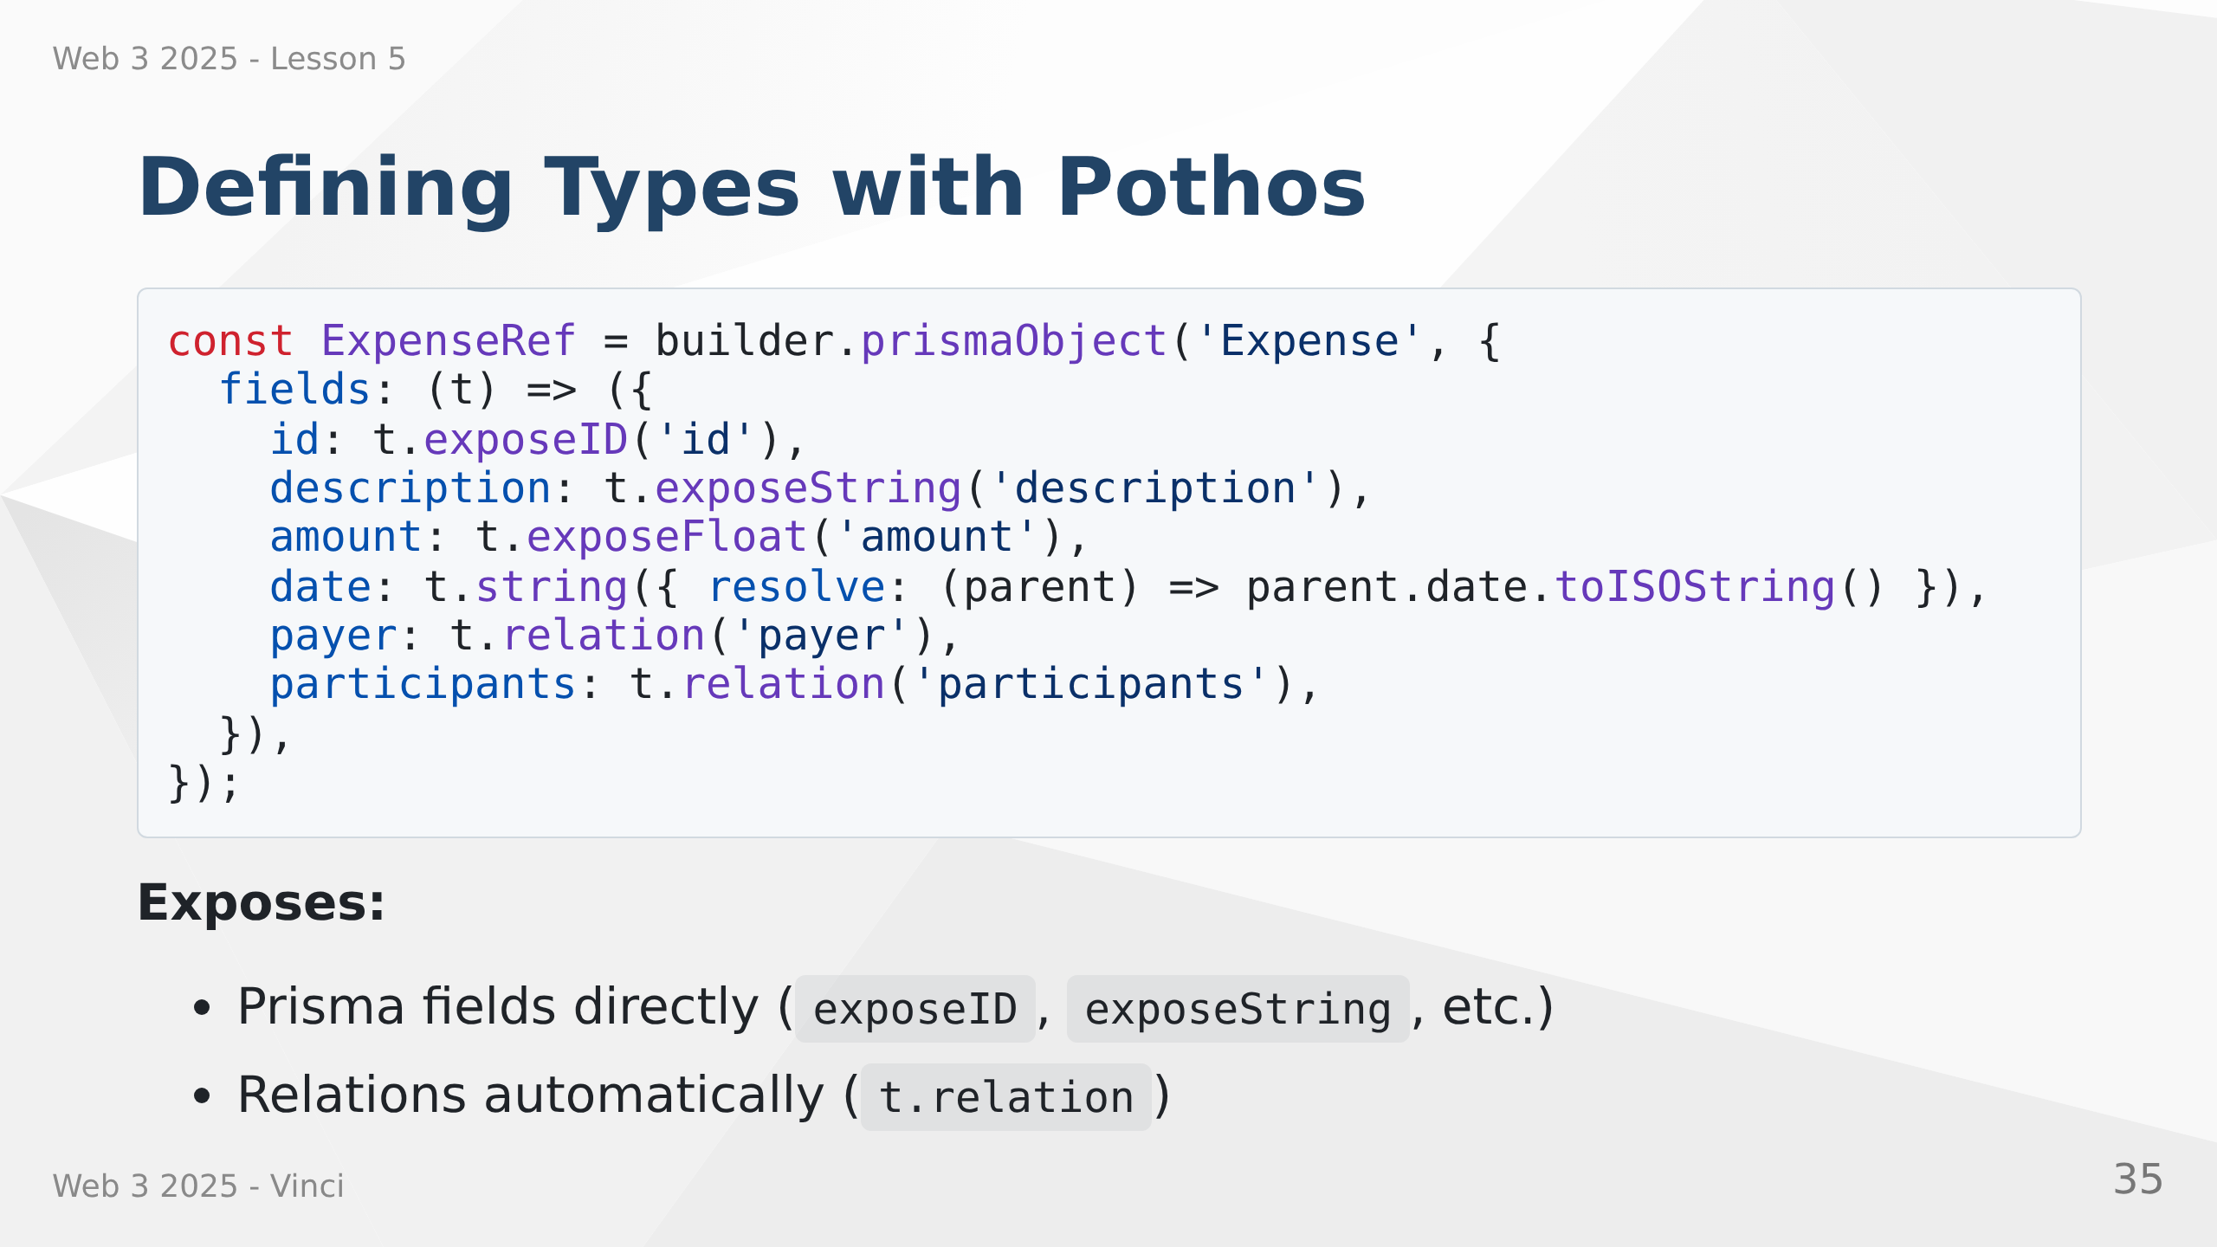
Notes:
Speaker Notes:
• prismaObject maps GraphQL type to Prisma model
• t.expose methods for simple fields
• t.relation for relationships - Pothos handles joins
• Type parameter ensures type safety
• Can add computed fields not in database

Slide 36
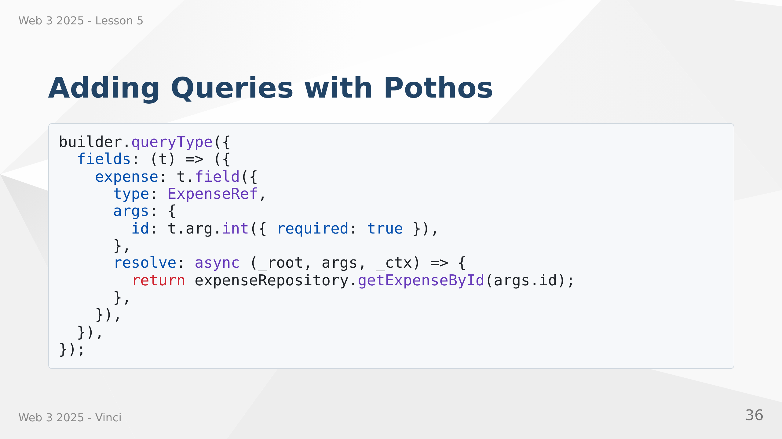

Slide 37
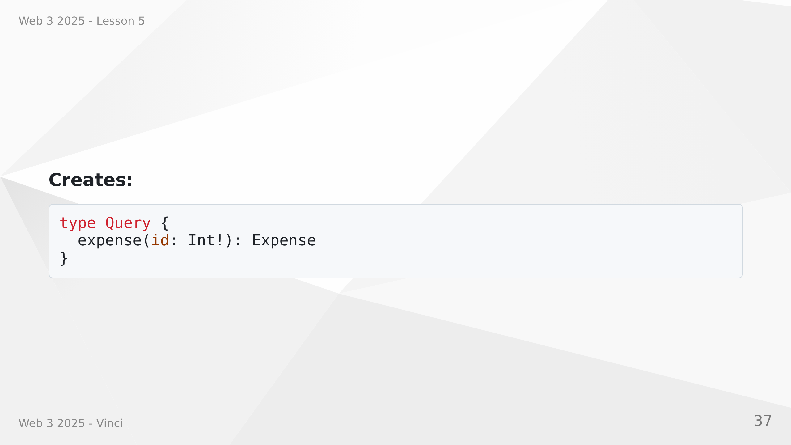
Notes:
Speaker Notes:
• queryType adds to Query type
• t.field defines individual query
• args define input parameters with types
• resolve function fetches the data
• Can call existing repository code

Slide 38
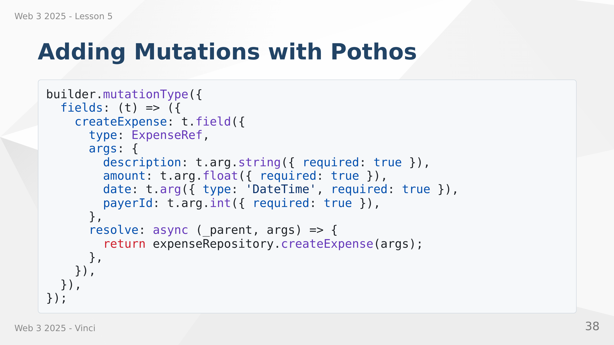
Notes:
Speaker Notes:
• mutationType adds to Mutation type
• Same pattern as queries
• Multiple arguments with types
• Returns created object
• Type-safe args object

Slide 39
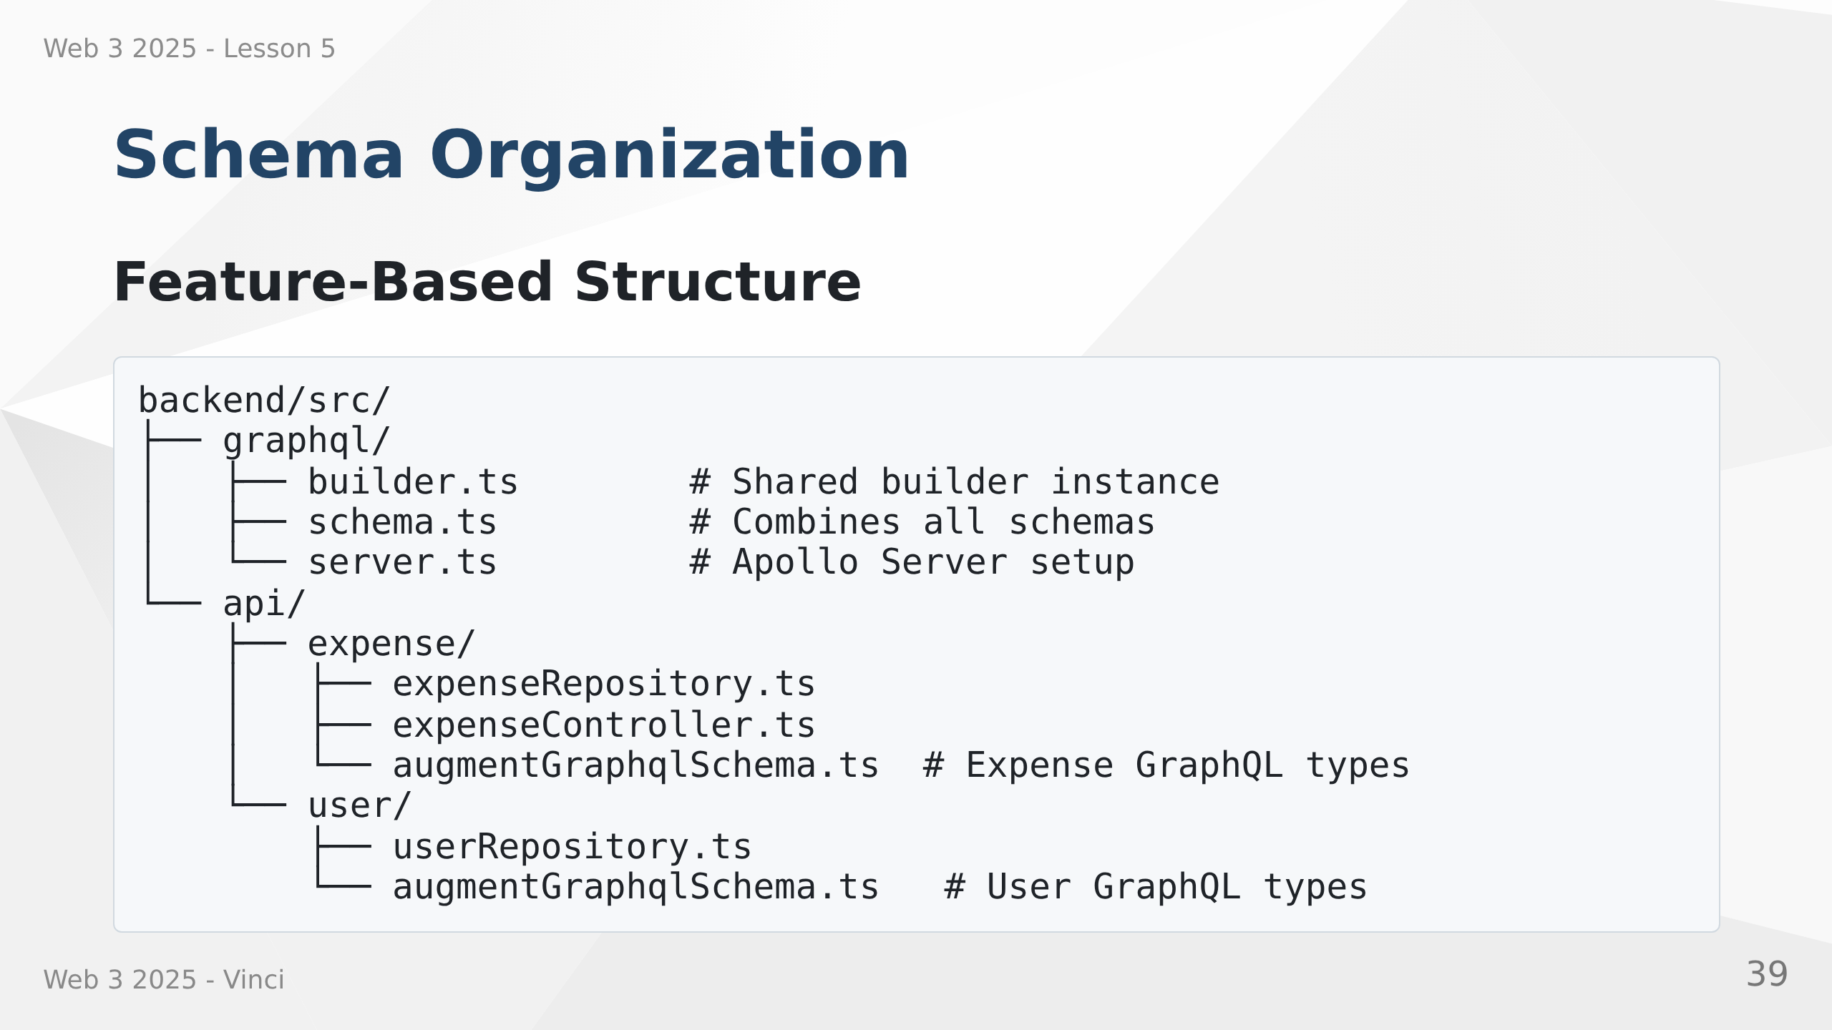
Notes:
Speaker Notes:
• Organize by feature, not by layer
• Each feature defines its own GraphQL types
• Keeps related code together
• Easy to find and modify
• Scales better than one large schema file

Slide 40
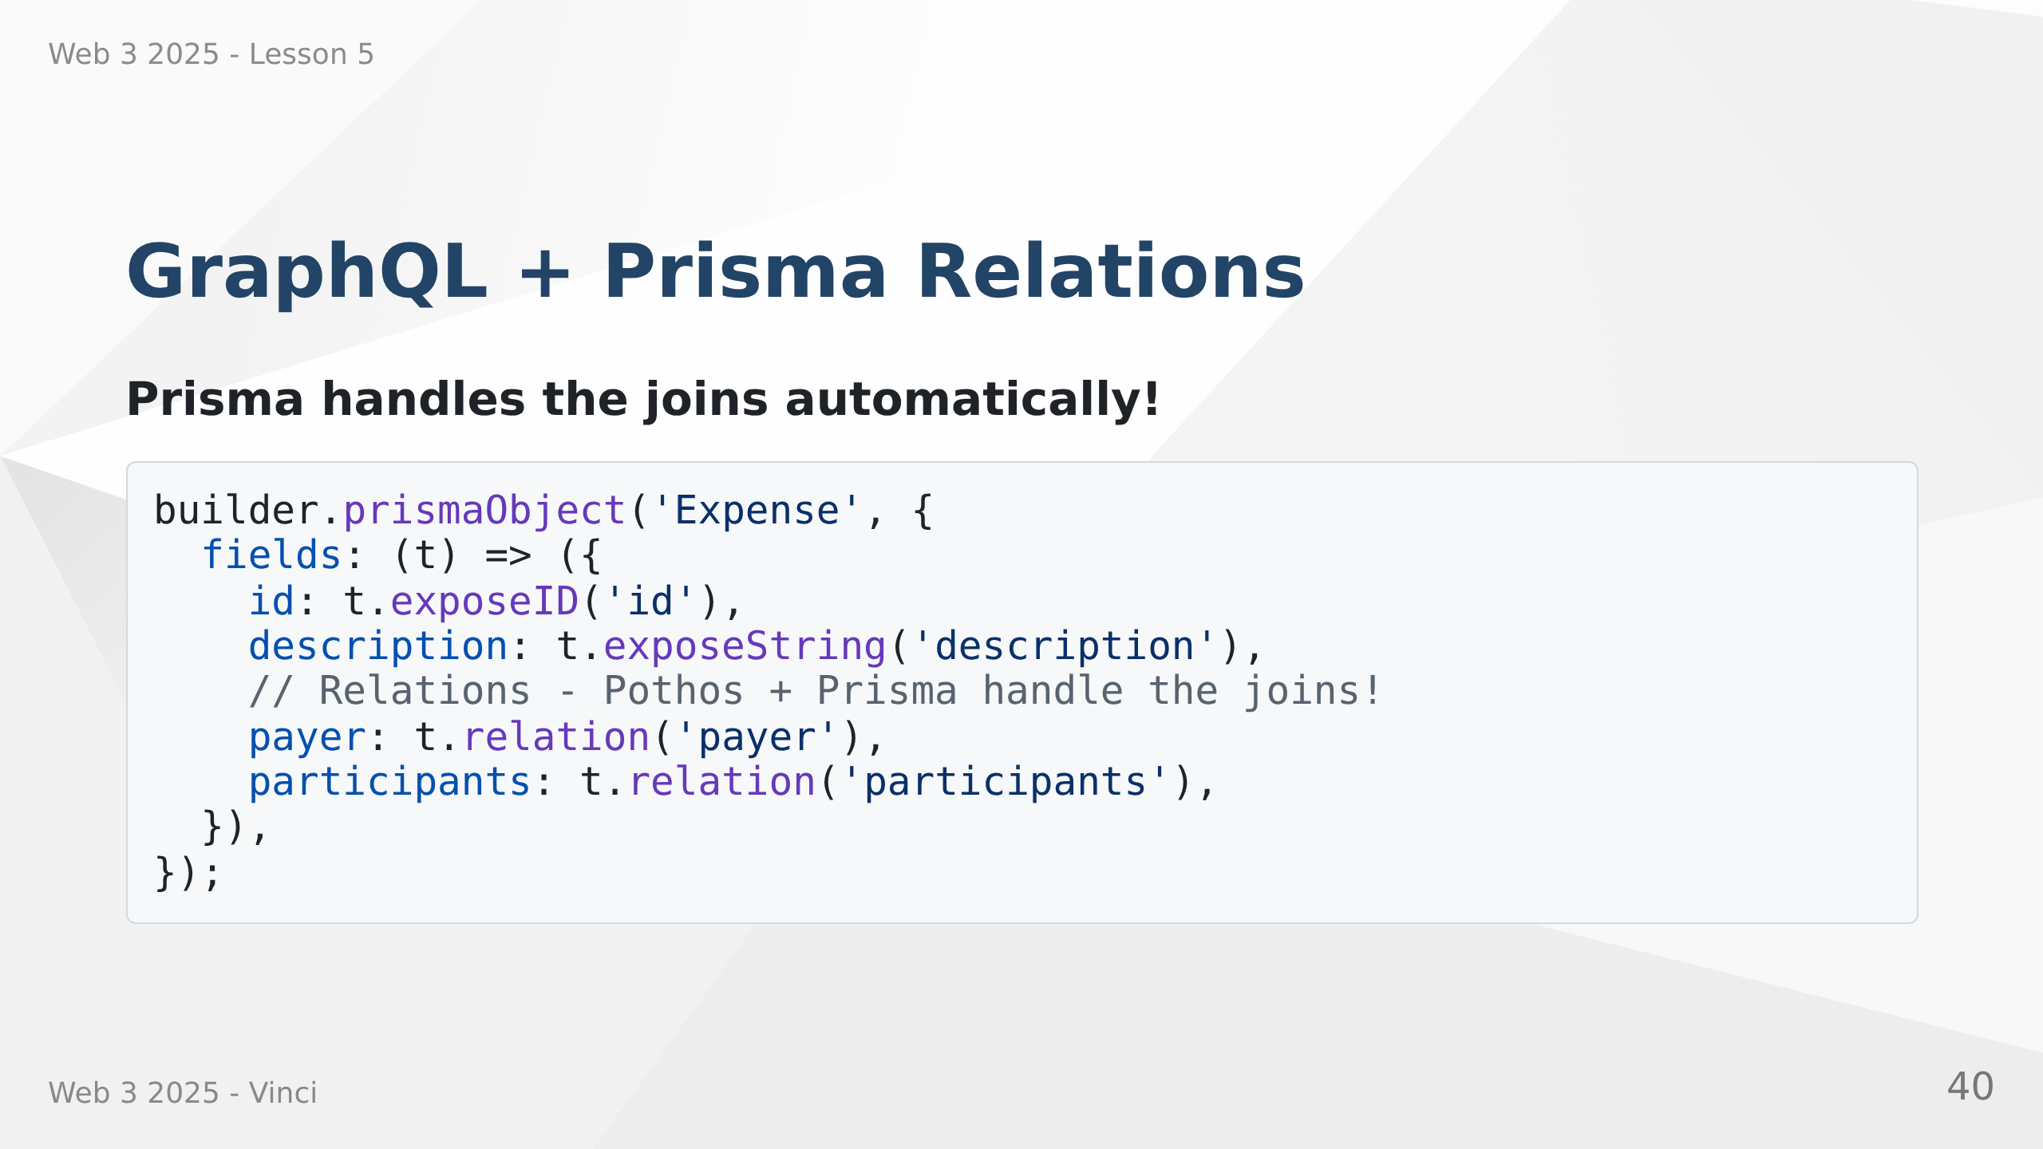

Slide 41
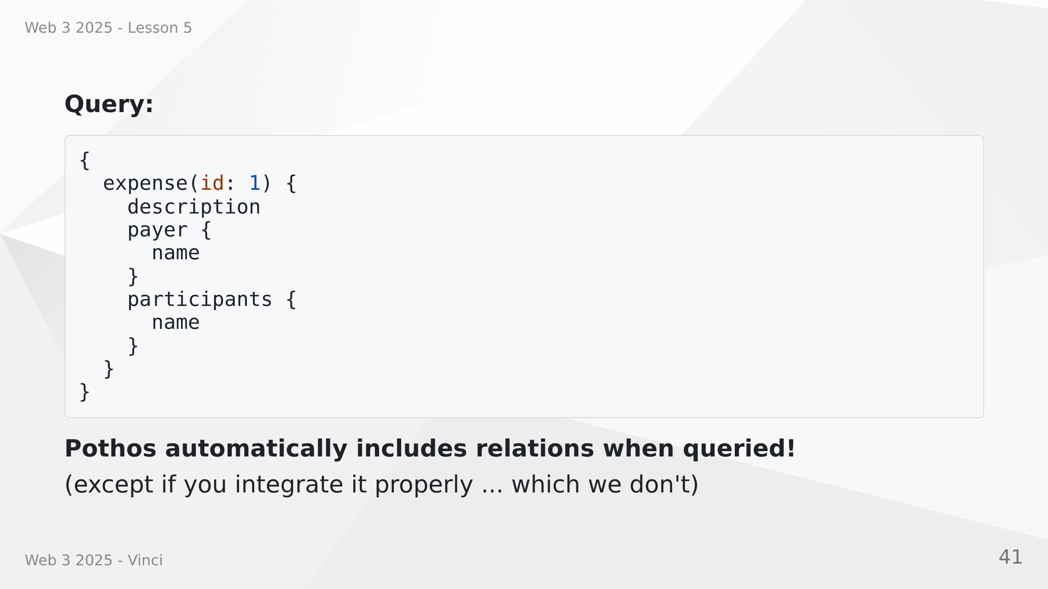
Notes:
Speaker Notes:
• t.relation leverages Prisma relationships
• Pothos generates efficient database queries
• Only fetches relations when requested in query
• Includes necessary joins automatically
• No N+1 queries - optimized by default

Slide 42
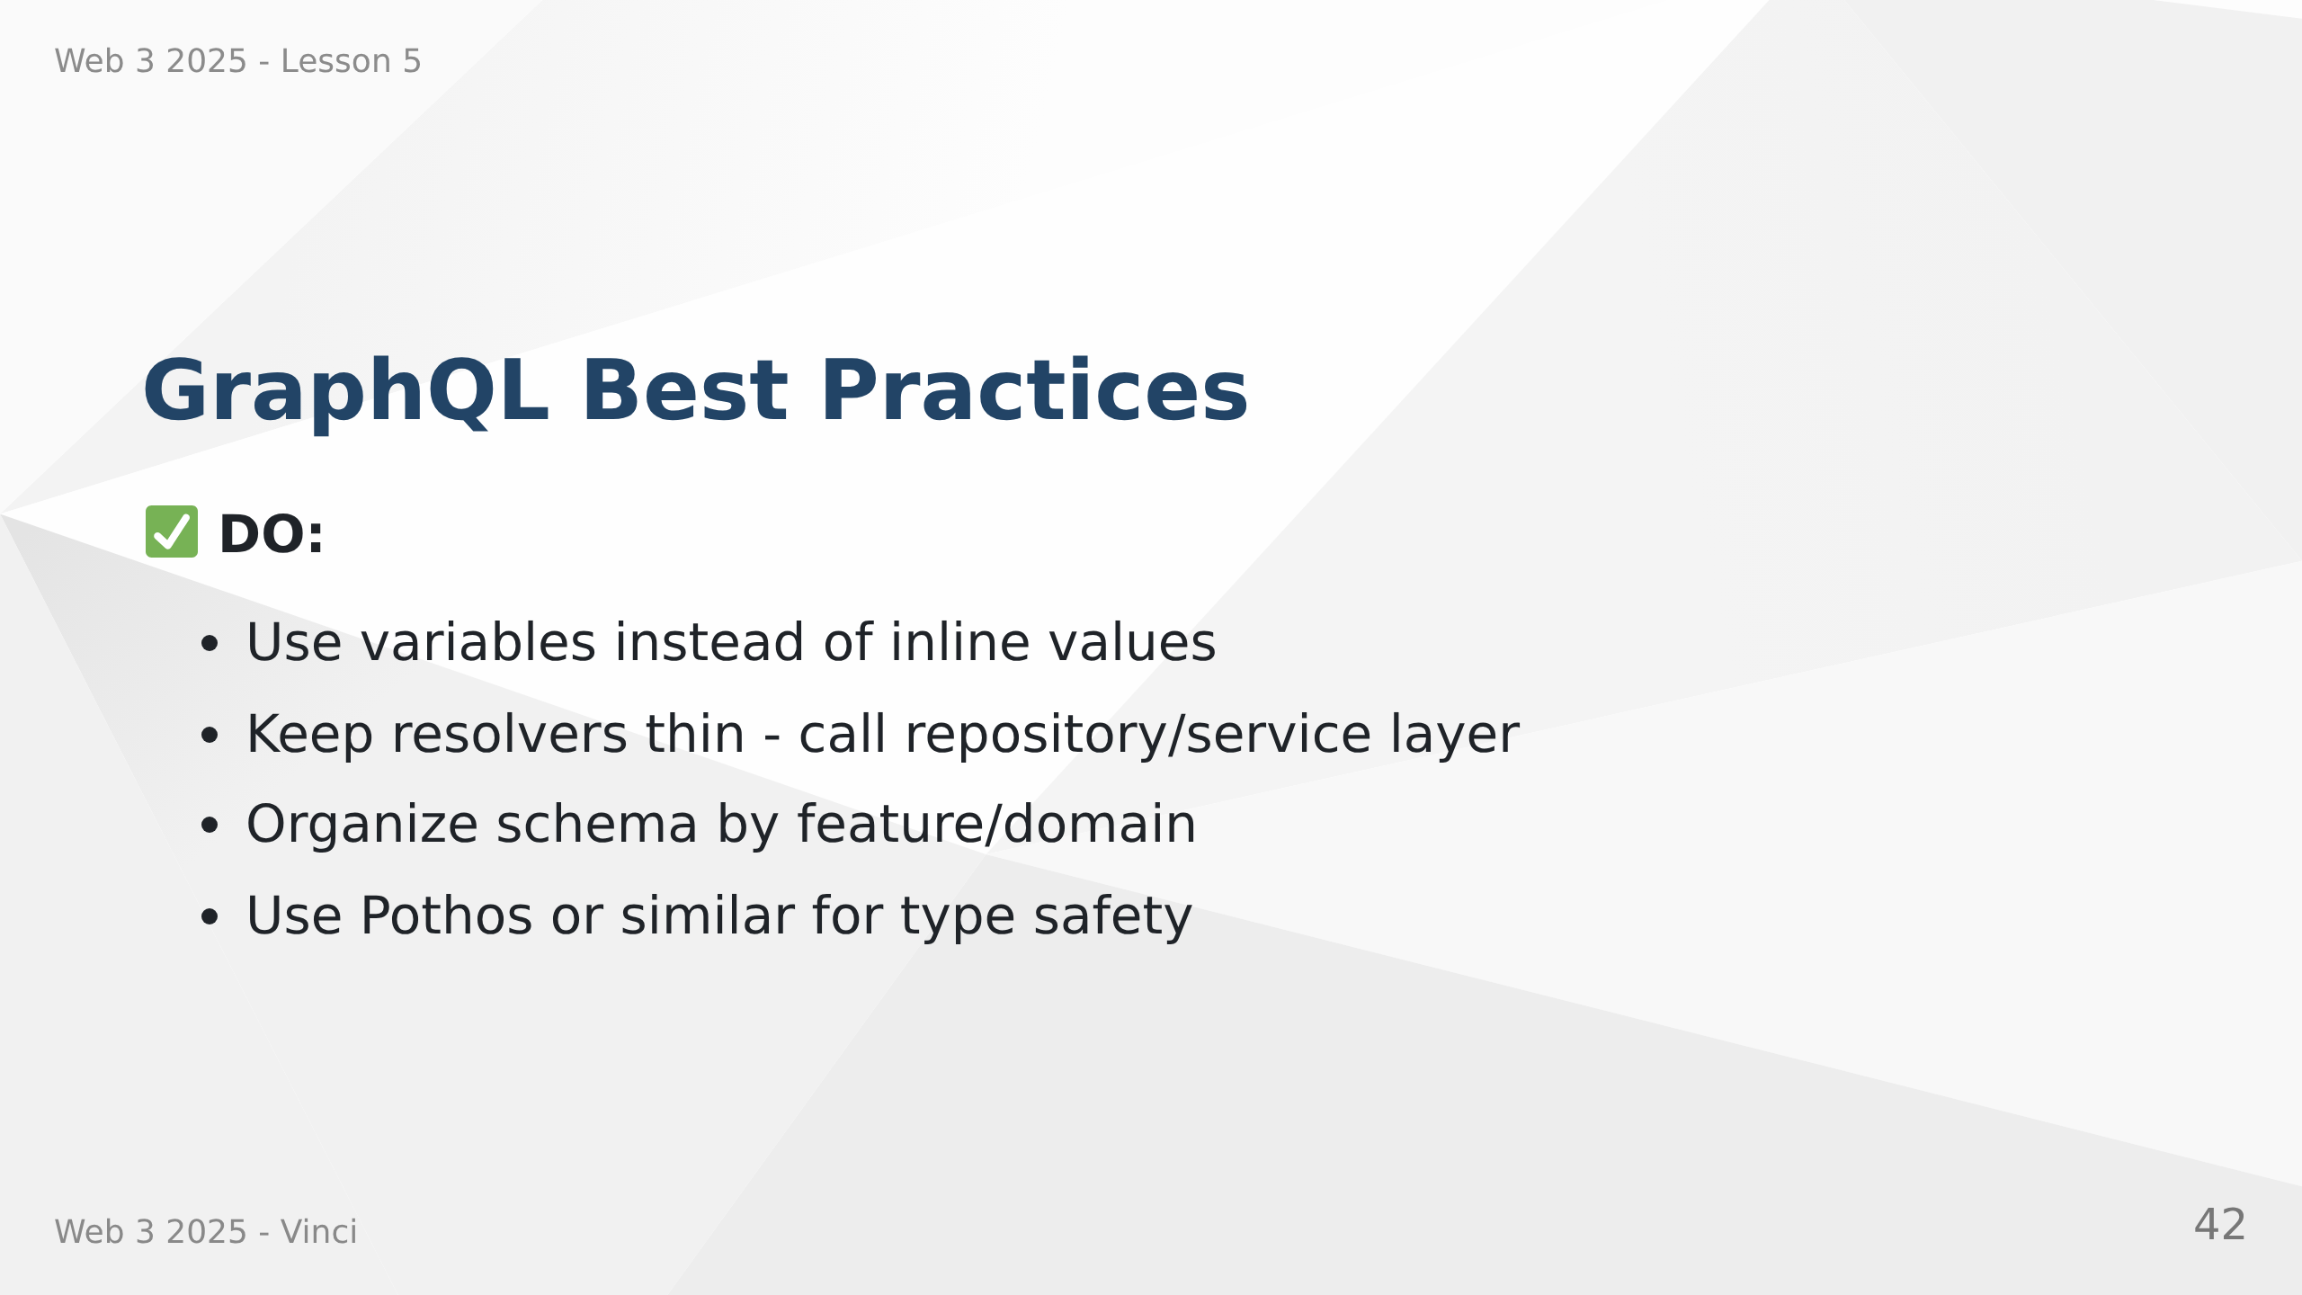

Slide 43
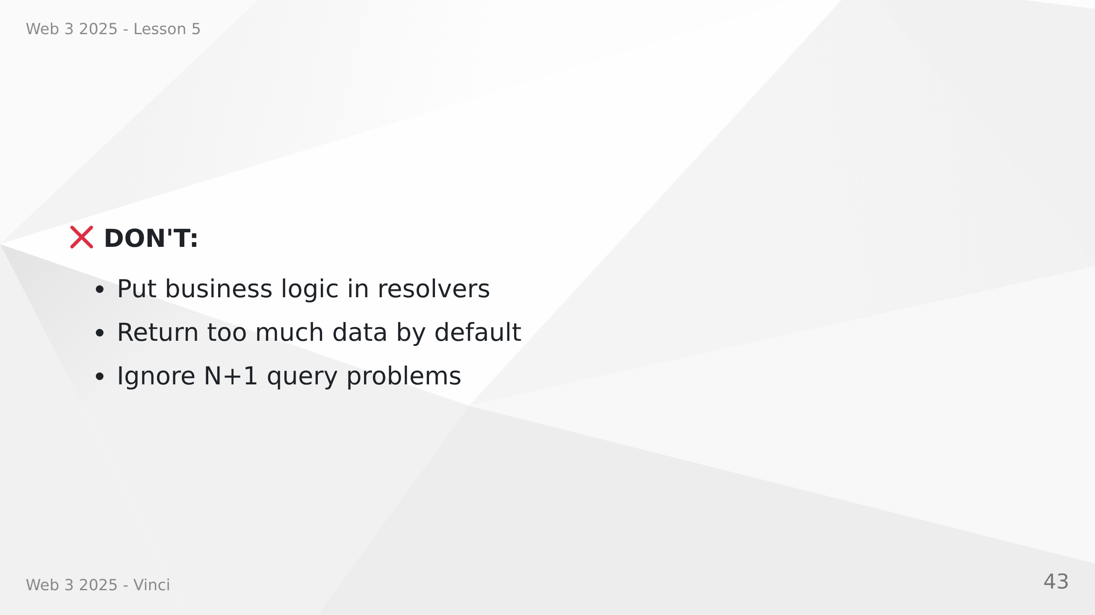
Notes:
Speaker Notes:
• Resolvers should delegate to business logic
• Schema organization matters as it grows
• Type safety prevents entire classes of bugs
• Documentation helps frontend developers
• Security and performance are ongoing concerns

Slide 44
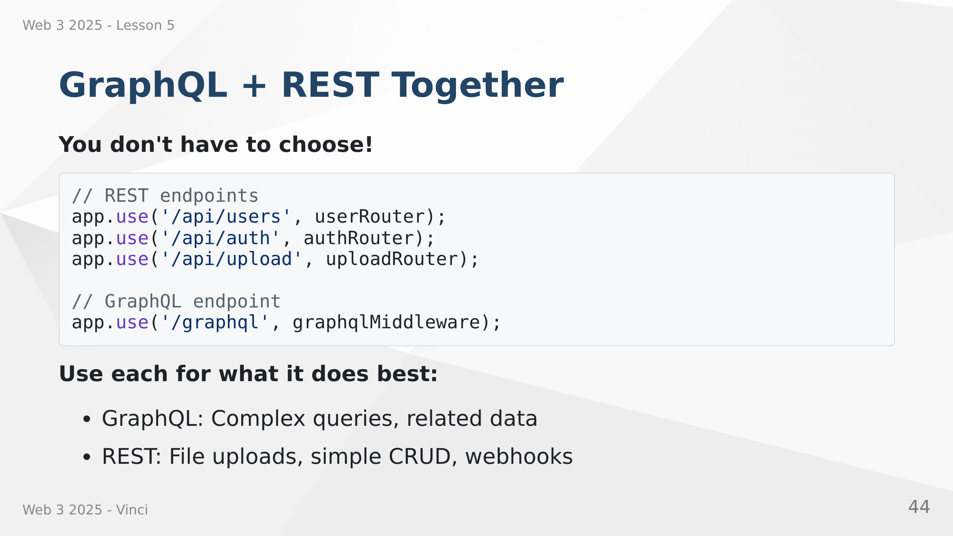
Notes:
Speaker Notes:
• Both can coexist in same application
• Use GraphQL for complex data fetching
• Keep REST for file uploads, downloads, webhooks
• Gradual migration possible
• Start with GraphQL for new features
• No need to rewrite everything at once

Slide 45
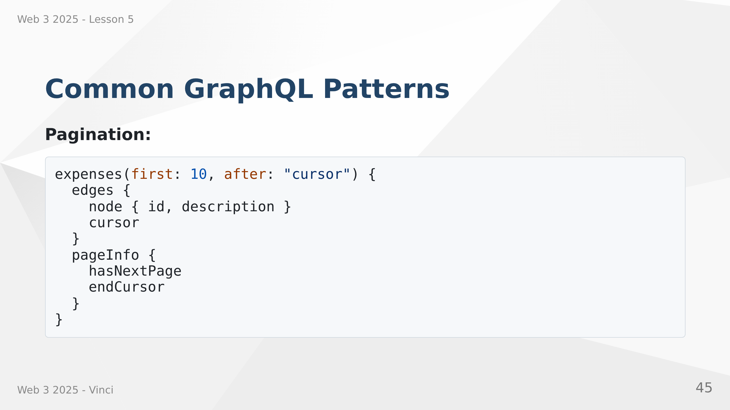

Slide 46
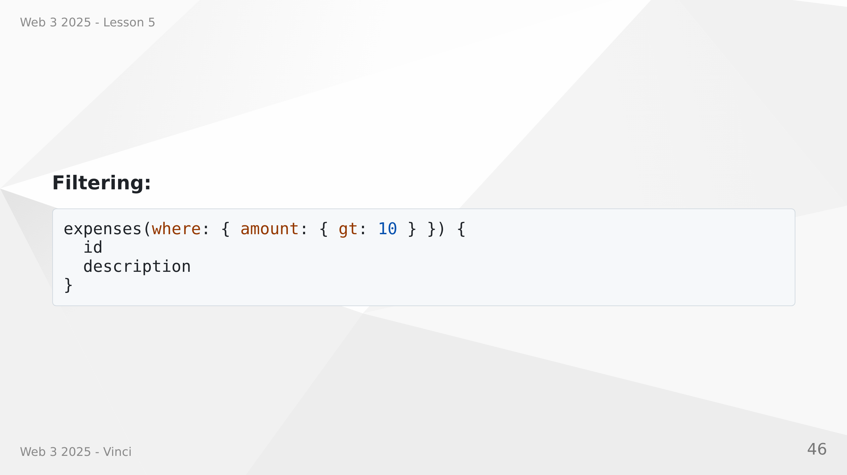
Notes:
Speaker Notes:
• Cursor-based pagination for large datasets
• Relay-style connections common pattern
• Filtering through where argument
• Can build complex query capabilities
• GraphQL specification doesn't mandate these
• Community conventions for consistency

Slide 47
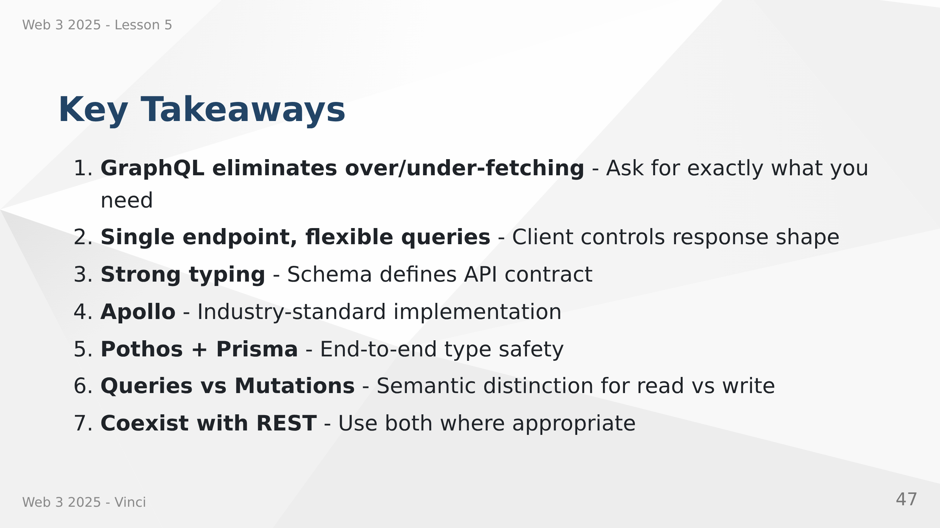
Notes:
Speaker Notes:
• GraphQL solves real problems with REST
• Not a replacement but a complement
• Type safety from database to frontend
• Tools and ecosystem are mature
• Production-ready for most use cases
• Consider team experience and project needs

Slide 48
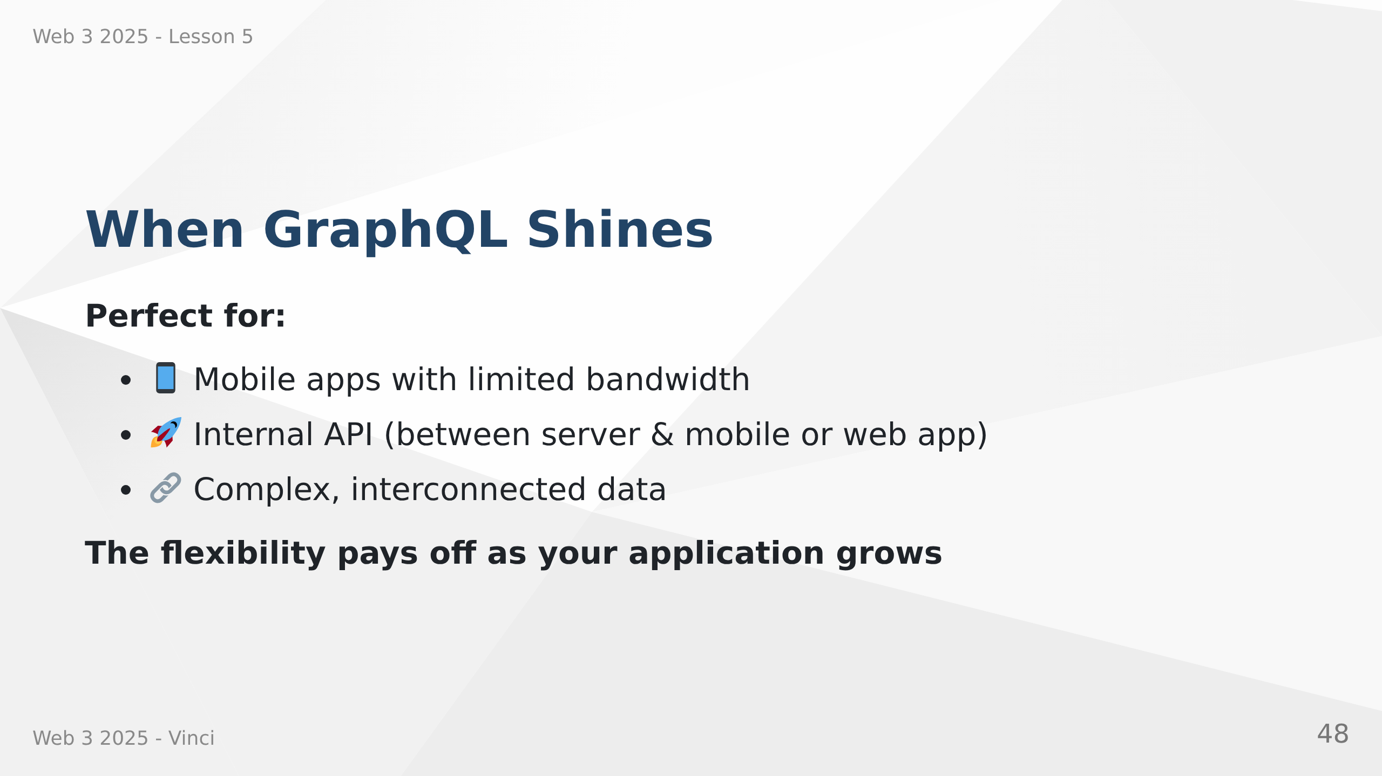
Notes:
Speaker Notes:
• Mobile benefits from reduced data transfer
• Different clients can request different fields
• Natural fit for graph-like data structures
• Frontend can evolve without backend changes
• GraphQL can aggregate multiple services
• Initial setup overhead worth it for complex apps

