Slide 1
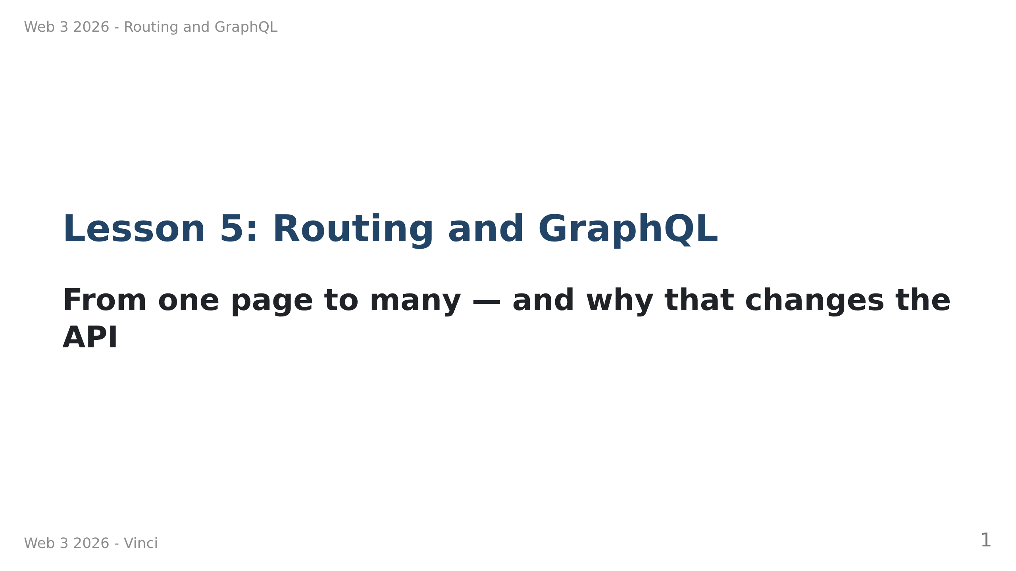
Notes:
Speaker notes:
• Two topics, but they are one story: routing creates the problem GraphQL solves.
• Order matters today. Don't jump ahead to GraphQL.
• Ask: who has used a site where the back button did nothing? That's today's starting point.

Slide 2
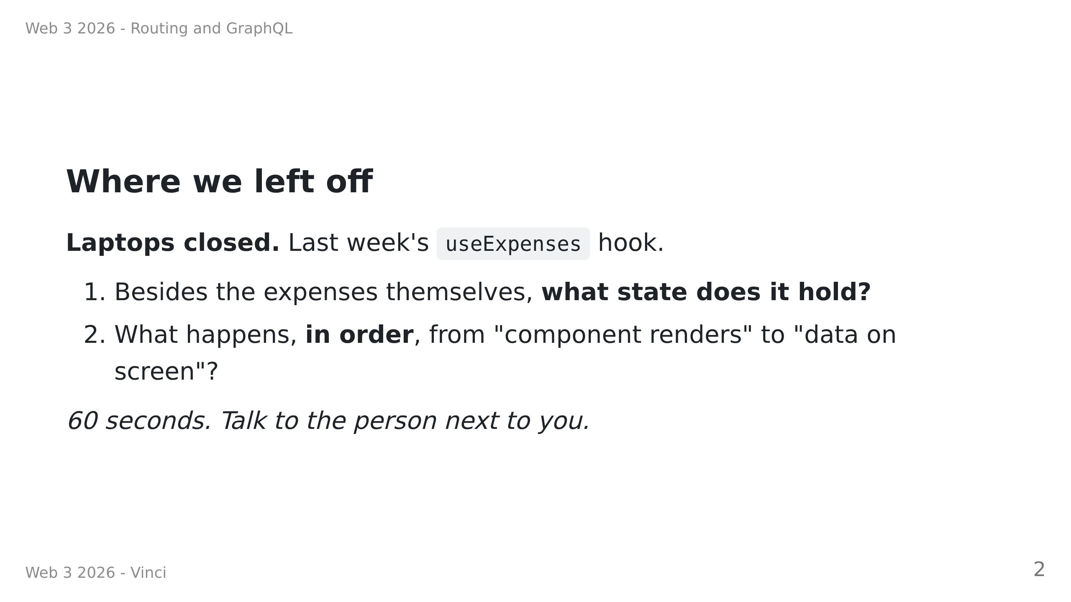
Notes:
Speaker notes — RETRIEVAL, not revision. Do not answer it for them.
Answers: (1) a `loading` flag, usually an error too.
(2) component renders with an empty list → useEffect fires → fetch → setState → re-render.
Make someone say the ORDER out loud — "renders first, data second" is the whole point.
Why open this way: in twenty minutes we delete every piece of this. They can only notice
what vanished if the old pattern is active in their head right now. Show them a loader
cold and they will nod and learn nothing.

Slide 3
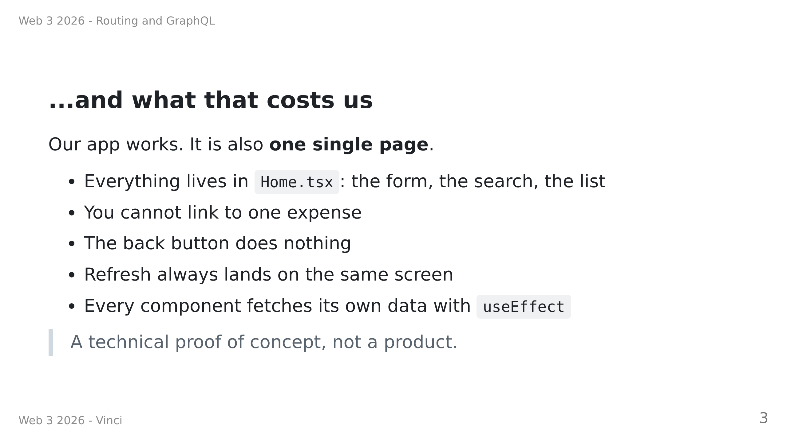

Slide 4
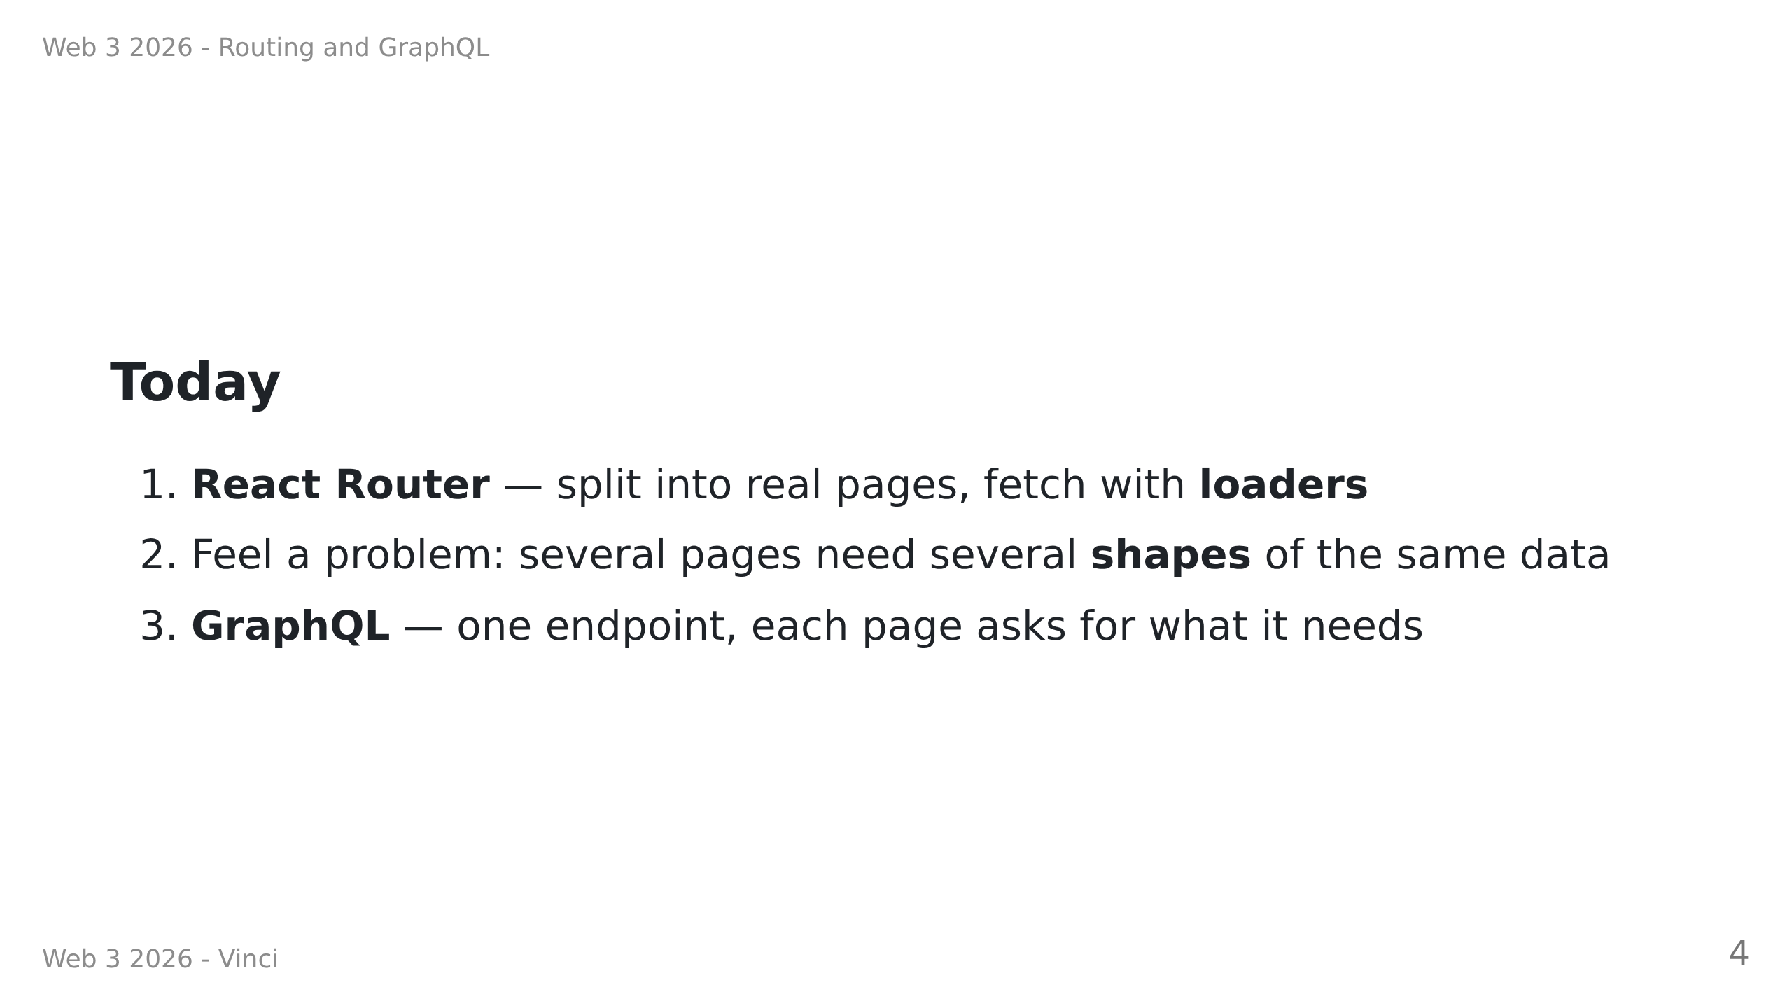
Notes:
Speaker notes:
• Emphasise step 2. Students who skip it think GraphQL is just "REST with extra steps".
• The pain is the point.

Slide 5
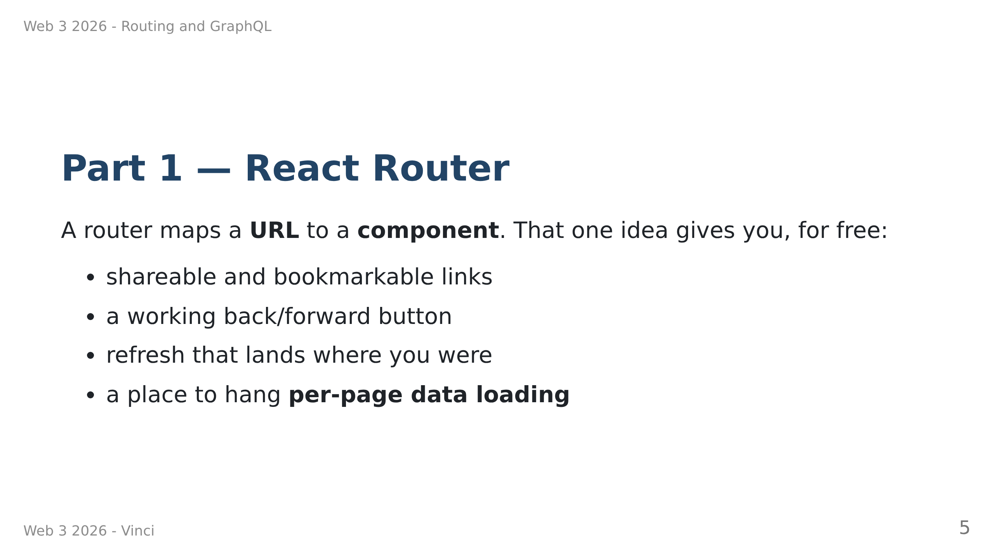

Slide 6
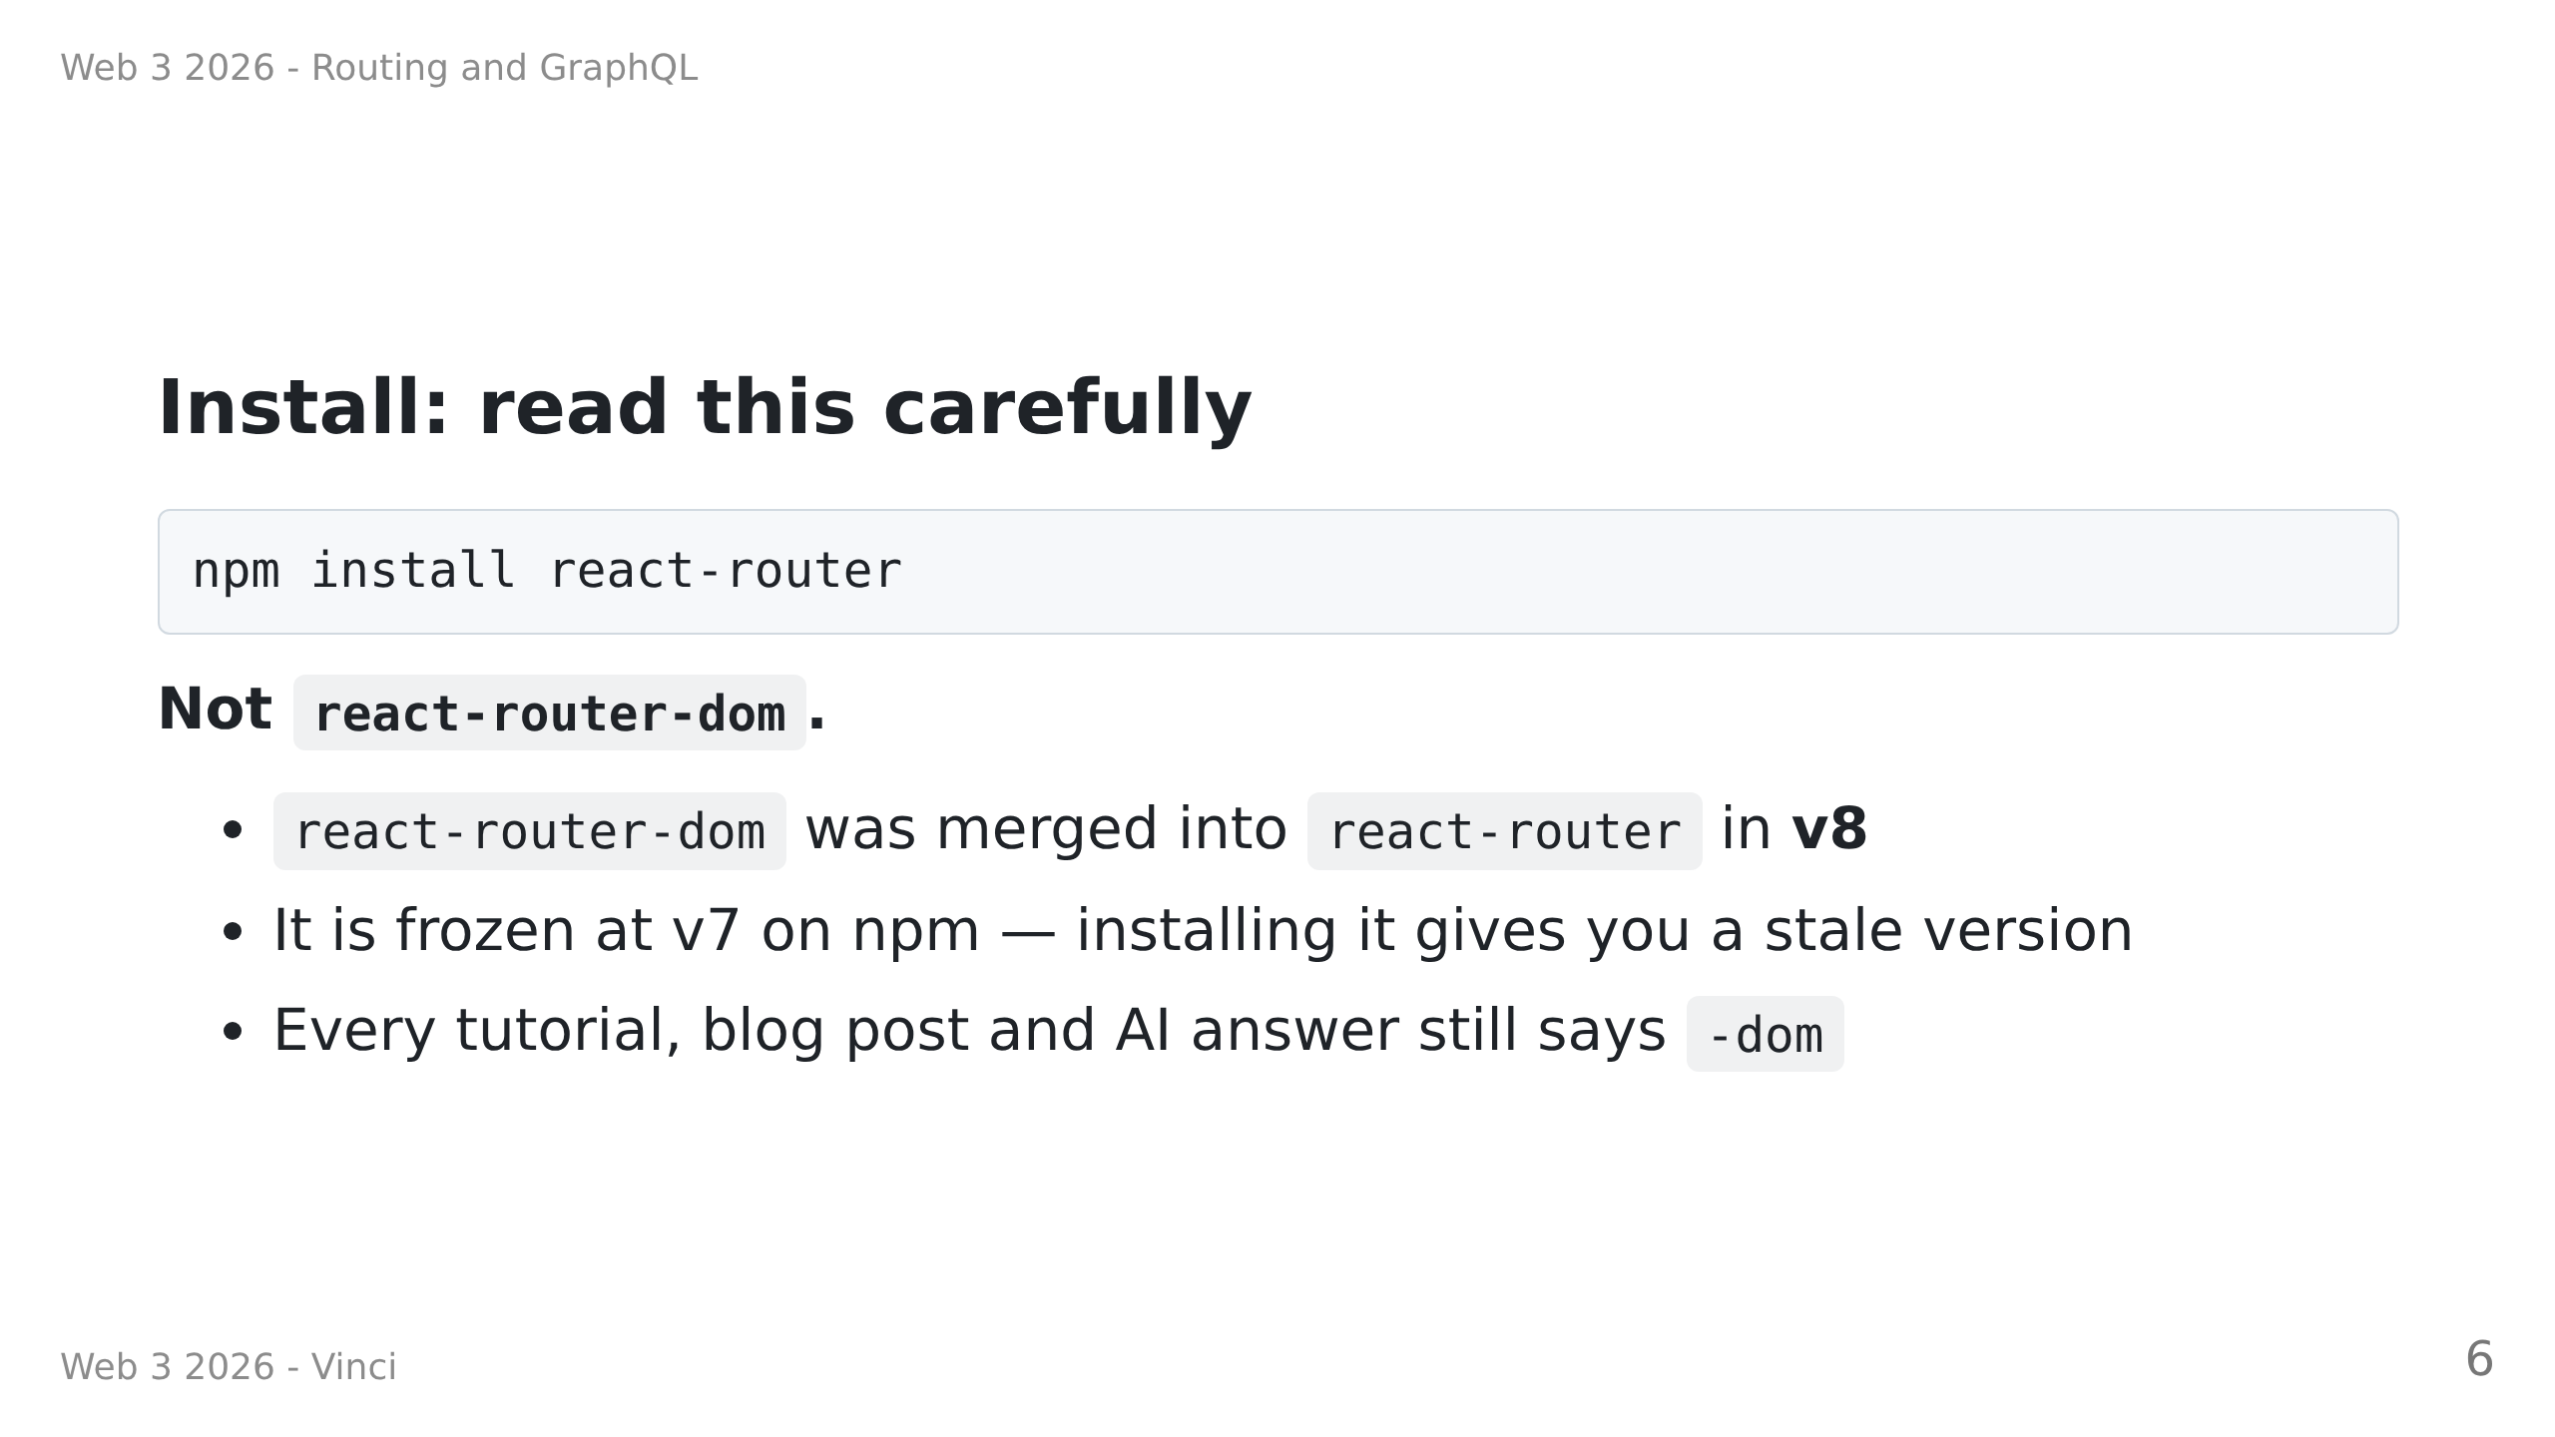
Notes:
Speaker notes:
• This WILL bite people. Say it twice.
• If a student has weird import errors, this is the first thing to check.

Slide 7
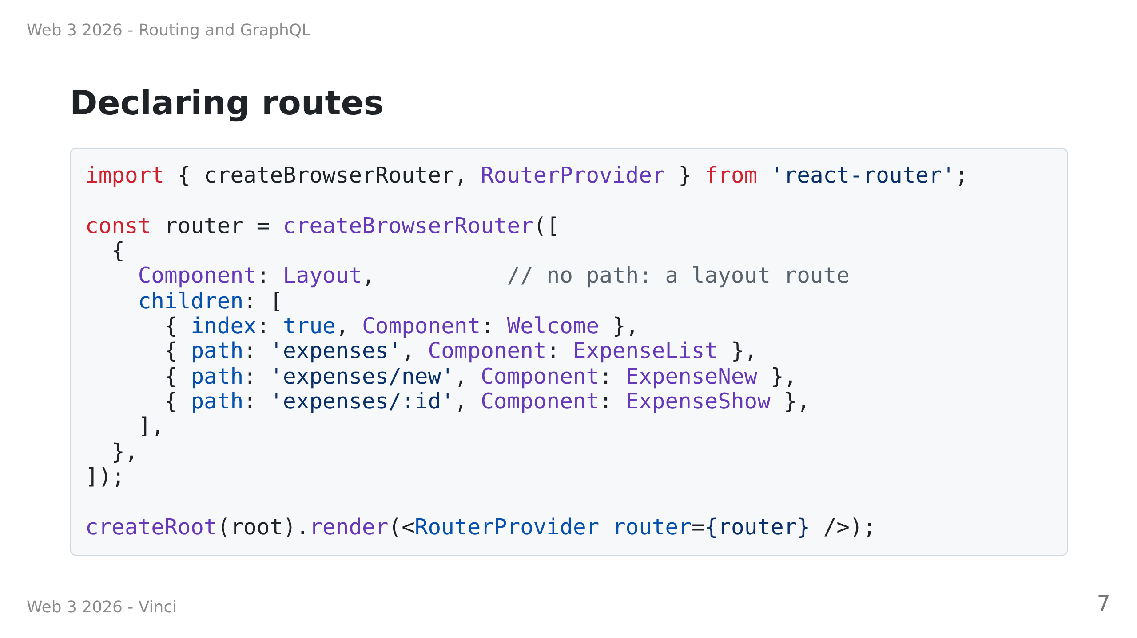

Slide 8
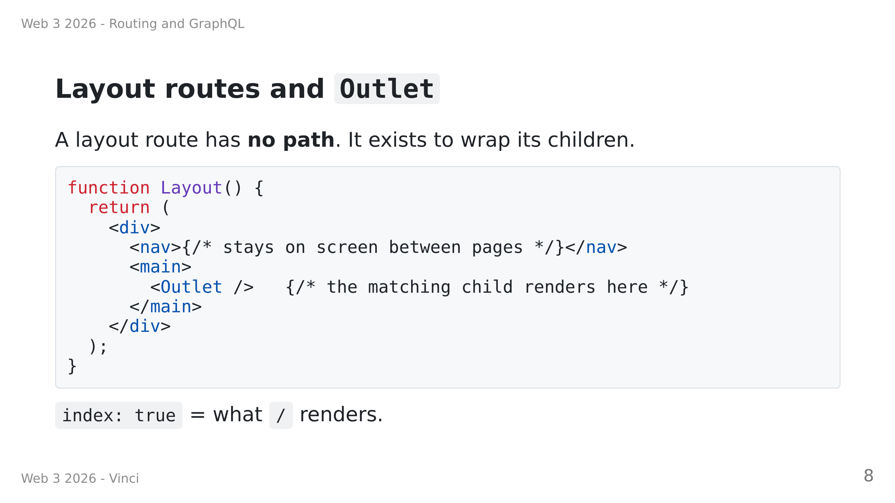

Slide 9
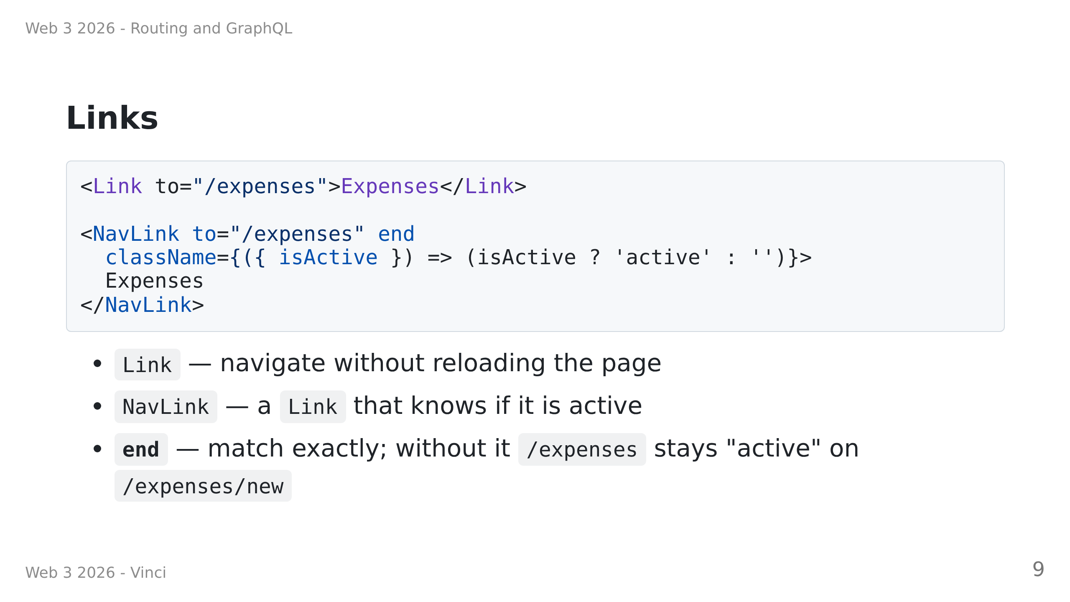

Slide 10
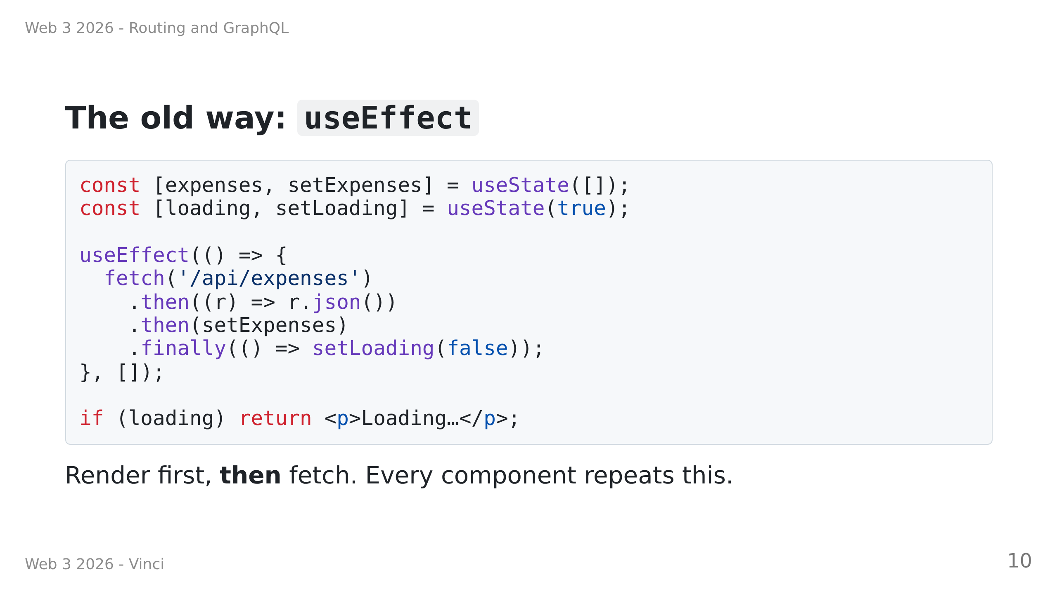

Slide 11
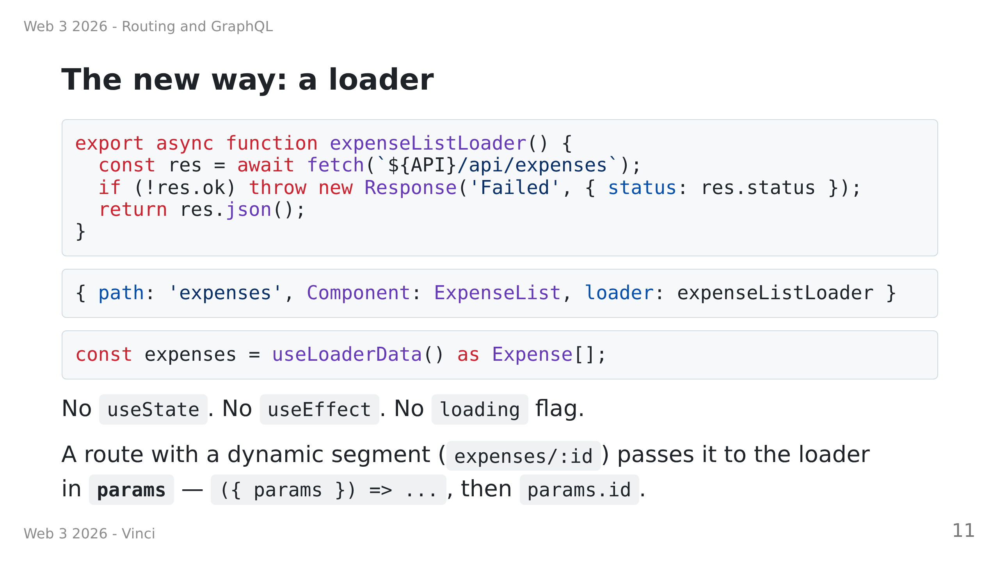
Notes:
Speaker notes:
• The router knows which page it is about to render, so it can fetch BEFORE rendering.
• The component becomes a pure function of its data. That is the real win.

Slide 12
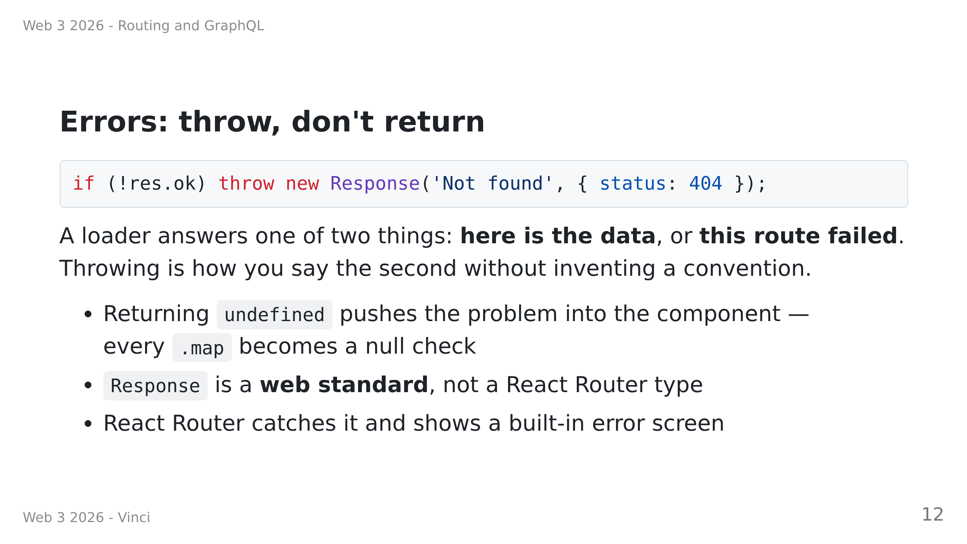

Slide 13
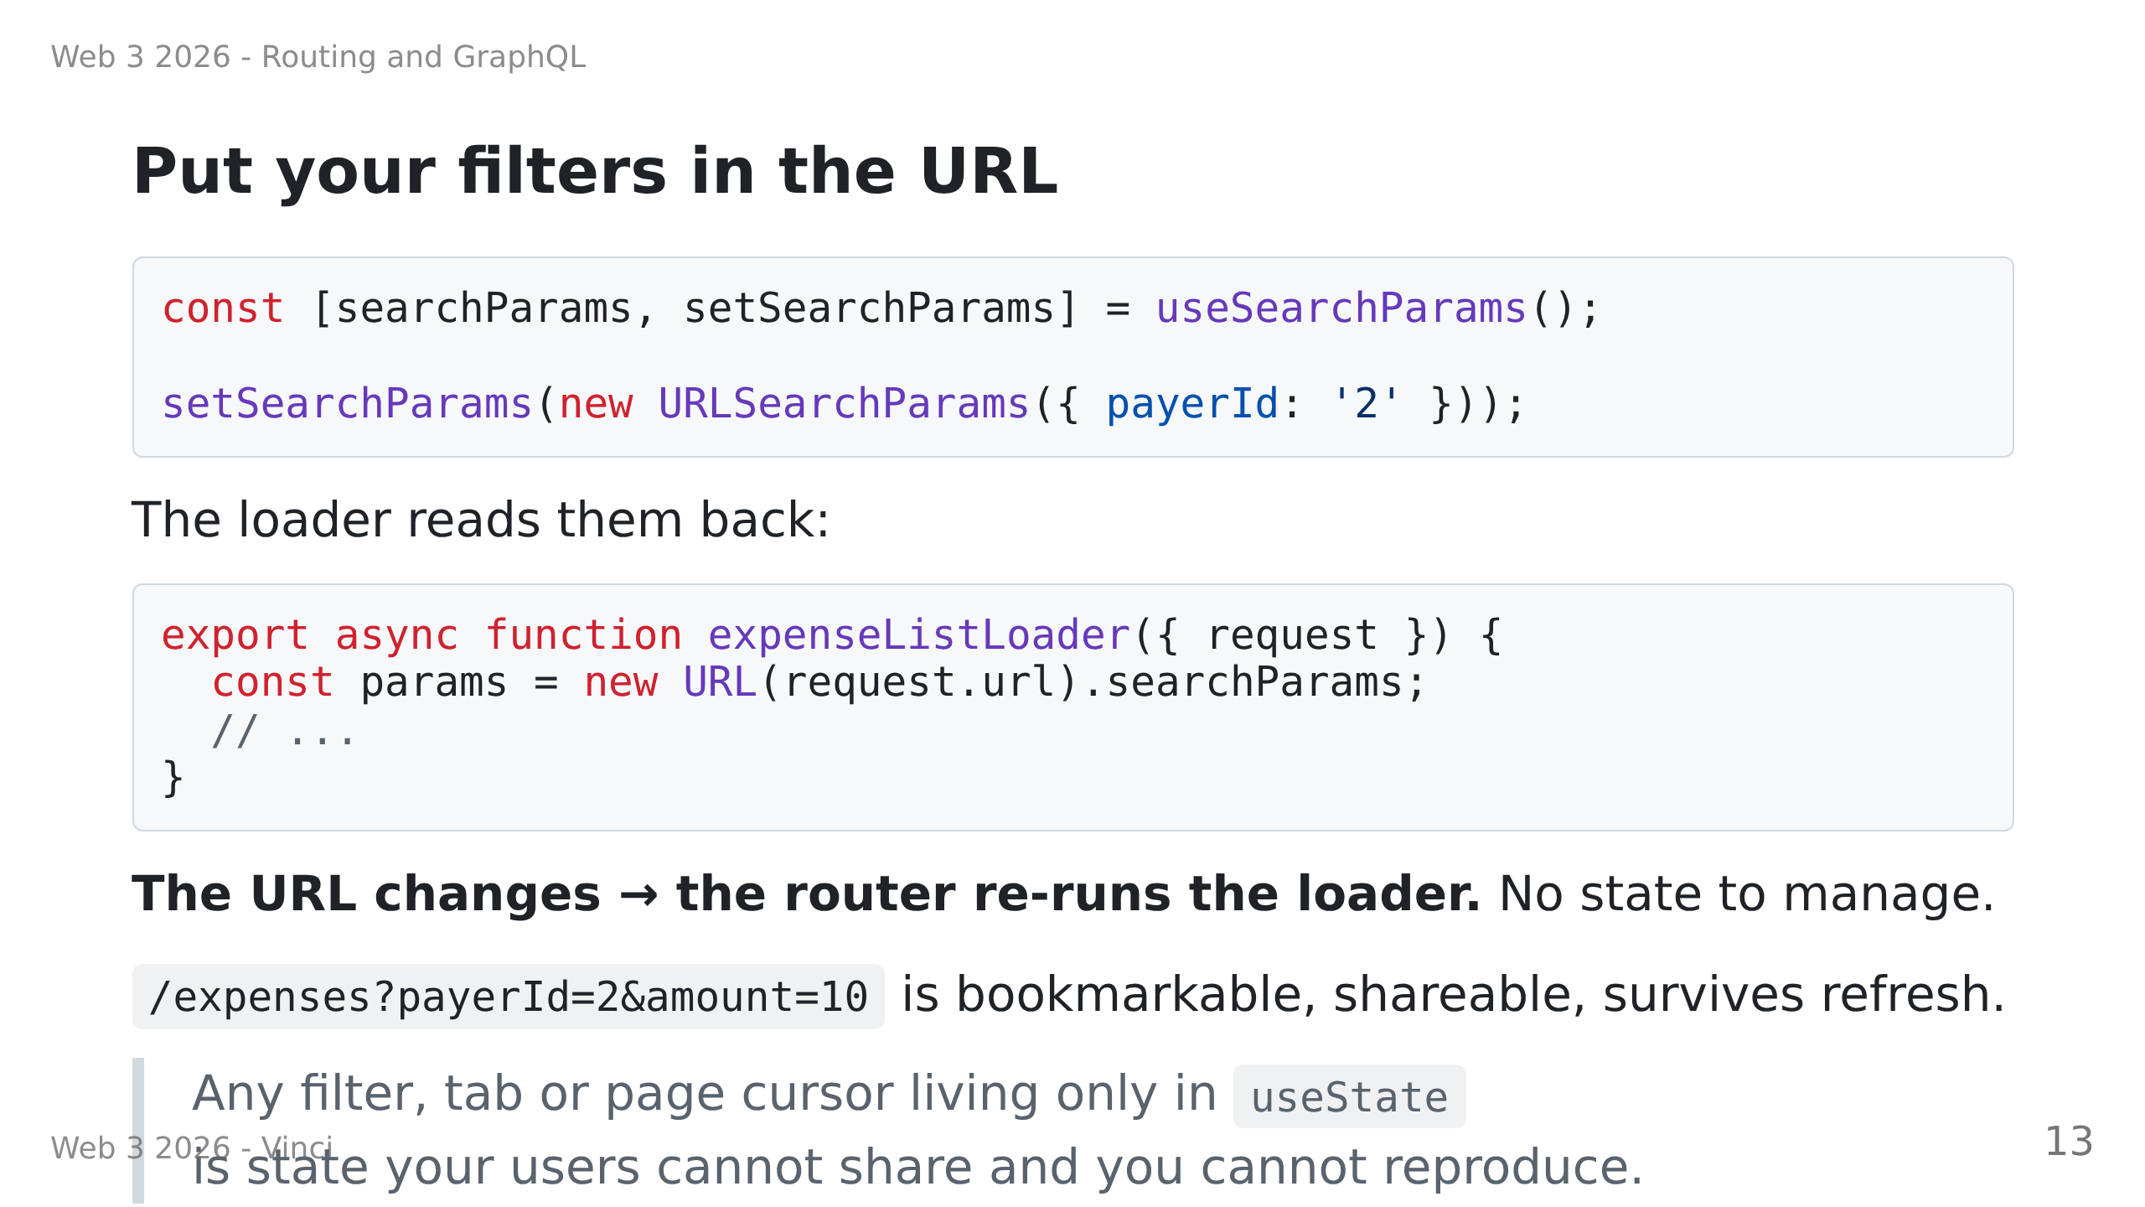

Slide 14
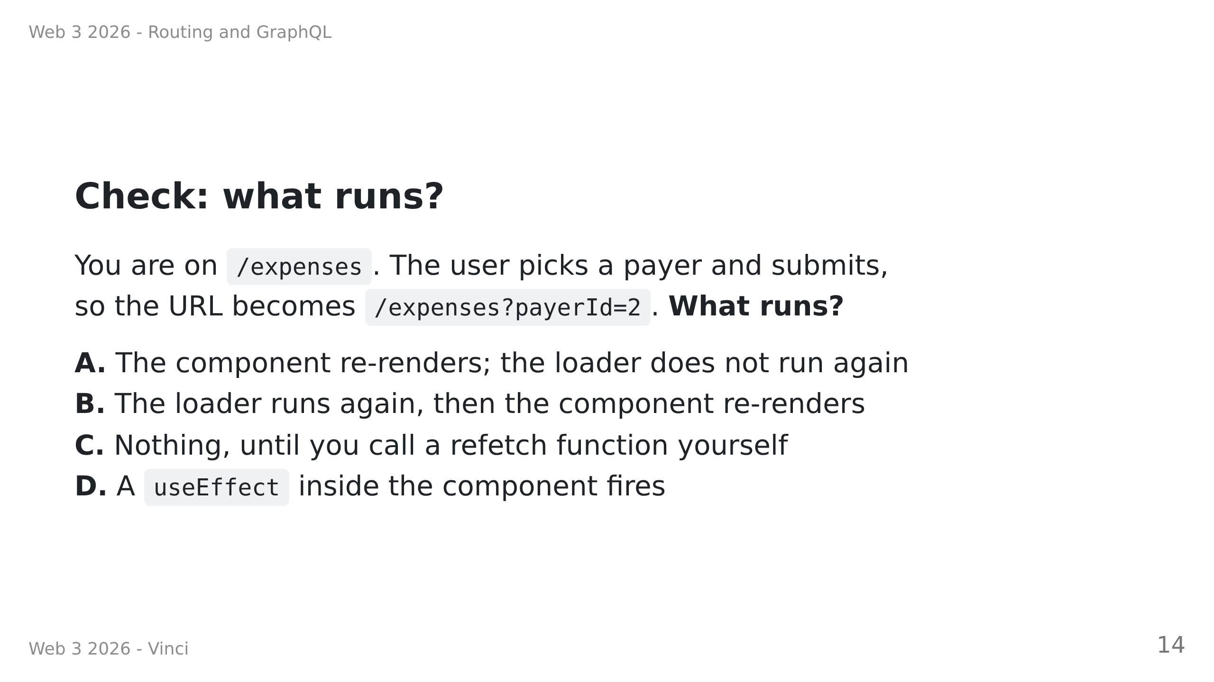
Notes:
HINGE QUESTION — all hands up at once, fingers 1-4. 60 seconds.
Answer: B.
Diagnosis:
• A or D → still on the useEffect model: the loader is "mount-only" in their head.
Re-show "Put your filters in the URL" and demo it live in the browser.
• C → thinks fetching is manual (react-query habit). Say: the ROUTER owns the trigger,
the URL is the input.
• Mostly B → move on, the key idea of Part 1 has landed.
Do not take hands-up volunteers — you will only hear from the three who already know.

Slide 15
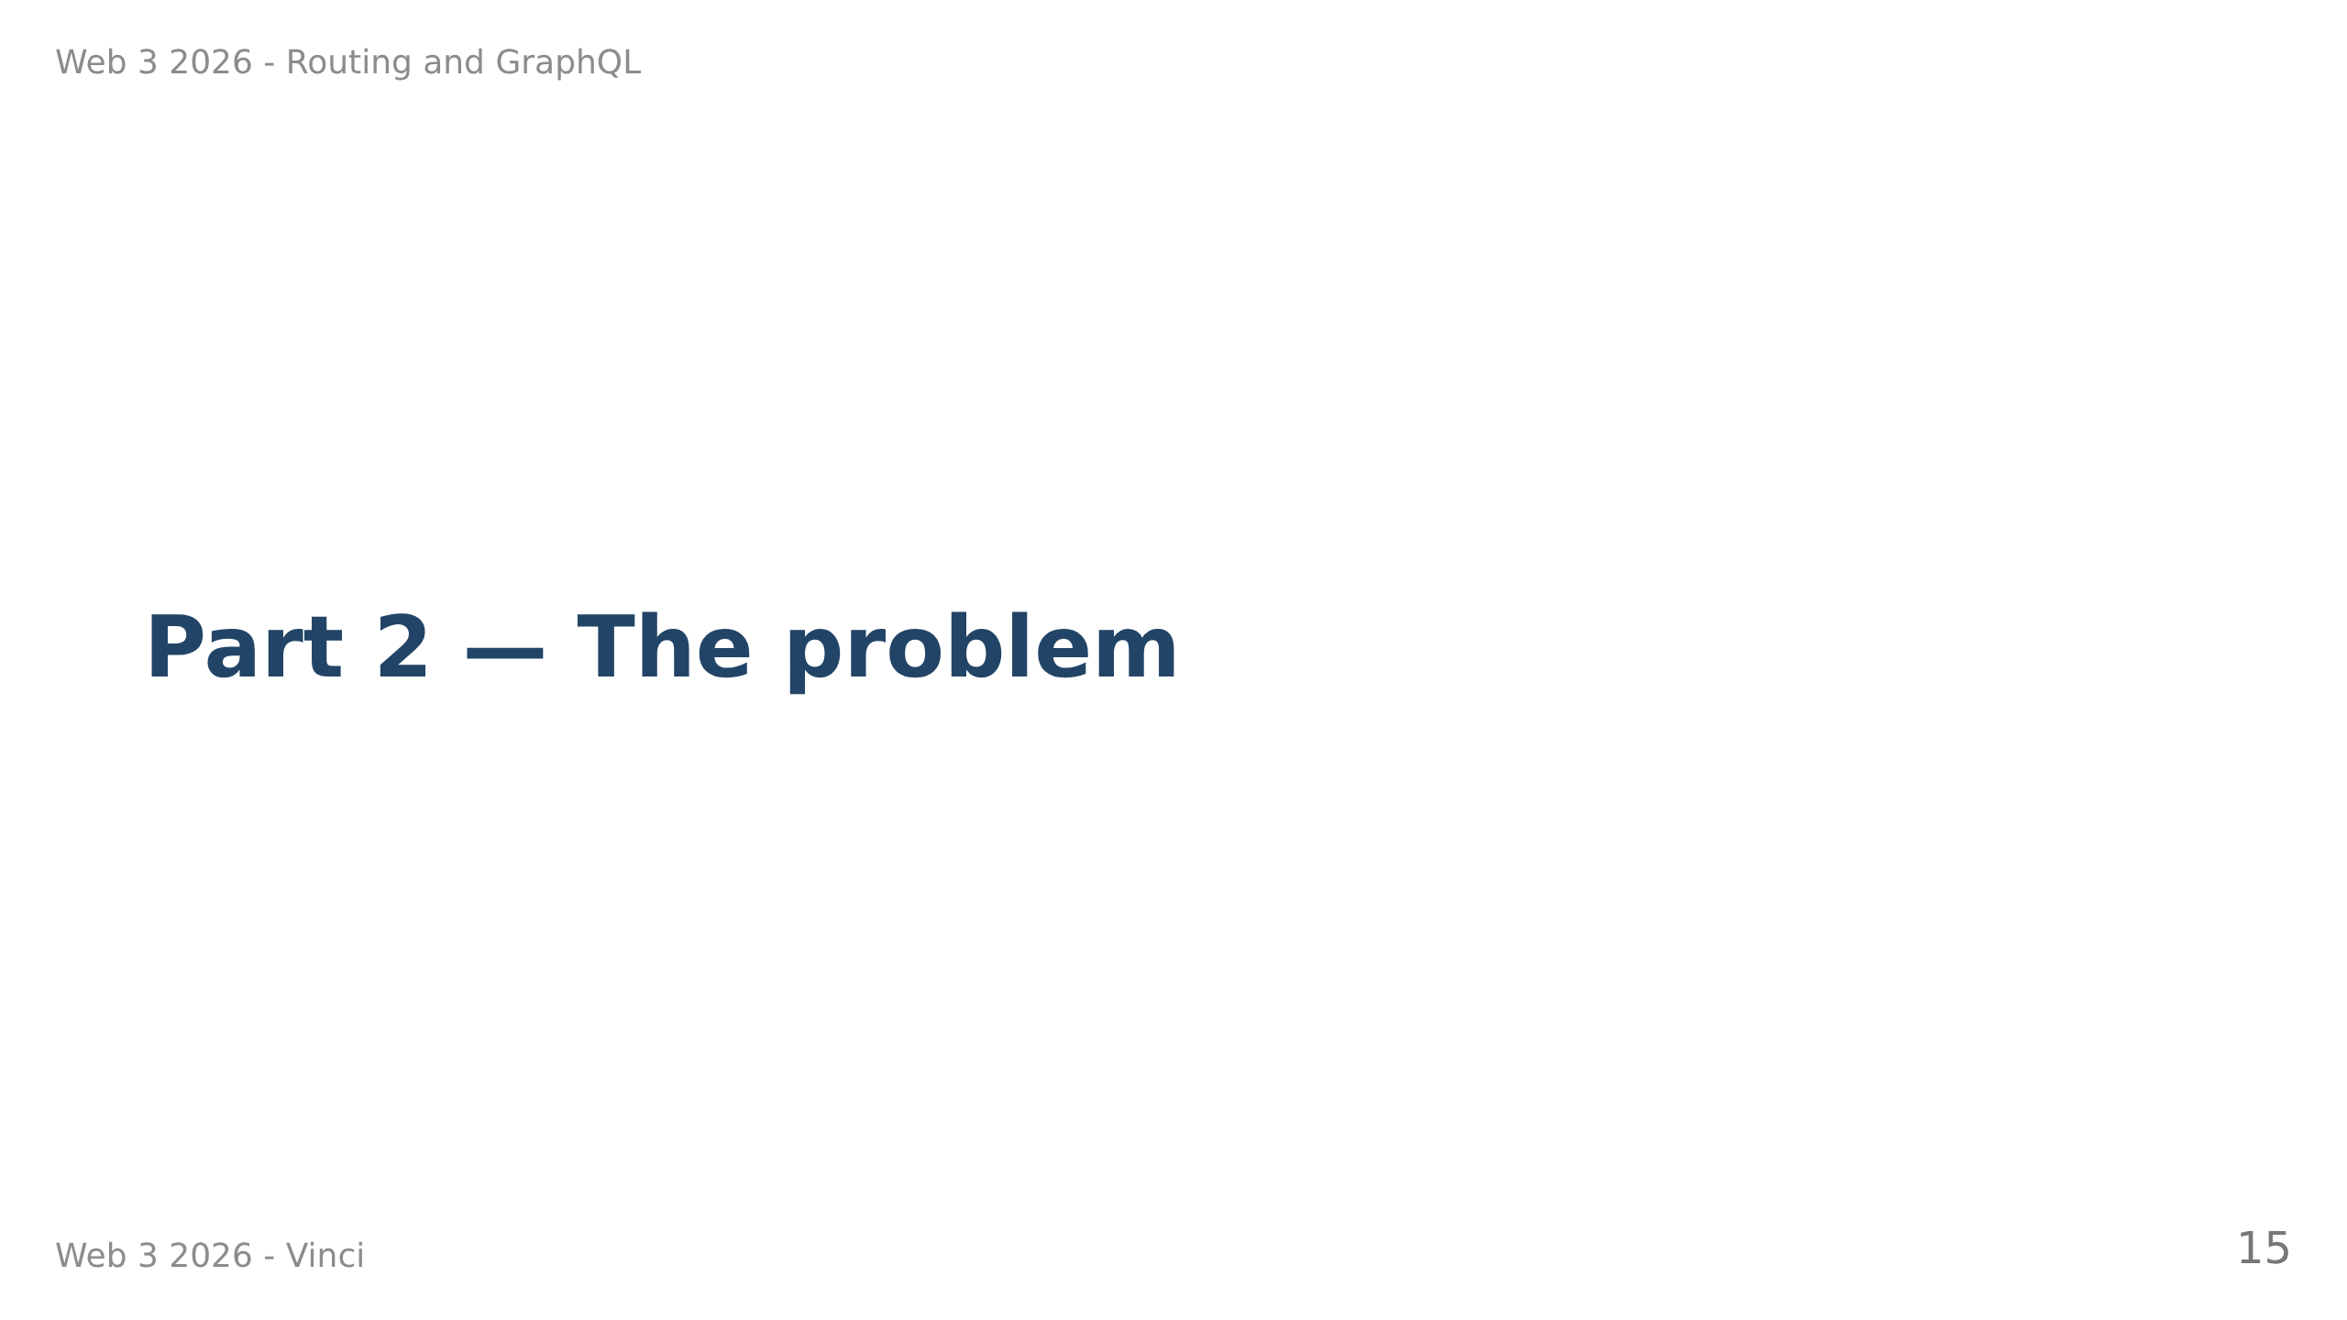

Slide 16
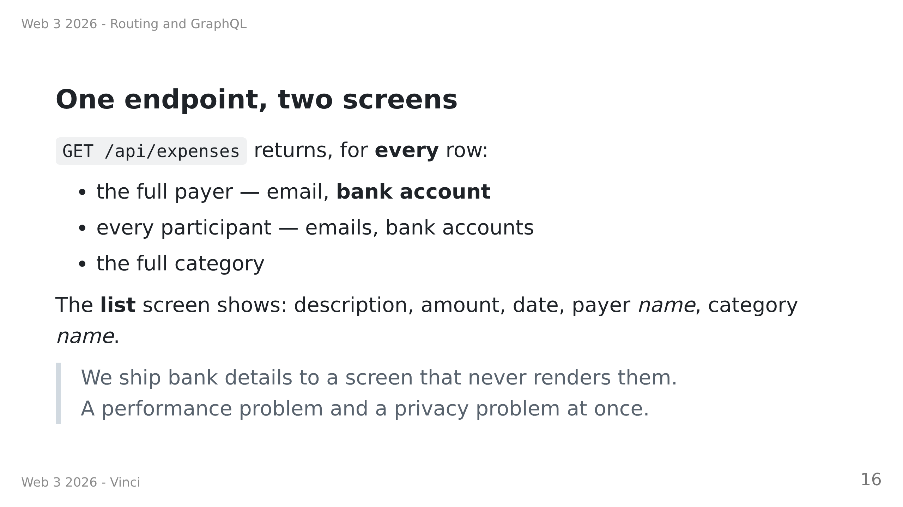

Slide 17
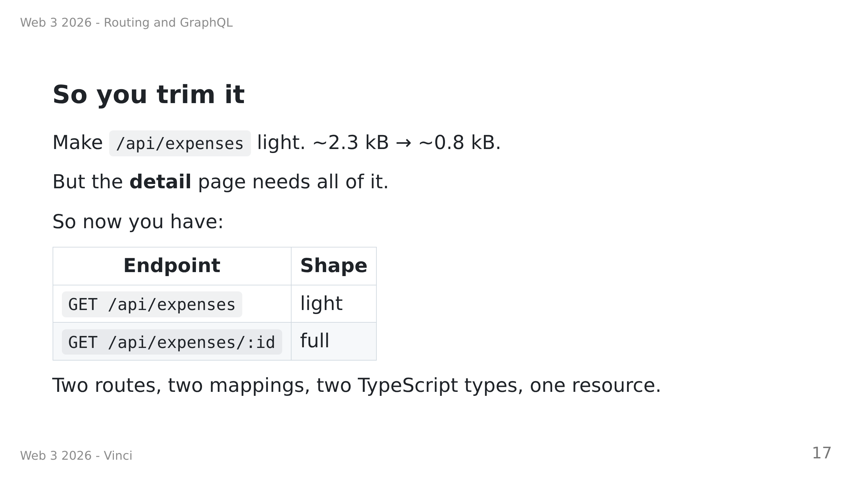

Slide 18
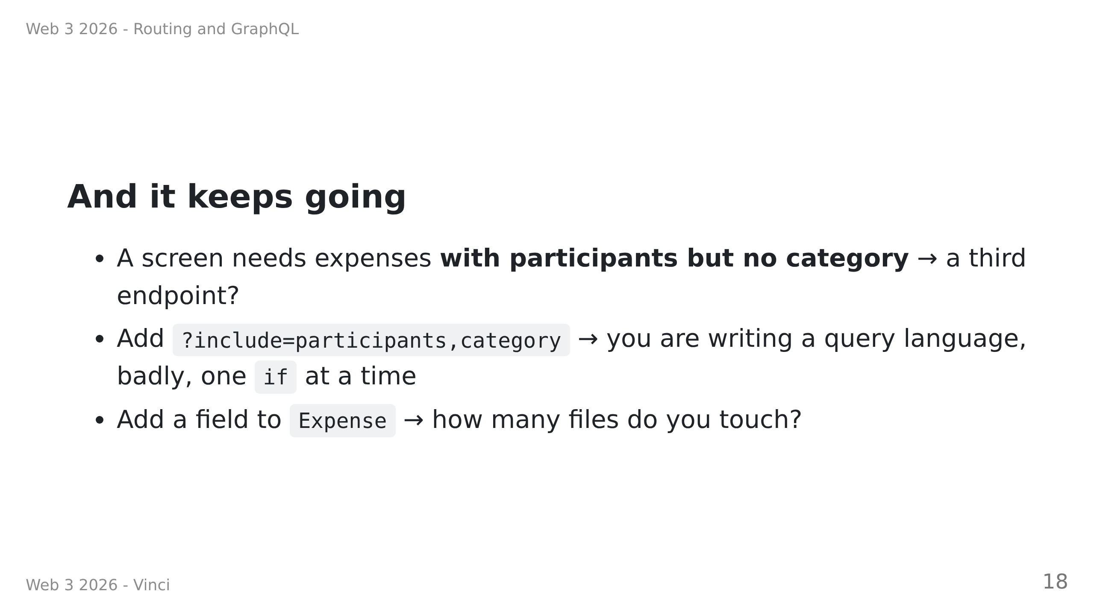
Notes:
Speaker notes:
• Ask the room for the ?include= answer before showing it. Someone always proposes it.
• That instinct is correct AND it is the smell. Name it.

Slide 19
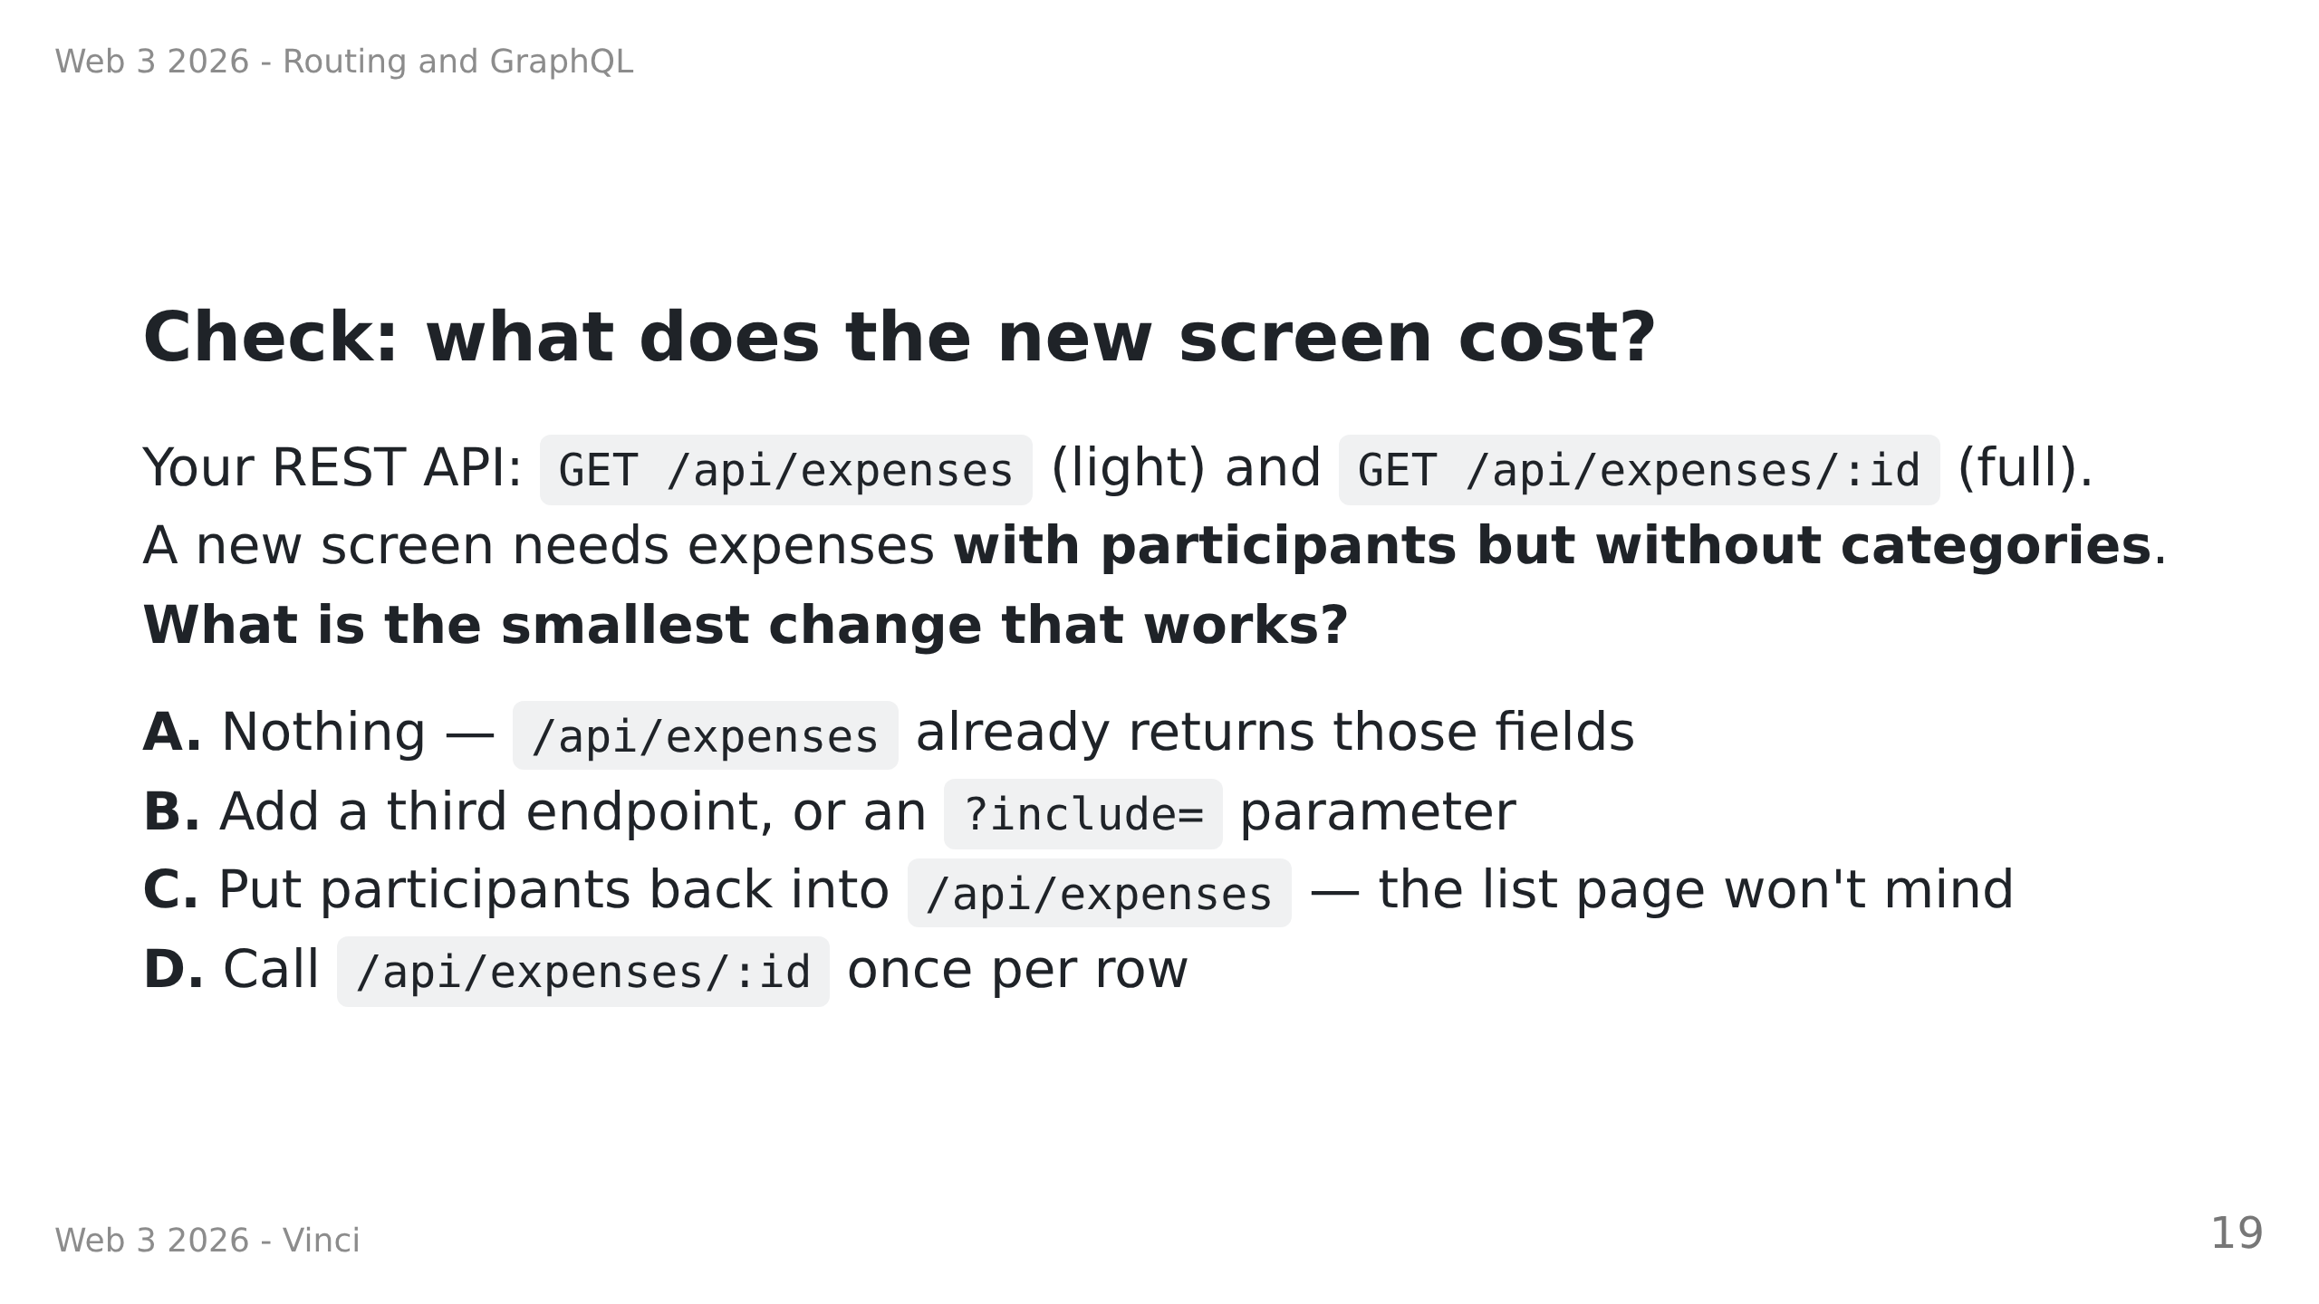
Notes:
HINGE QUESTION — 60 seconds, everyone answers. Answer: B.
This one decides whether Part 3 will mean anything, so do not skip it.
Diagnosis:
• A → never registered that we trimmed the list endpoint. Re-show "So you trim it".
• C → has not felt the over-fetching cost; would happily re-create the original problem.
Re-run the network-tab demo: 2.3 kB vs 0.8 kB, bank accounts on a list screen.
• D → right instinct about shapes, hasn't costed it. Name the N+1 problem, move on.
• Mostly B → the motivation has landed. Go straight to Part 3.

Slide 20
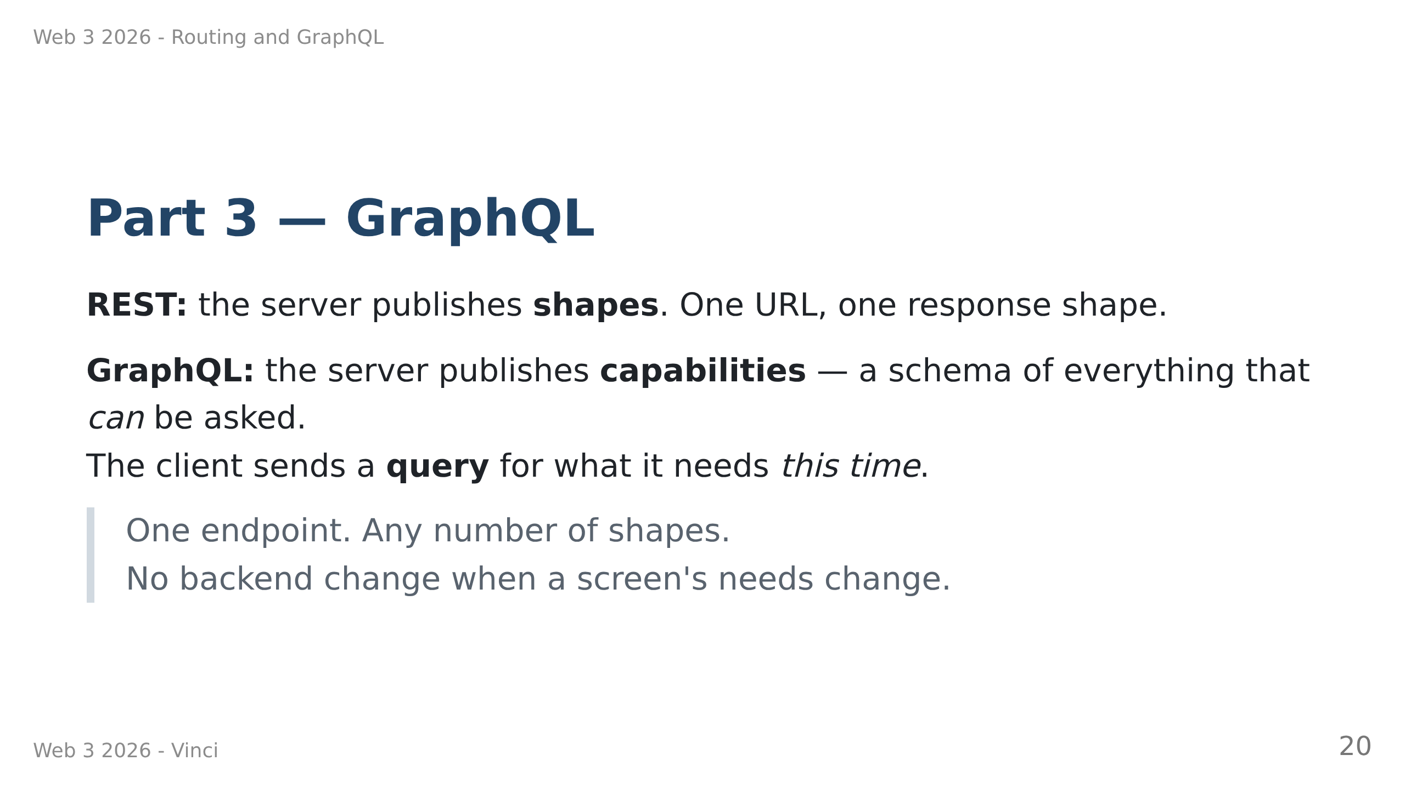

Slide 21
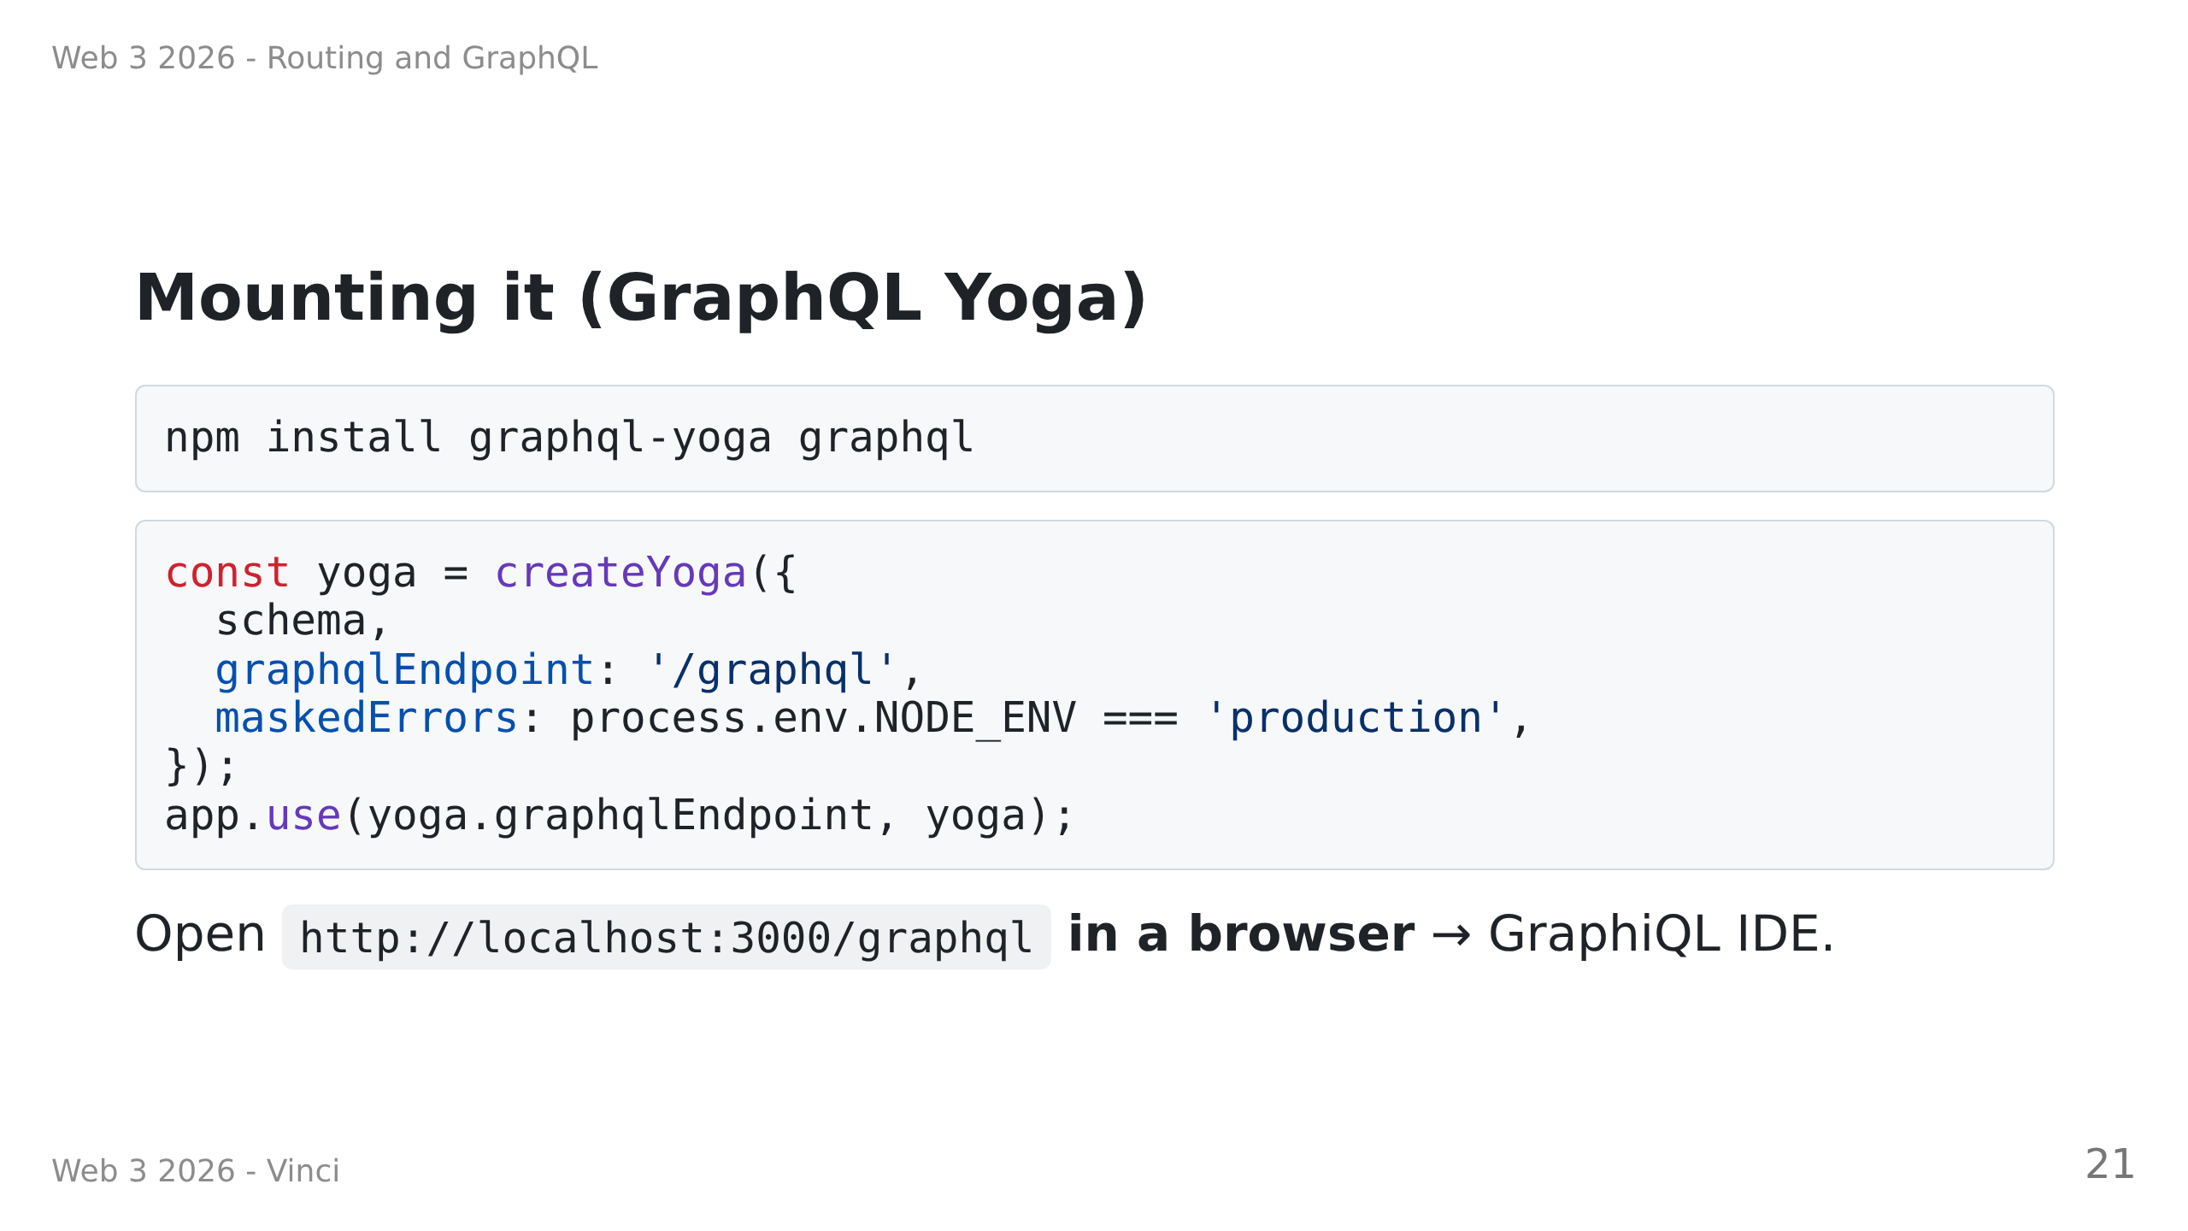
Notes:
Speaker notes:
• maskedErrors: without it every resolver error is "Unexpected error." and they will be lost for an hour.
• Demo GraphiQL live: the Docs panel is the selling point. The API documents itself.

Slide 22
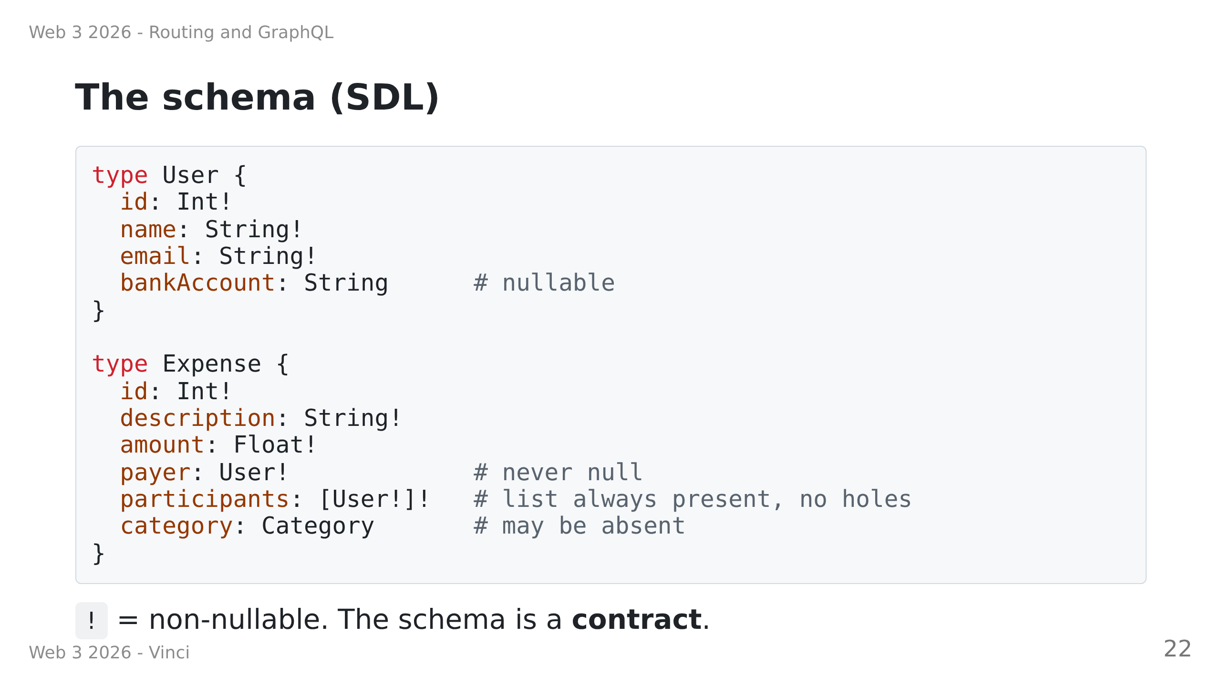

Slide 23
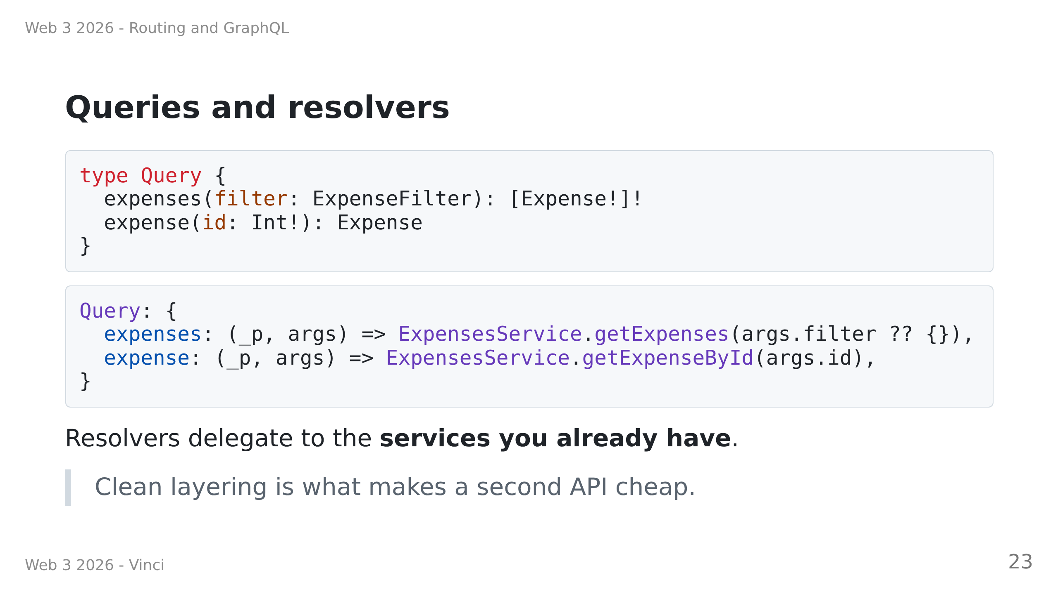

Slide 24
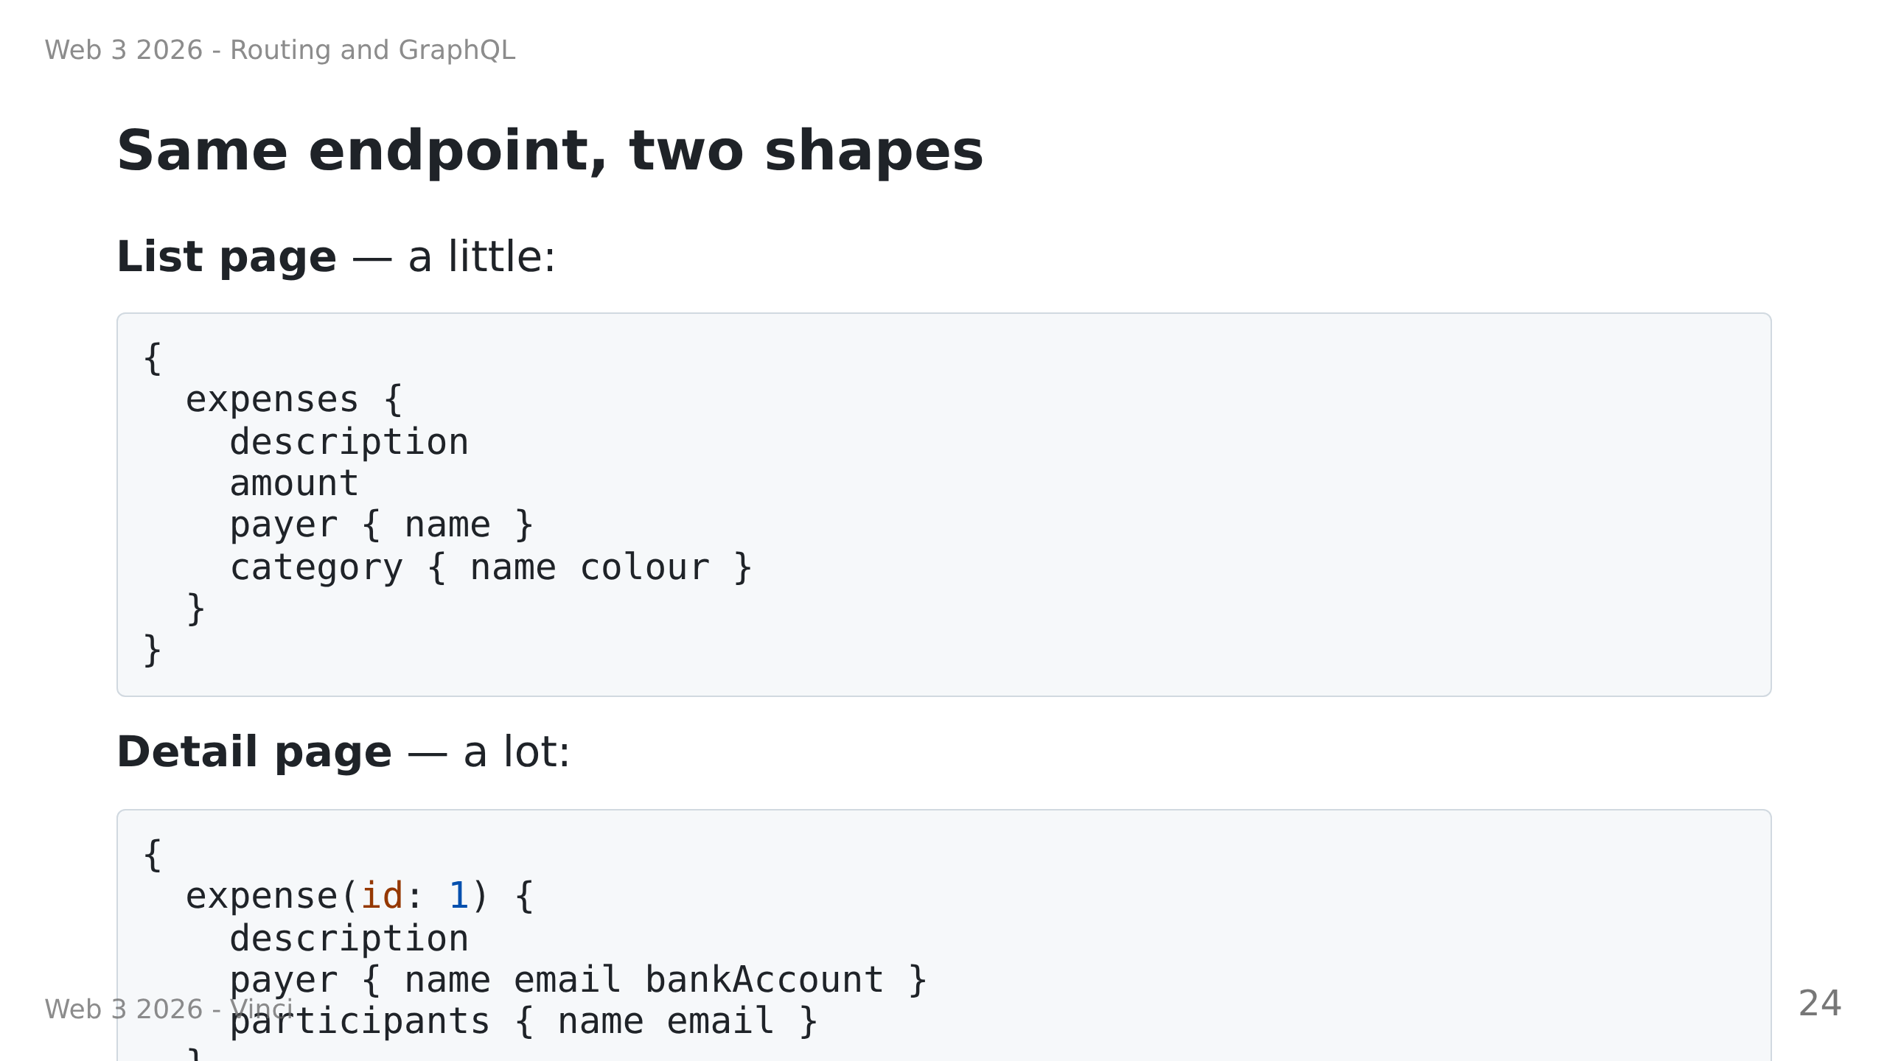

Slide 25
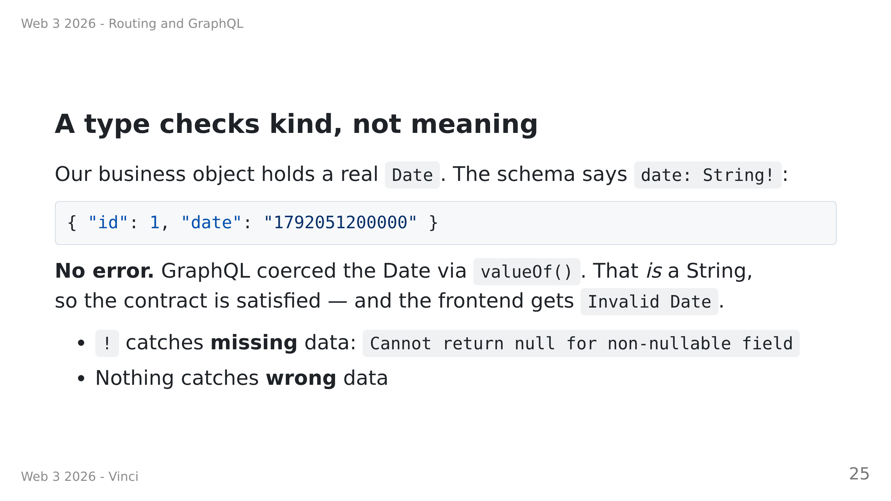

Slide 26
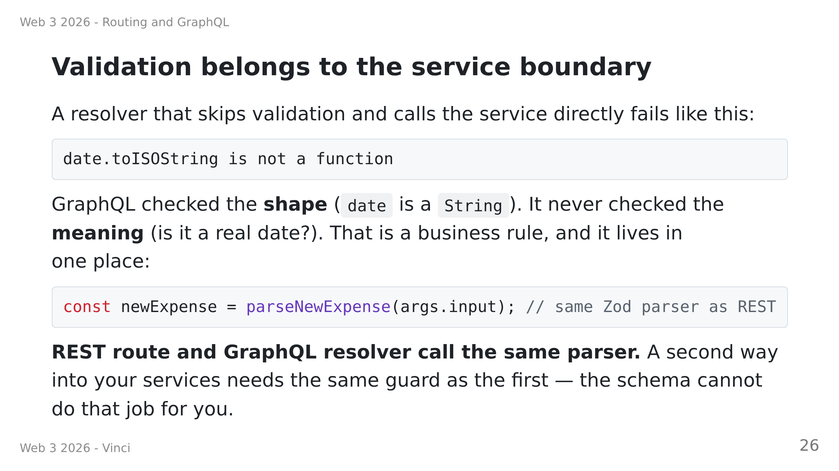

Slide 27
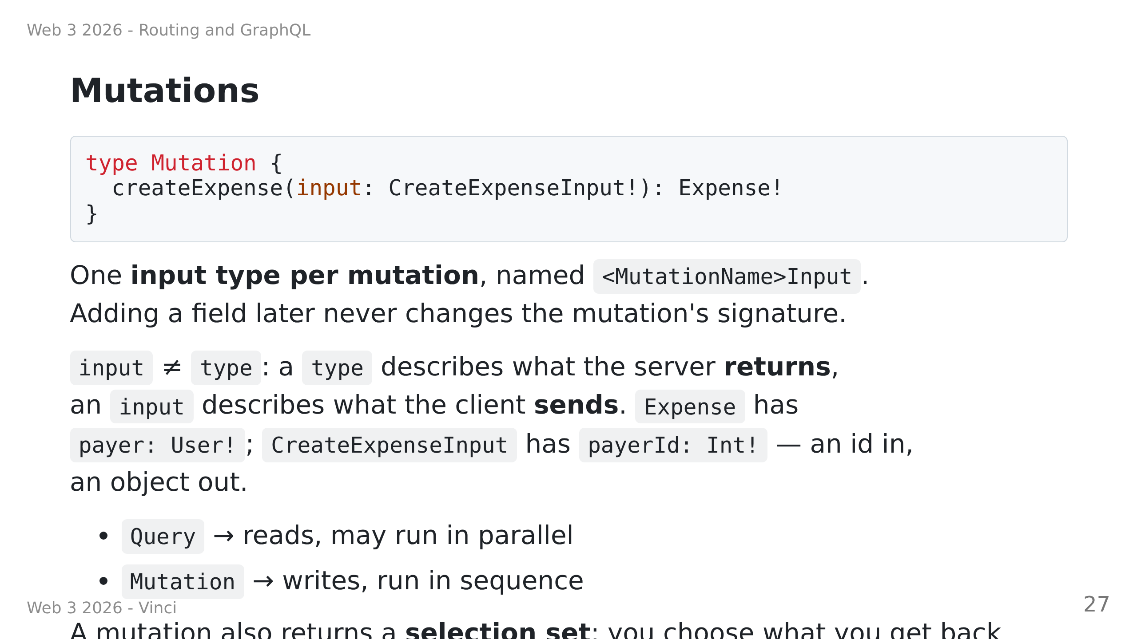

Slide 28
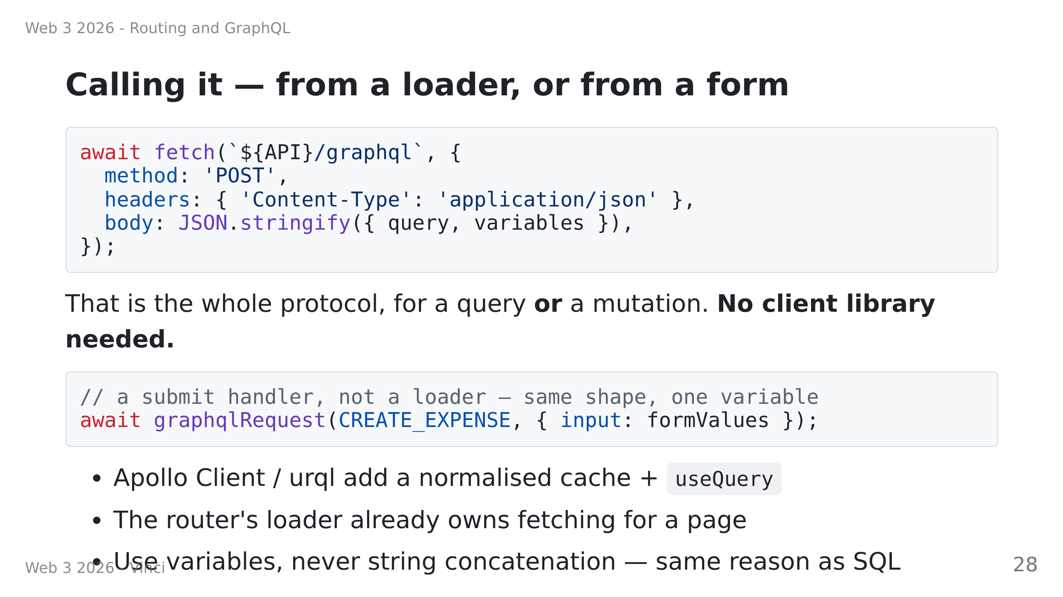

Slide 29
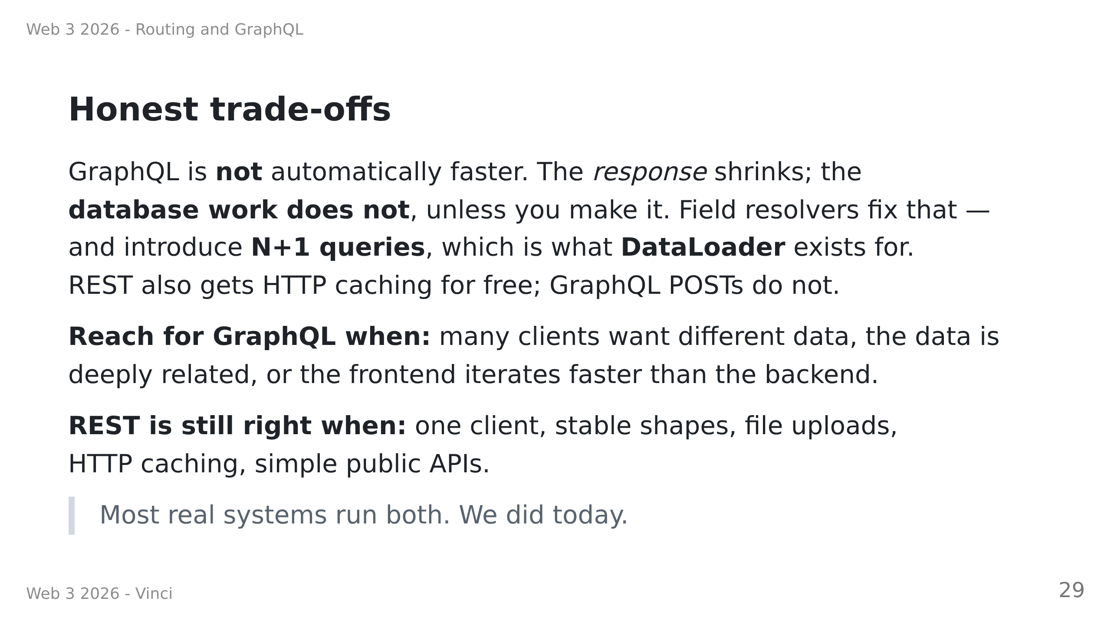

Slide 30
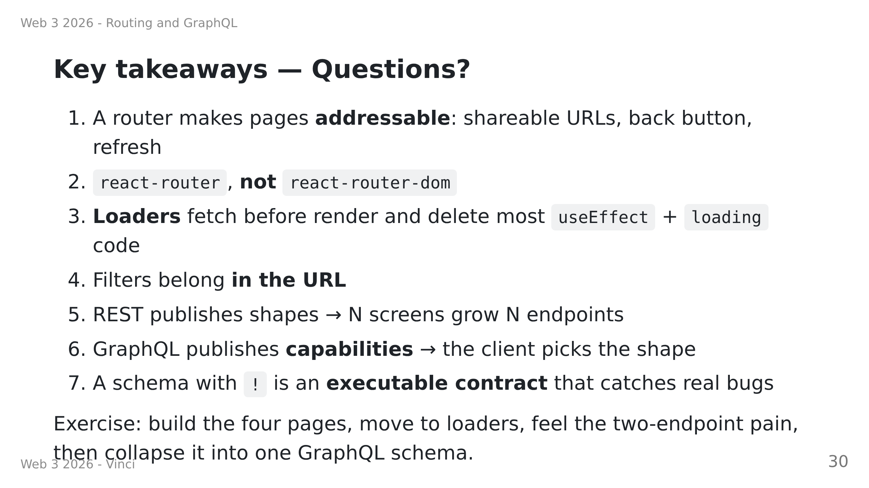
Notes:
Speaker notes:
• Remind them: do the exercise IN ORDER. The REST step is not busywork.
• Watch out for: react-router-dom, missing `end` on NavLink, maskedErrors,
the silent date coercion, and the resolver that skips parseNewExpense.

