Slide 1

CommuniCaid
Bridging the gap between stores and people with special needs
Notes:
Increasesa assebility of people

Slide 2

Story
This is SF, he communicates using signs

Slide 3

Story
He goes through a very frustrating experience
every time he does groceries

Slide 4



Story
?

Slide 5
Story
< Ohh ok!, here it is

Slide 6

Story
< How do you want to pay?

Slide 7
Story
…
It is $1.99
< How would you like
to pay?

Slide 8

Story
How can I improve my store?
…

Slide 9


Story
How can I improve my store?

Slide 10
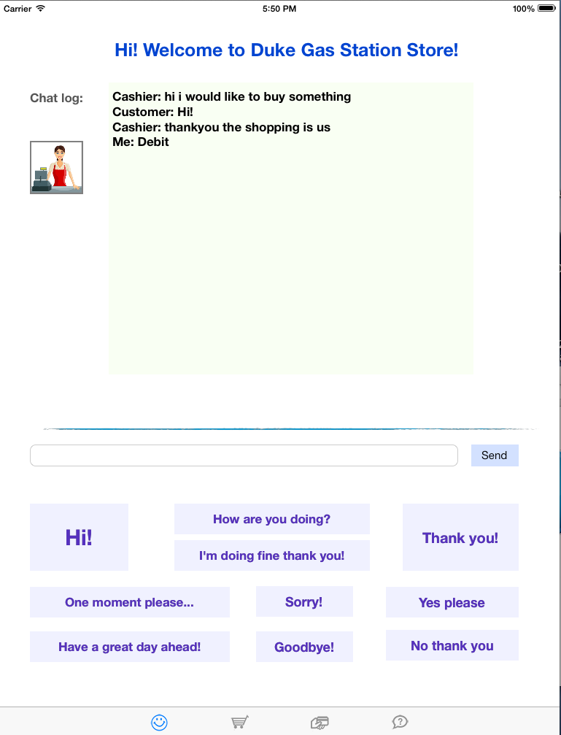
Communicaid
Developed to bridge this gap
Facilitate dialog
Cashier speech is translated into text
Customer can use sample answers or type

Slide 11


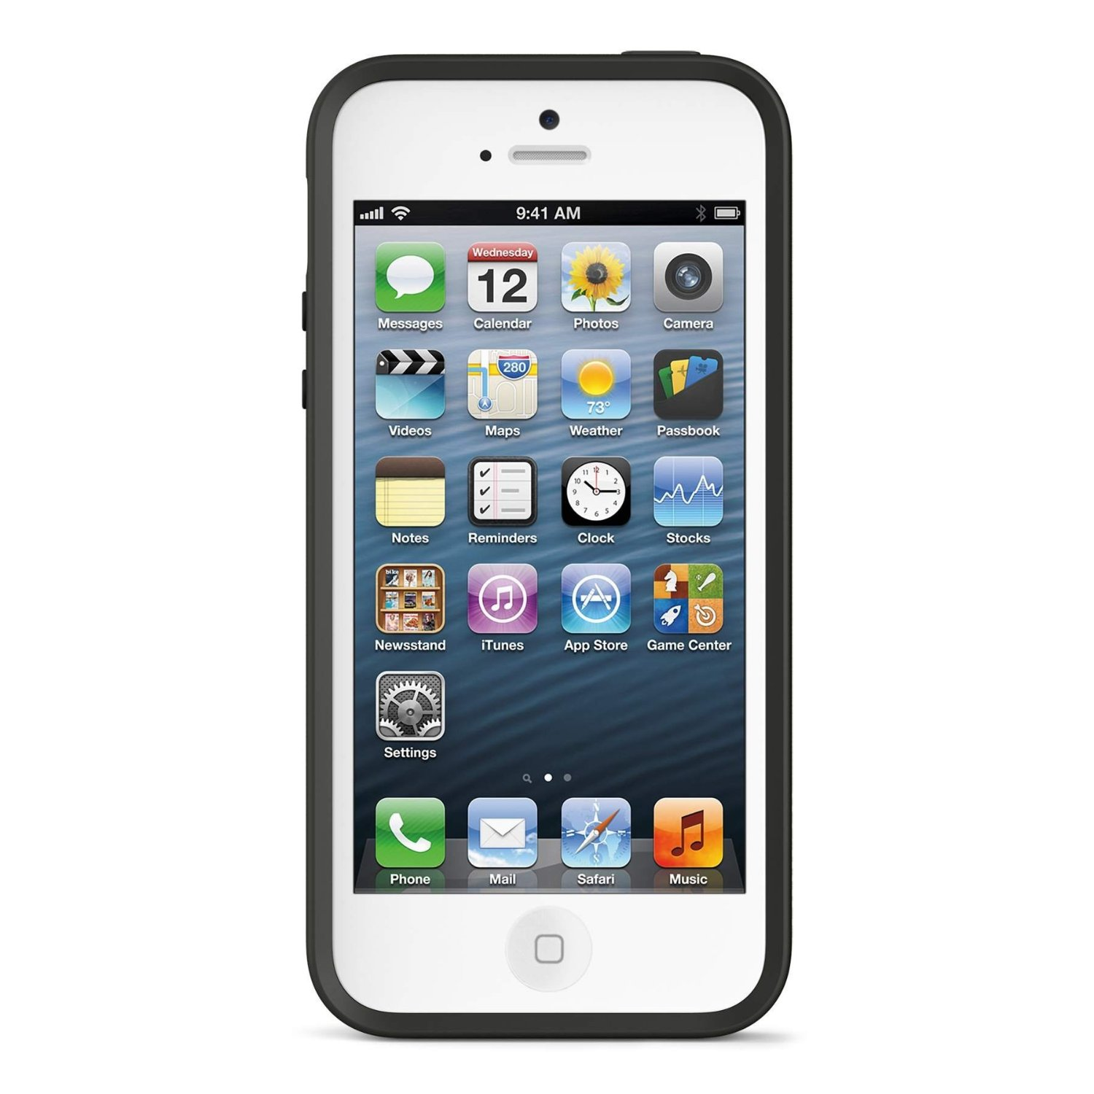


CommuniCaid
AT&T Speech API
Customer
Cashier

