Slide 1


Infineon PSOC6 Lecture project status
Team: T²C
Team Members: Theo Corneux, Tobias Holzner, Tobias Riedelberger
1. Progress report
Achieved since the Introduction Lecture :
Data Acquisition of right hand boxing punches from different people including uppercut, straight hit and sidehook.
Construction of battery & PSOC6 holder
3d printed prototype of said holder
Tried out data acquisition for punches of both hands using two separate boxing gloves.
Activities planned until next meeting:
Create classification project for collected data
Generating models and trying out different parameters to achieve the best outcome
Start the training job and evaluate the results
Convert the model and load it onto the PSOC6 board.
Write code in Thonny to use IMU on PSOC6 board using the IMU-Library
Issues / Support needed
Usefulness of collecting data for both hands (Maybe use the Rotate IMU Node to differ between inputs)
Is it possible to create custom nodes? Want to use them for discrete Integration to calculate maximum velocity of the punch
Should we focus on data from just one person for now or include many varying punch speeds and “techniques” from different people?

Slide 2
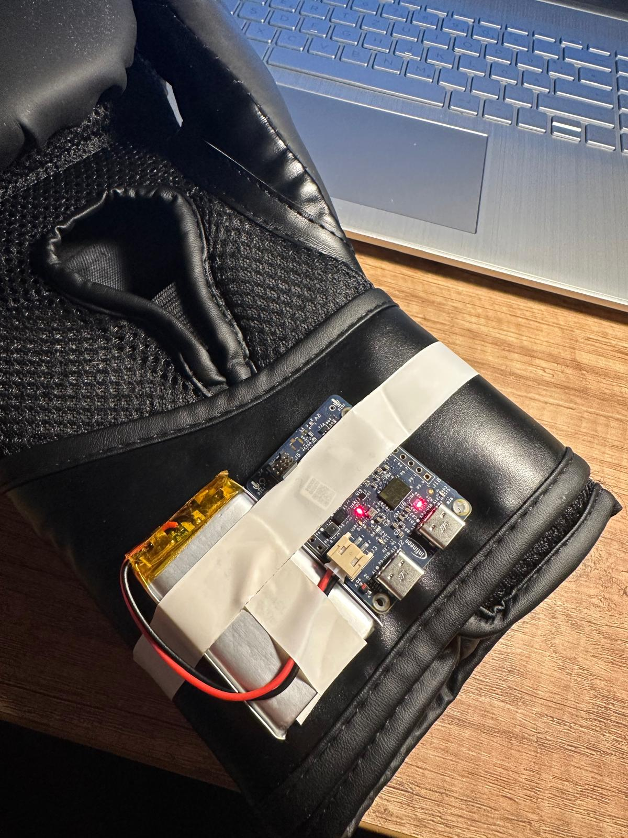
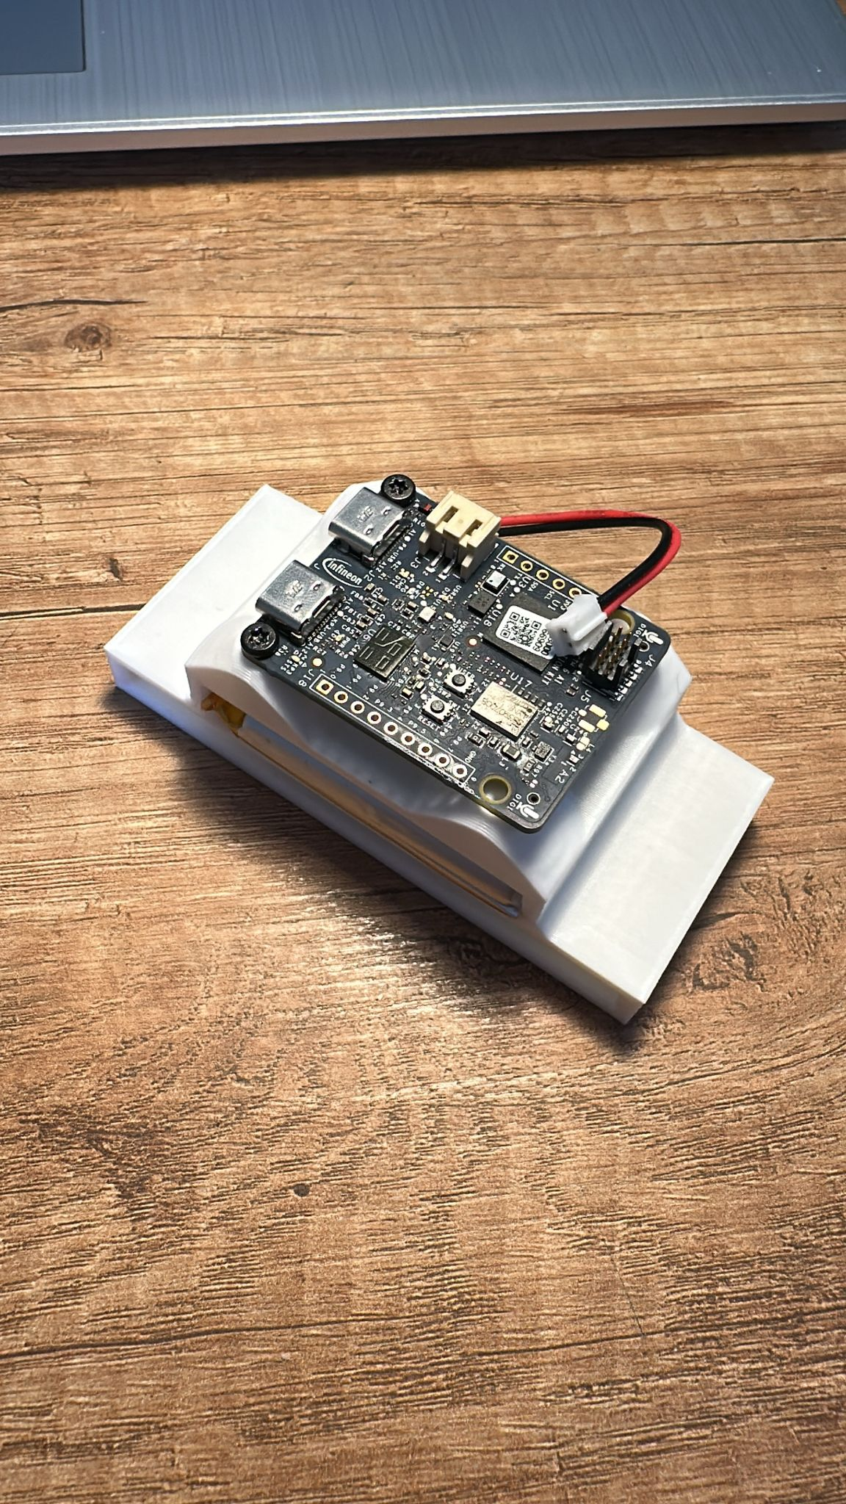
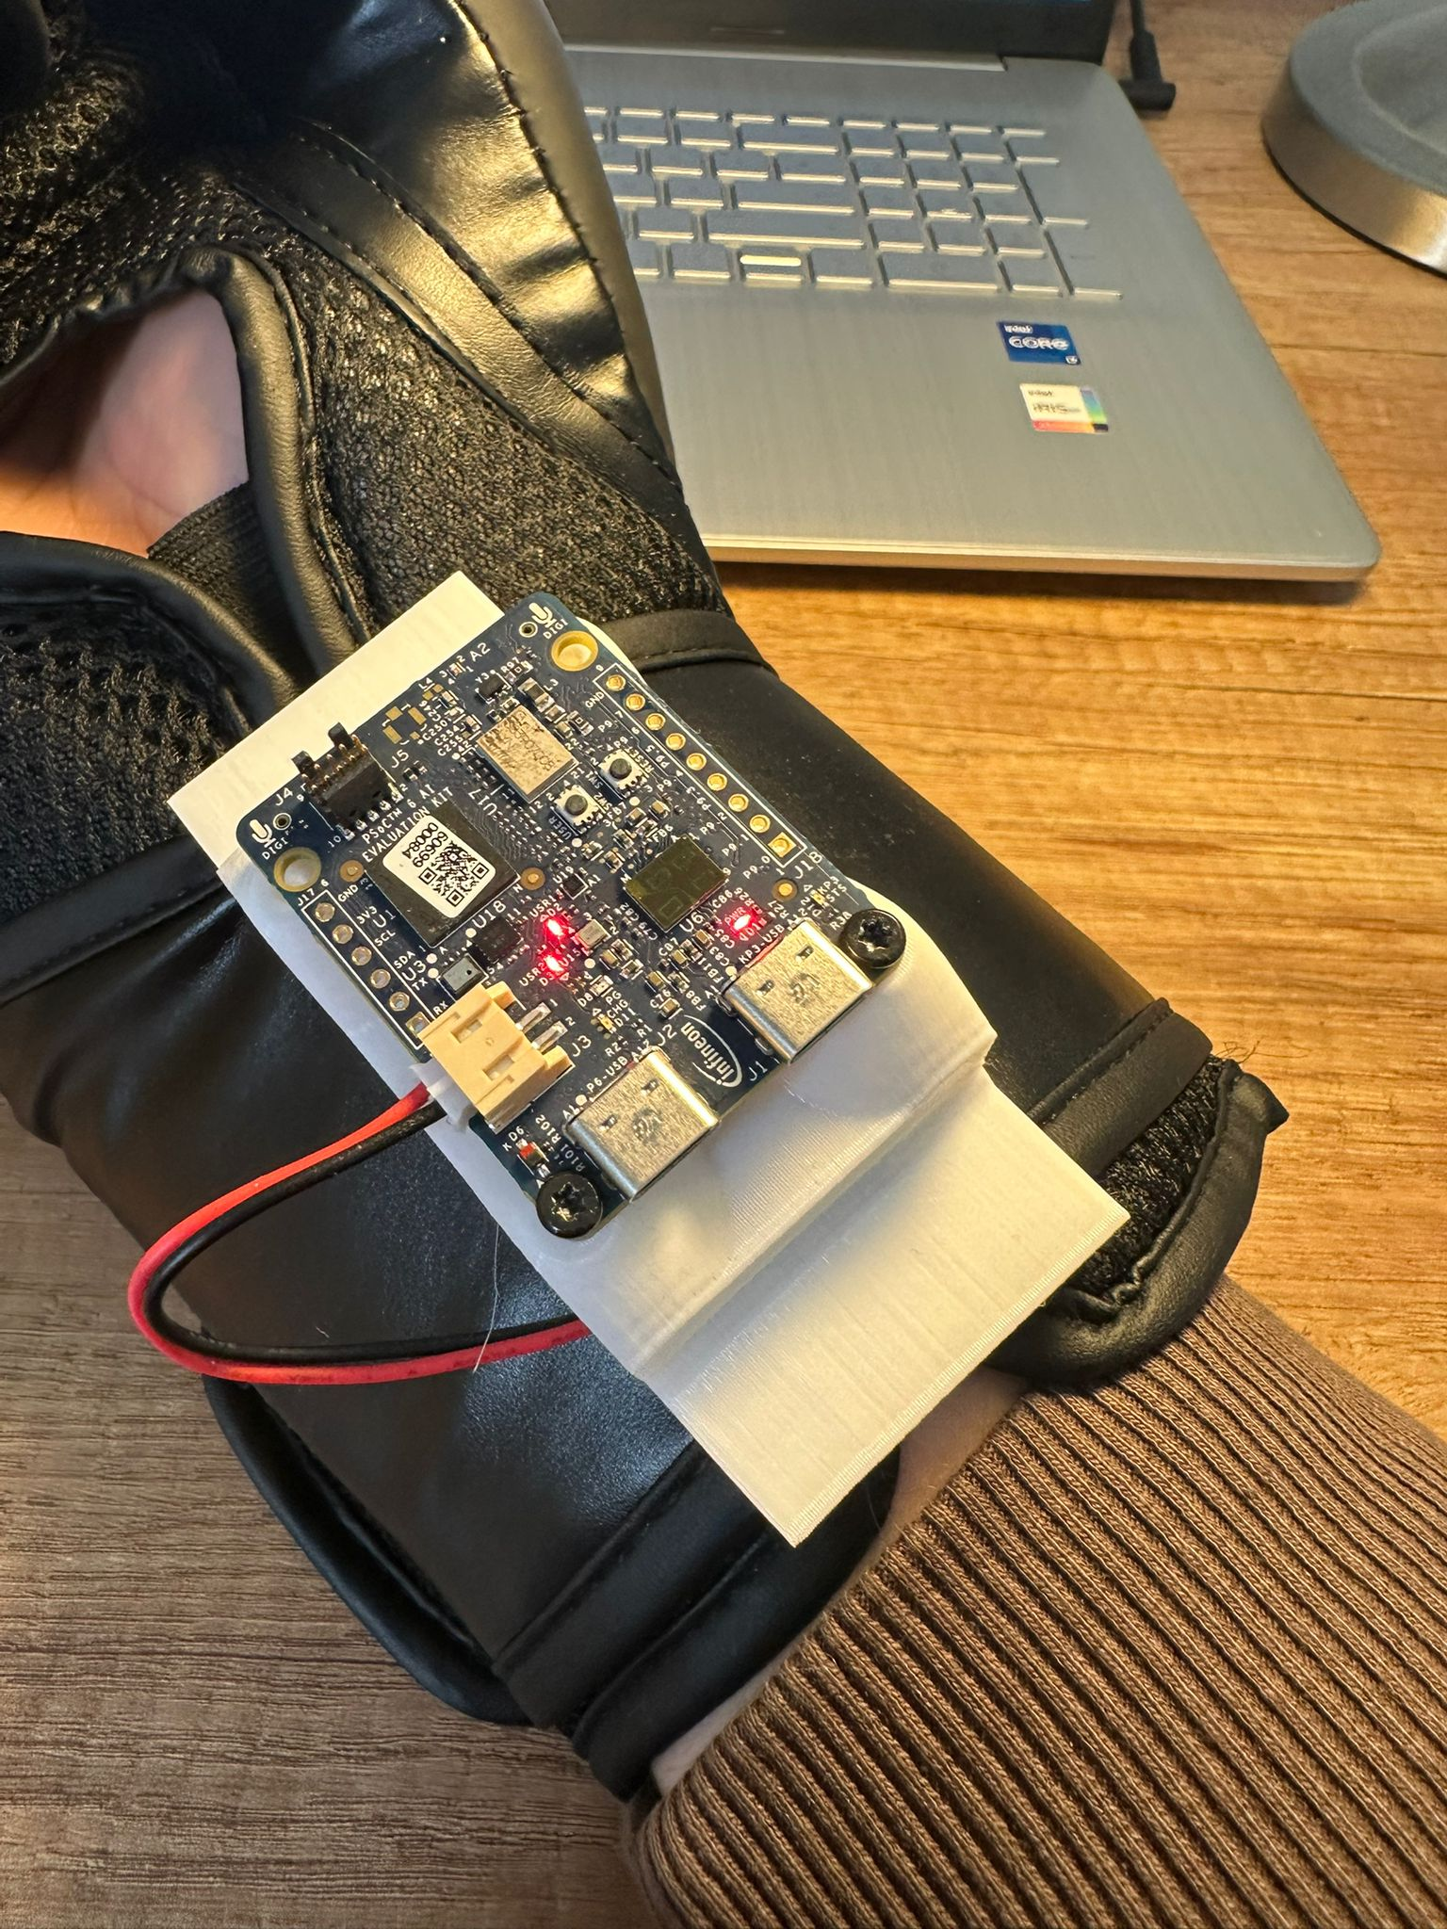
Progress-Documentation

Slide 3
Infineon PSOC6 Lecture project status
2. Progress report
Achieved since last meeting:
Design and print of newer holder
Acquisition of more training data
Reassessment of the labeling
Training of models with variation in given data
Work on reading the data of the IMU and writing it back via TCP/IP through Tera Term
Work on writing data of each boxing session onto webserver (Ubidots)
Activities planned until next meeting
Read out of maximum velocity and current punch through Tera Term
Optimizing parameters to achieve highest accuracy
Creating an interactive dashboard for webserver interface
Implementing the model in micro python into Thonny
Issues / Support needed
Battery ran out of power
Models' accuracy did not reach desired levels (Question if Labels are not set right or data is not enough…)
Changed names of sessions afterwards which lead to DeepCraft not finding/ having problems with the files
Purpose of preprocessor track
Reading the data out of the IMU only possible for a restricted time

Slide 4
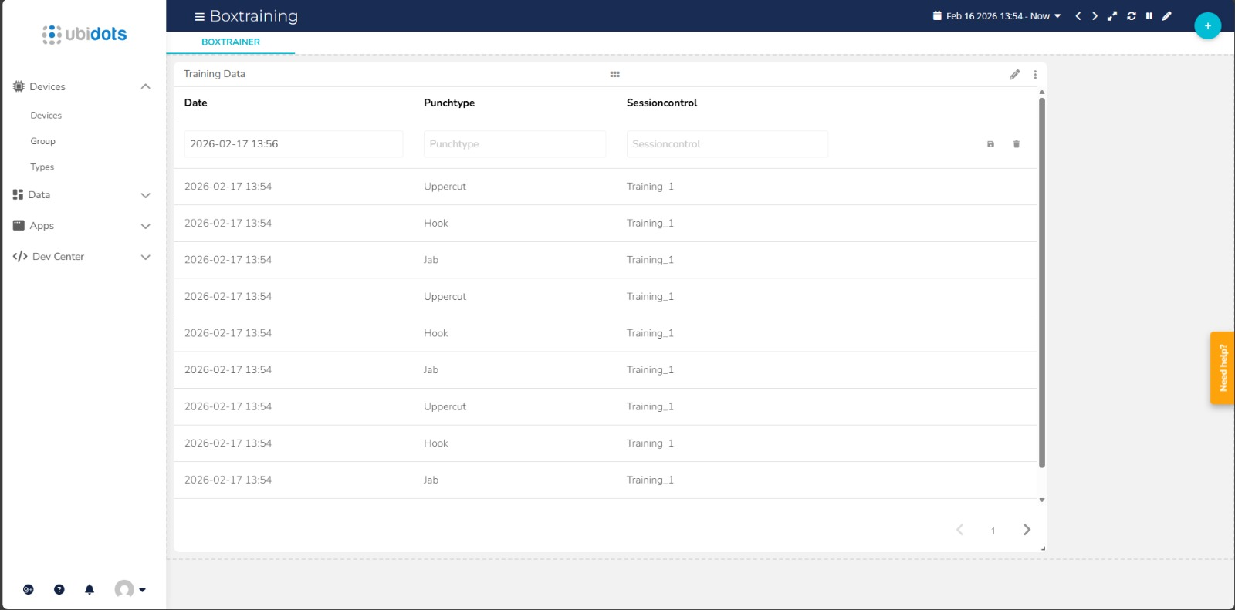
Progress-Documentation

Slide 5
Infineon PSOC6 Lecture project status
3. Progress report
Achieved since last meeting:
Collected more data to further increase accuracy of classification
Generated code to use for Micropython program
Converted model using the Deepcraft Micropython converter.
Implemented model into MP program
Activities planned until next meeting
Finish up, try out finished project
Create final presentation
Show what you have planned for the project presentation and your submission, you have more room on the next slide
Issues / Support needed
How much data do we need to enqueue before we can dequeue a result
Does the frequency of how often we enqueue data have to match with the sampling frequency we used for our data
Code generation only worked for one group member
Model conversion was confusing (documentation was not very helpful, errors occurred while running the pyscript in the console (Make file, elftools not found))

Slide 6
Infineon PSOC6 Lecture presentation and final submission plans
Short project presentation:
Present idea behind project and show data of every single punch and visualize the differences.
Show our constructed device to hold the PSOC6 and battery and how it is used on the boxing glove
Talk about the problems we faced while collecting data, labelling and trying to generate a model using our data combined
Show the final classification we used for the model and the Test-Score of the model we ended up using for our Micropython application on the PSOC6
Show the Micropython code and talk about the most important parts to provide a rough outline of the components and their functionality (Webserver, Read IMU-Data, how the model is used, …)
Demonstrate the functionality
Any special equipment need for demo at the demo Day ?
A Volunteer ;)

