Slide 1
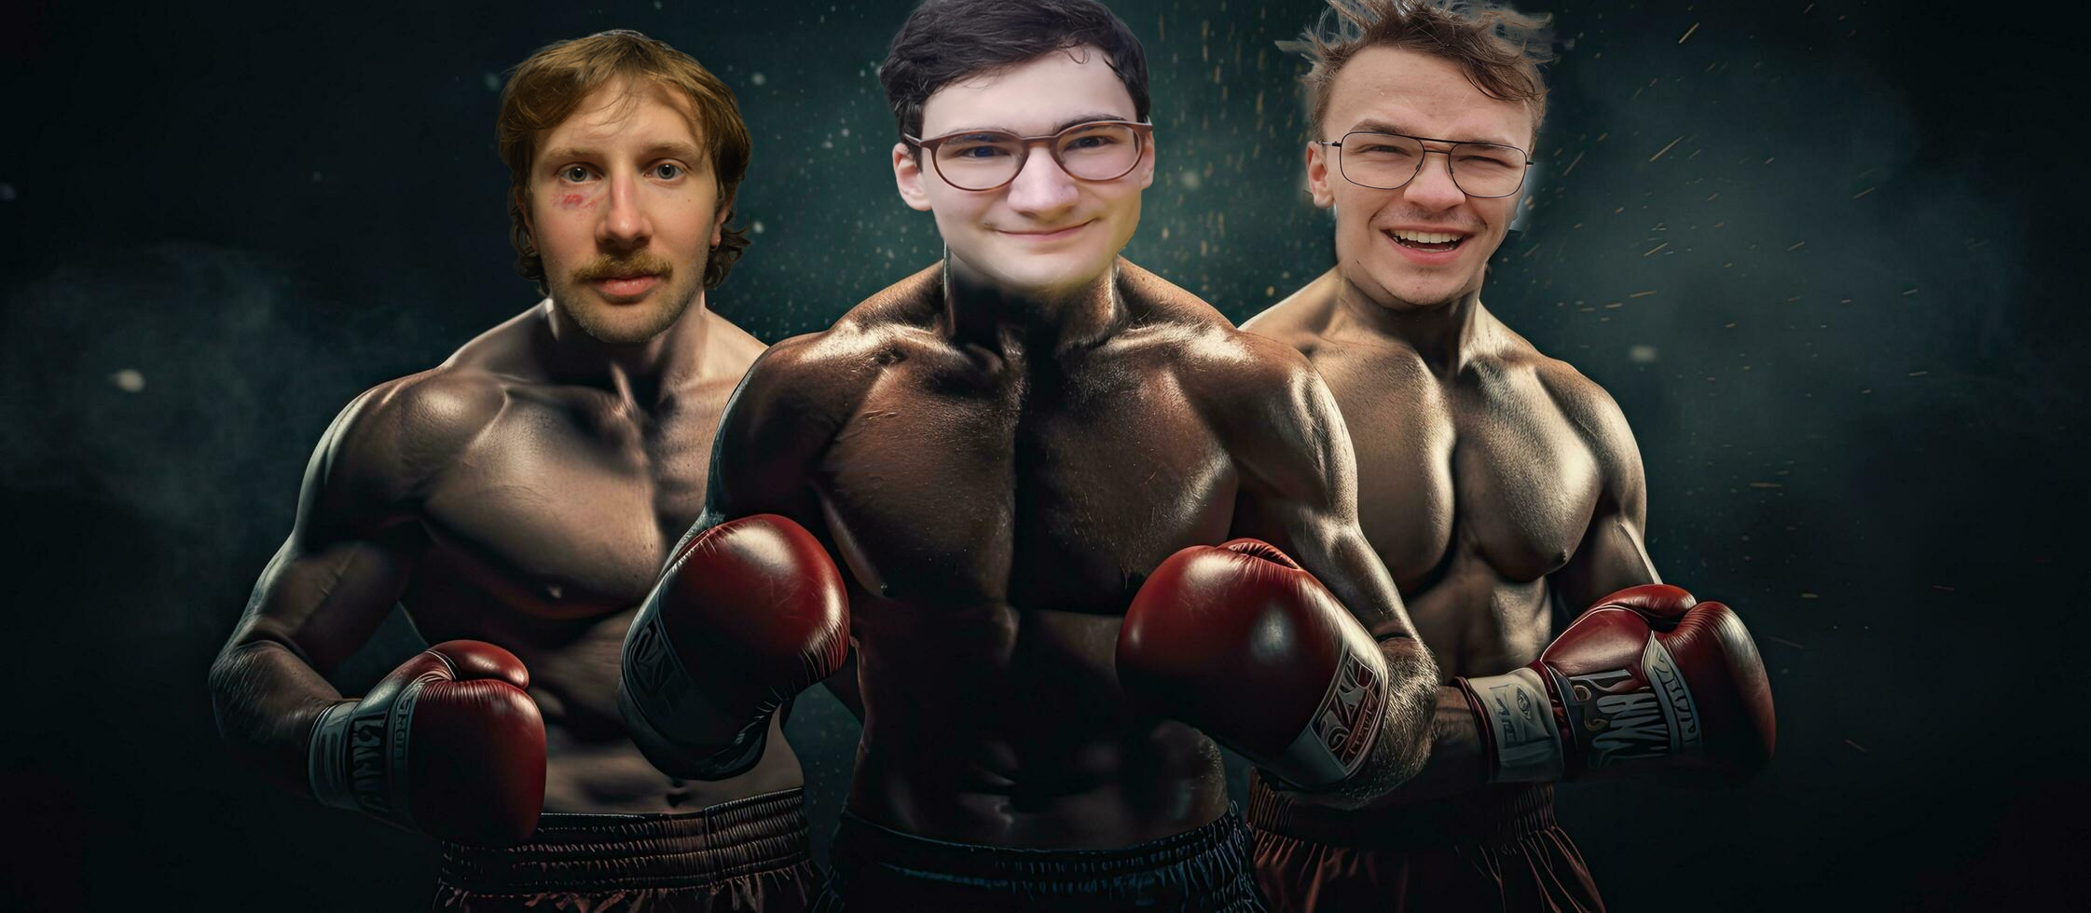
Punch Analyzer
Team T²C
TU Wien
Tobias Riedelberger, Theo Corneux, Tobias Holzner
Notes:
Riedi

Slide 2
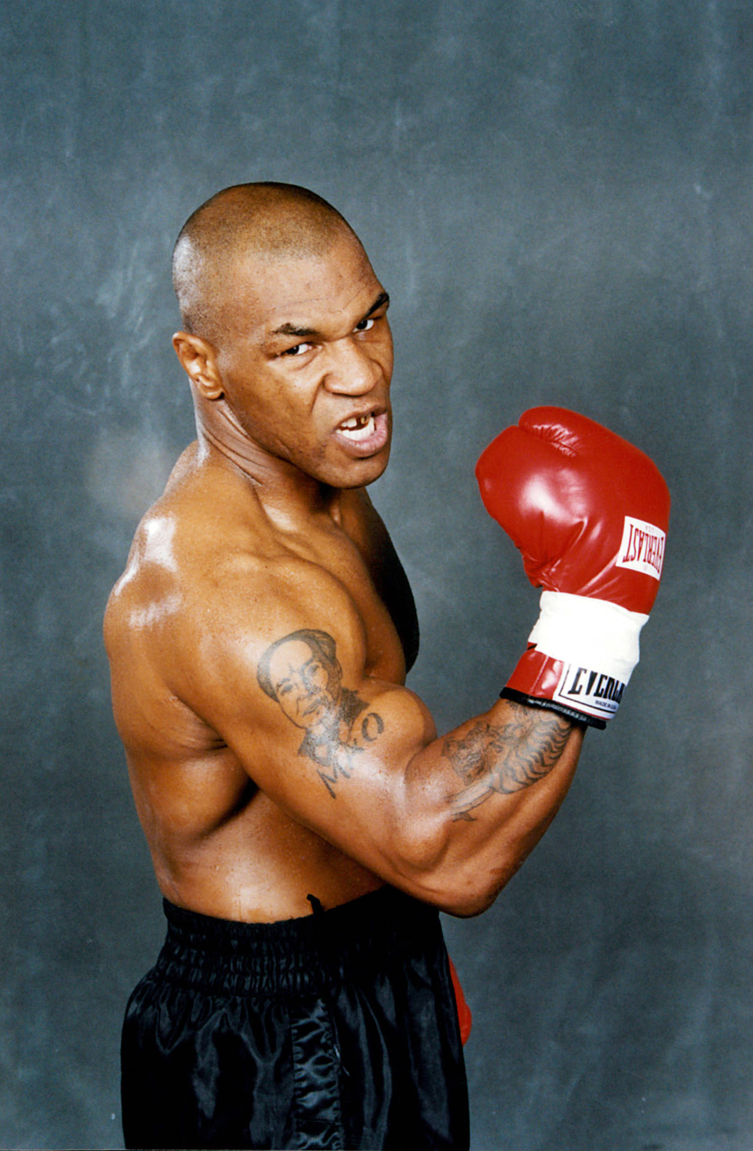
Project Idea
Punch detection and analyzation with IMU
Differentiation between punch types
Jab
Hook
Uppercut
Goals
Prevent developing habits/predictability
Game which gives different punch combinations
Notes:
The project idea was to detect and analyze thrown punches using the boards IMU
The punches we wanted to differentiate between were the jab , the hook and the uppercut
The goal of this product or idea was to help boxers understand their performance during boxing sessions and prevent them from developing habits of overusing the same type of punch and become less predictable for their opponent
We wanted to assist this process by implementing a game function in which the boxer gets rewarded points for following instructed punches
These punches would be ordered in a way that the boxer always uses different combinations and the longer he can hold out and the better the punch is thrown the more points he gets
Sadly the timespan of this project was not enough to implement this function

Slide 3
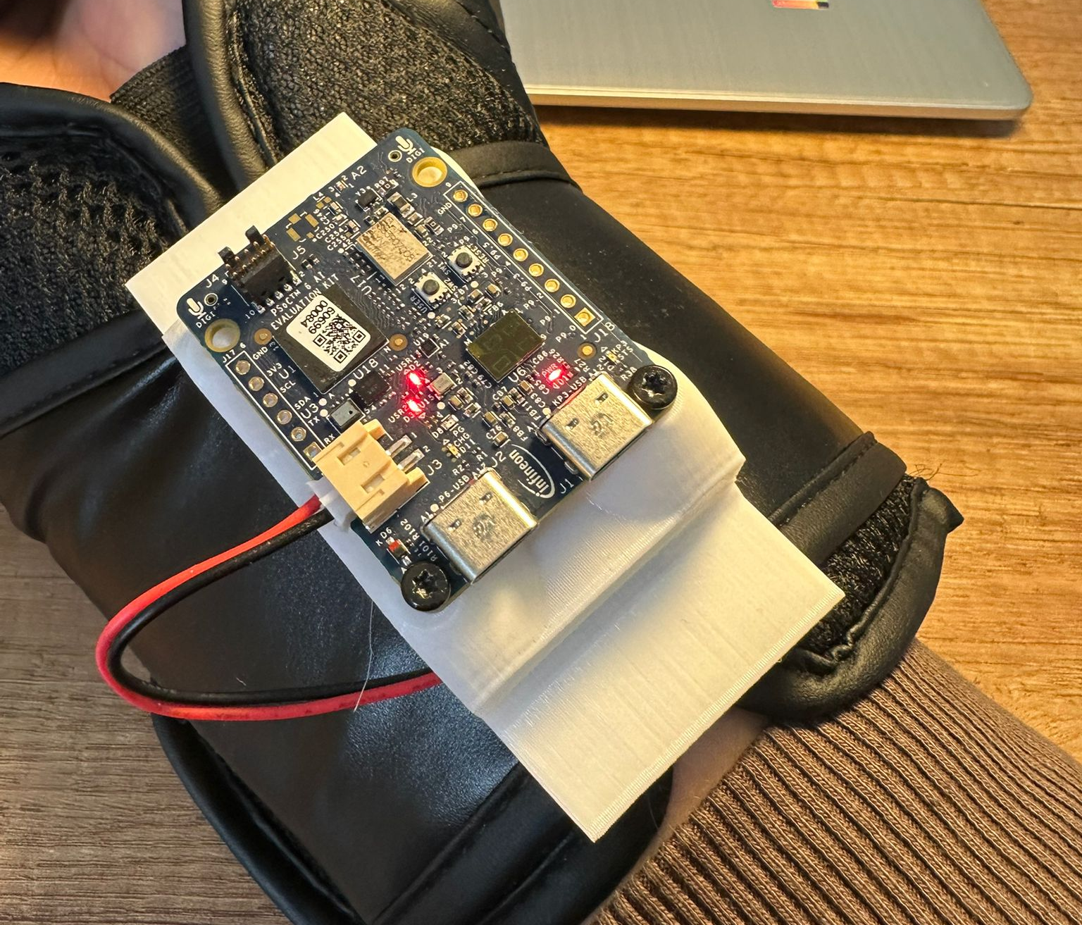
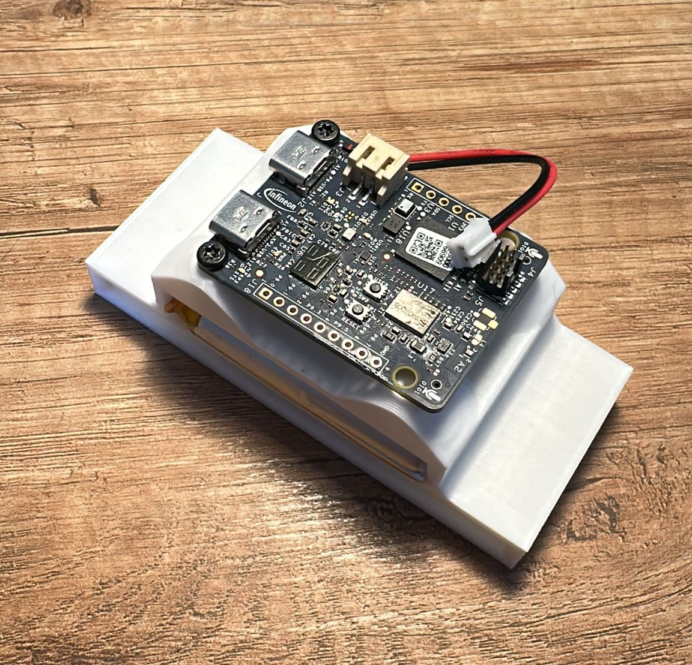
Design of Holder
Design of Holder
Purpose
Accurate collection and evaluation of data
Construction
Holder fixation on box latch
Custom fit cavity for battery
Screwing points for PSOC6
Result
Worked perfectly during testing
Notes:
We designed a holder for the board with the intention to meassure and evaluate data as closely as it would happen in a real life application
For this we constructed a 3d printed model that uses the boxing glove‘s latch to fixiate onto. This happend by threading the latch through a hole in the holder
On top of this hole is a custom fit cavity for the battery that was borrowed to us and on top of that is the PsoC that is simply screwed on.
During our testing this holder worked out perfectly with no rattling or unwanted noise in the sessions as we could fixiate it very tightly

Slide 4
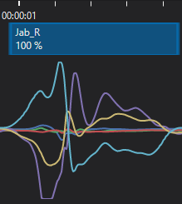
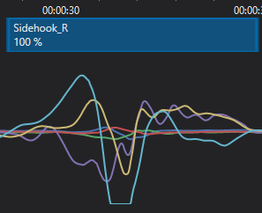
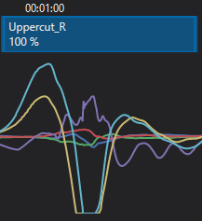
Data sampling
Sampled roughly 1h30min of data
1h labelled and rest unlabelled
Collection of right-hand punches
Collection of various punch techniques and speed
IMU Frequency of 400Hz
Notes:
The data we sampled contained roughly 1h30min and consists of about an hour of labled data and the rest of unlabeld data.
For collection only the right hand was used as we were told to only focus on a proof of concept for this project
The data we sampled was taken from every member of the team so we would have different techniques and all of us also tried to use different speeds for a greater variety
The sessions were mostly only one type of punch with enough time inbetween so we could label the data very accuratly
Some session also contained mixtures of punches to help the model in seeing faster transition between punches better
For sampling we used a IMU frequency of 400Hz
Under that you can see the three punches we labeld with the jab being the most unique and the other two with some similarities but still some great differences

Slide 5
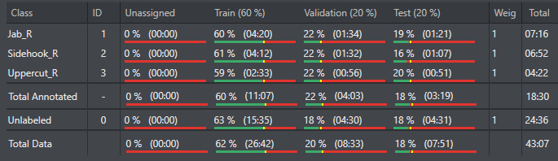
Final Classification
Data of one person
greater accuracy
45 minutes of data, 18,5 of which are labelled
Train/Validation/Test split is roughly 60/20/20
Implementation of negative Data
Notes:
Data of one person for greater accuracy. Gathered a total of 45 minutes of data, 18,5 labeled.
We chose a 60/20/20 split as suggested in the lecture part of the project.
Implemented negative data which consists of warming up, walking around and data which shows neither distinc punches thrown nor completly standing still.
On the picture you can see the specific splits for train/validation and test we achieved in our classification

Slide 6
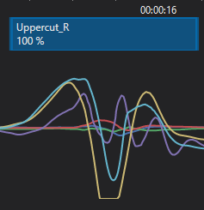
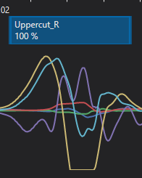
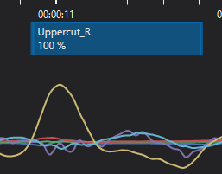
Notes:
Differene between tobi on the left and my data on the right is not as big as the difference to theos data in the middle. Its necessary to state that tobi and i have boxed multiple times before and theo took his first punches during our project (and with us as his coaches ;) ) That visualizes perfectly how significant the differences can be, therefore we decided to only use the data of one person

Slide 7

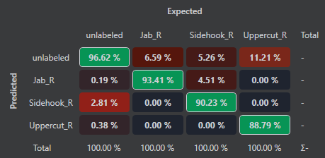
Final Classification
Contextual Window
Created a model with:
Model Family Conv1d
Medium Model Size
Balanced Optimization
Mid Learning Rate & Regularization
Different parameters used
Selection of classification with best test statistics
Notes:
We used the contextual window/sliding window as preprocessor layer for our classification with a window length of 0.5s and 2Hz prediciton frequency
For the model creation we used the model wizard and decided to go with the conv1d model family, medium model size. Balanced optimization as well as an medium learn rate and regularization.
We created a lot of models and tried out varying paramteres and played around with the contextual window parameters as well. The parameters mentioned before achieved the best statistics overall, which are shown on the slide. We can see upwards of 85% correct predicition for each punch type in the test statistics. For the jab and the sidehook they were even above 90%, which is more than good enough for our project

Slide 8


Micropython Code
Micropython Code
Code generation
Conversion to usable MP-model
Implementation in two programs
Testing
Notes:
MicroPython Implementation: The final phase of the project focused on the MicroPython code development.
Model Conversion: We selected the model with the best statistical performance, generated the corresponding C code, and converted it into functional MicroPython code.
Integration: This model was integrated into two separate programs, which will be demonstrated later in the presentation.
Accuracy Testing: For the final stage, we evaluated the reliability and precision of the punch detection system.

Slide 9
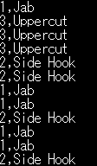
Micropython Code
Transmission of punch data to client via WiFi
Mode of operation
Read Acceleration and Gyroscope data
Hand over data to model
Decision Logic
Transmission of result to client
Calculating velocity of punch using the IMU-acceleration
Notes:
For the first program we implemented the most rudimentary functions which were detection and data transmission to a client via WiFi.
Quick overview of the mode of operation.
Read IMU
Hand over to the model
Decision logic probability had to surpass threshhold of 60% to be counted as a punch
Last but not least transmission of result to client (Tera Term) Connection with TCP/IP

Slide 10
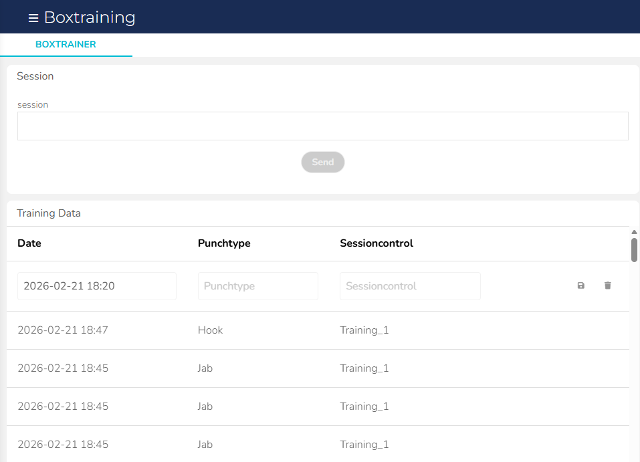
Micropython Code
Publish punch data to Ubidots
Mode of operation
Same as first program
Publish to MQTT server
Dashboard
Save data in a table
Start new training sessions with user button
Notes:
The second, more advanced part of the project involved connecting to an MQTT broker to publish the detected punch types.
We used Ubidots as our web dashboard to provide a clear and organized content table for the data.
The dashboard includes a Session Control column with custom session names, allowing users to track their progress and achievements for each individual training.
A new session can be triggered easily by pressing the user button directly on the board.

Slide 11
Problems faced
Overlapping labels, DEEPCRAFT Studio sometimes set two labels above each other
No clear indications on what makes model better or worse
It was not achievable to enqueue Data fast enough in our Micropython Code (fastest Loop runtime 3ms). Needed to downsample our Data to 100Hz
Using an if-selection to time enqueue did not work/lead to the PSOC6 stalling after a few seconds (Busy waiting). Used time.wait_ms() instead
Predictions for one punch are greater than 0.6 over two contextual windows.
Reaction and loop time got worse publishing messages to Ubidots
Notes:
We ran into some problems along our jorney, some of which i would like to talk about.
One problem we faced were overlapping labels, which were sometimes generated by Deepcraft Studio while setting a label in the session. These had to be found and deleted in the classification
Furthermore while playing around with model paramteres we found ourselves not really knowing which paramters lead to better results, besides gathering more data
When we implemented the Model in Micropython we had a model which used 400Hz IMU data, which we found out was very problematic because we werent able to enqueue the data fast enough. The fastest loop time we achieved were 3ms, which is half a ms off the desired 2,5ms/400Hz. Thats why we created an extra pythonscript to manually downsample the data files to 100Hz
Furthermore in the main loop we encountered problems while timing the enqueueing/IMU data sampling. Using an if-selection and timing the delay lead to the PSOC6 stalling after a few seconds, different tries to solve the problem like manually triggering the garbage collector did not work. Using time.wait_ms() to achieve the 10ms loop runtime worked out perfectly (bad practice nonetheless).
Another problem has to do with the sliding window and its length, sometimes when a punch reaches across two sliding windows/predicition periods it leads to the predicition value being higher than 0.6 which counts one punch as two. This could be fixed by trying out other sliding window values or peak detection in our Micropython code

Slide 12
Demonstration

Slide 13
About the future
Implementing the game function
Gathering more sampling data from more different people
Gather data of left-handed punches
Creation of charts for easier understanding/adding statistic analysis
Notes:
In the future we wanted to implement the game function that was mentioned earlier
Gather more data of different people and also have more session time in general
Also implement the data of left-handed punches as the product is not very usable without it
And finally create charts in the session analytics to make it easier for the user to see in the spot which punches and which combiantions were used the most

Slide 14
Thank you for your attention!
TU Wien
Tobias Riedelberger, Theo Corneux, Tobias Holzner

