Slide 1
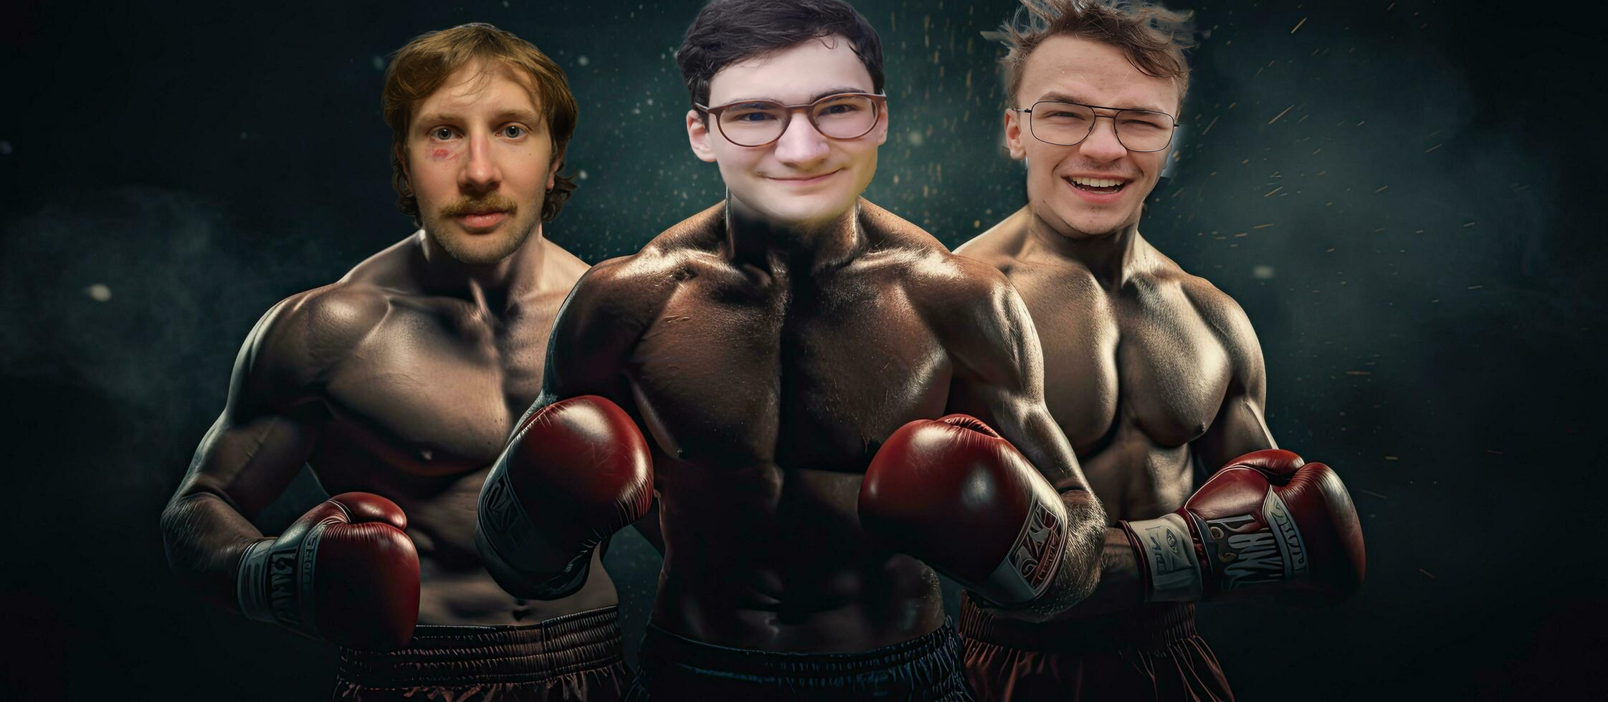
Punch Analyzer
Team T²C
TU Wien
Tobias Riedelberger, Theo Corneaux, Tobias Holzner

Slide 2
Project Idea
Using the boards IMU to detect the type of punch that is thrown
Jab
Hook
Uppercut
Helping boxers to analyse their performance in training
Understanding what combinations are used often to prevent developing tendencies/predictability
Expanding the boxer’s horizon by playing a game that demands different combinations

Slide 3
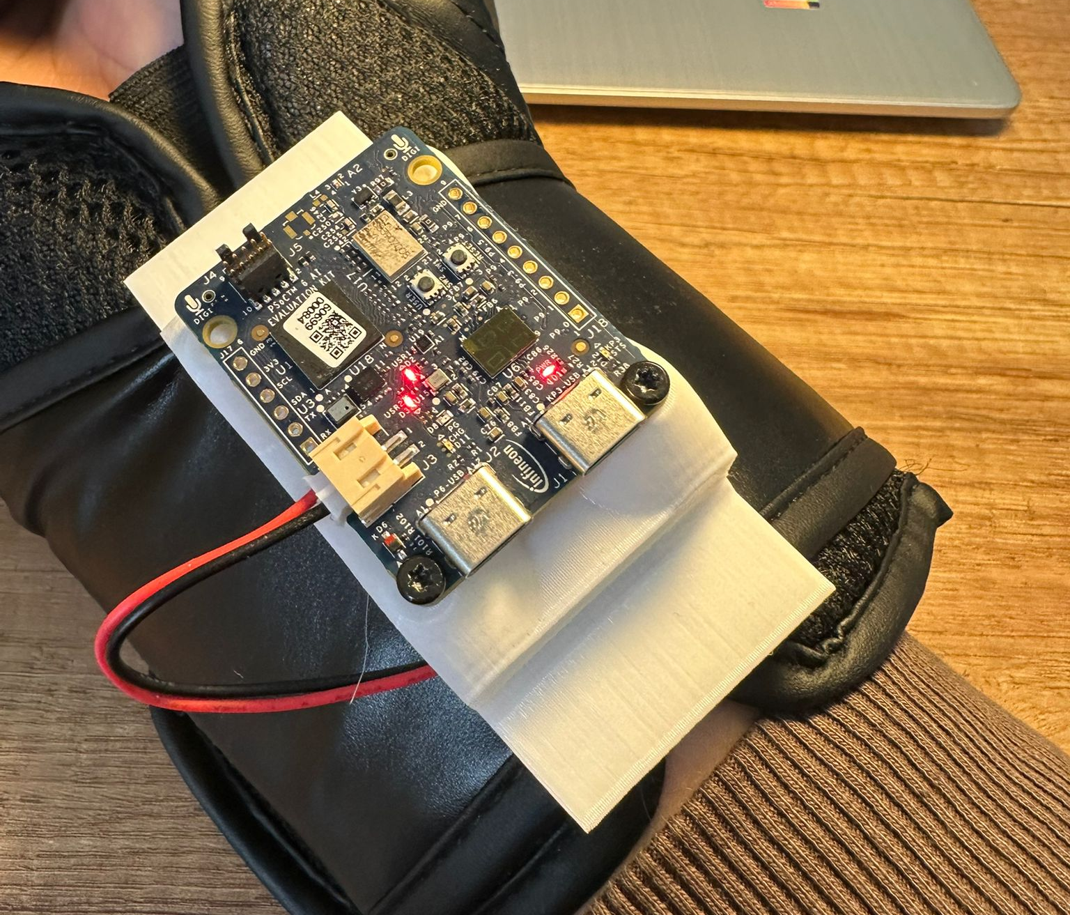
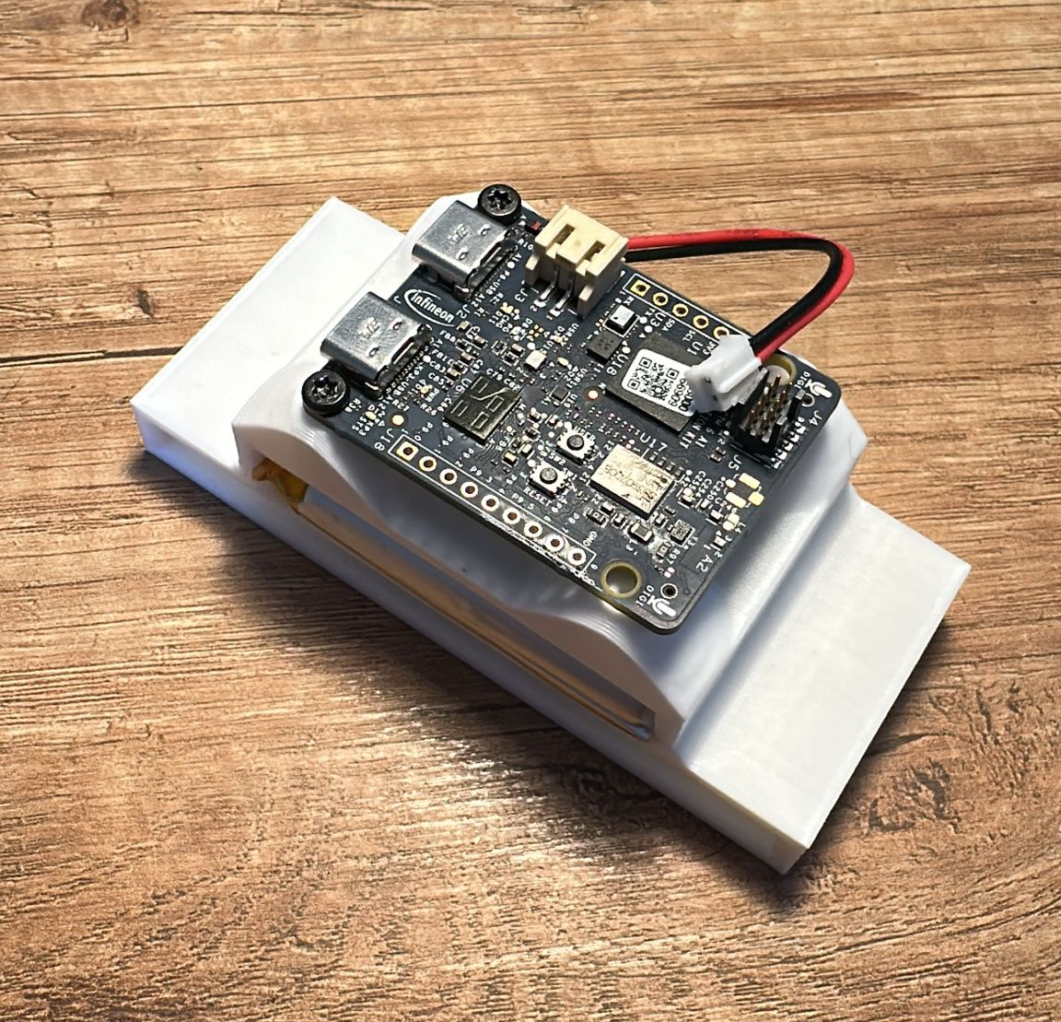
Design of Holder
Design of Holder
Holder can be fixated using boxing gloves latch
Custom fit cavity for battery
PSoC 6 is screwed on top
Worked perfectly during testing

Slide 4
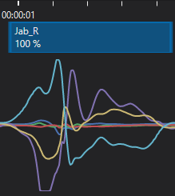
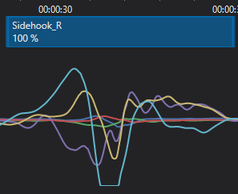
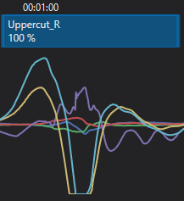
Data sampling
Sampled roughly 1h30min of data
Of which 1h consist of labelled data and the rest is unlabelled
Only used right hand for punches
Data of all three members was gathered using different types of speed and technique
The IMU Frequency was set to 400Hz

Slide 5
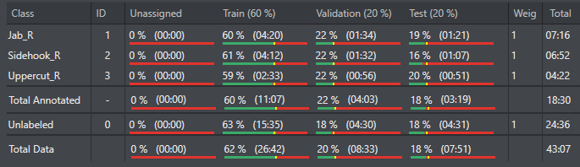
Final Classification
Only Data of one person was used to achieve greater accuracy
Train/Validation/Test split is roughly 60/20/20
45 minutes of data, 18,5 of which are labelled
Implemented negative Data (warming up, neither distinct punches nor no movement)

Slide 6
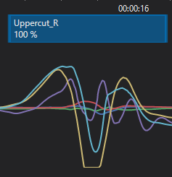
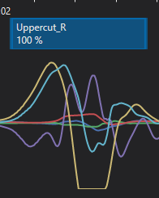
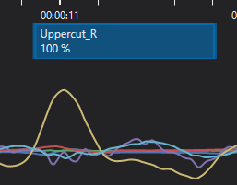

Slide 7

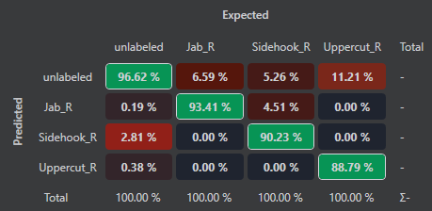
Final Classification
Preprocessor used: Contextual Window (0.5s length, 2Hz prediction frequency)
Created a model with:
Model Family Conv1d
Medium Model Size
Balanced Optimization
Mid Learn Rate & Regularization
Tried out different combination, the mentioned one lead to the best Test Statistics

Slide 8
Micropython Code
Generated Code of used Model and converted it to usable MP-model

Slide 9
Problems faced
Overlapping labels, DEEPCRAFT Studio sometimes set two labels above each other
No clear indications on what makes model better or worse
It was not achievable to enqueue Data fast enough in our Micropython Code (fastest Loop runtime 3ms). Needed to downsample our Data to 100Hz
Using an if-selection to time enqueue did not work/lead to the PSOC6 stalling after a few seconds (Busy waiting). Used time.wait_ms() instead
Predictions for one punch are greater than 0.6 over two contextual windows.

Slide 10
About the future
Implementing the game function
Gathering more sampling data from more different people
Gather data of left-handed punches to make it suitable for real training purposes
Creating a function to read the velocity of thrown punches/calculate it using the IMU-Data
Using the boards button to start and stop sessions
Creation of charts for easier understanding/adding statistic analysis (number of certain punches, highest velocity, …)

Slide 11
Demonstration

Slide 12
Thank you for your attention

