Slide 1
Streamline Variability Plots for Characterizing the Uncertainty in Vector Field Ensembles
Nicolas Grossmann, 1325103
Thomas Köppel, 1327052
Institute of Computer Graphics and Algorithms
Vienna y of Technology

Slide 2
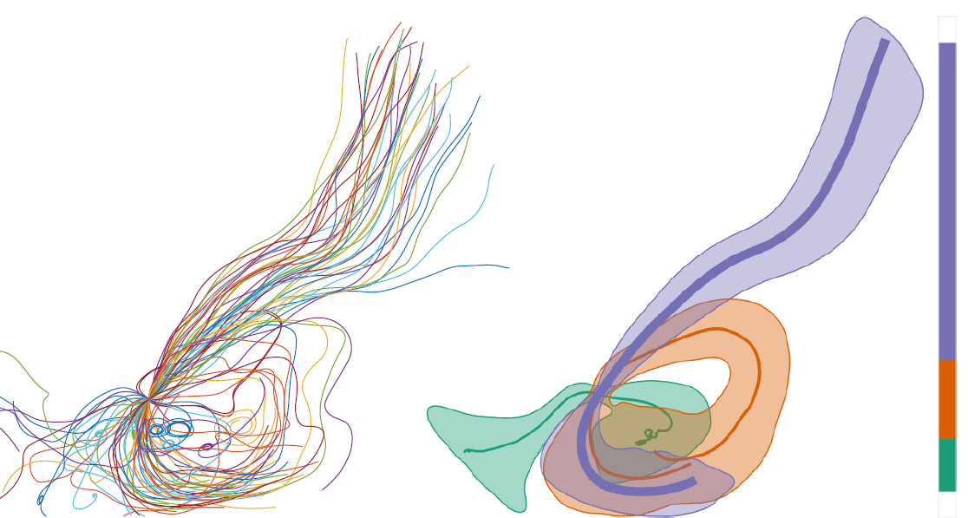
Beispiel

Slide 3
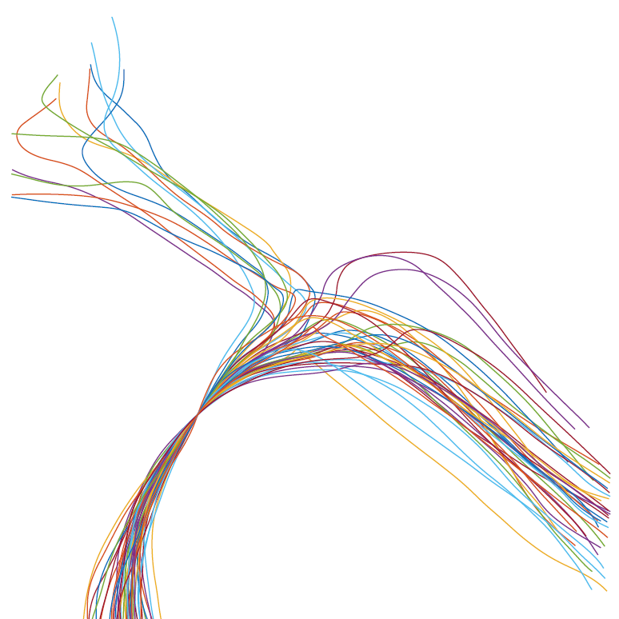
Schritt 1: Pfadlininen erzeugen

Slide 4
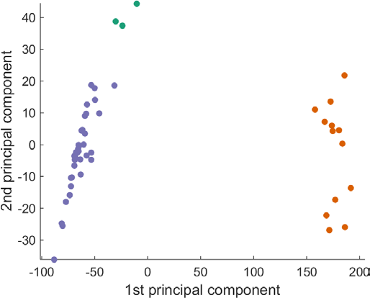
Schritt 2: PCA

Slide 5
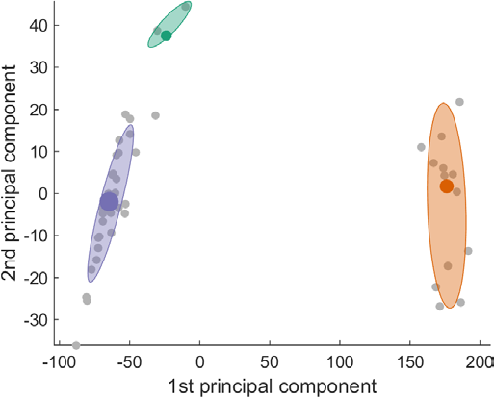
Schritt 3: Clustering

Slide 6
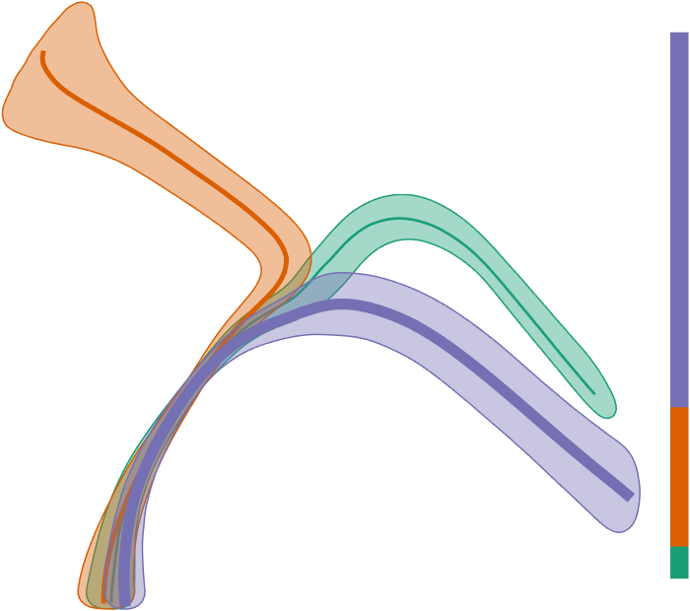
Schritt 4: Variability Plots

